Slide 1

Design, performance and future prospects of
vertex detectors at the FCC-ee
Fabrizio Palla
INFN Pisa
EPS-HEP 2025
6-11 July 2025
Marseille (France)

Slide 2
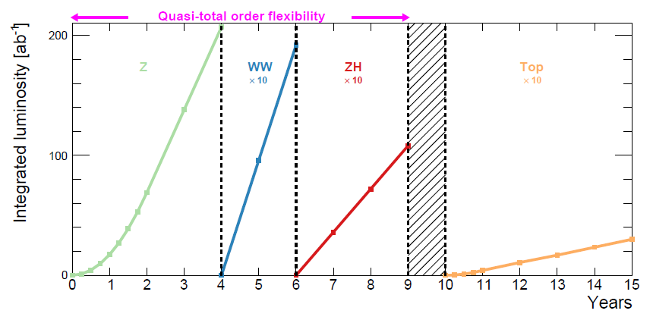
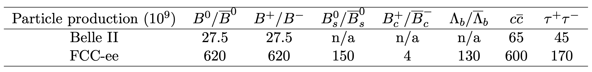
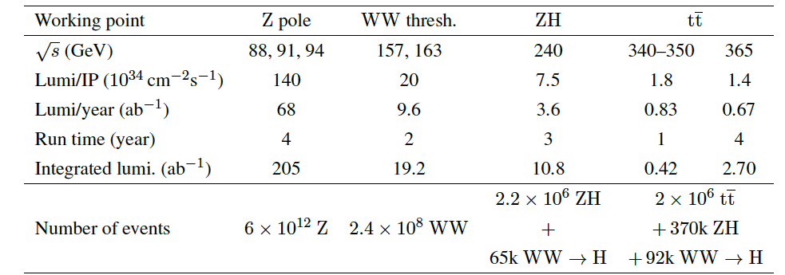
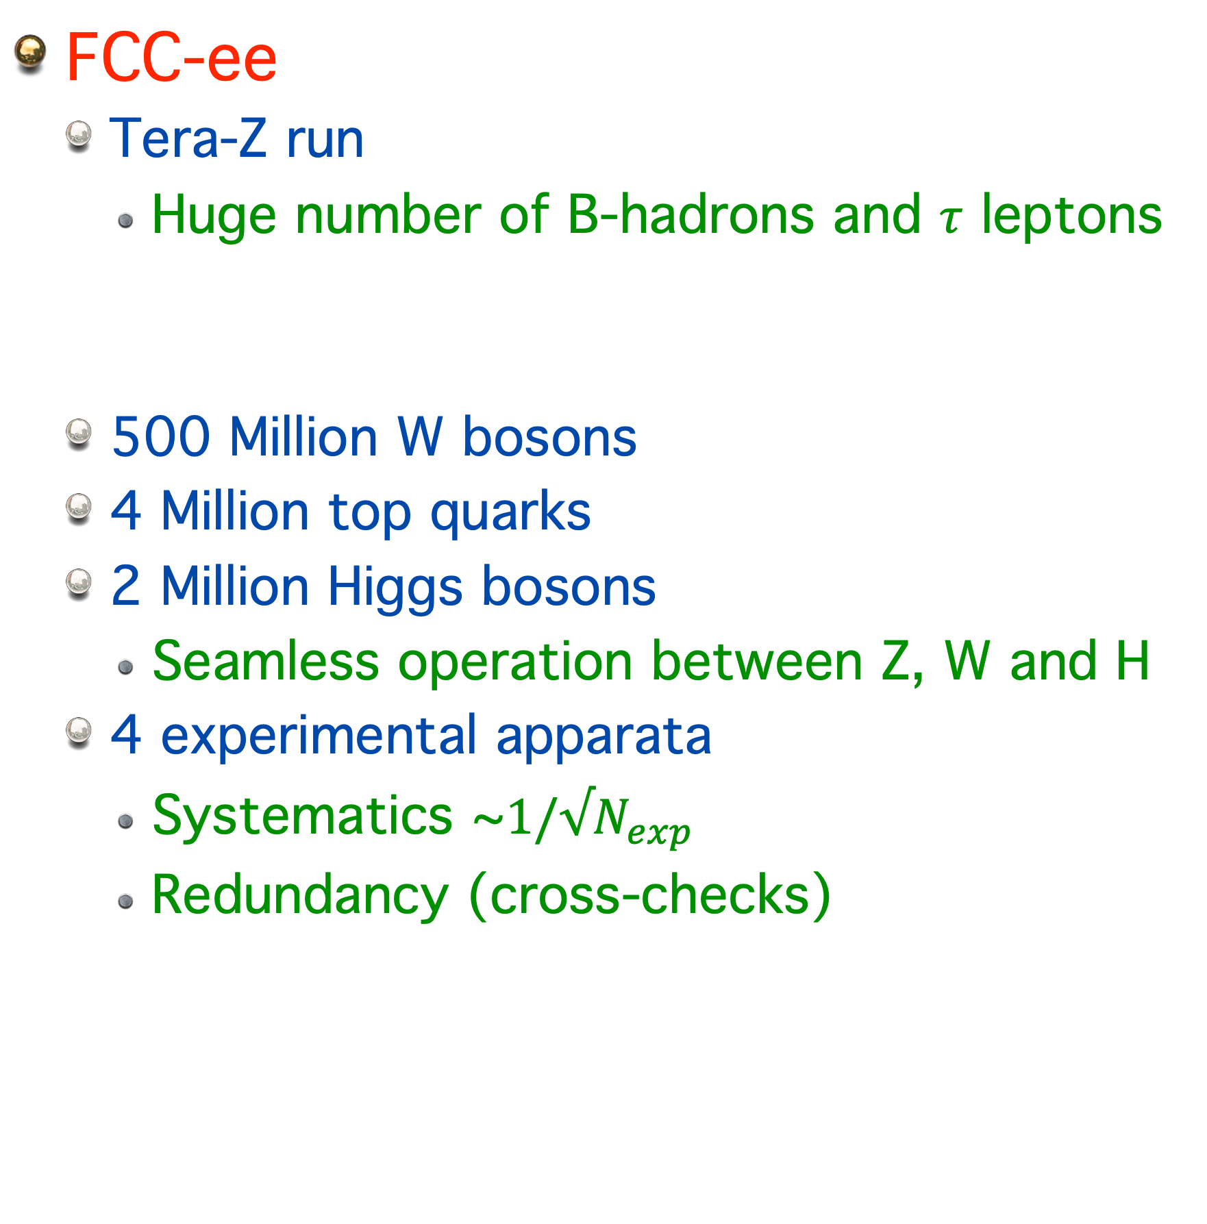
FCC-ee collider Physics
FCC-ee
  Tera-Z run
    Huge number of B-hadrons and $τ$ leptons
  500 Million W bosons
  4 Million top quarks
  2 Million Higgs bosons
    Seamless operation between Z, W and H
  4 experimental apparata
    Systematics ~$1/√N_{exp}$
    Redundancy (cross-checks)
NB. Operation sequence is not yet decided

Slide 3
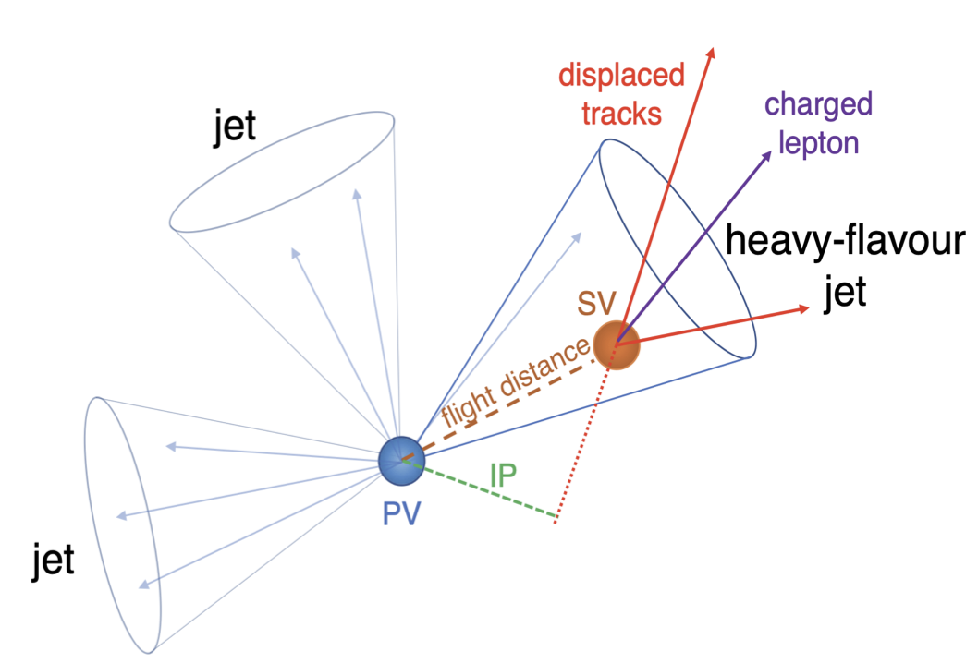
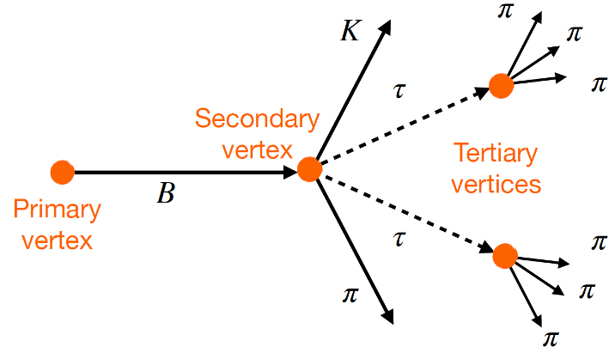
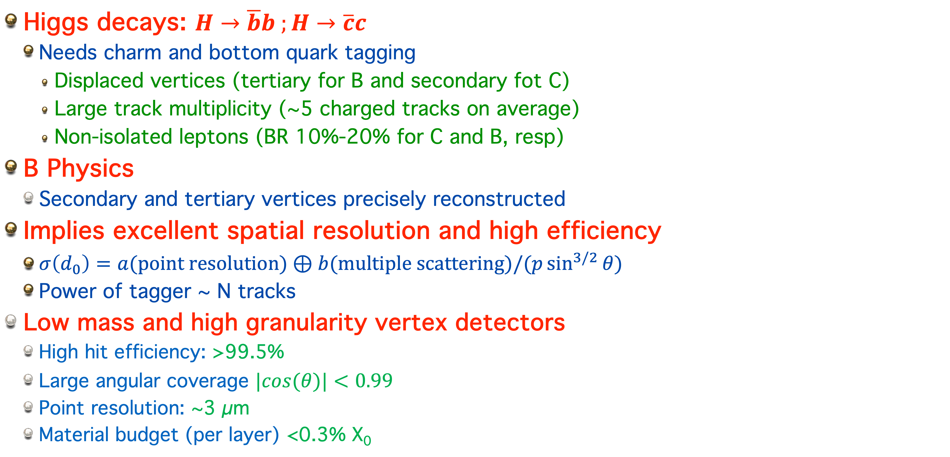

Main drive: Higgs and B physics
Higgs decays: $H→\overline{b}b ;H→\overline{c}c$
  Needs charm and bottom quark tagging
    Displaced vertices (tertiary for B and secondary fot C)
    Large track multiplicity (~5 charged tracks on average)
    Non-isolated leptons (BR 10%-20% for C and B, resp)
B Physics
  Secondary and tertiary vertices precisely reconstructed
Implies excellent spatial resolution and high efficiency
  $σ\left(d_{0}\right)=a(point resolution)⊕b(multiple scattering)/(p\sin^{3/2}{θ})$
  Power of tagger ~ N tracks
Low mass and high granularity vertex detectors
  High hit efficiency: >99.5%
  Large angular coverage $|cos(θ)|<0.99$
  Point resolution: ~3 µm
  Material budget (per layer) <0.3% X₀

Slide 4
Detectors for FCC-ee
CLD
ALLEGRO
VTX MAPS
Main Tracker:
  Drift Chamber/Straw/Si
Si/LGAD wrapper (TOF)
ECAL: Pb+L-Ar/W-L-Kr
HCAL: Fe+scintillator outside the Solenoid
PID: RICH (in case of Silicon main tracker)
Muons with RPC
VTX MAPS
Main Tracker: Silicon
Very high granularity (CALICE) inside the Solenoid
  ECAL Si+W
  HCAL Fe+scintillator
PID: RICH and TOF
Muons ID with RPC
IDEA
VTX MAPS
Main Tracker:
  He+Isob drift chamber
Si/LGAD wrapper (TOF)
DR calorimetry (fibres):
  ECAL: Crystals
  HCAL: Iron outside the Solenoid
HTS Solenoid (up to 3T)
Muon ID: µ-RWELL
VTX MAPS
Main Tracker: TPC
Very high granularity (CALICE) inside the Solenoid
  HCAL Fe+scintillator
  ECAL Si-W
Muons with scintillator
ILD
for
FCC-ee

Slide 5
Interaction region layout
Final focus quadrupoles inside the detector at 2.2 m from IP
Rigid lightweight support tube mechanical envelope
  Integrates the vertex detector and the Luminosity calorimeter with the beampipe
  Allows compact integration of the services and maintenance

Slide 6
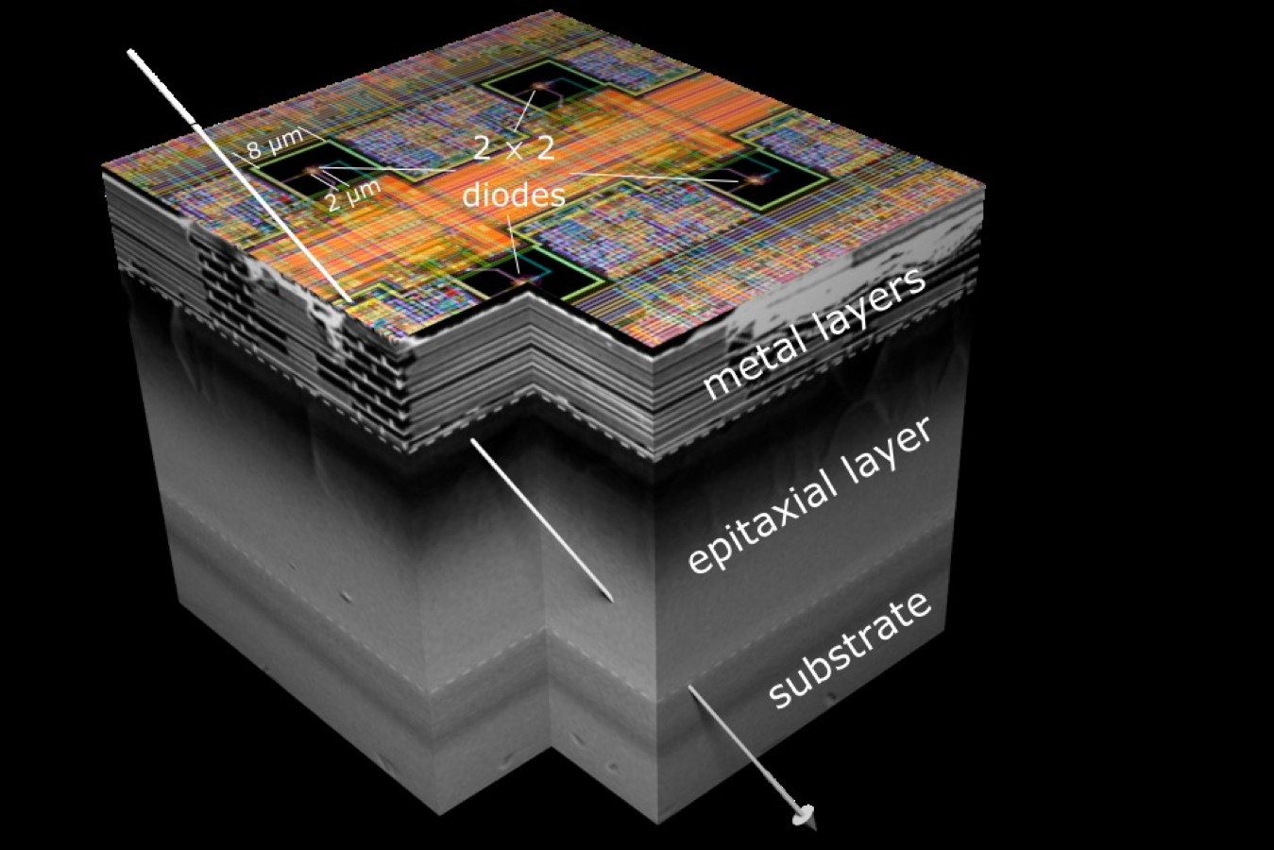

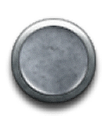
Technologies for vertex detectors
Monolithic Active Pixel Silicon Detectors (MAPS)
  CMOS sensors and electronics fully integrated
  Can reach 30 µm thickness (0.032% X0)
  Very low power (<50 mW/cm²)
  Sensors stitching up to 12” or ‘abuttable’
Several CMOS sensors in use or development
  Dependence on CMOS process (foundry) characteristics
    3 prominent ones: LFoundry, TJsc, TPSCo
    ECFA-DRD3 WG1 addresses the R&D
New trends and opportunities
  3D integration: possibility to have a more complex readout (and Silicon Photonics) tier bonded to a sensor one
Optimisation
  Spatial resolution vs timing vs power vs radiation tolerance

Slide 7
Technologies in DRD3/7
LFoundry 110 nm (ARCADIA)
  25 µm x 25 µm, abuttable
  Trigger less 100 MHz/cm2, 30 mW/cm2
  Ongoing R&D on gain layer (timing)
    candidate for ALICE3 TOF
  Runs in 2025 and 2026
TPSCo 65nm (ALICE, many)
  Stitching, long distance (20 cm) data transmission
  Several groups - ALICE driven R&D
  MOST for timing
TJ 180 nm
  Historic drivers: CERN, STFC, IPHC
    ALPIDE (ALICE)
    MIMOSIS (CBM µVertex)
    OBELIX (BelleII upgrade)
    JadePix, TaichuPix for CepC
TaichuPix

Slide 8
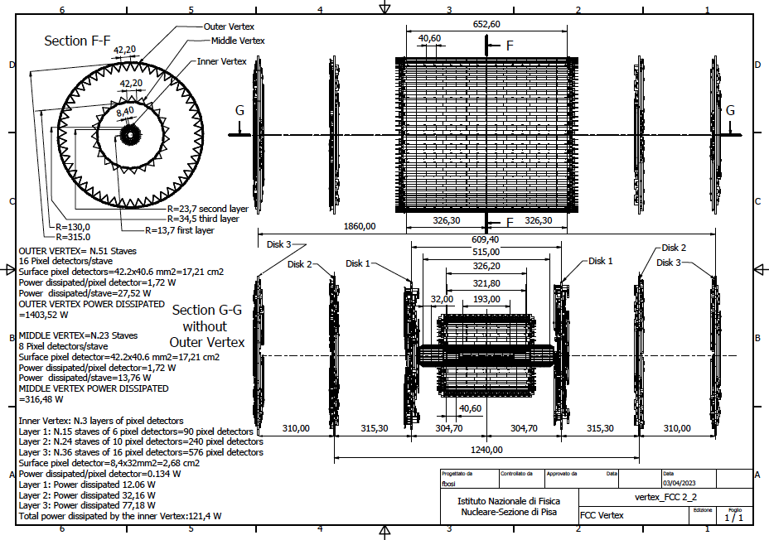
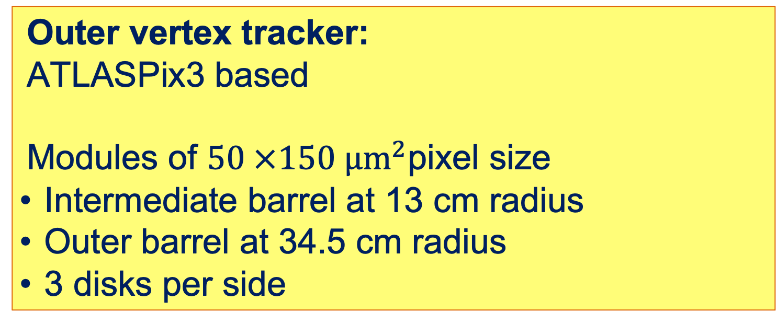
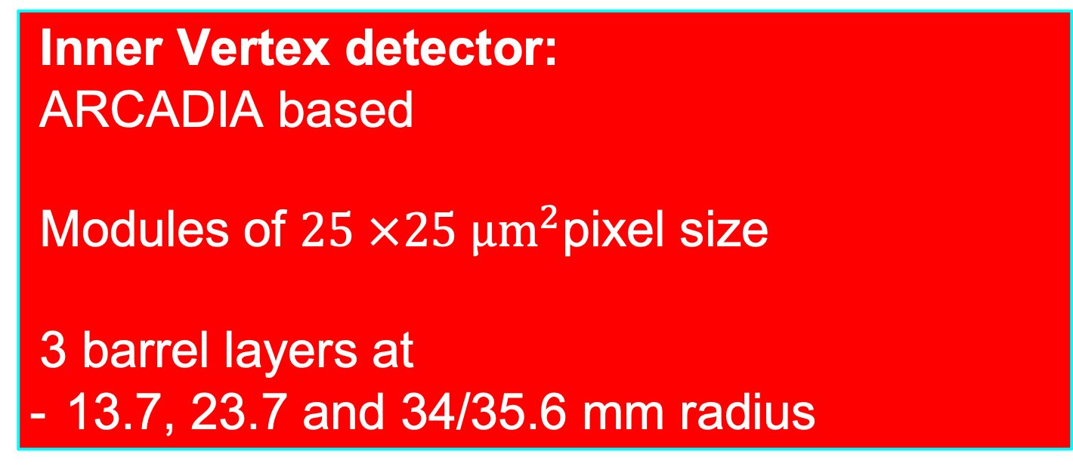
IDEA detector concept vertex detector
Outer vertex tracker:
ATLASPix3 based
Modules of $50 ×150 µm^{2}$pixel size
Intermediate barrel at 13 cm radius
Outer barrel at 34.5 cm radius
3 disks per side
Inner Vertex detector:
ARCADIA based
Modules of $25 ×25 µm^{2}$pixel size
3 barrel layers at
13.7, 23.7 and 34/35.6 mm radius
DRD8 WP1

Slide 9
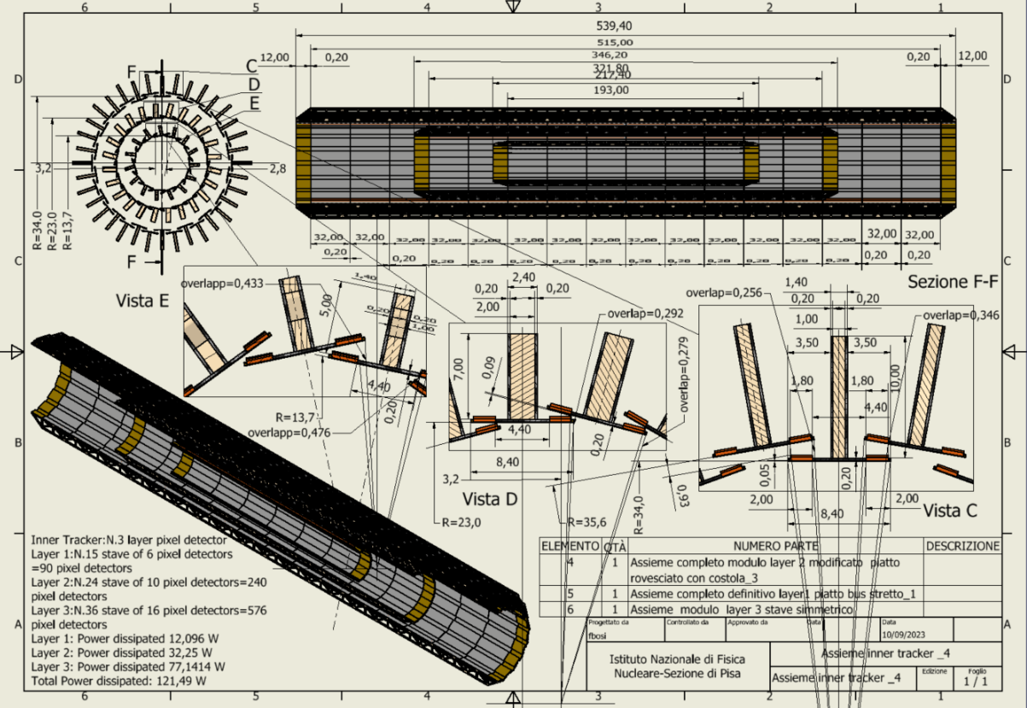
Inner vertex Layout
Total thickness per layer 0.25% X/X0​
Carbon Fibre ~60 %​
Silicon: ~20%​
Power and readout bus: ~20%
Layer # | Radius [mm] | No staves | No modules /stave | Total Length [mm] | Active Area [cm²] | Power [W]
1 | 13.7 | 15 | 6 | 217.40 | 241.92 | 12
2 | 23.7 | 24 | 10 | 346.20 | 645.12 | 32
3 | 34 & 35.6 | 36 | 16 | 539.40 | 1548.29 | 77

Slide 10
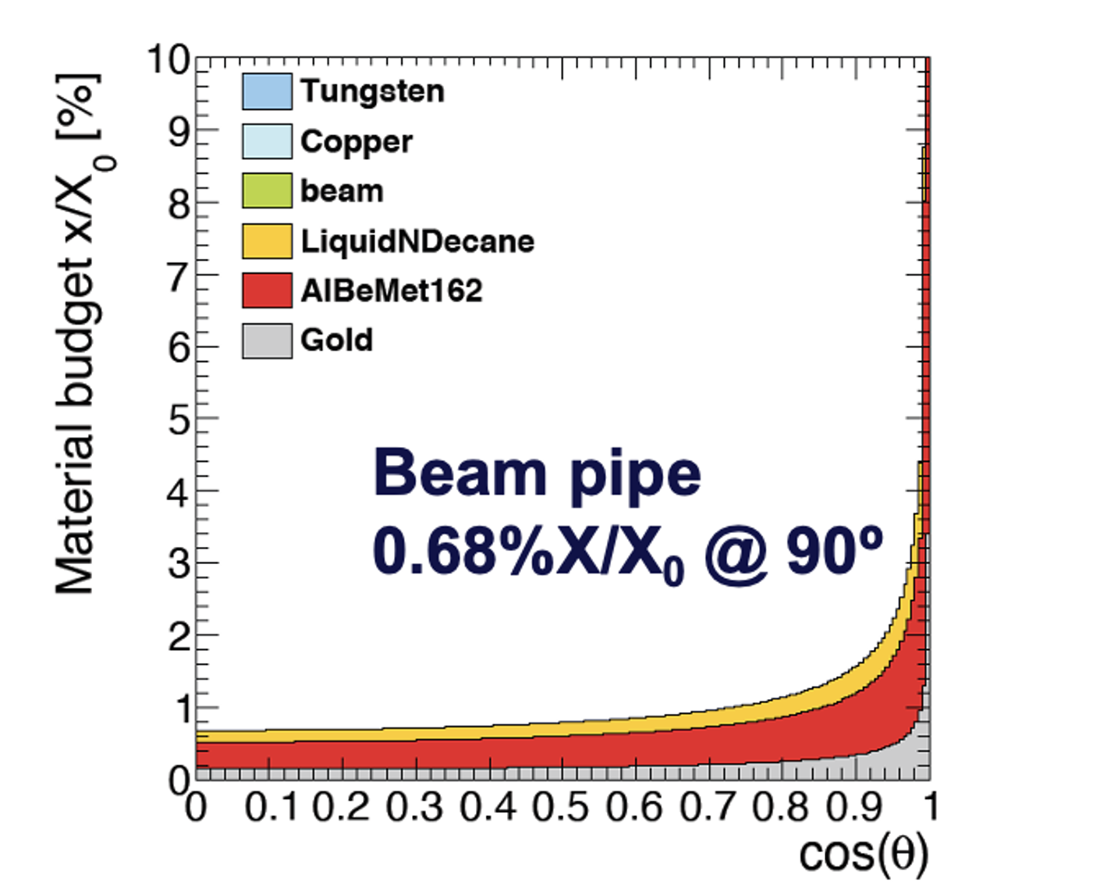
Simulated material budget
In agreement with CAD estimates
Smaller X/X₀ wrt IDEA CDR estimates even including power and readout cables in the sensitive region
Silicon only ~15% of the total
Impact parameter resolution limited by beam pipe material

Slide 11
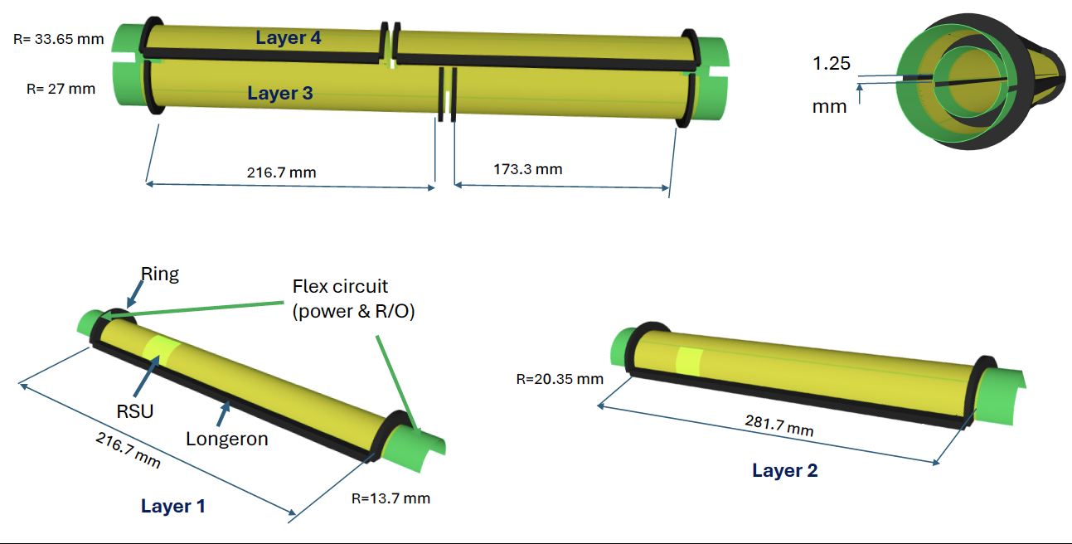
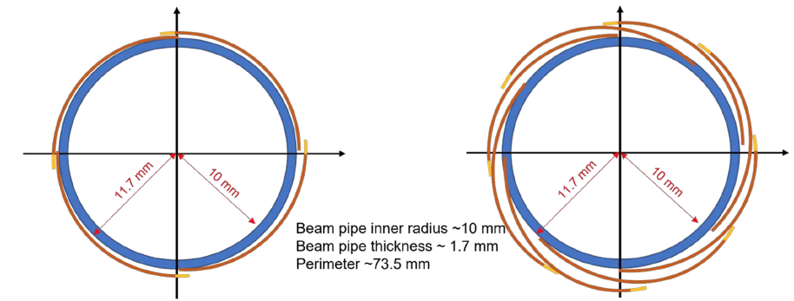
Lowering the material budget
Layer 1
Stitching of thin (<50 µm) sensors a la ALICE ITS3:
  One row of sensors ~30 cm long; R/O and powered on sides
  Can be ‘folded’ (curved): self-sustained mechanics: no piping and no cabling in the sensitive areas
Problems
  Currently internal and periphery circuitry ~5% inefficiency
  May not be fully hermetic; R&D on overlapping two layers
  Stitching rules may prevent optimal pitch size
10x
12 x
Layer 2
Layer 3
9 x
Layer 4
Two variants under study
12”

Slide 12
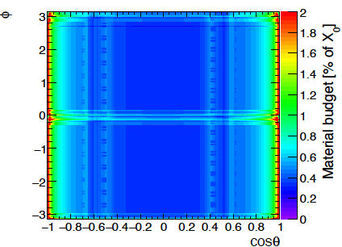
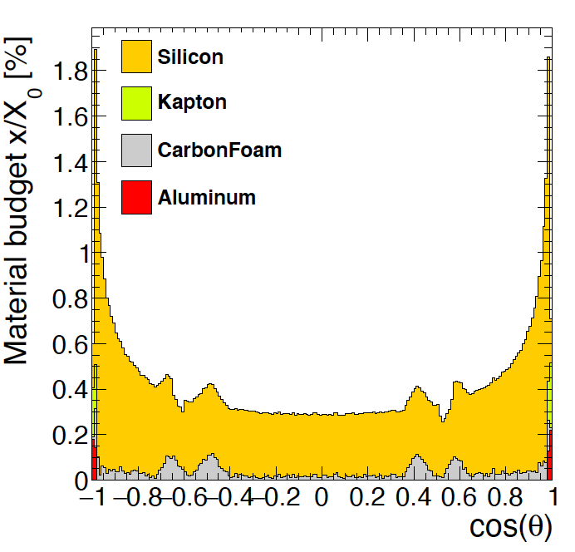
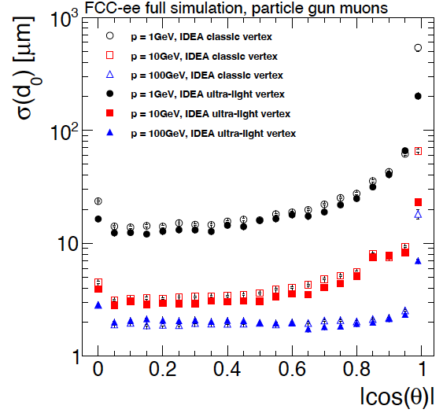

Material budget reduction and impact on resolution
Factor of ~3 smaller material budget compared to flat
  More uniform in $φ$ and 4 layers instead of 3
Improved impact parameter resolution especially at lower momentum
Curved
Layers 1 to 4
Traditional

Slide 13
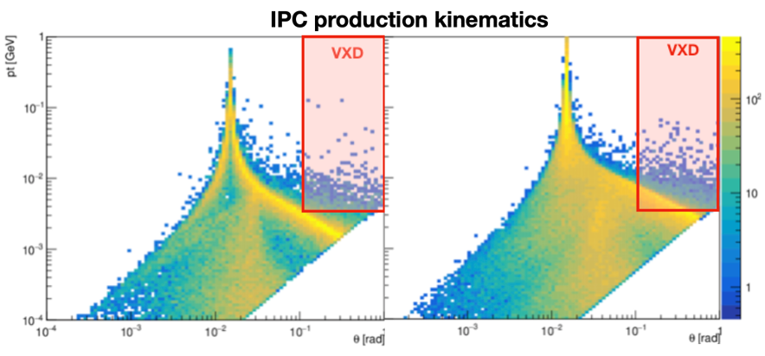
Machine backgrounds
Beamstrahlung limits the beam pipe size and determines occupancy in vertex detector
  IPC: Incoherent pair creation (real or virtual photon scattering e+ e-) dominant
    Lot of low p_{T} (few MeV) particles hitting the detectors directly or backscattering
    Hit rates of up to 200 MHz/cm² for the innermost layer: challenging for readout (~100 Gb/s per ladder)
Z
tt

Slide 14
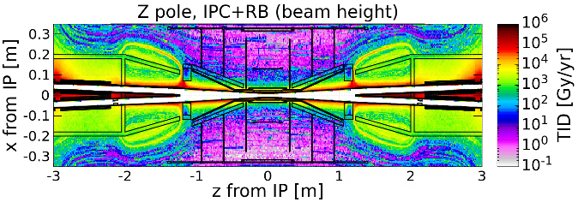
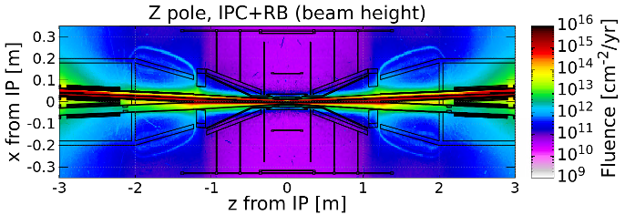
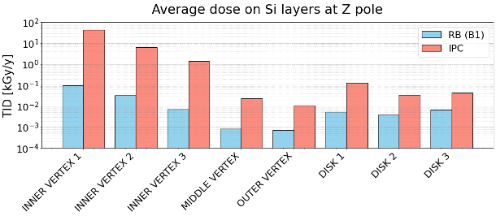
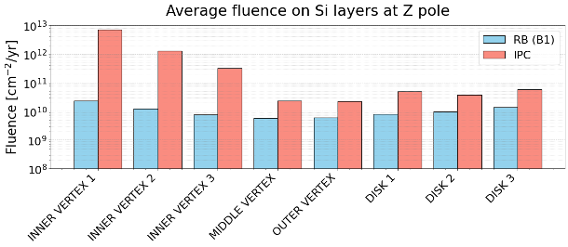
Vertex detector radiation levels
IPC dominant source
  Innermost layer (at ~1.3 cm) TID and fluence are one order of magnitude higher than second layer.
  Current MAPS technologies are OK
    At 15 cm distance, dose and fluence are about 3 orders of magnitude smaller than innermost layer

Slide 15
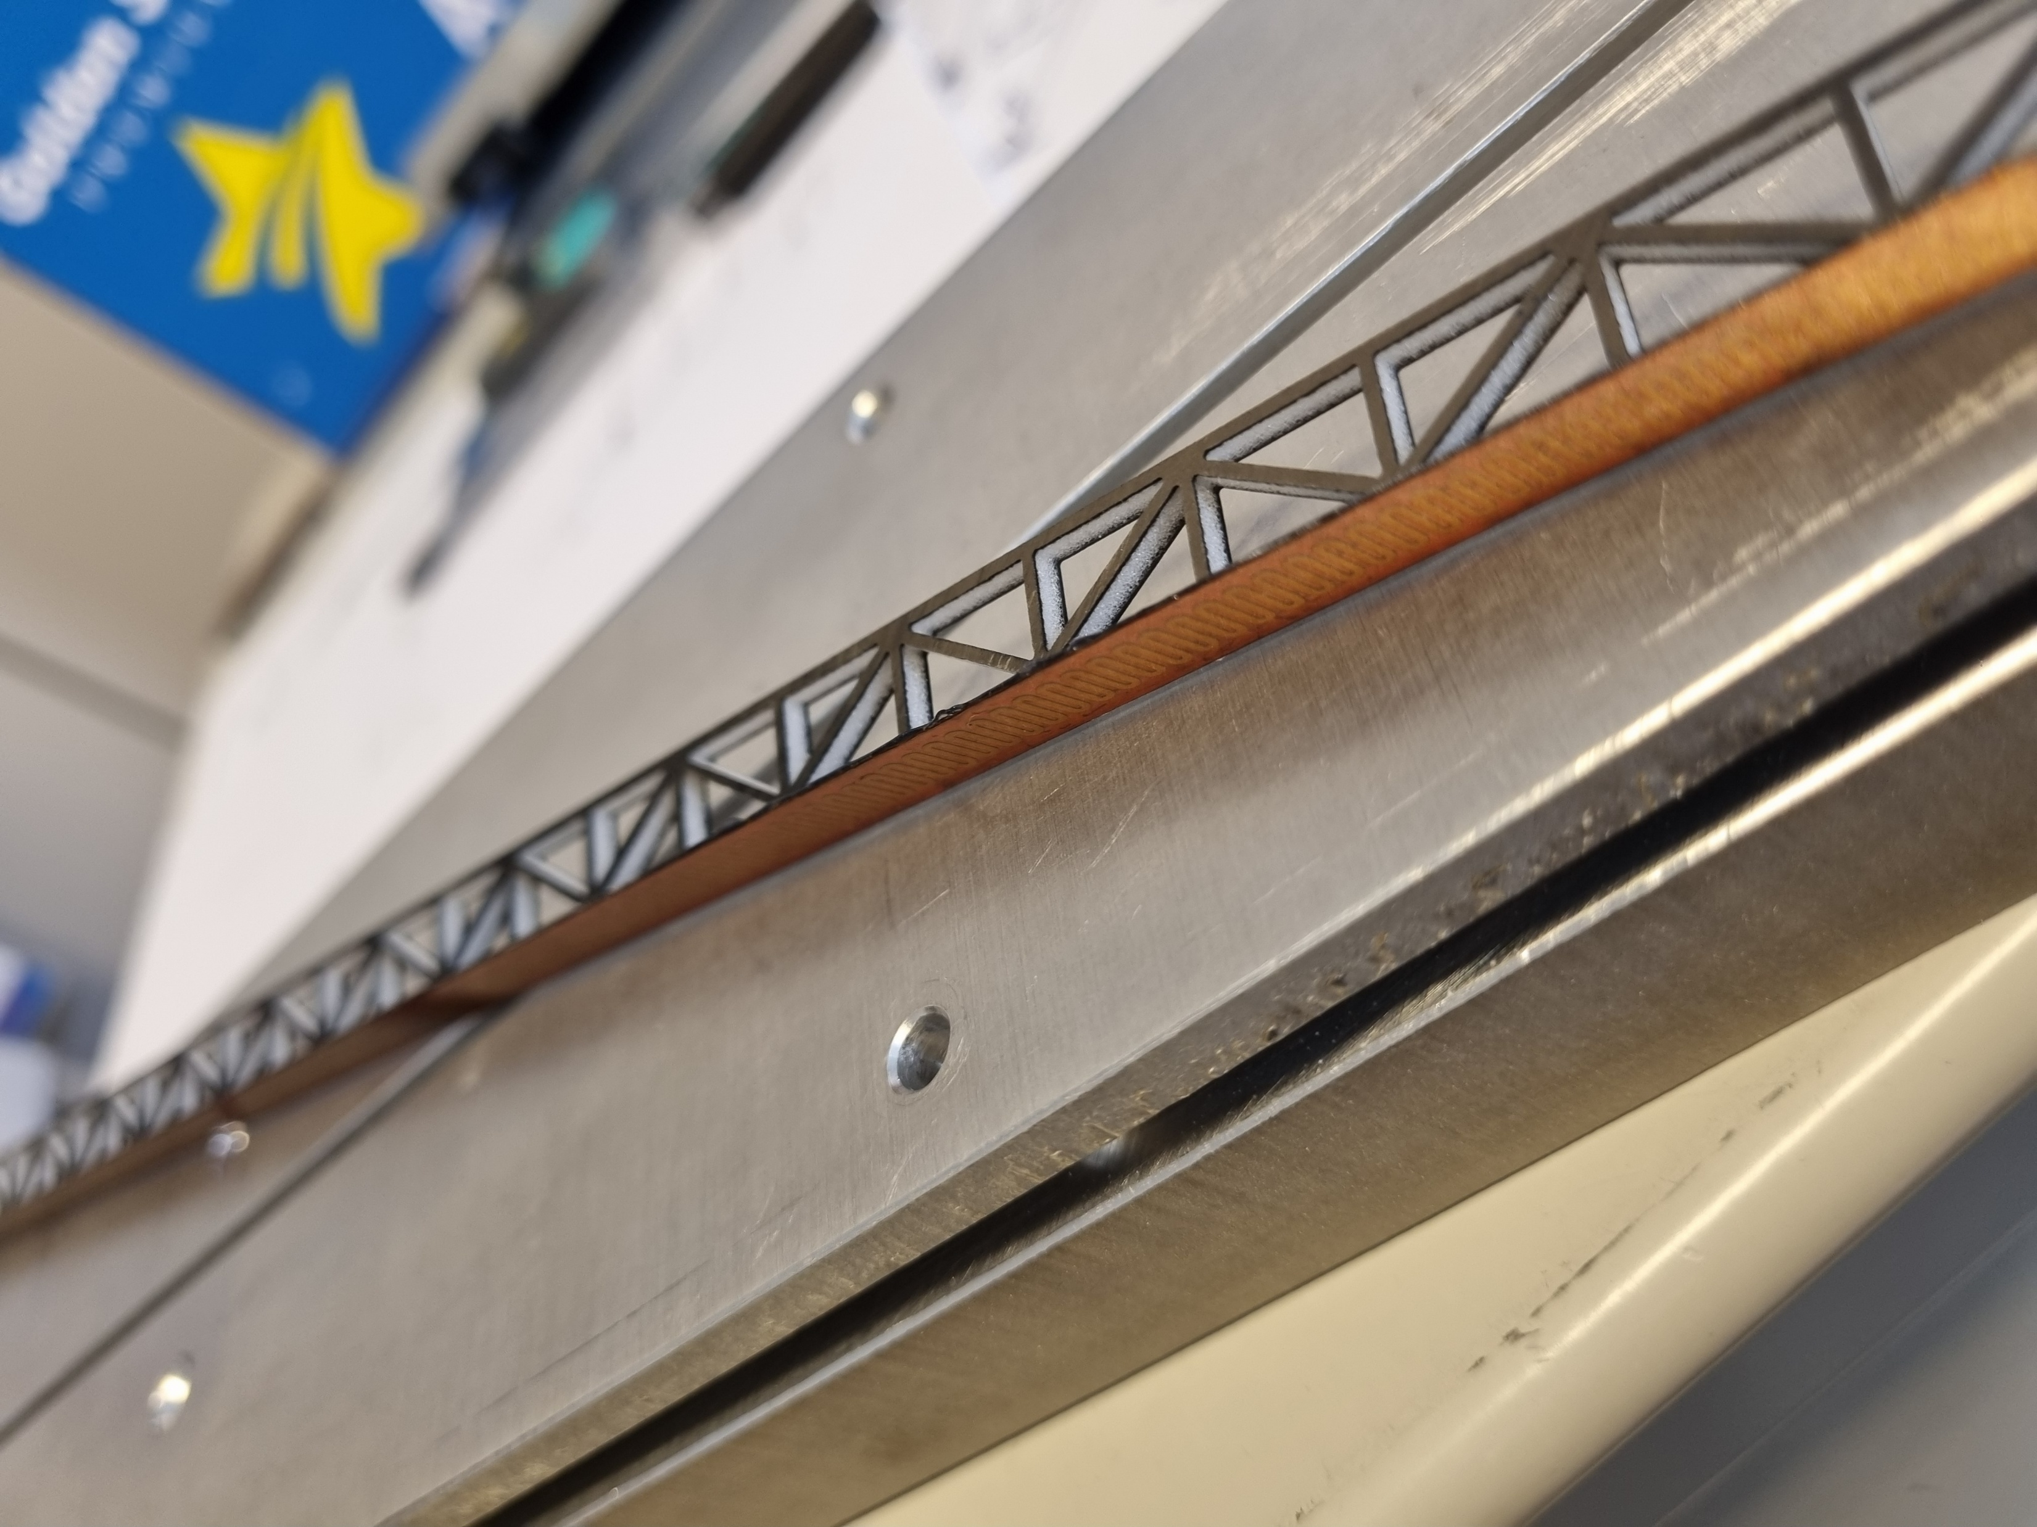
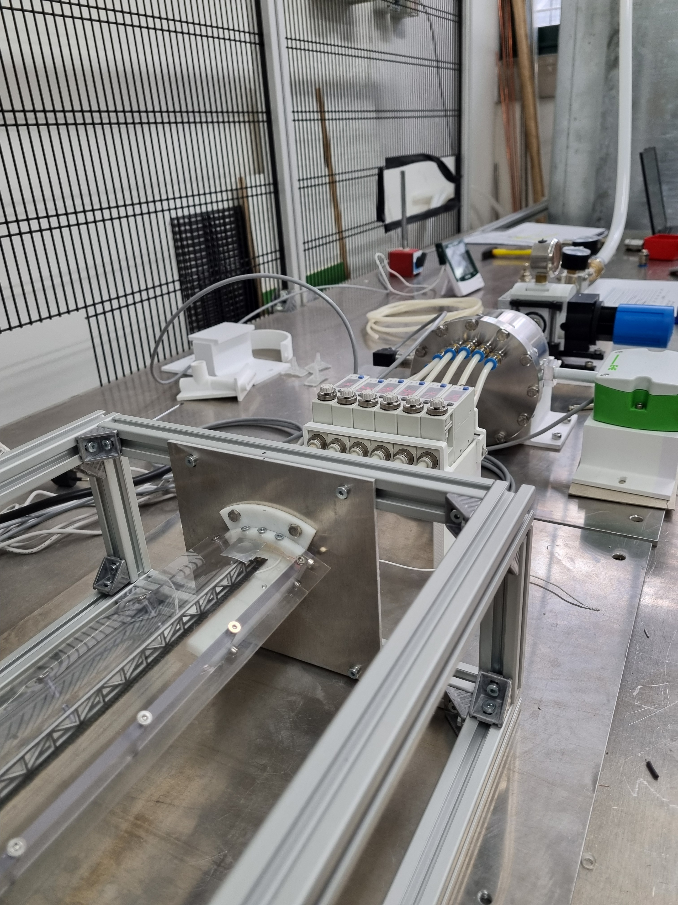
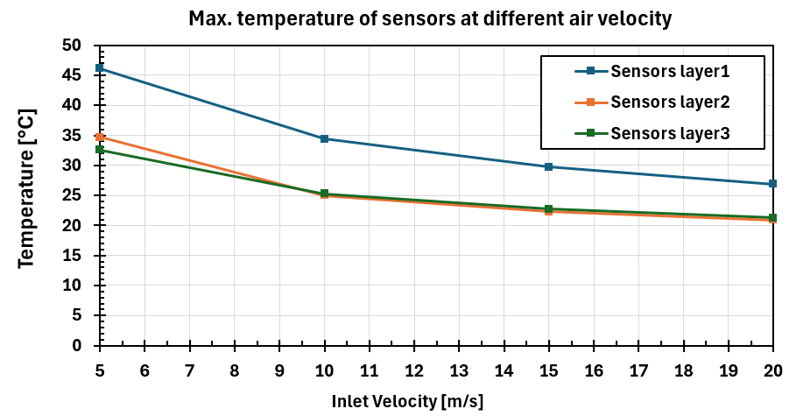
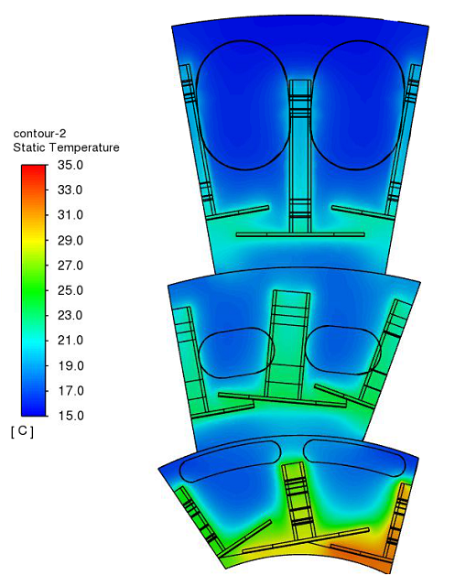
Vertex air cooling R&D
Use of air cooling (DRD8 WP1)
  Pixel matrix ~15-30 mW/cm²
    Large power on chip periphery (up to 400 mW/cm²)
Need to control vibrations
  Cooling displacement must be ≤1.5 µm
  Detailed CFD simulations
    A hot spot on L1 has been found which needs change in air flow
  A test set up has been built in Pisa to validate the simulation
T_{air} = 15ºC
Compressed air system under installation in Pisa

Slide 16
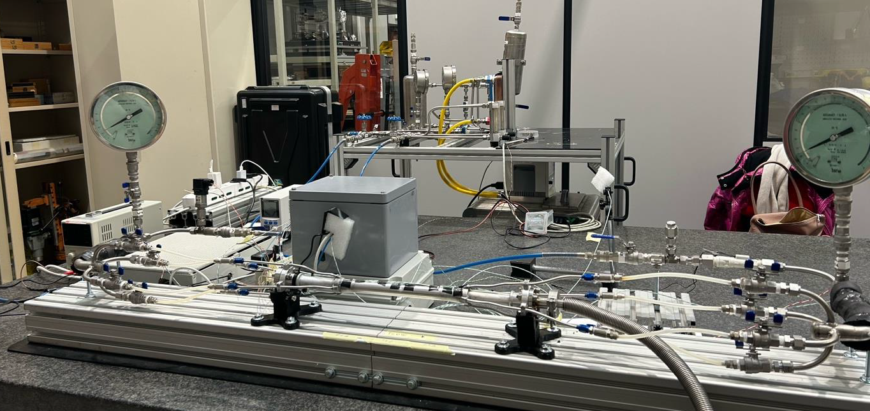
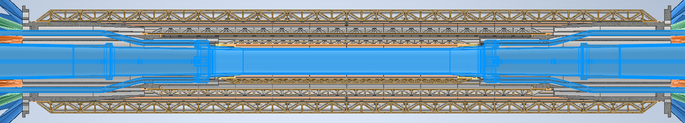
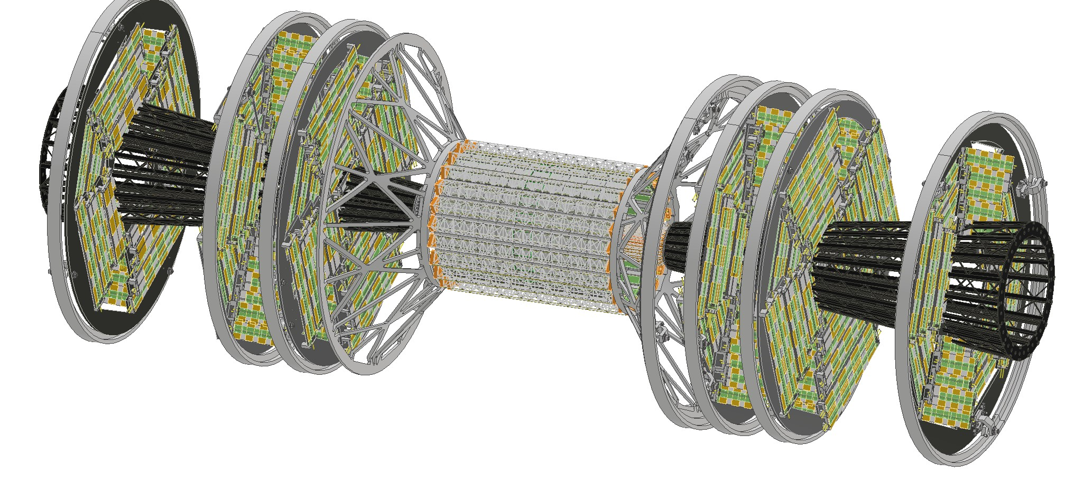
Vertex integration with beampipe – I
Integration is challenging due to interference of beampipe cooling services
First option:
  A conical structure, with the air ducts for the three layers inside, is fixed to the 3D printed support
    Uneasy integration of the disks
    Almost projective geometry
      Might result in showers in LumiCal
BEAM PIPE

Slide 17
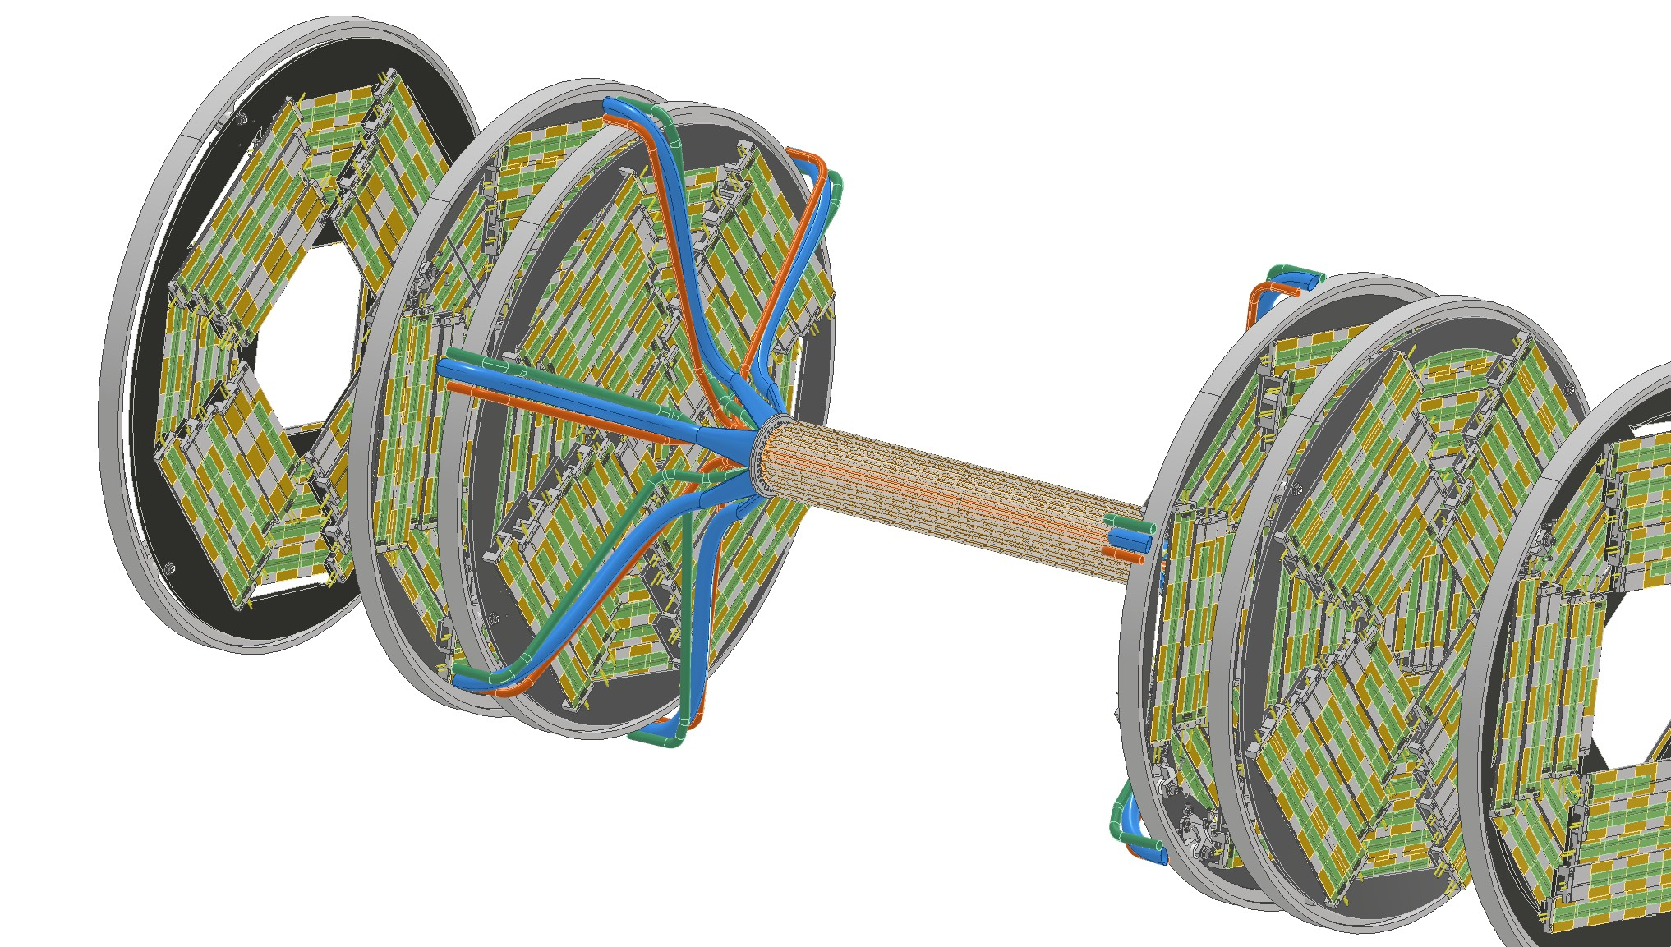
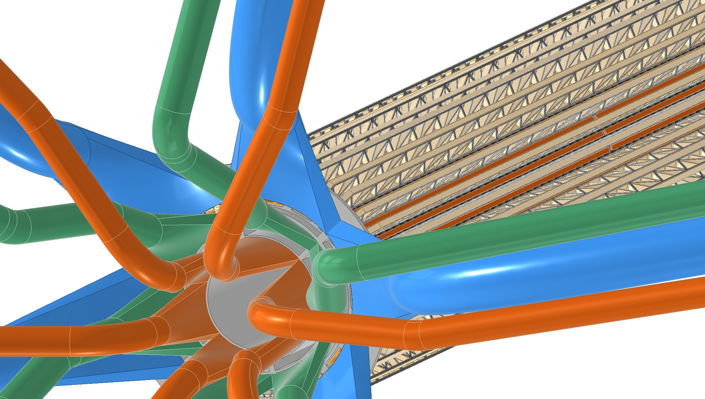
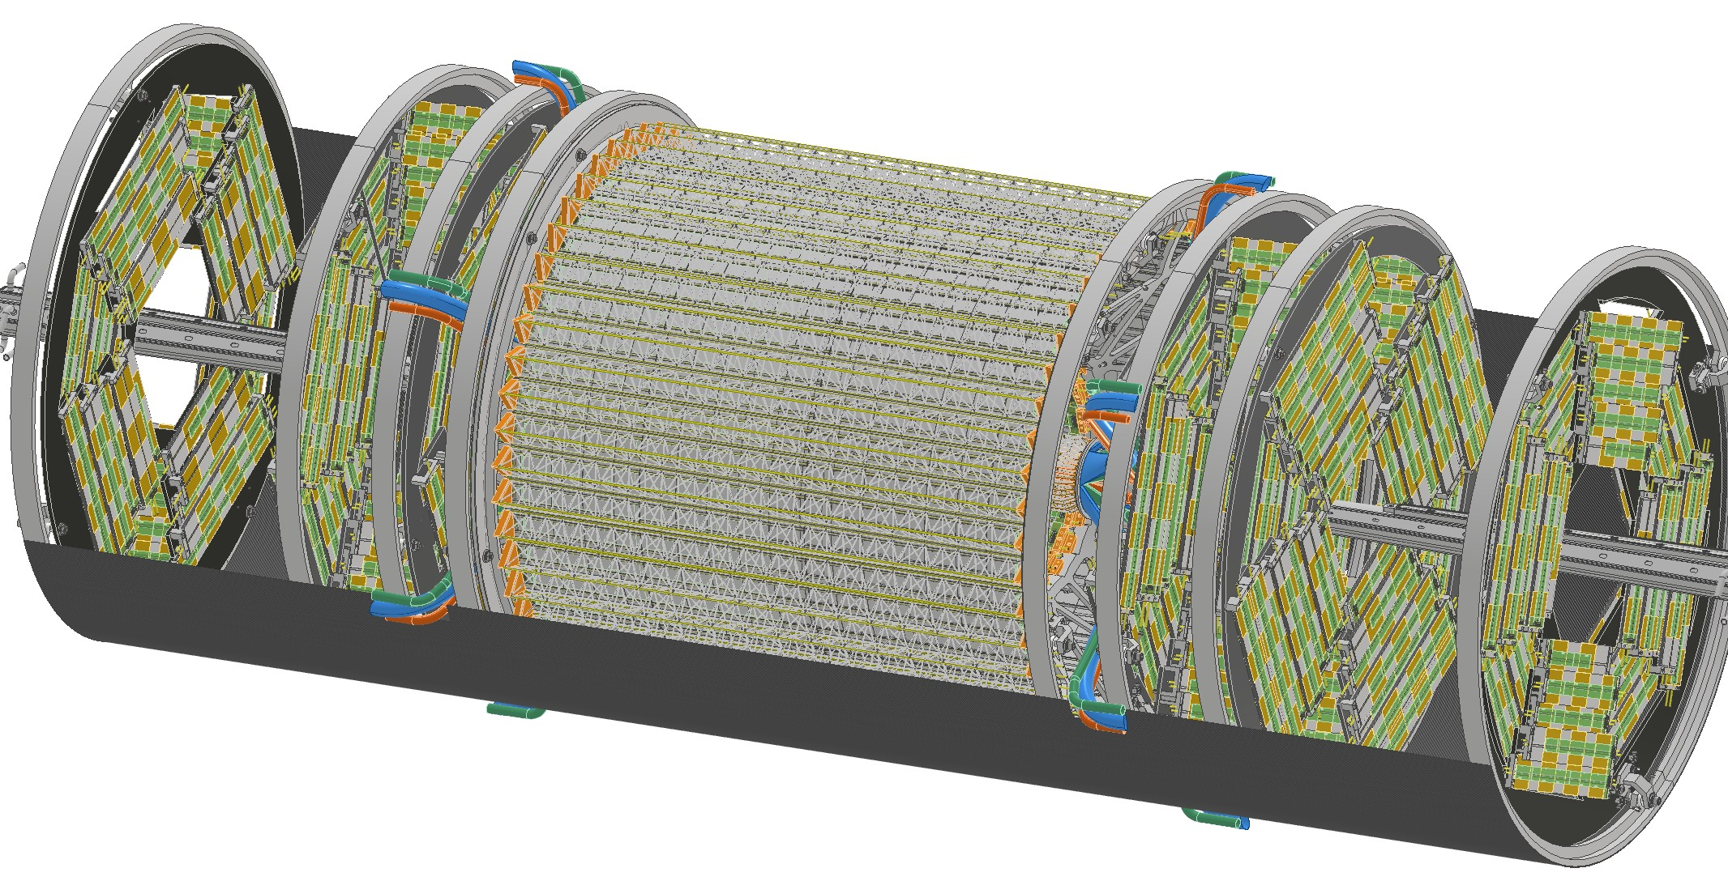
Vertex integration with beampipe – II
Second solution: radial service routings
  Better disks integration and minimal impact on LumiCal
  A mockup is being setup in Pisa and Frascati to validate it
Cables inlet/outlet
Inner Vertex

Slide 18
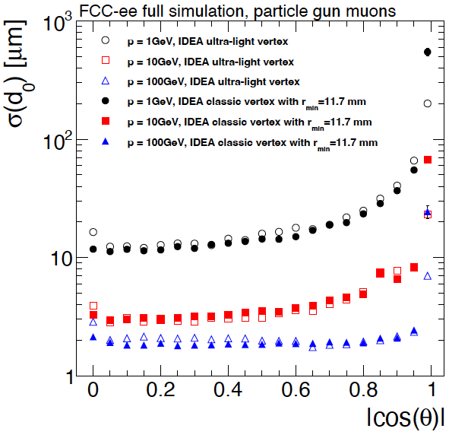
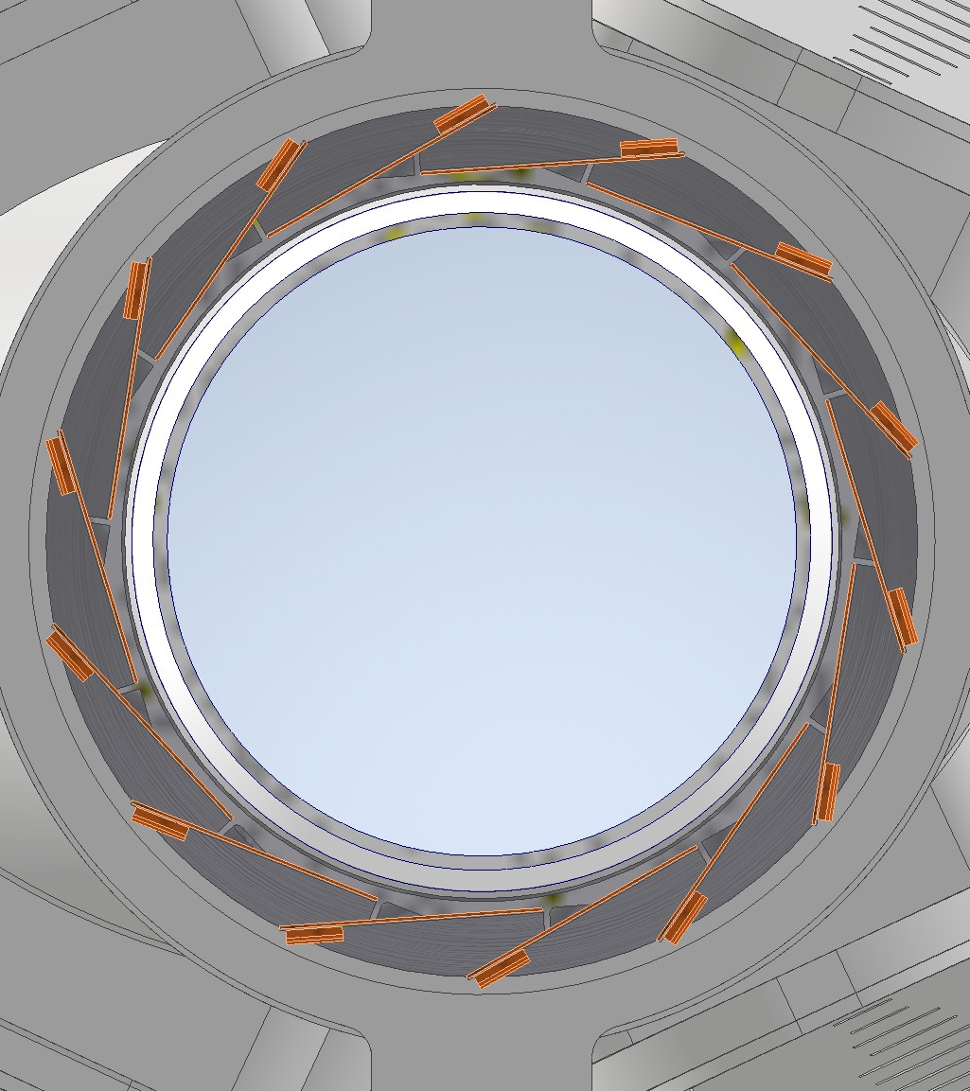
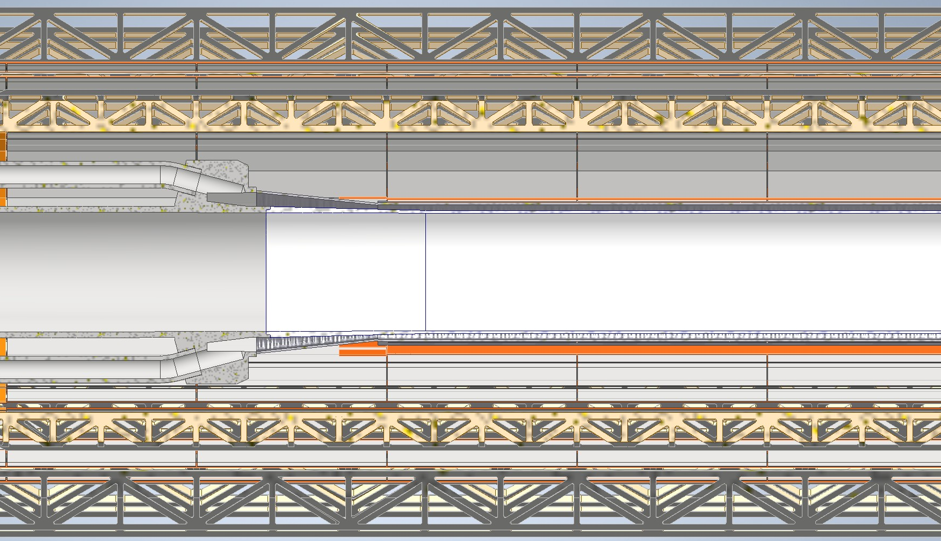
Going closer to the beam pipe and lowering material
Use the beam pipe coolant to cool as well the first vertex detector layer
  Can go closer to the beam pipe by ~2 mm
  Reduce the material budget of the stave stiffner
  Reduce the interference with the beam pipe cooling manifolds
  Better i.p. resolution wrt curved layout at nominal radius
LIQUID PARAFFIN
Electrical insulator

Slide 19
Conclusions and prospects
The vertex detector requirements for the FCC-ee demand excellent position resolution and low material budget
  MAPS detectors default choice for all detector concepts
  Mature technology being pursued by ALICE/Belle-II upgrade/ePIC
Different geometries are being studied
  ‘traditional’ flat sensors
  Stitched and bent silicon detectors
High data rates are expected which require further R&D on the technology itself to be pursued in DRD3 and DRD7
System integration and overall layout being studied
    Cooling, services, mechanics, alignment, beam backgrounds, maintenance …
    Avoid overdesign and find the best choice taking beampipe and central tracking in consideration

