Slide 1
Measurements of rare electroweak processes including vector boson scattering and tri-boson production with ATLAS
V. Kostyukhin Siegen University
On behalf of the ATLAS Collaboration

Slide 2
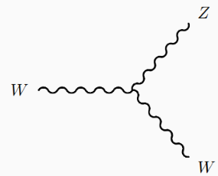
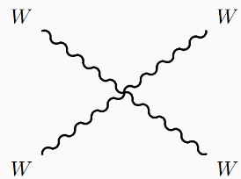
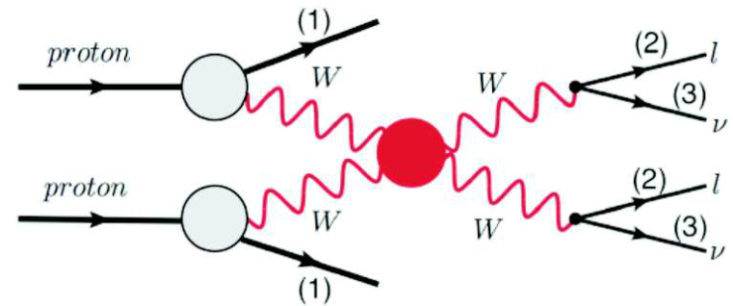
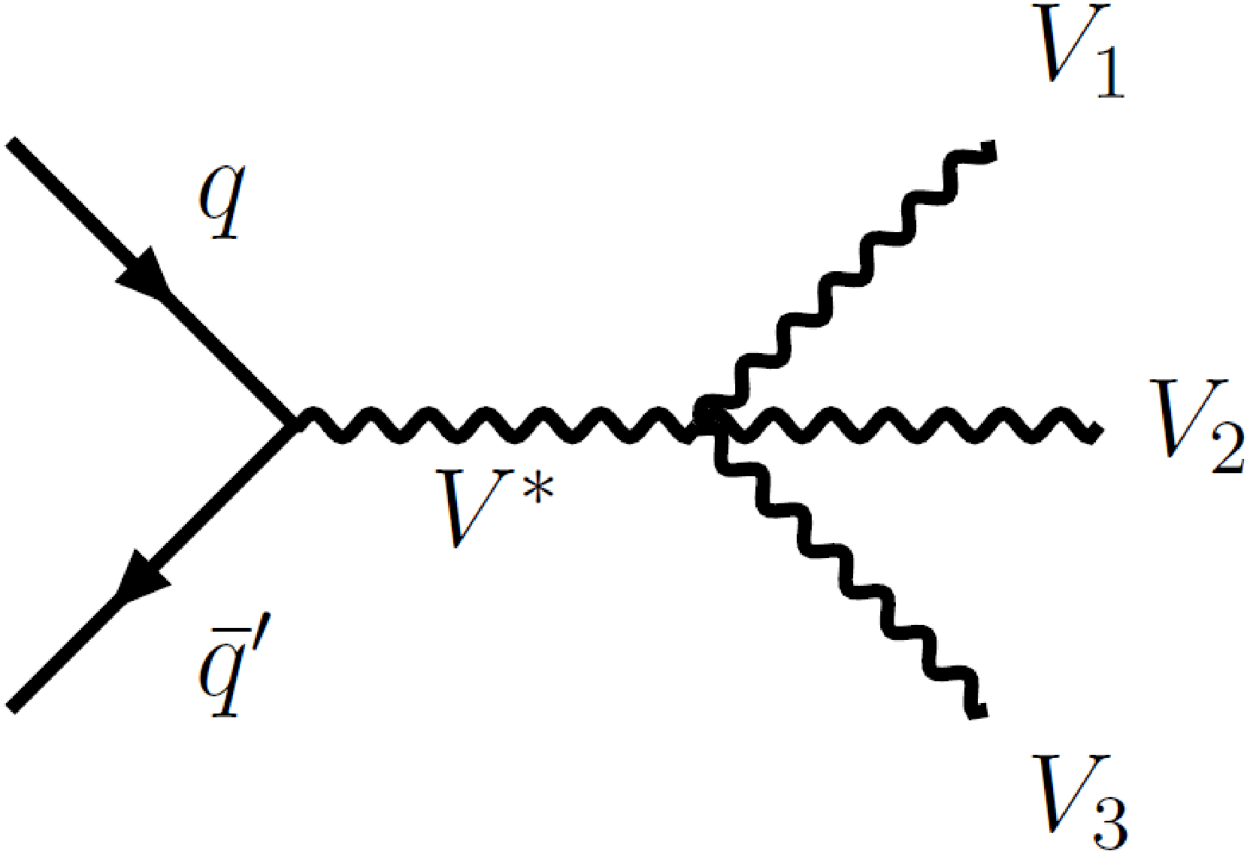
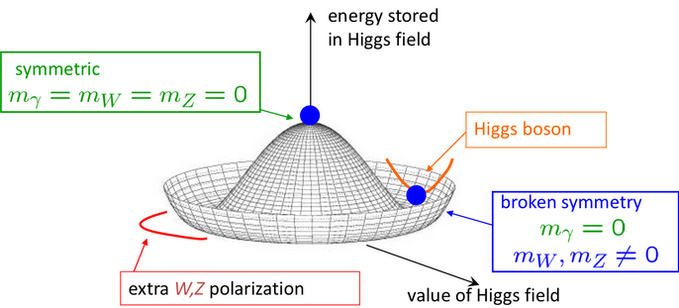
Why VBS and tri-boson
In the Standard Model (SM), the non-Abelian structure of the electroweak sector predicts the self-interaction of vector bosons leading to vertices with three or four bosons.
VBS
Tri-boson
Both triple and quartic vector boson couplings can be probed in the Vector Boson Scattering (VBS) and tri-boson production processes.
Electroweak symmetry breaking via Higgs mechanism leads to the appearance of masses and longitudinally polarised states of the vector bosons. Scattering of these states violates unitarity limit at ~TeV scale without meticulous compensation from Higgs exchange. Study of the VBS, especially polarised states, allows sensitive validation of the symmetry breaking in SM.
Deviations from the SM expectations would be hints of new physics at higher energy scales.
Dim-6(aTGC) and Dim-8(aQGC) EFT operators can be probed in VBS and tri-boson production processes
Notes:
Why study of VBS and tri-boson production is interesting?

Slide 3
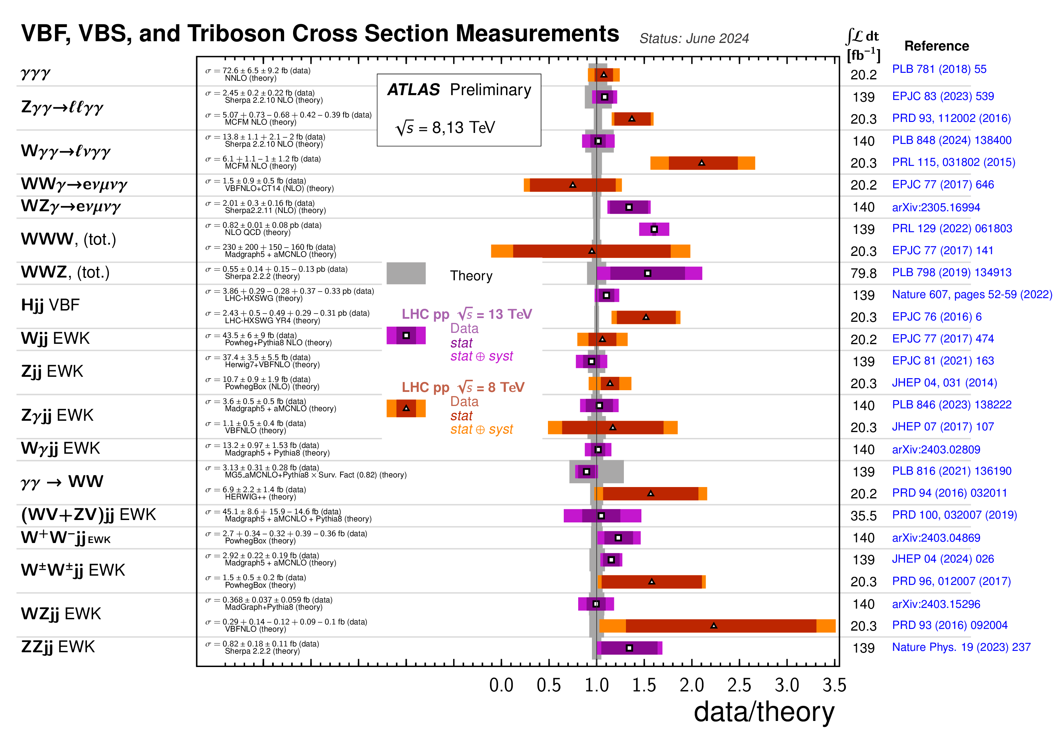
Outline
ATLAS is carrying out an extensive program of research on these processes
ATL-PHYS-PUB-2024-011
3 results appeared since Jun,2024 ATLAS summary publication and will be presented here:
Tri-boson VVZ production observation Phys. Lett. B 866 (2025) 139527
VBS W±W± polarisation observation arXiv:2505.08313
VBS VV production study in semileptonic mode arXiv:2503.17461
These analyses are based on 140fb⁻¹ data collected by ATLAS at sqrt(s)=13TeV in Run 2
Notes:
Atlas is carrying out an extensive program of research on these processes. This summary table demonstrates numerous ATLAS results on VBS and triboson production obtained in Run 1 and 2. It was published in June last year. Since then, ATLAS published 3 new results which I will review in my talk. They are tri-boson VVZ production observation, here V stands for W and Z, polarisation observation in the same-sign WW scattering,
VBS di-boson production study in semileptonic mode.
All analyses are based on 140fb^1 of data collected by ATLAS in Run 2

Slide 4
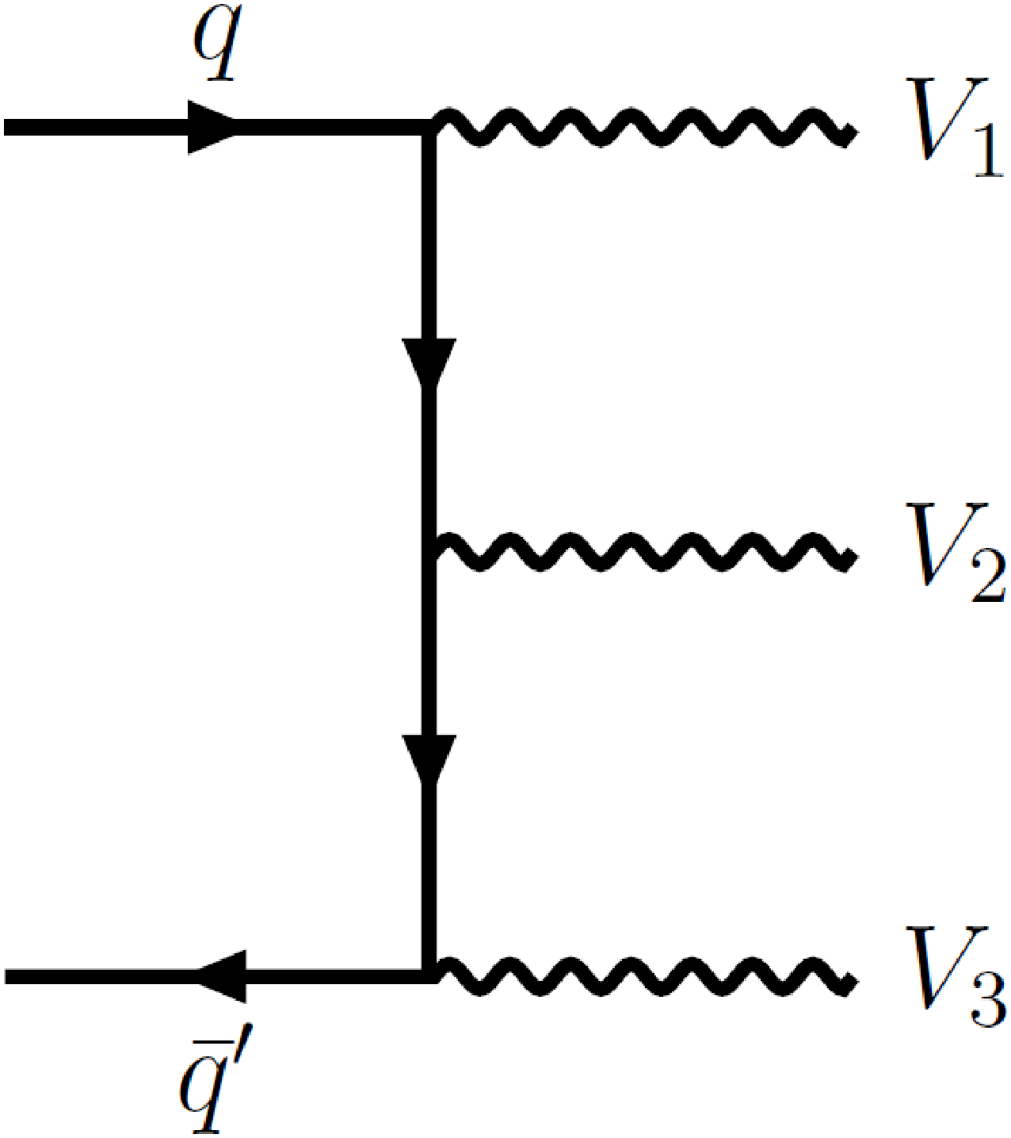
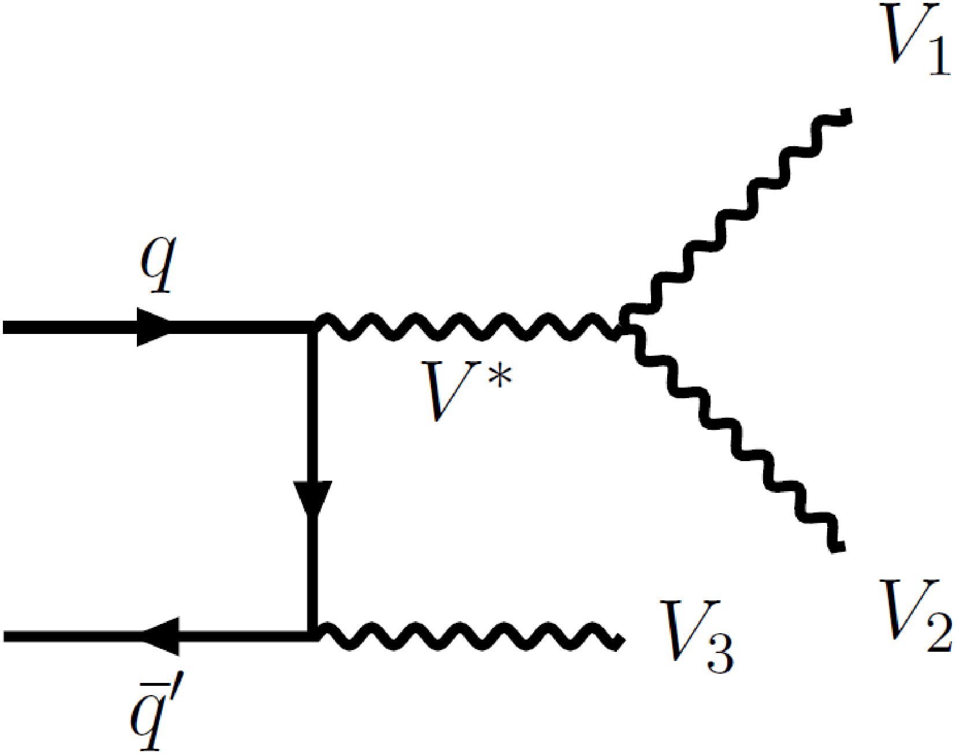
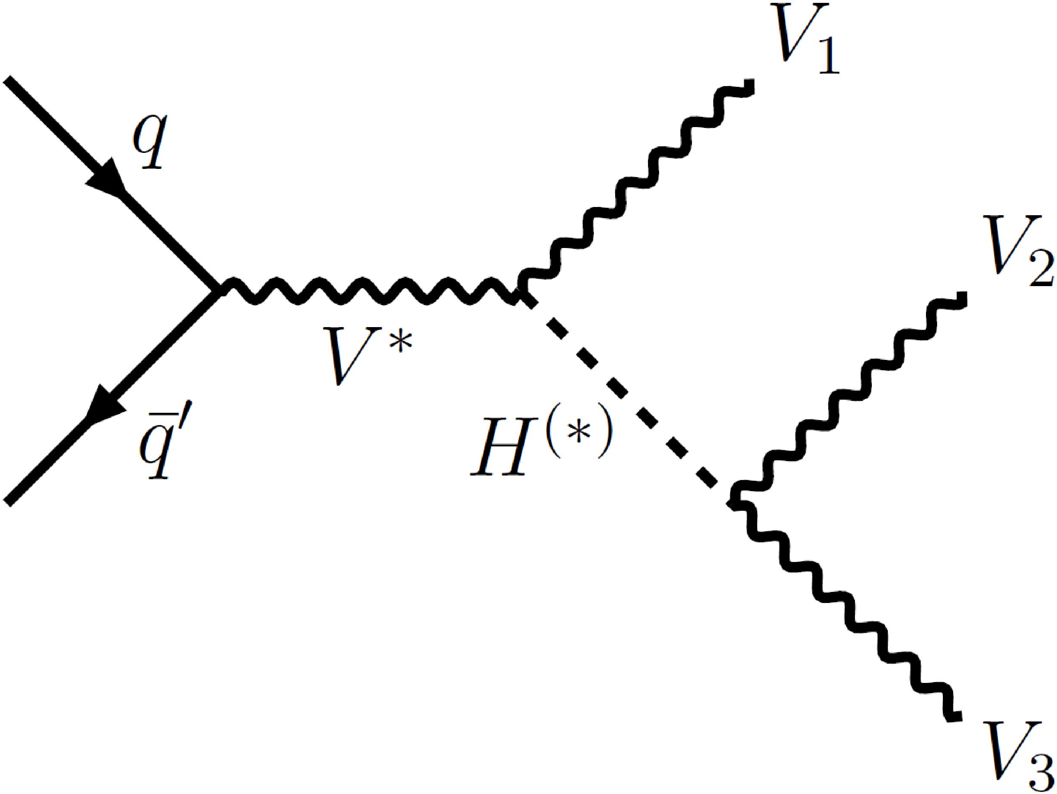
Tri-boson VVZ production
Phys. Lett. B 866 (2025) 139527
VVZ (V=W,Z) production process contains contributions from
triple gauge boson couplings (TGC)
quartic gauge boson couplings (QGC)
Higgs to vector boson couplings
Validation of non-Abelian SM nature
Hints of new physics if any deviations from SM
LO Feynman diagrams of VVZ production process
ATLAS previously observed WWW production at 8.0σ (Phys. Rev. Lett. 129 (2022) 061803).
This analysis targets an observation of the complementary VVZ(WWZ, WZZ, ZZZ) state and setting limits on dim-8 EFT operators.
Notes:
Let’s start with the tri-boson production study.

Slide 5
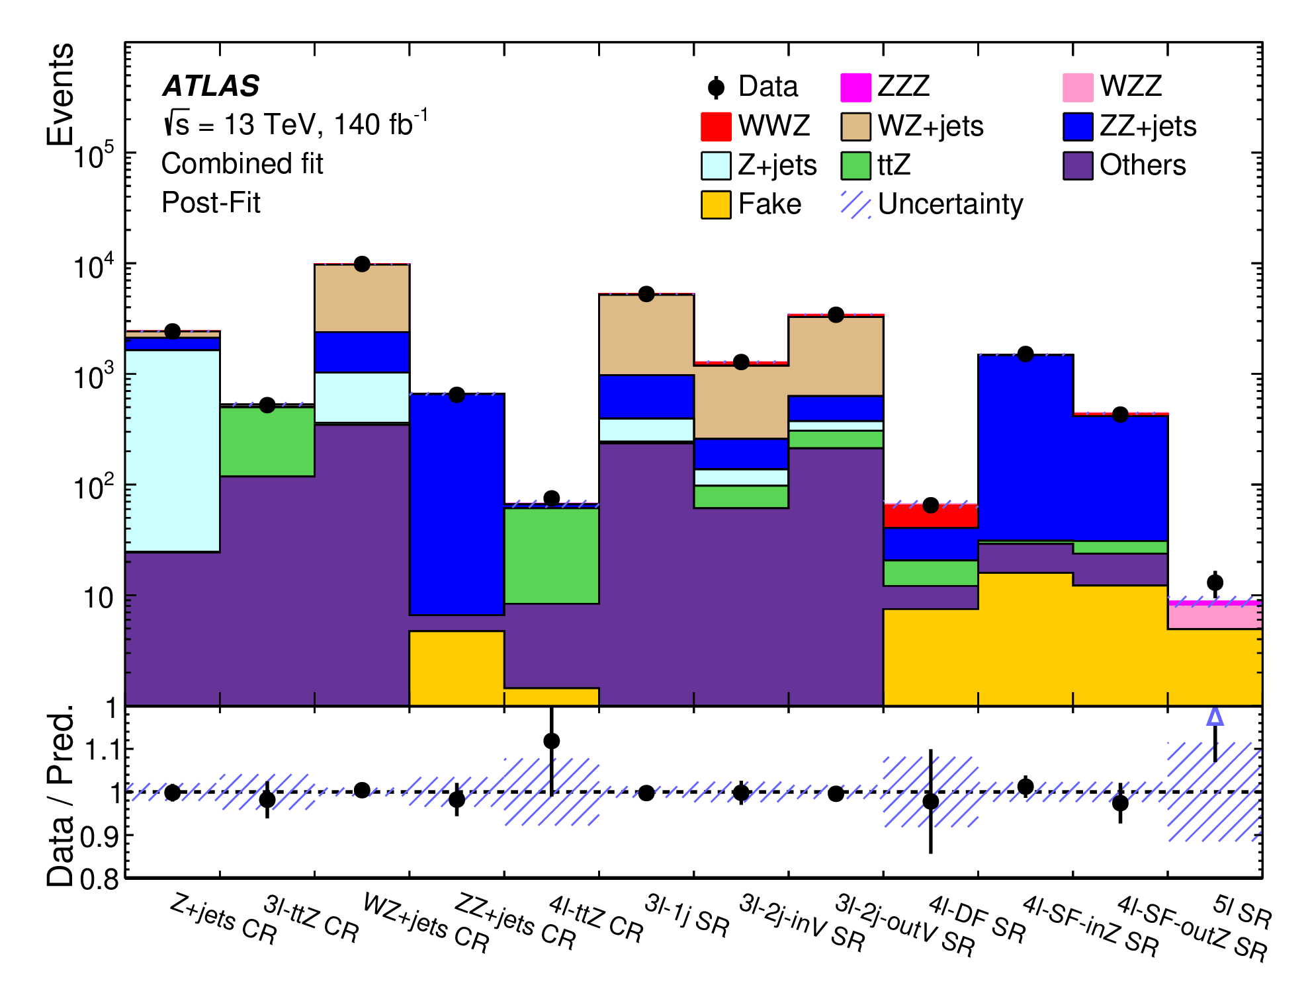
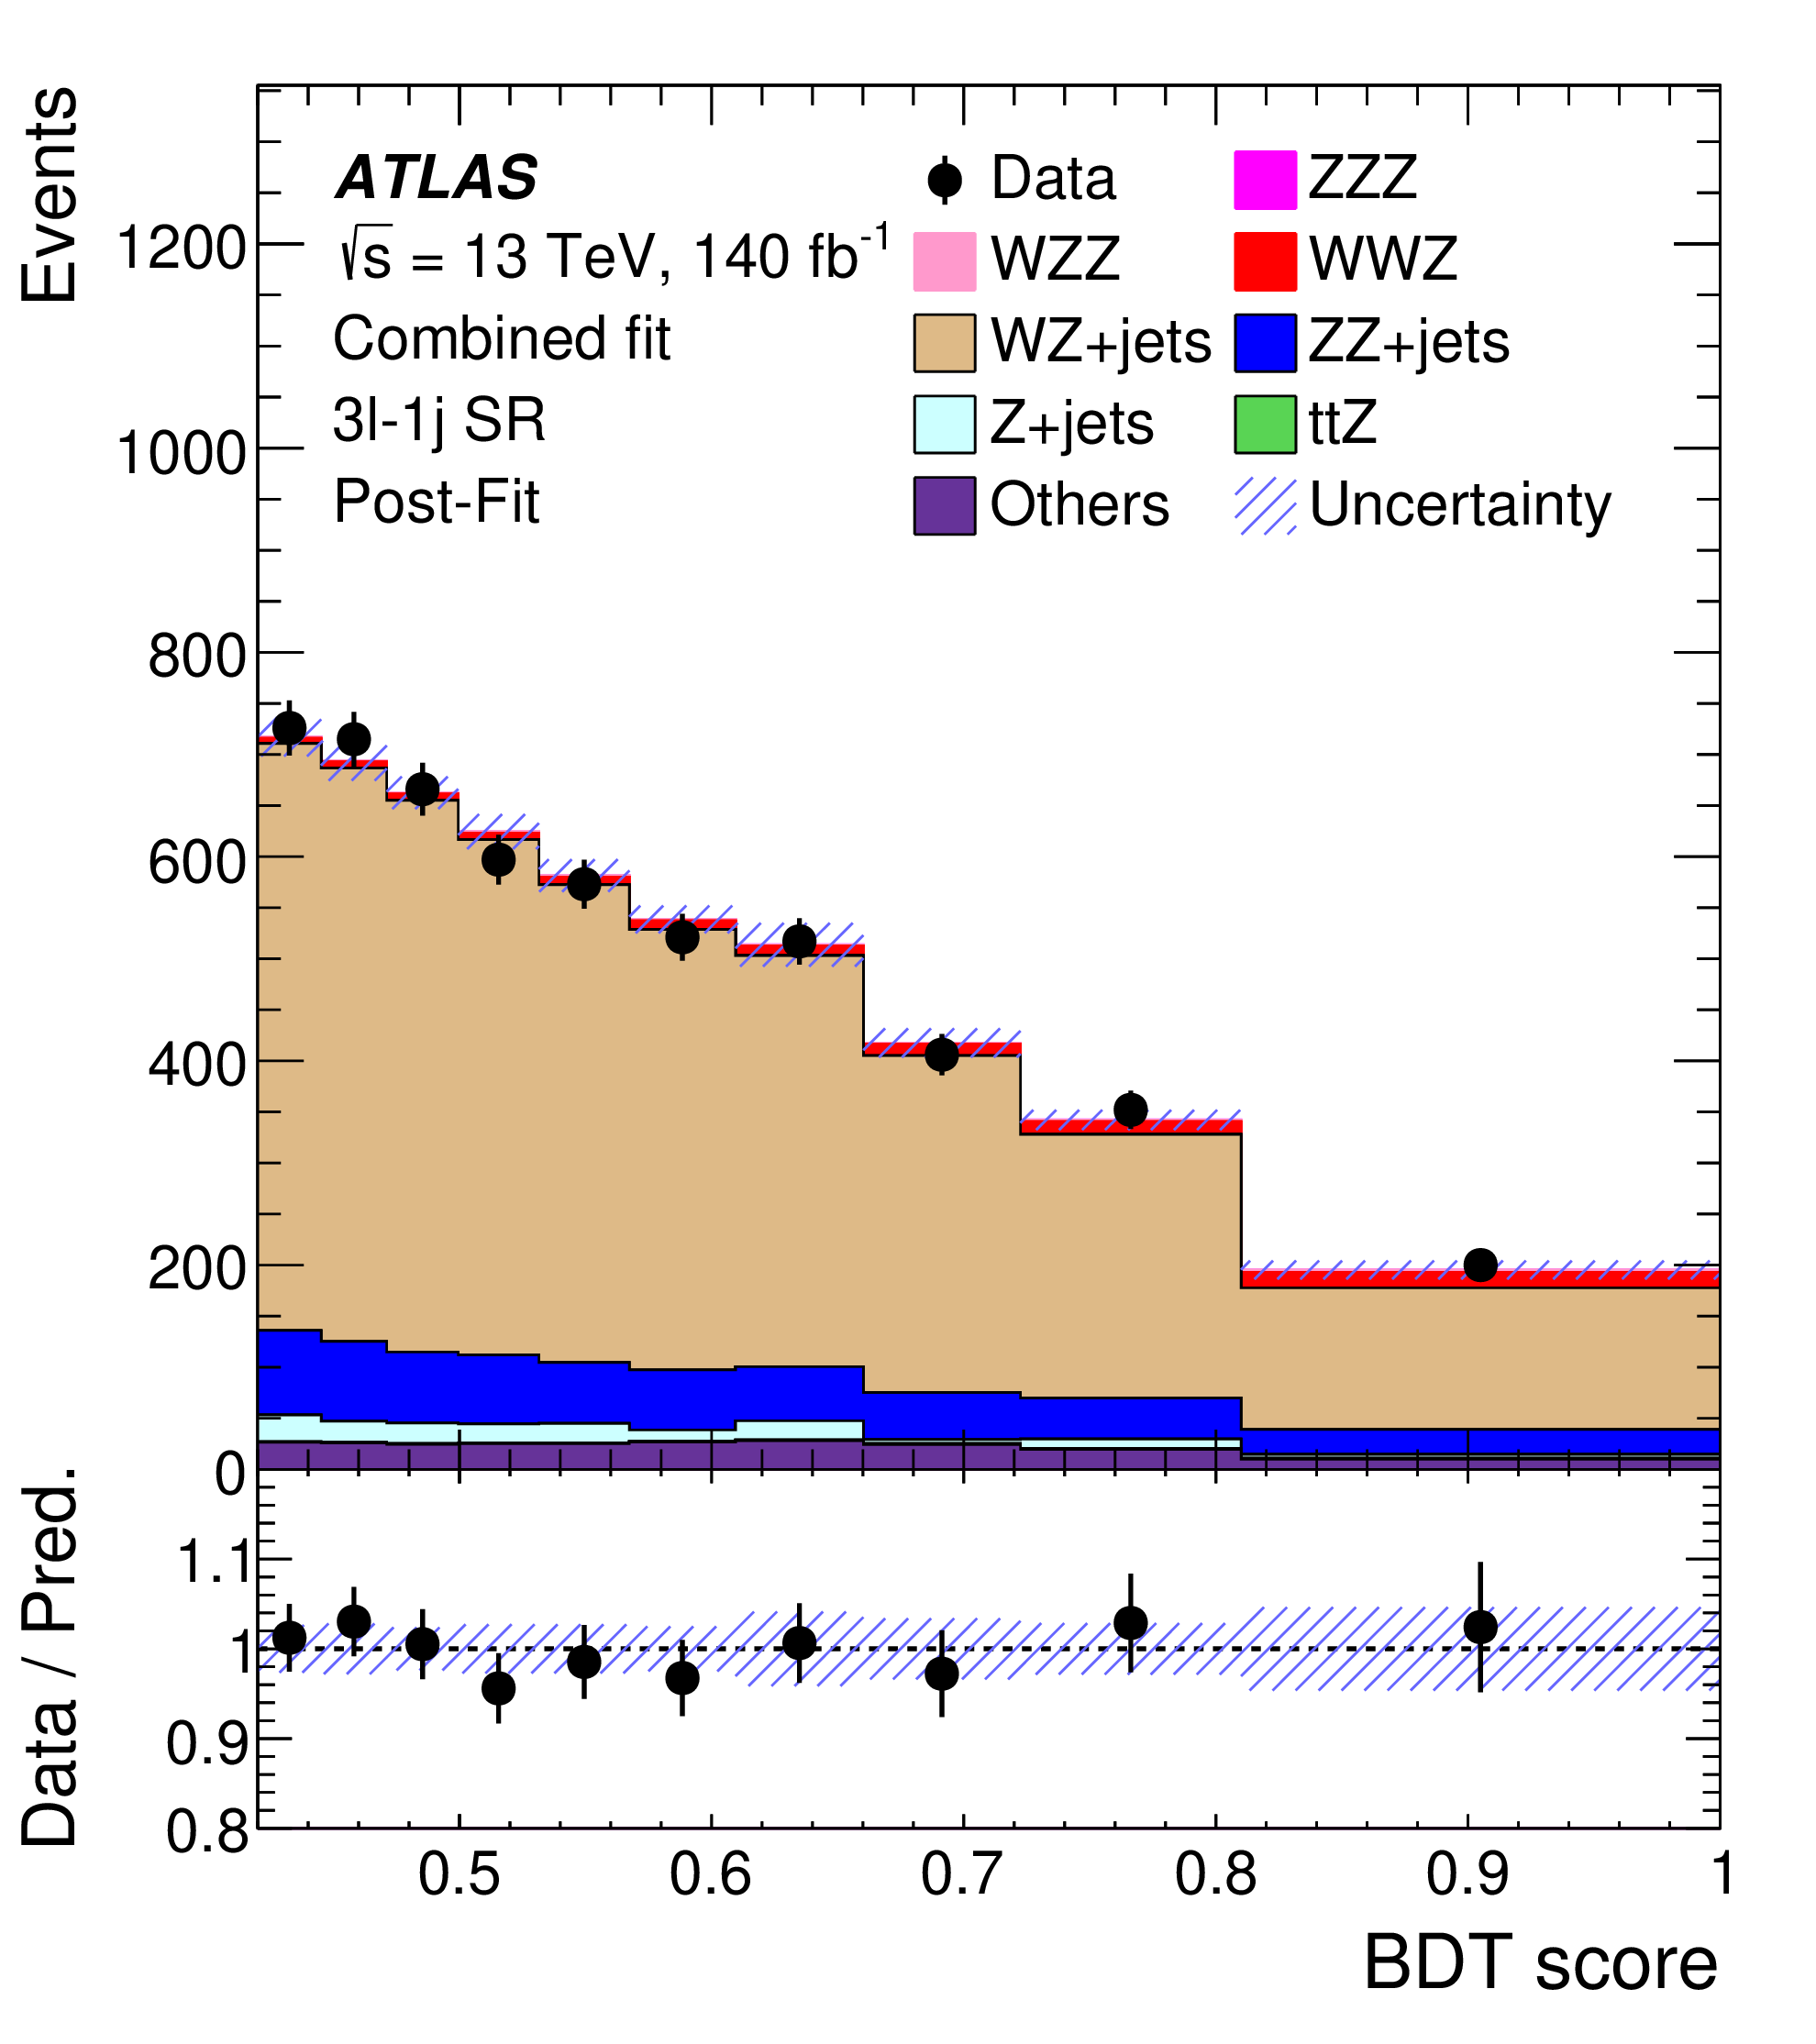
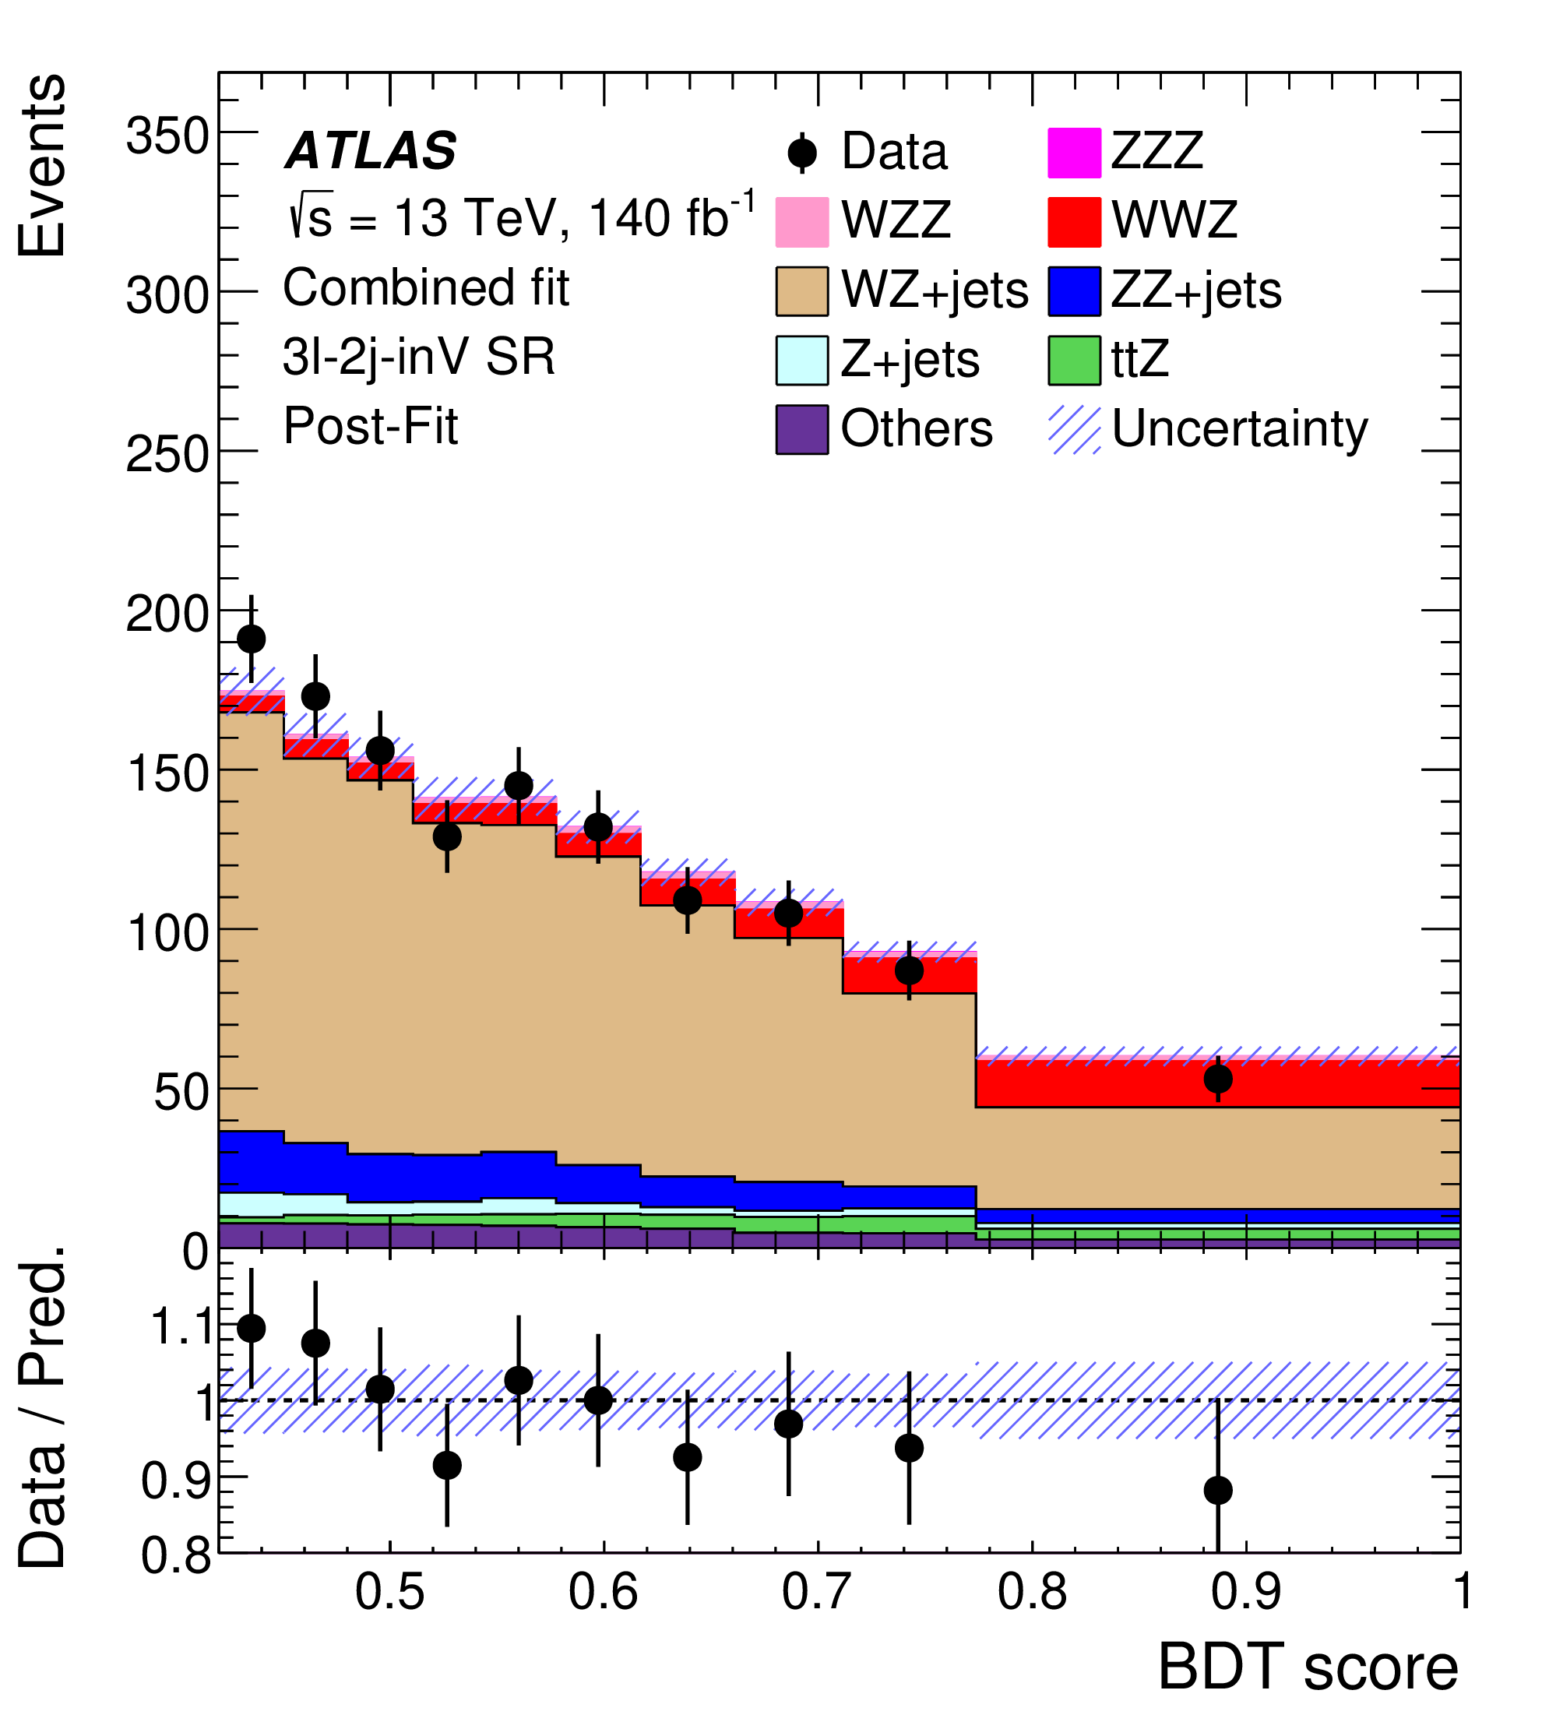
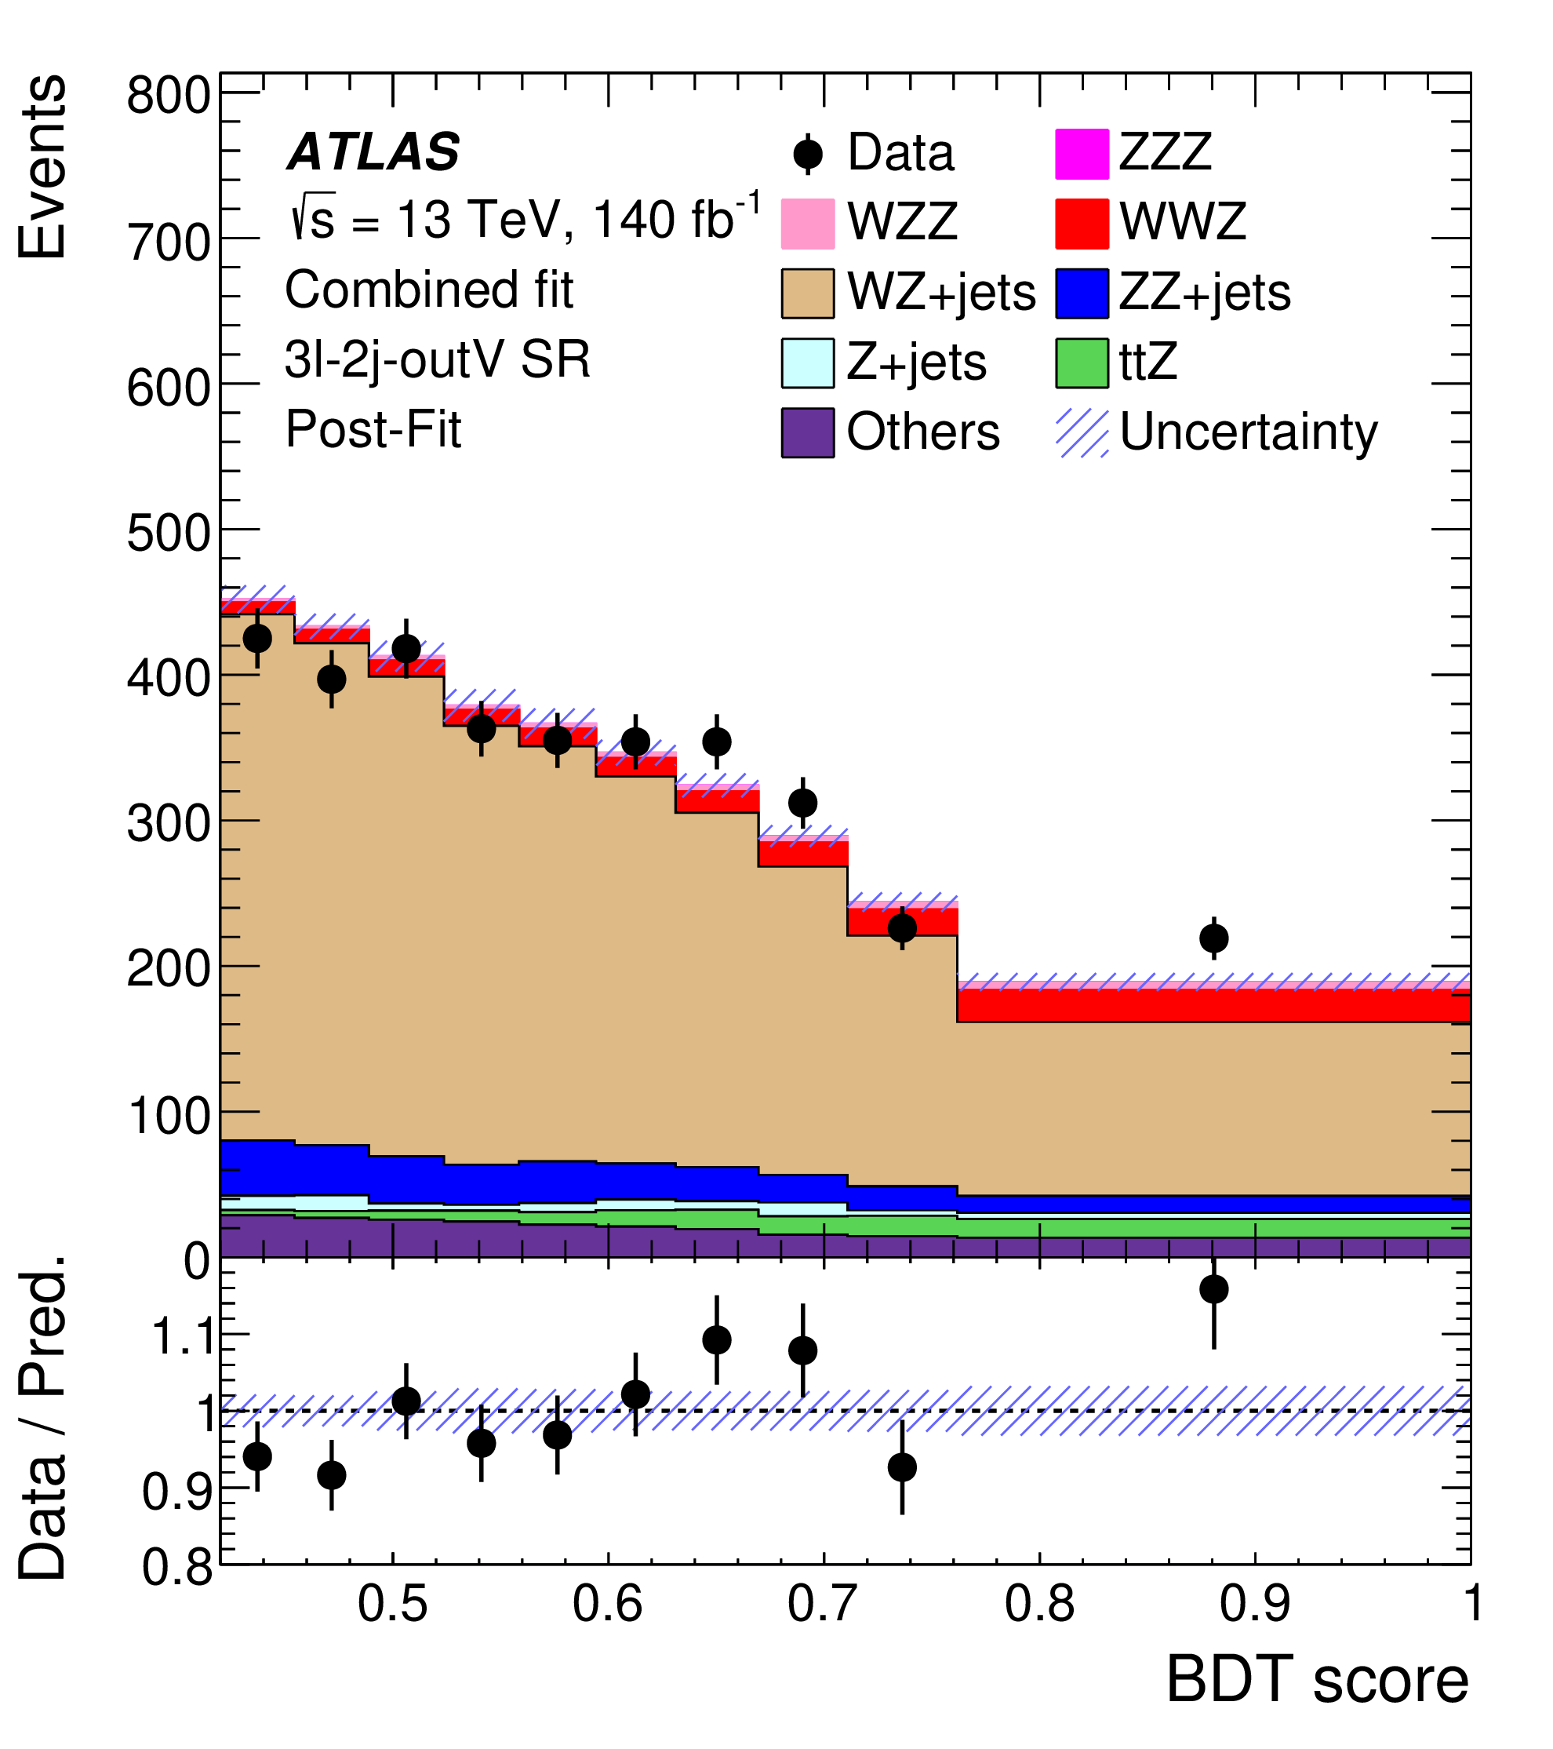
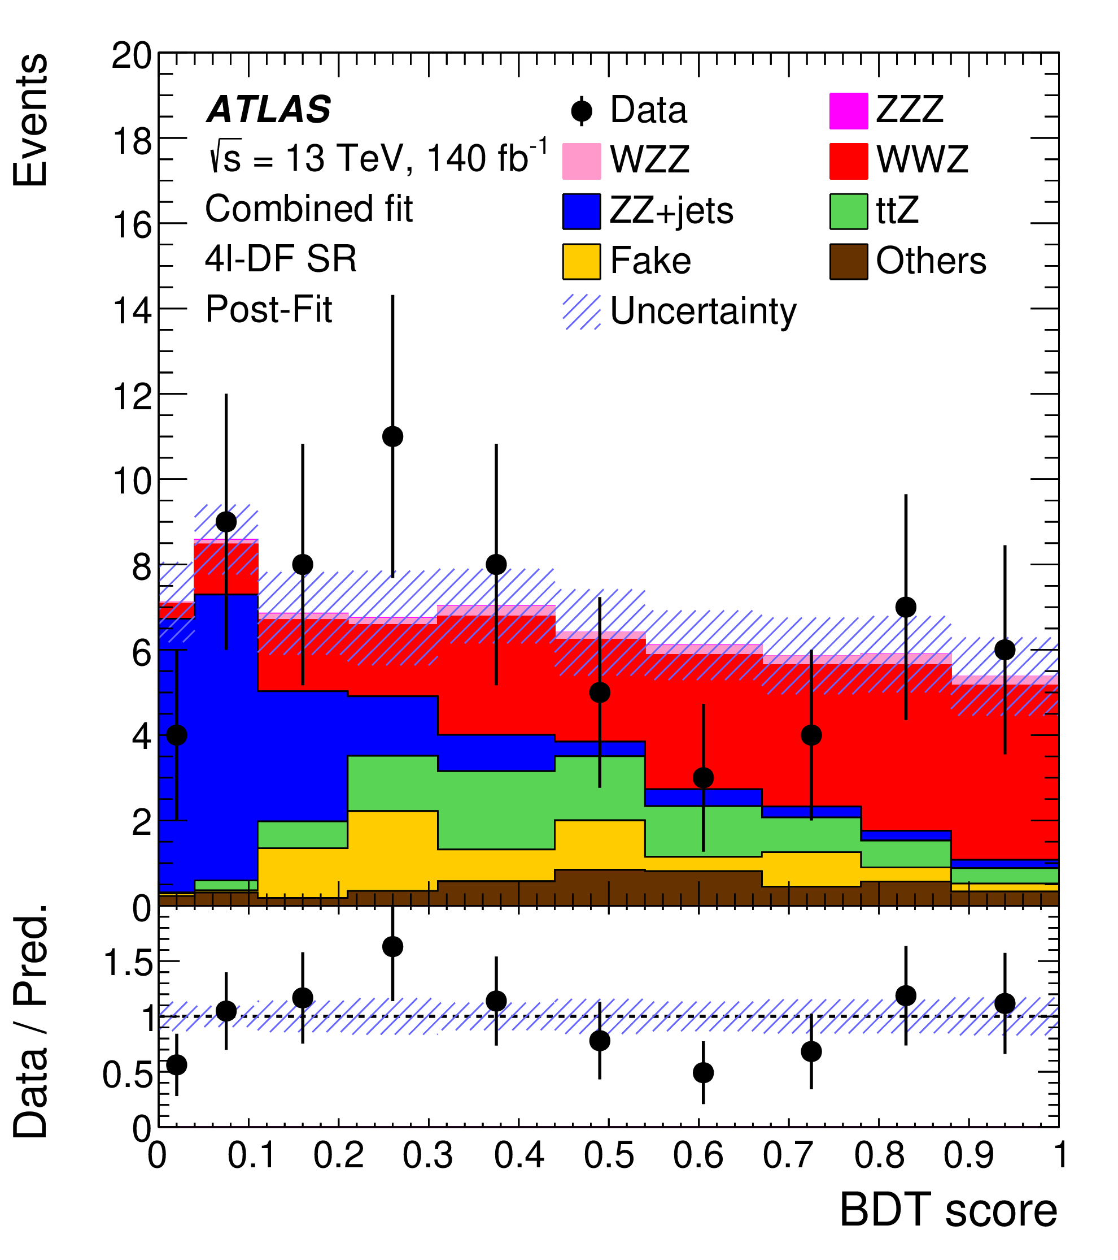
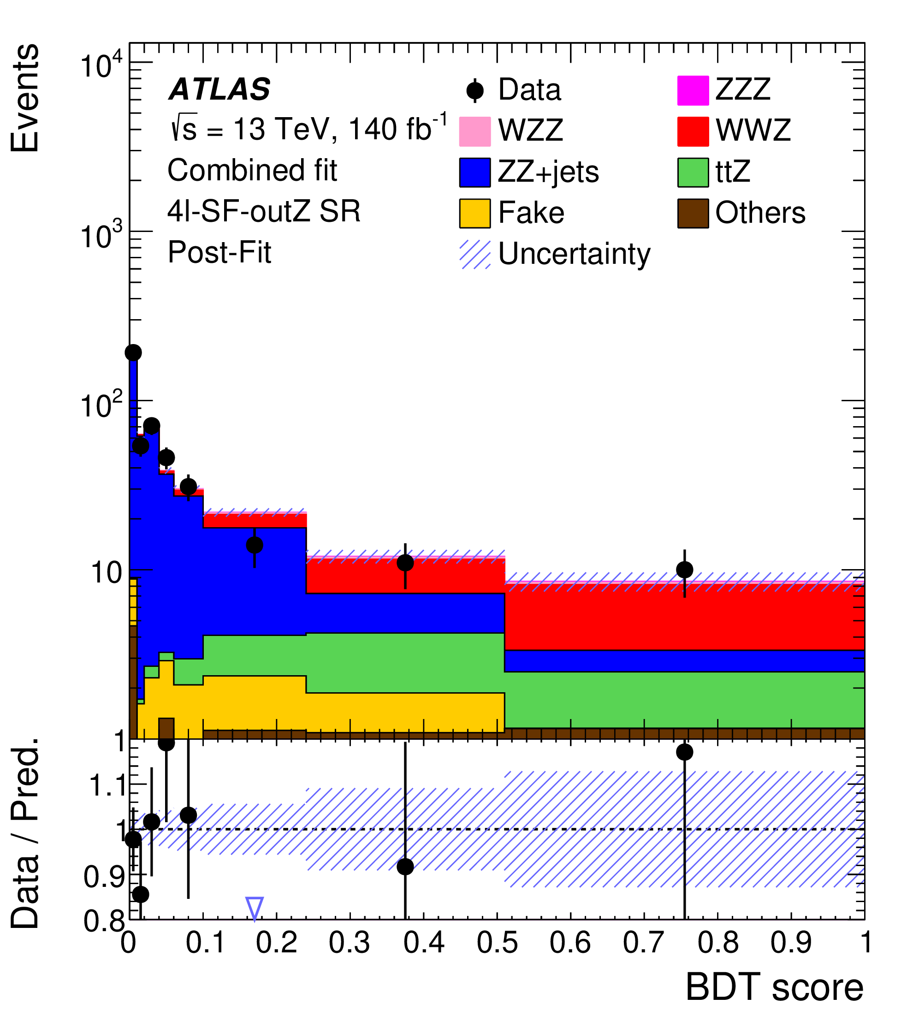
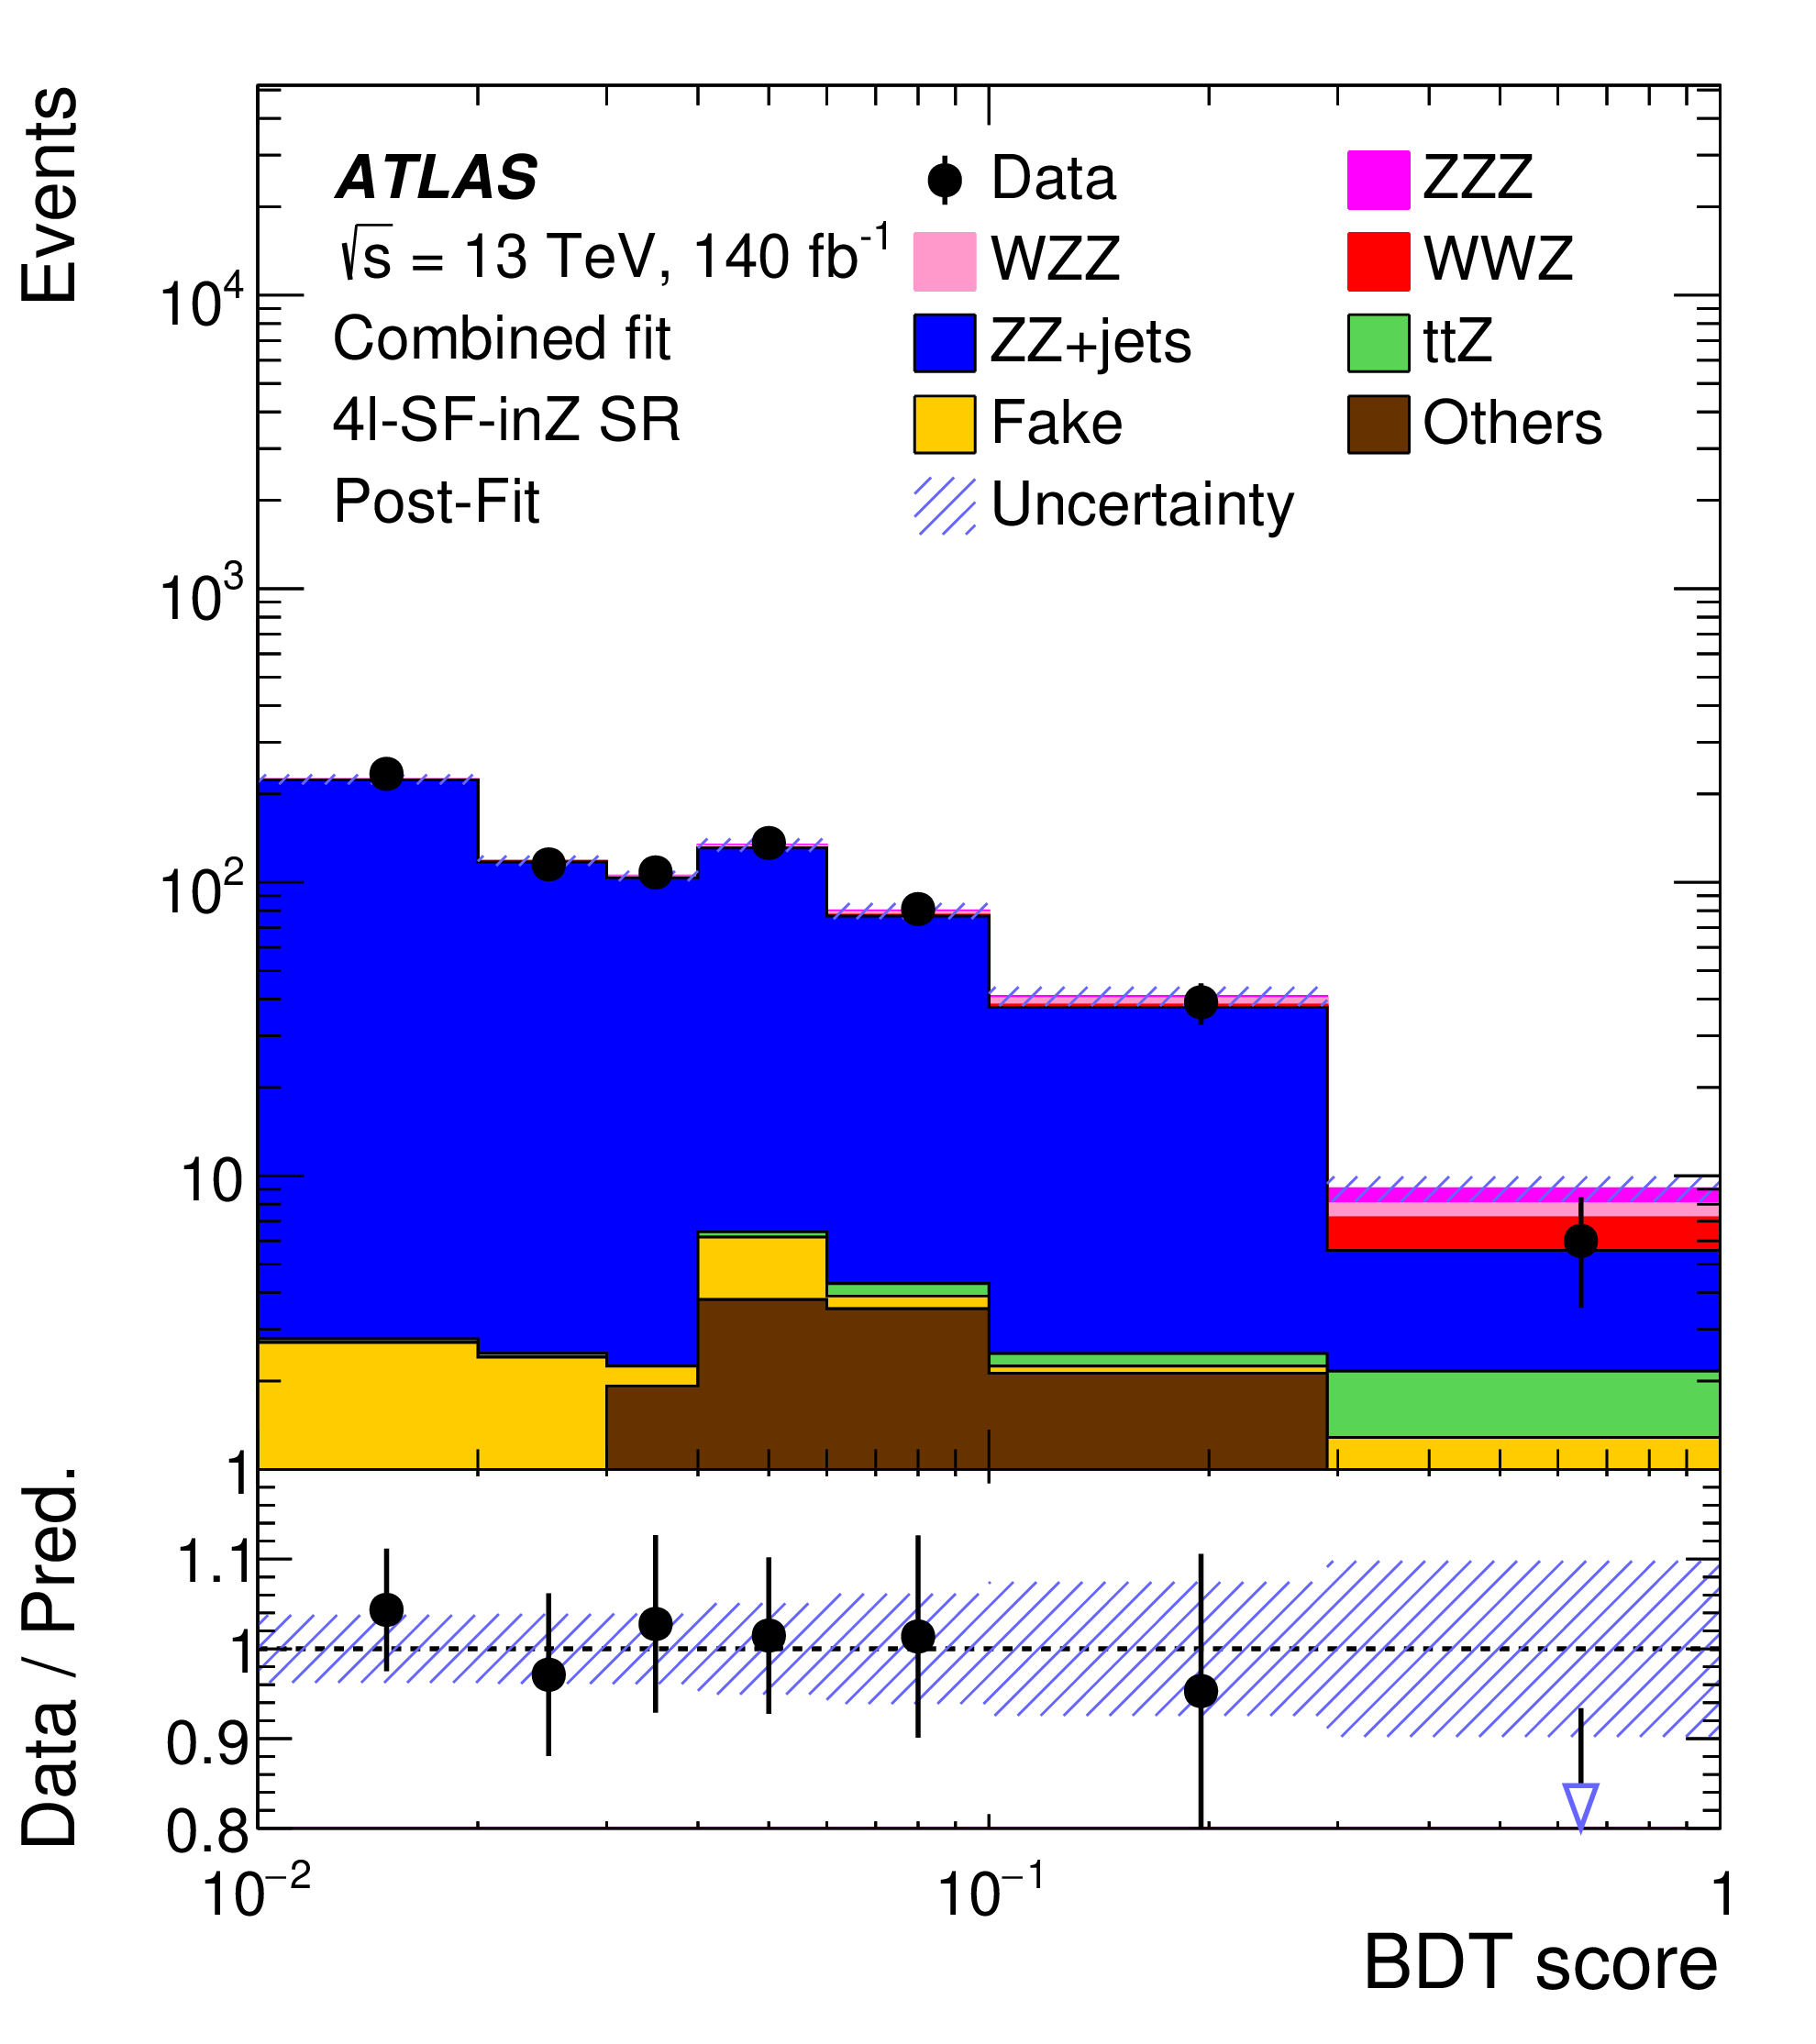
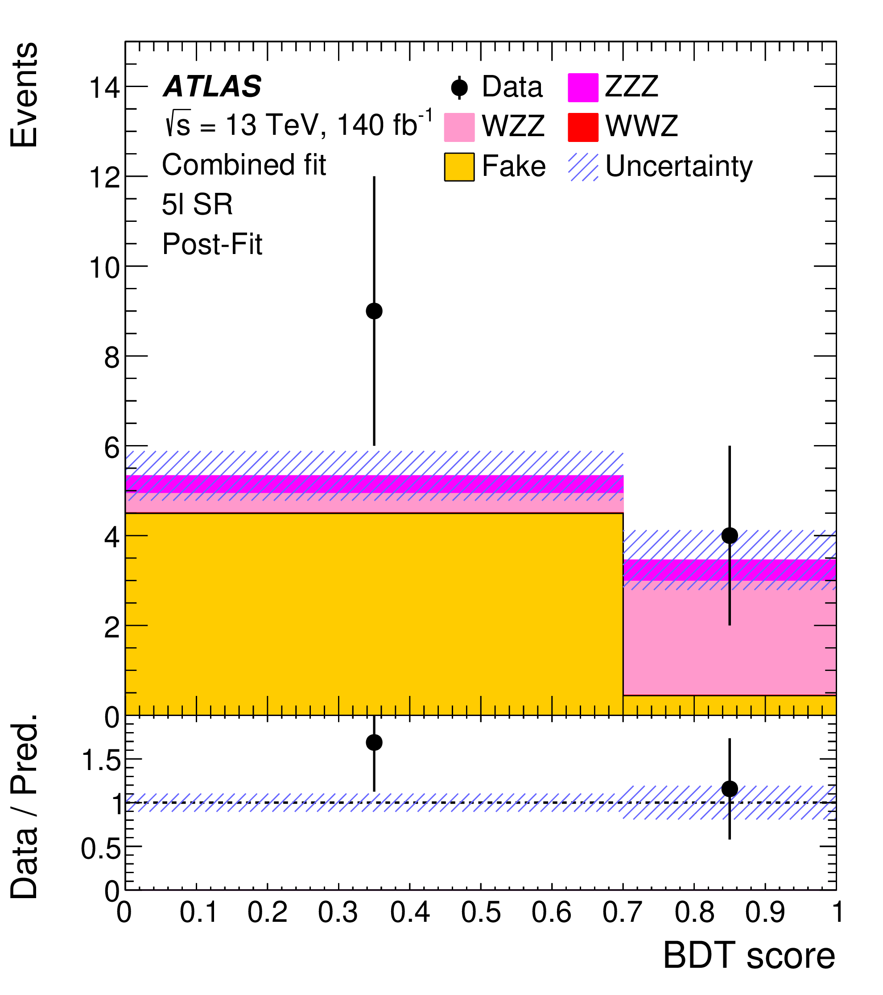
VVZ selection
At least one SFOS lepton pair in Z-mass window.
7 signal regions(SR) depending on number of final states leptons
5 control regions(CR) to control ttZ,Z+jets and di-boson bkgs.
Phys. Lett. B 866 (2025) 139527
inV - at least one jj pair has mass in W,Z mass window, outV – no such pair
inZ - second SFOS lepton pair has mass in Z mass window, outZ – SFOS mass not in Z
Classification BDTs in 7 signal regions to separate signal from background
Notes:
In this ATLAS analysis events with 3,4 and 5 leptons in final state were used. The tri-boson events with at least one Z were selected by requiring presence of at least one SFOS lepton pair in Z-mass window.
3 SRs were defined for 3L events as shown in table, label inV here means presence of at least one jet pair in the vector boson mass window, outV – no jet pair in this window.
3 SRs were defined for 4L events, label inZ here means presence of second SFOS lepton pair also in Z-mass window, outZ - second pair is outside it.
In 5L events 2 SFOS lepton pairs in Z-mass window must be present.
5 CRs were defined to control ttZ, Z+jets and di-boson backgrounds.
Composition and number of events in 7 SRs and 5 CRs are shown in the plot. Data agreement is good, but background is important and to separate it from signal 7 BDTs were trained per every SR. Their weight distributions are presented at the bottom in comparison with data.
For reference CRs: WZ CR: 3lep selection, BDT<0.42
ZZ CR: 4lep-SF-inZ selection, Etmiss<10GeV
Z+jet CR: 3ℓ-2j-inV selection, but W lepton 8<pt<15GeV
ttZ 3L CR: 3L selection, >=4jets, 2 b-tag
ttZ 4L CR: 4ℓ-SF-inZ selection, at least 1b-jet.
Profile likelihood – BDT in SRs, number of events(or jets) in CRs

Slide 6
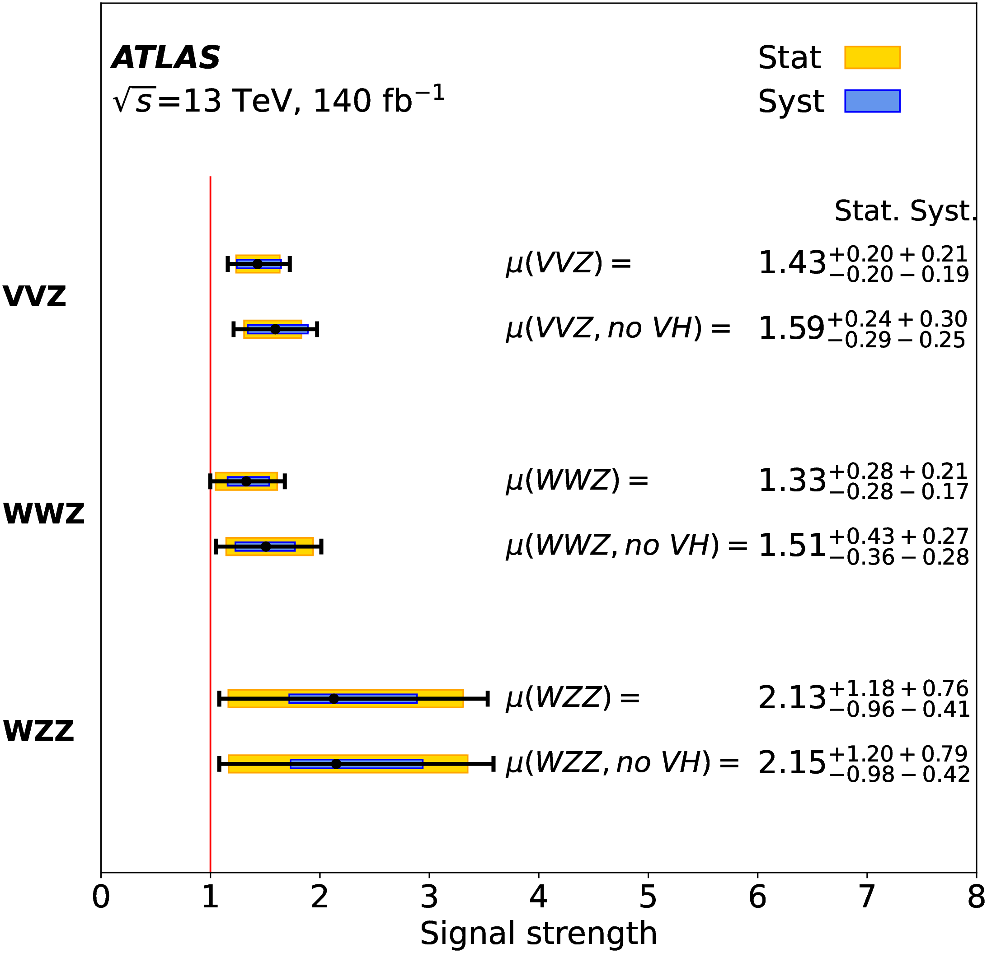
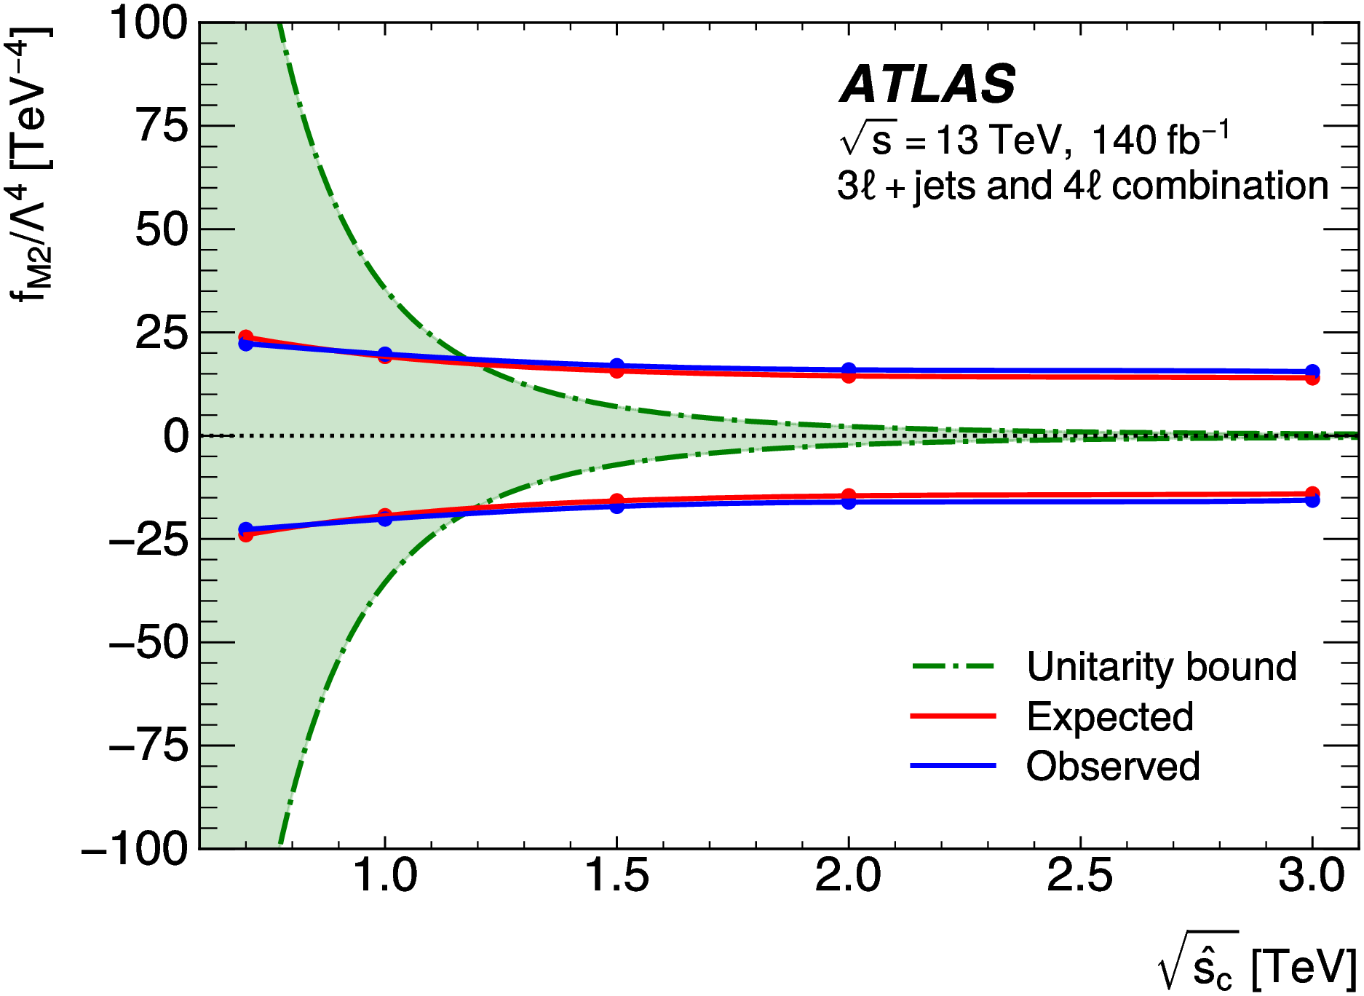
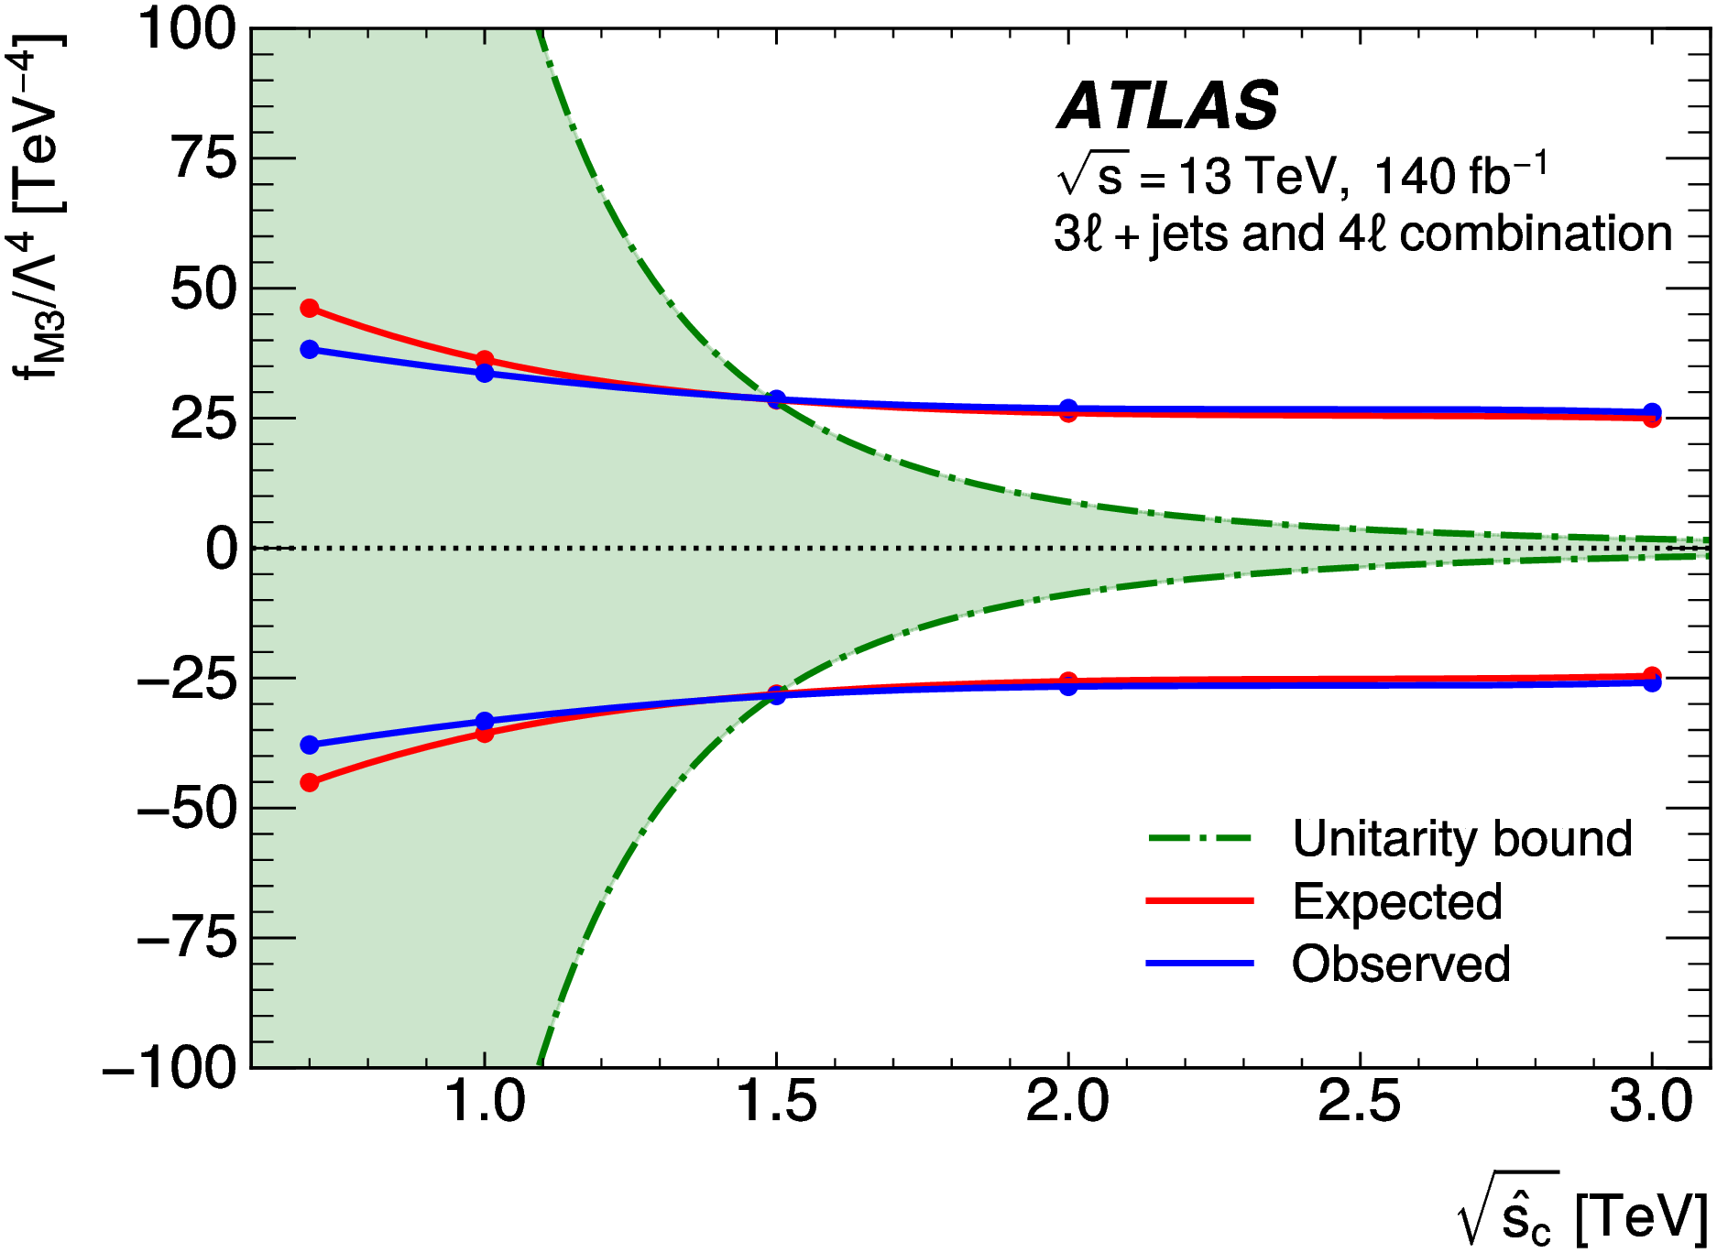
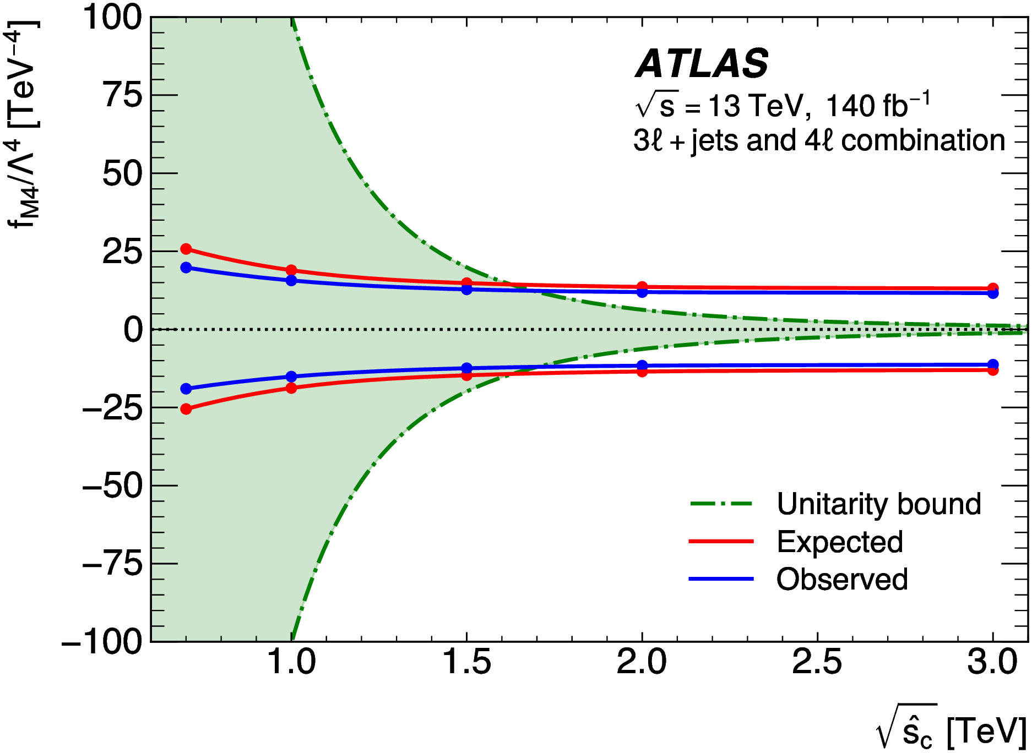
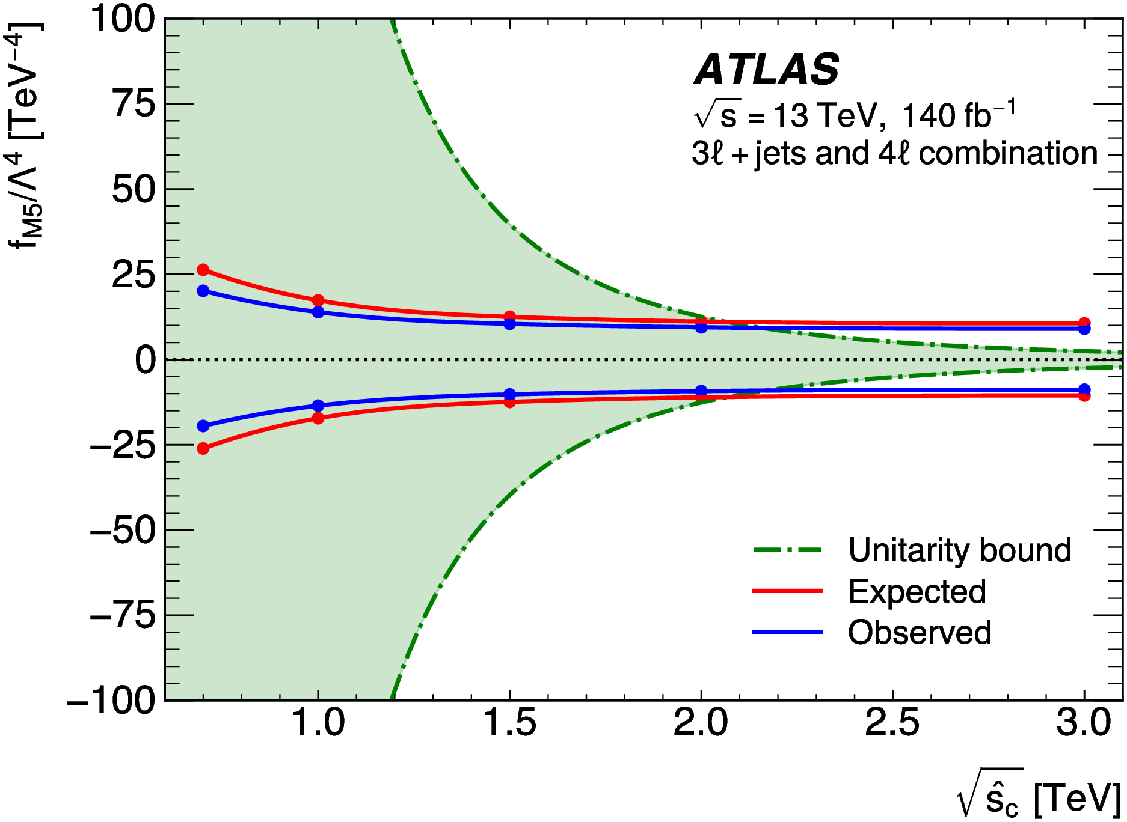
VVZ x-sec and EFT limits
Measured cross sections and significances for VVZ, WWZ and WZZ
Phys. Lett. B 866 (2025) 139527
VVZ=WWZ,WZZ,ZZZ
Unitarised dim-8 EFT operator limits with corresponding energy scales
MC predictions: Sherpa 2.2.2 and Powheg Box2
Observed dim-8 operator limits with unitarity bounds taken from Phys. Rev. D101(2020)113003
Notes:
Combined fit of SRs and CRs with all systematics gave results presented in this table. In the joint VVZ fit 3 states WWZ,WZZ,ZZZ are considered as a signal with fixed SM ratios. WWZ and WZZ individual cross-sections were obtained with fixed other cross-sections. Triple Z cross-section wasn’t estimated separately due to absence of the dedicated SR. CR Observed significance of the tri-boson production with at least one Z was 6.4 sigma.
Limits on 4 most sensitive dim-8 operators (aQGC) were obtained as well. To increase sensitivity the classification BDTs were retrained with included EFT contributions. The limits were obtained in a unitarity-respecting way. CR! Namely the limits are reported at the intersection of the calculated clipped limit curves with the bounds of the unitarity allowed regions. The unitarity bounds were estimated by adapting the existing calculation for dimension-8 operators in two-to-two scattering and setting the parton centre-of-mass energy to the maximum of the three di-boson invariant mass combinations in the tri-boson final state. This approach is illustrated in the pictures at the bottom of the slide, reported limits are highlighted by red circles.

Slide 7
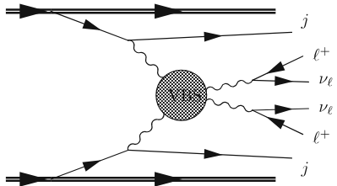
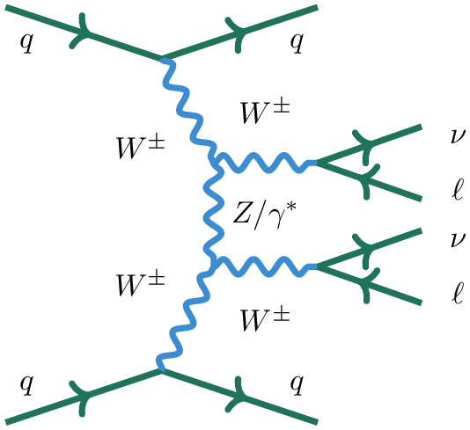
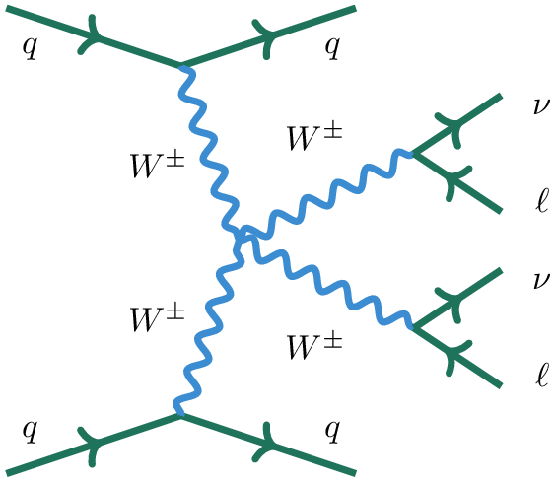
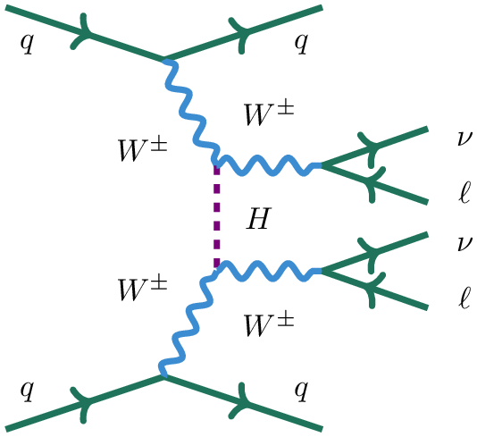
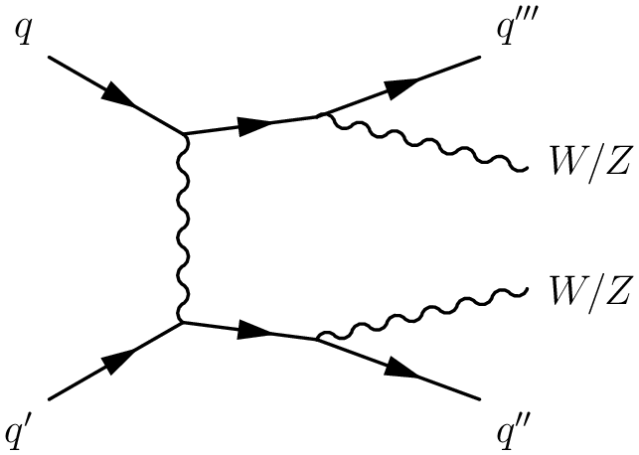
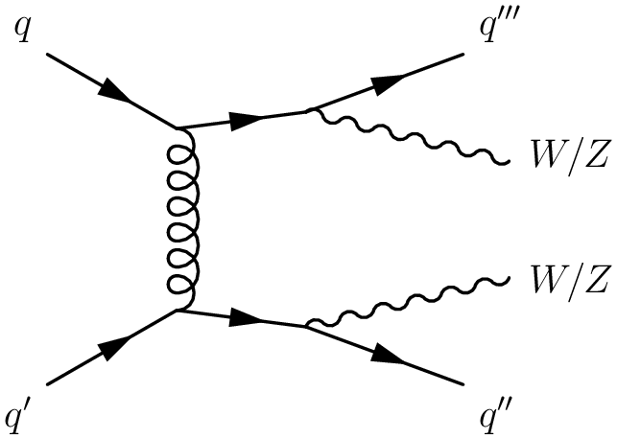
VBS at LHC
Experimental signature of VBS is a pair of vector bosons and two jets with a large rapidity separation and a large invariant mass
The process is a mix of electroweak VBS and non-VBS electroweak and QCD diagrams which can’t be disentangled (gauge invariance).
Selection of phase space with enhanced electroweak VBS contribution is needed
Small cross-section (~fb) entails important contributions from backgrounds with much bigger cross-sections – ttbar, W/Z+jets, etc.
VBS in pp collisions at LHC
Example fiducial VBS cross-sections from ATL-PHYS-PUB-2024-011
13TeV
13TeV
8TeV
13TeV
8TeV
Electroweak VBS diagrams
Non-VBS diagrams with the same experimental signature
EWK
QCD
W/Z/γ*
g
Notes:
Now let’s discuss the electroweak Vector Boson scattering at LHC. Experimental signature of VBS at LHC is a pair of vector bosons and two jets with a large rapidity separation and a large invariant mass as sketched here. The process is a mixture of electroweak VBS and non-VBS electroweak and QCD diagrams which can’t be disentangled due to gauge invariance. Some leading order example diagrams are shown at the bottom of the slide. To study electroweak VBS one needs to select a phase space where its contribution is enhanced.
Cross-section of VBS process is small, typical fiducial cross-sections used in different ATLAS publications are shown here. They are at the level of fb, what entails significant contributions from various background processes with much higher cross-sections in selected data.

Slide 8
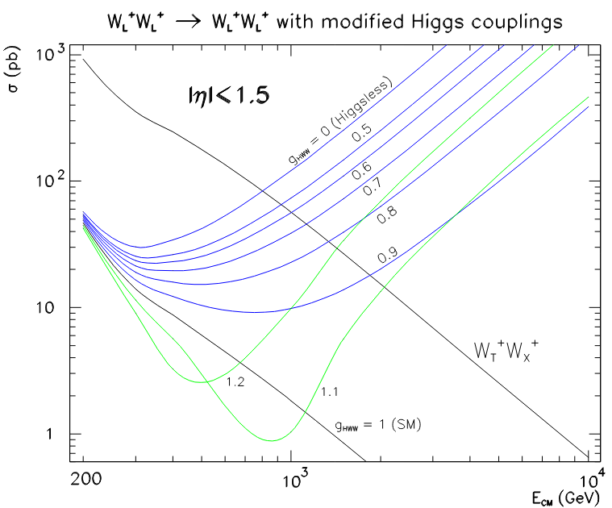
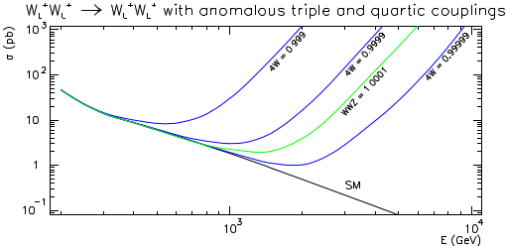
Polarised W±W± scattering
arXiv:2505.08313
Longitudinally polarised W(W_{L}) and Z(Z_{L}) bosons appear in SM via the Higgs mechanism of EWSB.
Higgs exchange neatly compensates the VBS process V_{L}V_{L}->V_{L}V_{L} divergence at TeV scale avoiding the unitarity limit violation.
Study of the W polarised states in the VBS process provides a precise test of the EWSB mechanism in SM.
VBS of the longitudinally polarized W bosons is very sensitive to aQGC.
arXiv:1412.8367
arXiv:1412.8367
Notes:
Longitudinally polarised W(WL) and Z(ZL) bosons appear in SM via the Higgs mechanism of EWSB. Higgs exchange neatly compensates the longitudinally polarised vector boson scattering divergence at TeV scale avoiding the unitarity limit violation.
Even small deviation of the Higgs-vector boson coupling from the SM value results in a sharp cross-section rise as illustrated on the bottom-left picture. Therefore, study of the W polarised states in the VBS process provides a precise test of the EWSB mechanism in SM . Moreover, scattering of the longitudinally polarized Ws is very sensitive to the aTGC and aQGC, as illustrated in the bottom-right plot. aQGC at 10^-4 level results in important cross-section increase already at TeV scale, what can be detected with already available data.

Slide 9
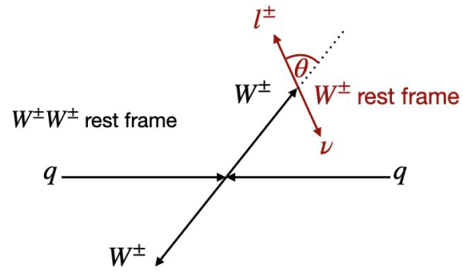
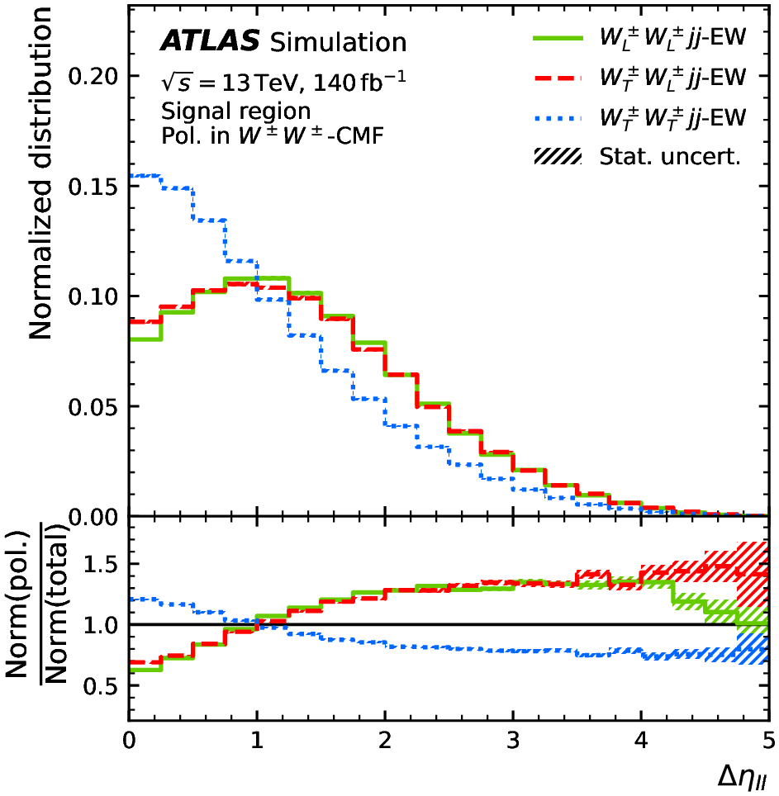
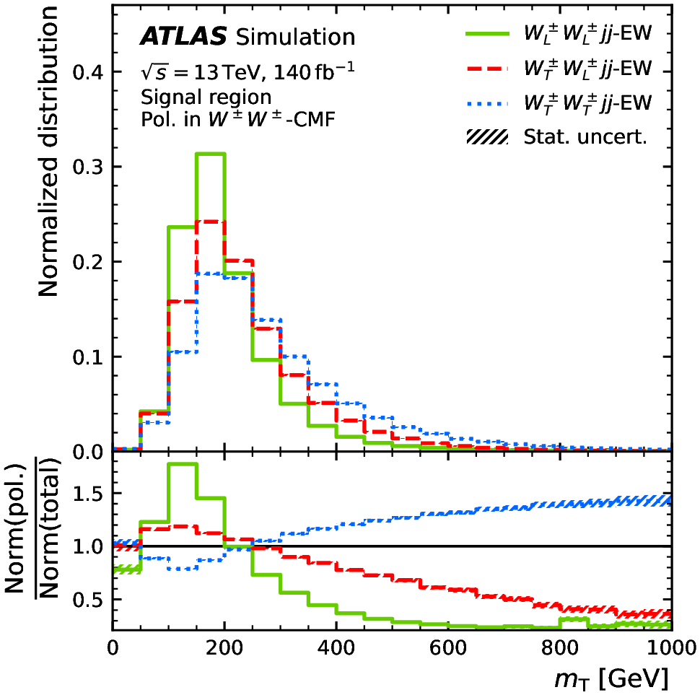
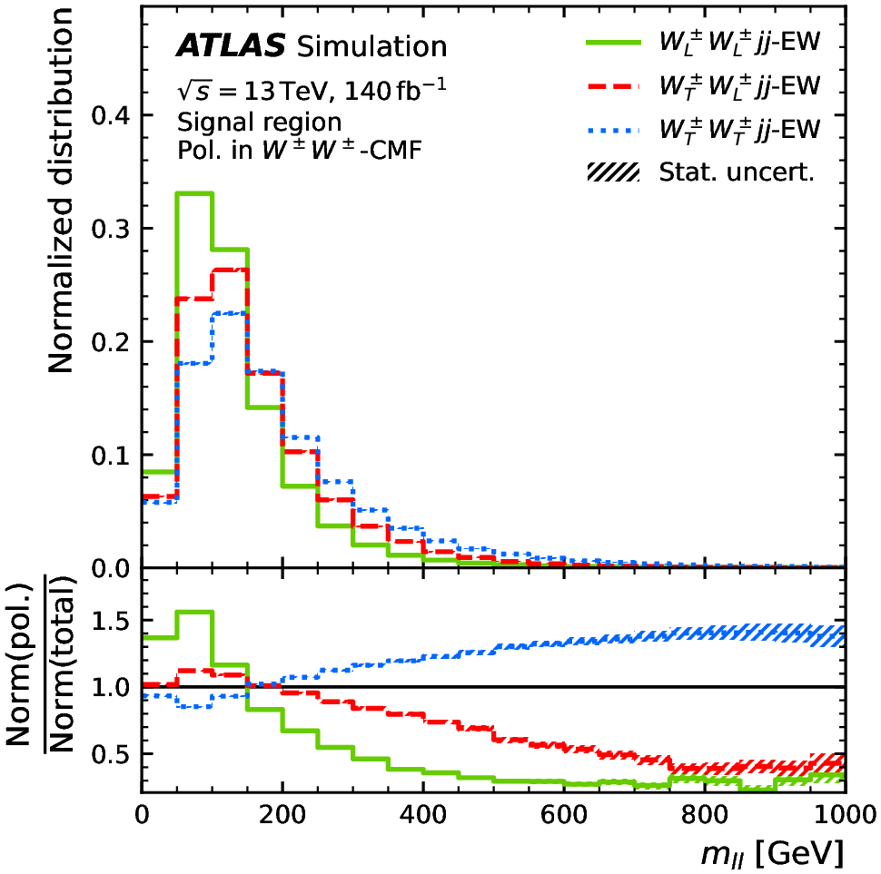
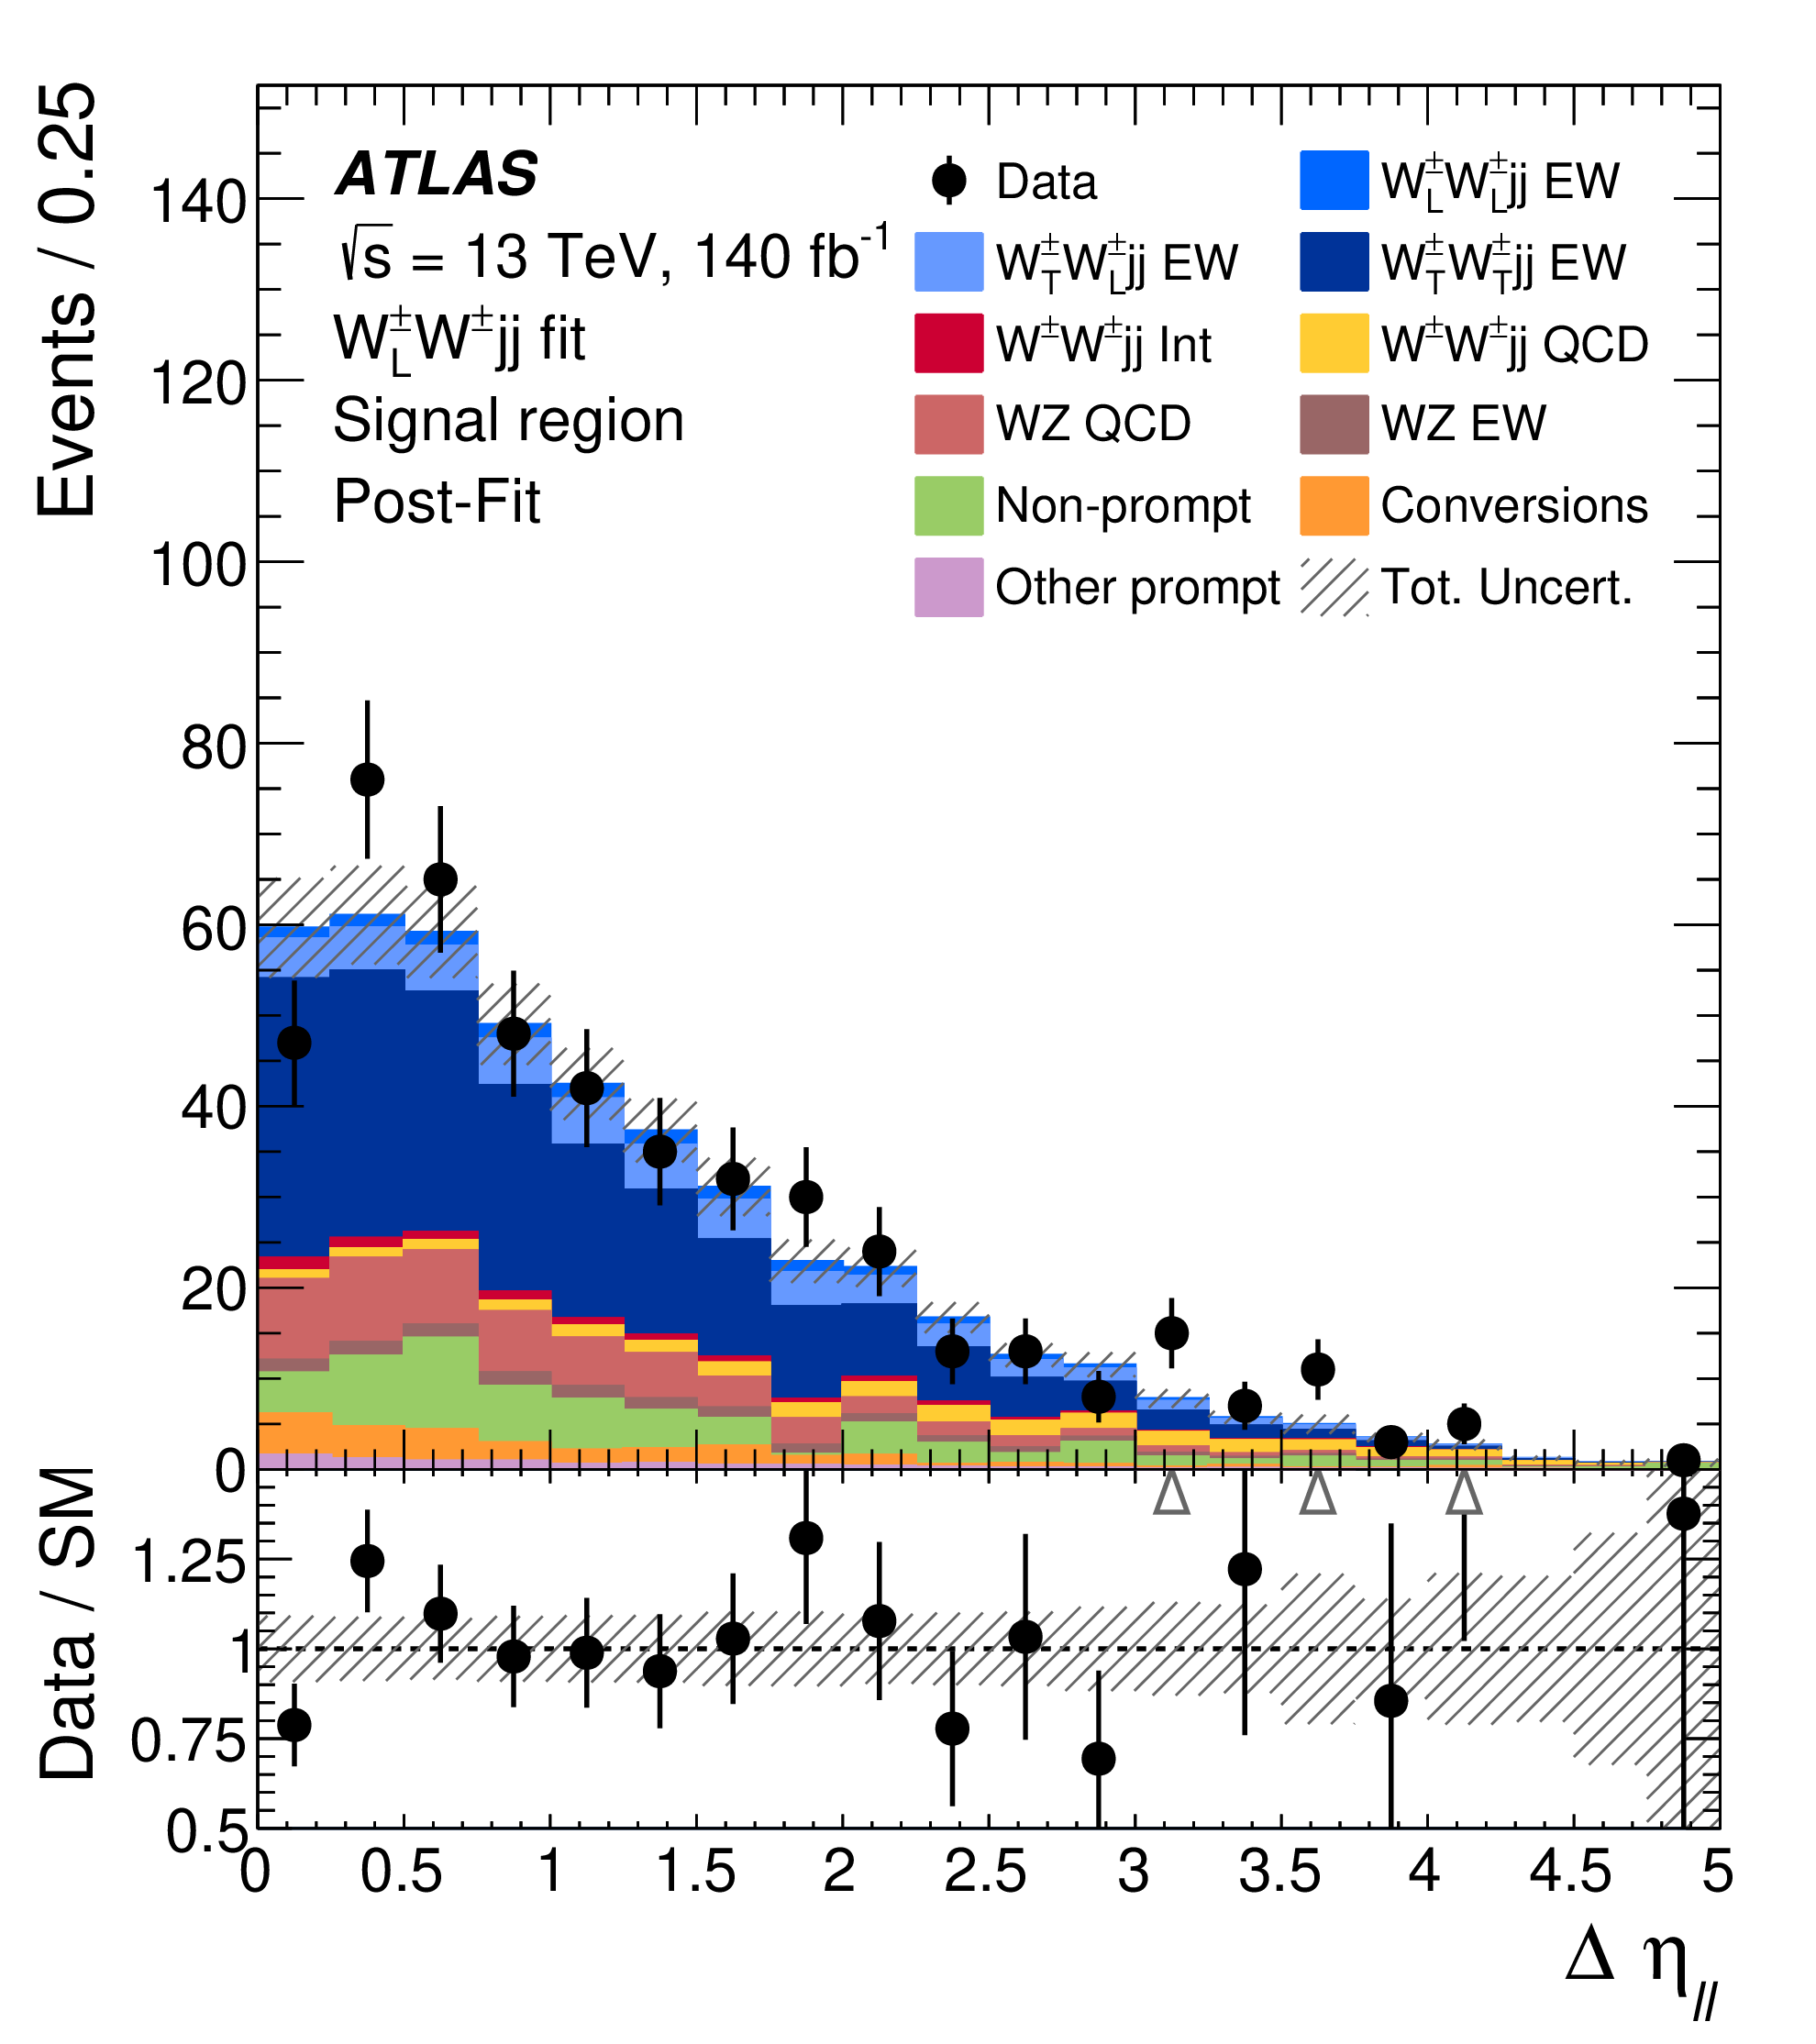
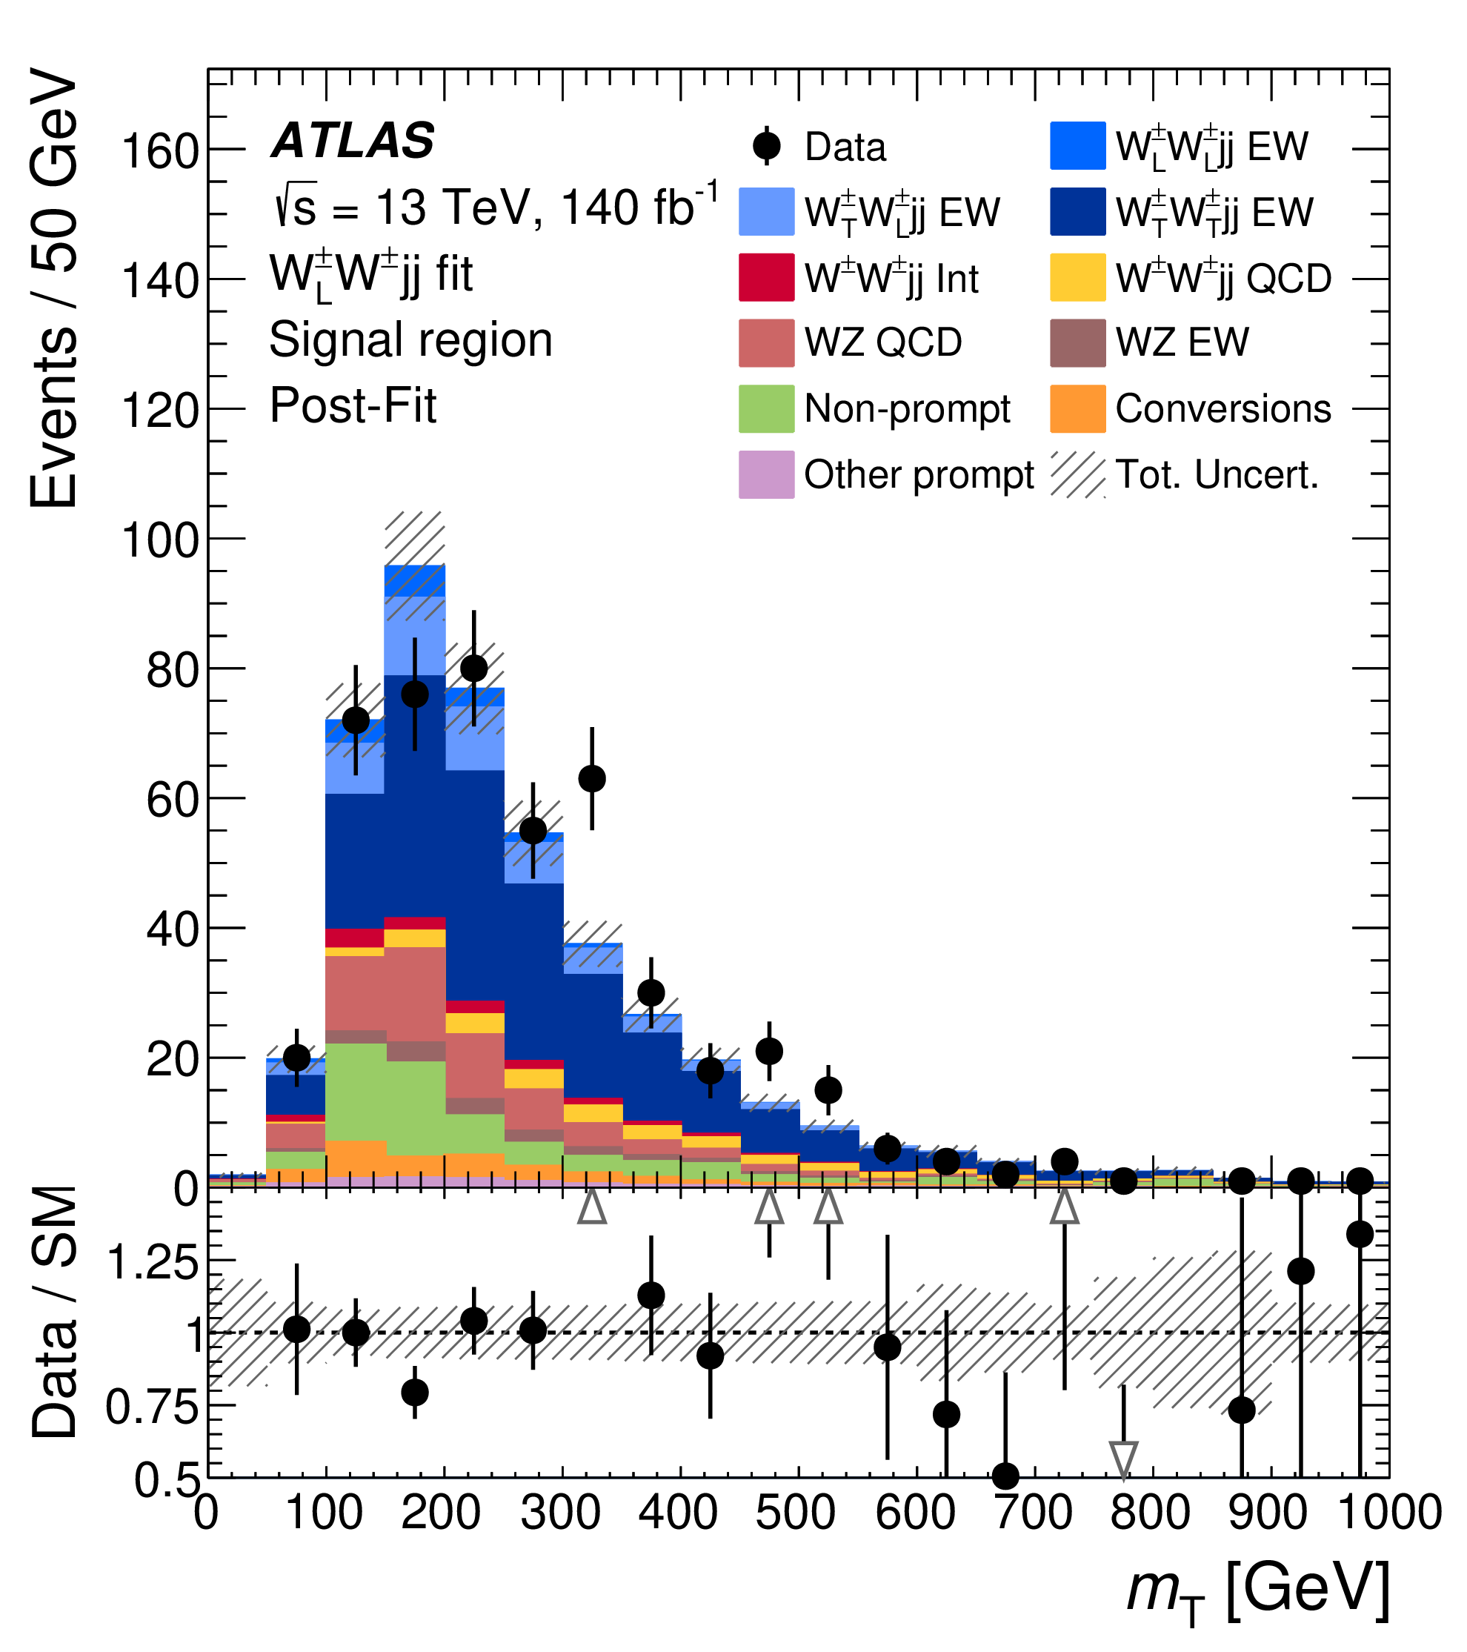
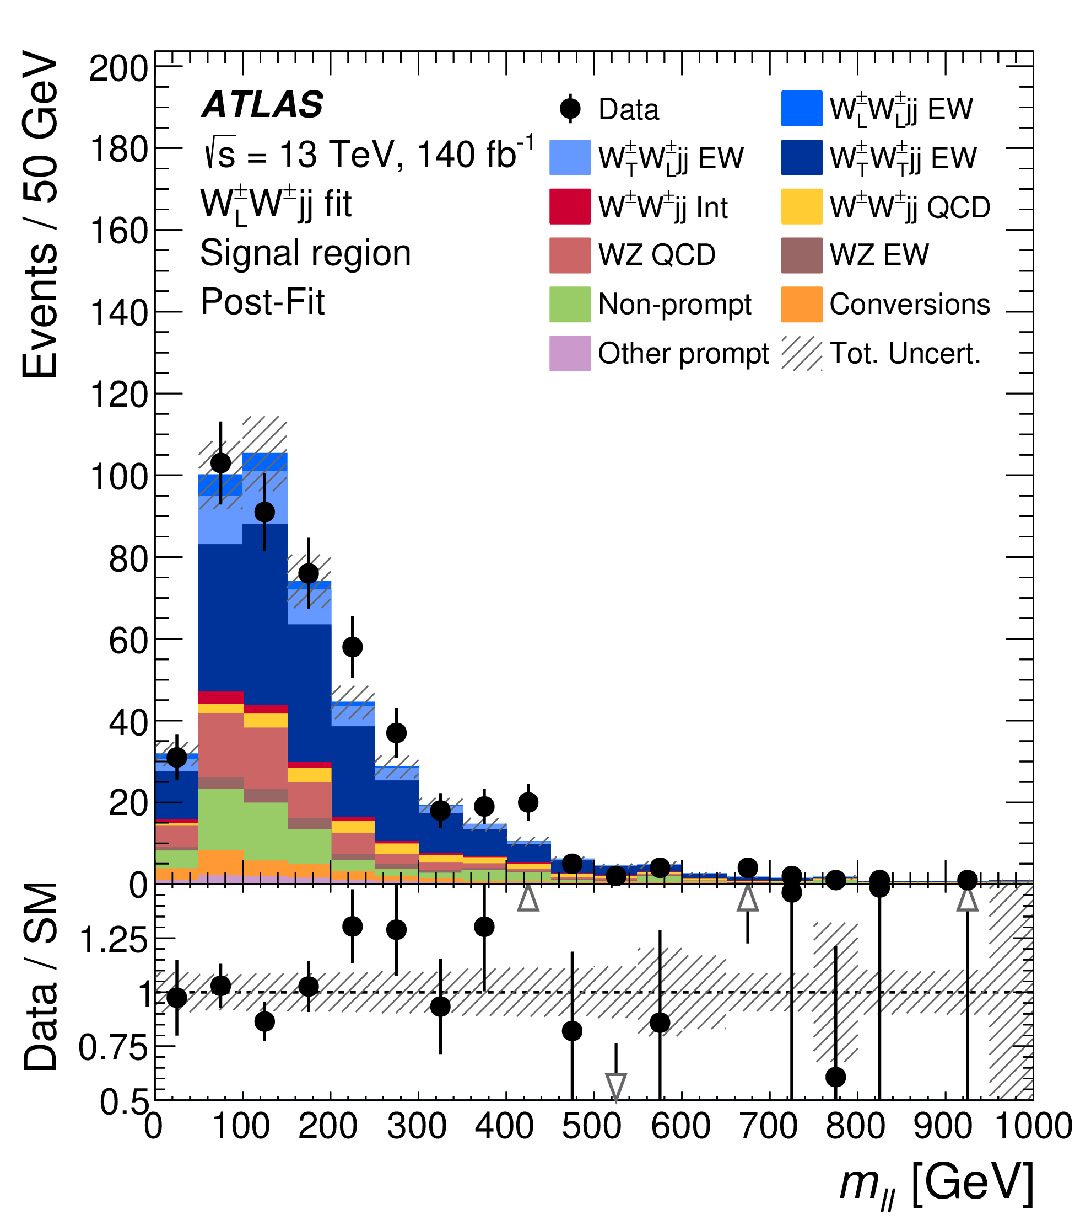
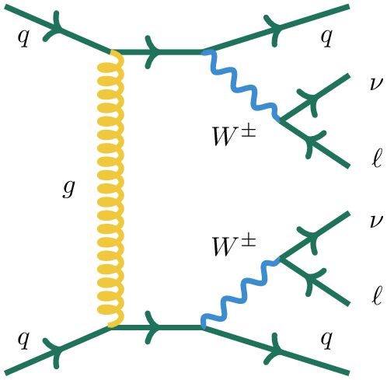
VBS W±W± selection
Event selection:
2 jets |η|<2.5 and p_{T}>65(35)GeV
M_{jj}>500GeV, |Δη_{jj}|>2
2 same-sign isolated leptons (e/μ) with p_{T}>27GeV and |η|<2.5
E_{T}^{miss} >20GeV
arXiv:2505.08313
VBS:
WW:
W polarisation states are defined in WW rest frame
Some kinematical variables sensitive to polarisation states. Shown are W_{L}W_{L} ,W_{L}W_{T}, W_{T}W_{T} states
Dominant backgrounds: QCD + non-prompt
Selected signal events. Different shades of blue correspond to the WW polarization states
QCD
Notes:
To select the same-sign WW scattering process, first, one needs to select the VBS topology. This was done by requiring energetic jets with pseudo-rapidity gap >2 and jet-jet mass more than 500GeV. Two Ws were selected by requiring 2 same-sign isolated leptons and missing energy. W polarization states can be distinguished because some kinematical variables are sensitive to them as illustrated on these plots showing lepton rapidity difference, transverse mass and di-lepton mass. In this study the W polarisation states were defined in the WW rest frame. The data distributions of these variables are shown on the bottom plots; main backgrounds are coming from QCD process and non-prompt leptons.

Slide 10
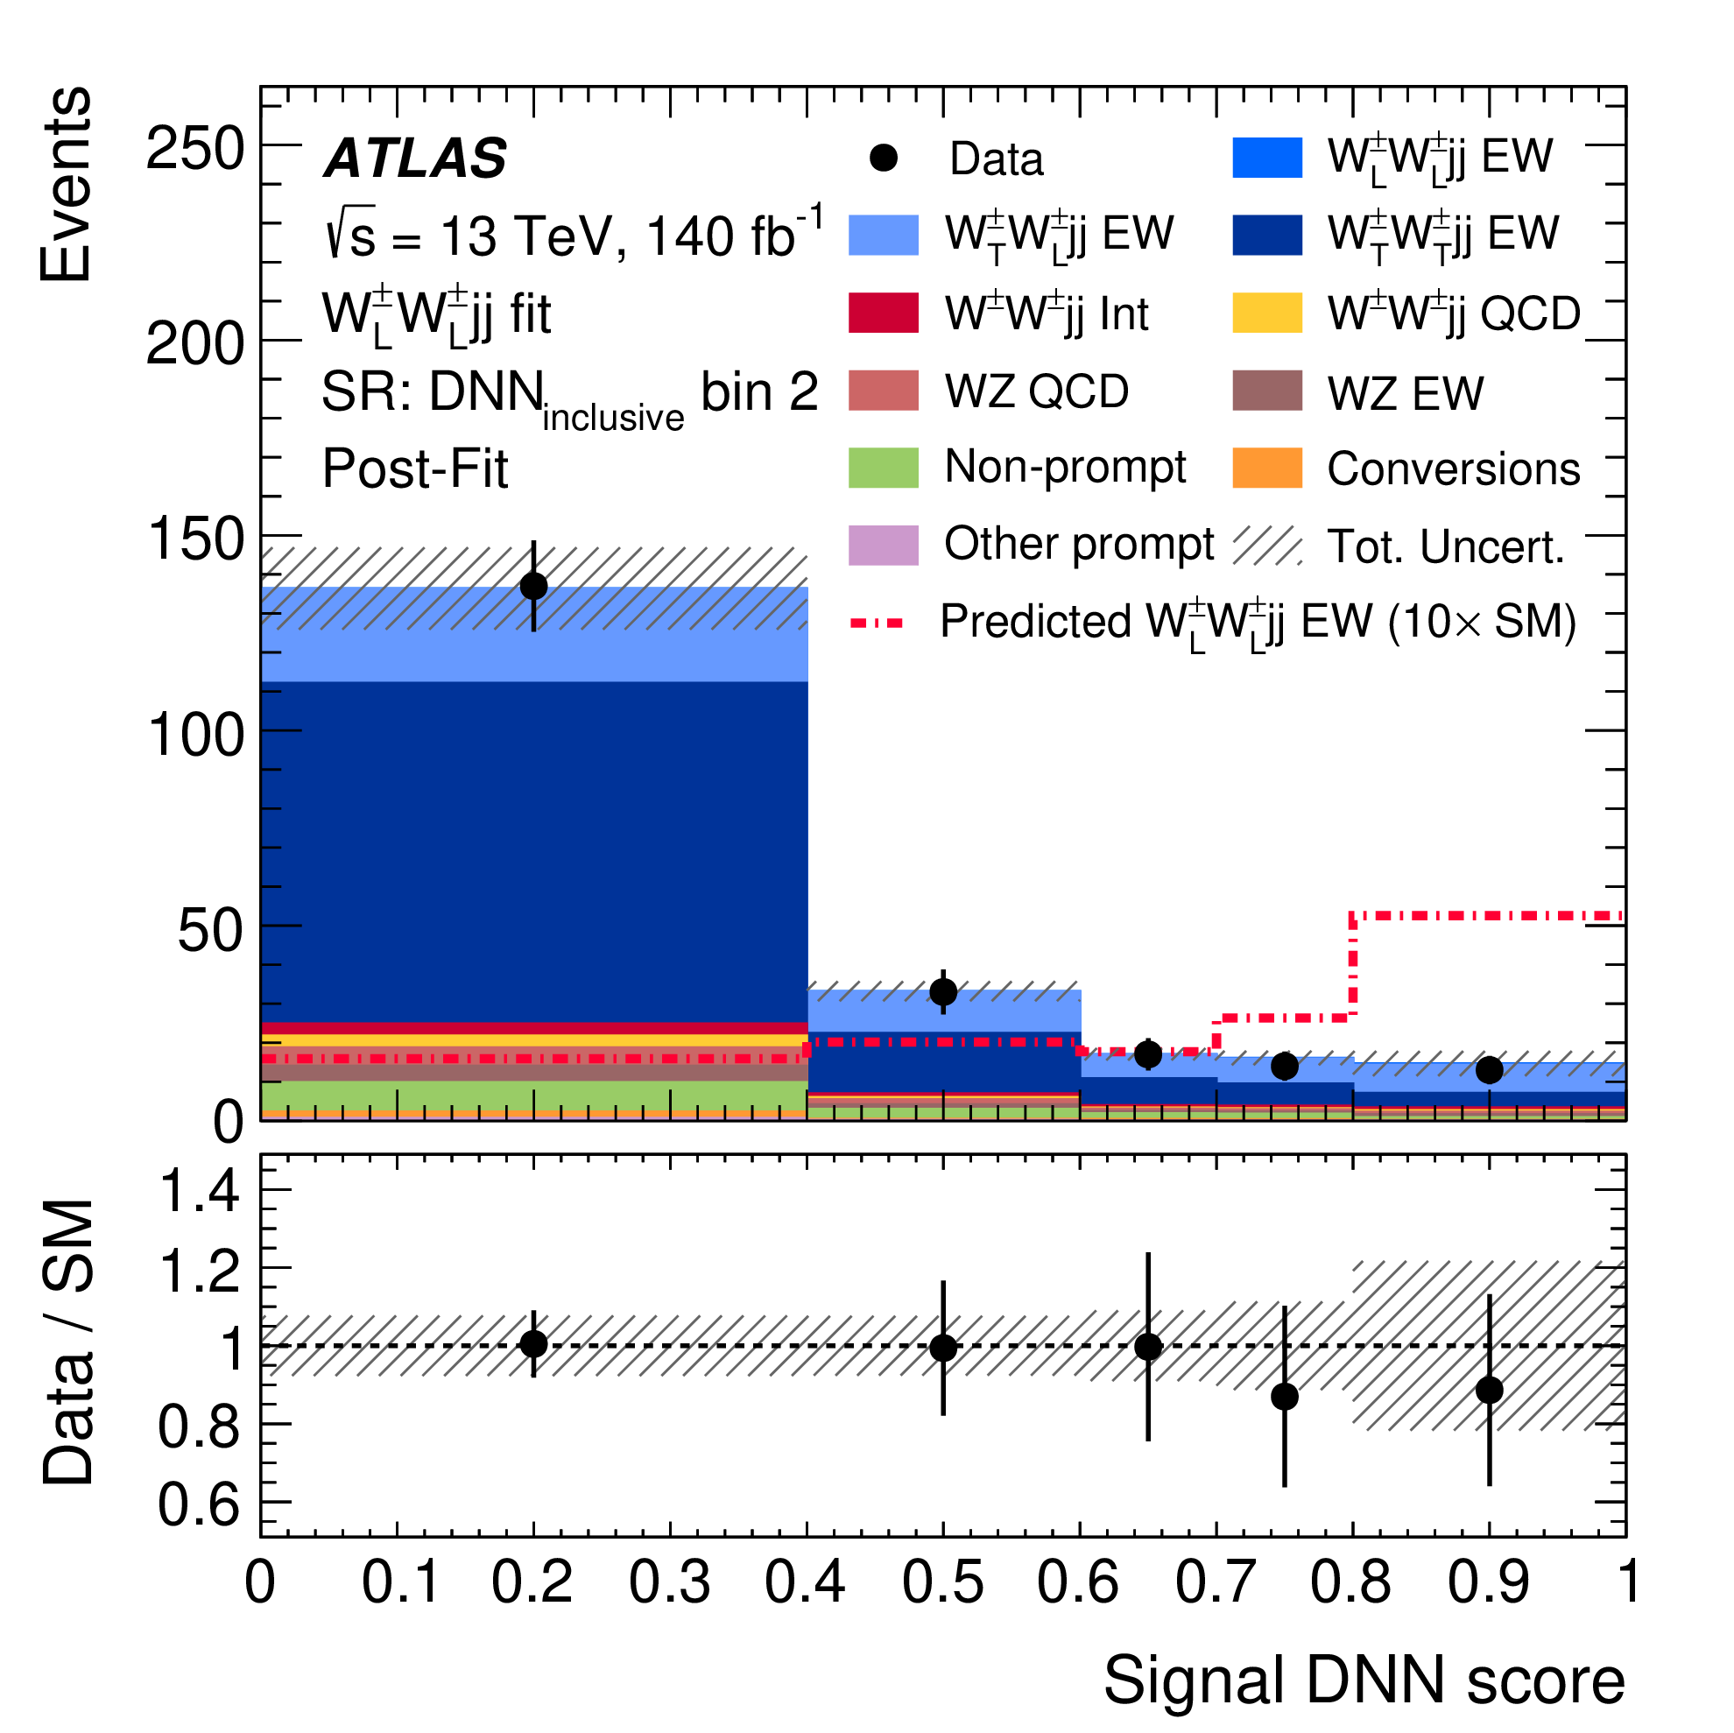
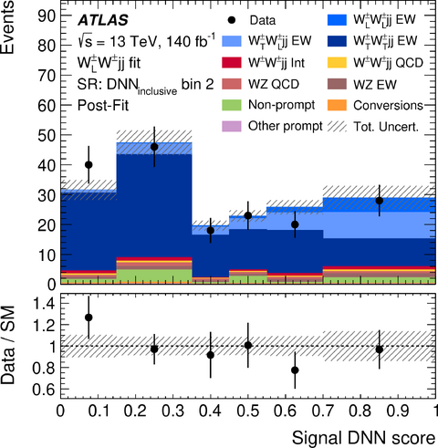
Polarisation W±W± measurement
3 classification DNNs are used
Inclusive DNN separates WWjj from background
DNN_{LL} selects W_{L}W_{L} state against W_{T}W_{L,T} one
DNN_{TT} selects W_{T}W_{T} state against W_{L}W_{L,T} one
arXiv:2505.08313
Background
DNN_{LL} for DNN_{inclusive}>0.6 and DNN_{TT} for DNN_{inclusive}>0.7
DNN_{LL}
Inclusive DNN
W_{L}W_{L}jj
W_{L}W_{T}jj
W_{T}W_{T}jj
DNN_{TT}
Combined fit results
^{(*)}
Longitudinally polarised states:
jjW_{L}W_{L} signal CL_{s} limit 0.47(0.70) fb
jjW_{L}W_{L,T} signal significance 3.3σ(4.0σ)
^{(*)} Signal predictions by Sherpa3
Notes:
To extract polarisation information 3 dedicated classification DNN were used. First one –inclusive DNN – was trained to separate signal from backgrounds. Two others were trained to split WW signal into definite polarisation states: 2 longitudinally polarised Ws against the rest and two transversely polarised Ws against the rest, The overall structure of these set of DNNs is shown on this sketch. Polarisation DNN weight distributions for events with big inclusive BDT weight (background-free region) are shown here. By fitting these DNN weights, cross-sections for different WW polarisation states were obtained, they are shown in the table together with MC predictions. Most interesting cross-section for 2 longitudinally polarised Ws fluctuated down, so only the limit is really meaningful, which happened to be 0.47fb. But the WW state with at least one longitudinally polarised Wl was observed at 3.3 sigma level.
INFO:
QCD WZ_{JJ} CR - 3 leptons. Mjj>200GeV, Mlll>106GeV
“Low Mjj” CR - 200<Mjj<500GeV
3 inclusive SRs - DNNinc: [0,0.2],[0.2,0.6], [0.6,1] for DNN_{LL} , [0.,0.3], [0.3,0.7], [0.7,1.] for DNN_{TT}

Slide 11
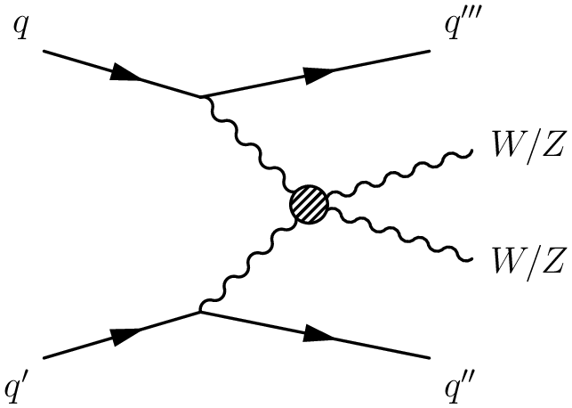
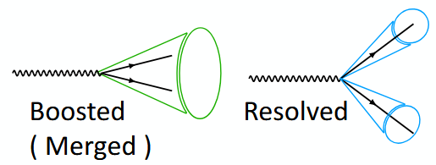
Semileptonic VBS VV study
Semileptonic mode - one boson decays to leptons, another decays to hadrons
Bigger number of events due bigger branching ratio what allows to reach higher momentum space as compared to leptonic mode
Better sensitivity to aQGC search
Bigger background due to other SM processes
arXiv:2503.17461
3 channels defined by number of leptons (0,1,2)
Hadronic vector boson decay is reconstructed in resolved (2 small-R jets) or boosted (one large-R jet) regime
Leptonic decay
Hadronic decay
0-lepton: Z→νν
1-lepton: W→lν
2-leptons: Z →ll
Notes:
Now let’s discuss the ALTAS study of the electroweak vector boson scattering in the semileptonic decay mode. In this mode one vector boson decays leptonically, while another one decays hadronically. Due to bigger branching ratio significantly bigger statistics is available as compared to the leptonic mode, what allows to investigate higher momentum space, important for aTGC and aQGC search. Leptonic vector boson decay can be Z to neutrinos, Z to 2 leptons or W to lepton neutrino, resulting in final states with zero, one or two leptons. To go even farther in momentum, ATLAS exploited boosted topology for the hadronically decaying vector boson in addition to the resolved two jets one.

Slide 12
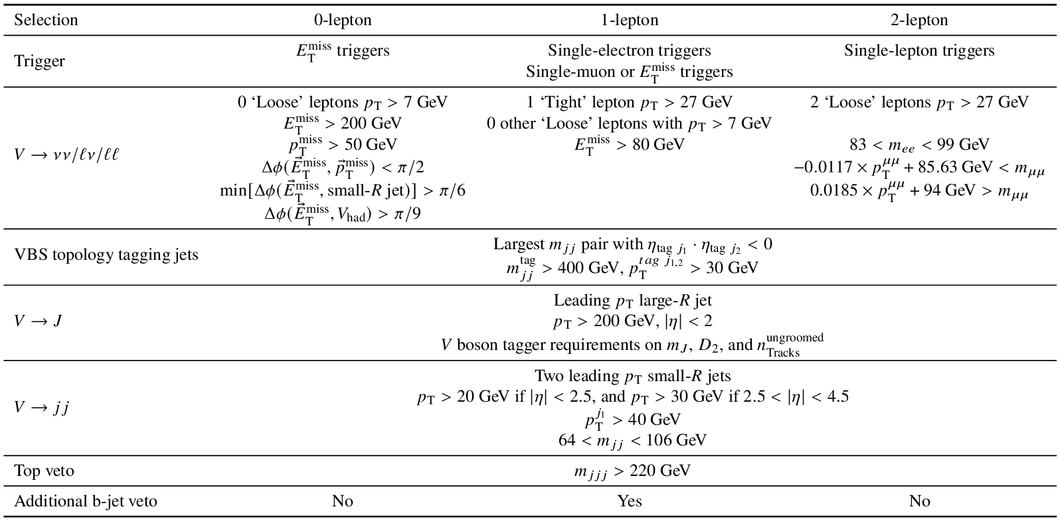
Semileptonic VBS VV selection
arXiv:2503.17461
VBS topology
Boosted V decay
Resolved V decay
Notes:
Event selection approach in this study was relatively straightforward. After selection of the good reconstructed objects – leptons, jets, missing energy- CR! first the VBS topology was selected by requiring two energetic jets with jet-jet mass bigger than 400 GeV and opposite pseudo-rapidity signs. CR! Boosted topology of the vector boson decay was identified by presence of large-R jet with pt>200GeV. CR! Resolved topology was identified by presence of the two small-R jets with the invariant mass of the jet pair in the W and Z vector bosons mass window.

Slide 13
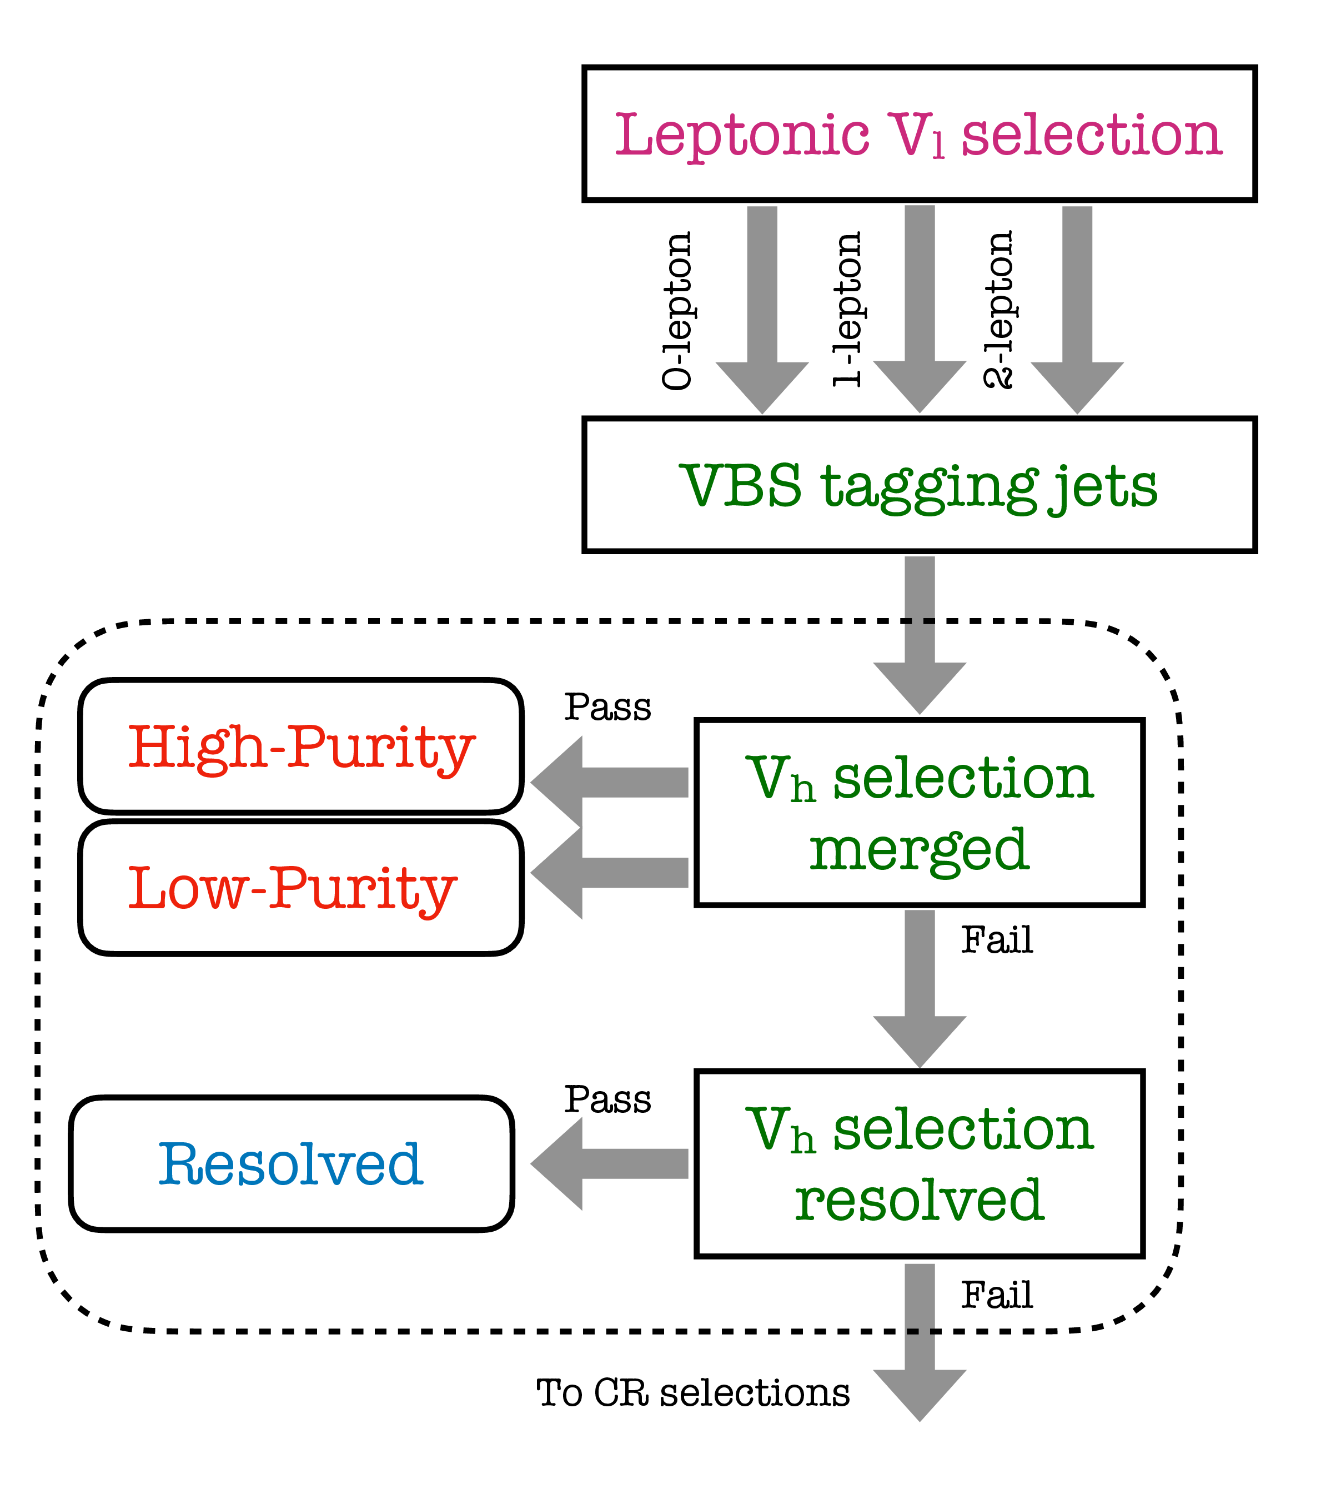
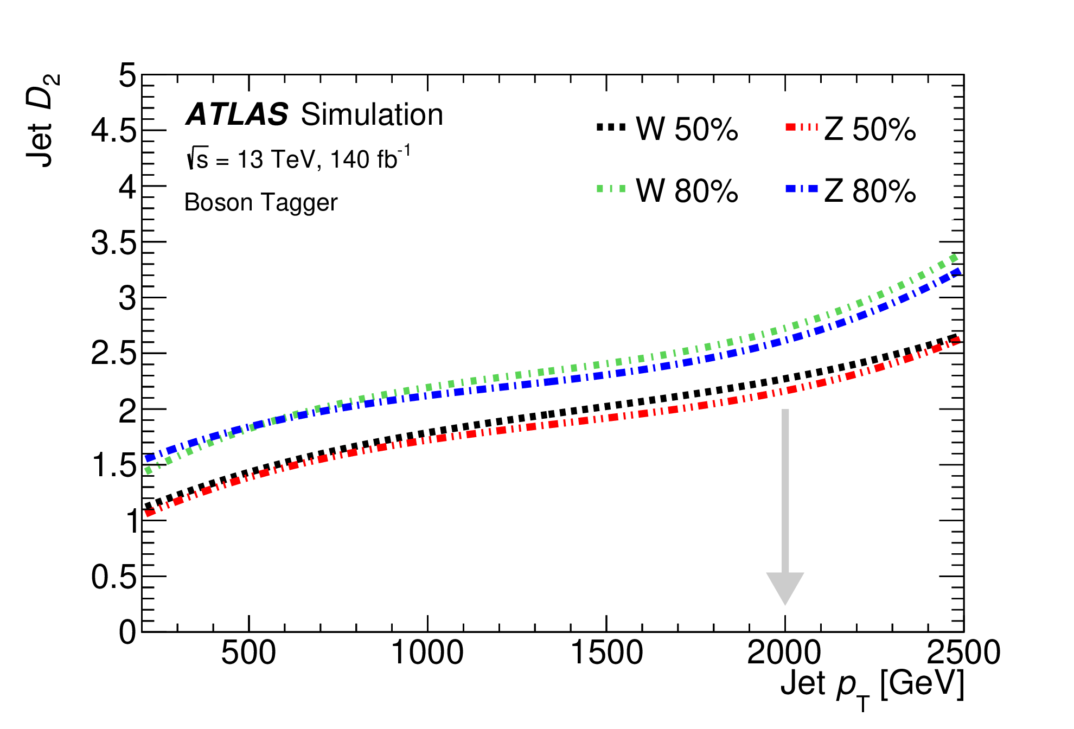
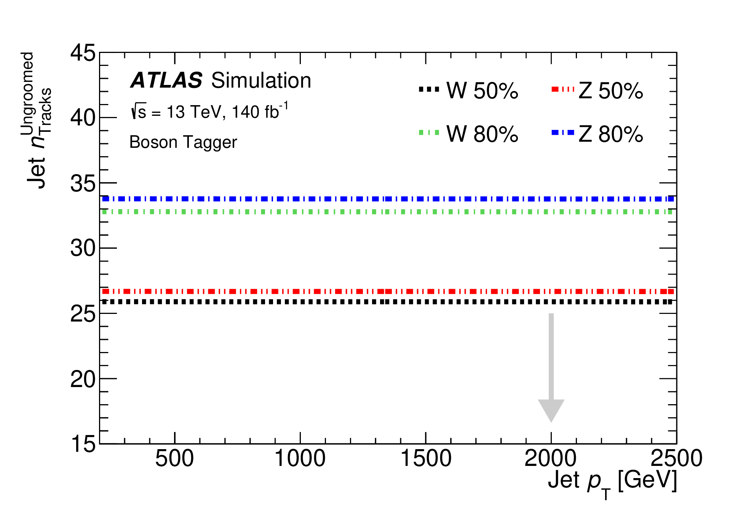
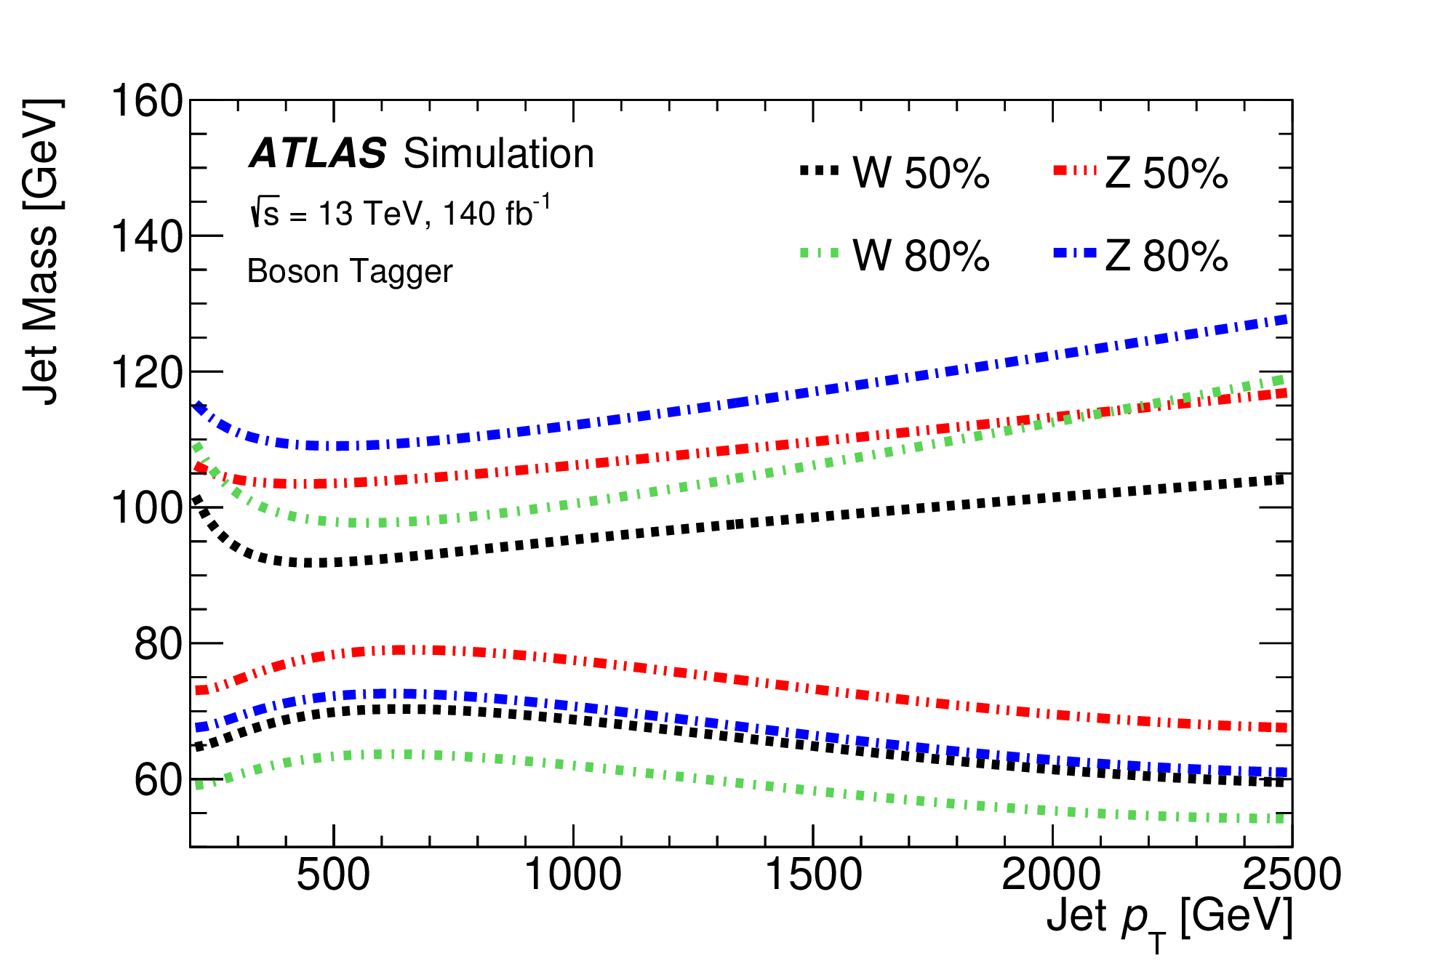
VBS VV event classification
Event selection procedure doesn’t provide unique event classification.
To resolve ambiguities:
additional categorization
arXiv:2503.17461
Large-R jet vector boson tagging
Simultaneous pt-dependent cuts on 3 large-R jet variables (M_{jet}, D₂, N_{tracks}) to define WPs
High-purity WP -> 50% efficiency
Low-purity WP -> 80% efficiency, but fail 50% WP cuts
Notes:
The selected events may have simultaneously a large-R jet and 2 small-R jets in the vector boson mass window. To resolve this ambiguity a preference was given to the boosted topology. i.e. if a good large-R jet is found, the event is always classified as a boosted one. Only if a good large-R jet is missing, an event can be classified as resolved. Boosted events were further divided into high-purity and low-purity categories based on a tagging algorithm using 3 pt-dependent variables – jet mass, number of tracks and D2. jet is considered tagged if all 3 variables lie simultaneously inside pt-depended 2D bands as shown in these pictures. The high purity Working Point corresponds to 50% tagging efficiency, Low-purity WP corresponds to selection efficiency between 50% and 80%.

Slide 14
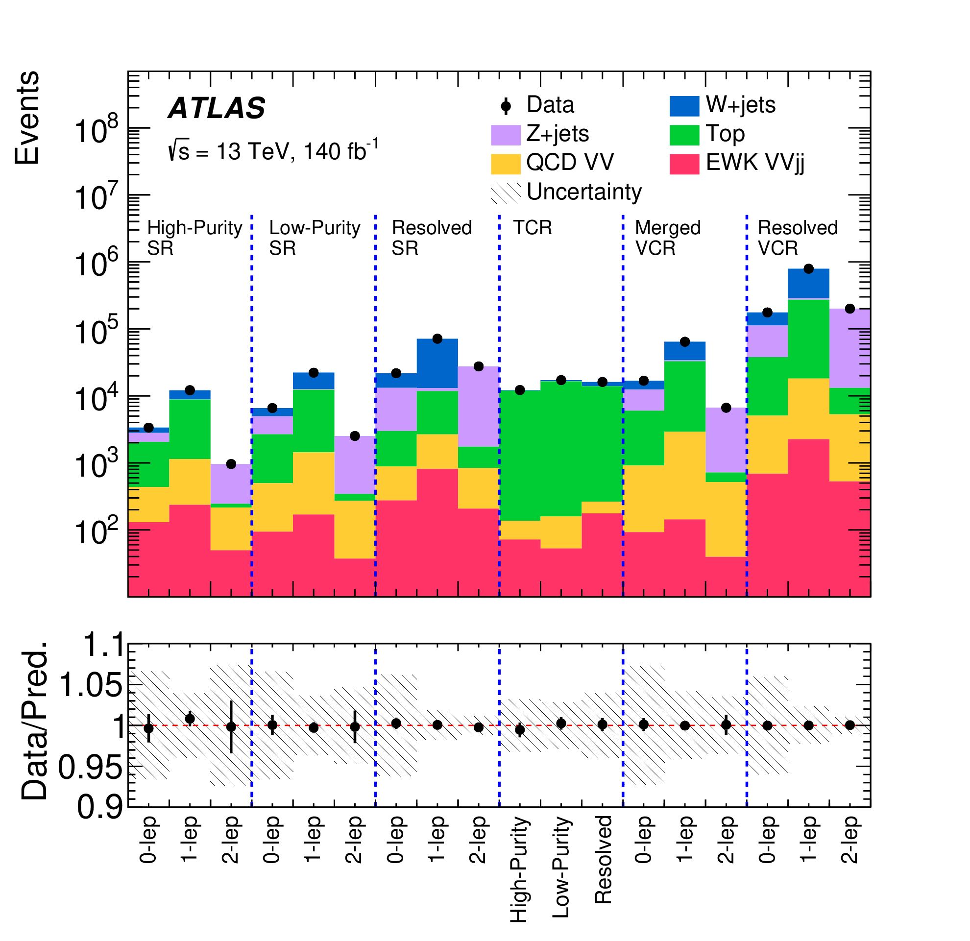
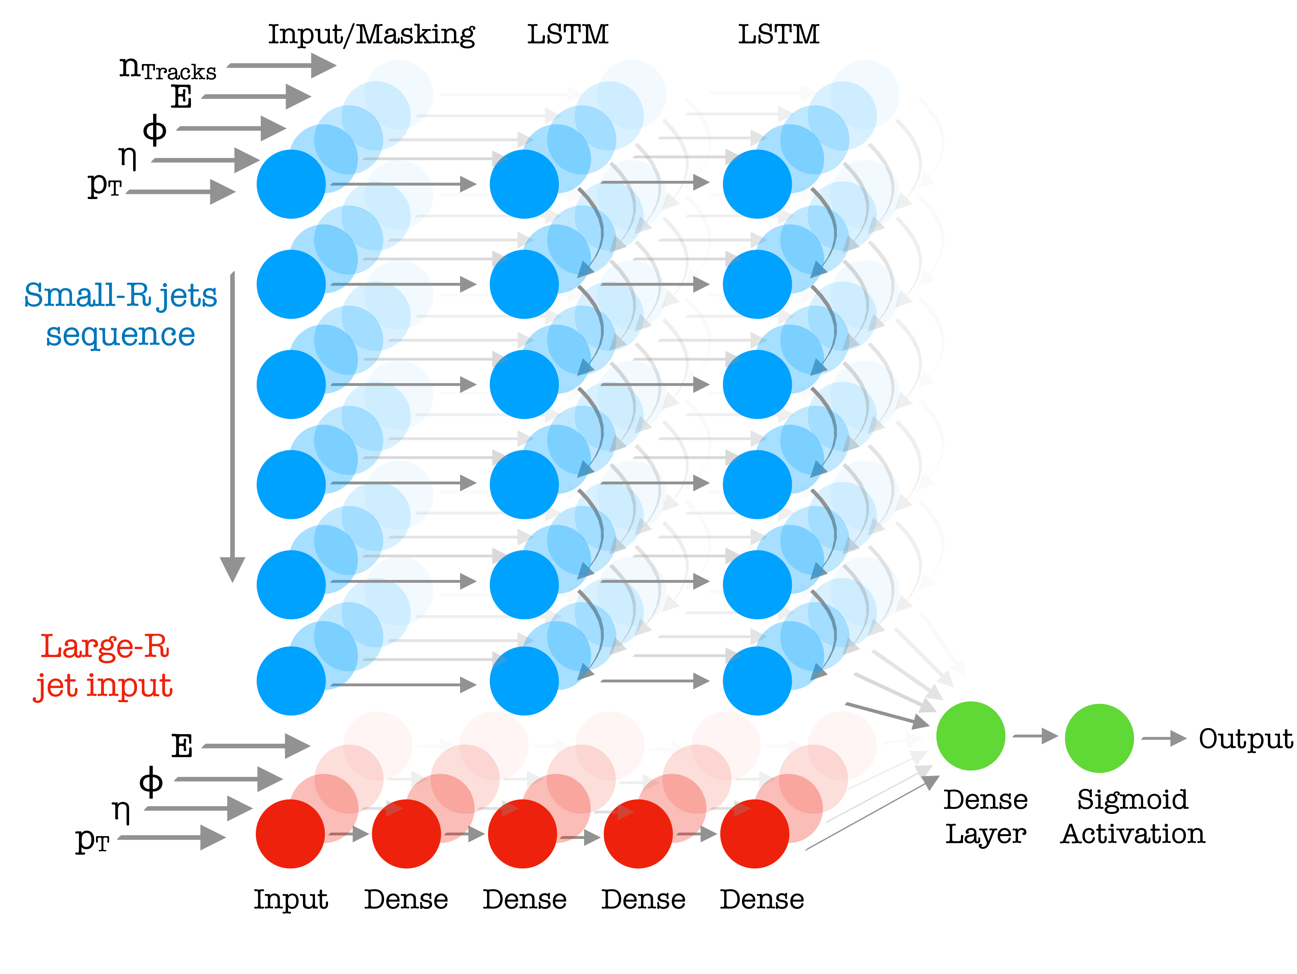
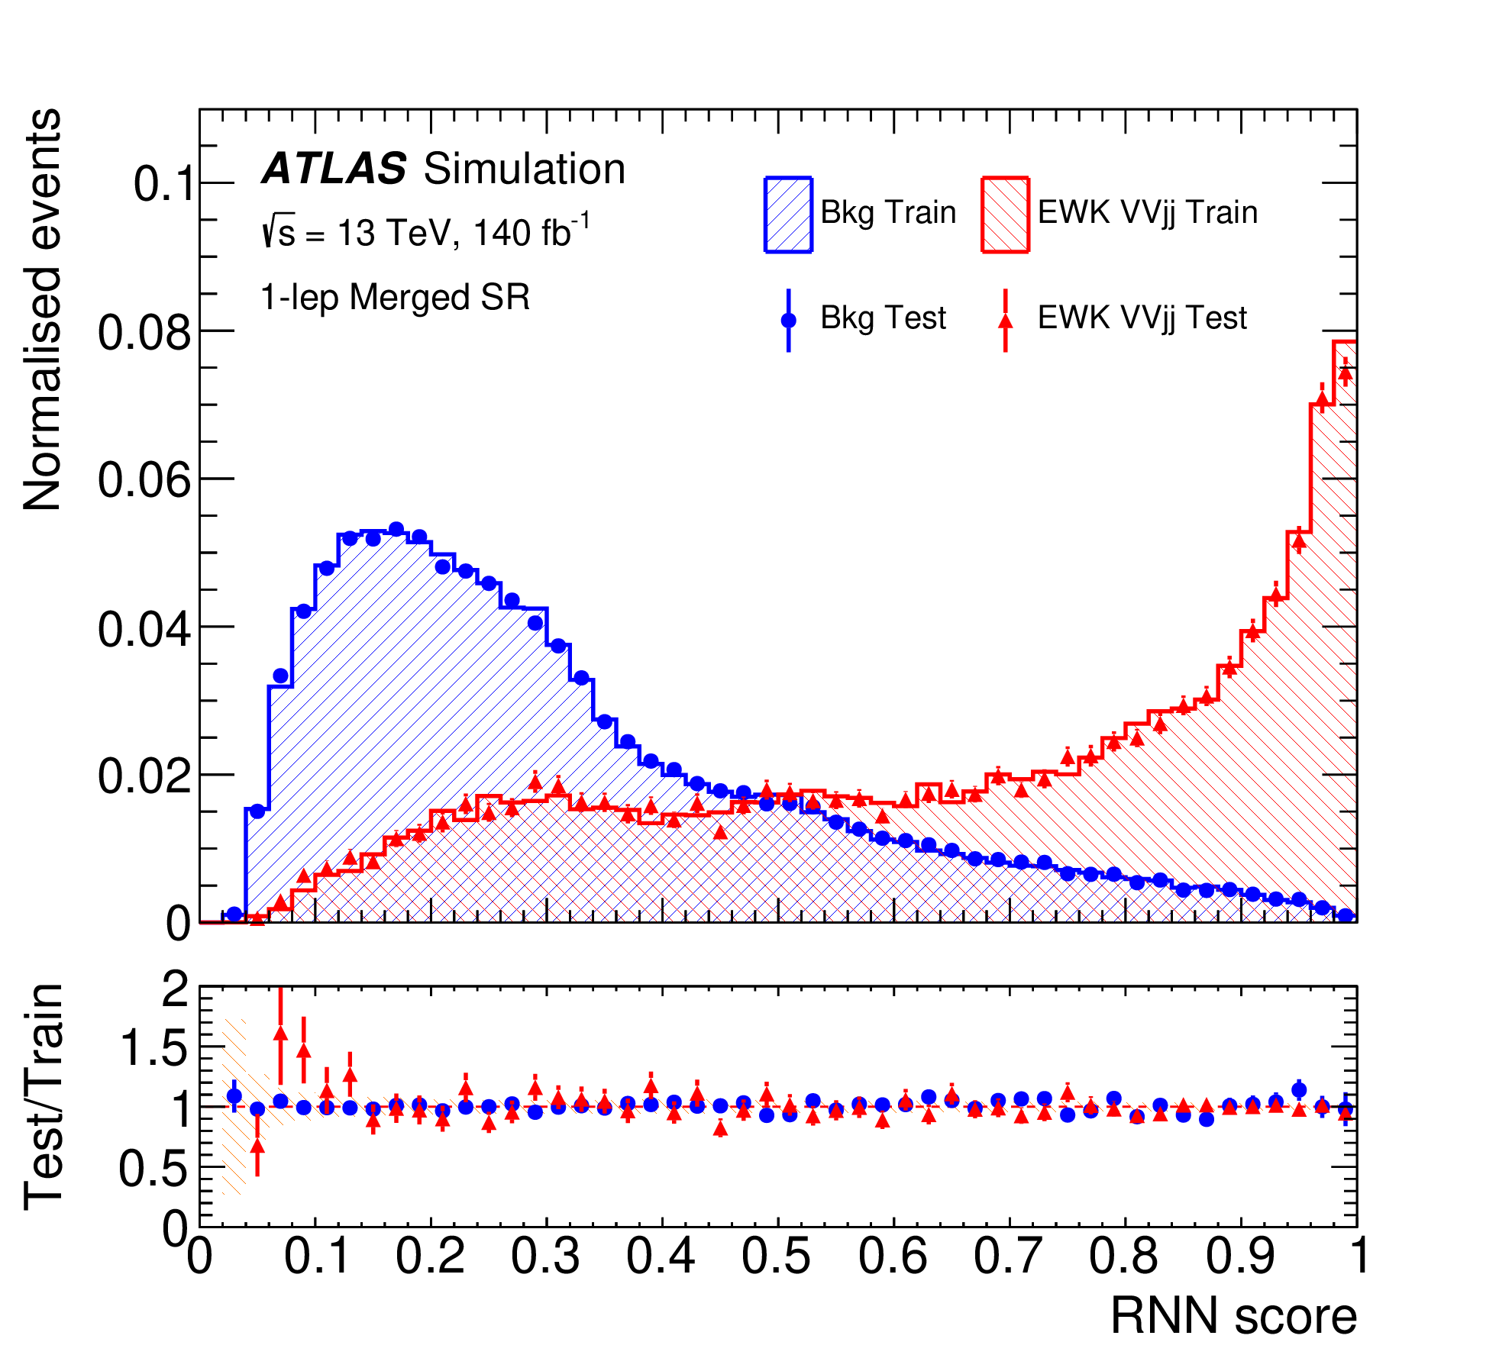
Background rejection
Selected events in signal and control regions
RNN event classificator
arXiv:2503.17461
SRs
CRs
Classification performance
Data description quality in signal regions (post-fit)
Notes:
Combining 3 lepton final states with resolved and boosted low- and high-purity classes, one gets 9 SRs. Additional 9 CRs were defined by inverting some quality cuts used to define SRs. Process composition and comparison with data in these regions are shown in top left plot. Data agreement is good, but background contribution is significant, so a Recurrent Neural Net classificator was employed to reduce it.
RNN structure is sketched on the top-right plot, 2 LSTM layers, shown in blue, deal with resolved topology, additional DNN block, shown in red, deals with large-R jet parameters. Performance of the classificator is demonstrated in the plots in the middle, data agreement is presented in the bottom plots. Red lines demonstrate electroweak VBS contribution multiplied by 20.

Slide 15
EWK VBS VV cross-sections
Expected^{(*)} and observed fiducial cross sections of the EWK VVjj process
arXiv:2503.17461
Data and predicted SR yields grouped into bins of log₁₀(S/B)
EWK VVjj observation significance 7.4σ(6.1σ)
^{(*)} Expected signal obtained with MadGraph5+aMC@NLO 2.6.6 at O(α⁶_{EWK})
Notes:
Plot on the right shows all SR events grouped according to S/B ratio. The rightmost part of this plot clearly confirms presence of signal shown in red.
The electroweak vector boson scattering process was observed with a significance of 7.4𝜎, while 6.1𝜎 was expected.
The production cross section was measured to be 29.2 ± 4.9 fb ( SM expected 20.4 ± 3.5fb) in a fiducial phase space close to the detector and analysis acceptance. Agreement to the SM predictions in sub-channels is good as can be seen in the plot, except may be 0-lepton channel with 2.3σ deviation.

Slide 16
EFT limits in EWK VBS VV
Expected and observed limits on the Wilson coefficients f_{N}/Λ⁴ of dimension-8 operators.
Last 2 columns – limits at unitarity bounds
arXiv:2503.17461
EFT operator contributions grow with VV mass
Eur. Phys. J. C (2018) 78:759
To increase aQGC sensitivity all SRs were split into low- and high-pt parts. Below is 2-lepton 𝑚_{𝑉𝑉}>1.5GeV large-R region fit. Additionally shown prediction for f_{T0} operator at f/Λ⁴=0.10 TeV⁻⁴
Observed limits with unitarity bounds on anomalous quartic couplings from Phys. Rev. D101(2020)113003
Notes:
The EFT dim-8 operators limits were established using similar fitting procedure as the for cross-section measurement. Anomalous coupling contributions grow with centre-of-mass energy as shown is this picture. To improve sensitivity all SR were additionally split into low- and high-pt parts., RNN weight in one high-pt SR is shown here with a guessed contribution of FT0 operator. Wilson coefficients were fitted one-by-one with free EWK contribution normalisation. Observed limits are presented in this table. Unitarized versions of the limits at the borders of the unitarity allowed phase space are also presented. Their calculation is illustrated in the bottom plots, reported values are marked by red circles.

Slide 17
Summary
In this talk recent ATLAS results on Vector Boson Scattering and tri-boson production at 13 TeV using 140fb⁻¹ data have been presented.
Observation of the tri-boson VVZ production with significance 6.4(4.7)σ;
First evidence of the same-sign WW scattering, where at least one W is longitudinally polarised, with 3.3(4.0)σ significance;
Observation of the electroweak di-boson scattering in the semileptonic mode with 7.4(6.1)σ significance;
Multi-boson physics at the LHC is progressing from observation to precise measurements. Look forward to analyses of the joint Run 2 and Run 3 data.

Slide 18
Backup: ATLAS summary plot 07.24
Summary of several SM total and fiducial production cross-section measurements from Run 2 and 3
ATL-PHYS-PUB-2024-011
Tri-boson
EWK VBS VV

Slide 19
Backup: Polarised WW in VBS
Variables used in the classification DNNs
arXiv:2505.08313

Slide 20
Backup: Polarised WW in VBS
Post-fit expected signal and background yields and observed data events in the SRs with different DNN_{inclusive} values
Total analysis error breakdown. Statistical error dominates.
arXiv:2505.08313
Measured and predicted cross-sections for WW polarisation states defined in the parton-parton reference frame. Measured jjW_{L}W_{L,T} signal significance is 2.5(3.5)σ

Slide 21
Backup: semileptonic VV in VBS
arXiv:2503.17461
Total cross-section error breakdown. Systematic errors dominate.
Simultaneous fit to μ_{EWK} and μ_{QCD}
Some tension in μ_{QCD} may indicate a poor generator modelling. μ_{EWK} is stable.
Notes:
The signal strengths of both electroweak and QCD associated diboson productions are measured in a two-dimensional fit, in agreement with the SM prediction.

Slide 22
Backup: semileptonic VV in VBS
arXiv:2503.17461
Truth level fiducial region definitions

Slide 23
Backup: VVZ observation
Data and post-fit predicted yields for all SRs. Statistical and systematic uncertainties are summed in quadrature.
Phys. Lett. B 866 (2025) 139527
Summary of statistical and systematic uncertainties in the signal strength in fit with VH included in the signal.
Statistical and systematic errors are ~equal.

Slide 24
Backup: VH(VV) contribution to VVZ
Phys. Lett. B 866 (2025) 139527
Contribution of the VH(->VV) process to the expected measurement significance

Slide 25
Backup: VVZ observation
Phys. Lett. B 866 (2025) 139527
Variables used in 3l,4l and 5l BDT classificators
4L BDT
5L BDT
3L BDT

