Slide 1
Quantum noise reduction in GW Detectors
Quantum noise reduction in GW Detectors
Jean-Pierre Zendri
INFN Sezione di Padova
Virgo & ET collaboration
EPS-HEP 2025
Marseille – France, 7-11 July 2025

Slide 2
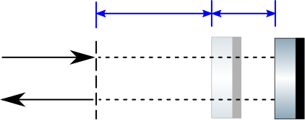










Single Mass
Signal
$$L_{0}=2π/k$$
$$∆x$$
$${\hat{E}}_{In}$$
${\hat{E}}_{In}(t)=A∙Cos\left(ω_{0}t\right)$
$${\hat{E}}_{out}$$
$${\hat{E}}_{out}(t)=A∙Cos\left(ω_{0}t−k∙2∆x\right)$$
Signal & Noise
•Phase noise competes directly with the signal (shot noise generator).
  •Amplitude noise generates radiation pressure fluctuations that generate a spurious displacement signal (back action noise generator) proportional to the optomechanical coupling κ$\left[Ω\right]$ (${κ∝(P}_{laser}×1/(mΩ^{2}))$)
$${\hat{E}}_{in}(t)=\left(A+a_{n}\right)∙Cos\left(ω_{0}t+φ_{n}\right)$$
$${\hat{E}}_{out}(t)=\left(A+a_{n}\right)∙Cos\left(ω_{0}t−k∙2∆x+φ_{n}\right)$$
Amplitude Noise
Phase Noise
Quadratures
$${\hat{E}}_{out}(t)=\left(A+a_{n}\right)Cos\left(ω_{0}t\right)+A∙{(φ}_{n}−k∙2∆x)Sin(ω_{0}t)$$
Amplitude Quadrature $X_{1}$
Phase or Signal Quadrature $X_{2}$

Slide 3
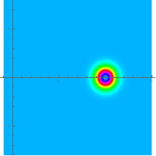
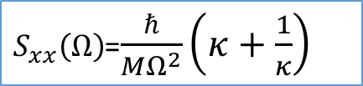

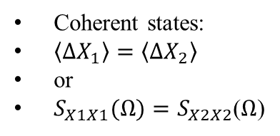

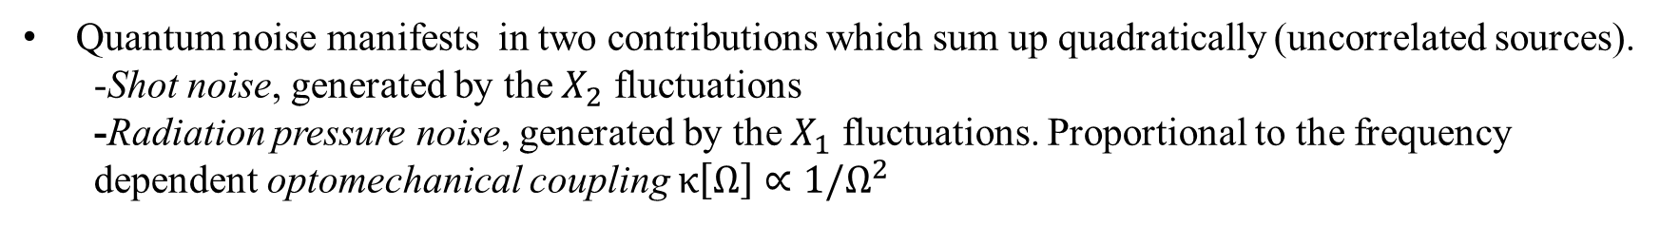



Single Mass quantum noise
Quantum mechanics constrains the quadratures noise
$${\hat{E}}_{out}(t)=X_{1}Cos\left(ω_{0}t\right)+X_{2}Sin(ω_{0}t)$$
$$\left\langle X_{1}\right\rangle =A \left\langle X_{2}\right\rangle =2Ak∙∆x$$
$$\left\langle {∆X}_{1}{∆X}_{2}\right\rangle =0 \left\langle {∆X}_{1}\right\rangle \left\langle {∆X}_{2}\right\rangle ≥1$$
$$X_{2}$$
Coherent states:
$\left\langle ∆X_{1}\right\rangle =\left\langle ∆X_{2}\right\rangle$
or
$S_{X1X1}(Ω)=S_{X2X2}$($Ω$)
$${∆X}_{1}$$
Uncorelated
Uncertainty Principle
$${∆X}_{2}$$
$$X_{1}$$
Standard Quantum noise
Coherent states
Quantum noise manifests in two contributions which sum up quadratically (uncorrelated sources).
  -Shot noise, generated by the $X_{2}$ fluctuations
  -Radiation pressure noise, generated by the $X_{1}$ fluctuations. Proportional to the frequency dependent optomechanical coupling κ$\left[Ω\right]∝1/Ω^{2}$
BA
Shot
$S_{xx}\left(Ω\right)$=$\frac{ℏ}{MΩ^{2}}\left(κ+\frac{1}{κ}\right)$
Standard Quantum noise Power Spectral Density

Slide 4
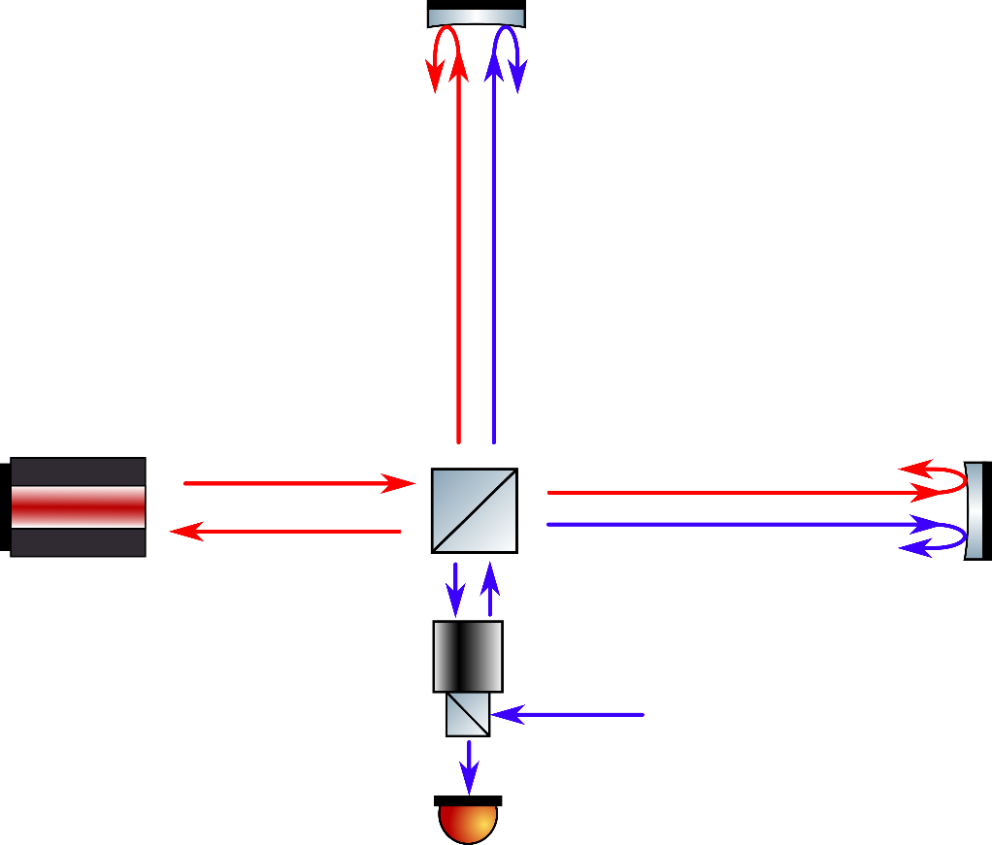
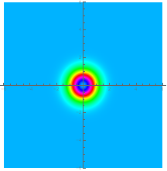






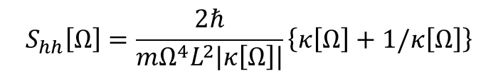





Quantum noise in Michelson Interferometer GW detectors
$$m$$
Michelson is sensitive to the relative variation of the arm lengths.
GWs produce a deformation of the two arms in antiphase.
Input laser quadrature fluctuations produce a common signal which is therefore not detected.
$$F_{RP}$$
Laser
$$m$$
$$E_{Las}$$
Quantum noise results from quantum vacuum fluctuations entering the detection port
BS
$$X_{2}$$
$$F_{RP}$$
$${\hat{E}}_{Vac}=\left[{\hat{X}}_{Vac1}\right]Cos\left(ω_{0}t\right)+\left[{\hat{X}}_{Vac2}\right]Sin\left(ω_{0}t\right)$$
$$E_{Vac}$$
$$E_{Out}$$
$$E_{Vac}$$
$$X_{1}$$
$$\left\langle X_{Vac1}\right\rangle =\left\langle X_{Vac2}\right\rangle =\left\langle X_{Vac1}X_{Vac2}\right\rangle =0 , ∆X_{Vac1}∆X_{Vac2}≥1$$
PD
Standard quantum limit
Quantum limited strain sensitivity
The Strain sensitivity is minimized for $κ\left[Ω\right]=1$
BA
Shot
$$S_{hh−SQL}\left[Ω\right]=\frac{2ℏ}{mΩ^{4}L^{2}}$$
$$S_{hh}\left[Ω\right]=\frac{2ℏ}{mΩ^{4}L^{2}\left|κ\left[Ω\right]\right|}\left\{κ\left[Ω\right]+1/κ\left[Ω\right]\right\}$$

Slide 5

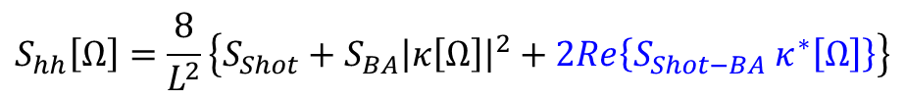
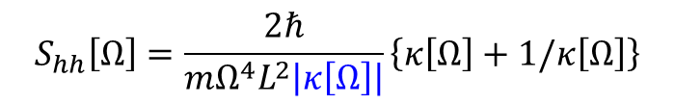
Surpass the Standard quantum limit
Can be the standard quantum limit surpassed?
$$S_{hh−SQL}\left[Ω\right]=\frac{2ℏ}{mΩ^{4}L^{2}}$$
Several proposed methods (and some implemented in large arm interferometers)
1. Modifying the quantum state of the light(squeezed light)
2. Creating correlations between the shot noise (Shot) and the back-action noise (BA)
$$S_{hh}\left[Ω\right]=\frac{8}{L^{2}}\left\{S_{Shot}+S_{BA}{\left|κ\left[Ω\right]\right|}^{2}+2Re\left\{S_{Shot−BA} κ^{∗}\left[Ω\right]\right\}\right\}$$
3. Modifying the dynamics of the tests mass ($κ\left[Ω\right]$ enhancement)
$$S_{hh}\left[Ω\right]=\frac{2ℏ}{mΩ^{4}L^{2}\left|κ\left[Ω\right]\right|}\left\{κ\left[Ω\right]+1/κ\left[Ω\right]\right\}$$
4.Back-action evading schemes

Slide 6
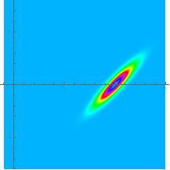
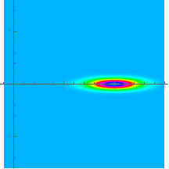
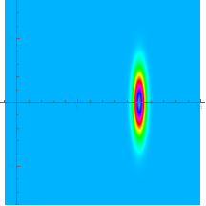
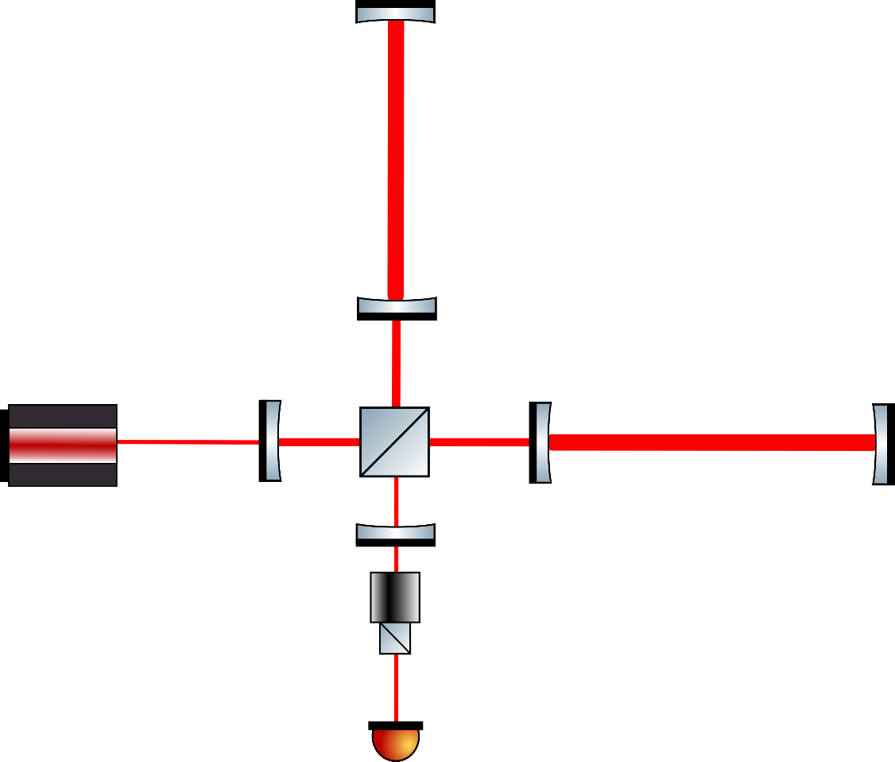
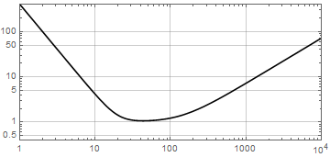
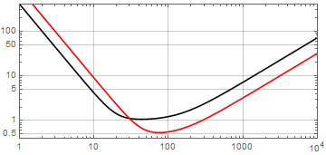
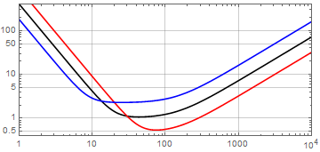
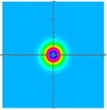
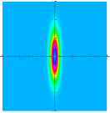
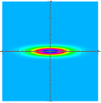
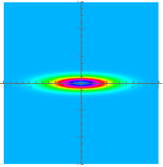
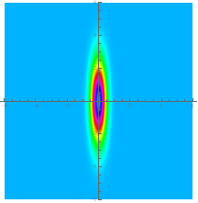

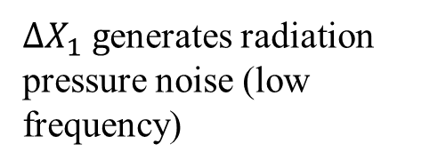
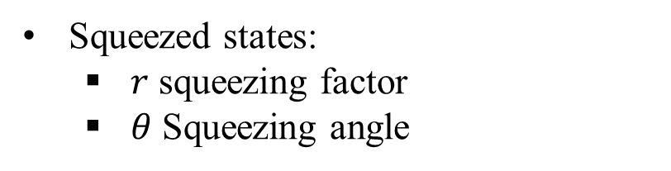


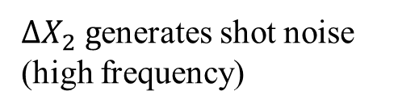




Michelson interferometer QN manipulation with squeezing
Coherent State
Squeezed State
Phase Squeezing
Ampl. Squeezing
Squeezed states:
  $r$ squeezing factor
  $θ$ Squeezing angle
$$X_{2}$$
$$X_{2}$$
$$X_{2}$$
$$X_{2}$$
$${∆X}_{1}$$
$${∆X}_{1}{∆X}_{2}=1$$
$${∆X}_{1}$$
$${∆X}_{1}$$
$${∆X}_{2}$$
$${∆X}_{SQZ}/{∆X}_{Cohe}=e^{−r}$$
$${∆X}_{2}$$
$$X_{1}$$
$$X_{1}$$
$${∆X}_{2}$$
$$X_{1}$$
$$X_{1}$$
$$θ$$
3.5 dB
3.5 dB
3.5 dB
Quantum noise can be manipulated with squeezed light
  $κ⟹κe^{∓r}$
  The Standard Quantum Limit cannot be surpassed for $θ=0, π/2$
$∆X_{2} g$enerates shot noise (high frequency)
$∆X_{1} g$enerates radiation pressure noise (low frequency)

Slide 7
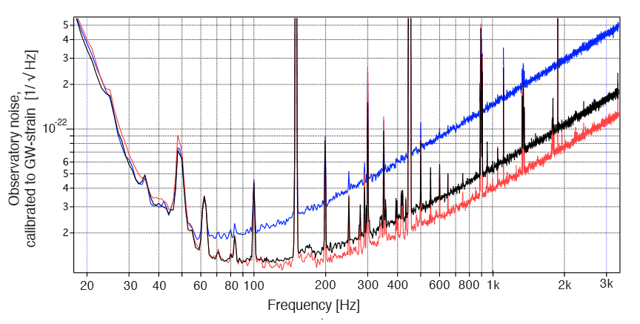
Michelson interferometer QN manipulation with squeezing
Coherent State
Squeezed State
Phase Squeezing
Ampl. Squeezing
Squeezed states:
  $r$ squeezing factor
  $θ$ Squeezing angle
$$X_{2}$$
$$X_{2}$$
$$X_{2}$$
$$X_{2}$$
$${∆X}_{1}$$
$${∆X}_{1}{∆X}_{2}=1$$
$${∆X}_{1}$$
$${∆X}_{1}$$
$${∆X}_{2}$$
$${∆X}_{SQZ}/{∆X}_{Cohe}=e^{−r}$$
$${∆X}_{2}$$
$$X_{1}$$
$$X_{1}$$
$${∆X}_{2}$$
$$X_{1}$$
$$X_{1}$$
$$θ$$
3.5 dB
3.5 dB
3.5 dB
Quantum noise can be manipulated with squeezed light
  $κ⟹κe^{∓r}$
  The Standard Quantum Limit cannot be surpassed for $θ=0, π/2$
$∆X_{2} g$enerates shot noise (high frequency)
$∆X_{1} g$enerates radiation pressure noise (low frequency)
Phys. Rev. Lett. 123, 231108 (2019)

Slide 8
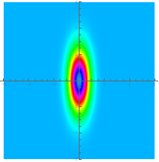
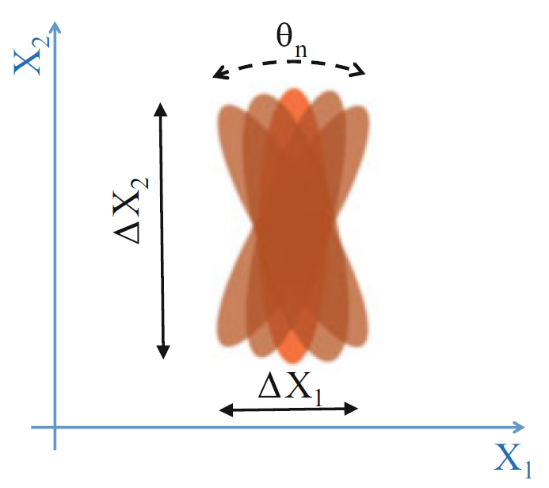




Squeezing degradation
  Quantum decoherence
Losses:$1−η$
  Loss mechanism (frequency dependent)
  Absorption, clipping and scattering
  Misalignment and geometrical mode mismatch
  Polarization mismatch
  Photodetector quantum efficiency
  VIRGO,LIGO (25-40)%
IN
OUT
$$E_{SQZ}$$
$$\sqrt{η}{∙E}_{SQZ}+\sqrt{1−η}{∙E}_{Coh}$$
$$E_{Coh}$$
  Dephasing
Generated by a phase jitter between the LO (ITF carrier) and the squeezed field which manifests with a squeezing angular jitter.
VIRGO, LIGO 30-50 mrad

Slide 9
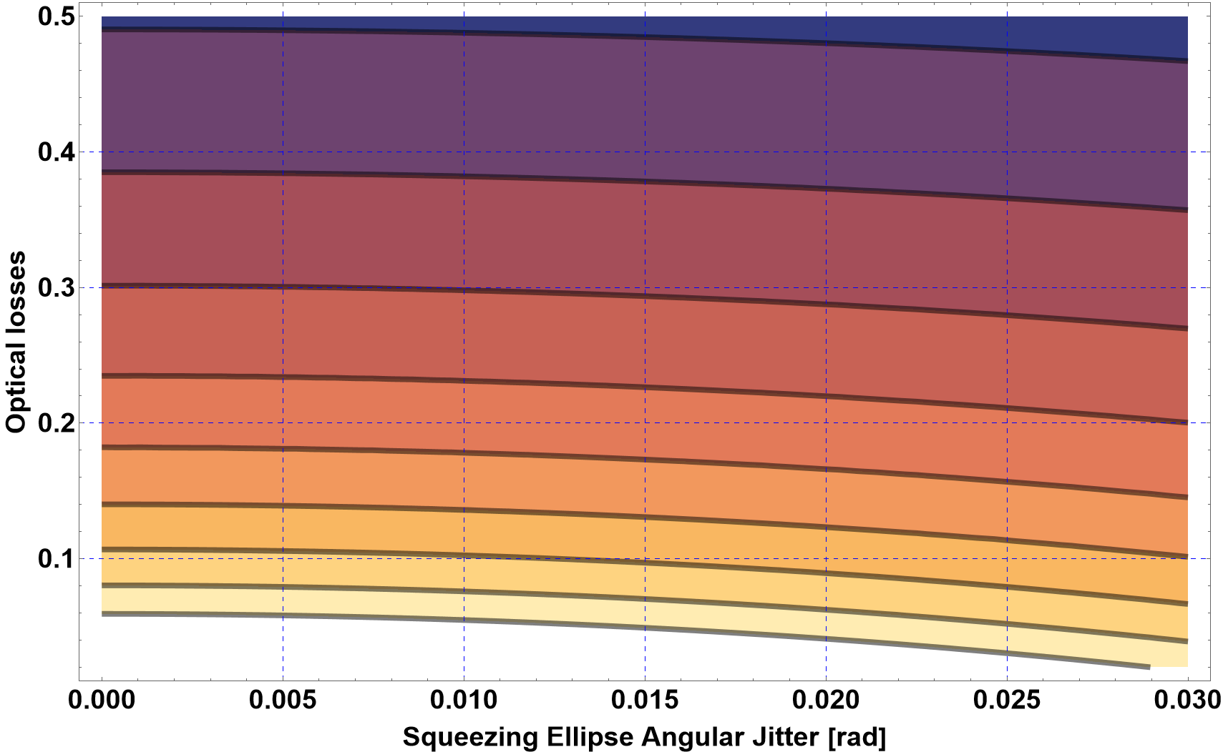
Squeezing degradation: past, present & future
Assumed Produced Squeezing 17 dB (LIGO O4)
3dB
Einstein Telescope
  Target >10 dB at high frequency
4dB
LIGO O4
5dB
6dB
7dB
8dB
ET
9dB
10dB

Slide 10
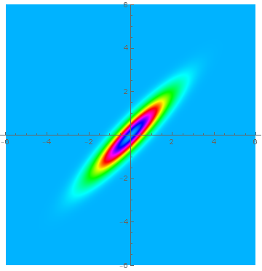
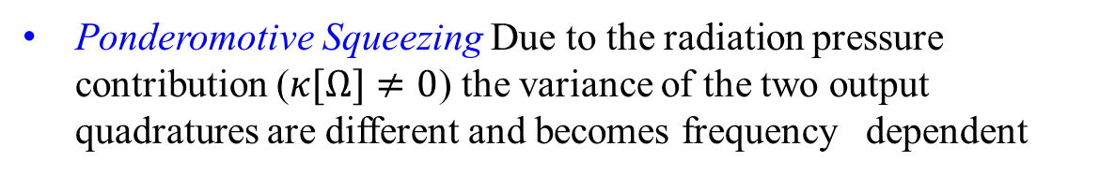










Michelson Interferometers: FDS
Input field
Output field
$$X_{Vac2}$$
Ponderomotive Squeezing Due to the radiation pressure contribution ($κ[Ω]≠0$) the variance of the two output quadratures are different and becomes frequency dependent
$$X_{out2}$$
$$X_{θ1}$$
$$X_{θ2}$$
$$θ_{SQZ}$$
$$X_{Vac1}$$
$$X_{out1}$$
$${\hat{X}}_{Out_{1}}={\hat{X}}_{Vac_{1}}(Ω)$$
Signal
Quadrature
$${\hat{X}}_{Out_{2}}={Exp[2iΩτ](\hat{X}}_{Vac_{2}}\left(Ω\right)+κ[Ω]{\hat{X}}_{Vac_{1}}(Ω))$$
$$κ\left[Ω\right]=\frac{4ω_{0}P_{arm}}{{m Ω}^{2}c^{2}}$$
Simple Michelson Interferometer
$$κ\left[Ω\right]=\frac{16ω_{0}P_{arm}}{mLc}\frac{γ}{Ω^{2}(Ω^{2}+γ^{2})}$$
Tuned Dual Recycled configuration (Virgo and LIGO so far)
Two poles for the detuned dual recycled interferometer (ET-LF)
Frequency Dependent Squeezing (FDS): the input squeezing ellipse is rotated by the ponderomotive effect. In general, this leads to a misalignment between the signal quadrature and that of lower noise. To compensate this effect a frequency-dependent vacuum squeezed field is injected into the interferometer

Slide 11
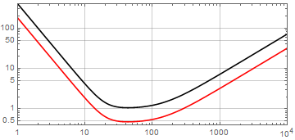
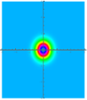
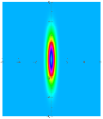
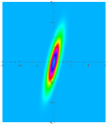
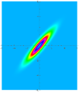
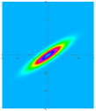
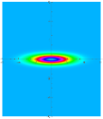
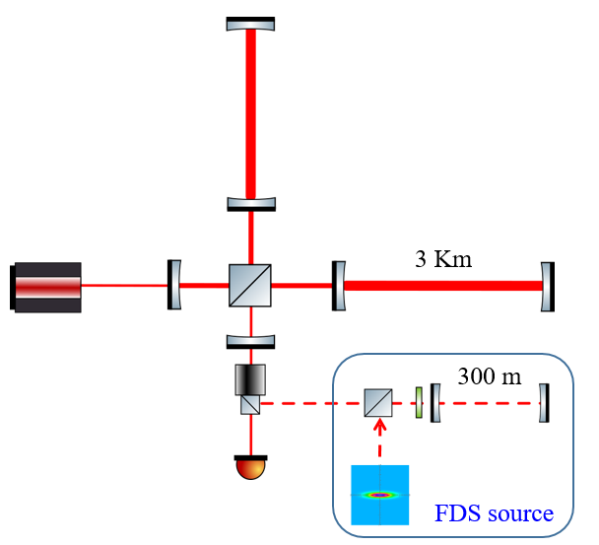
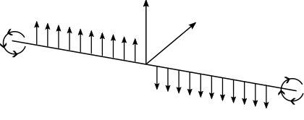
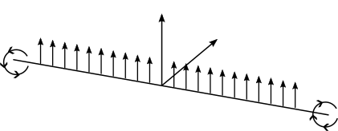
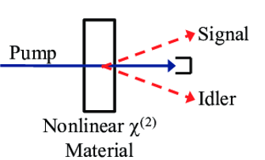
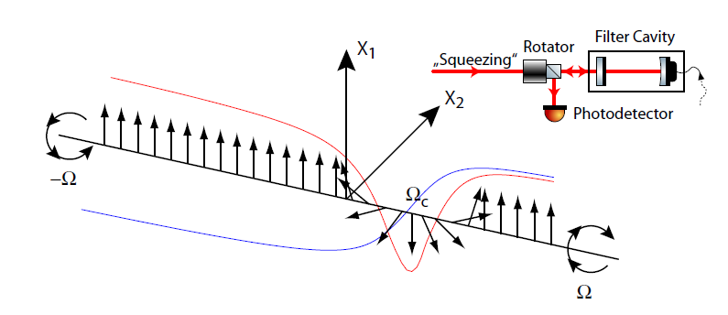
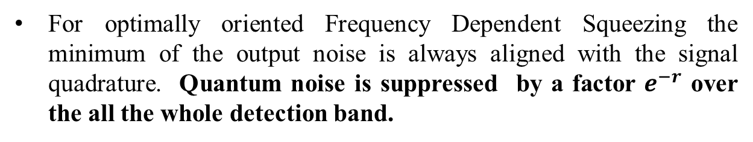
Frequency dependent squeezing
For optimally oriented Frequency Dependent Squeezing the minimum of the output noise is always aligned with the signal quadrature. Quantum noise is suppressed by a factor $e^{−r}$ over the all the whole detection band.
Optimally oriented Frequency Dependent Squeezing is generated by exploiting the dispersion in the reflection of a frequency independent squeezing source from detuned optical cavities (filter cavity).
Phase Squeezing
Amplitude Squeezing
SQZ FIS production
Degenerate parametric down convertion
Frequency dependent squeezing
$${2ω}_{0}={(ω}_{0}+Ω)+{(ω}_{0}−Ω)$$

Slide 12
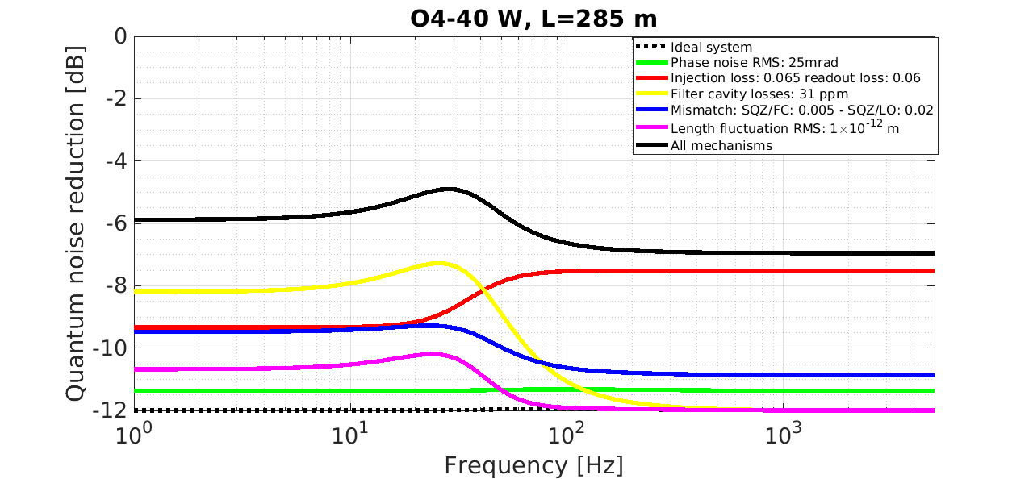
Filter Cavity Length Optimization
Cavity linewidth and detuning
depend on the crossover frequency when the shot noise equals the radiation pressure.
For both Virgo and LIGO about 25 Hz
Target parameters
Linewidth | 25 Hz
FC Round trip losses | 40 ppm
Residual FC length noise | 1 pm
Mode mismatch | 2%
Cavity length-dependent squeezing degradation sources
FC round trip losses (yellow):
Phase noise (pink): produced by the residual cavity length fluctuations which generate detuning variations
Cavity length-independent degradation sources
Mode mismatch between the squeezed beam and the FC
All other sources (injection and detection losses) assumed to be frequency independent
The optimal FC length is about 300 meters corresponding to finesse of 10000

Slide 13
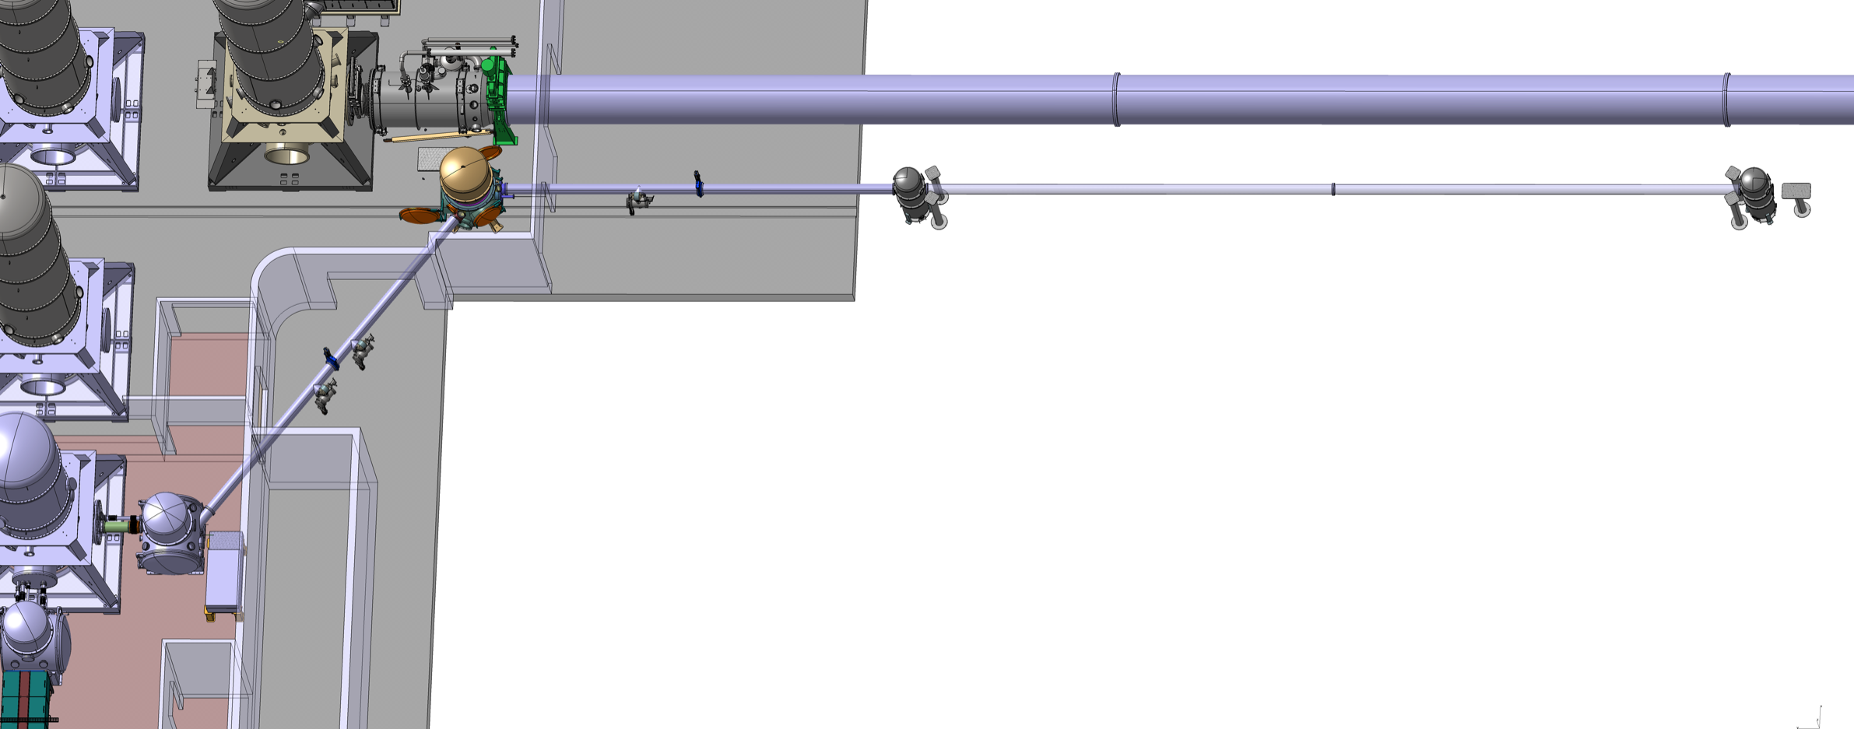
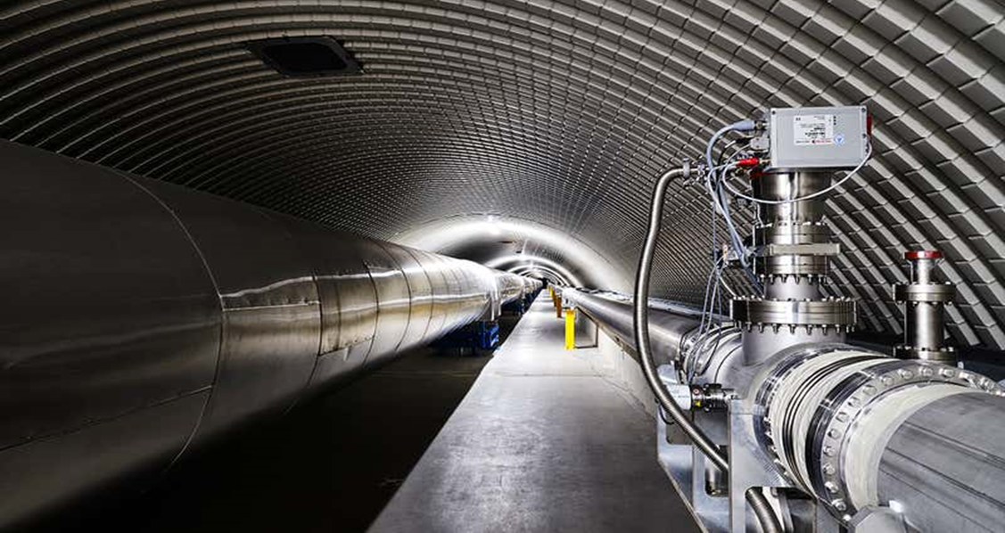
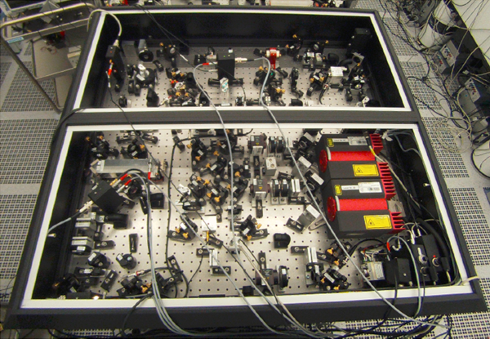
Virgo FDS source
285 m
BS
NI
North Arm
Filter Cavity
SR
Suspended Quantum Bench 1
Det
AEI frequency independent squeezer board

Slide 14

Virgo FDS source
Filter Cavity Mirrors
BS
NI
North Arm
SR
Det
IM suspension system
IM vacuum tank
Last suspension stage
Mirrors: Diameter 150 mm, Thickness 90 mm, Roughness <0.58 nm RMS

Slide 15


Frequency dependent squeezing recent implementations
LIGO (Livigston) sensitivity enhancement with FDS
The Virgo FDS source
-- No SQZ
-- FIS
-- FDS
Phys. Rev. Lett. 131, 041403 (2023)
Phys. Rev. X 13, 041021 (2023)

Slide 16

ET-HF & ET-LF
M Korobko, Galaxies 2025, 13, 11.
“Xylophone” configuration
Quantum noise reduction with SQZ
  Two filter cavities required for ET-LF
  Kilometre-scale filter cavities are required for broadband quantum noise reduction.

Slide 17






Alternative methods to beat the SQL: detuned SR
1. The SQL can be overcome by modifying the dynamics of the tests mass ($κ\left[Ω\right]$ enhancement)
Optical Spring
$S_{hh}\left[Ω\right]=\frac{2ℏ}{mΩ^{4}L^{2}\left|κ\left[Ω\right]\right|}\left\{κ\left[Ω\right]+1/κ\left[Ω\right]\right\}$=
Detuned SR cavity
2.Creating correlations between the shot noise (Shot) and the back-action noise (BA)
$$S_{hh}\left[Ω\right]=\frac{8}{L^{2}}\left\{S_{Shot}+S_{BA}{\left|κ\left[Ω\right]\right|}^{2}+2Re\left\{S_{Shot−BA} κ^{∗}\left[Ω\right]\right\}\right\}$$
Detuned (ET-LF)
Tuned (Virgo-LIGO)
Both methods are realized in the detuned signal recycled configuration
H. Miao PhD thesis

Slide 18












EPR-FDS squeezing
$$Sidebands entaglement$$
$$OPO$$
Pump: $2ω_{0}+∆$
Signal: $ω_{0}$
Idler: $ω_{0}+∆$
Energy conservation: $ω_{0}+Ω+ω_{0}−Ω+∆=2ω_{0}$+ $∆$
Advantage:
No needs of filter cavity
Drawback:
3dB loss of squeezing
Not effective for SR detuned configuration
$$ω_{0}+∆$$
$$OPO$$
$$Κ[ω]$$
$$ω_{0}$$
Y. Ma et al, Nature Phys 13, 776 (2017)

Slide 19




FDS through quantum teleportation
Phys Rev A 110, 022601 (2024)
Bob and Alice EPR entangled
$$\begin{matrix}∆(a_{1}+b_{1})\underset{→}{\text{E}\text{PR} }0 \\ ∆(a_{2}−b_{2})\underset{→}{\text{E}\text{PR} }0\end{matrix}$$
Victor squeezed
Advantage:
No needs of filter cavities for the SR detuned configuration (ET-LF)
Drawback:
4.8 dB of squeezing penalty
$$\left(\begin{matrix}B_{1} \\ B_{2}\end{matrix}\right)=\left(\begin{matrix}b_{1} \\ b_{2}\end{matrix}\right)+\left(\begin{matrix}v_{1}+a_{1} \\ v_{2}−a_{2}\end{matrix}\right)\underset{→}{\text{EPR}}\left(\begin{matrix}v_{1} \\ v_{2}\end{matrix}\right)$$
Output
Bob
Bell Meas.
FDS

Slide 20
Conclusions
The use of frequency-dependent squeezed (FDS) light has shown that it is possible to improve the sensitivity of large arm GW detectors across the entire detection band.
Further improvements are expected from activities aimed at reducing optical losses.
The baseline design of the third generation detectors (for instance ET) involves the use of FDS generated using the filter cavity technique.
R&D efforts are underway to develop alternative methods for reducing standard quantum noise and installation costs but are currently unable to guarantee the same performance as FDS.

Slide 21





Speed meters
Zero Area Sagnac interferometer
The generalized momentum “p” is a quantum non demolution observable (not affected by back action)
$$\left[\hat{p}\left(t\right),\hat{p}′(t′)\right]=0$$
The momentum of the test mass is a quasi quantum non demolution observable
$$x_{b}$$
Input
laser
Two basic schemes
  Michelson interferometer plus external “sloshing” cavity
  Speed meter
https://link.springer.com/article/10.1007/s41114-019-0018-y
$$x_{a}$$
Photodetector
Large scale proof of principle still lacking
New configurations compatible with the michelson interferometer configuration are being considered
$$δφ≈x_{a}\left(t\right)+x_{b}\left(t+τ\right)−x_{b}\left(t\right)+x_{a}\left(t\right)≈2 \text{v} τ$$
$τ$: propagation time v: speed

Slide 22






Dechoerence mitigation:Internal squeezing
Proof of concept
arXiv:2303.09983
1)Low readout losses dominant: parametric deamplification
Signal
Max 6 dB
Applicable for GW detectors?
>6 dB
2)Low internal losses dominant: parametric amplification
Several technological problems to deal with
To be combined with quantum back-action evading techniques
Cohe
Same SNR as input
SQZ
gain
Loss

