Slide 1
Search for new physics with charm rare decays at
Yong-Hua Zhan (詹永华), Sun Yat-sen University
On behalf of BESIII Collaboration
EPS-HEP 2025

Slide 2
Outline
Outline
BEPCII and BESIII
FCNC decays with charm
$J/ψ$ weak decays
Summary

Slide 3
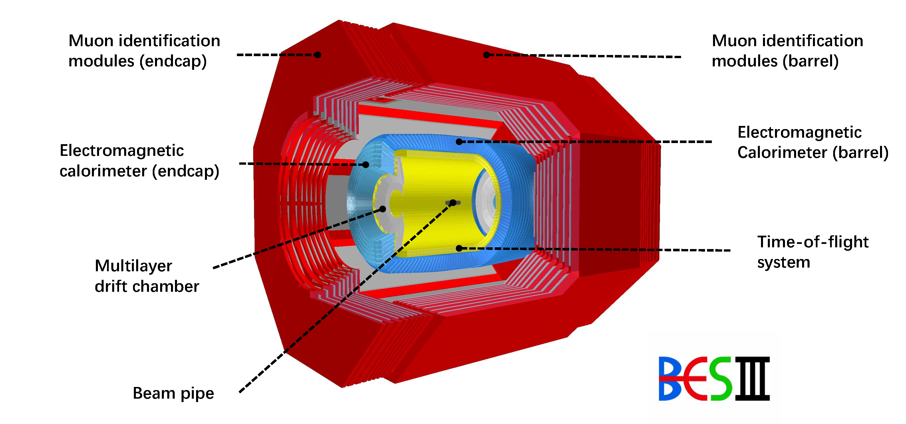
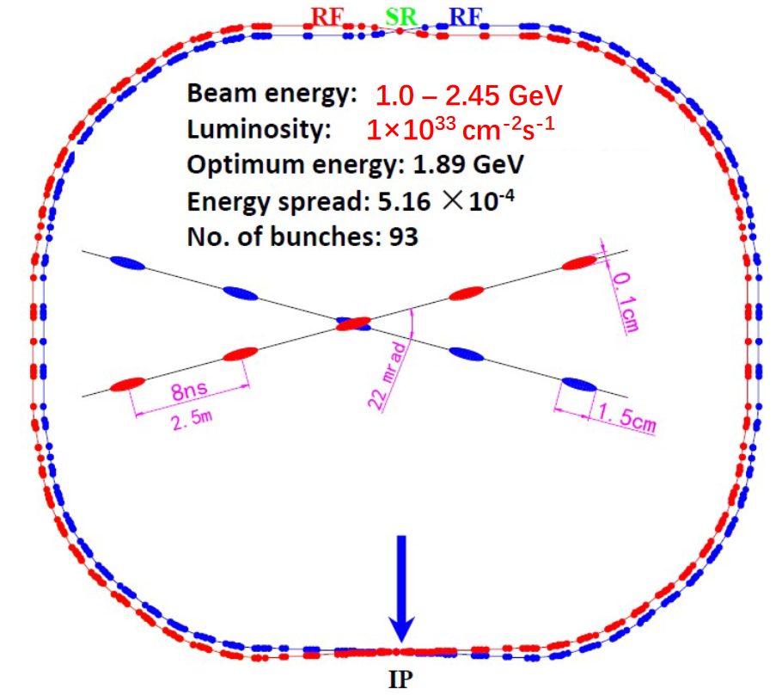
$$\text{BEPCII} \text{and} \text{BESIII}$$
BESIII Detector
Beijing Electron Positron Collider II
Multilayer drift chamber (MDC)
$The momentum resolution: 0.5\%$@ 1GeV/c
dE/dx resolution: $6\%$
Time-of-flight (TOF) system
The time resolution: 68ps(barrel)/60ps(endcap)
CsI(Tl) Electromagnetic calorimeter (EMC)
The energy resolution: $2.5\%$(barrel)/$5.0\%$(endcap) @1GeV
Supercon-ducting solenoidal magnet (1.0 T magnetic field)
Muon chamber (MUC) system

Slide 4
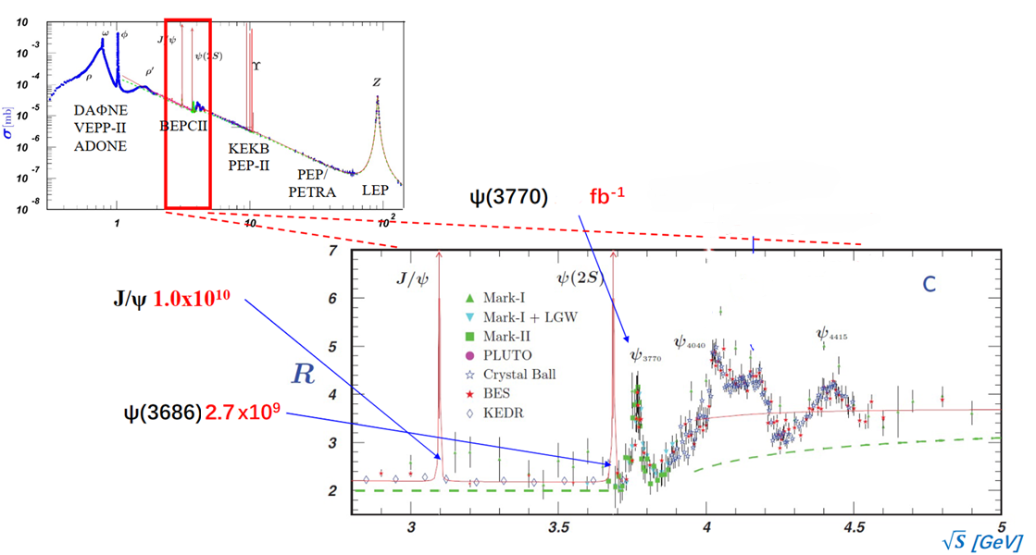
$$\text{BEPCII} \text{and} \text{BESIII}$$
The BESIII experiment has collected 2.7 billion $ψ(3686)$events, 10 billion $J/ψ$events, $20 fb^{−1}$D meson pairs at 3.773 GeV, and 7.33 $fb^{−1} D_{s}D_{s}^{∗}$events from 4.128 to 4.226 GeV.
$$20$$
4.128 to 4.226 GeV 7.33 $fb^{−1}$

Slide 5
$$\text{BEPCII} \text{and} \text{BESIII}$$
SM contribution is dominant
New Physics
Standard Model
SM contribution is highly suppressed
charmonium weak decays
FCNC (flavor-changing neutral current)
High order
…
New Physics
Standard Model
This work
Good sensitivity to NP
SM contribution is forbidden
New Physics
BNV/LNV (baryon and lepton number violation)
CLFV (charged lepton flavor violating)
…
To New Physics
B
E
S
I
I
I
High statistics
Clean background
Good resolution

Slide 6
$$\text{FCNC} \text{decays} \text{with} \text{charm}$$
Flavor-changing neutral currents (FCNC) transitions such as $c→u$manifest solely through loop-level interactions, which result in low branching fractions (BFs) of the corresponding decays.
Various new physics (NP) models beyond the SM suggest these BFs may be enhanced to exceed the SM prediction.
Any enhancement of the BF with respect to the SM would be a strong indication of NP.
Top-Color model[1]
Supersymmetric extensions of the SM with or without R-parity violation[2]
Two-Higgs doublet model[3]
Charmonium weak decay | Experimental upper limit (@90% C.L.) | data sample
$$J/ψ→D^{0}e^{+}e^{−}$$ | $<8.5×{10}^{−8}$ [4] | $$13.11×{10}^{8} J/ψ$$
$$ψ(3686)→D^{0}e^{+}e^{−}$$ | $<1.4×{10}^{−7}$ [4] | $$44.81×{10}^{7}ψ(3686)$$
$$J/ψ→D^{0}μ^{+}μ^{−}$$ | $<1.1×{10}^{−7}$ [5] | $(1.01×{10}^{10})$ $J/ψ$
$$J/ψ→D^{0}γ$$ | $<9.1×{10}^{−8}$ [6] | $(1.01×{10}^{10})$ $J/ψ$
$$D_{s}^{+}→π^{+}π^{0}e^{+}e^{−}$$ | $<7.0×{10}^{−5}$ [7] | $$(7.33 fb^{−1}) \sqrt{s}=4.128–4.226 GeV$$
$$D_{s}^{+}→K^{+}π^{0}e^{+}e^{−}$$ | $<7.1×{10}^{−5}$ [7]
$$D_{s}^{+}→K_{S}^{0}π^{+}e^{+}e^{−}$$ | $<8.1×{10}^{−5}$ [7]
[1] Phys. Lett. B 345, 483 (1995)
[2] Phys. Lett. B 119, 136 (1982)
[3] Phys. Rev. D15, 1958 (1977)
[4] Phys. Rev. D 96, 111101(R) (2017)
[5] JHEP 04,061 (2025)
[6] Phys.Rev.D 110, 112012 (2024)
[7] Phys.Rev.Lett. 133, 121801 (2024)

Slide 7
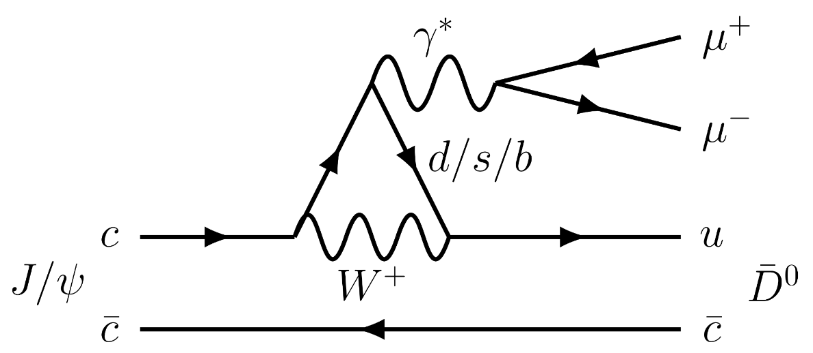
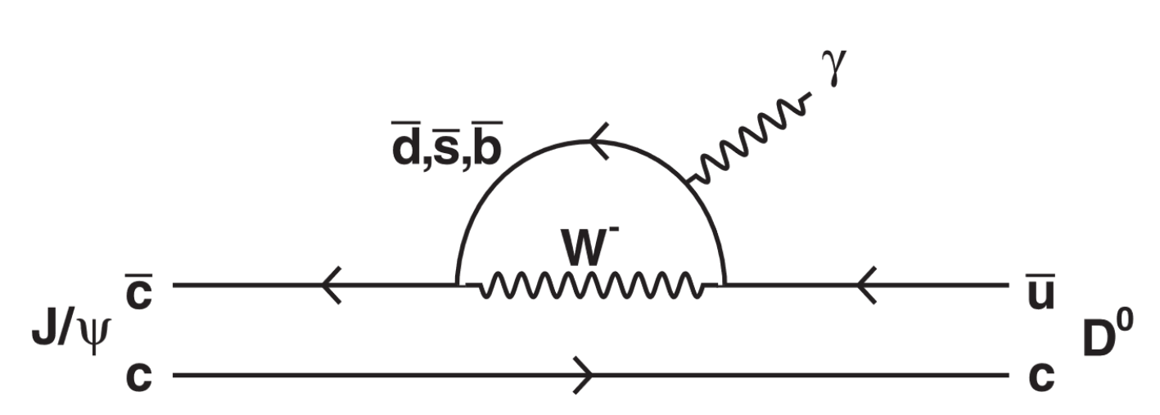
$$\text{FCNC} \text{decays} \text{with} \text{charm}$$
Reconstruct $D^{0}$meson:
$D^{0}→K^{−}π^{+}$(Mode I)
$D^{0}→K^{−}π^{+}π^{0}$ with $π^{0}→γγ$ (Mode II)
Figure (1): The Feynman diagram of $J/ψ→D^{0}μ^{+}μ^{−}$
Figure (2): The Feynman diagram of $J/ψ→D^{0}γ$
$D^{0}→K^{−}π^{−}π^{+}π^{+}$ (Mode III)
$J/ψ → D^{0}l^{+}l^{−}$ BFs ~ ${ 10}^{−13}$
one fewer decay vertex
$$J/ψ→D^{0}μ^{+}μ^{−}$$
JHEP 04,061 (2025)
$J/ψ → D^{0}γ$ BFs ~ ${10}^{−12}−{10}^{−11}$
Using $\left(1.0087±0.0044\right)×{10}^{10}J/ψ$ events.
To extract the BFs, an unbinned simultaneous maximum-likelihood fit is carried out to the selected samples of the three $D^{0}$ decay modes by sharing the same decay BF of $J/ψ → D^{0}γ$ ($J/ψ→D^{0}μ^{+}μ^{−}$).
$$J/ψ→D^{0}γ$$
Phys.Rev.D 110, 112012 (2024)

Slide 8
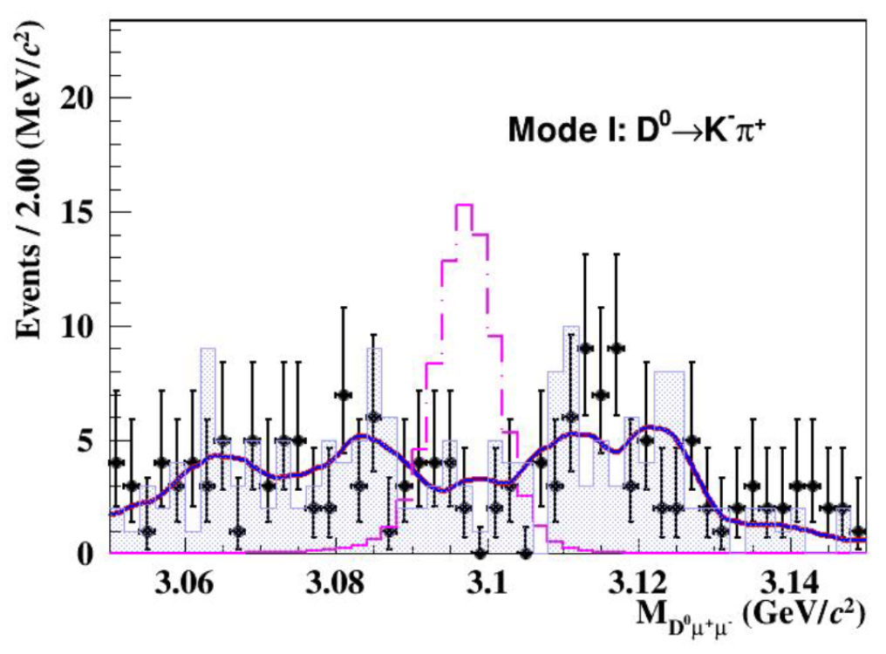
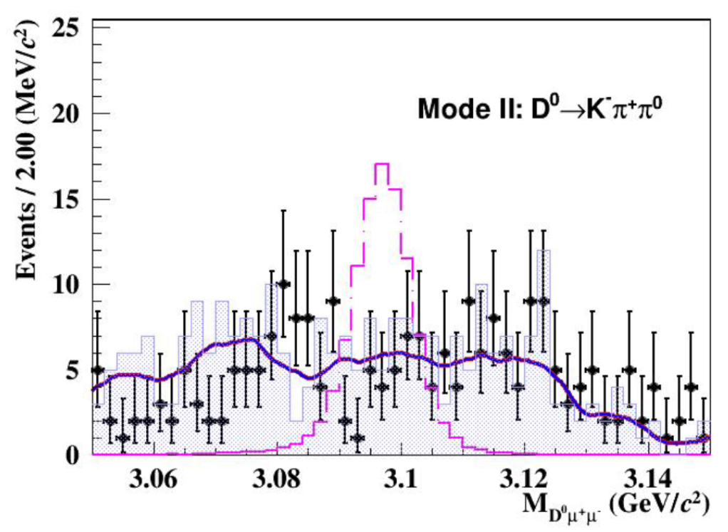
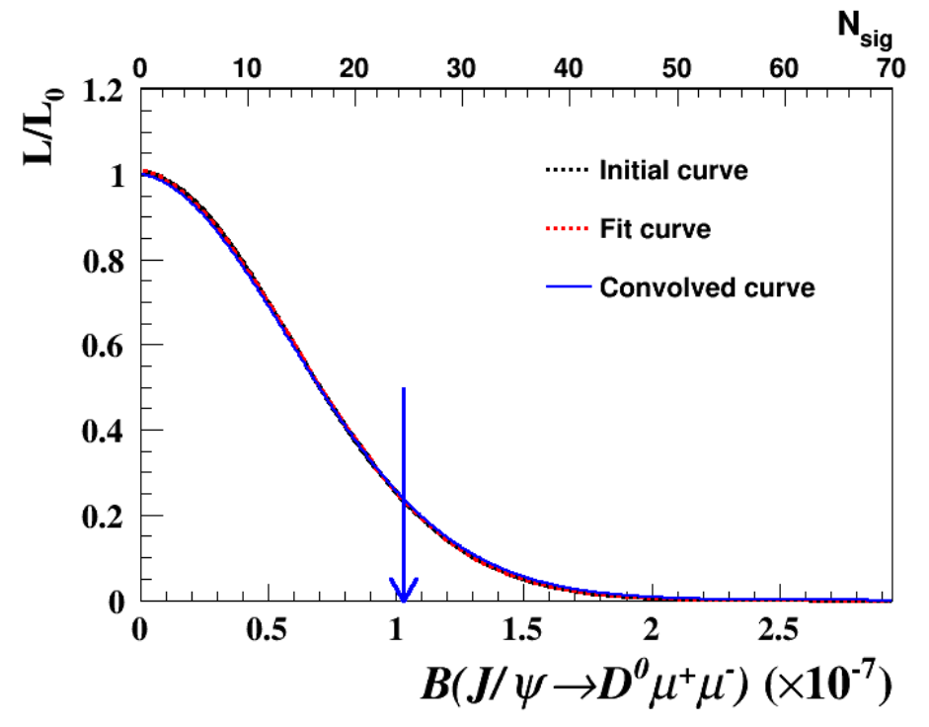
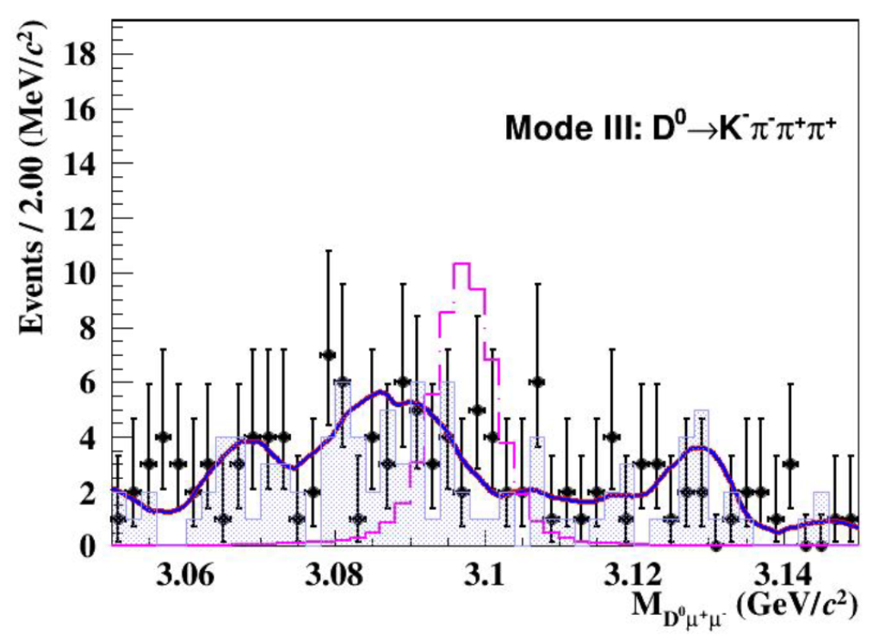
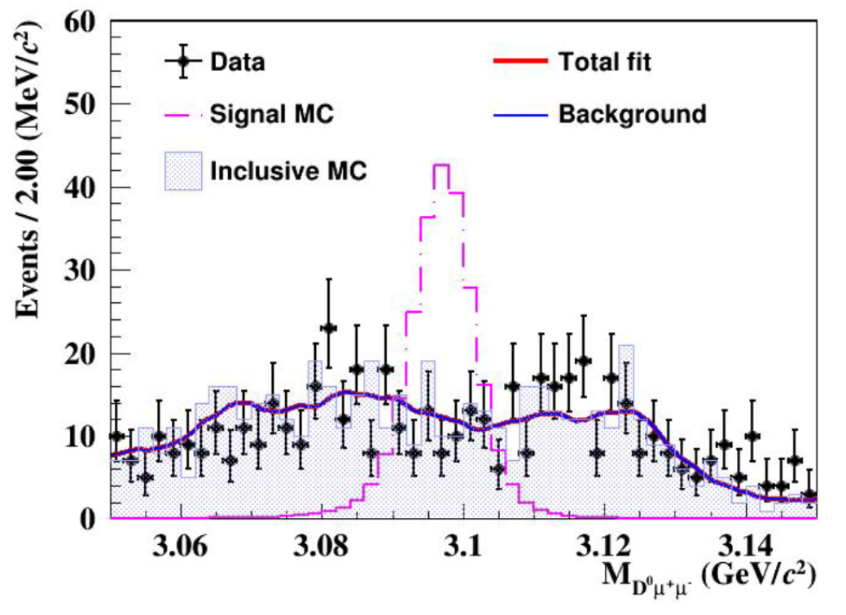
$$\text{FCNC} \text{decays} \text{with} \text{charm}$$
$$J/ψ→D^{0}μ^{+}μ^{−}$$
JHEP 04,061 (2025)
Figure (2): The distributions of normalized likelihoods versus signal yields $N_{sig}$ or BF of $J/ψ→D^{0}μ^{+}μ^{−}$.
No significant signal is observed.
$ℬ\left(J/ψ→D^{0}μ^{+}μ^{−}\right)<1.1×{10}^{−7} @90\%$ C.L.
This is the first search for a charmonium FCNC process involving muons in the final state.
Figure (1): The distributions of $M_{D^{0}μ^{+}μ^{−}}$for $J/ψ→D^{0}μ^{+}μ^{−}$of the selected candidates in data, signal MC sample, and inclusive MC sample.

Slide 9
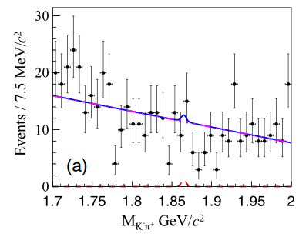
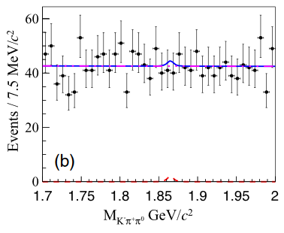
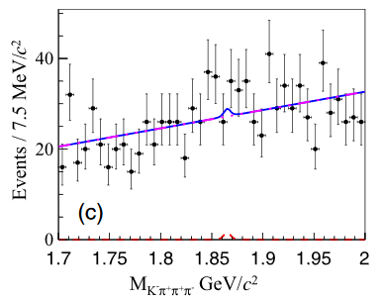
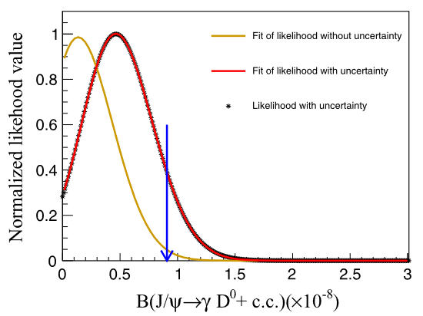
$$\text{FCNC} \text{decays} \text{with} \text{charm}$$
$$J/ψ→D^{0}γ$$
Phys.Rev.D 110, 112012 (2024)
Figure (1): The unbinned simultaneous fit on the invariant mass distributions of modes (a) I, (b) II and (c) III, where the dots with error bar are data, the blue lines are the fit result, and the red dotted and purple curves are the fitted signal and background, respectively.
The results are consistent with a background-only hypothesis.
$ℬ\left(J/ψ → D^{0}γ\right)<9.1×{10}^{−8} @90\%$ C.L., representing the most stringent limit to date.
It provides a valuable reference for studying different NP models and restrict the phase space of parameters.
Figure (2): The likelihood profile for $J/ψ → γD^{0}$combining the three decay modes to extract the upper limit on the BF.

Slide 10
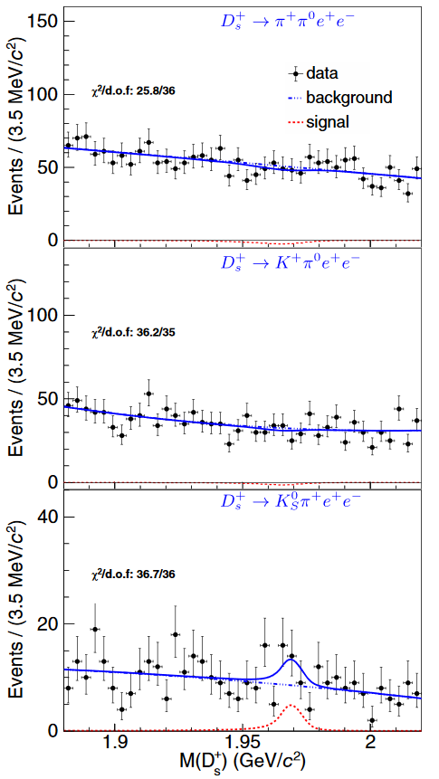
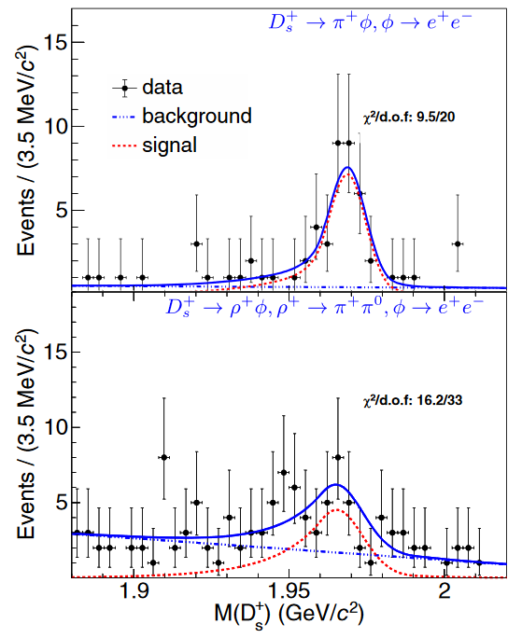
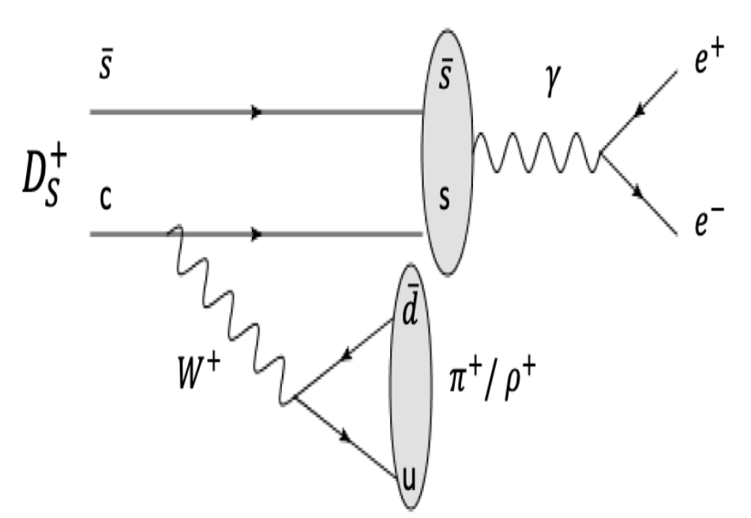
$$\text{FCNC} \text{decays} \text{with} \text{charm}$$
$$D_{s}^{+}→ρ^{+}φ$$
$$ρ^{+}→π^{+}π^{0}$$
$$φ→e^{+}e^{−}$$
$$D_{s}^{+}→π^{+}φ$$
$$φ→e^{+}e^{−}$$
$$D_{s}^{+}→h\left(h^{′}\right)e^{+}e^{−}$$
Phys.Rev.Lett. 133, 121801 (2024)
$$D_{s}^{+}→K_{S}^{0}π^{+}e^{+}e^{−}$$
$$D_{s}^{+}→K^{+}π^{0}e^{+}e^{−}$$
$$D_{s}^{+}→π^{+}π^{0}e^{+}e^{−}$$
7.8σ
Short-distance (SD) and long-distance (LD) contributions.
SD-only BFs
GIM
$${10}^{−9}$$
4.4σ
LD BFs
$${10}^{−6}$$
Use 7.33 $fb^{−1} D_{s}D_{s}^{∗}$events from 4.128 to 4.226 GeV.
We apply a single tag (ST) method to search for $D_{s}^{+}$ candidates.
Figure (1): Fits to the $M(D_{s}^{+})$distributions for $D_{s}^{+}→π^{+}π^{0}e^{+}e^{−},D_{s}^{+}→K^{+}π^{0}e^{+}e^{−}$, and $D_{s}^{+}→K_{S}^{0}π^{0}e^{+}e^{−}$. For $D_{s}^{+}→π^{+}π^{0}e^{+}e^{−}$, the $M(e^{+}e^{−})$is required to be outside the $φ$ mass window.
Figure (2): Fits to the $M(D_{s}^{+})$distributions for $D_{s}^{+}→π^{+}φ, φ→e^{+}e^{−}$ and $D_{s}^{+}→ρ^{+}φ,ρ^{+}→π^{+}π^{0}, φ→e^{+}e^{−}$.

Slide 11
$$\text{FCNC} \text{decays} \text{with} \text{charm}$$
$$D_{s}^{+}→h\left(h^{′}\right)e^{+}e^{−}$$
Phys.Rev.Lett. 133, 121801 (2024)
These two values are consistent with the direct calculations of $ℬ\left(D_{s}^{+}→π^{+}φ\right)∙ℬ\left(φ→e^{+}e^{−}\right)=\left(1.34±0.12\right)×{10}^{−5}$ and $ℬ\left(D_{s}^{+}→ρ^{+}φ\right)∙ℬ\left(φ→e^{+}e^{−}\right)=\left(1.67±0.11\right)×{10}^{−5}$ from the PDG[1].
For the three four-body decay modes, no significant signal is found. Therefore, we set upper limits on the BFs at the 90% confidence level.
Table 1: The signal yields ($N_{sig}$), signal efficiencies, the BFs, and the $90\%$confidence level upper limits, where the first uncertainty is statistical and the second systematic.
Decay | $$N_{sig}$$ | $$ε(\%)$$ | $$𝓑(×10^{−5})$$
$$D_{s}^{+}→π^{+}φ, φ→e^{+}e^{−}$$ | $${38.2}_{−6.8}^{+7.8}$$ | $$25.1$$ | $${1.17}_{−0.21}^{+0.23}±0.03$$
$$D_{s}^{+}→ρ^{+}φ, φ→e^{+}e^{−}$$ | $${37.8}_{−9.6}^{+10.3}$$ | $$12.1$$ | $${2.44}_{−0.62}^{+0.67}±0.16$$
$$D_{s}^{+}→π^{+}π^{0}e^{+}e^{−}$$ |  | $$7.4$$ | $$<7.0$$
$$D_{s}^{+}→K^{+}π^{0}e^{+}e^{−}$$ |  | $$5.3$$ | $$<7.1$$
$$D_{s}^{+}→K_{S}^{0}π^{+}e^{+}e^{−}$$ |  | $$6.7$$ | $$<8.1$$
[1] Phys. Rev. D 110,030001 (2024)

Slide 12
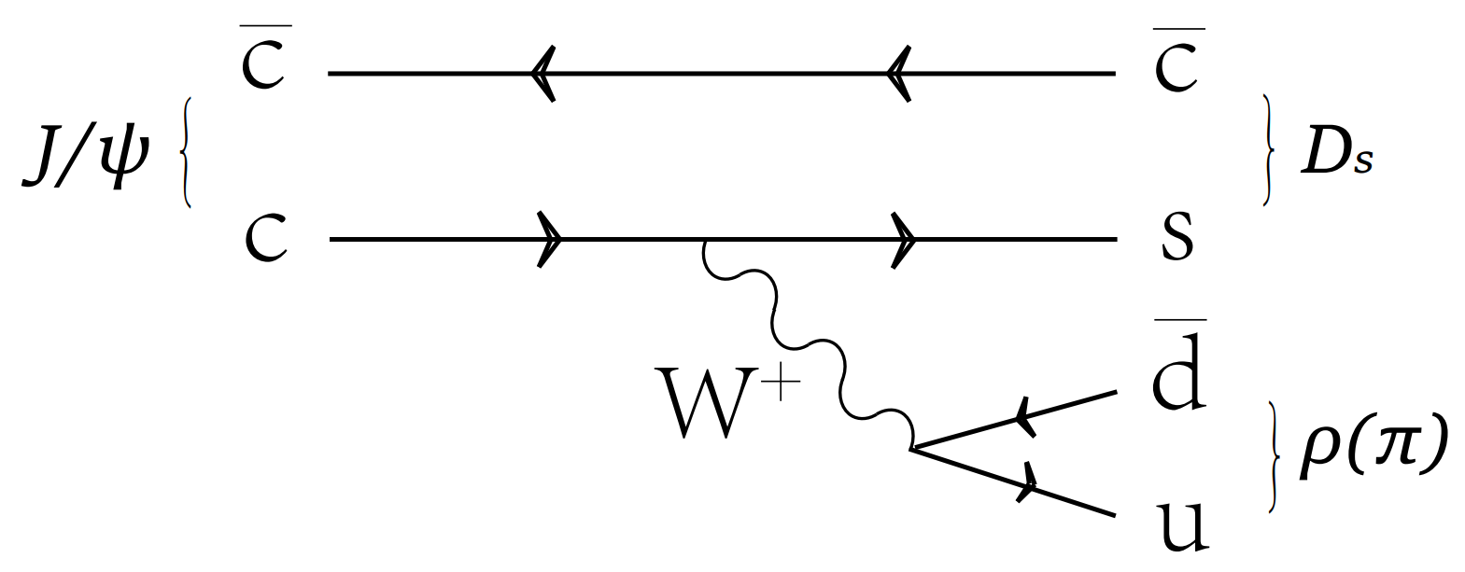
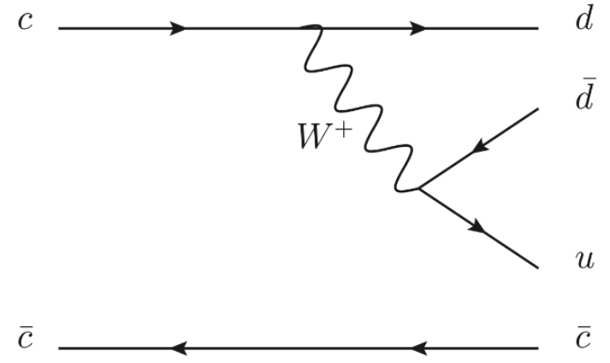
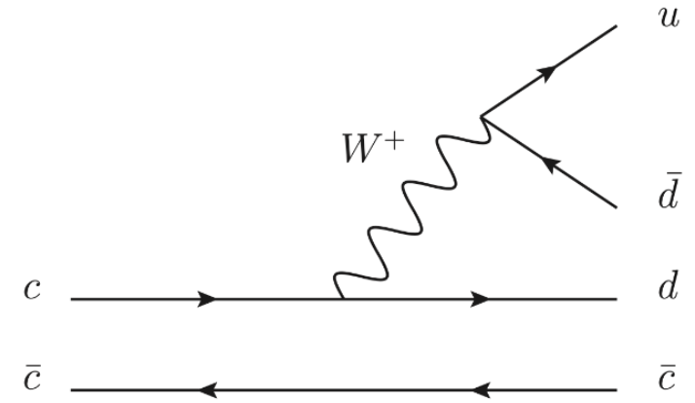
𝐽/𝜓 weak decays
Fig(c) The leading-order Feynman diagram of $J/ψ→D_{s}^{−}π^{+}$ and $J/ψ→D_{s}^{−}ρ^{+}$
Charmonium weak decay | $$\text{Experimental} \text{upper} \text{limit} \text{(@90\% }\text{C}\text{.}\text{L}\text{.)}$$ | Number of $J/ψ$ data events
$$J/ψ→D_{s}^{−}ρ^{+}$$ | $<8.0×{10}^{−7}$ [1] | BESIII ($1.01×{10}^{10}$)
$$J/ψ→D_{s}^{−}π^{+}$$ | $<4.1×{10}^{−7}$ [1] | BESIII ($1.01×{10}^{10}$)
$$J/ψ→D^{−}ρ^{+}$$ | $<6.0×{10}^{−7}$ [2] | BESIII ($1.01×{10}^{10}$)
$$J/ψ→D^{−}π^{+}$$ | $<7.0×{10}^{−8}$ [2]
$$J/ψ→{\overline{D}}^{0}ρ^{0}$$ | $<5.2×{10}^{−7}$ [2] | BESIII ($2.25×{10}^{8}$)
$$J/ψ→{\overline{D}}^{0}η$$ | $<6.8×{10}^{−7}$ [2] | BESIII ($2.25×{10}^{8}$)
$$J/ψ→{\overline{D}}^{0}π^{0}$$ | $<4.7×{10}^{−7}$ [2] | BESIII ($2.25×{10}^{8}$)
$$J/ψ→D^{−}μ^{+}ν_{μ}$$ | $<5.6×{10}^{−7}$ [4] | BESIII ($1.01×{10}^{10}$)
$$J/ψ→D^{−}e^{+}ν_{e}$$ | $<7.1×{10}^{−8}$ [3] | BESIII ($1.01×{10}^{10}$)
$$J/ψ→D_{s}^{−}e^{+}ν_{e}$$ | $<1.3×{10}^{−6}$ [5] | BESIII ($2.25×{10}^{8}$)
$$J/ψ→D_{s}^{∗−}e^{+}ν_{e}$$ | $<1.8×{10}^{−6}$ [5] | BESIII ($2.25×{10}^{8}$)
Fig(a) The leading-order Feynman diagram of $J/ψ→{\overline{D}}^{0}π^{0}$, $J/ψ→{\overline{D}}^{0}η$ and $J/ψ→{\overline{D}}^{0}ρ^{0}$
Fig(b) The leading-order Feynman diagram of $J/ψ→D^{−}π^{+}$ and $J/ψ→D^{−}ρ^{+}$
The inclusive branching fraction of the charmonium weak decays is predicted to be ${10}^{−8}$in the standard model.
If the BFs for weak decays of 𝐽/𝜓 are found to be within the range of ${10}^{−8}$ to ${10}^{−6}$, it would suggest the presence of new physics beyond the Standard Model.
Using $\left(1.0087±0.0044\right)×{10}^{10}J/ψ$ events.
To avoid high background from conventional $J/ψ$ hadronic decays, the ${\overline{D}}^{0}$, $D^{−}$ and $D_{s}^{−}$ mesons are tagged by the semi-leptonic decays.
[1] arXiv:2506.09386
[2] Phys. Rev. D 110, 032020 (2024)
[3] JHEP 01, 126 (2024)
[4] JHEP 06, 157 (2021)
[5] Phys. Rev. D 90, 112014 (2014)

Slide 13
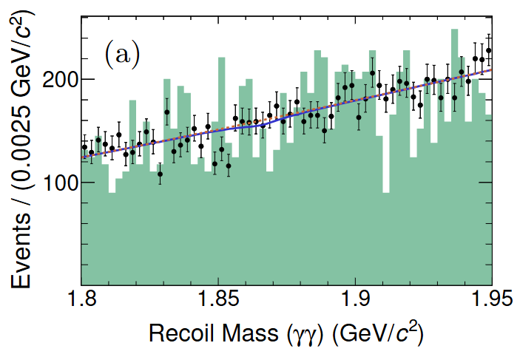
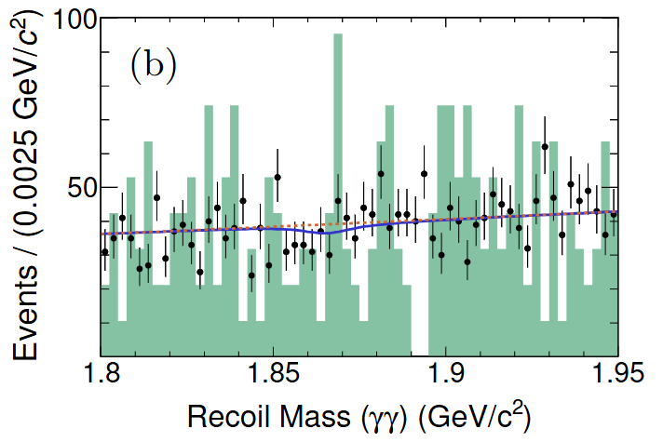
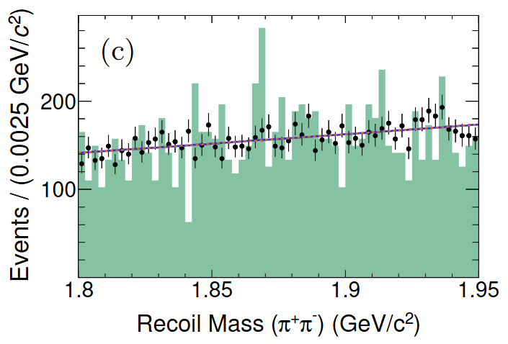
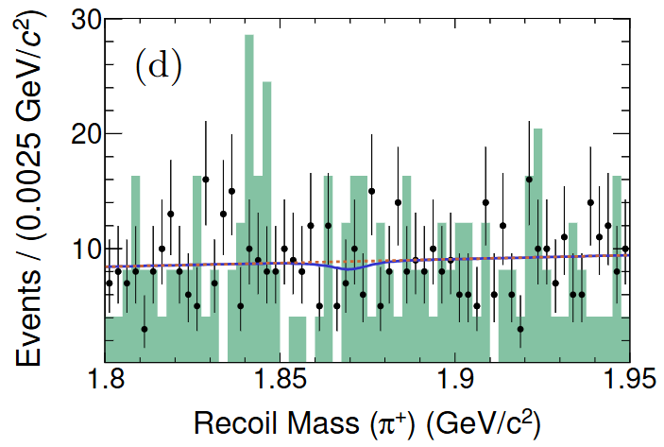
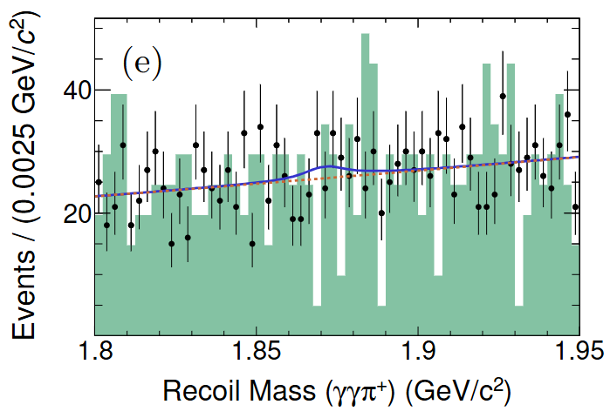
𝐽/𝜓 weak decays
Select those events for which the recoiling mass against the $π^{0}, η, ρ^{0}, π^{+},$and $ρ^{+}$ falls within the mass window $(1.80, 1.95) GeV/c^{2}$for all decay modes.
$$J/ψ→D^{−}ρ^{+}$$
$$D^{−}→K_{S}^{0}e^{−}{\overline{ν}}_{e}$$
$$K_{S}^{0}→π^{+}π^{−}$$
$$ρ^{+}→π^{+}π^{0}$$
$$π^{0}→γγ$$
$$J/ψ→{\overline{D}}^{0}π^{0}$$
$${\overline{D}}^{0}→K^{+}e^{−}{\overline{ν}}_{e}$$
$$π^{0}→γγ$$
$$J/ψ→{\overline{D}}^{0}η$$
$${\overline{D}}^{0}→K^{+}e^{−}{\overline{ν}}_{e}$$
$$η→γγ$$
$$J/ψ→{\overline{D}}^{0}ρ^{0}$$
$${\overline{D}}^{0}→K^{+}e^{−}{\overline{ν}}_{e}$$
$$ρ^{0}→π^{+}π^{−}$$
$$J/ψ→D^{−}π^{+}$$
$$D^{−}→K_{S}^{0}e^{−}{\overline{ν}}_{e}$$
$$K_{S}^{0}→π^{+}π^{−}$$
$J/ψ$weak decays containing a D meson
Phys. Rev. D 110, 032020(2024)
Figure: Fits of the accepted candidates to the recoiling mass spectra for $\left(a\right) J/ψ→{\overline{D}}^{0}π^{0}\text{,} \left(b\right) J/ψ→{\overline{D}}^{0}η, \left(c\right) J/ψ→{\overline{D}}^{0}ρ^{0}, \left(d\right) J/ψ→D^{−}π^{+}and \left(e\right) J/ψ→D^{−}ρ^{+}$.

Slide 14
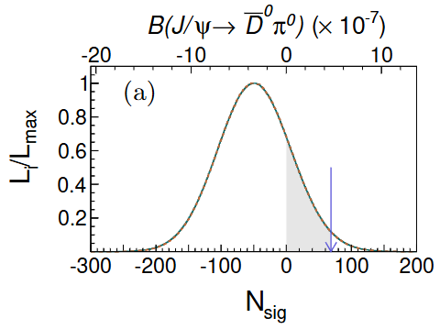
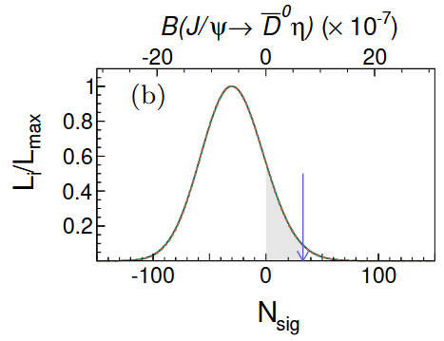
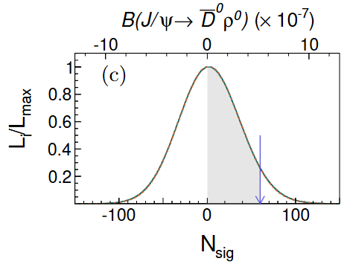
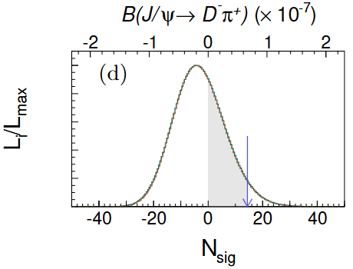
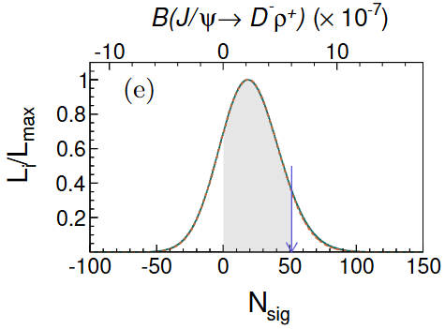
𝐽/𝜓 weak decays
No significant signal is observed in any of the decay modes. The branching fraction of signal decay is calculated as
where $N_{sig}$ is the number of signal events, $N_{J/ψ}$is the total number of $J/ψ$events, $ε$ is the signal detection efficiency, and $B_{sub}$ is the product of the branching fractions of all possible intermediate decays.
$J/ψ$weak decays containing a D meson
Phys. Rev. D 110, 032020(2024)
Figure: Normalized likelihood distributions for the fitted yields of signal events and corresponding branching fractions of $\left(a\right) J/ψ→{\overline{D}}^{0}π^{0}\text{,} \left(b\right) J/ψ→{\overline{D}}^{0}η, \left(c\right) J/ψ→{\overline{D}}^{0}ρ^{0}, \left(d\right) J/ψ→D^{−}π^{+}and \left(e\right) J/ψ→D^{−}ρ^{+}$, with (green solid curves) and without (orange dashed lines) smearing the systematic uncertainties. The blue arrows mark the upper limits at the $90\%$ C.L..

Slide 15
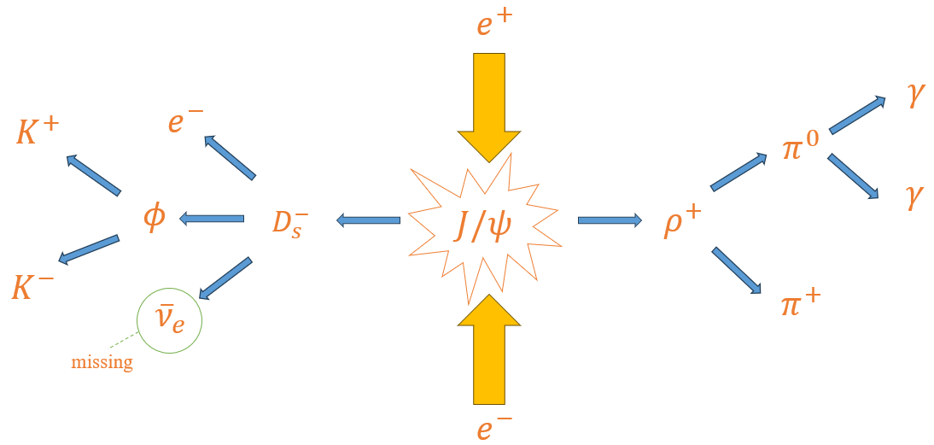
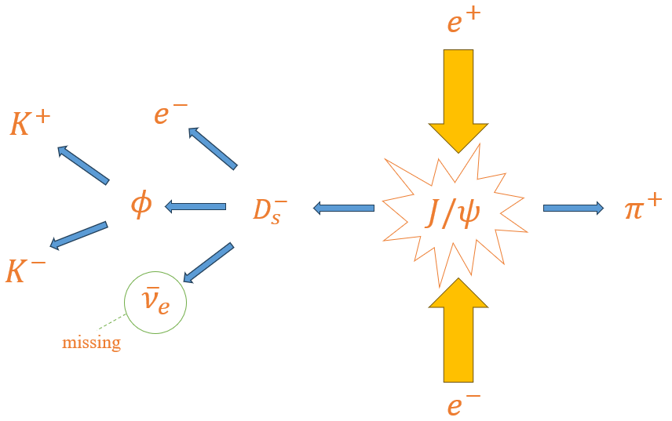
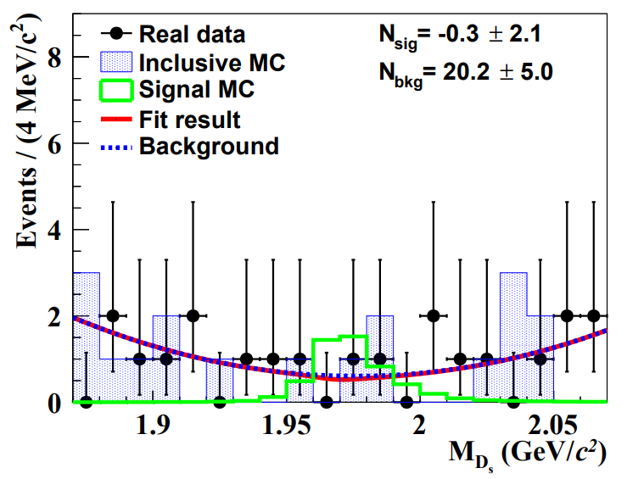
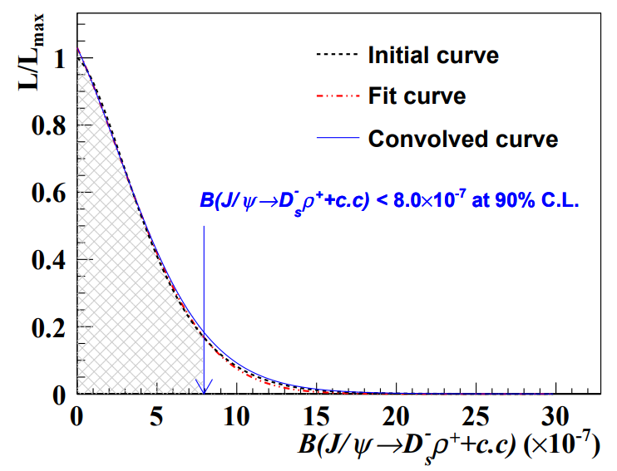
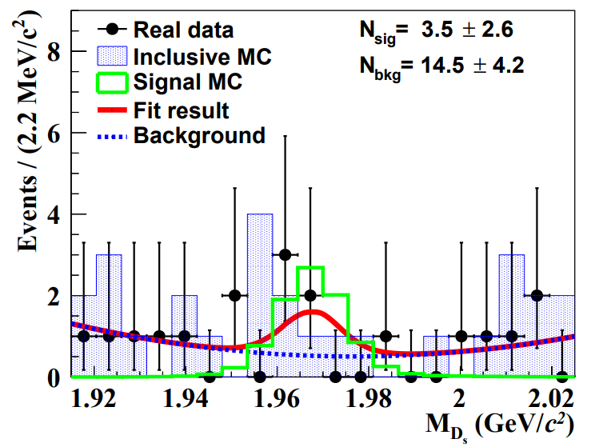
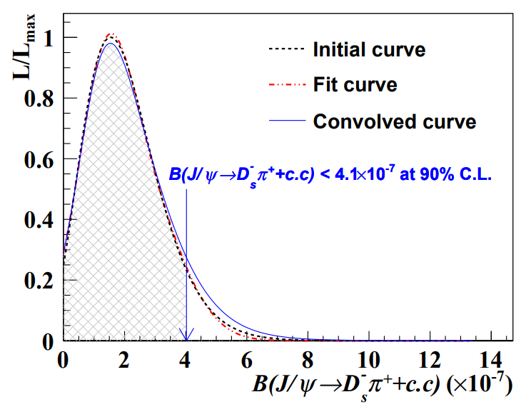
𝐽/𝜓 weak decays
Decay ：$J/ψ→D_{s}^{−}ρ^{+}$ and $J/ψ→D_{s}^{−}π^{+}$
Predicted relative ratio[1]：$\frac{𝓑(J/ψ→D_{s}^{−}ρ^{+})}{𝓑(J/ψ→D_{s}^{−}π^{+})}=4.2$
$J/ψ→D_{s}^{−}ρ^{+}$ and $J/ψ→D_{s}^{−}π^{+}$
arXiv:2506.09386
Figure (1): The $M_{D_{s}}$ distributions of the $J/ψ →D_{s}^{−}ρ^{+}$ Candidate events.
Figure (2): The distributions of the likelihood scan values for $J/ψ →D_{s}^{−}ρ^{+}$.
Figure (3): The $M_{D_{s}}$ distributions of the $J/ψ →D_{s}^{−}π^{+}$ Candidate events.
Figure (4): The distributions of the likelihood scan values for $J/ψ →D_{s}^{−}π^{+}$.
$ℬ\left(J/ψ→D_{s}^{−} ρ^{+}\right)<8.0×{10}^{−7} @90\%$ C.L.
The UL for $J/ψ→D_{s}^{−} ρ^{+}$has been improved by about an order of magnitude.
$ℬ\left(J/ψ→D_{s}^{−} π^{+}\right)<4.1×{10}^{−7} @90\%$ C.L.
The UL for $J/ψ→D_{s}^{−} π^{+}$has been improved by about three orders of magnitude.
[1] Int. J. Mod. Phys. A 14, 937-946 (1999)

Slide 16
Summary
BESIII performed a wide range study of new physics, with many first searches or best limits.
The latest search results for rare decays with charm in BESIII are reported.
BESIII has great potential with unique (and increasing) datasets and analysis techniques.

Slide 17
Thanks

