Slide 1
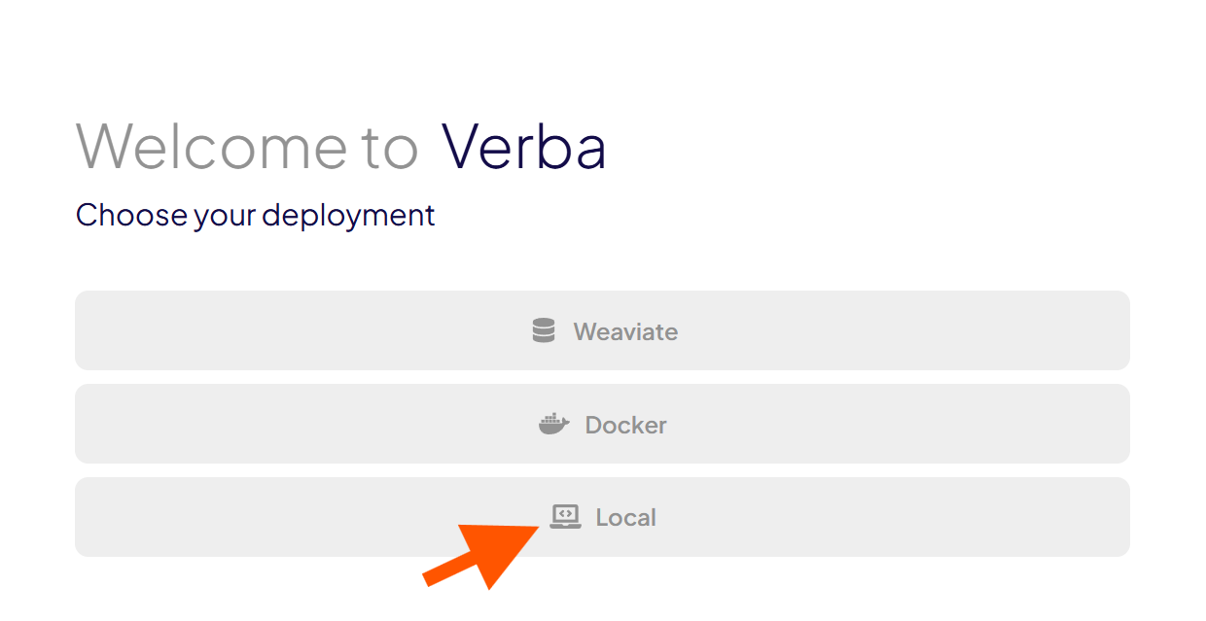
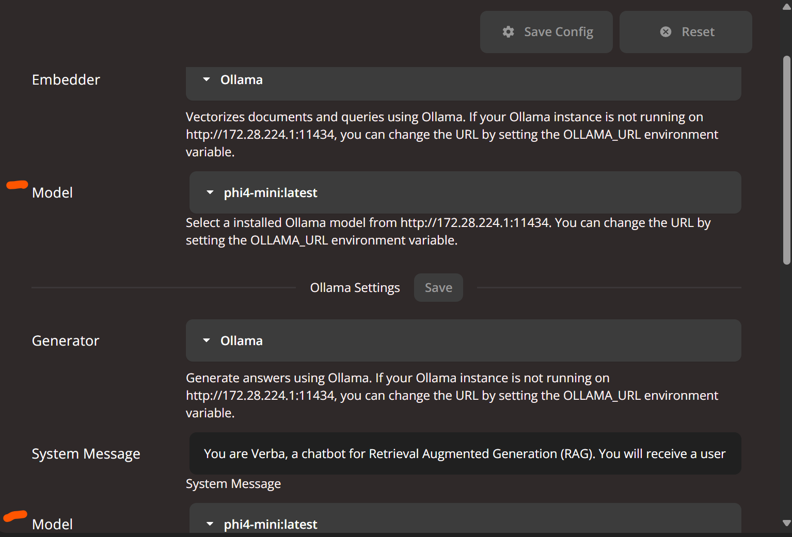
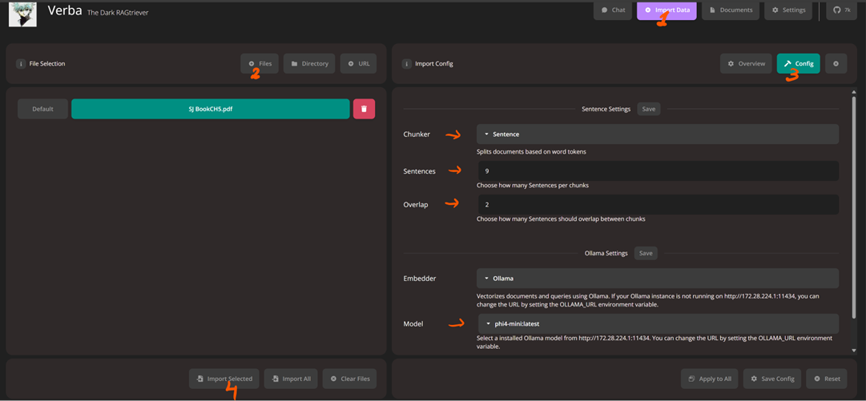
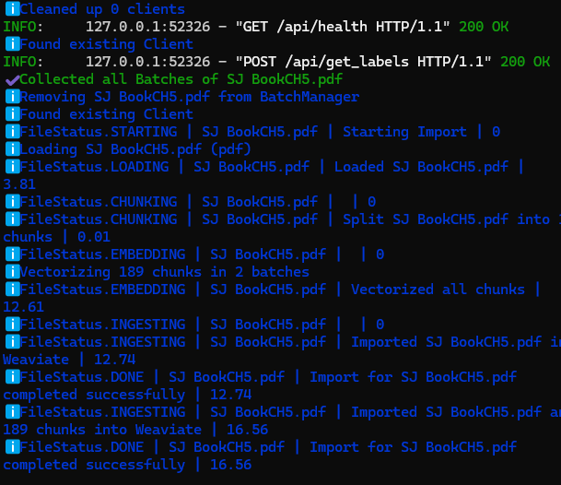
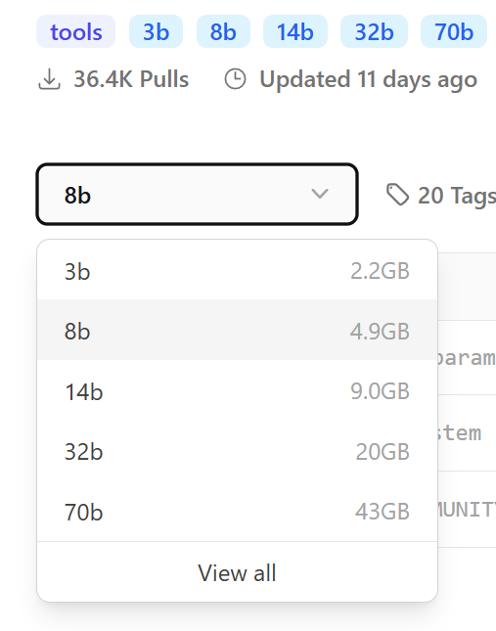
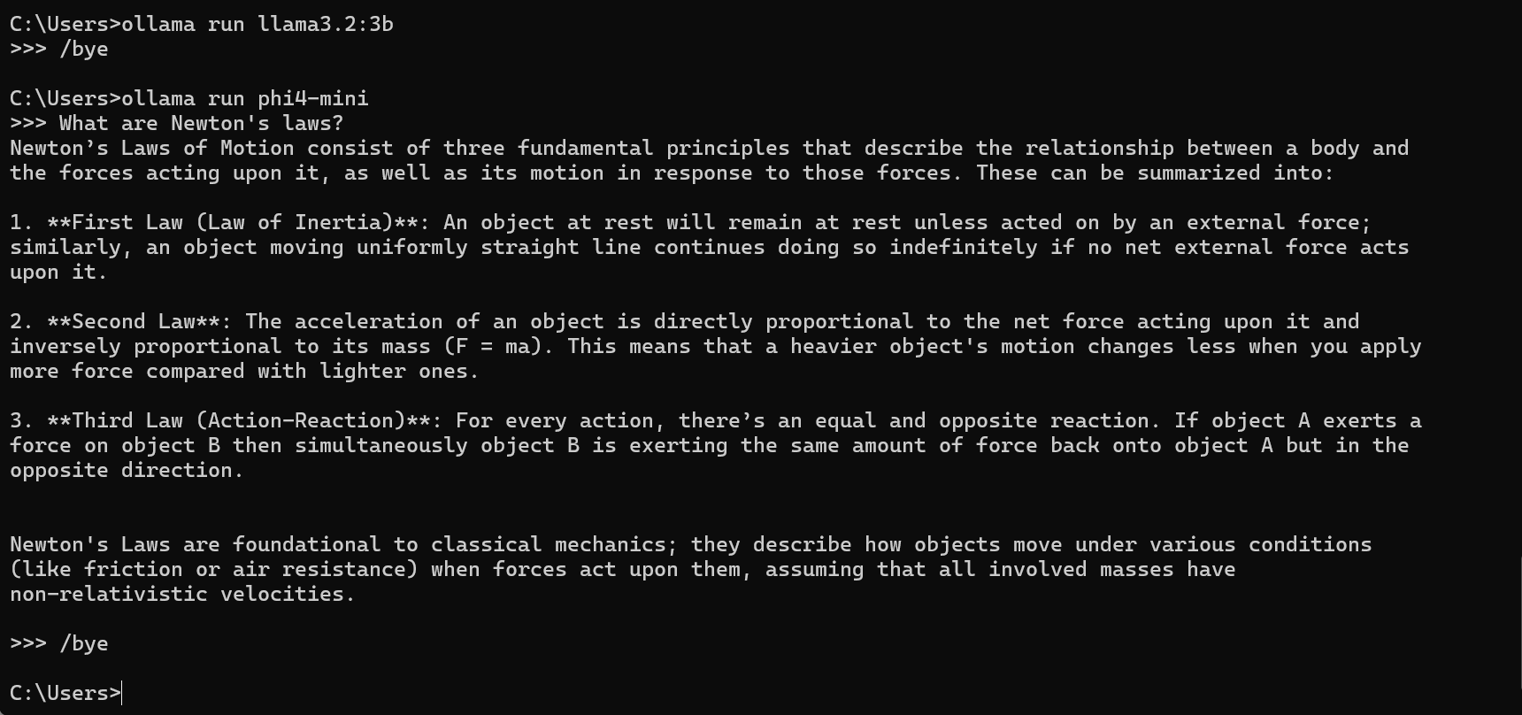
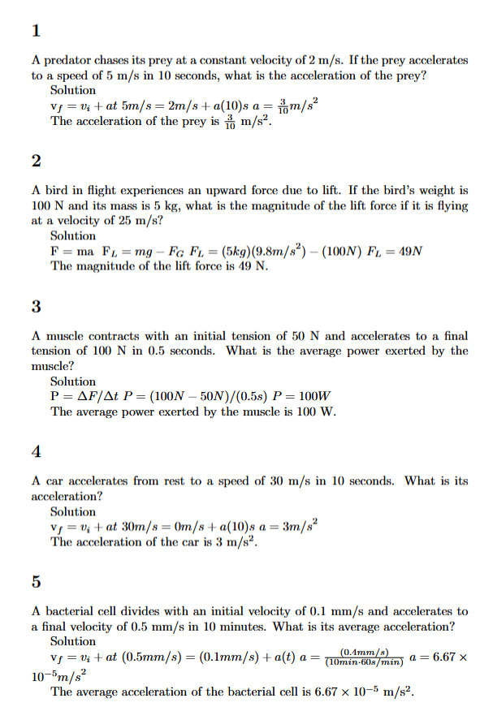
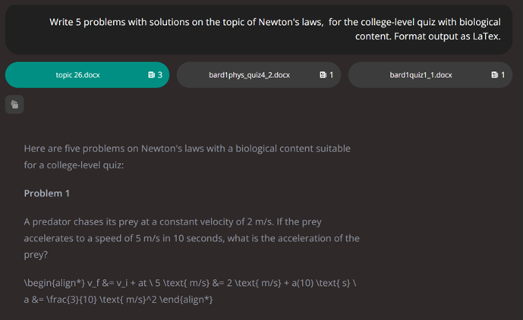
Using Local AI with RAG for Open Educational Materials Generation for Physics Education By: Dmitriy Beznosko*, Tatiana Krivosheev and Alexander Iakovlev for 2025 European Physical Society Conference on High Energy Physics *Presenter. dmitriybeznosko@clayton.edu
ABSTRACT: AI nowadays is a new tool that seems to be everywhere, including education. It brings convenience but also concerns - the two largest concerns with using AI by instructors are the safety of students’ data and the AI lack of the specific knowledge needed in a specific class. The data safety can be addressed by using a locally run large language models model using Ollama framework, a free tool that gives user the ability to run LLM locally on your system, so no data is transmitted. The approach of using the Retrieval Augmented Generation adds the user data to the as a context for the generation of the educational materials as well as homework and quiz assignments. Brief background, installation and configuration highlights with performance and use examples of different models will be presented.
Working with Verba
Due to limitations of the vectorization library weaviate (https://github.com/weaviate/weaviate), Verba can only be installed on a Linux-based OS, in WLS2 (Windows linux subsystem) or in a Docker container but not directly in Windows
It is a Python-based RAG environment with interface via web browser
Has shown to be most effective yet has a learning curve
Introduction
As Large Language Models (LLM, commonly also called AI) are becoming integrated into all areas of life, education is to follow the trend. Students are using AI and its now time for the instructors to use AI to make their life easier. The two main concerns that exist for the AI use by instructors is the lack of expertise in a specific topic and the concern for the privacy of the data.
A general LLM is designed to perform well in multiple areas from translation of text, writing code to reasoning and helping with cooking recipes. However, instructors often need a model that can help with specific tasks, such as generation of quiz and homework questions, training sets for students on a given chapter or topic, creation of grading rubrics and similar.
Work is sponsored by: ALG (Affordable Learning Georgia) round 26 RG017 grant
Config and Import the files
Select the right model, same for all tasks.
When running Verba in WLS2 and Ollama on your Windows (don’t run LLM in the virtualized environment), Ollama needs to be available on the assigned ip of your PC and not localhost only.
Import data
Choose files
Pdf or docx
Choose chunker
Set parameters
Import files
Go to Chat
Ask questions!
Running AI model locally
Easiest approach – install Ollama (https://ollama.com/download)
Other options are possible
Pick a model https://ollama.com/library?sort=newest
Decide the model size to get based on video card memory available (typically around 8G) or RAM on a device like a laptop
More parameters (like 8b over 3b) – better performance
If model doesn’t fit into video memory – very slow!
Configure Ollama to run on video card if on laptop
Download the model in command line: ollama pull llama3.2:3b
Can use run instead of pull – model will be loaded after downloading is complete.
ollama run modelname
ollama ls – list all local models
Ask Verba
Ask: Describe all three Newton's laws
SJ BookCH5.pdf 6 chunks
Certainly! Here is an explanation for each of Sir Isaac Newton’s Three Laws of Motion:
Newton's First Law - The law often referred to as the "Law of Inertia" states that: An object at rest will stay at rest, and An object in motion continues moving with a constant velocity (speed and direction) unless acted upon by an external force.
Newton's Second Law explains how acceleration occurs when there is a net force acting on the mass of any physical object or system: The law states that Force equals Mass times Acceleration (( F = ma )).
This means if you know the object's mass and its acceleration, you can find out exactly what amount of Net Force (the total combined forces) acts upon it.
Newton's Third Law is often called "action-reaction" law: For every action in nature there is an equal and opposite reaction - or whenever one object applies a force to another that causes the first object as well as its surroundings, then some other nearby objects apply forces of their own (and sometimes more) which cause reactions. In short terms: Whenever there's any interaction between two physical entities, each exerts an opposing pair. This means if there is no net acceleration in this scenario for both masses involved; thus it implies that the force one mass applies to another with a given magnitude will be equal and opposite as well.
In summary:
The first law explains why moving objects stop when friction or air resistance act on them, causing an unbalanced (net) opposing forces.
According to Newton's second law, acceleration happens only if there is some net force acting upon it – this could occur either due in part because of the object's own inertia being overpowered by a larger external "unbalanced" push-pull between two objects. Or even that object just doesn't have enough internal friction or cohesion for its particles to resist moving.
The third law explains how every action has an equal and opposite reaction, such as pushing off against something when walking (the force the ground pushes back is what makes you move forward) or why rockets can launch into space with a large amount of thrust.
Even with just one document added, we get much better responses. Let’s add a large collection of notes and sample quiz questions.
ASK: Write 5 problems with solutions on the topic of Newton’s laws for the college-level quiz with biological content. Format output as LaTeX.
Different models understand ‘college level’ differently so you may be more specific, such as calculus-based or algebra-based questions
Different models have varying success with LaTeX
A bit of clean-up may be needed.
Larger models do better!
Output is generated using overleaf
Running AI model locally
ollama run phi4-mini
Phi4-mini is a small 3.8b parameter model that takes only 2.5Gbytes video memoty
VERY BASIC ANSWER
What is RAG (Retrieval Augmented Generation)
RAG is a way to make your basic model more efficient in a specific area by providing it additional materials without retraining the actual model.
Provided materials are vectorized into chunks and saved locally, with the inquiry the relevant chunks are provided to a model as context from which answers are drawn.
This way, you effectively search for the answer within provided documents but using AI model.
Two options are reviewed: (the Golden RAGtreiver) Verba [1] and AnythingLLM [2]
[1] https://github.com/weaviate/Verba
Installation guide is also at https://medium.com/@ria.banerjee005/build-your-rag-with-verba-ollama-and-talk-to-your-own-data-187f61b72408
[2] https://anythingllm.com/desktop
Conclusions
AI can comfortably run on most modern PCs
Needs RAM and/or video card!
RAG provides enhancements in AI responses. Golden Verba or AnythingLLM
Can tune to topics as needed by providing materials
Help with quizzes and study guides
Can recognize images and handwriting with some models
Help with grading!
Secure and privately run on a local PC

