Slide 1
The SuperNEMO Demonstrator: a unique technology for high-precision measurements of ββ-decay modes
Miroslav Macko on behalf of the SuperNEMO Collaboration
miroslav.macko@cvut.cz
EPS-HEP conference 2025 | Marseille | 9th July 2025

Slide 2
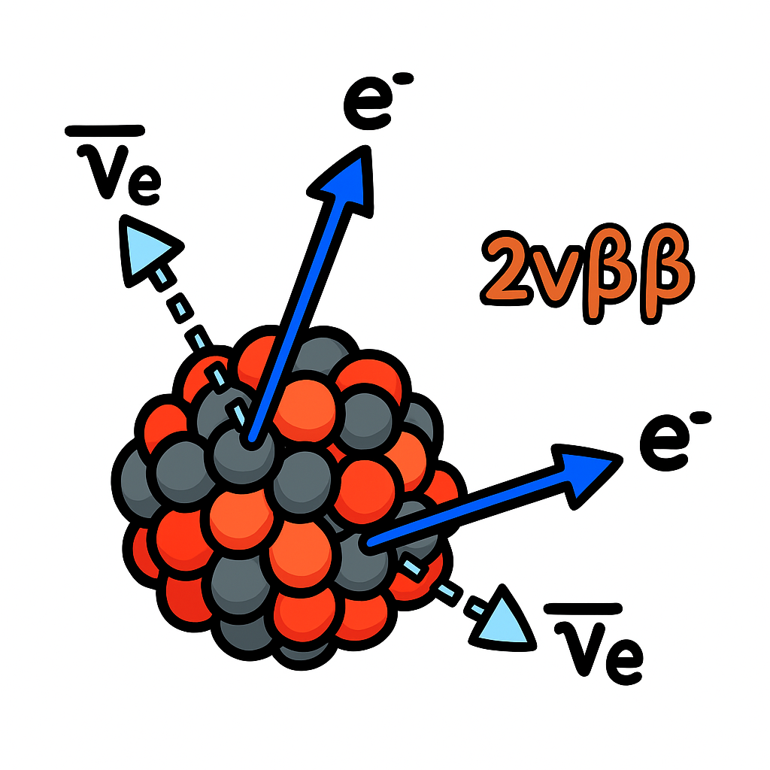
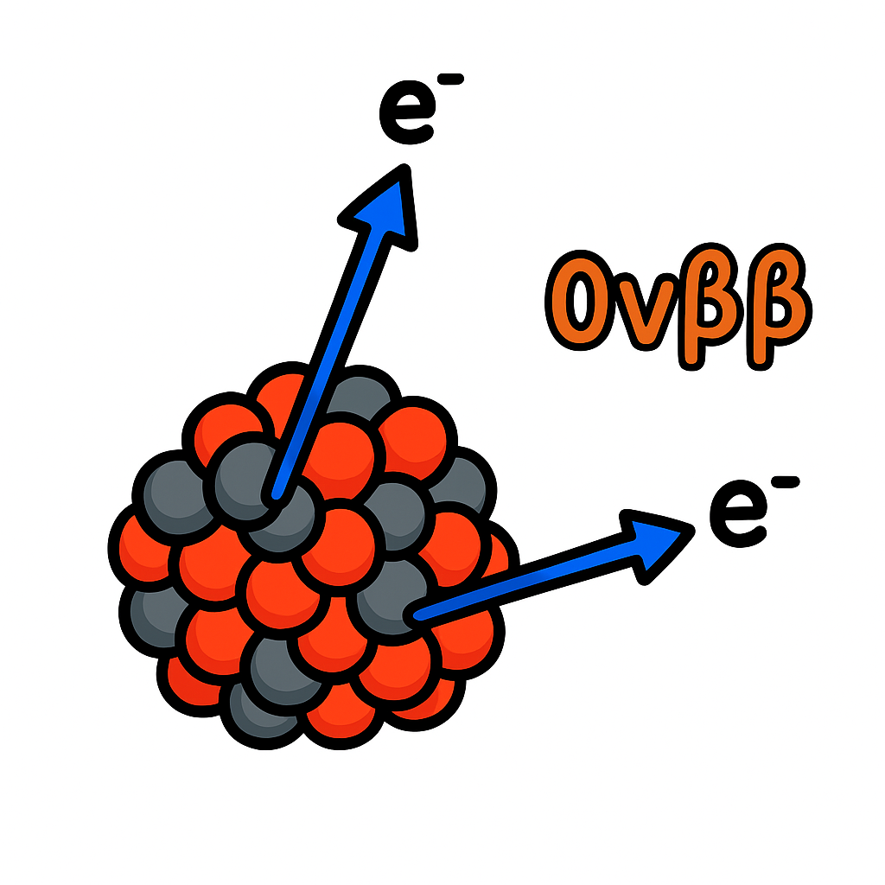
Presentation plan
Double beta decay
SuperNEMO Demonstrator
Background
New physics

Slide 3
Presentation plan
Double beta decay
SuperNEMO Demonstrator
Background
New physics

Slide 4
Double beta decay
1

Slide 5
Double beta decay
e⁻
ν_{e}
2νββ
e⁻
ν_{e}
1 s
10⁶ s
10¹² s
10¹⁰ y
10¹⁶ y
10²² y
10²⁸ y
BANG!
70 y
1

Slide 6
Double beta decay
e⁻
ν_{e}
2νββ
e⁻
ν_{e}
1 s
10⁶ s
10¹² s
10¹⁰ y
10¹⁶ y
10²² y
10²⁸ y
BANG!
70 y
1

Slide 7
Double beta decay
1 s
10⁶ s
10¹² s
10¹⁰ y
10¹⁶ y
10²² y
10²⁸ y
BANG!
70 y
1

Slide 8
Double beta decay
1 s
10⁶ s
10¹² s
10¹⁰ y
10¹⁶ y
10²² y
10²⁸ y
BANG!
70 y
1

Slide 9
Double beta decay
Why do we search for 0νββ?
Measurement of absolute neutrino mass
Lepton number violating process
Mass ordering
Might show a path beyond the SM
1 s
10⁶ s
10¹² s
10¹⁰ y
10¹⁶ y
10²² y
10²⁸ y
BANG!
70 y
1

Slide 10
Ingredients to bake a DBD experiment
?
?
?
?
2

Slide 11
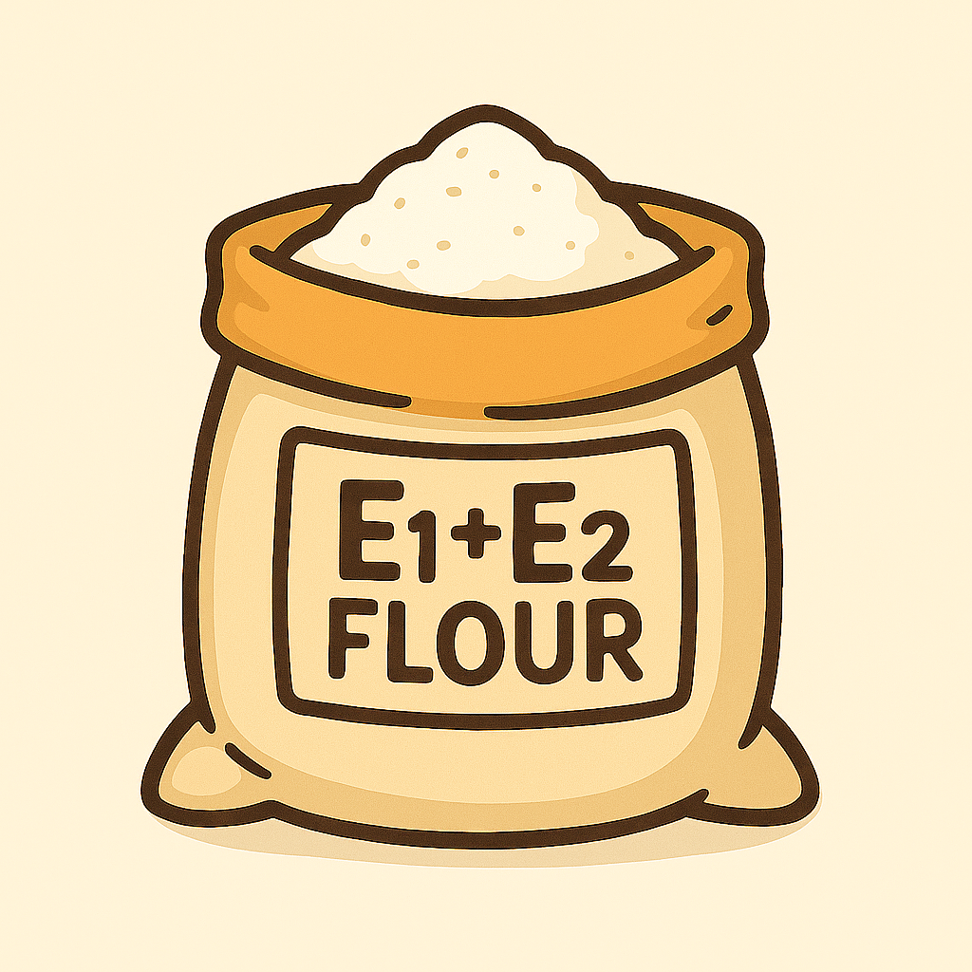
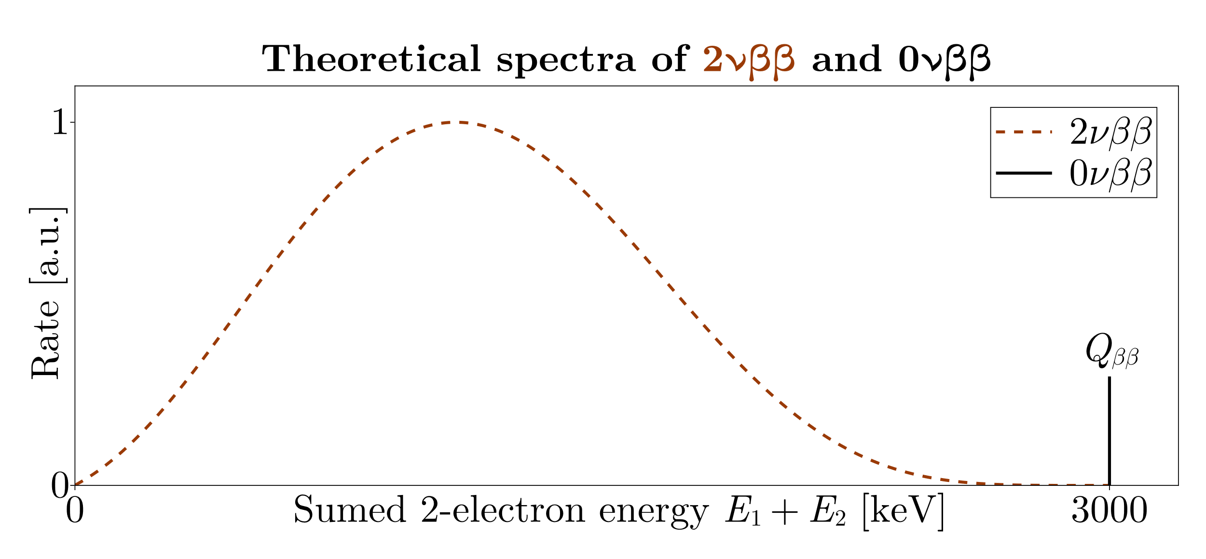
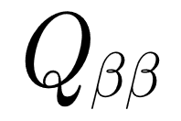
Ingredients to bake a DBD experiment
Energy measurement (flour)
?
?
?
Theoretical spectrum of $2νββ$ and $0νββ$
2

Slide 12
Ingredients to bake a DBD experiment
Energy measurement (flour)
?
?
?
Theoretical spectrum of $2νββ$ and $0νββ$
2

Slide 13
Ingredients to bake a DBD experiment
Energy measurement (flour)
?
?
?
Theoretical spectrum of $2νββ$ and $0νββ$
2

Slide 14
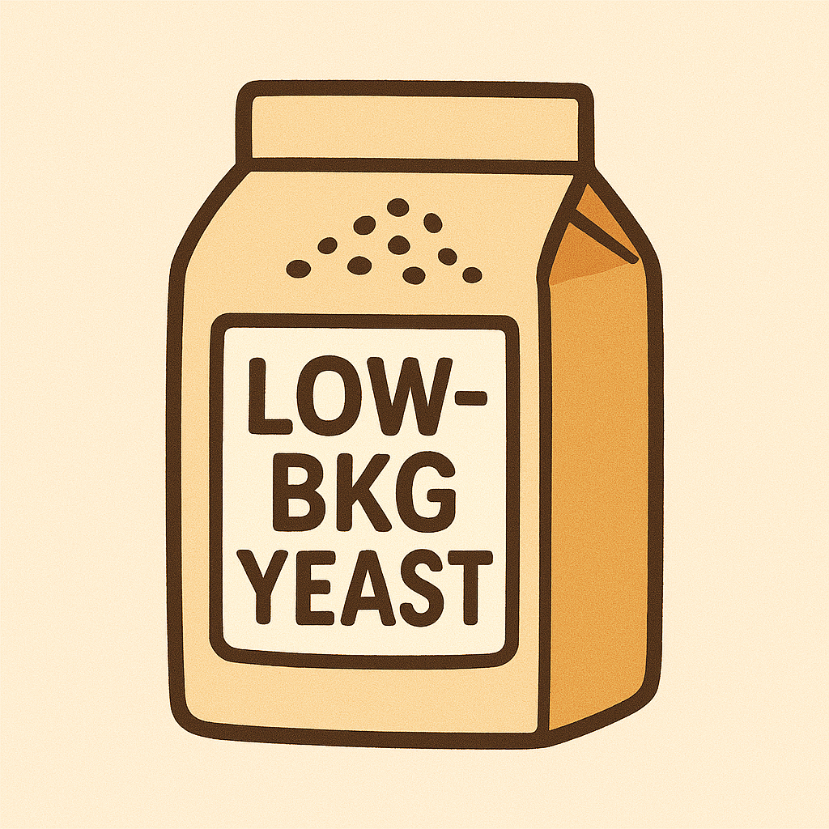
Ingredients to bake a DBD experiment
Energy measurement (flour)
Low background (yeast)
?
?
10⁻⁵ - 10⁻⁴ counts / keV.kg.yr in ROI
Theoretical spectrum of $2νββ$ and $0νββ$
2

Slide 15
Ingredients to bake a DBD experiment
Energy measurement (flour)
Low background (yeast)
Statistical methods (water)
?
10⁻⁵ - 10⁻⁴ counts / keV.kg.yr in ROI
Bayes / Frequentist $→$ T_{1/2} lower limit $→\left|m_{ββ}\right|$ upper limit
Theoretical spectrum of $2νββ$ and $0νββ$
2

Slide 16
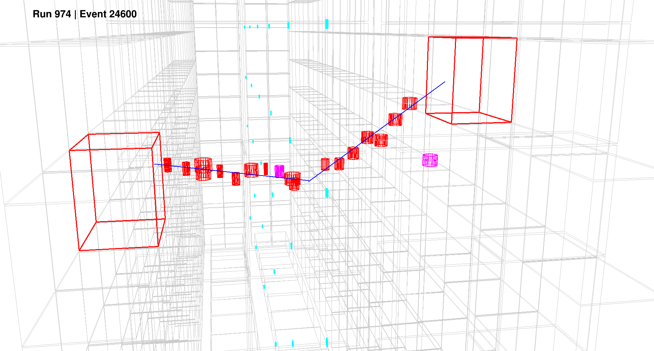
Ingredients to bake a DBD experiment
Energy measurement (flour)
Low background (yeast)
Statistical methods (water)
Track reconstruction (salt / spices)
10⁻⁵ - 10⁻⁴ counts / keV.kg.yr in ROI
Bayes / Frequentist $→$ T_{1/2} lower limit $→\left|m_{ββ}\right|$ upper limit
Theoretical spectrum of $2νββ$ and $0νββ$
2

Slide 17
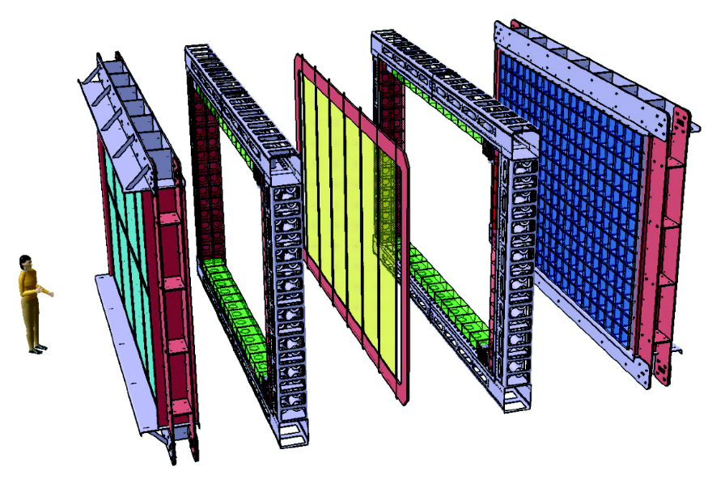
Presentation plan
Double beta decay
Tracker
Tracker
SuperNEMO Demonstrator
Background
New physics
Se foils
Calorimeter
Calorimeter

Slide 18
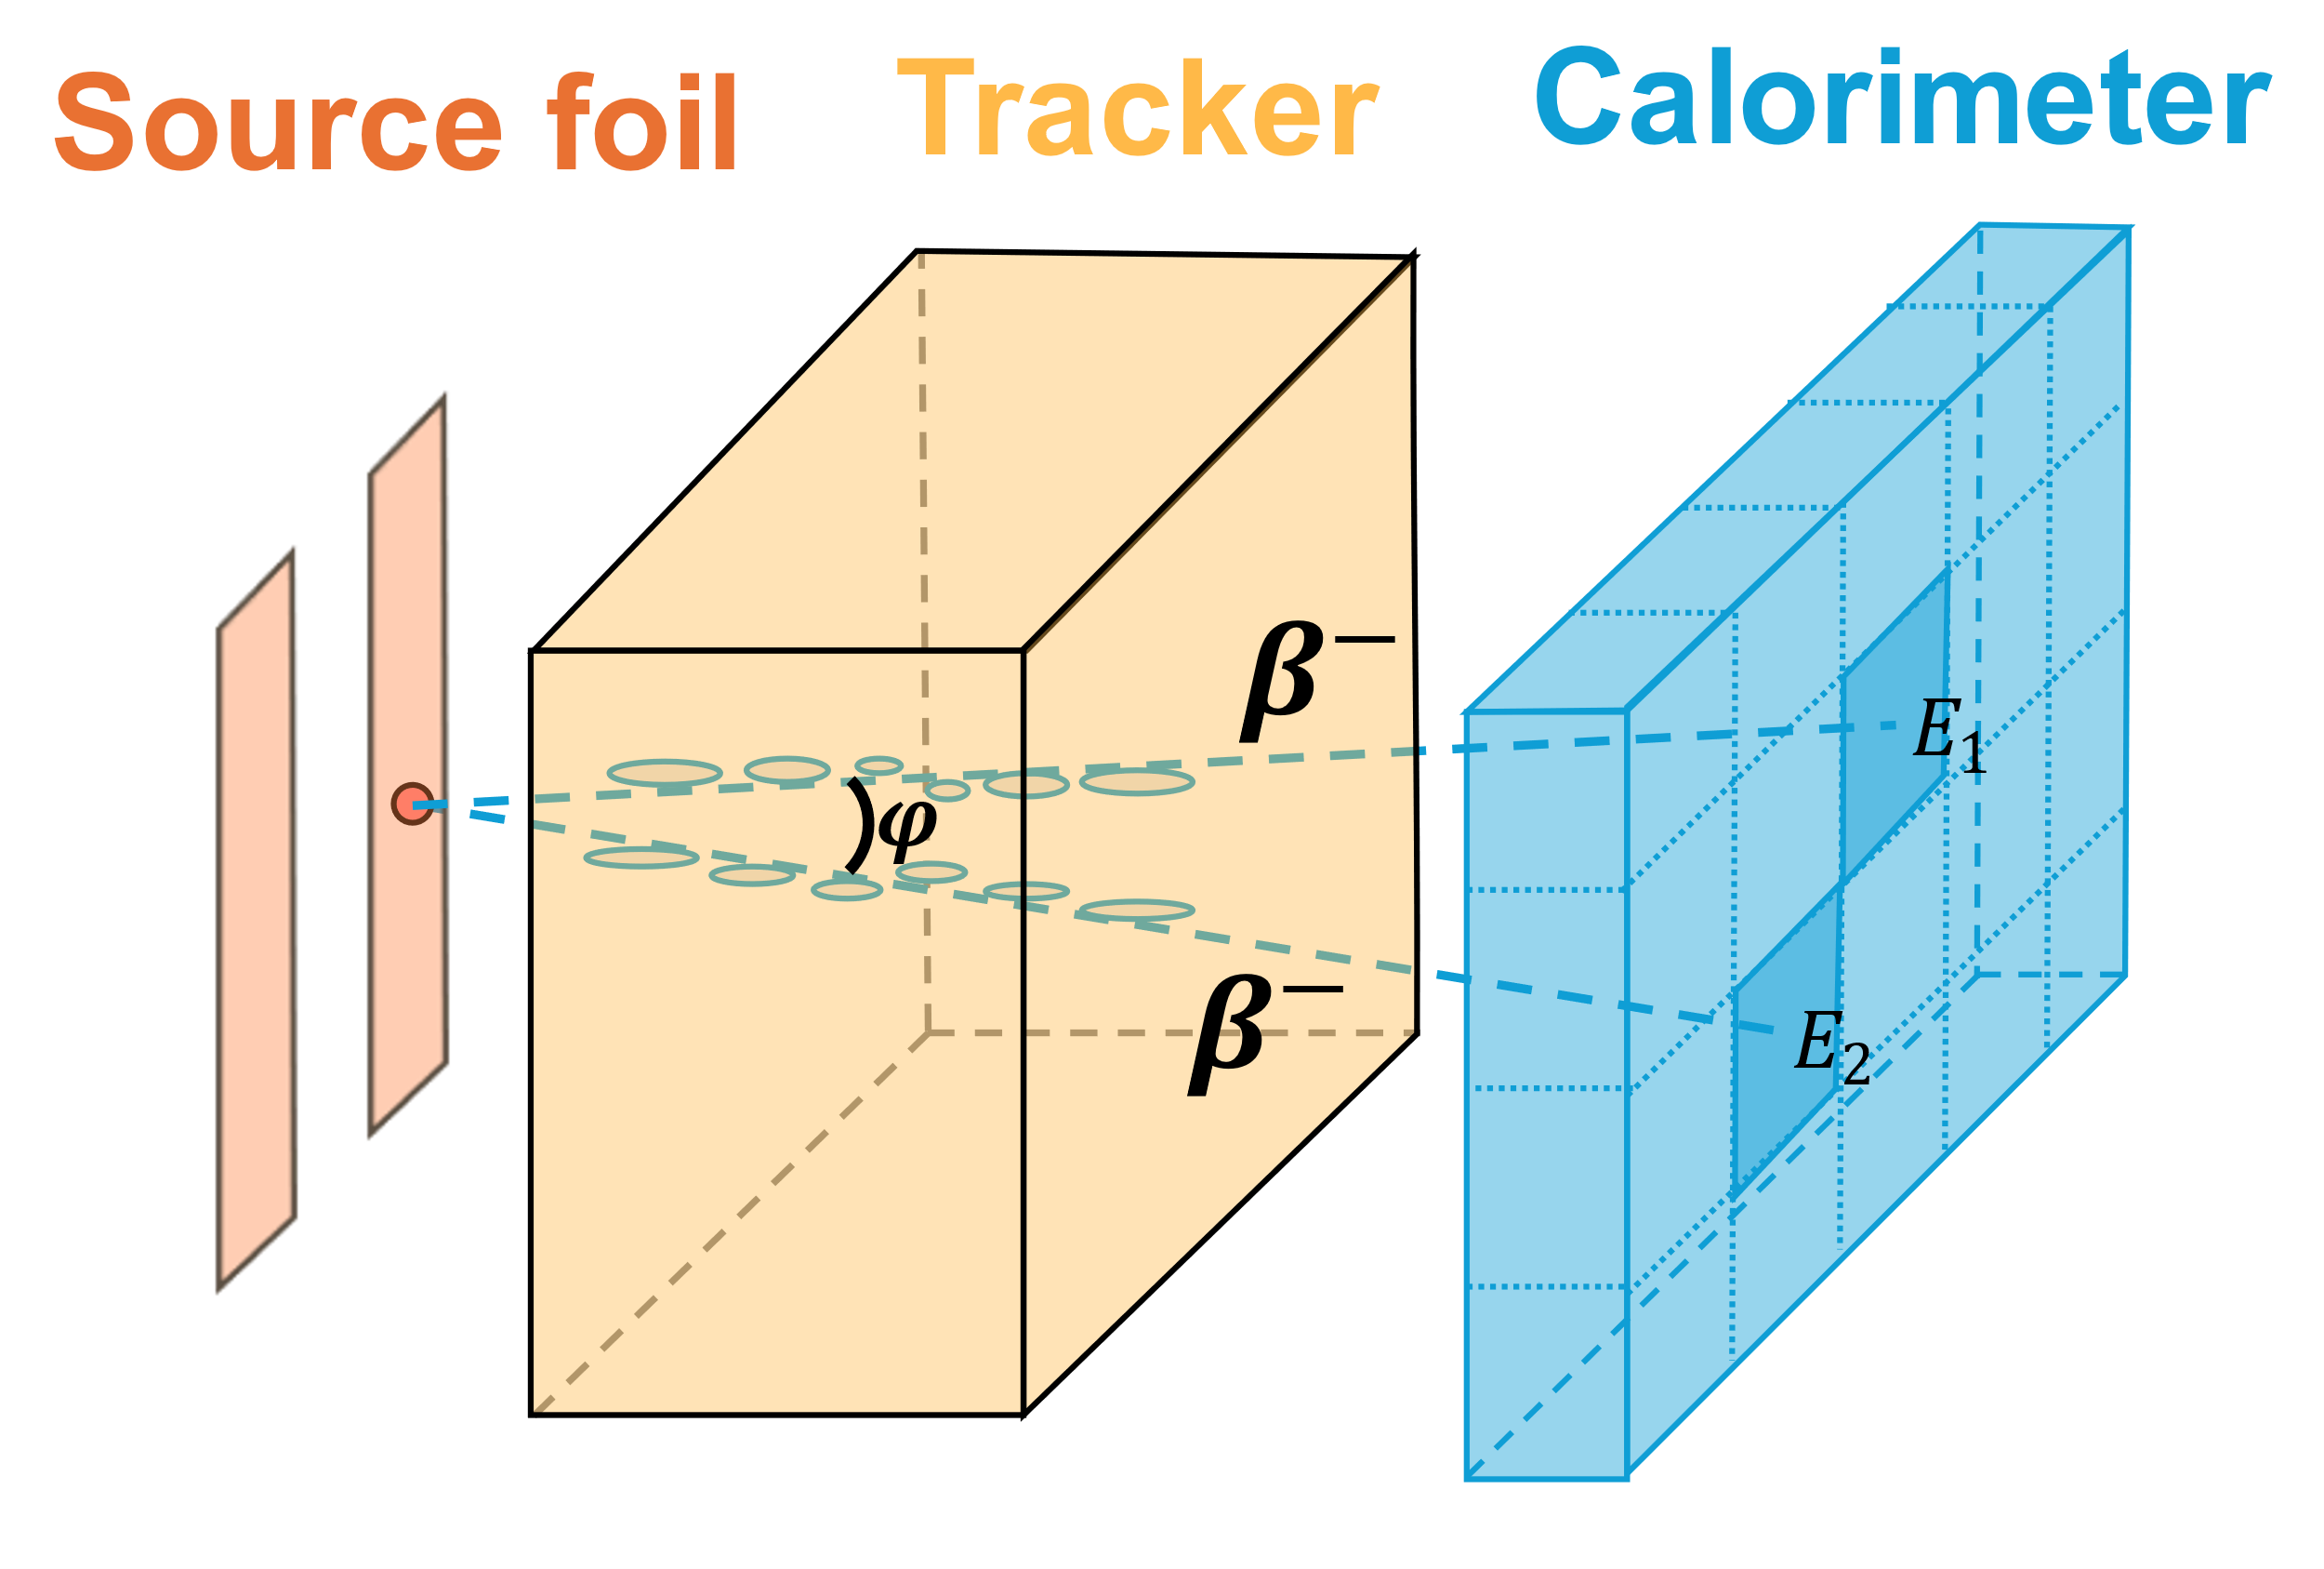
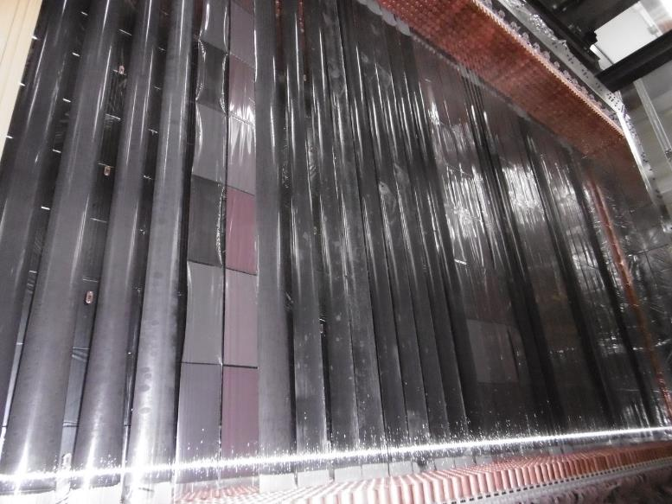
SuperNEMO Demonstrator – source foil
Free choice of isotope
34 strips of ${}_{}^{82}{Se}$
6.11kg mass, $\sim 50 mg/cm^{2}$
96-99.9% enrichment
Q $≈$ 3 MeV
If $0νββ$ discovered - measure isotope
3

Slide 19
SuperNEMO Demonstrator – source foil
Free choice of isotope
34 strips of ${}_{}^{82}{Se}$
6.11kg mass, $\sim 50 mg/cm^{2}$
96-99.9% enrichment
Q $≈$ 3 MeV
If $0νββ$ discovered - measure isotope
3

Slide 20
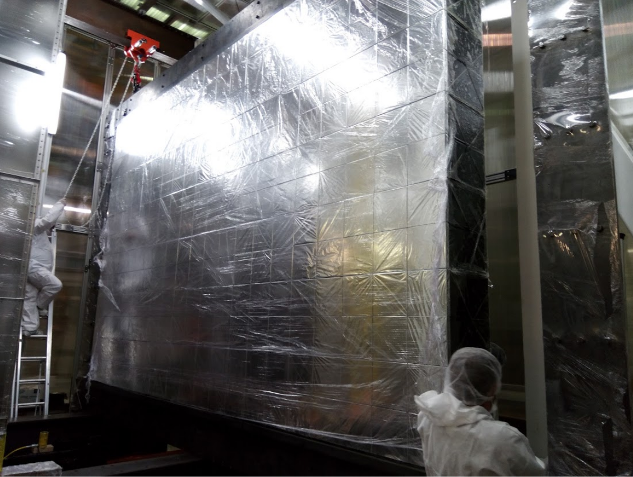
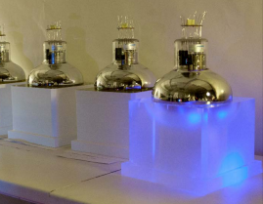
SuperNEMO Demonstrator - calorimeter
OM
712 Optical Modules (OM)
Target ~ 8% FWHM @ 1 MeV
8’’ + 5’’ PMTs
Time-resolution ~200 ps @ 1 MeV
Automatic calibration system
Status: working (97.4%)!
Calorimeter main wall ($6×4 m^{2}$)
Optical Module (OM): Polystyrene scintillator + PMT
4

Slide 21
SuperNEMO Demonstrator - calorimeter
OM
712 Optical Modules (OM)
Target ~ 8% FWHM @ 1 MeV
8’’ + 5’’ PMTs
Time-resolution ~200 ps @ 1 MeV
Automatic calibration system
Status: working (97.4%)!
Calorimeter main wall ($6×4 m^{2}$)
Optical Module (OM): Polystyrene scintillator + PMT
4

Slide 22
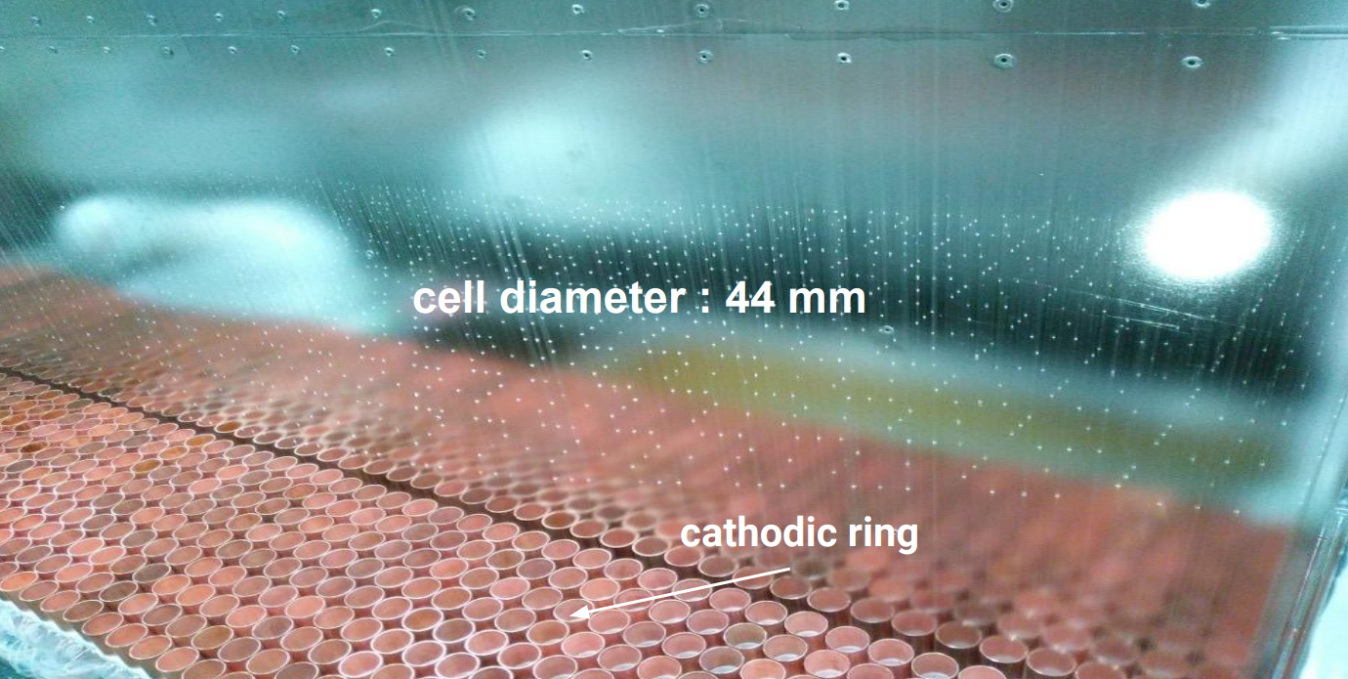
SuperNEMO Demonstrator - tracker
2034 drift cells (Geiger mode)
Allows particle identification
Full electron topology
Single-electron spectra
Angular distribution
Status: working (98.4%)!
5

Slide 23
SuperNEMO Demonstrator - tracker
2034 drift cells (Geiger mode)
Allows particle identification
Full electron topology
Single-electron spectra
Angular distribution
Status: working (98.4%)!
5

Slide 24
Why tracking?
More collected information = better cuts
6

Slide 25
Why tracking?
More collected information = better cuts
Events containing gammas
6

Slide 26
Why tracking?
More collected information = better cuts
Two electron tracks
Events containing gammas
6

Slide 27
Why tracking?
More collected information = better cuts
Two electron tracks
Events containing gammas
Vertex separation too large
6

Slide 28
Why tracking?
More collected information = better cuts
Two electron tracks
Events containing gammas
Vertex distance
Vertex separation too large
6

Slide 29
Why tracking?
More collected information = better cuts
Two electron tracks
Events containing gammas
External events
Vertex distance
Vertex separation too large
6

Slide 30
Why tracking?
More collected information = better cuts
Two electron tracks
Events containing gammas
External events
Vertex distance
TOF cut
Vertex separation too large
6

Slide 31
Why tracking?
More collected information = better cuts
Two electron tracks
Events containing gammas
External events
Vertex distance
TOF cut
And more!
Vertex separation too large
Golden event
6

Slide 32
Why tracking?
More collected information = better cuts
Two electron tracks
Events containing gammas
External events
Vertex distance
TOF cut
And more!
Vertex separation too large
Golden event
6

Slide 33
Tracking algorithm
SuperNEMO = very specific 3D tracking task
$$(x_{3},y_{3})$$
$$R_{3}$$
$$(x_{1},y_{1})$$
$$R_{1}$$
$$R_{2}$$
$$(x_{2},y_{2})$$
7

Slide 34
Tracking algorithm
SuperNEMO = very specific 3D tracking task
Combination of Legendre transform and MLM
$$(x_{3},y_{3})$$
$$R_{3}$$
$$(x_{1},y_{1})$$
$$R_{1}$$
$$R_{2}$$
$$(x_{2},y_{2})$$
7

Slide 35
Tracking algorithm
SuperNEMO = very specific 3D tracking task
Combination of Legendre transform and MLM
See poster #754 (Tomáš Křižák - today at 18:00)
$$(x_{3},y_{3})$$
$$R_{3}$$
$$(x_{1},y_{1})$$
$$R_{1}$$
$$R_{2}$$
$$(x_{2},y_{2})$$
Cimrman module!
7

Slide 36
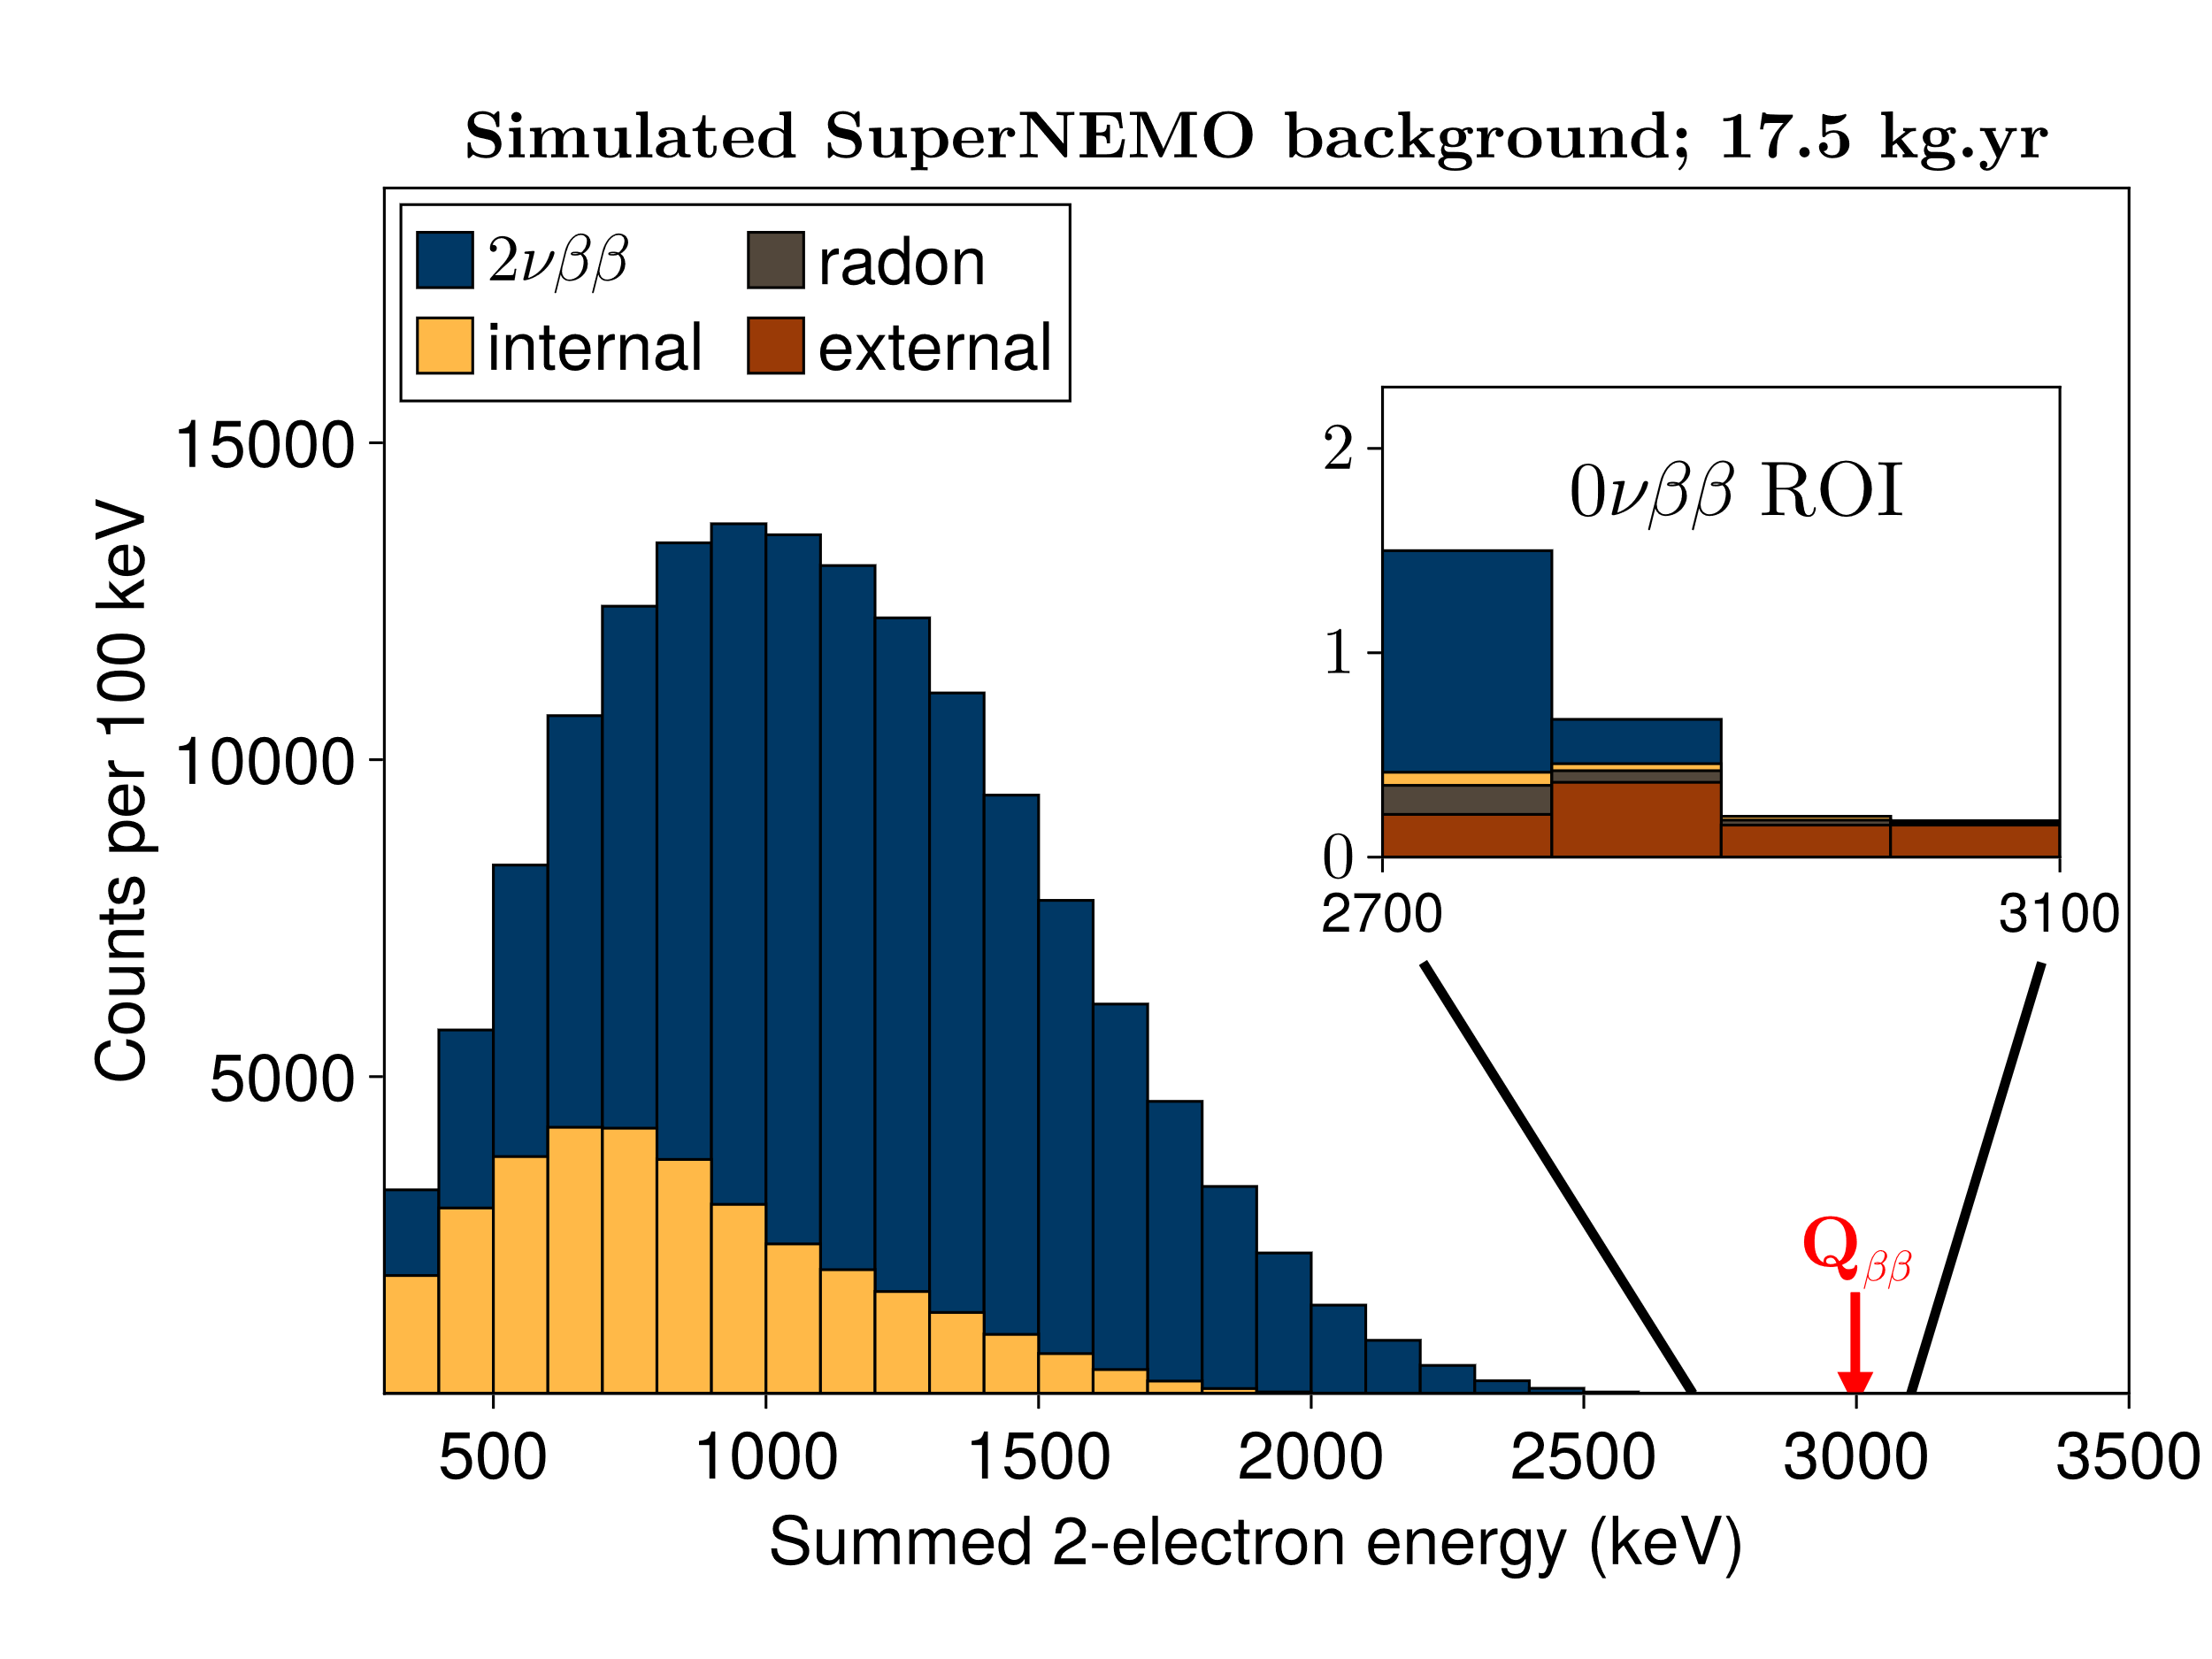
Presentation plan
Double beta decay
SuperNEMO Demonstrator
Background
New physics

Slide 37
Background sources
Internal background
$2νββ$
Foil contamination
8

Slide 38
Background sources
Internal background
$2νββ$
Foil contamination
External background
Detector contamination
Ambient (neutrons and gamma)
Radon gas
8

Slide 39
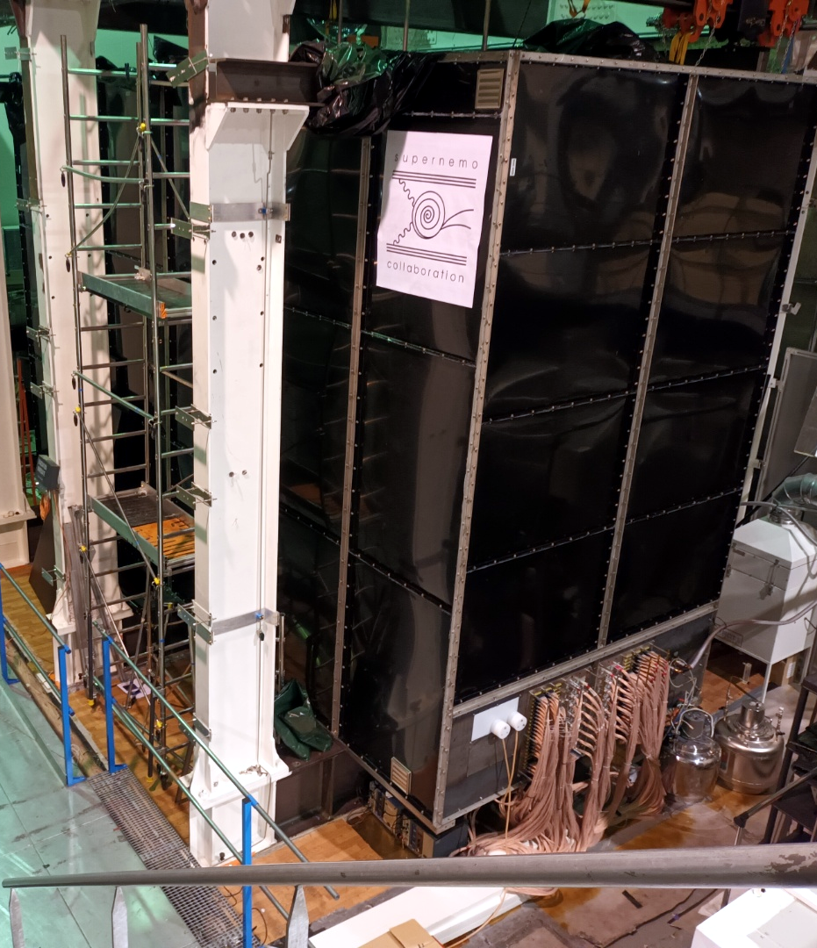
SuperNEMO - shielding
Anti-radon tent
aim$\sim 0.25 events$
in ROI @ $17.5 kg⋅yr$
9

Slide 40
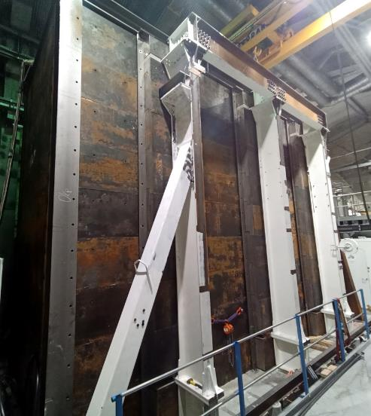
SuperNEMO - shielding
Anti-radon tent
Iron gamma shield
aim$\sim 0.25 events$
in ROI @ $17.5 kg⋅yr$
aim$\sim 0.07 events$
in ROI @ $17.5 kg⋅yr$
9

Slide 41
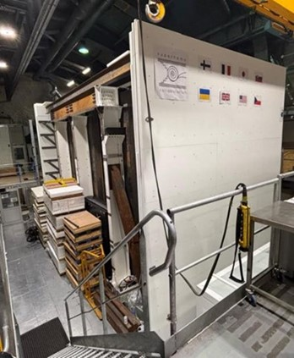
SuperNEMO - shielding
Anti-radon tent
Iron gamma shield
PE neutron shield
aim$\sim 0.25 events$
in ROI @ $17.5 kg⋅yr$
aim$\sim 0.07 events$
in ROI @ $17.5 kg⋅yr$
aim$\sim 0.65 events$
in ROI @ $17.5 kg⋅yr$
9

Slide 42
Background model
supernemo
preliminary
Expected 100k – 200k $2νββ$ events
Wide ROI for 0𝜈𝛽𝛽 (2700 - 3100) keV
Largest bkg.: $2νββ$ and neutrons
Bkg. Index $\sim$2 $×$10⁻⁴ cts / (keV$⋅$yr $⋅$kg)
10

Slide 43
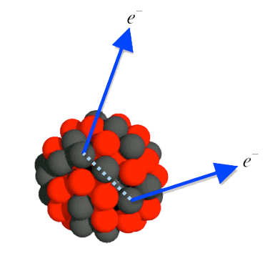
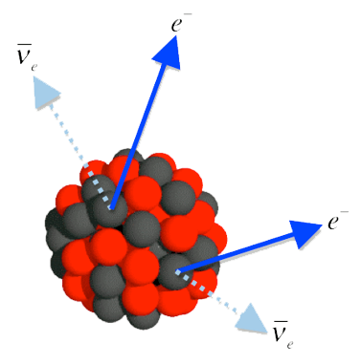
Presentation plan
Double beta decay
0νββχ⁰(χ⁰)
ν_{R}ν_{L}ββ
SuperNEMO Demonstrator
e⁻
e⁻
ν_{e} (LH)
Χ⁰ (2χ⁰)
Background
e⁻
e⁻
New physics
ν_{e} (RH)

Slide 44
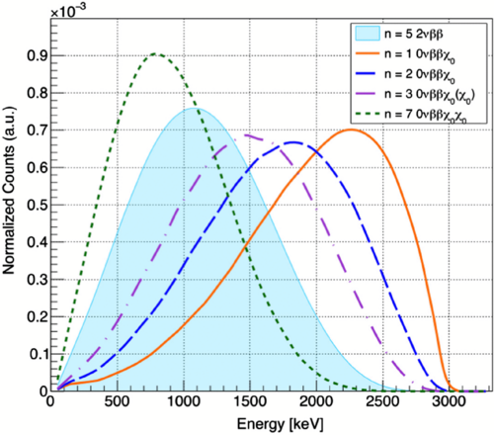
Modes beyond 0νββ
e⁻
Χ⁰ (2χ⁰)
0νββχ⁰(χ⁰)
e⁻
11

Slide 45
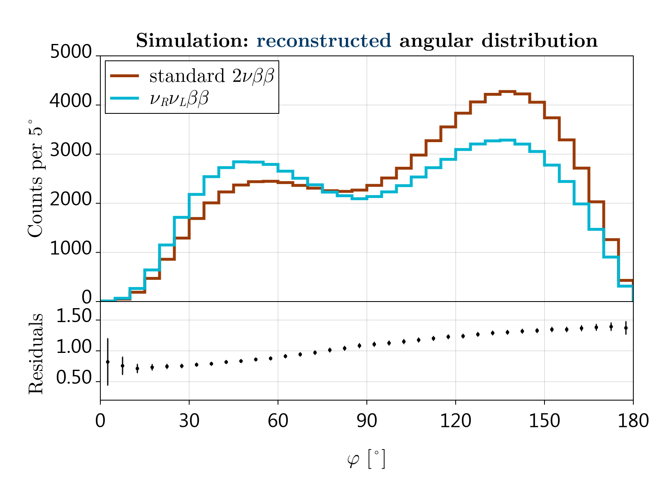
Modes beyond 0νββ
e⁻
e⁻
Χ⁰ (2χ⁰)
ν_{e} (LH)
ν_{R}ν_{L}ββ
0νββχ⁰(χ⁰)
e⁻
e⁻
ν_{e} (RH)
11

Slide 46
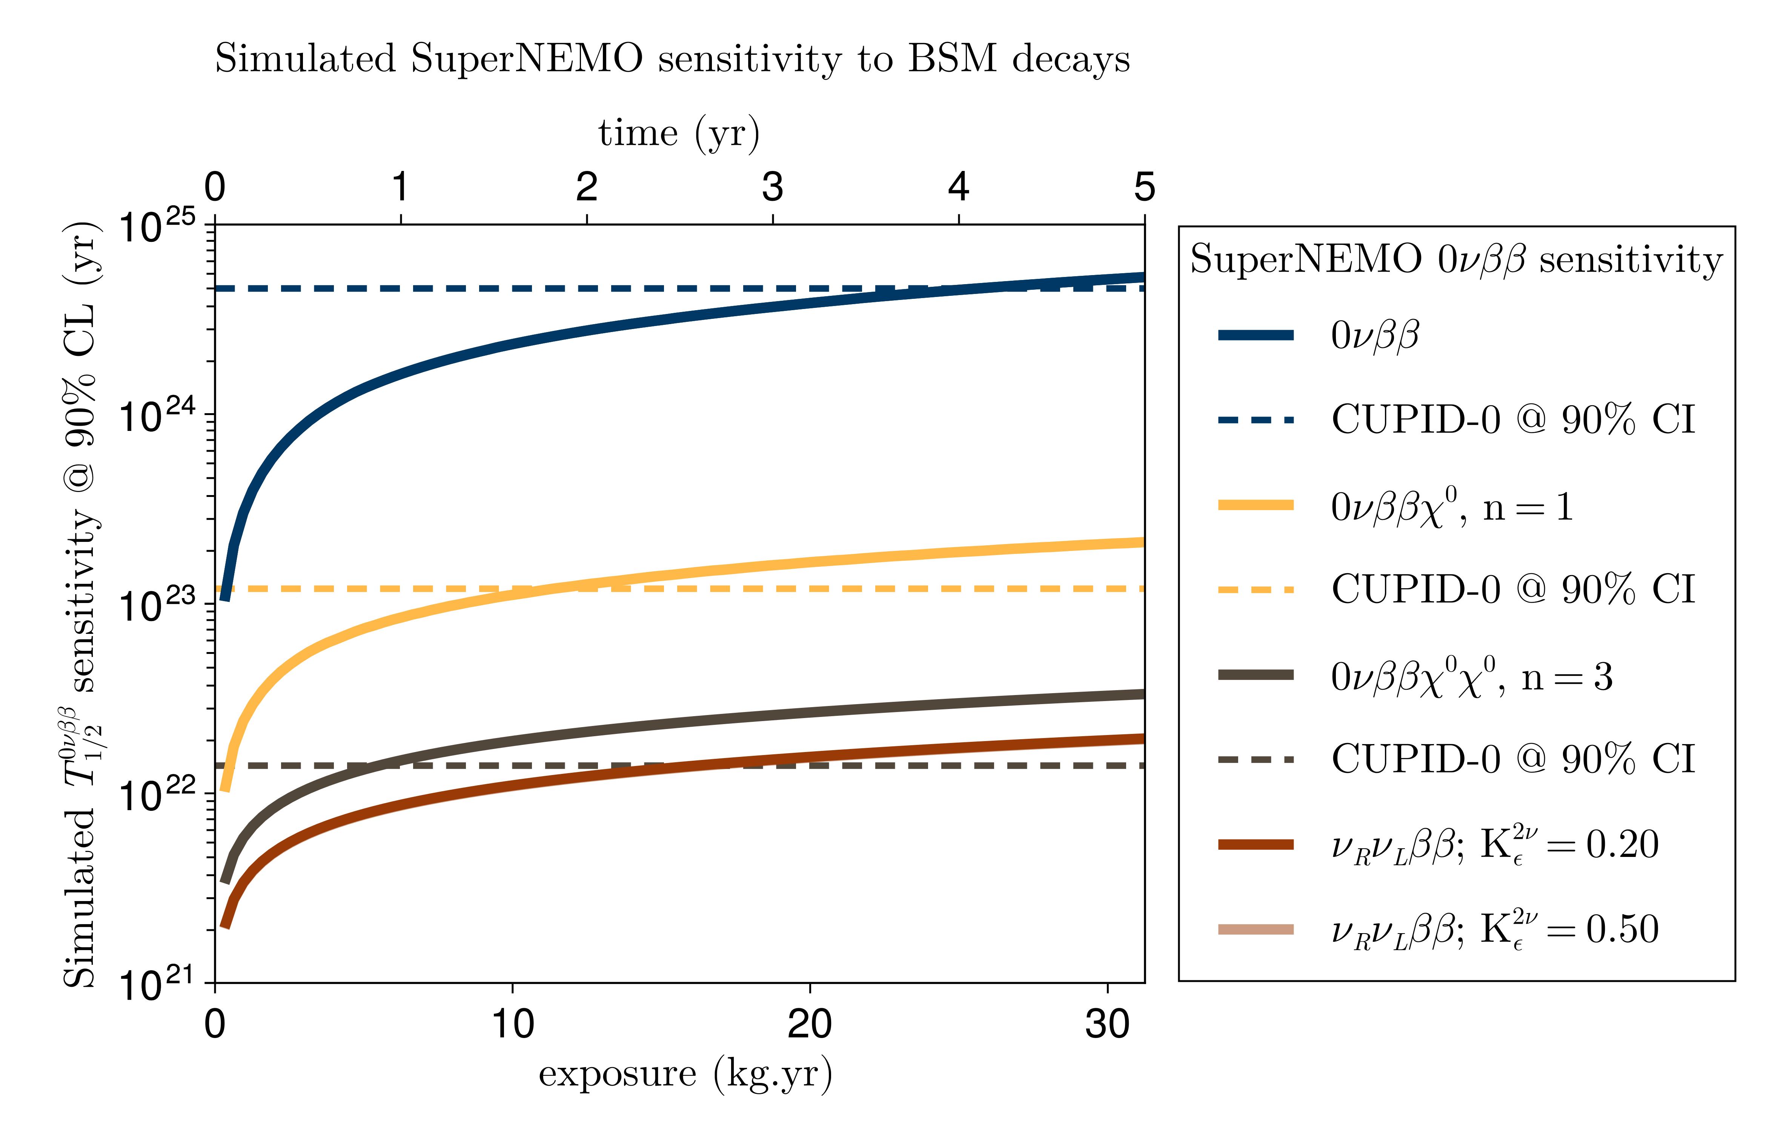
With enough time world best $0νββ$
Can achieve best for majoron (1-2 yr)
World first $ν_{R}ν_{L}ββ$
$2νββ$ to excited states, g_{A}, …
supernemo
preliminary
12

Slide 47
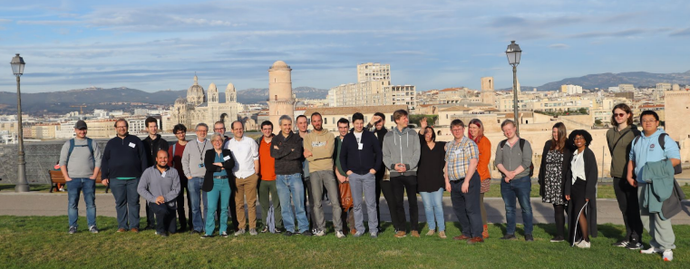
Conclusions
SuperNEMO
The tracking opens very unique possibilities
Detector running in $ββ$-mode!
Background data being assessed
We collected so far ~1 $kg⋅yr$of data
Background
Simulation expected ${<2×10}^{−4}$ $cts/(keV⋅yr⋅kg)$
Sensitivity
Estimated $0νββ$ sensitivity $≥4.6×10^{24}$ yr (Bayes, 90%)
Possible world´s best/first limits for 0νββχ⁰(χ⁰) and ν_{R}ν_{L}ββ
Collaboration meeting in Marseille, February 2024
This work was supported by the Czech Science Foundation (GAČR), project No. 24-10180S.
13

Slide 48
Conclusions
SuperNEMO
The tracking opens very unique possibilities
Detector running in $ββ$-mode!
Background data being assessed
We collected so far ~1 $kg⋅yr$of data
Background
Simulation expected ${<2×10}^{−4}$ $cts/(keV⋅yr⋅kg)$
Sensitivity
Estimated $0νββ$ sensitivity $≥4.6×10^{24}$ yr (Bayes, 90%)
Possible world´s best/first limits for 0νββχ⁰(χ⁰) and ν_{R}ν_{L}ββ
Collaboration meeting in Marseille, February 2024
Thank you for your attention!
This work was supported by the Czech Science Foundation (GAČR), project No. 24-10180S.
13

Slide 49
Backup slide
13

Slide 50
6

