Slide 1


K. Long, on behalf of the collaboration; 10 July, 2025
nu

Slide 2
Acknowedgements
I’m grateful to the nuSTORM collaboration† and, in particular, to:
for all the contributions to this talk!
† arXiv:2505.06137

Slide 3
Neutrinos from stored muons
Scientific objectives:
  %-level ( ν_{e}N ) cross sections
    Multi differential / E_{ν} scan
  BSM searches
    E.g. steriles beyond FNAL SBN
  Muon collider demonstrator
Precise neutrino flux:
  Normalisation: < 1%
  Energy (and flavour) precise
π ⇢ μ injection pass:
  “Flash” of muon neutrinos
(—)

Slide 4
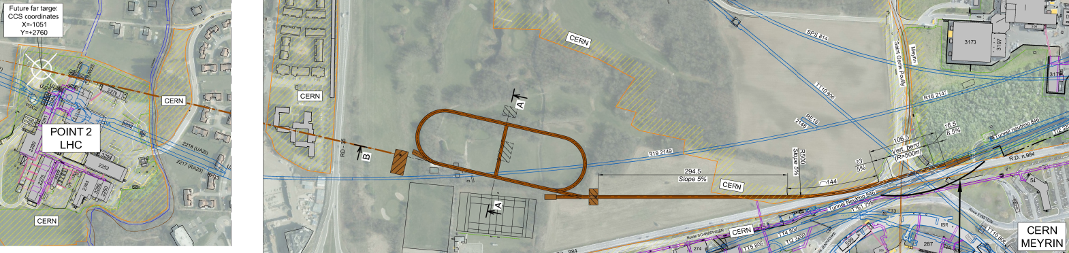
Feasbility of nuSTORM at CERN
CERN-PBC-REPORT-2019-003
DOI:10.17181/CERN.FQTB.O8QN
Extraction from SPS through existing tunnel
Siting of storage ring:
  Allows measurements to be made on/off axis
Far detector location (2 km) available
  highly sensitive sterile neutrino searches
  BSM and anomalies (via ν_{e} →ν_{μ})

Slide 5
nuSTORM specification: energy range
Guidance from:
  Models:
    Region of overlap
    0.5—8 GeV
  DUNE/Hyper-K far detector
  spectra:
    0.3—6 GeV
Cross sections depend on:
  Q² and W:
    Assume (or specify) a detector
    capable of measuring exclusive final states
    → E_{μ} < 6 GeV
So, stored muon energy range:
DUNE
Hyper-K
1 < E_{μ} < 6 GeV

Slide 6
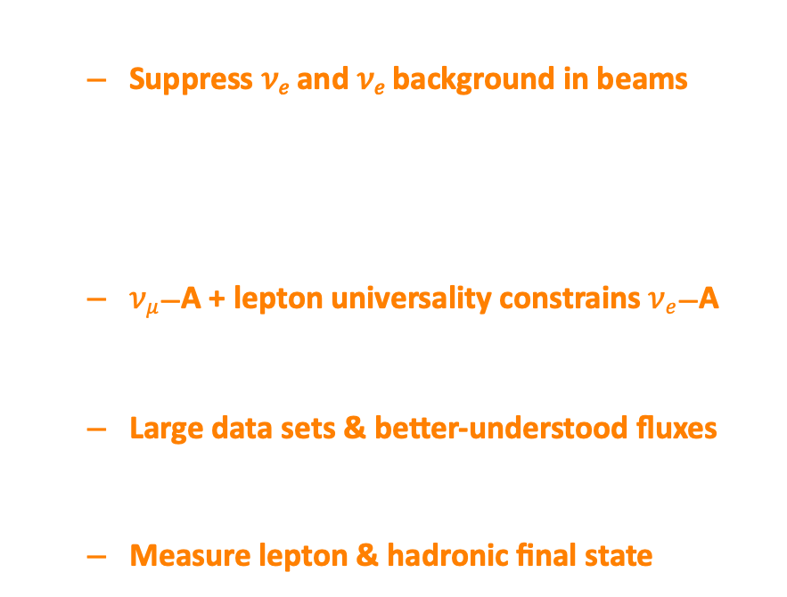
𝝂_{𝒆}/𝝂̅_{𝒆} interactions for oscillations
𝛿_{CP} requires 𝜈_{𝑒} and 𝜈_{𝑒} appearance
  Suppress 𝜈_{𝑒} and 𝜈_{𝑒} background in beams
Need $νe$/$\overline{ν}e$ interaction data
At 1st order precision:
  $νμ$—A + lepton universality constrains $νe$—A
𝛿_{CP} requires requires 2nd order precision!
  Large data sets & better-understood fluxes
High-specification detector:
  Measure lepton & hadronic final state

Slide 7
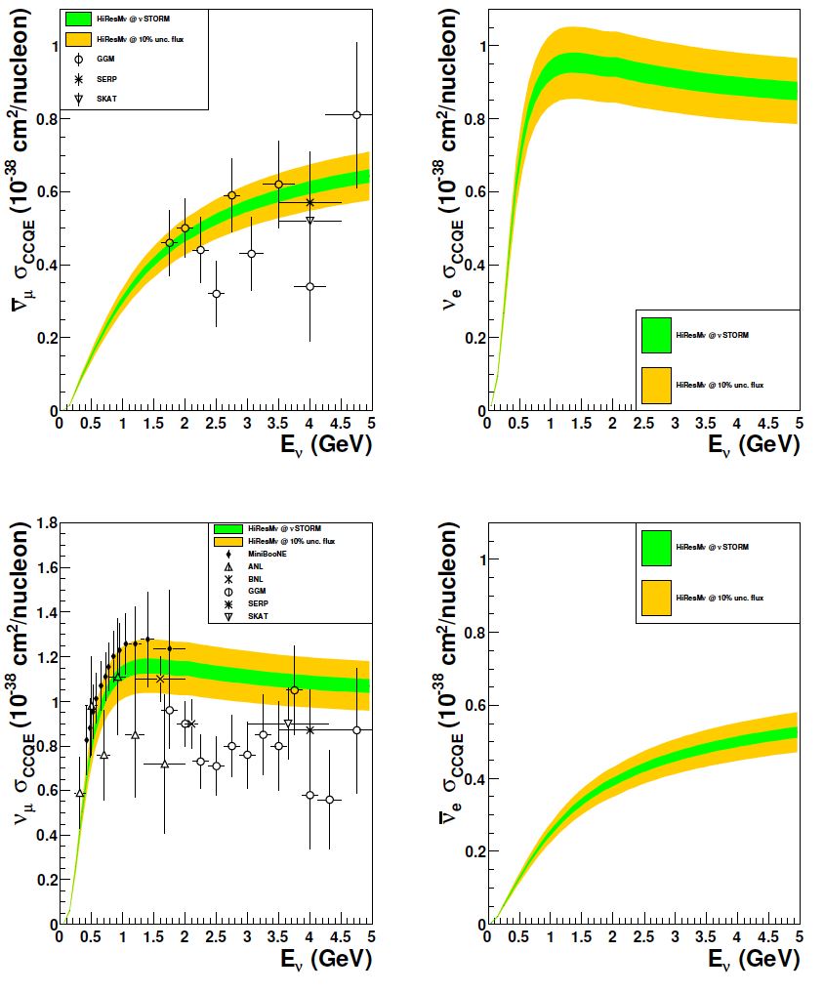
Cross sections & nuSTORM past
10.1103/PhysRevD.89.071301; arXiv:1305.1419
Detector:
O(10)-ton fiducial mass detector;
50 m from end of production straight;
10²¹ POT
1% (green) and 10% (yellow) flux uncertainty + detector systematics
Comment:
Very sparse existing data (mainly from MINERvA and T2K)

Slide 8
nuSTORM recent progress
Optimisation of accelerator facility
Horn geometry and target design simulation [FLUKA] aimed at improving the production and capture yield of low-energy pions (pπ ≤ 2 GeV/c)
Full simulation of transfer line, injection and production straight via Beam Delivery Software Simulation [BDSim] GEANT4 based
Potential of producing synthetic quasi-monoenergetic neutrino flux
New phenomenological studies to extend physics programme
Transverse Kinematic Imbalance to study nuclear effects in nA interactions
Neutrino trident production
Oscillation disappearance searches
Large Extra Dimensions
Lepton Flavour Violation

Slide 9
Neutrino fluxes at nuSTORM
NEW
State-of-the art flux at front face of 5 x 5 m² detector at 50 m from end of production straight

Slide 10
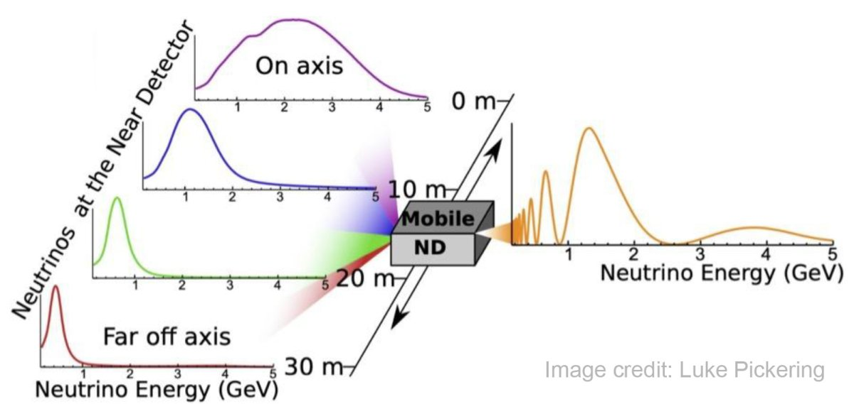
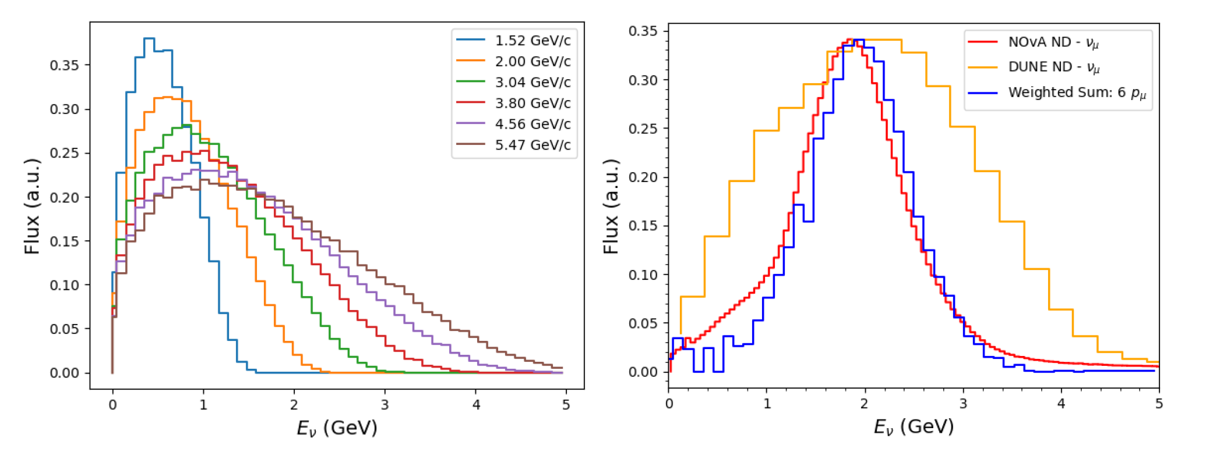
Synthetic flux at nuSTORM
NEW
PRISM concept
Combine multiple samples to synthetise flux
Hyper-K/DUNE:
  Different near detector locations off-axis
nuSTORM synthetic flux
Combine fluxes from muon beams of different momentum
Can produce synthetic ν_{e} beams!

Slide 11
Nuclear dynamics
Quasi-elastic
cross section
function of δα_{T}
Transverse boosting angle
Lu et al. Phys. Rev. C 94, 015503 (2016)
Low δα_{T}: impact of nuclear effects low:
  “Nuclear model calibration”
High δα_{T}: energy-dependent nuclear effects:
  Constrain nuclear models of, e.g. 2p2h, pion absorption, …

Slide 12
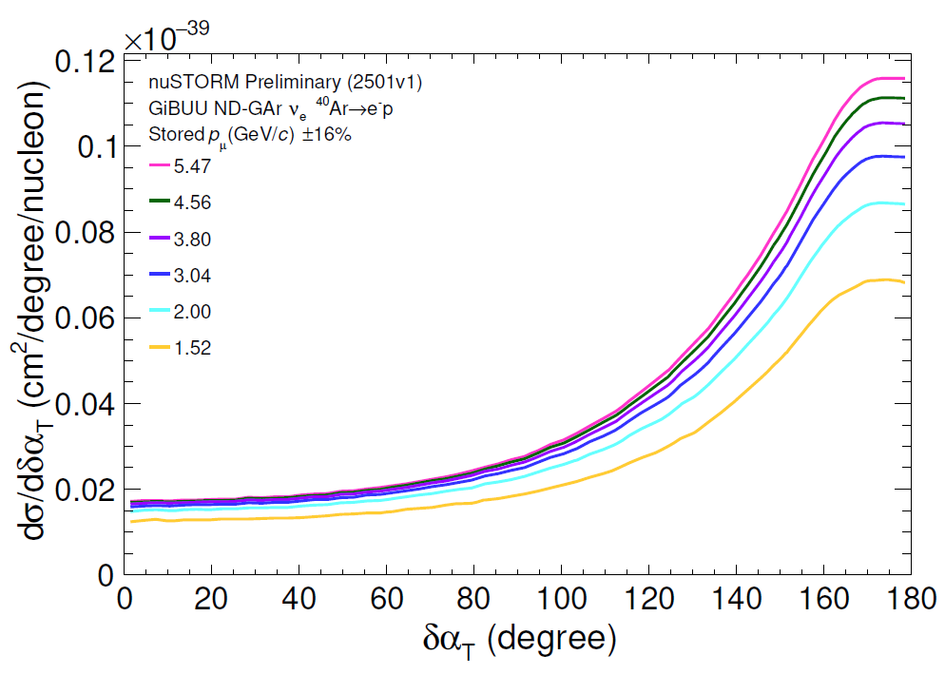
Nuclear dynamics
NEW
Quasi-elastic
Differential
cross section
vs δα_{T}
Insights on nuclear effects with minimal dependence on neutrino energy
Measured at T2K, MINERvA, MicroBooNE
[Phys.Rev.C 94, 015503,2016]

Slide 13

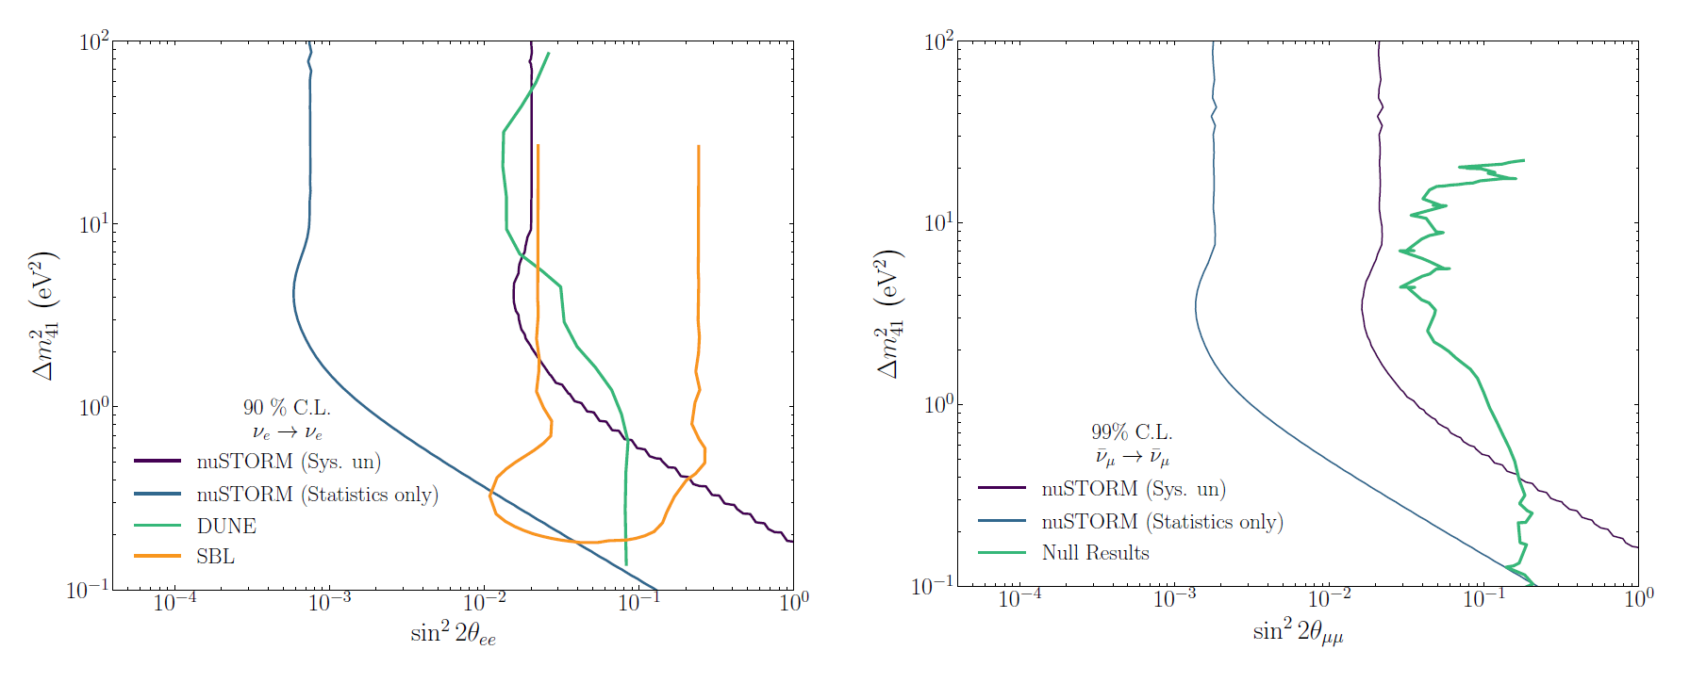
BSM: light sterile neutirnos
NEW
3+1 sterile neutrino survival probability:
[short-baseline approximation]
Sensitivity to disappearance:
  100t detector @ 50 m from end of production straight
  10²¹ POT
SBL is evidence from reactor anomaly
Combined null result from MINOS, CDHS Super-Kamiokande and MiniBooNE
arXiv: 2505.06137

Slide 14
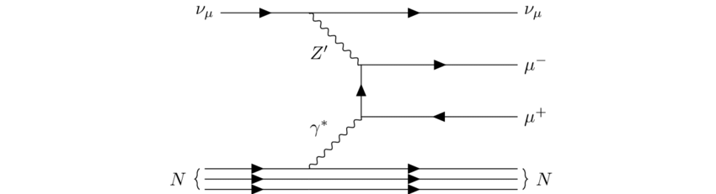
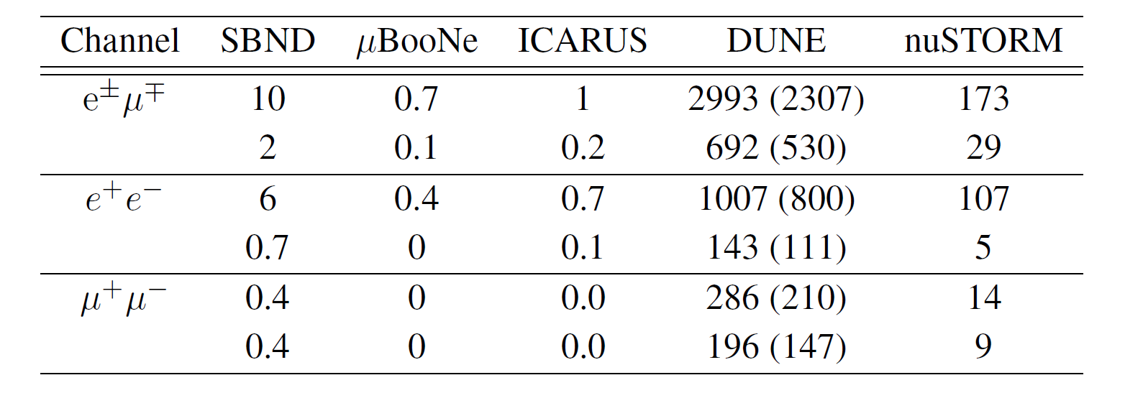
Rare SM processes: tridents
NEW
ν_{α} A → ν_{α} + l⁻ l⁺ A
arXiv: 2505.06137
Dominant source of ν_{µ} at nuSTORM is pion decay
  Flux approximately 100x that from muon decay
Dominated by coherent interactions
Sensitive to physics BSM: e.g., Z’
Projected SM trident yields could exceed those of all existing facilities
  Not competitive with DUNE
BSM

Slide 15
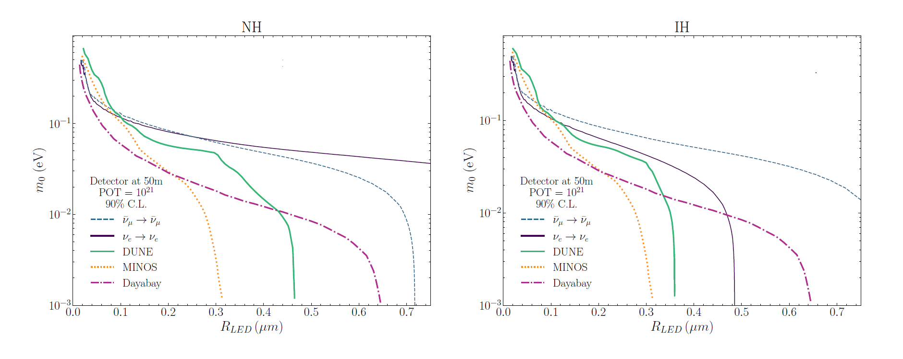
BSM: Large Extra-Dimensions
NEW
arXiv: 2505.06137
Large Extra Dimensions (LED) can explain the lightness of neutrino masses
  Dirac neutrinos are confined on a “brain” (our 3+1D Universe)
  Sterile neutrinos propagate through higher-dimensional “bulk” and mix with active neutrinos
Sensitivity to 𝜇m LED length scales
Competitive limits on LED length scale for lightest neutrino mass > 0.1 eV

Slide 16
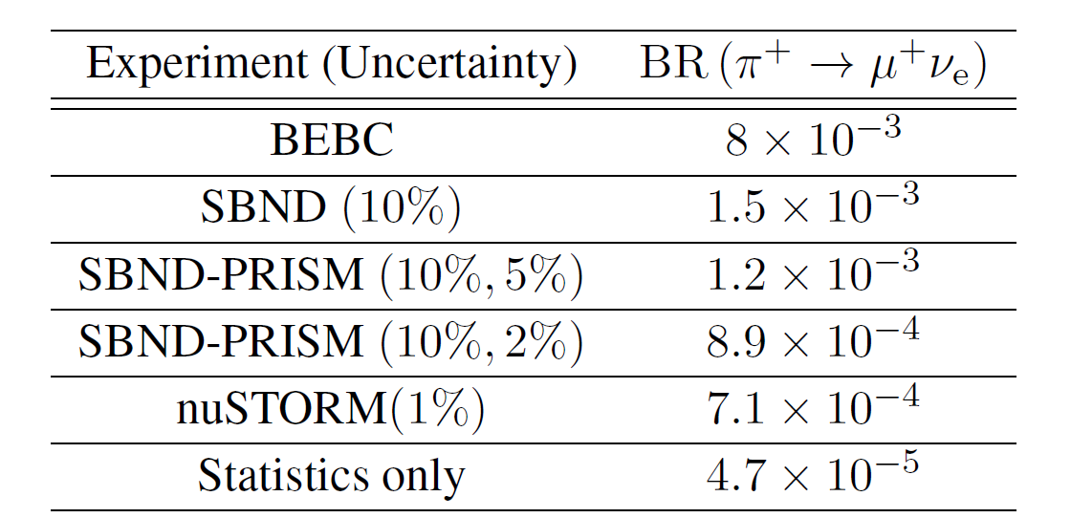
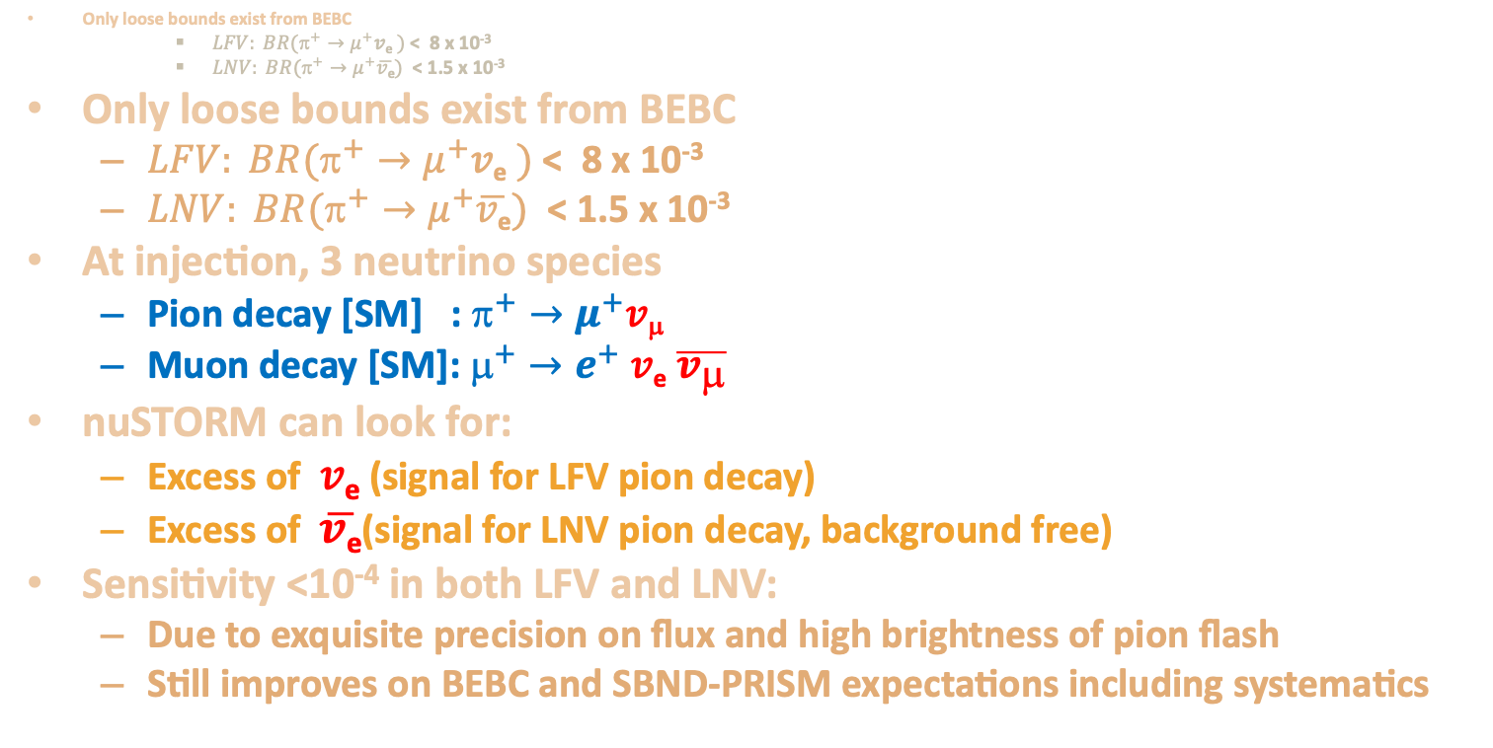
BSM: LFV and LNV in pion decays
NEW
Only loose bounds exist from BEBC
    $LFV: BR(^{+}→μ^{+}$𝑣_{e} $)$ < 8 x 10⁻³
    $LNV: BR(π^{+}→μ^{+}\overline{v\text{e}})$ < 1.5 x 10⁻³
Only loose bounds exist from BEBC
  $LFV: BR(^{+}→μ^{+}$𝑣_{e} $)$ < 8 x 10⁻³
  $LNV: BR(π^{+}→μ^{+}\overline{v\text{e}})$ < 1.5 x 10⁻³
At injection, 3 neutrino species
  Pion decay [SM] : $^{+}→μ^{+}$𝑣_{μ}
  Muon decay [SM]: $^{+}→e^{+}$ 𝑣_{e} $\overline{v_{μ}}$
nuSTORM can look for:
  Excess of 𝑣_{e} (signal for LFV pion decay)
  Excess of $\overline{v\text{e}}$(signal for LNV pion decay, background free)
Sensitivity <10⁻⁴ in both LFV and LNV:
  Due to exquisite precision on flux and high brightness of pion flash
  Still improves on BEBC and SBND-PRISM expectations including systematics
LFV sensitivity at 90% CL

Slide 17
Conclusions
nuSTORM will be a unique facility:
  %-level electron and muon neutrino cross-sections
    Neutrino energy scan; spectrum at each point precisely known
  Exquisitely sensitive BSM & sterile neutrino searches
  Serve as muon accelerator test bed
Recent developments:
  Optimisation of the beamline;
  Development of simulation;
  Synthetic beam
Feasibility of executing nuSTORM at CERN:
  Established through Physics Beyond Colliders study
nuSTORM: a step towards the muon collider:
  Proof-of-principle of high brightness stored muons beams

Slide 19
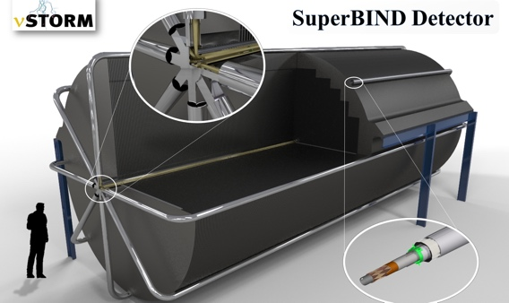
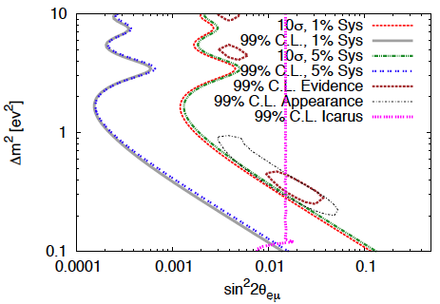
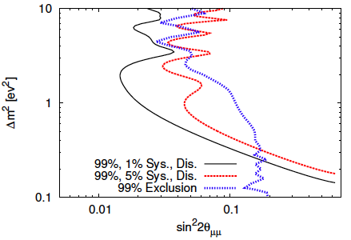
Sterile neutrino; sensitivity
Adey et al., PRD 89 (2014) 071301

Slide 20
nuSTORM: towards the Muon Collider
Fixed Field Alternating gradient
(FFA) lattice to improve
acceptance of muons
FODO lattice,
to minimise dispersion
R&D platform for technologies important for the realisation of a Muon Collider (MC)
Complete implementation for large acceptance storage-ring (inc. injection and extraction sections);
develop and test FFA magnet technology
Ideal testbed for developing and validate beam-monitoring instrumentation for MC

Slide 21
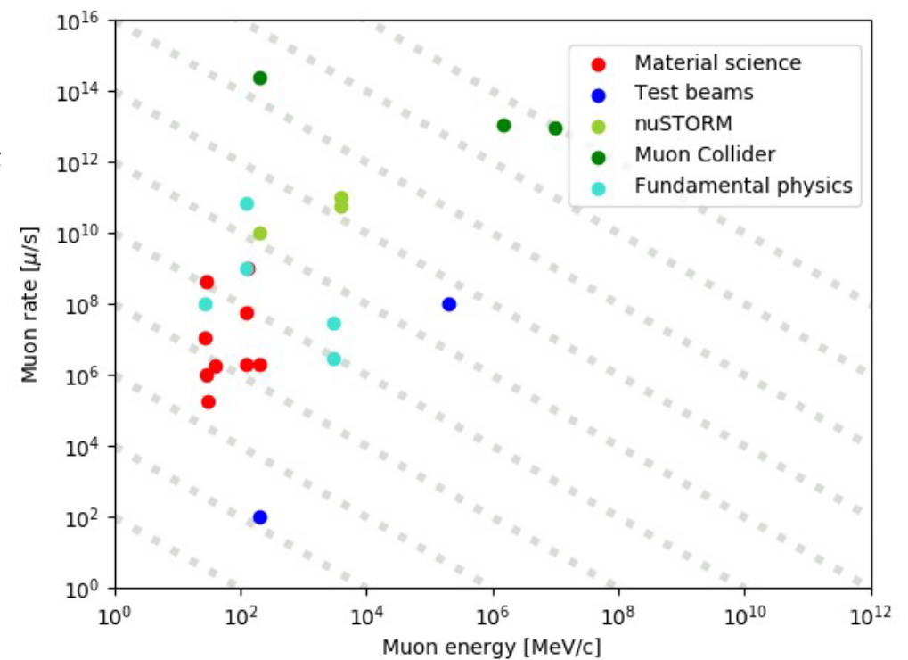
nuSTORM: towards the Muon Collider
arXiv:2303.08533
Would be:
highest power stored muon beam
before Muon Collider or Neutrino Factory
FODO lattice,
to minimise dispersion

