Slide 1








PALAIS DU PHARO​, MARSEILLE
07 – 11 JULY, 2025
Cosmic rays results with the High Energy Particle Detector 01 (HEPD-01) on board the China Seismo-Electromagnetic Satellite
Beatrice paniCO
INFN Naples
University “FeDERico II”, Naples

Slide 2


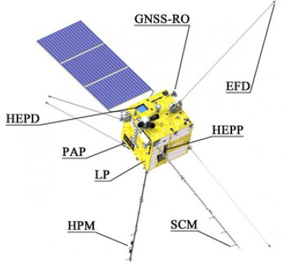
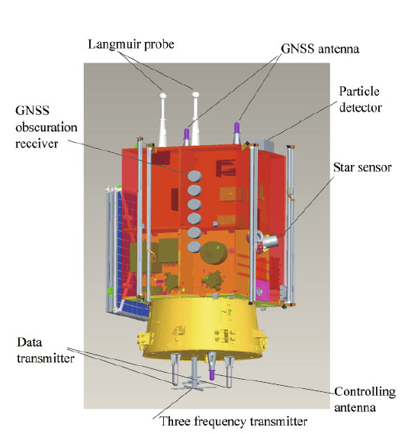
HEP 2025
The CSES-LIMADOU mission
Collaboration China National Space Administration (CNSA) - Italian Space Agency (ASI)
Developed by:
  China Earthquake Administration (CEA)
  Italian National Institute for Nuclear Physics (INFN)
  National Institute for Astrophysics - Institute for Space Astrophysics and Planetology (INAF-IAPS)
  Italian National Institute of Geophysics e Volcanology (INGV)
  Chinese and Italian Universities
Space mission with several instruments on board for different goals:
a Search-Coil Magnetometer, a High-Precision Magnetometer and Electric Field Detector for measuring the magnetic and electric fields
a Plasma Analyser Package and a Langmuir Probe for measurements of local plasma disturbances
a GNSS Occultation Receiver and a three frequency (VHF/UHF) Transmitter for the study of profile disturbances of plasma
the High-Energy Particle Package and High-Energy Particle Detector for the measurement of the flux and spectrum of energetic particles
Limadou refers to the Italian contribution to the mission
Realization of High-Energy Particle Detector (HEPD-01)
Partecipation in the realization of the Electric Field Detector (EFD)
98° inclination Sunsynchronous circular orbit
Altitude ~500 km
Launched 2018/02/02
B. Panico 07/07/2025

Slide 3
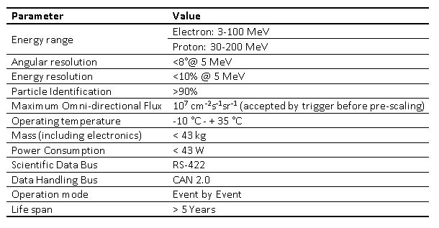
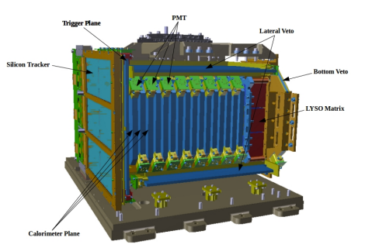
HEP 2025
The HEPD-01
The High-Energy Particle Detector (HEPD-01) is entirely designed and integrated by the Italian members of the CSES – LIMADOU mission
It works as an excellent Cosmic Rays and Space Weather detector flying on a LEO orbit
It covers the highest energy region of sensitivity of CSES-01 and - concerning cosmic rays – it lowers the energy threshold of PAMELA and AMS-02 and provides unique opportunities for sub-GeV cosmic-ray physics
Tracker: Particle trajectory
  made of two planes of double-side silicon micro-strip sensors; each tracker plane includes 3 ladders made of 2 modules
Trigger system: starts acquisition
  made of one layer of plastic scintillator, divided into 6 segments; different trigger combinations can be used
Calorimeter (2 parts): energy deposit
  Tower: The first part is made with 16 plastic scintillator planes, 1cm thick
  LYSO: The bottom part of the calorimeter consists of a layer with 9 crystals, to enlarge the energy threshold
Veto system: rejects secondaries
  Made of five plastic scintillator counters, 5 mm thick
Electronics sub-system
B. Panico 07/07/2025

Slide 4
HEP 2025
A lot of results
Re-entrant proton/lepton populations, solar injections from strong solar events, the re-arrangements of particles in geomagnetic storms can affect what happens al low-mid latitudes, although the galactic environment affect higher latitudes.
Study of GCRs gives an estimation of the standard situation that is expected in the near-Earth environment regarding external phenomena, helping isolating sudden transients originating within the Earth.
Also strong gamma-rays from powerful GRBs can affect directly the ionosphere
Determination of the energy spectra of galactic cosmic rays
Solar modulation of light nuclei
Solar physics: SEPs and Forbush decrease
GRBs
Other issues
B. Panico 07/07/2025

Slide 5
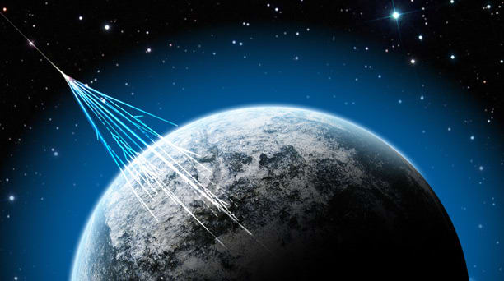
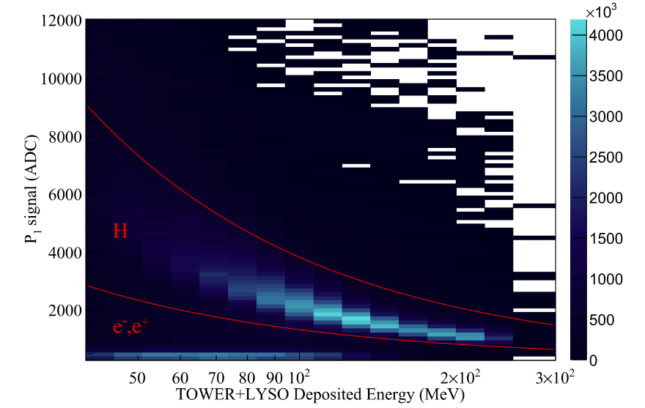
HEP 2025
Galactic Cosmic Rays
Galactic Cosmic-Ray Hydrogen Spectra in the 40–250 MeV Range Measured by the High-energy Particle Detector (HEPD) on board the CSES-01 Satellite between 2018 and 2020
The Astrophysical Journal, 901:8 (7pp), 2020 10.3847/1538-4357/abad3e
Many properties of the CR transport and CR interactions with the magnetosphere can be inferred from GC protons. They can also easily be compared between different solar cycles.
Orbital parameter to discriminate particles coming from outside the magnetosphere and the under-cutoff re-entrant albedo populations we made use of the AACGM (Altitude-Adjusted Corrected GeoMagnetic) coordinates to calculate the McIlwain parameter L
  L-shell parameter > 7
Trigger selection
  particles hit T & P1 & P2 (trigger and first two planes of the plastic scintillator tower)
Full containment inside the calorimeter in order to achieve a precise energy reconstruction
Plain continuity
Proton selection
  PID based on dE/dx vs Edep
Hydrogen and electron/positron signals on plane P1 as a function of the total energy deposited inside the calorimeter (TOWER+LYSO). To better visualize the separation in the plot, only vertical particles (θ < 15°) have been selected. The red curves identify the selection used in this analysis to discriminate between hydrogen nuclei and the rest.
B. Panico 07/07/2025

Slide 6
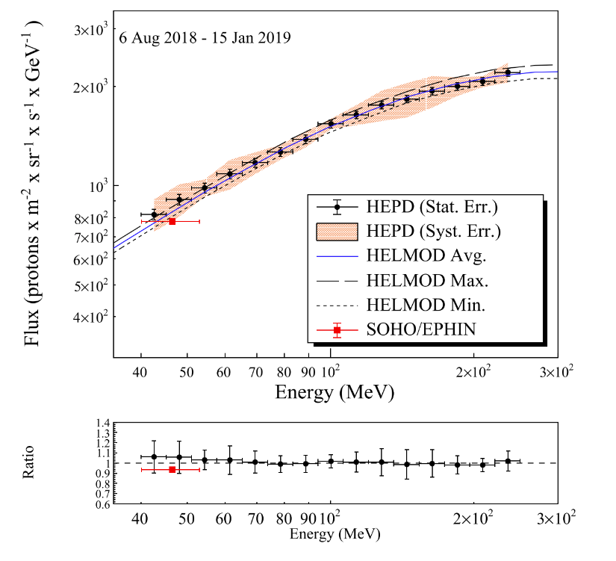
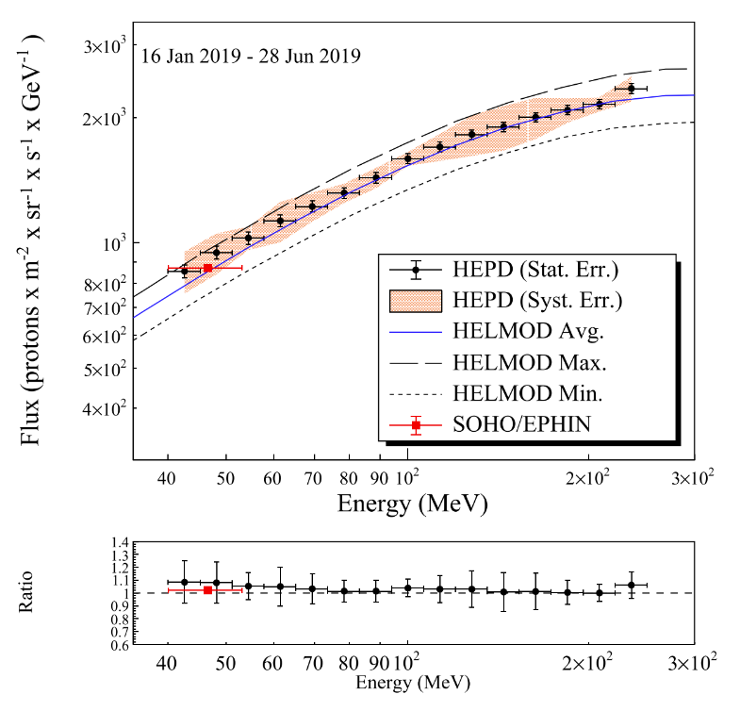
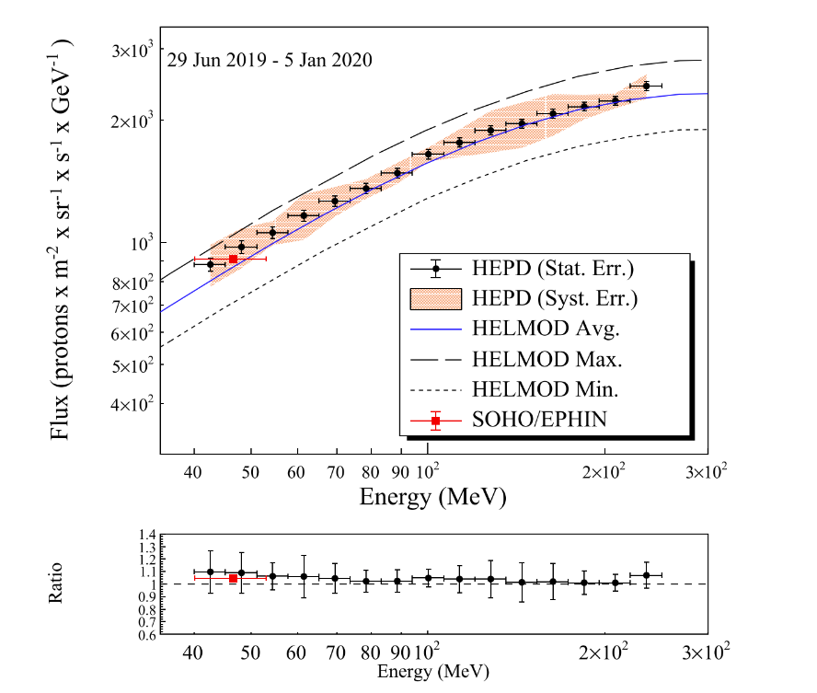
HEP 2025
Galactic Cosmic Rays
Galactic Cosmic-Ray Hydrogen Spectra in the 40–250 MeV Range Measured by the High-energy Particle Detector (HEPD) on board the CSES-01 Satellite between 2018 and 2020
The Astrophysical Journal, 901:8 (7pp), 2020 10.3847/1538-4357/abad3e
B. Panico 07/07/2025

Slide 7
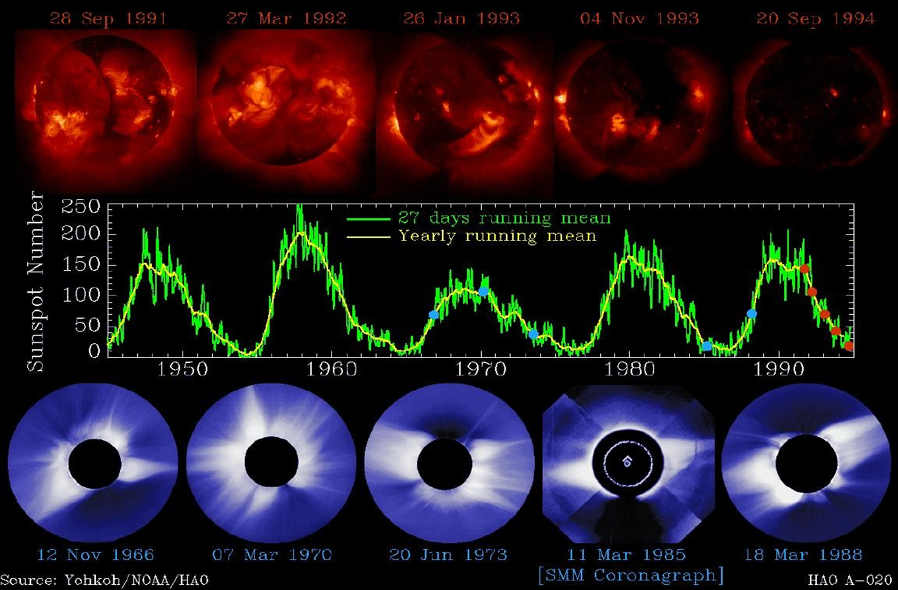
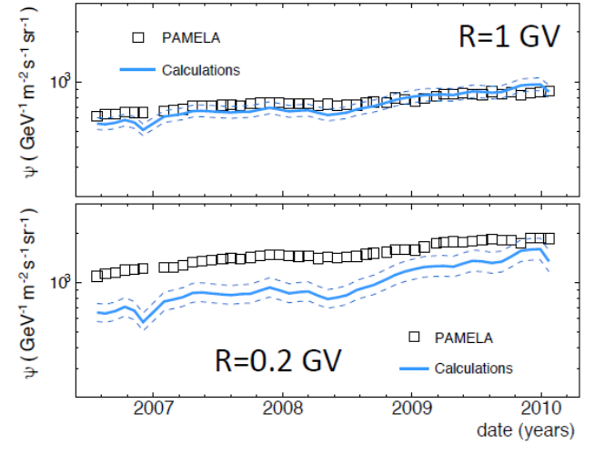
HEP 2025
Solar modulation
​Source of Solar Wind & Solar Energetic Particles​
Chance to study directly acceleration and propagation mechanisms
Source of the highest CR flux to Earth ​
Data recorded by several space experiment were used to determine the solar modulation parameters over different solar cycles 23 and 24, based on the force-field approximation
The Carrington system is based on the average rotation rate of the Sun’s photosphere, with the reference longitude rotating with the photosphere at approximately the same rate. In this system, surface features remain approximately at the same longitude from one map to the next, just as Earth’s surface features remain at the same longitude as the Earth rotates.
B. Panico 07/07/2025

Slide 8
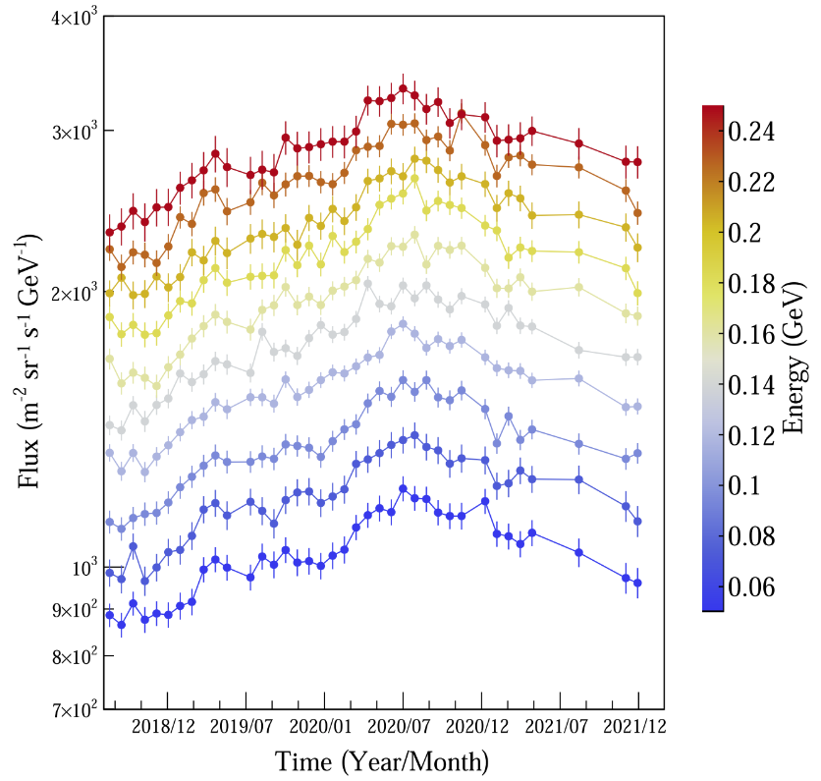
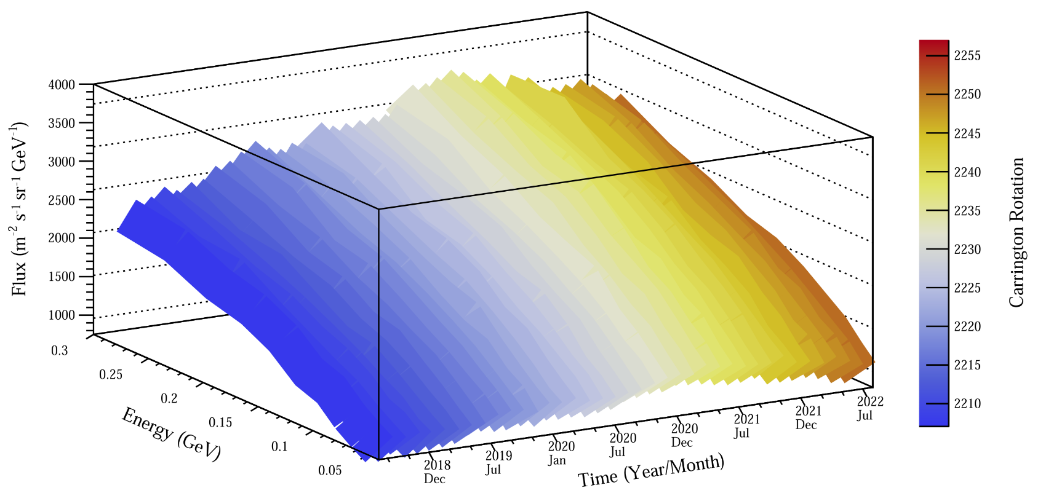
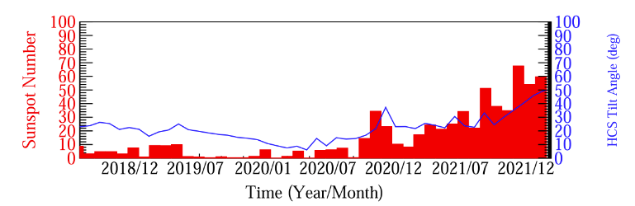
HEP 2025
Galactic Cosmic Rays
Time Dependence of 50–250 MeV Galactic Cosmic-Ray Protons between Solar Cycles 24 and 25, Measured by the High-energy Particle Detector on board the CSES-01 Satellite
The Astrophysical Journal Letters, 945:L39 (8pp), 2023 https://doi.org/10.3847/2041-8213/acbea7
Modelization of the heliosphere during the maximum phase of solar cycle
49 time-profile of GCR protons in 10 energy intervals between 2018 and 2022​
Comparison with Parker Solar Probe (SPS ) and SOHO/EPHIN​
Time profile of GCR protons measured by HEPD-01 in 10 energy intervals (upper panel) between 2018 and 2022. Error bars take into account both statistical and systematic uncertainties. Sunspot number (red) and HCS tilt angle values (blue) as a function of time, in the same period (bottom panel).
Evolution of HEPD-01 GCR protons as a function of energy and time between 2018 and 2022 (CRs 2207-2255). It is clear how spectra slowly rise before 2020 July, to start decreasing from the second half of 2020 onward.
B. Panico 07/07/2025

Slide 9
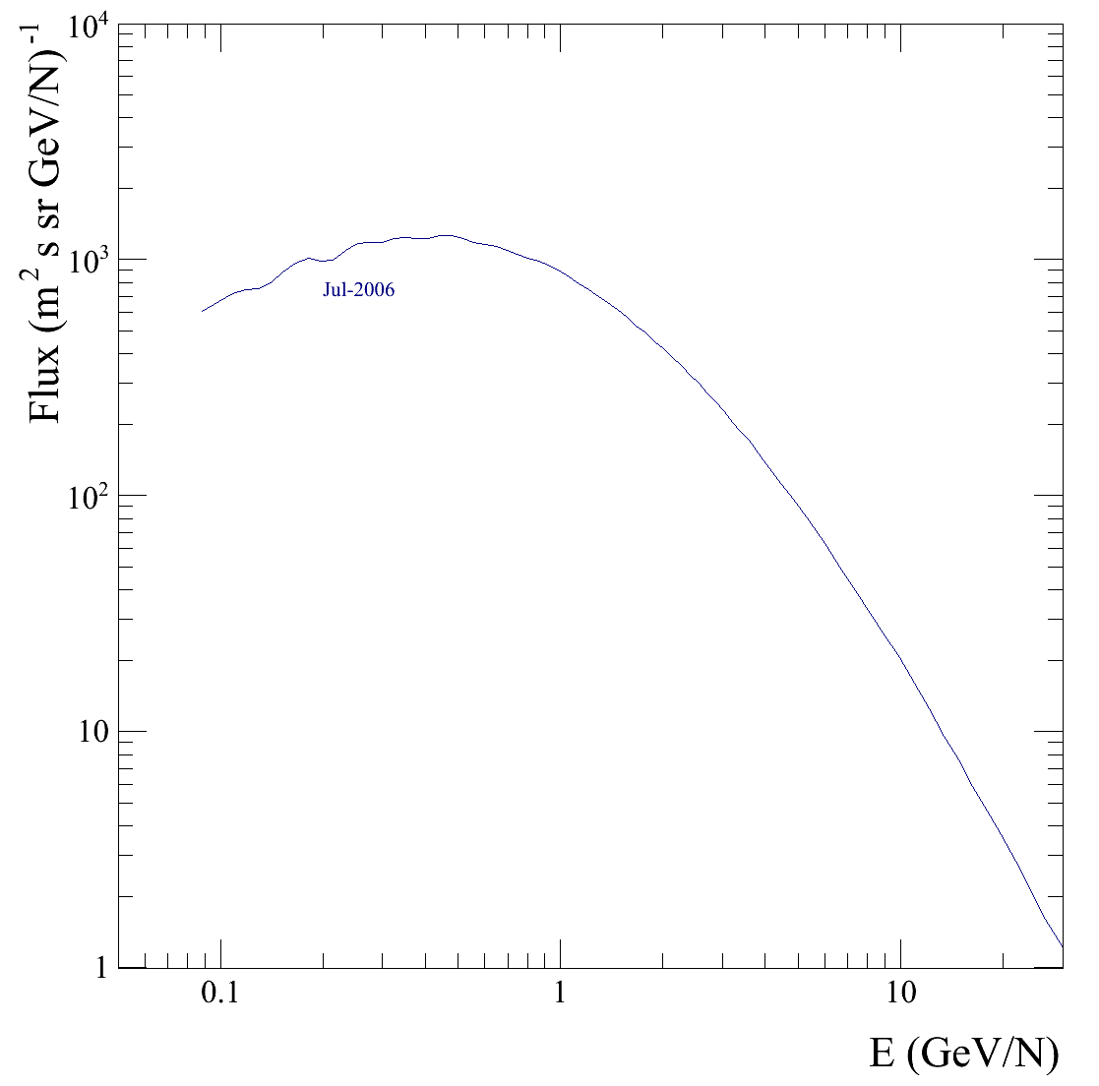
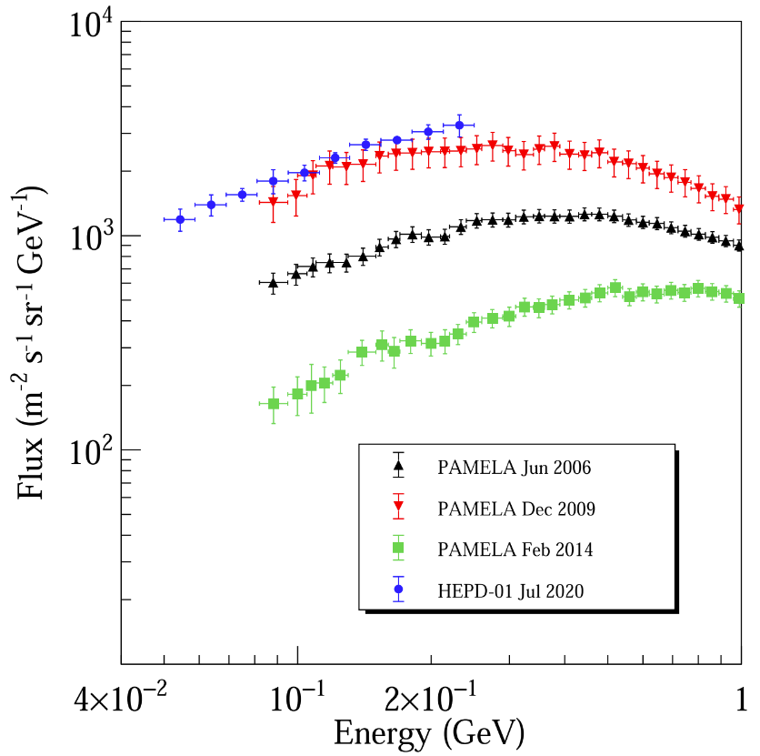
HEP 2025
Galactic Cosmic Rays
Time Dependence of 50–250 MeV Galactic Cosmic-Ray Protons between Solar Cycles 24 and 25, Measured by the High-energy Particle Detector on board the CSES-01 Satellite
The Astrophysical Journal Letters, 945:L39 (8pp), 2023 https://doi.org/10.3847/2041-8213/acbea7
HEPD-01 data on CR 2233 (2020 July) together with three proton spectra from the PAMELA detector—2006 June (black), 2009 December (red), and February 2014 (green). The spectrum from HEPD-01 is higher than the one from 2009 by PAMELA.
PAMELA Proton fluxes
During the 24th solar cycle; it is a weak, very long and peculiar solar minimum. Measurements are closer to interstellar medium and a good reference field for dosimetry interstellar flux
B. Panico 07/07/2025

Slide 10
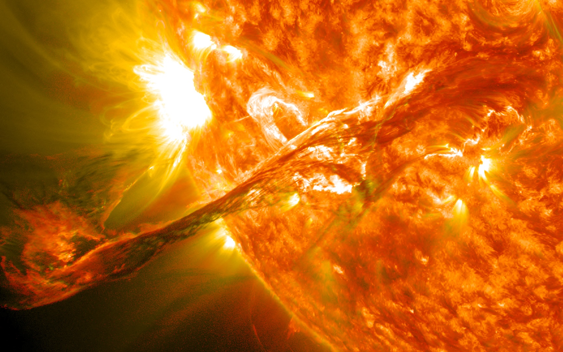
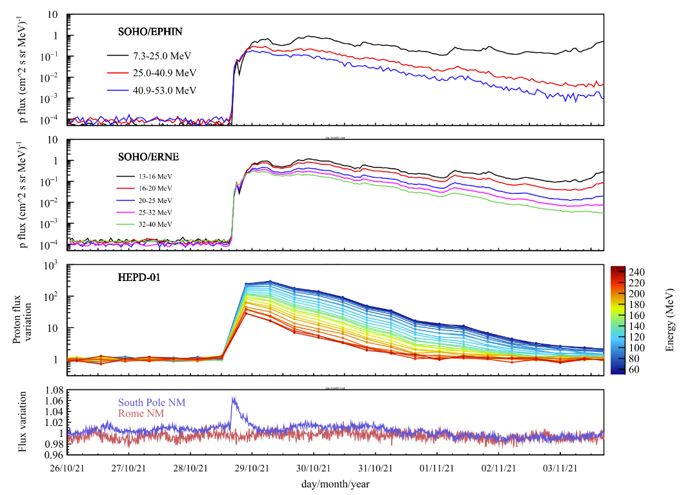
HEP 2025
Solar Energetic Particles
The First Ground-Level Enhancement of Solar Cycle 25 as seen by the High-Energy Particle Detector (HEPD-01) on Board the CSES-01 Satellite
Space Weather 21, 1 (2023) 10.1029/2022SW003191
SEP spectra are useful to model the production/acceleration of solar particles
The first solar flare seen by HEPD01 was emitted on October 28, 2021
Time evolution of the 2021 October solar energetic particle event, as seen by EPHIN and ERNE (first two panels)—both located on the SOHO spacecraft placed in the Lagrangian Point L1—in 3 and 5 energy intervals, respectively. The passage of the shock is evident in both the time-profiles. A >300x variation of
∼50 MeV proton fluxes was registered by the High-Energy Particle Detector at Low-Earth Orbit (third panel). Finally, time-profiles of two Neutron Monitors on ground (South Pole and Rome) are shown in the fourth panel.
B. Panico 07/07/2025

Slide 11
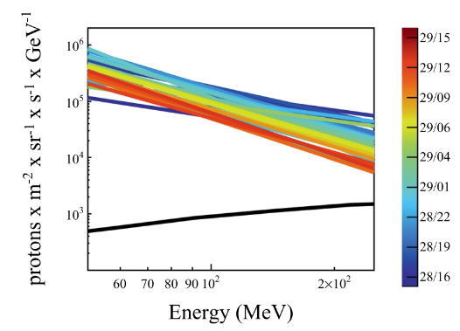
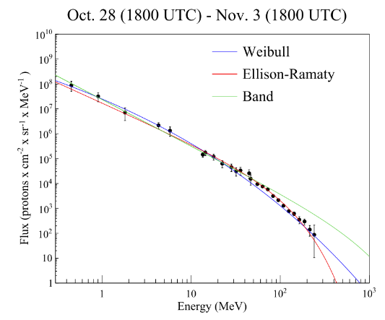
HEP 2025
Solar Energetic Particles
The First Ground-Level Enhancement of Solar Cycle 25 as seen by the High-Energy Particle Detector (HEPD-01) on Board the CSES-01 Satellite
Space Weather 21, 1 (2023) 10.1029/2022SW003191
High-Energy Particle Detector 30-min solar energetic particles (SEP) proton fluxes as a function of energy for the days of 28 and 29 October (see color bar on the right). The galactic cosmic-ray (GCR) spectrum—obtained during the 7 days before the start of the SEP—is reported as a comparison (black curve).
The pure, energy-extended event-integrated solar proton spectrum obtained by combining the observations of the High-Energy Particle Detector with the ones from ACE, SOHO/EPHIN, and SOHO/ERNE. The vertical error bars account for both statistical and systematic uncertainties, plus the 20% added to account for other uncertainties. The blue, red and green curves represent the fit performed by using the Weibull, Ellison-Ramaty and Band functions respectively.
B. Panico 07/07/2025

Slide 12
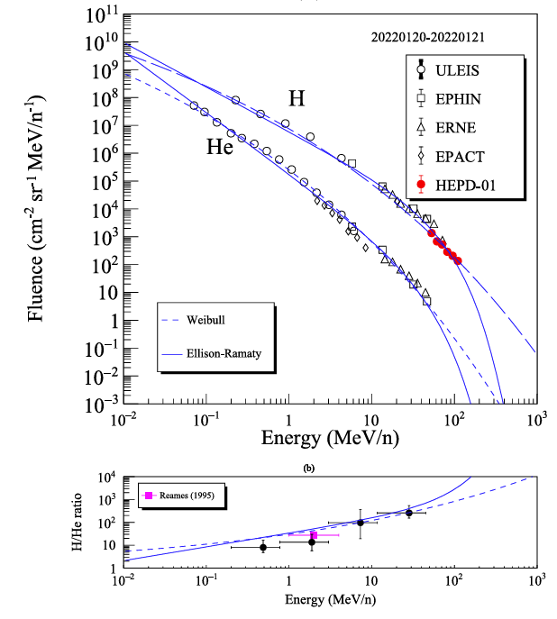
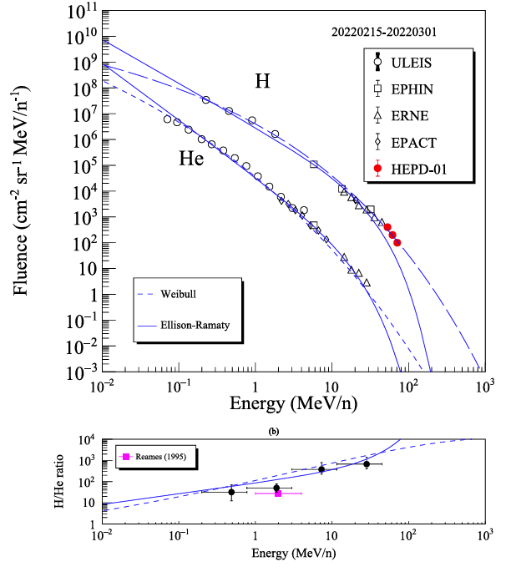
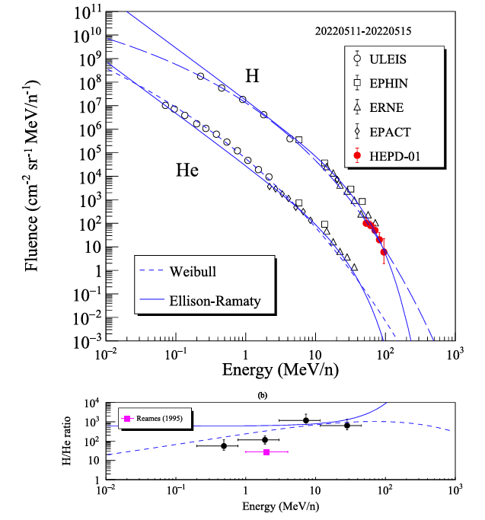
HEP 2025
Solar Energetic Particles
Multispacecraft Observations of Protons and Helium Nuclei in Some Solar Energetic Particle Events toward the Maximum of Cycle 25
Astrophysical Journal 974, 176 (2024) 10.3847/1538-4357/ad7395
B. Panico 07/07/2025

Slide 13
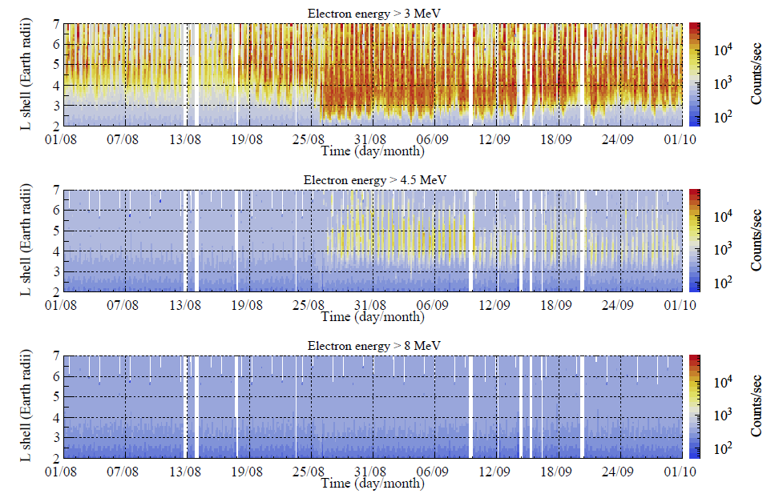
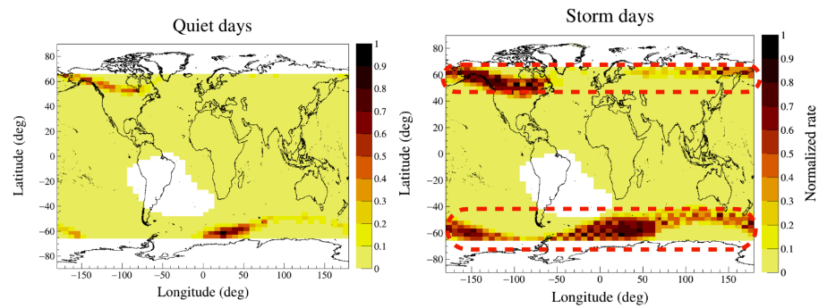
HEP 2025
The geomagnetic storm
The August 2018 Geomagnetic Storm Observed by the High-Energy Particle Detector on Board the CSES-01 Satellite
Appl. Sci. 11 12, 5680 (2021) 10.3390/app11125680
The first storm observed by HEPD01, probably caused by a filament eruption
Observed on the 20th of August 2018
A clear enhancement of HEPD-01 count rate for electrons @ L >= 3
On the Magnetosphere-Ionosphere Coupling During the May 2021 Geomagnetic Storm
Space Weath. 20 6 (2022) 10.1029/2021SW003016
B. Panico 07/07/2025

Slide 14
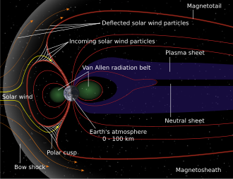
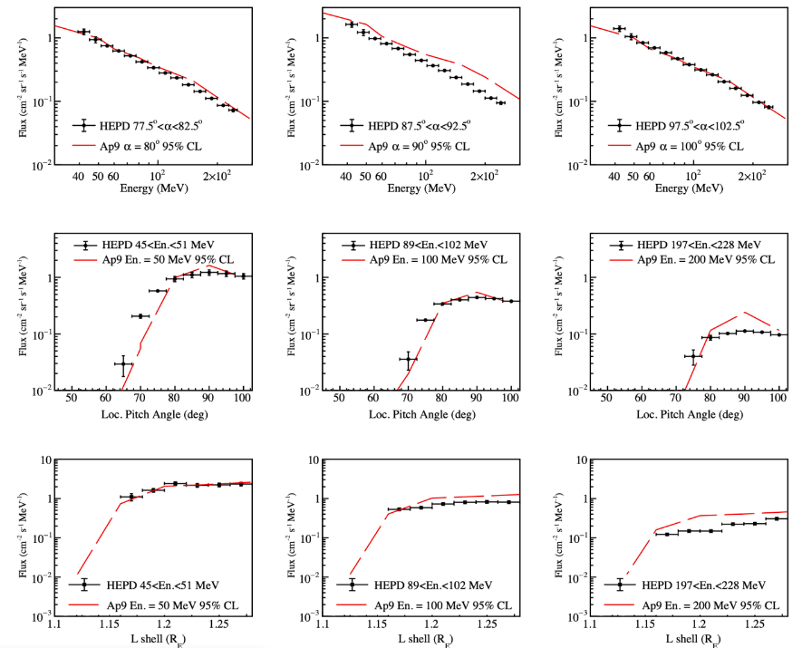
HEP 2025
Protons in the SAA
New results on protons inside the South Atlantic Anomaly, at energies between 40 and 250 MeV in the period 2018–2020, from the CSES-01 satellite mission
Phys. Rev. D 105, 062001 (2022) 10.1103/PhysRevD.105.062001
HEPD-01 provides differential fluxes from protons trapped in SAA
South Atlantic Anomaly (SAA) proton fluxes as a function of energy (top panels), local pitch angle (middle panels) and Lshell (Earth radii, bottom panels) obtained by HEPD-01 between August 2018 and December 2020
Comparison with predictions from the NASA AP9 model at 95% C.L
Extended dataset and mapping of the inner belt region​ respect to Appl. Sci. 11, 3465 (2021) 10.3390/app11083465
B. Panico 07/07/2025

Slide 15
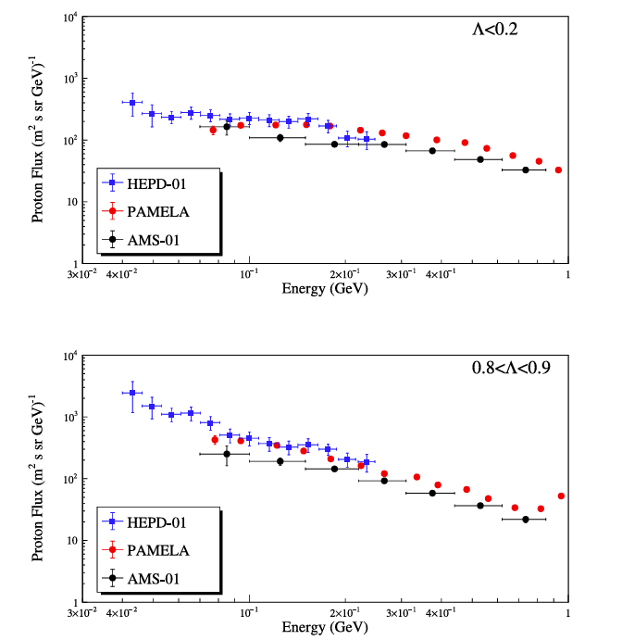
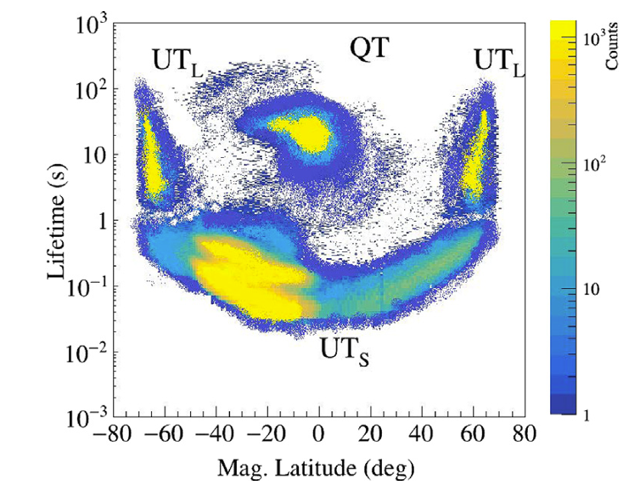
HEP 2025
Re-entrant protons
Measurements of low-energy, re-entrant albedo protons by the
HEPD-01 space-borne detector
Astrop. Phys. 162, 102993 (2024) 10.1016/j.astropartphys.2024.102993
Albedo protons divided into quasi-trapped and un-trapped. ​
The un-trapped are divided into short lifetime particles and pseudo-trapped long lifetime population​
Comparison between total albedo proton flux measured outside the SAA by HEPD-01 (blue), PAMELA (red) and AMS-01 (black) in two regions of magnetic latitude: 𝛬 < 0.2 and 0.8 <𝛬 < 0.9 (top and bottom panels, respectively).
Distribution of the lifetimes of the proton albedo populations as a function of the AACGM magnetic latitude. Different proton populations– QT, UT_{S} and UT_{L} occupy different sectors of the plot.
B. Panico 07/07/2025

Slide 16
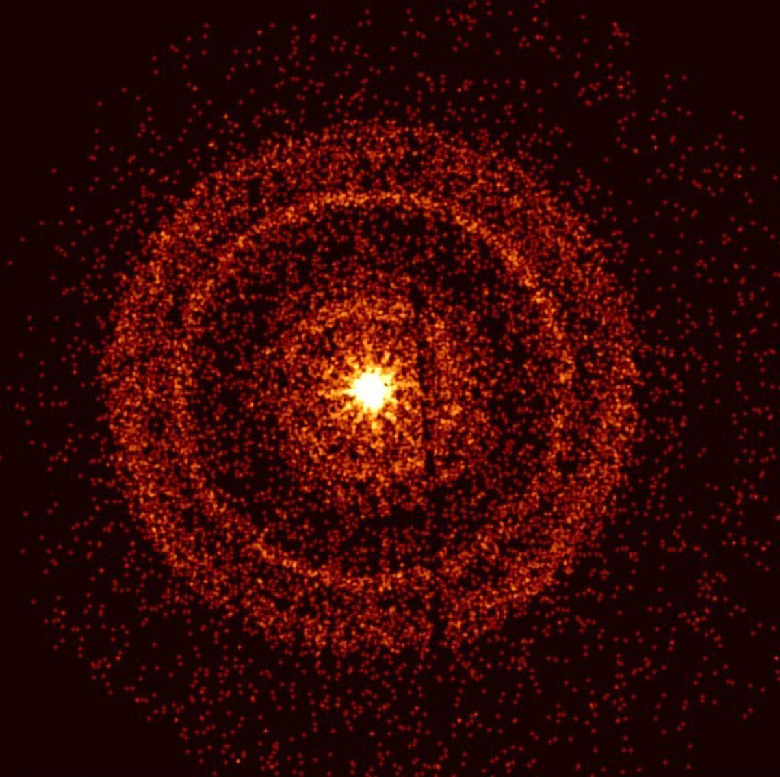
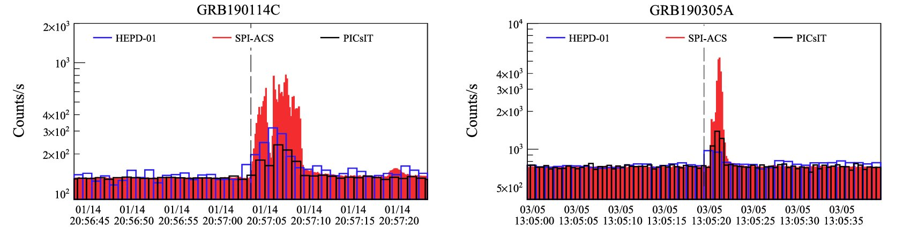
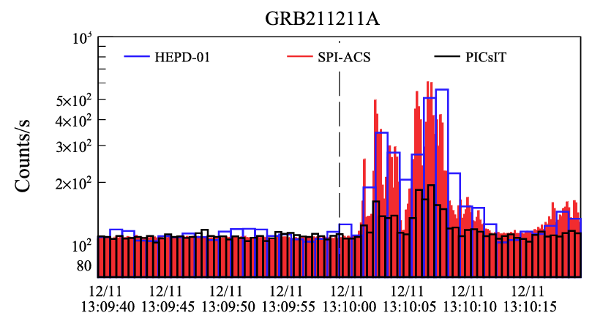
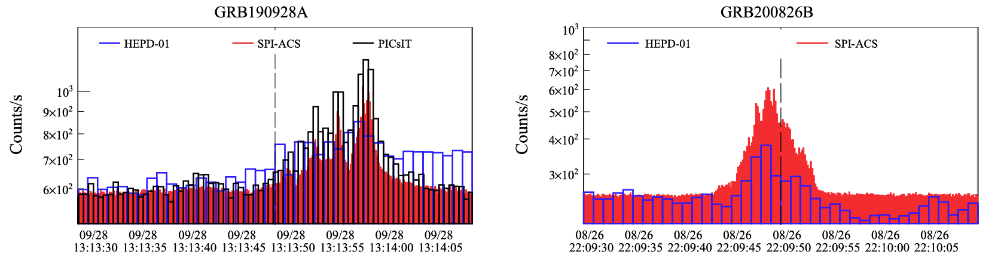
HEP 2025
GRBs
Gamma-Ray Burst Observations by the High-Energy Particle Detector on board the China Seismo-Electromagnetic Satellite between 2019 and 2021
The ApJ 960 21, 2024 10.3847/1538-4357/ad06ae
Time profiles of the low-energy electrons detected by the most superficial trigger configuration of HEPD-01—in blue—in comparison with the time profiles of the signals obtained from other instruments like PICsIT and SPI-ACS, in black and red, respectively. For better visualization, SPI-ACS and PICsIT data points are normalized to HEPD-01 ones. Each panel refers to a specific GRB. The vertical dashed line marks the trigger time T0 for the start of each GRB.
B. Panico 07/07/2025

Slide 17
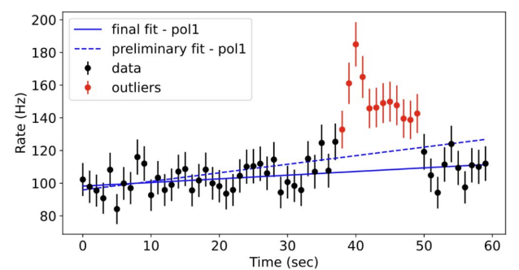
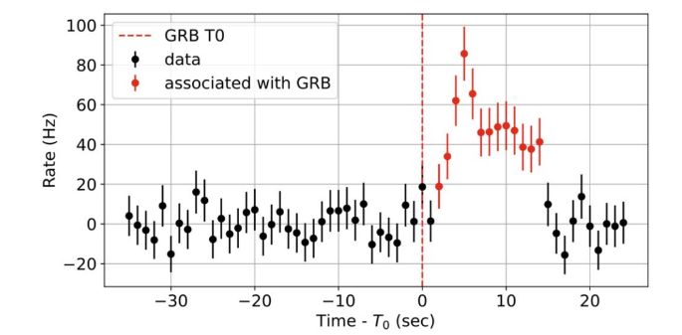
HEP 2025
GRBs
The Catalogue of Gamma-Ray Burst Observations by HEPD-01
in the 0.3 – 50 MeV Energy Range
The ApJ 976 239, 2024 10.3847/1538-4357/ad822c
Example of the fitting procedure. Dots and error bars correspond to the measured rate and the related uncertainty. The blue, dashed line is the initial first-degree polynomial that best fits the whole set of 60 data points within the window. Data points colored in red, which significantly deviate from the initial model, are identified as outliers according to the procedure described in the main text. The blue, solid line corresponds to the second first-degree polynomial fit, carried out by excluding outlier points. As the sum of normalized residuals S is equal to 42.5, the window is flagged as anomalous. The red, dashed vertical line corresponds to the trigger time of GRB 220624A
B. Panico 07/07/2025

Slide 18
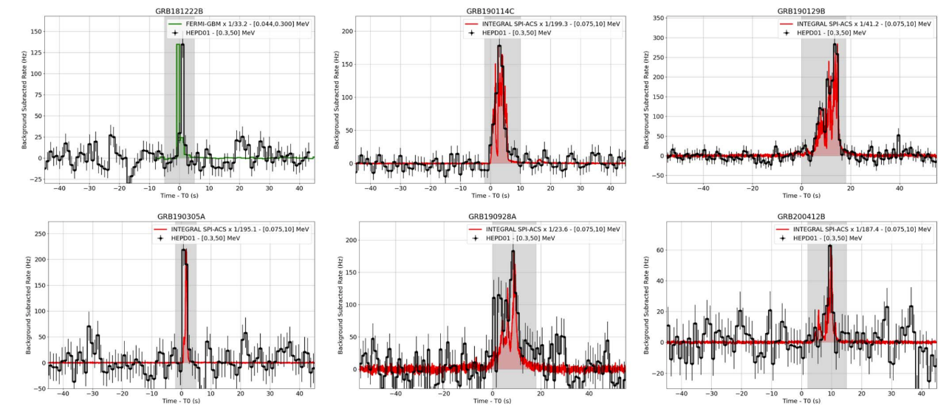
HEP 2025
GRBs
The Catalogue of Gamma-Ray Burst Observations by HEPD-01
in the 0.3 – 50 MeV Energy Range
The ApJ 976 239, 2024 10.3847/1538-4357/ad822c
B. Panico 07/07/2025

Slide 19
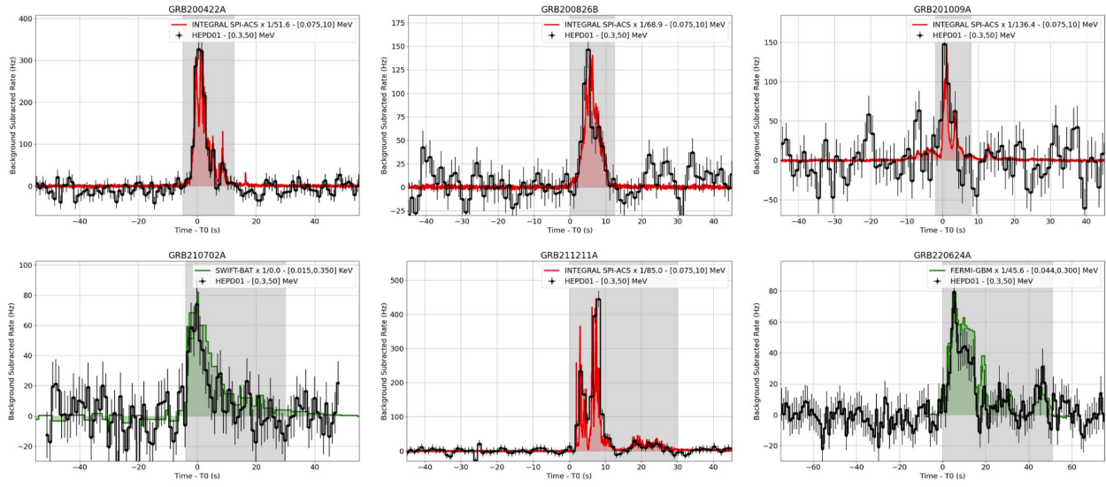
HEP 2025
GRBs
The Catalogue of Gamma-Ray Burst Observations by HEPD-01
in the 0.3 – 50 MeV Energy Range
The ApJ 976 239, 2024 10.3847/1538-4357/ad822c
B. Panico 07/07/2025

Slide 20
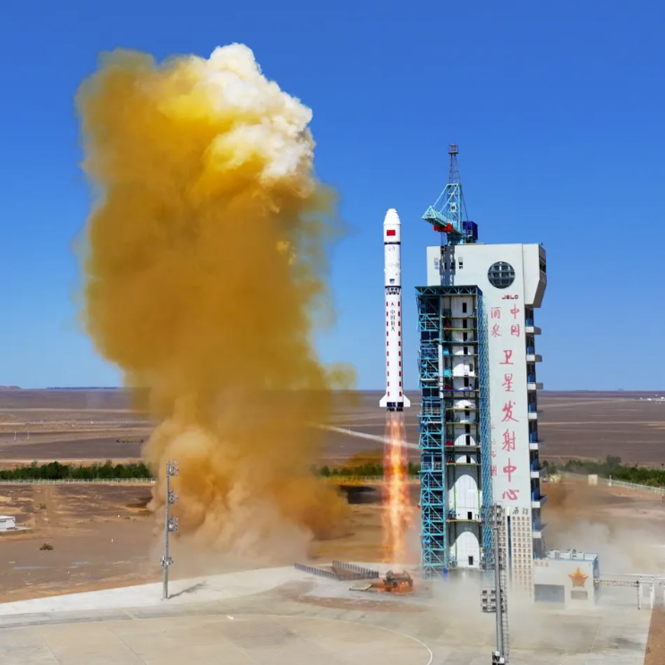
HEP 2025
Summary & Outlook
In this talk the wide scientific program of HEPD-01 on board of the CSES-01 satellite have been exploited.
HEPD-01 proved to be a precious instrument for the study of galactic cosmic rays spectrum, solar activity and GRBs with results on :
• the galactic hydrogen energy spectrum,
• the measurement of proton fluxes in the SAA,
• solar modulation of galactic cosmic rays,
• particle spectrum during SEPs and
• measurements for Gamma-Ray Bursts between 2019 and 2021
In June 2025 a new phase of the CSES mission started:
the new CSES-02, with HEPD-02 onboard, has been succesfully launched !
Also the High-Energy Particle Detectors 02 (HEPD-02) has been designed, assembled, integrated and tested by the Italian team Limadou-HEPD.
Great results expected to multi-messenger observations in the period 2025-2030+!!!
B. Panico 07/07/2025

