Slide 1
Axions, Versatile Friends to Probe Beyond the Standard Model
Théo Brugeat
Laboratory of Subatomic Physic and Cosmology
Theoretical physics team
In collaboration with Christopher Smith

Slide 2
Outline
Axion Solution to Strong CP puzzle
Landscape of Axion models
Baryonic Axions in Neutron Oscillations (2412.06434)
Conclusion

Slide 3
Strong CP Puzzle
Axion Solution to Strong CP
Excess of the meson η’ mass
CP violating electroweak processes
Non-trivial Quantum Chromodynamic vacuum structure
Yukawa phases of Quarks-Higgs couplings
$${δℒ}_{CP}=(θ_{QCD}− \text{Arg} Y_{u}− \text{Arg} Y_{d}\text{)}\frac{α_{S}}{8 π}G_{μν}{\tilde{G}}^{μν}$$
Neutron Electric Dipole Moment experiment: $\overline{θ}≔θ_{QCD}− \text{Arg} Y_{u}− \text{Arg} Y_{d }<{10}^{−10}$
How Yukawa phases speaks to Gluons:
$ψ_{L}→e^{+\frac{iα}{2}}ψ_{L}$ $ψ_{R}→e^{−\frac{iα}{2}}ψ_{R}$
$${\overline{ψ}}_{L}ψ_{R}→e^{iα}{\overline{ψ}}_{L}ψ_{R}$$
$+{δℒ}_{Ano}∝α$ $F_{μν}{\tilde{F}}^{μν}$
$$⇒$$
What about $SU\left(2\right)×{U(1)}_{Y}$?
Chiral anomaly of fermions.

Slide 4
Strong CP Puzzle
Axion Solution to Strong CP
Similar contributions for $SU\left(2\right)×{U(1)}_{Y}$ :
$${δℒ}_{CP}=θ_{SU(2)}\frac{g^{2}}{16π^{2}}W_{μν}{\tilde{W}}^{μν}+θ_{U(1)}\frac{g^{′2}}{16π^{2}}B_{μν}{\tilde{B}}^{μν}+\overline{θ}\frac{α_{S}}{8 π}G_{μν}{\tilde{G}}^{μν}$$
${U(1)}_{ℒ+ℬ}$ is anomalous $⇒$rotate away
${U(1)}_{Y}$ is trivial $⇒$ Integrate by parts
How Yukawa phases speaks to Gluons:
$ψ_{L}→e^{+\frac{iα}{2}}ψ_{L}$ $ψ_{R}→e^{−\frac{iα}{2}}ψ_{R}$
$${\overline{ψ}}_{L}ψ_{R}→e^{iα}{\overline{ψ}}_{L}ψ_{R}$$
$+{δℒ}_{Ano}∝α$ $F_{μν}{\tilde{F}}^{μν}$
${U(1)}_{ℒ−ℬ}$ is not anomalous.
QCD operator cannot be removed.
$$⇒$$
Chiral anomaly of fermions.

Slide 5
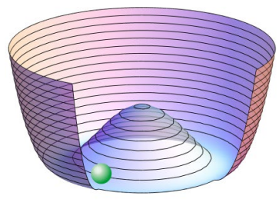
How to Cook Axions(KSVZ type)
Axion Solution to Strong CP
1. Consider $φ$ with global ${U(1)}_{PQ}$ coupled to colored fermions:
$$ℒ_{KSVZ}={\overline{ψ}}_{L/R}iDψ_{L/R}+yφ{\overline{ψ}}_{L}ψ_{R}−\frac{G_{μν}G^{μν}}{4}−\overline{θ}\frac{α_{S}}{8 π}G_{μν}{\tilde{G}}^{μν}+V(φ^{†}φ)$$
2. ${U(1)}_{PQ}$ is chiral, hence anomalous:
3. Potential induces a spontaneous breaking:
$$φ→e^{iθ}φ$$
$ψ_{L}→e^{+iθ}ψ_{L}$ $ψ_{R}→e^{−iθ}ψ_{R}$
$$J^{μ}= \overline{ψ}γ^{μ}γ^{5}ψ$$
$$∂_{μ}J^{μ}∝G_{μν}{\tilde{G}}^{μν}$$
$$φ=(σ+v)e^{ia/v}$$
$$\left\langle 0 | J^{μ} | a(p)\right\rangle =ivp^{μ}$$
$$⇒$$
Axions have a shift invariance, up to the anomalous coupling.
$$ℒ_{KSVZ}=−\frac{G_{μν}G^{μν}}{4}+ {\frac{1}{v}∂}_{μ}a J^{μ}−\left(\overline{θ}+\frac{a}{v}\right)\frac{α_{S}}{8 π}G_{μν}{\tilde{G}}^{μν}−\frac{1}{4}{g_{aγγ}^{0}aF}_{μν}{\tilde{F}}^{μν}+…$$
[Peccei,Quinn(1977), Weinberg(1978),Wilczek(1978)]

Slide 6
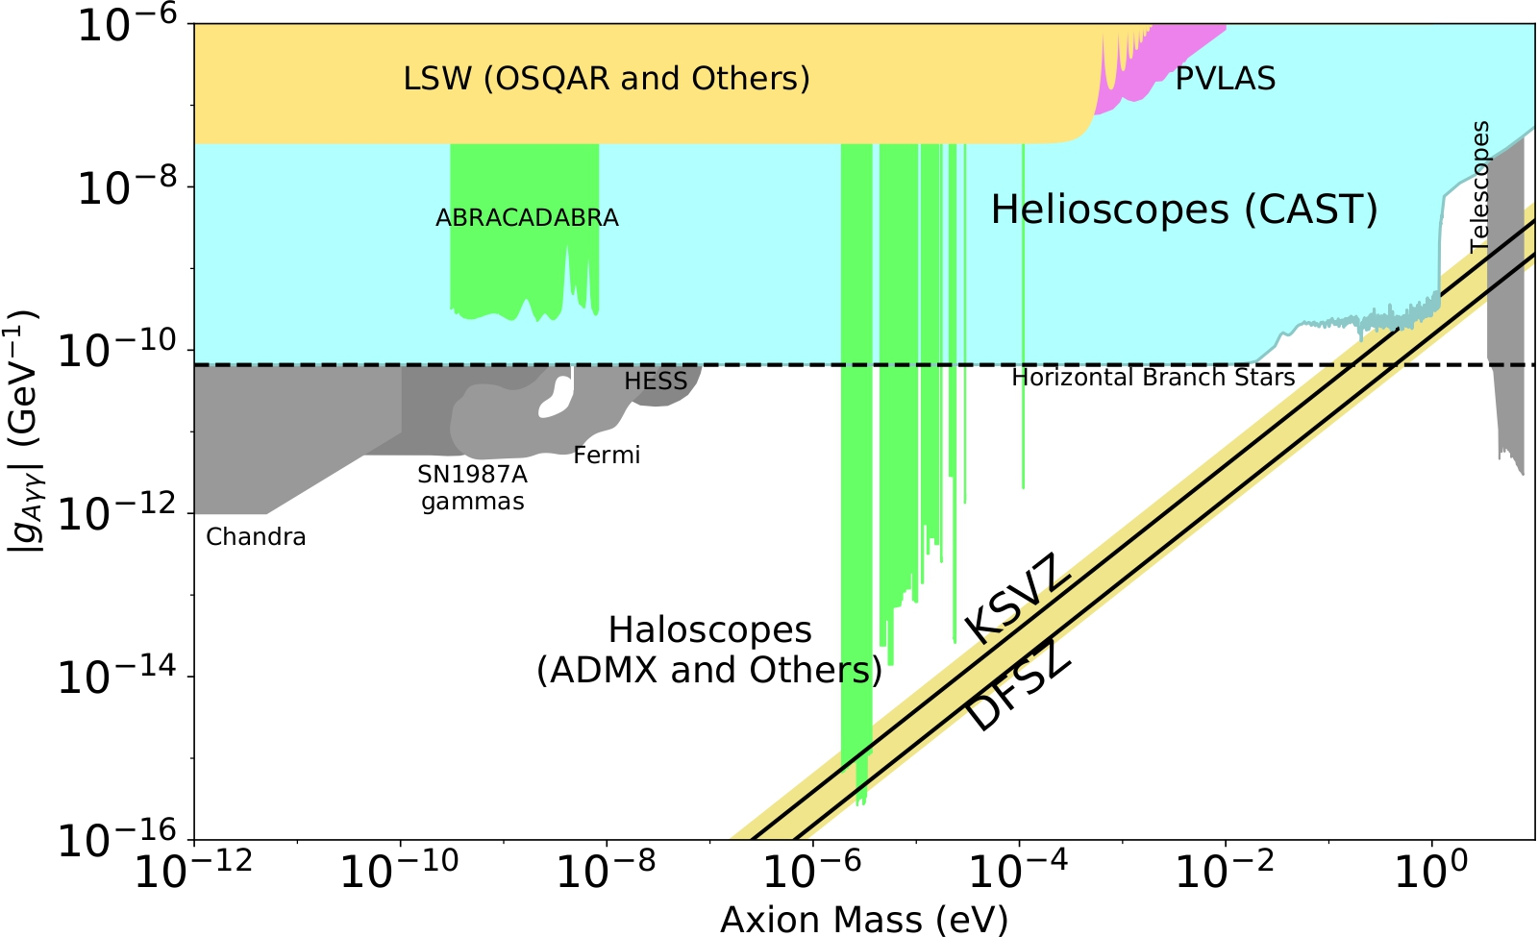
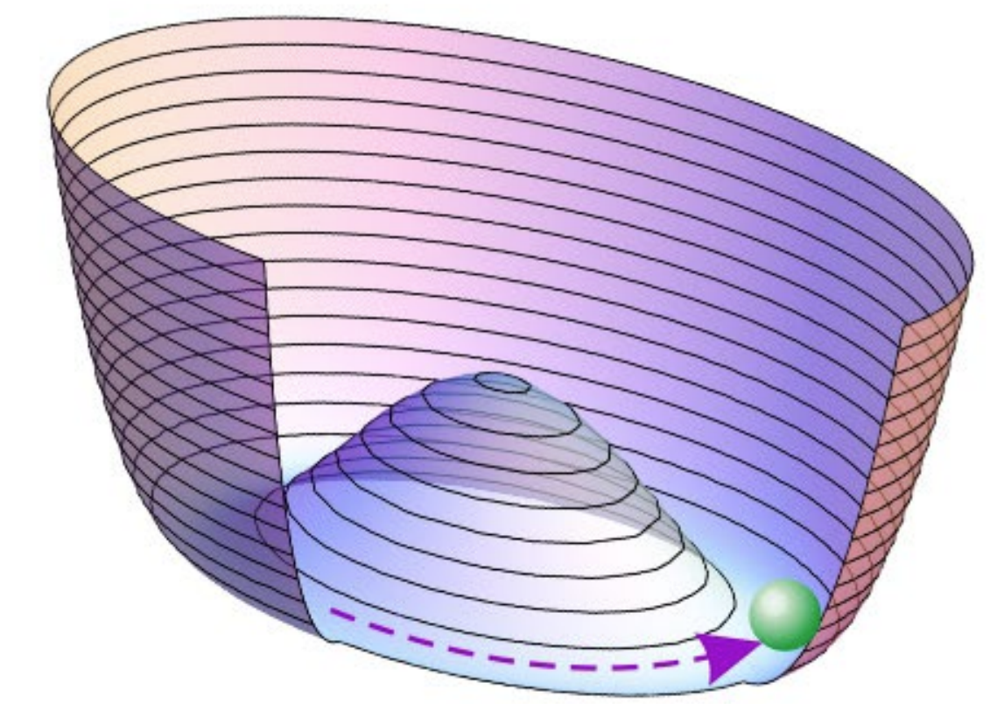
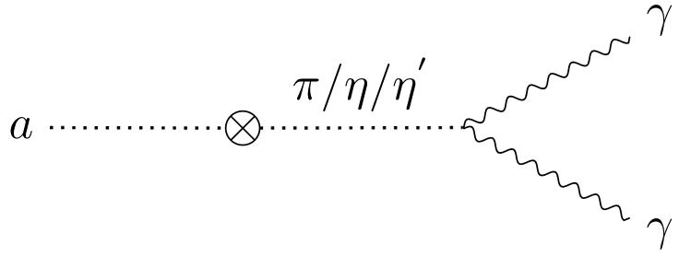
Axions Solves Strong CP
Axion Solution to Strong CP
[PDG 2019 (simplified)]
Below $Λ_{QCD}$ $⇒$ contribution to axion’s potential
Axions are light and weakly interacting.
$$m_{a}≈6\left(\frac{{10}^{12}GeV}{v}\right)μeV$$
$$⇒$$
$a$ mixes with $π,η,η^{′}$ $⇒v>30v_{EW}$.
$$\left\langle a\right\rangle =0$$
$$\left\langle a\right\rangle =−v\overline{θ}$$
$g_{aγγ}$ and $m_{a}$ gets correlated:
$−\left(\overline{θ}+\frac{a}{v}\right)\frac{α_{S}}{8 π}G_{μν}{\tilde{G}}^{μν}$
$$V_{eff}\left(\overline{θ}+\frac{a}{v},π,η,…\right)$$
Mass computed from Chiral theory:
$$\frac{v^{2}m_{a}^{2}}{f_{π}^{2}m_{π}^{2}}=\frac{m_{u}m_{d}}{m_{u}+m_{d}}$$
$$−\frac{1}{4}{g_{aγγ}aF}_{μν}{\tilde{F}}^{μν}∝aE∙B$$
$${g_{aγγ}=g}_{aγγ}^{0}+g_{aγγ}^{π,η,η^{′}}≈m_{a}{10}^{−10±1}$$

Slide 7
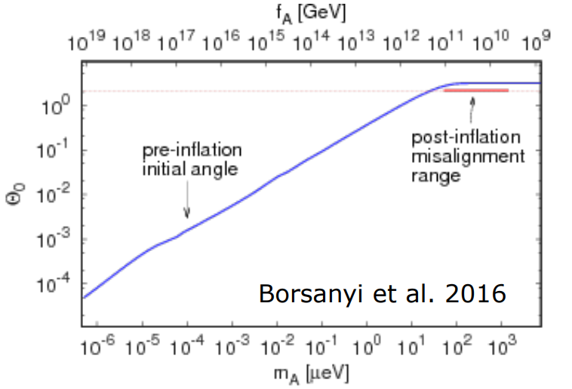
Axions as Cold Dark Matter
Axion Solution to Strong CP
[PDG 2019 (simplified)]
Axions production : misalignement mechanism.
Axions are light and weakly interacting.
$$m_{a}≈6\left(\frac{{10}^{12}GeV}{v}\right)μeV$$
Non-thermal production
$⇒$ Axions are cold.
NOW*
$a$ mixes with $π,η,η^{′}$ $⇒v>30v_{EW}$.
Density of state depends on unknown $θ_{i}$:
$g_{aγγ}$ and $m_{a}$ gets correlated:
$$n\left(T\right)≈vm_{a}\left(T\right)θ_{i}^{2}$$
$$−\frac{1}{4}{g_{aγγ}aF}_{μν}{\tilde{F}}^{μν}∝aE∙B$$
$${g_{aγγ}=g}_{aγγ}^{0}+g_{aγγ}^{π,η,η^{′}}≈m_{a}{10}^{−10±1}$$

Slide 8
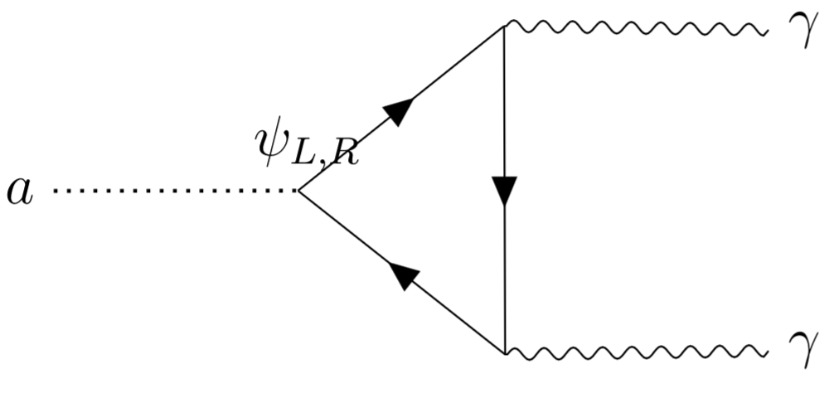
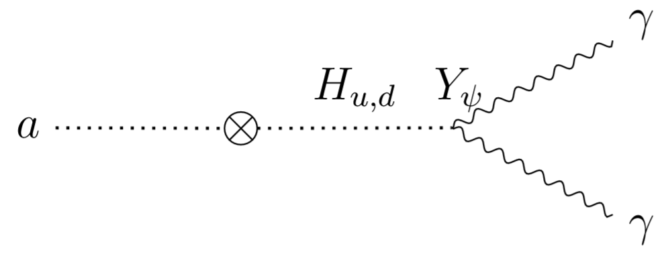
Models of Invisible Axions
Landscape of Axion models
$$φ=(σ+v)e^{ia/v}$$
One new scalar field, two path to reach SM:
KSVZ: $φ{\overline{ψ}}_{L}ψ_{R}$
DFSZ: $φH_{u}^{†}H_{d}$
$$v≫v_{EW}$$
[Kim (1979), Shifman,Vainhstein,Zakharov (1980)]
[Dine,Fischer,Srednicky(1981), Zhitnitsky(1980)]
Small mixing of pseudo-scalar modes.
Coupling to SM by gauge bosons:
Coupling to SM by left fermions:
$$\frac{a}{16π^{2}v}\sum_{X∈SM}{g_{X}^{2}N_{X}X_{μν}{\tilde{X}}^{μν}}$$
$$\frac{a}{v}\sum_{ψ_{L}∈SM}{χ_{ψ}{\overline{ψ}}_{L}γ^{5}ψ_{L}}$$

Slide 9
Extensions Beyond DFSZ/KSVZ
Landscape of Axion models
Beyond, many alternatives of models:
QCD axions off the band: heavy (mirror QCD) or ultra light ($Z_{n}$-symmetry) axions, enlarging the band (many fields), …
DM axion off misalignment mass range: Only a fraction of DM, kinetic misalignement, topological defects, curvature-induced production,…
Axion-like particles (no correlation of $m_{a}$ and $g_{aγγ}$): Do not solve Strong CP, but natural DM candidate and arise in string theory.
[Di Luzio, Mescia, Nardi (2016)]
[Di Luzio, Gavela, Quilez, Ringwald (2021)]
[Gaillard, Gavela, Houtz, Quilez, del Rey (2018)]
[Co, Hall, Harigaya (2019)]
[Marsch (review,2015)]
[Eröncel, Gouttenoire, Sato, Servant, Simakachorn (2025)]
[Ringwald (review, 2014)]

Slide 10
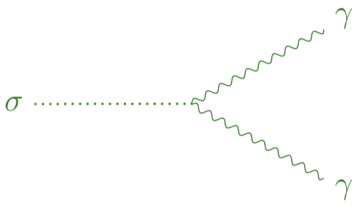
Space-Time Entanglement
Landscape of Axion models
Some models predicts axions and dilatons together (e.g. Einstein-Cartan gravity):
[Karananas, Shaposhnikov, Zell (2025)]
The dilaton phenomenology close to axions:
Scalar field weakly interacting, May play a role in cosmological scenarios, Goldstone with anomalous coupling to the gauge bosons.
[Banerjee, Csáki, Geller, Heller-Algazi, Ismail (2025)]
[Adler, Collins, Duncan (1977)]
$$J^{μ}=x_{ν}T^{μν}$$
$${{ ∂}_{μ}J}^{μ}=2M_{H}^{2}{\left(1+γ\right)\left|H\right|}^{2}+\sum_{X∈SM}{β_{X}X_{μν}X^{μν}}$$
But space-time symmetries are much more involved:
Inverse Higgs constraint : 5 broken generators $→$ 1 Goldstone, Current of the symmetry with explicit coordinates dependance, $⇒$Deriving effective theories consistently is tedious.
[Low, Manohar (2001)]
[Coleman Callan Jackiw (1970)]

Slide 11
Mixing with $ℒ,ℬ$
Landscape of Axion models
Peccei-Quinn is a flavor symmetry which can naturally mix with $ℒ,ℬ$.
Breaking spontaneously $ℒ \text{or} ℬ$ could explain matter asymetry.
Closeness of seesaw scale and $v$: $⇒$ attemps to unite them with $φN_{R}N_{R}$.
Cosmological role as DM candidate: $⇒$ axions inducing baryogenesis ?
[Dias,Machado, Nishi, Ringwald, Vaudrevange (2014)]
DM and baryonic relic densities are close $⇒$ motivates such models.

Slide 12
Baryon Violation
Baryonic Axion in Neutron Oscillations
Baryogenesis requires $B,L$ violating processes. A naturally preferred mode $⇒$ $ΔB=2$ models.
$$ℒ=\overline{n}\left(iγ^{μ}∂_{μ} −m\right)n −ε\left(\overline{n}n^{C}+{\overline{n}}^{C}n\right) −μ_{n}F^{μν}\left(\overline{n}σ_{μν}n\right)$$
[Mohapatra (1980)]
$$i\frac{d}{dt}\left(\begin{matrix}n \\ n^{C}\end{matrix}\right)=\left( \begin{matrix}E & ε \\ ε & E^{C}\end{matrix}\right)\left(\begin{matrix}n \\ n^{C}\end{matrix}\right)$$
Non-Relativistic description: 2 by 2 system with $ΔE=2μ_{n}B$.
$P_{n→n^{C}}\left(t\right)=e^{−Γt}\frac{ε^{2}}{{\left(\frac{ΔE}{2}\right)}^{2}+ε^{2}}{\sin\left(t\sqrt{{\left(\frac{ΔE}{2}\right)}^{2}+ε^{2}}\right)}^{2}$.
In quasi-free regime $tΔE≪1$: $P_{n→n^{C}}\left(t\right)≈e^{−Γt}{\left(εt\right)}^{2}$,
Energy splitting is hard to minimize,
Current bound: $ε≤0.8×{10}^{−23}eV.$
[ILL,Grenoble (1994)]

Slide 13
Dark Matter Enhanced Oscillations
Baryonic Axion in Neutron Oscillations
Baryonic Dark Matter: $λφ{\overline{n}}^{C}n⇒$ dynamical parameter$.$
$$ε→ε\left(t\right)=ε_{0}\sin{m_{φ}t}$$
$P_{n→n^{C}}\left(t\right)=e^{−Γt}\frac{ε_{0}^{2}}{{\left(\frac{ΔE−m_{φ}}{2}\right)}^{2}+ε_{0}^{2}}{\sin\left(t\sqrt{{\left(\frac{ΔE−m_{φ}}{2}\right)}^{2}+ε_{0}^{2}}\right)}^{2}$.
$$i\frac{d}{dt}\left(\begin{matrix}n \\ n^{C}\end{matrix}\right)=\left( \begin{matrix}E & ε(t) \\ ε(t) & E^{C}\end{matrix}\right)\left(\begin{matrix}n \\ n^{C}\end{matrix}\right)$$
$$⇒$$
Rabi Resonance at $ΔE=$ $m_{φ}$:
$P_{n→n^{C}}\left(t\right)=$ $e^{−Γt}$ ${\sin\left(tε_{0}\right)}^{2}$.
[Rabi (1937)]
[Smith,TB (2024)]
Convert 50% of the neutrons ?!
From $μ_{n}=6.02× {10}^{−8}eV.T^{−1},$ $m_{φ}\sim 1μeV⇒B≈16T$,
Tuning at the precision of $ε_{0}$ ...
The ILL measurements give a bound : $P_{n→n^{C}}\left(t\right)≈e^{−Γt}{\left(\frac{ε_{0}}{m_{φ}}t\right)}^{2}$,
Well choosen magnetic field may improve the constraint.
$$ε_{0}≤{10}^{−15}eV$$

Slide 14
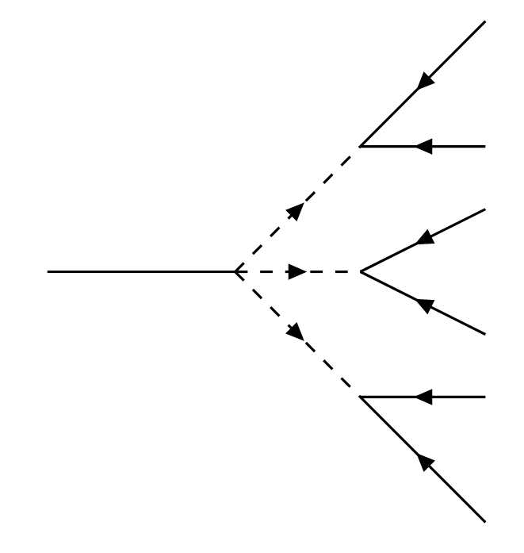
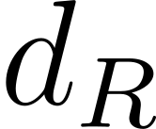
Axionic Couplings to Baryonicity
Baryonic Axion in Neutron Oscillations
Two $\left(ΔB,ΔL\right)=(2,0)$couplings in SM:
SSB of Baryonic number, axion = « baryonon »:
$$ℒ_{eff}⊃−e^{ia/v}\left(m_{S}\overline{n}n^{C}+m_{P}\overline{n}γ^{5}n^{C}\right)$$
Dominant contribution is constant$:ve^{ia/v}=\left(v+ia+…\right)$
[Arias-Aragón,Smith(2022)]
Identify Baryonic and Peccei-Quinn using Diquarks.
$$ℒ_{linear}⊃−i\frac{a}{v}\left(m_{S}\overline{n}n^{C}+m_{P}\overline{n}γ^{5}n^{C}\right)$$
$${U(1)}_{PQ}={U(1)}_{B}: ℒ_{eff}⊃−ε_{S}φ\overline{n}n^{C}−ε_{P}φ\overline{n}γ^{5}n^{C}$$

Slide 15
Axionic Couplings to Baryonicity
Baryonic Axion in Neutron Oscillations
Two $\left(ΔB,ΔL\right)=(2,0)$couplings in SM:
SSB of Baryonic number, axion = « baryonon »:
$$ℒ_{eff}⊃−e^{ia/v}\left(m_{S}\overline{n}n^{C}+m_{P}\overline{n}γ^{5}n^{C}\right)$$
Dominant contribution is constant$:ve^{ia/v}=\left(v+ia+…\right)$
[Arias-Aragón,Smith(2022)]
Identify Baryonic and Peccei-Quinn using Diquarks.
$$ℒ_{linear}⊃−i\frac{a}{v}\left(m_{S}\overline{n}n^{C}+m_{P}\overline{n}γ^{5}n^{C}\right)$$
Parity odd $(γ^{5})$ couplings are technically challenging for Non-Relativistic reduction.
$${U(1)}_{PQ}={U(1)}_{B}: ℒ_{eff}⊃−ε_{S}φ\overline{n}n^{C}−ε_{P}φ\overline{n}γ^{5}n^{C}$$

Slide 16
Derivative Coupling in Oscillations
Baryonic Axion in Neutron Oscillations
$$ℒ⊃ −e^{ia/v}\left(m_{S}\overline{n}n^{C}+m_{P}\overline{n}γ^{5}n^{C}\right)$$
Baryonic current is $ΔB$=0 !
Field redefinition
$$ℒ⊃−\left(m_{S}\overline{n}n^{C}+m_{P}\overline{n}γ^{5}n^{C}\right)+\frac{1}{v}∂_{μ}a\left(\overline{n}γ^{μ}n\right)+( {δℒ}_{Ano})$$
$U\left(2\right)$ diagonalization with Weyl rotations
$O(3)$ mixing with $ΔB$=2 currents
$$ℒ⊃−ε\left(\overline{n}n^{C}+{\overline{n}}^{C}n\right)+\frac{1}{v}∂_{μ}a\left(\overline{n}γ^{μ}n+ε_{+}{\overline{n}}^{C}γ^{μ}γ^{5}n+ε_{−}\overline{n}γ^{μ}γ^{5}n^{C}\right)+( {δℒ}_{Ano})$$
Can be turned off!
Coupling to axion wind, in oscillations description:
Extra derivative in the coupling:
Signal for QCD axions way too small.
$$ε\left(t\right)=\frac{ε_{±}}{v}\vec{∇}a=\frac{m_{a}ε_{±}v_{DM}}{v}\sin{{(m}_{a}t)}$$
What about other probes : Solar axions, Binary systems, …
[Smith,TB (2024)]

Slide 17
Conclusion
Conclusion
Resonances from DM is relevant for future neutron experiments,
Baryonic QCD axion requires another probe, what source would be best ?
The formalism fits to Leptogenesis by identifying axion to majoron,
Hints of Baryonic/Leptonic Dark Matter would motivate the investigations.

Slide 18
Thank you for your attention!

Slide 19
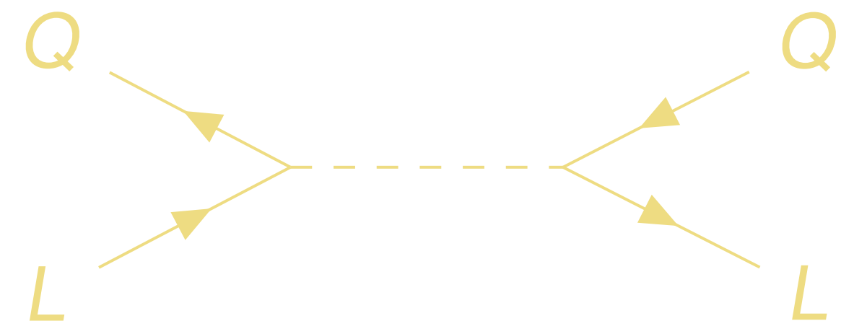
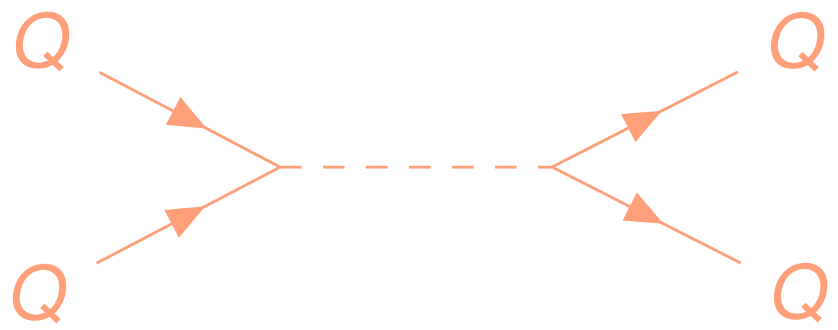
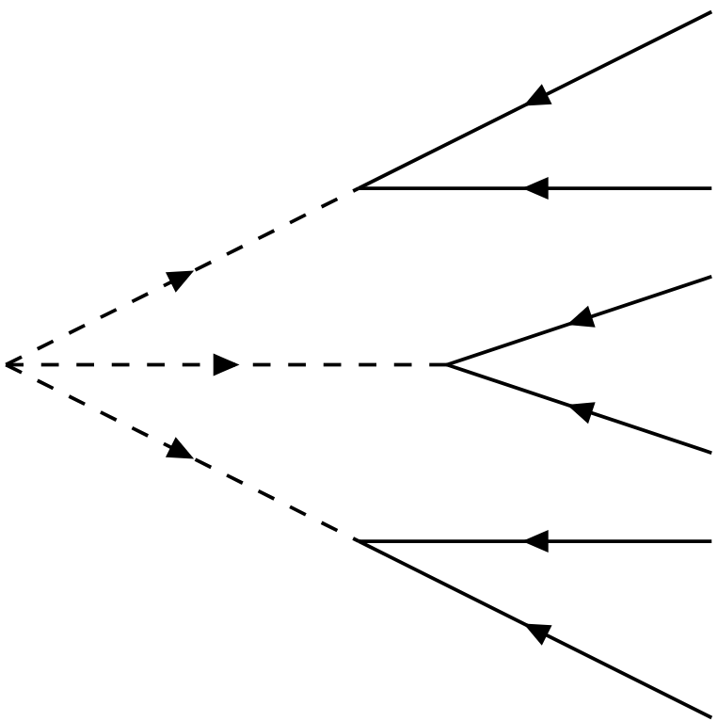
Leptoquark and Diquarks : mediators of B-violation
Leptoquark and Diquark are mediating Fermi interactions to colored pairs of Quark/Lepton. They arise naturally in some theories (SUSY).
They are classified according to their SM charges and carry Leptonic/Baryonic Number.
They can be used to construct (ΔB,ΔL) = (2,0) couplings.
On the right : scalar coupling, requiring 2 di-quarks.

Slide 20
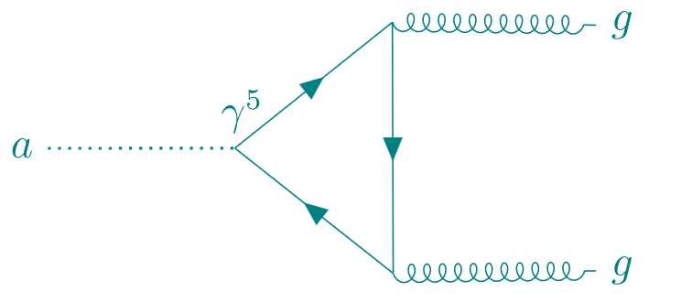
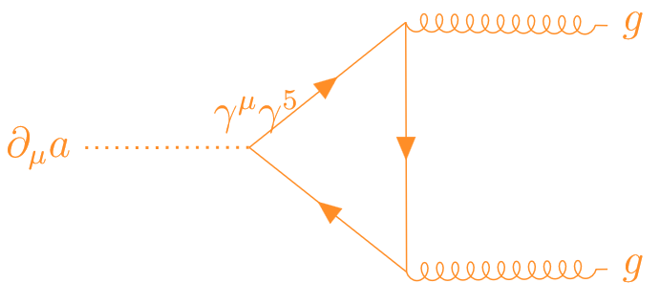
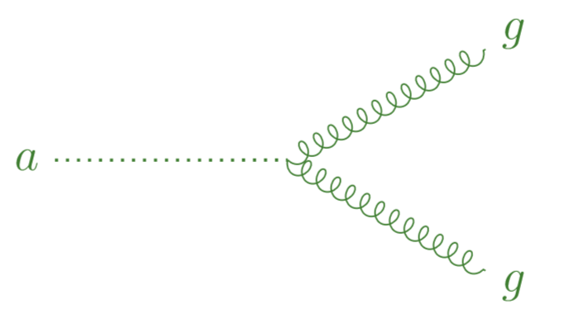
Reparametrization Invariance
Axion Solution to Strong CP
In the UV, CPV gauge coupling is not always explicit:
$$ℒ_{Polar}=−\frac{G_{μν}G^{μν}}{4}−\overline{θ}\frac{α_{S}}{8 π}G_{μν}{\tilde{G}}^{μν}+\overline{ψ}iDψ+m\overline{ψ}e^{iγ^{5}a/v}ψ$$
$$∂_{μ}\overline{ψ}γ^{μ}γ^{5}ψ=im\overline{ψ}γ^{5}ψ{+\frac{α_{S}}{8 π}G}_{μν}{\tilde{G}}^{μν}$$
Change variables to make the fermions PQ invariant $ψ→$ $e^{iγ^{5}a/2v}ψ$:
$$ℒ_{Der}=−\frac{G_{μν}G^{μν}}{4}−\left(\overline{θ}−\frac{a}{v}\right)\frac{α_{S}}{8 π}G_{μν}{\tilde{G}}^{μν}+\overline{ψ}iDψ+m\overline{ψ}ψ+\frac{1}{2v}∂_{ μ}a J^{μ}$$
[Quevillon Smith (2019)]

