Slide 1
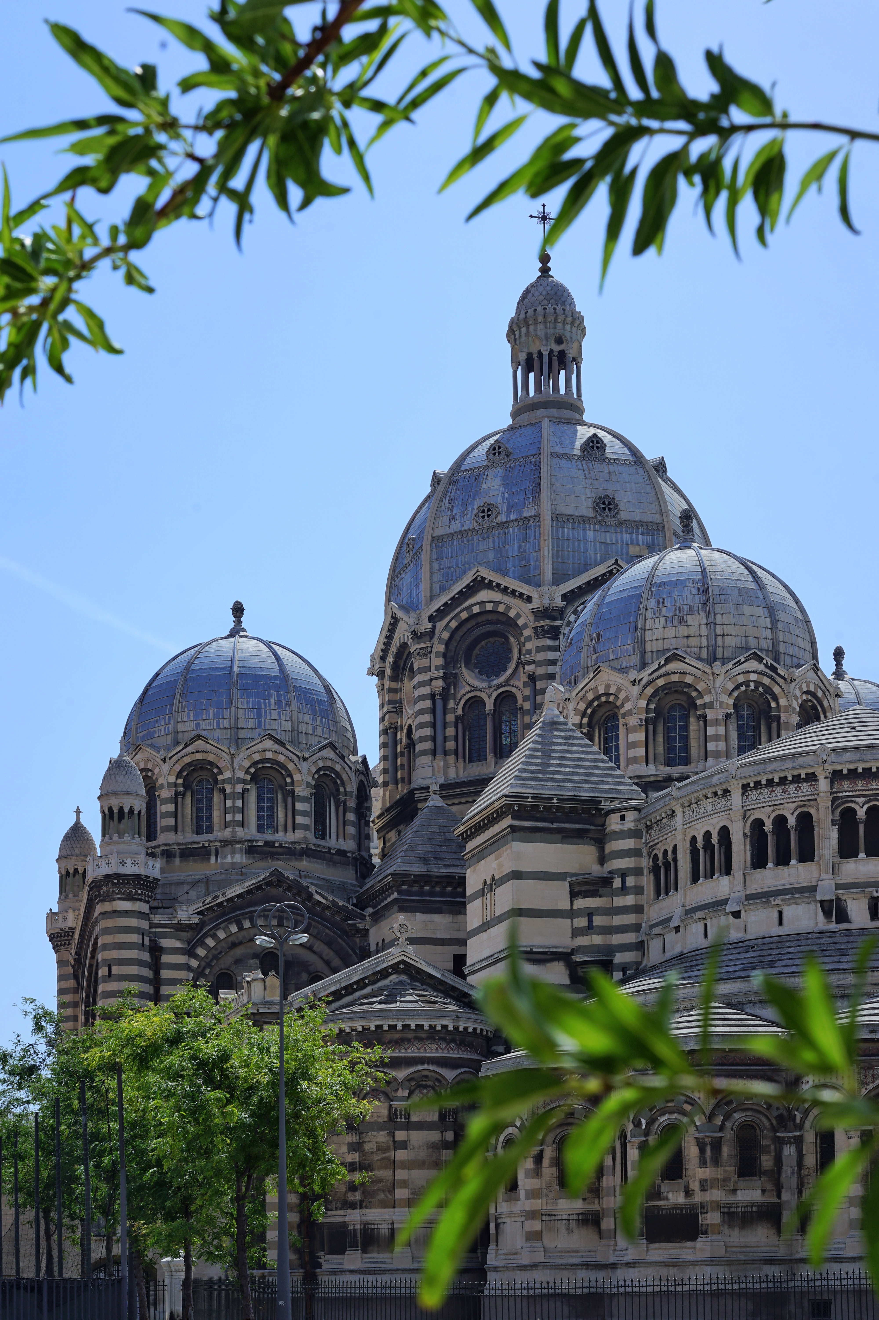
Status of the MilliQan Experiment during Run 3
Juan Salvador Tafoya Vargas (UC Davis)
on behalf of the milliQan Collaboration
EPS-HEP 2025 Marseille
2025.07.11

Slide 2
New physics and dark matter → Hidden Valley
U(1)
U(1)*
electron
γ
photon
γ*
dark photon
dark electron
strength: e
Natural strength (LO):
α/π ≈ 1/1000
strength: e’ ≈ e
No signs of new physics seen at the LHC (yet)
SM extensions that include dark (or hidden) sectors give very plausible hint
Photons and dark photons originate from different $U(1)$
gauge groups, but they can interact through kinetic mixing
Interaction with dark electrons is around
1/1000 as strong as the standard model
from naturalness arguments

Slide 3
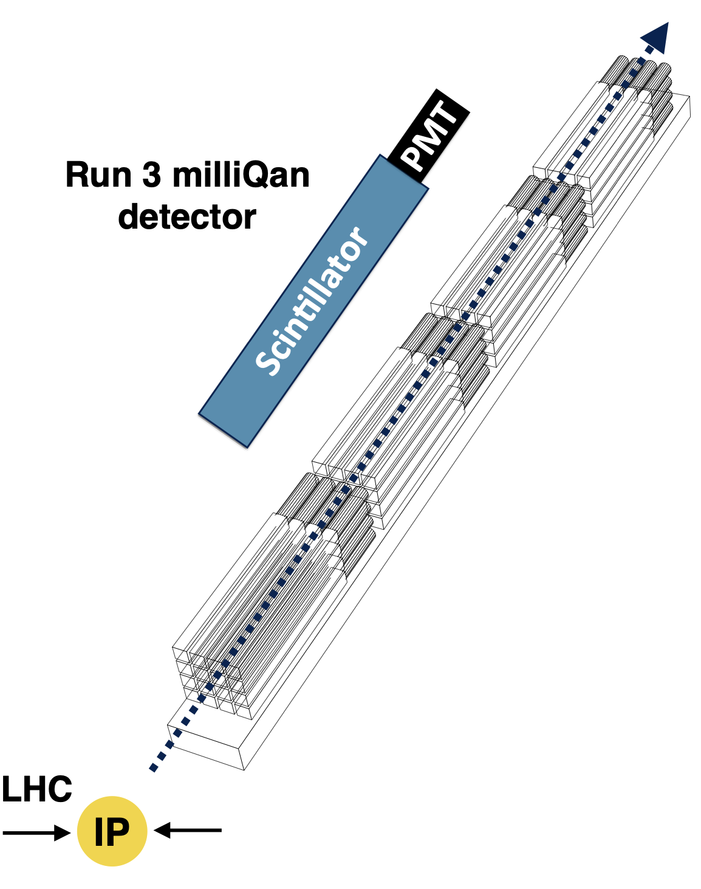
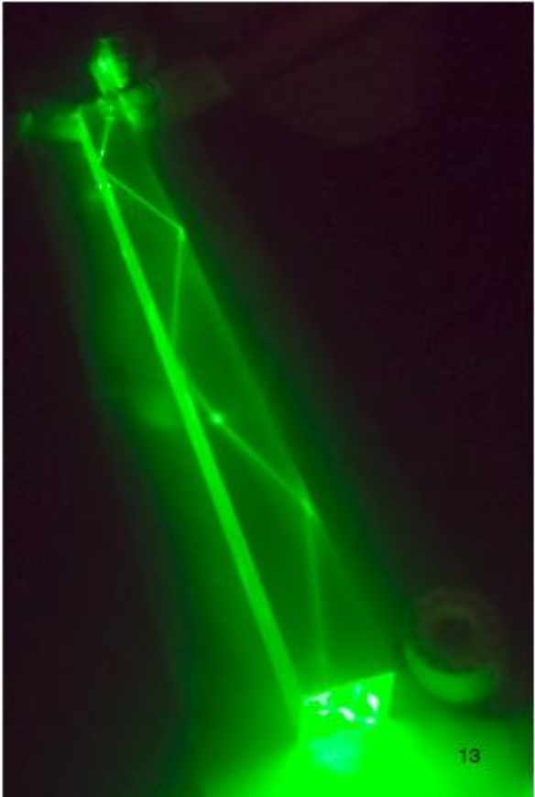
Millicharged particle searches at the LHC
Millicharged particles (mCPs) are well motivated in dark sector theories, but difficult to detect because the interaction strength is reduced by a factor $(Q/e)^{2}$.
A complementary LHC hidden/dark sector experiment proposed by Andy Haas and Chris Hill in 2014
Core concept: Use array of efficient long scintillator bars + PMTs to detect ionisation from mCPs.
Challenges:
Expect few scintillation photons to be produced
→ must be able to detect single scintillation photons
Well controlled backgrounds → signatures “point” at the interaction point, triggering on sets of signals within small time windows (~20 ns)
$$⟨E⟩∝{\left(\frac{Q}{e}\right)}^{2}l_{scint}$$

Slide 4
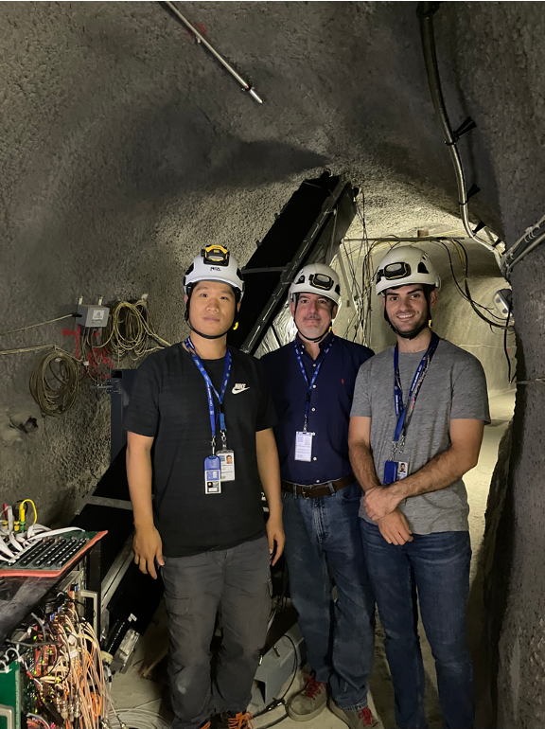
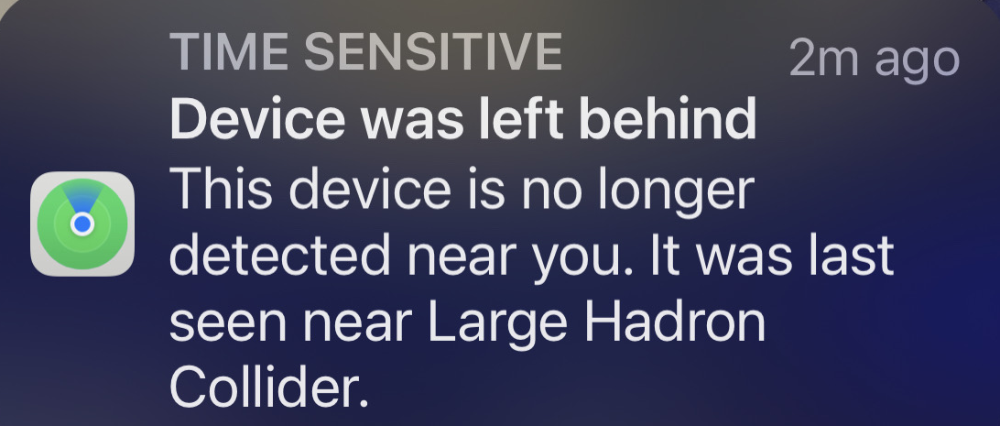
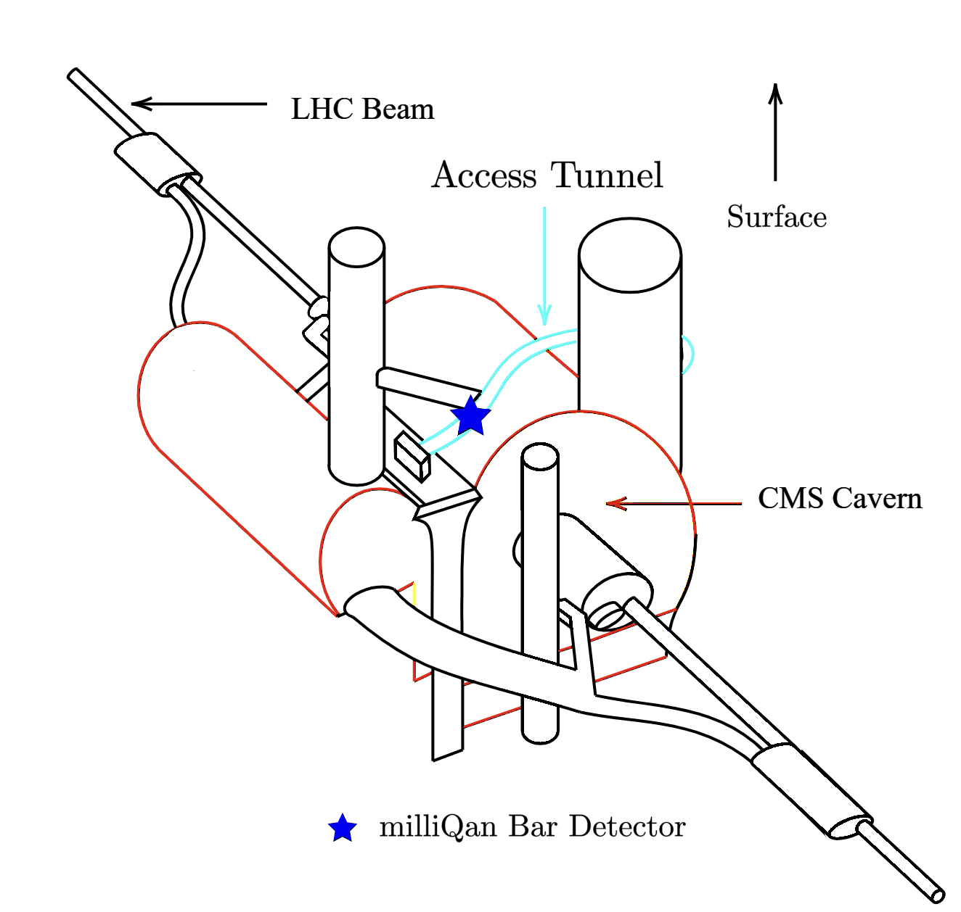
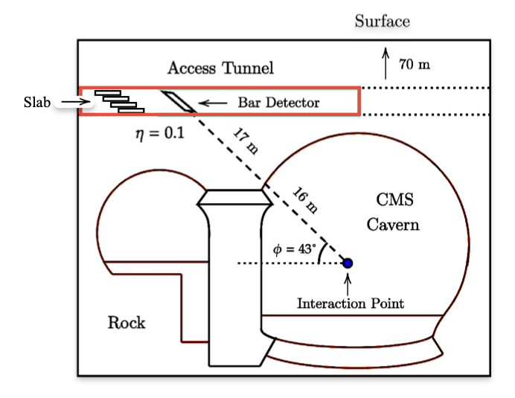
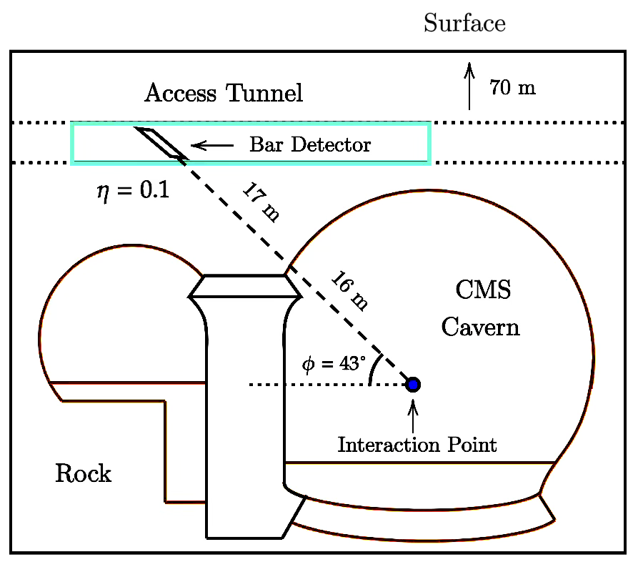
The milliQan experimental site
In a tunnel above CMS at CERN, off-axis from LHC
2 detectors, in PX56 drainage gallery
33m from CMS I.P. at an angle $η≈0.1$, $ϕ=43$
17m of rock - natural shielding from beam and I.P. subproducts
70m underground - cosmic muon flux suppressed by a factor of ~100 (compared to surface)

Slide 5
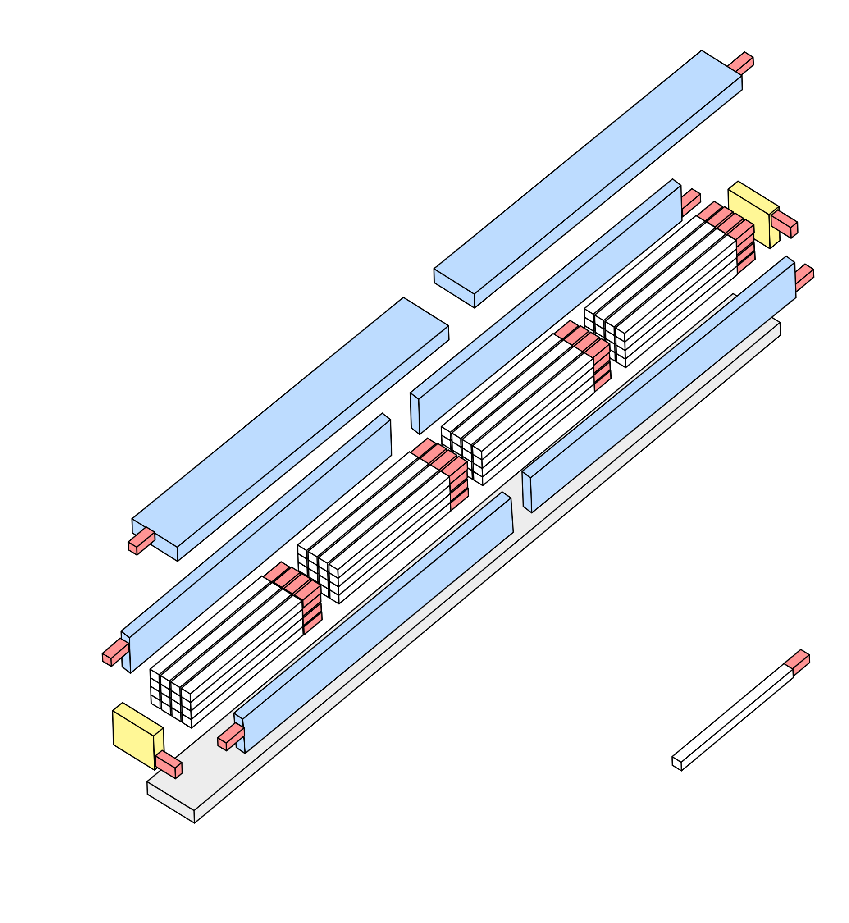
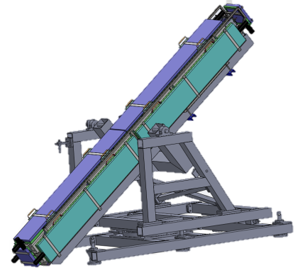
Run 3 bar & slab detector designs
Scintillator panels
Each has 4 radial “layers” of EJ200 scintillator oriented at CMS
4x4 array of 60 x 5 x 5 cm “bars”
Twelve 40 x 60 x 5 cm “slabs” equivalent to the coverage of ~1000 bars
Coupled to Hamamatsu R878 PMTs (amplified to allow sPE sensitivity)
Bar detector has veto panels to provide active rejection of cosmic and beam muon deposits
DAQ uses CAEN V1743 digitizers readout by custom FPGA-based trigger board
Photomultiplier tube
Structural
To CMS I.P.
Scintillator slab

Slide 6
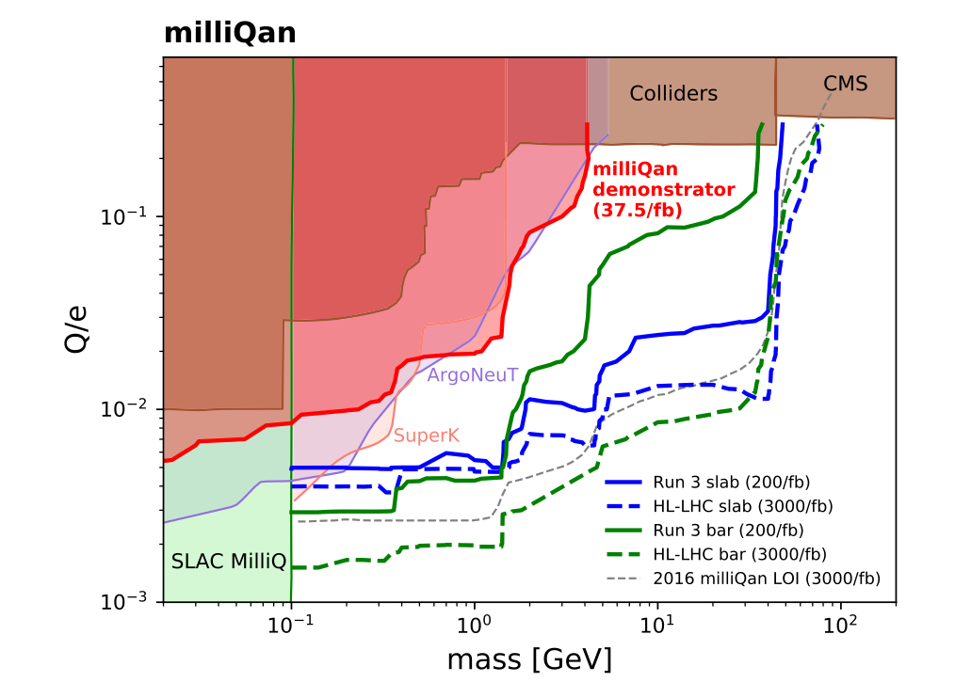
Expected sensitivity for LHC Run 3
Pending: 2nd array of what?
Phys. Rev. D 104, 032002
Incorporating lessons learned from Run 2 bar “demonstrator,” Run 3 design:
Added 4th layer of scintillator bars
Added FPGA-based trigger logic
Added 2nd array
Run 3 detector is sensitive to significant region of unexplored parameter space
Charge limited region: very high mCP flux but low efficiency
(Bars)
Acceptance limited region: high efficiency but mCP flux is low
(Slabs)

Slide 7
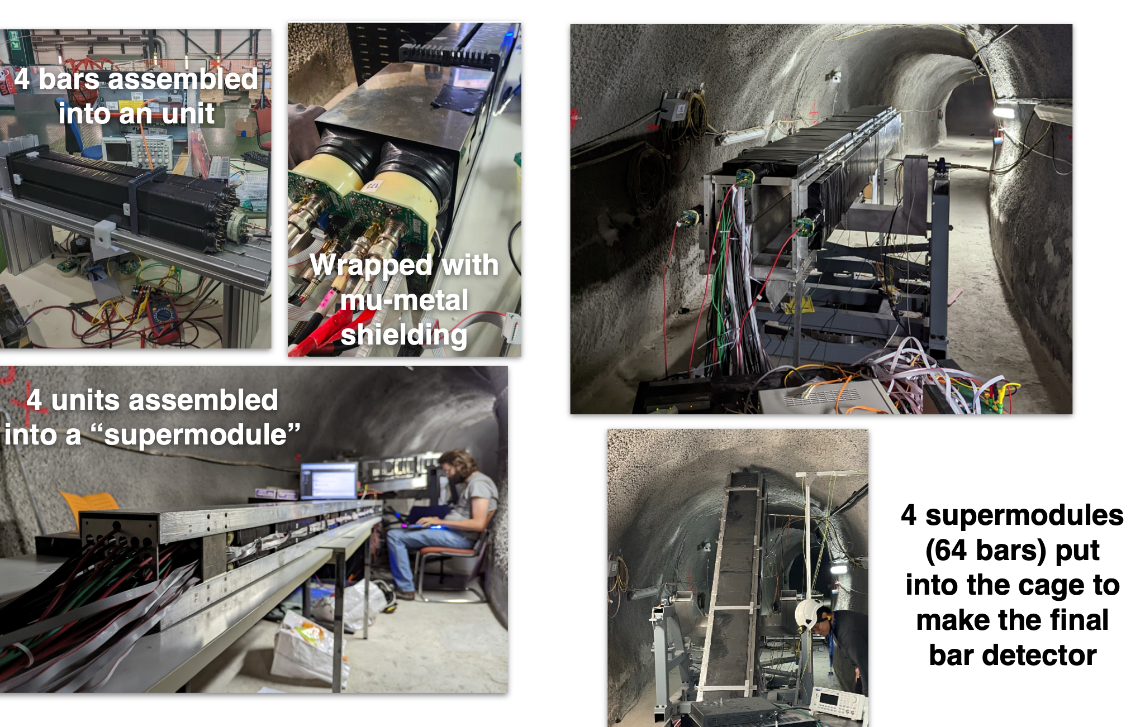
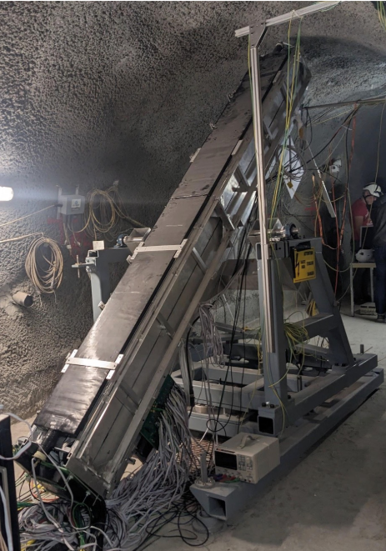
Bar detector completed in spring 2023

Slide 8
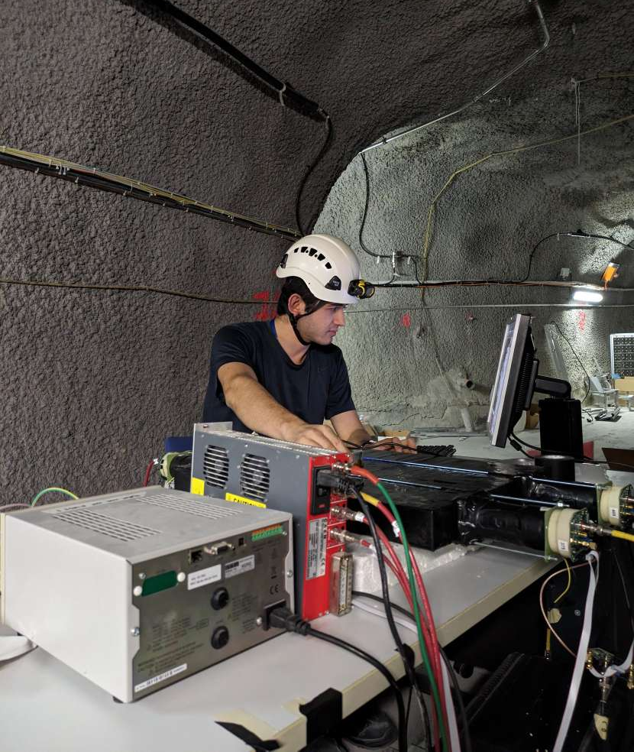
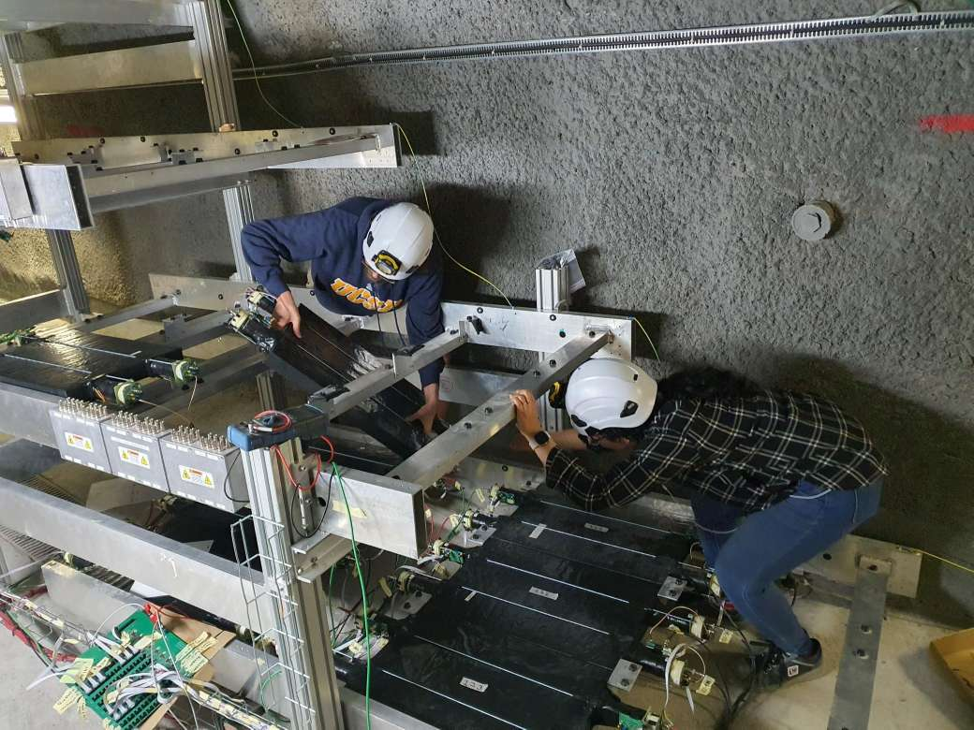
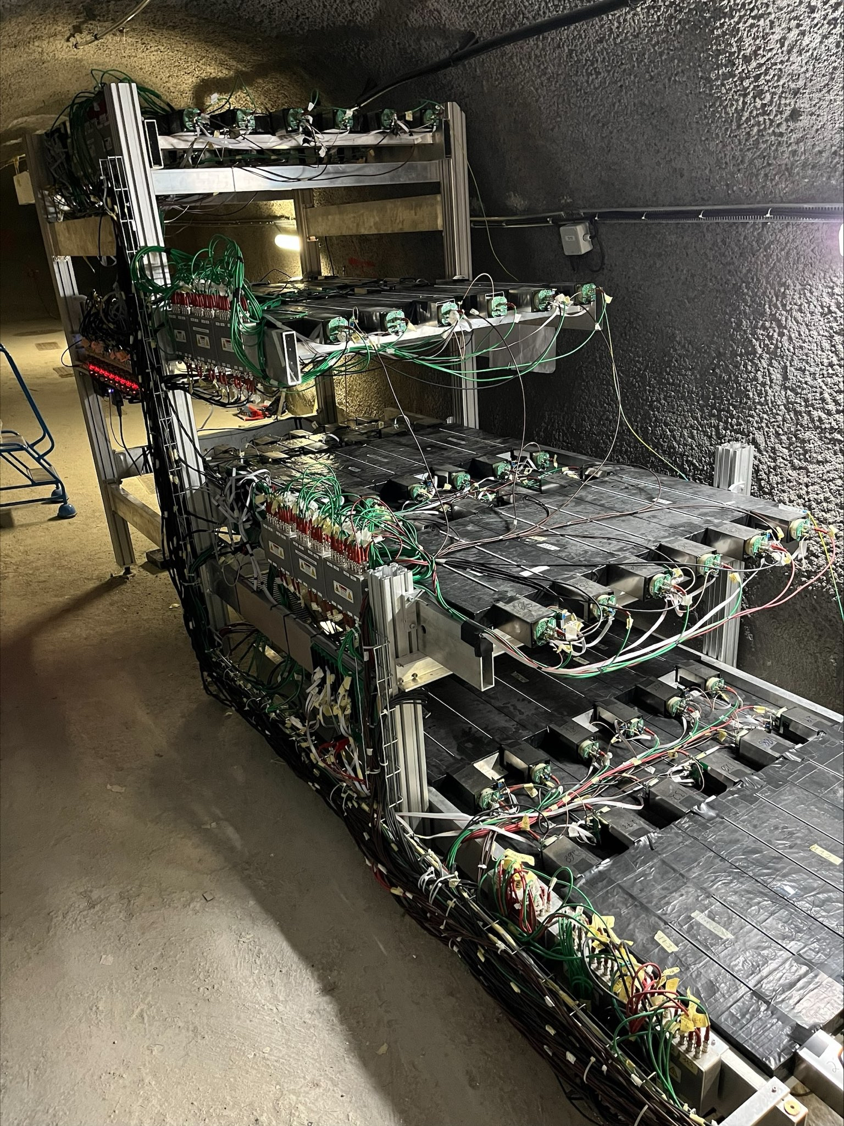
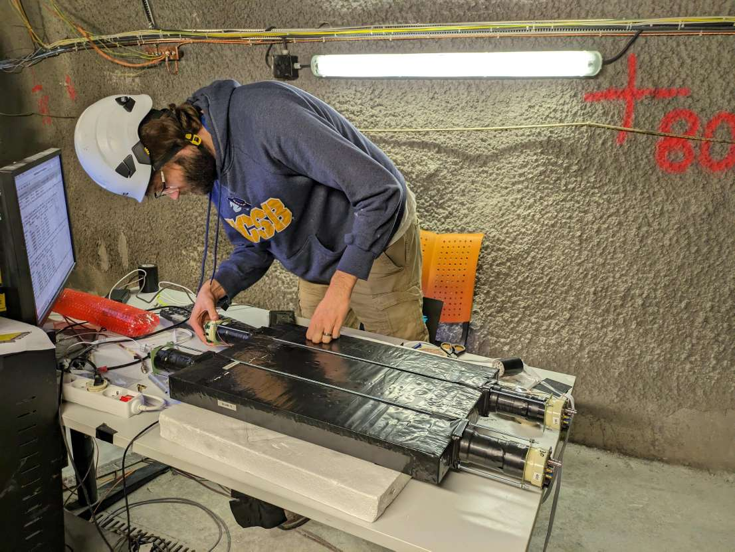
Slab detector completed in summer 2024
Smoothly taking data since October 2024
Fully commissioned now, will take physics-data remainder of 2025.

Slide 9
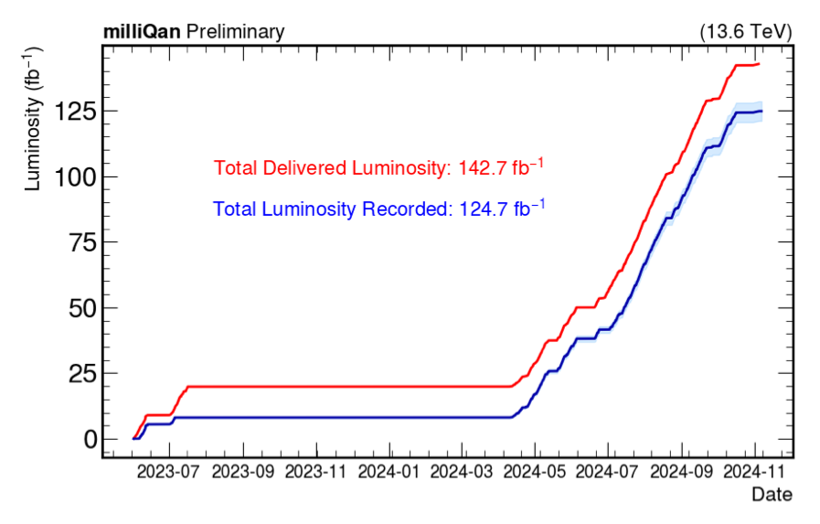
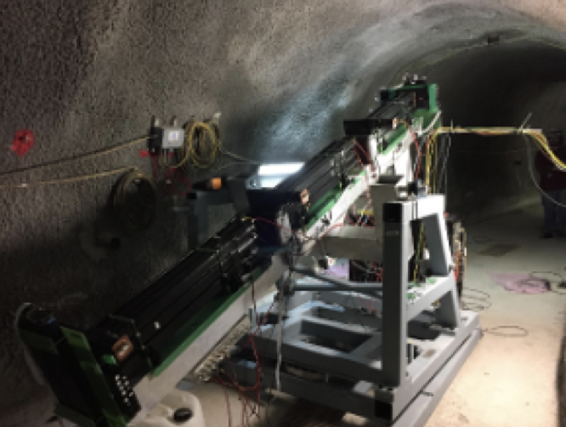
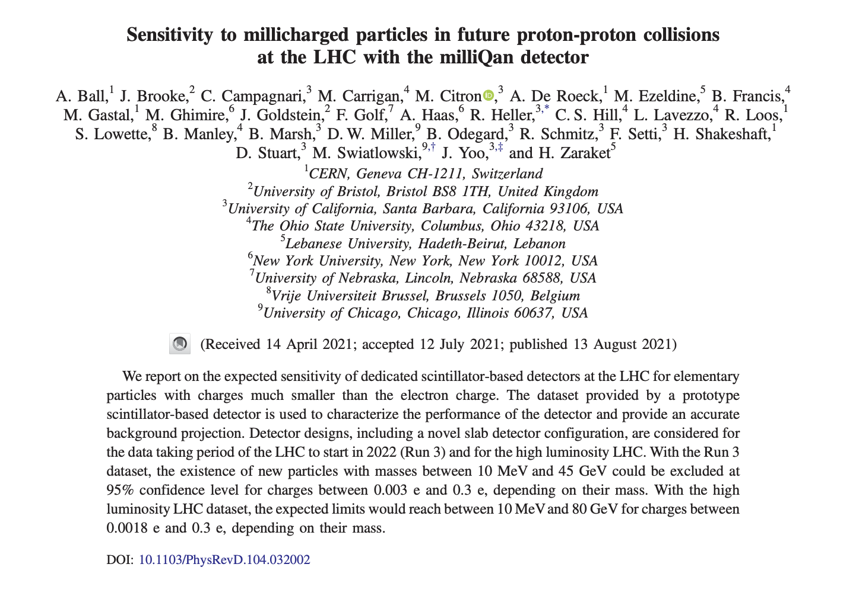
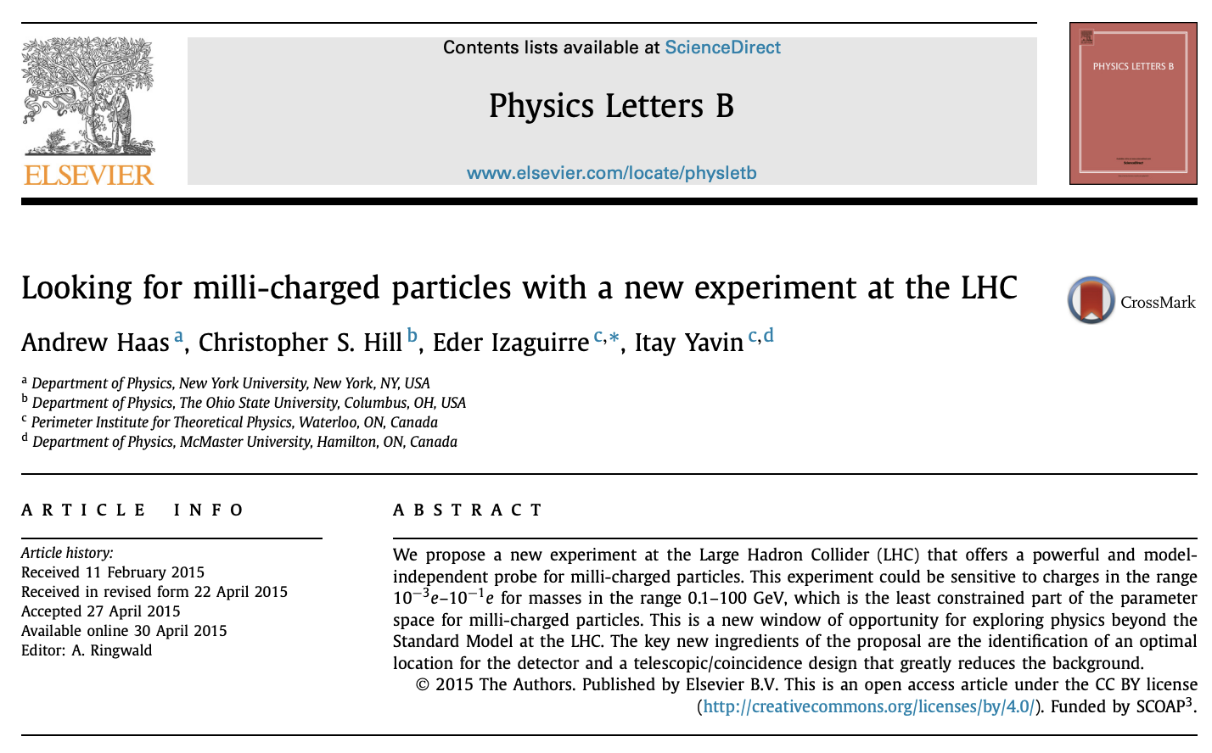
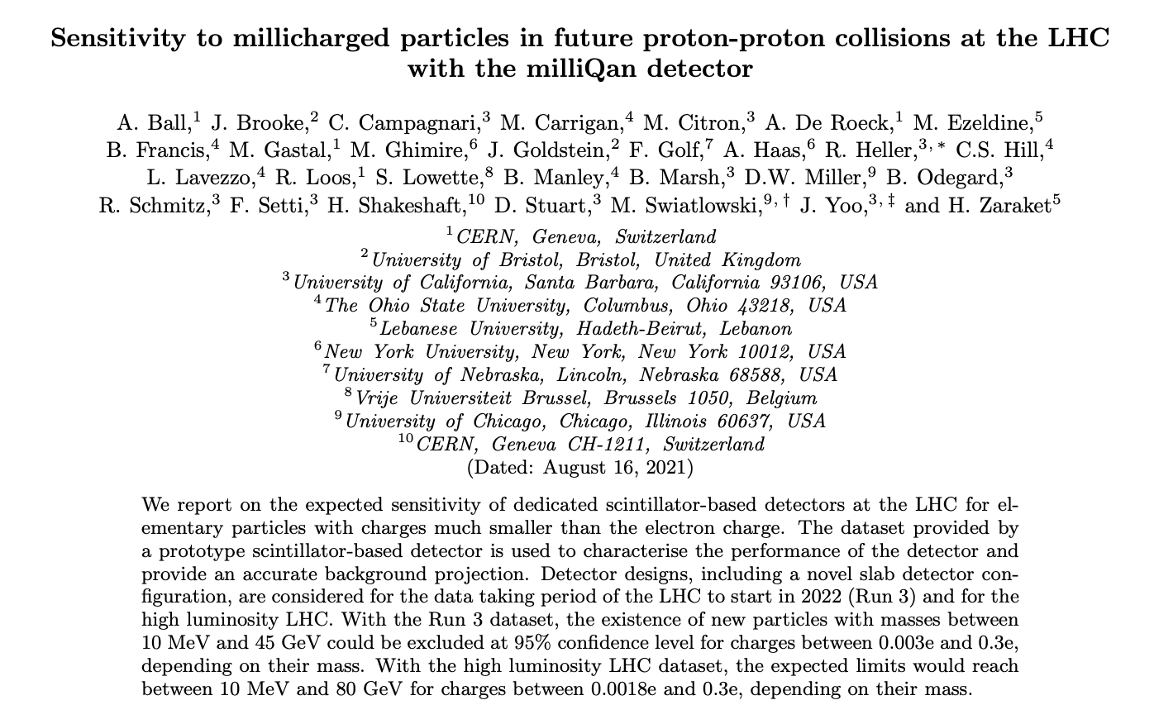
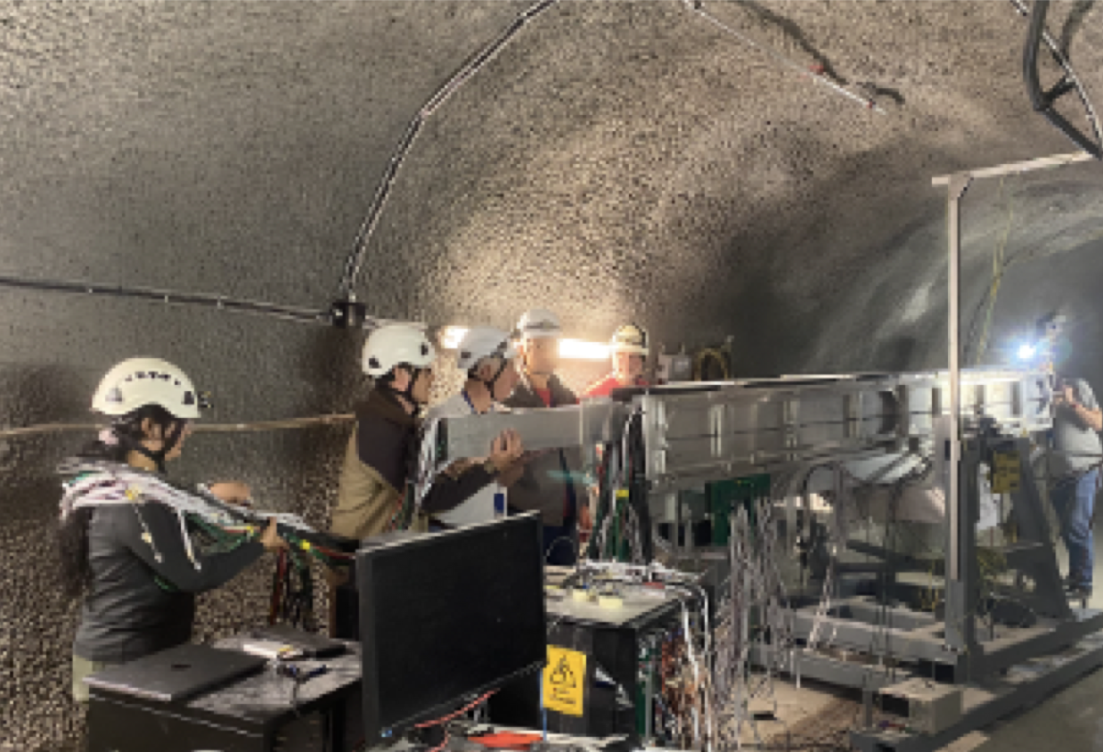
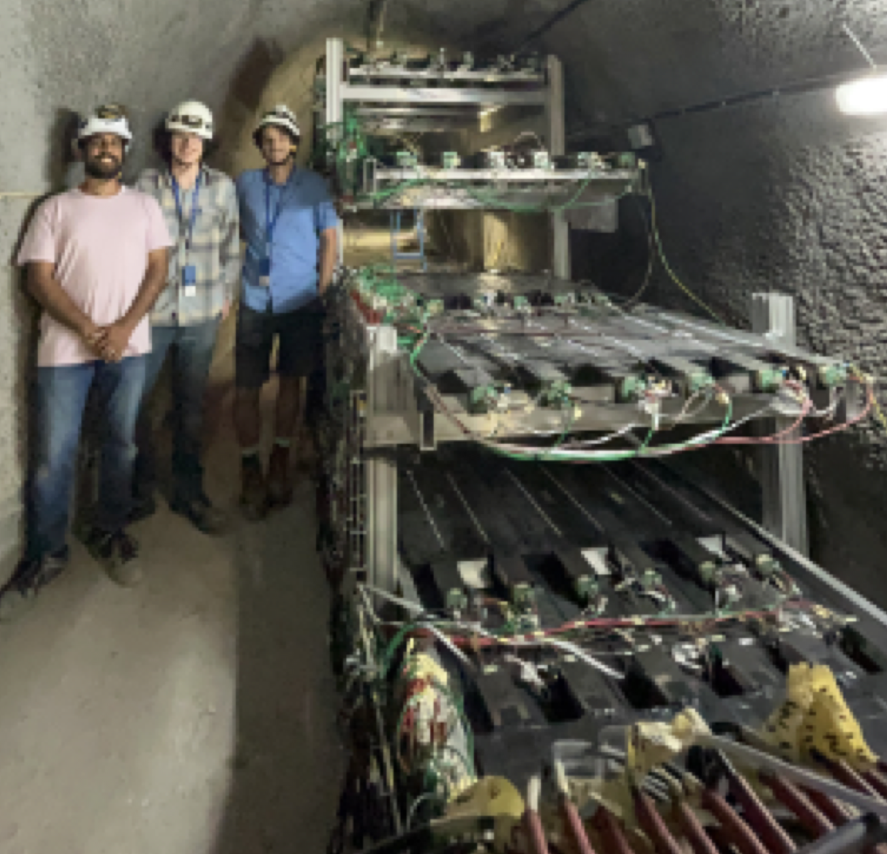
Summary of timeline
milliQan demonstrator commissioned
(June 2018)
Run 3 projections paper
(June 2023)
Showing first results today!
Collected $124.7{fb}^{-1}$ data
(Dec 2024)
Bar commissioned
(June 2023)
milliQan proposal
(2014)
millliQan demonstrator paper
(2022)
Bar detector construction begins
(2022)
Slab detector commissioned
(July 2022)
Bar detector search
(May 2025)

Slide 10
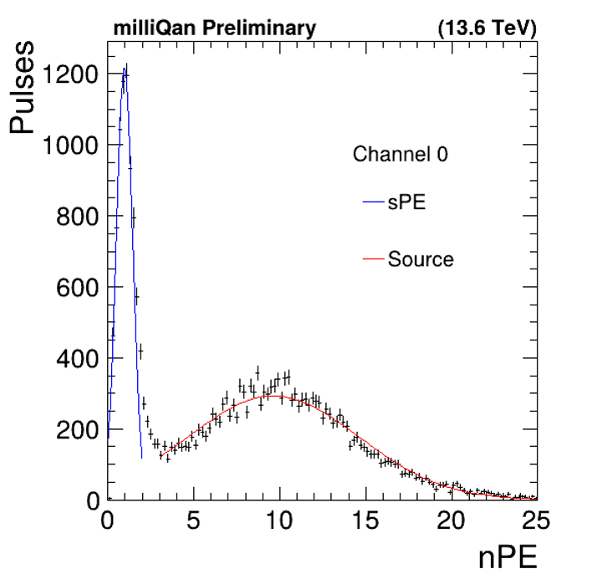
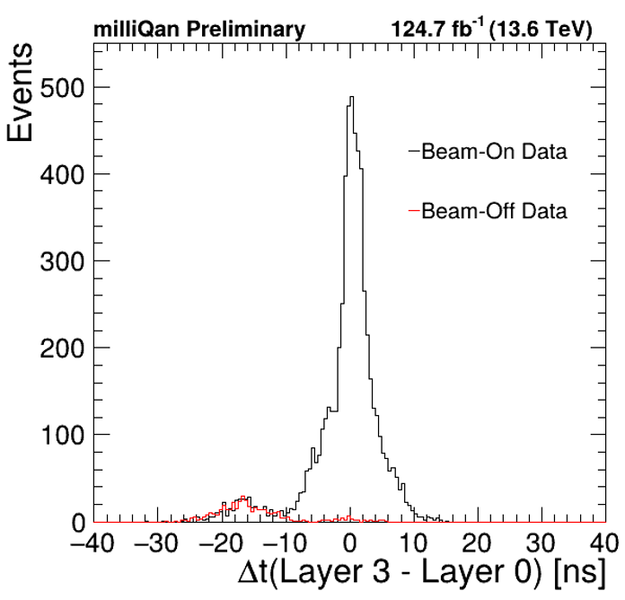
Energy and timing calibrations
Measure response of every scintillator+PMT module using ${}^{109}Cd$ source (22 keV X-ray)
Calibrate each channel in GEANT4 simulation to ensure accounts for differences in PMT quantum efficiency, bar wrapping, optical coupling, etc…
Correct for timing shifts due to differences in electronics/cable lengths with beam on/off data + cosmic muons
Calibrate such that particles traveling straight through detector from I.P. have same time in all channels
Timing validated
with beam and cosmic muons

Slide 11
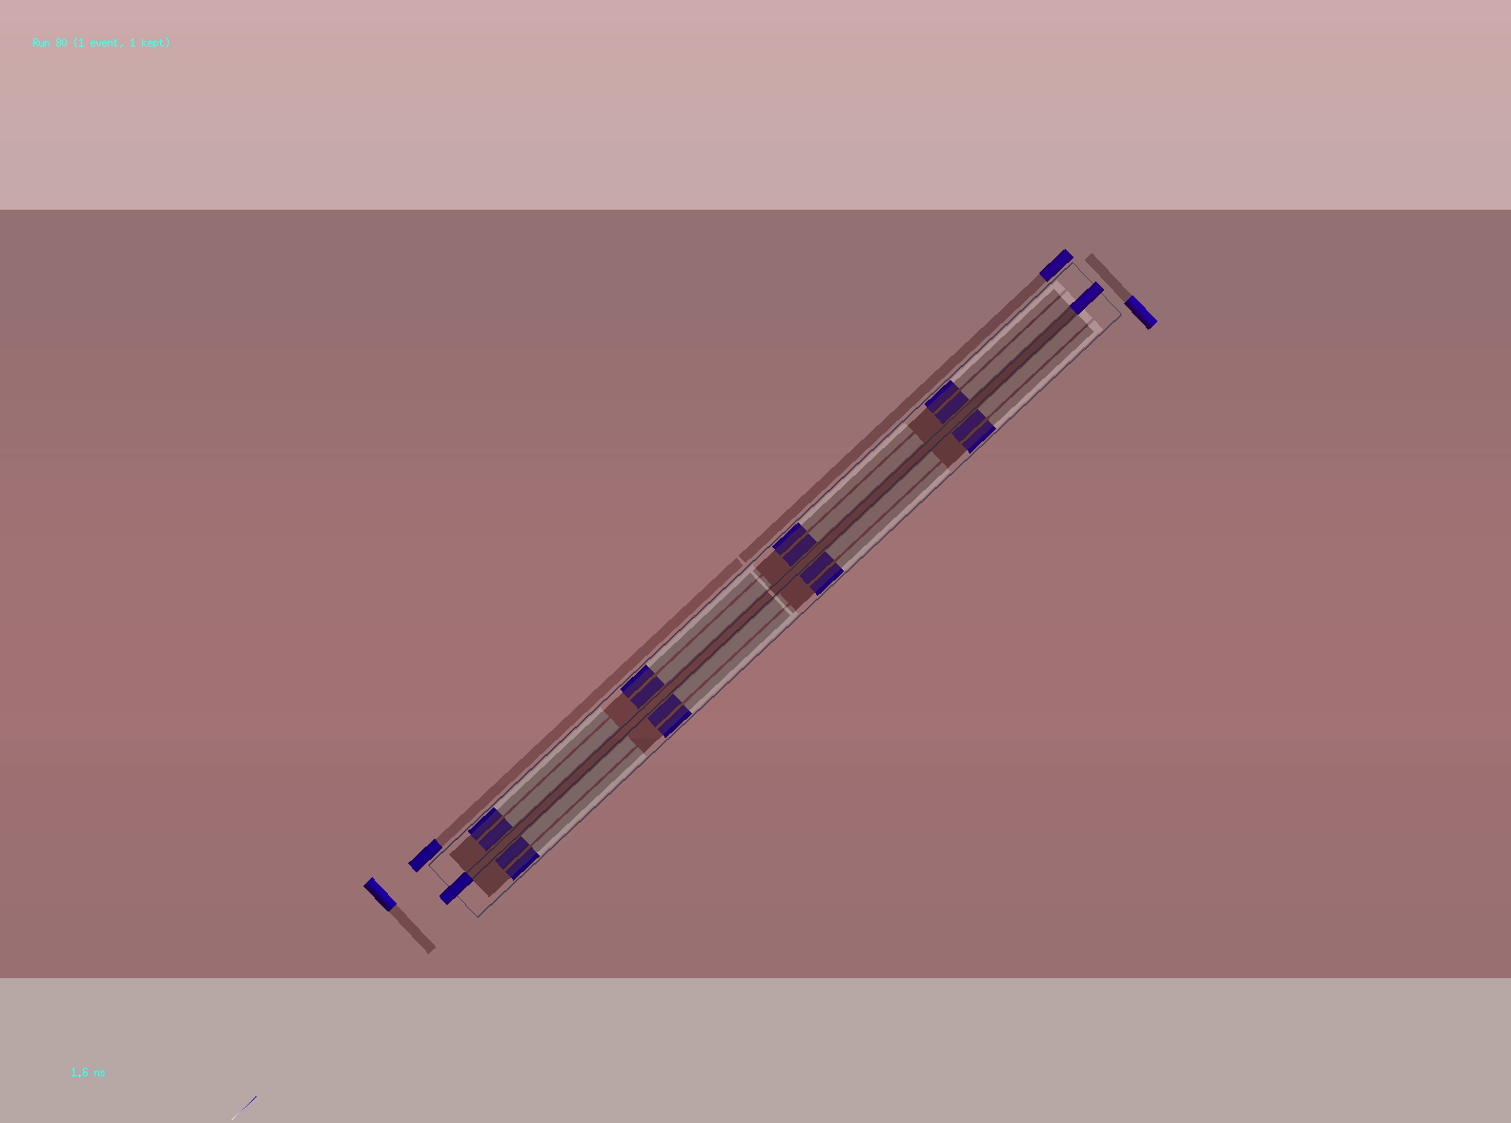
A fully calibrated GEANT simulation
Rock
Tunnel
Legend:
$μ$, $γ$, $mCP$, $e^{-}$,
optical photon

Slide 12
Run 3 search for mCPs, started in 2023
Detector and GEANT4 simulation fully calibrated with collected data
Bar detector collected 124.7 fb-1 of physics-quality data in 7800 h of operation
Web based DQM tools allow rapid response when issues arise
>95% data collection efficiency since 2024!
Carried out a first search for the mCPs with this dataset

Slide 13
Validating simulation and alignment with muons
measured ~0.2º misalignment
Fixing for 2025 running!
Using paths of muons measure ~0.2º misalignment → correcion applied to MC (~12% impact on signal a efficienty)
Measured muon rate in agreement with simulation: obserbed $0.21±0.05{pb}^{-1}$ for $0.21±0.05{pb}^{-1}$ expected

Slide 14
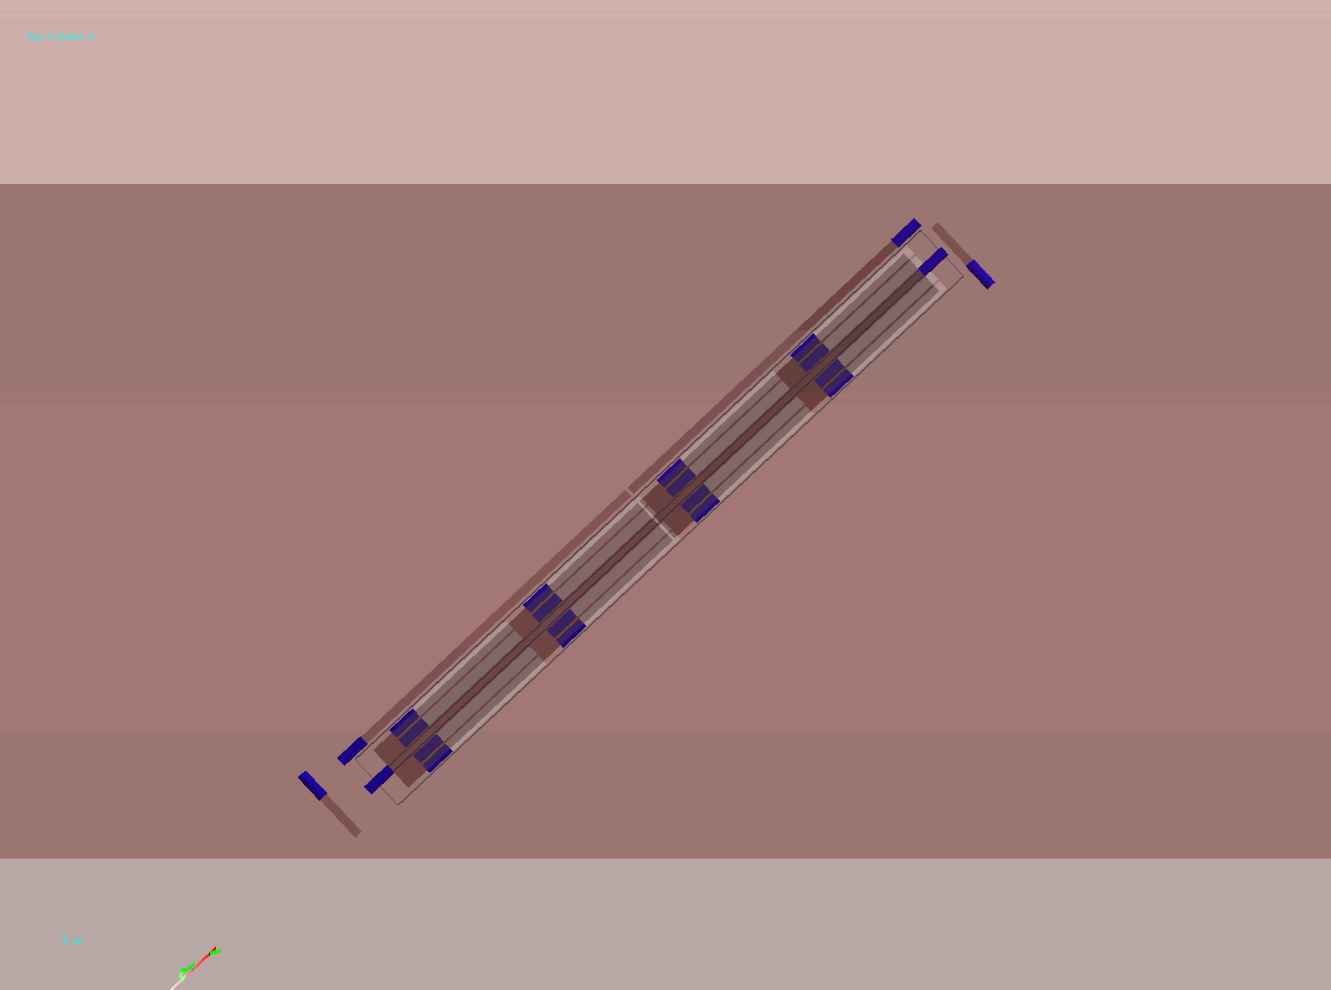
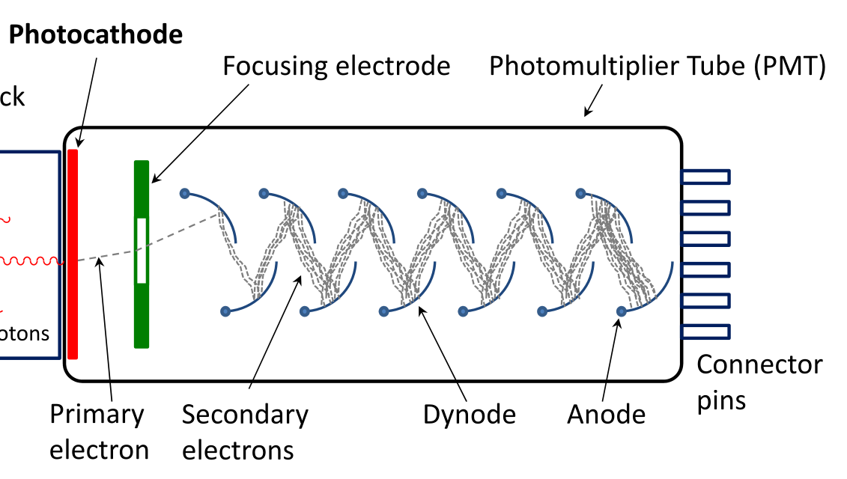
Main mCP backgrounds + mitigation
Background: PMT dark rate (random in time)
Background: beam/cosmic muon + secondaries
Thermionic
emission
~ kHz rate
Veto events with single deposit per layer forming pointing path to I.P. if also have
deposits in side panels
Require 4 layer coincidence
(hit in each layer within 20 ns window)

Slide 15
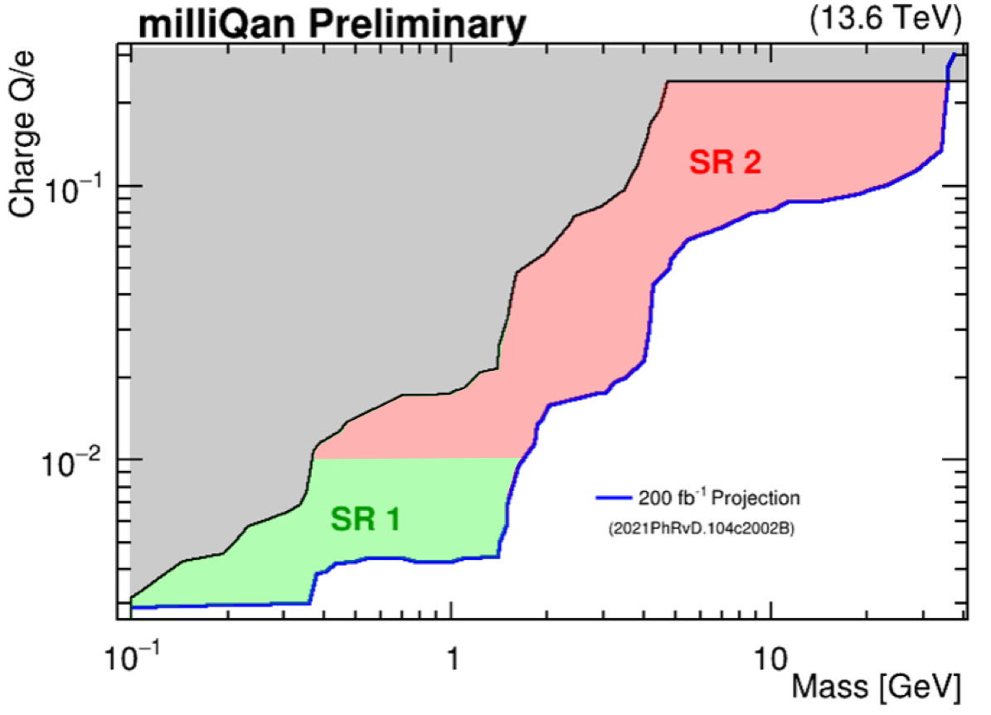
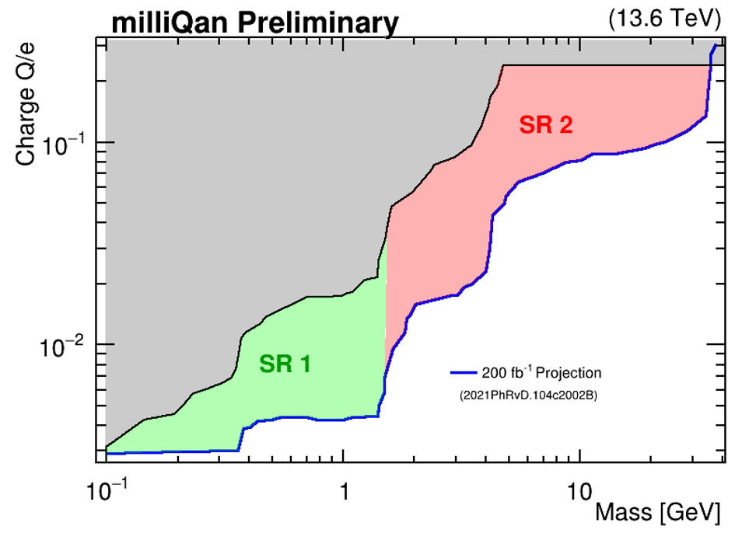
Search in two orthogonal signal regions
SR1: lower charges
Veto events with hits in front/back panels and saturating pulses deposited in any bar.
SR2: higher charges
Require events to have ≥1 hits in front/back panel (but with < 70 nPE).
Q/e = 0.002
SR1
Q/e = 0.01
SR2

Slide 16
Background prediction/validation: SR1
Q/e = 0.002
Background predicted using ABCD method inverting timing and pointing path requirements in “beam-on” dataset (data taken during LHC collisions).
Validate prediction method using beam-off dataset and “nearly pointing” control region (max deviation from straight-path of one bar/layer).
Beam-off SR1
Prediction: ${0.32}_{-0.16}^{+0.24}$Observation: $0$
Beam-on SR1 control region
Prediction: ${0.31}_{-0.18}^{+0.28}$
Observation: $1$

Slide 17
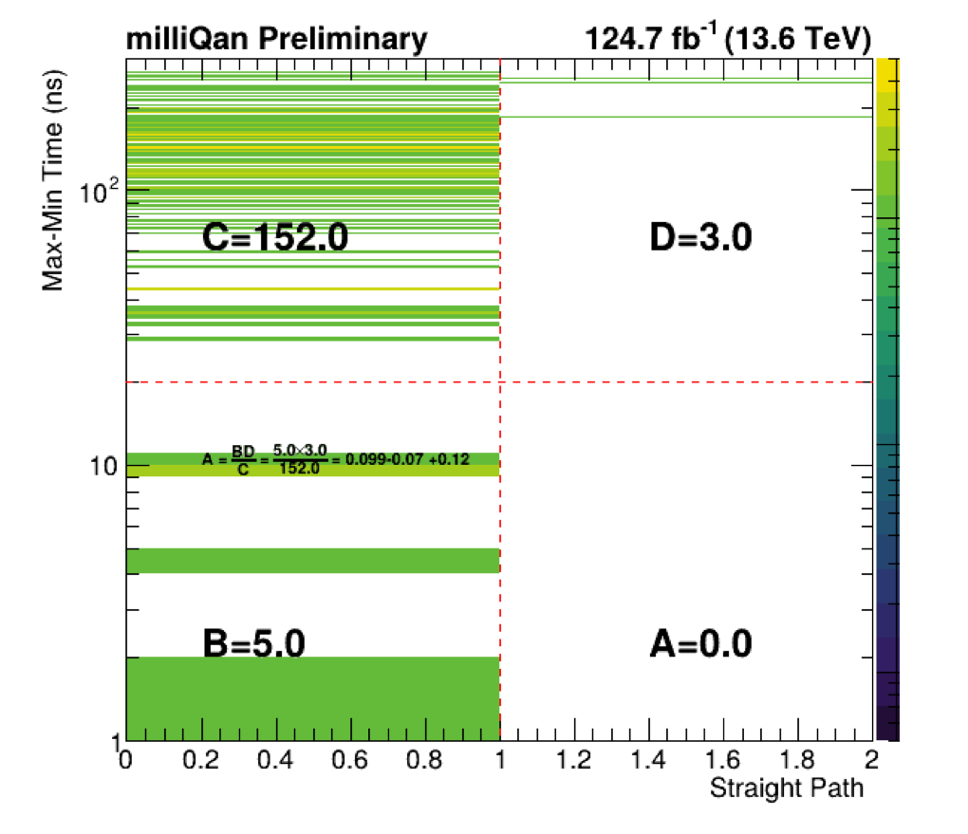
SR1 search results
Prediction: ${0.10}_{-0.07}^{+0.12}$
Observation: $0$
Result:
Observation consistent with background expectation
No mCP signal :(
“No”
“Yes”

Slide 18
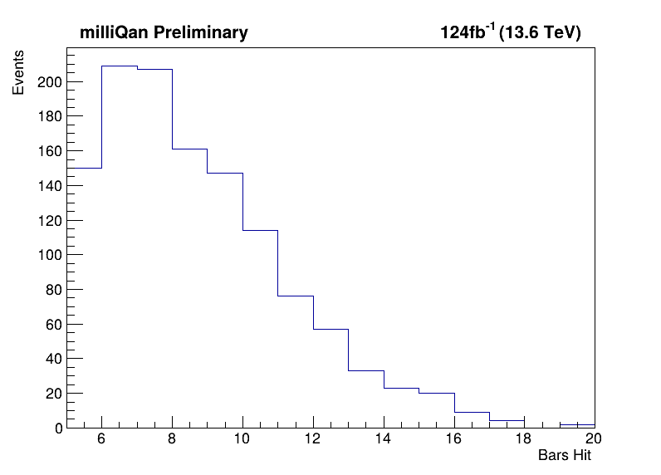
Background prediction/validation: SR2
Dominant background for SR2 is from beam muons that shower through detector — can’t predict in beam-off dataset
Background predicted using ABCD method inverting front/back panel nPE and number of bar requirements
Validate prediction method using 5-6 bar hit control region
Q/e = 0.01
Beam-on SR2 control region
Prediction: ${3.40}_{-1.20}^{+1.69}$ Observation: 5
CR

Slide 19
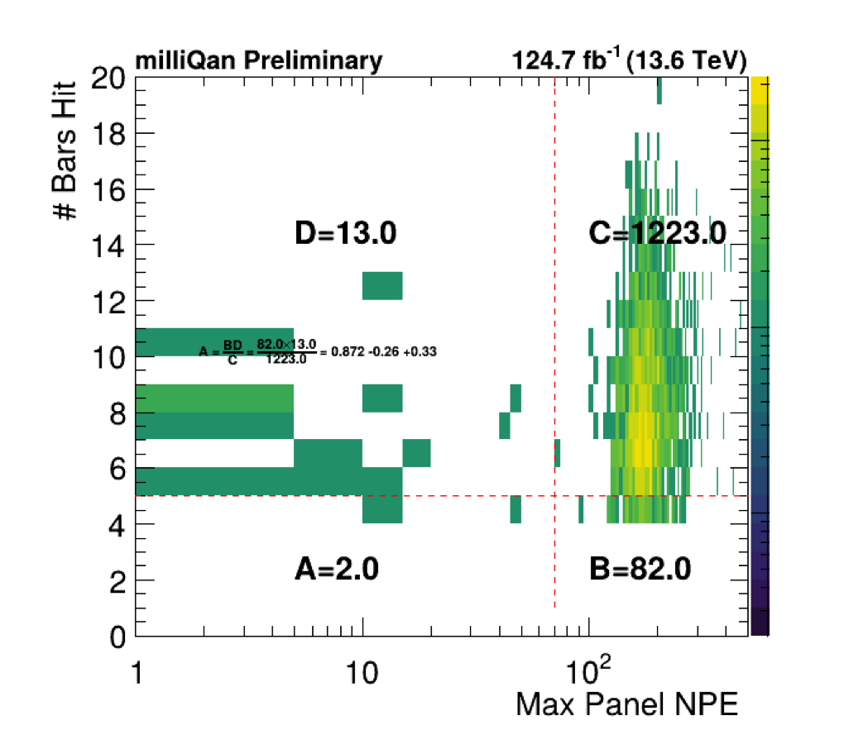
SR2 search results
Prediction: ${0.87}_{-0.26}^{+0.33}$
Observation: $2$
No significant excess in SR1/SR2 … proceed to set limits
Result:
Agreement within ~1.2σ

Slide 20
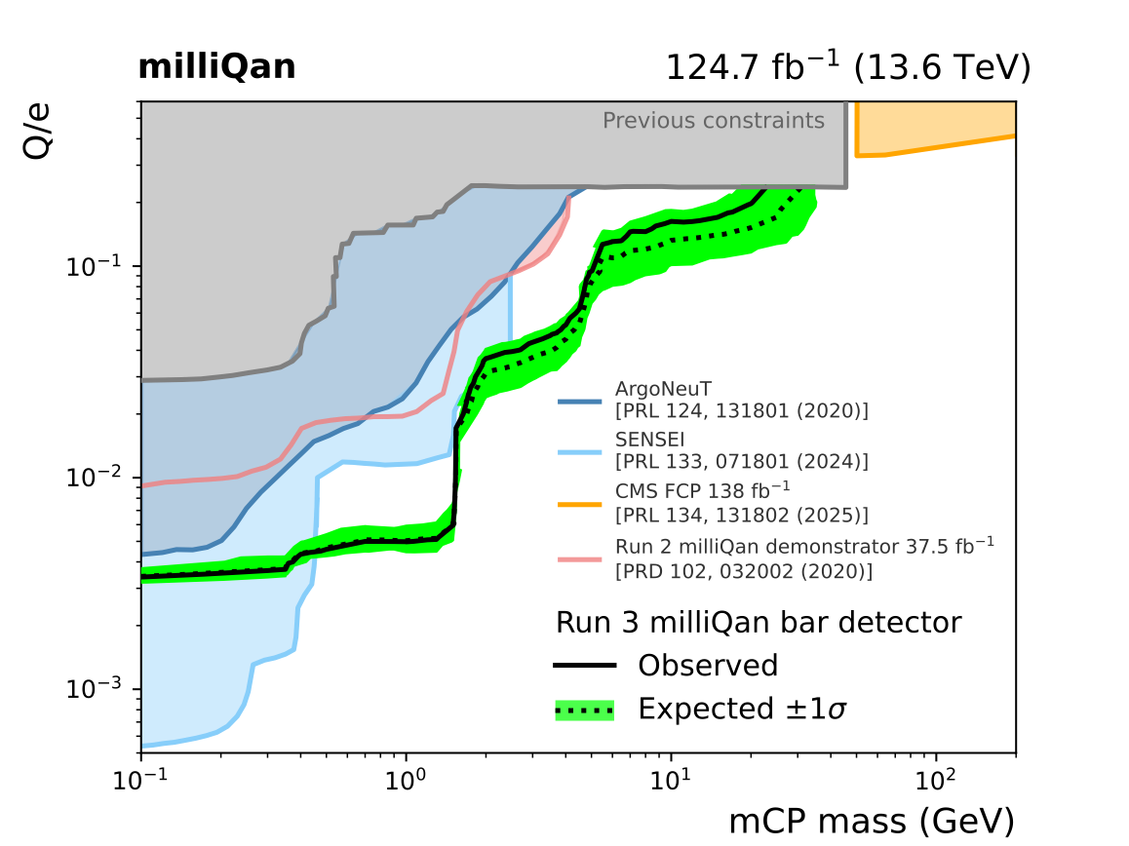
Search results!
Results significantly extend constraints in charge/mass plane
World leading limits on mCPs with masses 0.5 - 25 GeV!
This despite only 40% of full Run 3 dataset analyzed (and only using data collected with bar detector)
Paper available at https://arxiv.org/abs/2506.02251 !

Slide 21
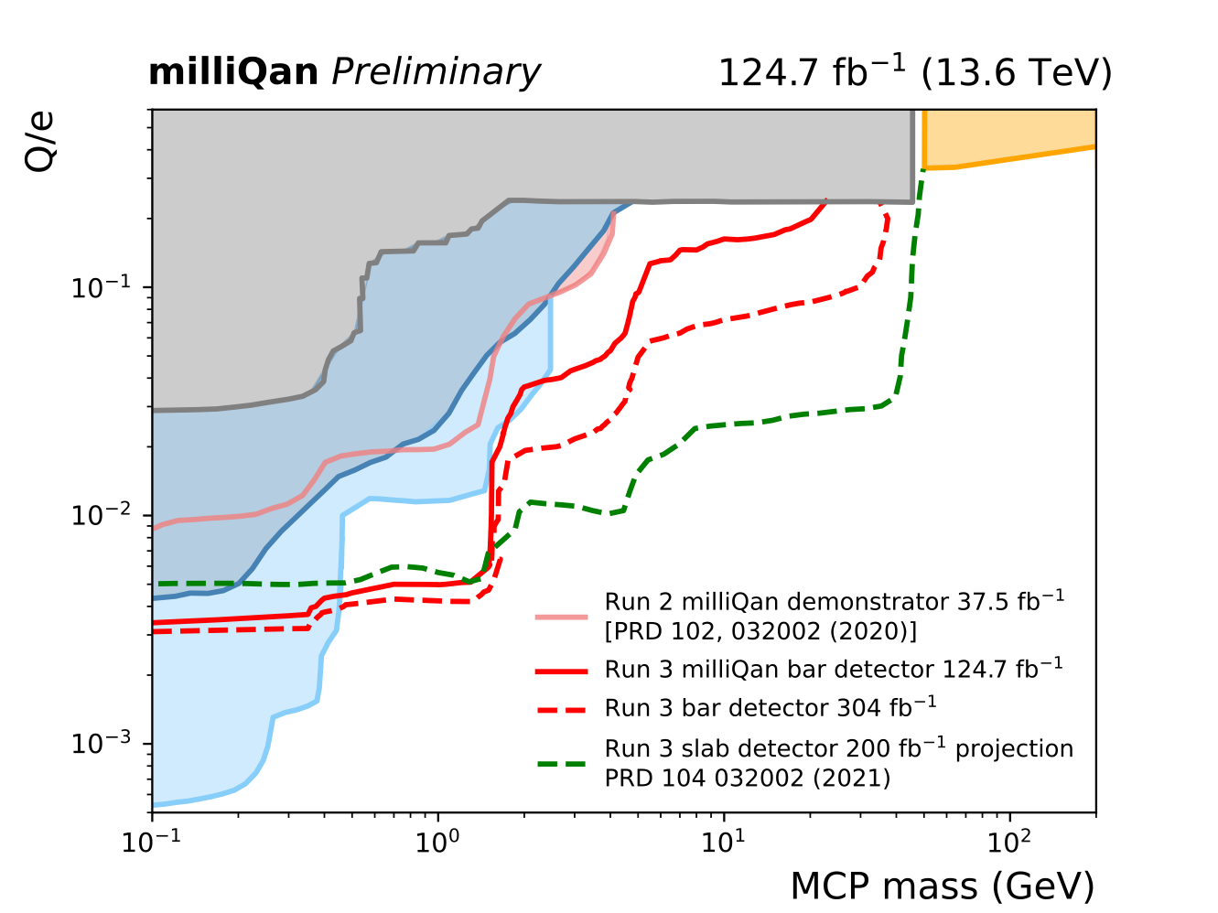
Expectation for full Run 3
Adding 2025+2026 data gives significant guaranteed extension in reach with bar detector
Addition of hermetic front panel will reduce background << 1 for SR2
Search already designed, will allow rapid top up
Slab detector is online for 2025 running will extend even further!

Slide 22
Summary & Outlook
milliQan has searched for millicharged particles using 124.7 ${fb}^{-1}$ pp collision data at $\sqrt{s}$ = 13.6 TeV collected by its bar detector in 2023-24
No candidate mCP events were observed and we have set world leading constrains on millicharged particles with masses 0.5 - 25 GeV.
We look forward to exploring the remainder of the significant accessible parameter space with the addition of 2025-26 Run 3 data that will include our slab detector
For more information and a general overview of the experiment, check out this short film about milliQan produced for the recent 2025 APS global physics summit:
https://www.youtube.com/watch?v=rFjgGTclM9E

Slide 23
The milliQan collaboration
This speaker supported by funding from DOE Office of Science

Slide 24
End

Slide 25
Backup

Slide 26
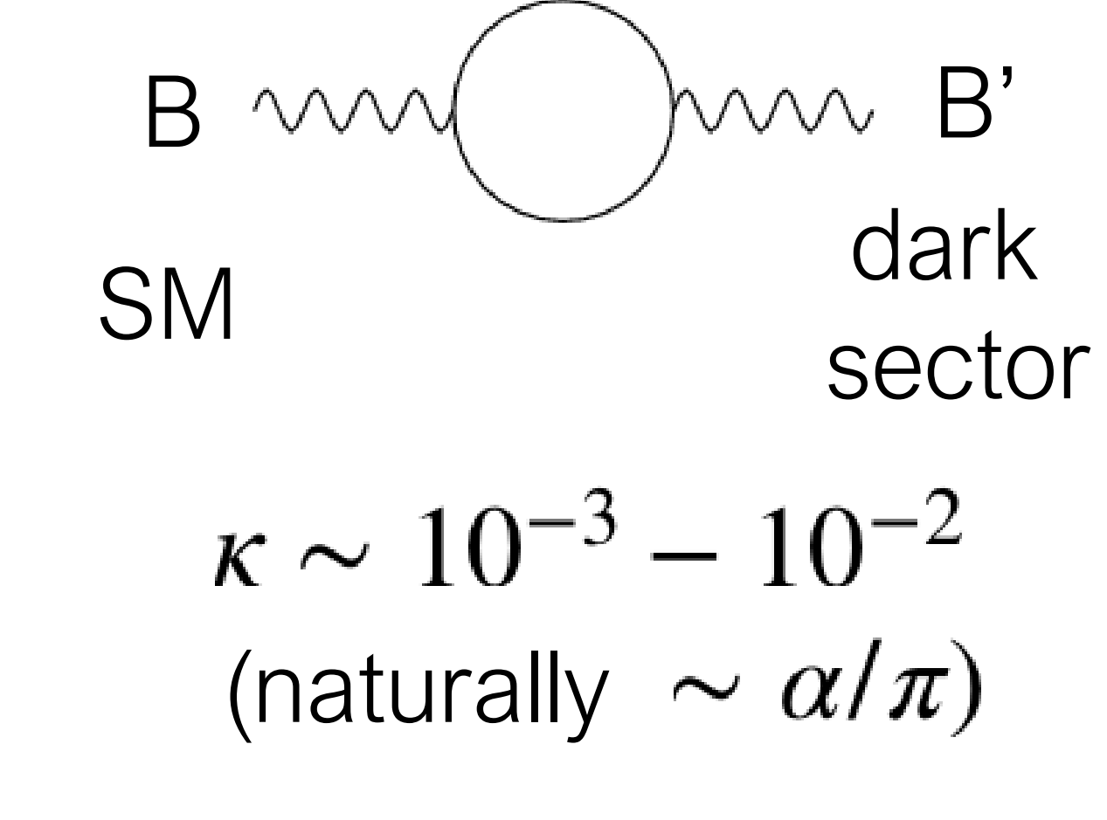
Why millicharged particles?
Standard motivation: Introduce new, hidden $U(1)$ with a massless field A', a “dark photon” that couples to a massive “dark fermion” ψ’
$ψ^{′}$ has mass $M_{mCP}$ and charge under the new $U(1)$ of $e^{′}$
Gauge transformation of $A_{μ}^{′}→A_{μ}^{′}+κB_{μ}$ introduces coupling $\overline{ψ^{′}}κe^{′}γ^{μ}B_{μ}ψ^{′}$
Conclusion: Coupling arises between dark fermion and SM photon of charge $κe^{′}cosθ_{W}$ . mCP parameters are entirely defined by their mass and charge
see e.g. arXiv:2104.07151v2 for more details
massless “dark photon”
“dark fermion” with mass $M_{mCP}$ , charge $e^{′}$
mixing term

Slide 27
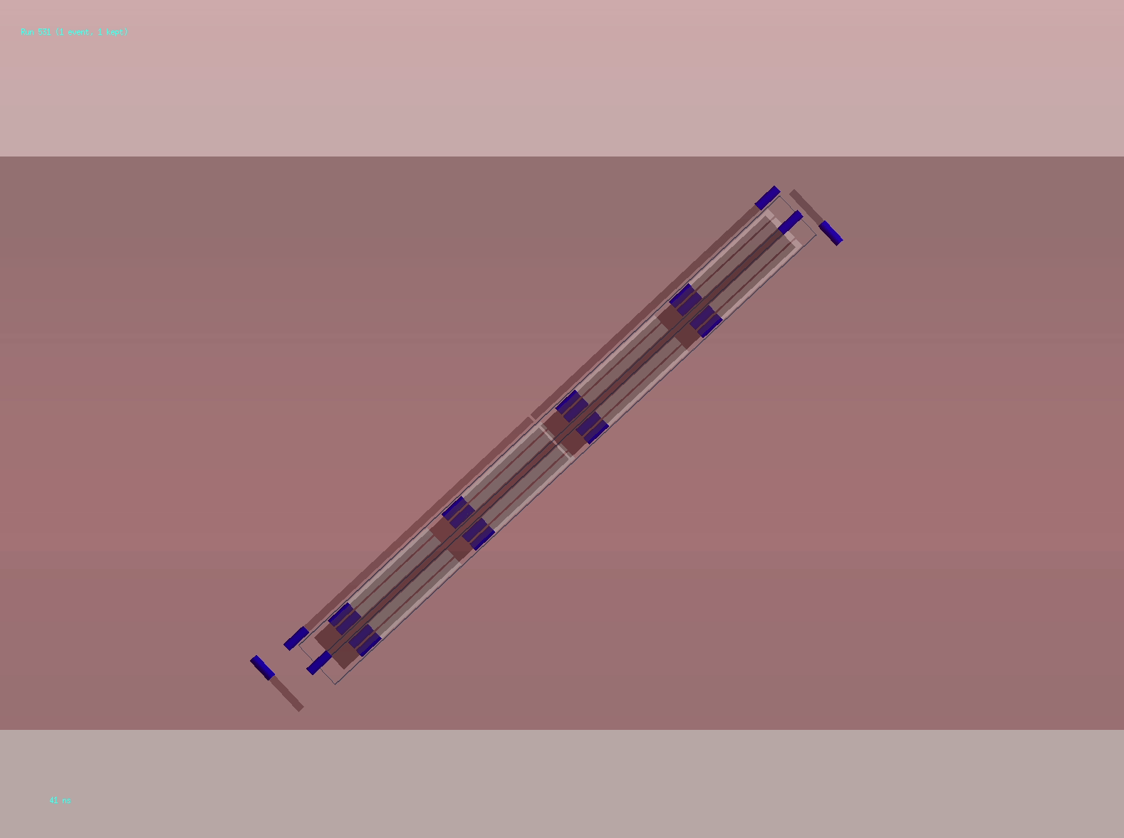
Millicharged particle through detector
Rock
Tunnel
$$Q_{mCP}=0.01e$$
Legend:
$μ$, $γ$, $mCP$, $e^{-}$,
optical photon

Slide 28
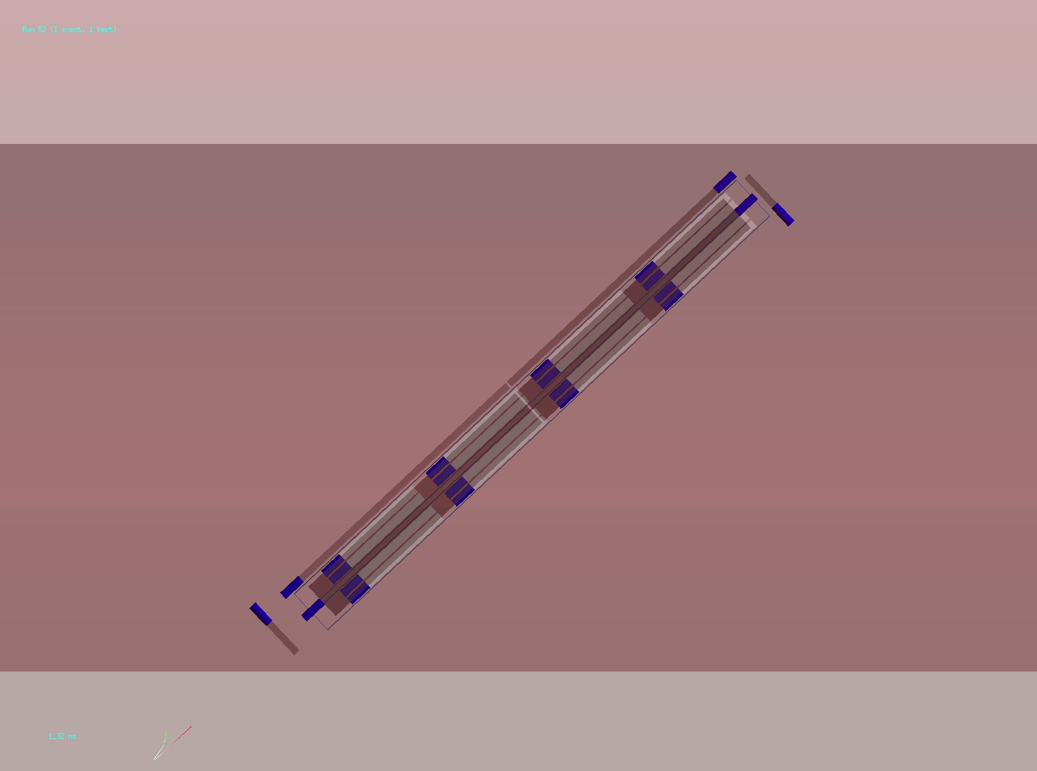
Through going muons
Rock
Muons from CMS I.P. go through all 4 layers
Useful for alignment and calibration
Deposits large signal in bars and show-up in front+back panels
Tunnel
Legend:
$μ$, $γ$, $mCP$, $e^{-}$,
optical photon

Slide 29
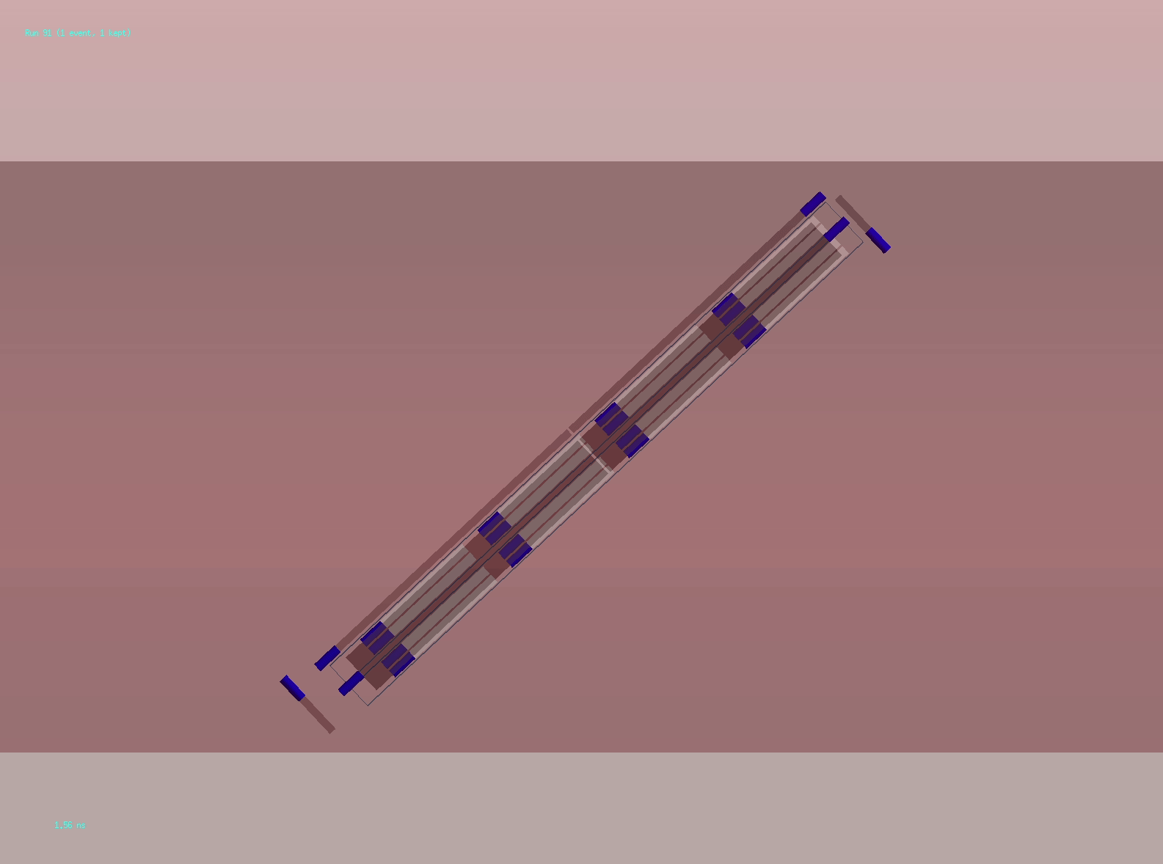
Background from cosmic ray showers
Rock
With quad coincidence, random backgrounds are negligible
Dominant remaining background from cosmic ray showers
Correlated hits between layers
Veto by thin scintillator panels surrounding detector
Tunnel
Legend:
$μ$, $γ$, $mCP$, $e^{-}$,
optical photon

Slide 30
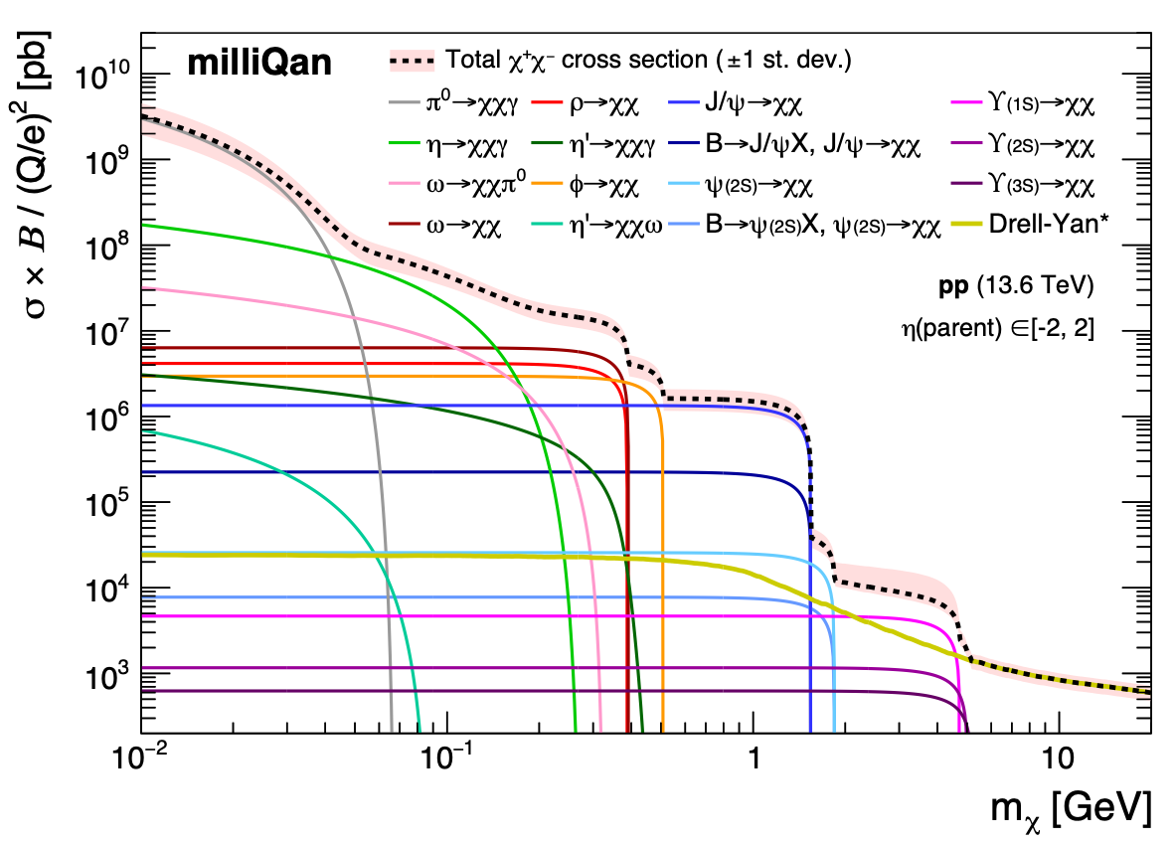
Signal simulation
Signal simulation comprised of a wide range of DY/meson producction channels

Slide 31
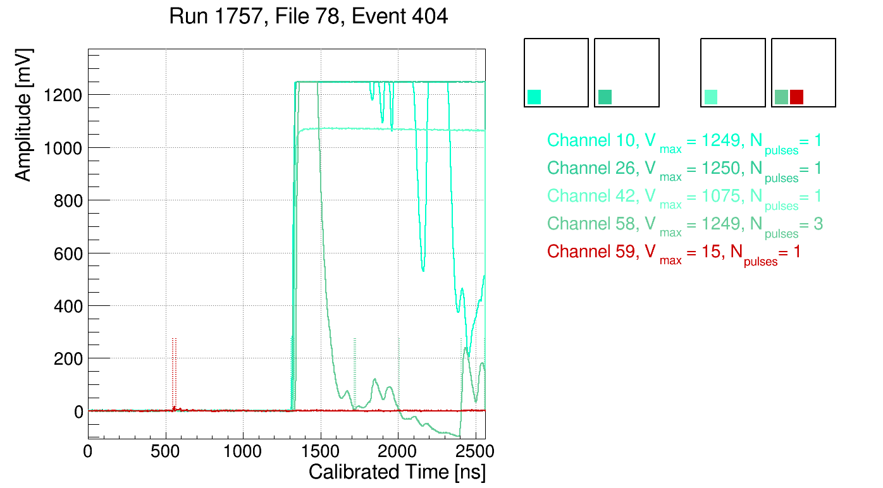
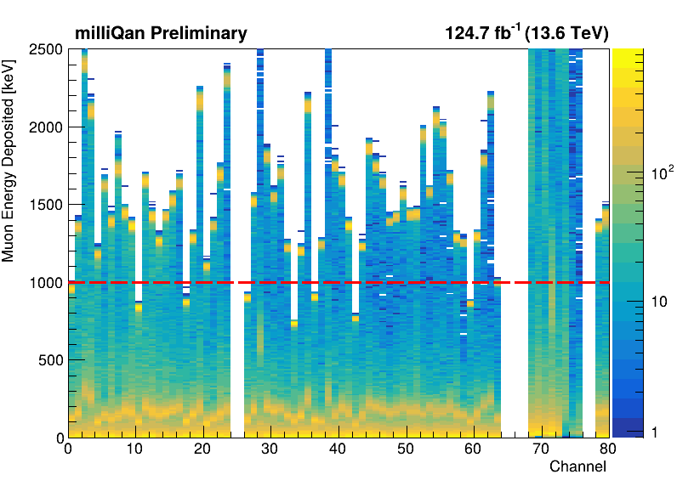
Muon event that initially leaked into SR1
Event displays clearly indicate the observed event is a muon that evaded veto
Due to 8 out of 80 channels saturating at lower than nominal energy (black circles)
Energy deposited by a muon in such a channel thus below veto threshold (red line)
Somewhat improbably, this turned out to be the case for 3/4 channels hit by the muon in this event!
Addressed by lowering the muon veto threshold for these channels and re-running analysis
NB: front/back panels not quite hermetic - will be fixed for 2025/2026 operation
For full transparency, we document this as a post-unblinding fix

Slide 32
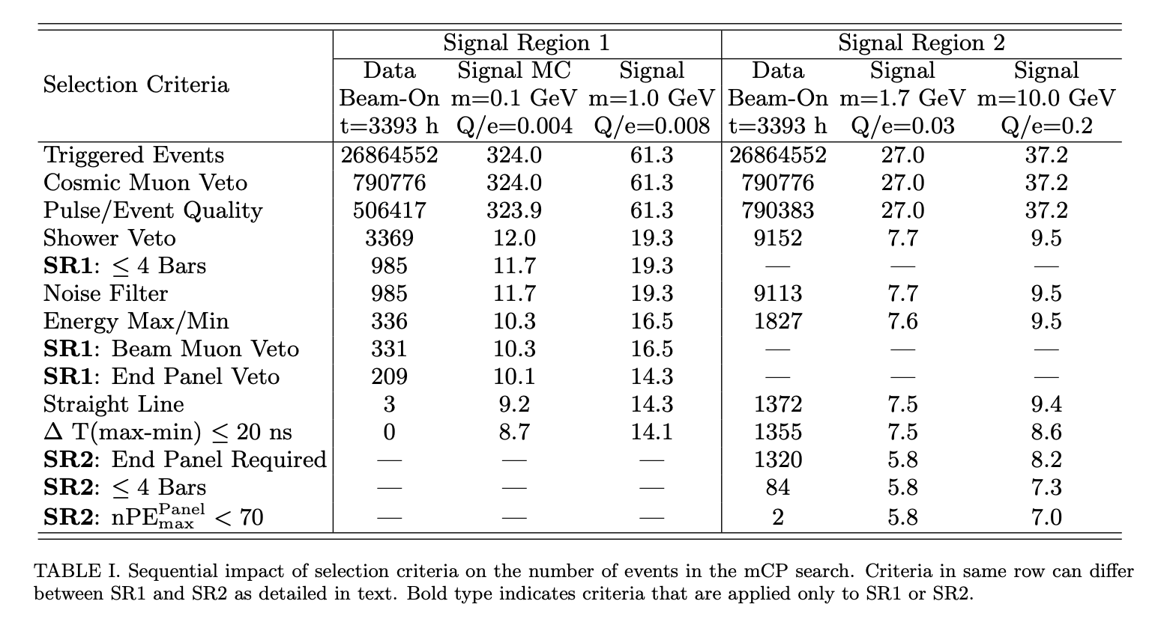
Cutflow for SR1 & SR2

Slide 33
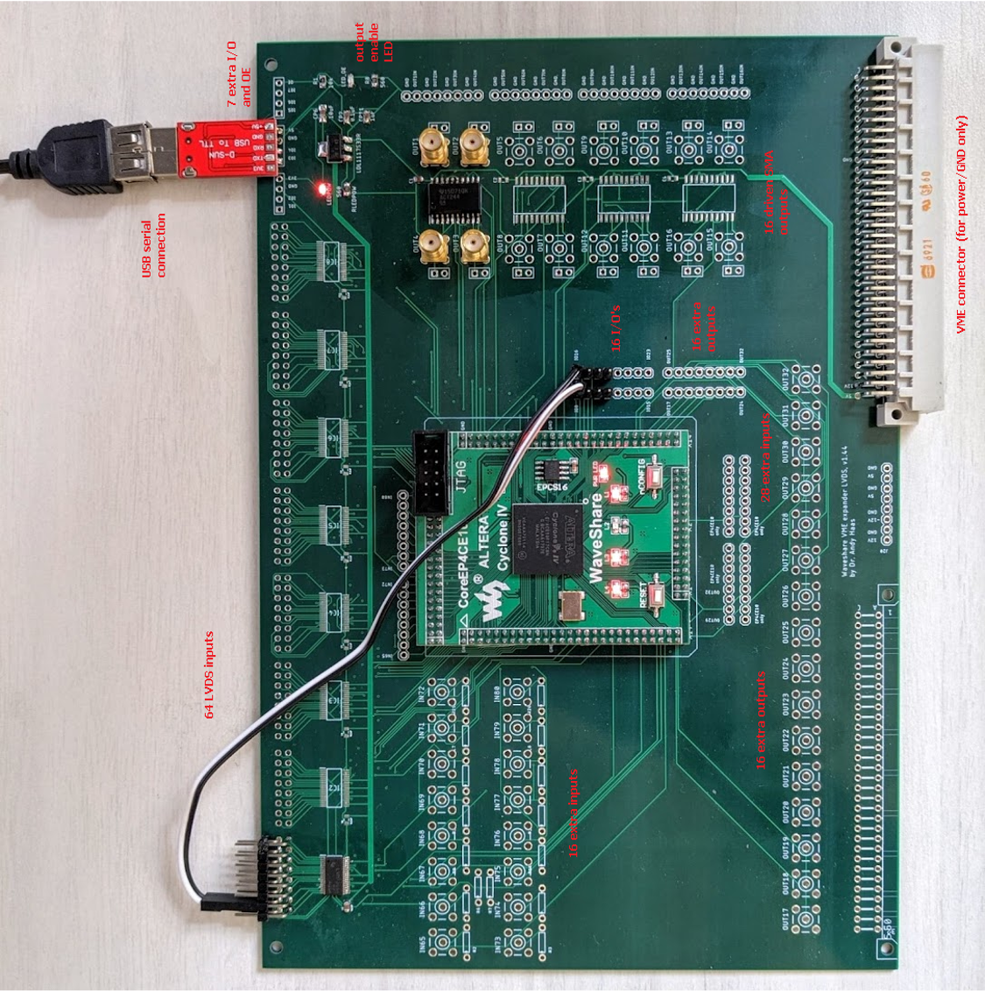
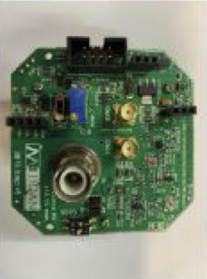
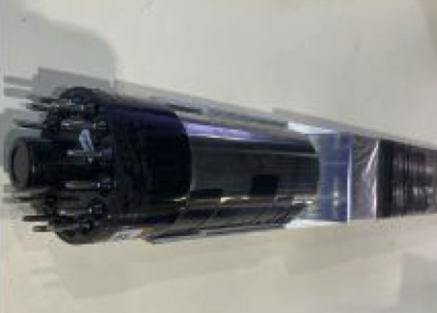
Trigger and DAQ
DAQ Computer
Digitized Pulses
Uses new “trigger board” to trigger the detectors
PMT data input to CAEN digitizer
Digitizers send triggers from PMTs to trigger board
Trigger board logic determines if board should fire
Uses FPGA to program our trigger menu
Trigger Information
Trigger Board
Global Trigger
Channel Triggers
PMT Pulse
CAEN Digitizer
=
+
Scintillator Bar
PMT base
PMT

Slide 34
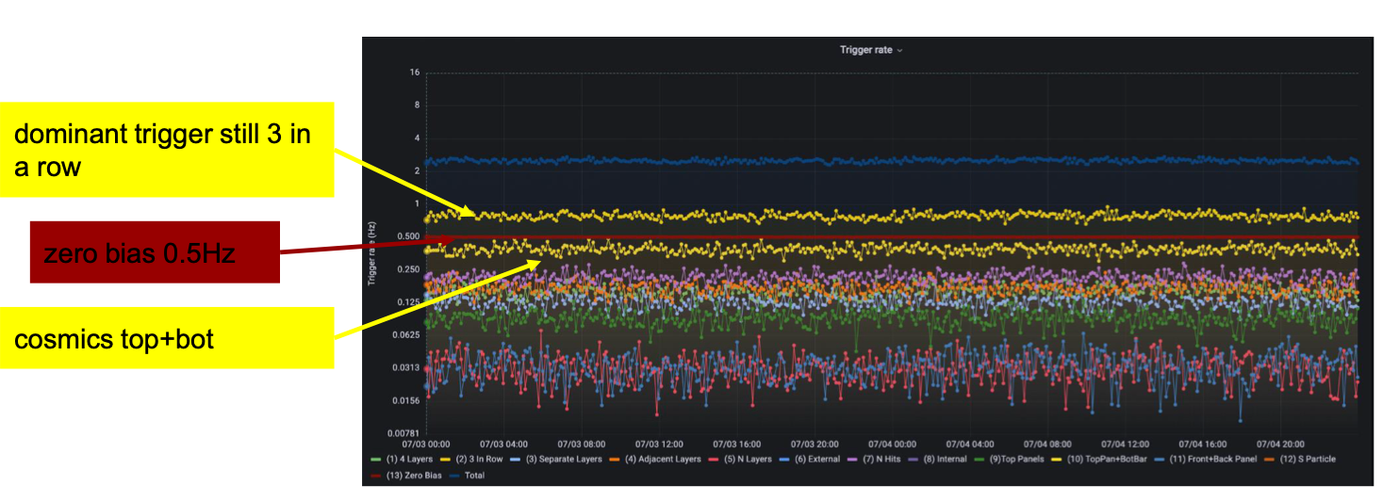
DAQ & Trigger Monitoring
Web-based interfaces/DBs to run & monitor the detector
Stable continuous data taking since June 1st 2023

Slide 35
from arXiv:2104.07151v2
One can consider a dark sector containing a massless abelian gauge field, A′, that couples to a new dark fermion, χ, with order one coupling, e′. A kinetic mixing, κ, can be introduced between the A′ and SM hypercharge B. Under a convenient basis, A′ is decoupled from the SM sector and the Lagrangian can be written as
In this case, the χ acts as a field with hypercharge κe′. The new fermion is generically called a millicharged particle since a natural value for κ, and therefore the χ effective electric charge, of ~αe/π ~10⁻³e arises from one-loop effects. The parameter space 1 < m_{χ} < 100 GeV, an ideal mass range for production at the LHC, is largely unexplored by direct searches.

