Slide 1
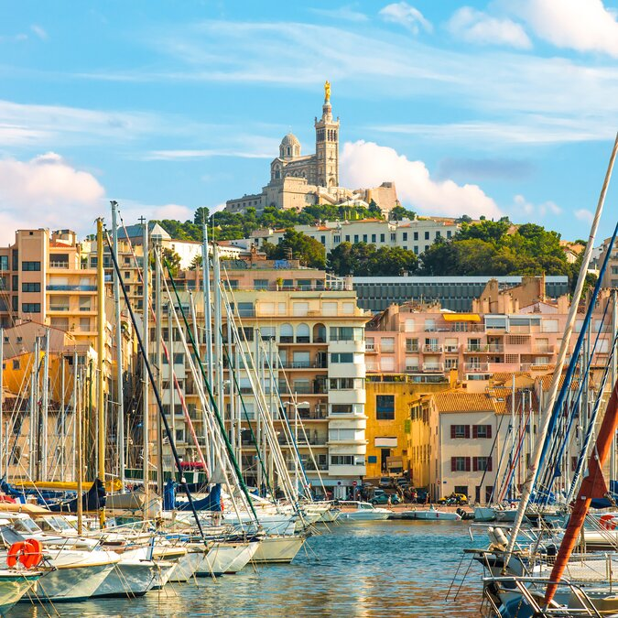
looking forward to millicharged particles at the LHC
Juan Salvador Tafoya Vargas (UC Davis)
on behalf of the FORMOSA Collaboration
EPS-HEP 2025 Marseille
2025.07.09

Slide 2
Searching for new physics
New physics searches limited by the design of existing general-purpose experiments
Take advantage of already-happening LHC collisions
→ forward region of e.g. ATLAS I.P. very rich in SM and potential new physics
Physics collisions already happening → no considerable additional operational cost
→ Initial investment needed for the construction of the facility in the forward region
→ Allows for design and installation of dedicated detectors

Slide 3
New physics and dark matter → Hidden Valley
U(1)
U(1)*
electron
γ
photon
γ*
dark photon
dark electron
strength: e
Natural strength (LO):
α/π ≈ 1/1000
strength: e’ ≈ e
No signs of new physics seen at the LHC (yet)
SM extensions that include dark (or hidden) sectors give very plausible hint
Photons and dark photons originate from different $U(1)$
gauge groups, but they can interact through kinetic mixing
Interaction with dark electrons is around
1/1000 as strong as the standard model
from naturalness arguments

Slide 4
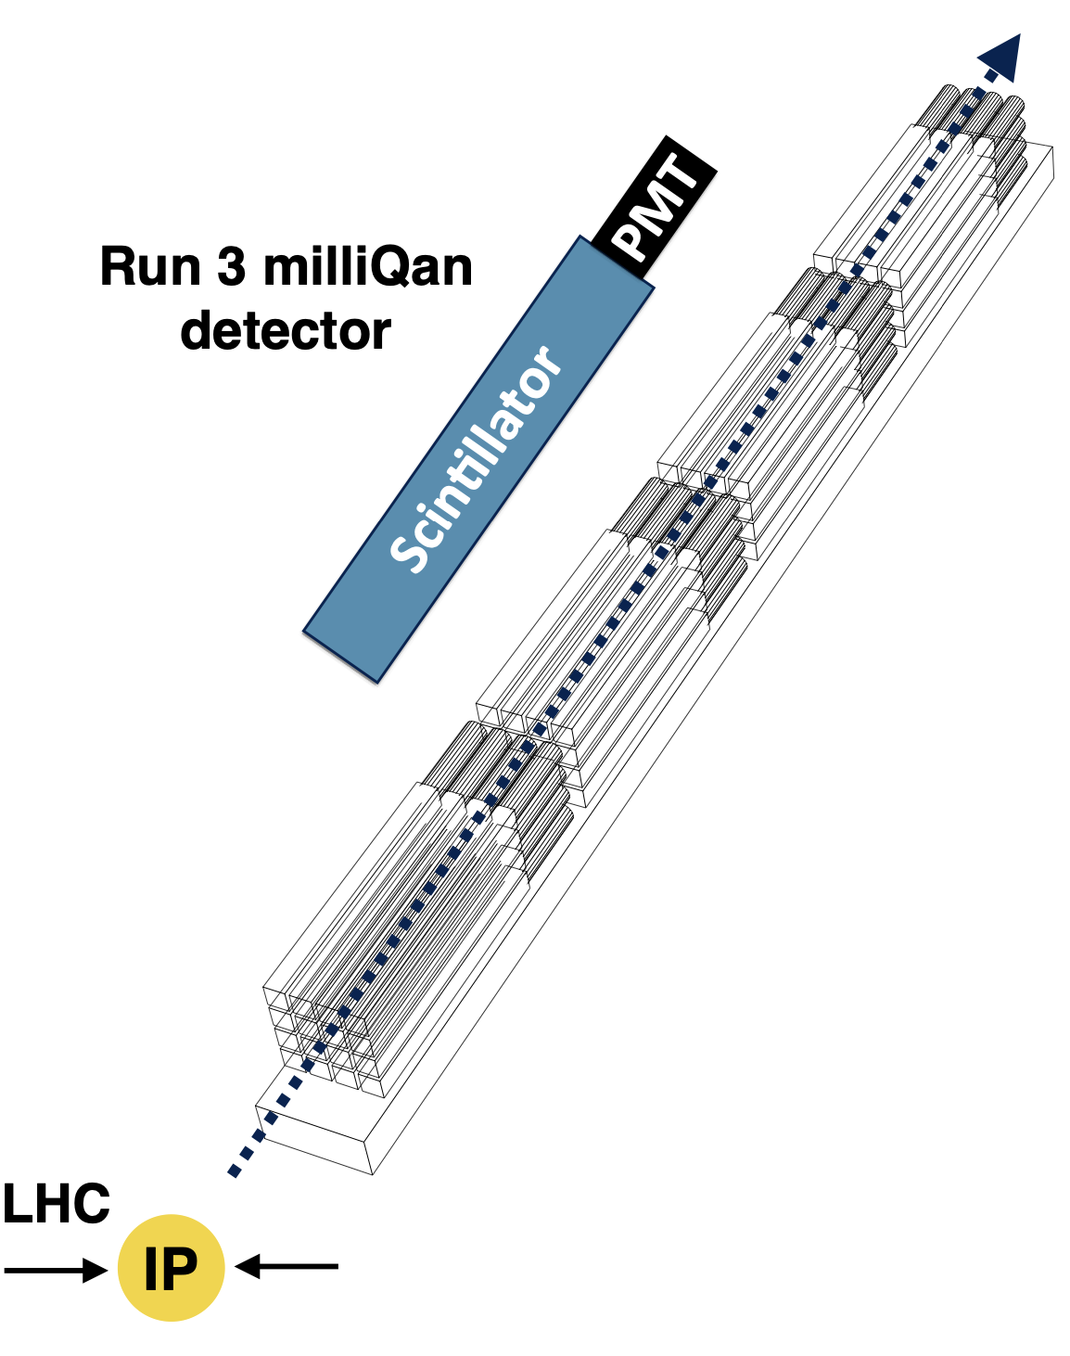
Millicharged particle searches at the LHC
Millicharged particles (mCPs) are well motivated in dark sector theories, but difficult to detect because the interaction strength is reduced by a factor $(Q/e)^{2}$.
Core concept: Use array of efficient long scintillator bars + PMTs to detect ionisation from mCPs.
Challenges:
Expect few scintillation photons to be produced → must be able to detect single scintillation photons
Well controlled backgrounds → signatures “point” at the interaction point, triggering on sets of signals within small time windows (~15 ns)
$$⟨E⟩∝{\left(\frac{Q}{e}\right)}^{2}l_{scint}$$

Slide 5
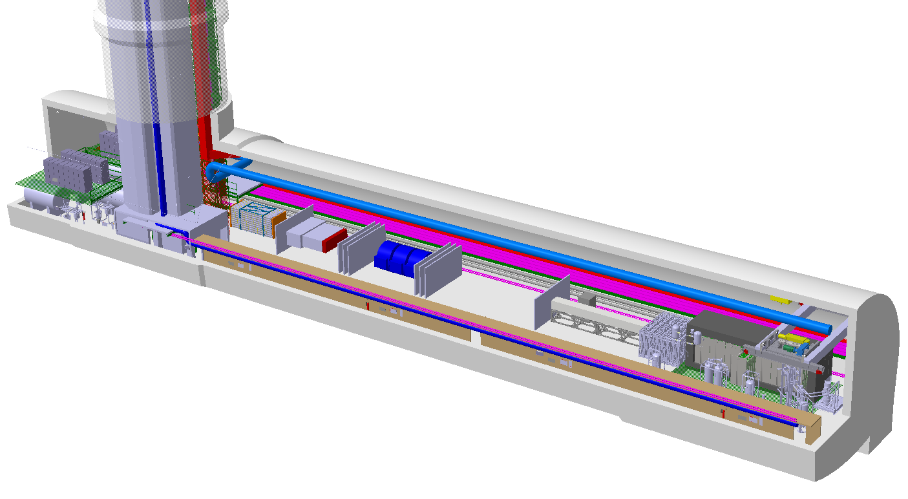
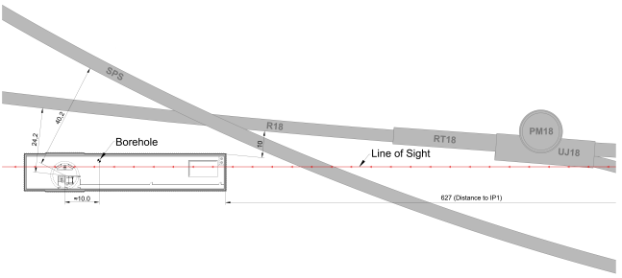
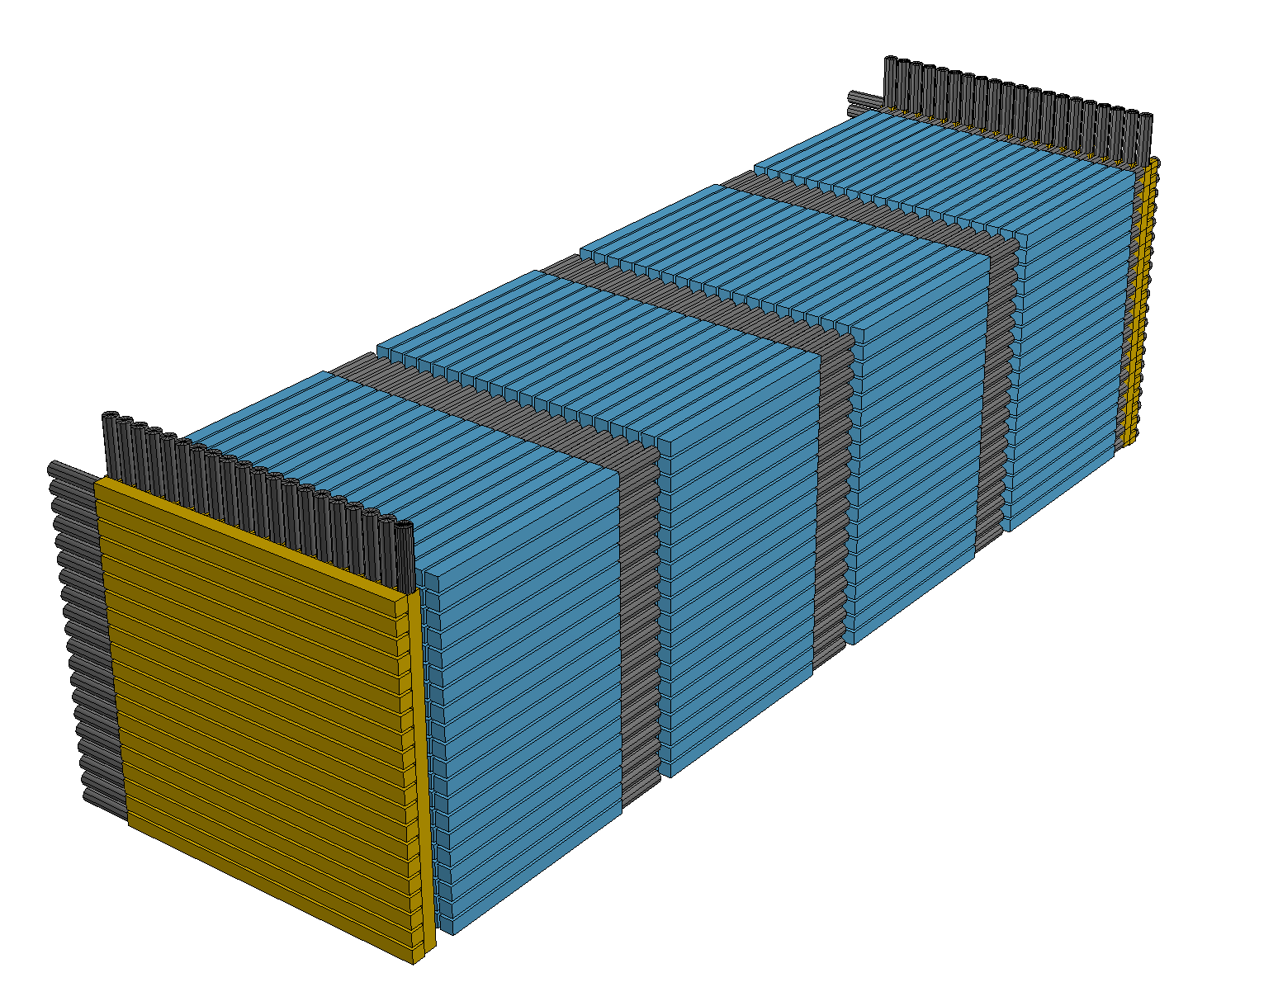
FORMOSA at the FPF
See Akitaka Ariga’s FPF talk!
LHC
FORMOSA
Nominal Beam Axis
SPS
FASER2
FPF
FASERnu2
FLArE
Aimed at the ATLAS I.P., located in the very-forward region (η > 9)
Expect to see ~250x rate of millicharged particle detection in the forward region compared to the central one (i.e. milliQan, η ∼ 0)
20 rows x 20 cols x 4 layers of bars for detection
Shielded from most SM particles produced at the I.P. by ∼ 200m of rock
Shielded from LHC beam radiation by >10m of rock
Main background: collision muons → segmented muon veto panels
FORMOSA design
in FPF paper

Slide 6
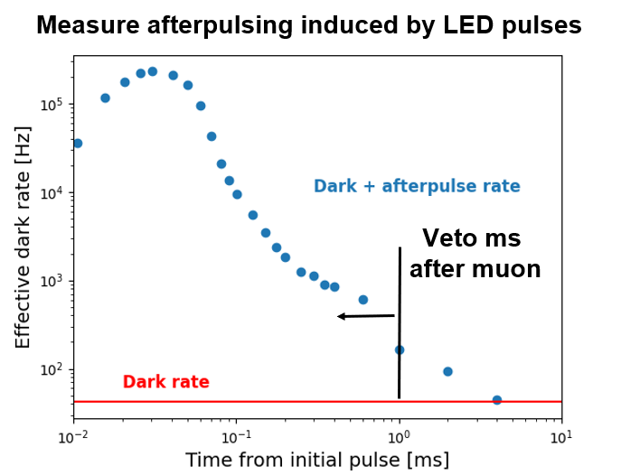
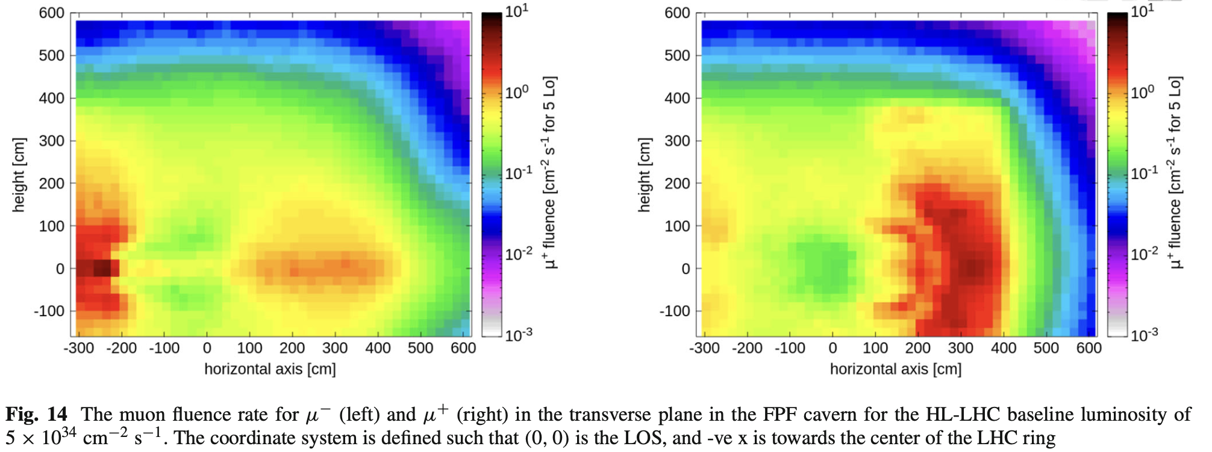
Main background at FPF: I.P. muons
Muon background/radiation flux simulated and validated (CERN FLUKA team)
expected muon flux $O(1Hz/{cm}^{2})$ within 1m of LOS
affected by triplet magnets
studing if flux can be reduced with sweeper magnet
Important to understand DAQ strategy to take into account muon-induced activity
Large induced signals (such as those left by muons) can lead to a temporary ”increase” of the PMT’s dark rate, making triggering unreliable.
Lab bench studies suggest we can work around it by applying a small cooldown deadtime.
See FPF’s input to ESPPU for more details

Slide 7
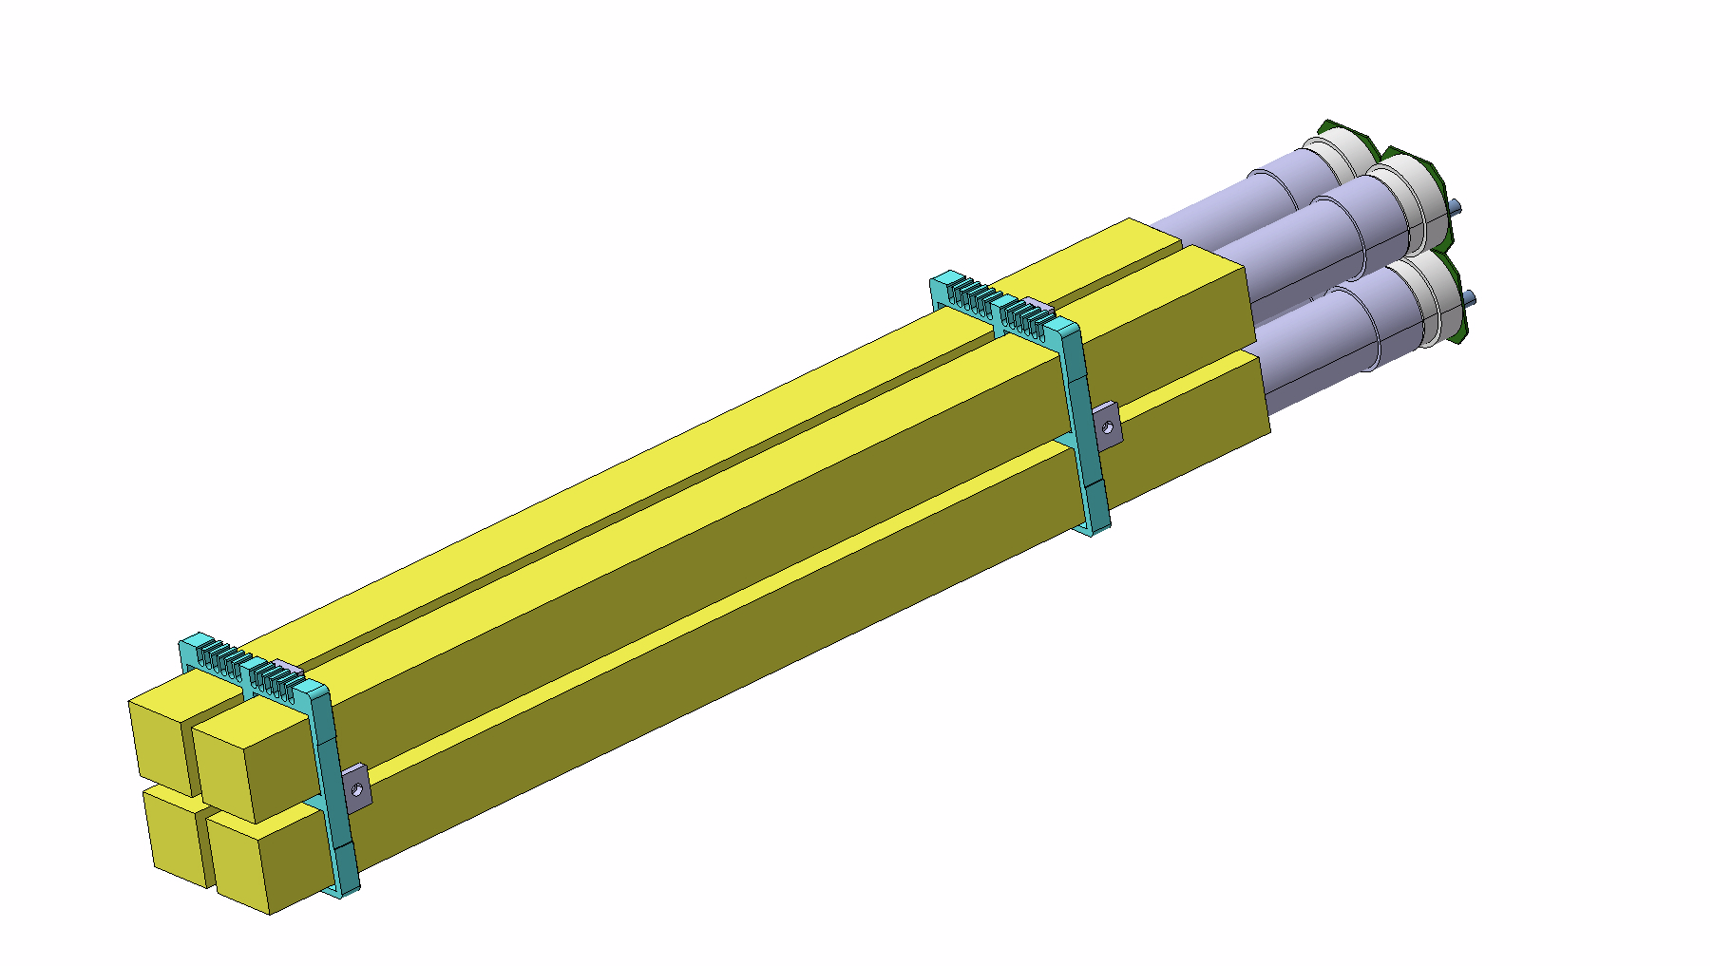
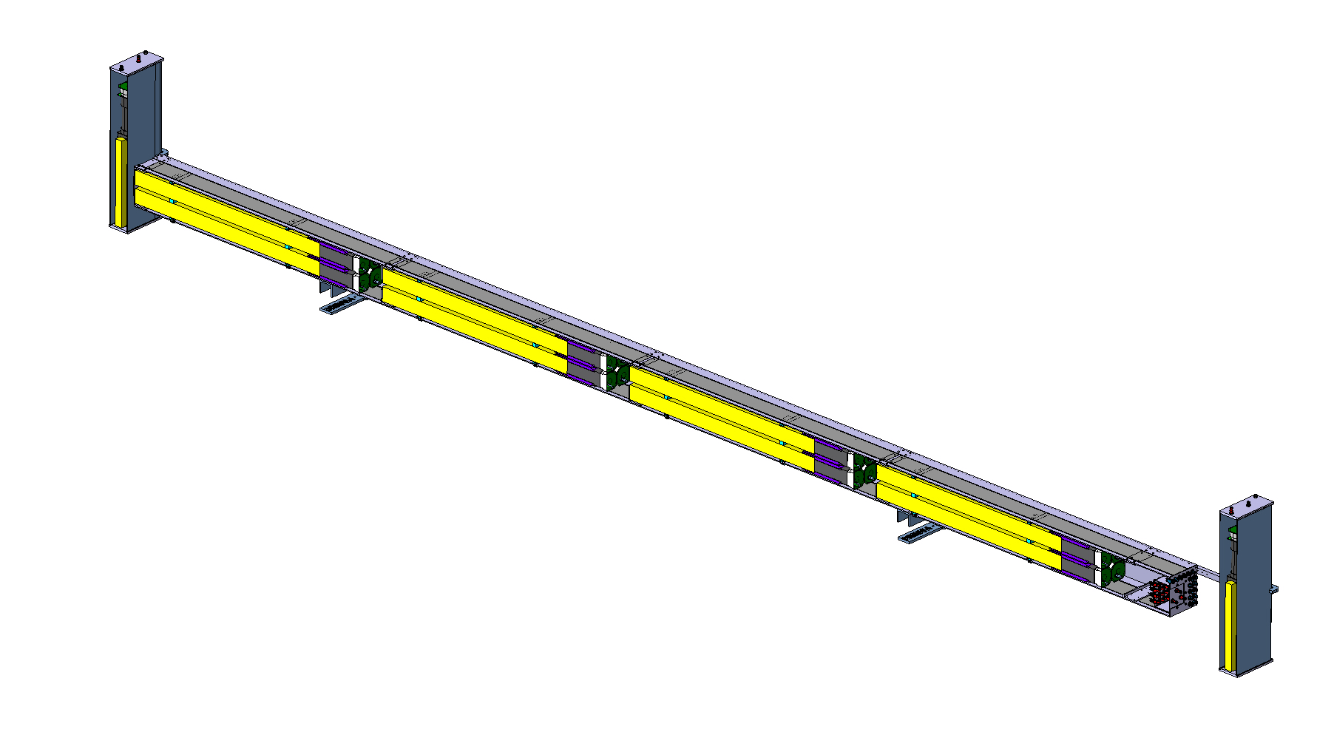
The FORMOSA demonstrator
A small-scale version of the full FORMOSA was installed during YETS2023-2024 to prove concept and target new phase space
2 rows x 2 columns x 4 layers of bars
front+back muon veto panels
Located in the UJ12 cavern (behind FASER), in the opposite side of the to-be FPF
Additional features added later:
CeBr3 test module
Hermetic side+top panels
80cm
PMT
80cm
scintillator
$$⟨E⟩∝{\left(\frac{Q}{e}\right)}^{2}l_{scint}$$
~440cm
40cm
20cm

Slide 8
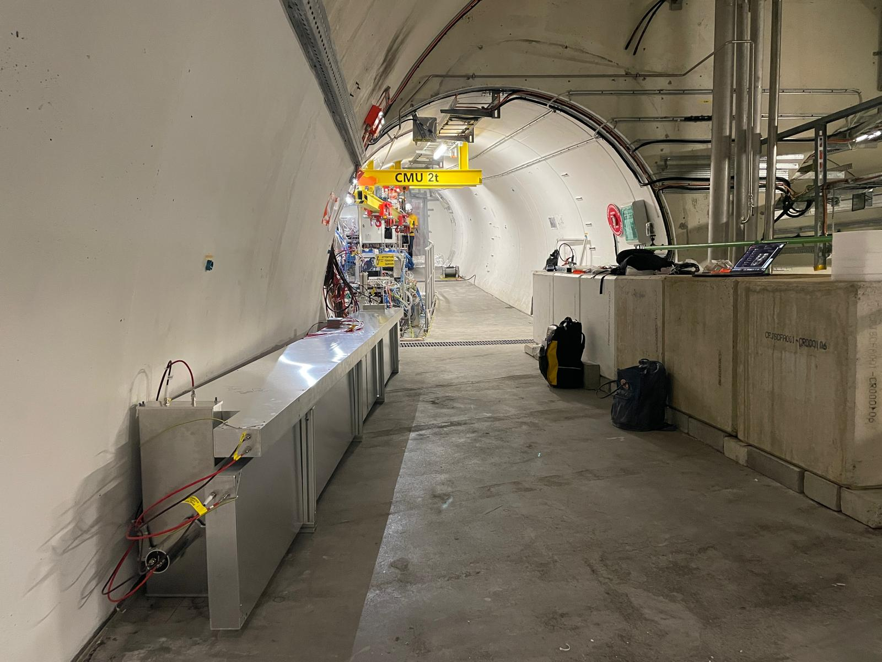
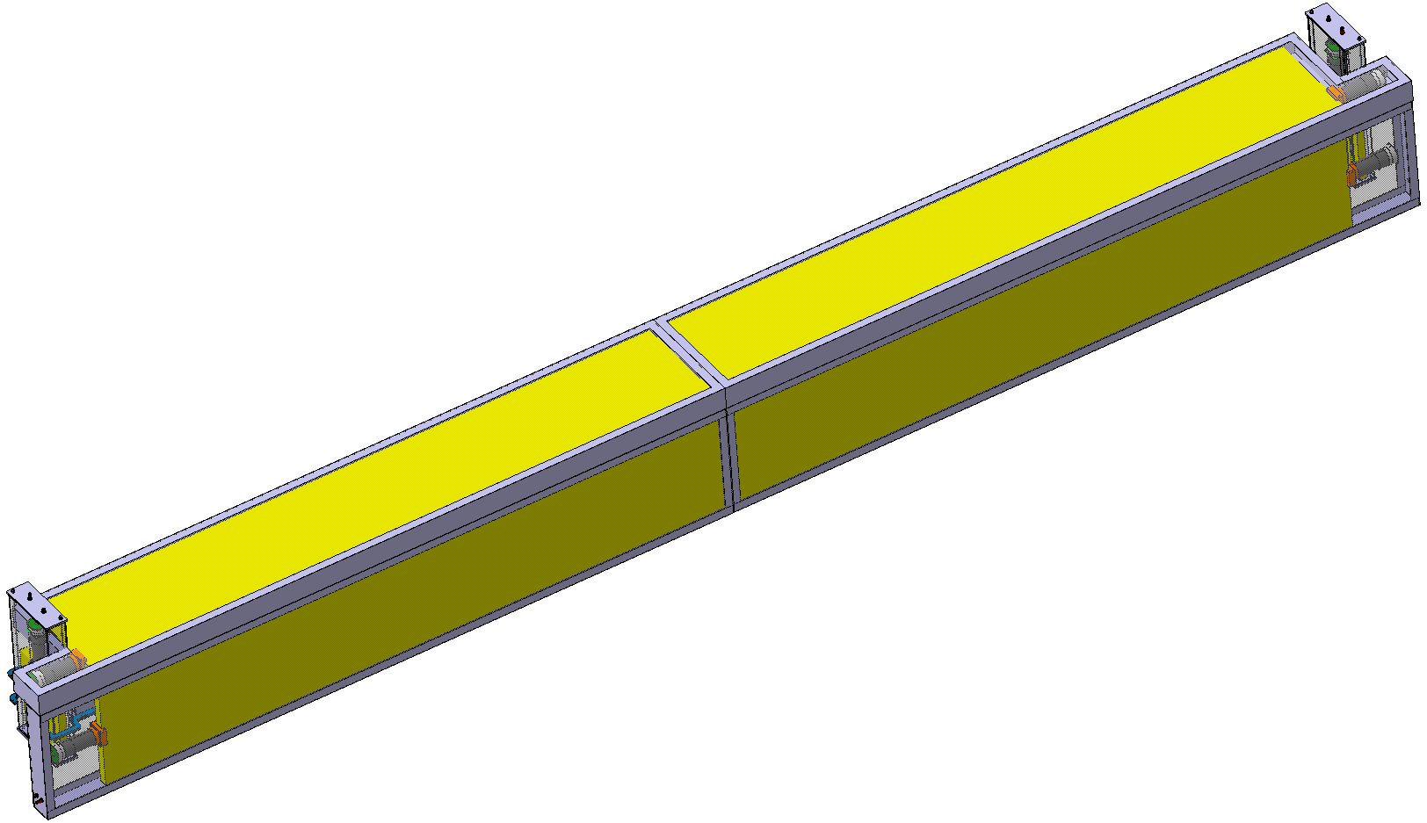
The FORMOSA demonstrator
The FORMOSA demonstrator
Proof of concept: collecting data and validating design/DAQs through Run 3
Design evolving to test new technologies and adapt to UJ12’s environment
2024
2025
80cm
PMT
80cm
scintillator
~440cm
40cm
L.O.S.
20cm

Slide 9
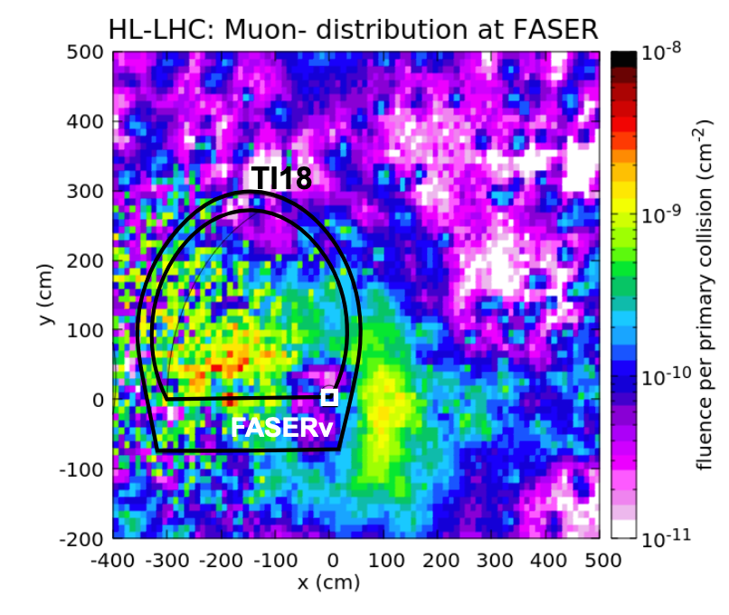
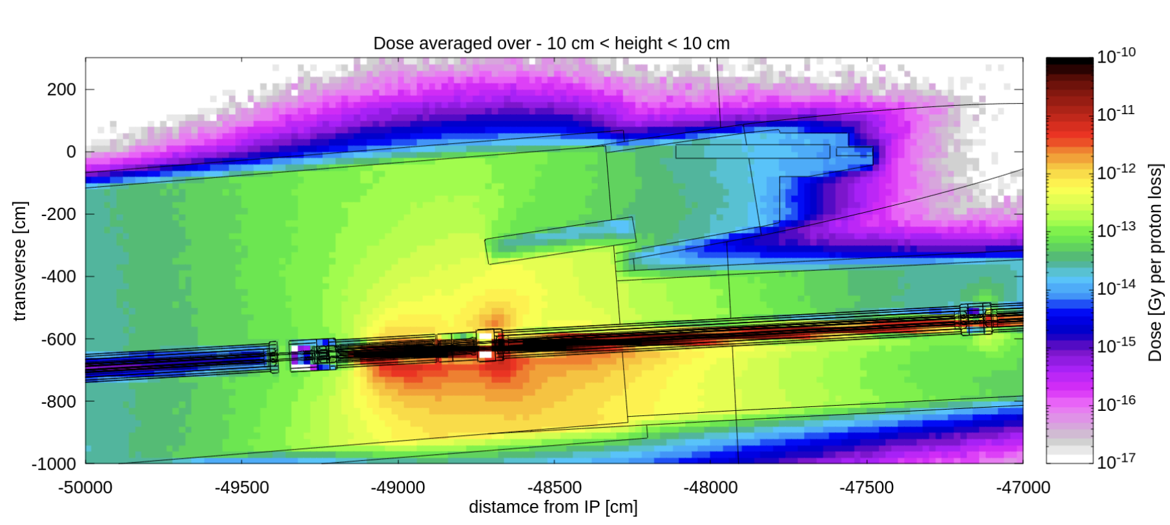
Main backgrounds at the demonstrator
Dominant expected background in the forward region: afterpulses initiated by through-going muons
An additional challenge at demonstrator: Q12 beam background
(N.B. this background will NOT be present in the FPF)
ATLAS I.P.
Continuous work to tailor our DAQ to further mitigate background effects and enhance sensitivity to (true) signal signatures
FORMOSA
FASER
LHC
beam 1
Muon rate through each “path” ~1/40ms
beam 2
Q12
Lab study:
Can devote a ms of deadtime to cool down following a collision muon. But muons are frequent (~100Hz for demonstrator), so can’t wait too long
Absolute average dose due to proton loses at Q12 (simulation provided by FASER)
Side panels
Large front+back muon veto panels

Slide 10
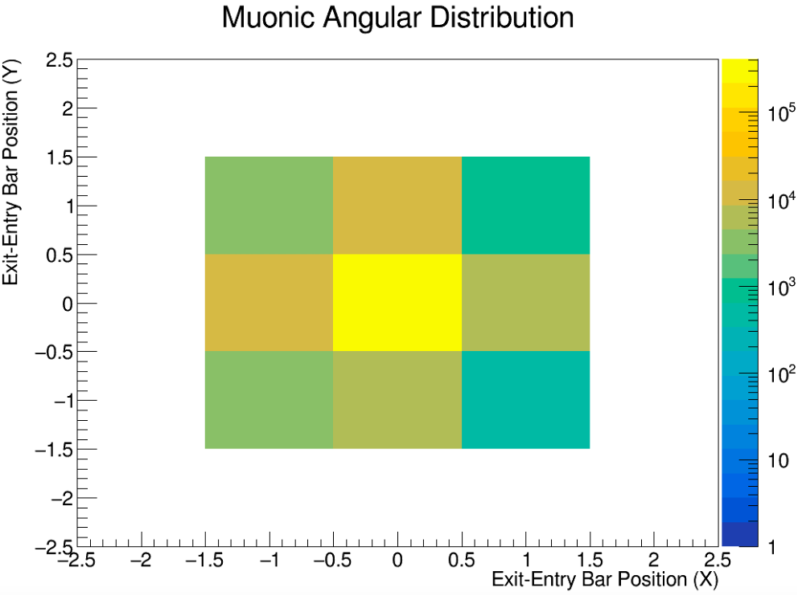
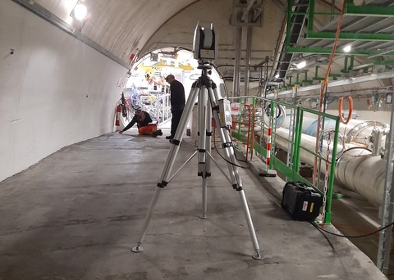
Alignment validation
Checking the distribution of the “exit - entry” bar number of collision muon events
→ LHC collisional data confirms alignment!

Slide 11
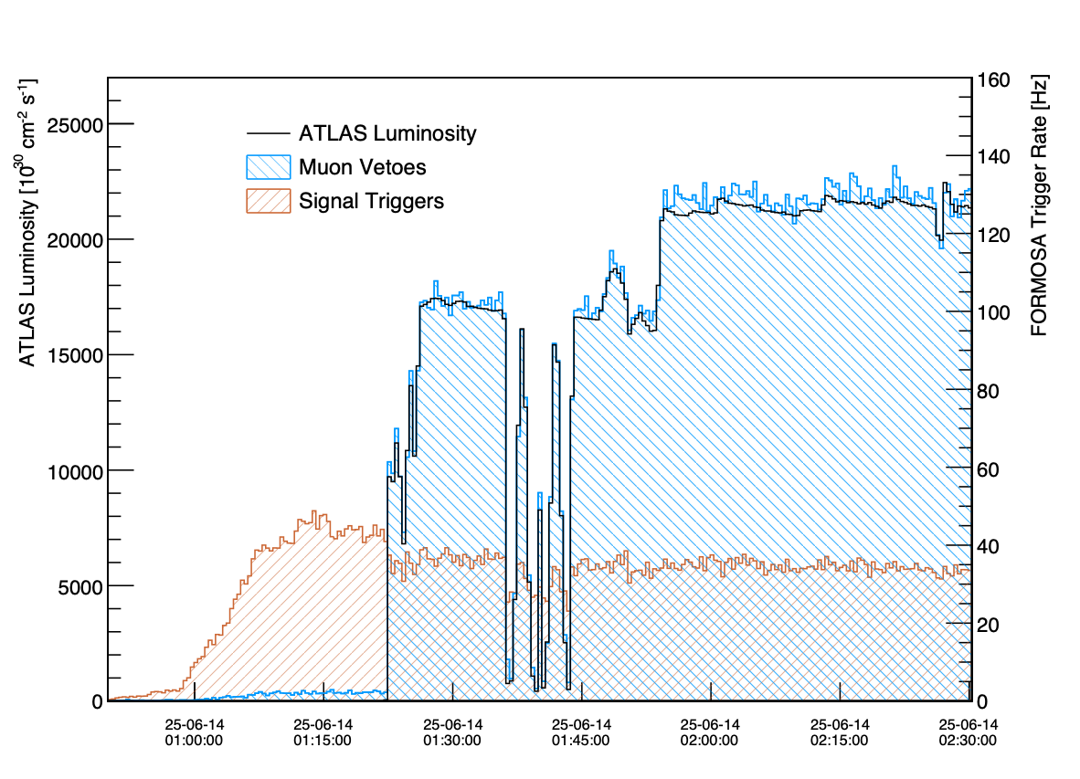
DAQ validation
Flexible DAQ allows us to efficiently veto muons and beam backgrounds to trigger signal without prescale!
Data from the 14th of June 2025
Signal triggers stably collecting data
Muons very effectively vetoed!

Slide 12
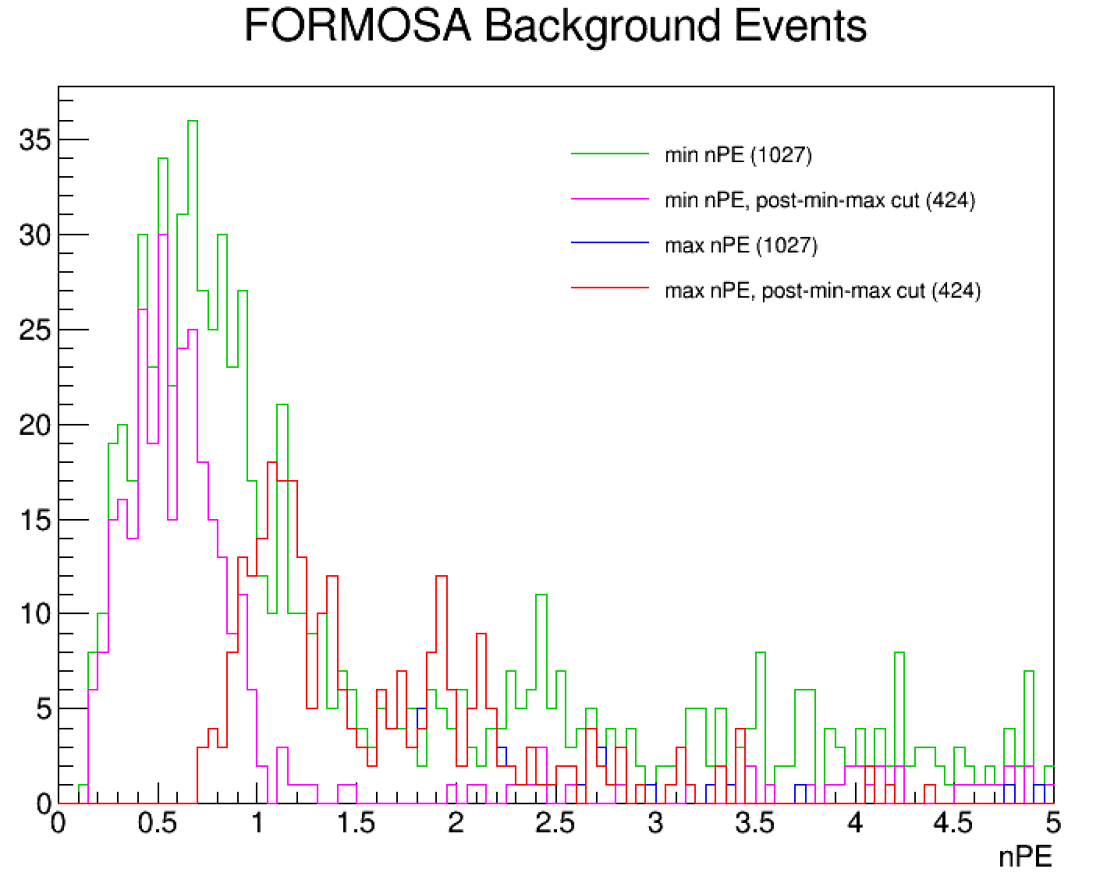
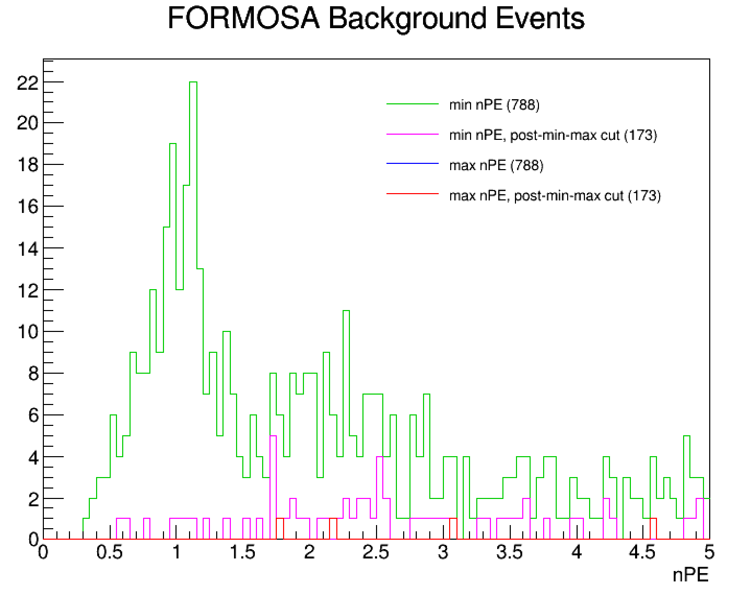
This plot needs to be redone since stuff changed ever since
Background nPE spectra
No muon veto
1ms muon dead time
Run1331
Run1448
Each run corresponds to 1 fill
Preliminary set of selections
Vast majority of the background events in this plot occur outside of the region we expect for mCP-like deposits (i.e. > 5 nPE)
Caveat: study done with an underestimated ability to veto muons → to improve after DAQ upgrade

Slide 13
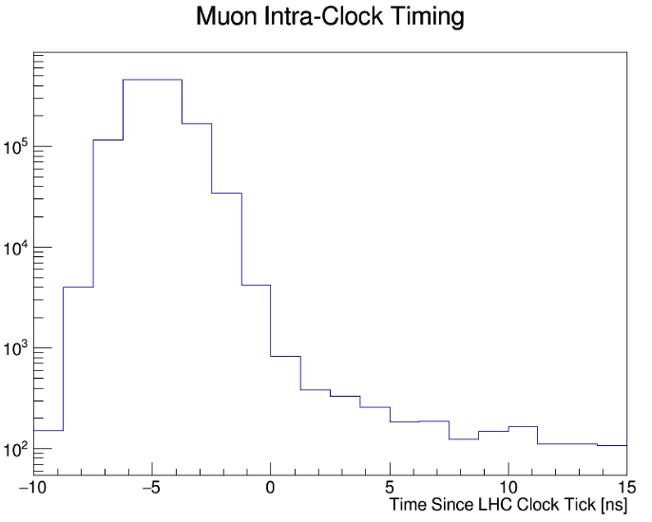
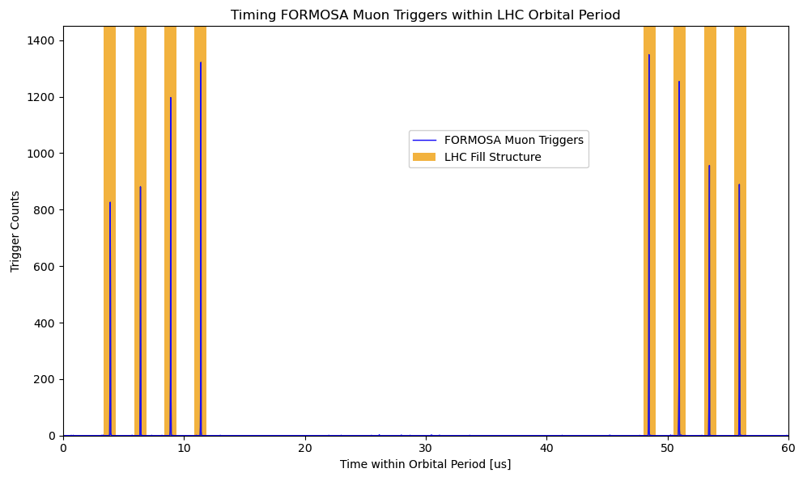
Timing studies
Enlarged for visual clarity
Muon arrival peak
Flat beam background
Looking between LHC clock-ticks
Looking within orbital of a 12b fill with 8 colliding bunches

Slide 14
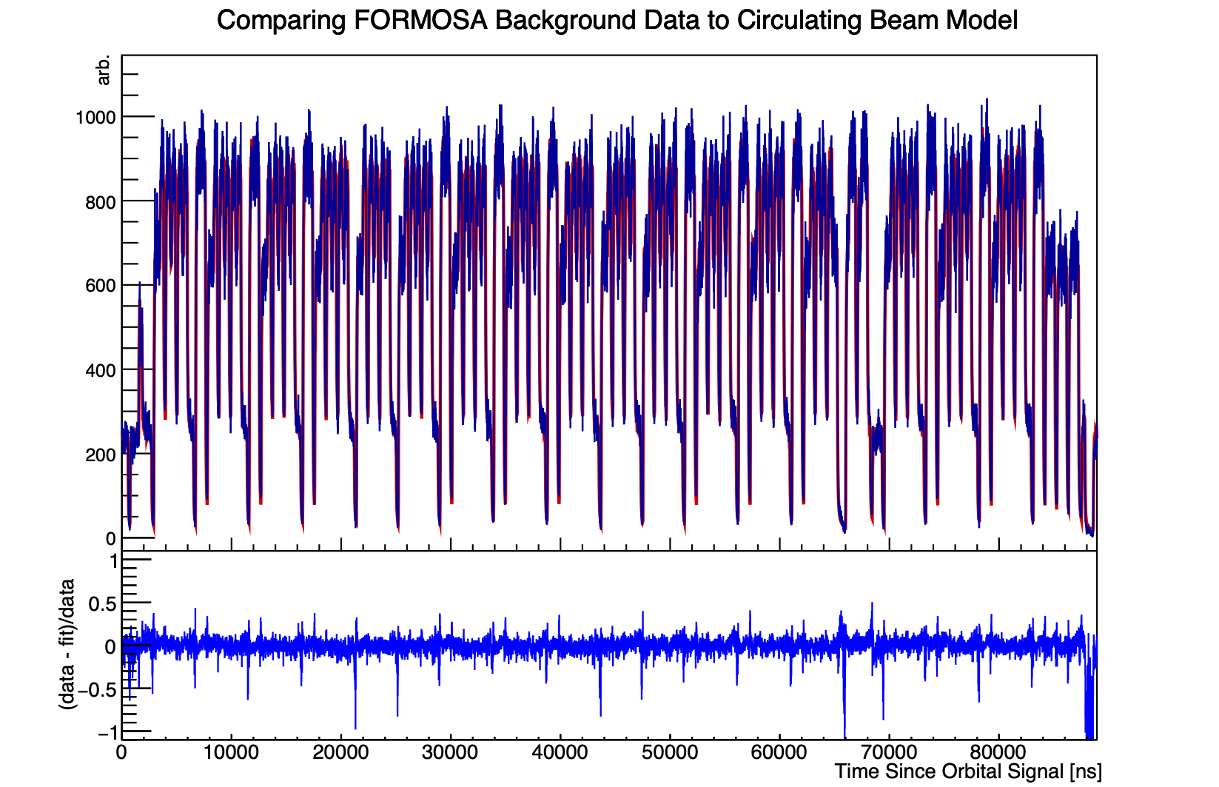
Timing studies: probing the LHC’s fill scheme
Fill with 2460b
We have excellent timing resolution!
Next step: to understand our trigger activity relative to the LHC’s bunch structure

Slide 15
Timing studies: probing the LHC’s fill scheme
We want to compare our trigger times since last orbital signal against the LHC’s fill scheme and I.P.1’s collision scheme.
A first study:
Track/move the position of all beam 1 and 2 bunches in their corresponding directions
Each bunch/collision contributes with Landau-distributed trigger activity
Place the demonstrator at 465m away from I.P.1

Slide 16
Timing studies: probing the LHC’s fill scheme
Data
Fit
3 contributions (beam 1, beam 2 and I.P.1’s collisions) are enough to understand our trigger activity and position ourselves relative to the LHC’s orbital signal!
N.B. LHC collisions every 25ns while DAQ clock runs at 8ns!

Slide 17
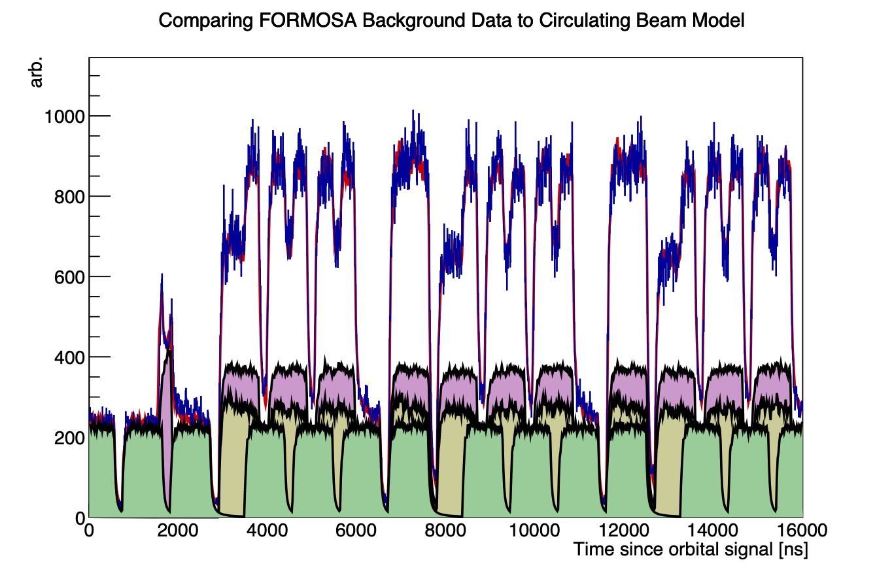
Timing studies: probing the LHC’s fill scheme
Zooming-in and drawing separate contributions hints origin of different signatures
Data
Fit
Beam 1 contribution
Beam 2 contribution
Collision contribution
Extremely valuable information for signal/bakcground separation!

Slide 18
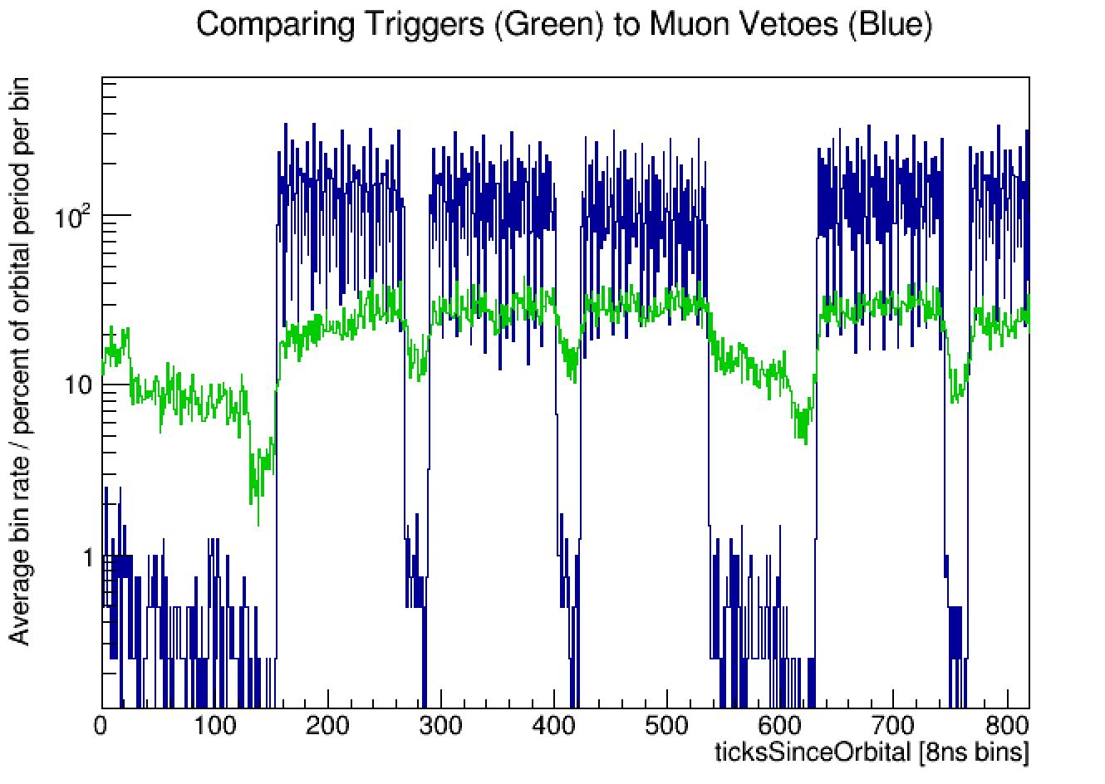
Muon veto studies
Fill with 2460b
N.B. LHC collisions every 25ns while DAQ clock runs at 8ns!
Crucial to determine when physics from collisions may be happening!

Slide 19
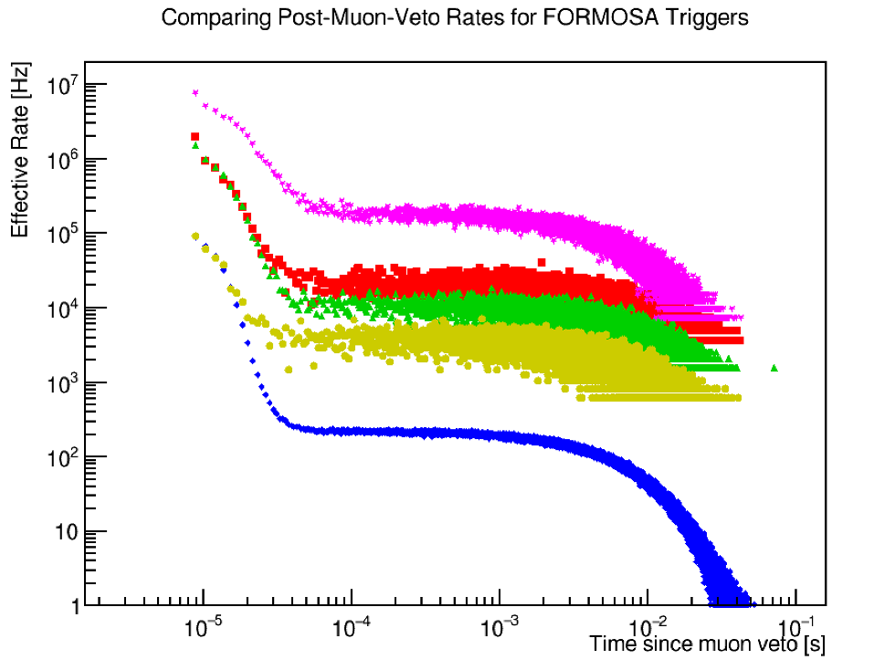
Muon veto and afterpulsing
Signal triggers
4Layers
nLayers$≥$3
nBars$≥$3
2Layers (both)
Special run with no muon deadtime
Study done for a single PMT suggests 1 ms of deadtime is enough
For ~100 Hz rate of muons, this corresponds to 10% deadtime
Overall scaling still in progress
Data suggest 100 μs deadtime is enough for signal triggers to recover back to nominal/healthy rates! This corresponds to 1% deadtime

Slide 20
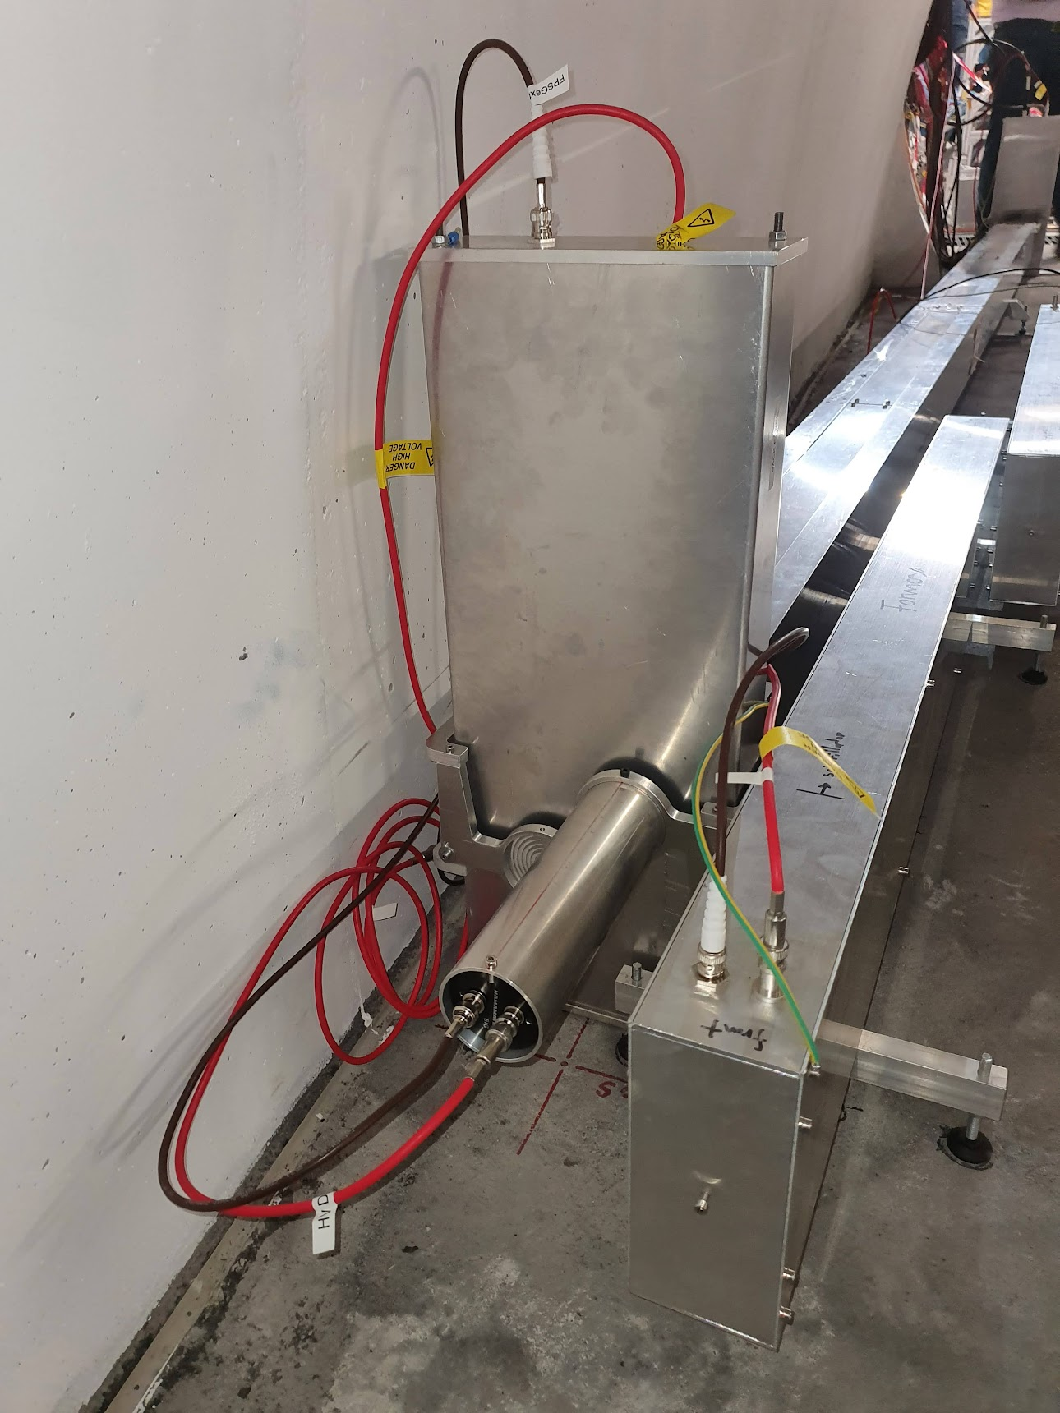
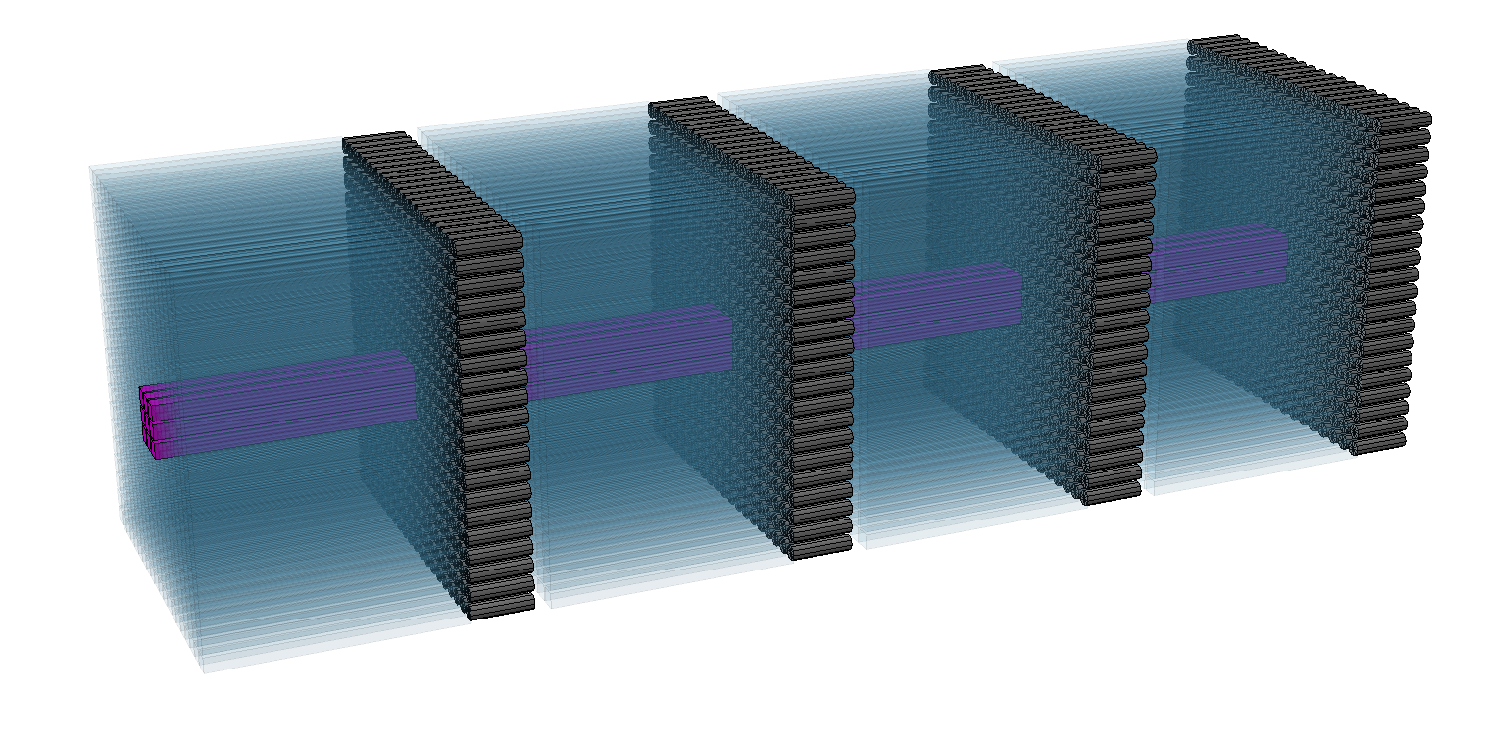
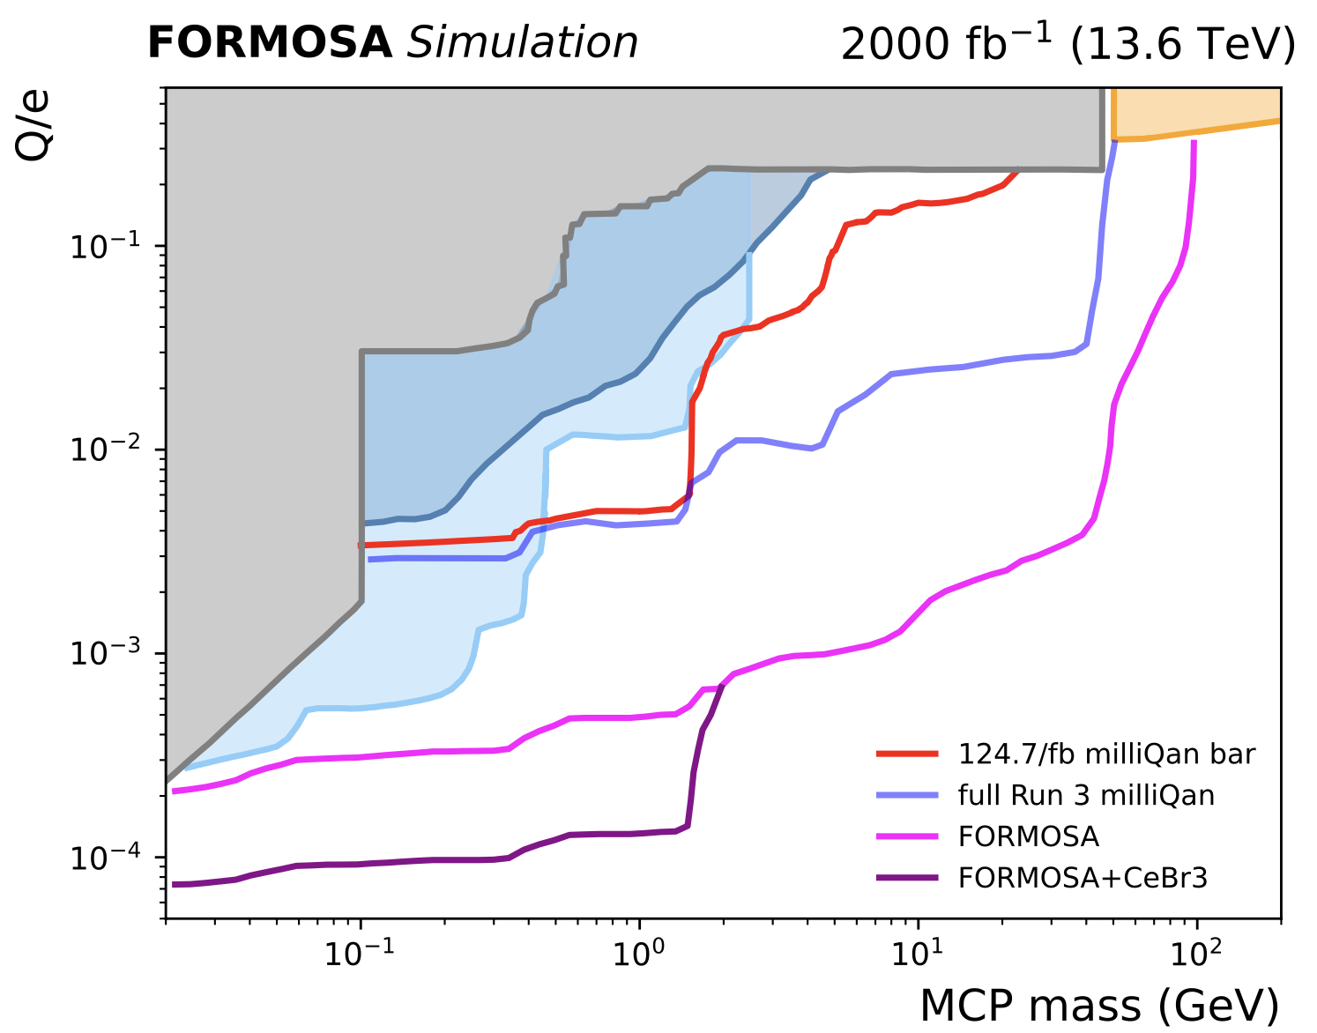
FORMOSA: CeBr3 module
Incorporated CeBr3 module into demonstrator in Sept 2024
CeBr3
Earlier constraints
CMS
ArgoNeuT
Investigate feasibility of FORMOSA subdetector made from CeBr3
Factor ~35 larger light yield for same length compared to plastic, fast with low internal radioactivity
Considerable sensitivity gain possible! Studies ongoing using test module
SENSEI

Slide 21
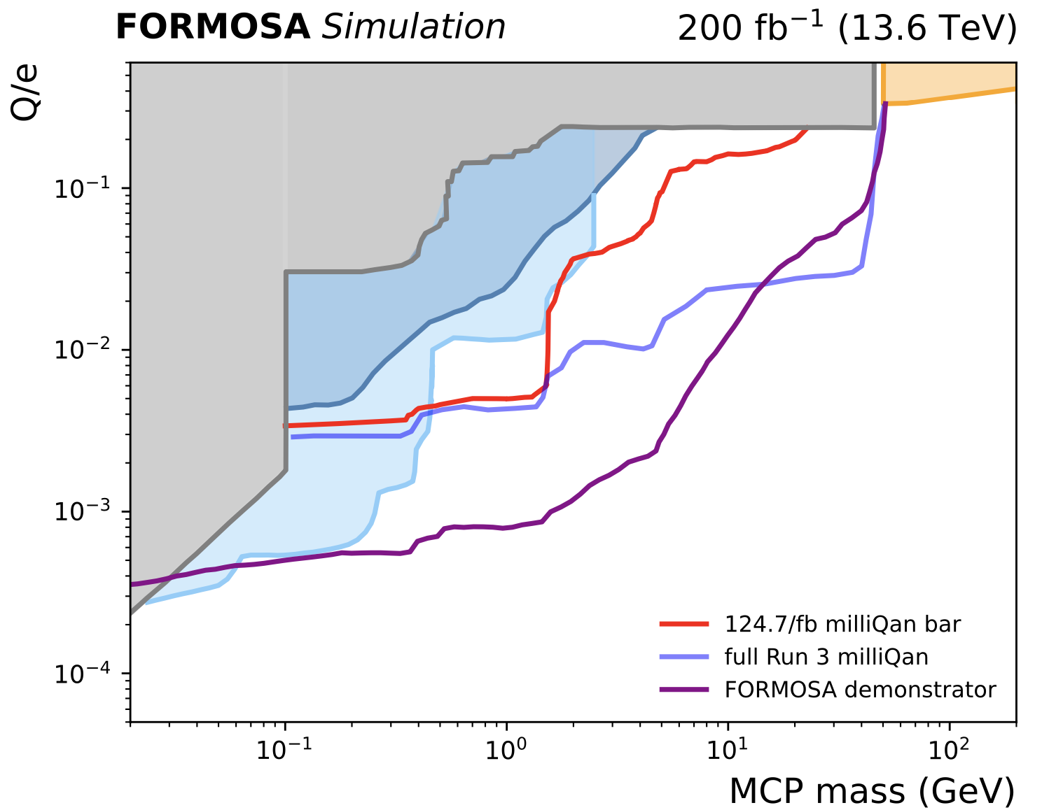
FORMOSA demonstrator sensitivity
Earlier constraints
CMS
ArgoNeuT
Hermetic rejection panels added in earlier this year: will attempt search with 2025 LHC data!
Expand demonstrator size for early HL-LHC if funding allows
SENSEI
4x4 FORMOSA demonstrator
(first year of run 4)

Slide 22
The FORMOSA collaboration
Members from 8 institutions and growing!
This speaker supported by funding from DOE Office of Science

Slide 23
Summary
Demonstrator installed last year and taking data through 2024
DAQ (hardware and firmware) validated
Alignment with L.O.S. to I.P. validated
Verified we are measuring physics correlated to LHC activity
Capable of identifying and vetoing online muons generated by I.P. collisions
Intra-clock timing proving useful for understanding activity and backgrounds
Hermetic side and top panels installed to improve background understanding
CeBr3 test module installed to carry out extended studies
Demonstrator currently taking data stably!

Slide 24
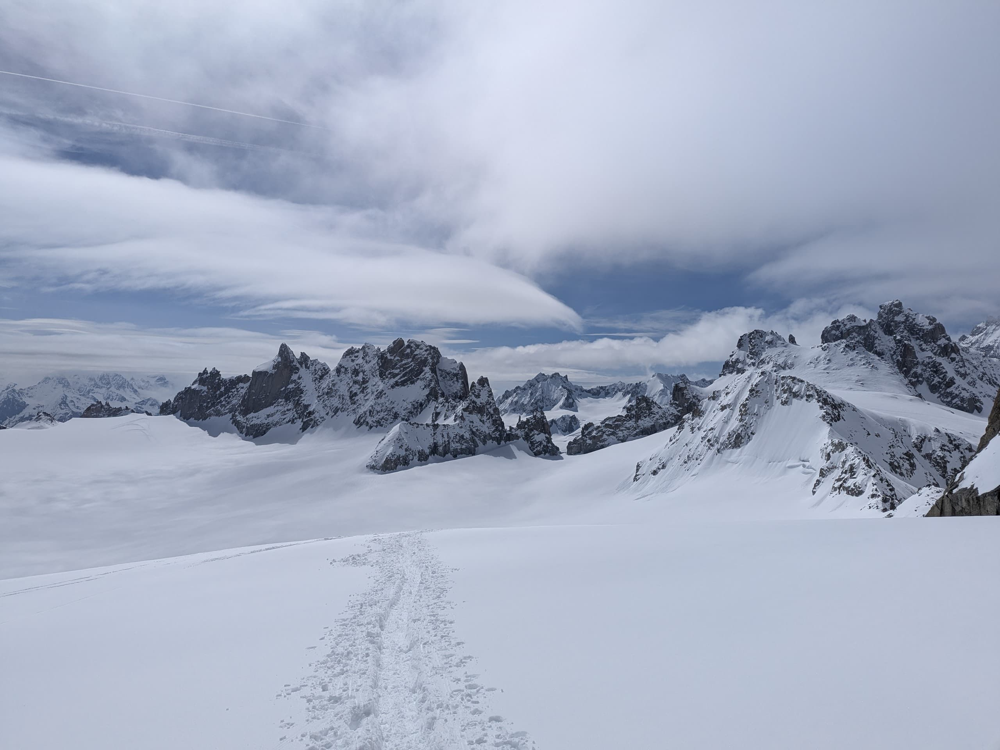
End

Slide 25
Backup

Slide 26
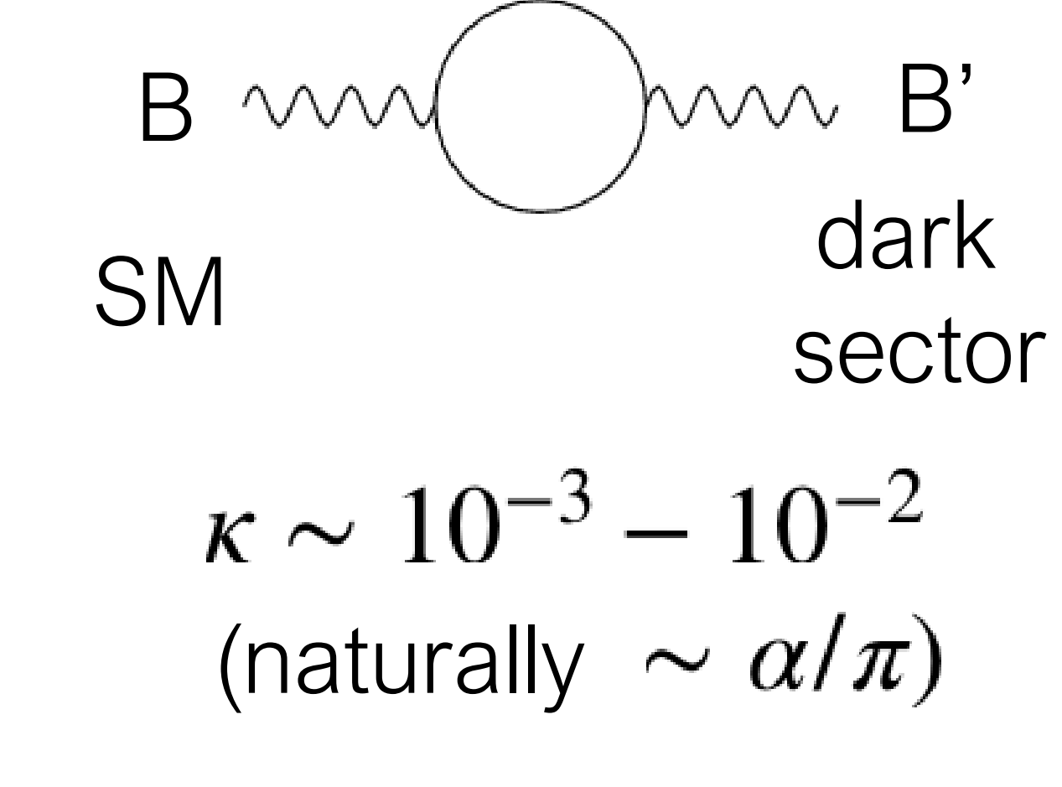
Why millicharged particles?
Standard motivation: Introduce new, hidden $U(1)$ with a massless field A', a “dark photon” that couples to a massive “dark fermion” ψ’
$ψ^{′}$ has mass $M_{mCP}$ and charge under the new $U(1)$ of $e^{′}$
Gauge transformation of $A_{μ}^{′}→A_{μ}^{′}+κB_{μ}$ introduces coupling $\overline{ψ^{′}}κe^{′}γ^{μ}B_{μ}ψ^{′}$
Conclusion: Coupling arises between dark fermion and SM photon of charge $κe^{′}cosθ_{W}$ . mCP parameters are entirely defined by their mass and charge
see e.g. arXiv:2104.07151v2 for more details
massless “dark photon”
“dark fermion” with mass $M_{mCP}$ , charge $e^{′}$
mixing term

Slide 27
from arXiv:2104.07151v2
One can consider a dark sector containing a massless abelian gauge field, A′, that couples to a new dark fermion, χ, with order one coupling, e′. A kinetic mixing, κ, can be introduced between the A′ and SM hypercharge B. Under a convenient basis, A′ is decoupled from the SM sector and the Lagrangian can be written as
In this case, the χ acts as a field with hypercharge κe′. The new fermion is generically called a millicharged particle since a natural value for κ, and therefore the χ effective electric charge, of ~αe/π ~10⁻³e arises from one-loop effects. The parameter space 1 < m_{χ} < 100 GeV, an ideal mass range for production at the LHC, is largely unexplored by direct searches.

Slide 28
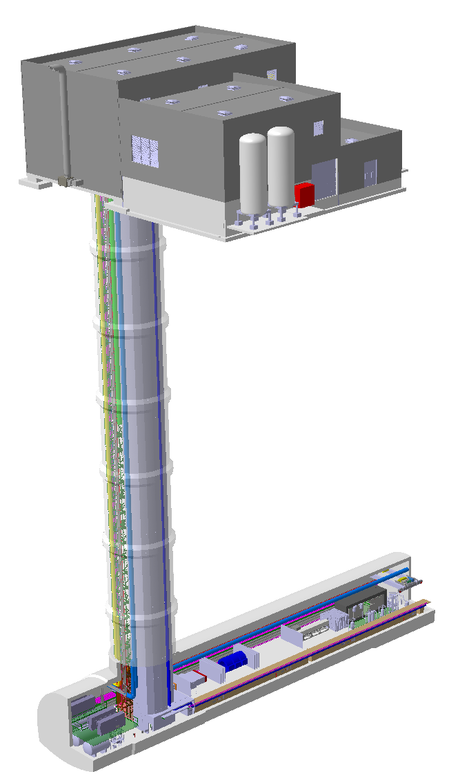
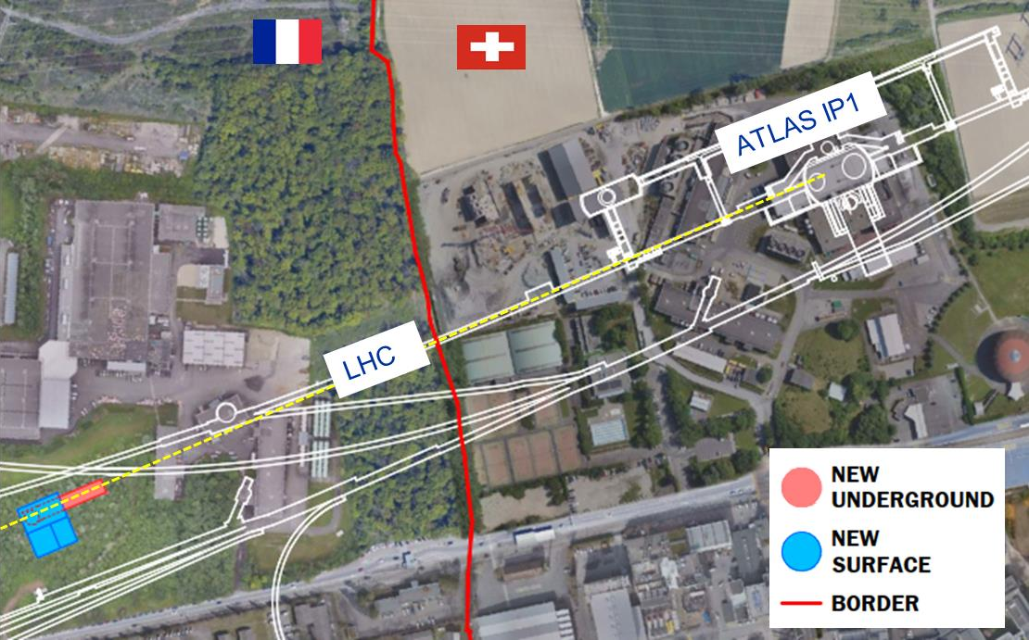
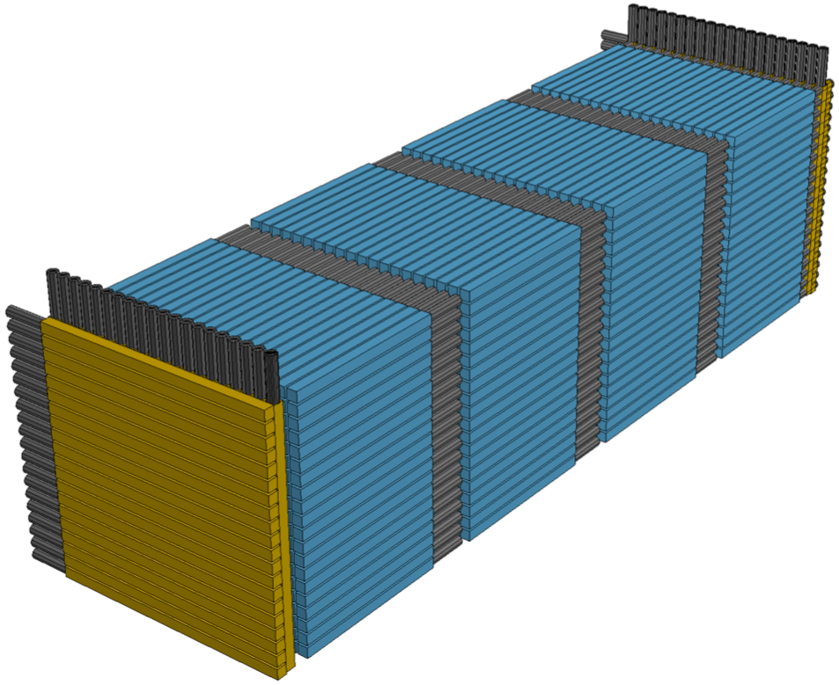
FORMOSA at the FPF
Surface building
See Akitaka Ariga’s FPF talk!
ATLAS I.P.1
SM18
L.O.S.
Shaft
SMA18
LHC
SPS
Cavern
FORMOSA
Nominal Beam Axis
FASER2
FASERnu2
FLArE

Slide 29
DAQ validation
Stable beams
Adjust
Squeeze
Ramp
Data from the 14th of June 2025
Signal triggers stably collecting data
Muons very effectively vetoed!

Slide 30
Timing studies: probing the LHC’s fill scheme
Data
Fit
Beam 1 contribution
Beam 2 contribution
Collision contribution
Fit function:

