Slide 1
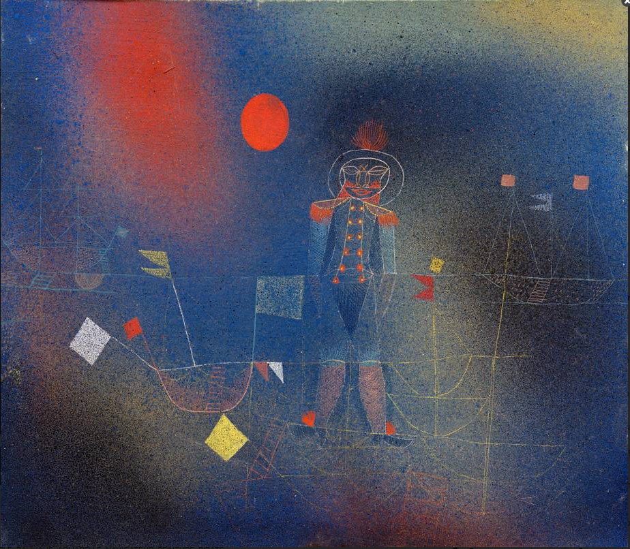




Liquid He tuning of dark matter axion haloscopes
T. Grenet, R. Ballou, P. Pugnat, P. Perrier, F. Gay, A. Talarmin
EPS-HEP 2025 Marseille
Adventurer on the sea, Paul Klee

Slide 2
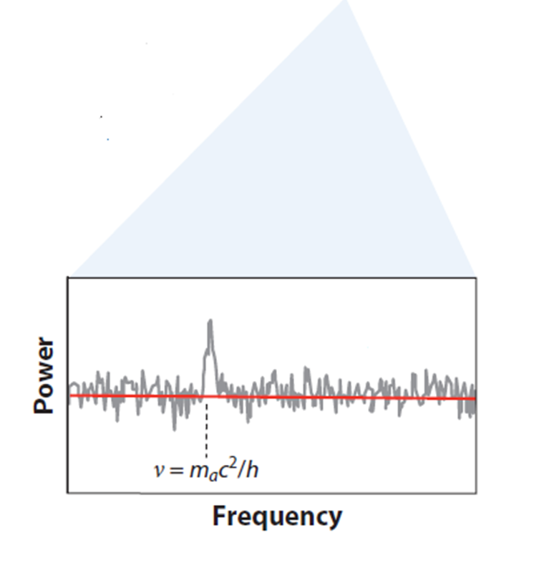
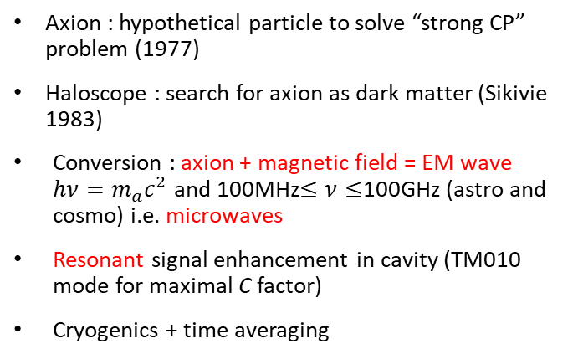


The haloscope in a nutshell
Standard Sikivie haloscope axion signal :
Axion : hypothetical particle to solve “strong CP” problem (1977)
Haloscope : search for axion as dark matter (Sikivie 1983)
Conversion : axion + magnetic field = EM wave $hν=m_{a}c^{2}$ and 100MHz$≤ν≤$100GHz (astro and cosmo) i.e. microwaves
Resonant signal enhancement in cavity (TM010 mode for maximal C factor)
Cryogenics + time averaging
$$P=g_{aγγ}^{2}\frac{ρ_{DM}}{m_{a}^{2}}νB^{2}VCQ_{0}$$
${{10}^{−23}<P}_{KSVZ}<{10}^{−21}$ W
For a typical cylindrical cavity haloscope
Spectrum analyser
preamplifier
Expected axion signal
Thermal power
Collecting antenna

Slide 3
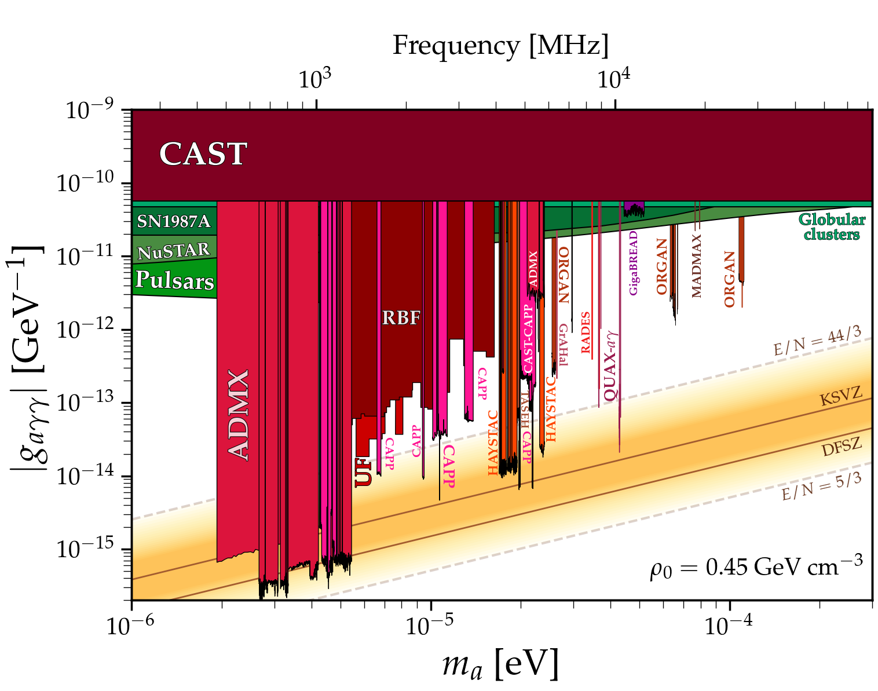


Need for volume
$$ν_{TM010}=\frac{2,405}{2π\sqrt{μ_{0}μ_{r}ε_{0}ε_{r}}R}$$
Scan speed
$$\frac{dν}{dt}∝\frac{Q_{0}B^{4}V^{2}C^{2}}{{(k_{B}T_{Noise})}^{2}}$$
High frequency => smaller radius => smaller volume => less signal power
Complex geometries needed to keep volume -> difficult mechanical tuning
Different approaches : Madmax, Alpha...
Excluded by a haloscope
Area of theoretical interest for QCD axion

Slide 4




Cavity tuning with liquid
Continuous tuning
No dead time : can be fast for broad exploration
At cryogenic temperature : liquid He
Start with a standard cylinder cavity
Questions :
δν(h) during filling ?
TM010 mode geometry ?
Liquid stability ?
Speed control ?
$$ν_{TM010}=\frac{2,405}{2π\sqrt{μ_{0}μ_{r}ε_{0}ε_{r}}R}$$
$$δν≈2\%$$
He gas
$$ε_{r}≈1.01$$
Height : 15 cm
Internal radius : 18 mm
TM010 frequency in vacuum : 6.38 GHz
He liquid
$$ε_{r}≈1.05$$
h

Slide 5
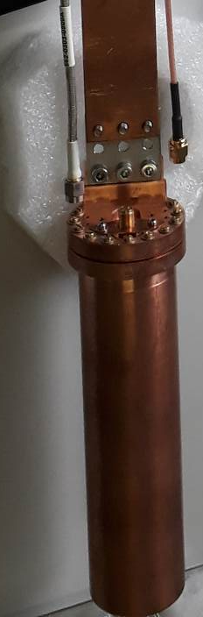
Evolution of frequency while filling
ν(h) is not constant : need to adapt filling speed
Order of magnitude
1 kHz ≡ 1µm
Black = simulation
Red = experiment
≈ 130 MHz
Height : 15 cm
Internal radius : 18 mm
TM010 frequency in vacuum : 6.38 GHz

Slide 6

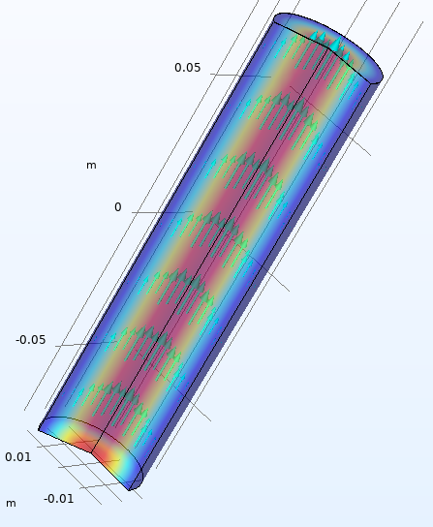
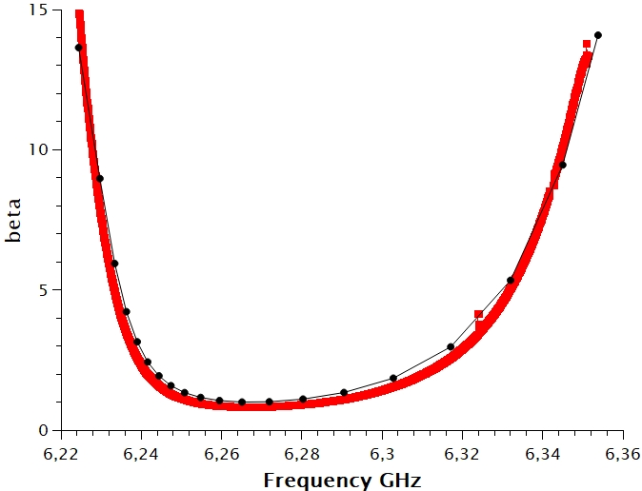
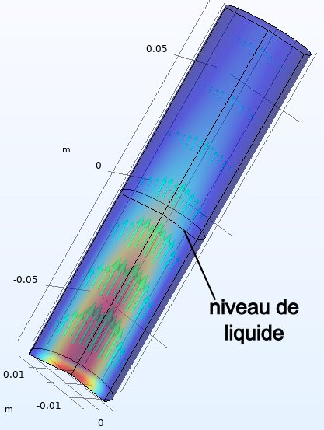

TM010 geometry
Collecting antenna
Partial filling localizes electric field :
Effect on collecting antenna coupling β
Effect on form factor C
$$\frac{dν}{dt}∝\frac{C^{2}β^{2}}{{(1+β)}^{3}}$$
Full
gHe or LHe
Black = simulation
Red = experiment
Broad range usable without adjusting antenna
Reasonable effect on C
gHe
Filling
Filling
LHe
Liquid surface
Filling hole at mode surface current node
Simulations with Comsol

Slide 7
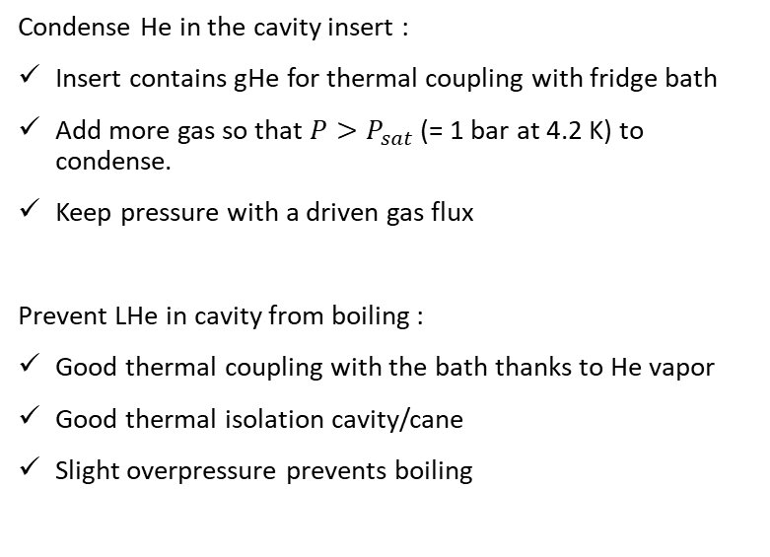
Condensing LHe
Condense He in the cavity insert :
Insert contains gHe for thermal coupling with fridge bath
Add more gas so that ${P>P}_{sat}$ (= 1 bar at 4.2 K) to condense.
Keep pressure with a driven gas flux
Prevent LHe in cavity from boiling :
Good thermal coupling with the bath thanks to He vapor
Good thermal isolation cavity/cane
Slight overpressure prevents boiling
Condensation on cold walls makes a thin continuous film
gHe
P>Psat
LHe
Cryostat bath

Slide 8
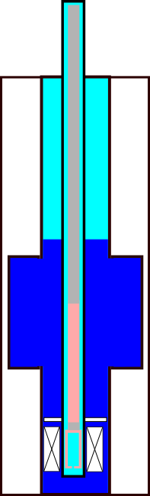
Broad “fast” scan
He bath recovery
T
Needle valve for precise flux control
P
Inject gHe from bottle : condensate in insert
T
P
Typical flux : 0.001 mol/min
100 L safety vessel
gHe bottle 150 bar
Sensitivity to perturbations of cryostat bath :
Change of pressure in recuperation lines
Evolution of LHe level of the bath

Slide 9
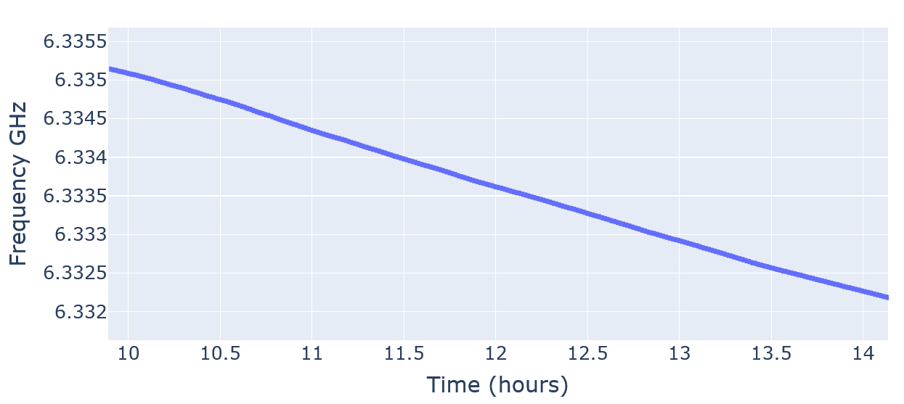
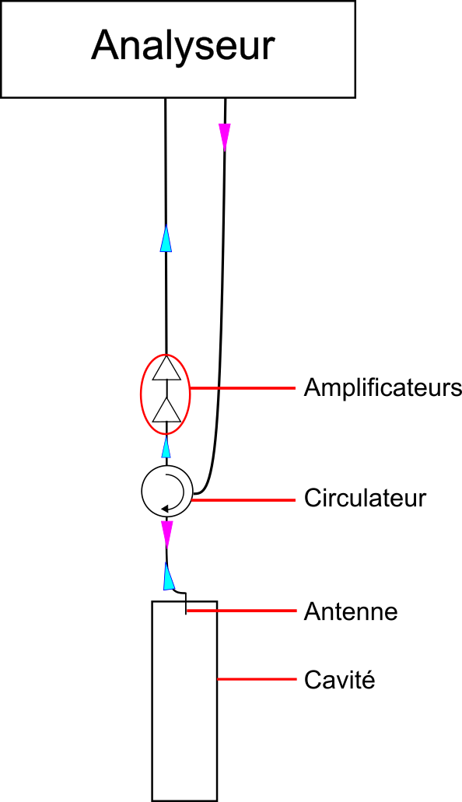
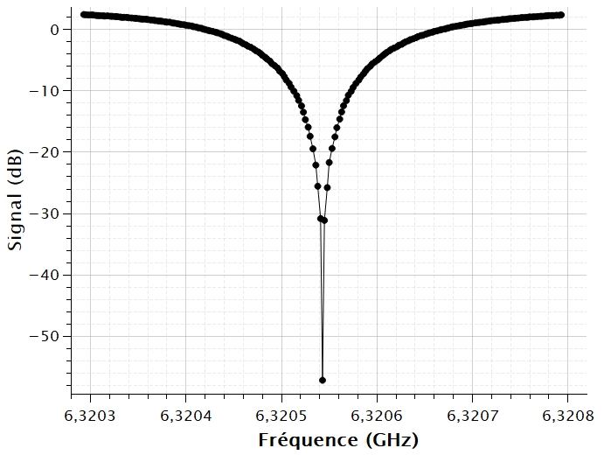
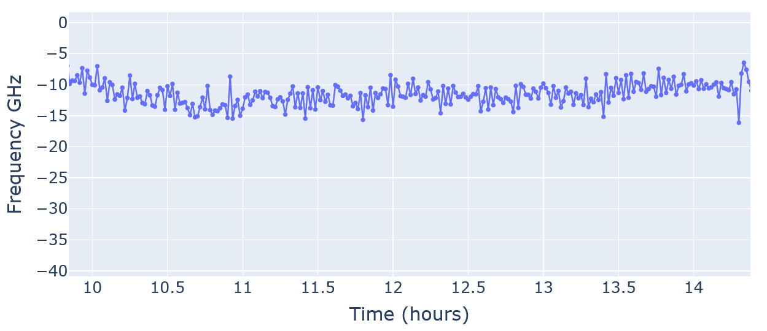
Speed and stability
Reflexion on antenna port at critical coupling
(NB : 1 kHz/min ≡ 1µm/min)
Good speed control over time
Scan as fast as desired for broad exploration
Anything between 2 weeks and 1-hour complete filling
Thin shape => no significant fast oscillations : resonance frequency stable during data acquisition

Slide 10
Slow scans
He bath recovery
T
P
Inject gHe from bottle : condensate in insert
One-way valve
T
P
Stop injection = stop scanning ?
Natural cryostat drift :
Small residual condensation
frequency drift (a few kHz/min)
Vacuum chamber
Pumping group
T
T
T
T
P
P
Vacuum gauge
Reversible process : filling / emptying
Pump to compensate bath effect and slowly fill cavity (condensation leads)
Pump to slowly empty cavity (pumping leads)
Gentle pumping : no ebullition
gHe bottle 150 bar
100 L safety vessel
Needle valve for precise flux control

Slide 11
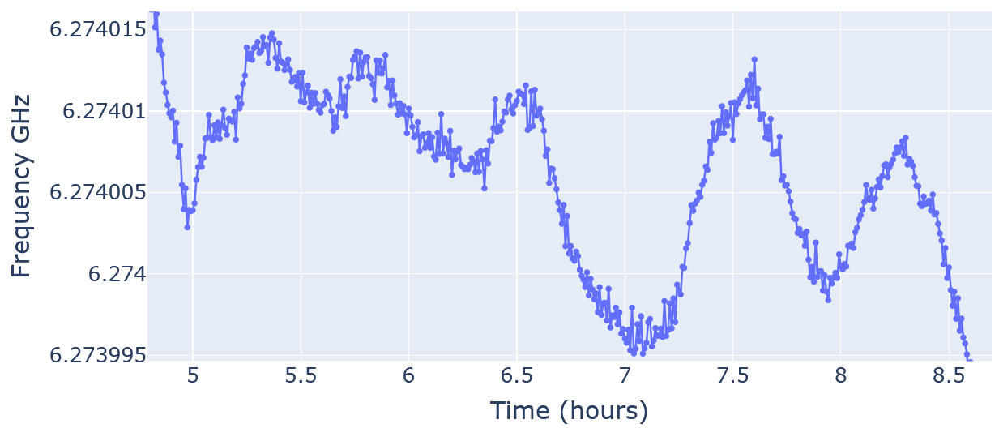
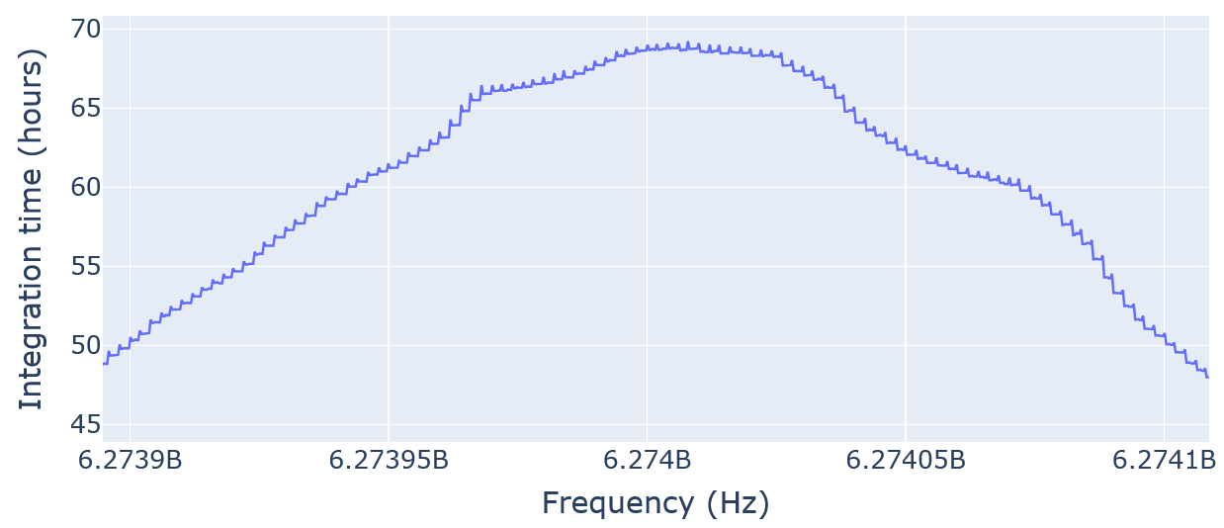



“chi va piano, va sano”
Stay stable : $\left|ν_{a}−ν_{c}\right|≪Δν_{c}$ (cavity bandwidth, 250 kHz here)
Reversible filling / emptying allows back and forth motion keeping frequency in a 20 kHz window for a few hours
$$ν_{a}$$
$$ν_{c}$$
Reminder : 1 kHz ≡ 1 µm
Equivalent drift 50 nm/min
Integration time after multiple scans (focus on 200 kHz)

Slide 12
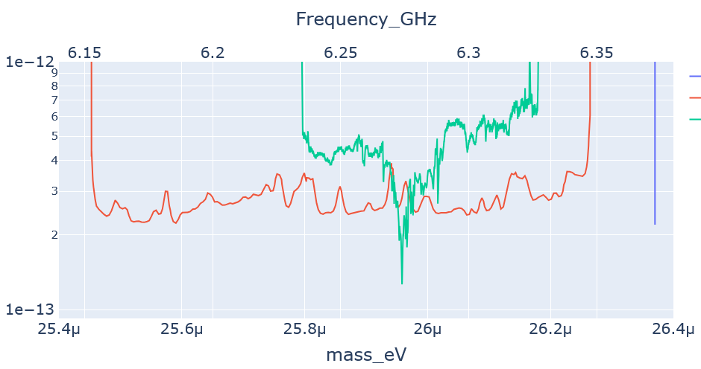
Resulting exclusion plot
ORGAN-Q
GrAHal 2021
This work

Slide 13
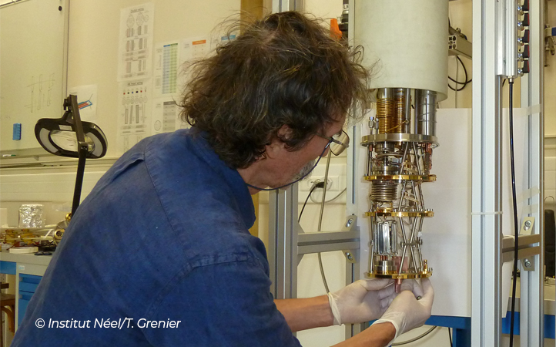
Conclusion
Achieved at 4.2 K with a cylinder cavity :
Experimental data in agreement with cavity filling simulations (mode frequency and antenna coupling)
Constant frequency tuning speed achieved for ‘fast’ broad scans (dν/dt ≥ 10 kHz/min)
Slow back and forth in a small frequency window (≥ 20 kHz) allows higher sensitivity
What’s next ?
Cylinder cavity filling with superfluid in dilution (T < 100 mK)
Apply filling to high volume high frequency cavity designs

Slide 14
Liquid He tuning of dark matter axion haloscopes
Thank you !
T. Grenet, R. Ballou, P. Pugnat, P. Perrier, F. Gay, A. Talarmin
EPS-HEP 2025 Marseille
Adventurer on the sea, Paul Klee

Slide 15
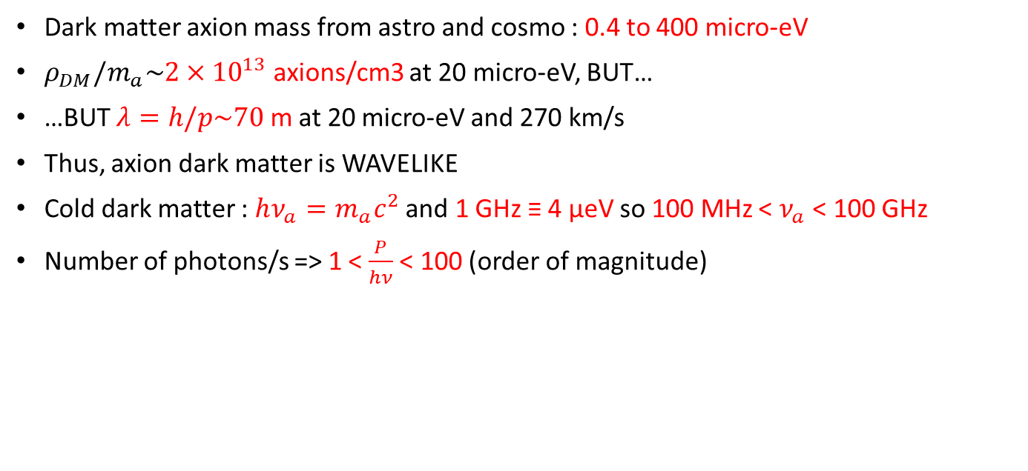
Axion dark matter
Dark matter axion mass from astro and cosmo : 0.4 to 400 micro-eV
$ρ_{DM}/m_{a}\sim {2×10}^{13}$ axions/cm3 at 20 micro-eV, BUT…
…BUT $λ=h/p\sim 70$ m at 20 micro-eV and 270 km/s
Thus, axion dark matter is WAVELIKE
Cold dark matter : $hν_{a}=m_{a}c^{2}$ and 1 GHz ≡ 4 µeV so 100 MHz < $ν_{a}$ < 100 GHz
Number of photons/s => 1 < $\frac{P}{hν}$ < 100 (order of magnitude)

Slide 16



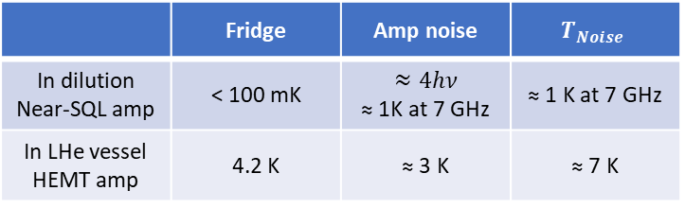
4.2 K interest
$$\frac{dν}{dt}∝\frac{Q_{0}B^{4}V^{2}C^{2}}{{(k_{B}T_{Noise})}^{2}}$$
$T_{Noise}=T_{Fridge}+T_{Amp noise}$
 | Fridge | Amp noise | $$T_{Noise}$$
In dilution Near-SQL amp | < 100 mK | $$≈4hν$$ ≈ 1K at 7 GHz | ≈ 1 K at 7 GHz
In LHe vessel HEMT amp | 4.2 K | ≈ 3 K | ≈ 7 K
Competitive with ${V≈10×V}_{Cylinder}$

