Slide 1
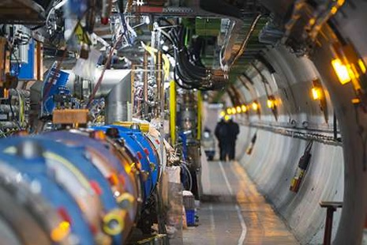
Unbinned machine-learned measurements for the LHC with systematic uncertainties
Lisa Benato, Cristina Giordano, Claudius Krause, Ang Li, Robert Schöfbeck, Dennis Schwarz, Maryam Shooshtari, Daohan Wang (HEPHY Vienna), EPS 2025, Marseille, July 9th, 2025

Slide 2
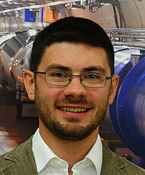
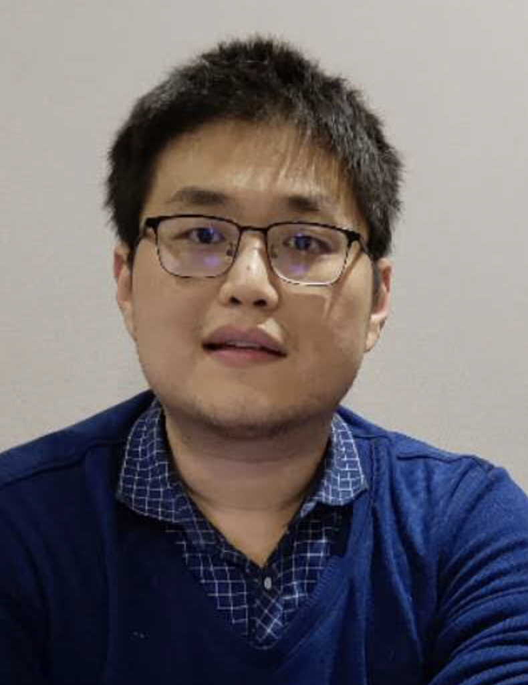
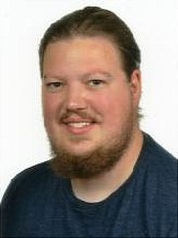
Who we are & where we come from
Joint venture of the [CMS Data Analysis] group & [Machine learning] group @ HEPHY (Vienna)
”You should use that unbinned method for this new challenge … ”
” … ”
Claudius Krause ML
R, Schöfbeck CMS
M. Shooshtari, CMS
D. Wang, ML
C. Giordano, CMS
L. Benato,CMS
D. Schwarz, CMS
Ang Li, CMS

Slide 3
Starting point
``Refinable modeling for unbinned SMEFT analyses`` [RS, MLST 6 015007 (2025)]
Statistical footing of systematics treatment
Stage wise unbinned model building
How to handle SMEFT
Higgs Uncertainty Challenge [link]:
Apply to unbinned inclusive xsec measurements
Divide & Conquer: go piece by piece
Build all known dependencies into the test statistic
Arbitrarily accurate modeling of systematics
Won 1st prize (ex-aequo) [ 2505.05544 ]
[Mach. Learn. Sci. Technol. 6 015007 (2025)]
arXiv:2505.05544

Slide 4
Test statistic
Profile log-likelihood ratio:
For extended likelihood:
Its (log-) ratio:
Need to evaluate the differential cross section ratio (DCR) and the inclusive cross section for new observed data ( 𝓓 ) and as a function of the model parameters.
(μ, 𝜈) = (1,0) is the “nominal” parameter point

Slide 5
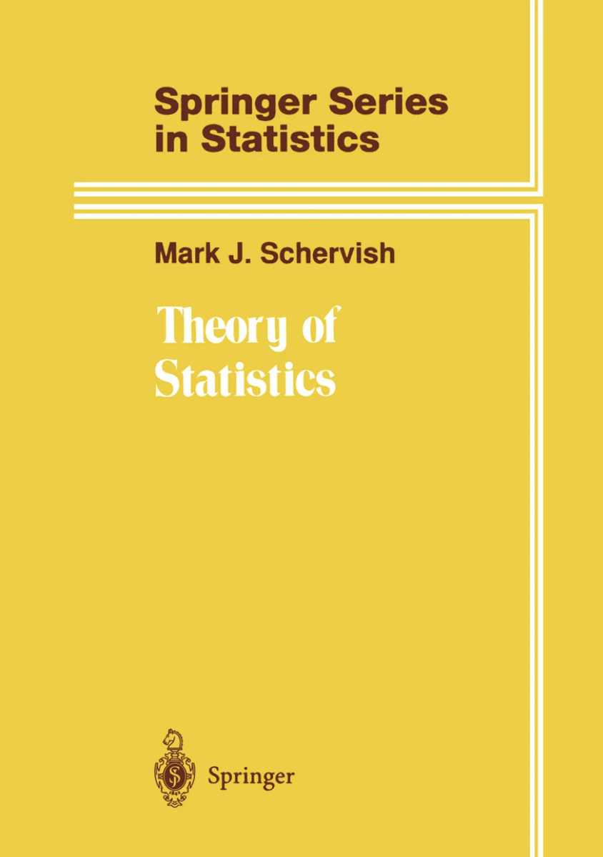
Modeling across the fields
Mathematical statistics: dσ(x| μ,𝛎) A measure on a probability space
Random variable x takes values in a “set” (continous / discrete parts)
dσ maps unions and intersactions of subsets of this space (σ-field) to ℝ
Here: Continous variables + overflows
DCR = Radon-Nikodym derivative
150 yrs of measure theory: Relevant for overflow bins, Fisher information, etc.
And when you ask yourself “can I do this?”
What is ?
Physics: dσ(x| μ,𝛎)/dx Unbinned differential cross section (detector-level, fiducial, total) Access to dσ(x| μ,𝛎) via expensive sampling
Machine-learning: dσ(x| μ,𝛎) defines a pdf
The inclusive model is not particularly useful.
μ … POI ∊ ℝ
𝛎 … nuisance parameters ∊ ℝ^{M}
x … observation

Slide 6
What to do with
dσ(x| μ,𝛎) encodes the field’s knowledge within the simulation and in systematic procedures
Extract from the bottom of a river (of wikis)
Wield its power to our advantage: Expand dσ(x| μ,𝛎) into sub-processes and encode analytic dependencies, as if you had the power to evaluate
Can’t keep it, though.
Get rid of dσ(x| μ,𝛎) by forming ratios, which we do evaluate with ML surrogates

Slide 7
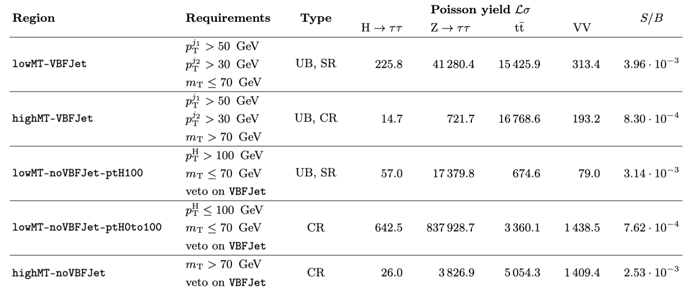
analysis regions
FAIR-HUC Challenge: H→𝝉𝝉 inclusive cross section measurement in 𝝉_{lep}𝝉_{had} channel
Overwhelming backgrounds: Z →𝝉𝝉, top quark pairs, diboson (VV), [no fakes, non-prompt]
We split into five regions: two signal regions and three control regions
lowMT-VBFJet vector boson fusion (VBF) with about 90% of sensitivity
lowMT-noVBFJet-ptH100 ggH (no label for production mode)
Main SR for VBF (90% sensitivity)
Unbinned CR
SR for ggH
90% of data → One bin for bkg norm
Split off tt and VV CR (2 bins)

Slide 8
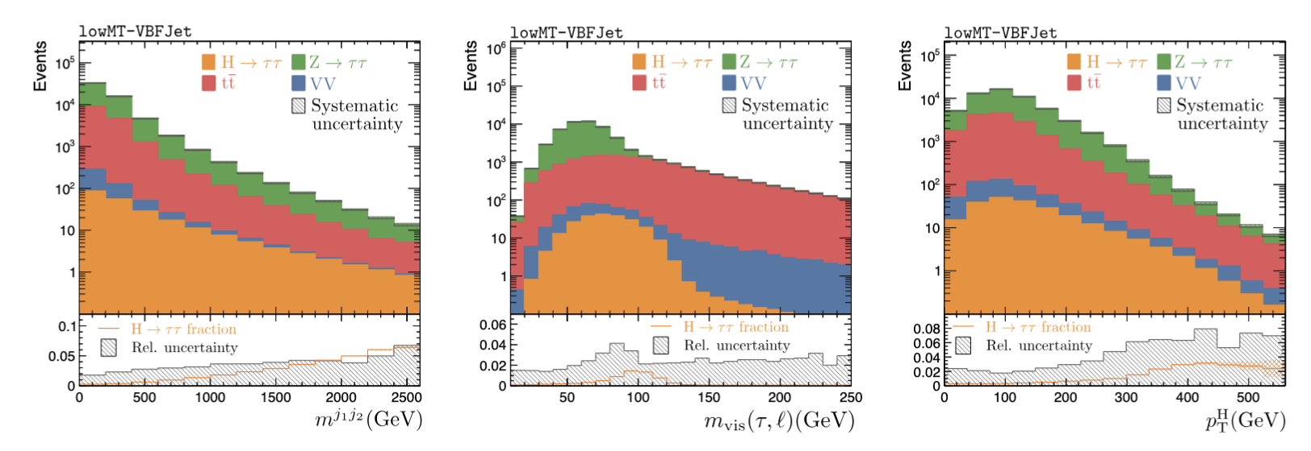
Challenge data set
28 features but no silver bullet
Tight in-situ constraints on systematics are needed
Three “normalization” effects: 0.1% bkg (on everything), 2% ttbar, and 25% diboson(VV)
Three “calibration” effects: jes, tes, met. Those modify x
7 parameters: 1 POI μ, 6 nuisances 𝜈 and a subset 𝜈_{calib} that refers to jes, tes, met
Good design!
Doable - but challenging

Slide 9
There and back again …
First implement POI and the normalization uncertainties in an additive expansion
Relate to reference model and factorize the calibration-type systematics
Repeat for Z, tt, VV & put it together:
NB1: Still avalid measure
NB2: The additive ansatz facilitates to refinable modeling.
Form ratio wrt total nominal (a choice)
model systematics per-process (another choice)
Parametric ML surrogate
Classifier (Likelihood -ratio trick)
DCR =
= surrogate

Slide 10
Refining the model
Why build the model this way? Because we’ll never be quite done.
Add a new background
Extend towards SMEFT: Follow the playbook
Only two more
pieces needed!
Old model
SMEFT is quadratic in θ
Refine further

Slide 11
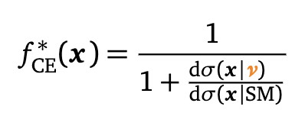
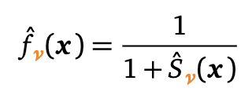
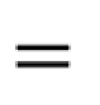
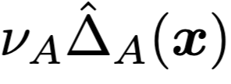
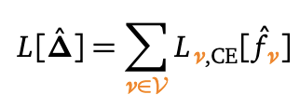
Training the surrogates
Learning systematic parametrizations:
Multiclassifier output ~ the class probability Use “probability weighting”
Convert back to cross-section weighting as
Tensorflow NN with 28/128/128/4
Softmax output; Adam opt., moderate L1/L2 reg.
“Likelihood
ratio trick”
Unbinned version of combine treatment

Slide 12
Example systematics
Per region, train up to (log-) quadratic order
The CE loss can be written as
Tensorflow; 28/256/256/9; Adam
Training data: All systematic samples with |𝜈_{jes}|+ |𝜈_{jes}|+ |𝜈_{met}| ≤ 2

Slide 13
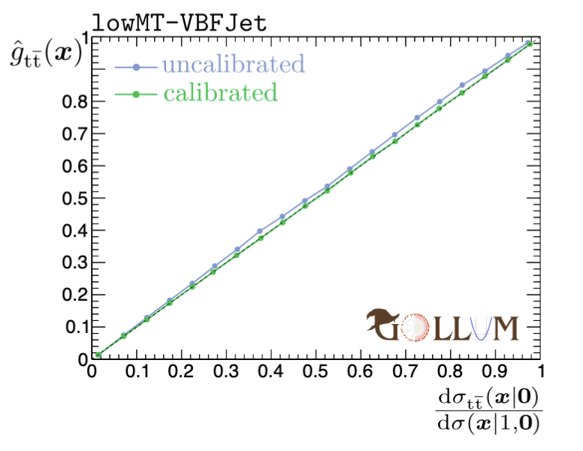
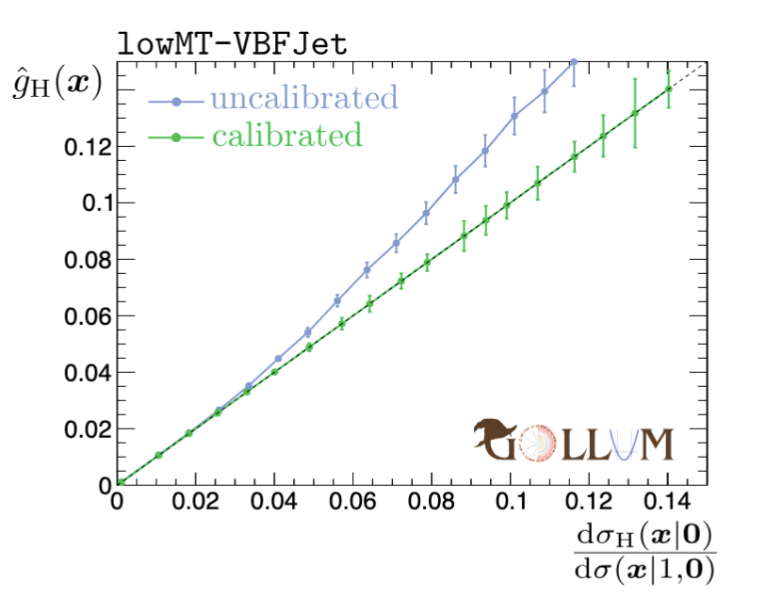
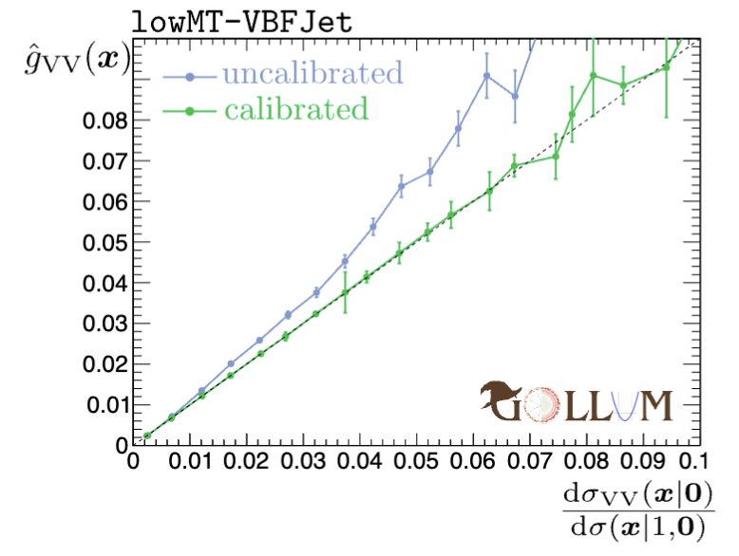
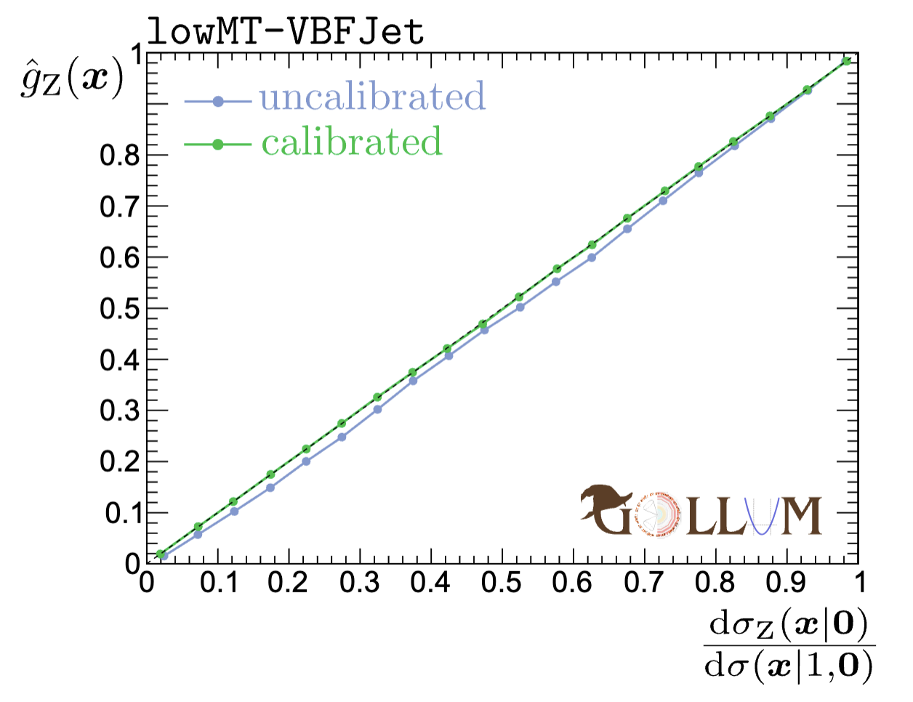
Calibration
And then, it fails! Problem: Multiclassifer is not well calibrated
Events in the bin 0.19<g_{Z}(x)<0.21 need to ~20% fraction of Z
g_{H} is off by ~7%, g_{Z} is off by a -2% (x10-x100!) → drastic impact
Staged isotonic regression provides excellent calibration

Slide 14
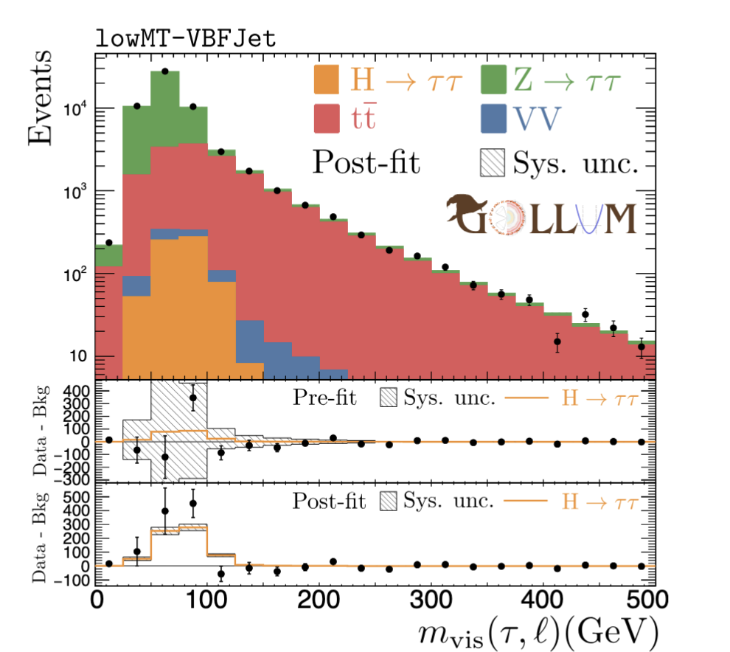
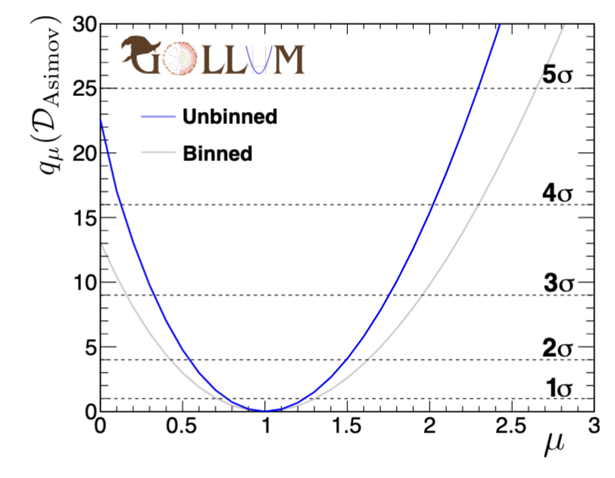
Asimov results
Add likelihood from all signal and control regions:
Impacts & constraints
Constraints are desired!
Post-fit distributions:
μ ^{true} = 3, μ^{MLE} = 3.24

Slide 15
Toy studies
50k toys, sampling the distribution from the challenge paper

Slide 16
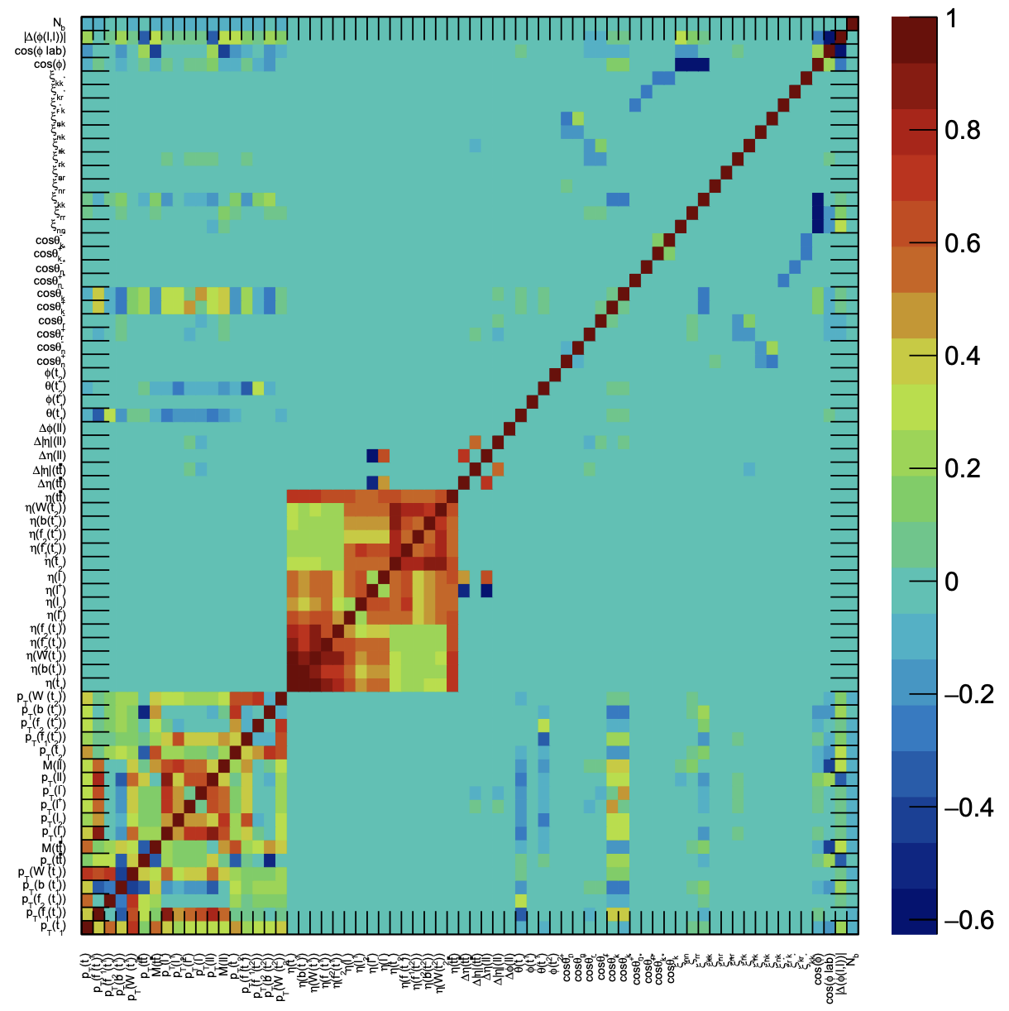
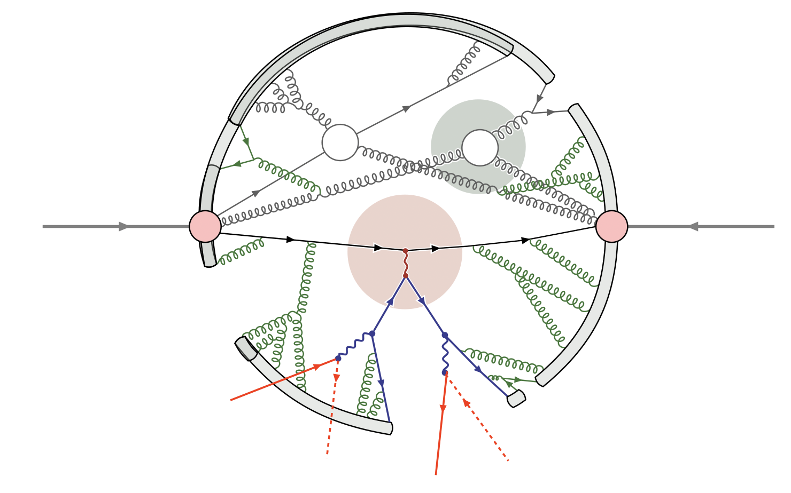
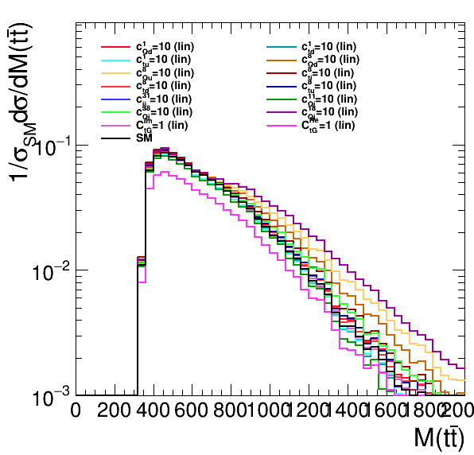
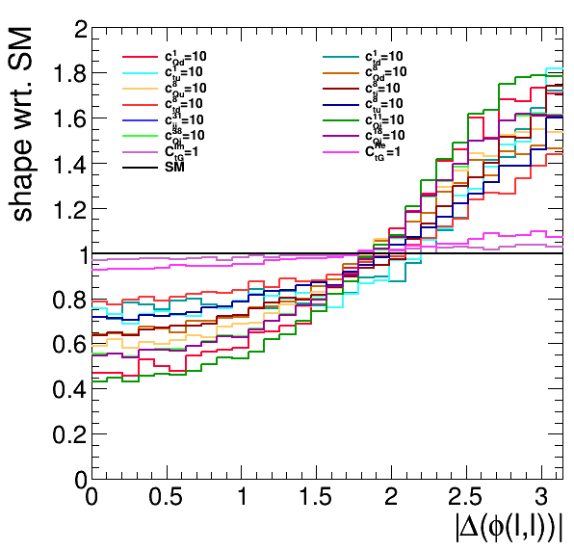
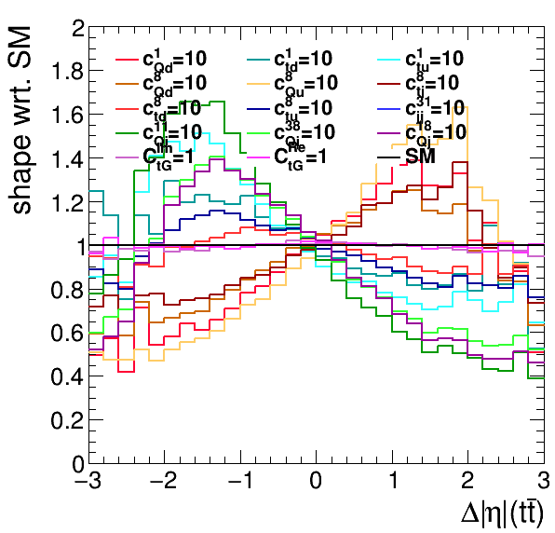
SMEFT with Top quark pairs in the 2ℓ channel
Clean probes of new physics in a messy environment
spin correlation
p
p
polarisation
charge asymmetries
ℓ
rapidities
𝛎
ℓ
𝛎
momenta/ masses
energetic observables
spin correlation
≳ 72 features
≳ 15 SMEFT POIs
charge asymmetry
linear feature correlation in tt(2ℓ)

Slide 17
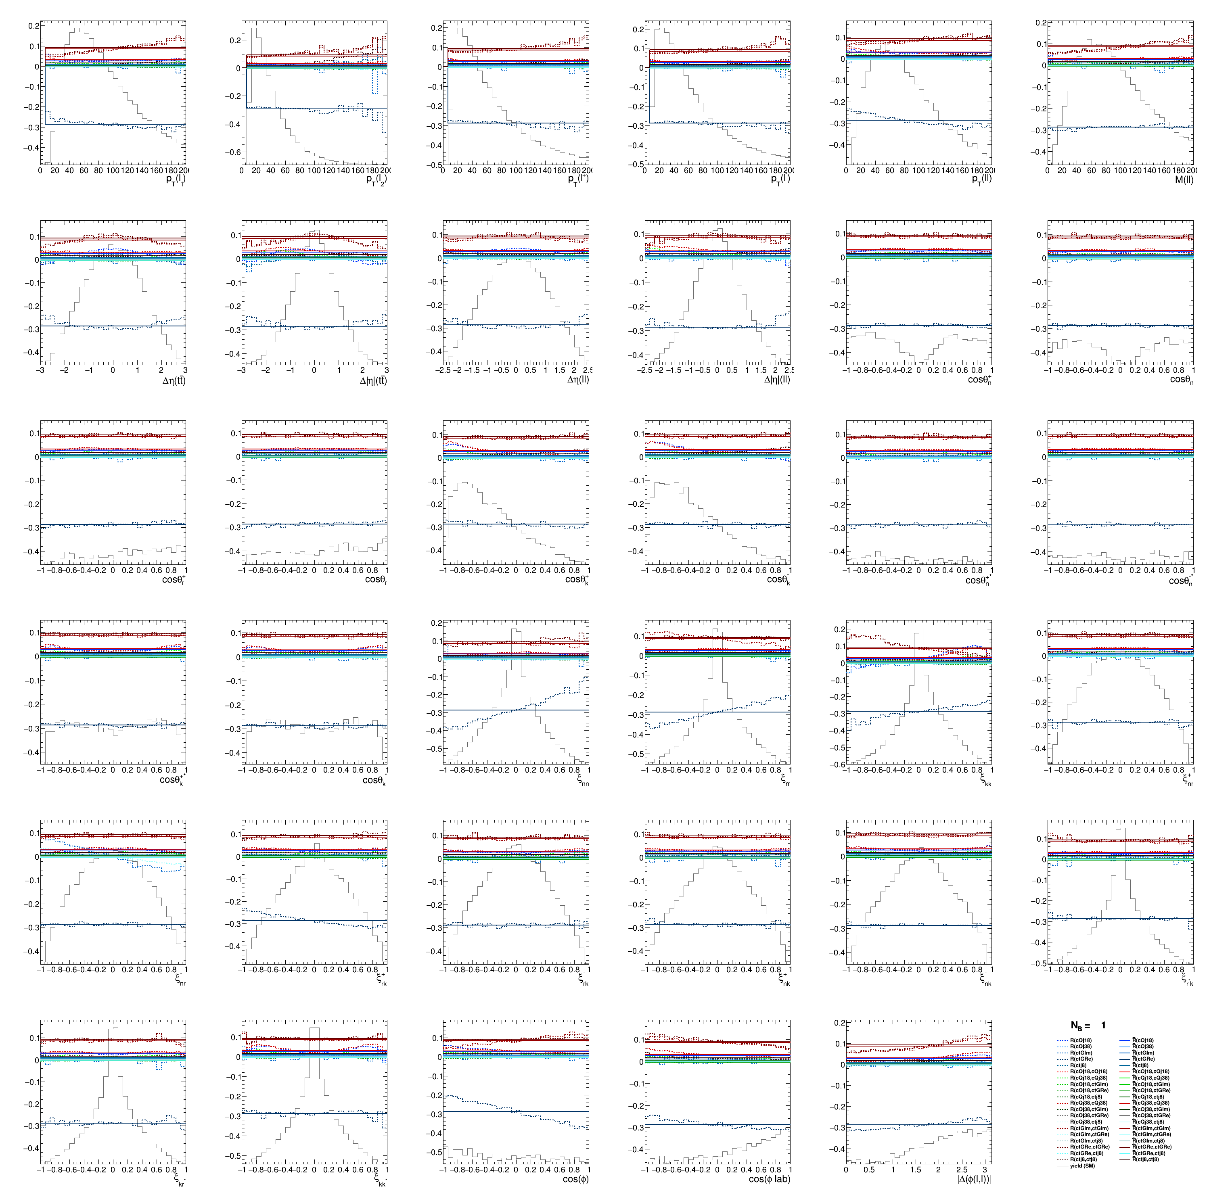
Learning SMEFT in TT(2ℓ)
From the playbook:
Quadratic SMEFT model
Learn with “Boosted Information Tree (BIT)” [2107.10859], [2205.12976] [MLST 6 015007 (2025)]
5 POIs, 20 functions simultaneously learned
35 features top quark pairs (2ℓ)
300 trees, D=5, ~9 hrs of training
(Systematics-free) Unbinned analysis shows ~x5 sensitivity gain in profiled limits ML4EFT R. Ambrosio, J. Hoeve, M. Madigan, J. Rojo, V. Sanz [2211.02058]

Slide 18
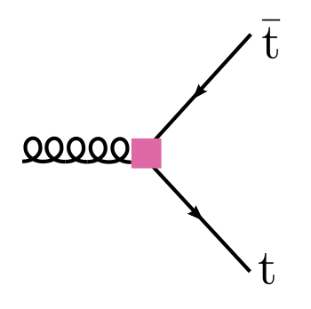
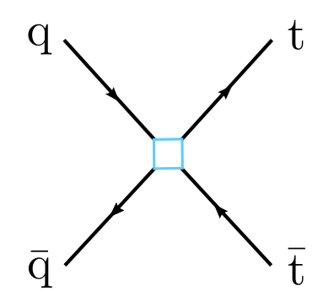
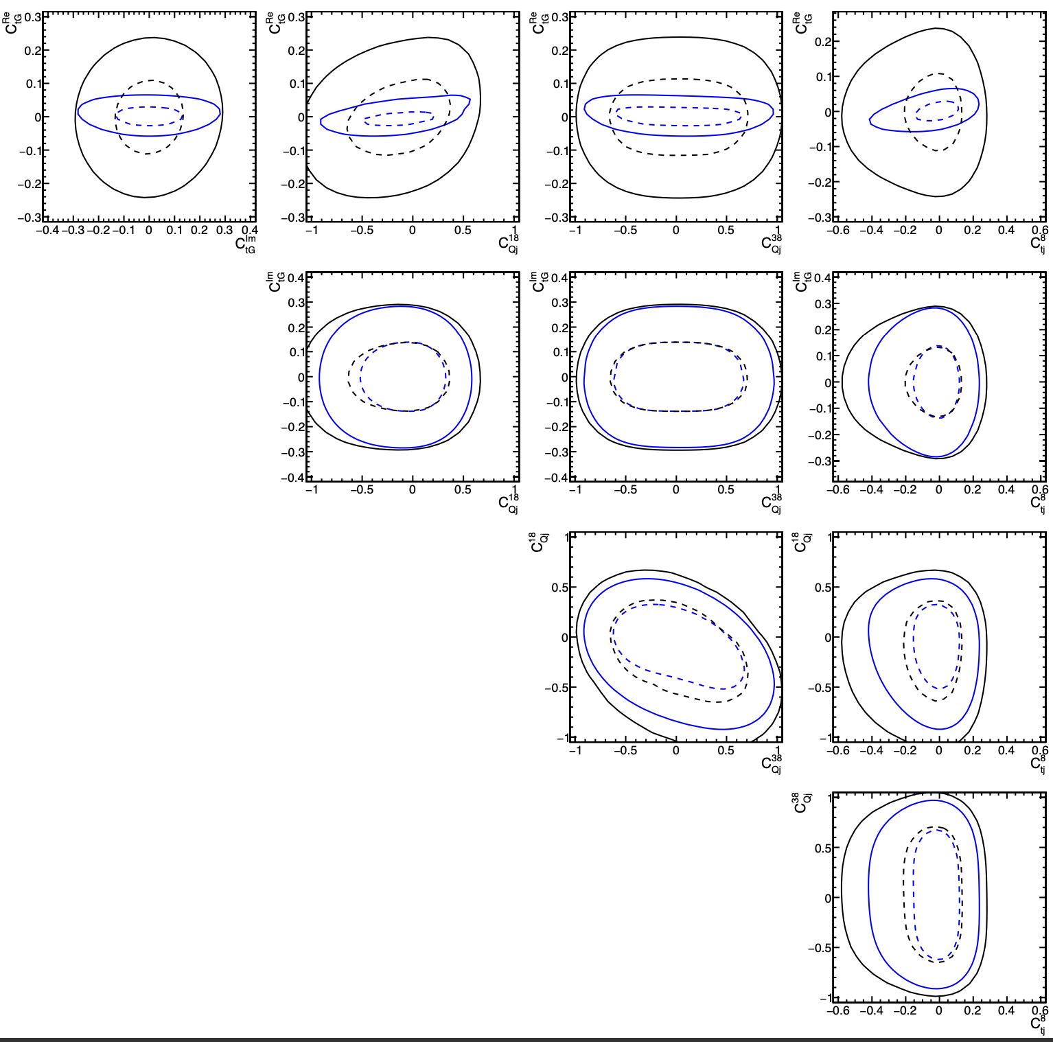
Delphes Results
CP-odd
iso-singlet
iso-triplet
right-handed
TT(2ℓ) + DY background
CP-even
Uncertainty | Nuisances | size
Lepton efficiency | 1 | <1%
Jet energy scale | 6 | ~2-15%
Jet energy resolution | 1 | ~2-3%
B-tagging | 5 | 1-10%
DY normalization | 1 | floating
TT(2ℓ) normalization | 1 | 20%
Powheg vs. MG | 1 | ~5%
𝛼_{S} in PS | 2 | <1%
ME scales | 2 | 2-20%
PDF | 100 | < 0.1%
Luminosity | 1 | 5%
Re[C_{tG}] suffers from normalization
CP-odd
iso-singlet
Asimov expected 68% (dashed) and 95% (solid) CL intervals
profiled, without systematics
profiled, with systematics
iso-triplet

Slide 19
What did we learn?
This was a great challenge!
Doable but challenging & realistic
Lessons learned:
Calibrated classifiers are key; otherwise, ML part was straightforward
Numerics! Instead of multiplying exp, must accumulate logs
Numerics! Likelihood ratios have dramatic cancellations away from the minimum; 6-7 digits must be accurately modeled
Numerics! The constant piece in the extended likelihood, ℒσ (μ𝜈), is CPU intensive and demanding
We’re now more ready than we were before thanks to the challenge ☺
today

Slide 20
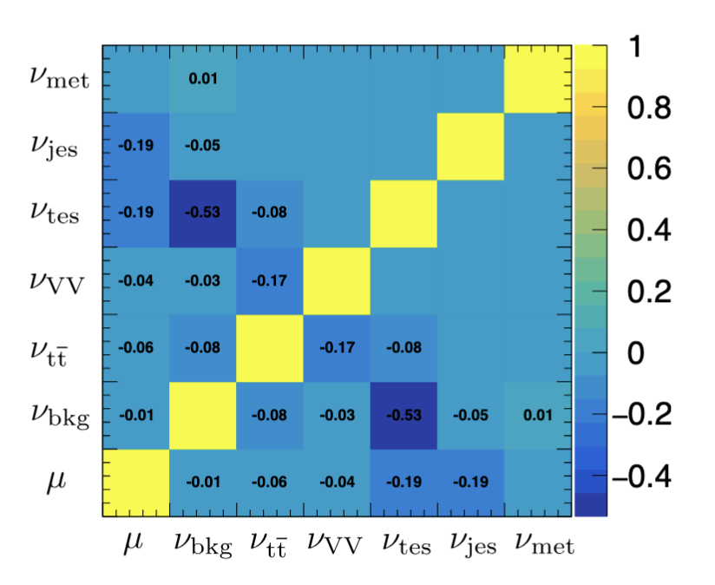
Impacts
Post-fit, the measurement is statistically dominated.
Post-fit impacts are below ~5%!

Slide 21
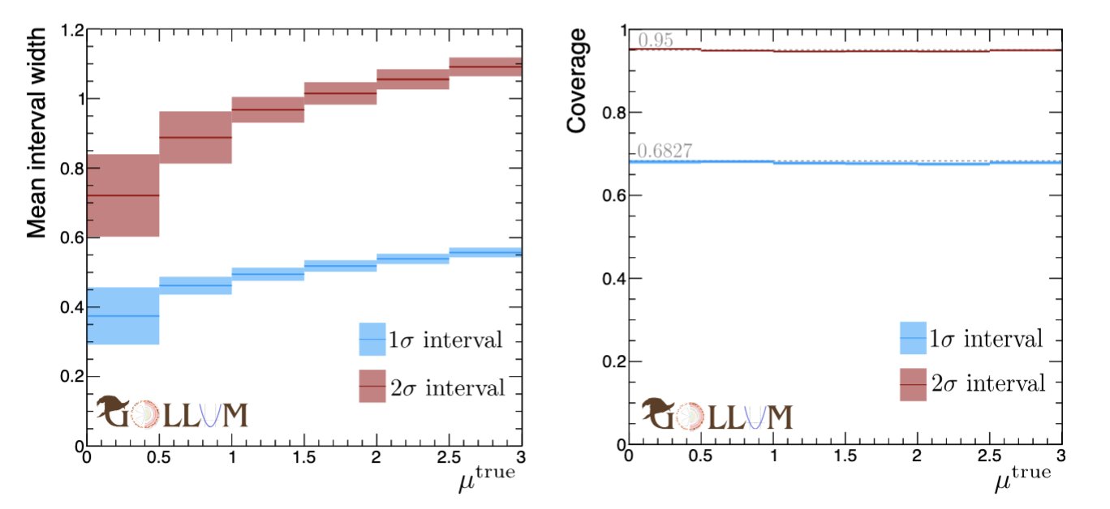
Interval size and coverage
Interval size grows with μ_{true}. Coverage is excellent.
Note to the organizers: Our submitted model fits the MLE but does not re-minimize the nuisances when scanning to find the interval boundaries. This solves the timing problem that appears only at the remote cluster [see email]. The simplification causes a flat deficiency of 4.5% in the interval width which we calibrated by inflating the interval. Apparently, this inflation factor is slightly imperfect, hence our imperfect coverage in the last submitted model. Results in the plots are fully profiled.

Slide 22
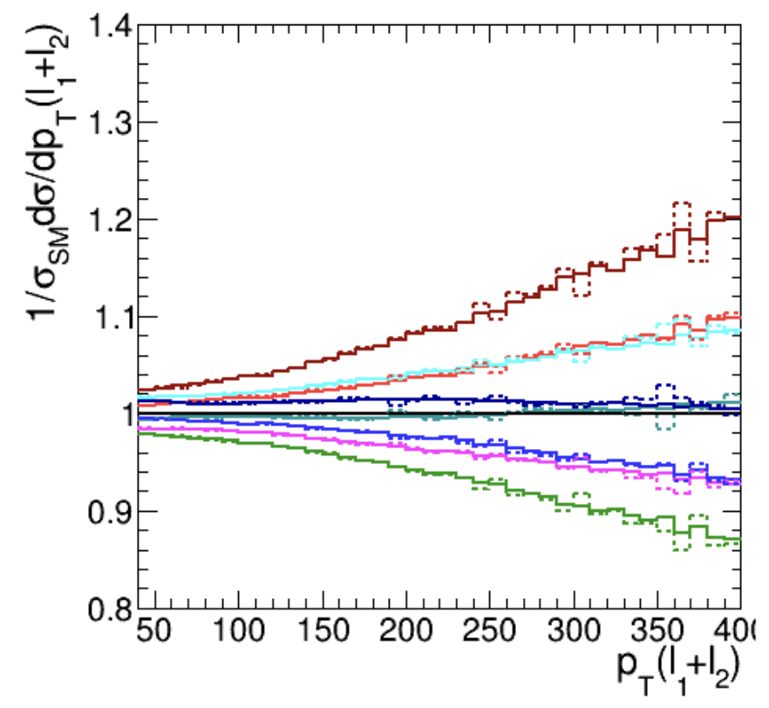
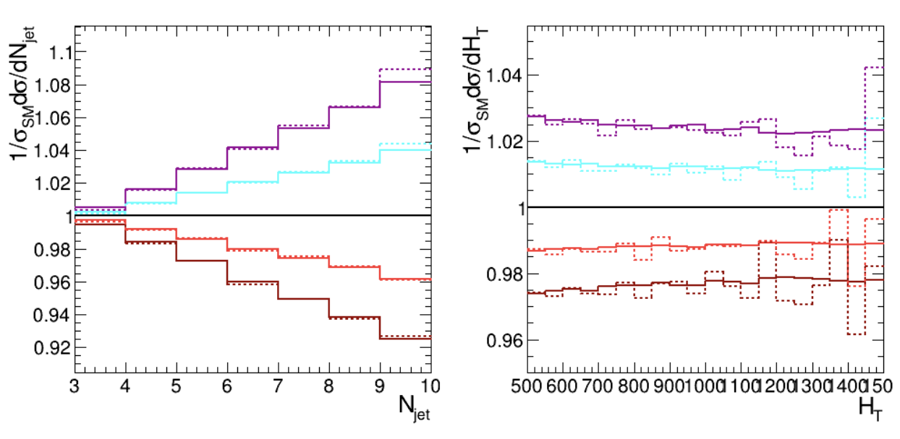
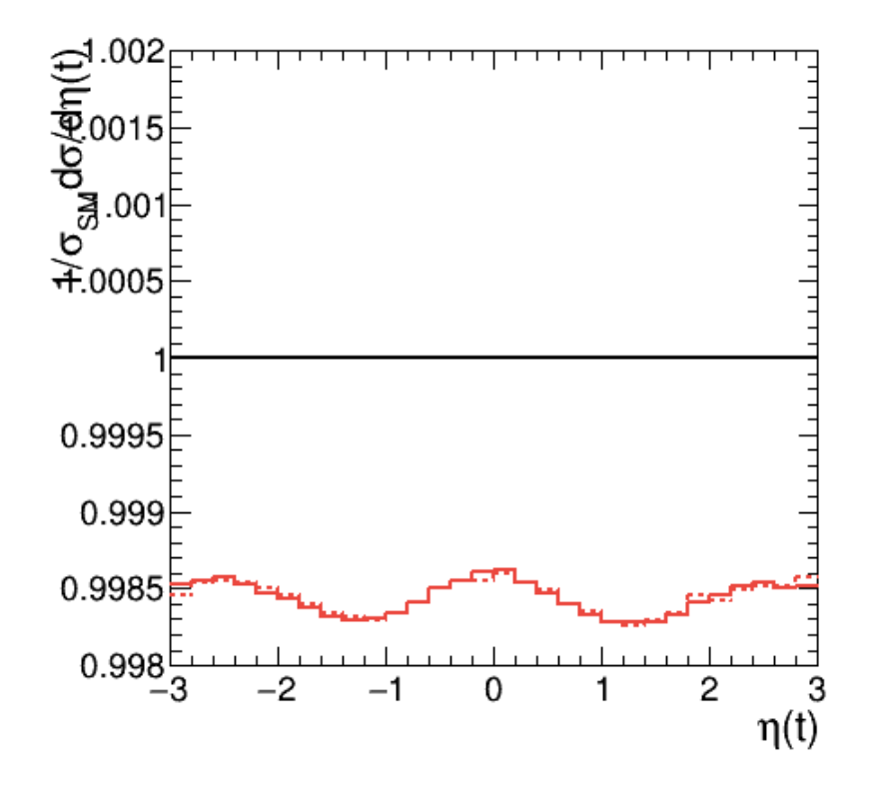
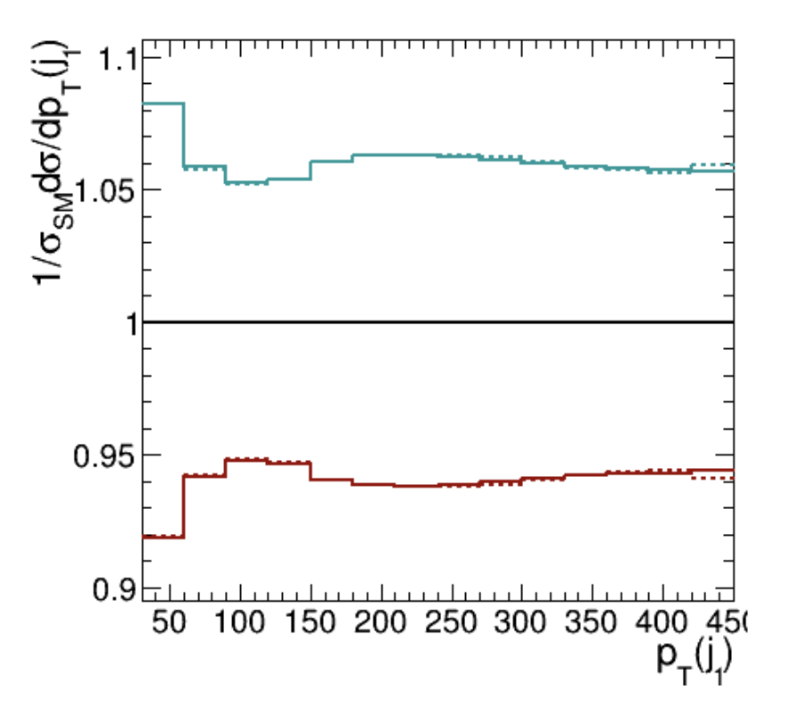
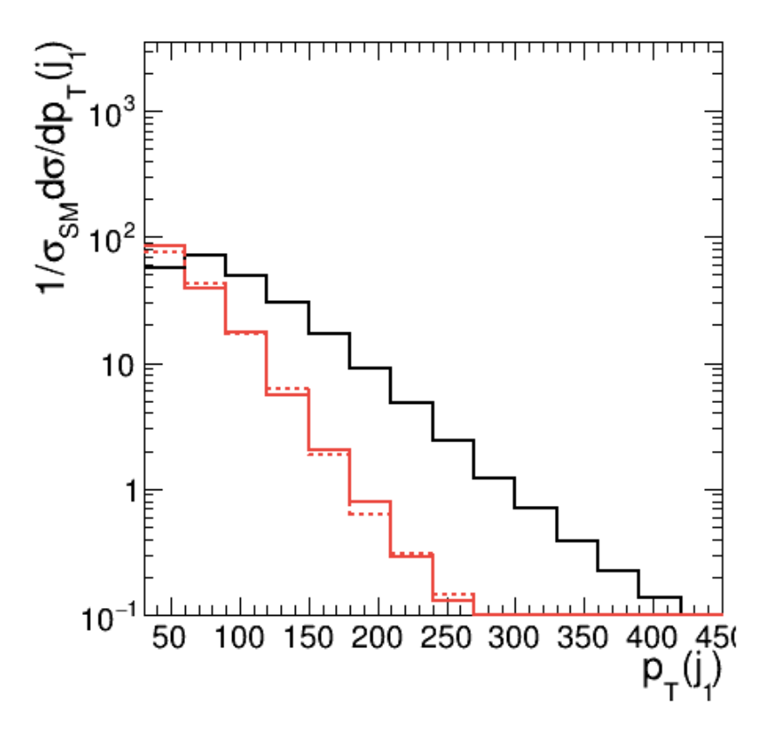
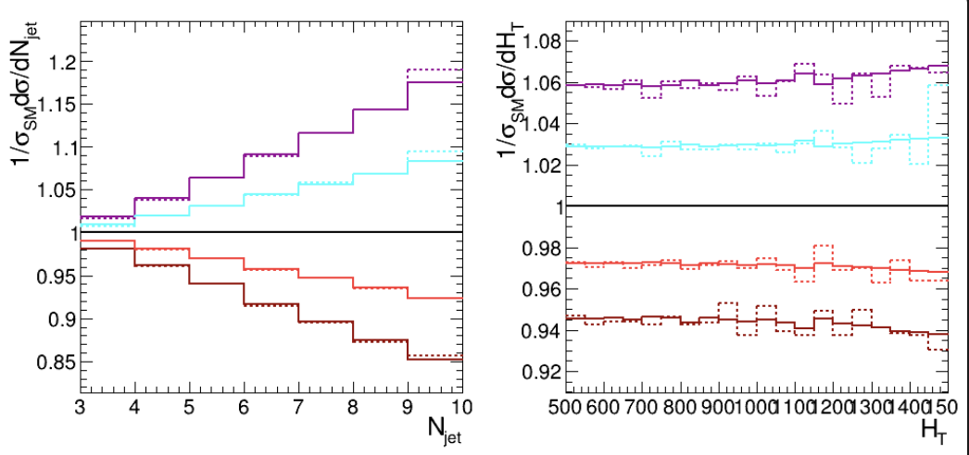
Examples systematics
1D projections for a few values of 𝛎. Available parametrically as S(x|𝛎).
Semi-realistic toy study (Delphes) with publicly available information
ME scales
JES Flavor QCD
PDF #12
mis-btag
btag efficiency
Drell-Yan classifier
JES Abs Scale

Slide 23
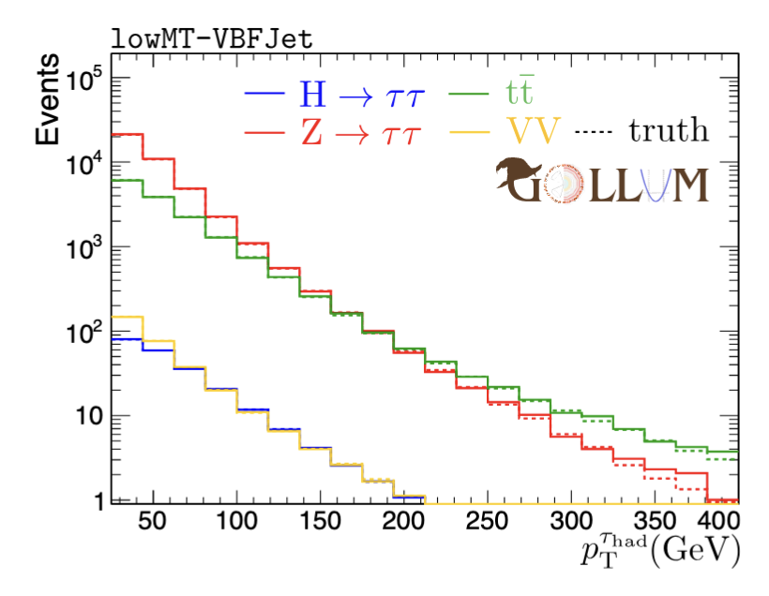
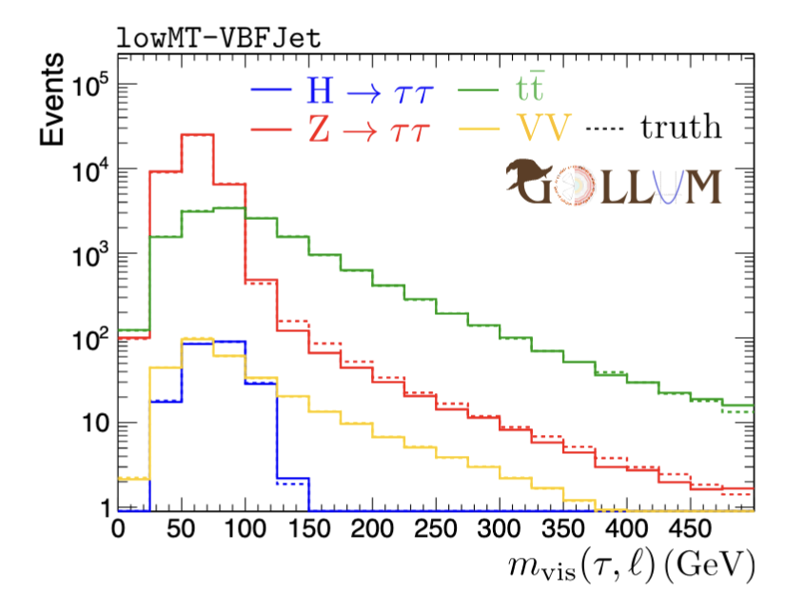
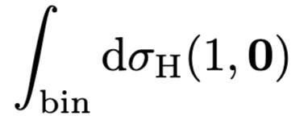
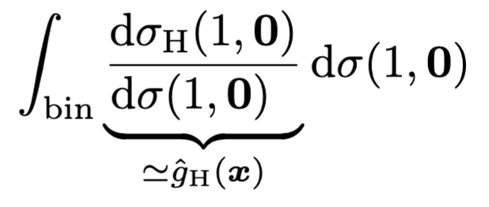
multiClassifier training
Multiclassifier output is proportional to the class probability
Here, we use “probability weighting” that we convert to cross-section weighting as
Tensorflow NN with 28/128/128/4
Softmax output; Adam opt., moderate L1/L2 reg.
Each bin compares with or, empirically, with

Slide 24
learning parameterizations (Generic)
“Likelihood ratio trick”
Parametric ansatz:
Implement coefficient functions Δ(x) as NNs or trees:
Sum over more data sets than independent. :
enough to learn non-parametric DCR

Slide 25
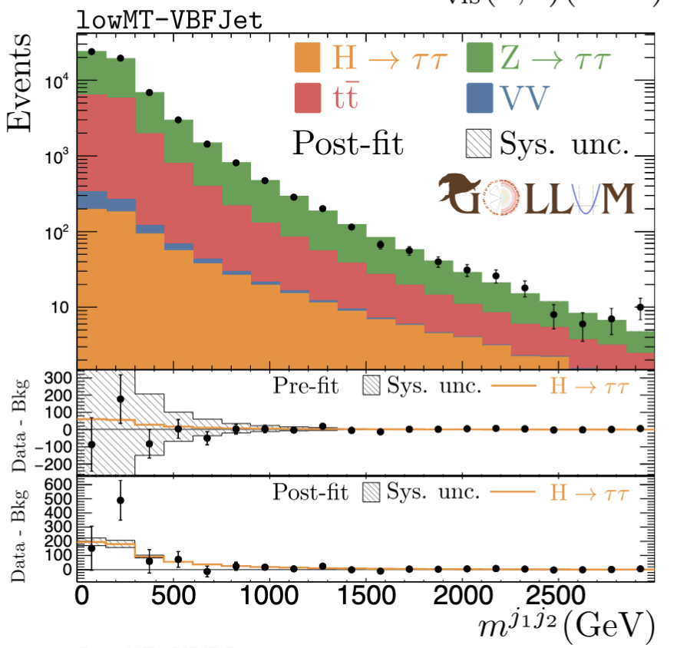
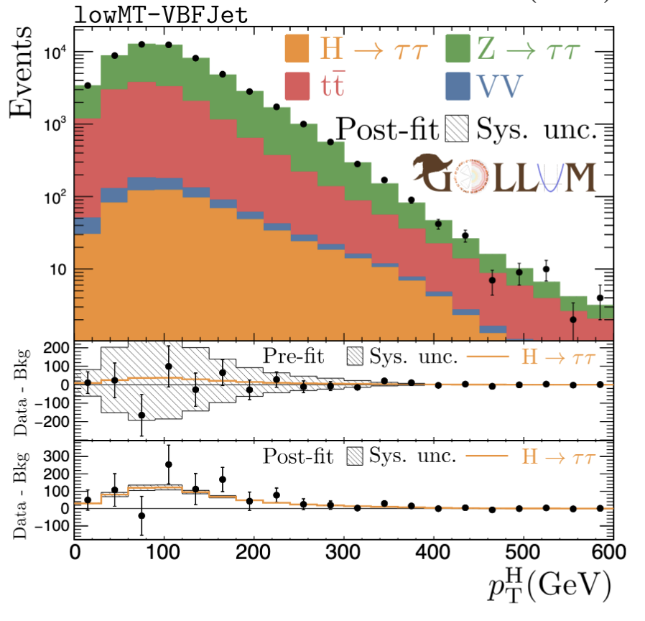
Postfit distributions
μ ^{true} = 3, μ^{MLE} = 3.24

