Slide 1
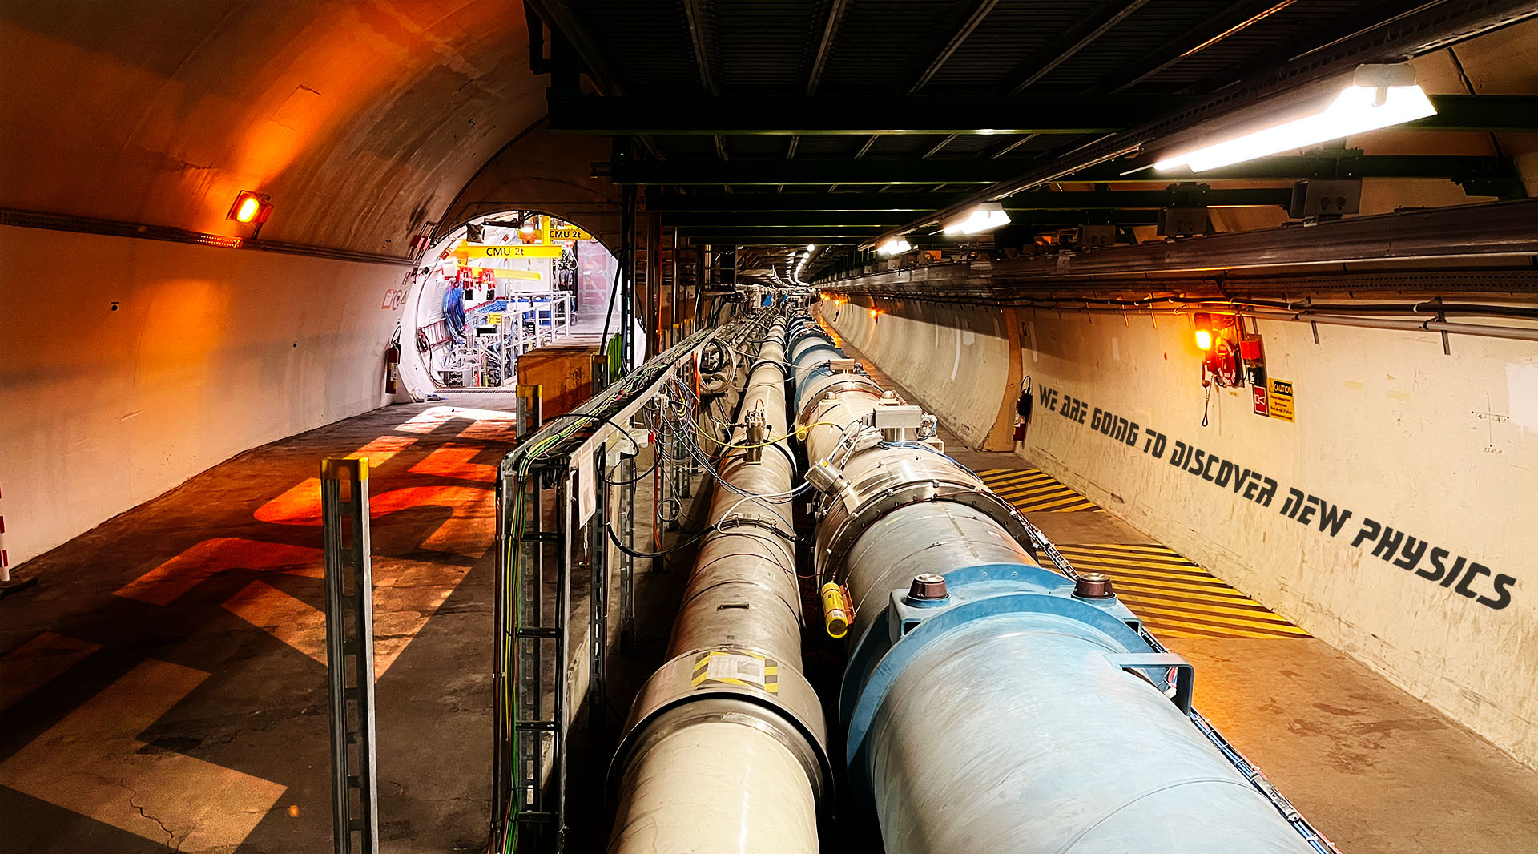









Neutrino results at the FASER experiment
Akitaka Ariga
University of Bern
On behalf of the FASER Collaboration

Slide 2

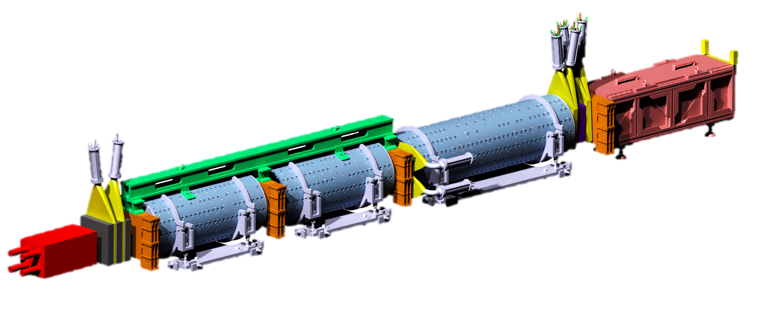


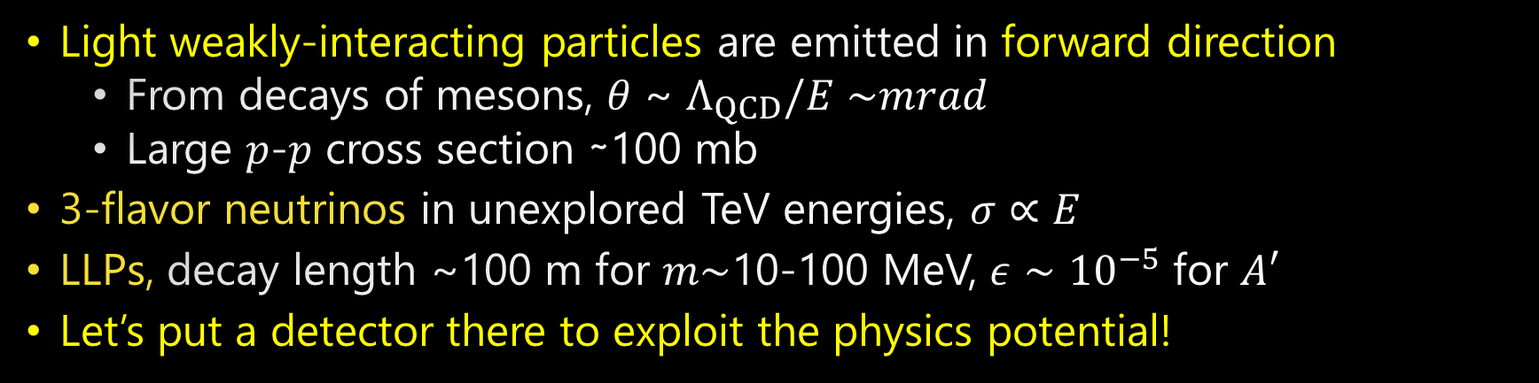






Physics concept of “forward” beam at the LHC
Light weakly-interacting particles
14TeV $p$-$p$ collisions
$$ALPs$$
$$A′$$
$$ν_{μ}$$
$$ν_{e}$$
$$ν_{τ}$$
$p$-$p$ collision axis
Strongly interacting massive particles
Light weakly-interacting particles are emitted in forward direction
  From decays of mesons, 𝜃 ~ $Λ_{QCD}/E∼$𝑚𝑟𝑎𝑑
  Large 𝑝-𝑝 cross section ∼100 mb
3-flavor neutrinos in unexplored TeV energies, $σ∝E$
LLPs, decay length ~100 m for 𝑚$∼$10-100 MeV, $ε∼{10}^{−5}$ for $A′$
Let’s put a detector there to exploit the physics potential!

Slide 3


The FASER experiment
FASER TP arXiv:1812.09139,
FASER$ν$ Eur. Phys. J. C (2020) 80: 61
FASER web page: https://faser.web.cern.ch/
FORWARD SEARCH EXPERIMENT AT THE LHC
Targets long-lived BSM particles (e.g. A’, ALPs) and SM neutrinos (and $μ)$
Located 480 m downstream of ATLAS interaction point
First experiment to utilize “collider neutrinos”
p-p collision at ATLAS
LHC tunnel
Charged particles
Neutrinos and LLPs
FASER
Neutral hadrons
LHC magnets
100 m of rock
Service tunnel
480 m

Slide 4
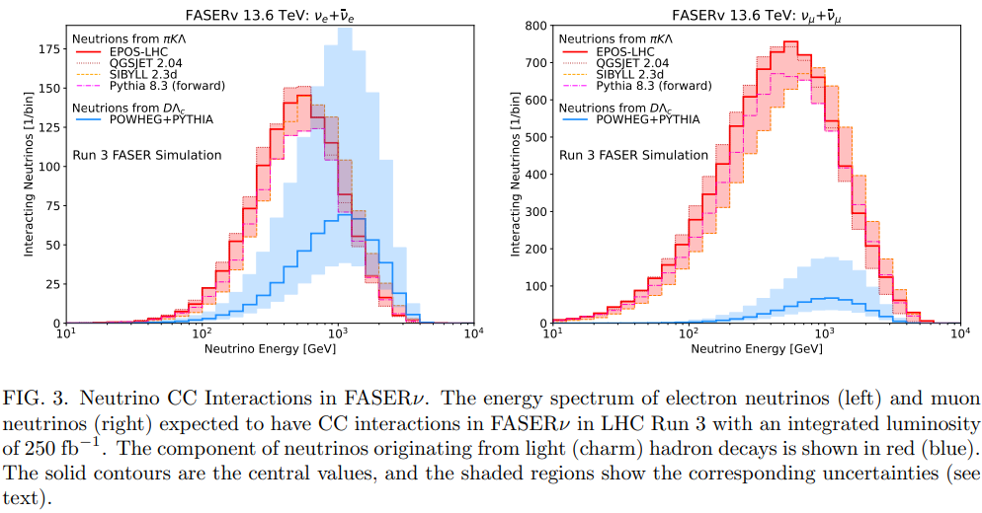
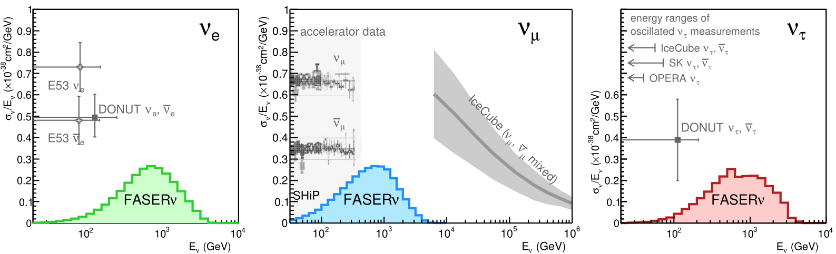
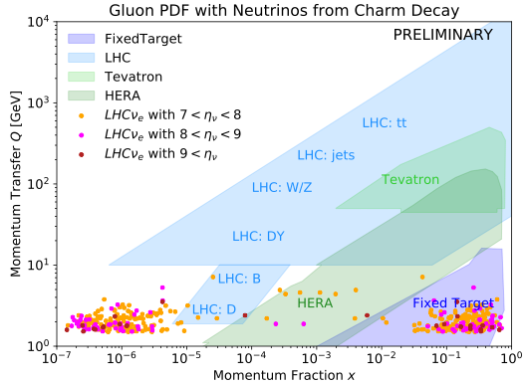

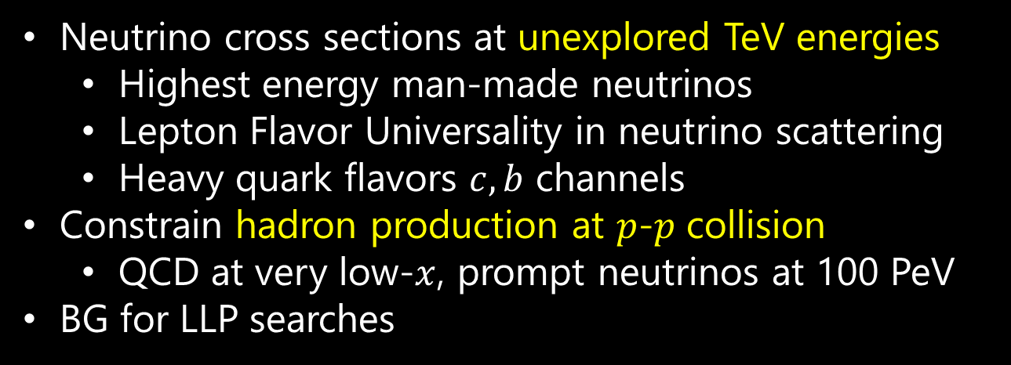

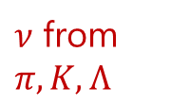
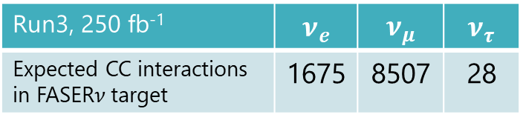
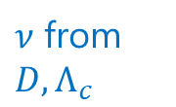
Neutrino studies in FASER
$ν_{e}$ flux uncertainty
$ν$ from $D, Λ_{c}$
$ν$ from $π,K,Λ$
Neutrino cross sections at unexplored TeV energies
  Highest energy man-made neutrinos
  Lepton Flavor Universality in neutrino scattering
  Heavy quark flavors $c, b$ channels
Constrain hadron production at $p$-$p$ collision
  QCD at very low-$x$, prompt neutrinos at 100 PeV
BG for LLP searches
$$x∼{10}^{−6}$$
Run3, 250 fb⁻¹ | $$ν_{e}$$ | $$ν_{μ}$$ | $$ν_{τ}$$
Expected CC interactions in FASER$ν$ target | 1675 | 8507 | 28
2402.13318
Notes:
Arxiv

Slide 5











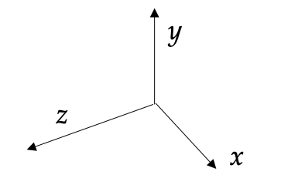
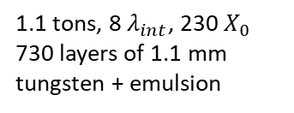
FASER detector
(ariXiv:2207.11427)
Small, inexpensive detector
  10 cm radius
  7 m long
2 x 20 mm thick
35 x 30 cm area
3 x 3 layers of ATLAS SCT strip modules
3 x 20 mm thick
30 x 30 cm area
4 LHCb Outer
ECAL modules
1.1 tons, 8 $λ_{int}$, 230 $X_{0}$
730 layers of 1.1 mm tungsten + emulsion
10mm thick + dual PMT readout (σ = 400 ps)
Air-core magnets
0.57 T Dipoles
1.5 m decay volume

Slide 6
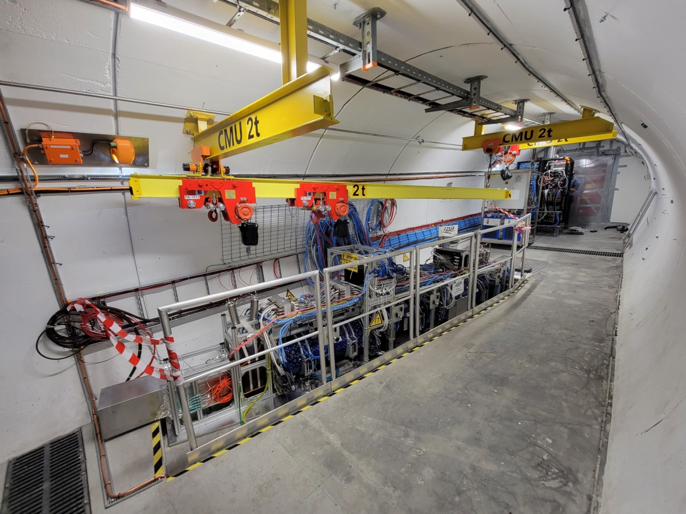
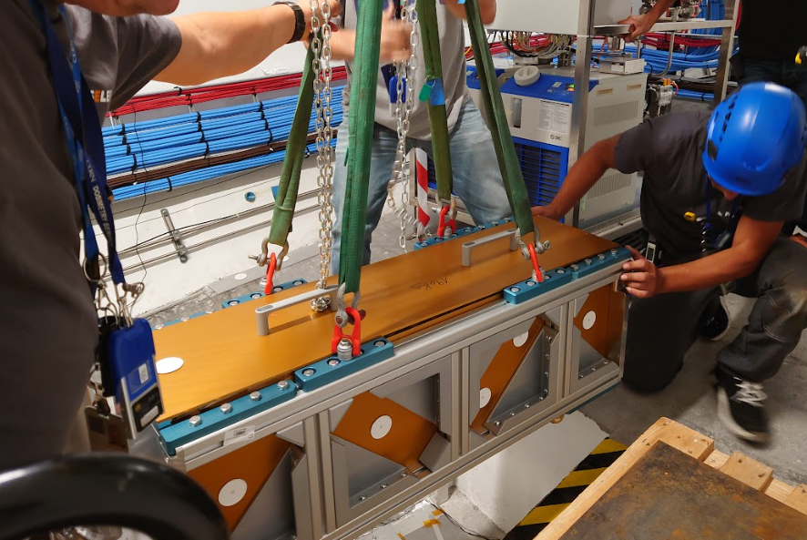


FASER$ν$
IFT
Veto
Decay volume
Tracking spectrometer
Calorimeter
Pre-shower
FASER$ν$ installation
3 times / year

Slide 7
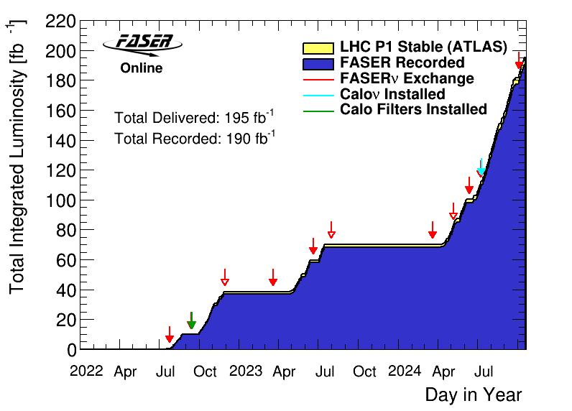
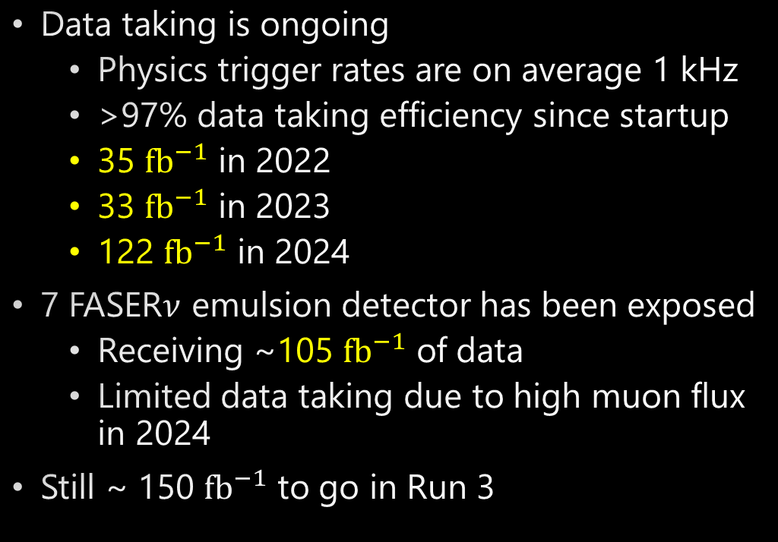

Data taking in LHC-Run 3
Data taking is ongoing
  Physics trigger rates are on average 1 kHz
  >97% data taking efficiency since startup
  35 $fb^{−1}$ in 2022
  33 $fb^{−1}$ in 2023
  122 $fb^{−1}$ in 2024
7 FASER$ν$ emulsion detector has been exposed
  Receiving ~105 $fb^{−1}$ of data
  Limited data taking due to high muon flux in 2024
Still ~ 150 $fb^{−1}$ to go in Run 3
(1 fb⁻¹ = 10¹⁴ $p$-$p$ collisions)

Slide 8
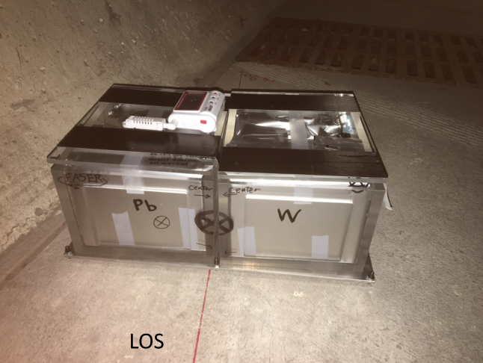
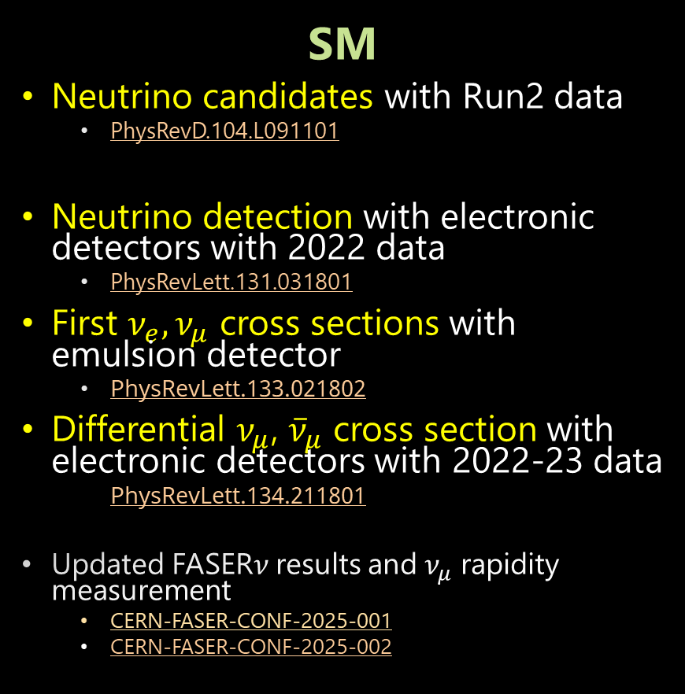
Results from the FASER experiment
SM
Neutrino candidates with Run2 data
  PhysRevD.104.L091101
Neutrino detection with electronic detectors with 2022 data
  PhysRevLett.131.031801
First $ν_{e}, ν_{μ}$ cross sections with emulsion detector
  PhysRevLett.133.021802
Differential $ν_{μ}$, ${\overline{ν}}_{μ}$ cross section with electronic detectors with 2022-23 data
  PhysRevLett.134.211801
Updated FASER$ν$ results and $ν_{μ}$ rapidity measurement
  CERN-FASER-CONF-2025-001
  CERN-FASER-CONF-2025-002
2018
2019
2020
2021
2022
2023
2024
2025
Run 2
Run 3
BSM
Dark photon with 2022 data
  j.physletb.2023.138378
Axion-Like-Particles (ALPs) with 2022, 2023 data
  JHEP01(2025)199
See FASER BSM searches in EPS-HEP by X. Ai
https://indico.in2p3.fr/event/33627/contributions/154654/
Notes:
Arxiv-> paper

Slide 9
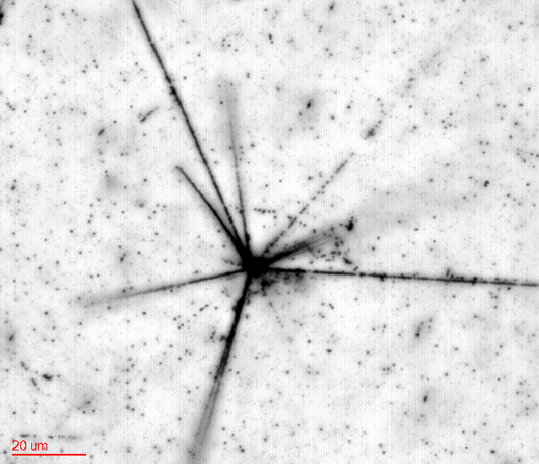
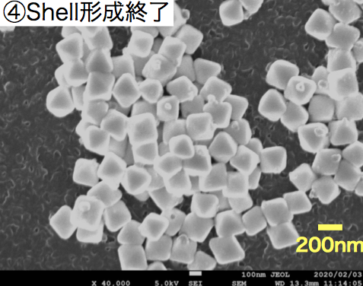
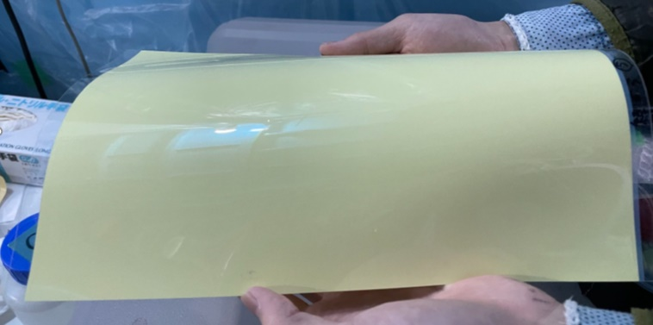


Emulsion tracker
Silver bromide crystals ~ 200 nm, quantum sensors for charged particles
Super large number of detection channels ~ $8×{10}^{14}$ detection channels / film (30 x 25 cm² in FASER$ν$)
3D tracking device with 50 nm intrinsic resolution
Anti-proton annihilation
Silver bromide crystals
Emulsion films produced in Japan
$$20 μm$$

Slide 10
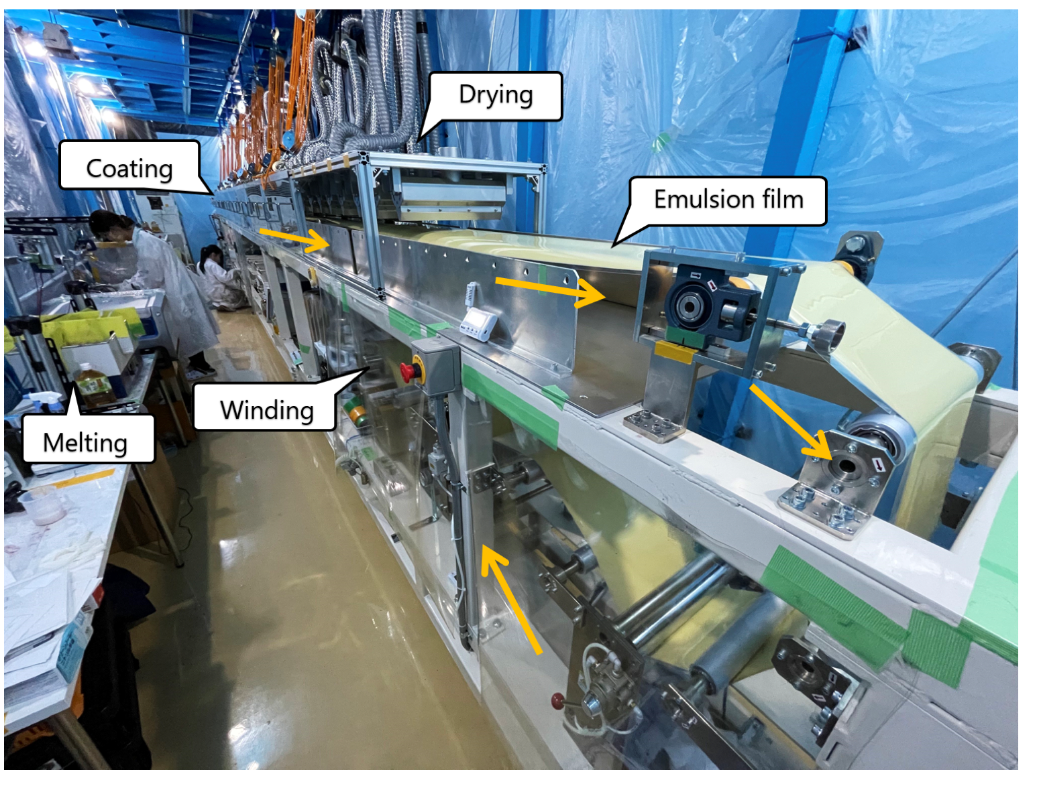
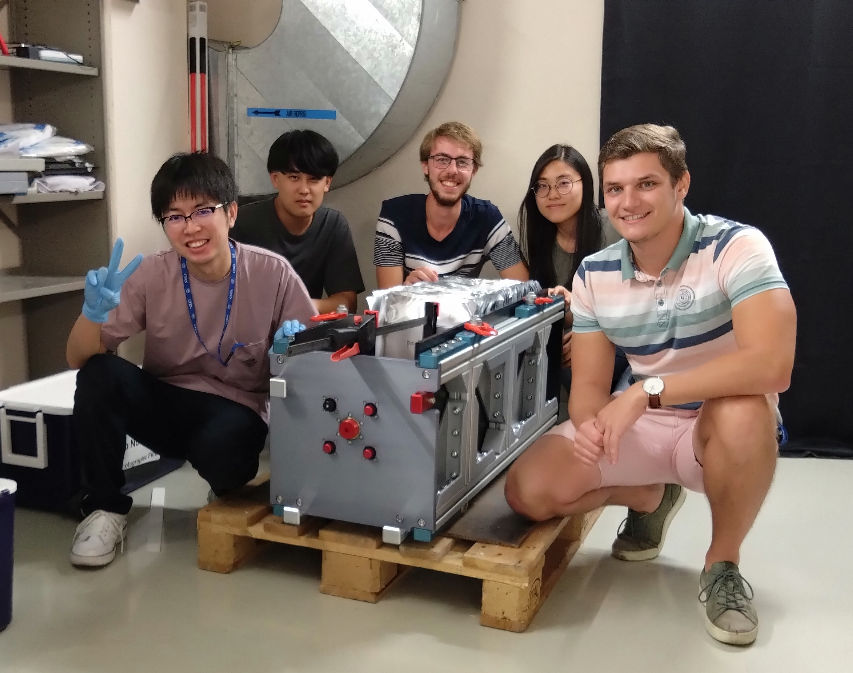
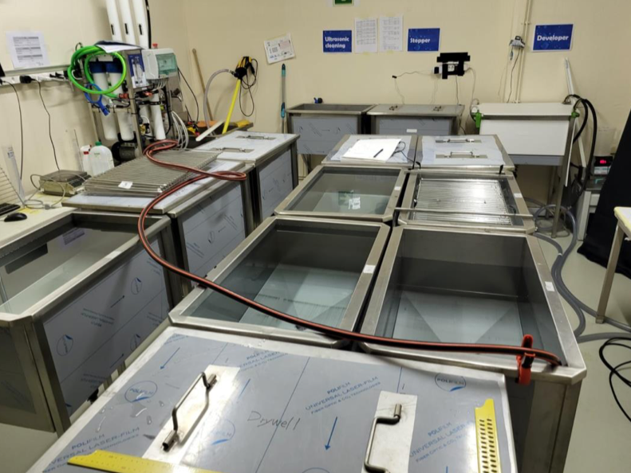
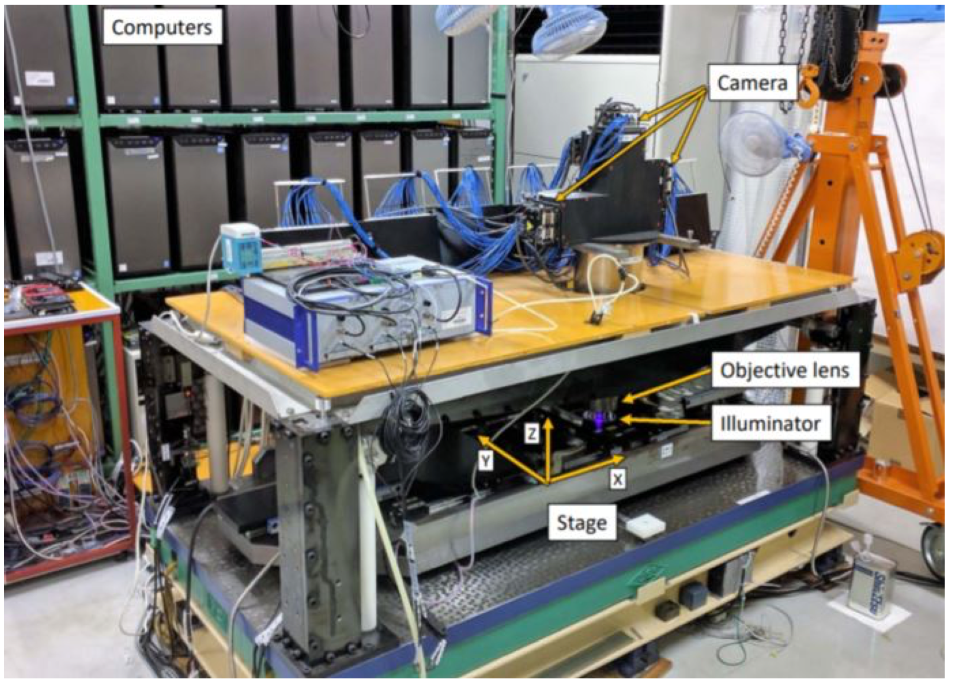
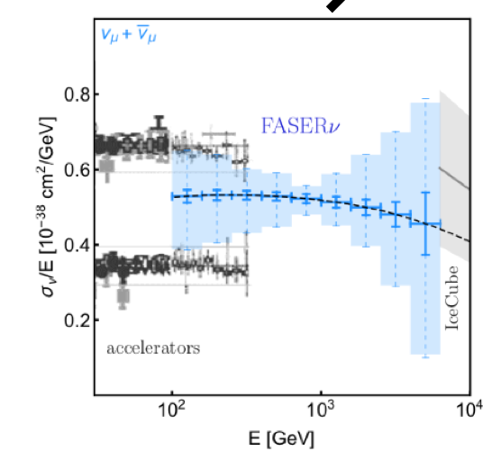
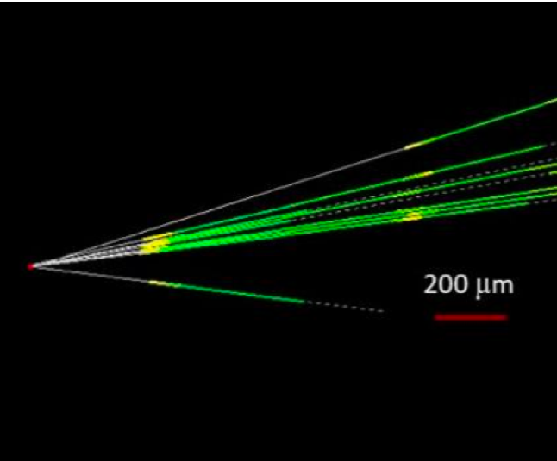
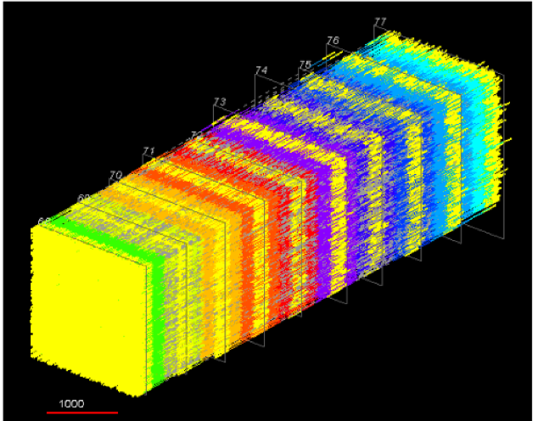
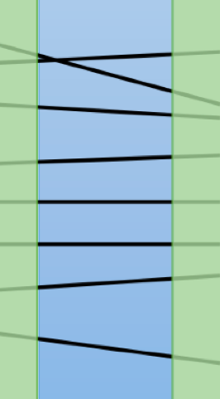

FASER$ν$ steps, 3 detectors per year
Reconstruction paper: 2504.13008
Japan
CERN
Japan
Film production
Assembly
Exposure
Disassembling
Development
Readout
Offline analysis
Physics analysis
$e, μ$ ID
$τ$ decay search
charge ID
E$ν$ reco
charm/beauty
etc.
Vertex reconstruction
Track reconstruction
Alignment
10

Slide 11
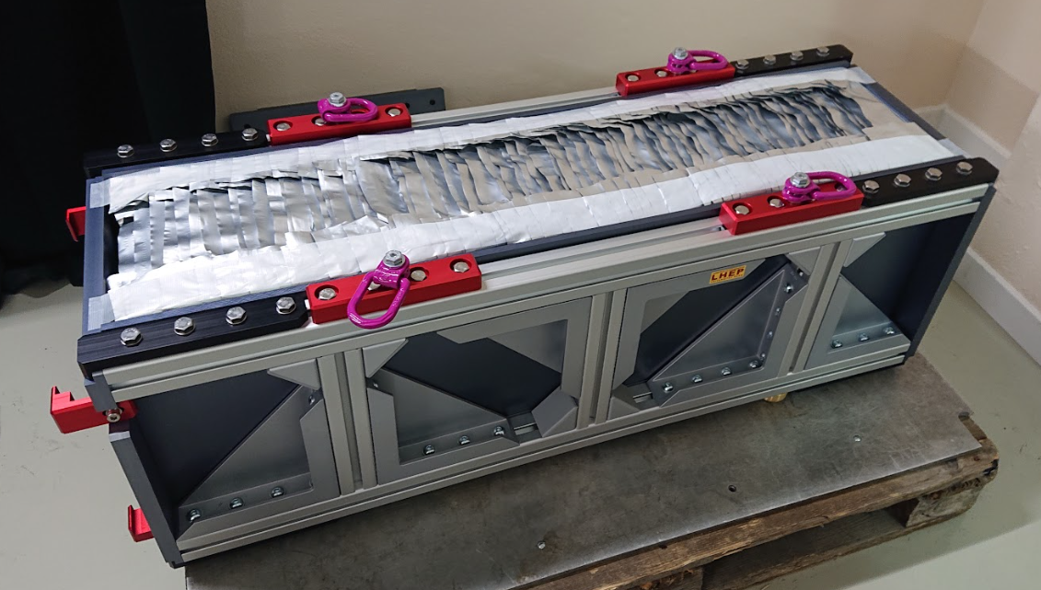
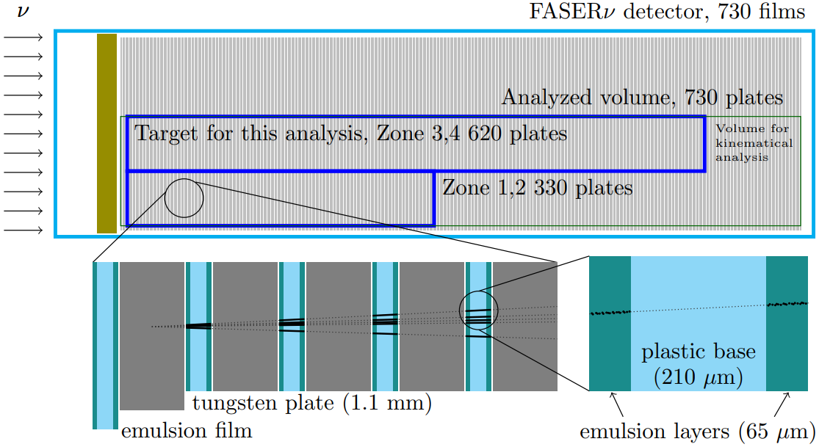
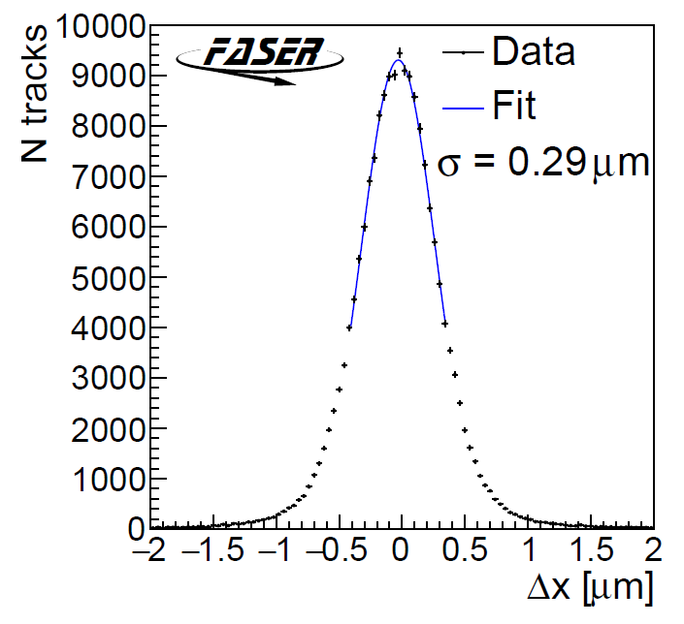
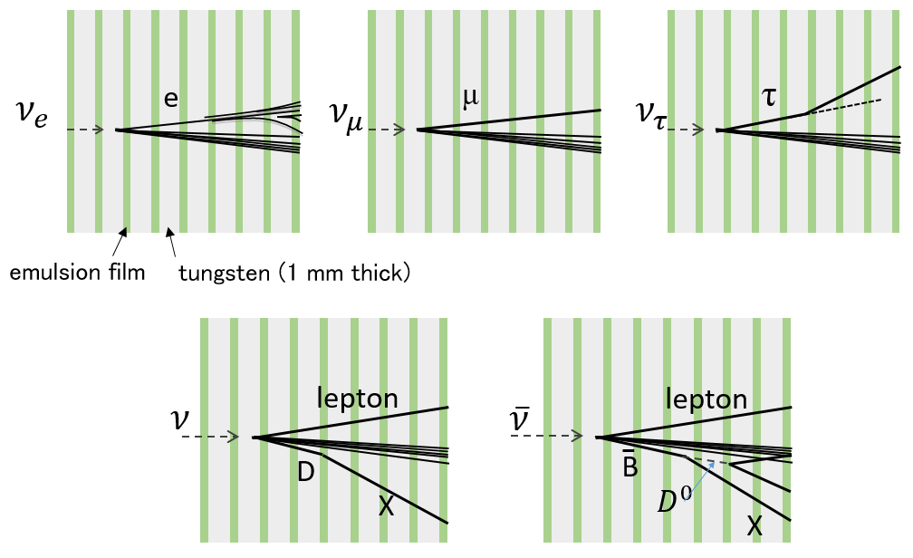
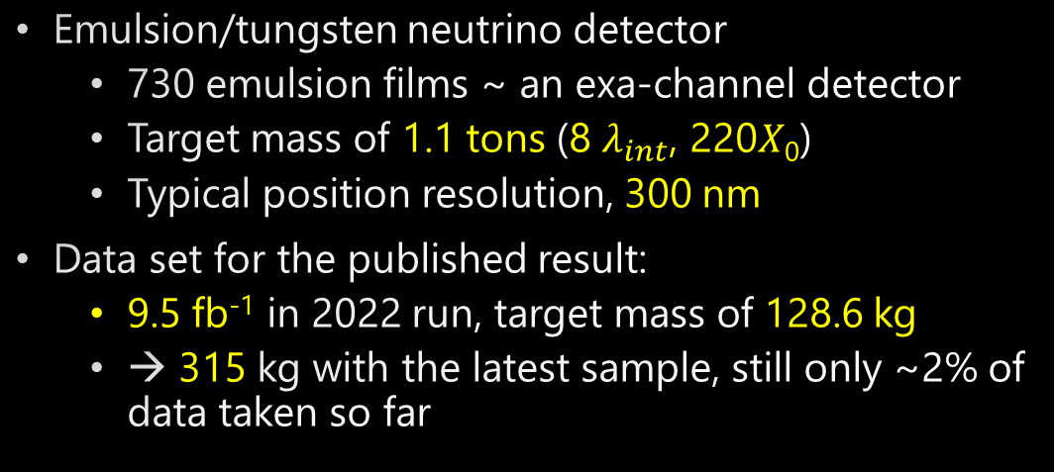

FASER$ν$ and current sample
Emulsion/tungsten neutrino detector
  730 emulsion films ~ an exa-channel detector
  Target mass of 1.1 tons (8 $λ_{int}$, 220𝑋₀)
  Typical position resolution, 300 nm
Data set for the published result:
  9.5 fb⁻¹ in 2022 run, target mass of 128.6 kg
  → 315 kg with the latest sample, still only ~2% of data taken so far
1.3 m

Slide 12
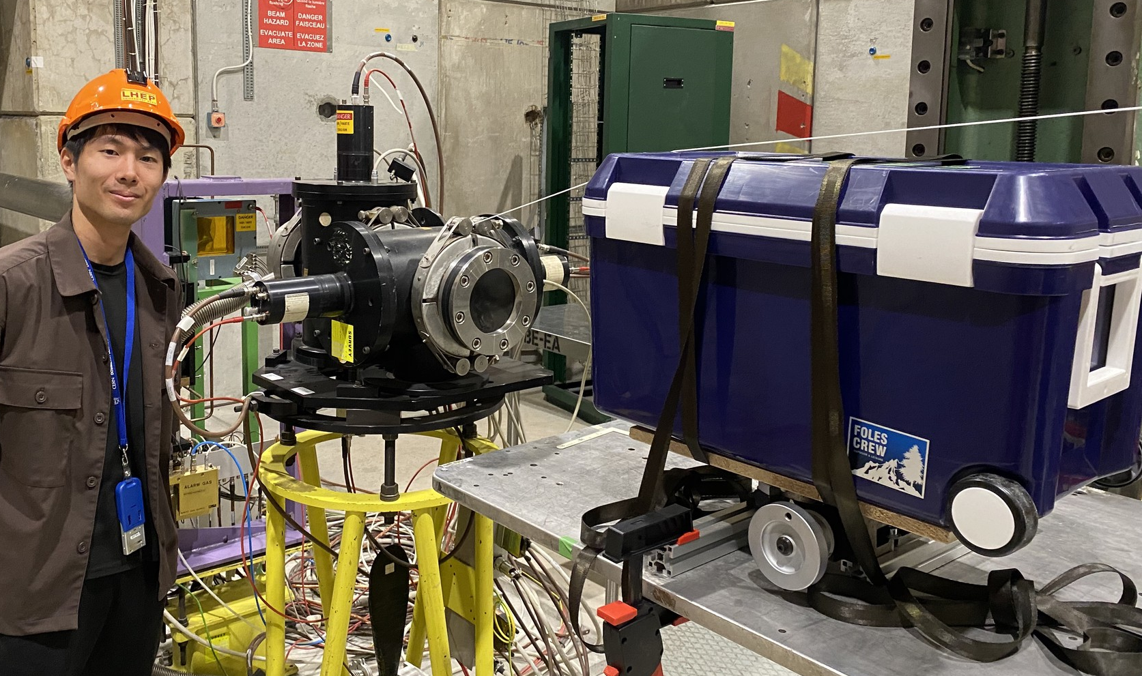
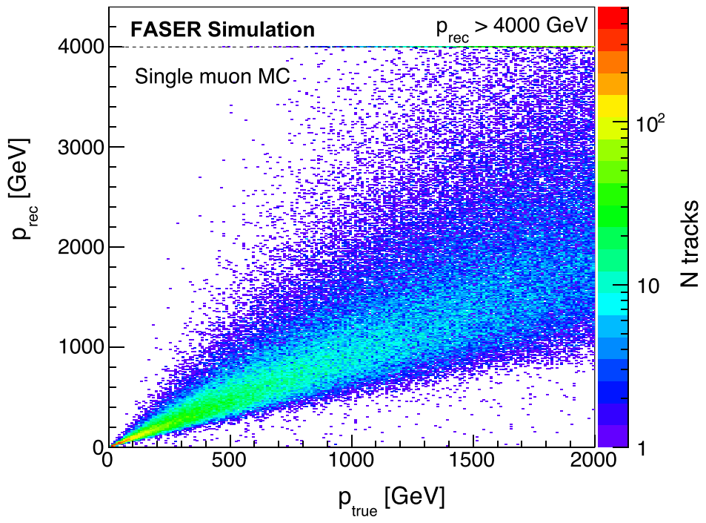
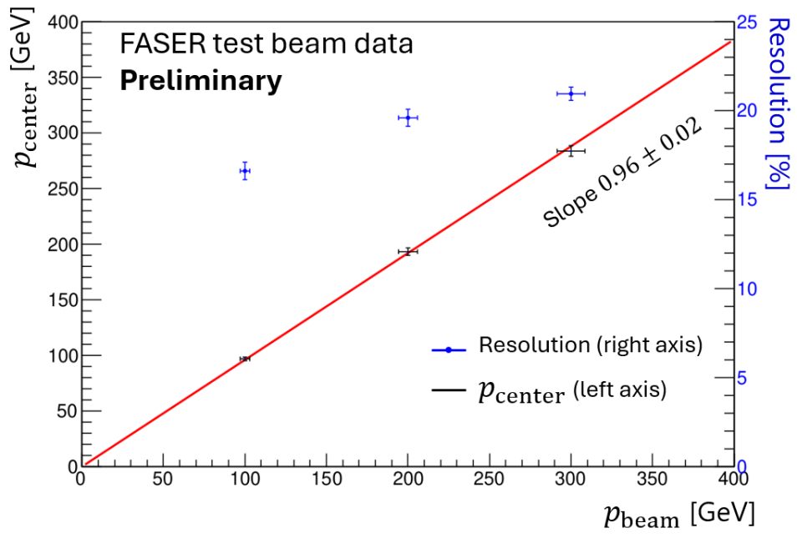
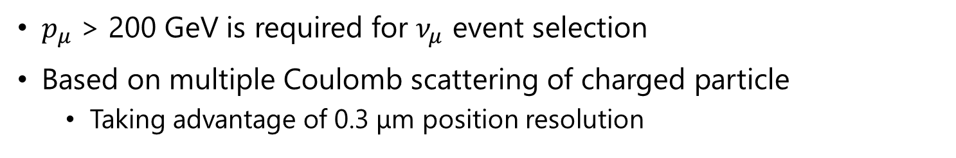
Kinematical tools: Muon momentum measurement
$p_{μ}$ > 200 GeV is required for $ν_{μ}$ event selection
Based on multiple Coulomb scattering of charged particle
  Taking advantage of 0.3 μm position resolution
Good linearity even above 1 TeV
Test beam at SPS(H8 beamline) in 2024
Method was validated at 100, 200, and 300 GeV
~20% resolution at 200 GeV
Notes:
I’ll talk about muon momentum measurement.
To select the good neutrino candidate, it is important to do kinematical measurement.
Currently, we are applying 200 GeV momentum cut for numu event selection.
The method is only based on MCS, because no magnetic field applied to emulsion detector, but taking advantage of high positional resolutions, we can measure the momentum.

Slide 13
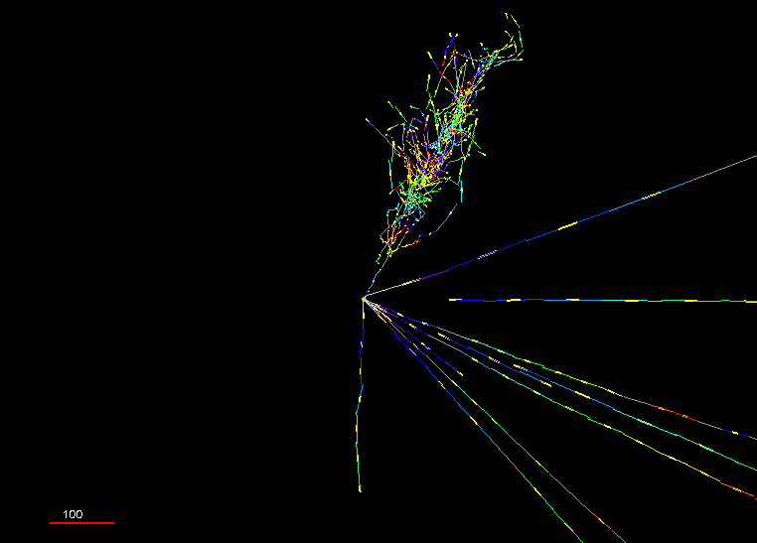
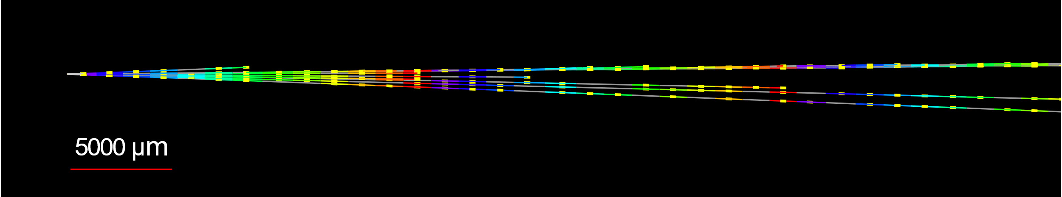



Animated event display of Pika-$ν$ event
$ν_{e}$ candidate
Try an interactive display! http://physics.s.chiba-u.ac.jp/lepp/pika-nu.html
Beam view
Side view
Vertex with 11 tracks
  615 µm inside tungsten
e-like track from vertex
  Single track for 2X₀
  Shower max @ 7.8Χ₀
  θ_{e} = 11 mrad to beam
Back-to-back topology
  175° between e & rest
100 $μm$

Slide 14

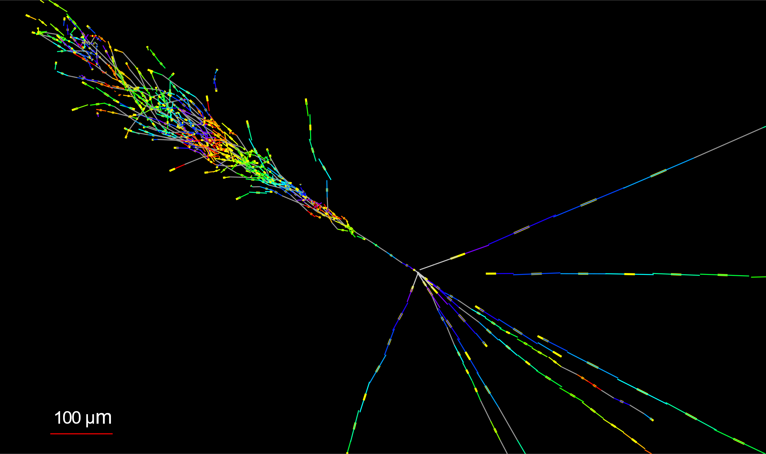


Electron neutrino observation in FASERν
  $ν_{e}$ CC event, “Pika-$ν“$ event
Side View
$E_{e}=1.5$ TeV
Vertex with 11 tracks
  615 µm inside tungsten
e-like track from vertex
  Single track for 2X₀
  Shower max @ 7.8Χ₀
  θ_{e} = 11 mrad to beam
Back-to-back topology
  175° between e & rest
Beam View

Slide 15
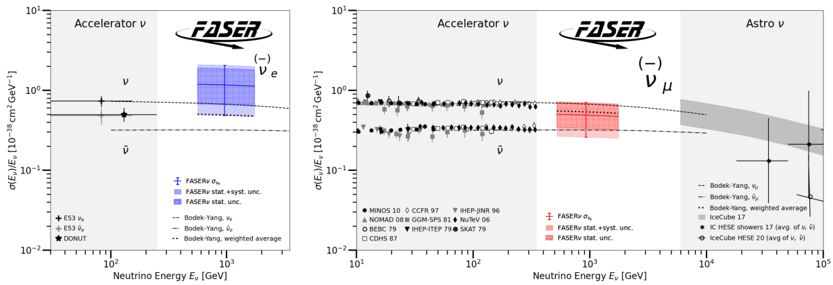
First cross section measurements at TeV energies
4 $ν_{e}$ and 8 $ν_{μ}$ observed events with negligible BG, both above 5 $σ$
PhysRevLett.133.021802
Relative measurement wrt theoretical curve.
L=9.5 fb⁻¹, m=128.6 kg

Slide 16
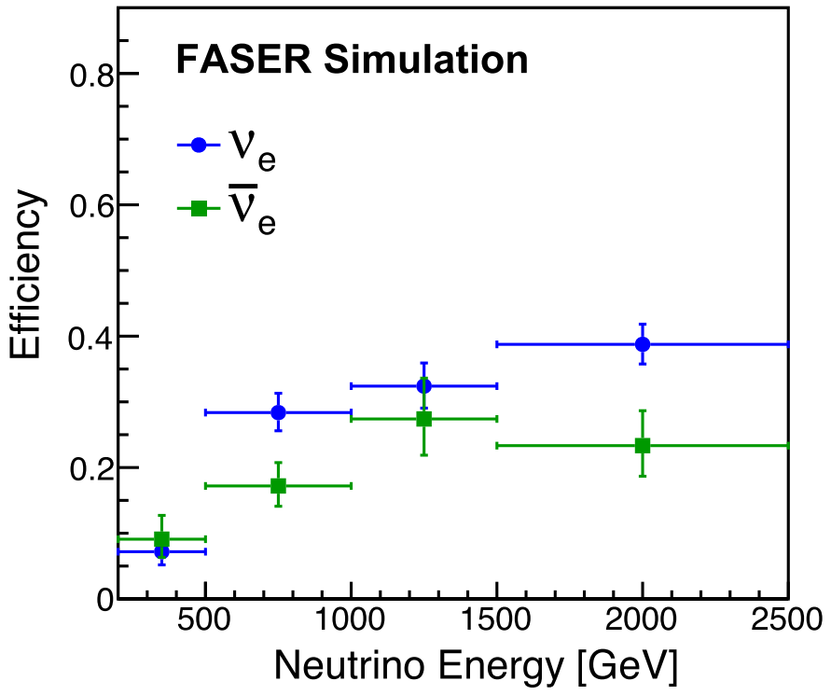
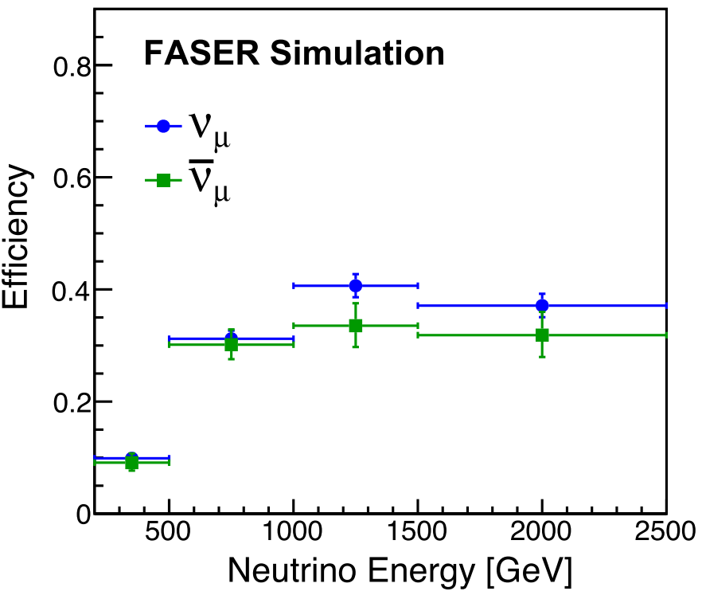
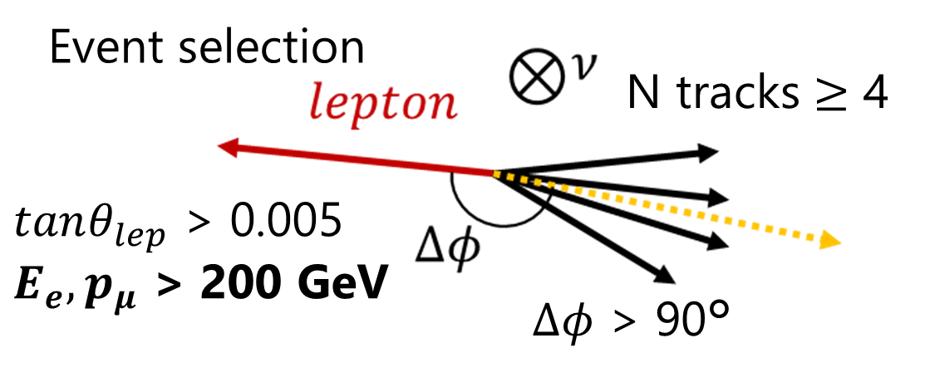
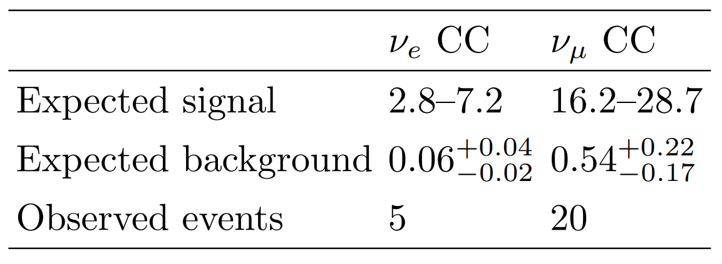

Neutrino event selections and results
CERN-FASER-CONF-2025-002
Neutrino detection efficiency as a function of neutrino energy
Strategy
  Search for neutral vertex
Signal: Neutrino interaction
Background: Neutral hadron interaction
→ Suppressed by topological and kinematical selections
Preliminary results with ~300 kg x 9.5 fb⁻¹ data
Note: $E_{e}$ ~25% resolution at 200 GeV
from the simulation

Slide 17
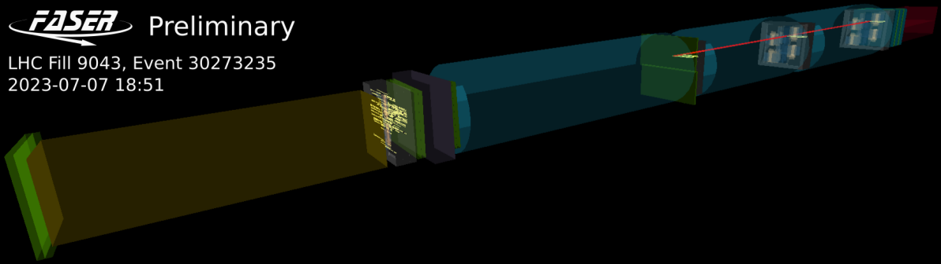


Results with Electronic detectors
Detection of high energy muons emerging from the FASER$ν$ target
First detection of neutrinos at the LHC was done by electronic detectors
$ν_{μ}$ measurement as a function of energy in 2024, using data set of 2022-2023 (65.6 ${fb}^{−1}$)
  PhysRevLett.131.031801
  PhysRevLett.134.211801
Spectrometer: 0.55 T magnets with silicon strip trackers
Request a high energy particle > 100 GeV in spectrometer
FASER$ν$ as target 1.1 t, 8 $λ_{int}$
Extrapolation of the particle should be within r<12 cm at the VETO
Request no VETO hits

Slide 18


Observed events and kinematics
362 observed, 322$±$51 $ν_{μ}$CC expected + 24 non-$ν_{μ}$CC BG
Muon momentum is unfolded into neutrino energy

Slide 19



Interpretations of $ν_{μ}$ interaction rate
FASER’s result = interaction rates
neutrino cross section
Cross section
uncertainty
FASER’s result can be interpreted in two ways
  Neutrino cross sections
  Flux measurement → hadron production model study
Neutrino flux
Analysis in $π/K$ production ratio at $p$-$p$ collisions

Slide 20






Neutrino rapidity measurement
CERN-FASER-CONF-2025-001
To study the characterization of forward hadron production at the LHC
  Define five rapidity bins (annular regions) around line of sight (black cross)
  Rapidity from transverse position of reconstructed $μ$, then unfolded to $ν$ rapidity
Rapidity $y=−\ln{\tan\left(θ/2\right)}$
$y_{pos}$ [mm]
# Neutrino interactions/cm²
$x_{pos}$ [mm]
Neutrino rapidity

Slide 21

LHC continues collecting data
LHC is the biggest investment in particle physics
LHC takes data in Run 3 till 2026, collecting only ~15% of luminosity, still on its long way to the completion
HL-LHC will start 2030, last till 2041 or later
How can we exploit the physics potential of the LHC?
FASER has been a path-finder experiment
  Provide timely results in a cost-efficient way, despite of many constraints
  We had a strategy to open a new field with FASER and enlarge later
Today
Forward Physics Facility!

Slide 22




Forward Physics Facility at the HL-LHC
HL-LHC provides x20 proton collisions
Extending sensitivities for new particle searches and neutrino physics by 2 to 4 orders of magnitude
See more detail in the talk in EPS-HEP
The Forward Physics Facility at the LHC
UJ18
ATLAS
UJ12
LHC
LOS
New shaft and hall
FASER2
FASER$ν$2 20 tons
FLArE
Nominal beam axis
FORMOSA
CERN GIS

Slide 23




FPF documentation
Photo at FPF8 workshop
FPF workshop series:
FPF1, FPF2, FPF3, FPF4, FPF5, FPF6, FPF7, FPF theory day, FPF8
FPF paper:
2109.10905
~75 pages, ~80 authors
Snowmass Whitepaper:
2203.05090
~450 pages, ~250 authors
Recent Summary:
FPF Update
Technical Documents:
Facility Technical Study
Muon Flux Study
Vibration Study
Geotechnical Report
ESPPU scientific program:
EPJ C: doi.org/10.1140/epjc/s10052-025-14048-6
~25 pages, ~26 authors

Slide 24





FASER in LHC-Run4
FASER$ν$ location, on axis
CERN-LHCC-2023-009
Meanwhile, FASER operation in Run 4 was approved
  Run 3: ~250 $fb^{−1}$, Run 4: ~680 $fb^{−1}$
Neutrino physics will continue at the LHC
Data taking with FASER$ν$ may be limited due to high muon BG
  R&D for FASER$ν$ is ongoing, including a muon sweeper magnet
In addition, possible upgrades under discussion
  FASER$ν$ location (on axis) and behind FASER (off axis)
  Electronic-based neutrino detector, targeting $ν_{e}$ and $ν_{μ}$
Space available behind FASER detector, off axis

Slide 25

Summary
FASER is a pathfinder experiment, opening a new window to utilize “collider neutrinos”
Taking data in LHC-Run 3, collecting 190 $fb^{−1}$ of data by 2024
First neutrino cross section measurements in TeV energy range both by the FASER$ν$ and electronic detectors
More results are coming!
Strong physics cases in future programs
  FASER in Run 4 approved
  Forward Physics Facility (FPF) under discussion

Slide 26















FASER INSTITUTIONS
96 collaborators, 26 institutions, 10 countries
International laboratory covered by a cooperation agreement with CERN

Slide 27
Related talks in EPS-HEP
The Forward Physics Facility at the LHC
  https://indico.in2p3.fr/event/33627/contributions/155270/
  Akitaka Ariga (University of Bern (CH) and Chiba University (JP))
  7TH July 10:15
Neutrino results at the FASER experiment (This talk)
  https://indico.in2p3.fr/event/33627/contributions/154587/
  FASER Collaboration, Akitaka Ariga (University of Bern (CH) and Chiba University (JP))
  8th July 08:50
Long lived particle searches at FASER
  https://indico.in2p3.fr/event/33627/contributions/154654/
  FASER Collaboration, Xiaocong Ai (Zhengzhou University)
  11th July 09:10

Slide 28
Backup

Slide 29


Neutrinos as a probe
TeV Energy Neutrino Interaction
l
intrinsic
charm
neutrino DIS at TeV scale
large x PDFs: x~1
charm
fragmentation
color transparency
p
g,q
D
hadronization in nuclear medium
v
cc
BFKL dynamics
forward charm
¹⁸⁴W
q
p
g,q
ultra low-x
PDFs: x~10⁻⁷
color glass condensate
strangeness
nuclear PDFs
shadowing
EMC effect
Forward Particle Production

Slide 30

The layout of the LHC neutrino experiments

Slide 31



















$$ν_{e}$$
FASER Preliminary
$$ν_{e}$$
Rotated view
Pika-$ν$ event
Beam view
Pika-$ν$ event
$$e$$
1.5 TeV
$$e$$
500 $μ$m
100 $μ$m
$$ν_{μ}$$
$ν_{μ}$ Rotated view
Beam view
$$μ$$
$$μ$$
360 GeV
1000 $μ$m
200 $μ$m

Slide 32


Neutrino interaction rates in Run 3
arXiv:2501.10078
$$350 fb^{−1}$$

Slide 33


Slide 34


FASER measures $ν_{ℓ}$ interaction rates, and then?
Precise knowledge of flux
Hadron production models
External validation data
FASER’s interaction rate measurements
Neutrino cross section measurements
Test Lepton Flavor Universality
Search for new interactions
FASER’s result = interaction rates
SM neutrino cross section is decent
Neutrino flux measurement
neutrino cross section
Assuming LFU is valid
Study hadron/neutrino production at very high-energy
Prompt neutrinos
QCD at small $x$
Cross section
uncertainty
Neutrino flux
uncertainty
Neutrino flux

Slide 35











BG muon measures
FASER$ν$ with 10 ${fb}^{−1}$ in
$2 mm×2 mm×10 films$
Background muon limits sensitivities, in FASER$ν2$ and others
  Estimated to be O(1) Hz/cm²
Reducing background muons is essential both for cost and physics reach
→ Implementation of a “Sweeper magnet”
Track density
~$3×{10}^{5} tracks/cm^{2}$
$μ^{+}$ fluence expected in FPF ~O(1) Hz/cm²
Sweeper magnet
Simulated muon rates with/without sweeper magnet
Place a permanent magnet along the wall of the LHC tunnel
1 T x 40 m long
$$\frac{1}{5}$$
Charged particles
muons produced after D1
$$ν$$
$ν$ and LLPs
FPF
$$\frac{1}{3}$$
D1 magnet
Neutral hadrons
LHC tunnel

Slide 36

4 proposed FPF experiments, diverse detectors for a broad physics program
FASER2
FASER$ν$2
FLArE
Nominal beam axis
FORMOSA

Slide 37

Systematic uncertainties

Slide 38








FASER$ν$ performances
BG muon angular distribution (Data)
Angular spread of muon peaks
$$∼0.4 mrad$$
Position resolution ~$300 nm$
20 mrad
FASER Preliminary
Electron energy reconstruction
$$\frac{ΔE}{E}∼0.25 @ 200 GeV$$
Muon momentum measurement
$$\frac{ΔP^{RMS}}{P}∼0.3 @ 200 GeV$$

Slide 39




Axion-like Particles (ALPs) search
production
FASER is sensitive to axion-like particles (ALPs) coupling to SU(2)_{L} gauge bosons, mainly produced in $B$ meson decays
Signal: $a→γγ$ appearing from ‘nothing’ with ~TeV of energy
  Can decay anywhere in FASER spectrometer volume
decay
4-m-long decay volume
Selection
No signal in 5 veto counters and timing scintillators
Evidence of EM shower in pre-shower counters
> 1.5 TeV in calorimeter
In time with LHC collision
Notes:
Magnetic volume, 4 m long decay volume

Slide 40




Background for ALPs
Dominant BG: Neutrino interactions → simulated to be $0.4±0.4$ events
Negligible BG from others: neutral hadrons, large-angle muons, non-collision / cosmics
BG validated by control regions: ex) “Neutrino interaction in calorimeter”-like
(Large EM in calo, but little in pre-shower)
Simulated interaction or decay position of $a, ν_{e}, ν_{μ}$ in control sample
Neutrino control region

Slide 41



ALPs results
Public documentation to be released soon
Expect 0.4 $±$ 0.4 from $ν$ interactions in 58 fb⁻¹
1 observed event after unblinding
Exclude uncovered parameter space significantly
Notes:
Significant
300 events at the edge of previous limits.

Slide 42

Event display of 1 selected event: “ALPtrino” event
Pre-shower
Calorimeter
1.6 TeV
No signal in veto and timing scintillators
Waveforms of PMTs (ns-mV)

Slide 43





Direct observation of $ν_{μ}$ interactions at the LHC by the FASER electronic detectors
Shown in Moriond 2023, now published in Phys. Rev. Lett. 131, 031801 (2023)
Selection: No veto, P>100 GeV, $r_{veto}$<12cm
Unblinded results:
153 events in the signal region with 35.4 fb⁻¹
(significance of 16$σ$)
First direct observation of $ν_{μ}$ interactions at the LHC
Spectrometer to measure particle momenta
FASER$ν$ as passive target

Slide 44

FASER$ν$ steps, 3 detectors per year
Japan
CERN
Japan
Film production
Assembly
Exposure
Disassembling
Development
Readout
Offline analysis
Physics analysis
$e, μ$ ID
$τ$ decay search
charge ID
E$ν$ reco
charm/beauty
etc.
Vertex reconstruction
Track reconstruction
Alignment
44

Slide 45











CERN Emulsion Facility
Dark room at CERN established in 80s → Obsolete
Emulsion experiments are increasing: NA65/DsTau, FASER$ν$, SND@LHC, SHiP, test beams…
Refurbished recently, big thanks for supports from CERN!
Experiments share installation and equipment
Temperature controlled developer bath
Film drying
Dark room operation
Assembling of FASER$ν$ and SND@LHC
Development timer
Microscope
Asbestos floor removed, new shiny floor, modern climate control, card lock system…
Disposal
Development room
13 x 100L tanks
Easy disposal system

Slide 46


Emulsion readout systems
Total emulsion film surface in FASER$ν$2: $∼$530 m²/year
  $∼$2400 h/year with HTS
  or $∼$420 h/year with HTS2
HTS-1
 | Field of view (mm²) | Readout speed (m²/h/layer)
S-UTS | 0.04 | 0.0072
HTS-1 | 25 | 0.45
HTS-2 | 50 | 2.5
HTS-3 | ? | ?

Slide 47





Muons at FASER site
Angular distribution (Data)
Muons brings rich info to validate beamline simulation
Eventually we could validate hadron production models at $p$-$p$ collisions
From IP
From backward
0.5 fb⁻¹
FASER preliminary
10 fb⁻¹
$±$20 mrad

Slide 48












Event selection
FASER$ν$ analysis
Selection criteria
Vertex reconstruction ($N_{track}≥5$, $N_{track}$(tan$θ≤$0.1)$≥$4)
$E_{e}$ or $p_{μ}$>200 GeV
tan$θ_{e}$ or tan$θ_{μ}$>0.005
$φ$>90°
$$θ$$
$$e$$
$$ν_{e}$$
$←$ $p$ high
neutral
hadron
$←$ $p$ high,
$θ$ small
$$φ$$
$$e$$
$ν$ beam

Slide 49








First detection of $ν_{e}$ and $ν_{μ}$ with FASER$ν$ detector
arXiv: 2403.12520
High purity selection
Vertex reconstruction ($N_{track}≥5$, $N_{track}$(tan$θ≤$0.1)$≥$4)
$E_{e}$ or $p_{μ}$>200 GeV
tan$θ_{e}$ or tan$θ_{μ}$>0.005
$φ$>90°
 | Expected background | Expected signal | Observed | Significance
$ν_{e}$ CC | 0.025^{+0.015}_{-0.010} | 1.1-3.3 | 4 | 5.2$σ$
$ν_{μ}$ CC | 0.22^{+0.09}_{-0.07} | 6.5-12.4 | 8 | 5.7$σ$
First detection of $ν_{e}$ at the LHC!
Electron angle
Electron energy
$$φ$$
$$e$$
$$ν$$

Slide 50




Neutrino event characteristics
CERN-FASER-CONF-2025-002
$ν_{e}$
$ν_{μ}$
Characteristics of the observed 𝜈 interactions are in good agreement with MC

Slide 51


Neutrino flux and expected number of interactions
https://arxiv.org/abs/2402.13318
Expected number of CC interactions in FASER$ν$ with 250 fb⁻¹

Slide 52











Neutrinos = proxy of forward hadron production
Pion, Kaon, charm contribute to different part of energy spectra and flavor
FASER$ν$ provides important inputs to validate/improve generators → Muon excess, prompt neutrinos
$$K$$
$$D$$
$$π$$
$$ν_{e}$$
$$ν_{μ}$$
$$K$$
$$D$$
$$D_{s}$$
$$ν_{τ}$$

Slide 53













Heavy-flavor-associated channels
Measure charm production channels
  Large rate ~ 10% $ν$ CC events, $𝒪(1000)$ events
  First measurement of $ν_{e}$ induced charm prod.
Search for Beauty production channels
  Expected SM events ($ν_{μ} CC b$ production) are $𝒪(0.1)$ events in Run 3, due to CKM suppression, $V_{ub}^{2}≃{10}^{−5}$
$$ν_{τ}$$
$$τ$$
$$W^{±}$$
$$ℓ=e, μ$$
$$d$$
$$V_{cd}$$
$$c$$
$$\overline{ν}N→ℓ\overline{B}X$$
$$νN→ℓBDX$$

Slide 54





Sterile neutrino oscillation
Due to unique energy and baseline ($L/E\sim {10}^{−3}$ m/MeV), FASER$ν$ is sensitive to large $Δm^{2}\sim {10}^{3}$ eV².
Neutrino spectrum deformation
Competitive in disappearance channels.
$ν_{e}$ disappearance
$ν_{μ}$ disappearance

Slide 55







Expected neutrino spectra
Expected CC interactions with 150 fb⁻¹
$$⟨E_{ν_{μ}}⟩∼900 GeV$$
 | FASER$ν$ | SND@LHC
Target mass | 1100 kg | 800 kg
Location | On axis | Off axis
Features | High energy & high statistics | More neutrinos from charm decay
$$⟨E_{ν_{μ}}⟩∼500 GeV$$
10.1103/PhysRevD.104.113008
$$η=$$

Slide 56

FASER AND FASERν TIMELINE
In-situ BG measurement
Pilot neutrino detector
LOI submitted to CERN LHCC
ERC awarded for FASERν
FASER fully constructed and installed
FASERν fully constructed and installed
Technical Proposal submitted to CERN LHCC
FASER approved as 8th LHC detector by CERN
Concept paper: Feng, Galon, Kling, Trojanowski
FASERν approved as 9th LHC detector by CERN
FASER and FASERν announce first physics results
FASER and FASERν begin collecting data in Run 3
Funding from Heising-Simons and Simons Foundations
FASER and FASERν announce more physics results
Spare detector parts from ATLAS and LHCb Collaborations

Slide 57


Forward Physics Facility (FPF) at the HL-LHC
FPF White Paper (2022/3)
http://arxiv.org/abs/2203.05090
FPF 5th workshop (2022/11)
https://indico.cern.ch/event/1196506/
FPF Facility studies (2023/3)
https://cds.cern.ch/record/2851822
BSM particles can be detected in various ways
Giving access to wide range of models
Neutrinos can be used to search for BSM effects
Production
Propagation
Interaction

