Slide 1
$CP$ violation measurements in $B$ to open charm decays at LHCb
Rudolf G. C. Oldeman
Università degli studi di Cagliari e INFN sezione di Cagliari
On behalf of the LHCb collaboration
EPS-HEP conference
July 7-11, 2025, Marseille

Slide 2
Outline
CKM matrix, the angle $γ$, $CP$ violation
Recent LHCb results on $γ$
$B^{−}→D^{0}K^{∗}{(892)}^{−}$ JHEP 02 (2025) 113
$B_{s}^{0}→D_{s}^{∓}K^{±}$ JHEP 03 (2025) 139
$γ$ combination LHCb-CONF-2024-004
$CP$ violation in $B→DD$ JHEP 01 (2025) 061
Outlook

Slide 3
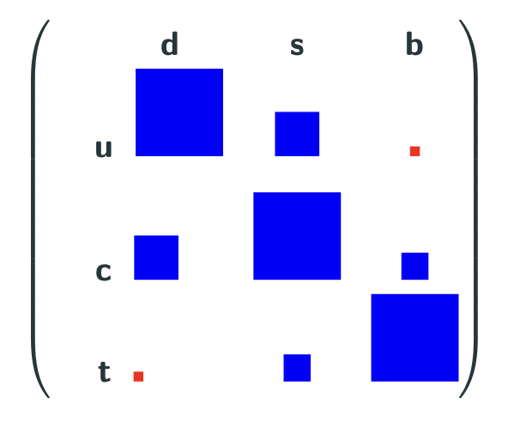
Heavy flavour physics
Quarks change flavour through coupling with the $W^{±}$ boson
The CKM matrix describes the amplitude of these transitions
Very-off-diagonal elements $V_{ub}$ and $V_{td}$ have a large complex phase
$→O(1)$ $CP$ violation

Slide 4
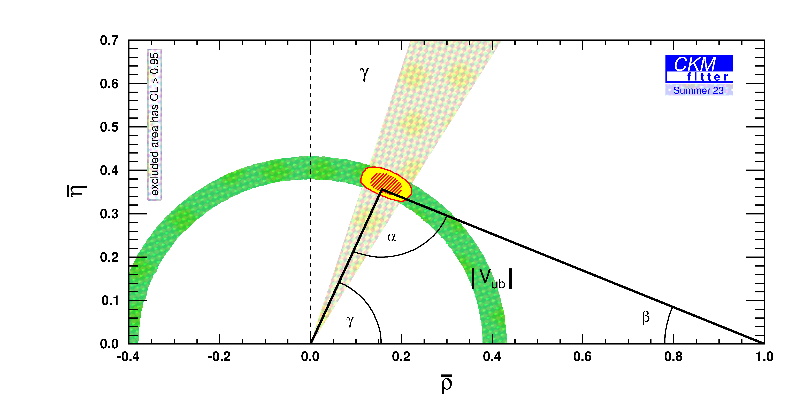
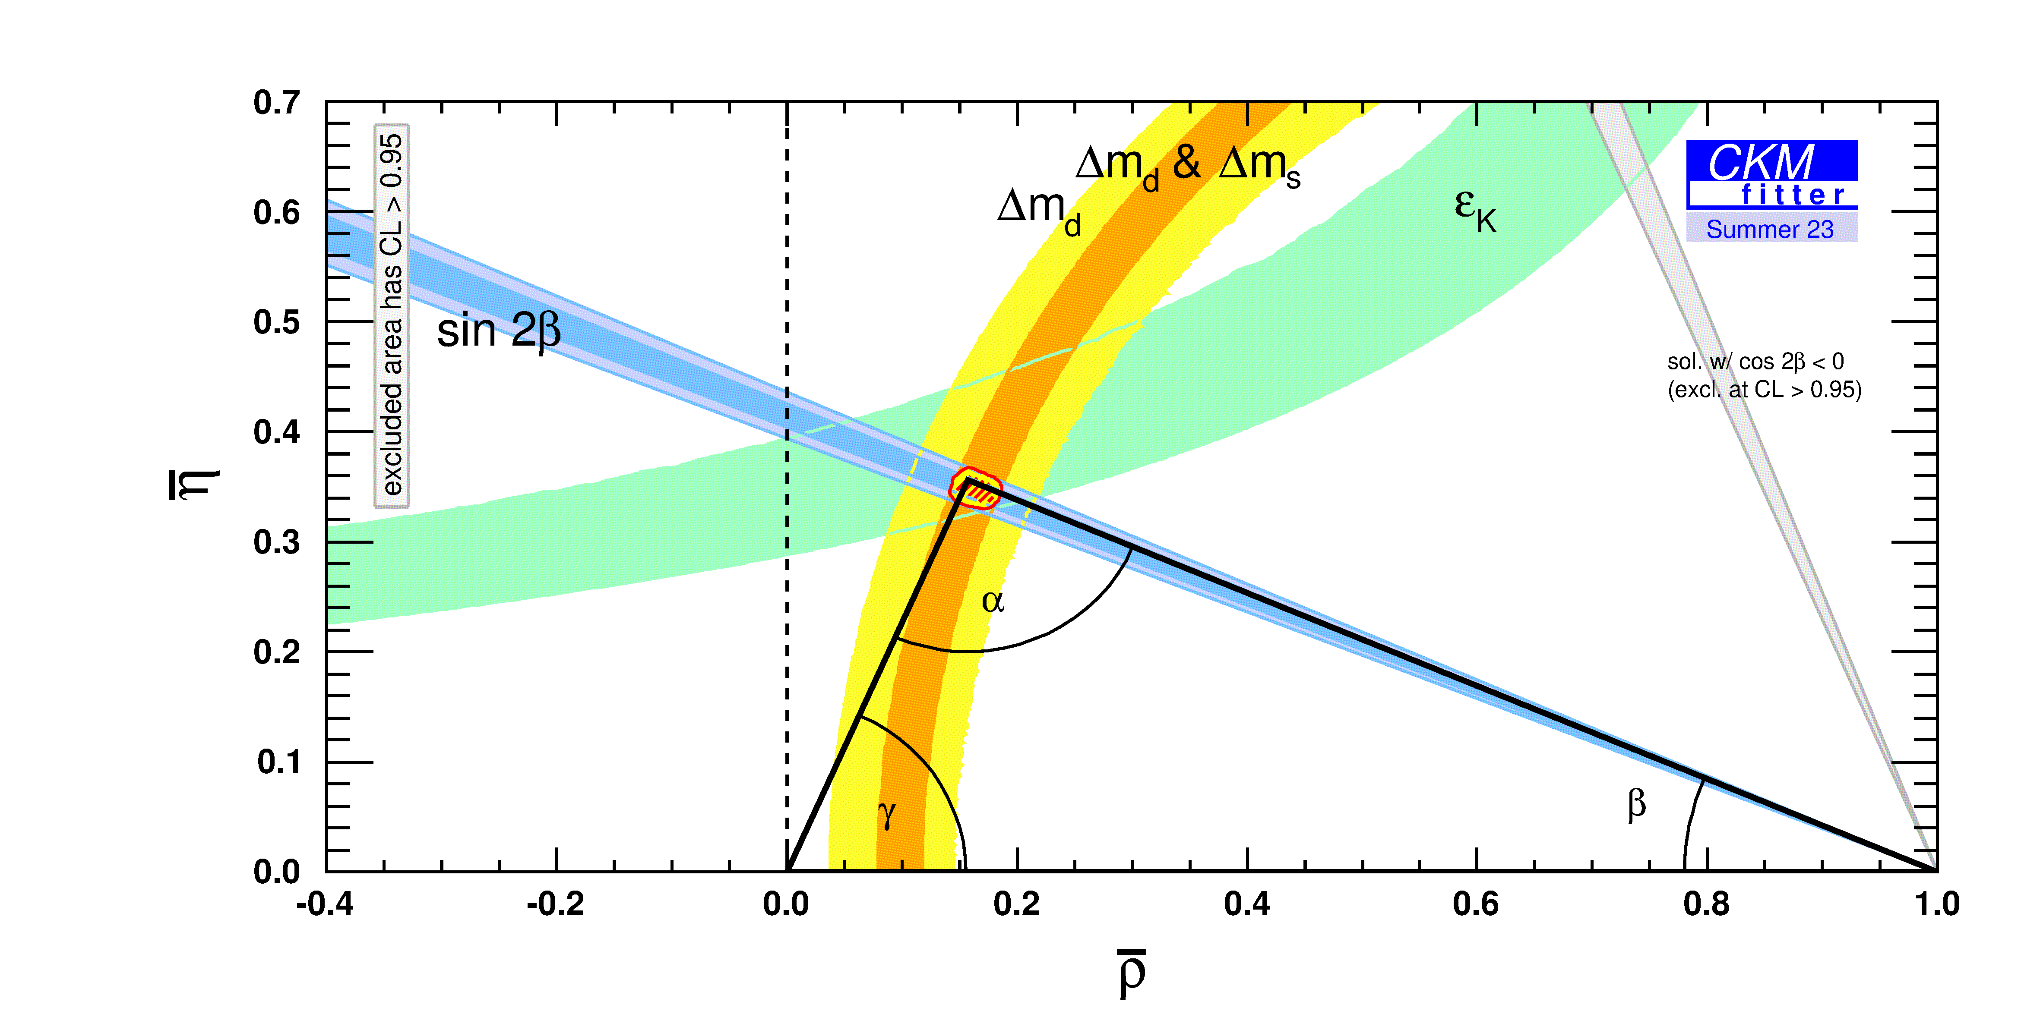
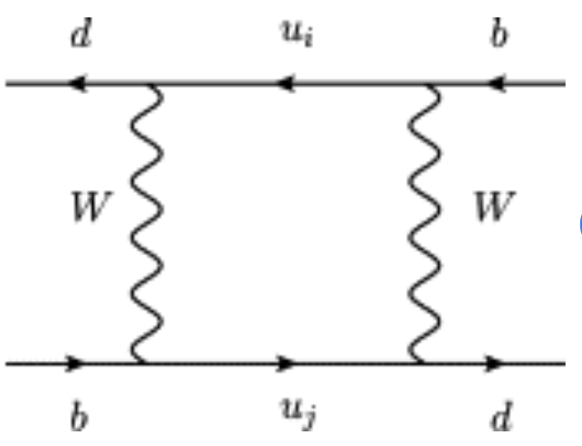
Trees and loops
EPJC 41 (2005) 1
Determination of $\overline{ρ}$ and $η$̅ from decays without loops (trees)
Determination of $\overline{ρ}$ and $η$̅ from processes with loops
$${\overline{B}}^{0}$$
$$B^{0}$$
Inconsistencies between the two methods indicates new particles in loops.
So far: CONSISTENT.

Slide 5
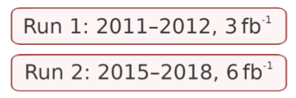
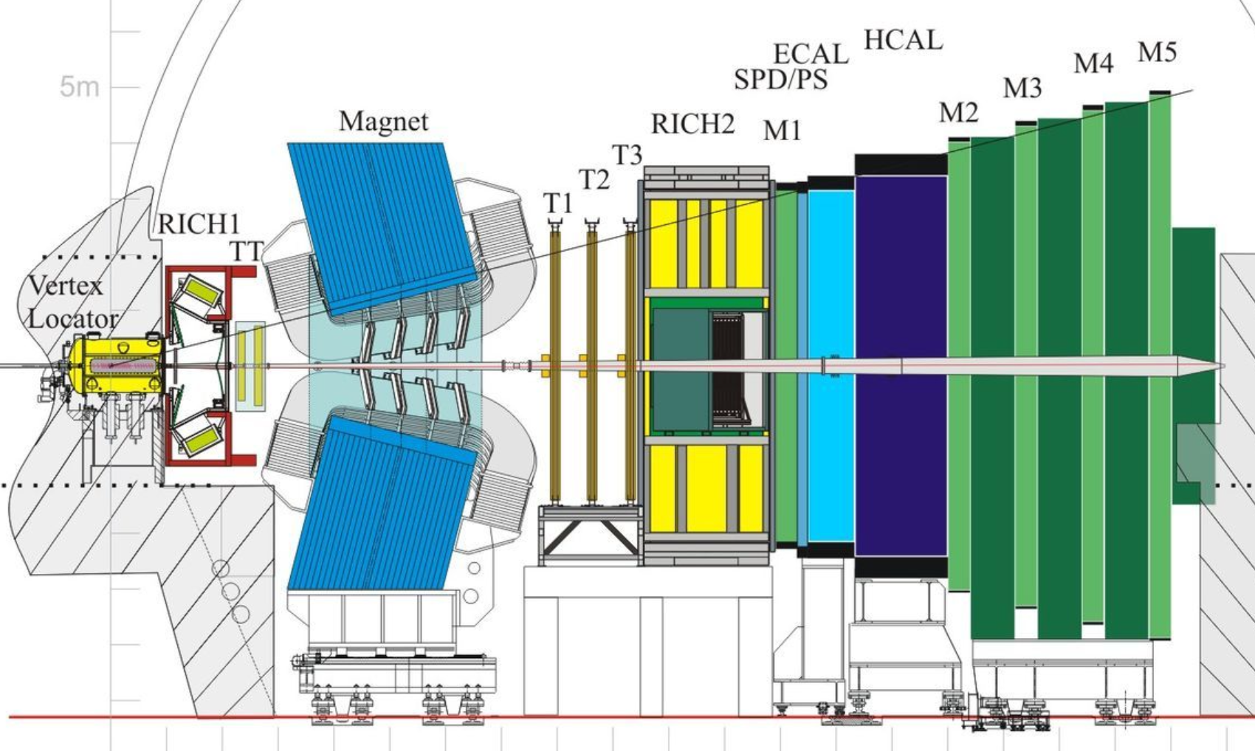
The LHCb experiment at CERN
$$2<η<5 (10<θ<300mrad)$$
$$∆p/p\sim \left(0,5−1,0\right)\%$$
$$ε\left(μ\right)≈98\%$$
$$σ_{IP}=(15+29/p_{T})μm$$
p
p
$π/K$ separation for $2<p<100 GeV$
The LHCb Dectector
JINST 3 (2008) S08005
LHCb Detector Performance
Int. J. Mod. Phys. A30 1530022 (2015)

Slide 6
Outline
CKM matrix, the angle $γ$, $CP$ violation
Recent LHCb measurements of $γ$
$B^{−}→D^{0}K^{∗}{(892)}^{−}$
$B_{s}^{0}→D_{s}^{∓}K^{±}$
$γ$ combination
$CP$ violation in $B→DD$
Outlook

Slide 7
Measuring $γ$ in $B^{−}→D^{0}K^{(∗)−}$ decays
$γ=φ_{3}≡arg⁡({−V_{ud}V_{ub}^{∗}}/{V_{cd}V_{cb}^{∗}})$ or “the phase of $V_{ub}$”
Interference requires final state common to $D^{0}$ and ${\overline{D}}^{0}$
Amplitude ratio: $\frac{𝒜(B^{−}→{\overline{D}}^{0}K^{−})}{𝒜(B^{−}→D^{0}K^{−})}=r_{B}e^{i(δ_{B}−γ)}$ ($r_{B}≈0.1$)
Strong phase $δ_{B}$ same for $B^{−}$ and $B^{+}$
Weak phase $γ$ opposite for $B^{−}$ and $B^{+}$
Theory uncertainty $O({10}^{−7})$

Slide 8
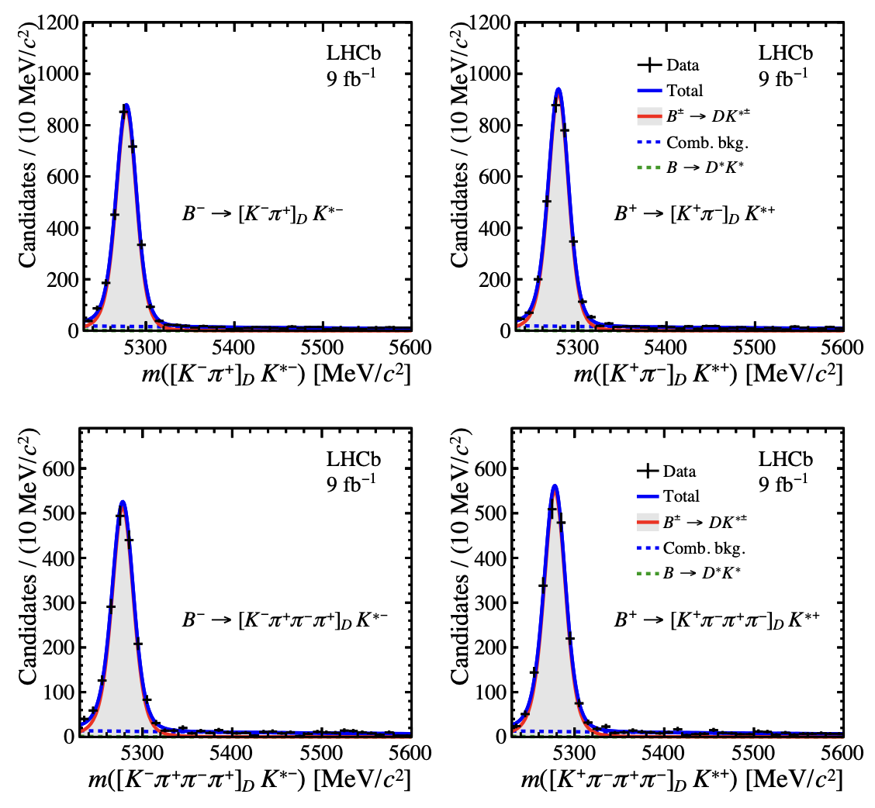
$B^{−}→D^{0}K^{∗}{(892)}^{−}$: same-sign
JHEP 02 (2025) 113
$$B^{−}$$
$$B^{+}$$
Complementary to $B^{−}→D^{0}K^{−}$
Reconstruct $K^{∗}{(892)}^{−}→π^{−}K_{S}^{0}$
Same-sign $D$ decays:
High statistics
Almost zero $CP$ asymmetry
Normalisation for other channels

Slide 9
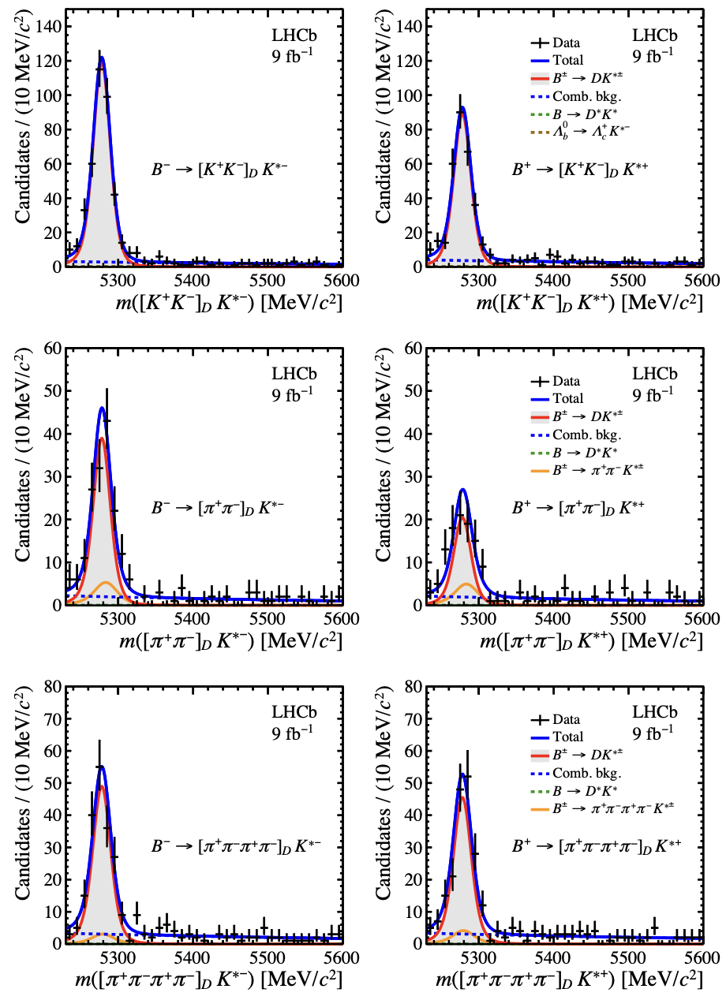
$B^{−}→D^{0}K^{∗}{(892)}^{−}$: (quasi-) $CP$ eigenstates
JHEP 02 (2025) 113
$$B^{−}$$
$$B^{+}$$
Observables:
Yield ratio $R_{CP}≡\frac{Γ\left(B→D_{CP}\right)}{Γ\left(B→D_{SS}\right)}×\frac{ℬ(D^{0}→SS)}{ℬ(D^{0}→SS)}$
$CP$ asymmetry $A_{CP}≡\frac{Γ\left(B^{−}\right)−Γ\left(B^{+}\right)}{Γ\left(B^{−}\right)+Γ\left(B^{+}\right)}$
Interpret as :
$R_{CP}=1+r_{B}^{2}+r_{B} cos δ_{B} cos γ$
$A_{CP}={2r_{B} sin δ_{B} sin γ}/{R_{CP}}$
Corrections:
Coherence factor $κ=0.95±0.06$ dilution from non-resonant $B^{−}→Dπ^{−}K_{S}^{0}$
$CP$-even fraction $F_{CP}=0.735±0.016$ for $D→π^{+}π^{−}π^{+}π^{−}$

Slide 10
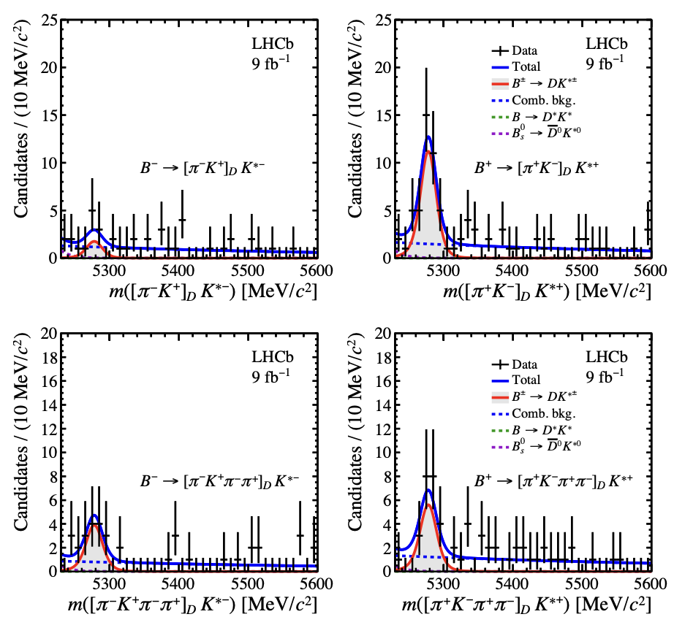
$B^{−}→D^{0}K^{∗}{(892)}^{−}$: opposite sign
JHEP 02 (2025) 113
$$B^{−}$$
$$B^{+}$$
Observables:
Yield ratio $R_{OS}≡\frac{Γ\left(B→D_{OS}\right)}{Γ\left(B→D_{SS}\right)}$
$CP$ asymmetry $A_{CP}≡\frac{Γ\left(B^{−}\right)−Γ\left(B^{+}\right)}{Γ\left(B^{−}\right)+Γ\left(B^{+}\right)}$
Interpret as :
$R_{OS}=r_{B}^{2}+r_{D}^{2}+2r_{B}cos (δ_{B}+δ_{D})cos γ$
$A_{CP}={2r_{B} sin \left(δ_{B}+δ_{D}\right) sin γ}/{R_{OS}}$
where:
$r_{D}$ is OS/SS amplitude ratio
$δ_{D}$ is OS vs SS strong phase
Additional dilution in 4-body channels
First observation!

Slide 11
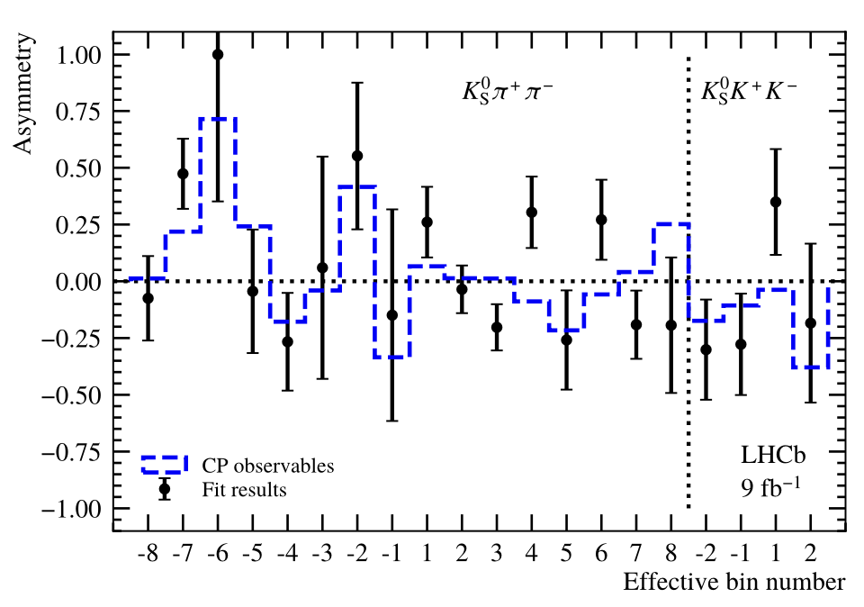
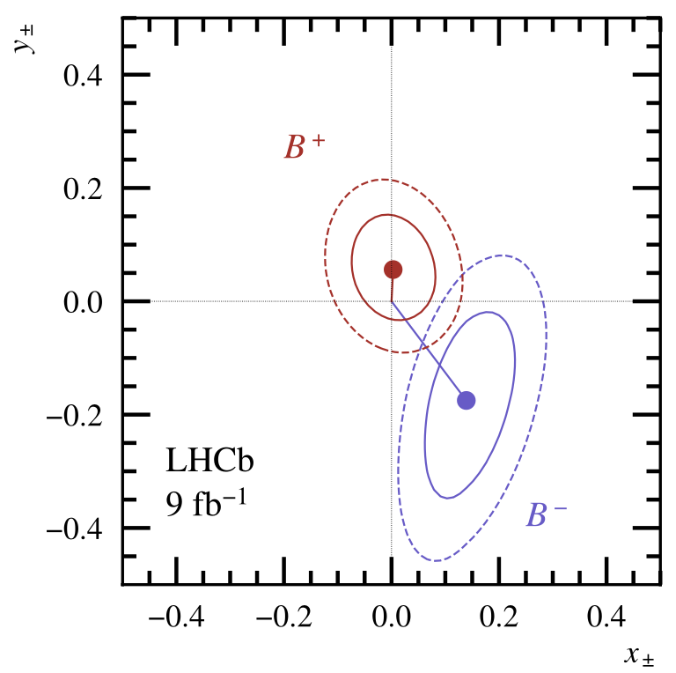
$B^{−}→D^{0}K^{∗}{(892)}^{−}$: $K_{S}^{0}h^{+}h^{−}$ modes
JHEP 02 (2025) 113]
$δ_{D}$ varies strongly over the phase space
Divide the Dalitz space in 16 ($K_{S}^{0}π^{+}π^{−}$) or 4 ($K_{S}^{0}K^{+}K^{−}$) bins
Requires external input from CLEO [PRD82 (2010) 112006 ] and BESIII [PRD101 (2020) 112002, PRD102 (2020) 052008]
Fit for $x_{±}=r_{B}cos(δ_{B}±γ)$, $y_{±}=r_{B}sin (δ_{B}±γ)$
$B^{−} −B^{+} o$pening angle is $2γ$

Slide 12
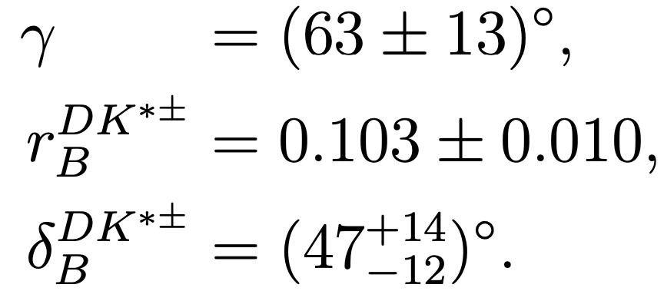
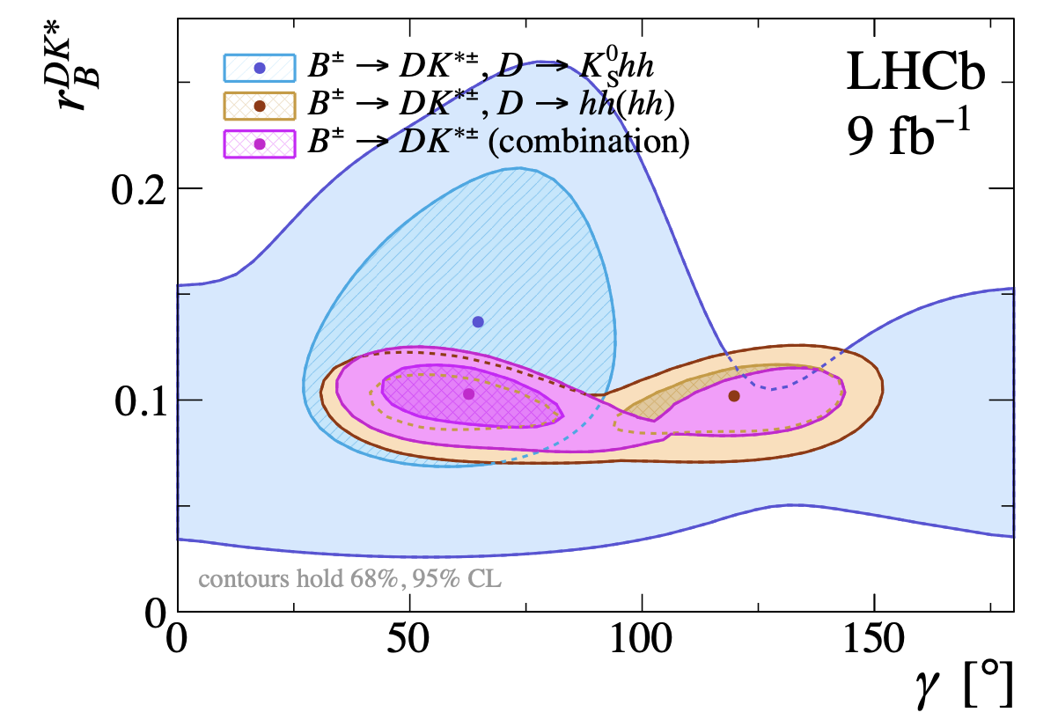
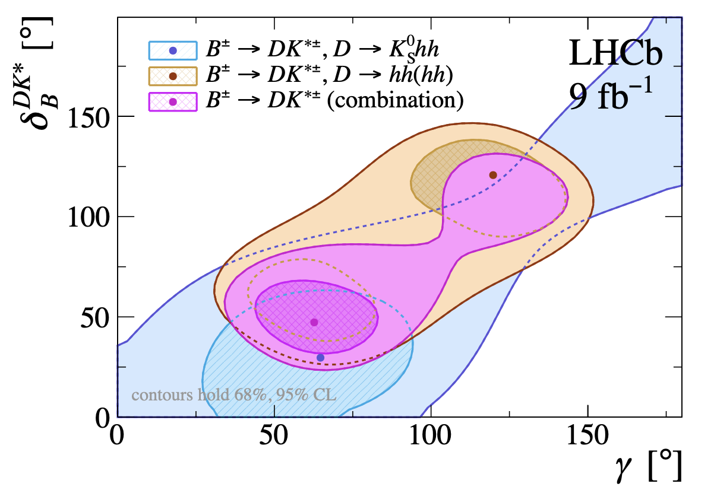
$B^{−}→D^{0}K^{∗}{(892)}^{−}$: results
JHEP 02 (2025) 113]
Result of fit to all modes:
Uncertainty dominated by statistics

Slide 13
Outline
CKM matrix, the angle $γ$, $CP$ violation
Recent LHCb measurements of $γ$
$B^{−}→D^{0}K^{∗}{(892)}^{−}$
$B_{s}^{0}→D_{s}^{∓}K^{±}$
$γ$ combination
$CP$ violation in $B→DD$
Outlook

Slide 14
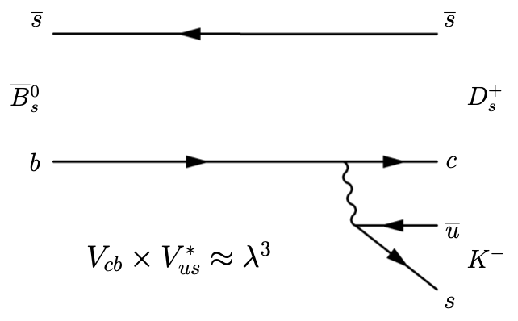
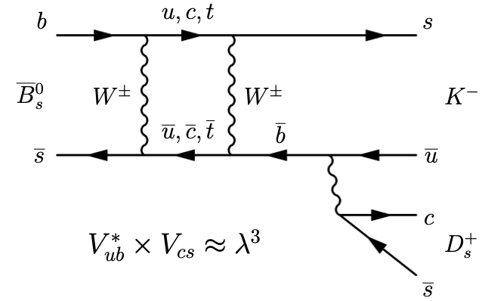
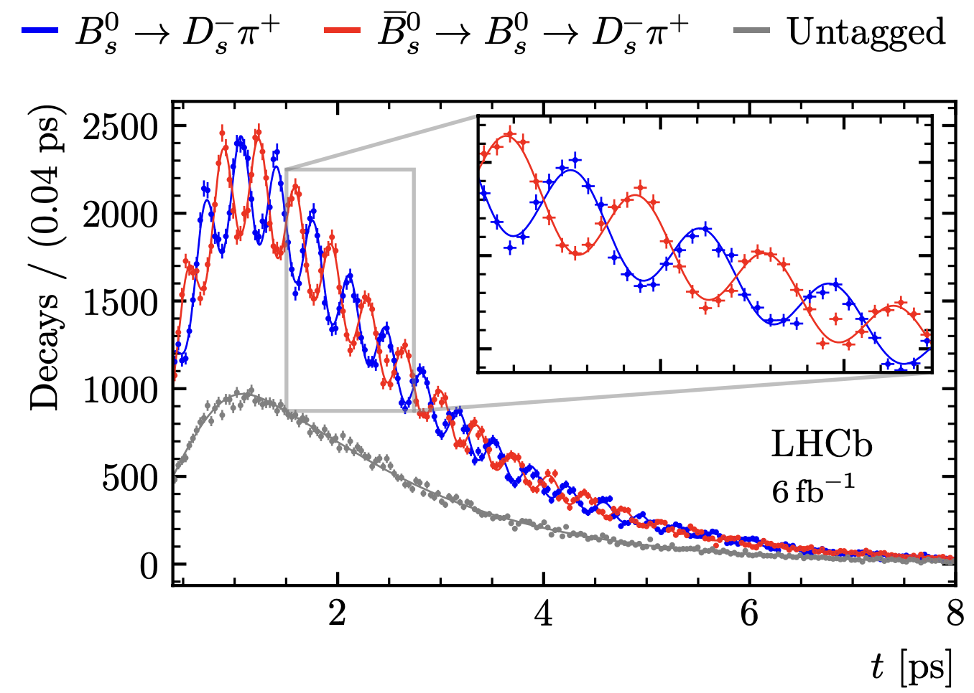
Measuring $γ$ with $B_{s}^{0}→D_{s}^{∓}K^{±}$ decays
Interference between mixed and non-mixed decays
CPV modulated by fast $B_{s}^{0}−{\overline{B}}_{s}^{0}$ oscillations
decay-time resolution $46 fs$
Requires flavour tagging
LHCb $εD^{2}=6.1\%$
Measure $γ−2β_{s}$
subtract $φ_{s}=−2β_{s}=−31±18 mrad$
Nature Phys., 18(1):1-5, 2022

Slide 15
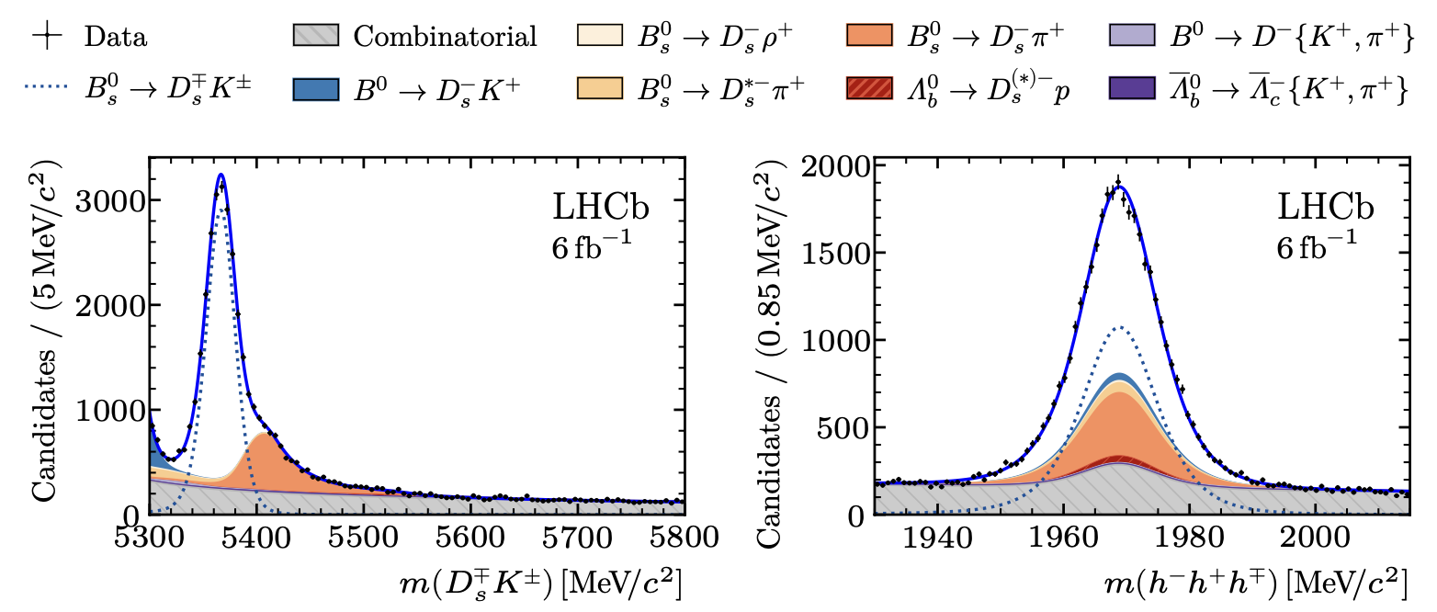
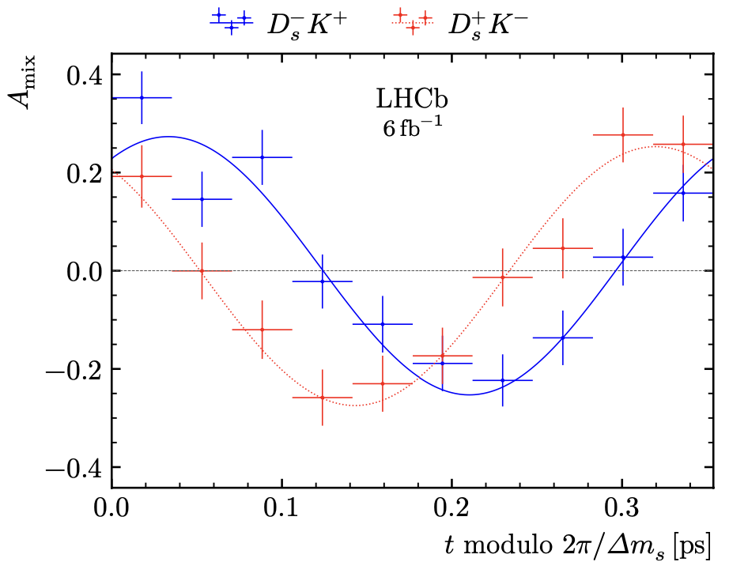
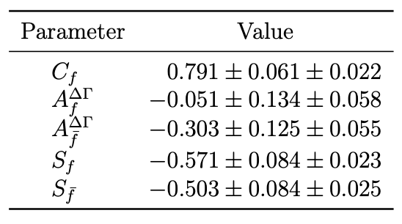
CKM-angle $γ$ using $B_{s}^{0}→D_{s}^{∓}K^{±}$
JHEP 03 (2025) 139
Select $D_{s}^{−}→K^{−}K^{+}π^{−}$, $π^{−}π^{+}π^{−}$, $K^{−}π^{+}π^{−}$. 2D fit in $m\left(B\right)$, $m\left(D\right)$. $N\left(B_{s}^{0}\right)=20949±180$
asymmetry: $CP$-fit observables:

Slide 16
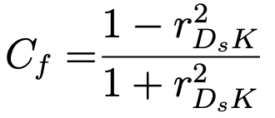
$B_{s}^{0}→D_{s}^{∓}K^{±}$ fit interpretation
JHEP 03 (2025) 139
$CP$ fit observables
related to
amplitude ratio $r_{D_{s}K}$,
strong phase difference $δ$,
CKM angle $γ$

Slide 17
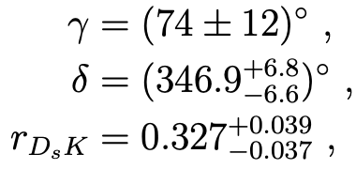
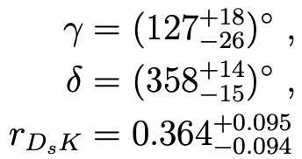
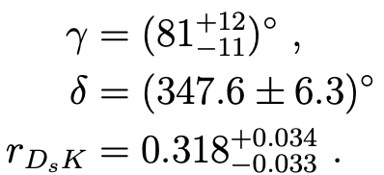
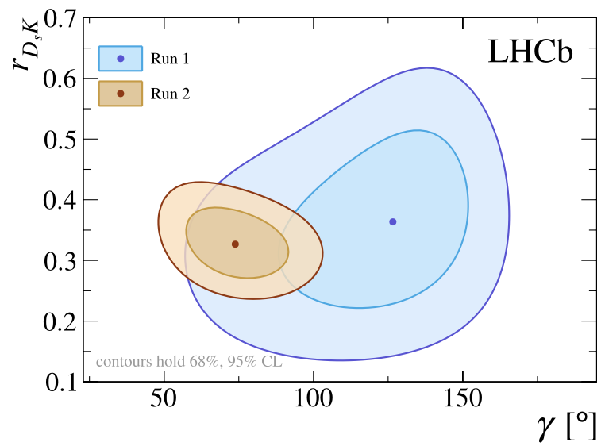
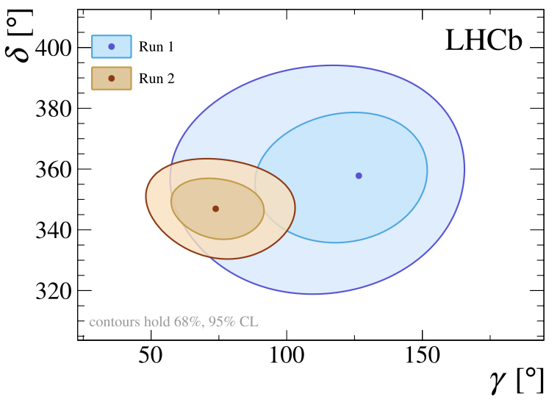
$B_{s}^{0}→D_{s}^{∓}K^{±}$ results
JHEP 03 (2025) 139
New Run 2 result: combine with Run 1: Combination:

Slide 18
Outline
CKM matrix, the angle $γ$, $CP$ violation
Recent LHCb measurements of $γ$
$B^{−}→D^{0}K^{∗}{(892)}^{−}$
$B_{s}^{0}→D_{s}^{∓}K^{±}$
$γ$ combination
$CP$ violation in $B→DD$
Outlook

Slide 19
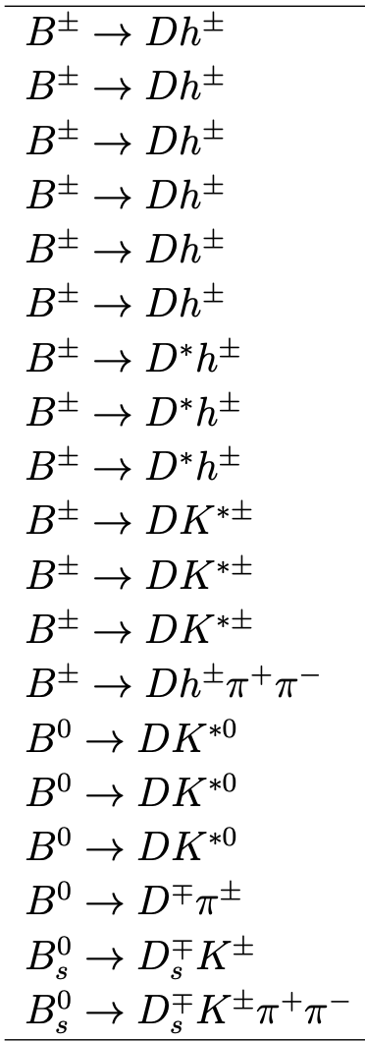
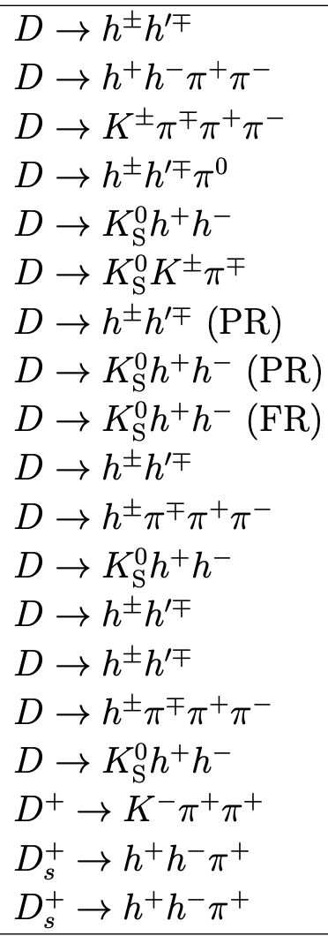
LHCb combination of CKM-angle $γ$ and charm
LHCb-CONF-2024-004
Combine LHCb’s $B$ decays sensitive to $γ$ and charm mixing, CPV
198 input variables
53 free parameters
Frequentist (FC) approach
Plug-in treatment of nuisance pars
$P$-value from $χ^{2}$ and sim: $20.8\%$

Slide 20
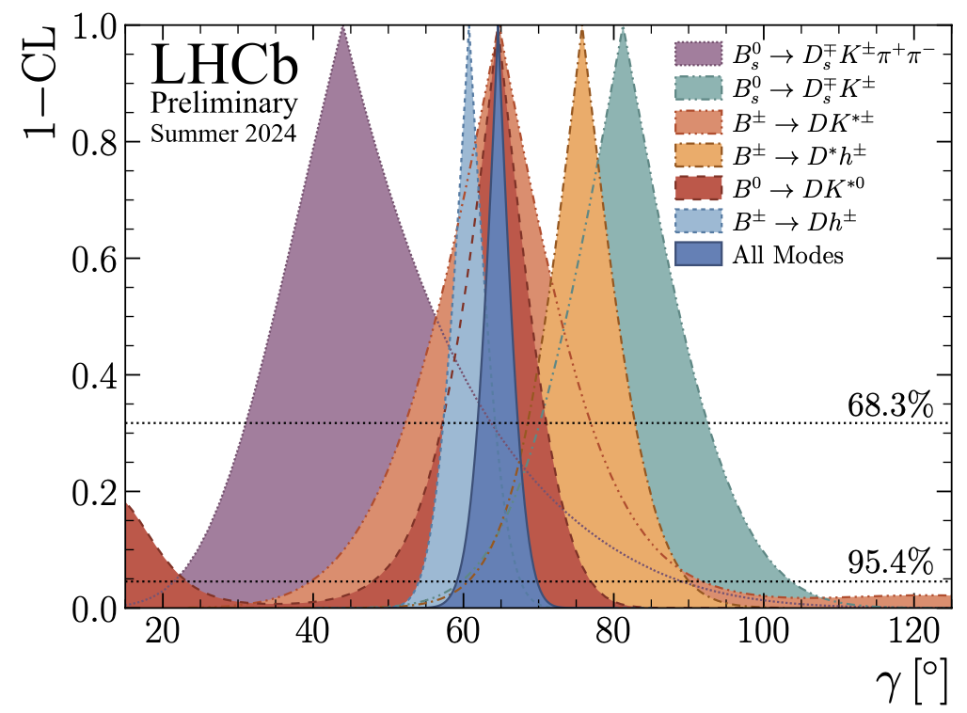
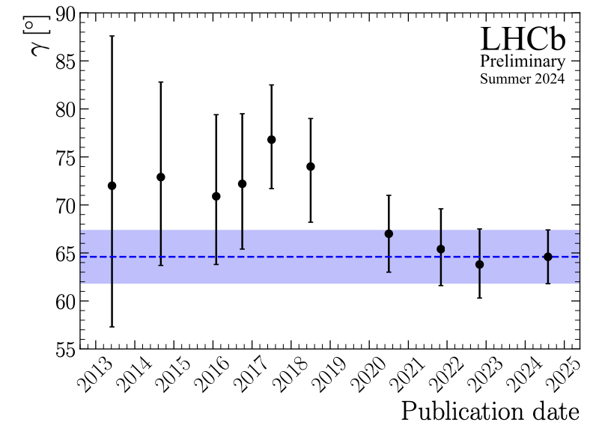
LHCb combination of CKM-angle $γ$ and charm
LHCb-CONF-2024-004
Result: $γ=\left(64.6±2.8\right)°$
Includes $1.4°$ systematic
Indirect determinations:
$γ=\left({66.0}_{−1.9}^{+0.7}\right)°$ CKMfitter (frequentist)
EPJC 41 (2005) 1
$γ=\left(64.9±1.4\right)°$ UTfit (Bayesian)
JHEP 10 (2006) 081
Good consistency between different modes
Steady improvement over time

Slide 21
Outline
CKM matrix, the angle $γ$, $CP$ violation
Recent LHCb measurements of $γ$
$B^{−}→D^{0}K^{∗}{(892)}^{−}$
$B_{s}^{0}→D_{s}^{∓}K^{±}$
$γ$ combination
$CP$ violation in $B→DD$
Outlook

Slide 22
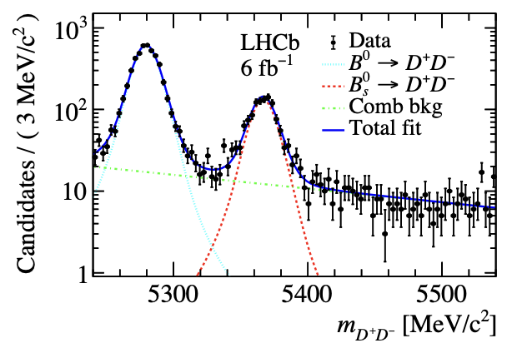
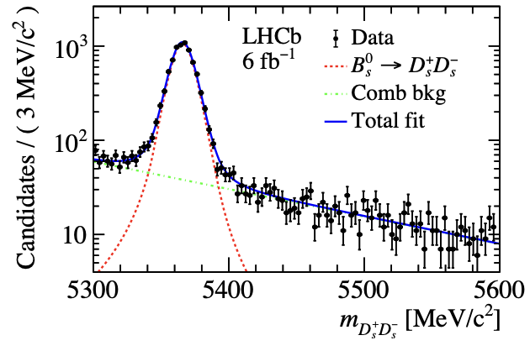
CPV in $B^{0}→D^{+}D^{−}$ and $B_{s}^{0}→D_{s}^{+}D_{s}^{−}$
JHEP 01 (2025) 061
Time-dependent, flavour-tagged
Sensitive to weak phases $β$, $β_{s}$
Dominated by tree diagram
Smaller contributions from
penguin
exchange
penguin annihilation
Reconstruct
$D^{+}→K^{−}π^{+}π^{+}$, $K^{−}K^{+}π^{+}$
$D_{s}^{+}→K^{−}K^{+}π^{+}$, $π^{−}π^{+}π^{−}$, $K^{+}π^{+}π^{−}$

Slide 23
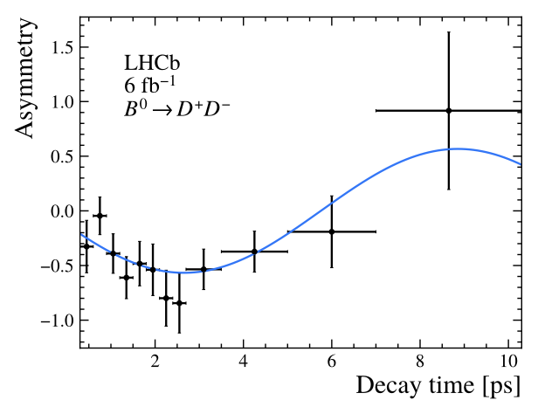
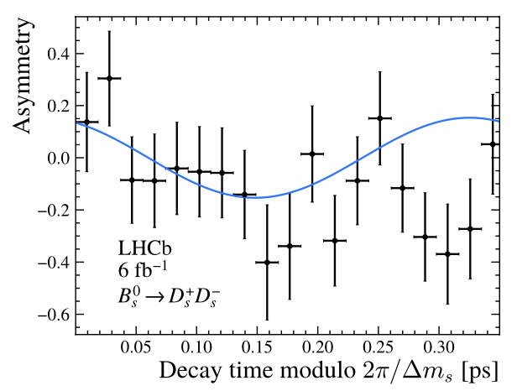
CPV in $B^{0}→D^{+}D^{−}$ and $B_{s}^{0}→D_{s}^{+}D_{s}^{−}$
JHEP 01 (2025) 061
For tree-only, and no New Physics, expect
$S_{D^{+}D^{−}}=−\sin{2β}, C_{D^{+}D^{−}}=0$
Result (Run 2 data)
$S_{D^{+}D^{−}}=−0.552±0.100±0.010$
$C_{D^{+}D^{−}}= 0.128±0.103±0.010$
$φ_{s}=−0.086±0.106±0.028$ rad
$\left|λ_{D_{s}^{+}D_{s}^{−}}\right|= 1.145±0.126±0.031$
Combined with Run 1:
PRL 117(2016) 261801, PRL 113 (2014) 211801
$S_{D^{+}D^{−}}=−0.549±0.085±0.015$
$C_{D^{+}D^{−}}= 0.163±0.088±0.009$
$φ_{s}=−0.055±0.090±0.021$ rad
$\left|λ_{D_{s}^{+}D_{s}^{−}}\right|= 1.054±0.099±0.020$

Slide 24
Outline
CKM matrix, the angle $γ$, $CP$ violation
Recent LHCb measurements of $γ$
$B^{−}→D^{0}K^{∗}{(892)}^{−}$
$B_{s}^{0}→D_{s}^{∓}K^{±}$
$γ$ combination
$CP$ violation in $B→DD$
Outlook

Slide 25
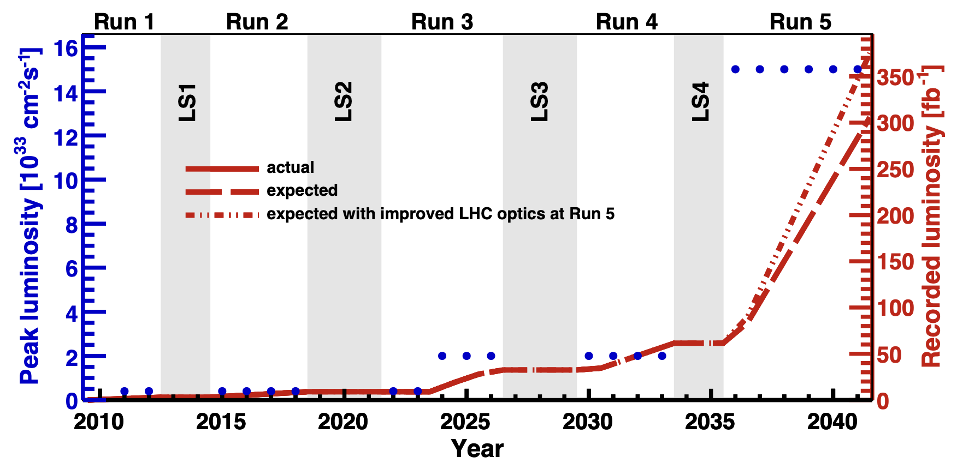
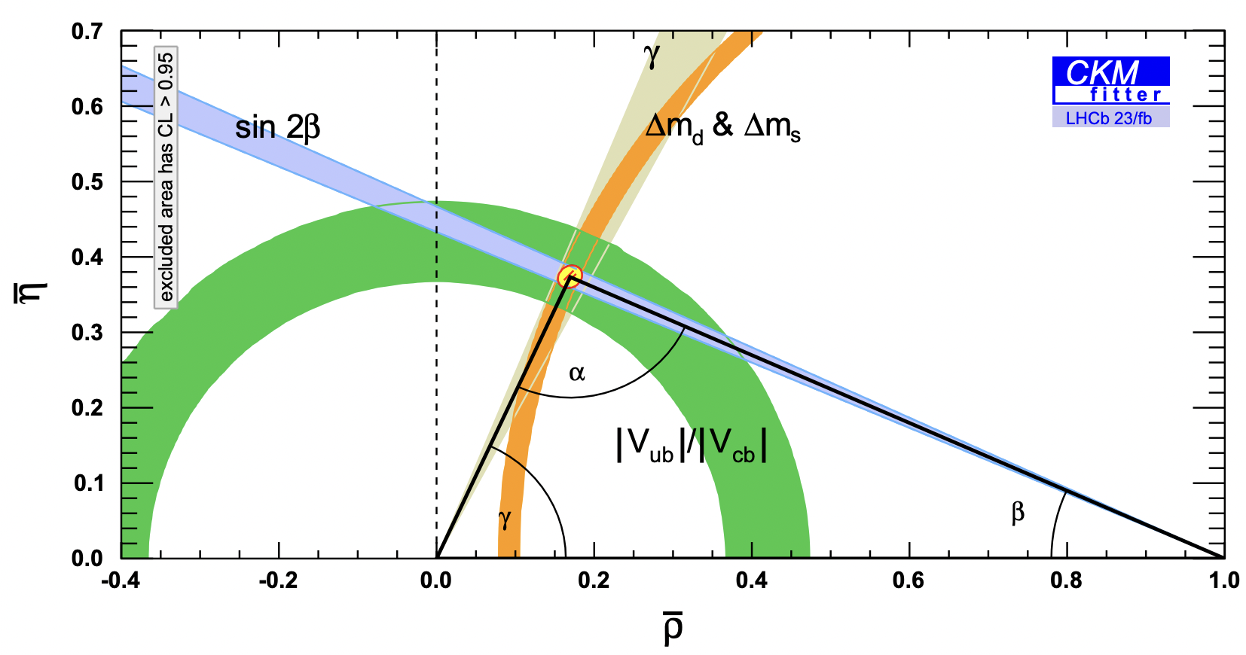
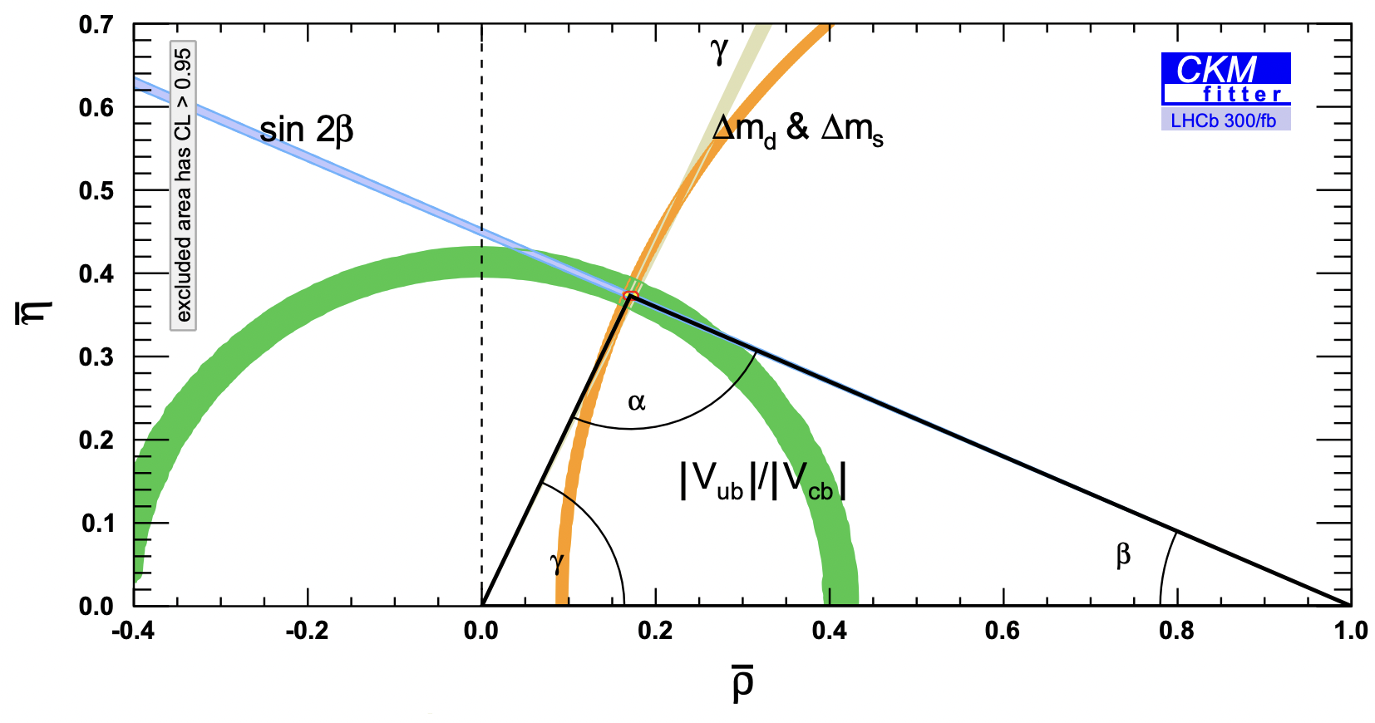
Outlook
today
Upgrade 1:
$ℒ 0.4→2.0 ×{10}^{33}$(x5)
$ε(B→hadronic)$ 2x
Upgrade 2:
$ℒ 2.0→15 ×{10}^{33}$(x7.5)
LHCb
LHCb Upgrade I
Upgrade II
LHCb 23 fb⁻¹ $Δγ≈1,5°$
LHCb 300 fb⁻¹ $Δγ≈0,35°$
EPJC 41 (2005) 1 , LHCb-PUB-2018-027

Slide 26
Conclusions
LHCb reaches high precision even with ‘difficult’ open-charm $B$ decays
$γ=\left(64.6±2.8\right)°$ approaches precision of CKM fit
Flavour-tagged time-dependent $B→DD$ analyses
Probe non-tree contributions to CPV
Promising outlook
Run 3 with 5x luminosity and 2x efficiency well underway
Clear plan to Upgrade II

Slide 27
BACKUP

Slide 28
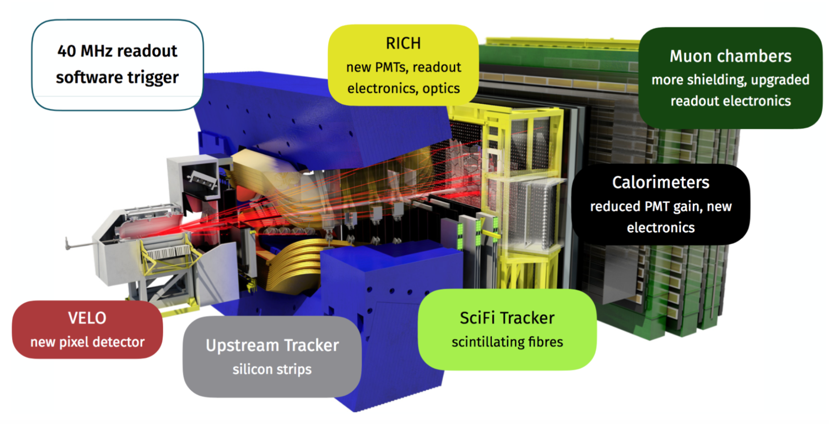
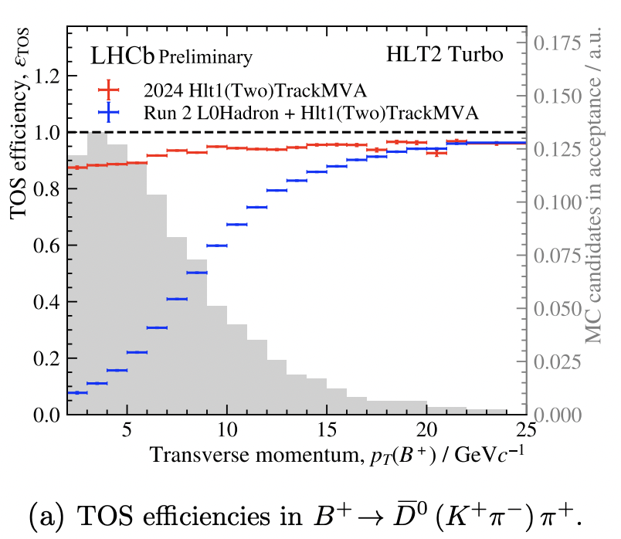
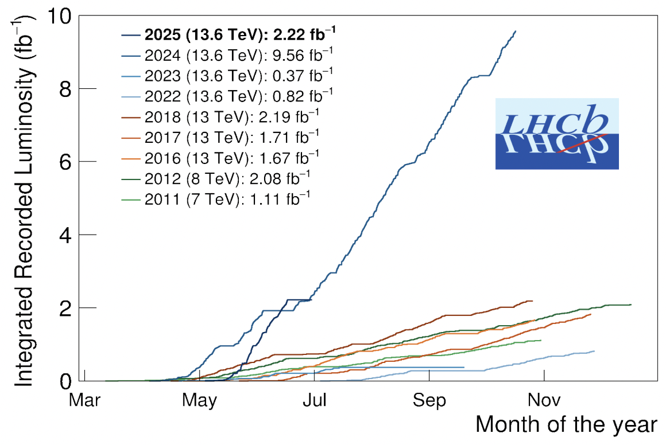
The LHCb upgrade
JINST 19 (2024) P05065
Raise lumi from 0.4 to 2.0 x 10³³
40MHz readout – removed L0 trigger
Software HLT1 (GPU) and HLT2 trigger
~2x higher efficiency for hadronic $B$ decays
See also, “The upgraded LHCb trigger system”,
D. vom Bruch 7/7 14:00 T12
LHCb-FIGURE-2024-030

Slide 29
Upgrade II
Goal is to reach $300 {fb}^{−1}$
$L_{inst}≈1,5∙{10}^{34}{cm}^{−2}s^{−1}$
Pileup of 40
Separate collisions with $O(10ps)$ timing
First enhancements in LS3,
Full installation in LS4

Slide 30
