Slide 1
Primal S-matrix bootstrap with dispersion relations
Zhuo-Hui Wang (University of science and technology of China)
based on: 2506.22546 w/ Claudia de Rham, Andrew J. Tolley and Shuang-Yong Zhou
@ EPS-HEP 2025

Slide 2
S-matrix bootstrap
Causality + Unitarity
Allowed space of QFT
Dual approach
Primal approach
rule out unviable space
optimize dual varibles
rule in viable space
optimize primal varibles
amplitude, partial waves...
de Rham et al., 1702.06134
Guerrieri, Sever, 2106.10257
...
recent review:
de Rham et al., 2210.03199
QFT theory space
Paulos et al., 1708.06765
...
recent review:
Kruczenski, Penedones & van Rees, 2203.02421

Slide 3
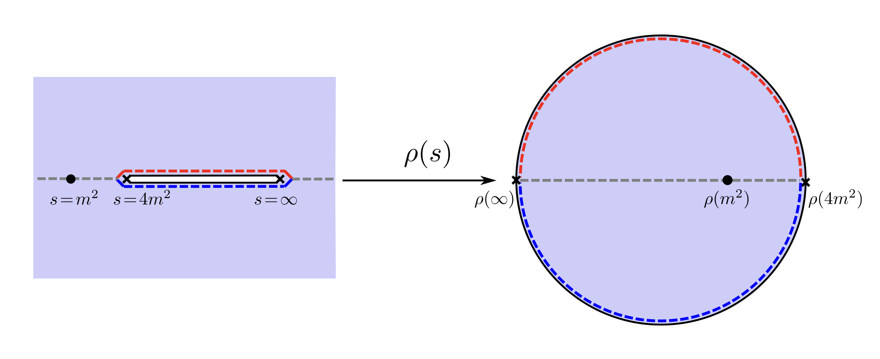
Previous primal method
Paulos et al., 1708.06765
Causality
maximal analyticity： Amplitude analytic in tri-cutted plane
Expansion around origin
$$M=\sum{\#ρ^{\#}(s)ρ^{\#}(t)ρ^{\#}(u)}$$
optimize
Allowed space of QFT
Unitarity
partial wave projection
impo$se{ |S}_{l}|≤1$

Slide 4
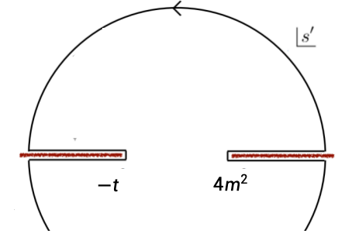
Why dispersion relations?
dispersion relation
Rigorously proven
Cacaulity
Analyticity
Dispersion relation
(scalar field without bound states, fixed $−4m^{2}<t<4m^{2}$)
Analyticity in cutted complex $s$ plane
Jin-Martin bound: $\lim_{s→∞}{|M(s,t)|<{|s|}^{2}}$
Crossing symmetry
Whole amplitude
Imaginary part on the branch cut

Slide 5
Why dispersion relations?
Rogorously proven analyticity
Ansatz on physical observables
Easy to include high spin bound states
Jin-Martin bound build in
Partial wave expansion
Bootstrap glueball couplings
Softer high energy behavior: fractional dispersion relations

Slide 6
Our Method

Slide 7
Ansatz
Convergence of the dispersion relation
Function basis
Unitarity + Large spin behavior:
unitarity: $|1+\sqrt{(s−4m^{2})/s}{ a}_{l}(s)|≤1$
allow threshold singularity for spin-0
from Froissart-Gribov formula
threshold behvaior + unitarity √

Slide 8
Ansatz+ Dispersion relation
Extract the real parts of the partial waves
Roy equation only valids in a finite range of $s$...
Massive field: Finite correlation length L
Full unitarity: for $s<s_{max}$
Allow a cutoff on spin
Discretize $t$ in $(−4m^{2},4m^{2})$
real part of the partial waves
Valid for any $s$ ✔
Less computation cost
Capture Jin-Martin bound for t>0

Slide 9
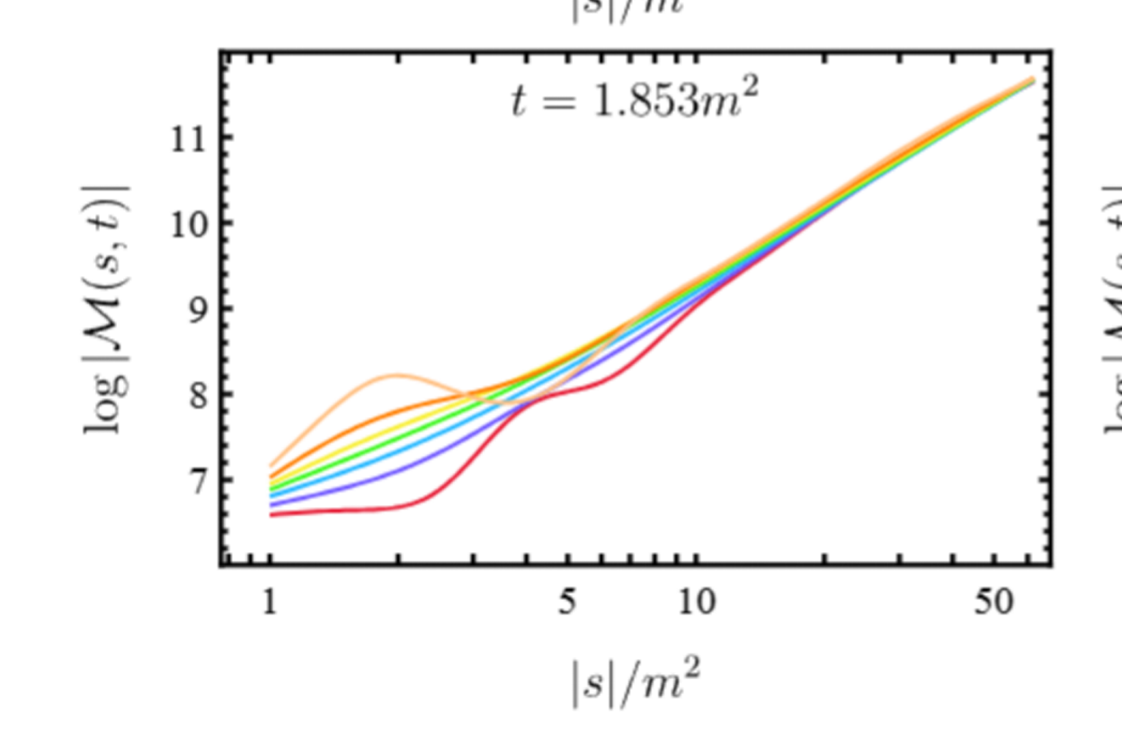
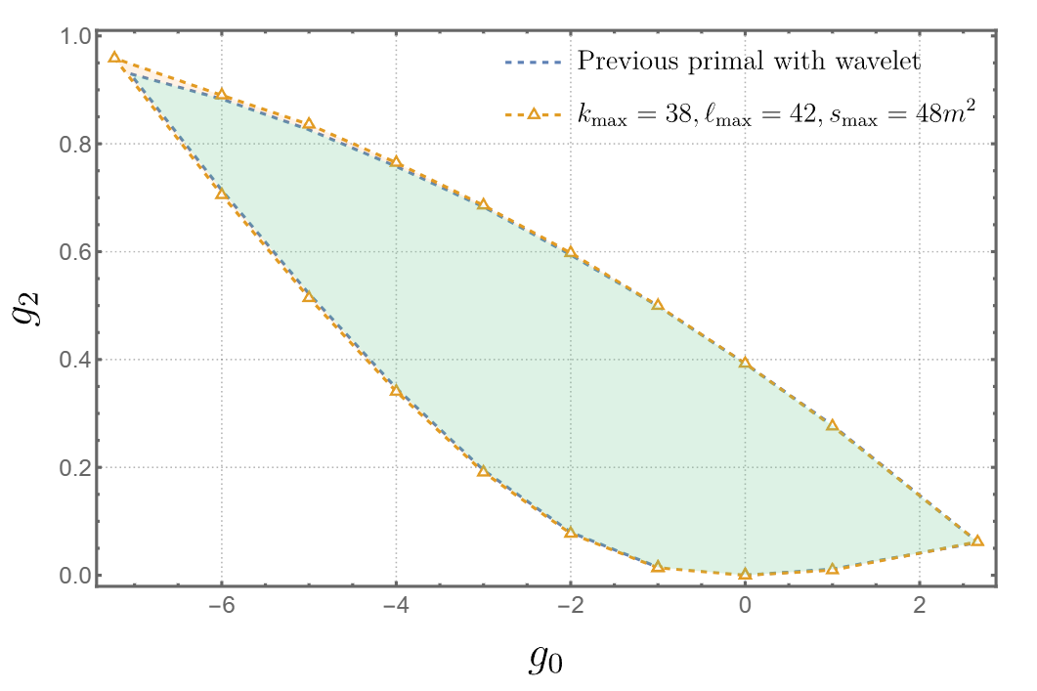
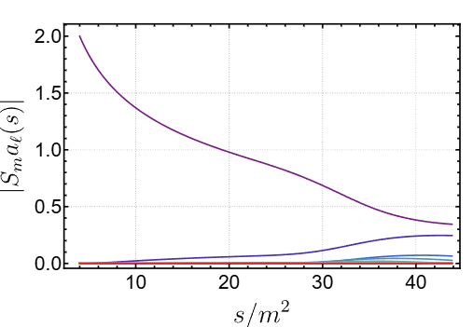
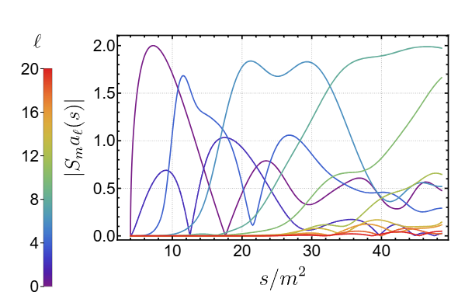
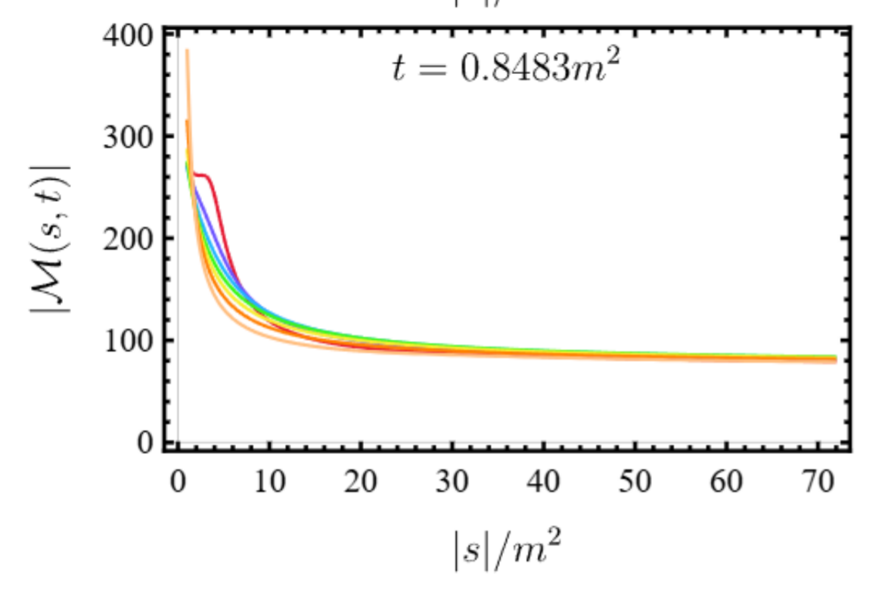
Impose unitarity and Optimize
bounds on coefficients
Consistent with the previous method
Different behavior of the left and right kink
Elias Miro, Guerrieri & Gumus, 2210.01502

Slide 10
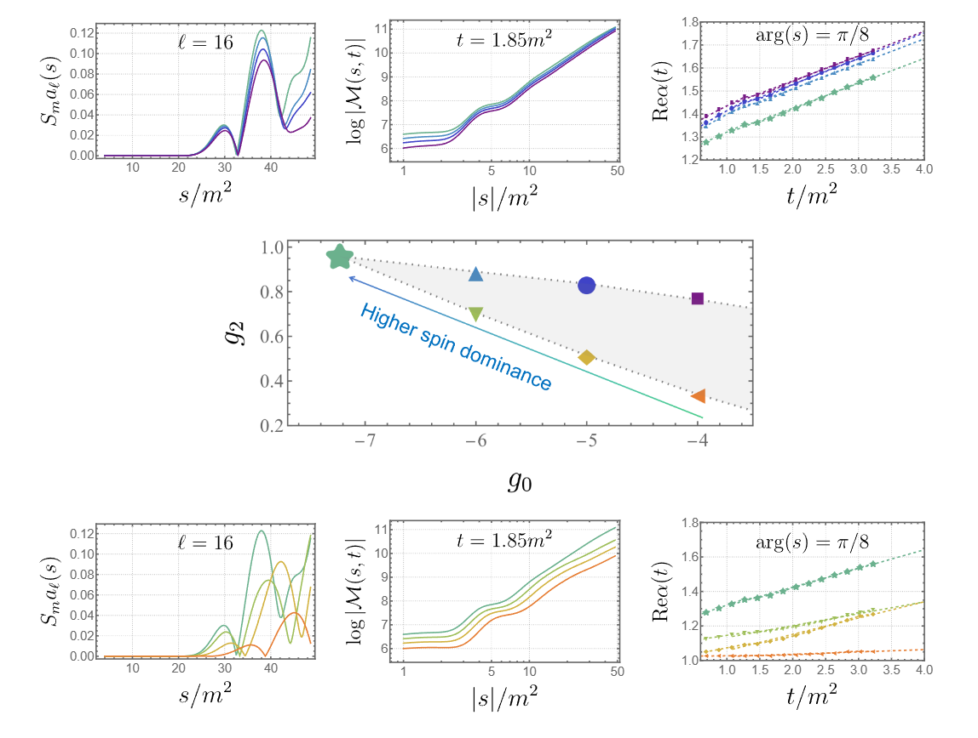
Amplitudes and along the boundary
Fastest growth:
$$s^{1.7\sim 1.8}$$
Along the lower bound
High spin partial waves
significant earlier
faster divergence

Slide 11
Adding bound states
spin-0: crossing symmetric ansatz
spin$≥2$: crossing symmetric + Jin-Martin bound?
Hard to construct
Use dispersion relation!
Change ansazt: Add large spin factor from bound states contribution

Slide 12
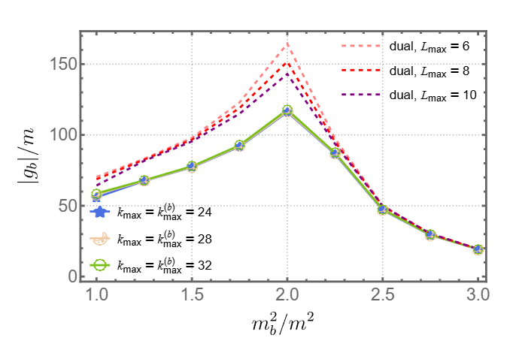
For the dual approach, see: Guerrieri, Hebbar & van Rees, 2312.00127
Spin-2 bound state
Glueballs couplings

Slide 13
Fractional dispersion relations
softer large $s$ behavior
fractional subtraction
$s_{i}>4m^{2}, {0<r}_{i}<1$, no pole contribution
Mix real and imaginary part
Piecewise ansatz on the discontinuity

Slide 14
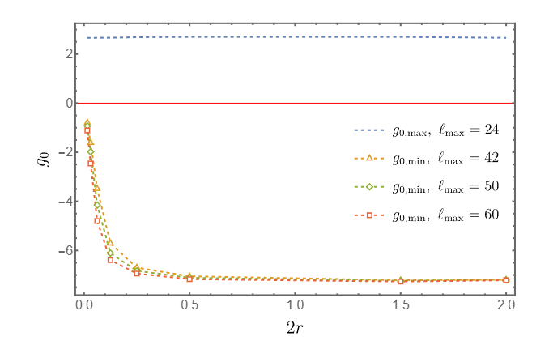
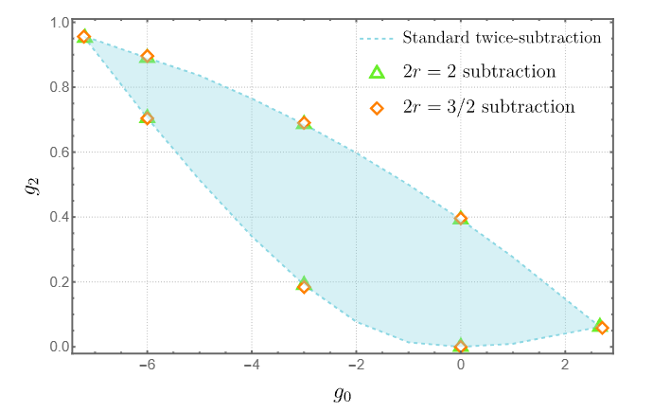
Piecewise ansatz encode multi-particle thresholds
bounds with different subraction orders
If no subtarction:
Most of the parameter space consistent with $s^{\sim 0.1}$
lower bound tends to 0

Slide 15
Summary
Thank you!!!
A primal bootstrap method with dispersion relations and parametrizing the physical partial waves
Easy to include high spin bound states
Interference between the large $s$ behavior and the bounds
Only need Rigorously proven analyticity
Jin-Martin bound build in
Primal bootstrap for glueball couplings

Slide 16
backup

Slide 17
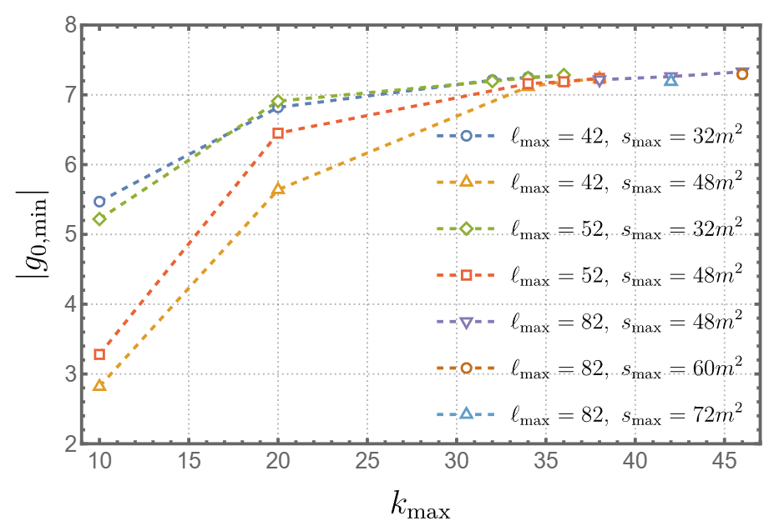
Convergence test

Slide 18
