Slide 1
Matrix moment approach to positivity bounds and
UV reconstruction from IR
Shi-Lin Wan & Shuang-Yong Zhou
July 8th, @EPS-HEP2025
Marseille, France
Based on arXiv 2411.11964

Slide 2
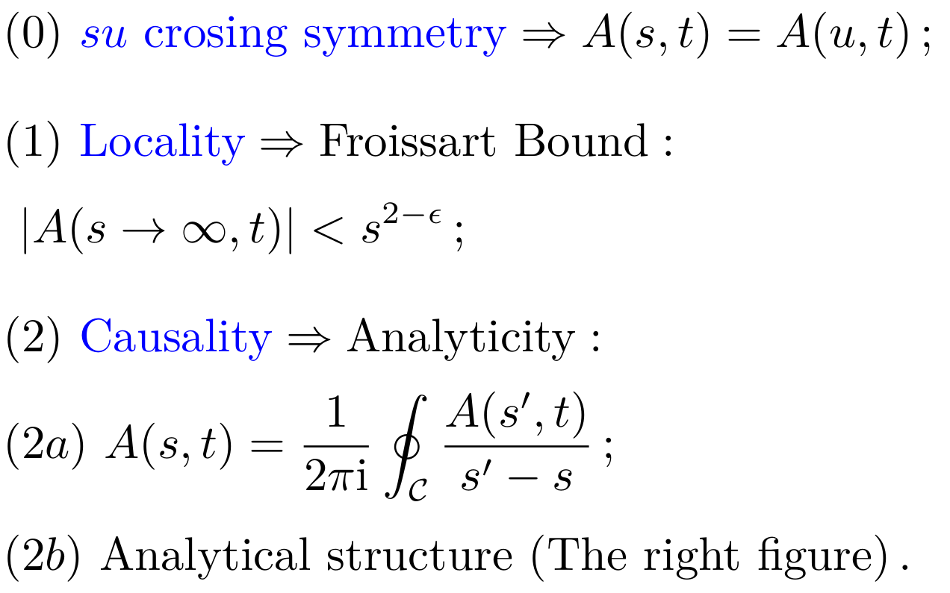
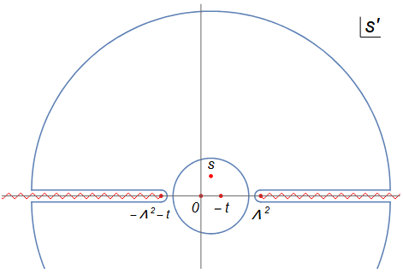
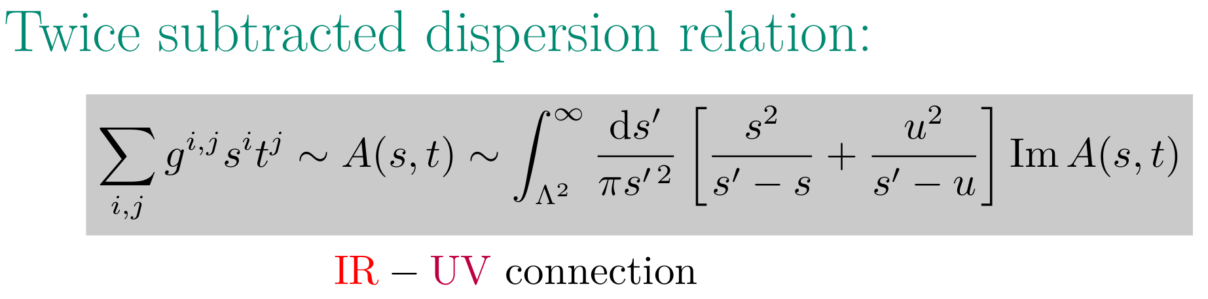
Dispersion Relation
Introduction

Slide 3
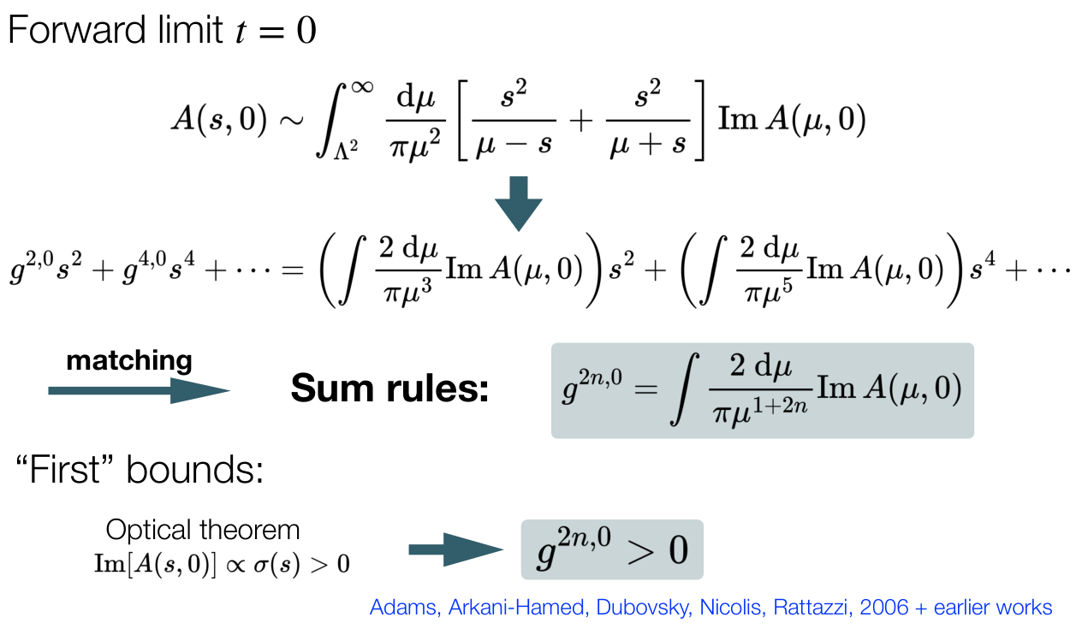
Positivity Bounds
Introduction

Slide 4
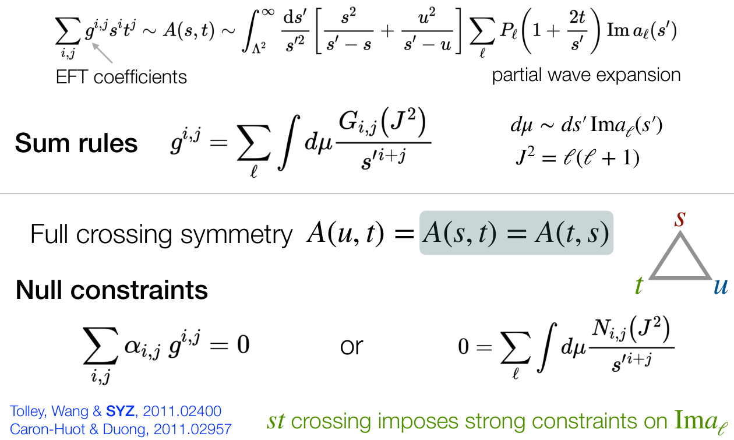
Two-Sided Bounds
Introduction

Slide 5
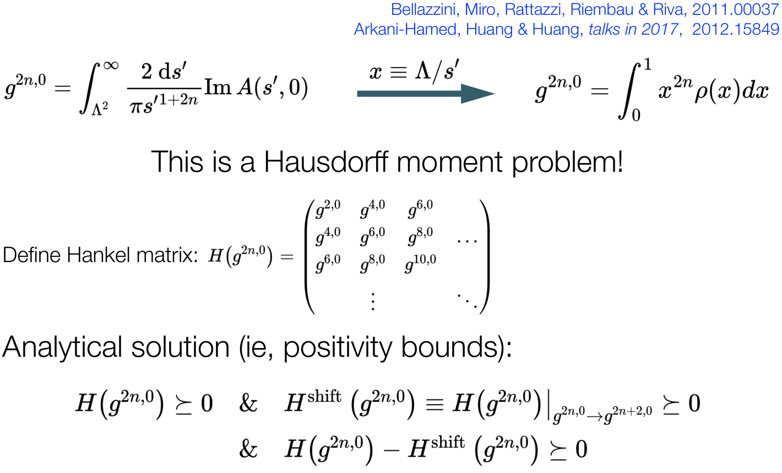
EFT-Hedron for t=0
Introduction

Slide 6
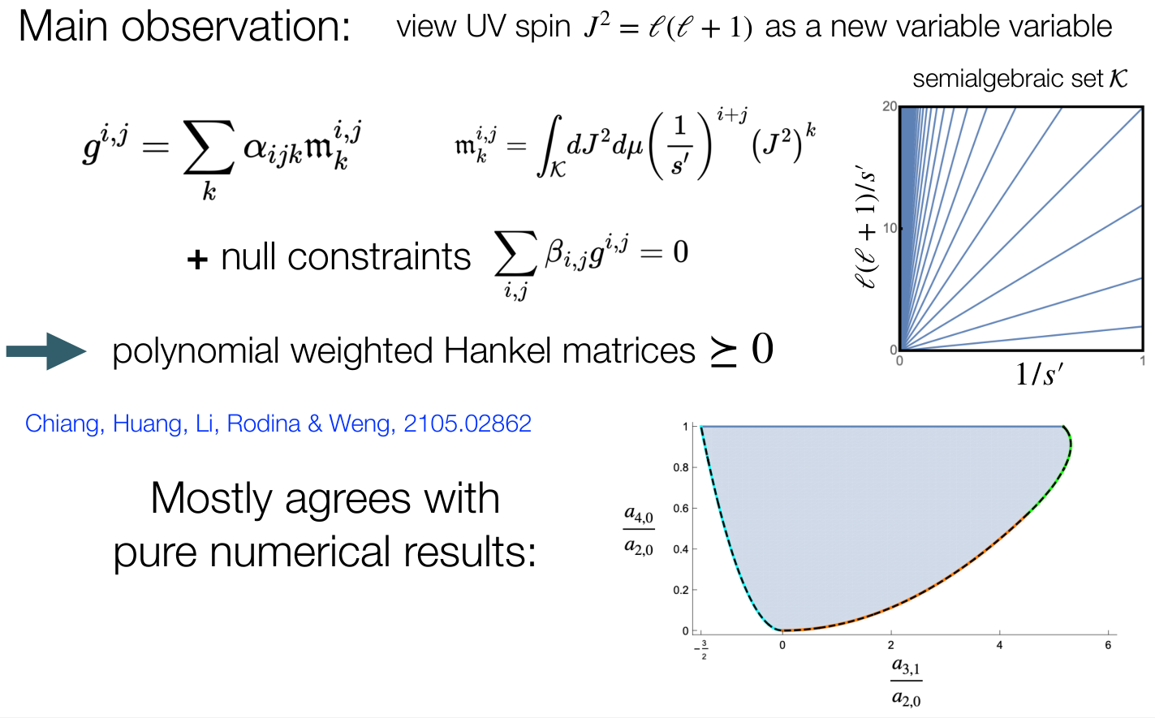
t≠0: Bi-variate Formulations
Introduction

Slide 7
What’s next
The moment problem
Bi-variate moment formulation is numerically slow
  (Mixed-variate moment formulation)
Formulate positivity bounds with Multi-DoFs as moment problems
  Fields with spin (and multiple fields)
Remove differences between analytic and numerical methods
  Necessary and sufficient condition
  (Truncation and flat extension)
Infer the UV spectrum from IR EFT coefficients
  Curto-Fialkow method
  (Complete moment sequence)
  Uniqueness of spectrum
Notes:
However, there are still a lot of problems.
In our papers, we solve most problems of this analytic method and basically make this analytic method to give the best bounds just like the SDPB.
We also find a method to generate UV spetrum

Slide 8
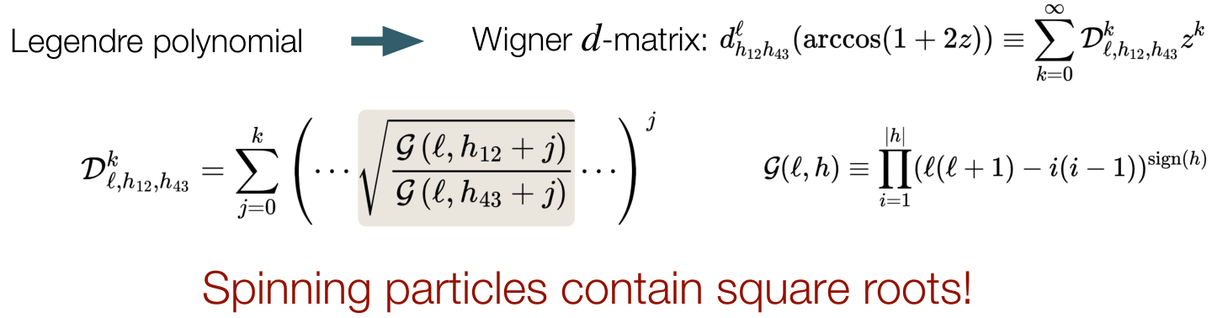
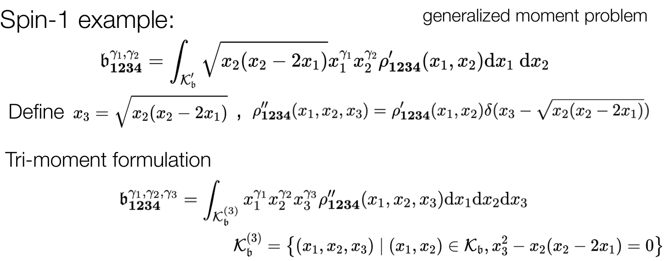
Fields with Spin: Semi-algebriac Function
The moment problem

Slide 9
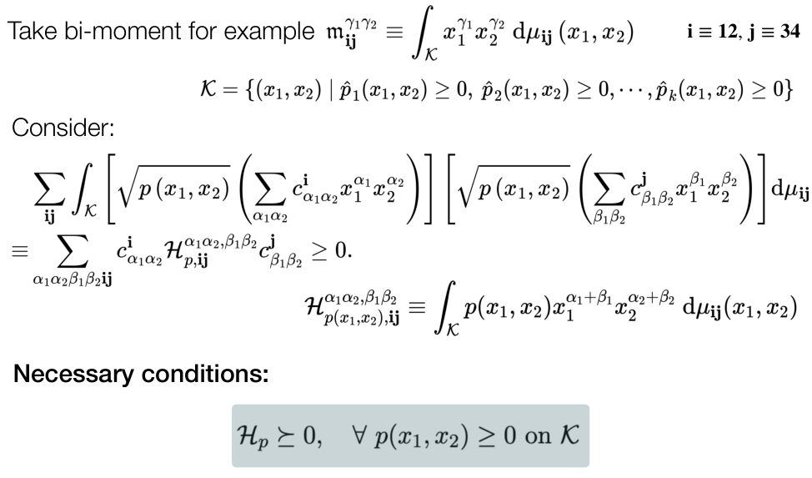
Necessary Condition
The moment problem

Slide 10
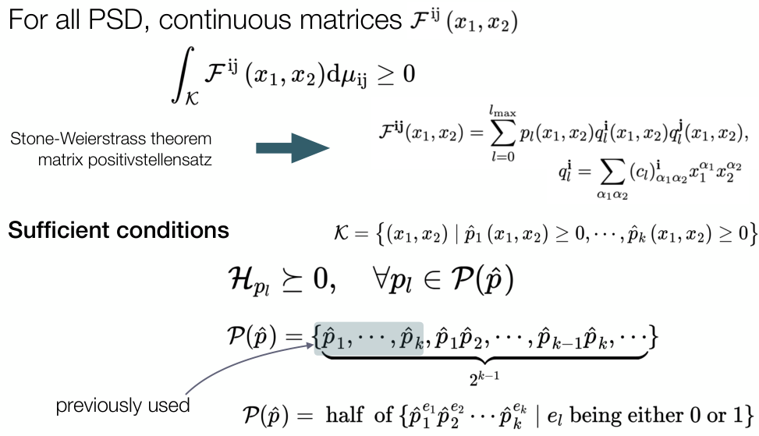
Sufficient Condition
The moment problem

Slide 11
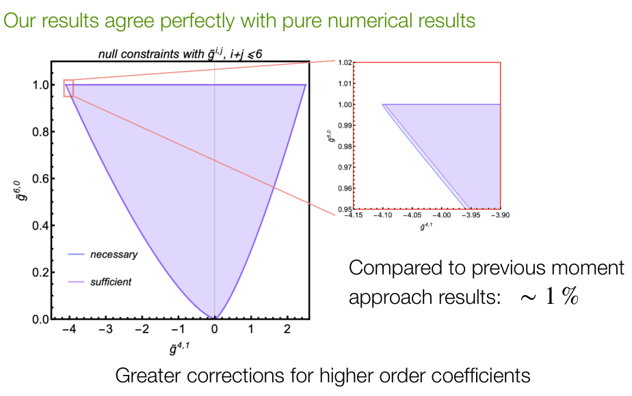
Corrections to previous scalar bounds
The moment problem

Slide 12
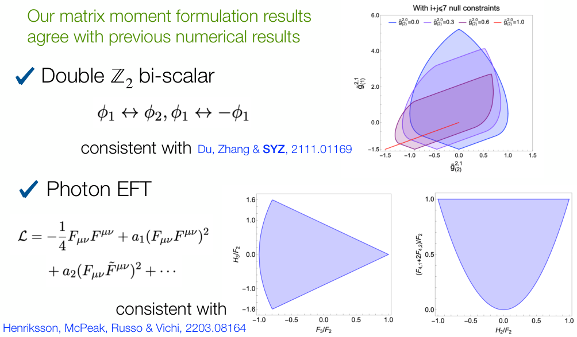
Multi-DoFs Results
The moment problem

Slide 13
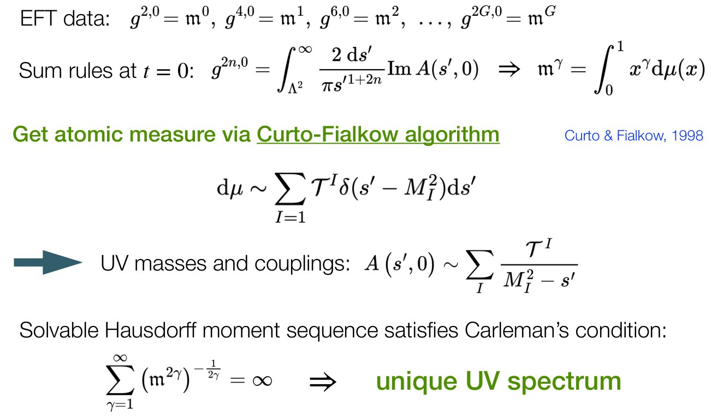
Curto-Fialkow algorithm
Inverse problem

Slide 14
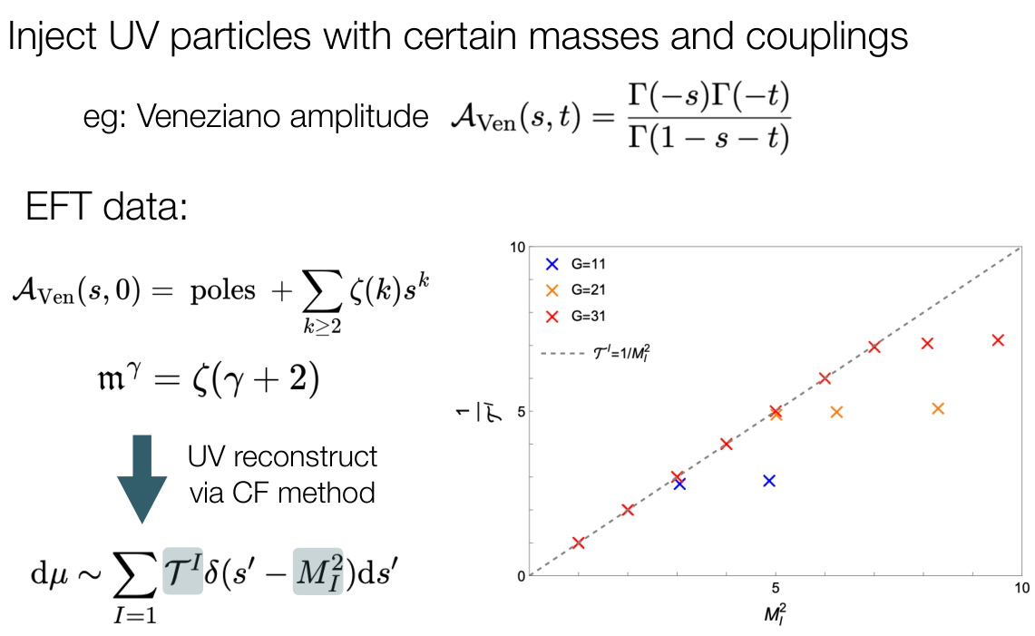
Example: Veneziano amplitude
Inverse problem

Slide 15
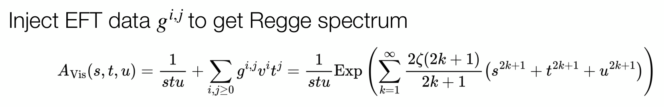
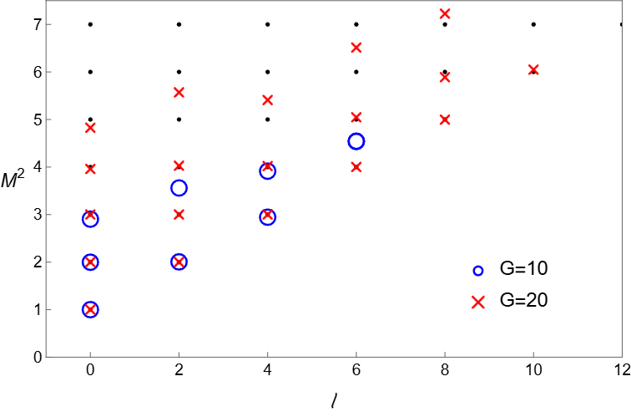
Example: Virosoro amplitude
Inverse problem
Crossing symmetry
No linear transformation
from EFT coefficients to moments
unique mass spectrum
“Interpolation”:
unique moment sequence

Slide 16
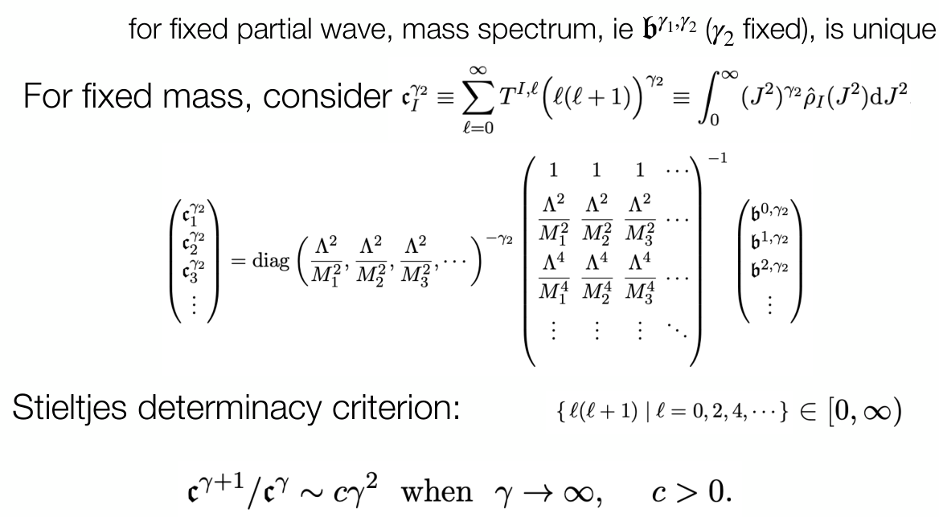
Uniqueness criterion
Inverse problem

Slide 17
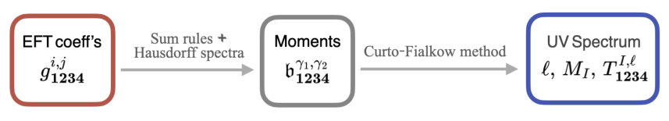
Summary
Moment problem as alternative approach to get positivity bounds — connection with math literature
Generalized the moment formulation to include multiple fields and spin
Inverse problem: extract UV spectrum from EFT data

