Slide 1
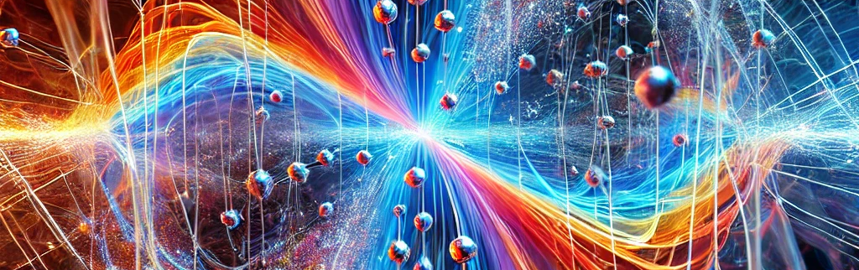

Full NNLO QCD Corrections to B Meson Mixing
© ChatGPT
EPS HEP 2025, Marseille, 8th July 2025
Pascal Reeck

Slide 2
Motivation
What is B meson mixing?
Why does it matter?
Why is our calculation useful?

Slide 3
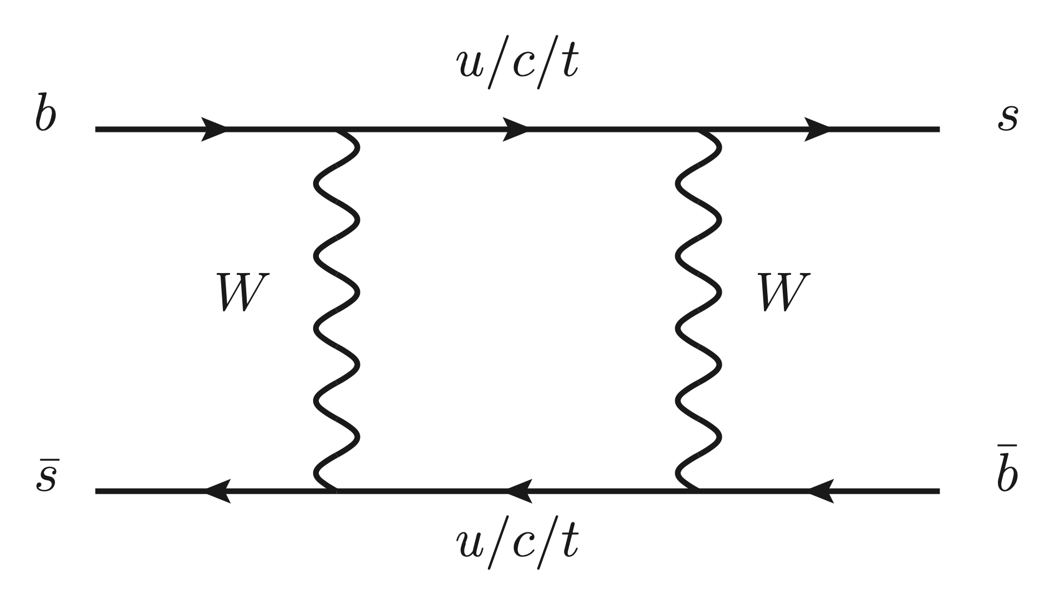
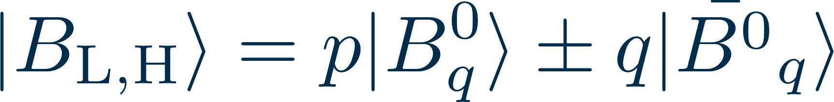
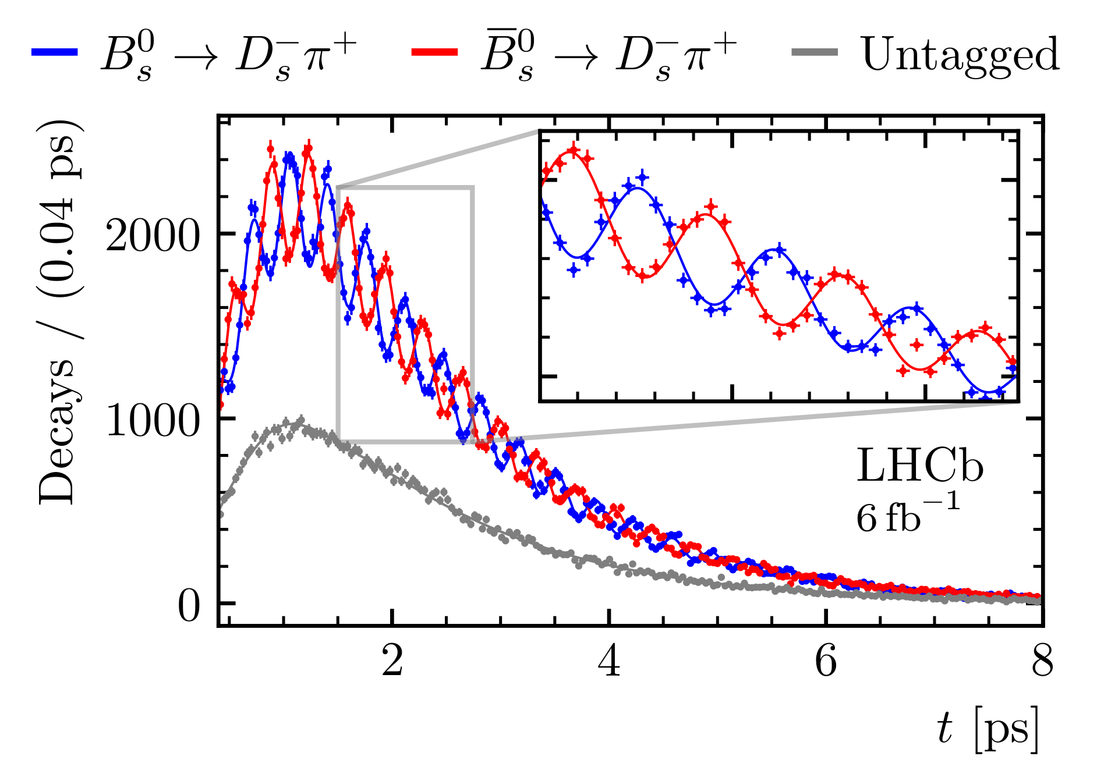


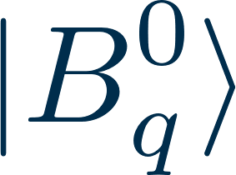
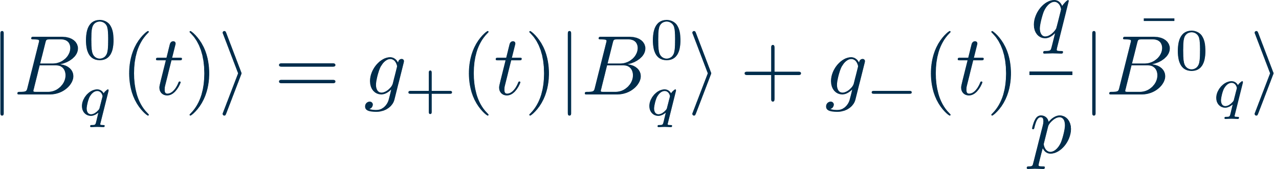
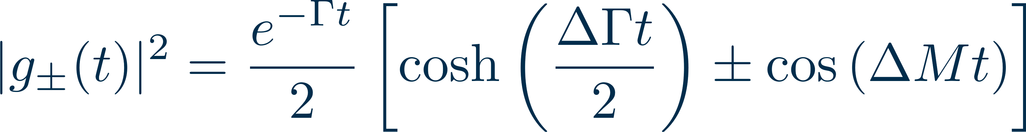
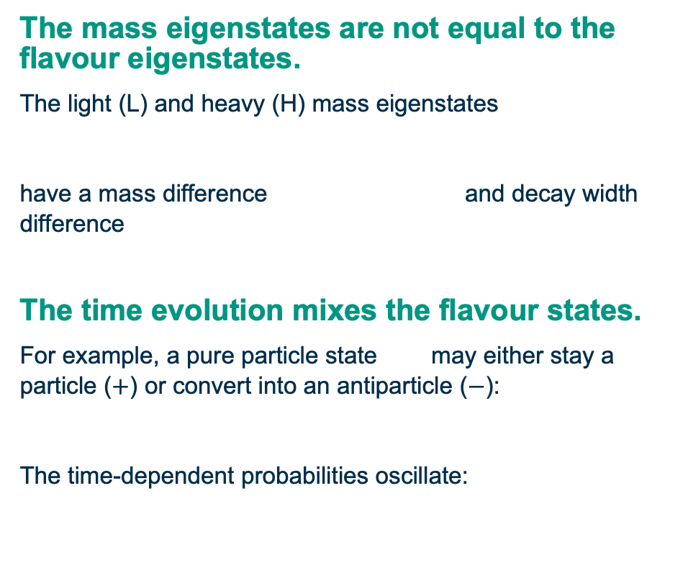
Neutral B mesons exhibit particle-antiparticle mixing.
          The mass eigenstates are not equal to the flavour eigenstates.
The light (L) and heavy (H) mass eigenstates
have a mass difference and decay width difference
          The time evolution mixes the flavour states.
For example, a pure particle state may either stay a particle ($+$) or convert into an antiparticle ($−$):
The time-dependent probabilities oscillate:
© By LHCb - https://lhcb-public.web.cern.ch/Images2021/BsOsc21.png
Notes:
Add afs?

Slide 4
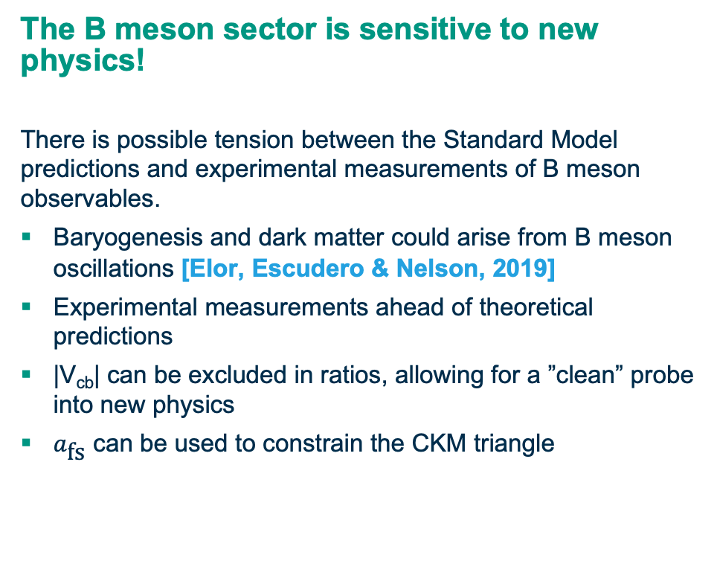
Why do we care about B meson mixing?
          The B meson sector is sensitive to new physics!
There is possible tension between the Standard Model predictions and experimental measurements of B meson observables.
  Baryogenesis and dark matter could arise from B meson oscillations [Elor, Escudero & Nelson, 2019]
  Experimental measurements ahead of theoretical predictions
  |V_{cb}| can be excluded in ratios, allowing for a ”clean” probe into new physics
  $a_{\text{fs}}$ can be used to constrain the CKM triangle
© [Gerlach, Nierste, Reeck, Shtabovenko, Steinhauser, 2025]
To identify room for new physics, we need to improve the theoretical prediction of $Γ_{12}$!

Slide 5
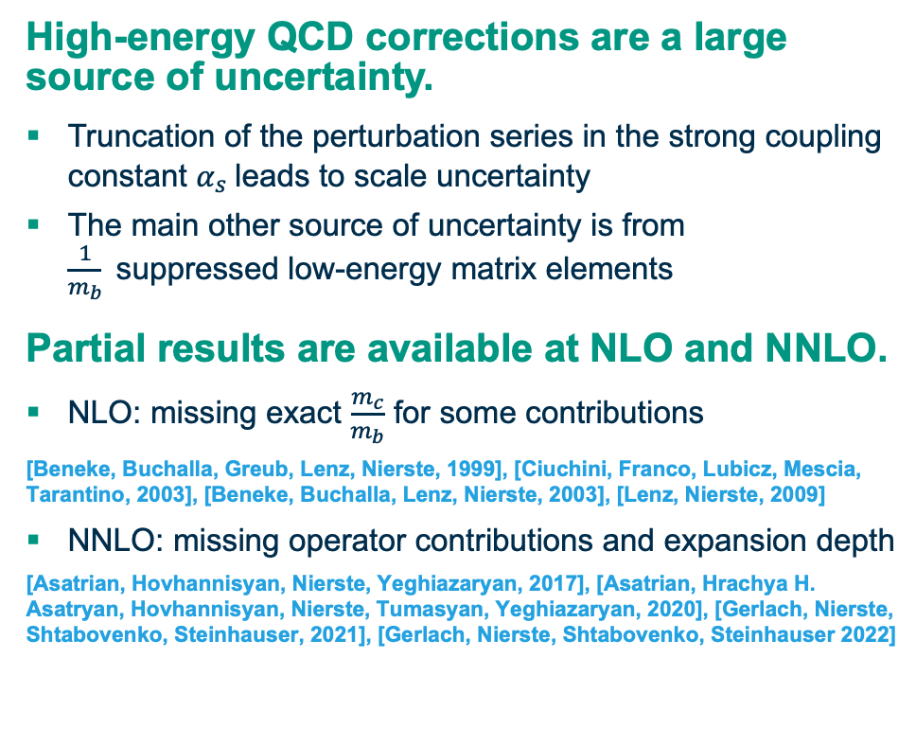
Our goal is to reduce the uncertainty due to high-energy QCD corrections.
          High-energy QCD corrections are a large source of uncertainty.
  Truncation of the perturbation series in the strong coupling constant $α_{s}$leads to scale uncertainty
  The main other source of uncertainty is from $\frac{1}{m_{b}}$suppressed low-energy matrix elements
          Partial results are available at NLO and NNLO.
  NLO: missing exact $\frac{m_{c}}{m_{b}}$ for some contributions
  [Beneke, Buchalla, Greub, Lenz, Nierste, 1999], [Ciuchini, Franco, Lubicz, Mescia, Tarantino, 2003], [Beneke, Buchalla, Lenz, Nierste, 2003], [Lenz, Nierste, 2009]
  NNLO: missing operator contributions and expansion depth
  [Asatrian, Hovhannisyan, Nierste, Yeghiazaryan, 2017], [Asatrian, Hrachya H. Asatryan, Hovhannisyan, Nierste, Tumasyan, Yeghiazaryan, 2020], [Gerlach, Nierste, Shtabovenko, Steinhauser, 2021], [Gerlach, Nierste, Shtabovenko, Steinhauser 2022]
47%
100%
52%
1%
NNLO QCD diagrams need to be computed to improve the precision of our prediction.
Total squared uncertainty (NLO)
Perturbative
Sub-leading matrix elements
Remaining input

Slide 6
Technicalities
Matching procedure
Evanescent operators
Fierz symmetry

Slide 7
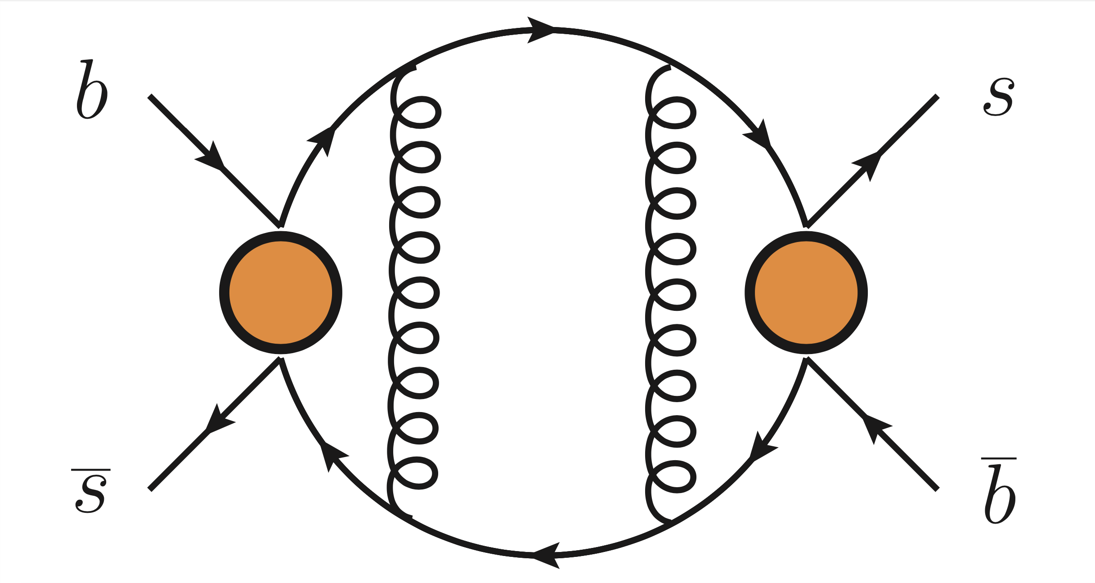
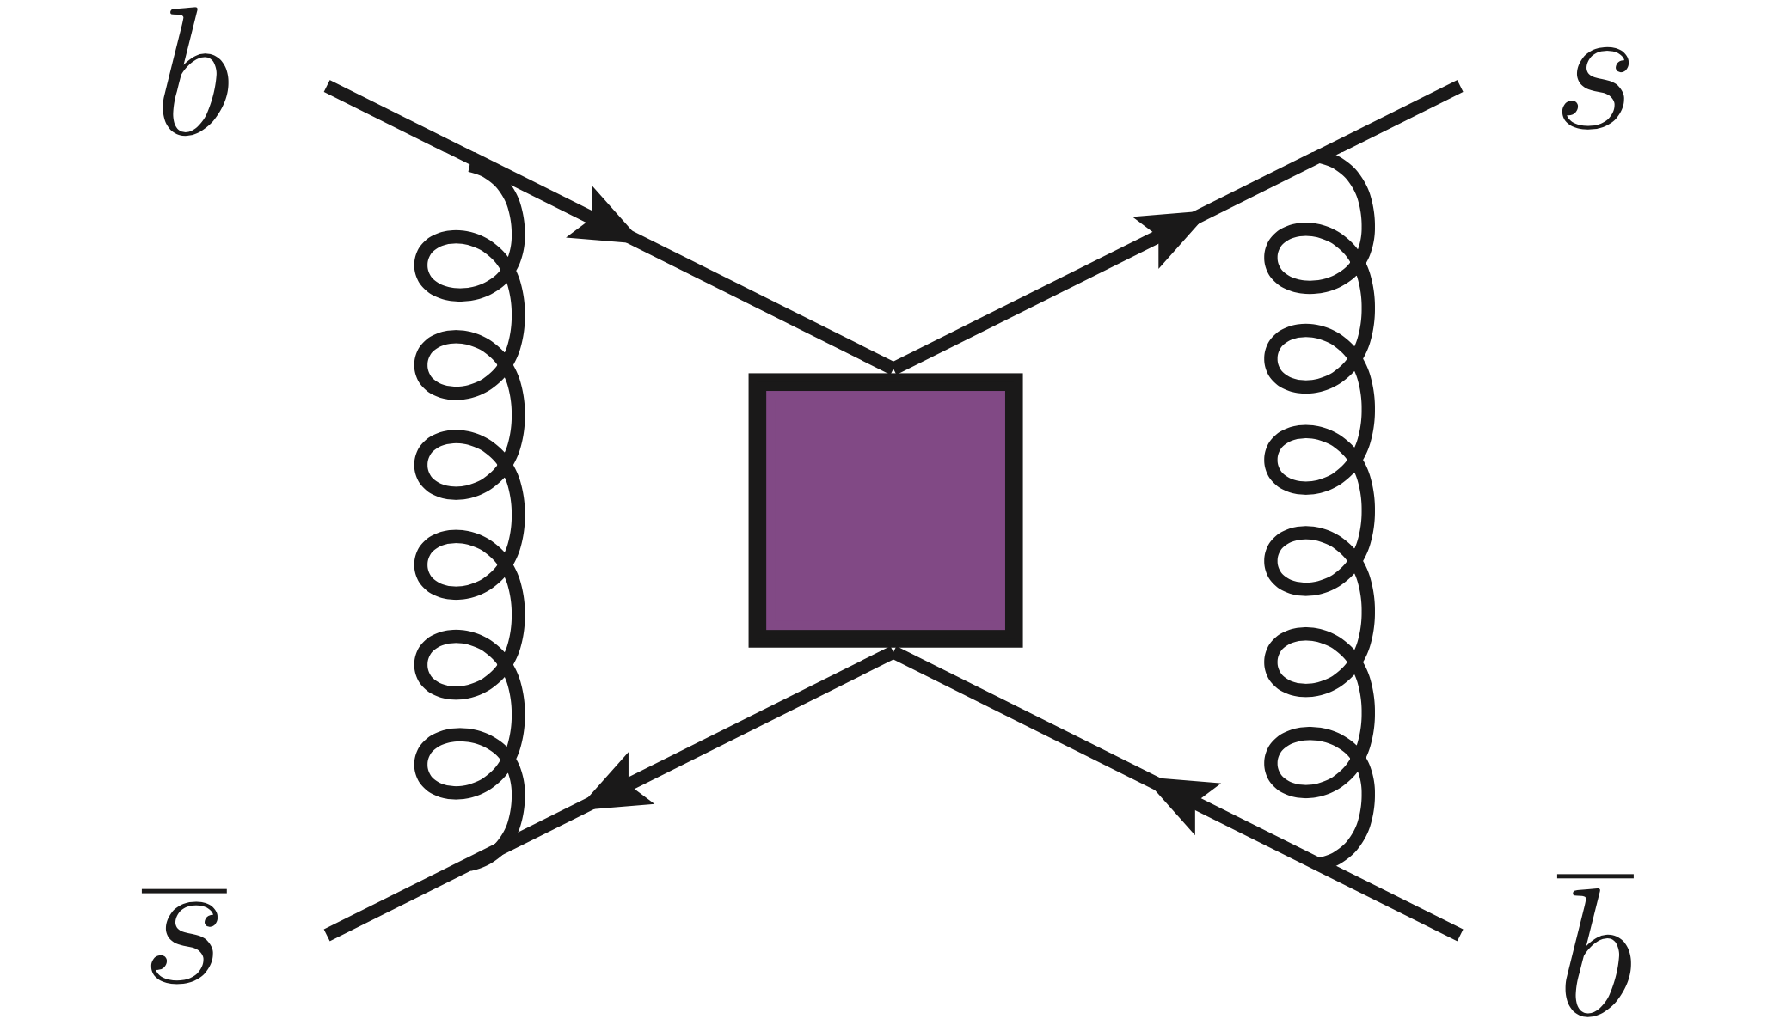
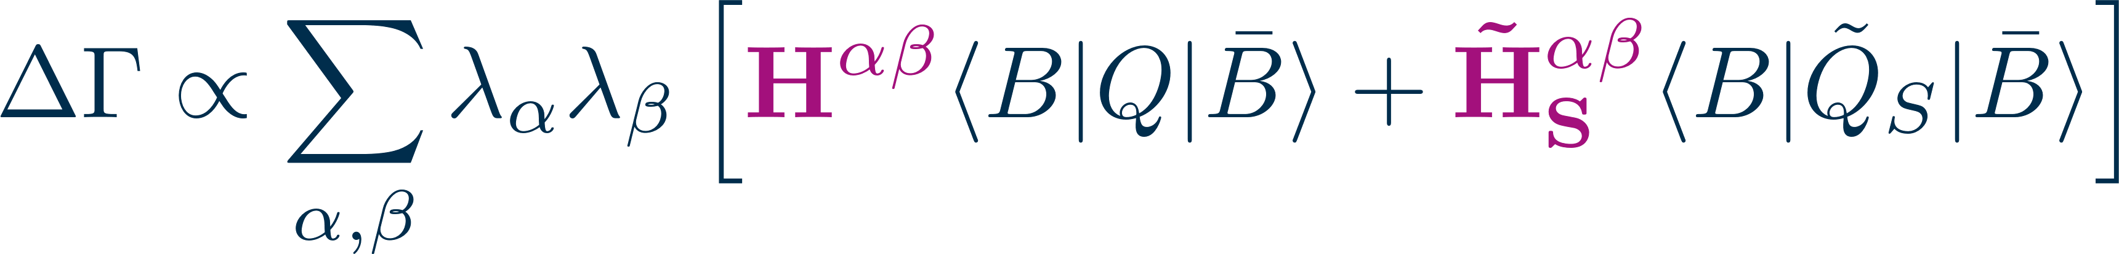
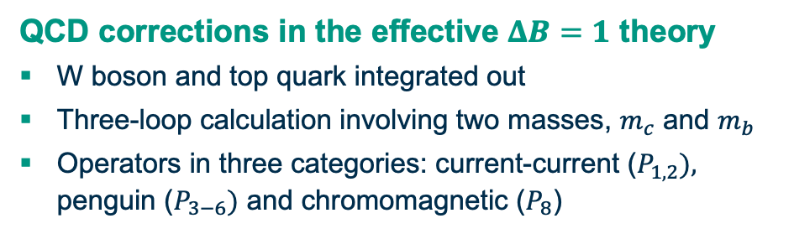

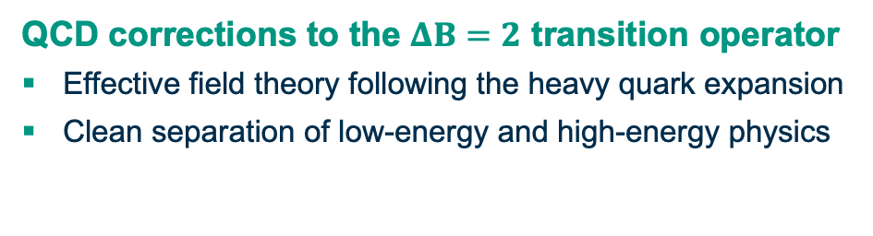
We can complete the calculation of by matching two different QCD amplitudes.
$$ΔΓ$$
  QCD corrections in the effective $ΔB=1$ theory
  W boson and top quark integrated out
  Three-loop calculation involving two masses, $m_{c}$ and $m_{b}$
  Operators in three categories: current-current ($P_{1,2}),$ penguin ($P_{3−6})$ and chromomagnetic ($P_{8}$)
QCD corrections to the $ΔB=2$ transition operator
  Effective field theory following the heavy quark expansion
  Clean separation of low-energy and high-energy physics
Notes:
Why effective field theories? Average out behaviour of high energy degrees of freedom, reduce number of mass scales
Contract W propagator to a point effectively
Why two effective field theories? Local correlators are easier on the lattice
Step 1: integrate out W, Higgs, top; leads to DB1 theory. Problem: cannot calculate non-local matrix element non-perturbatively easily. Need a second EFT
Step 2: calculate DB1 amplitude in terms of renormalised DB2 matrix elements. For this purpose we also need to calculate the DB2 amplitude. This process is called matching
Maybe split into several slides, first one should be overview of steps, possibly a table where the rows are 1) SM, 2) DB1 theory 3) DB2 theory? Columns are diagram and short description

Slide 8
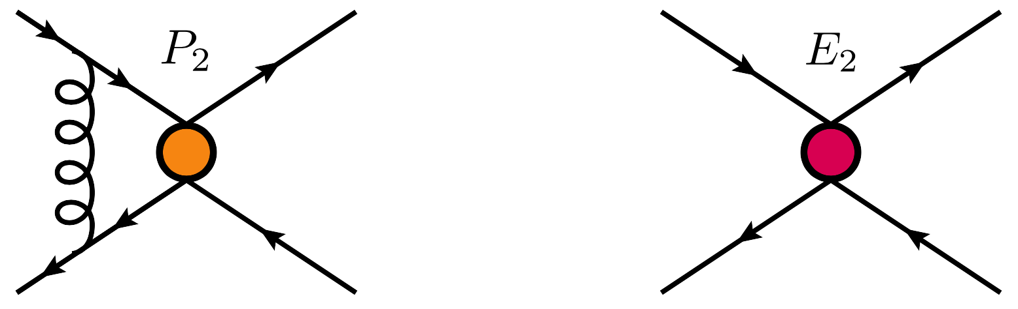
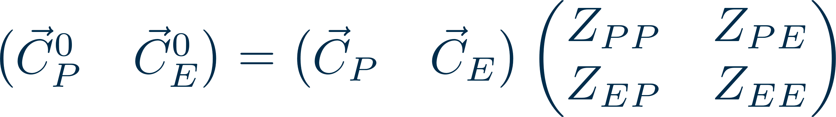
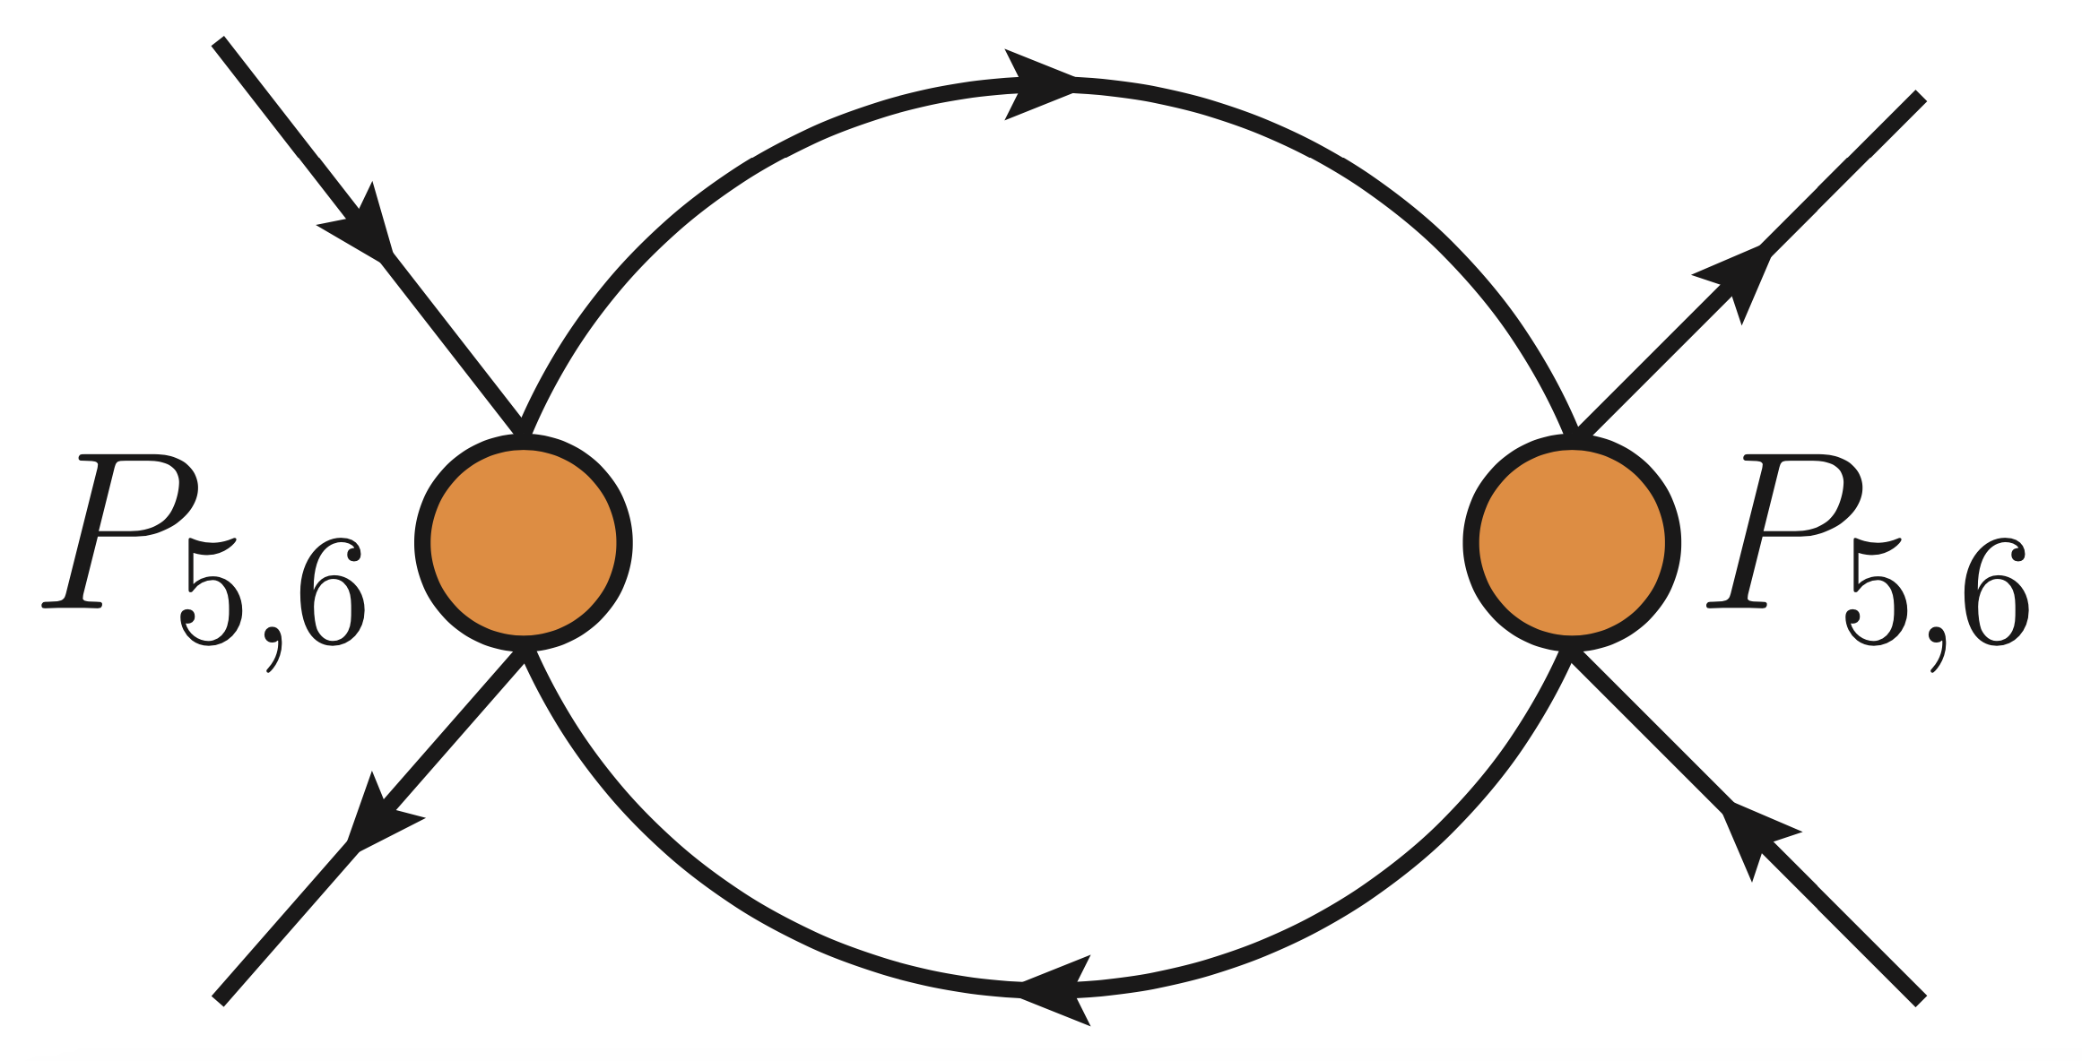
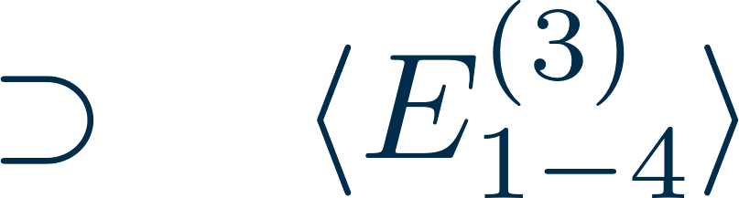
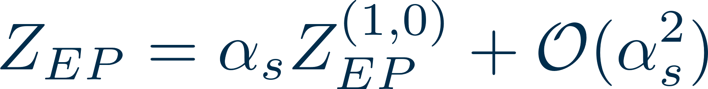
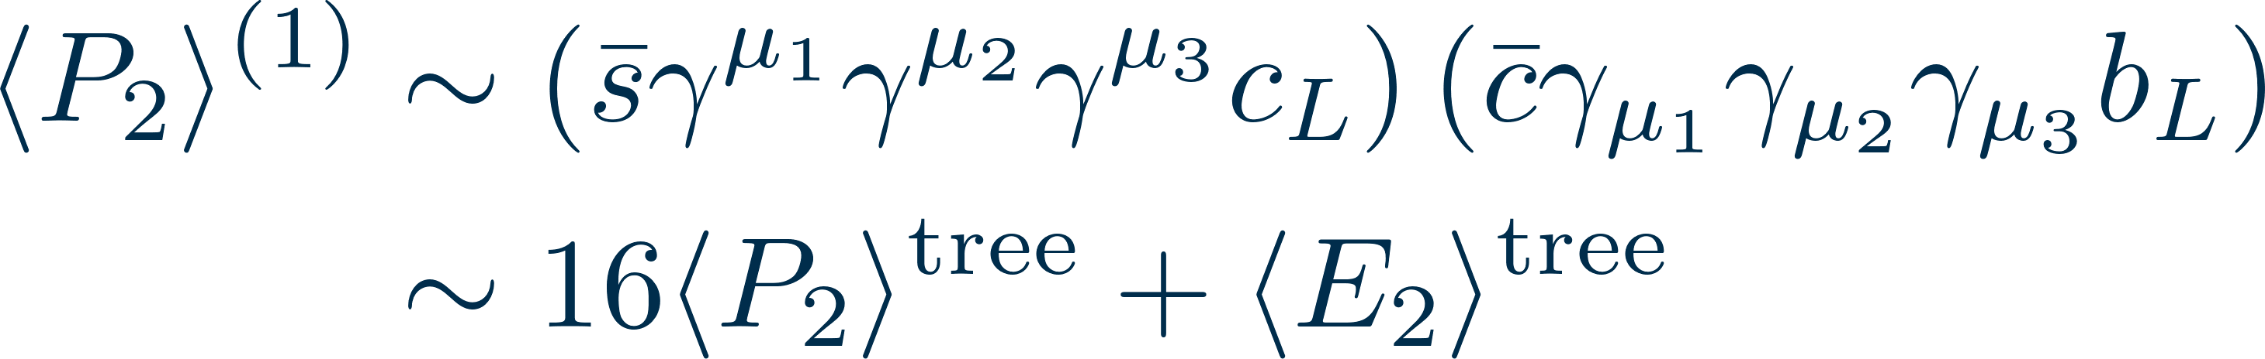
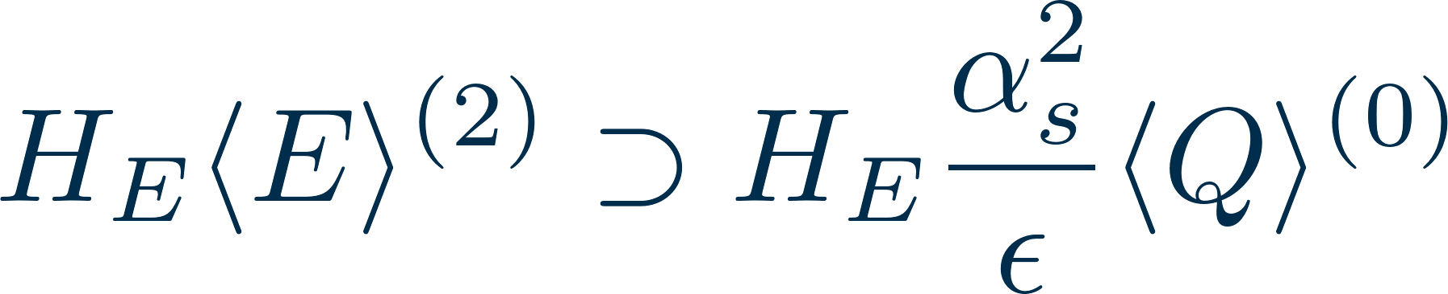
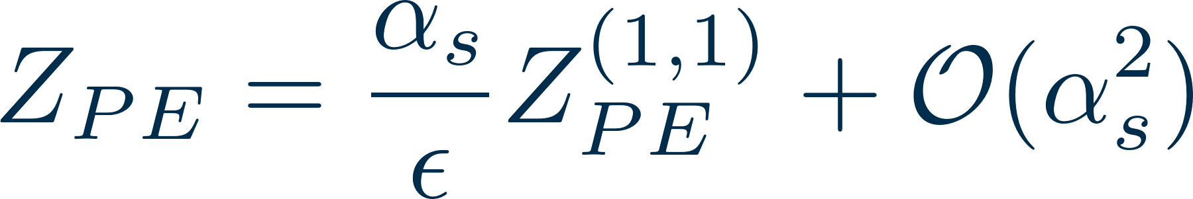
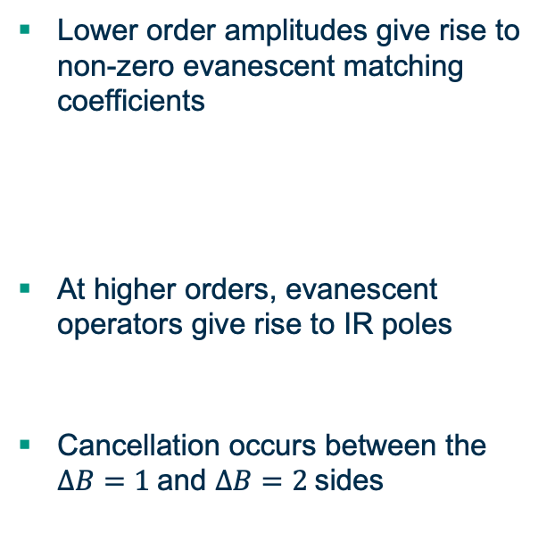
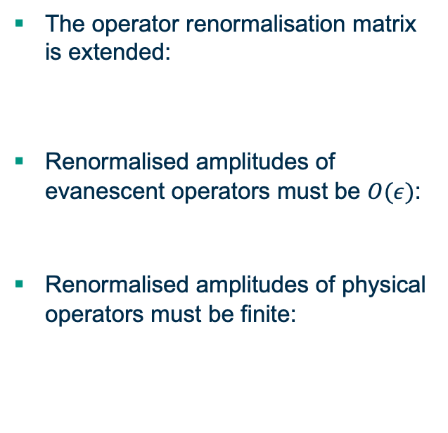
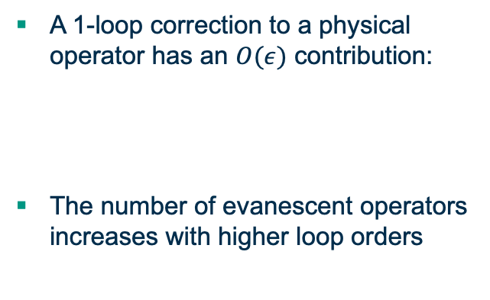

Evanescent operators present a unique challenge in dimensional regularisation.
Evanescent operators appear in
d = 4 – 2 $ε$ dimensions
Additional counterterms arise from evanescent operators
IR divergences cancel in the matching with evanescent operators
  The operator renormalisation matrix is extended:
  Renormalised amplitudes of evanescent operators must be $O(ε)$:
  Renormalised amplitudes of physical operators must be finite:
  Lower order amplitudes give rise to non-zero evanescent matching coefficients
  At higher orders, evanescent operators give rise to IR poles
  Cancellation occurs between the $ΔB=1$and $ΔB=2$sides
  A 1-loop correction to a physical operator has an $O(ε)$ contribution:
  The number of evanescent operators increases with higher loop orders

Slide 9
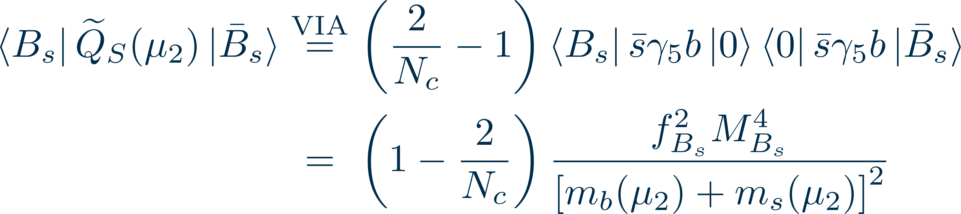
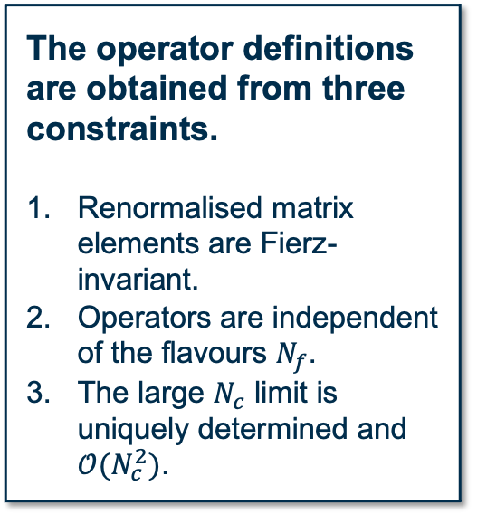
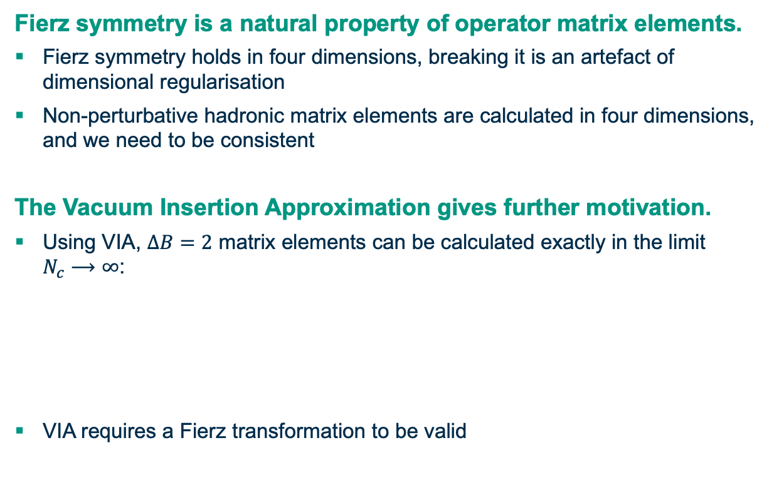
Fierz symmetry must be obeyed and can be implemented through the correct choice of evanescent operators.
  Fierz symmetry is a natural property of operator matrix elements.
  Fierz symmetry holds in four dimensions, breaking it is an artefact of dimensional regularisation
  Non-perturbative hadronic matrix elements are calculated in four dimensions, and we need to be consistent
  The Vacuum Insertion Approximation gives further motivation.
  Using VIA, $ΔB=2$ matrix elements can be calculated exactly in the limit $N_{c}⟶∞$:
  VIA requires a Fierz transformation to be valid
The operator definitions are obtained from three constraints.
The operator definitions are obtained from three constraints.
Renormalised matrix elements are Fierz-invariant.
Operators are independent of the flavours $N_{f}$.
The large $N_{c}$ limit is uniquely determined and $𝒪(N_{c}^{2})$.

Slide 10
Results
Status of the calculation
Physical observables
Constraints on the CKM triangle

Slide 11
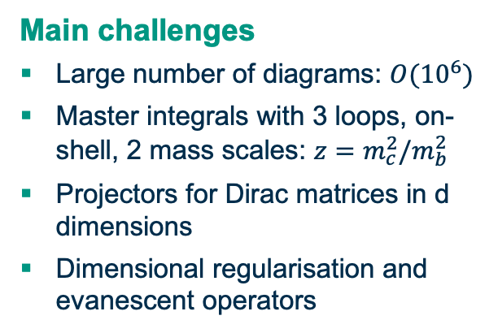

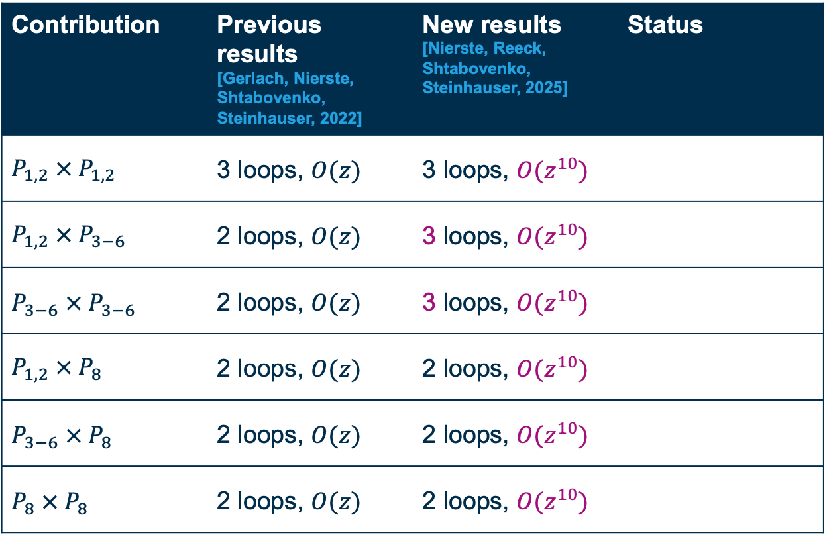
We have calculated all NNLO contributions to .
$$ΔΓ$$
Contribution | Previous results [Gerlach, Nierste, Shtabovenko, Steinhauser, 2022] | New results [Nierste, Reeck, Shtabovenko, Steinhauser, 2025] | Status
$$P_{1,2} × P_{1,2}$$ | 3 loops, $O(z)$ | 3 loops, $O(z^{10})$
$$P_{1,2} ×{ P}_{3−6}$$ | 2 loops, $O(z)$ | 3 loops, $O(z^{10})$
$$P_{3−6} ×{ P}_{3−6}$$ | 2 loops, $O(z)$ | 3 loops, $O(z^{10})$
$$P_{1,2} × P_{8}$$ | 2 loops, $O(z)$ | 2 loops, $O(z^{10})$
$$P_{3−6} ×{ P}_{8}$$ | 2 loops, $O(z)$ | 2 loops, $O(z^{10})$
$$P_{8} × P_{8}$$ | 2 loops, $O(z)$ | 2 loops, $O(z^{10})$
  Main challenges
  Large number of diagrams: $O({10}^{6})$
  Master integrals with 3 loops, on-shell, 2 mass scales: $z=m_{c}^{2}/m_{b}^{2}$
  Projectors for Dirac matrices in d dimensions
  Dimensional regularisation and evanescent operators

Slide 12
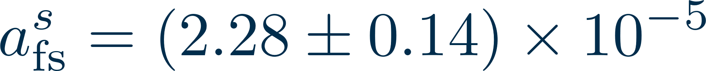


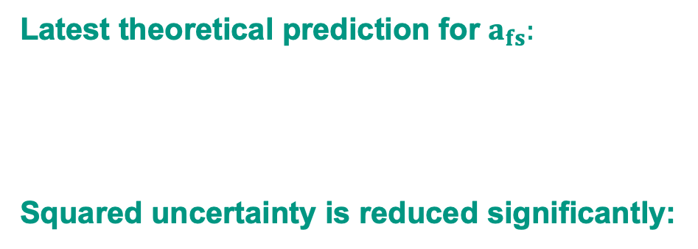
With NNLO corrections, and can be calculated to high precision.
$$ΔΓ$$
$$a_{fs}$$
Latest theoretical prediction for $ΔΓ:$
Latest theoretical prediction for $a_{fs}:$
Squared uncertainty is reduced significantly:
-37%
47%
15%
Perturbative
Sub-leading matrix elements
Remaining input
© [Gerlach, Nierste, Reeck, Shtabovenko, Steinhauser, 2025]
NLO
NNLO
Notes:
Higher orders in OS get bigger and bigger

Slide 13
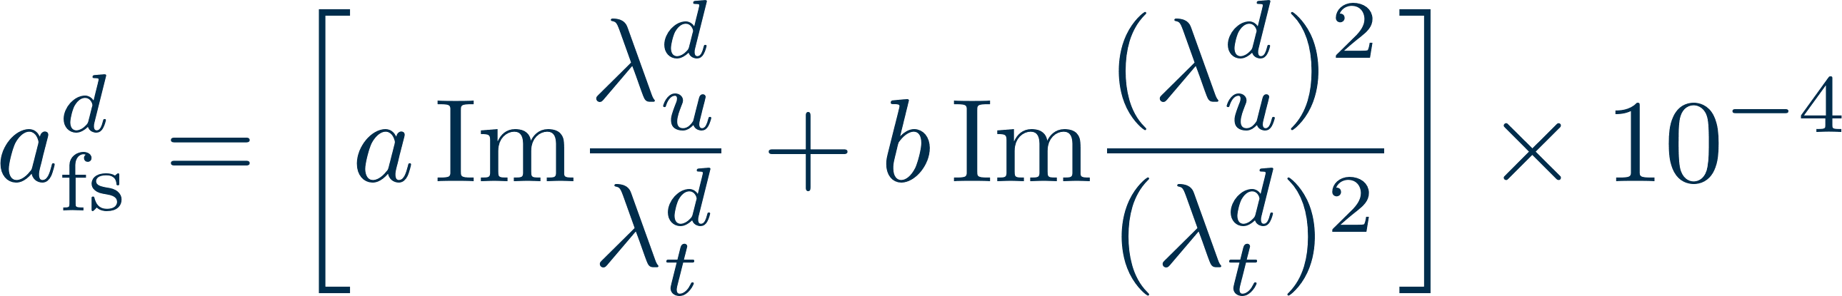
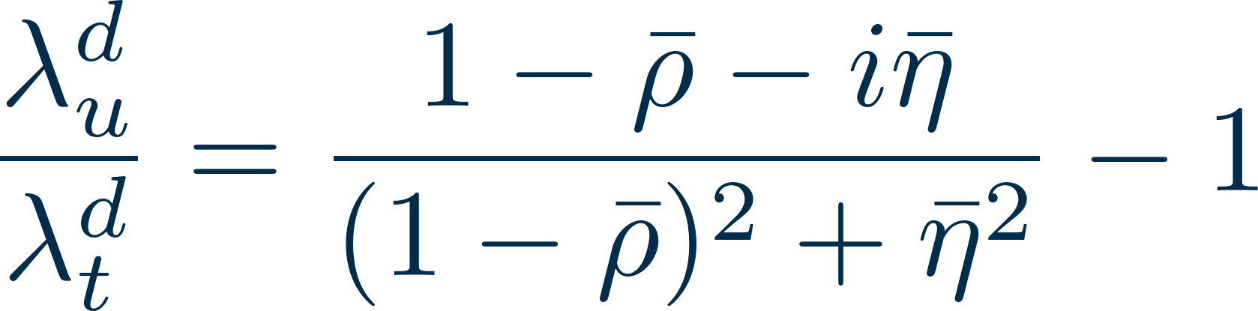
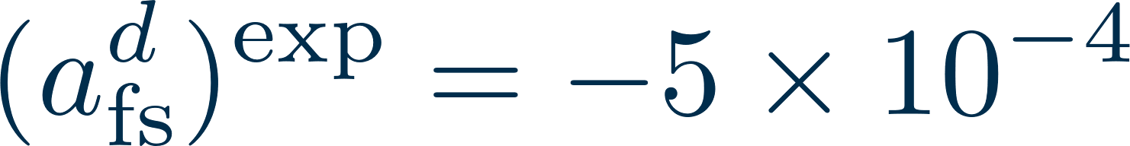
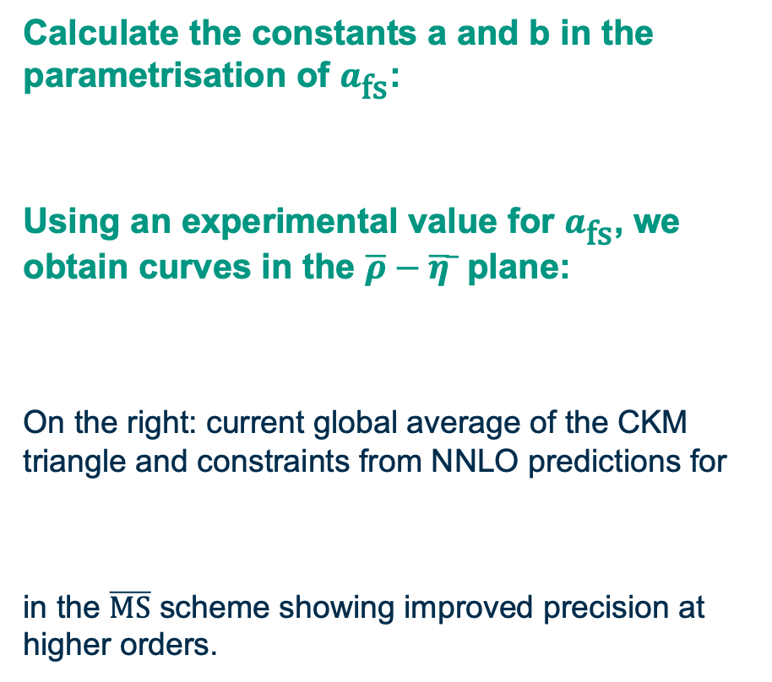

A future measurement of provides a strong constraint on the apex of the CKM triangle.
$$a_{fs}$$
Calculate the constants a and b in the parametrisation of $a_{\text{fs}}$:
Using an experimental value for $a_{\text{fs}}$, we obtain curves in the $\overline{ρ}−\overline{η} ̅$ plane:
On the right: current global average of the CKM triangle and constraints from NNLO predictions for
in the $\overline{\text{MS}}$ scheme showing improved precision at higher orders.
© [Gerlach, Nierste, Reeck, Shtabovenko, Steinhauser, 2025]

Slide 14
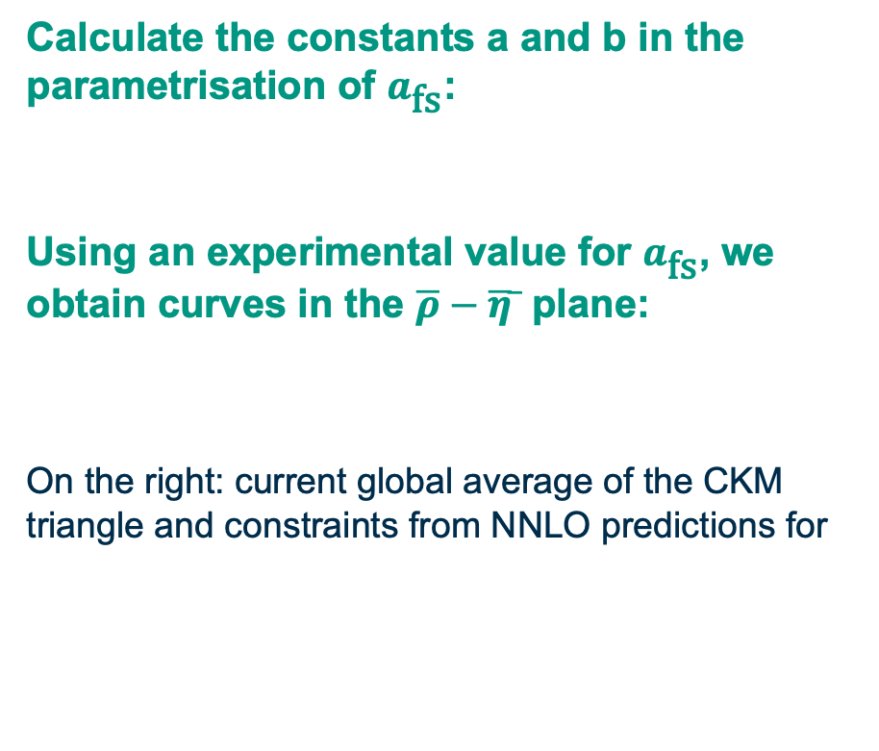
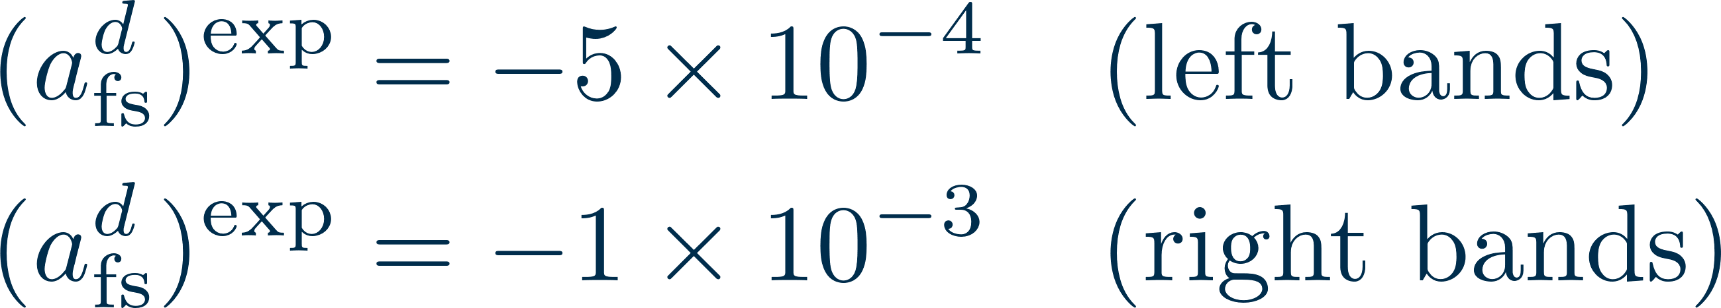
A future measurement of provides a strong constraint on the apex of the CKM triangle.
$$a_{fs}$$
Calculate the constants a and b in the parametrisation of $a_{\text{fs}}$:
Using an experimental value for $a_{\text{fs}}$, we obtain curves in the $\overline{ρ}−\overline{η} ̅$ plane:
On the right: current global average of the CKM triangle and constraints from NNLO predictions for
© [Gerlach, Nierste, Reeck, Shtabovenko, Steinhauser, 2025]

Slide 15
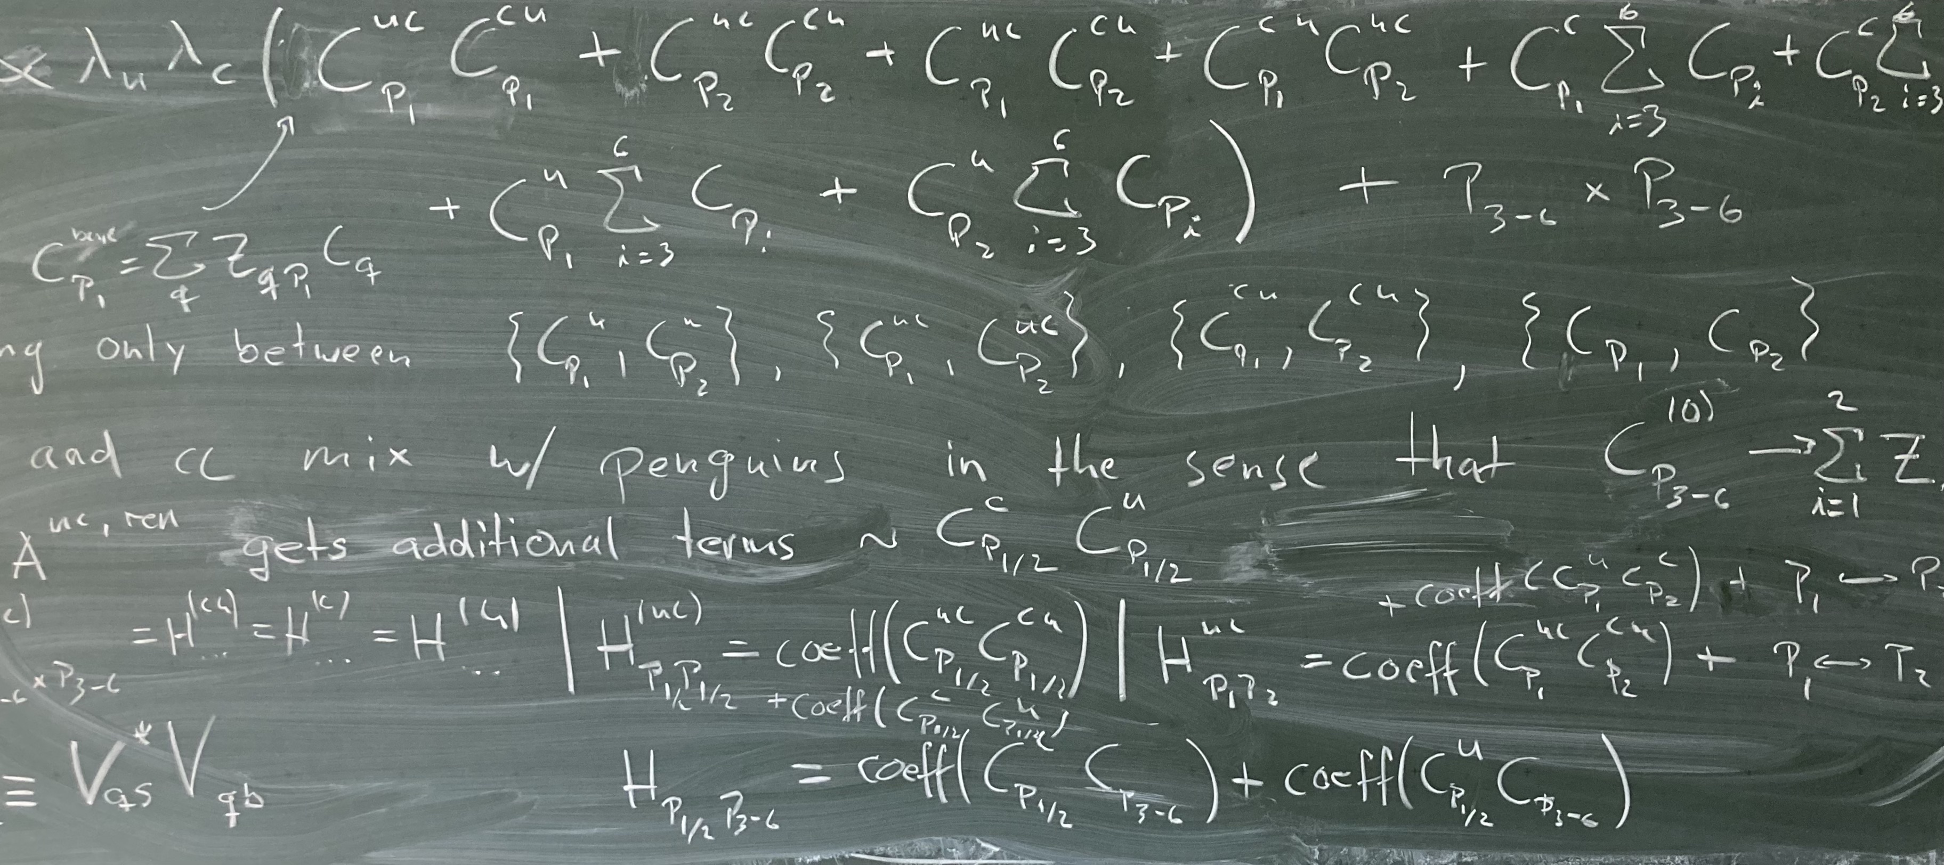
Thank you for your attention!

