Slide 1
Highlights from the Fermilab muon g-2 Experiment
Saskia Charity for the Fermilab g-2 collaboration
EPS-HEP, Marseille, 08 July 2025

Slide 2
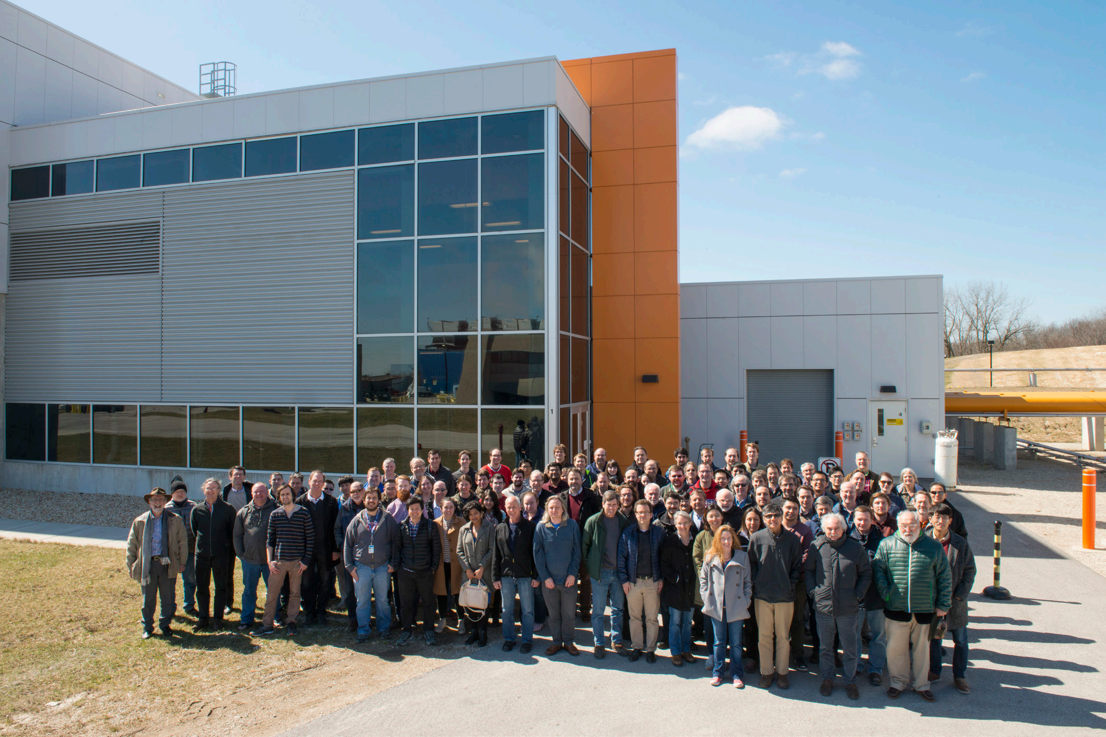
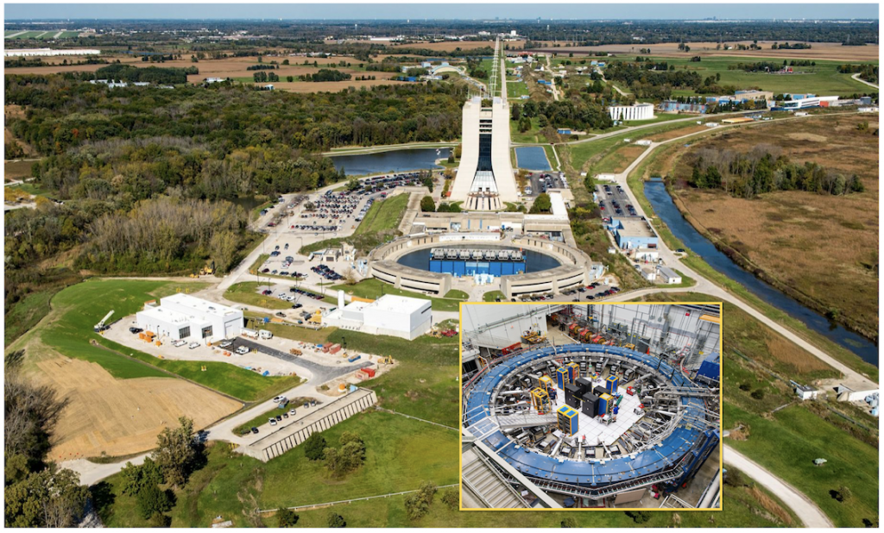
The Fermilab Muon g-2 Experiment
Muon g-2 building
Fermilab Muon Campus
Goal: Measure muon anomalous magnetic moment a_{μ} to 140 parts per billion

Slide 3
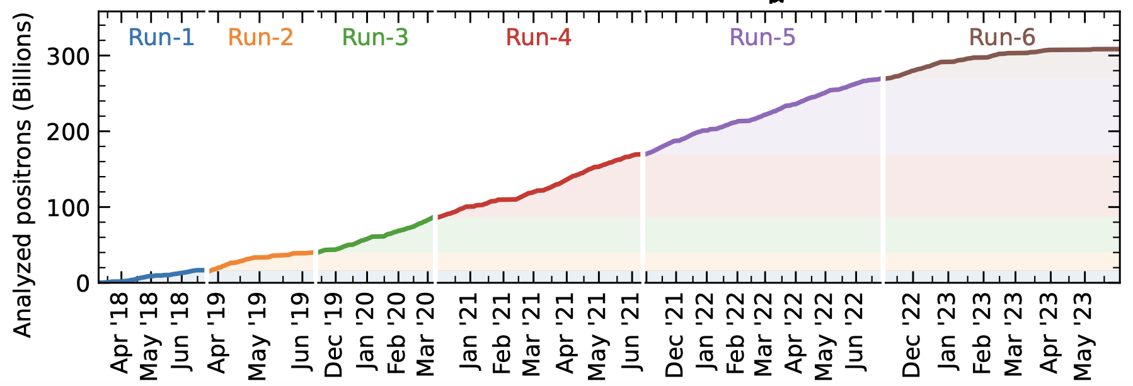
The Fermilab Muon g-2 Experiment
6 data-taking runs between 2018 (Run-1) and 2023 (Run-6)
2021: published Run-1 data, a_{μ} to 0.46 ppm Phys. Rev. Lett. 126, 141801
2023: published Run-2/3 data, a_{μ} to 0.20 ppm Phys. Rev. Lett. 131, 161802
Today: focus on final g-2 result with full dataset

Slide 4
Background: why measure a_{μ}?

Slide 5
Why muons?
The muon sector is a convenient place to test the Standard Model
(m_{μ} / m_{e})² ~ 43,000 : enhanced sensitivity to heavy particles
Highly polarized muon beam from pion decays
Muon decays “self-analyzing”
Long enough lifetime (2.2 μs) to study them in storage rings
Publication | Laboratory | Uncertainty
1961 | CERN | 0.4%
1968 |  | 0.02%
1979 |  | 7 ppm
2006 | Brookhaven National Laboratory | 540 ppb
2021 2023 2025 | Fermi National Accelerator Laboratory | Goal: 140 ppb
>50 years of a_{μ}

Slide 6
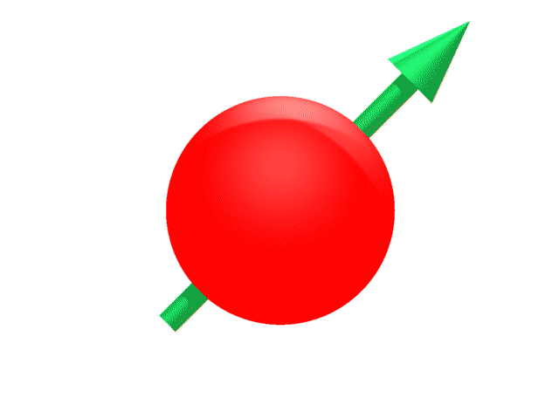
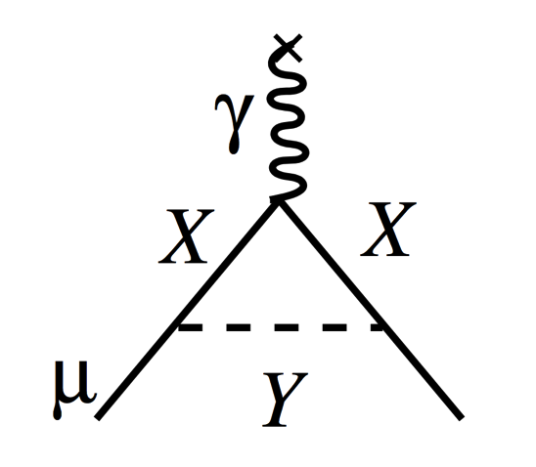
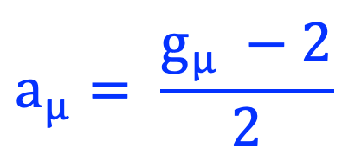
Magnetic moments: what is a_{μ}?
g determines spin precession frequency in a magnetic field
B
Torque in B-field
Magnetic Moment
For a pure Dirac spin-½ charged fermion, g is exactly 2
Interactions between the muon and virtual particles alter the value
X & Y particles could be SM or new physics
$$a_{μ}= \frac{g_{μ} −2}{2}$$

Slide 7
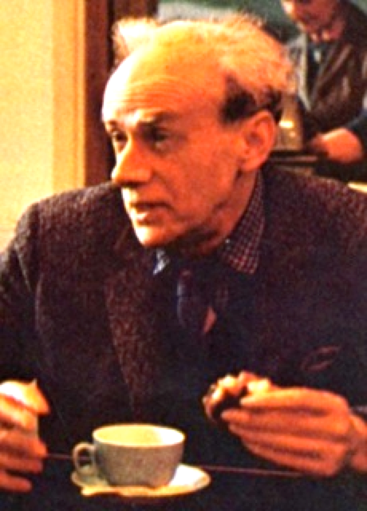
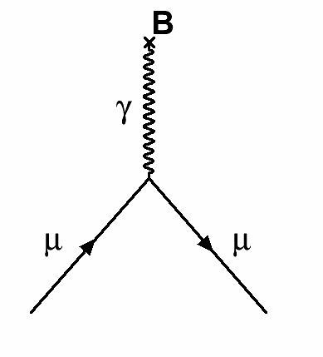
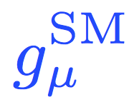
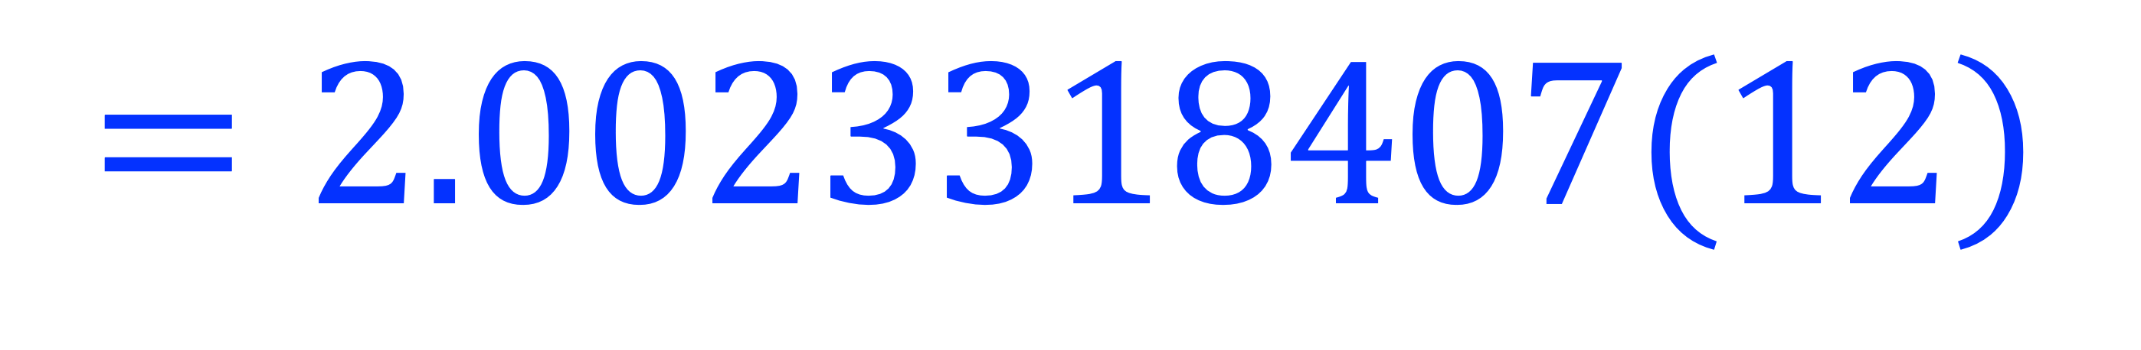
Standard Model components of g_{μ}
Dirac
Charged,
spin ½

Slide 8
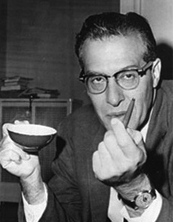
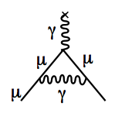
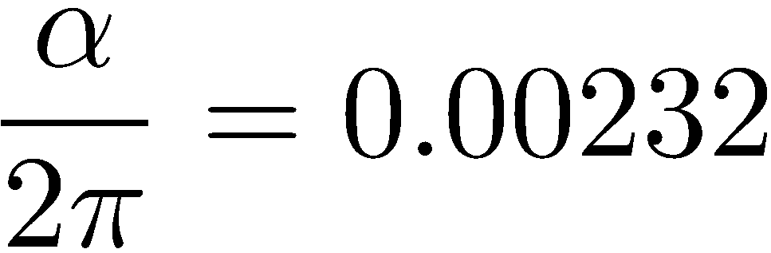
Standard Model components of g_{μ}
Dirac
Charged,
spin ½
Schwinger
1st Order QED

Slide 9

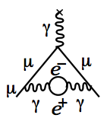
Standard Model components of g_{μ}
Dirac
Charged,
spin ½
Up to 10th Order QED
Kinoshita
+12671 diagrams
Schwinger
1st Order QED

Slide 10
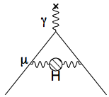
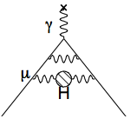
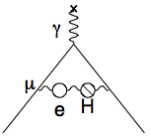
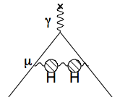
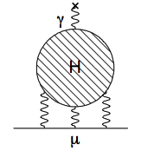
Standard Model components of g_{μ}
Dirac
Charged,
spin ½
Up to 10th Order QED
Kinoshita
+12671 diagrams
Hadronic
Schwinger
1st Order QED

Slide 11
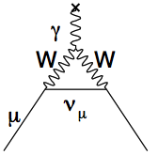
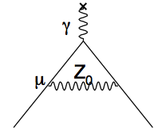
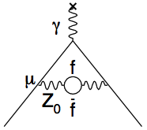
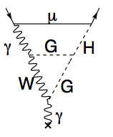
Standard Model components of g_{μ}
Dirac
Charged,
spin ½
Up to 10th Order QED
Kinoshita
+12671 diagrams
Electroweak
Hadronic
Schwinger
1st Order QED

Slide 12
Standard Model components of g_{μ}
Dirac
Charged,
spin ½
Up to 10th Order QED
Kinoshita
+12671 diagrams
Electroweak
Hadronic
BSM?
Schwinger
1st Order QED

Slide 13
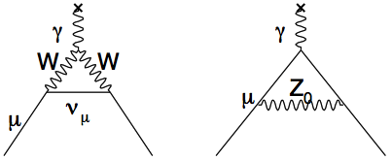
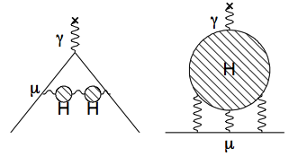
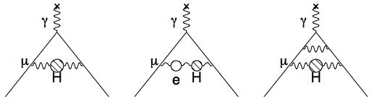
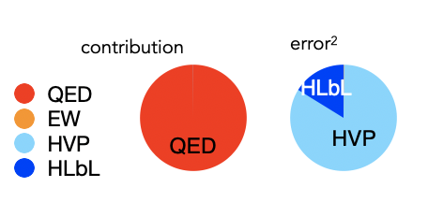
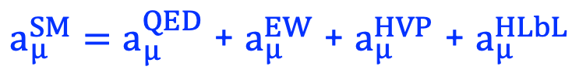
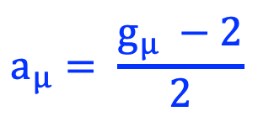

Standard model prediction of a_{μ}
Dirac
Hadronic Light-by-Light (HLbL)
Hadronic Vacuum Polarization (HVP)
QED
Electroweak
$$a_{μ}= \frac{g_{μ} −2}{2}$$
$a_{μ}^{SM}$portion
~99.99%
~1 ppm
~59 ppm
~1 ppm
$a_{μ}^{SM}=a_{μ}^{QED}$ + $a_{μ}^{EW}$ + $a_{μ}^{HVP}$ + $a_{μ}^{HLbL}$
a_{μ}SM provided by g-2 Theory Initiative (TI)
Uncertainty dominated by hadronic terms – in particular HVP

Slide 14
Fermilab g-2 Experiment: measurement principle

Slide 15
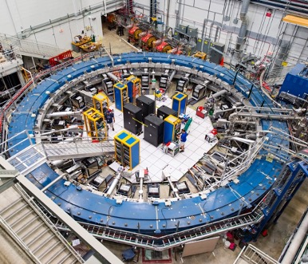
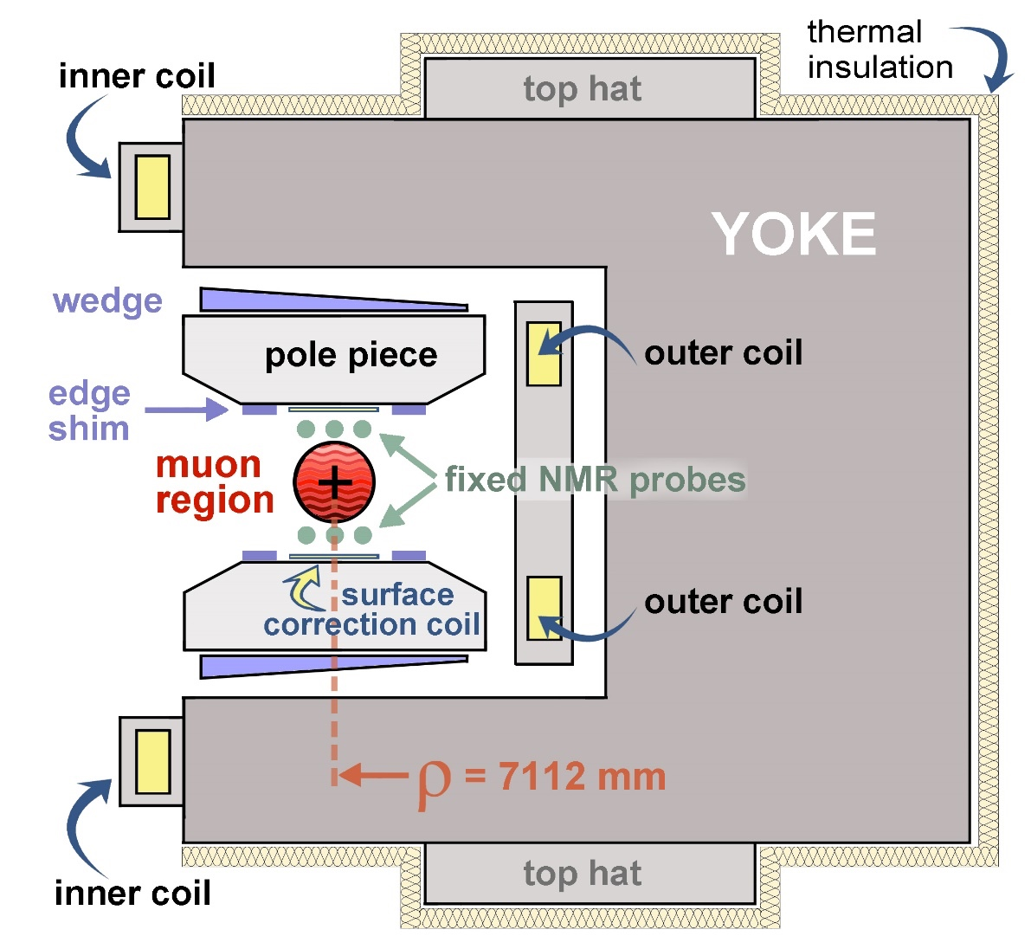
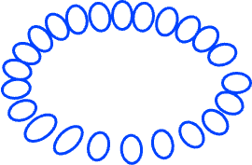



Muons in the Storage Ring
Positive muons, 3.09 GeV/c, injected into Storage Ring in 125 ns bunches
Muons orbit inside storage ring, spin precesses about vertical B field
Decay to positrons → lower momentum → spiral into centre of storage ring
$$μ^{+}$$
$$μ^{+}$$
$$e^{+}$$
B
Calorimeters
14m diameter storage ring
Orbiting muons decay to electrons → detected by calorimeters
Cross-section slice of magnet
1.45 T vertical B field in muon region

Slide 16
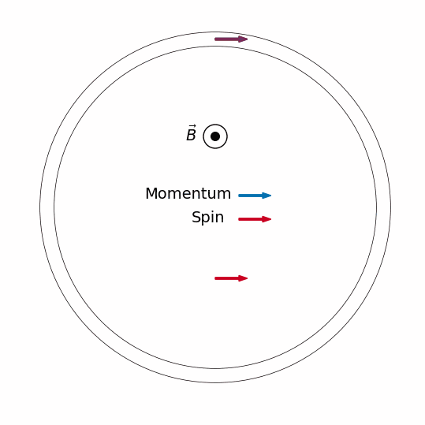
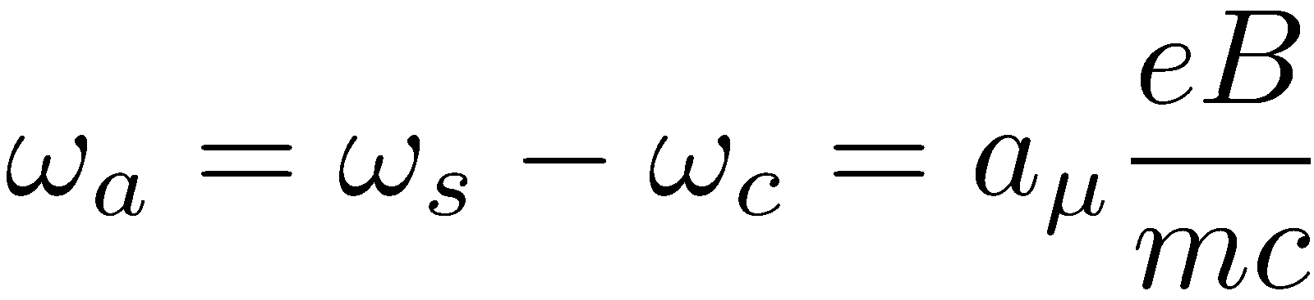
Spin Precession & Measurement Principle
Muons orbit the ring with cyclotron frequency ω_{c}
Spin precesses with frequency ω_{s}
Both spin and cyclotron frequencies are proportional to B
Spin rotates ahead of momentum as the muon orbits the ring
Difference frequency ω_{a} is proportional to a_{μ} and B
Measure
138 ns
149 ns
Extract
If g were exactly 2, ω_{s} = ω_{c} and ω_{a} = 0 → no precession

Slide 17
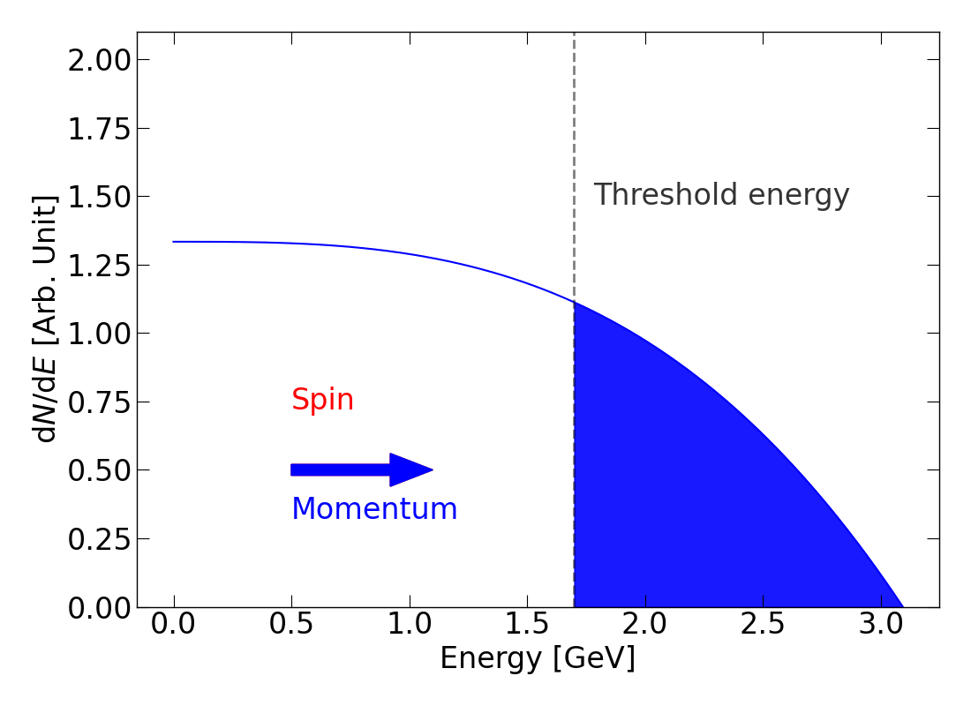
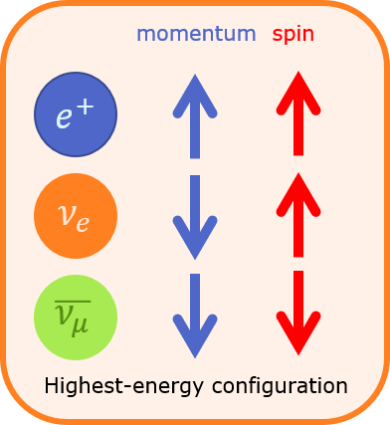
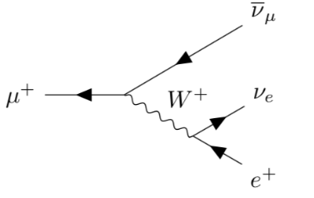
Measuring ω_{a}
Highest energy e⁺ preferentially emitted in direction of muon spin
Oscillation in number of emitted decay e⁺ vs time directly proportional to decay asymmetry
Count N(t) = number of e⁺ above an energy threshold over time
Higher fraction detected above threshold when e⁺ emitted parallel to muon spin
N(t) depends on anomalous precession frequency ω_{a}
Frequency of oscillation = ω_{a}

Slide 18
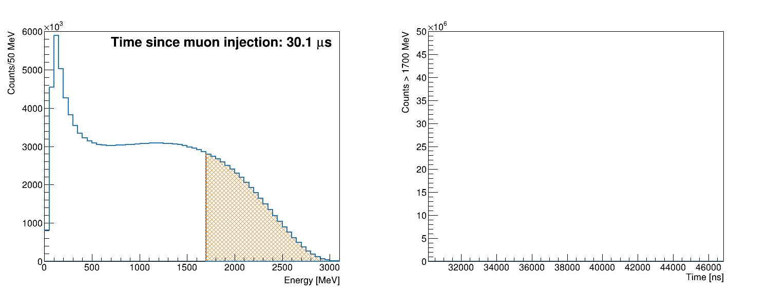
Measuring muon spin precession
Number of high energy positrons oscillates as a function of time as muon spin points towards/away from detector
Count positrons above an energy threshold
Counts oscillate at frequency ω_{a} → extract from time spectrum
Real Data (Run-3a)
Energy Spectrum
Time Spectrum
Threshold Energy

Slide 19
Experiment design and analysis techniques

Slide 20
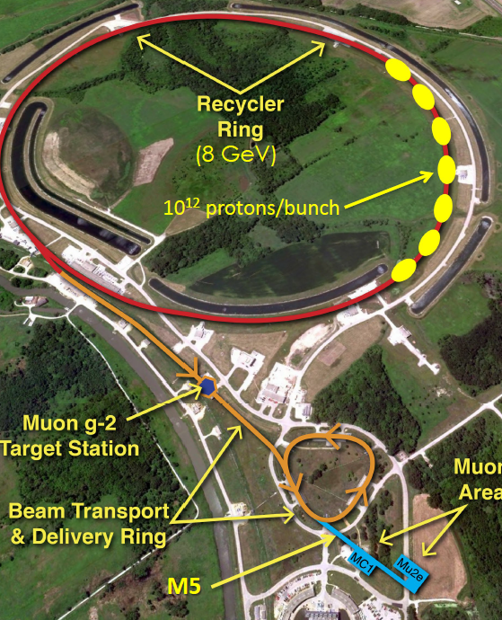
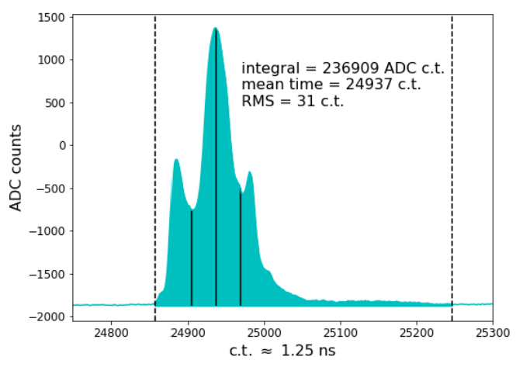
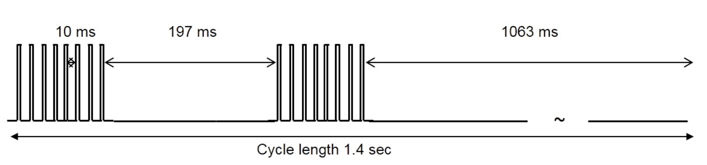
The FNAL Muon Campus
Recycler ring: 8 GeV protons
  10¹² protons / bunch ; 10k stored muons / bunch
8 GeV protons → pion production target
Pions → delivery ring → decay to μ⁺ and momentum-selected
3.09 GeV μ⁺ → g-2 storage ring magnet
Beam arrives in 120 ns wide bunches
Each bunch corresponds to a “fill” → 1 ms

Slide 21
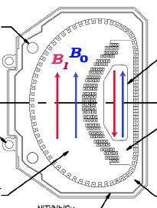
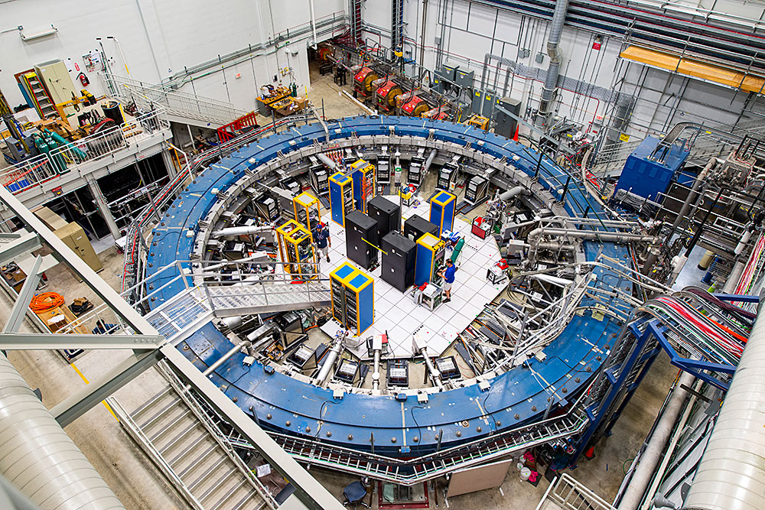
Injecting and storing the beam
Beam injected through inflector magnet → cancel main magnetic field

Slide 22
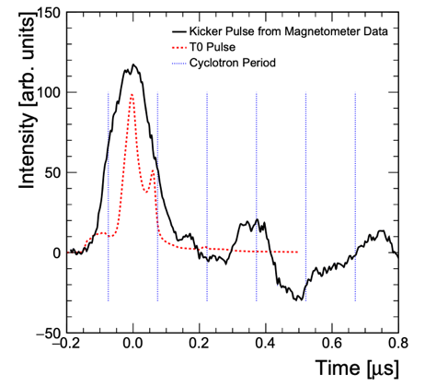
Injecting and storing the beam
Beam injected through inflector magnet → cancel main magnetic field
Kicker magnet applies fast radial magnetic field on first turn

Slide 23
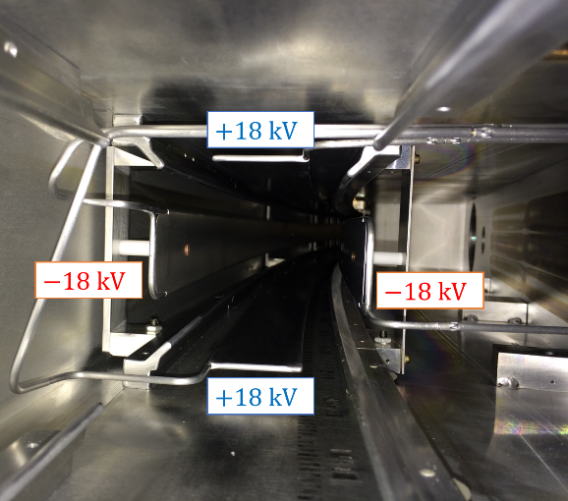
Injecting and storing the beam
Beam injected through inflector magnet → cancel main magnetic field
Kicker magnet applies fast radial magnetic field on first turn
Quads pulse throughout muon fill → vertical focusing

Slide 24
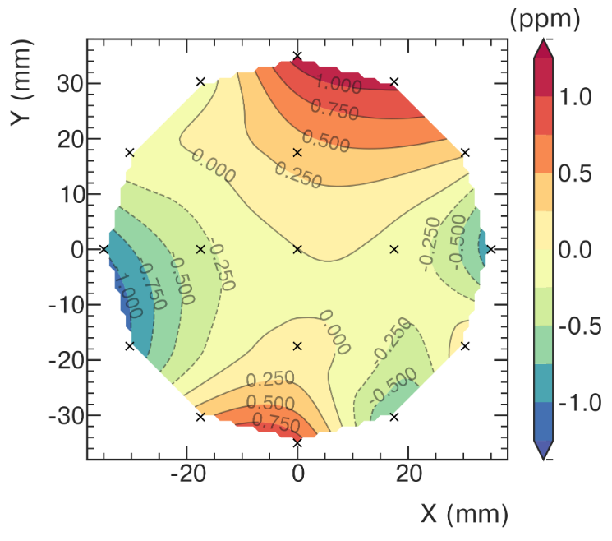
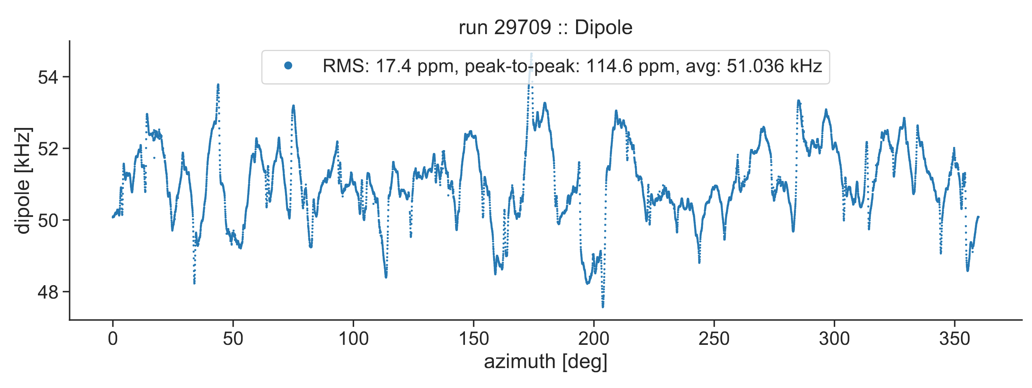
Injecting and storing the beam
Beam injected through inflector magnet → cancel main magnetic field
Kicker magnet applies fast radial magnetic field on first turn
Magnetic field map measured every 3 days, changes monitored continuously
Quads pulse throughout muon fill → vertical focusing

Slide 25

Injecting and storing the beam
Beam injected through inflector magnet → cancel main magnetic field
Straw trackers measure beam profile at 180º and 270º
Kicker magnet applies fast radial magnetic field on first turn
Magnetic field map measured every 3 days, changes monitored continuously
Quads pulse throughout muon fill → vertical focusing

Slide 26


Extracting ω_{a}: 5-parameter fit function
Five-parameter fit function
$$N\left(t\right)=N_{0}e^{−t/τ}[1 −A\cos{(ω_{a}t+ϕ)} ]$$
Time-dilated muon lifetime
Precession frequency
Number of e⁺ vs time
Average spin phase at injection
Asymmetry

Slide 27




Fitting the oscillation
27
Calorimeter Performance
$χ^{2}$/ndf = 51530/4150
Simplest 5-parameter fit function captures exponential decay and the g-2 oscillation only
Not sufficient → large spikes in residuals FFT
Need to measure and account for additional terms in the fit due to beam dynamics

Slide 28


Tracking detectors: measuring the muon beam
Calorimeter Performance
Straw trackers: two stations located at 180⁰ and 270⁰
One station = 8 modules
One module = 128 Argon-Ethane gas-filled straws
Fit tracks and extrapolate to muon decay point
Tracker Module
10 cm

Slide 29

Tracker measurement of the muon beam
29
Calorimeter Performance
The mean and width of the muon beam distribution varies as a function of time
Average radial and vertical position vary around the ring → measure at two locations
Frequency of beam oscillations must be measured → affects ω_{a} measurement
EPS-HEP contribution on muon g-2 beam dynamics
725 Bottalico T07 parallel 09/07

Slide 30



Full fit function
30
Calorimeter Performance
$$ω_{a}/2π$$
$χ^{2}$/ndf = 4007/4097
Accounting fully for all the beam oscillations shifts ω_{a} by 𝒪 1 ppm
Final fit function has >30 fit parameters
5 different analysis teams, 8 methods, 20 different analyses
5-parameter fit
Full fit
EPS-HEP contribution on ω_{a} analysis:
723 Zaid T07 parallel 09/07

Slide 31

Extracting a_{μ}
How to measure the other terms with the same precision as ω_{a} to extract a_{μ}?
We started with the simple expression:

Slide 32


Extracting a_{μ}
How to measure the other terms with the same precision as ω_{a} to extract a_{μ}?
We started with the simple expression:
Both external ratios from CODATA 2022
Rev. Mod. Phys. 97, 025002

Slide 33







Measuring the muon-weighted magnetic field
NMR probes (petroleum jelly) measure the proton Larmor frequency ($ω_{p}∝B$)
Azimuthally-averaged field map weighted by the muon beam distribution
  Fixed probes: 24/7
  Trolley (in vacuum): every 3-4 days
Petroleum jelly NMR probes calibrated with H₂0 probes (cylindrical and spherical)
17 trolley probes
Field map: ~9000 slices around the ring
Calibration cross-checked with ³He and continuous-wave NMR probes

Slide 34
Corrections and uncertainties

Slide 35

Corrections to a_{μ}

Slide 36

Corrections to a_{μ}
Beam dynamics corrections
see EPS-HEP parallel 725 T07 (Bottalico) Wed 09/07

Slide 37

Corrections to a_{μ}
Transient magnetic field corrections

Slide 38






Transient magnetic field corrections: B_{k}
Dedicated measurements with in-situ magnetometers during beam-off periods
Spatial model
Fiber magnetometer
Free laser magnetometer
Benchtop measurements to determine spatial model, which agrees with in-situ measurements

Slide 39


Uncertainties in Run-456
TDR goal of 100 ppb systematic reached
  No dominant source of systematic
  Further improving would require reduction in many categories

Slide 40

Statistical uncertainty
$$\frac{ω_{a}}{{\tilde{ω}}_{p}^{′}}$$ | Analyzed Positrons (10⁹) | Fraction (%) | Stat. Uncertainty (ppb)
Run-1 | 15.4 | 5 | 434
Run-2/3 | 70.9 | 23 | 201
Run-4/5/6 | 222.2 | 72 | 114
Run-1-6 | 308.5 | 100 | 98
TDR goal: 100ppb

Slide 41

Total uncertainty
$$\frac{ω_{a}}{{\tilde{ω}}_{p}^{′}}$$ | Stat. Uncertainty (ppb) | Syst. Uncertainty (ppb) | Total Uncertainty (ppb)
Run-1 | 434 | 159* | 462
Run-2/3 | 201 | 78* | 216
Run-4/5/6 | 114 | 76 | 137
Run-1-6 | 98 | 78 | 125
TDR goal: 140ppb

Slide 42
The updated muon g-2 result
Run-2/3 (2023) halved the uncertainty of the Run-1 (2021) result
Run-4/5/6 (2025) data reduced uncertainty by a further factor of 1.8
$a_{μ}\left(FNAL\right)=116 592 0705 \left(148\right) × {10}^{−12} (127 ppb)$
$a_{μ}\left(EXP\right) =116 592 0715 \left(145\right) × {10}^{−12} \left(124 ppb\right)$

Slide 43


Consistency checks
EPS-HEP contribution on combination of analyses and consistency checks in the a_{μ} analysis:
328 Lusiani T07 parallel 09/07

Slide 44


Comparison with SM Theory
The Muon $g−2$ Theory Initiative latest compilation White Paper 2025: arXiv:2505.21476
HVP $e^{+}e^{−}$ (data-driven approach) was not included for the WP25
  tensions still to be understood
WP25 (based on lattice QCD) agrees with the experiment
Many related EPS-HEP 2025 contributions:
  802 Lellouch T07 09/07
  468 Vanhove T07 09/07
  753 Gerardin T07 09/07
  760 Lupo T07 09/07
  604 Cotrozzi T06 08/07

Slide 45
The future: what’s next for muon g-2?

Slide 46



Experimental efforts
Proposed MUonE @ CERN
Alternative approach to measure $a_{μ}^{HVP,LO}$.
Continued efforts to understand the tensions among the data-driven HVP evaluations
New $e^{+}e^{−}$ analyses
Improvement of MC generators
Muon g-2/EDM Experiment @ J-PARC
Innovative novel techniques (muon acceleration, spiral injection, etc.)
https://g-2.kek.jp
EPS-HEP contributions on MUonE:
507 Spedicato T06 parallel 08/07
509 Arena T11 parallel 07/07
EPS-HEP contribution on JPARC g-2:
457 Venanzoni T09 parallel 10/07
Related EPS-HEP contributions:
575 Paltrinieri T06 parallel 08/07
604 Cotrozzi T06 parallel 08/07

Slide 47






BSM searches with the FNAL experiment
Muon Electric Dipole Moment (EDM) search
Muon EDM in the SM beyond experimental reach (< 10³⁸ e.cm)
A large muon EDM would tilt the muon spin precession plane
Current limit by the BNL g-2 experiment: $1.8 ×{10}^{−19}e⋅cm$
Projected limit with FNAL experiment: $≤3 ×{10}^{−20} e⋅cm$
CPT and Lorentz Invariance Violation
  Siderial motion modulates $ω_{a}$
  Current limit (BNL): $1.4 × {10}^{−24} GeV$
  Projected limit (FNAL Run-2/3): $𝒪\left({10}^{−25}\right) GeV$
Ultralight Scalar Dark Matter
  $ω_{a}$ modulated at the DM Compton frequency
Projected sensitivity PRD 102, 115018 (2020)

Slide 48



Summary
$a_{μ}\left(FNAL\right)=116 592 0705 \left(148\right) × {10}^{−12} (127 ppb)$
$a_{μ}\left(EXP\right) =116 592 0715 \left(145\right) × {10}^{−12} \left(124 ppb\right)$
https://arxiv.org/abs/2506.03069

Slide 49
Summary
$a_{μ}\left(FNAL\right)=116 592 0705 \left(148\right) × {10}^{−12} (127 ppb)$
$a_{μ}\left(EXP\right) =116 592 0715 \left(145\right) × {10}^{−12} \left(124 ppb\right)$
https://arxiv.org/abs/2506.03069
Thank you!

Slide 50













Acknowledgements
Department of Energy (USA)
National Science Foundation (USA)
Istituto Nazionale di Fisica Nucleare (Italy)
Science and Technology Facilities Council (UK)
Royal Society (UK)
Leverhulme Trust (UK)
European Union's Horizon 2020
Strong 2020 (EU)
German Research Foundation (DFG)
National Natural Science Foundation of China
MSIP, NRF and IBS-R017-D1 (Republic of Korea)

Slide 51
Backups

Slide 52


Current status of the HVP prediction
Two ways to compute non-perturbative HVP terms
Data-driven (dispersive)
Lattice QCD
Extract a_{μ} via dispersion relation with hadronic cross-sections measured at e⁺e⁻ colliders
Over 20 years of data from X different experiments
Numerical integration on finite space-time lattice
Determination of a_{μ} from first principles
52

Slide 53

MUonE
53

Slide 54

Lattice QCD
54

Slide 55

Status of HLbL
55

Slide 56

SM Summary from TI WP2025
56

Slide 57


Relativistic expression for ω_{a}
Non-relativistic limit
Motion non-perpendicular to B-field
Cyclotron motion assumes motion perpendicular to B-field
Relativistic motional magnetic field
Proportional to electric field
Disappears for “magic” γ = 29.3
→ magic momentum 3.09 GeV / c
E-field correction
Not all muons are at the ‘magic’ momentum of 3.1 GeV
Vertical momentum component aligned with B field
Pitch correction

Slide 58

CPT and Lorentz Violation

Slide 59

Dark Matter

