Slide 1


Heavy Ions @ LHC - Theory Perspective
Urs Achim Wiedemann
CERN Theory Department

Slide 2
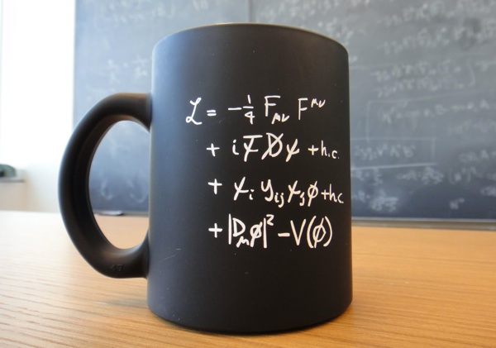
Heavy Ion Physics @ LHC ⬄ High Energy Physics
HEP
What are the fundamental constituents of matter and the laws governing their interactions?
Aim:
origin of mass, matter-antimatter asymmetry, dark matter …
HIP
How do non-abelian quantum field theories give rise to equilibrium and non-equilibrium properties? How do collective phenomena arise from fundamental interactions?
HIP ⬄ HEP
Sociologically
HEP and HIP in same collaborations
Future-oriented
common trajectories identified in EPPS
Technologically
Common detectors, common R&D
Scientifically
(this talk)
U.A. Wiedemann, plenary ICHEP 2020, arXiv:2101.01971

Slide 3
Recall
Generic phenomena
Yayun He et al, arXiv:2201.08408

Slide 4
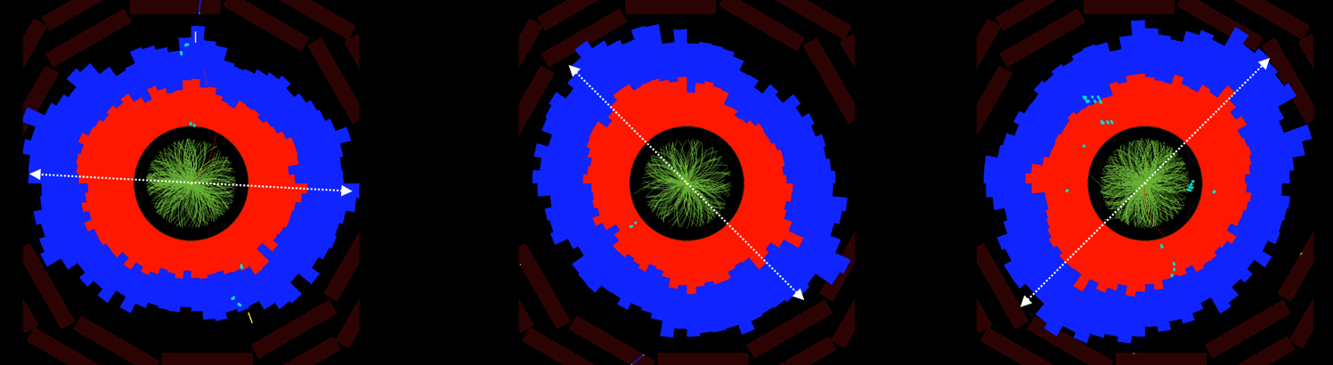
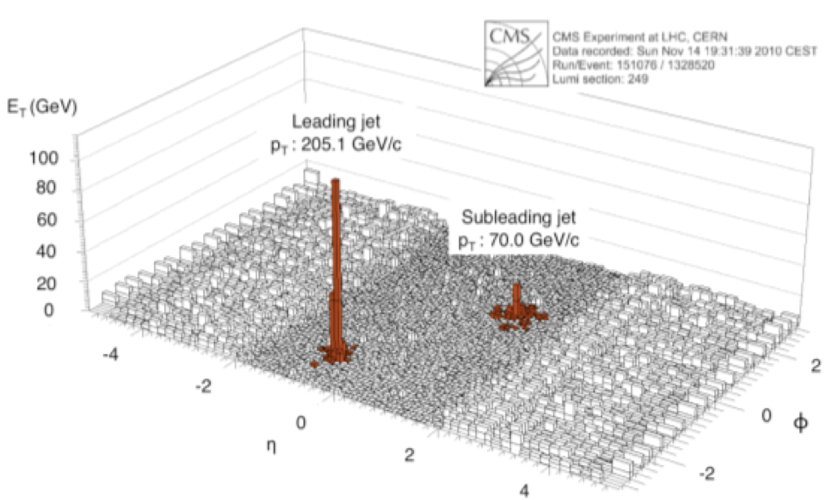
Heavy-ions: generic & large emergent phenomena
FLOW
Collective Motion of essentially all soft hadrons.
Jet Quenching
These phenomena are:
Numerically large
Generic
Quantified on top of pp baseline.
Allows for detailed experimentation of collective phenomena.
Yayun He et al, arXiv:2201.08408

Slide 5
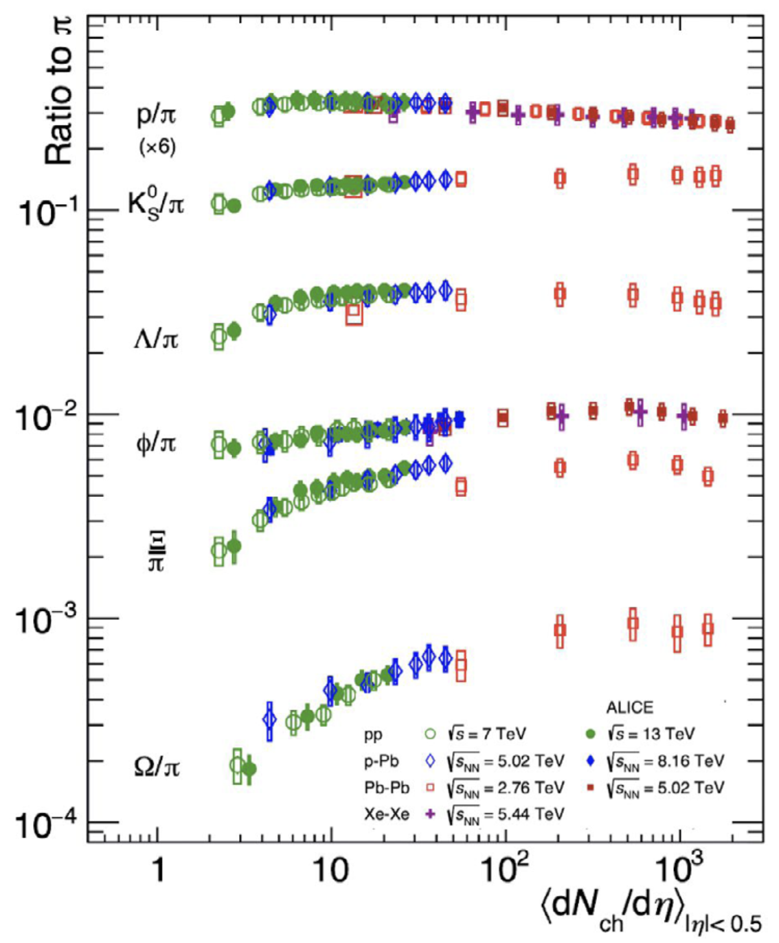
… continued
Strangeness enhancement
“Hadrochemistry” changes generically with system size.
“ Collective effects are observed in high-multiplicity pp events, similar to the signals traditionally attributed to the formation of a Quark Gluon Plasma in heavy ion collisions … there is still not a unified framework.”
Torbjörn Sjöstrand, “Collective Effects, the viewpoint of HEP MC Codes” 1808.03117
ALICE Coll, arXiv:2211.04384
Yayun He et al, arXiv:2201.08408

Slide 6
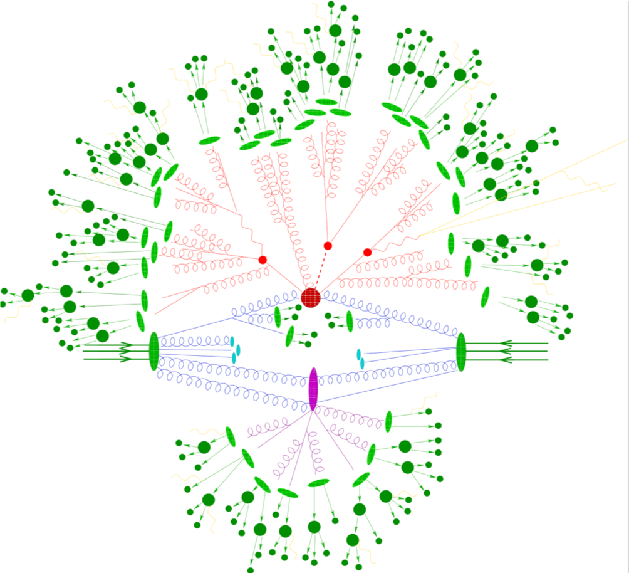
These emergent phenomena are not accounted for in the
default (MC) picture of proton-proton collisions
A free-streaming but fragmenting “gas”
Included:
Multiple Parton Interactions
Hard Processes
Parton Showers
Hadronization
Hadronic decays
Electroweak processes
BSM
Not included:
any notion of “medium-dependence”, such as jet quenching, flow, hadrochemistry
Yayun He et al, arXiv:2201.08408

Slide 7
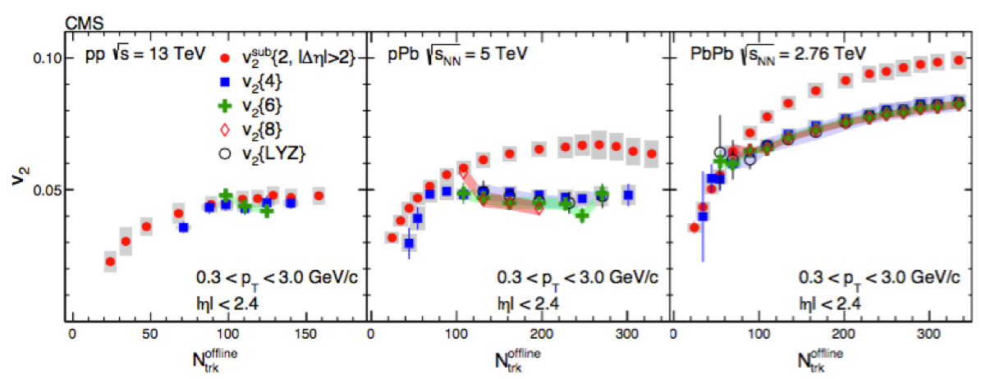
and yet, collective phenomena
smoothly extend to proton-proton collisions
CMS, Phys. Lett. B765 (2017) 193
Yayun He et al, arXiv:2201.08408

Slide 8
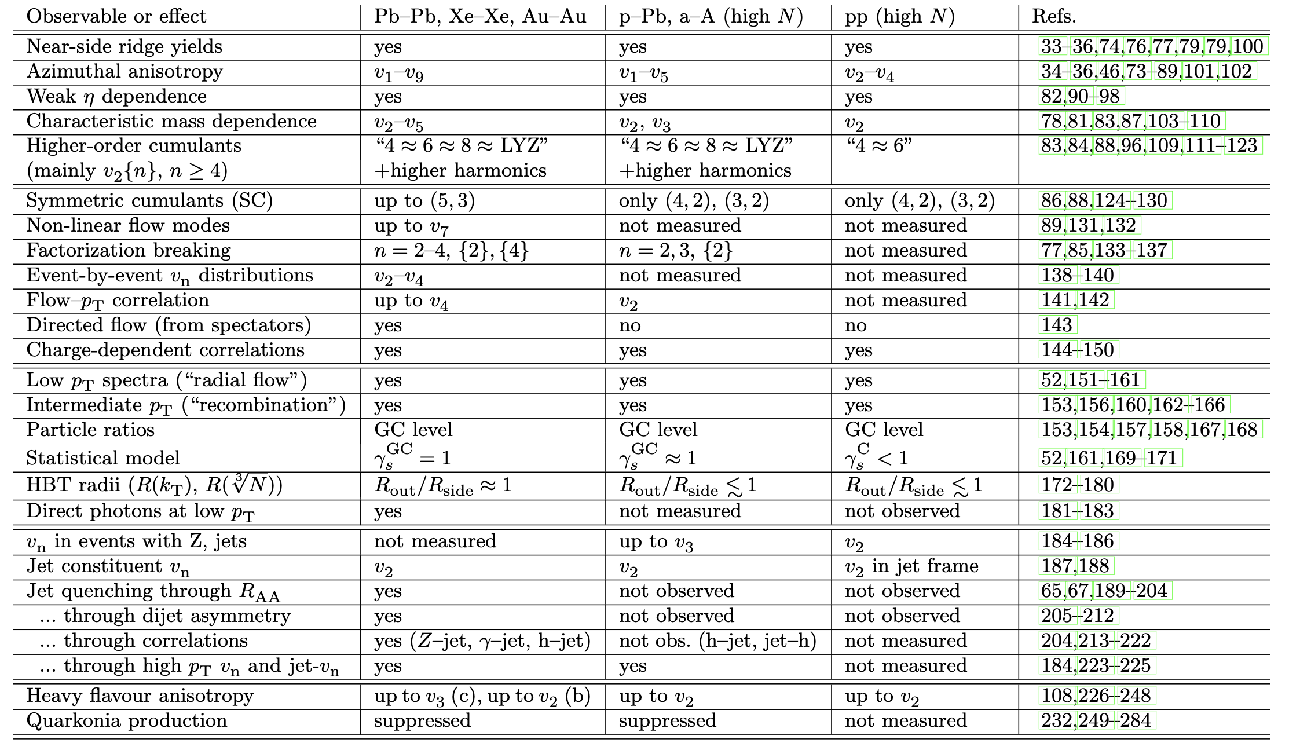
… smoothly extend to proton-proton collisions
200 publications from all LHC and RHIC collaborations:
Precursor phenomena of collectivity seen in pp and pA.
Table from: Jan Fiete Grosse-Oertringhaus & UAW, arXiv:2407.07484
Yayun He et al, arXiv:2201.08408

Slide 9
Why is quantifying fluid dynamics in AA-collisions of fundamental interest?
Dissipative fluid dynamics
Perfect fluid dynamics
Free streaming
QCD transport theory
Invoking final state interactions
Yayun He et al, arXiv:2201.08408

Slide 10
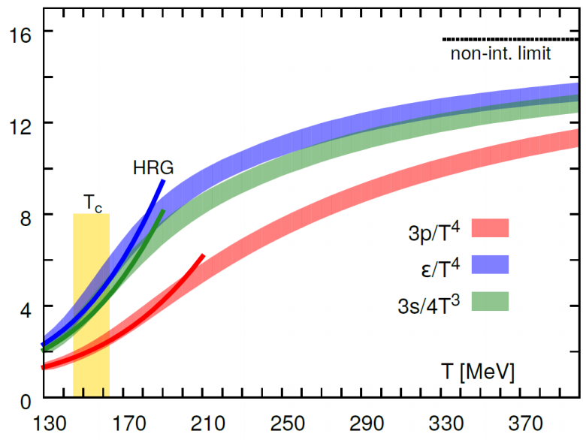
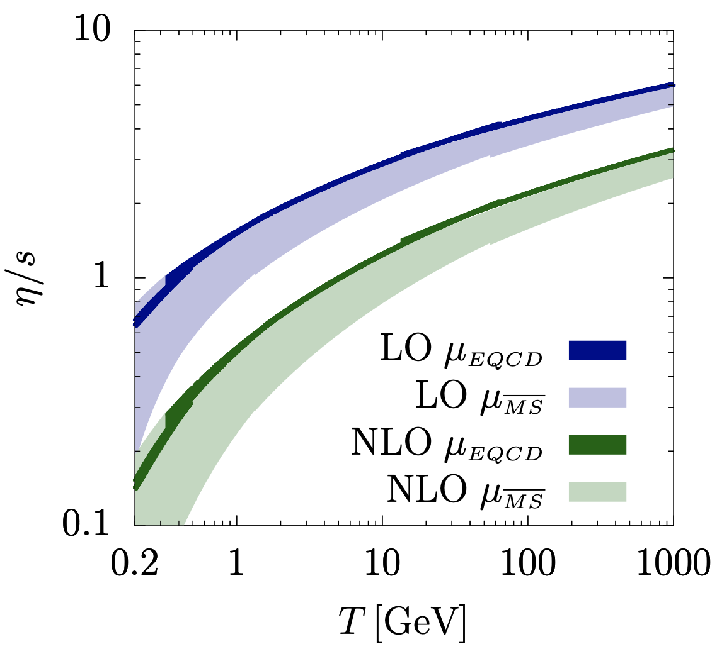
Fluid dynamics ⬄ access to QGP properties calculable from 1st principles in QCD
based only on: E-p conservation:
2nd law of thermodynamics:
sensitive only to properties of matter that are
calculable from first principles in quantum field theory
- EOS: and sound velocity
- transport coefficients: shear , bulk viscosity, …
- relaxation times: , , …
Lattice QCD =>
Finite Temp pQCD =>
AdS/CFT =>
J. Ghiglieri, G. Moore, D. Teaney, QCD Shear Viscosity at (almost) NLO, JHEP 03 (2018) 179
D. Bazavov et al, The equation of state in (2+1)-flavor QCD, Phys. Rev. D90 (2014) 094503
S. Borsanyi et al, JHEP 09 (2010) 073

Slide 11


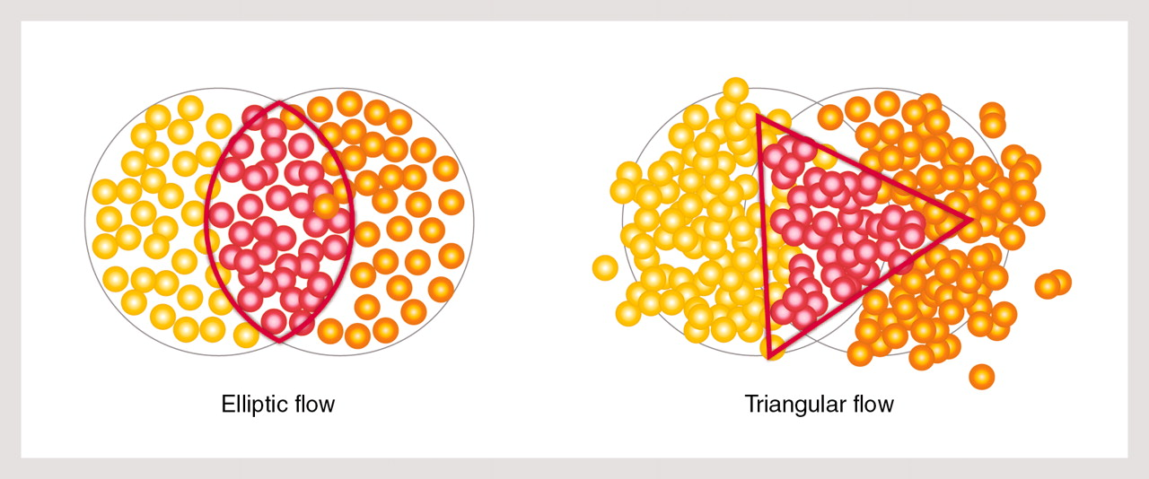
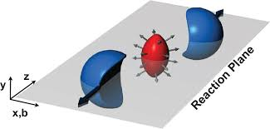
Concept: testing medium properties via fluid response
Excite medium
Listen to response
Analyze
In theory:
In experiment:
Prepare different excitations measure their response

Slide 12
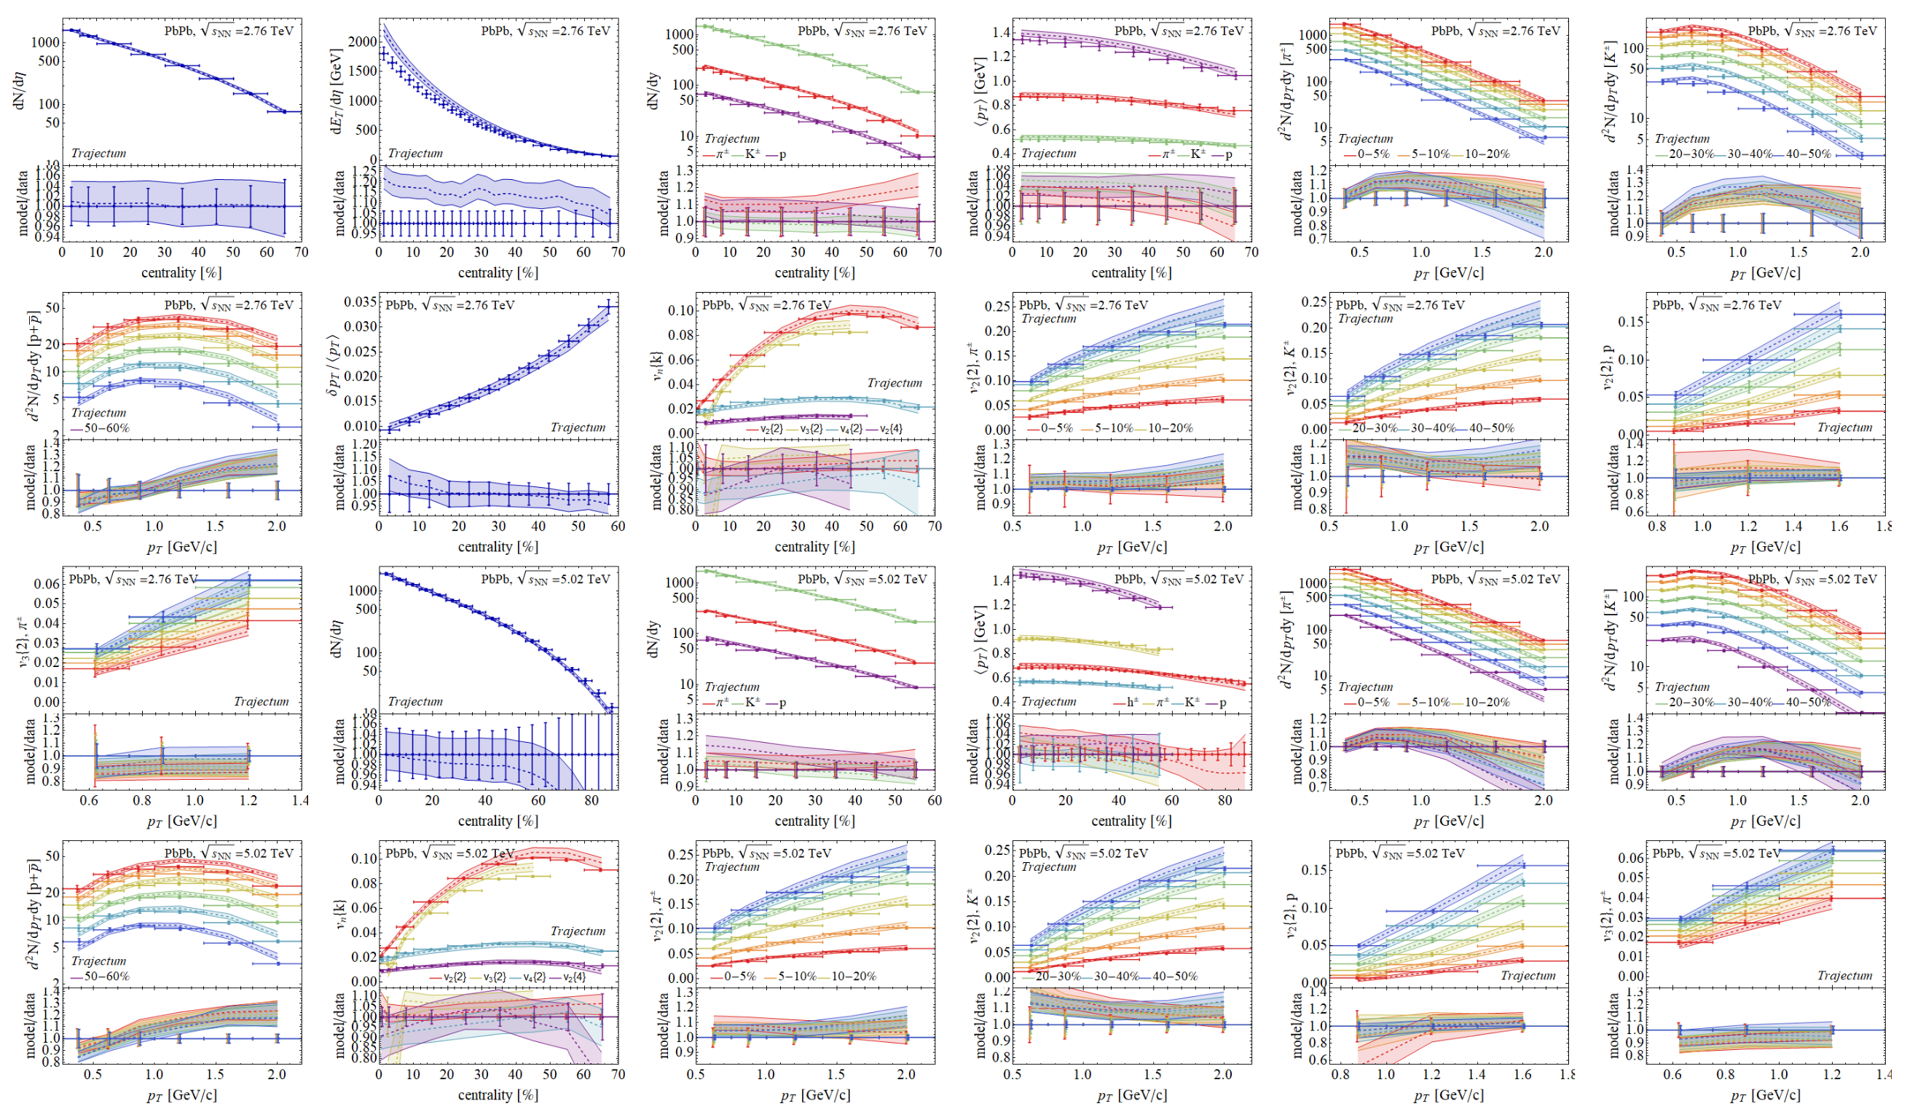
Comparison to Hydro-Models
Quantifies QGP properties and QGP evolution
Largely restricted to light-flavored hadron species so far.
Bayesian inference analysis involving 670 LHC data points.
* G. Nijs, W. van der Schee, 2304.06191.
Yayun He et al, arXiv:2201.08408
Notes:
In little bangs as in the Big Bang, material properties are accessed by fluctuation studies

Slide 13
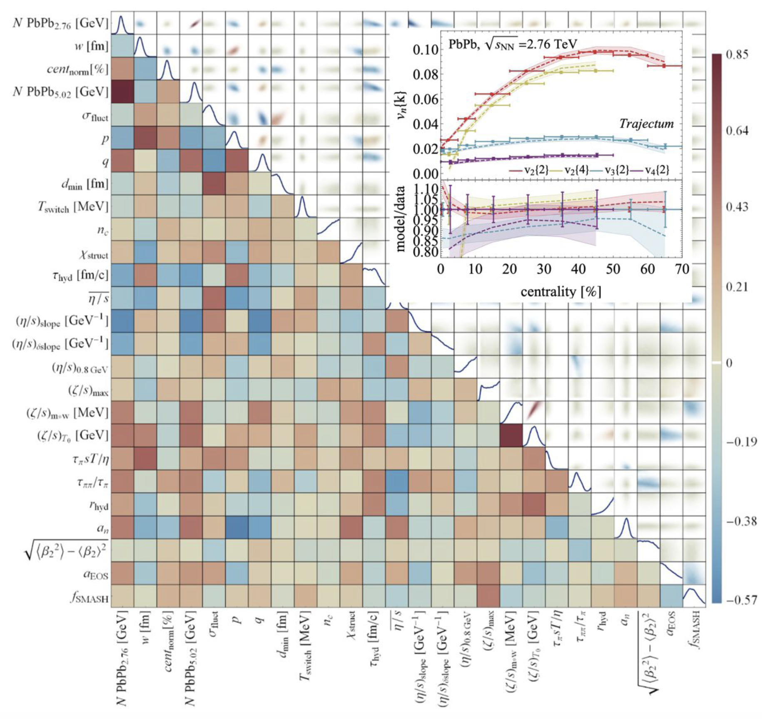
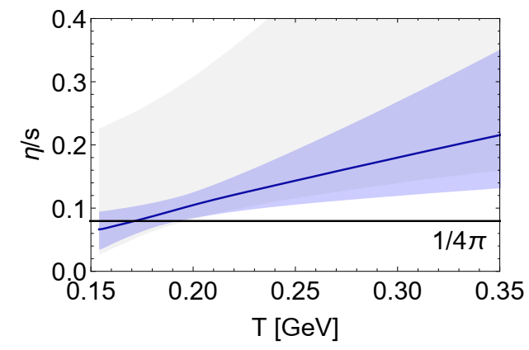
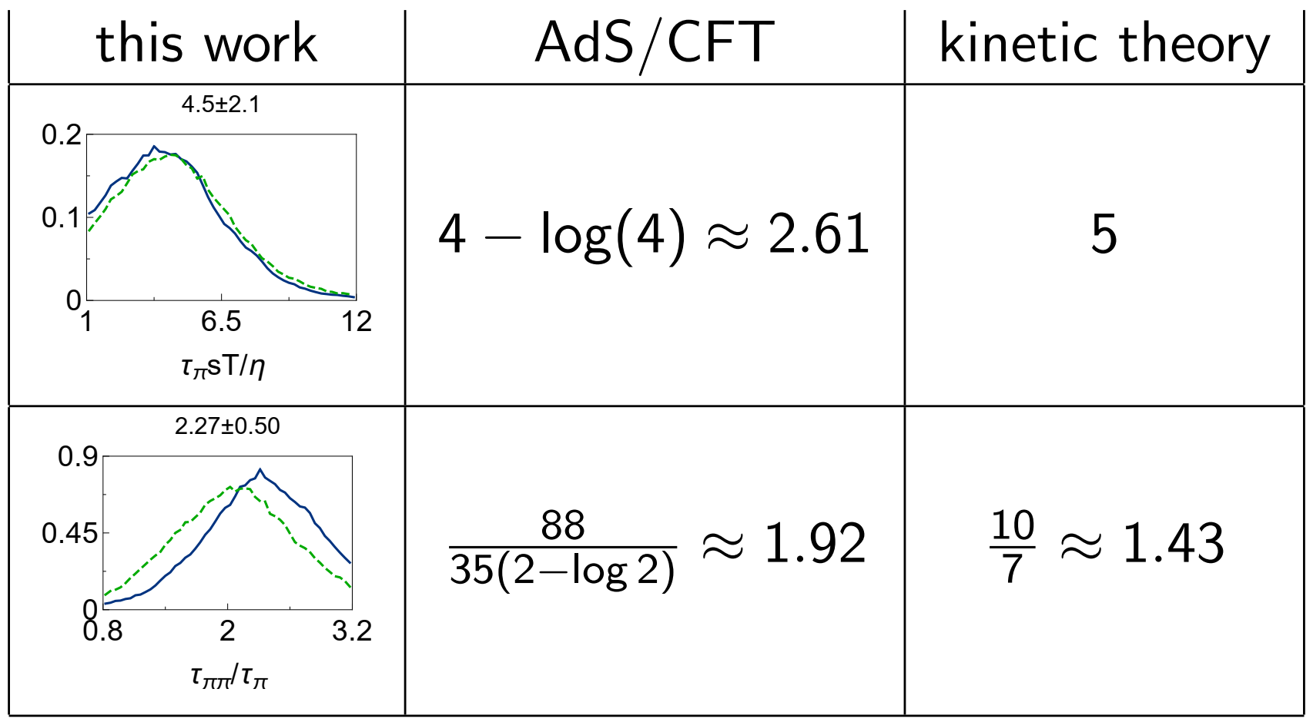
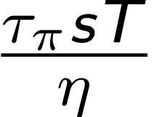
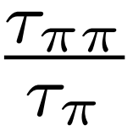
Bayesian Inference
Shear viscosity over entropy
NGSS*
Relaxation times
NGSS*
H. Song, S. Bass, U. Heinz, T. Hirano, C. Shen, Phys. Rev. Lett. 106 (2011) 192301
Giacalone, Nijs, van der Schee, Phys.Rev.Lett.131 (2023) 20, 20
*G. Nijs, U. Gursoy, W. v.d. Schee, R. Snellings, arXiv:2010.15130, arXiv:2010.15134

Slide 14
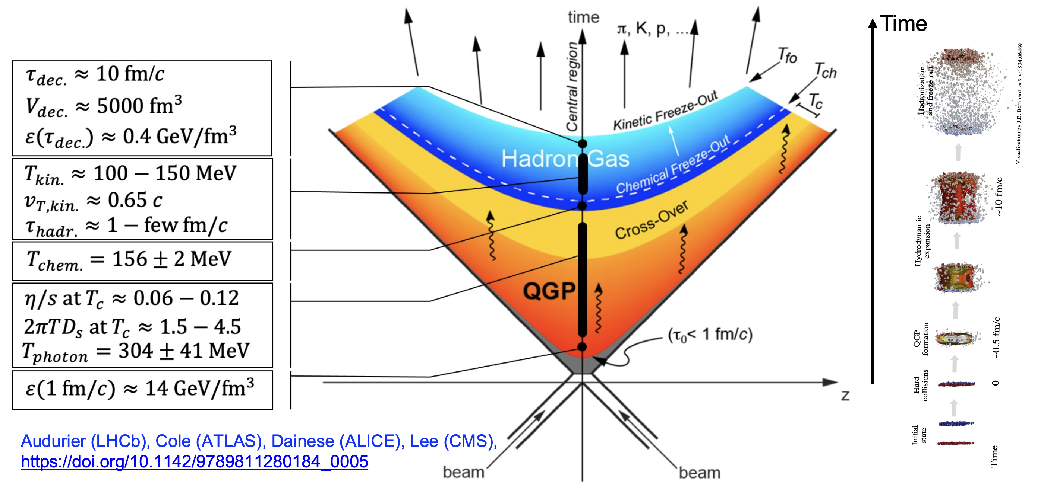
Quantitative support for a default picture of AA
Yayun He et al, arXiv:2201.08408
Notes:
In little bangs as in the Big Bang, material properties are accessed by fluctuation studies

Slide 15
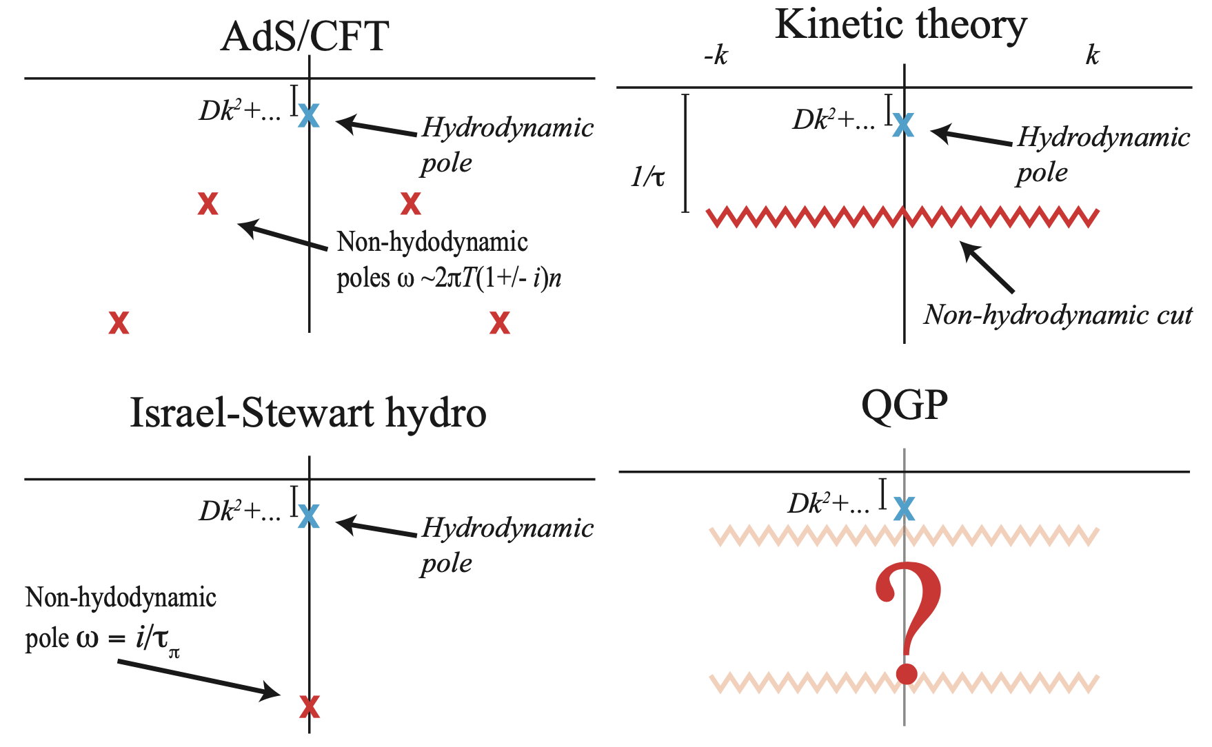
Limits of fluid dynamic behavior?¹
Hydrodynamic excitations
Non-hydro excitations, e.g.
Universal in QFTs
Consequence of conservation laws
No QFTs without non-hydro modes
Consequence of causality
Excitations of various plasmas:
Hydro-modes dominate if
Hydro-dominated wavelengths satisfy
Such wavelengths do not fit into a proton !
Dynamical origin of collectivity in pp rests under debate.²
1. A. Kurkela, UAW, B. Wu, Eur. Phys. J.C79 (2019) 11, 965
2. Jan Fiete Grosse-Oertringhaus & UAW, arXiv:2407.07484
Yayun He et al, arXiv:2201.08408
Notes:
In little bangs as in the Big Bang, material properties are accessed by fluctuation studies

Slide 16

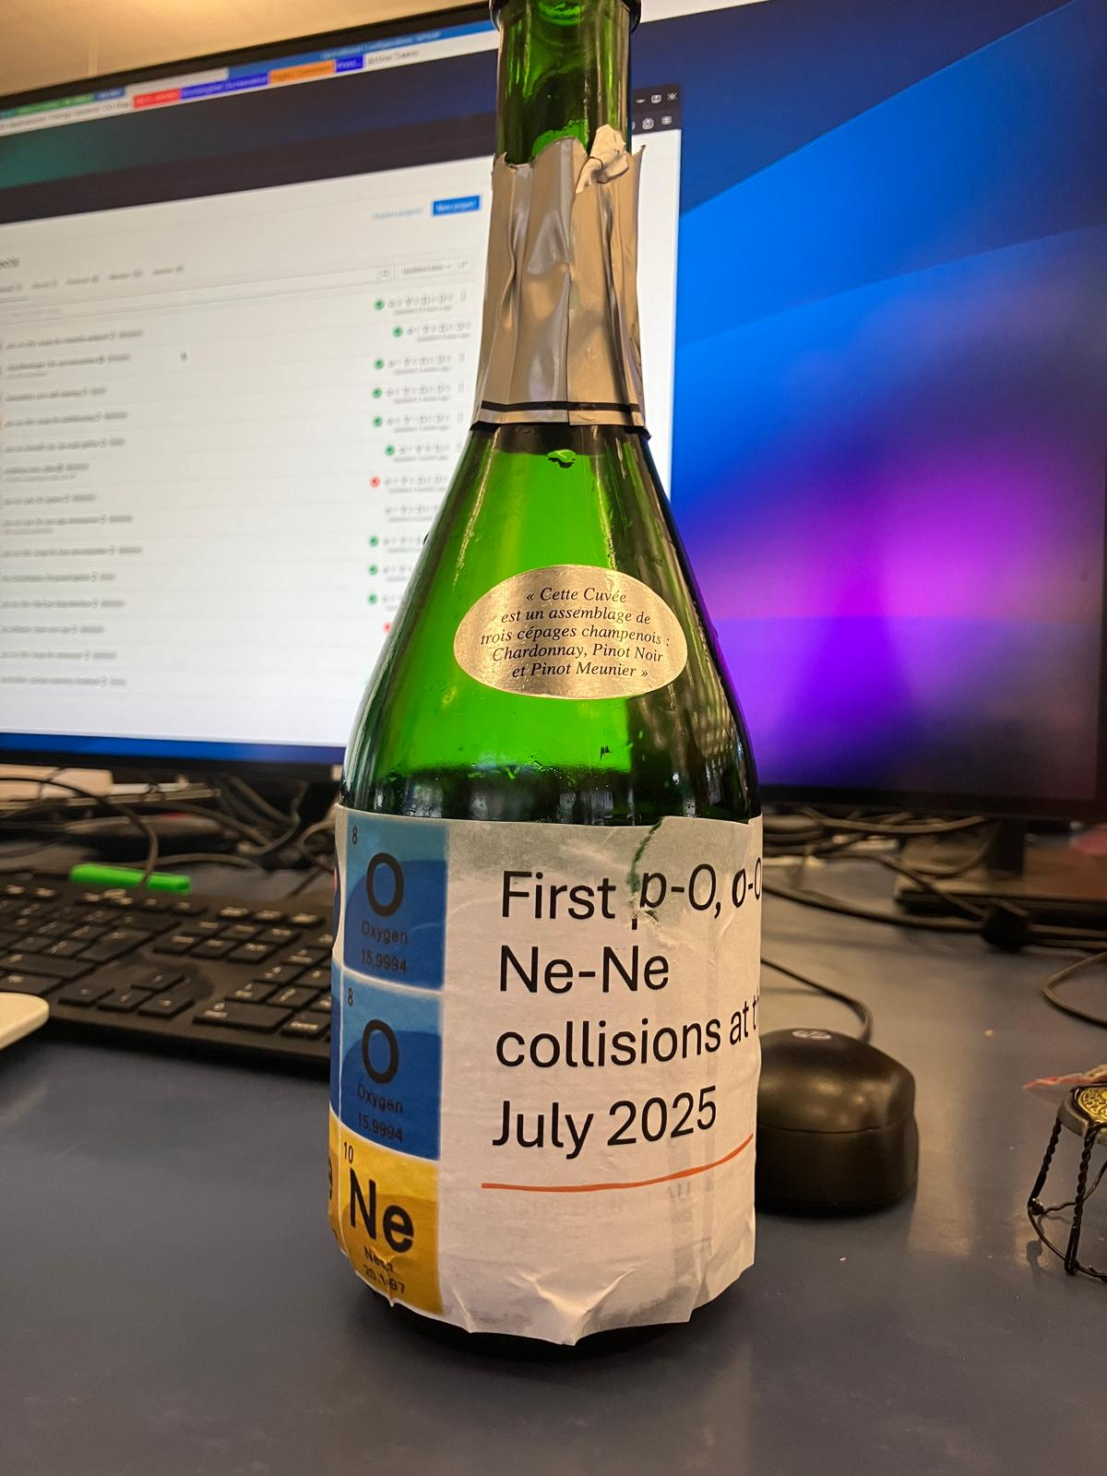

J. Brewer, A. Mazeliauskas, W. v.d. Schee (org) , cern.ch/OppOatLHC
“Opportunities of OO and pO collisions at the LHC”, Jasmine Brewer and Aleksas Mazeliauskas, arXiv:2103.01939
2. CERN TH workshop: Light ion collisions at the LHC, https://indico.cern.ch/event/1436085/

Slide 17
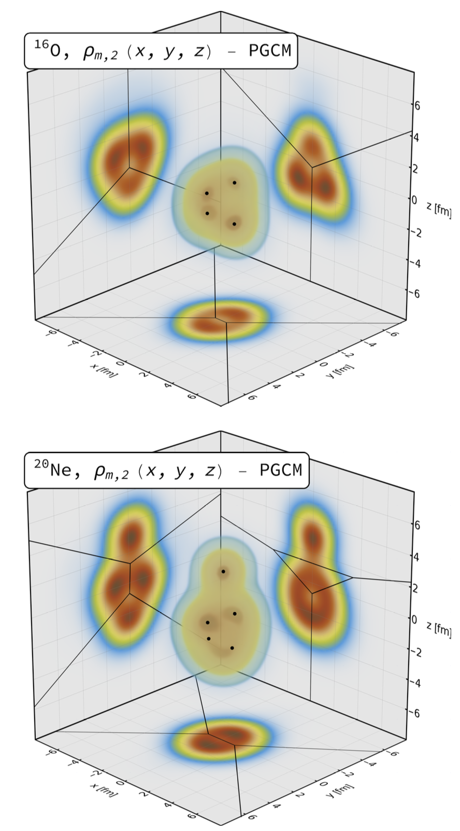
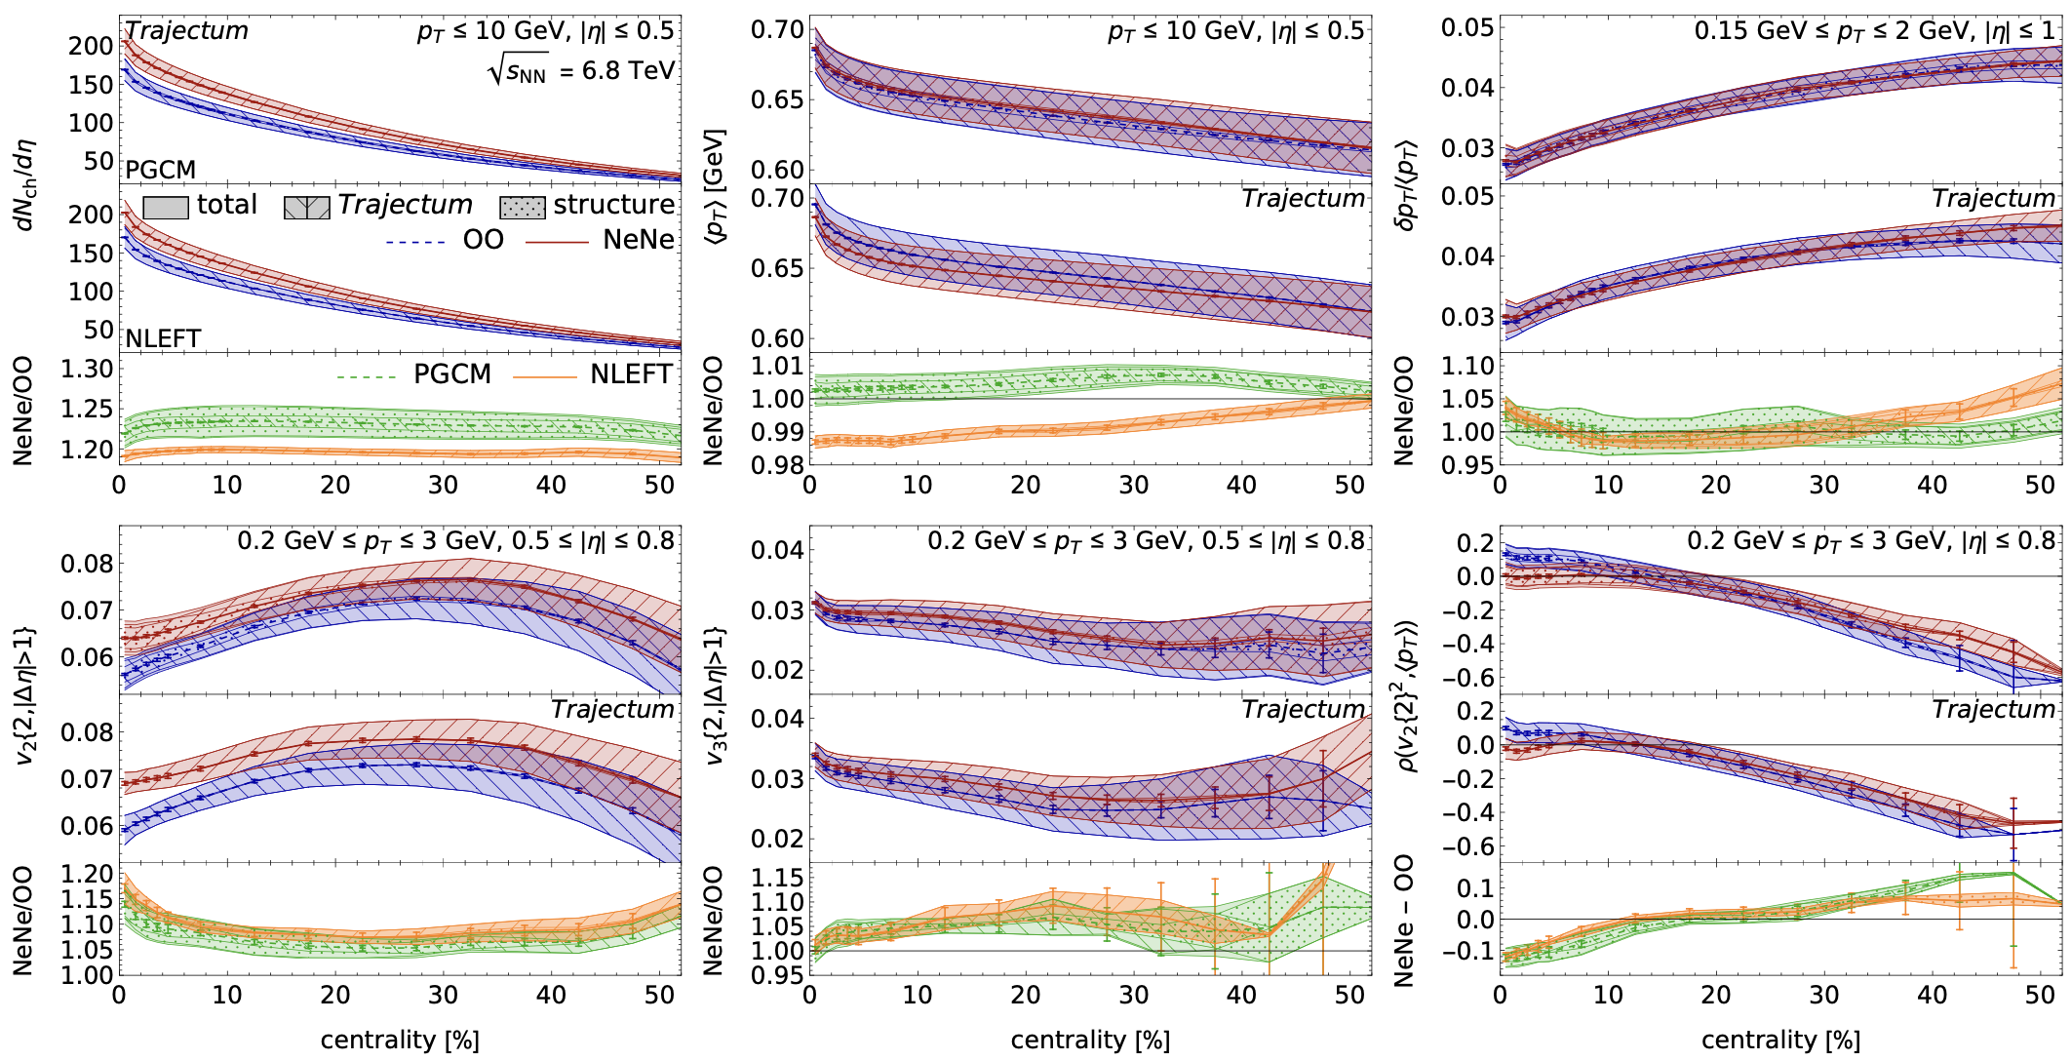
Fluid response in OO & NeNe ⬄ nuclear structure
Understanding fluid response gives access to nuclear structure¹
Ultra-relativistic collisions provide two-dimensional density projections of (fluctuating) nuclear structure
J. Brewer, A. Mazeliauskas, W. v.d. Schee (org) , cern.ch/OppOatLHC
1. G. Giacalone et al. , Phys .Rev. Lett. 135 (2025) 1, 012302

Slide 18
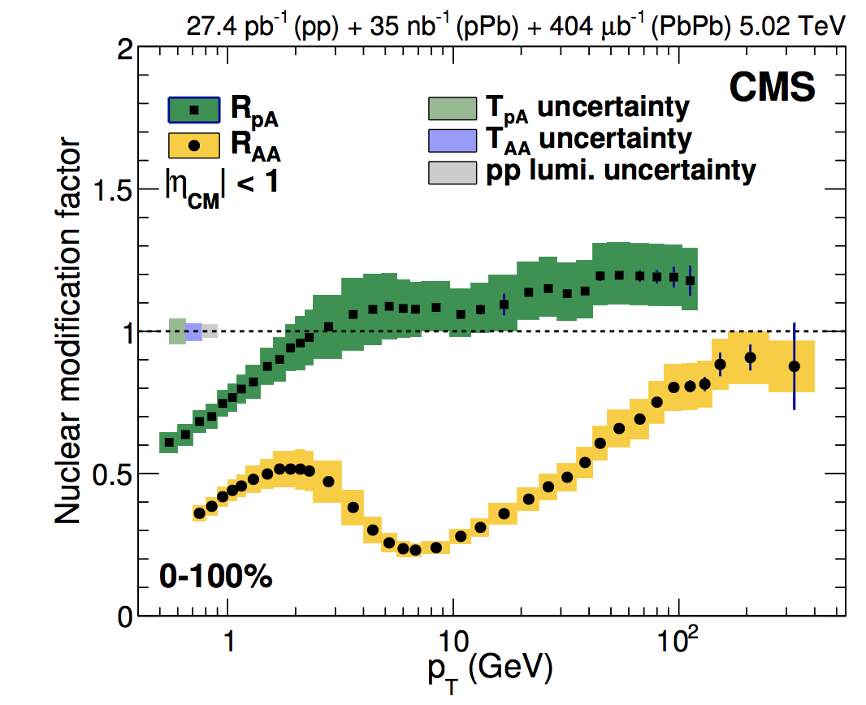

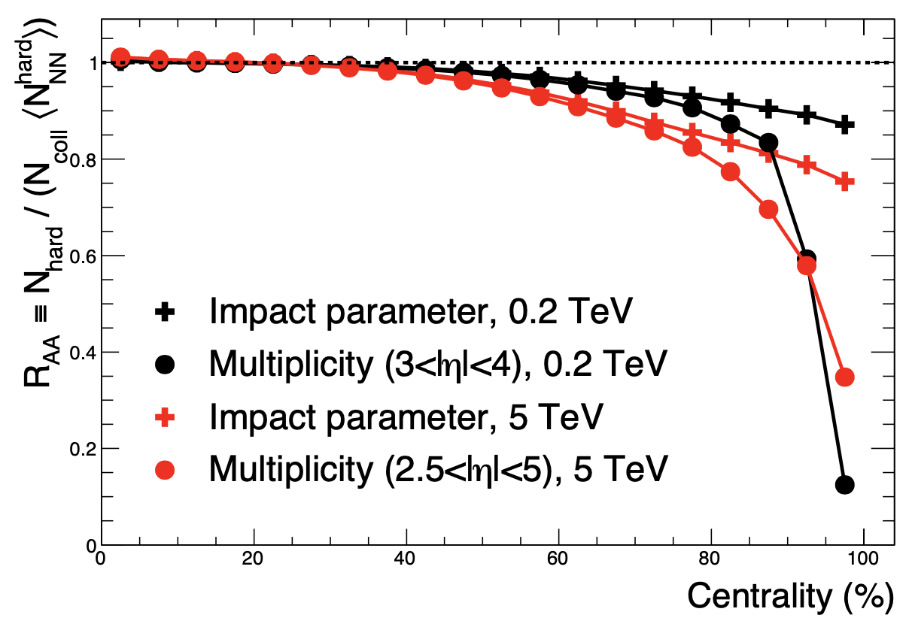
Jet quenching in small systems
Collectivity requires final state interaction
Final state interactions imply jet quenching
Jet quenching not seen in pPb or peripheral PbPb
Why?
Soft physics modelling uncertainties increase in small systems*
Because the effect is not there. Then, what I told you so far is wrong!
Because the effect is too small to be measured.
How to improve accuracy of null-hypothesis
on top of which an effect could be seen?
*C. Loizides, A. Morsch, Absence of jet quenching in peripheral nucleus-nucleus collisions, Phys. Lett. B773 (2017) 408
CMS, JHEP 04 (2017) 039

Slide 19
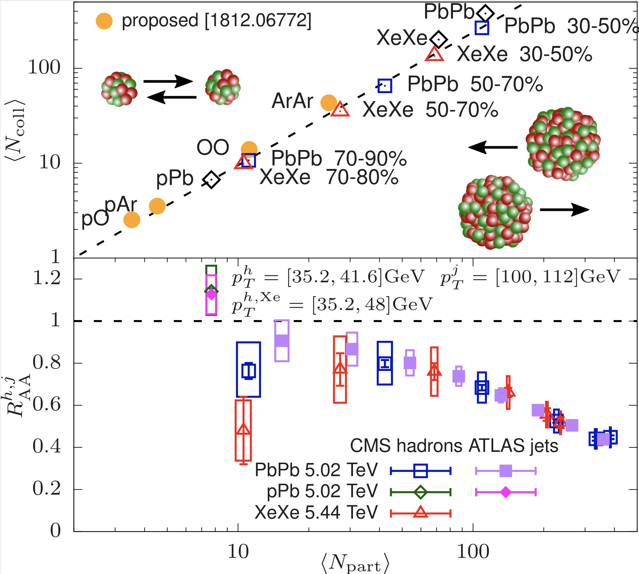
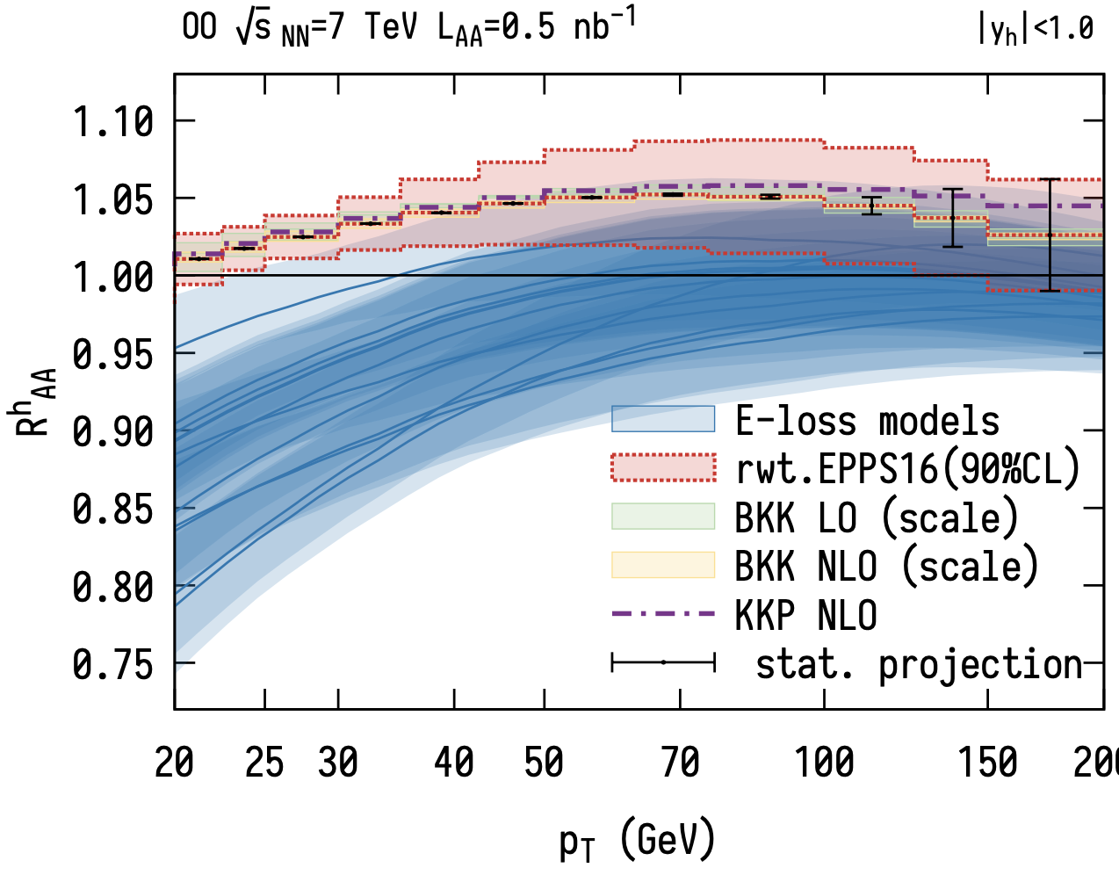
A small system: Oxygen-Oxygen @ LHC
Inclusive OO ~ 70-90 % PbPb, perturbatively controlled baseline*
2-5 % theory precision on no-quench baseline*
systematically controlled pQCD standard
Jet quenching
*A. Huss, A. Kurkela, A. Mazeliauskas, R. Paatelainen, W. v.d. Schee, UAW, Phys.Rev.Lett. 126 (2021) 19, 192301

Slide 20
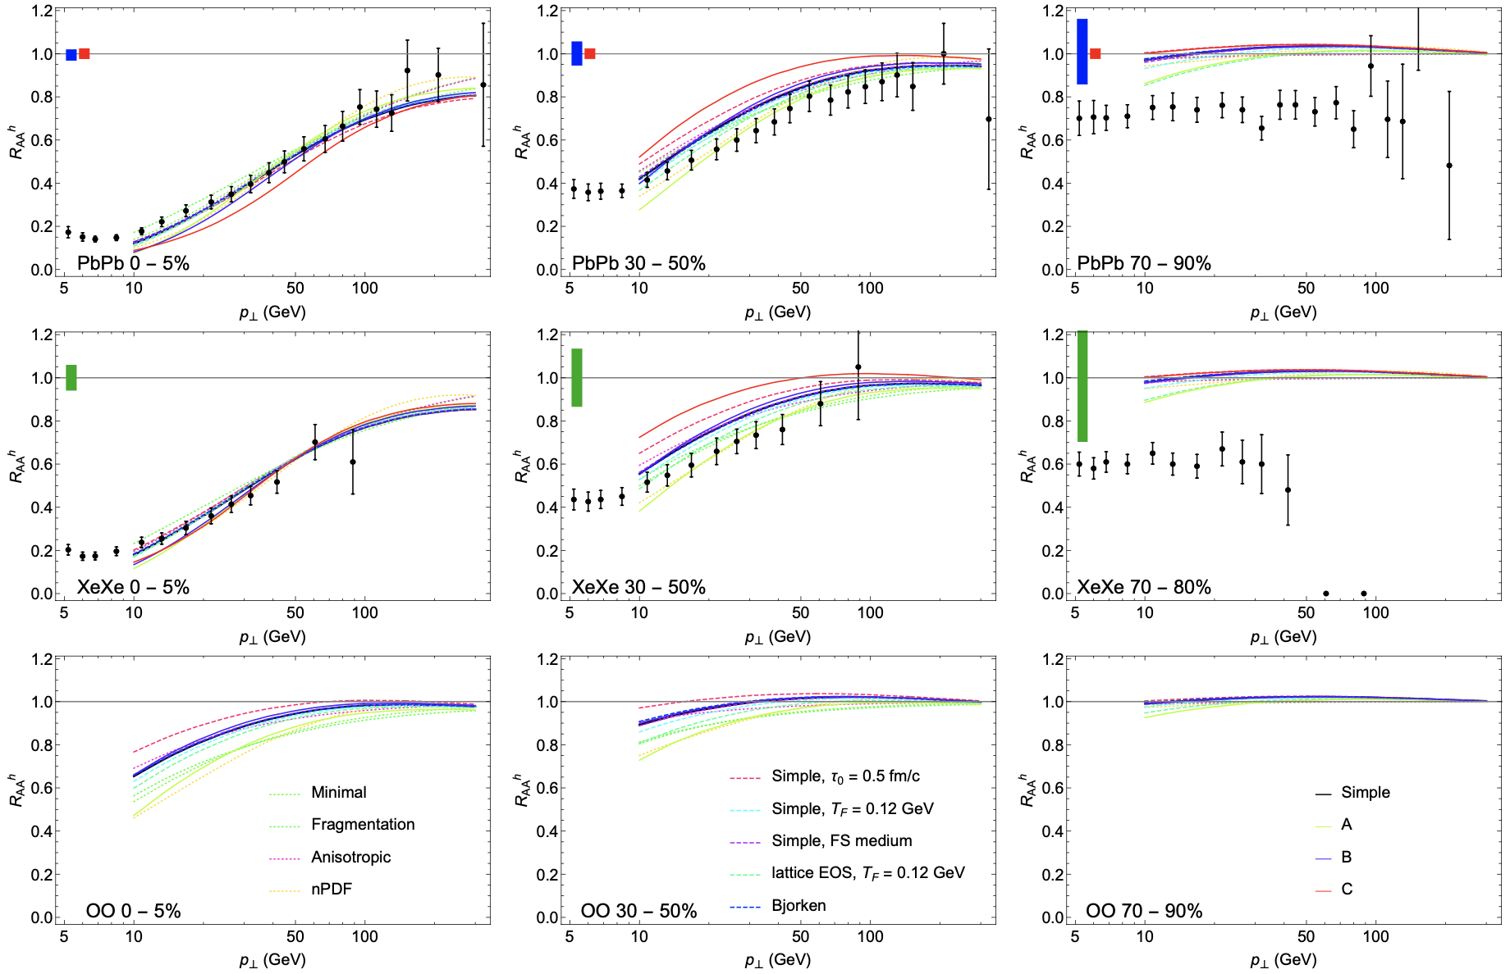
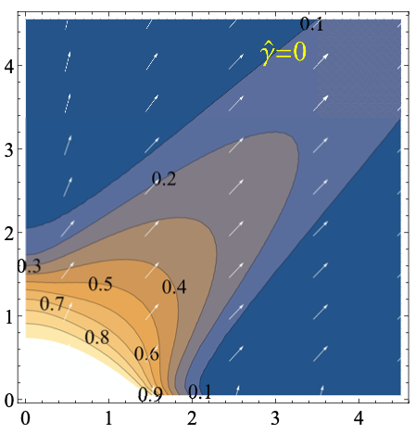
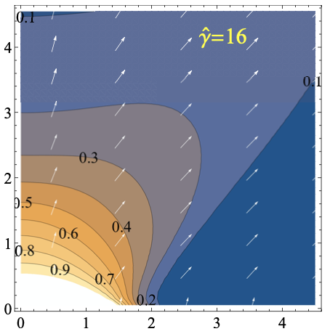
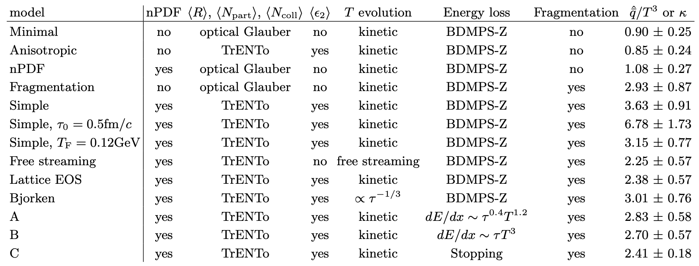
A comment on methodology: estimating quenching in OO
To extrapolate jet quenching from central PbPb to OO
Vary freely what you don’t know*
- Initial conditions
- collective expansion
Anchor on what is measured and extrapolate*
*A. Huss, A. Kurkela, A. Mazeliauskas, R. Paatelainen, W. v.d. Schee, UAW, Phys.Rev.C103 (2021) 5, 054903
Other recent R_{AA} comparisons: Chien et al. 1509.02936, Bianchi et al. 1702.00481, Andres et al 1606.04837, Noronha-Hostler et al. 1602.03788, Casalderrey et al. 1405.3864, Jetscape 2102.11337

Slide 21
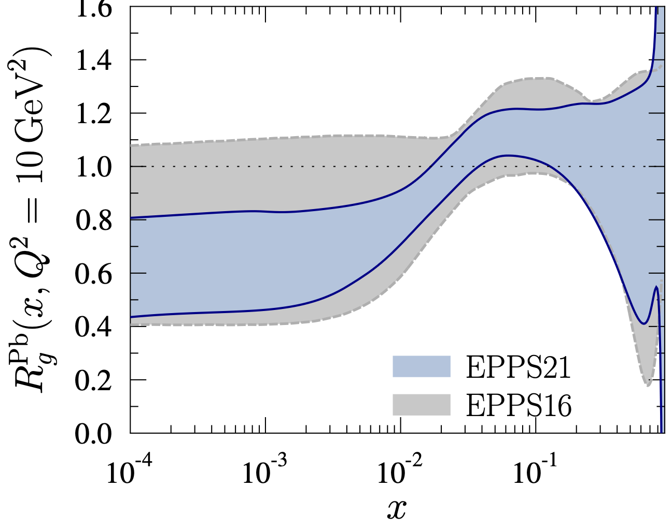
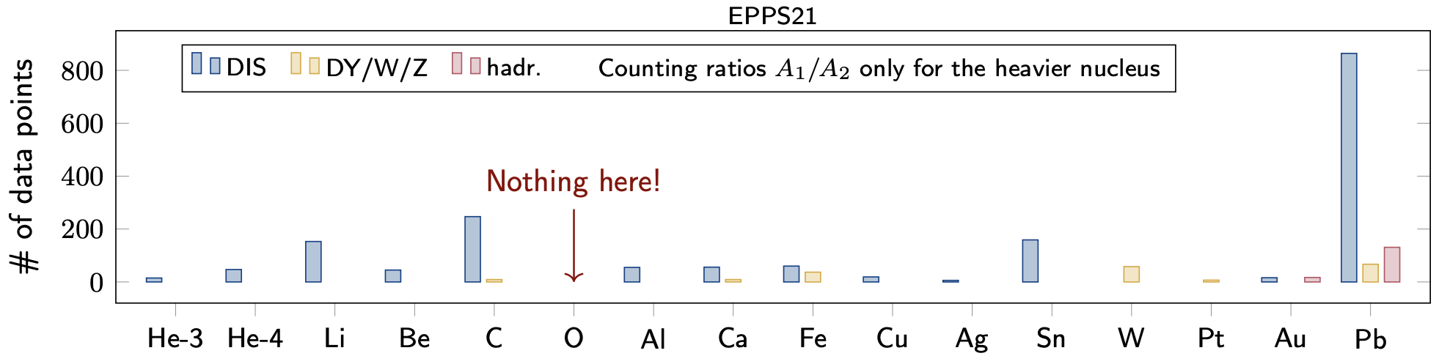
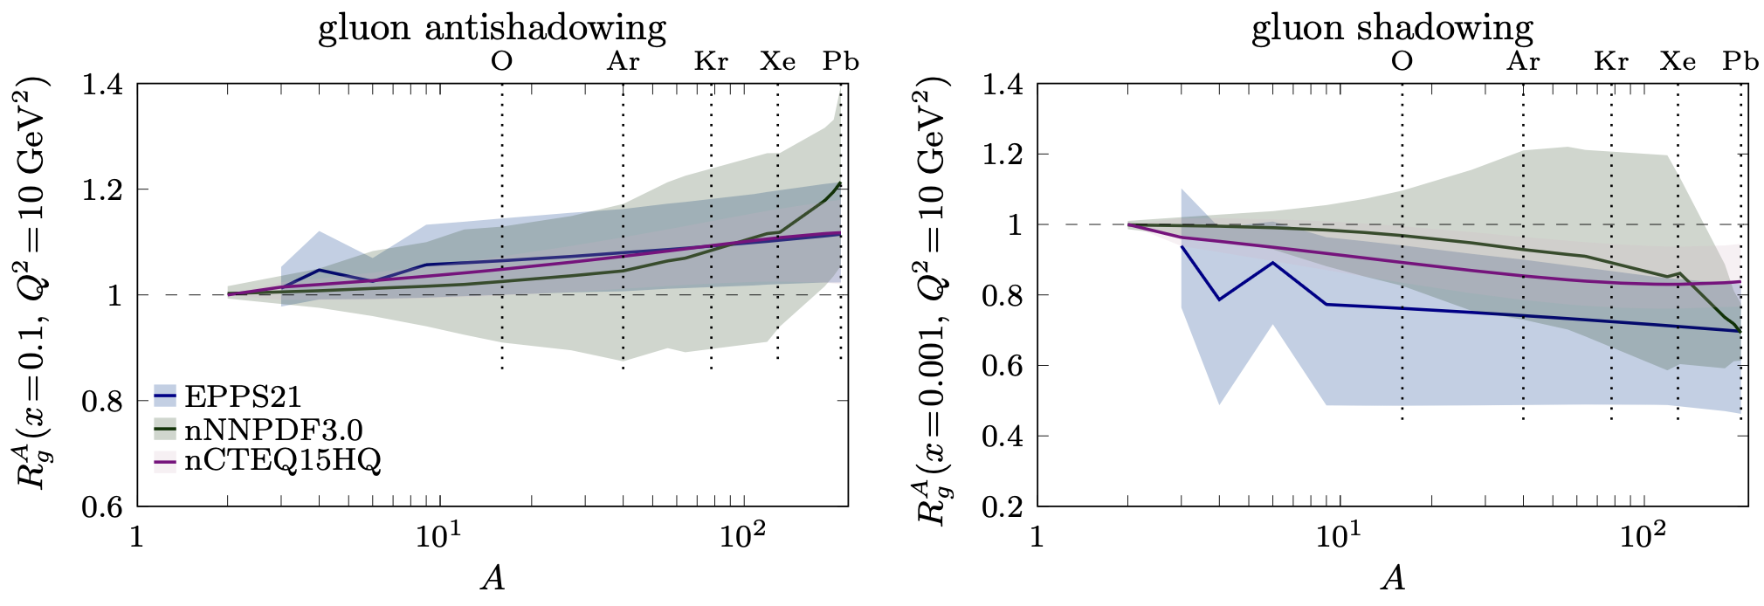
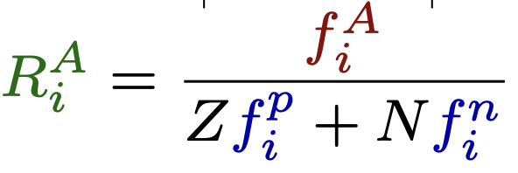
…further OppOrtunities: pO constrains nuclear pdfs
A-dependence of nuclear gluon pdf is poorly known
Constraints from pO data*
*Petja Paakinen, Phys. Rev. D105 (2022) 3, L031504

Slide 22
Open Questions
that drive future experimentation
EPPS input
Microscopic mechanisms of quark interactions in the QGP
Quark-mass dependence of thermal equilibration
Mechanisms of hadron formation in high-density QCD environment
QGP electromagnetic radiation throughout its temporal evolution
Mechanism of chiral symmetry restoration in the QGP
Inner workings of the QGP
QGP substructure and medium-response via jets and rare probes
Yayun He et al, arXiv:2201.08408

Slide 23
Open Question
Microscopic mechanisms of quark interactions in the QGP
Quark-mass dependence of thermal equilibration
Mechanisms of hadron formation in high-density QCD environment
QGP electromagnetic radiation throughout its temporal evolution
Mechanism of chiral symmetry restoration in the QGP
Inner workings of the QGP
QGP substructure and medium-response via jets and rare probes
Yayun He et al, arXiv:2201.08408

Slide 24
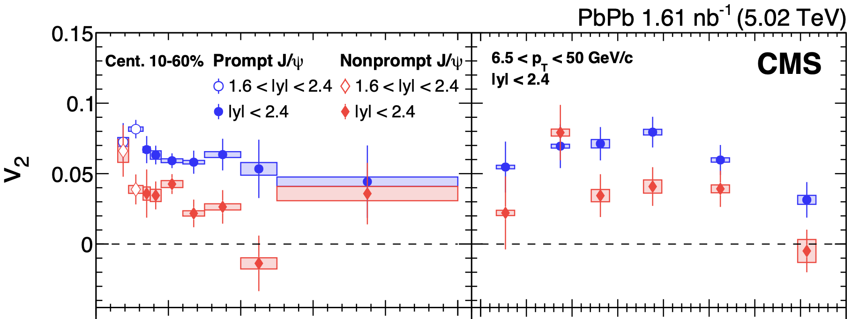
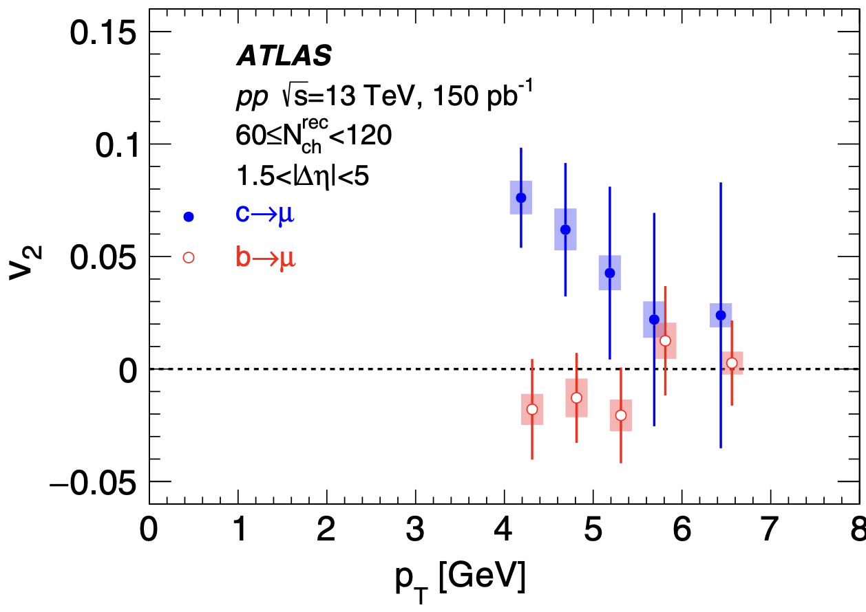
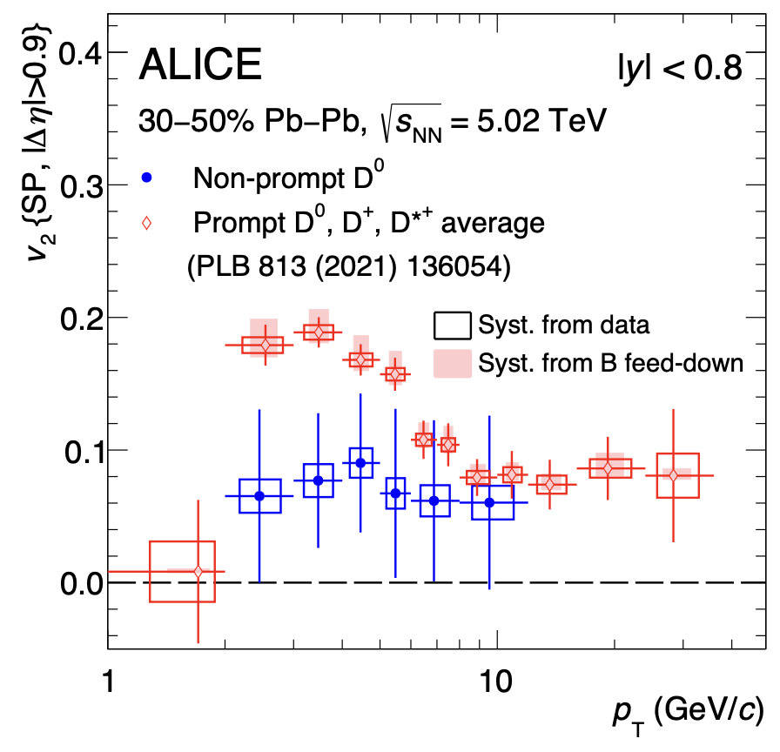
Heavy Flavor – unique opportunities
EXP: evidence that beauty flows less¹ and is less quenched than charm.
CMS
CMS
Mass hierarchy of incomplete kinetic equilibration ?
b presents interesting mass scale for testing QCD transport
Precision down to p_{T} = 0 needed!
CMS, JHEP10 (2023) 115; ATLAS PRL 124, 082301 (2020)
2. R. Rapp et al Nucl.Phys.A 979 (2018) 21-86;

Slide 25
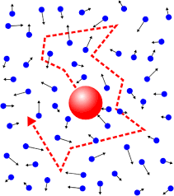
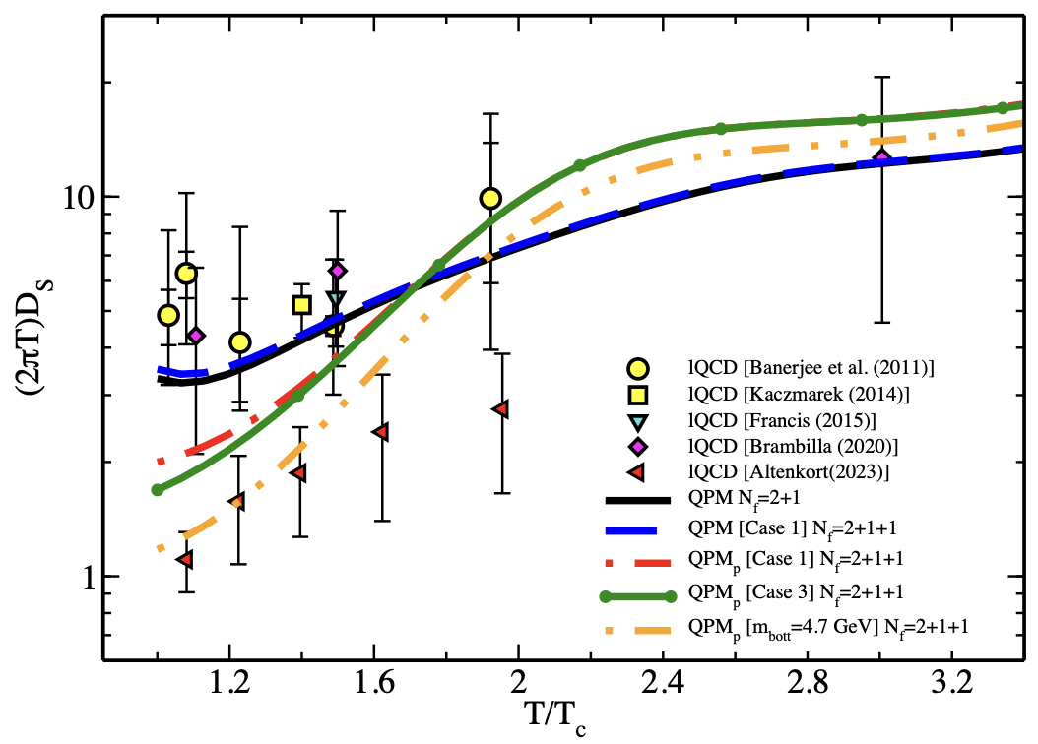
Heavy Flavor – unique opportunities
Theory:
Heavy flavor transport is governed by drag and diffusion calculable from 1st principles in QFT. Testable relations
Einstein relation
Velocity dep. at strong coupling^{3,4}:
Aim: extraction of heavy flavor transport coefficients¹
Charm equilibrates a factor faster than beauty => test incomplete b equilibration.
Lattice QCD and model calculations of the
heavy quark diffusion coefficient²
1. R. Rapp et al Nucl.Phys.A 979 (2018) 21-86;
2. Sambataro et al, Eur. Phys. J. C84 (2024) 9,881
3. S. Gubser, Nucl. Phys. B 790 (2008) 175
4. K. Rajagopal, B. Scheihing-Hitschfeld UAW, JHEP 2501.06289

Slide 26
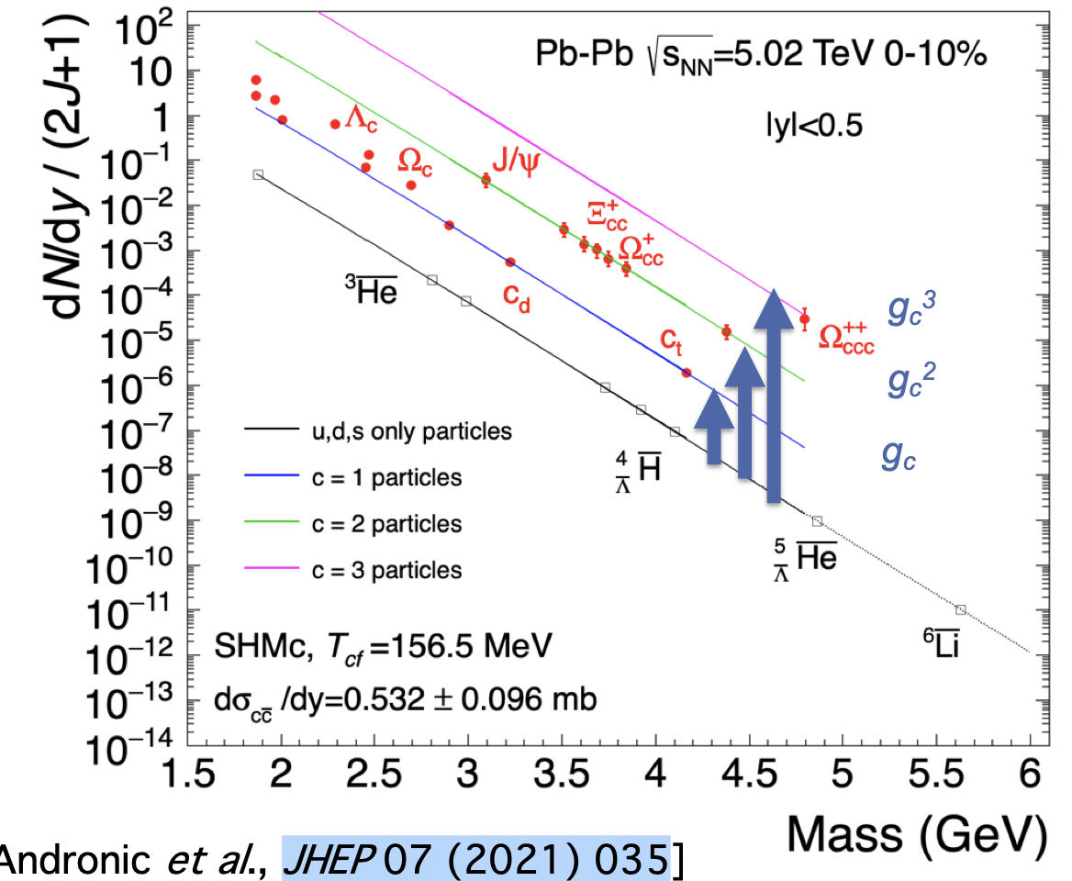
Heavy flavor – chemical equilibrium
Charm is not produced thermally, but it can be distributed statistically in hadronization.¹
Hadronization via fragmentation versus hadronization via recombination.
Multi-charmed baryons (accessible in run 5) particularly important since negligible production rate in single parton scatterings.
In reach of HL-LHC runs 3-5.
Huge enhancements predicted, up to factor 10³ w.r.t. pp for .^{2,3}
1. A. Andronic et al. JHEP 07 (2021) 035
2. F. Becattini, Phys.Re.Lett. 95 (2005) 022301
3. V. Minissale et al., Eur.Phys.J. C. 84 (2024) 3, 228

Slide 27
Open Question
Microscopic mechanisms of quark interactions in the QGP
Quark-mass dependence of thermal equilibration
Mechanisms of hadron formation in high-density QCD environment
QGP electromagnetic radiation throughout its temporal evolution
Mechanism of chiral symmetry restoration in the QGP
Inner workings of the QGP
QGP substructure and medium-response via jets and rare probes
Yayun He et al, arXiv:2201.08408

Slide 28
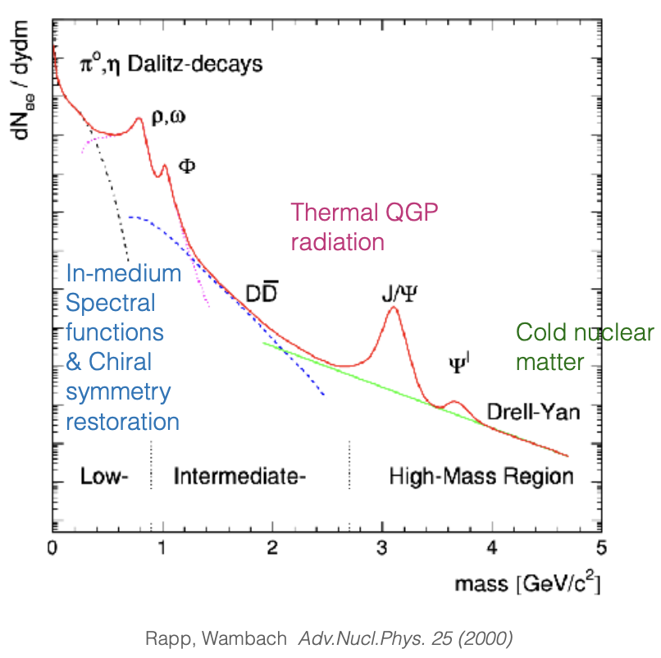
Electromagnetic radiation of QGP
TH: thermal production sensitive to EM spectral function and bkg QGP evolution.
Photon spectrum:
Blue-shifted spectrum!
Difficult to disentangle early and late time contributions.
Dilepton spectrum:
Varying invariant mass M_{ee} => disentangling contributions
from different times.
Dilepton invariant mass spectrum needs excellent knowledge of background to address QGP-induced electromagnetic signals.

Slide 29
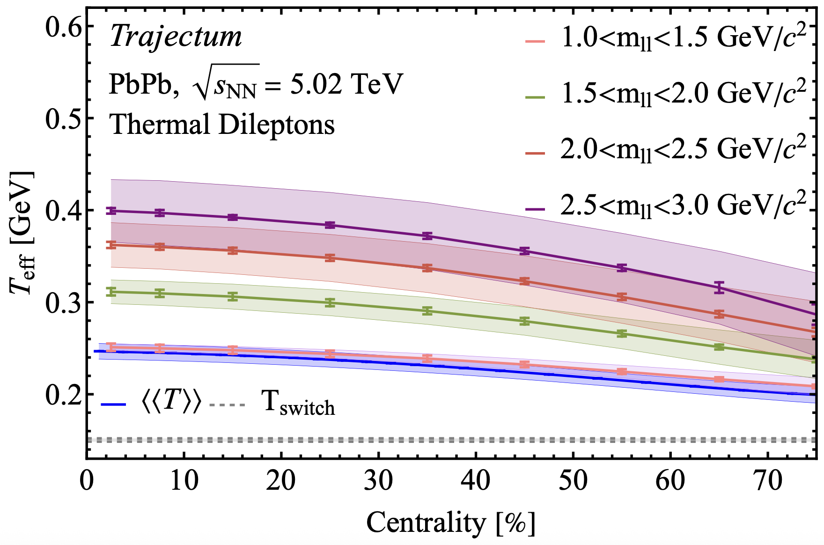
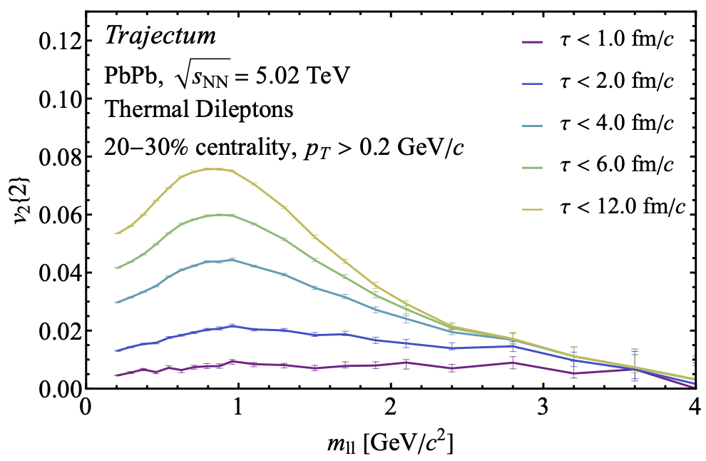
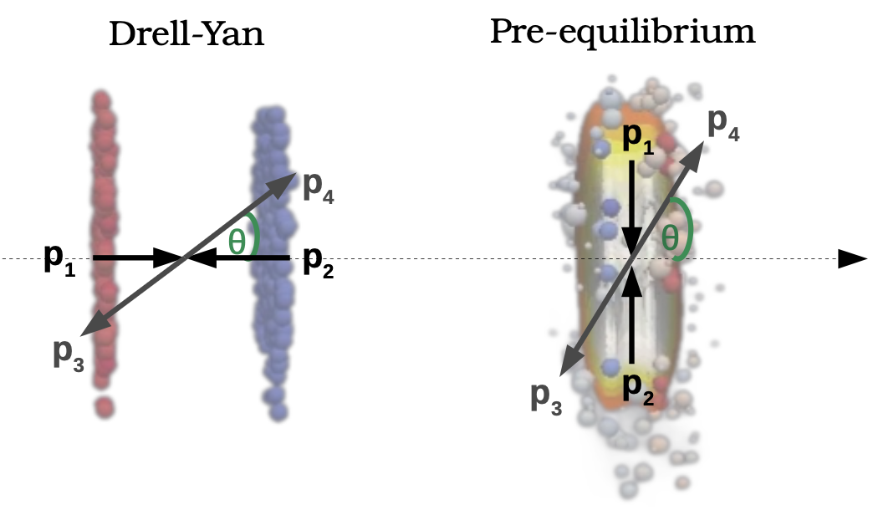
Dilepton flow and spectrum
Dileption spectrum and flow can provide differential picture of QGP time evolution.^{1,2}
Later
Later
High-precision di-lepton measurements:
access to signatures of chiral symmetry restoration.
There is room for more ambition:
In dileption rest frame, opening angle of dilepton pair preferentially aligned with opening angle of quark pair.
This polarization³ in Collins-Soper frame is sensitive to the QGP bulk anisotropy at early times.
O. Massen et al. arXiv:2412.09671;
Kasmaei et al, PRD 99 (2019) 3
3. Coquet et al, Phys.Rev.Lett. 132 (2024) 23, 232301

Slide 30
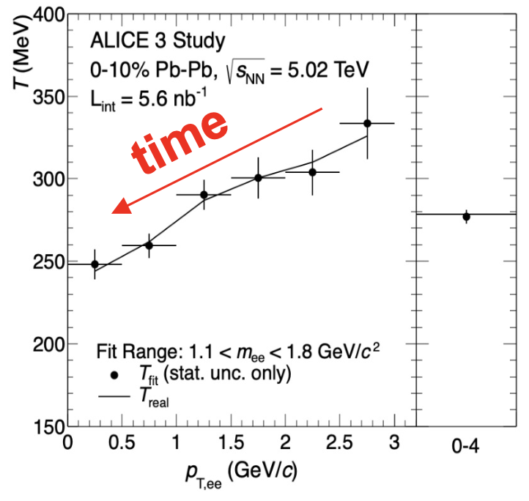
QGP time evolution via dileptons in reach of ALICE 3

Slide 31
Open Question
Microscopic mechanisms of quark interactions in the QGP
Quark-mass dependence of thermal equilibration
Mechanisms of hadron formation in high-density QCD environment
QGP electromagnetic radiation throughout its temporal evolution
Mechanism of chiral symmetry restoration in the QGP
Inner workings of the QGP
QGP substructure and medium-response via jets and rare probes
Yayun He et al, arXiv:2201.08408

Slide 32
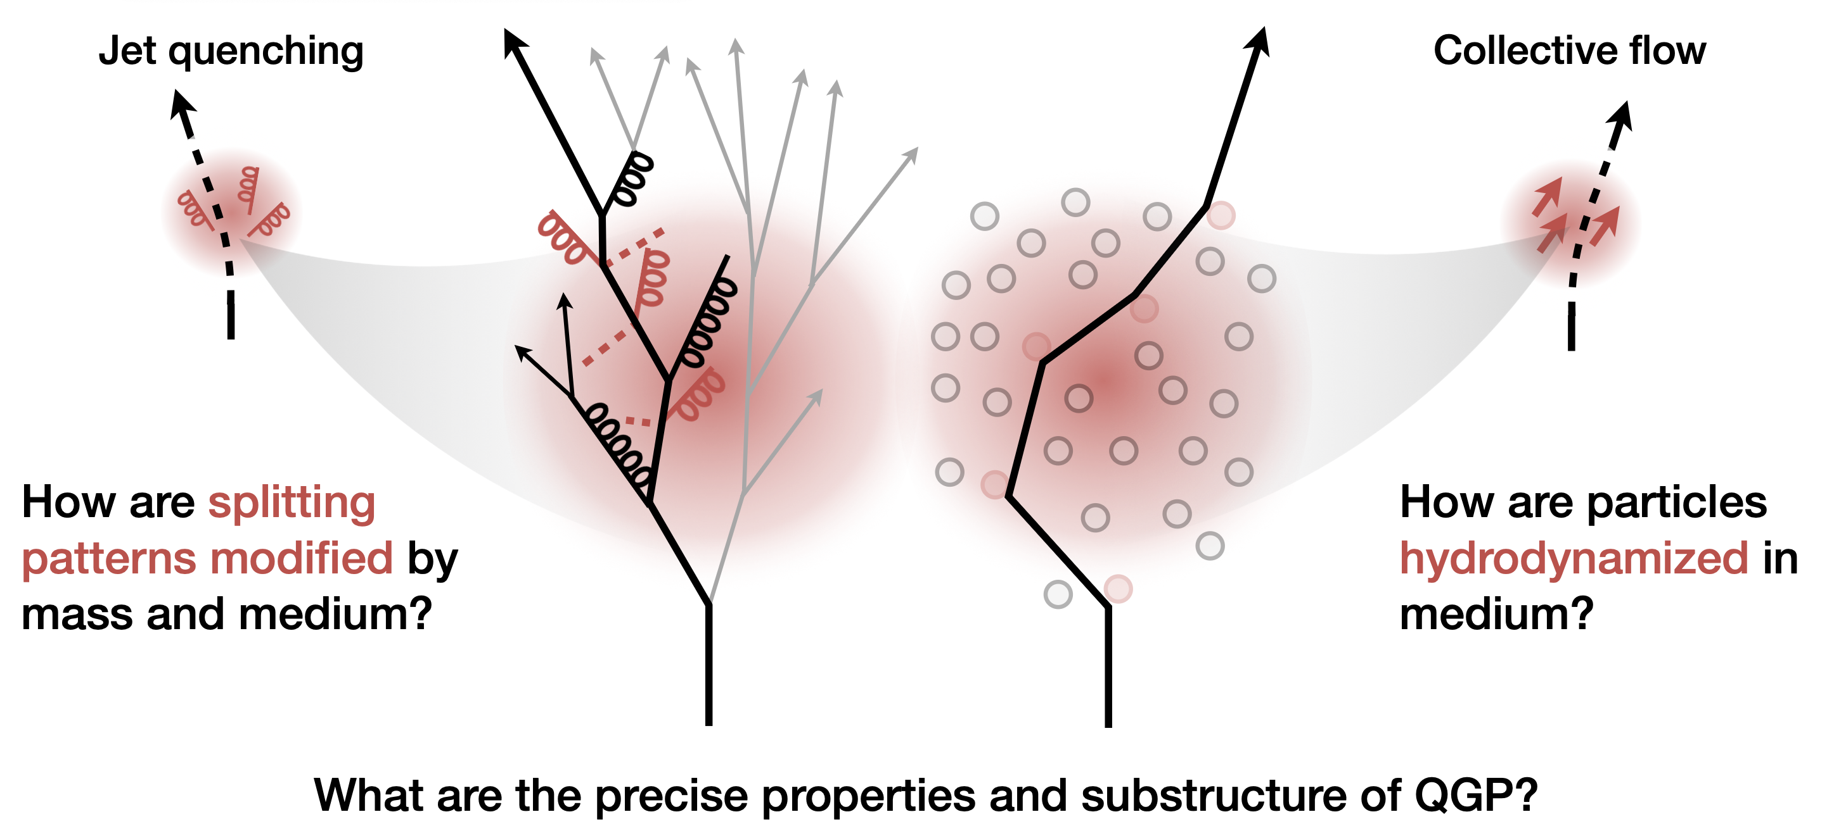
Open questions
Inner Working of the QGP?
J. Wang (CMS) in Town Meeting on Heavy Ion and QGP Physics, 17 Feb 2025, https://indico.cern.ch/event/1483832/
Yayun He et al, arXiv:2201.08408

Slide 33
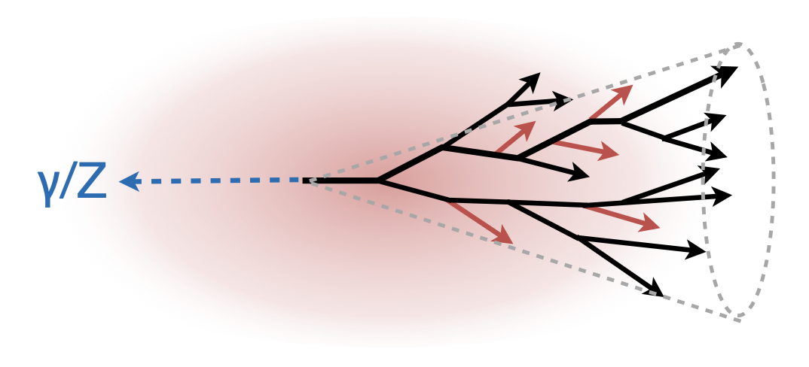
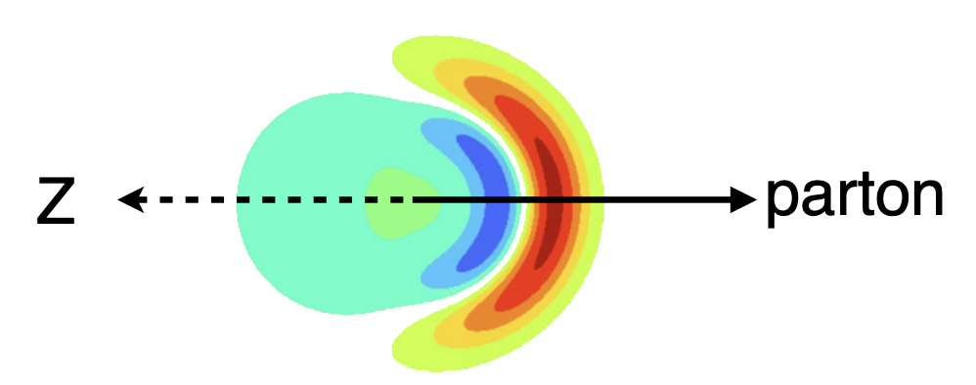
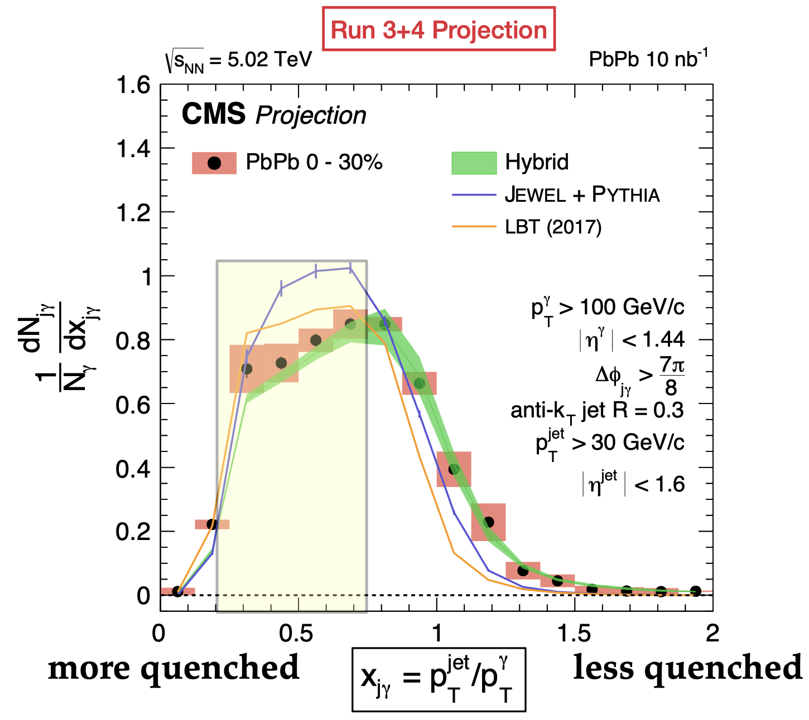
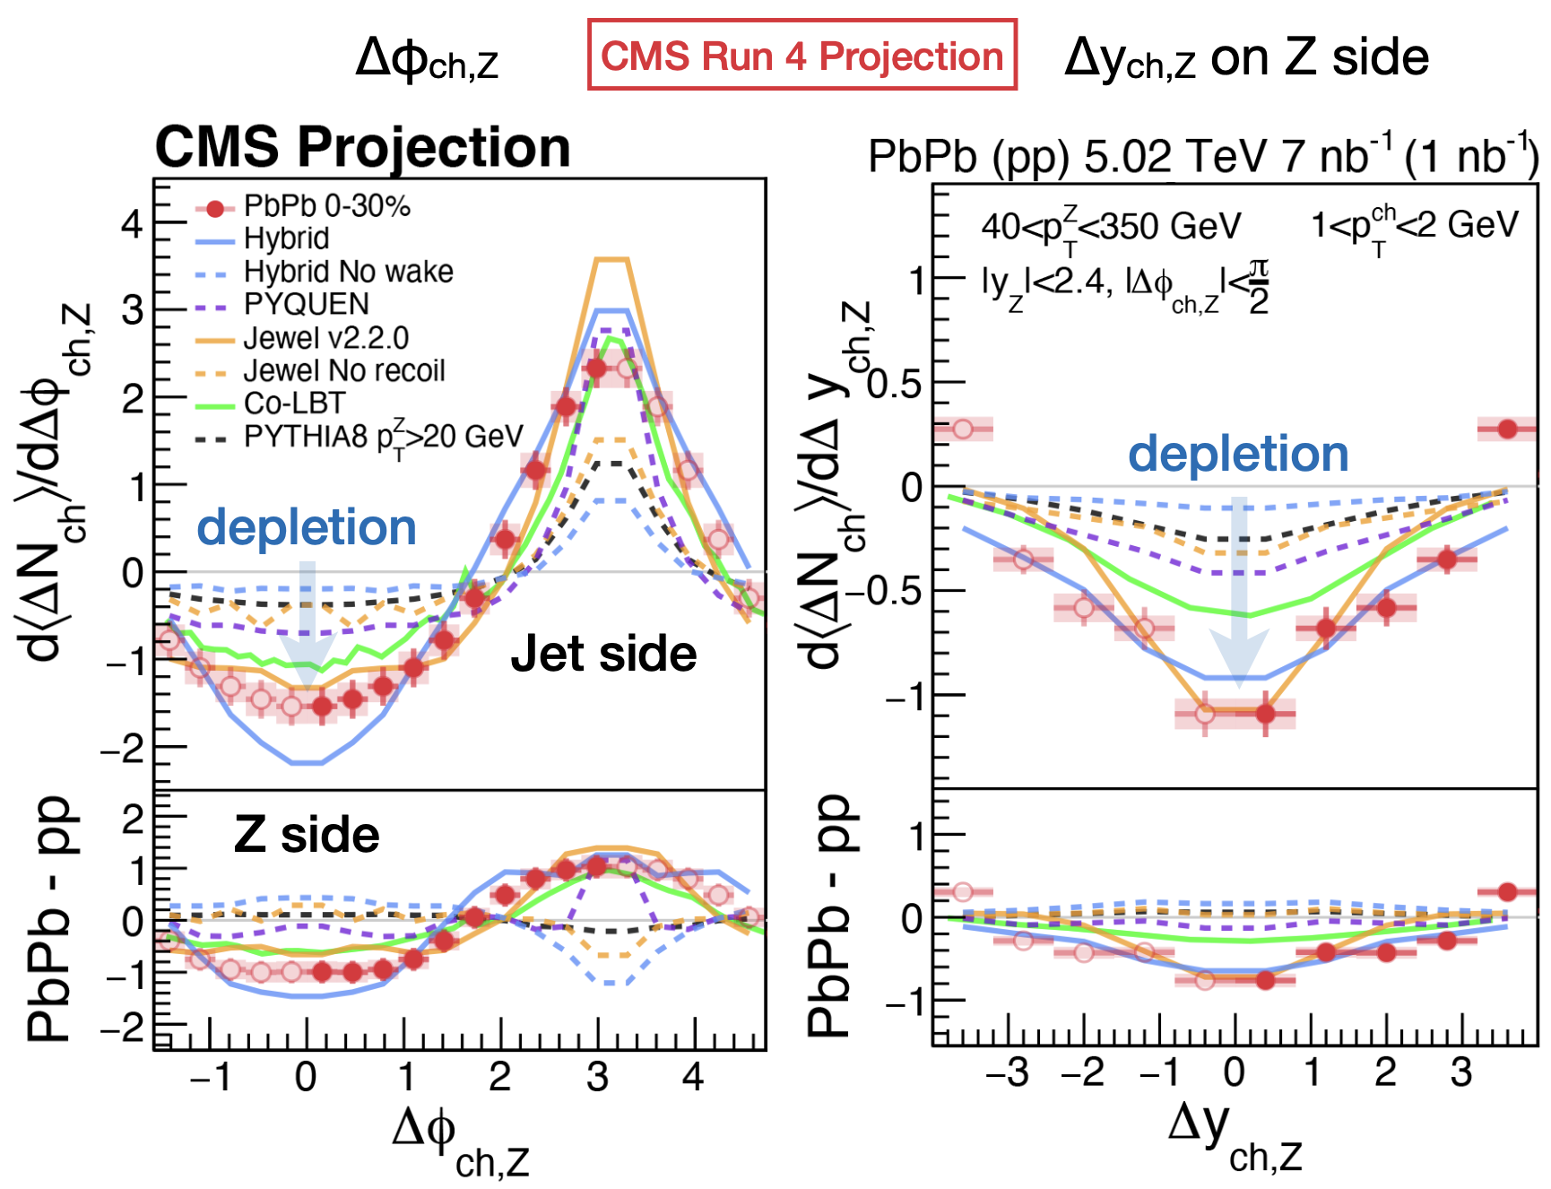

Rare hard probes¹
Precision in heavy flavor quenching
J. Wang (CMS) in Town Meeting on Heavy Ion and QGP Physics, 17 Feb 2025, https://indico.cern.ch/event/1483832/
Yayun He et al, arXiv:2201.08408

Slide 34





Heavy flavor - continued
Back-to-back open charm correlations
  Access to QGP constituents via
  Rutherford-like experiment.
  Constrains e-loss and angular decorrelation simultaneously.
Near-side open charm correlations¹
  Access to medium-modified splitting function
  Unique enhancement as a consequence of quenching
  Requires > 10 nb⁻¹ PbPb
1. M. Attems, J. Brewer, G.M. Innocenti, A. Mazeliauskas, S. Park, W. v.d.Schee, G. Soyez, UAW, Phys. Rev. Lett. 132 212301 (2024) .

Slide 35

QCD formation time via quenched jets
To measure , determine E_{g}, z and k_{c}
Strategy:
  reconstruct kinematics by tracing c and cbar to common vertex.
  compare kinematic -distribution in medium and vacuum.
QGP is unique in providing a spatial reference scale against which the QCD formation time can be measured.
J. Brewer, W. v.d.Schee, U.A. Wiedemann, 2503.11764

Slide 36



Testing QGP evolution with time-delayed quenching
. : time-delayed hard partons in QGP¹. Quenching changes reconstructed W-mass.
CMS expects first 3.8 modification in run2.
Luminosity-limited throughout HL-LHC.
Much better @ FCC-hh.
1 Apolinario et al., PRL 120 (2018) 23, 232301
Yayun He et al, arXiv:2201.08408

Slide 37
Conclusion
Nuclear beams will continue to enrich the HL-LHC programme scientifically, technologically and sociologically.
Novel opportunities in the next decade include
  Determining the transport properties of heavy flavor.
  Determining how the QGP radiates throughout its evolution.
  Determining the inner workings of the QGP via hard probes.
Full exploitation of HL-LHC as a heavy ion collider requires new detectors with frontier technology (ALICE3, LHCbUpg2, rate capabilities of ATLAS and CMS upgrades). High integrated luminosities during runs 4 and 5 are essential.
Yayun He et al, arXiv:2201.08408

Slide 38
Back-up
Yayun He et al, arXiv:2201.08408

Slide 39

ALICE 3
Id68:ALICE
Id7:HITownMeeting
Id106:NuPECC
Yayun He et al, arXiv:2201.08408

Slide 40

LHCb
ATLAS, CMS
Id82:LHCb
Id7:HITownMeeting
Id106:NuPECC
Id170:ATLAS+CMS
Id7:HITownMeeting
Id106:NuPECC
Yayun He et al, arXiv:2201.08408

Slide 41

NA60+/DICE
NA61/SHINE
Id171:NA61
Id7:HITownMeeting
Id106:NuPECC
Id131:NA60+
Id7:HITownMeeting
Id106:NuPECC
Id235:PBC
Yayun He et al, arXiv:2201.08408

Slide 42

Heavy Flavor flow: model comparisons
TH/models
  sensitivity to HF transport established
  Today: rough estimates
  inclusion in global Bayesian inference analysis to be done
Exp:
  HF flow needs to be known with precision of light-flavored flow.
  Coverage towards p_{T}=0 needed.
In reach of ALICE3, LHCbUpg2 at fwd y, NA60+.
ALICE, Phys.Lett. B813 (2021) 136054

Slide 43
Example 3: Heavy quark transport – beyond Foker-Planck
Langevin / Fokker-Planck describes random medium-induced momentum kicks
Drag and momentum broadening calculable from 1st principles in QFT
Einstein relation needed for Langevin / Fokker-Planck to thermalize
In strongly coupled N=4 SYM, Einstein relation is violated at finite velocity.*
“Because of the dramatic failure of the Einstein relation, it doesn’t make sense to
plug the trailing string predictions into a Langevin description … “ Gubser 2006
* violation beyond leading log also in finite temperature QCD, G.D. Moore & D. Teaney PRC71 (2005) 064904

Slide 44

Solution if Fokker-Planck fails: Kolmogorov-equation (Keq)
We have calculated in N=4 SYM the entire probability distribution ,
analytic control over all higher moments
This specifies the Kolmogorov evolution eq. of heavy quark momentum distribution
The kernel is defined in terms of
We find: FP eq = K-eq truncated to 2nd moments => FP does not thermalize
But: all order K-eq thermalizes
This solves Gubser’s problem.
We have derived an equilibration condition for the kernel of the K-eq that replaces the Einstein relation and is valid irrespective of coupling strength 2504.21139
K. Rajagopal, B. Scheihing-Hitschfeld, U.A. Wiedemann, 2501.06289

