Slide 1
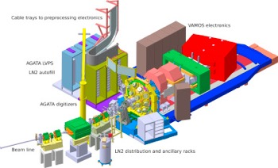
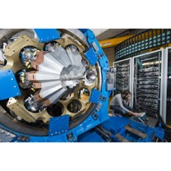
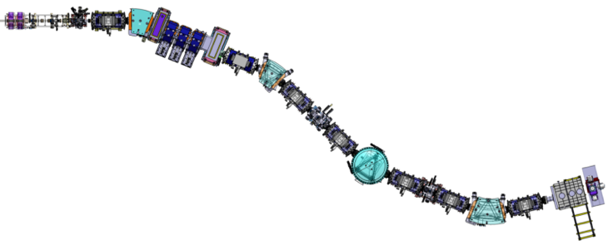
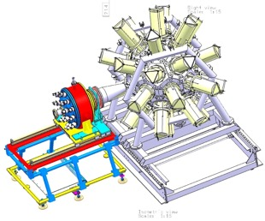

COPIGAL mini workshop
Scientific Center of Polish Academy of Sciences in Paris
November 28th – 29th 2024
(Prompt) Gamma Spectroscopy of Heavy and Superheavy Nuclei
Adam Maj, Piotr Bednarczyk and D.A.
Outline
MNT to produce light n-rich actinides at the lower end of N = 152 (around uranium)
Gamma multiplicities and the CN spin distribution at S³
Decay Spectroscopy After Separation (DSAS) at S³
Activities employing the Recoil Filter Detector (RFD)
VAMOS + AGATA +
…
RFD?
+ ...
S³
+ PARIS
Dieter Ackermann
Caen, France
Paris, November 29th 2024

Slide 2
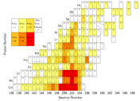
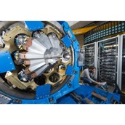






Accepted proposal @ GANIL PAC 2017
- possibly scheduled in year 2021 (re-submittal …)
E766: Identification of exotic reaction channels in ²³⁸U+²³⁸U
GANIL PAC Meeting
November 29th/30th 2017
D. Ackermann¹, S. Heinz², D. Boilley¹, L. Caceres¹, A. Chbihi¹, E. Clement¹, L. Corradi³,
P. Delahaye¹, H.M. Devaraja², E. Fioretto³, G. De France¹, M.O. Fregeau¹, F. Galtarossa³,
D. Hinde⁴, I. Itkis⁵, A. Karpov⁵, E. Kozulin⁵, G. Knyazheva⁵, A. Lemasson¹, M. Lewitowicz¹, G. Montagnoli³, K. Novikov⁵, I. Pchelintsev⁵, G. Pollarolo⁷, J. Piot¹, M. Rejmund¹, V. Saiko⁵, H. Savajols¹, C. Simenel⁴, A.M. Stefanini³, Ch. Stodel¹, S. Szilner⁸
¹GANIL, Caen, France
²GSI, Darmstadt, Germany
³LNL, Legnaro (PD), Italy
⁴ANU, Canberra, Austalia
⁵FLNR/JINR, Dubna, Russia
⁷Università degli Studi di Torino, Torino, Italy
⁸Ruder Boskovic Institute, Zagreb, Croatia
closed neutrons
(sub)shells
protons
sphericity
N = 152
deformation
Z = 100
246
6
?
247
(5/2)
limit of
knowledge
since 1970s
→ accessible
now by deep-
inelastic
(n, p transfer)
Am
Pu
246
14
1
0⁺
247
(5/2)
245
23
(9/2⁻)
VAMOS + AGATA
AGATA at GANIL
- ΔA/A = 1/500
isotope specific
nuclear structure data
→ achieved for
lead isotopes
new development:
coupling with
(existing) planar Ge
(LEPS) detectors
D. Ralet et al., Phys. Scr. 92, 054004 (2017)

Slide 3
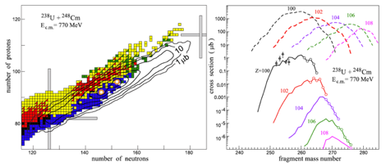
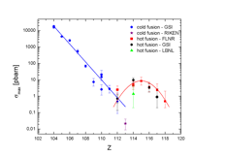

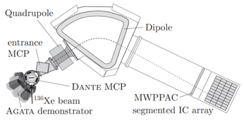
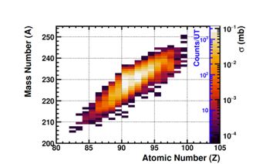
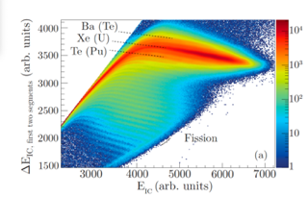

Multi Nucleon Transfer as an alternative tool
- n-rich very heavy and superheavy nuclei, RIB production
Science cases and applications
      neutron-rich nuclei
      region around N=126 south of ²⁰⁸Pb
      $→$ stellar nucleosynthesis
      region around N=152 n-rich actinides
      $→$superheavy nuclei
      new target-ion source for GANIL future
      $→$Radioactive Ion Beams (RIB) production
D. Ackermann and Ch. Theisen
Phys. Scr. 92 (2017) 083002 (83pp)
access to heavy
n-rich nuclei
via MNT
1 pb
V. Zagrebaev et al., EPJ Web of Conferences 86, 00066 (2015)
PRISMA
Installations at GANIL & LEGNARO
      VAMOS++ and second arm +EXOGAM
      (proposal Oct. 2024) ²³²Th(6 AMeV) +⁹⁶Zr at GANIL)
      PRISMA + AGATA
      (LOI May 2024 ¹³⁶Xe+²³⁸U at 1GeV and 𝜽_{lab}~50°)
VAMOS
A. Vogt, et al. PRC 92, 024619 (2015)
simulation of
heavy nuclei
production

Slide 4

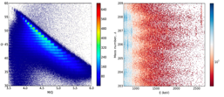

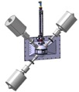
Deep in-elastic reactions in collision of ²³⁸U+²³⁸U at VAMOS+AGATA
- experiment at VAMOS
State of the art for heavy and superheavy element (SHE) research
      discovery Z ≤ 118
      nuclear structure information Z ≤ 110
      accessible (sub)shells Z=100,108 / N=152
Scientific quest
      production and nuclear structure of neutron-rich actinides
      → approach: (multi) nucleon transfer
      → isotope specific γ-spectroscopy
Experimental quest
      world class mass resolution ΔA/A = 1/250
      → upgraded VAMOS spectrometer
      high-Z identification by X-rays in-beam
      → planar Ge (LEPS) and AGATA
Envisaged results
      pioneering production and unprecedented
      isotope identification for ²³⁸U+²³⁸U
SHN
closed neutrons
(sub)shells
protons
N = 152
sphericity
deformation
Z = 100
limit of knowledge since 1970s
→ accessible now b deep-inelastic
reactions (n, p transfer)
Am
Pu
246
6
?
247
(5/2)
245
23
(9/2⁻)
246
14
1
0⁺
247
(5/2)
246
14
1
0⁺
- ΔA/A = 1/500
isotope specific
nuclear structure data
→ achieved for
lead isotopes
D. Ralet et al., Phys. Scr. 92, 054004 (2017)
new development:
coupling with
(existing) planar Ge
GANIL-IPNO

Slide 5
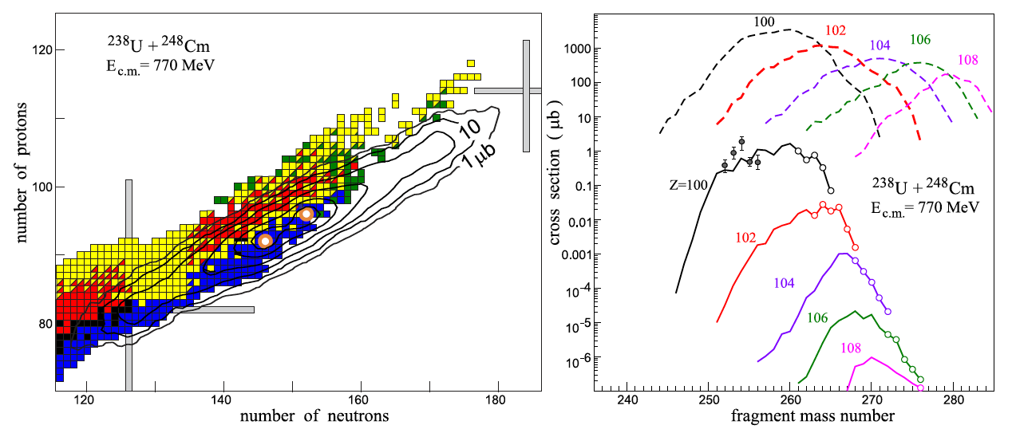

Multi Nucleon Transfer
- very heavy and superheavy nuclei
1 pb
V. Zagrebaev et al., EPJ Web of Conferences 86, 00066 (2015)

Slide 6
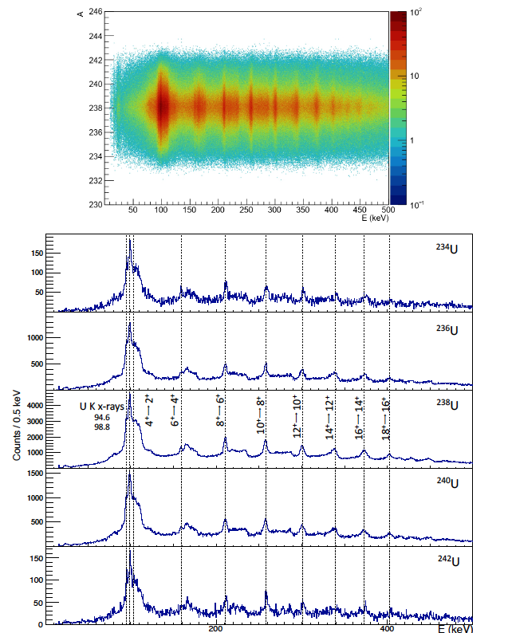
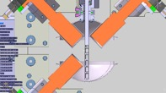
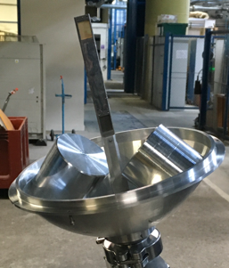
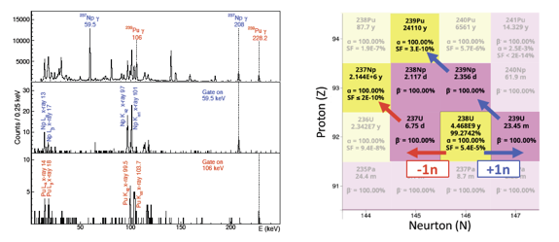

Multi Nucleon Transfer
- ²³⁸U+²³⁸U @ VAMOS+AGATA+ID-fix (Ph.D. Ablaihan Utepov)
ID-fix
A-$γ$ coindidences
(preliminary)
AGATA
VAMOS
target ladder
with Al-degrader
offline Al-degrader measurement

Slide 7
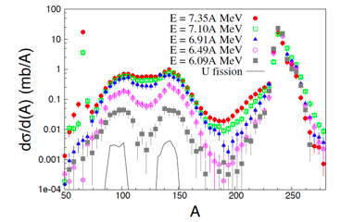
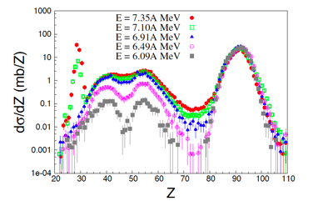
Motivation and opportunities
VAMOS+AGATA and planar Ge-detectors: improved A resolution and Z sensitivity by X-rays
  n-rich light trans-actinides by (multi-nucleon) transfer in the region beyond ²³⁸U
  → basis for future spectroscopy at the lower end of N=152
  shell effects around ²⁰⁸Pb
  detection of n-rich fission fragments (add-on)
  production of SHN in deep-inelastic reaction (speculation)

Slide 8
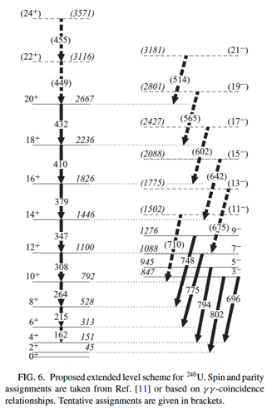
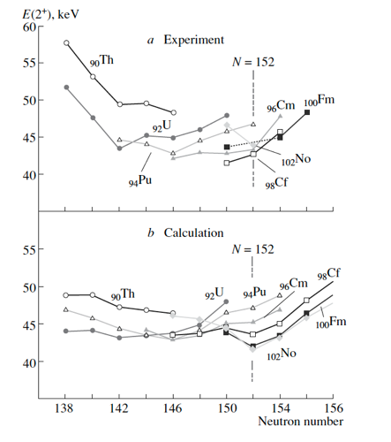
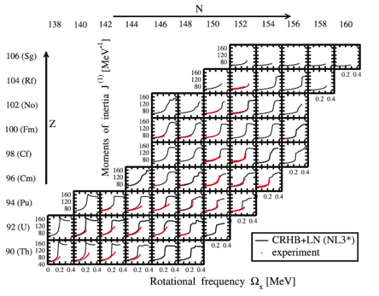
Neutron-rich actinides at the lower end of N=152
- ²³⁸U + ²³⁸U at PRISMA+AGATA at LNL
²⁴⁰U
T. Ishii et al., Phys. Atom. Nucl. 70 (2007) p. 1457
B. Birkenbach et al.PRC 92
044319 (2015)
A.V. Afanasjev Phys. Scr. 89, (2017) 054001
²³⁸U⁽¹⁸O,¹⁶O)²⁴⁰U and ²⁴⁴Pu, ²⁴⁸Cm
¹³⁶Xe + ²³⁸U – 2n transfer

Slide 9
Earlier measurement at AGATA+PRISMA at LNL
- ^{236,238,240}U structure features/X-rays for PID
$J_{kin}$ alignment, octupole vibrations vs. static (oct.) deformation
PID by X-rays
S.S. Hota et al.,
Phys. Lett. B 739,
13–8 (2014)
²⁴⁰U
B. Birkenbach et al., PRC 92 044319 (2015)
A. Vogt et al., PRC 92, 024619 (2015)
D. Ackermann and Ch. Theisen, Phys. Scr. 92, 083002 (2017)

Slide 10
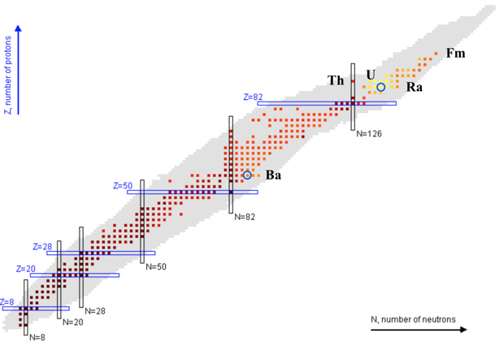




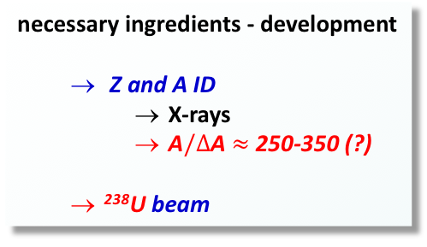
²³⁸U+²³⁸U @ AGATA+VAMOS/PRISMA
- challenges and opportunities
necessary ingredients - development
  Z and A ID
    X-rays
    A$/∆$A$≈$ 250-350 (?)
  ²³⁸U beam
SHE
shell effects
octupole deformation/vibration
alignment
…
²⁰⁸Pb
shape co-existence?
?
¹⁸⁶Pb
L. P. Gaffney et al.
Nature
H. Heyde and P Wood
Rev. Mod. Phys. 83, 1467 (2011)
A. Andreyev et al.
Nature

Slide 11
ANR NEUTRANS
NEUtron rich TRAnsfer reactions for Nuclear Synthesis
B. Sulignano (CEA)
D. Ackermann (CEA –GANIL)
I. Stefan (IJC Lab)

Slide 12
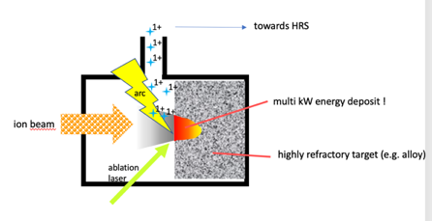
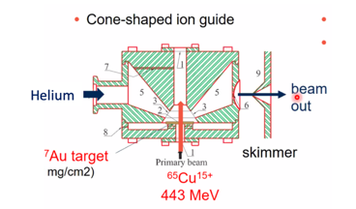

Preliminary simulation for GAS-CELL development
RIB production with NEWGAIN beams: NEW target-ion source/gas-cell concept using MNT reactions:
Technical challenge: exploit the full beam power and dissipate the full beam intensity in the target to efficiently explore all reaction channels $→$ simulations needed
Nier-Bernas Ion Source
GAS-CELL
GANIL Future Project - H. Franberg, S. Grévy
MNT

Slide 13
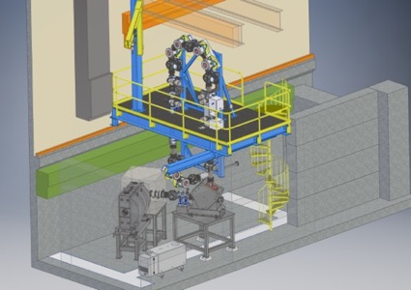
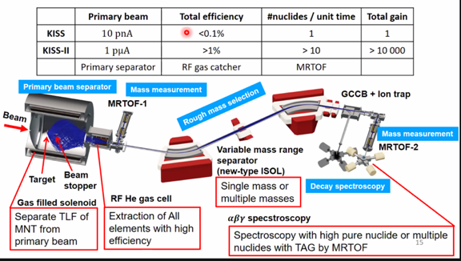
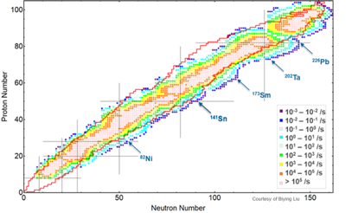
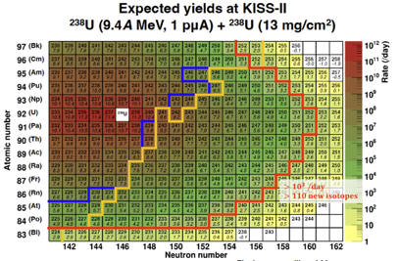
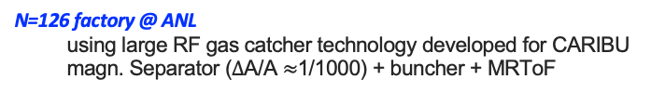
RISKS (Competitors)
N=126 factory @ ANL
  using large RF gas catcher technology developed for CARIBU
  magn. Separator ($Δ$A/A $≈$1/1000) + buncher + MRToF
KISS II project @ RIKEN(not yet financed)
  1 500 000 000 Yen for the project
  10.223 million euros for a solenoid gas cell
https://www.anl.gov/phy/the-n126-factory
Y. Watanabe
December 2022
courtesy of I. Stefan

Slide 14
Accepted proposal @ GANIL PAC 2017
- possibly scheduled in year 2021 (re-submittal …)
GANIL PAC Meeting
November 27th/28th 2024
VAMOS + AGATA

Slide 15
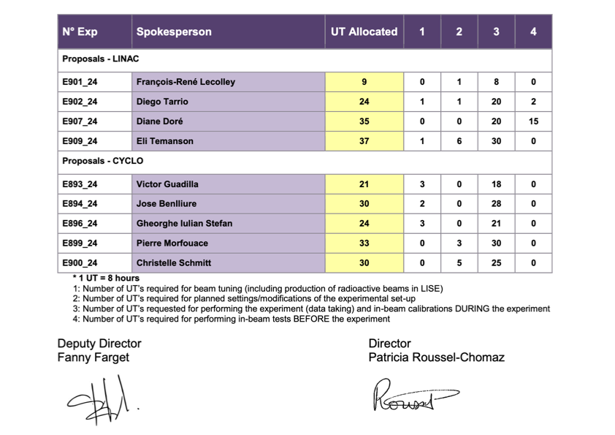
MNT proposal E896_24 @ GANIL PAC 2024
⁹⁶Zr+²³²Th in inverse kinematics at 6 AMeV
GANIL PAC Meeting
November 27th/28th 2024
Study of the Heavy Fragment survival in Multi Nucleon Transfer reactions
Spokesperson Iulian Stefan,
Back-up Spokesperson Navin Alahari, Barbara Sulignano, D.A.
VAMOS + EXOGAM

Slide 16
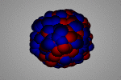
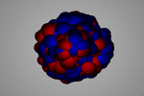
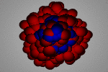
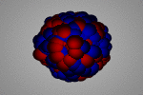
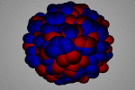
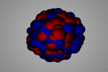
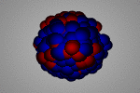
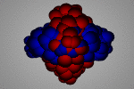
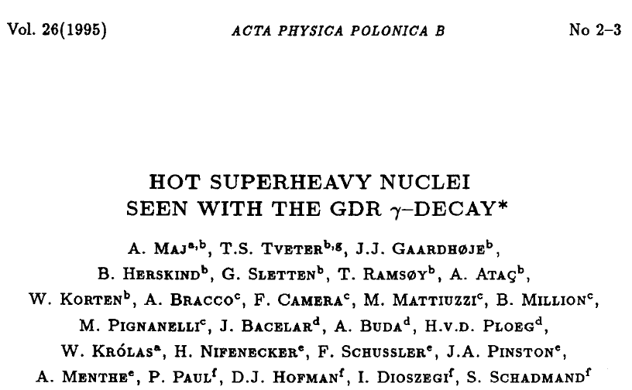
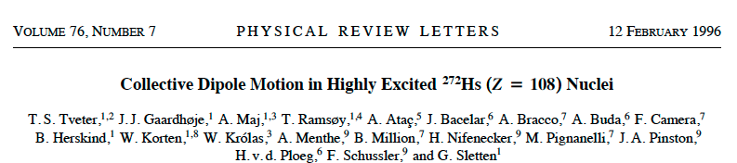
Study of the giant dipole resonance in hot superheavy nuclei
- from: M. Vandebrouck (A. Maj) AGATA@LNL 2019
Electric GR
T = 0
isoscalar
T = 1
isovectorial
monopole
(GMR)
dipole
(GDR)
quadrupole
(GQR)
Experiments in Grenoble performed
by the HECTOR collaboration
(Copenhagen, Krakow, Milano)

Slide 17
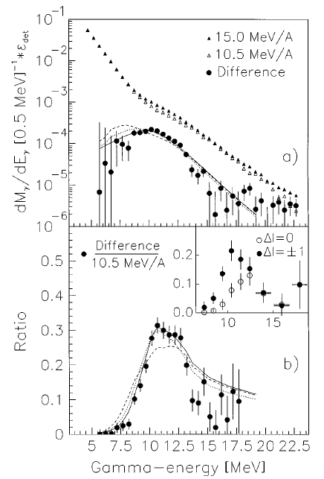
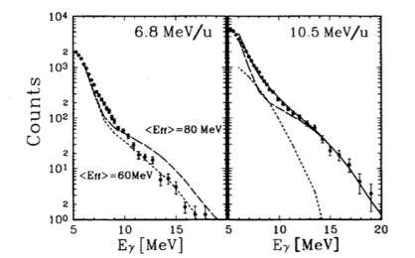


Measurement of $γ$ – fission coincidences
- ⁴⁰Ar (6.8, 10.5, 15 MeV/u) + ²³²Th → ²⁷²Hs*
$γ$ – fission coincidences
$$energy differential method$$
Difference between the two g spectra in coincidence with fission fragments
Bump in the range of the GDR energy predicted for the composite system (E_{GDR} (A = 272) ≈ 12.2 MeV)
In addition:
Angular distribution. Measurement of the anisotropy W(0°)/W(90°). Compatible with dipole emission from a compact, slightly prolate shape
Lifetime estimate ≈ 2.5 × 10⁻²⁰ s
A. Maj et al. Acta Phys. Pol. B 26, 417 (1995)
T.S. Tveter et al. Phys. Rev. Lett. 76, 1035 (1996)

Slide 18
Perspectives
- model predictions
Possibility to study low-energy component of the GDR with AGATA
E. Litvinova and H. Wibowo, Phys. Rev. Lett. 121, 082501 (2018)
The low-energy enhancement at high temperatures is quite generic. It is seen (in calculations) in Ca, Ni and Sn and in all E0, E1 and E2 channels.

Slide 19
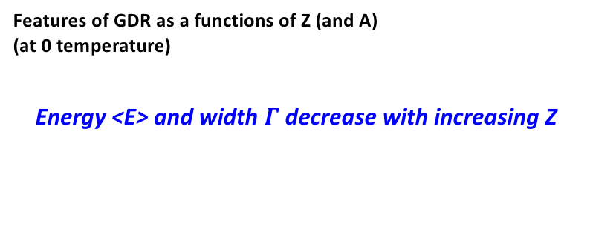
Perspectives
- model predictions
Features of GDR as a functions of Z (and A)
(at 0 temperature)
  Energy <E> and width $Γ$ decrease with increasing Z
EME1
EME1
E. Litvinova, P. Ring and V. Tselyaev
PRC 78, 014312 (2008)
EME1
EME1
EME1
EME1
E. Litvinova and P. Schuck
PRC 100, 064320 (2019)
E. Litvinova
private communication

Slide 20
possible setup: AGATA, PARIS, 2-arm PRISMA/VAMOS
Bragg Chamber
E, Z
Quadrupole
PPAC
(t, ΔTOF)
- 37°
Dipole
37°
Beam
MCP
Target
(t, x, y)
60°
t, X, Y
MWPPAC
ΔE, E_{res}
Ionization
chamber

Slide 21
Gamma multiplicities with PARIS
- studies of the entry distribution in the E*-$ℓ$plane

Slide 22
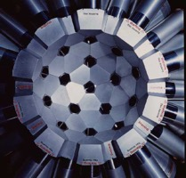

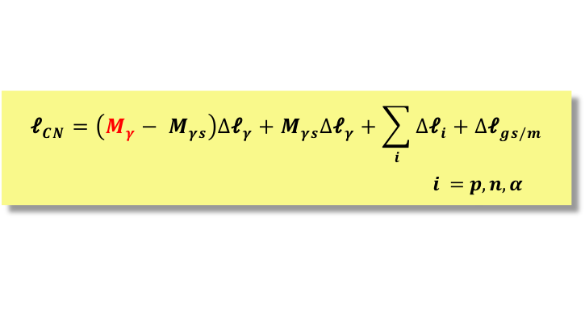


Fusion barrier distribution – alternative approach
- the CN spin distribution
$D_{b}$ from 1st derivative of the transfer function $T_{\text{𝓁}}$equivalent to $E∙σ_{fus}$
high spin part covers complete barrier distribution at one E_{proj} rather than many precise cross section measurements at small ΔE
n-rich projectiles for isospin dependent fusion barrier investigations
...
instrumental requirements:
highly efficient (≈80% at E_{γ} < 500 keV)
γ multiplicity array (e.g. GAMMASHPERE, PARIS, ...)
ER trigger
  not evaporation channel selective
  → only separator
  channel selective
  → e.g. Ge-detector (array) , AGATA, GAMMASPERE, GRETINA...)
separator
→ E_{pro} ≈ 5 AMeV
→ E_{ER} ≈ 0.1-1 AMeV
  gas filled (TASCA, VAMOS, PRISMA)
  → Bρ ≥ 2.5 Tm
  vacuum type
    v-filter (SHIP, LISE)
    mass spectrometer (FMA/RMS...)
  ...
πR²
πR²
$$σ_{\text{𝓁} }$$
T_{𝓁}
T_{E'}
D_{b}
𝓁
𝓁
E'
E'
$$M_{γ}$$
γ multiplicity filter + ER trigger
$${\text{𝓁}}_{CN}=\left(M_{γ}− M_{γs}\right)∆{\text{𝓁}}_{γ}+M_{γs}∆{\text{𝓁}}_{γ}+\sum_{i}{∆{\text{𝓁}}_{i}}+∆{\text{𝓁}}_{gs/m}$$
$i =p,n,α$
D. Ackermann et al., EPJ A 20 (2004) 151

Slide 23




Fusion barrier distribution – alternative approach
- the CN spin distribution
$D_{b}$ from 1st derivative of the transfer function $T_{\text{𝓁}}$equivalent to $E∙σ_{fus}$
high spin part covers complete barrier distribution at one E_{proj} rather than many precise cross section measurements at small ΔE
n-rich projectiles for isospin dependent fusion barrier investigations
...
instrumental requirements:
highly efficient (≈80% at E_{γ} < 500 keV)
γ multiplicity array (e.g. GAMMASHPERE, PARIS, ...)
ER trigger
  not evaporation channel selective
  → only separator
  channel selective
  → e.g. Ge-detector (array) , AGATA, GAMMASPERE, GRETINA...)
separator
→ E_{pro} ≈ 5 AMeV
→ E_{ER} ≈ 0.1-1 AMeV
  gas filled (TASCA, VAMOS, PRISMA)
  → Bρ ≥ 2.5 Tm
  vacuum type
    v-filter (SHIP, LISE)
    mass spectrometer (FMA/RMS...)
  ...
πR²
πR²
$$σ_{\text{𝓁} }$$
T_{𝓁}
T_{E'}
D_{b}
𝓁
𝓁
E'
E'
$$M_{γ}$$
γ multiplicity filter + ER trigger
$${\text{𝓁}}_{CN}=\left(M_{γ}− M_{γs}\right)∆{\text{𝓁}}_{γ}+M_{γs}∆{\text{𝓁}}_{γ}+\sum_{i}{∆{\text{𝓁}}_{i}}+∆{\text{𝓁}}_{gs/m}$$
$i =p,n,α$
D. Ackermann et al., EPJ A 20 (2004) 151

Slide 24

Extraction of the barrier distribution for ⁶⁴Ni+¹⁰⁰Mo
- analysis by Varinderjit Singh, Panjab University, India
spin 𝓁 → E‘
Step wise transformation σ_{𝓁} to D_{b}
transmission function T(E‘) (T(𝓁))
barrier distribution
  covers large energy range E‘ for one E_{beam}
  sensitive only for fusion-evaporation
  fission cut-off leads to truncation at low E‘↔ high 𝓁
πR²
πR²
$$σ_{\text{𝓁} }$$
T_{𝓁}
T_{E'}
D_{b}
𝓁
𝓁
E'
E'
priliminary – analysis ongoing

Slide 25



application for exotic nuclei
- $γ$ multiplicity array (e.g. PARIS) at S³’s intermediate focus
High beam intensity
  High power target: >> 1pµA (= 6.10¹²p/s)
Convergent mode
6 charge states & no mass resolution
𝚫dp/p=20%,
𝚫𝝦=90mrad,
𝚫𝛗=140mrad)
¹⁰⁰Sn transmissions 65%
(10x10cm)
Achromatic point
Target position
Final focal plane
Primary beam dump
Secondary beam dump
  Versatile multistep separator
  Ion optics configuration: Q³DQ³Q³DQ³Q³EQ³Q³DQ³
  →
High mass resolution mode
3 charge states & M/𝚫M = 505
𝚫dp/p=16%
𝚫𝝦=45mrad
𝚫𝛗=140mrad)
¹⁰⁰Sn transmissions 40%
(10x10cm)
Two basic modes of operation:
High transmission vs high mass resolution
Notes:
New SPIRAL2 roadmap
SC 13 june & 23 octobre 2013
Recent decisions werre taken
For those who don’t know what SPIRAL2 is, Let me start by a brief description of the project. Here you have the layout of this facility which will be constructed in two phases. The first phase which is presently in construction is based …
Attached to this fisrt phase, two new experimental are also under construction : one dedicated to NFS and the other which will host the new S3 spectrometer, I will describe later.
The second phase which in the detail design phase, will concern the production building …. New DESIR facility recentky funded …
This facility will deliver in a near future, both high intensity stable beams and and intensity of radioactive beams.
Here you have the layout of the facility
SPIRAL2 est une priorite nationale tel que decrit dans la Feuille de route TGIR en France (rapport ministère 2012)
Incluses dans la liste ESFRI des grandes infrastructures européennes et NuPECC Road-map 2010 et
sections efficaces extrêmement faibles
• production majoritaire d’espèces indésirables
• très courte durée de vie des noyaux d’intérêt
DEUX installations complémentaires en EUROPE
Desir : (faisceaux radioactifs de basse énergie très loin de la stabilité).
Nouveau pour GANIL

Slide 26






21 November 2024: First S³ commissioning milestone achieved, with snow ...
On your marks …
Get set …
Go!
First high-intensity beam at S³:
80 μAe
(5,7 pμA, 3.6x10¹³ pps, 1.14 kW)
Courtesy Hervé Savajols
M. Grasso (Journée projets IN2P3)

Slide 27
SHE research at SPIRAL2
- short and long term
S³ pre-proposals (LINAG A/Q=3)
  basic nuclear properties (masses, ionization potential, quadrupole moments, radii ...)
  K-isomers
  single particle states
  new isotopes – limits of stability
  odd-Z nuclei
  reaction mechanism
  N=152, 162
LINAG A/Q=7
– access extended in A and Z
  SHE Synthesis
    fusion-evaporation
    Deep inelastic, MNT
    (²³⁸U+²³⁸U – approved
    proposal at GANIL)
  detailed and extended spectroscopy
  (see above)
152
162
184
120
beam intensities [particle μA]* | SPIRAL2 GANIL, Caen
 | LINAG A/q=3 | LINAG A/q=7 (project)
¹⁸O | 216 | 375
¹⁹F | 57 | 50
³⁶Ar | 35 | 40
⁴⁰Ar | 5.8 | 30
⁴⁰Ca | 6 | 20
⁴⁸Ca | 2.5 | 15
⁵⁸Ni | 2.2 | 10
⁸⁶Kr | 0 | 20
¹²⁴Sn | 0 | 10
¹³⁶Xe | 0 | 10
²³⁸U | 0 | 2.5
114
108
E_{shell}
1 particle μA
= 6.2 x10¹² particles/s
Calc.: A. Sobiszewski

Slide 28
Day 1 experiments – SIRIUS
- update (S³ meeting in June 18th – 22nd 2018)
Pre-proposals selection criteria:
high impact” (discovery & unique proposals for S³, e.g. “High-Resolution mode” (HRM))
feasibility.
152
162
184
N° | Title | Spokesperson | Beam | UT | Comments
1 | Search for the end of stability of the nobelium isotopes (Isomeric state in ²⁵⁰No and identification of ²⁴⁹No) | A. Lopez-Martens (CSNSM) P. Greenless (U. JYFL) B. Sulignano (Irfu) | 48Ca | 81 | Isotope discovery. Study fission in SHE.
2 | Search for new isotopes: ²⁵²Rf (GS & Isomeric) | B. Sulignano (Irfu) J. Khuyagbaatar (GSI) Ch. Theisen (Irfu) | 50Ti | 81 | Isotope discovery.
3 | Detailed investigation of isomeric states in ²⁵⁴Rf | B. Sulignano (Irfu) J. Khuyagbaatar (GSI) Ch. Theisen (Irfu) | 50Ti | 18 | Flight length of S³ could be too long for the shortest lived isomeric state.
4 | Alpha-decay spectroscopy of odd-Z isotopes in fermium region | S. Antalic (U. Bratislava) D. Ackermann (GANIL) | 48Ti | 36 | Possible with the convergent mode
5 | Search for high-K isomeric states in ²⁶⁰Sg | D. Ackermann (GANIL) S. Antalic (U. Bratislava) | 54Cr | 63 | Possible with the convergent mode. Run at lower intensity in Dubna in 2019 If Beam energy & intensity available in Dubna.
120
114
108
E_{shell}
Calc.: A. Sobiszewski

Slide 29







Search for high-K isomeric states in ²⁶⁰Sg
- pre-proposal June 2018 (earlier data B. Sulignano/B. Streicher - Ph.D. Thesis)
Excitation function:
1n channel
σ _{max}(²⁶⁰Sg) = 0.65 nbarn
$α$spectrum
D. Ackermann¹, S. Antalic², B. Andel², Z. Asfari³, L. Caceres¹, P. Chowdhury⁴,
P. Delahaye¹, O. Dorvaux³, A. Drouart⁵, B. Gall³, K. Hauschild⁶,
F.P. Heßberger⁷, J. Khuyagbaatar^{7,8}, F.G. Kondev⁹, A. Korichi⁶, N. Lecesne¹,
M. Lewitowicz¹, A. Lopez-Martens⁶, A. Mistry^{7,8}, P. Mošať², C. Petrache⁶,
J. Piot¹, H. Savajols¹, D. Seweryniak⁹, Ch. Stodel¹, B. Sulignano⁵, Ch. Theisen⁵,
M. Vandebrouck⁵, P.T. Greenlees¹⁰, J. Uusitalo¹⁰ and the Nuclear
Spectroscopy group of JYFL¹⁰
¹ GANIL, CEA/DRF-CNRS/IN2P3, Caen, France
² Comenius University in Bratislava, Bratislava, Slovakia
³ IPHC, Strasbourg, France
⁴ University of Massachusetts, Lowell, MA
⁵ Irfu, CEA, Université Paris-Saclay, Gif-sur-Yvette, France
⁶ CSNSM, Orsay, France
⁷ GSI, Darmstadt, Germany
⁸ Helmholtzinstitut Mainz, Mainz, Germany
⁹ ANL, Argonne, IL, U.S.A.
¹⁰ JYFL, Jyväskylä, Finland
$α$: E – time correlation
sf decay time

Slide 30


Level systematics for Lr isotopes
- S. Antalic et al. pre-proposal (talk on Tuesday, May 15th 2019)
Theory: A. Parkhomenko and A. Sobiczewski, APPB 35, 2447 (2004)
F.P. Heßberger, EPJ Web of Conferences 131, 02005 (2016)
1/2-[521] and 7/2-[514] states stem from 2f_{5/2} and 2f_{7/2} defining possible the shell gap at Z=114. Both responsible for isomers in Lr isotopes.
Uncertain g.s. configuration for most of the Lr isotopes and completely missing data on excited levels.
There are almost no new data available in last 10 years

Slide 31

Odd-Z isotopes at S³
- S. Antalic, D.A. et al. pre-proposal
N = 152
²⁴⁵Md
Possible isomer in ²⁴⁵Md
ground-state configuration of ²⁴¹Es
(3/2⁻[521] vs. 7/2⁺[633])
Excitation energy E* of 7/2⁻[514] level in ²⁴¹Es
Partial fission and β-decay half-life
²⁵³Lr
Indification of 1/2⁻[521] isomers in ²⁴⁹Md and ²⁵³Lr
E* for isomers along ²⁵⁷Db → ²⁵³Lr → ²⁴⁹Md
Partial fission half-life
²⁵⁴Lr
Confirmation of an isomer in ²⁵⁰Md.
β-decay study of ²⁵⁴Lr and possible population of non-yrast states in ²⁵⁴No
²⁵⁵Db
Confirmation of ²⁵⁵Db
1/2⁻[521] isomers in ²⁴⁷Md and ²⁵¹Lr.
E* of isomers along ²⁵⁷Db → ²⁵³Lr → ²⁴⁹Md
Partial fission half-life
Z = 100
Ch. Theisen et al.,
Special Issue SHE of
Nuclear Physics A 944
(2015) p. 333-375
Am
Pu
246
6
?
247
(5/2)
245
23
(9/2⁻)
246
14
1
0⁺
247
(5/2)

Slide 32




Solving the ²⁴⁴⁻²⁴⁵Md puzzle
- ANL/ATLAS Exp. #2059 (Ph.D. Shayan Kumar)
BGS
FIONA
(trochoidal)
mass spectrometer
J. Pore et al. at the BGS+FIONA of LBNL
discovery claim: new most n-deficient Md-isotope ²⁴⁴Md
contradiction to GSI date
earlier (SHIP) and recent (TASCA)
J. L. Pore et al., Phys. Rev. Lett. 124, 252502 (2020)
Solution at ANL/ATLAS: simultaneous
mass measurement + decay spectroscopy
FMA + X-array
V. Ninov et al., Z. f. Phys. A 356, 11 (1996)
J. Khuyagbaatar et al., Phys. Rev. Lett. 125, 142504 (2020)
F.P. Heßberger
J. Pore
Khuyagbaatar

Slide 33




Solving the ²⁴⁴⁻²⁴⁵Md puzzle
- ANL/ATLAS Exp. #2059 (Ph.D. Shayan Kumar)
²⁴⁴Md?
Experiment at the FMA May/June 2024
Preliminary results:
  ²⁴⁷Md: $α$decay from g.s. and isomer
  ^{244,245}Md: two $α$decay energies
  x-section $≈$ 0.1 nbarn
²⁴⁵Md
²⁴⁷Md

Slide 34

Recoil Filter Detector for in beam gamma spectroscopy of heavy (SH) nuclei
Experience from EUROBALL (1999-2003)
A- Coulex, FF, etc.
B- ER
Increased sensitivity to gamma radiation from fusion reactions (at low σ) :
Selection of Evaporation Residues by TOF
Reduction of the overhelming fission background
¹⁷⁶Yb(³⁰Si,xn) ^{200, 201}Po
EB+RFD
EB
¹⁸⁴W(¹⁹F, xn) ^{196, 197}Bi
B. Rosse et al. , Int. J. Mod. Phys. E, 13 (2004), p. 47

Slide 35



²³⁸U(¹⁸O,4n)²⁵²Fm @90MeV
Search for excited states in „double magic” ²⁵²Fm
test experiment at EBIV and RFD (2001):
Significant reduction of the fission baskground
Indication of Fm X-rays !
Slow recoils (majority stopped in the RFD mylar foils ?)
U target imperfections
Fm X-rays
Typical reaction products distribution (simulation)
EUROBALL and RFD in 2001
Generated by AI
²⁵²Fm: Graal of SH research

Slide 36


Recoil Filter Detector (RFD) at HIL UW Warsaw
SONATA BIS, NCN grant (M.Matejska-Minda et al.)
RFD @ GALILEO LNL
RFD modernization:
1) Scintillators, isolators, Mylar foils
2) New generation of PMT’s - Silicon PhotoMultipliers (SiPM)
higher segmentation and
higher counting rate capabilities
3) DAQ
Pulse Shape Discrimination using state-of-the-art digitizers
no hardware filtering
tigerless system, all data written on discs
reduced deadtime
4) Adaptation of the machanical structure, a reaction chamber, etc.
RFD coupled to EAGLE array @ HIL
Attempt to perform in-beam gamma spectroscopy of SHE

Slide 37

Future prospects
RFD at Radioactive Ion Beams (SPIRAL2, SPES)
High energy and intensity of heavy RIB
Access to Heavy Nuclei (transactinides) at high spin
Needed:
Fission supression
Doppler correction (fast recoils v/c > 4% )
PACE4
Stable Beam
σ_{resid} = 150 mb
σ_{fission} = 75-95%
RIB
σ_{resid} = 70 mb

Slide 38




Experimental approach at ANL – October 2021
¹⁸O + ²³⁸U ➔ ²⁵²Fm + 4n
E. Donets et al., Soviet Journal of Nuclear Physics 2, 723 (1966).
(Gamma-Ray Energy Tracking In-beam Nuclear Array)
S. Paschalis et al., Nucl. Instru. Meth. A 709, 44 (2013)
Efficiency at 121 keV ~ 11 %
$$ΔM/M≈350$$
40x40 strips
4x4cm²
For ²⁵²Fm:
M/Q
$$σ≈750nb$$
8.2 m
Fragment Mass Analyser at ANL
C. N. Davids et al., Nucl. Instru. Meth. B 70, 358 (1992)
Target thickness: 182 μg/cm²
Beam intensity: 2-48 pnA
Beam energy 89 MeV
Duration: 10 days
Expected number of ²⁵²Fm nuclei in the DSSD assuming a Transmission of 1 % ~ 300
^{238U(18O, xn)256-xnFm}
measured using Radiochemical methods at JINR, Dubna
Courtesy Rikel Chakma, ANL (former postdoc at GANIL)

Slide 39




Results from the ²⁵²Fm Experiment
1904
16⁺
𝛄-ray spectra observed in GRETINA
1470
14⁺
$$E(I)=\frac{ℏ^{2}}{2𝒥}\left(I(I+1)\right)$$
1092
12⁺
770
10⁺
²⁵⁶No
504
8⁺
294
6⁺
T_{1/2} = 2.9 s
140
4⁺
alpha-decay
42
2⁺
0
0⁺
M. Asai et al, JAEA-Review 2016-025
²⁵²Fm
$$\frac{N_{Expected{}^{252}Fm}}{N_{DSSD}}≈\frac{300}{4.2×{10}^{6}}$$
Difficult to extract the ²⁵²Fm rotational band because of
Large background → Need better rejection
Low number of recoils at the focal plane → Need higher transmission
Courtesy Rikel Chakma, ANL (former postdoc at GANIL)

Slide 40





Results from the ²⁵²Fm Experiment
$$Eα=7 ±0.5 MeV$$
E_{𝛂} (keV)
K.-H. Schmidt’s method (97 % confidence)
K.-H. Schmidt, et al. Z Physik A 316, 19–26 (1984).
Detected 11 counts of ²⁵²Fm full energy alpha decay
in 26.95 h
$$T_{1/2}=9_{−3}^{+17}h$$
Literature (NNDC)
$$T_{1/2}=25.38(12)h$$
Will be feasible at S³ in GANIL, France, for example.
Better rejection ~ 100 x FMA
Transmission > 20 x FMA
Mass resolution ~ 1.4 x FMA
Courtesy Rikel Chakma, ANL (former postdoc at GANIL)

Slide 41
²³⁸U(¹⁸O,4n)²⁵²Fm @90MeV
Search for excited states in „double magic” ²⁵²Fm
test experiment at EBIV and RFD (2001):
Significant reduction of the fission baskground
Indication of Fm X-rays !
Slow recoils (majority stopped in the RFD mylar foils ?)
U target imperfections
Fm X-rays
Typical reaction products distribution (simulation)
EUROBALL and RFD in 2001
Generated by AI
²⁵²Fm: Graal of SH research

Slide 42
Recoil Filter Detector for in beam gamma spectroscopy of heavy (SH) nuclei
Experience from EUROBALL (1999-2003)
A- Coulex, FF, etc.
B- ER
Increased sensitivity to gamma radiation from fusion reactions (at low σ) :
Selection of Evaporation Residues by TOF
Reduction of the overhelming fission background
¹⁷⁶Yb(³⁰Si,xn) ^{200, 201}Po
EB+RFD
EB
¹⁸⁴W(¹⁹F, xn) ^{196, 197}Bi
B. Rosse et al. , Int. J. Mod. Phys. E, 13 (2004), p. 47

Slide 43
Recoil Filter Detector (RFD) at HIL UW Warsaw
SONATA BIS, NCN grant (M.Matejska-Minda et al.)
RFD @ GALILEO LNL
RFD modernization:
1) Scintillators, isolators, Mylar foils
2) New generation of PMT’s - Silicon PhotoMultipliers (SiPM)
higher segmentation and
higher counting rate capabilities
3) DAQ
Pulse Shape Discrimination using state-of-the-art digitizers
no hardware filtering
tigerless system, all data written on discs
reduced deadtime
4) Adaptation of the machanical structure, a reaction chamber, etc.
RFD coupled to EAGLE array @ HIL
Attempt to perform in-beam gamma spectroscopy of SHE

Slide 44
Future prospects
RFD at Radioactive Ion Beams (SPIRAL2, SPES)
High energy and intensity of heavy RIB
Access to Heavy Nuclei (transactinides) at high spin
Needed:
Fission supression
Doppler correction (fast recoils v/c > 4% )
PACE4
Stable Beam
σ_{resid} = 150 mb
σ_{fission} = 75-95%
RIB
σ_{resid} = 70 mb

Slide 45

SPES RIB: fission on Ucx
RIB production with NEWGAIN beams possible alternative RIB production scheme
^{133,135}I
⁹⁰⁻⁹²Rb
Fission

Slide 46


Experimental investigation of alternative parity bands in actinides
²²⁰Ac
σ=-1
σ=+1
1980-1990
Beams : C, O, N
Targets: Pb, Bi
Max.Spin J~20h
²⁰⁹Bi(¹²⁻¹⁴C, xn)²¹⁷⁻²²⁰Ac
Alternative parity bands
Schultz 1992
¹²C
¹⁴C
²⁰⁹Bi
²²⁴Ra
RIB COULEX

Slide 47


Alternative use of a symmetric reaction with a RIB
RIB: ⁹⁰⁻⁹²Rb at 10⁹⁽⁷⁾ pps
c
c
Target: ¹³⁰Te
High spins ?

Slide 48











Collaboration
Physics Division
SHE France international
In conclusion:
These activities are a continuous effort of working group
- (Prompt) Gamma Spectroscopy of
Heavy and Superheavy Nuclei -
within COPIGAL
Adam Maj, Piotr Bednarczyk, D.A.
Mainz
Darmstadt
M. Block
H.M. Devaraja
S. Heinz
F.P. Heßberger
S. Hofmann
I. Kojouharov
J. Maurer
A. Mistry
Univ.
Bratislava
M. Block
J. Khuyagbaatar
A. Mistry
M. Laatiaoui
S. Raeder
et al.
D.A.
D. Boilley
L. Caceres
P. Delahaye
Q. Hourdille
N. Lecesne
M. Lewitowicz
J. Piot
H. Savajols
Ch. Stodel
A. Utepov
B. Andel
S. Antalic
P. Mošať
A. Drouart
B. Sulignano
Ch. Theisen
M. Vandebrouck
Th. Goigoux
Z. Favier
O. Dorvaux
B. Gall
Z. Asfari
Univ.
Jyväskylä
Dubna
Argonne
K. Hauschild
A. Lopez-Martens
A. Korichi
A. Karpov
A.G. Popeko
A.V. Yeremin
et al.
D. Seweryniak
M. Carpenter
F.G. Kondev
T. Lauritsen
P.T. Greenlees
J. Uusitalo
et al.
Krakow
Kalamazoo
Univ.
Leuven
A. Maj
P. Bednarczyk
et al.
P. Van Duppen
et al.
E. Litvinova
et al.
Notes:
nuclear reaction dynamics
inelastic reactions (multi-)nucleon transfer reactions
Wylczynski plot
“proximity” potential
incomplete fusion
SHE synthesis

Slide 49


Low Energy Nuclear Dynamics: FUSION27
Bordeaux May 24th – 28th 2027
Fusion dynamics
Superheavy elements
Fission and quasi-fission dynamics
Transfer reactions and deep-inelastic collisions
Near-barrier collisions with weakly bound and unstable nuclei
Tunneling: deep sub-barrier fusion and spontaneous fission
Nuclear reactions relevant to astrophysics
Accelerators and instrumentation for reactions around the barrier
Theoretical developments in fusion and large amplitude collective motions
Palais DE LA BOURSE, Bordeaux, Aquitaine - France
https://indico.in2p3.fr/event/34700/

Slide 50
Results 2/2
Difference between the two g spectra in coincidence with fission fragments
Bump in the range of the GDR energy predicted for the composite system (E_{GDR} (A = 272) ≈ 12.2 MeV)
In addition:
Angular distribution. Measurement of the anisotropy W(0°)/W(90°). Compatible with dipole emission from a compact, slightly prolate shape
Estimation of the lifetime ≈ 2.5 × 10⁻²⁰ s
T.S. Tveter et al. Phys. Rev. Lett. 76, 1035 (1996)

Slide 51

How can we go further?
T.S. Tveter, J.J. Gaardhoje, A. Maj et al.
Phys. Rev. Lett. 76, 1035 (1996)

Slide 52

Results 1/2
γ energy spectra measured in coincidence with fission fragments
A. Maj et al. Acta Phys. Pol. B 26, 417 (1995)
Comparison with statistical model calculations for the fission fragments
Contribution of a pre-fission component seems to be needed

Slide 53
Experiment
Fusion-fission reaction
Beam: ⁴⁰Ar 6.8, 10.5, 15 MeV/nucleon
Target: ²³²Th
Aim
Measurement of the γ-rays coming from the de-excitation of the GDR populated in the composite system around ²⁷²Hs(Z=108)
What was measured?
- Fission fragments in PPAC
- Gamma from de-excitation of the composite system and of the fission fragments
T.S. Tveter et al. Phys. Rev. Lett. 76, 1035 (1996)
A. Maj et al. Acta Phys. Pol. B 26, 417 (1995)

