Slide 1
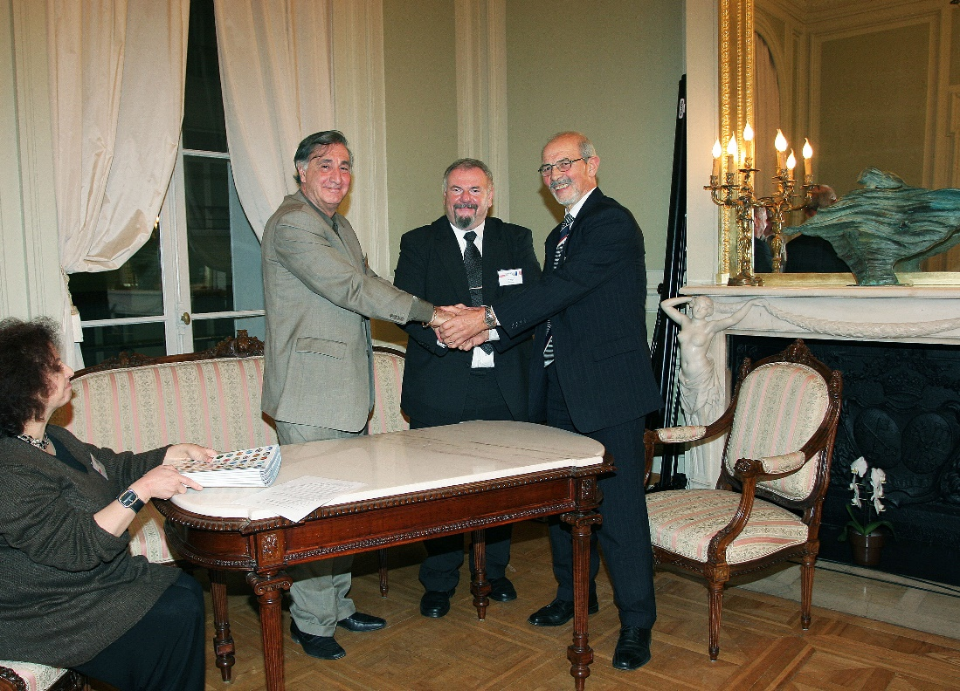
Signature ceremony of the LEA COPIGAL Agreement
November 26, 2008 (for 4 years)
at the Polish Academy of Sciences Scientific Center in Paris
Sydney Gales Marek Jeżabek Jan Styczeń

