Slide 1
Gamma-ray spectroscopy studies of neutron-rich light nuclei at GANIL and CCB IFJ PAN
Michał Ciemała (IFJ PAN Kraków)
Emmanuel Clement (CNRS GANIL)
28/11/2024 COPIGAL Workshop

Slide 2
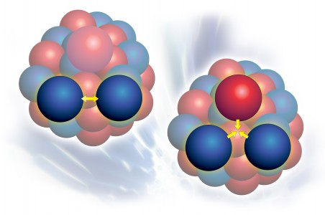
Nuclear force is the „heart” of nuclear physics, and has been studied from ~1930.
During the past few decades a large effort has been made toward describing the nucleon-nucleon (NN) interaction in the framework of chiral Effective Field Theory (EFT). The main idea is to exploit the symmetries of QCD to obtain an effective theory for low energy nuclear systems.
NN
NN+NNN
3 body interactions are common in many fields of complex systems.

Slide 3
Binding energy of selected light nuclei:
values from the experiment (black) and calculations performed with: (i) two-body interactions only (NN) and, (ii) two-body + three-body terms (NN + NNN).
Are there observables, which are more
sensitive to the three-nucleon term
of the nucleon-nucleon interaction?
For example, electromagnetic observables?
4
He
6
He
8
6
He
Li
7
Li
8
Li
9
Li
8
Be
9
Be
10
experiment
10
Be
B
calculations NN
calculations NN+NNN
Argonne V₁₈ potential and Green’s function Monte Carlo (GFMC) method;
Pieper & Wiringa, Ann. Rev. Nucl. Part. Sci. 51, 53 (2001)
12
C
For binding energy and excited state energy, the effect of three-nucleon forces
is of the order of 10-30%.

Slide 4
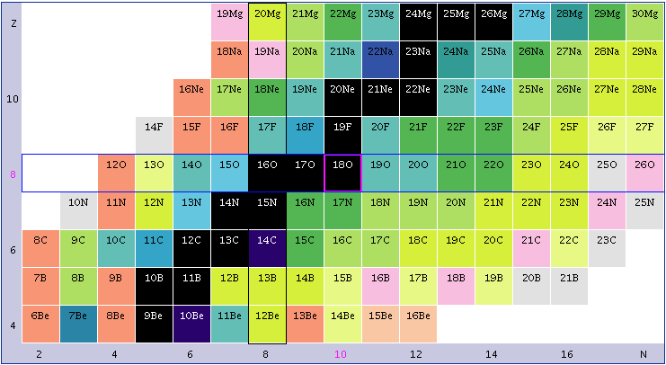
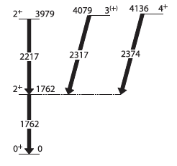
ab initio
Many-Body-Pert. Theory calculations
of the 2⁺₂ lifetimes
J.D. Holt, et al., Eur. Phys. J. A49, 39 (2013).
Z
NN NN+NNN
320 fs 200 fs
¹⁸O
²⁰O
¹⁶C
50
N
NN NN+NNN
300 fs 80 fs
≈ 15 ps
11 ps
ab initio
No-Core-SHELL Model
calculations
C. Forssén, et al., J. Phys. G: Nucl. Part. Phys. 40, 055105 (2013).
¹⁶C
²⁰O
M. Petri et al., Phys. Rev. C 86, 044329 (2012).
M. Wiedeking et al., Phys. Rev. Lett. 94, 132501 (2005).

Slide 5

Experiment at GANIL, Caen, France
One of the most sophisticated setups: VAMOS+AGATA+PARIS
Beam: ¹⁸O ions, 7.0 MeV/A
Target: ¹⁸¹Ta 4 μm thick
Goal:
excited state lifetime determination
Detectors used:
AGATA+PARIS+VAMOS setup
Beam time:
10 days data taking in July 2017
E. Clement et al. NIMA 885, 1-12 (2017)
Experiment Spokespersons: S. Leoni, B. Fornal, M. CiemaŁa
Milano – IFJ PAN Krakow

Slide 6
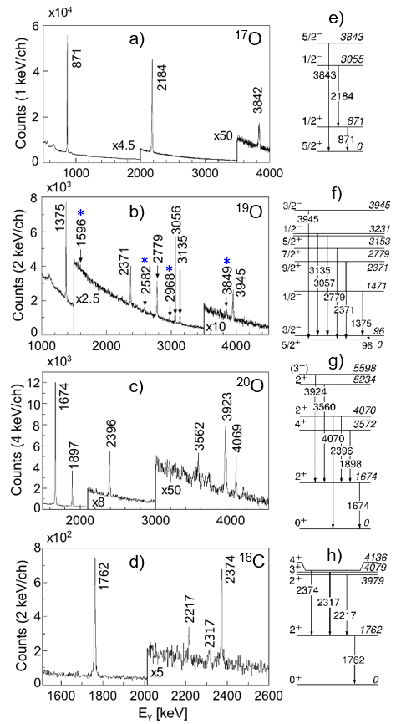
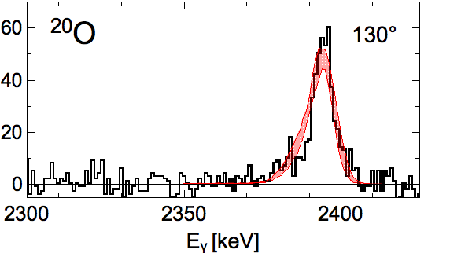
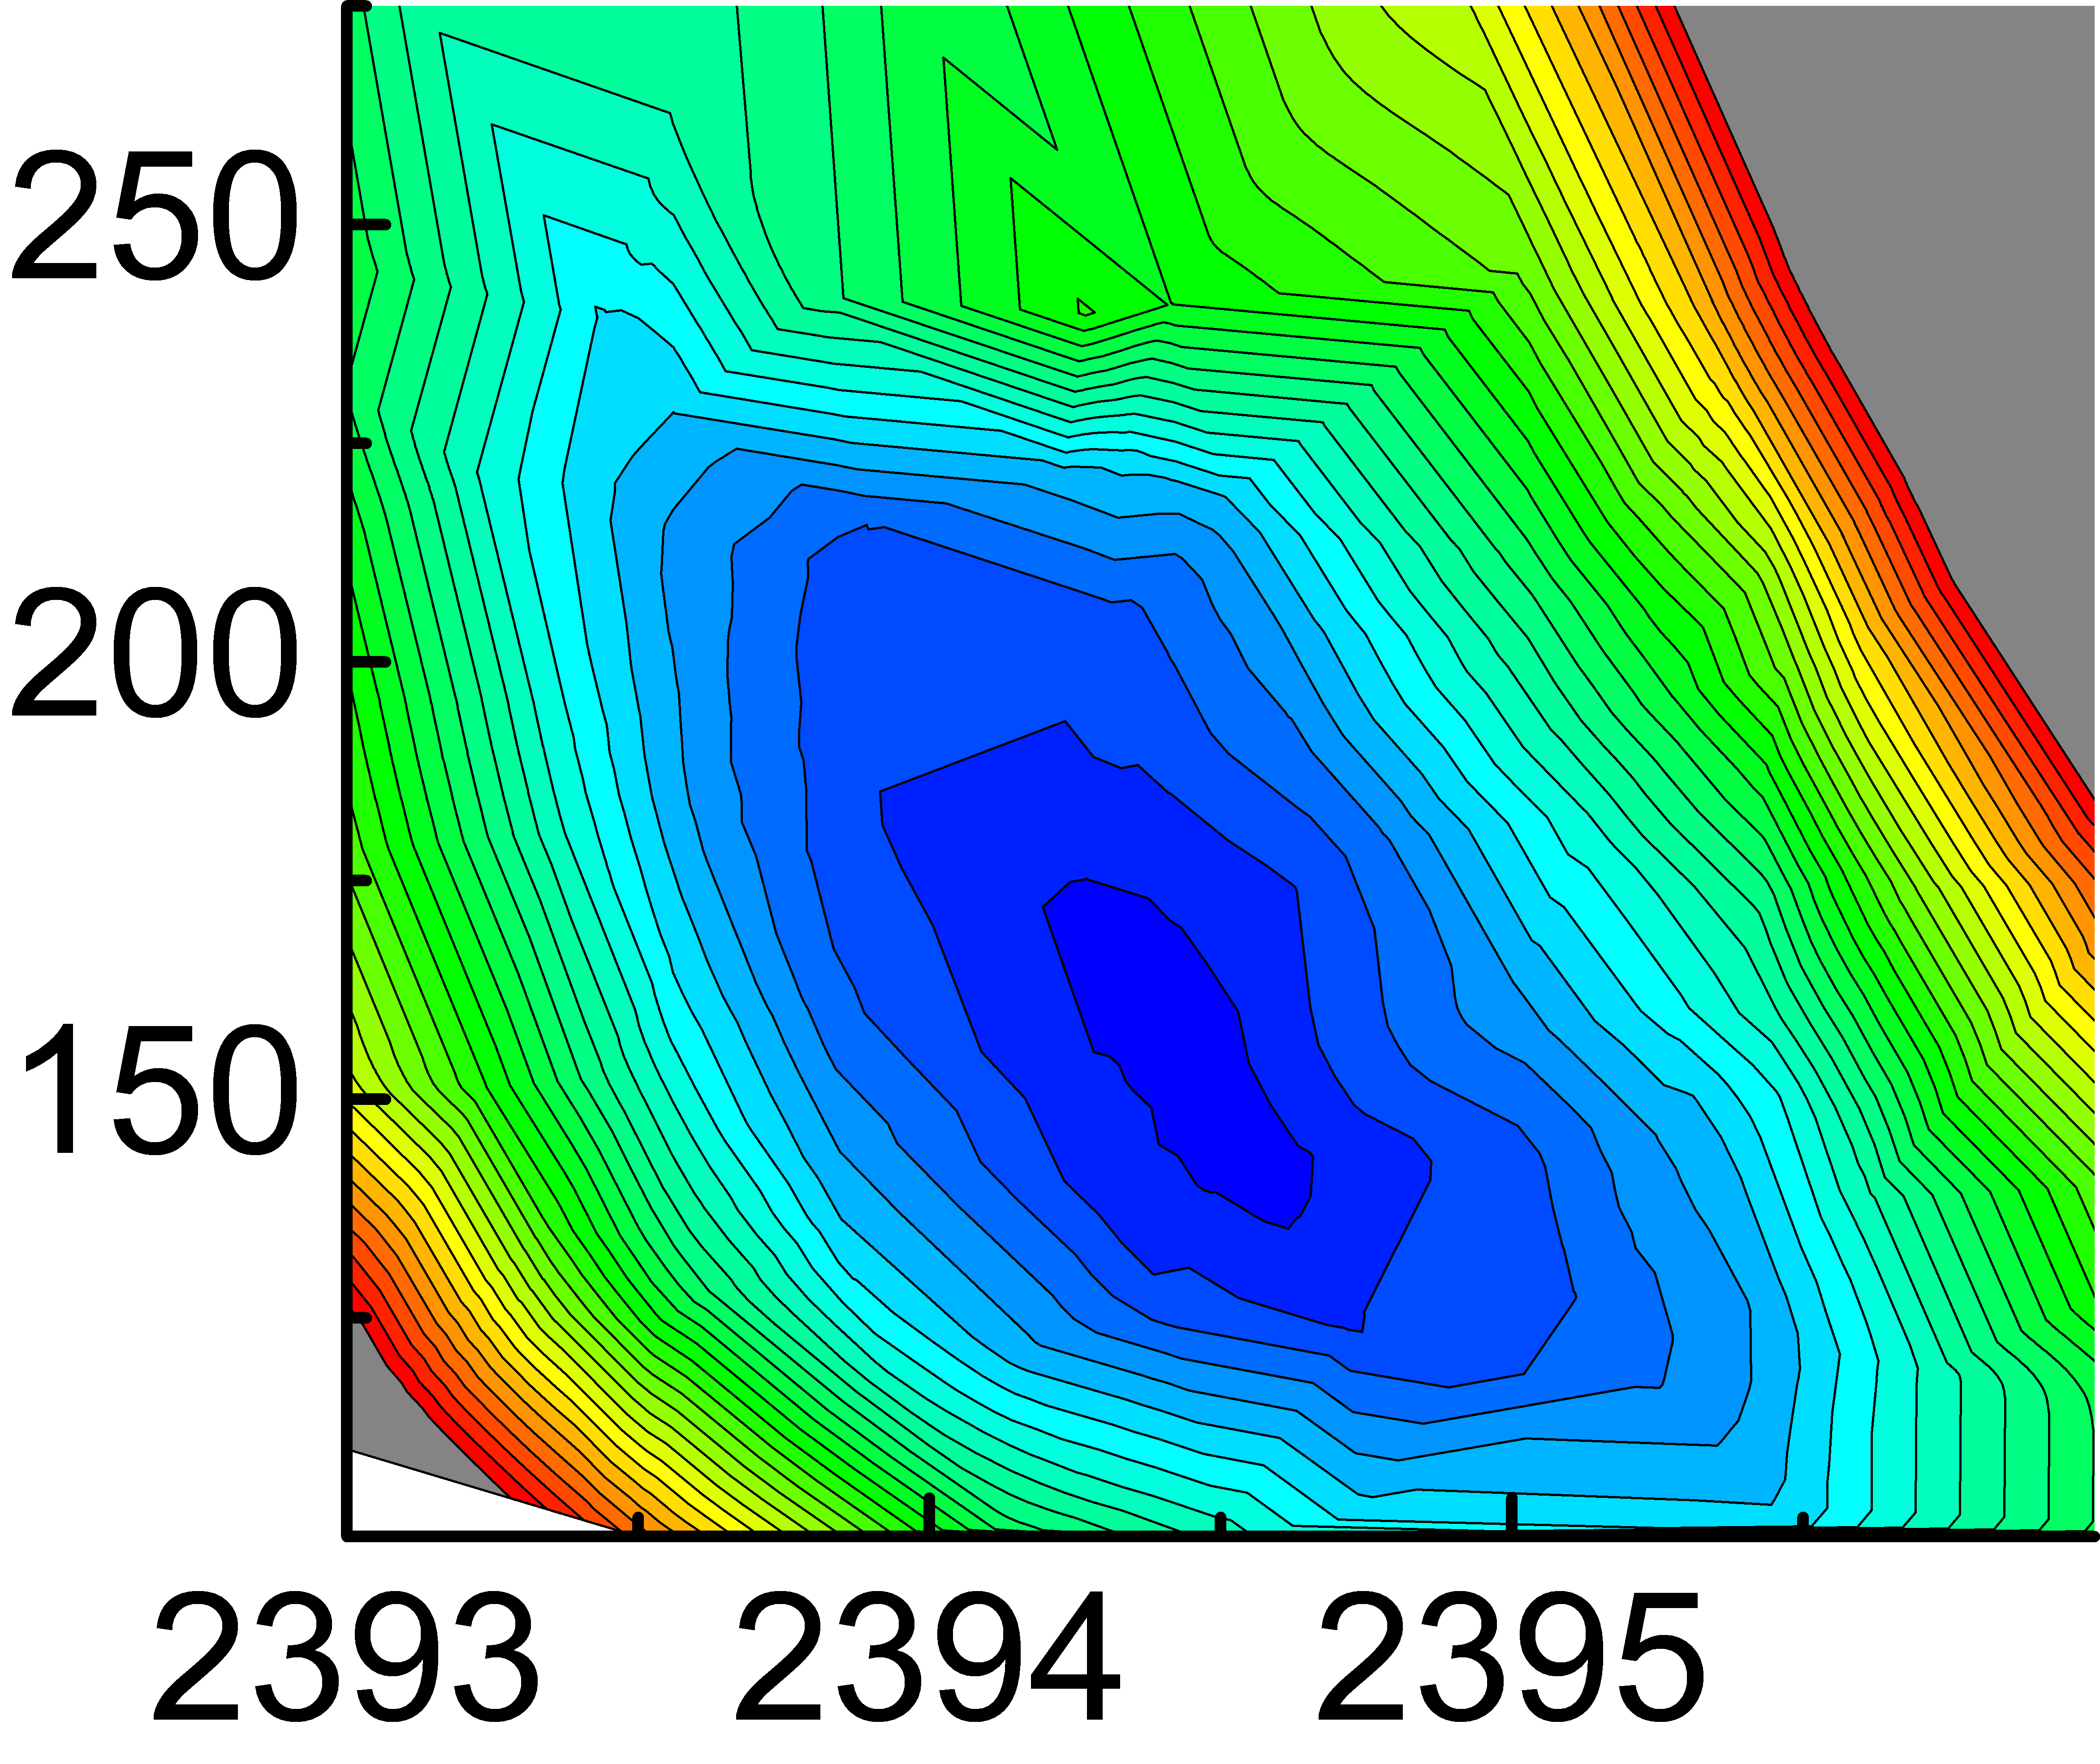
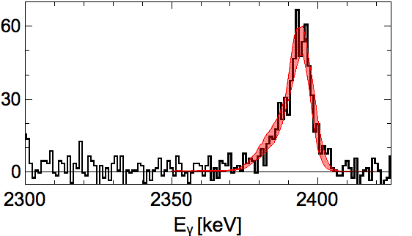
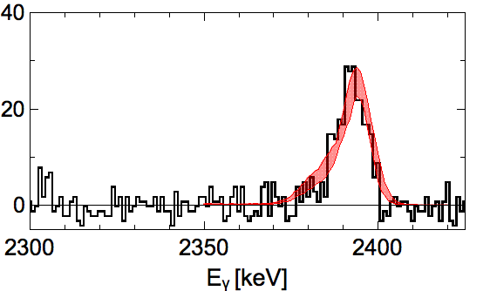
DSAM measurement: Case of interest – ²⁰O
¹⁸O (7 MeV/A) + ¹⁸¹Ta target (6 mg/cm²)
²⁰O
²⁰O
^{130°}
τ
2395
^{130°}
[fs]
^{150°}
⁺⁸⁰
^{150°}
τ = 150 fs
₋₃₀
Literature Eγ = 2395(1) keV
E_{γ}
[keV]
^{170°}
^{170°}

Slide 7
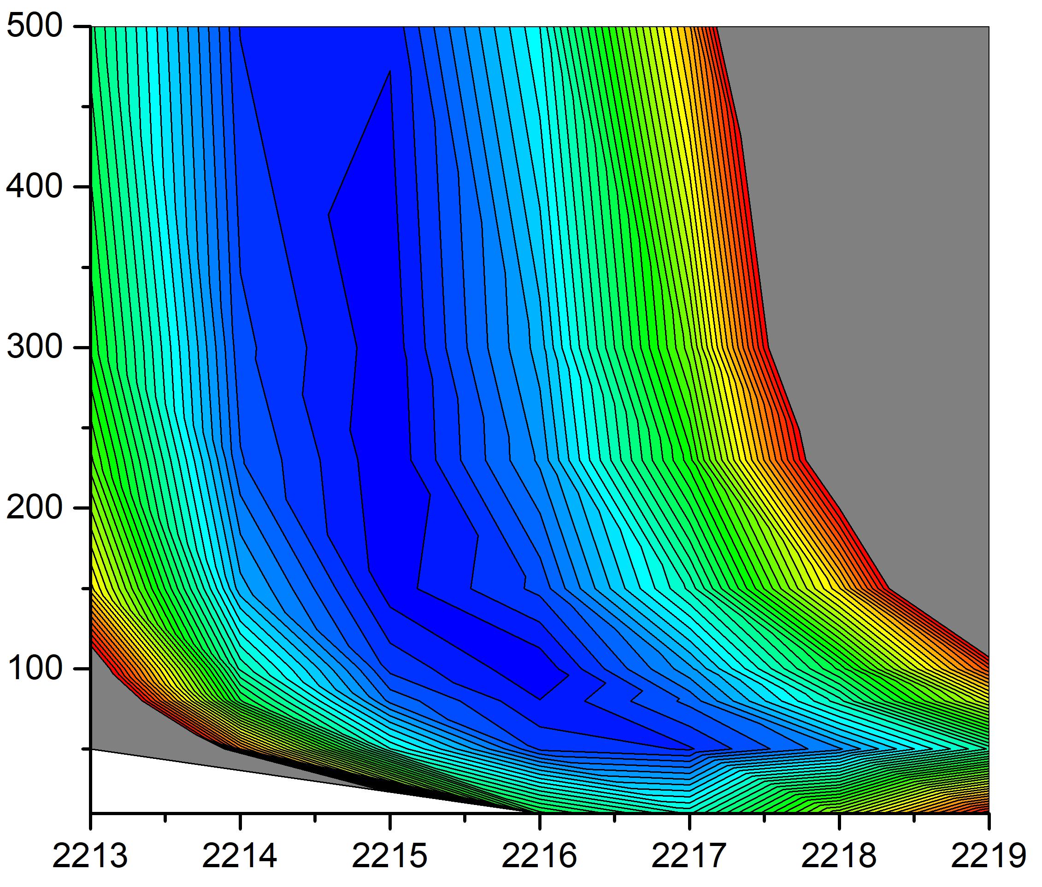
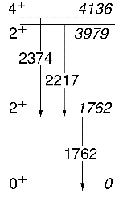
DSAM measurement: Case of interest – ¹⁶C
¹⁸O (7 MeV/A) + ¹⁸¹Ta target (6 mg/cm²)
τ
¹⁶C
[fs]
¹⁶C
¹⁶C
Literature Eγ = 2217(2) keV
E_{γ}
[keV]

Slide 8
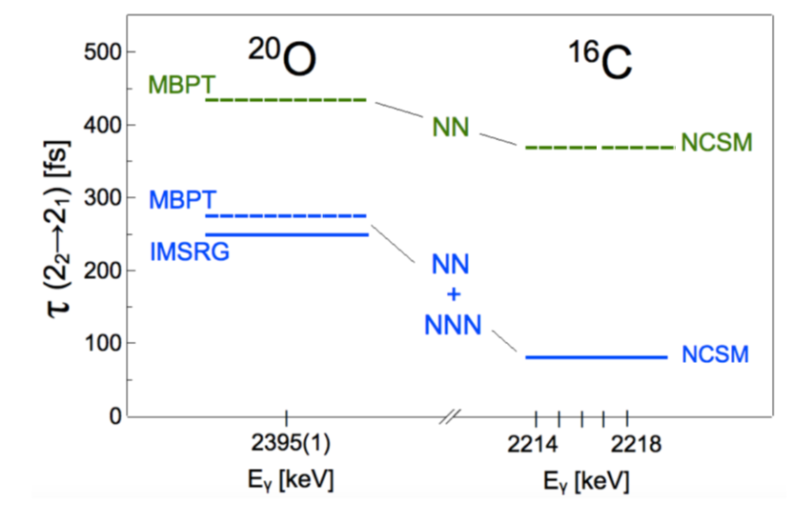
Results
Pioneer work at AGATA-VAMOS-PARIS :
M. Ciemala et al , PRC. C101, 021303(R) (2020)
NO sensitivity would be obtained
with conventional HPGe detectors
For ²⁰O, our result is fully consistent with the ab initio calculations which include three-nucleon forces (calculation employing only NN interaction are NOT satisfactory).
MBPT: J.D. Holt, et al., Eur. Phys. J. A49, 39 (2013).
IMSRG: S.K. Bogner, et al., Phys. Rev. Lett. 113:142501 (2014).
and K. Hebeler, et al., Annu. Rev. Nucl. Part. Sci. 65, 457 (2015).
NCSM: C. Forssén, et al., J. Phys. G: Nucl. Part. Phys. 40, 055105 (2013).
NN:D.R. Entem and R. Machleidt, Phys. Rev. C 68, 041001(R)
(2003); J. Simonis, et al., Phys. Rev. C 93, 011302(R) (2016).
Partial lifetimes, with branching taken into account.

Slide 9
E775s: Testing 3-body interactions from controlled lifetime measurement using a RIB beam
Method: Lifetime measurement in the femto-sec. scale (DSAM method) using the direct reaction
¹⁹O(d,p)20O from a post-accelerated ¹⁹O beam from the SPIRAL1 facility. (5x10⁵pps @ 8 MeV/A ).
Unique at GANIL.

Slide 10
E775 GANIL, Results
AGATA measured gamma-ray energies
MUGAST measured ²⁰O Excitation energy
The sensitivity of AGATA allows to measured the slowing down process to extract the nuclear lifetime of the 2+ 2 state at 2.4 MeV
Confirm the short value only compatible with a 3-body contribution as in M. Ciemala et al , PRC. C101, 021303(R) (2020)
The question is now the accuracy of the ab-initio calculation
70(10) fs
I. Zanon, E. Clément, A. Goasduff, et al Physical Review Letters, 2023, 131 (26), pp. 262501
Measured Gamma-ray Energy and simulations

Slide 11
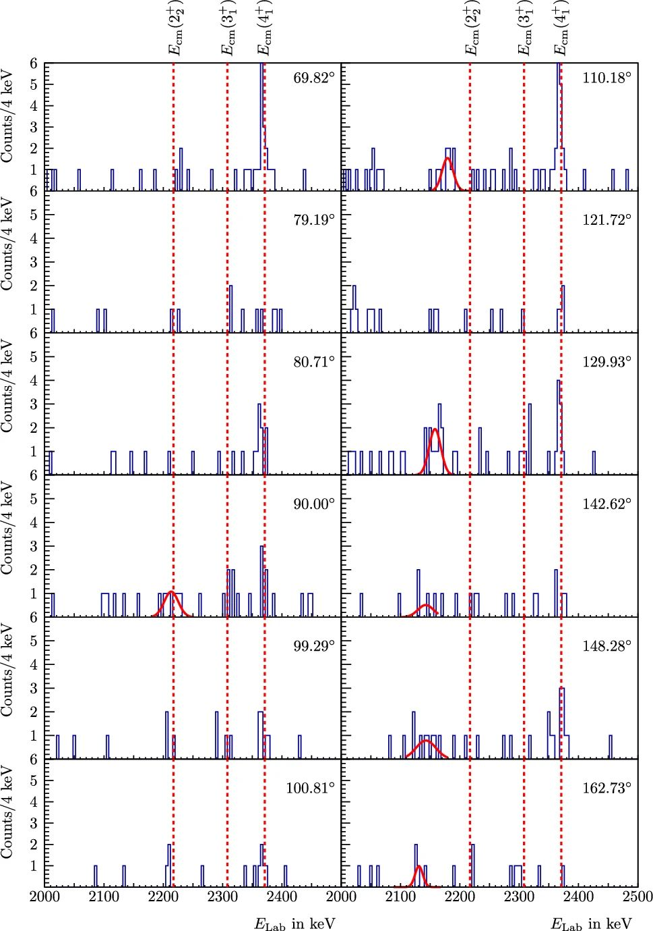
¹⁶C case – latest news
Latest experimental results:
M. Mathy, M. Petri, et al., Lifetimes of excited states in 16 C as a benchmark for ab initio developments, Eur. Phys. J. A, (2024) 60:181
From GAMMASPHERE+MICROBALL detector arrays at ANL.
Also ¹⁵C(d,p)¹⁶C DSAM experiment performed at ANL with GRETINA+GODDESS in July 2021, I Zanon, E. Clement, M. Siciliano et al. - undergoing analysis

Slide 12
¹⁶C case – latest news
M. Mathy, M. Petri, et al., Lifetimes of excited states in 16 C as a benchmark for ab initio developments, Eur. Phys. J. A, (2024) 60:181

Slide 13
Perspective for future: ¹⁶C and ¹⁸C
In 2019 LoI was presented on AGATA@LNL for stable beams workshop. As well as twice during pre-PAC in 2021 and 2022.
M. Ciemała, F. Crespi, et al.
„Lifetime measurements of excited states in neutron-rich C isotopes”
Setup: PRISMA, AGATA and PARIS
Target: ¹⁹⁸Pt, beam ¹⁸O
AGATA – Lifetimes of the second 2⁺ states: by Doppler Shift Attenuation.
PRISMA – Ion identification, measurement of velocity vector.
One of the physics cases for
AGATA white book:
Korten, W., Atac, A., Beaumel, D. et al. Physics opportunities with the Advanced Gamma Tracking Array: AGATA. Eur. Phys. J. A 56, 137 (2020).

Slide 14
Perspective for future: ¹⁶C and ¹⁸C
In 2019 LoI was presented on AGATA@LNL for stable beams workshop. As well as twice during pre-PAC in 2021 and 2022.
M. Ciemała, F. Crespi, et al.
„Lifetime measurements of excited states in neutron-rich C isotopes”
Setup: PRISMA, AGATA and PARIS
Target: ¹⁹⁸Pt, beam ¹⁸O
AGATA – Lifetimes of the second 2⁺ states: by Doppler Shift Attenuation.
PRISMA – Ion identification, measurement of velocity vector.
Charged particle detector – Ion identification, measurement of velocity vector -> for the Zero Degree configuration of AGATA@LNL
One of the physics cases for
AGATA white book:
Korten, W., Atac, A., Beaumel, D. et al. Physics opportunities with the Advanced Gamma Tracking Array: AGATA. Eur. Phys. J. A 56, 137 (2020).

Slide 15
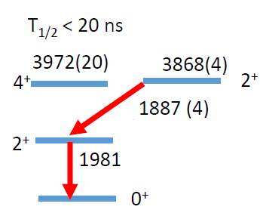
Perspective for future GANIL: ²⁴Ne
Emmanuel Clement „ DSAM Measurement in 24Ne – Ab-Initio test”, pre-LoI for the AGATA@GANIL campaign
Setup: AGATA + GRIT + SPIRAL1
radioactive beam
For the AGATA@GANIL campaign in 2028/9
²⁴Ne
T1/2 < 70fs
B. A. Watson, et al
Phys. Rev. C 9, 1200 (1974) ²²Ne(t,p) reaction
G. Lotay, J. Henderson, W.N. Catford et al. Physics Letters B 833 (2022) 137361

Slide 16
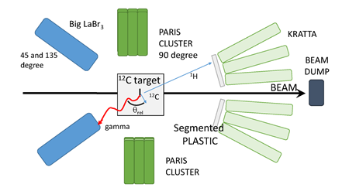
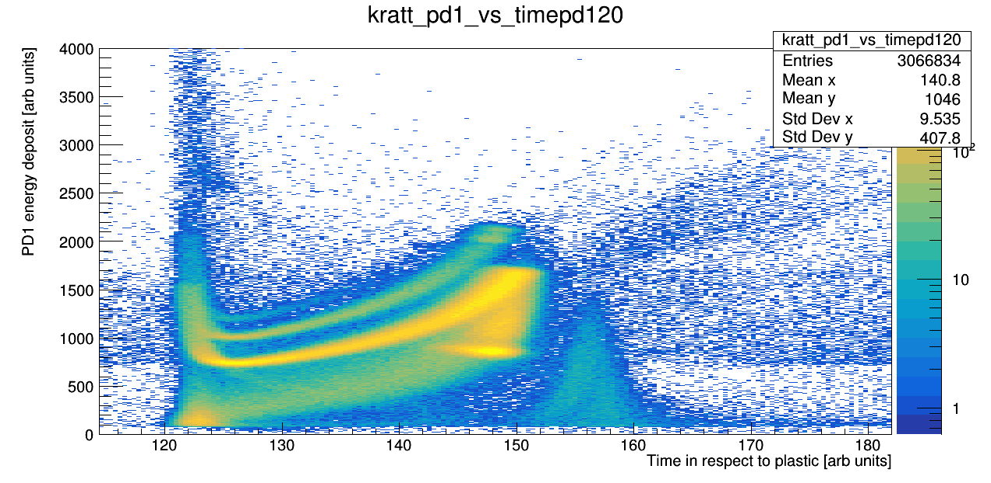
Other activities, CCB, IFJ PAN
Accepted Proposal: Lifetimes measurements of excited states in light nuclei ¹¹C
M. Ciemała
IFJ PAN, Krakow
Collaboration:
M. Kmiecik, A. Maj, N. Cieplicka, B. Fornal, M. Ziębliński, J. Łukasik, P. Pawłowski et al.
IFJ PAN, Krakow
S. Leoni, S. Ziliani, F. Crespi, S. Bottoni et al.
University of Milano and Sez. INFN Milano
E. Clément et al.
GANIL
Goal of this experiment is to validate a method for short lifetime measurement of excited states in light nuclei with use of the KRATTA (+plastics) array coupled with scintillator (LaBr₃ and PARIS) at CCB.
d
p
Deuter id plot with use of KRATTA PSA techique
Data taken during N. Cieplicka et al. Exp. at CCB

Slide 17
Conclusions
Tested experimentally the impact of the NNN interactions to nuclear structure observables.
Novel method, together with the most sophisticated experimental setup, lead to the first lifetime measurement of second 2⁺ in ²⁰O, fully consistent with ab initio calculations including three body interactions.
Extracted estimates of lifetime of second 2⁺ in ¹⁶C: it depends on non-shifted gamma-ray energy → new measurement is needed. Still not precisely measured, recently estimations of the lower and upper limits established.
Developed Experimental approach essential for short lifetime measurements in unexplored regions of the nuclear chart, with future intense beams, produced by Isotope Separation On-Line (ISOL) techniques.
Our work significantly broadens the possibilities for nuclear structure high-precision measurements in hard-to-reach exotic systems.

Slide 18
Acknowledgements
S. Leoni, S. Ziliani, F.C.L. Crespi, G. Benzoni, A. Bracco, C. Boiano, S. Bottoni, S. Brambilla, F. Camera, S. Coelli,
B. Million, O. Wieland University and INFN Milano, Italy
M. C., B. Fornal, A. Maj, P. Bednarczyk, Ł.W. Iskra, N. Cieplicka-Oryńczak, J. Grebosz, M. Kmiecik, K. Mazurek, B. Wasilewska Institute of Nuclear Physics, PAN, Poland
E. Clément, G. De France, B. Jacquot, Y. Kim, A. Lemasson, M. Lewitowicz, H. Li, M. Rejmund - GANIL, CEA/DSAM and CNRS/IN2P3, France
M. Bast, M. Beckers, T. Braunroth, C. Fransen, A. Goldkuhle, C. Muller-Gatermann - IKP Cologne, Germany
O. Dorvaux, Ch. Schmitt - CNRS/IN2P3, IPHC UMR 7178, France
S. Erturk - Nigde University, Turkey
M.N. Harakeh - KVI - Center for Advanced Radiation Technology, Groningen, Netherlands
A. Karpov - JINR, Dubna, Russia
M. Kicińska-Habior - Faculty of Physics, Warsaw University, Poland
S.M. Lenzi - Padova University and INFN, Italy
I. Matea, I. Stefan - IPN Orsay Laboratory, Orsay, France
C. Michelagnoli - Institut Laue-Langevin (ILL), Grenoble, France
M. Matejska-Minda, P. Napiorkowski - Heavy Ion Laboratory, University of Warsaw, Poland
V. Nanal, R. Palit - Tata Institute of Fundamental Research, Mumbai, India
D.R. Napoli - INFN Laboratori Nazionali di Legnaro, Italy
M. Stanoiu - IFIN-HH, Bucharest, Romania
E. Vardaci - Università degli Studi di Napoli and INFN sez. Napoli, Italy
M. Zielińska - IRFU, CEA/DRF, Centre CEA de Saclay, F-91191 Gif-sur-Yvette Cedex, France
J. Holt - TRIUMF, Vancouver , Canada
J. Menendez - Center for Nuclear Study, University of Tokyo, Japan
A. Schwenk - TU Darmstadt, ExtreMe Matter Institute EMMI, GSI, Darmstadt and Max-Planck-Institut für Kernphysik, Heidelberg, Germany
J. Simonis - Institut fur Kernphysik and PRISMA Cluster of Excellence, Mainz University, Germany
AGATA
PARIS
VAMOS
Collaborations

Slide 19
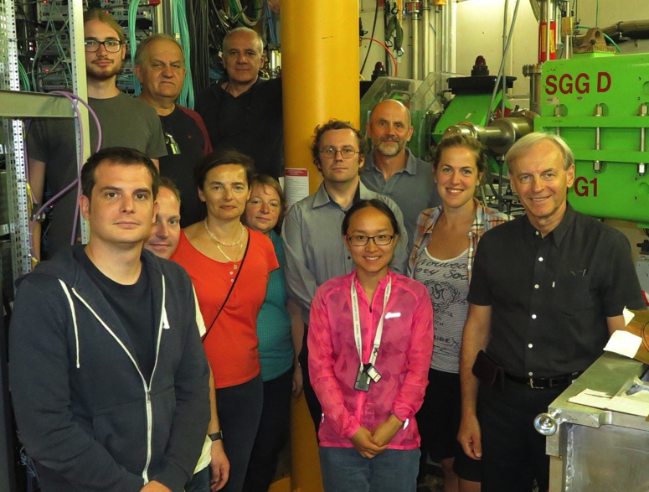
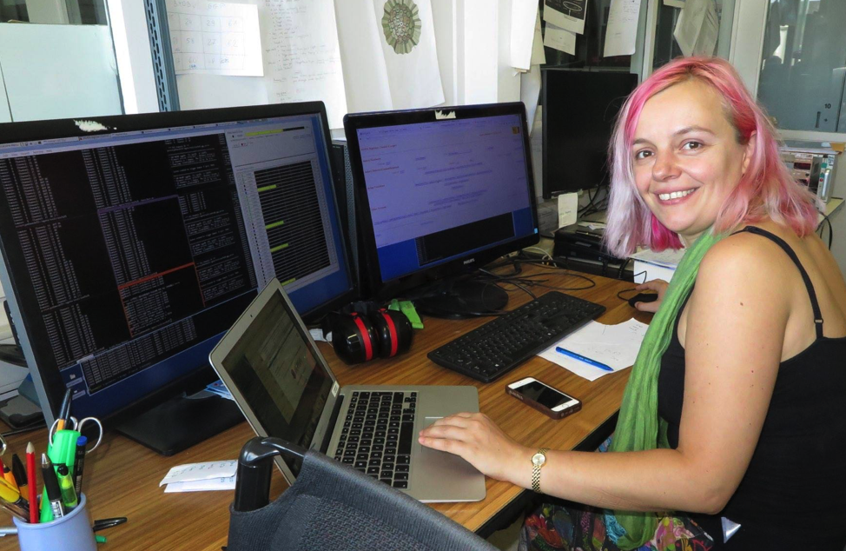
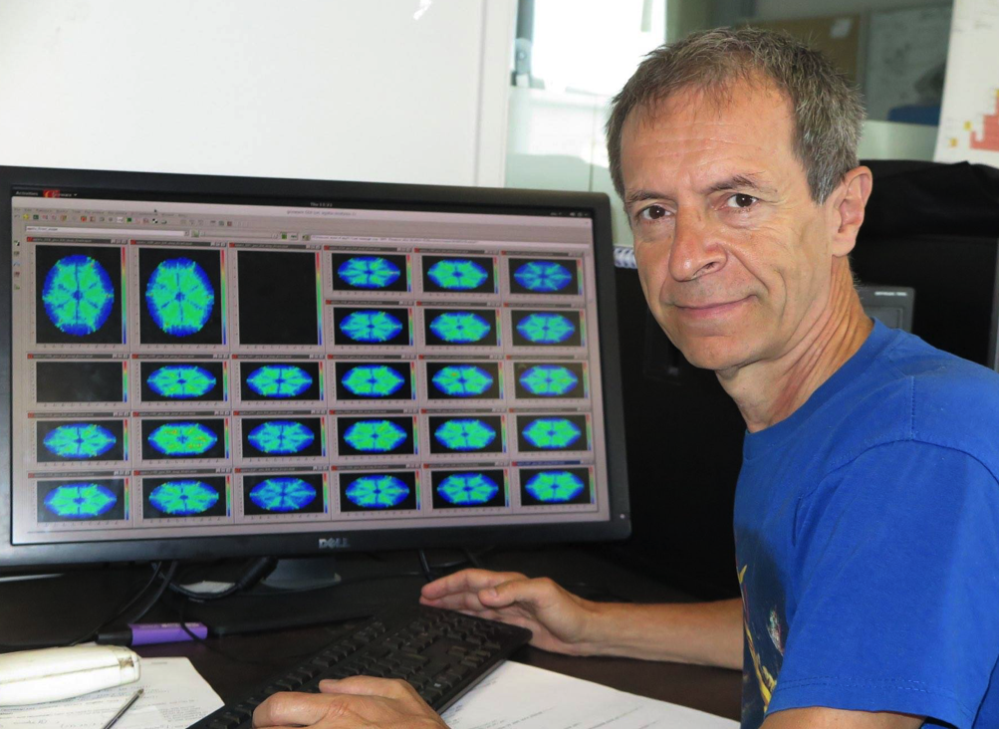
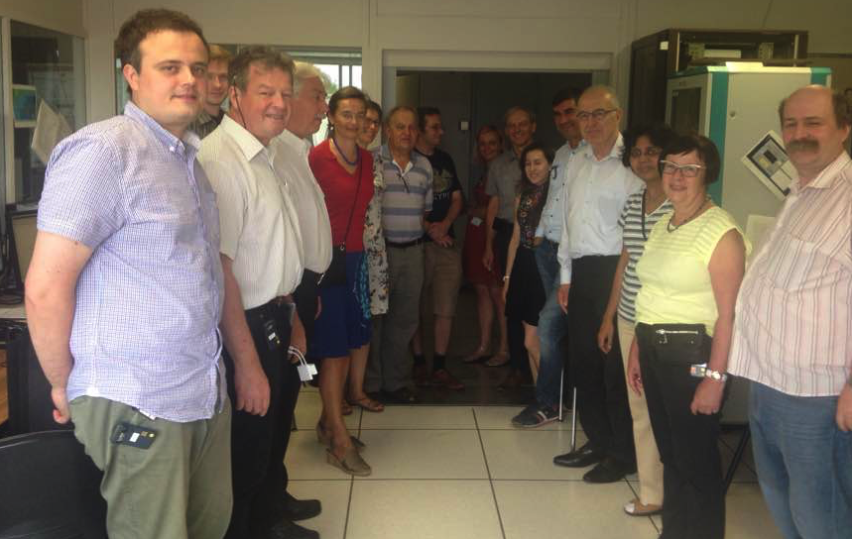
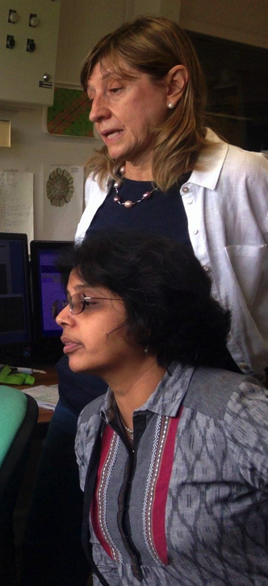
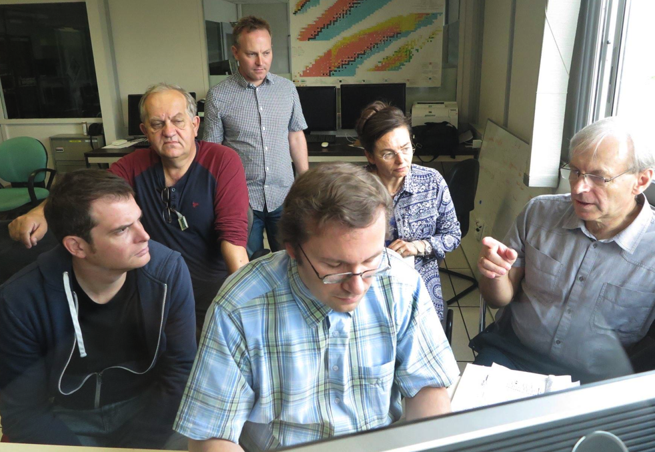
Italian-Polish-French collaboration and AGATA+VAMOS+PARIS setup allowed successful experiment at GANIL.

Slide 20
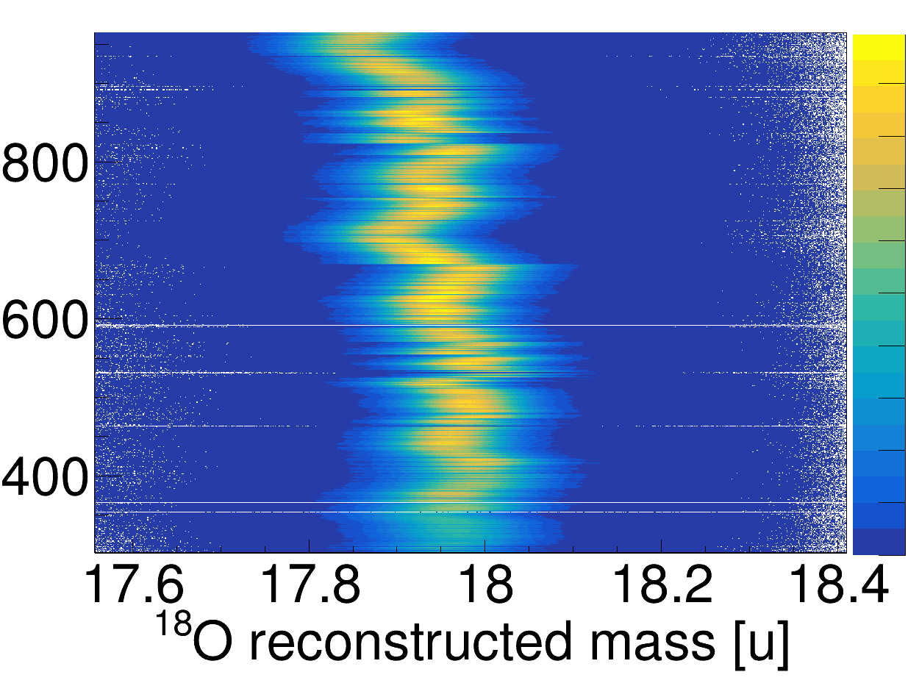
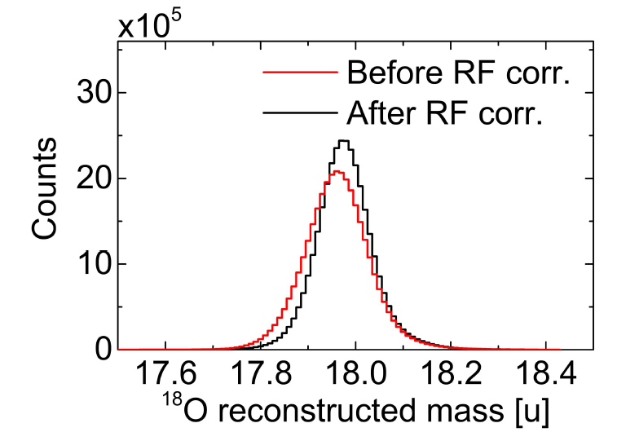
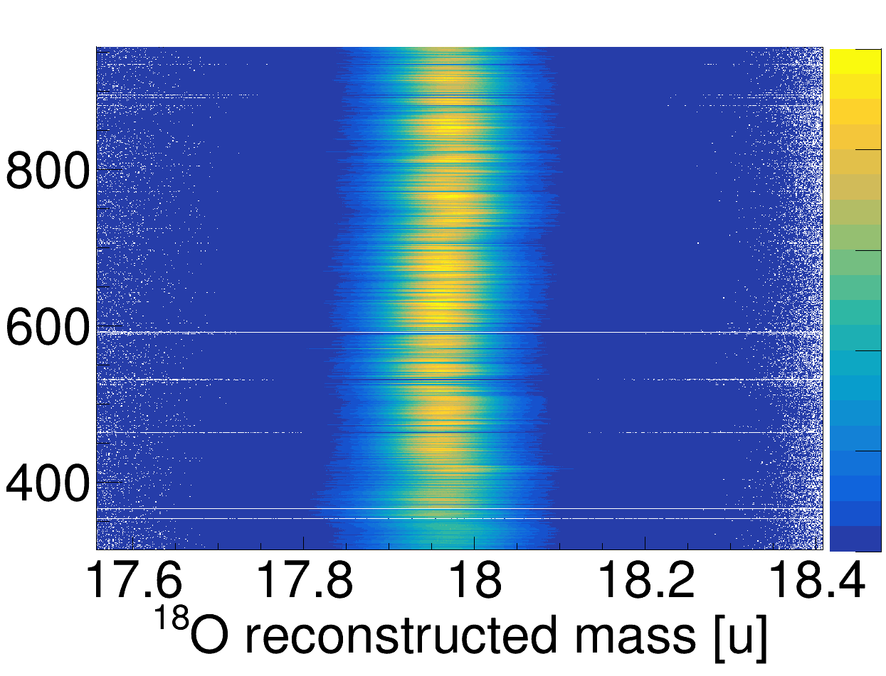
PARIS timing: large improvement in ion mass reconstruction
We measure velocity by: measuring the path in the spectrometer and the time between RF and Plastic at the end of focal plane.
¹⁸O MASS reconstruction using
ion Time of flight with respect to cyclotron RF
but RF signal is NOT stable in time
Time of experiment
¹⁸O MASS reconstruction after PARIS correction
Using the excellent time response of PARIS
(LaBr₃ part, FWHM < 1ns)
RF fluctuations are corrected

Slide 21
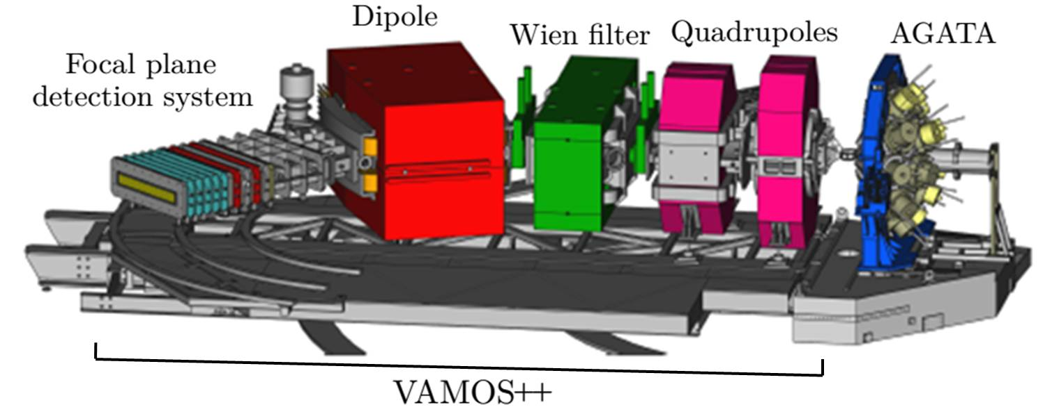
Experimental setup –VAMOS++ magnetic spectrometer
Allows to analyse and select the ions of interest resulting in the reaction.
VAMOS++ at 45 degree
VAMOS entrance detector:
2 Drift Chambers (for ions angle)
VAMOS focal plane:
DC (for Brho reconstruction),
6 rows of Ionization Chambers (for ΔE)
Plastic (for trigger and ToF)
Angular acceptance:
+/- 6 degree in theta, +/- 15 degree in phi

Slide 22

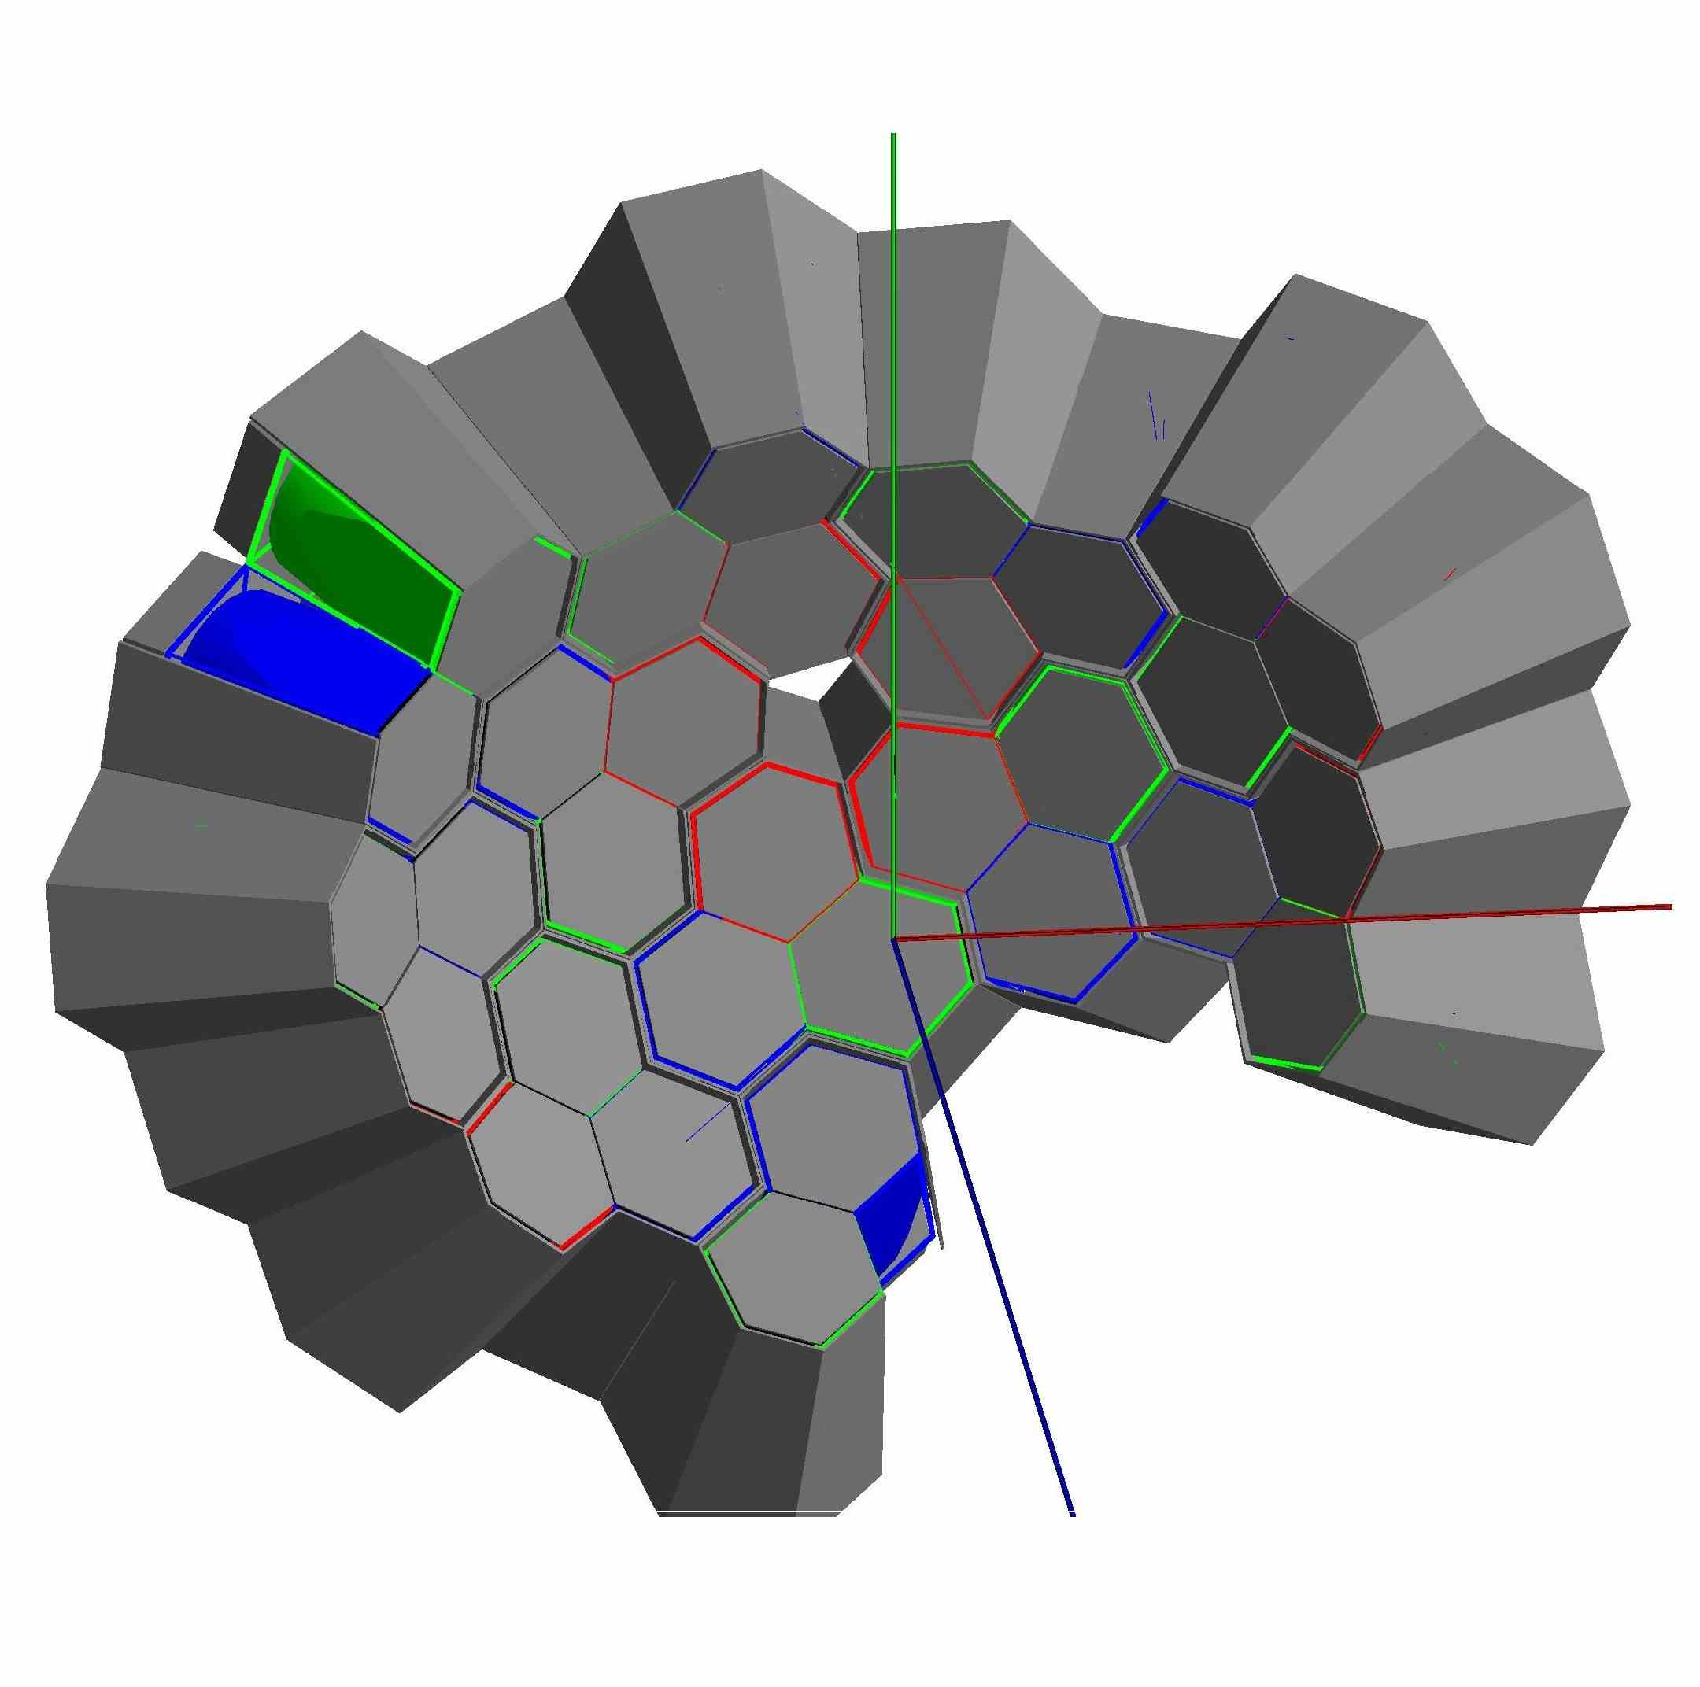
Experimental setup -AGATA
AGATA - Advanced Gamma Tracking Array, high resolution gamma-ray detector
AGATA is being built within large European collaboration.
After completion of construction AGATA will be the world-best gamma spectrometer.
AGATA White Book:
W. Korten et al, Eur. Phys. J. A (2020) 56:137
AGATA
31 crystals (backward angles)
Working during our experiment
at GANIL
AGATA
36 segments per crystal (6 longitudinal rings and 6 transversal sectors)
Tracking algorithms allow to reconstruct the
path of the interacting g-ray in the detection material, its energy and incoming direction.

Slide 23
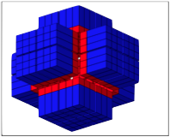
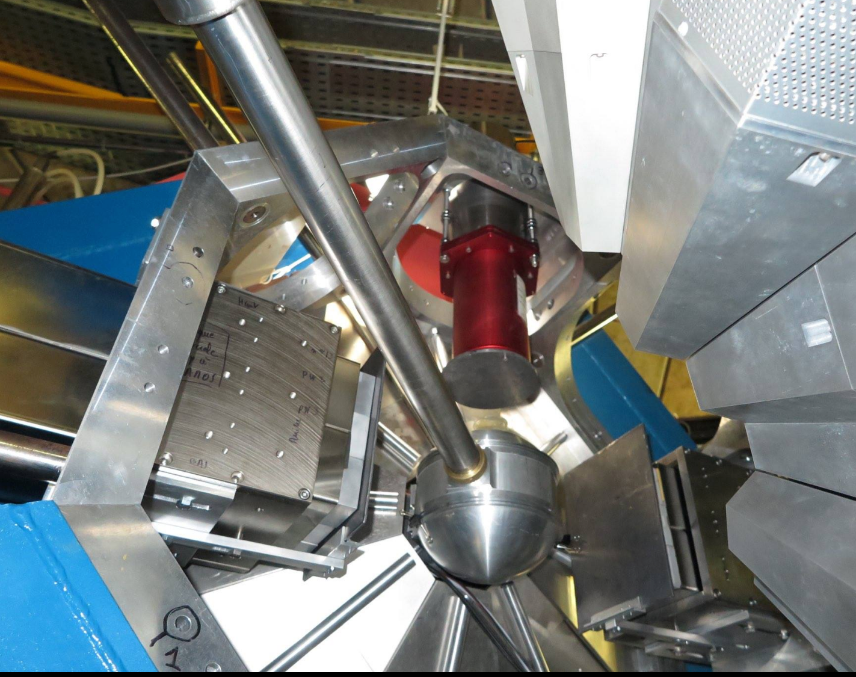
Experimental setup - PARIS (High energy gamma-ray calorimeter)
High efficiency gamma detector, based on scintilation materials,
for medium resolution spectroscopy
and calorimetry of g-rays in large energy range.
It is characterized by very good time resolution (< 1 ns).
PARIS is made of clusters:
1 Cluster = 9 phoswiches
2 PARIS clusters (18 phoswiches used)
used in our experiment.
For measurement of high energy gamma-rays and for time definition.
24 PARIS cluster view
PARIS is constructed in international collaboration coordinated by IFJ PAN Krakow.
After completion of construction PARIS will be the world-best high-energy gamma calorimeter

Slide 24
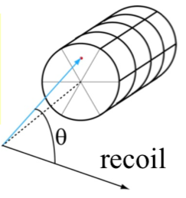

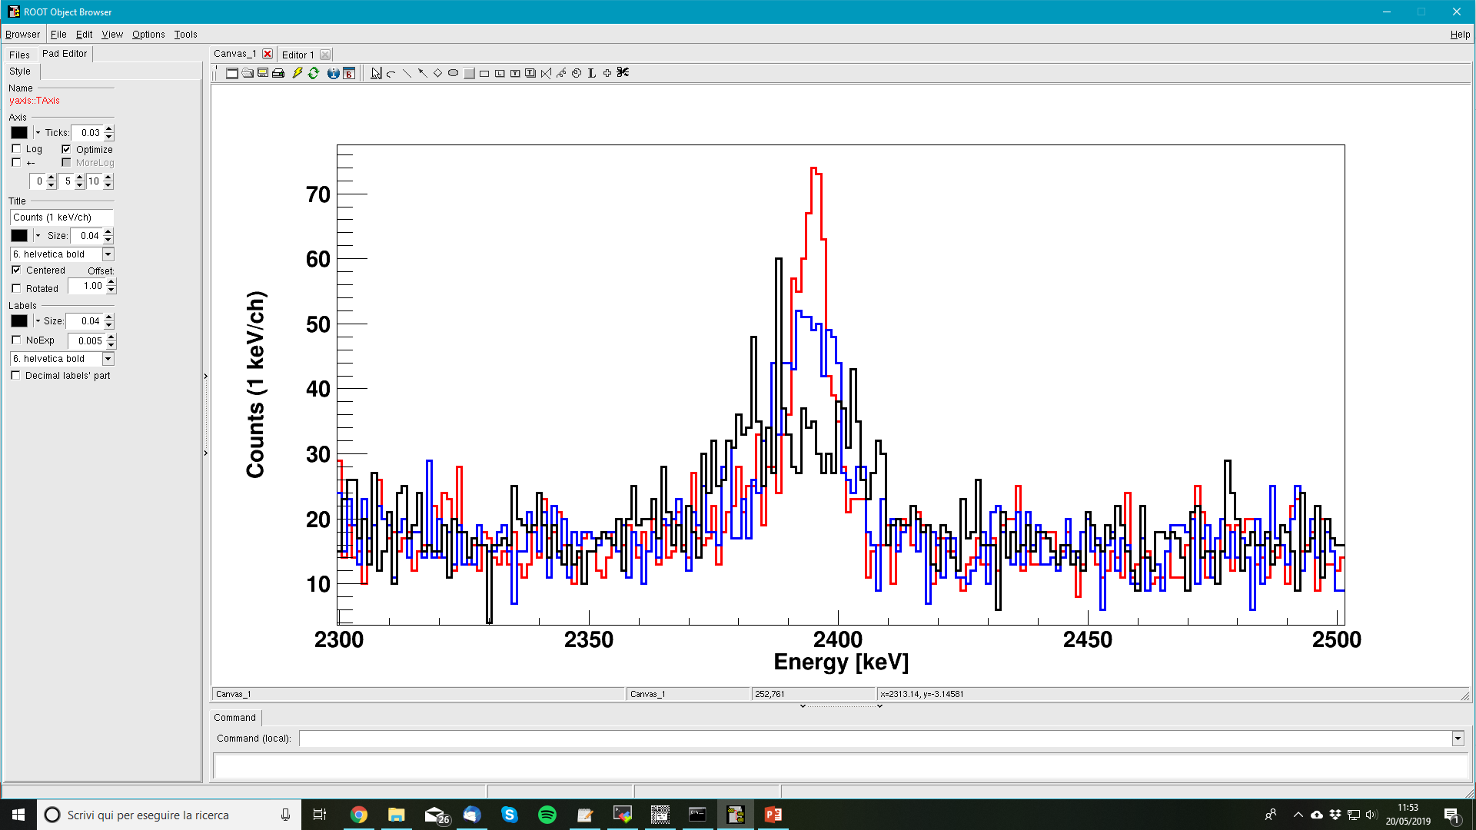
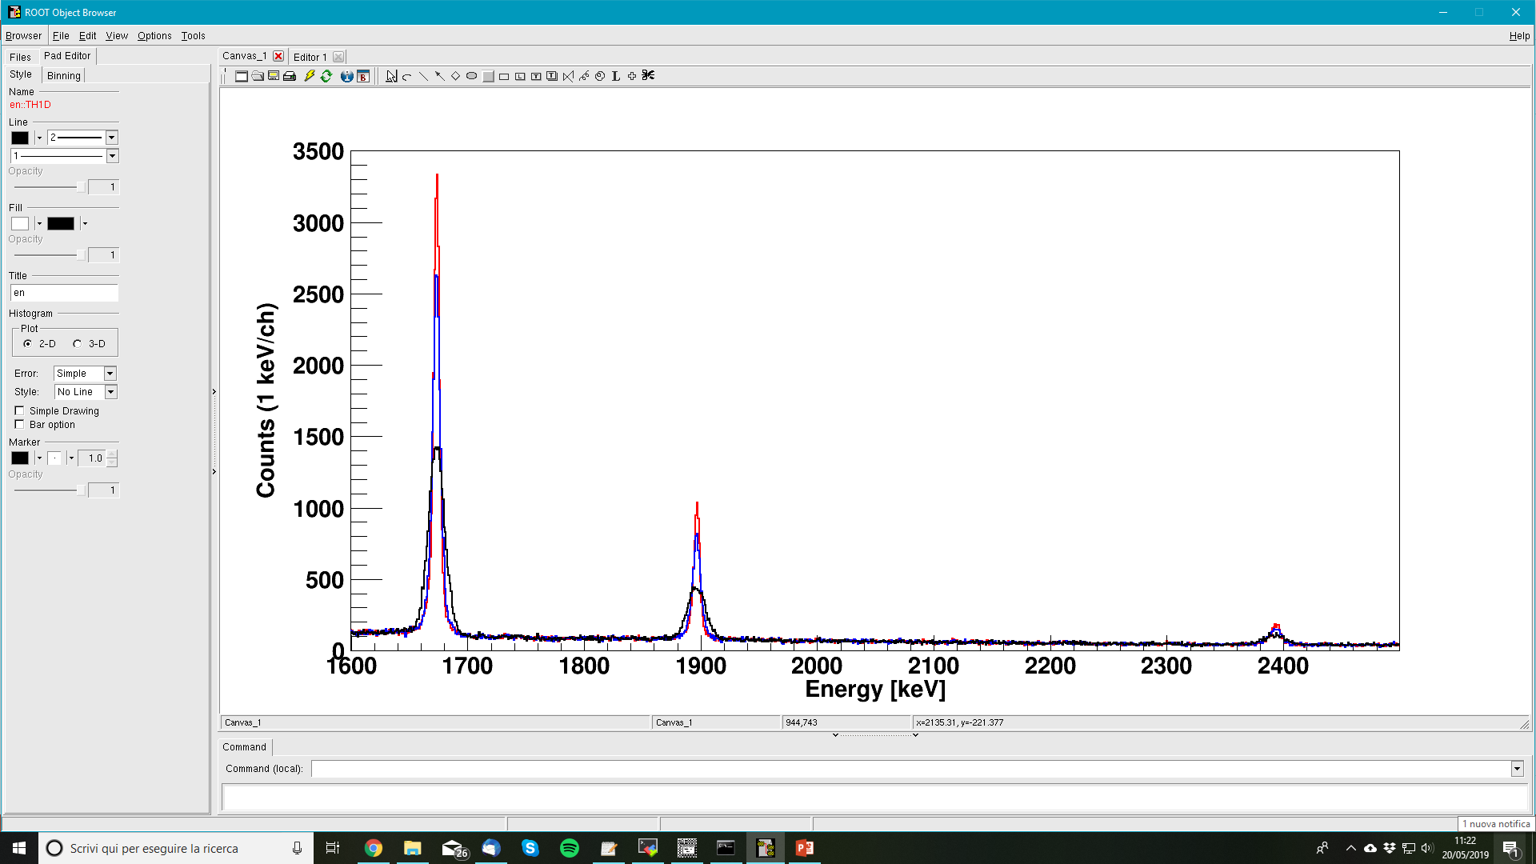
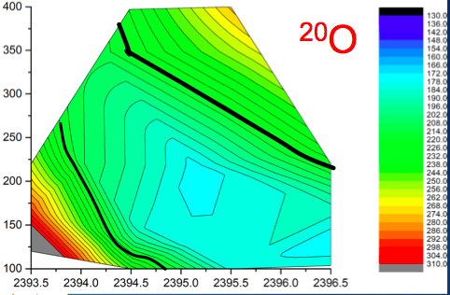
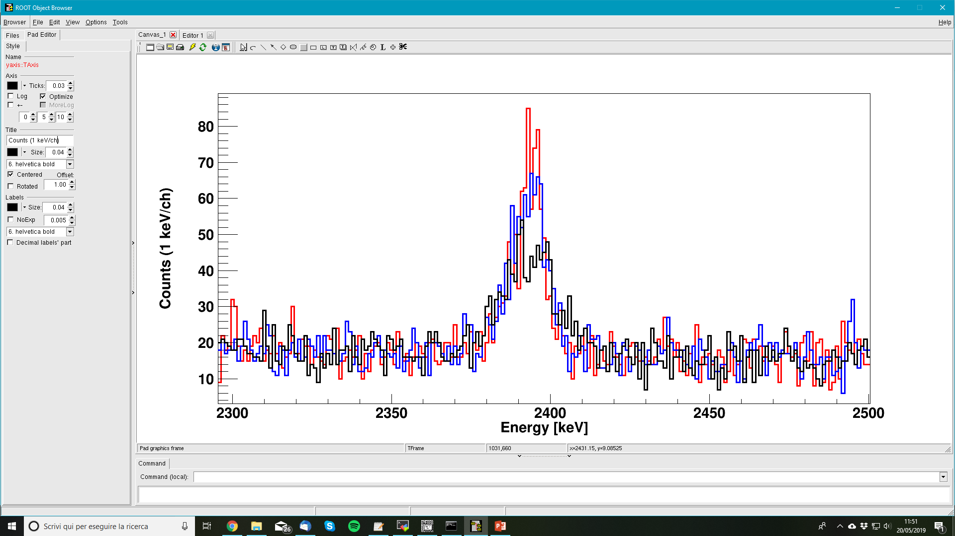
Large improvement with AGATA
FULL Tracking
²⁰O
2⁺₂ → 2⁺₁ (2396 keV)
^{130°}
²⁰O
red - tracking
blue - segment center
black - crystal center
Center
Front Segment
²⁰O
^{150°}

Slide 25
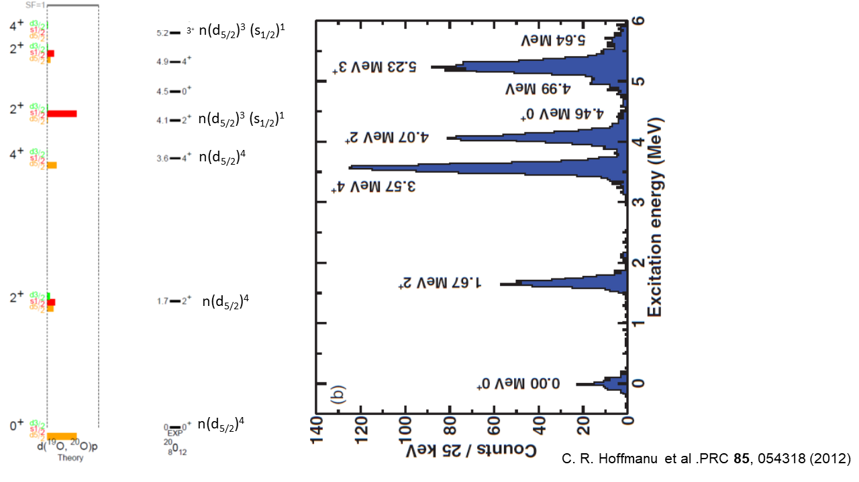
Oxygens
 | T. Ostuka, et al., Phys.Rev.Lett.105:032501,2010

Slide 27
²⁰O excited states lifetimes – other experiment at GANIL
E. Clement, A. Goasduff et al., experiment performed February/March 2020:
Lifetime measurements of the 2⁺₂ and 3⁺₁ states in ²⁰O populated by direct nucleon transfer
Experimental setup contains: MUGAST (charget particles), VAMOS++ spectrometer, AGATA.
¹⁹O(d,p)²⁰O reaction
Data under analysis.

Slide 29
Simulation ingredients – velocity, stopping powers, theta
VAMOS++ acceptance take into account (Brho, E, M, Q)

Slide 30
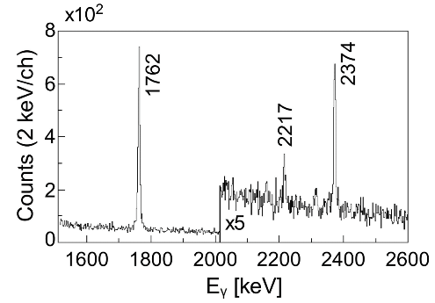
AGATA Spectra –Tracked and Doppler Corrected
NN NN+NNN
300 fs 80 fs
¹⁶C
¹⁶C
Ion gated by VAMOS
spectrometer

Slide 31
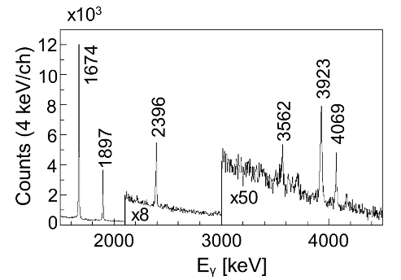
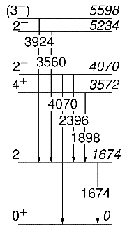
AGATA Spectra –Tracked and Doppler Corrected
NN NN+NNN
320 fs 200 fs
²⁰O
²⁰O
Ion gated by VAMOS
spectrometer

Slide 32
²⁰O spectra (ion of interest)
AGATA
PARIS
²⁰O
²⁰O
Efficiency in comparison with AGATA
Energy | 2 clusters + 2 big LaBr₃’s
1982 keV (¹⁸O) | 0.92 of AGATA
7010 keV (¹⁴C) | 1.48 of AGATa

Slide 33
²⁰O spectra (ion of interest)
AGATA
PARIS
²⁰O
²⁰O
Efficiency in comparison with AGATA
Energy | 2 clusters + 2 big LaBr₃’s
1982 keV (¹⁸O) | 0.92 of AGATA
7010 keV (¹⁴C) | 1.48 of AGATa

Slide 34
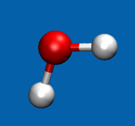
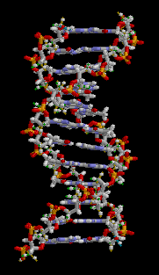
water molecule
H₂O
DNA molecule
three body interaction
contribution 14.5%
three body interaction
contribution 24%
Source: en.wikipedia

Slide 35
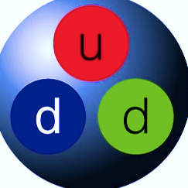
The potential of a system of three or more nucleons must be accompanied by a contribution from the irreducible three-body force that is absent in the case of an isolated pair
V = V₁₂ + V₂₃ + V₁₃ + V₁₂₃
Notes:
Pojawia się dodatkowy (niewielki) przyczynek do potencjału, którego nie ma dla przypadku izolowanej pary – nazywamy to nieredukowalną siłą trzyciałową

Slide 36
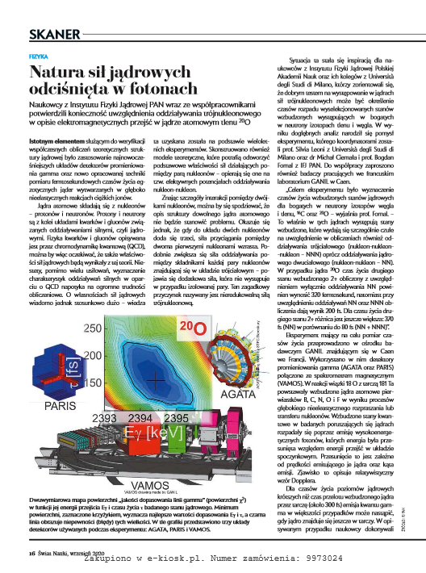
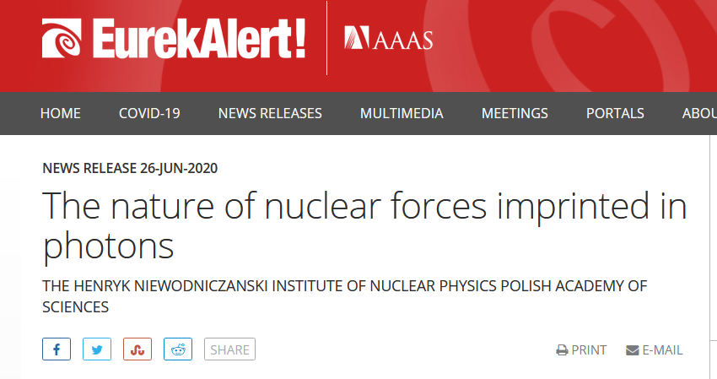
Papers published/in preparation:
1. M. Ciemała , S. Ziliani, F.C.L. Crespi, S. Leoni, B. Fornal, A. Maj, et al., „ Testing ab initio nuclear structure in neutron-rich nuclei:Lifetime measurements of second 2⁺ state in ¹⁶C and ²⁰O”, Phys. Rev. C 101, 021303(R), 2020.
2. M. Ciemała, S. Ziliani, F.C.L. Crespi, S. Leoni, B. Fornal, A. Maj, et al., „ Accessing tens-to-hundreds femtoseconds nuclear state lifetimes with low-energy binary heavy-ion reactions„ submitted to EPJA (description of the method) https://arxiv.org/abs/2012.05180
3. S. Ziliani, M. Cimała, F.C.L. Crespi, S. Leoni, B. Fornal, et al. „Complete spectroscopy of bound negative-parity states in ¹⁸N” (in preparation)
….
Proceedings:
1. M. Ciemała et al., Acta Phys. Pol B 50(2019), No. 3, 615
2. S. Ziliani et al., Acta Phys. Pol B 50(2019), No. 3, 625
3. M. Ciemała et al., Acta Phys. Pol B 51(2020), No. 3, 699
4. S. Ziliani et al., Acta Phys. Pol B 51(2020), No. 3, 709
5. S. Ziliani, Il Nuovo Cimento C, 4-5(2020), 107
….

Slide 37
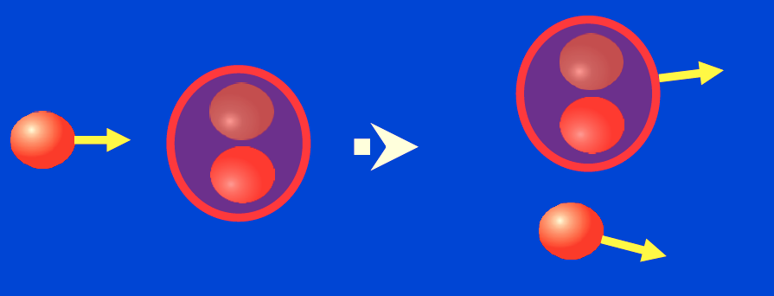
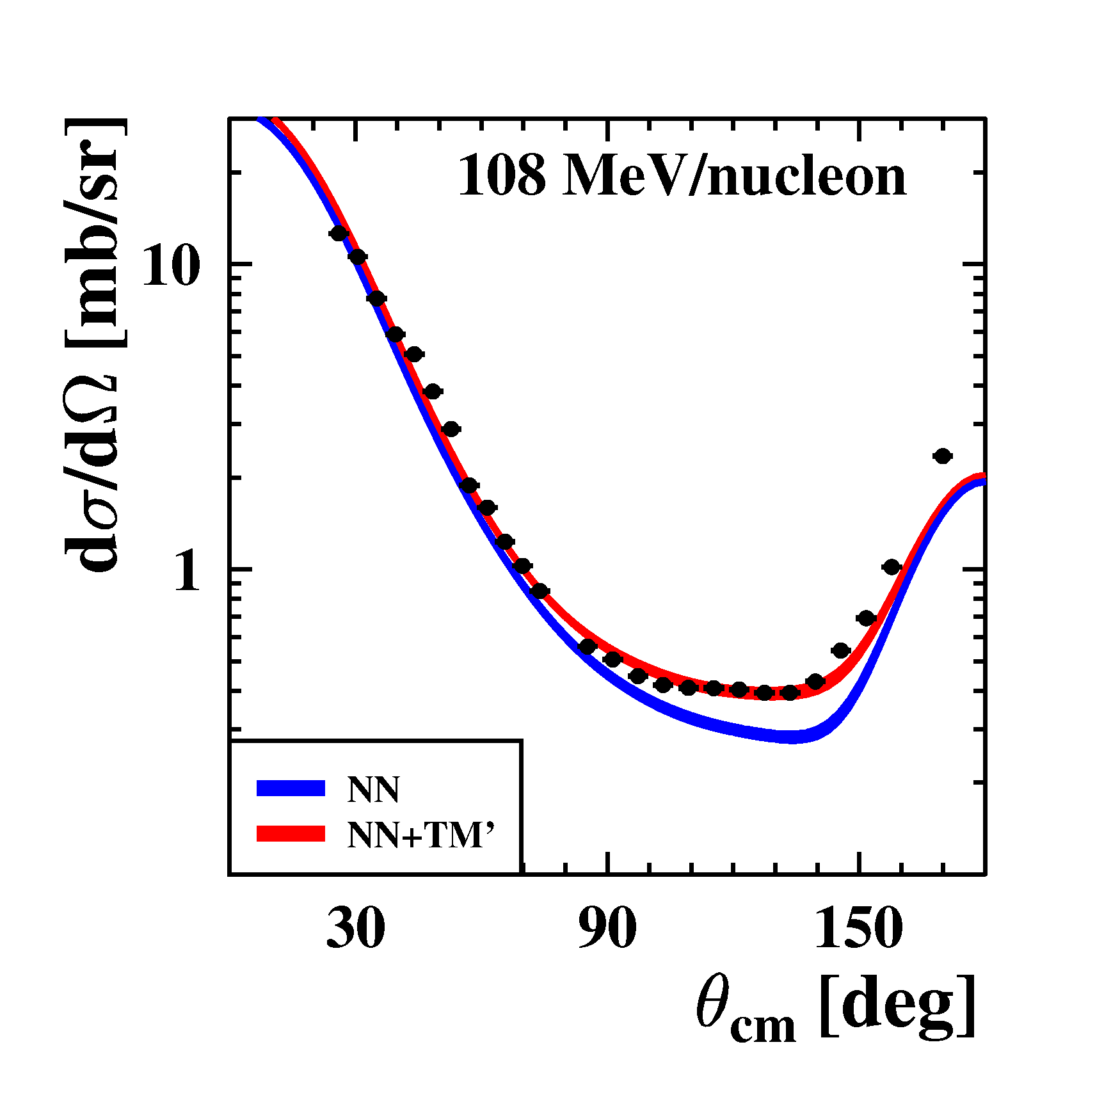
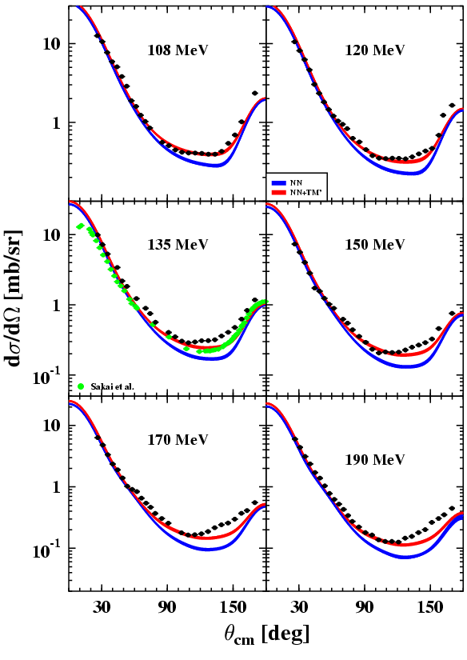
Proton-deuteron elastic scattering
Experiments at CCB IFJ PAN with
BINA setup
proton
θ_{P}
b
θ_{D}
deuteron
108 MeV
10²
190 MeV
10¹
experiment
10⁰
experiment
calculations NN
calculations NN
calculations NN+3N
calculations NN+3N
S. Kistryn, A. Kozela, E Stephan,
(UJ, IFJ PAN, UŚ)
K. Ermisch (J. Golak, R. Skibiński, H. Witała) et al., Phys. Rev. C 68, 051001(R) (2003)

Slide 38
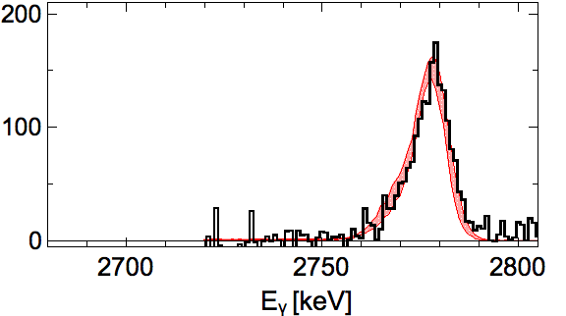
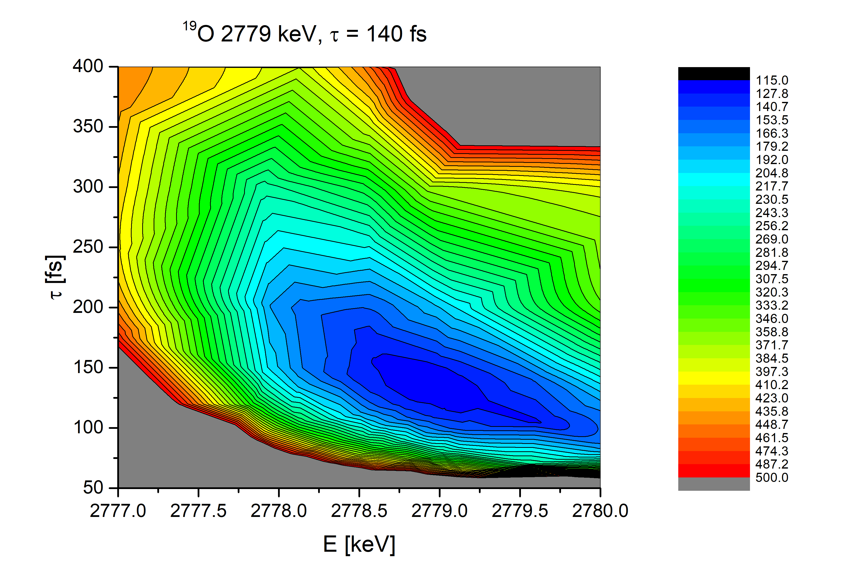
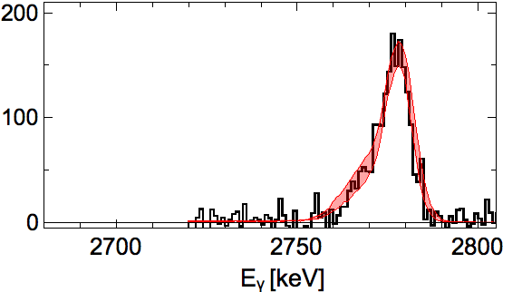
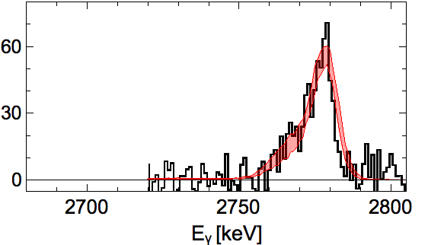
TEST of KNOWN lifetimes in the 100s femtoseconds region
¹⁹O
¹⁸O (7 MeV/A) + ¹⁸¹Ta target (6 mg/cm²)
^{130°}
¹⁹O
2779
τ
[fs]
^{150°}
⁺⁵⁰
τ = 140 fs
₋₄₀
Very old
literature values (1971)
= 70(26) fs
= 117(26) fs
^{170°}
E_{γ}
[keV]
Literature Eγ = 2779(1) keV

Slide 39
TEST of KNOWN long lifetime in the region
^{130°}
¹⁹O
¹⁸O (7 MeV/A) + ¹⁸¹Ta target (6 mg/cm²)
¹⁹O
>3.5 ps
100 fs
^{150°}
τ
2371
500 fs
[fs]
^{170°}
τ > 400 fs
E_{γ}
[keV]
Literature Eγ = 2371(1) keV

Slide 40
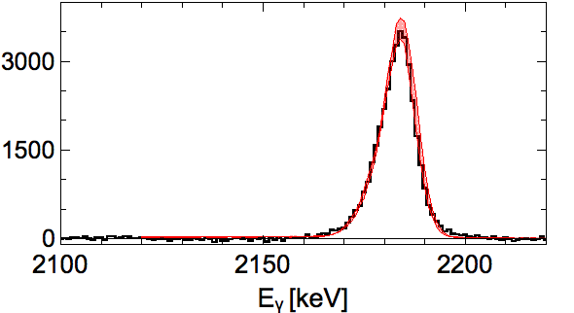



TEST of KNOWN Lifetimes in the 100s femtoseconds region
¹⁷O
115(+80,-60) fs
¹⁸O (7 MeV/A) + ¹⁸¹Ta target (6 mg/cm²)
2184
^{130°}
¹⁷O
¹⁷O
τ
[fs]
^{150°}
⁺⁴⁰
τ = 159 fs
₋₂₀
^{170°}
E_{γ}
[keV]
Very old
literature values (1964)
= 115(+80,-60) fs
Literature Eγ = 2184.48(20) keV

