Slide 1
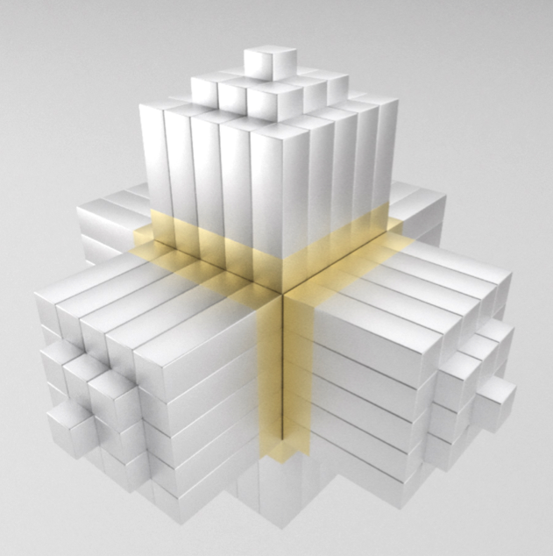
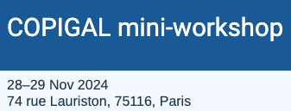
Development of the PARIS array
Adam Maj
IFJ PAN Kraków
for the PARIS Collaboration
adam.maj@ifj.edu.pl
paris.ifj.edu.pl

Slide 2
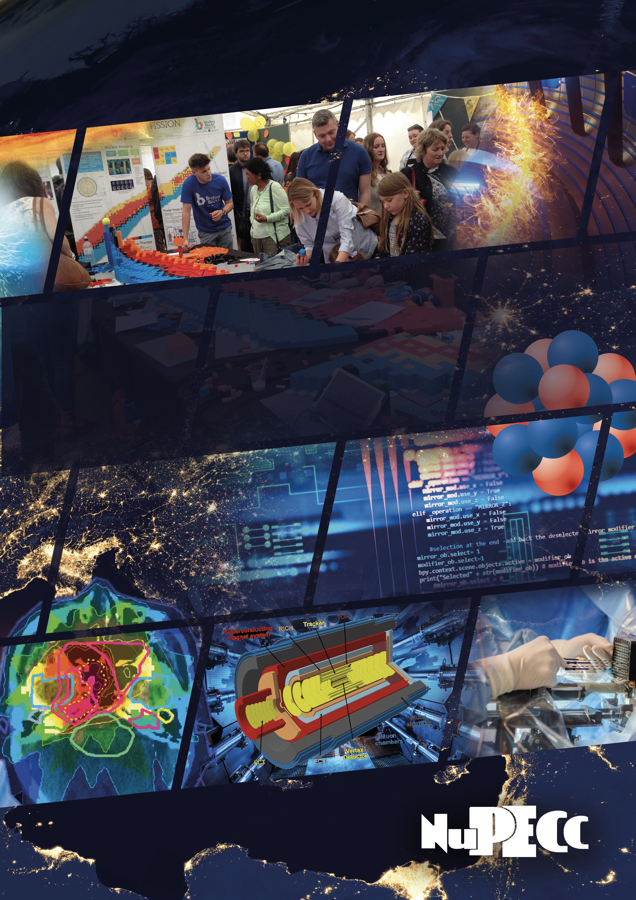
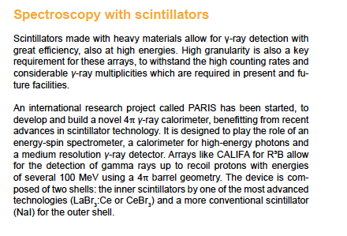
excerpt from the
NUPECC Long Range Plan 2024
https://www.nupecc.org/lrp2024/Documents/nupecc_lrp2024.pdf

Slide 3
Plan of the seminar
Introduction
The concept of the PARIS project
Initial tests of PARIS
Early years of PARIS (Phase1: 1-4 clusters)
Physics done with PARIS Phase2 (8 clusters)
PARIS performance
Towards Phase3 - 4π PARIS calorimeter
Summary

Slide 4
Introduction – why one needs a new gamma calorimeter?

Slide 5
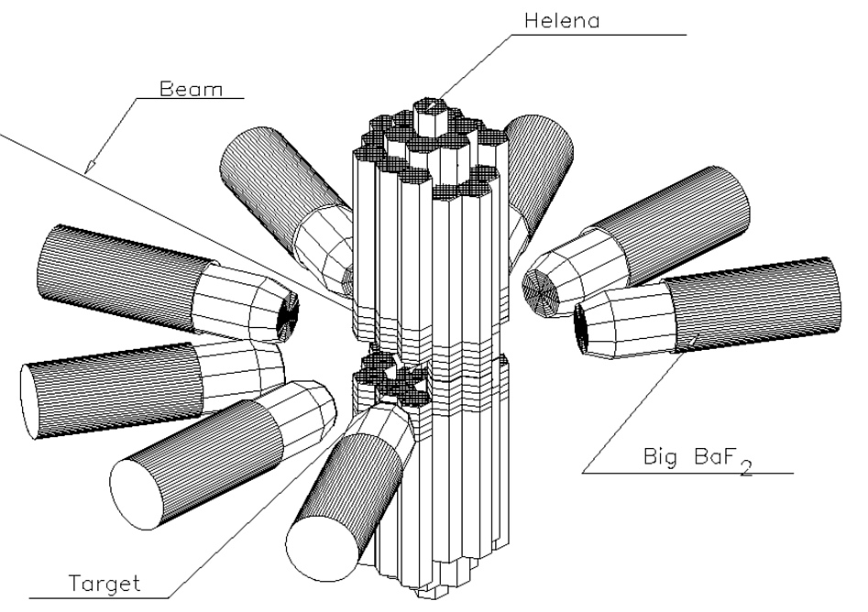
In the measurement of gamma radiation, the best detector should have excellent energy and time resolution, good full energy peak efficiency and no internal radiation.
The best energy resolution is provided, at the moment, by HPGe detectors but the cost, the maintenance and the performances in terms of time resolution are far from being ideal. In addition, the intrinsic full energy peak efficiency for high-energy gamma rays (5 MeV < E_{γ} < 30 MeV) is quite low and, at the moment, large volume single HPGe crystals (e.g. vol. > 1 liter) are not commercially available.
In the past decades, the measurements of high-energy gamma rays were done using arrays of scintillator detectors as for example (in the 80') the Oak Ridge Spin Spectrometer, the Darmstadt Crystal Ball or the French Chateau de Crystal or TAPS
In the 90' the Milano-Copenhagen-Krakow collaboration built the Hector array (based on large volume BaF₂ detectors) and, more recently, the Milano group built the Hector⁺ array (based on large volume LaBr₃:Ce detectors). Presently there are other detectors for high-energy gamma-rays: OSCAR, CALIFA, ELIGANT, ….
WHY do we need another yet one?
HECTOR: 8 big (14cm x 18cm) BaF₂ crystals
Time resolution <1 ns
Energy resolution = 11%
HELENA (multiplicity): 38 small BaF2
Time resolution ≈ 500 ps
Used in:
NBI Copehnagen, Grenoble, LNL Legnaro,
GSI Darmstadt, CCB IFJ PAN

Slide 6
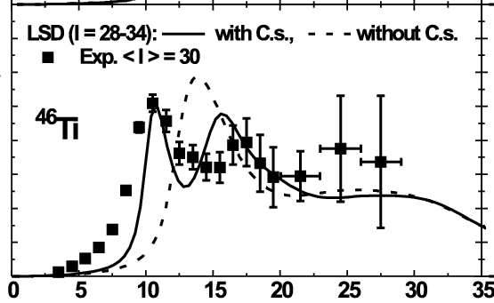
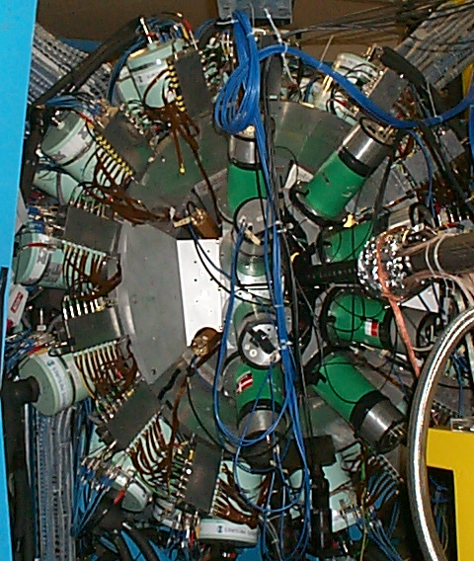
Example of physics case for which better detector array is needed:
“A search for nuclear Jacobi and Poincare shape transitions”
HECTOR + EUROBALL experiments in Strasbourg (France)
105 MeV ¹⁸O + ²⁸Si ⇒ ⁴⁶Ti*
l_{max}≈35 , E* = 88 MeV
A.Maj et al., Nucl. Phys. A731, 319 (2004)
A.Maj et al., Eur. Phys. J. A20, 165 (2004)
M. Kmiecik et al., Acta Phys. Pol. B36, 1169 (2005)
The existence of Jacobi's nuclear shapes in ⁴⁶Ti at high spins was confirmed.
BUT STUDIES OF SUCH EFFECTS IN HEAVIER NUCLEI AND ESPECIALLY - A SEARCH FOR POINCARE SHAPES REQUIRE MUCH MORE EFFECTIVE DETECTOR.

Slide 7
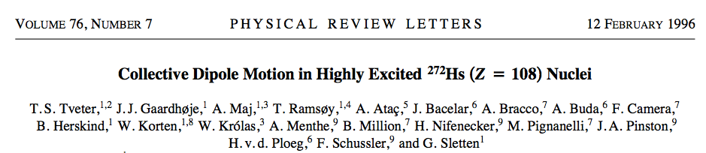
Example of physics case requiring better detector array:
Properties hot superheavy nuclei
Difference between the two gamma spectra in coincidence with fission fragments shows a bump in the range of the GDR energy predicted for the composite system - E_{GDR} (A = 272) ≈ 12.2 MeV
This means that we could isolate the pre-fission GDR gamma-decay of hot superheavy nuclei, using differential technique.
TO APPLY THE TECHNIQUE FOR HEAVIER NUCLEI – MORE EFFICIENT ARRAY IS NEEDED

Slide 8
General assumptions
The new gamma calorimeter shall:
be transportable (between different facilities: SPIRAL2, ALTO, Legnaro, Kraków, Warsaw, Mumbai,...)
be modular (to be connected with other detectors: AGATA, EXOGAM, GRIT, NEDA, FAZIA, ACTAR, VAMOS,…)
have high granulation (multiplicity measurement, Doppler correction,...)
have very high efficiency for high-energy γ-rays
have good timing resolution (<600 ps) – to resolve gamma’s from neutrons by ToF
have energy resolution as good as possible
have some position sensitivity
be readout by digital lectronics

Slide 9
The concept of the PARIS array

Slide 10
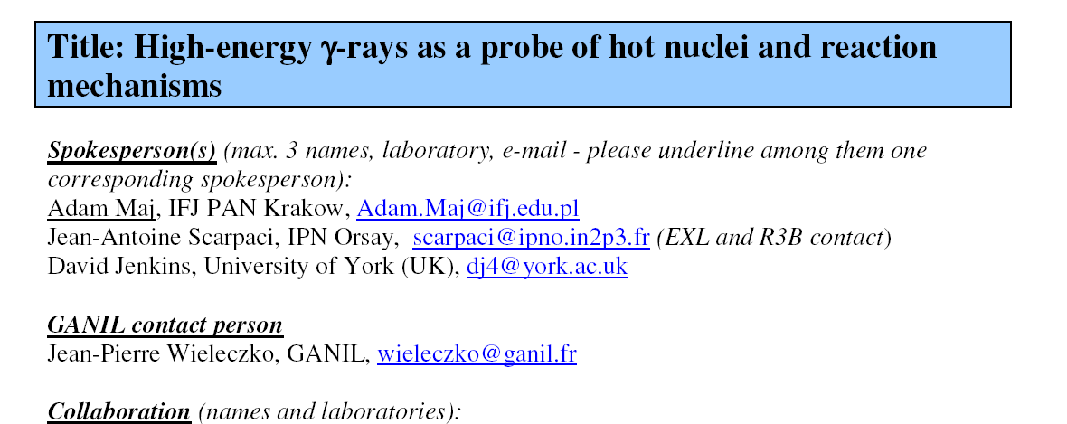

4-5-6th October, 2005 „Future prospects for high resolution gamma spectroscopy at GANIL”
Convenors : Bob Wadsworth and Wolfram Korten
WG „Collective modes in continuum” – convenors: Silvia Leoni & Adam Maj;
M. Kmiecik: talk on possible Jacobi shapes in exotic nuclei
GANIL
SAC open session
October 19th, 2006
Aim: to design and build
efficient gamma calorimeter
PARIS

Slide 11
PARIS main physics cases
HOT ROTATING NUCLEI
Jacobi and Poincare shape transitions
Studies of shape phase diagrams of hot nuclei
Hot GDR in neutron-rich nuclei
Isospin mixing at finite temperatures
Links between GDR emission and SD/HD structure
GDR and PDR built on isomeric states
Onset of chaotic regime (+AGATA)
A.Maj, J. Dudek, K. Mazurek, M. Kmiecik, M. Ciemała
A. Bracco, F. Camera, S. Leoni, I. Mazumdar, D.R. Chakrabarty, V. Nanal, M. Kicinska-Habior, M. Harakeh, P. Bednarczyk
REACTION MECHANISMS
Onset of multifragmentation and GDR
Reaction mechanism studied via gamma-rays
Heavy ion radiative capture
Nuclear astrophysics
Fission of SHE nuclei
J.P. Wieleczko, S. Santonocito, Ch. Schmitt, O. Dorvaux, S. Courting, D.G. Jenkins, S. Harissopulos, A. Maj
SHELL STRUCTURE
Multiple Coulex of SD bands in light nuclei
Relativistic coulex
Shell structure at intermediate energies
Near barrier resonances
3-body force
F. Azaiez, J. Stephan, B. Fornal, S. Leoni, P. Napiorkowski,
P. Bednarczyk, A. Maj, Z. Dombradi, M. Ploszajczak, S. Leoni, B. Fornal, M. Ciemała, M. Lewitowicz
COLLECTIVE MODES
PDR in neutron-rich and proton-rich nuclei
Gamma-decay of GDR and GQR built on ground states
GDR built on isomeric states
A.Bracco, A. Maj, D. Beaumel, I. Matea, F. Crespi,
M. Kmiecik, M. Lewitowicz, M. Harakeh, M. Kmiecik

Slide 12
PARIS design assumptions:
High efficiency (≈4π) gamma detector, based on new scintilation materials,
consisting of 2 shells
for medium resolution spectroscopy
and calorimetry of γ-rays in large energy range
NaI
Inner sphere, highly granular, made of new crystals (LaBr3 or CeBr3), to be used as a gamma multiplicity filter, sum-energy detector (calorimeter), detector for the gamma-transition up 10 MeV with medium energy resolution, fast timing.
LaBr3
Outer sphere, high volume conventional crystals (NaI), for high-energy photons, active shield for the inner shell.
CeBr3
2-shell concept, in addition to being more economic, shall help to distinguish a high-energy photon from a cascade of low energy gamma transitions in fusion evaporation reactions
The idea od PARIS was proposed by the Krakow group and developped jointly
by physicists from Poland, France, India, UK and Italy

Slide 13
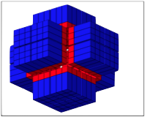
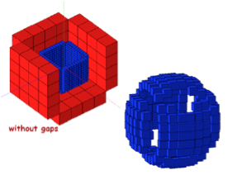
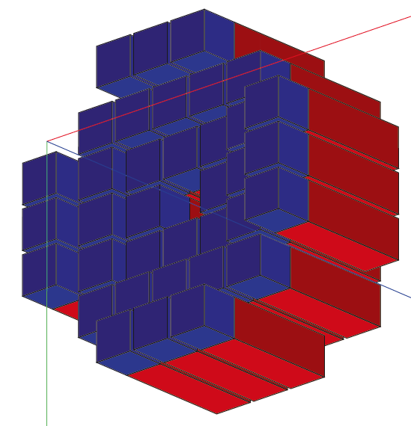
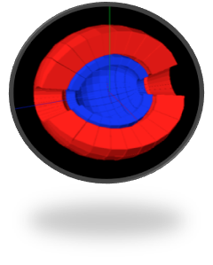
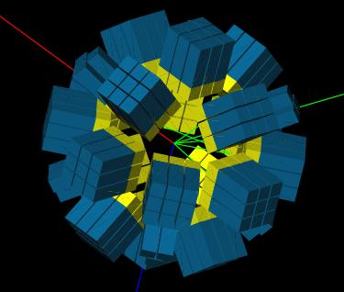
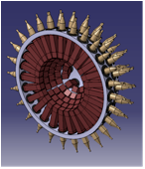
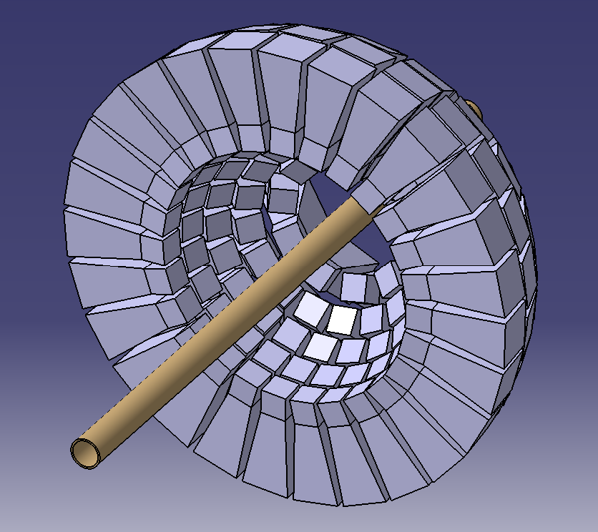
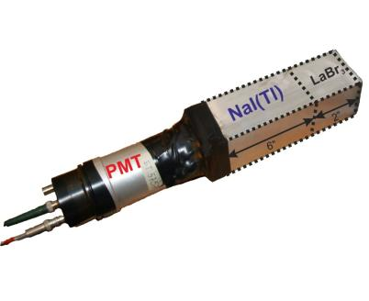
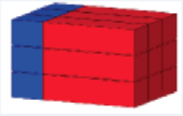
Several geometries studied
‘cubic’-like
‘Ideal’ - spherical
‘radial’-like
PARIS to be made of rectangular phoswiches
Arranged in clusters (9 phoswiches each)
This allows cubic, wall or semi-spherical geometry with 24 clusters (216 phoswiches)

Slide 14
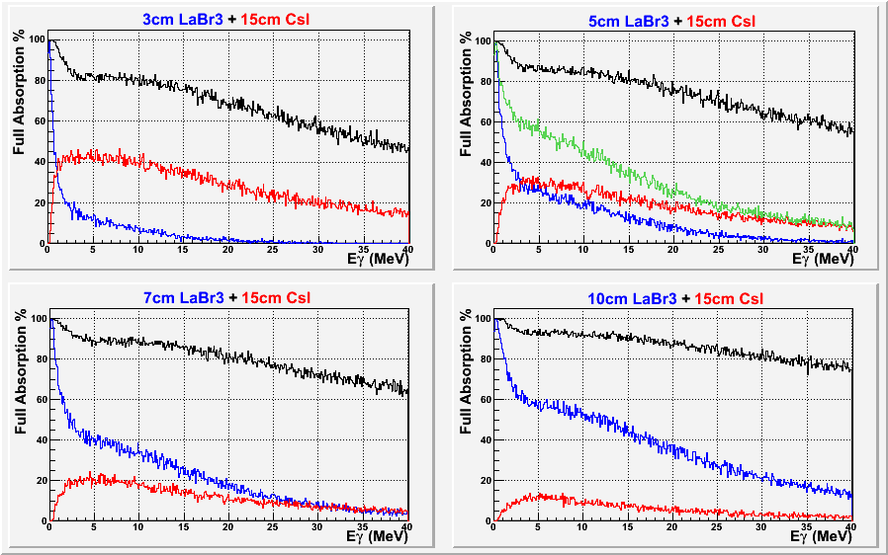
Simulations: O. Stezowski, M. Ciemała, M. Labiche et al..
Phoswich 2” LaBr3 + 6”NaI
Extensive simulation studies have been performed to understand how γ–rays with energies from few keV up to 50 MeV are absorbed and recovered.
All the considerations drive the design of the basic element of PARIS as composed of
a phoswich 2”x2”x2” LaBr3 (or CeBr3) followed by 2”x2”x6” NaI.
placed at a reasonable distance (ca. 20 cm) from the target position it gives a 4π array composed of ca. 200 of elements for optimal characteristics in non-relativistic domain (β < 10%).

Slide 15
PARIS Organization
PARTNERS:
IN2P3 (France), COPIN (Poland), GANIL/SPIRAL2 (France), TIFR/BARC/VECC (India), IFIN HH (Romania),
INFN (Italy), UK, Turkey, GSI/FAIR Darstadt, JINR Dubna*
PARIS Steering Committee
Angela Bracco (INFN, Italy)
Wilton Catford (UK)
Oliver Dorvaux (IN2P3, France)
Sefa Ertuerk (Turkey)
Bogdan Fornal (COPIN, Poland) - Vice-Chair
Juergen Gerl (GSI/FAIR, Germany)
Marek Lewitowicz (GANIL, France) - Chair
Vandana Nanal (India)
Yuri Penionzhkevich (JINR Dubna, Russia)
Mihai Stanoiu (Romania)
PARIS Project Manager (since 2006)
Adam Maj (Krakow)
Working Groups and their Coordinators
Piotr Bednarczyk (Krakow) - Online user interface integration
Sergio Brambilla (Milano) - Electronic and DAQ integration
Michał Ciemała (Krakow) - Physics event generators, off-line data analysis and data management
Oliver Dorvaux (Strasbourg) - Detectors
Iolanda Matea (Orsay) - Mechanical integrations
Oliver Stezowski (Lyon) - Simulations and characterization
PARIS Collaboration Council (21 institutions)
F. Camera (INFN and U. Milano) - chair and PARIS spokesman
C. Bhattacharya (VECC Kolkata), W. Catford (U. Surrey), M. Cinausero (LNL Legnaro), S. Courtin (IPHC Strasbourg),
Zs. Dombradi (ATOMKI Debrecen), C. Ducoin (IPN Lyon), S. Ertuerk (U. Nigde), N. Gelli (U. Florence), J. Gerl (GSI),
A.K. Gourishetty (IIT Roorkee), D. Jenkins (U. York), M. Kmiecik (IFJ PAN Krakow),
B. Kumar Nayak (BARC Mumbai), M. Labiche (STFC Daresbury), V. Nanal (TIFR Mumbai), P. Napiorkowski (HIL Warsaw), M. Ploszajczak (GANIL), Y. Sobolev (JINR Dubna), M. Stanoiu (IFIN-HH Bucharest), J. Wilson (IPN Orsay)
*) Suspended in March 2022

Slide 16
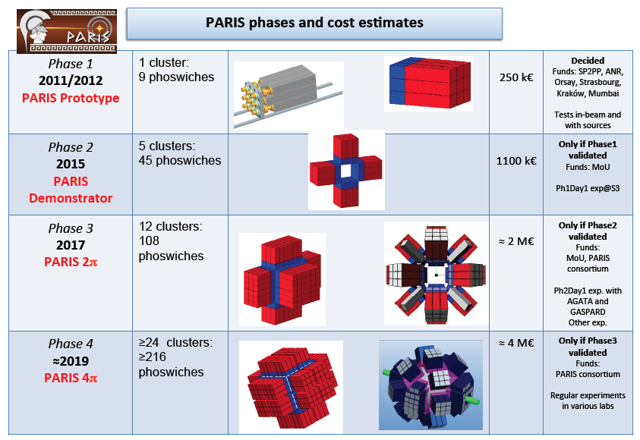
PARIS Demonstrator MoU (2011-2021) and PARIS phases
MoU on PARIS Demonstrator (Phase 2) was prepared and agreed to be signed by all the partners
PARIS cluster
8 clusters:
72 phoswiches
IPN Orsay
.
AGATA@GANIL
.
.
S3@GANIL
.
CCB Krakow
.
.
LNL/SPES
.
.
SPIRAL2 phase2
.
2017
2022
2025?

Slide 17
S. Brambilla, P. Bednarczyk, O. Dorvaux, A. Czermak, P. Napiorkowski
Electromnics for PARIS
  Comercial digitizers (CAEN V1730)
  16 channel, 500 MS/s, 12/14 bit
  Tested in Krakow, July 2015 – works very well (good time resolution, time resolition – 0.7ns, low deadtime)
  Occasionally other local digitizers (e.g. FASTER in IJCLab, NFS)

Slide 18
Initial tests of PARIS

Slide 19
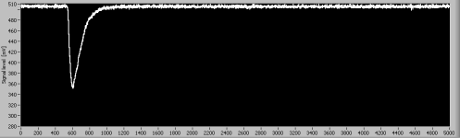
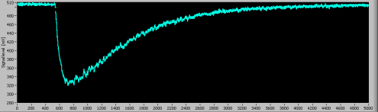
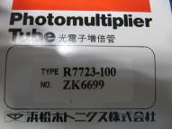
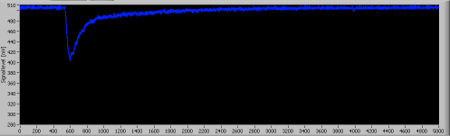
Phoswich tests
10 ns risetime
LaBr3 or CeBr3
Single pulses
HAMAMATSU
The PARIS PHOSWICH at work
Mixed signal

Slide 20
6.13 MeV γ source
A test measurement at IFJ PAN, Kraków (2011) with BafPro module from Milano
Sources
proton beam
LaBr3 resolution
(seen through 6” long NaI):
ca. 4%
The phoswich concept works !
Other tests:
Strasbourg, Orsay, Milano, Warsaw, Mumbai
M. Zieblinski et al.,
Acta Phys.Pol. B44, 651 (2013)

Slide 21
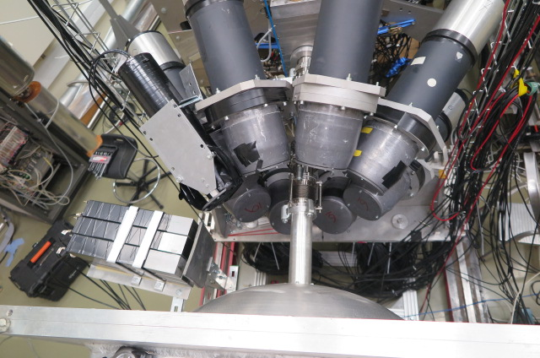
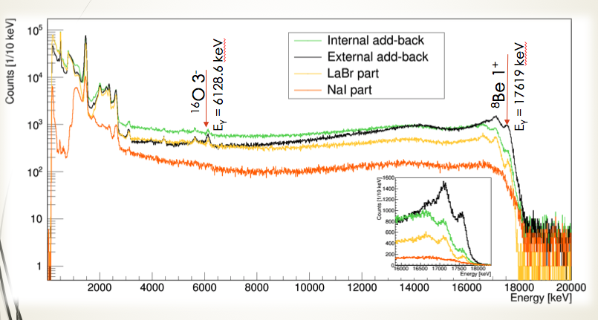
Exp. in ATOMKI Debrecen – March 2017
(p,gamma) – reaction on LiBO target
Testing PARIS cluster add-back with high-energy gamma-rays
The cluster concept works!
B. Wasilewska et al., paper in preparation

Slide 22
Early years of PARIS (Phase1: 1-4 clusters)

Slide 23
1-4 clusters of PARIS were used inexperiments performed in
GANIL:
  2 clusters + AGATA + VAMOS (2017)
in 4 exp. in CCB in IFJ PAN Krakow (2 clusters + 4 Large LaBr3 + KRATTA+DSSSD) 2016-2024
in 6 exp. in IPN / IJCLab Orsay
1-4 clusters, standalone and with nuBall1, BEDO, Corset, … (2016-2022)

Slide 24

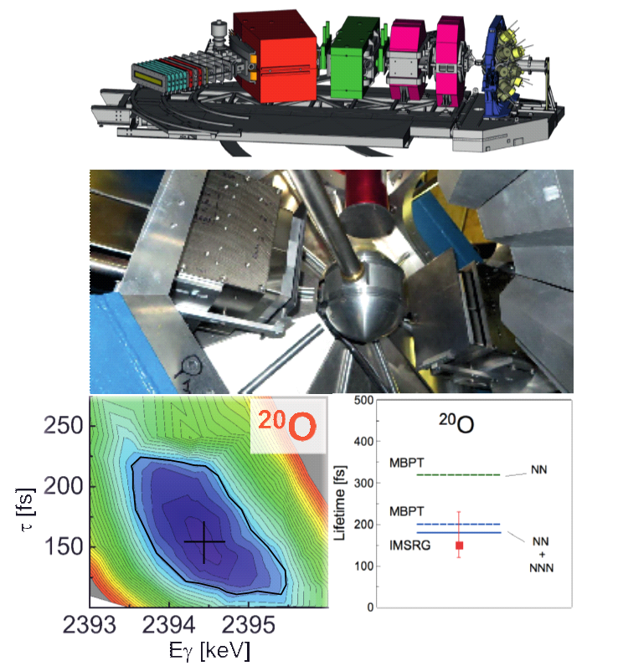
GANIL (France)
Performed:
S. Leoni, B. Fornal, M. Ciemala et al., “Lifetimes in A=18 region – verifying theory predictions (NN or NNN)”
(PARIS: 2 clusters + 2 large LaBr3), AGATA, VAMOS, Plunger (July 2017)
Results published:
M. Ciemała et al. Phys. Rev. C101, 021303(R) (2020)
M. Ciemała et al., EPJ A57, 156 (2021)
S. Ziliani et al., Phys. Rev. C104, L041301 (2021)
The achieved results on transition probabilities in neutron-rich ²⁰O (for the second 2⁺ state) agree well with predictions from theories assuming
3-body interactions.
For the first time information about 3-body forces came from the gamma-spectrocopy studies.
In addition, in the same experiment, were measured lifetimes for the low-lying states in other neutron-rich nuclei: ¹⁷N, ¹⁸N, ¹⁶C, ¹⁷O, ¹⁹O, ¹⁴C

Slide 25

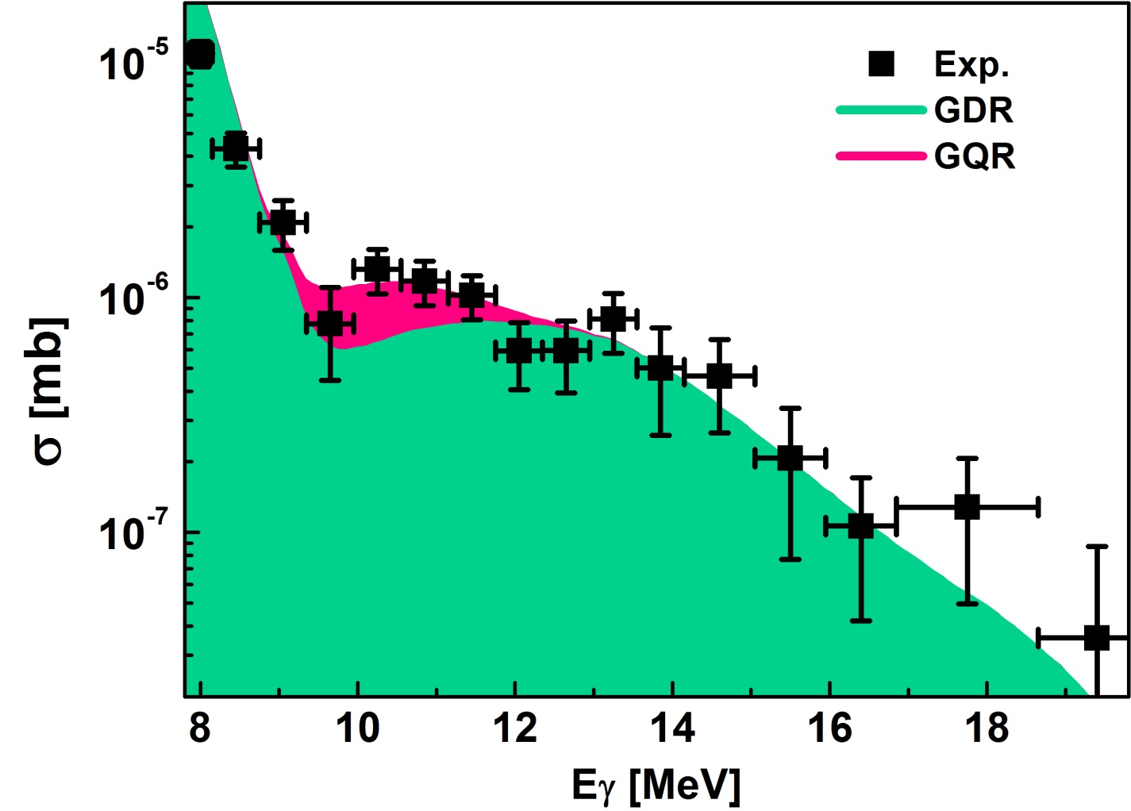
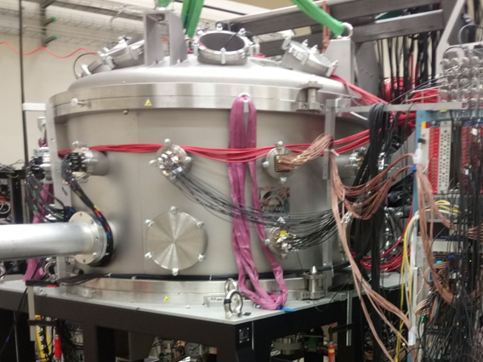
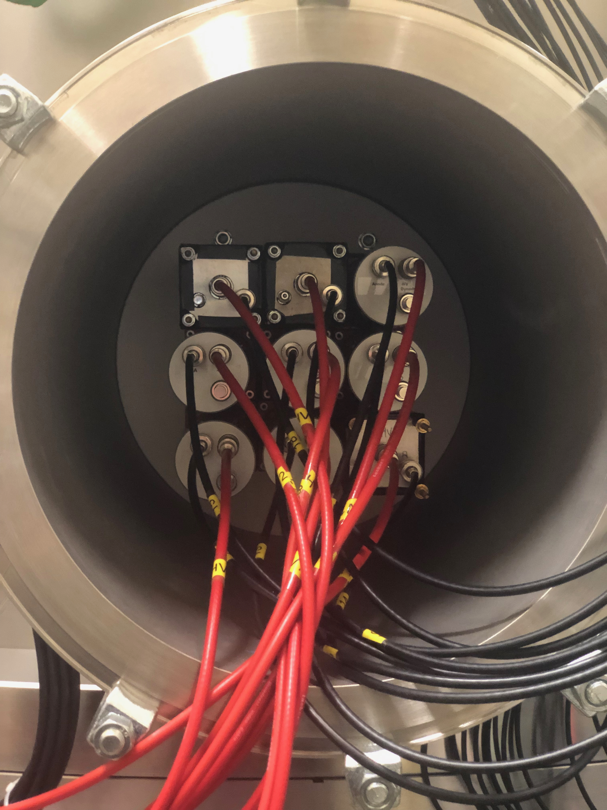
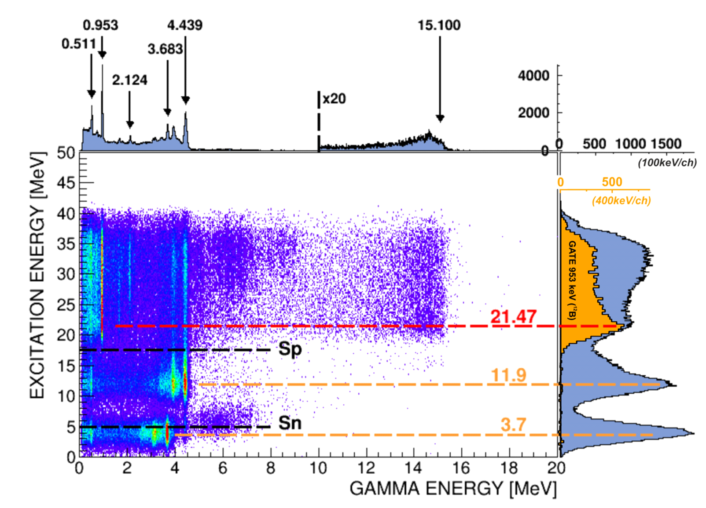
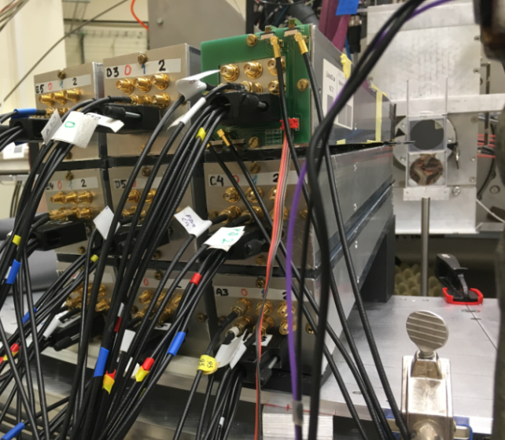
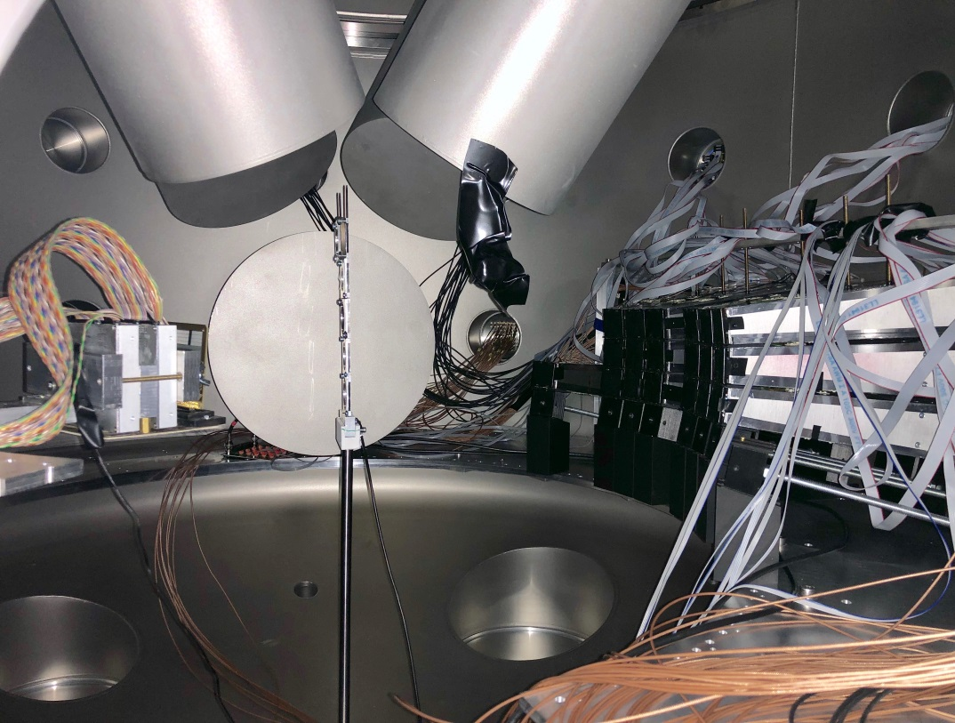
CCB@IFJ-PAN Krakow (Poland) (2 PARIS clusters) - „Studies of resonances in nuclei using high-energy proton beam in p,p’ reactions at forward angles”
Gamma-decay of GQR in ²⁰⁸Pb and ¹²⁴Sn (M. Kmiecik, F. Crespi)
Decay of the M4 resonance (21.5 MeV) in ¹³C nucleus has been identified (N. Cieplicka, S. Leoni, B. Fornal)

Slide 26
PARIS timing
We measure V by: measure path in spectrometer and time between RF and Plastic at the end of focal plane.
¹⁸O MASS reconstruction with RF
RF signal was NOT stable in time in respect to beam on target – best observable is Mass (calculated from Brho and V)
Time of experiment
Using PARIS (LaBr₃ part, FWHM < 1ns) vs. RF timing to correct RF fluctiations (up to 2 ns)
Thanks to PARIS timing we recovered good A reconstruction/stability (it means also good V)!

Slide 27
3-4 clusters of PARIS in CCB @ IFJ PAN Krakow for 2024/2025 campaign
(weekends only)
PDR in ⁵⁸Ni and ⁶²Ni (O. Wieland, M. Kmiecik)
PDR in ⁶⁴Ni (A. Giaz, M. Ciemała)
M4 stretched states in ¹⁶O and ¹²C (N, Cieplicka, G. Corbari)
Evolution of prompt fission gamma-ray emission with excitation energy and the Thorium anomalies (Ch. Schmitt, M. Ciemała, J. Wilson)
Gamma decay study of the Double Isobaric Analog State in 48Ti (D. Stramaccioni)
cf. talk of Maria Kmiecik

Slide 28

IJCLab Orsay (France)
Early years (2017-2019) experiments:
E. Kozulin, I. Harca, E. Vardaci et al. “Prompt γ-rays as a probe of nuclear dynamics” (2017)
I. Matea, J. Wilson, M. Ciemala et al. „PARIS cluster response to fast neutrons” (2017)
M. Lebois, Q. Liqiang et al. “Prompt gamma and neutron emission for 238U fast neutron induced fission as a function of incident neutron energy” (2017)
I. Matea et al., „PDR studies in very neutron rich nuclei around N=50 shell closure through beta-decay” (2019)
M. Babo, A. Gottardo et al., “81Zn ground-state spin determination from pandemonium free beta-delayed spectroscopy of 81Ga” (2019)
A. Oberstedt, “Measurement of prompt gamma ray spectra from the reaction 233U(n,f)” (2019)

Slide 29
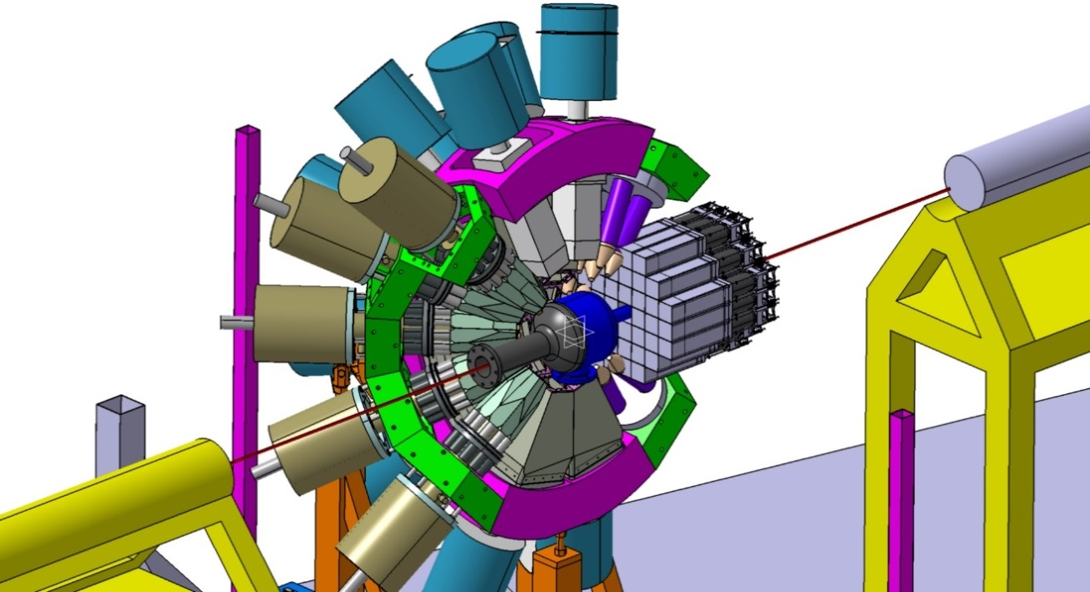
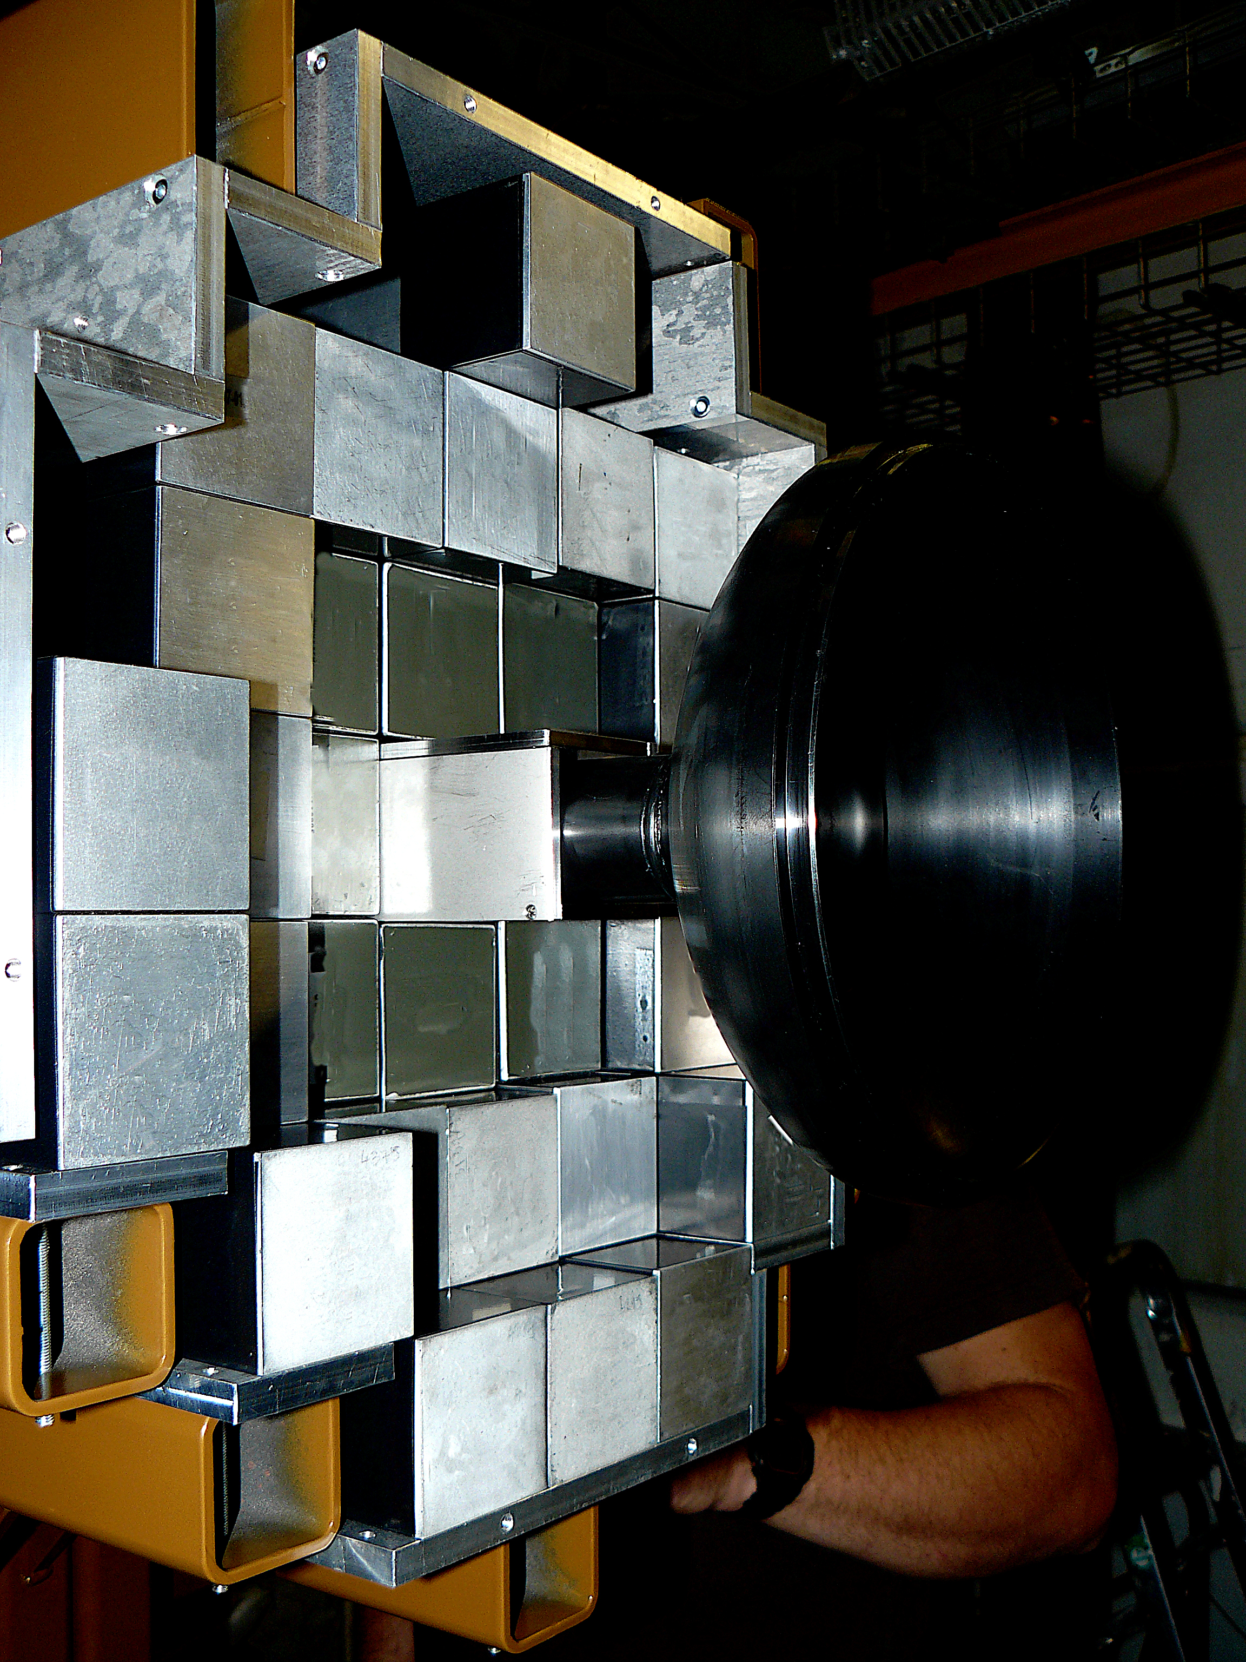
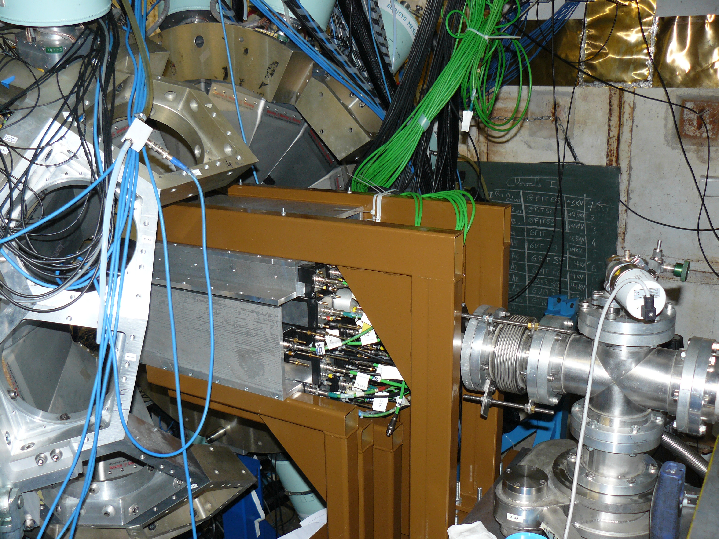
IJCLab Orsay (France) - nuBall 1 campaign
M. Kmiecik, F. Crespi, J. Wilson, M. Ciemała et al., „Feeding of low-energy structures in 188Pt of different deformations by the GDR decay: the nuBall array coupled to PARIS”
(June 2018)
nuBall (24 clover HPGe detectors, 10 coaxial Ge detectors)
4 PARIS clusters (34 phoswich LaBr₃/CaBr₃+NaI detectors - „wall”

Slide 30
Physics done with PARIS Phase2 (8 clusters)

Slide 31
8 clusters of PARIS were used in following experiments
GANIL:
  VAMOS (2022)
  LISE (2022) (2 exp.)
  NFS (2022)
IJCLab Orsay
  8 clusters in the Wall geometry with nuBall2 (2022/2023)

Slide 32
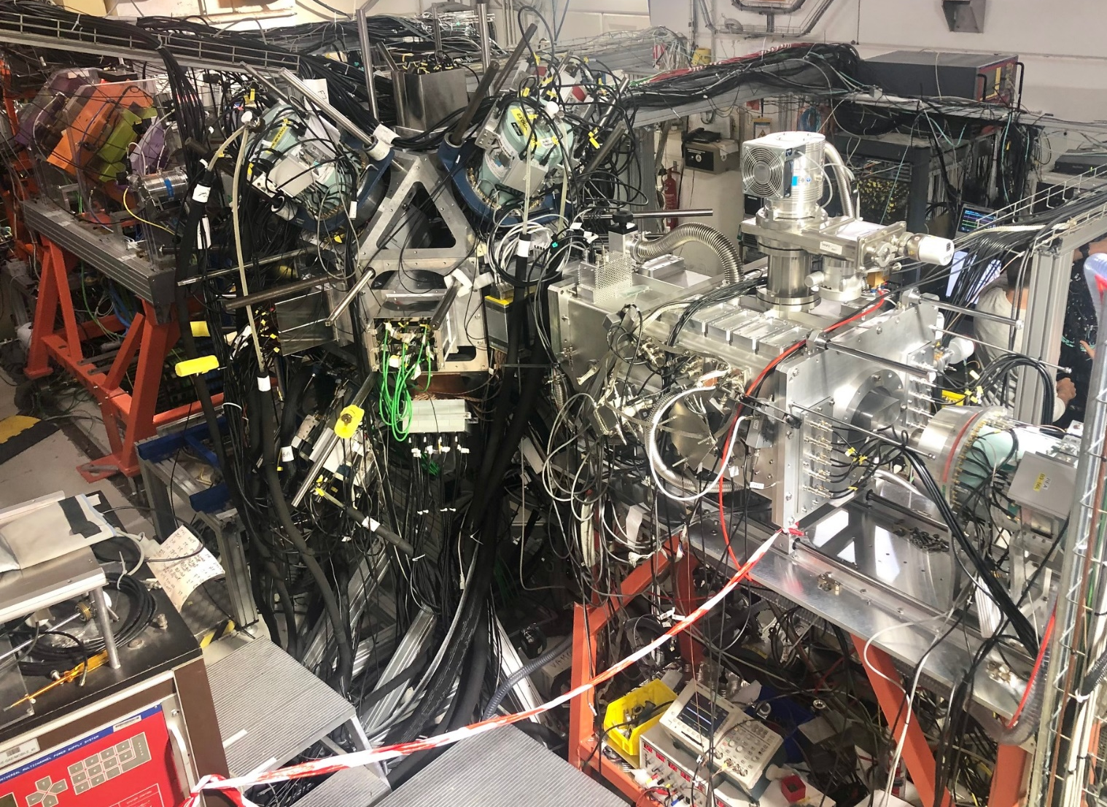
Brochette mode 2022:
1) Nuclear, 2) Coulomb excitation, 3) isomer and beta-decays
ACTAR
TPC
ZDD
”Study of deformed and spherical 2+ states via Coulomb excitation and first time measurement of PDR in 34Si,” R. Lica, S. Calinescu, O. Sorlin, et al.
„Study of Proton/Neutron contribution along Silicium isotopic chain” S. Grévy, R. Thomas, O. Sorlin et al.
CATS
EXOGAM 0°
8 PARIS
8 EXOGAM
Annular Si
LISE 2022
Data are being analyzed
Photo: V. Morel
First achievement world-wide: 3 experiments in one !

Slide 33
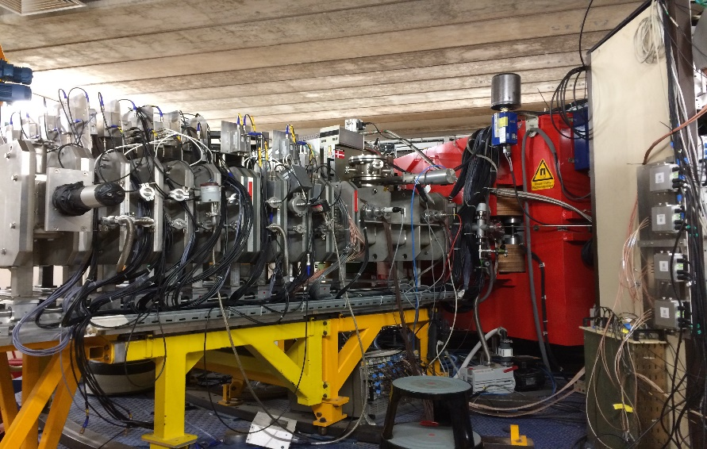
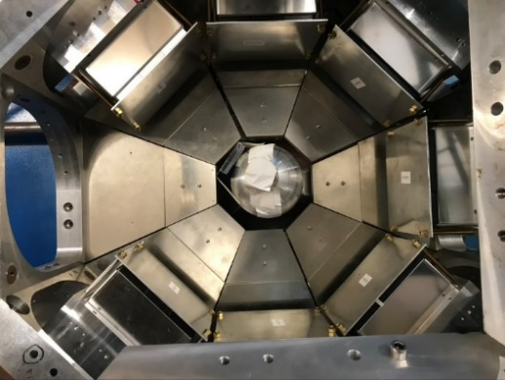
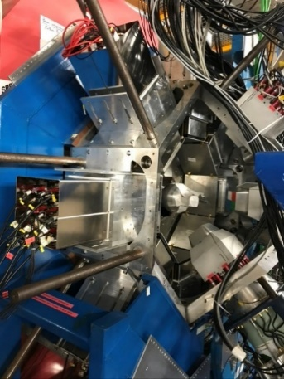
Insight into fission from the γ probe
Going beyond current status with PARIS@VAMOS
Spokespersons: C. Schmitt, M. Ciemala
VAMOS++
PARIS
EXOGAM
+
+
3 clovers @ 135°
8 clusters @ 90°
²³⁸U + ⁹Be →²⁴⁷Cm* (E*~ 43MeV)
cf. talk of Michał Ciemała

Slide 34
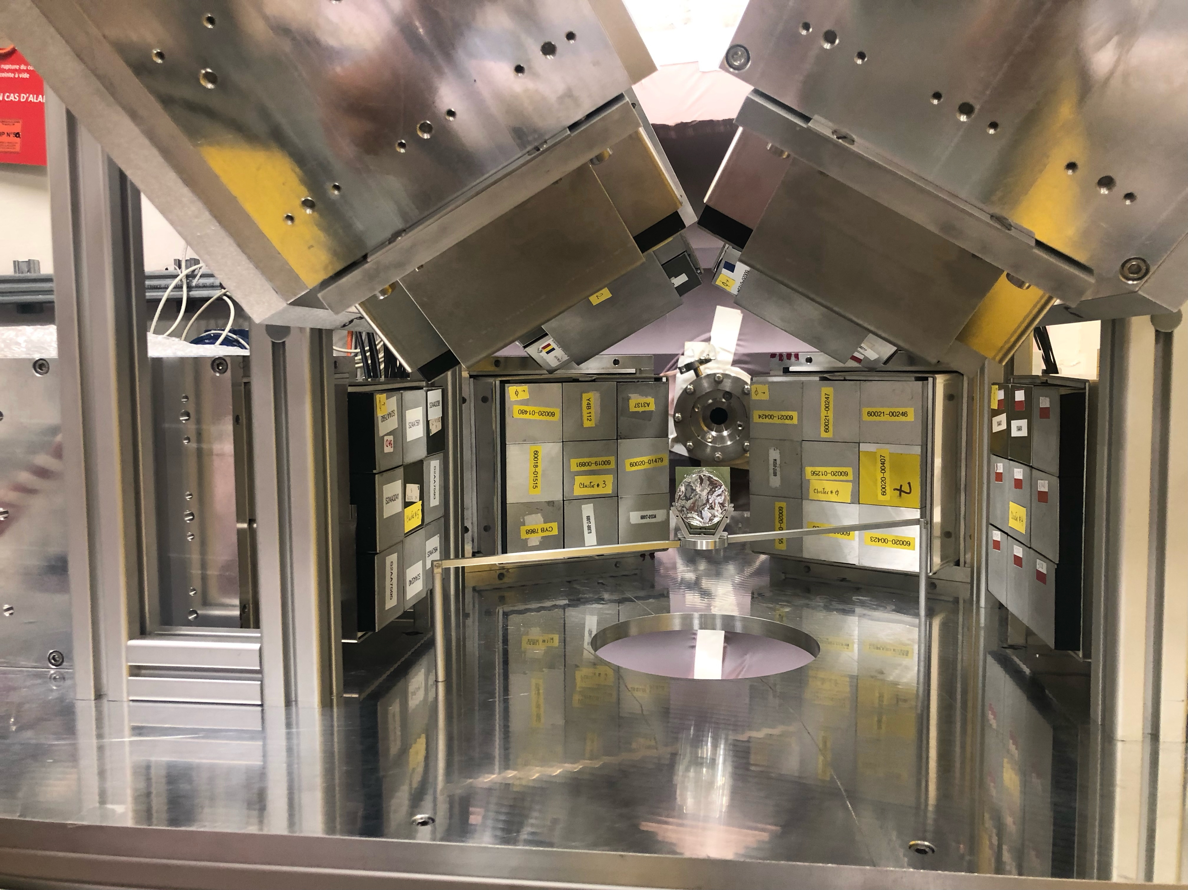
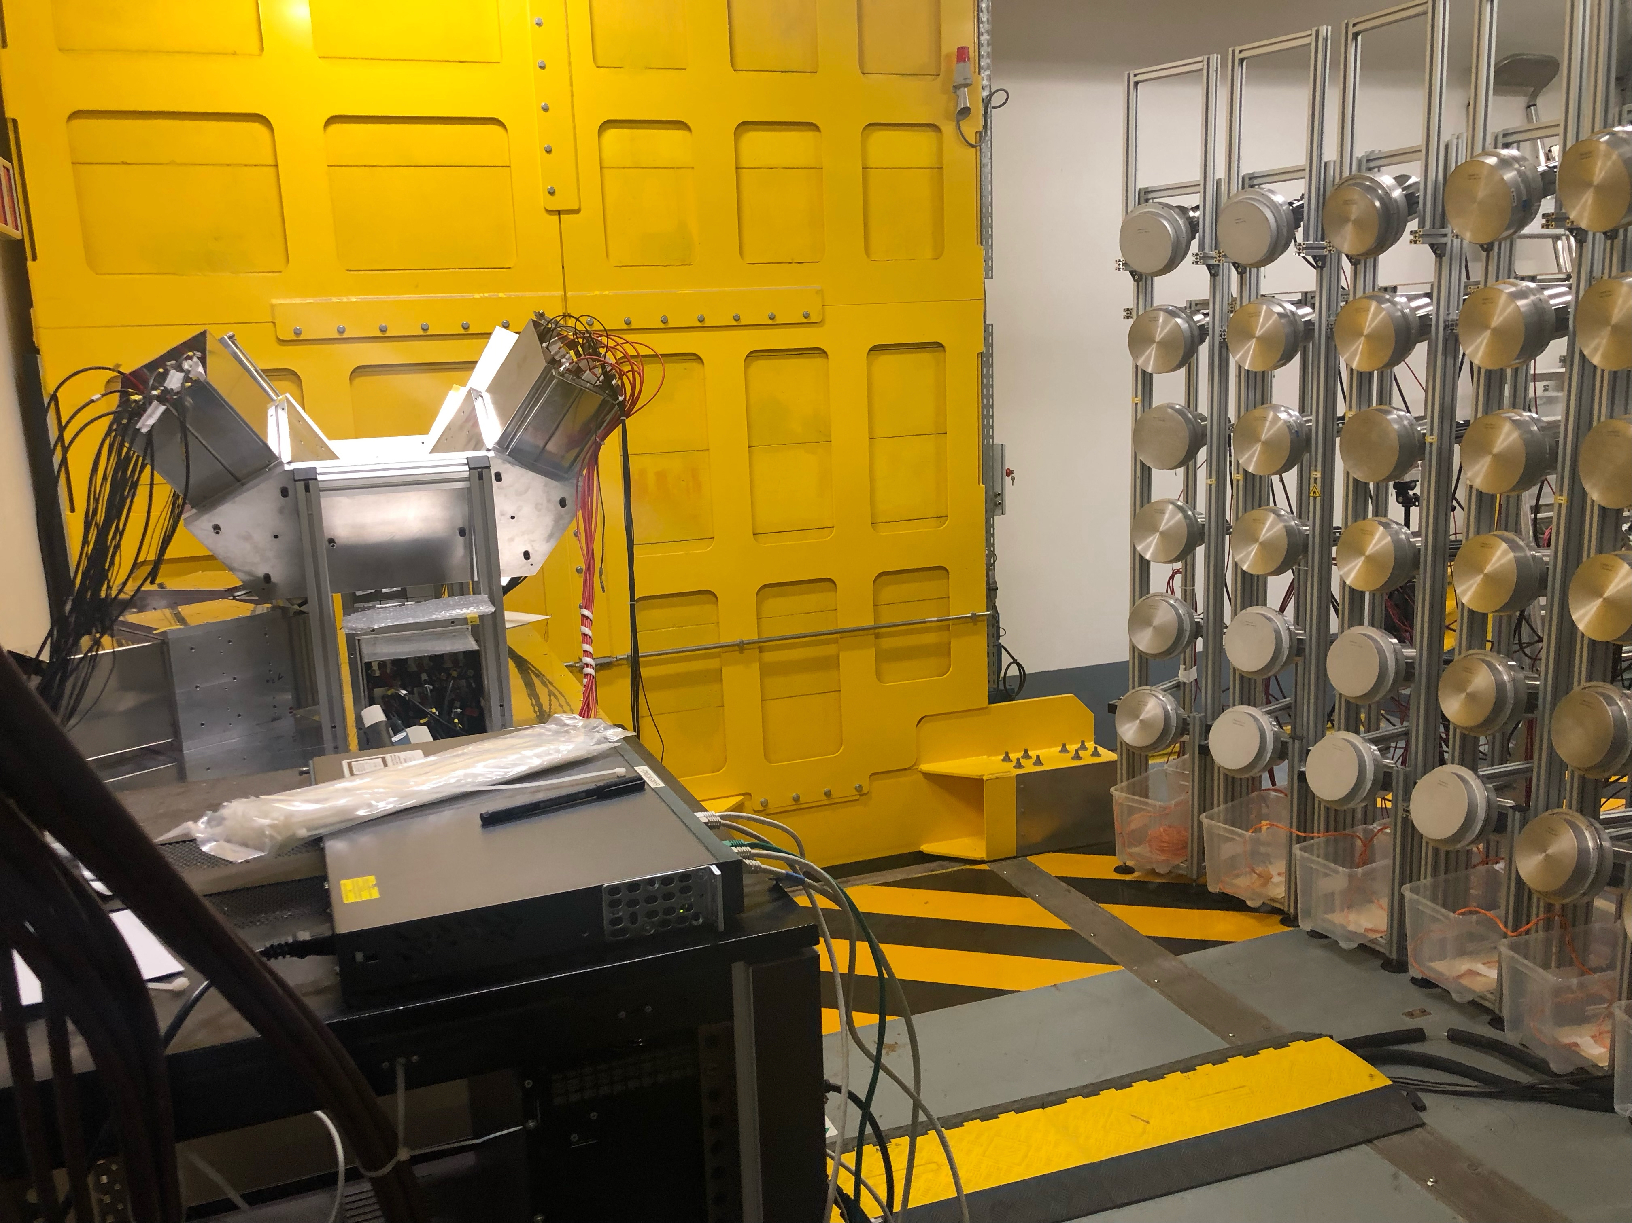
8 clusters at NFS with MONSTER
M. Vanderbrouck, I. Matea, et al.
”Pygmy dipole resonance in ¹⁴⁰Ce using the (n, n’g) reaction at NFS”
Data are being analysed

Slide 35
IJCLab Orsay (France) - nuBall2 campaign
M. Ciemała, M. Kmiecik, F. Crespi et al., “Links between 80Sr compound nucleus’ shape and its residue’s deformation studied with the GDR”
J. Wilson, S. Oberstedt, Ch. Schmitt et al. „Detailed spectroscopy of fission isomers un uranium isitopes”
P . Napiorkowski, A. Maj, F. Azaiez et al. „Coloumb excitation of super-deformed band in 40Ca”
M. Matejska-Minda et al., “Investigation of high spin structures in 44Ti and 42Ca via discrete and continuum gamma spectroscopy using”
M. Lebois et al., “Neutron-gamma de-excitation of fission fragments: Level lifetimes in exotic neutron-rich nuclei”
C. Hiver, J. Wilson et al., „Search for fission shape isomer in 232Th”
nuBall (24 clover HPGe detectors, 10 coaxial Ge detectors)
8 PARIS clusters (72 phoswich LaBr₃/CaBr₃+NaI detectors - „wall”
Data are being analysed

Slide 36
PARIS performance

Slide 37
PARIS Energy resolution
PARIS cluster energy resolution as a function of gamma-ray energy: simulation and experimental results. The continuum line indicates the 1/sqrt(E) energy dependence of the FWHM.
Energy resolution (sigma = 16 keV for 500 keV, Doppler corrected) beta ~0.1c, angle ~90 degree,
72 detectors near to magnetic field of VAMOS++ spectrometer).
Courtesy of Michał Ciemała.

Slide 38
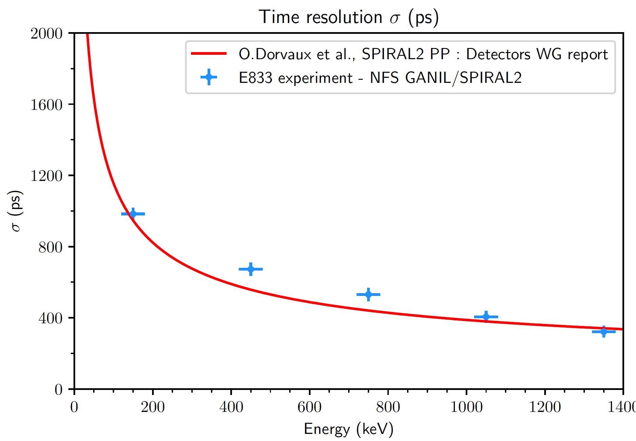
PARIS time resolution
Time resolution (sigma) in the PARIS@NFS experiment.
Courtesy of Perine Miriot-Jaubert.
ToF sigma for prompt gamma peak ~0.8 ns
72 detectors with both LaBr/CeBr type phoswiches
with all E gamma energies abvove ~80 keV threshold
Courtesy of Michał Ciemała

Slide 39
PARIS fold resolution, 31 detectors
4n channel
6n channel
Fusion-evaporation reaction
¹⁸O + ¹⁷⁴Yb -> ¹⁹²Pt*
In general:
PARIS performs accoding to the expactations based on simulations
PARIS prompt gamma FOLD (gated by +/- 3sigma PARIS-RF),
distributions normalized to integral equal to 1

Slide 40
Towards Phase3 - 4π PARIS calorimeter

Slide 41

PARIS Whitebook
(concept, physics case, outlook)
Editorial Board:
F. Camera (chair), A. Maj (co-chair),
S. Leoni, Ch. Schmidt, I. Mazumdar
M. Lewitowicz (GANIL)
I. Matea, J. Wilson (IPN Orsay)
M. Kmiecik (IFJ PAN Krakow)
M. Cinausero, F. Crespi (LNL Legnaro)
V. Nanal (TIFR Mumbai)
http://rifj.ifj.edu.pl/handle/item/333
ISBN 978-83-63542-22-1

Slide 42
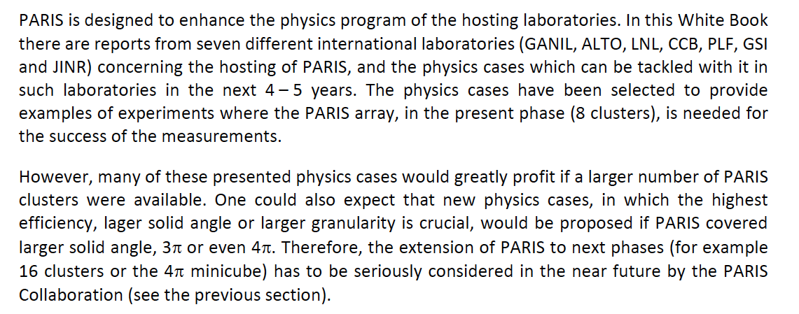
An excerpt from the Summary of the PARIS White Book:

Slide 43
PARIS Steering Committee extended of the PARIS MoU by another 5 years (2022-2026) with the aim to reach the goal of
PARIS 4π minicube stage (6 superclusters 5x5 = 150 phoswiches)

Slide 44
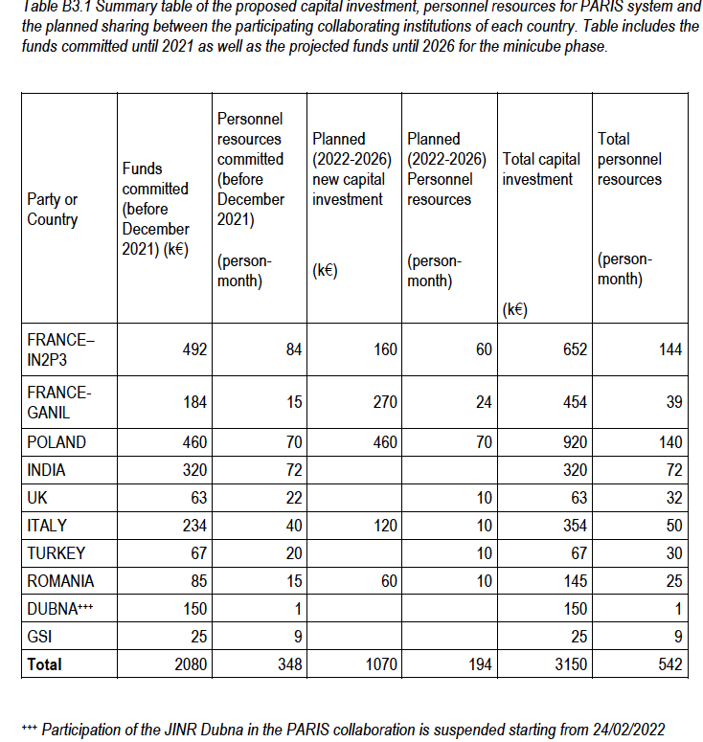
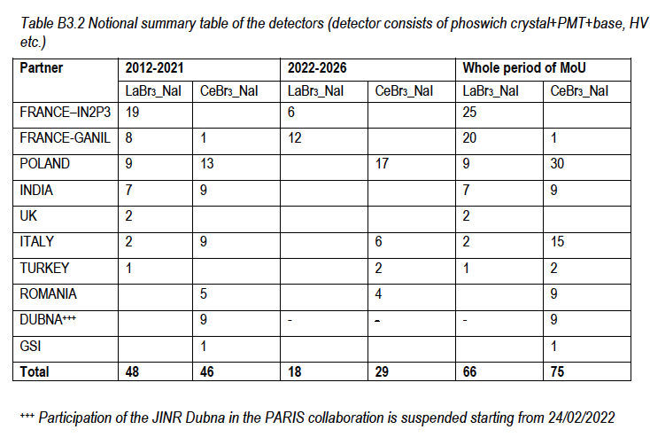
Extended PARIS MoU
2024
23
20
17+6*
13
2
13
1
7
xxxx
0
102
*) bought for Poland
by GANIL from the
Polish Harmonia Grant

Slide 45
Presently PARIS collaboration possesses 11 clusters:
4 LaBr3_NaI clusters (produced by Saint Gobain)
6 CeBr3_NaI cluster (produced by Scionix)
1 mixed LaBr_NaI and CeBr3_NaI
Detectors are normally in the owners laboratories
(for example: 3 clusters are presently in IFJ PAN Krakow, 2 in Mumbai, rest in Orsay, Milano, …)
According to the MoU the partners should make them available for the experimental campaigns in the host laboratories: GANIL, IJCLaB Orsay, LNL Legnaro, IFJ PAN, Mumbai, …

Slide 46
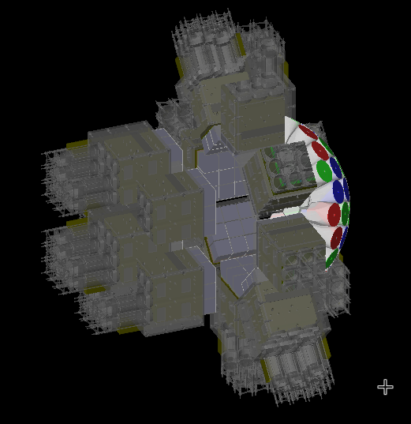
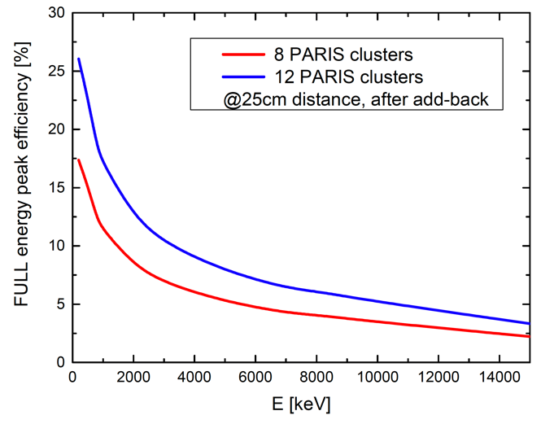
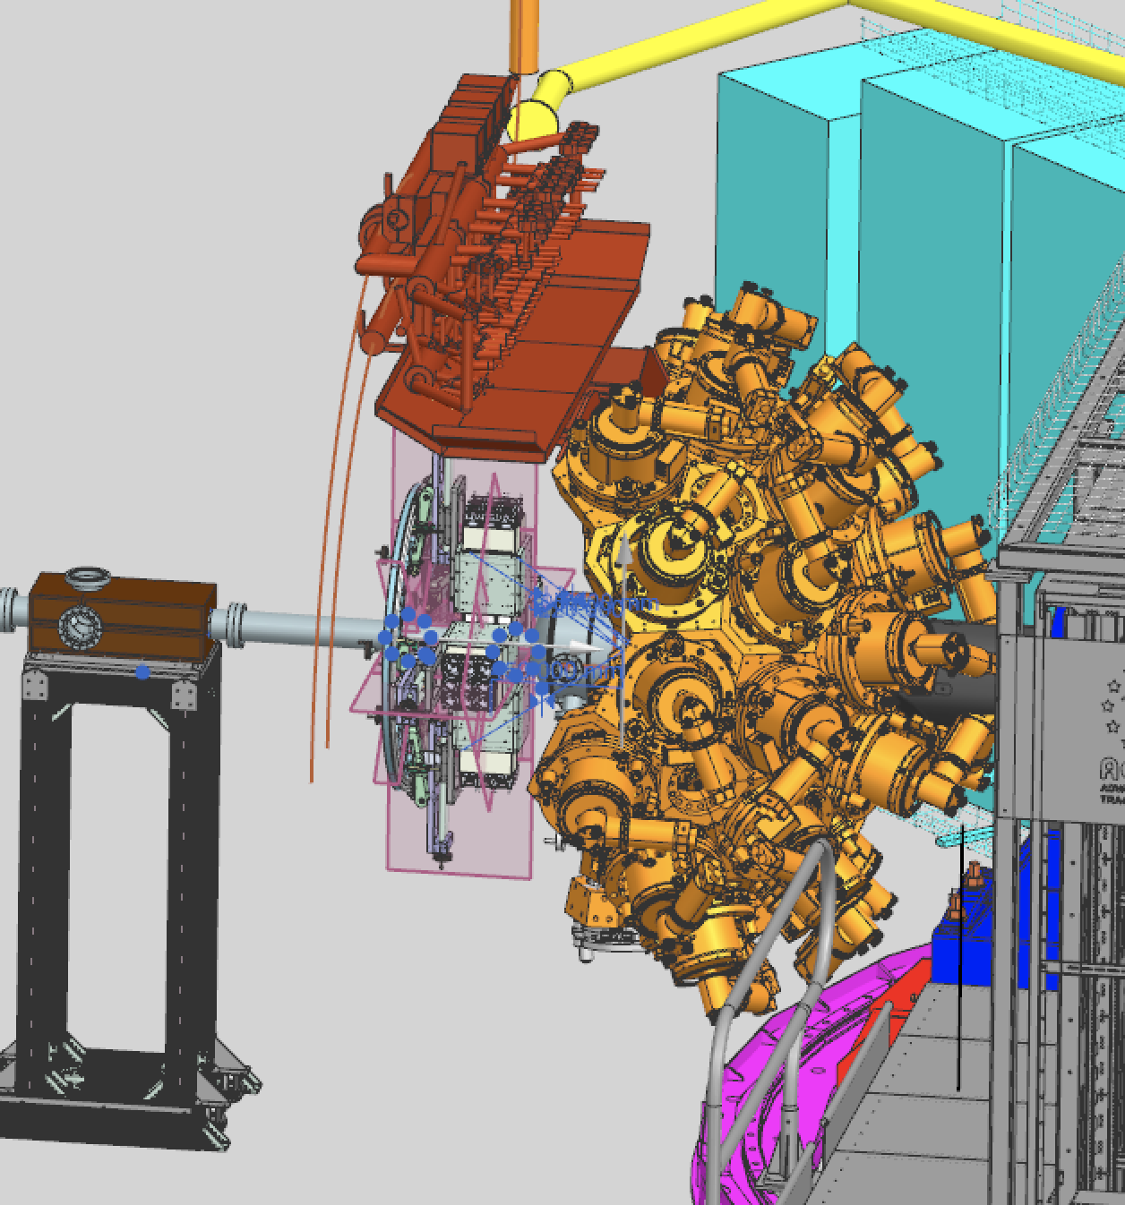
The PARIS Collaboration proposes to bring the PARIS calorimeter in its present stage (8-12 clusters) to LNL Legnaro, and couple it to the AGATA array for the experiments during the AGATA Zero Degree Campaign (2025)
Up to 12 clusters at the distance of 25 cm from the target in two configurations (depending on available space and number of clusters available) are envisaged: either 8 clusters in a ring geometry at 90 degrees (75° to 105°), or 10-12 clusters: 6-8 in the ring geometry at 90 degrees and 4 clusters in the “wall geometry” at forward angles (10° to 45°).
Ongoin work for the details of the mechanical coupling by
IJCLab Orsay (I. Matea, Ch. le Galliard), IFJ PAN Krakow (B. Sowicki, A. Maj, M. Ciemała),
LNL Legnaro (S. Pigliapoco, M. Rampazzo, J.J. Valiente-Dobon), Milano (F. Camera, G. Benzoni, B. Million)

Slide 47
Perspectives: LNL Legnaro
AGATA@LNL (2026???)
Preliminary list of LoIs AGATA+PARIS in LNL:
Measurement of Isospin Mixing (F. Camera et al.,)
GDR feeding of SD states (G. Benzoni)
Gamma and Particle Decay of Giant Resonances Excited by Inelastic Scattering of 17O ions at 20 MeV/A (F Crespi et al.)
Onset of collectivization/clusterization in Oxygen neutron-nuclei (S. Leoni, B. Fornal et al.)
Lifetime measurements of excited states in neutron-rich C isotopes: a test of the three-body forces (M. Ciemala, B. Fornal, S. Leoni et al.)
The search for Jacobi shape transitions in hot rotating nuclei from the Mo-Ba region (M. Kmiecik, A. Maj , S. Leoni et al.)
Investigation of a high spin structure in the vicinity of 44Ti via discrete and continuum γ-spectroscopy with AGATA+EUCLIDES+PARIS detectors (P. Bednarczyk et al.)
Coulomb excitation of the super-deformed structures in A∼40 mass region (AGATA+SPIDER+PARIS) (K. Hadynska-Klek et al.)
Further experimental cases at SPES, also using PARIS-ACTAR

Slide 48
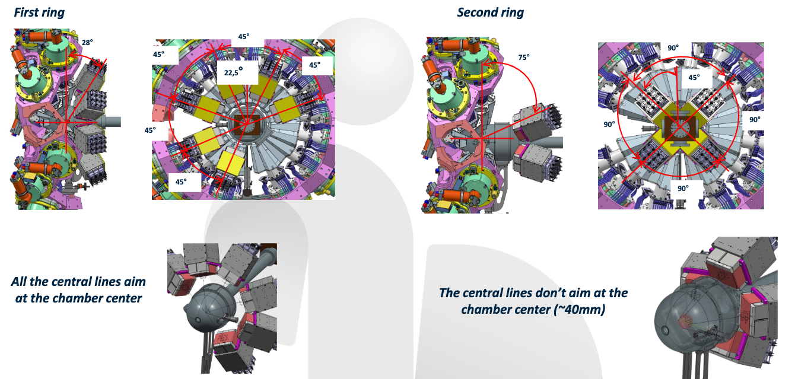
Preparations for Paris@AGATA in LNL Legnaro - 2 rings
Courtesy of Christine LE GALLIARD (IJC Lab, Orsay)

Slide 49



Preparations for PARIS@AGATA in LNL Legnaro - 2 rings
Courtesy of Christine LE GALLIARD (IJC Lab, Orsay)

Slide 50
New perspectives for PARIS for > 2025
Campaigns in
GANIL/SPIRAL2
LoI „ Accessing the structure of the pygmy dipole resonance through neutron inelastic scattering at GANIL-SPIRAL2/NFS”, Bahini et al.
Warsaw Heavy Ion Laboratory?
HiSpec/DeSpec@GSI/FAIR?
Mumbai?

Slide 51
Summary

Slide 52
The concepts of PARIS phoswich (LaBr3+NaI, CeBr3+NaI) and PARIS cluster of 9 phoswiches, were proved to work according to expectations based on simulations
Results from the first PARIS experiments done in GANIL, IPN Orsay and CCB at IFJ PAN Krakow, are coming and are promising
PARIS, either standalone or coupled to other detectors, performs well
At present PARIS possesses 11 clusters (100 phoswich detectors)
PARIS campaigns are planned
    in IFJ PAN Krakow, 3 clusters (2025)
    LNL Legnaro (10 clusters, as an acillary detector to AGATA, 2026?)
    Possibly at NFS GANIL/SPIRAL2 (2025 ?)
New MoU till 2026 (ca. 16 clusters – a compact 4π geometry of the PARIS Calorimeter) is signed
Open session of PARIS Collaboration meeting: Bormio, February 5-6, 2025
paris.ifj.edu.pl

Slide 53
Another excerpt from the
NUPECC Long Range Plan 2024 (still under preparation)
To push the frontiers of spectroscopy and lifetime measurements at the limits of energy and production, superb resolution and high-efficiency for gamma-ray spectroscopy is essential.
It is therefore mandatory to recommend the full completion of the European flagship gamma spectrometer AGATA-4π (with ancillaries) which is and will stay the major workhorse for nuclear structure gamma-spectroscopy and nuclear astrophysics precision physics, at both radioactive and stable ion-beam facilities.

Slide 54
Acknowledgements
M. Ciemała, M. Kmiecik, B. Fornal, P. Bednarczyk, M. Ziębliński, J. Grębosz, B. Sowicki et al. (IFJ PAN Kraków)
M. Lewitowicz, E. Clement, A. Lemasson et al.. (GANIL)
O. Dorvaux, C. Schmitt et al.. (IHPC Strasbourg)
J. Wilson, I. Matea, Ch. le Galliard et al. (IPN Orsay)
P. Napiorkowski, K. Hadyńska-Klęk et al. (HIL Warsaw)
A. Bracco, S. Leoni, F. Camera, S. Brambilla, F. Crespi et al. (University of Milano)
V. Nanal, C. Gosh, B. Dey, I. Mazumdar et al. (India)
D. Jenkins et al. (York), W. Catford (U. Surrey)
M. Stanoiu et al.. (Bucharest)
J. Gerl (GSI),
PARIS, AGATA, VAMOS, nuBall and LICORNE collaborations
Technical staff of IJCLab Orsay, IFJ PAN Krakow, GANIL Caen, ATOMKI Debrecen
Saint Gobain and Scionix
ENSAR2 and EURO-LABS (TNA support), COPIGAL and POLITA collaboration projects, Polish NCN grants
V

