Slide 1
OSCARS Consolidation and Terminology Workshop: CTA use case @ ESCAPE
Giovanni Guerrieri, Frederic Gillardo, Marion Pierre for the ESCAPE cluster
30-09-2024

Slide 2
Cherenkov Telescope Array (CTAO)
The CTAO is the next evolution in the exploration of the most explosive phenomena in the gamma-ray Universe.
Unraveling the mysteries behind cosmic particles, supermassive black holes and even dark matter are well within our reach.
But as the first open data observatory of its kind, the possibilities for entirely new discoveries are endless.
Three differents type of Telescope :
SST : Small-Sized Telescope, detecting the highest energy gamma rays.
MST: Medium-Sized Telescope, covering the middle of the CTAO’s energy range
LST : Large-Sized Telescope, detecting lower-energy gamma-ray signals.

Slide 3
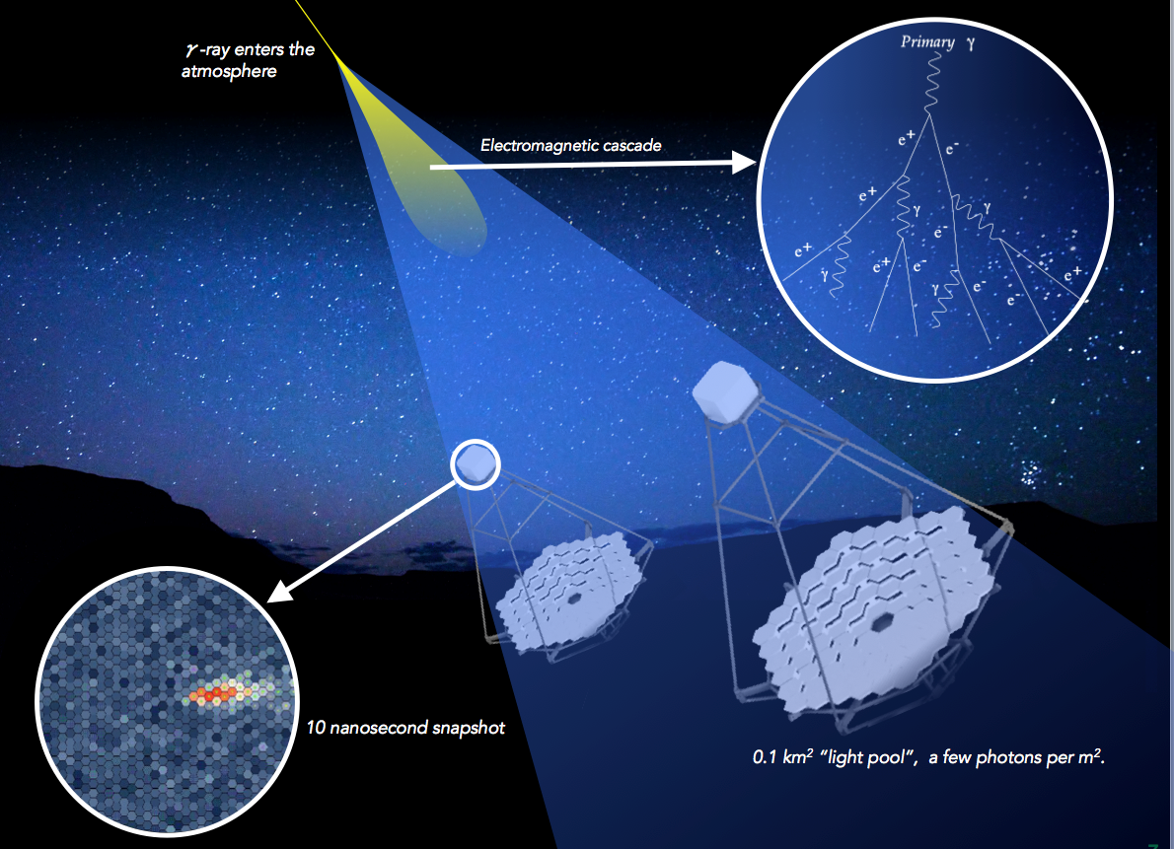
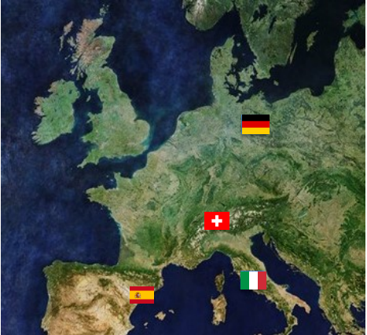
Sites
« ON SITE » :
North Site at La Palma (Canary Islands, Spain)
South Site at Paranal (ESO, Chile)
« OFF-SITE » :
CSCS, Lugano in Switzerland
PIC, Barcelona in Spain
DESY, Zeuthen in Germany
INAF/INFN, Frascati in Italy
As with all ESCAPE use cases, the created Datalake is FAIR, scalable and centralizes data.
4 PB quantity/ year
File DL0 raw

Slide 4
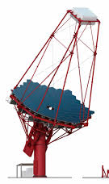
RUCIO
OFF SITE
Data Orchestration :
Receive an alert when new files need to be processed.
Make a copy of these files on an « OFF-SITE ».
Make a second copy of these files on a second « OFF-SITE ».
Validates the presence of two copies and deletes the « ON-SITE » base files.
DESY
INAF
1
2
3
4
PIC
CSCS
3
1
ON SITE
4
ACADA
2

Slide 5
DIRAC
Tape
Checks for unprocessed files.
Launches processes from DL0 (=raw data).
Backs up files from DL0 to DL3 on tape or disk.
Algorithms will evolve and improve over time. It will always be possible to reprocess files using DL0 backups.
DL0
DESY
INAF
1
DL1
RUCIO CATALOGUE
DL2
DL3
2
DL0
Calibration
2
3
DL1
DL1
DL1
Tape
PIC
CSCS
Stereoscopie
1
3
DL2
Algorithms
Disk
DL3
Algorithms
ON SITE
Science
DL6

Slide 6
IAM
Authentification users
Access Management :
From a user account, IAM will create a token allowing access to the Datalake, while managing the type of access granted.
This service allows you to manage several types of user accounts:
University accounts
Git accounts, etc.
DESY
DL0
DL1
Tape
DL2
DL3
RUCIO CATALOGUE
DL0
PIC
DL1
DL1
DL1
Tape
DL2
ON SITE
Disk
ACADA
DL3
FTS
(FTP, WebDav)
DL6

Slide 7
METADATA
METADATA
Metadata are essential for:
Facilitating search: They help researchers locate and understand available data.
Ensuring data quality: By providing information about the provenance and processing methods, they ensure that users can assess the reliability of the data.
Encouraging collaboration: By making data and its context accessible, metadata facilitate sharing among different teams and disciplines
What is the most efficient database for storing this type of data while ensuring quick query responses?
PostgreSQL or MongoDB : in testing…
*MongoDB seems to be the most suitable for metadata that evolves over time
Characteristics of the images:
Observation parameters,
Telescope configuration,
Environmental conditions at the time of collection,
Team that initiated the request,
Etc.
?

