Slide 1
OSCARS WP2 Homework (16/09/2024) PaNOSC Cluster (ESRF, DESY)
The OSCARS project has received funding from the European Commission’s Horizon Europe Research and Innovation programme under grant agreement No. 101129751

Slide 2
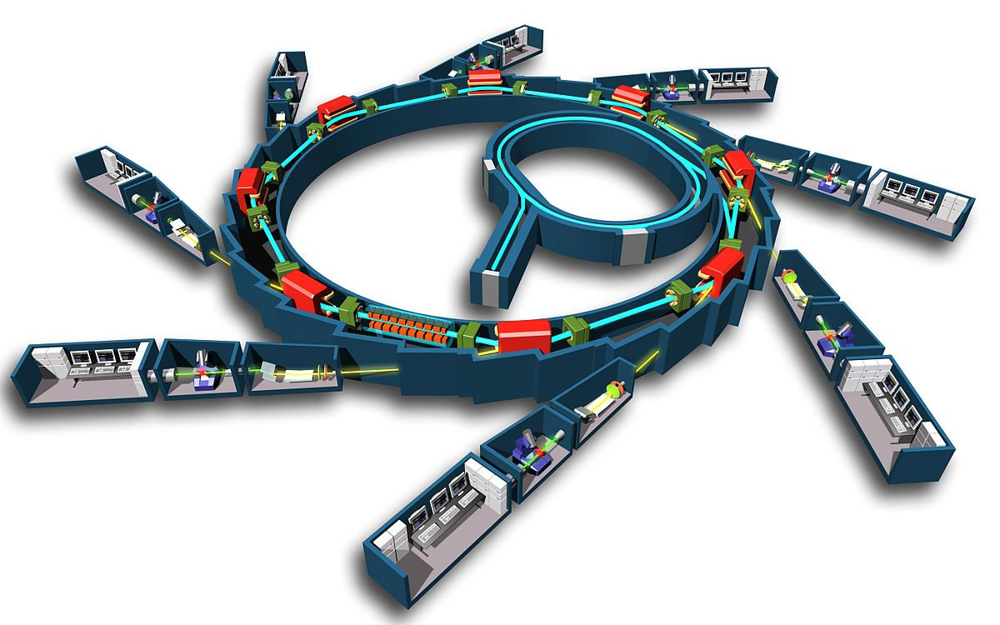
How do PaN facilities work?
User: has an idea / need to study a sample
Proposal: User writes a proposal for one of the PaN facilities
Review committee: Reviews proposal and rates scientific quality
Beamline scientist: Review proposal and checks feasibility
Beamtime allocated: User travels to facility / sends sample
Experiment: Sample(s) are exposed to beam + data collected
Analysis: Data is reduced, analysed + curated (DOI)
Publication: User publishes results (DOI) in peer review journal
This project has received funding from the European Union’s Horizon 2020 research and innovation programme under grant agreement No. 823852

Slide 3
PaNOSC lustrum – 5 years of PaNOSC
PANOSC: the photon and neutron open science cloud
Photon and Neutron FAIR Data Commons: PaN Data Portal - https://data.panosc.eu
FAIR data policy and DMPs → 90% of PaN RIs (15)
Standardised metadata (Nexus/HDF5) → ALL PaN Ris (18)
Federated search API for data catalogues → 8 PaN RIs
Open Data portal for FAIR data → 8 PaNs RIs
Community AAI UmbrellaId → 90% PaN RIs (15)
JupyterLab notebooks service → 90% PaN RIs, 100s users daily
Nexus/HDF5 web visualization → ALL PaN RIs, 1000s worldwide
Remote data analysis with VISA → 8 PaN RIs, 100s users monthly
Simulation software (ViNYL) → 4 PaN RIs, 10s users monthly
PaN-learning platform (pan-learning.org) → 100s users monthly

Slide 4
PaNOSC lustrum – next 4 years of PaNOSC
PANOSC: the photon and neutron open science cloud
Photon and Neutron FAIR Data Commons: OSCARS
FAIR data policy and DMPs → 50% FAIR
Standardised metadata (Nexus/HDF5) → OSCARS + PaN RIs
Federated search API for data catalogues → OSCARS
Open Data portal for FAIR data → OSCARS
Community AAI UmbrellaId → replace with EOSC AAI
JupyterLab notebooks service → PaNOSC service
Nexus/HDF5 web visualization → PaNOSC service
Remote data analysis with VISA → OSCARS
Simulation software (ViNYL) → PaN RIs
PaN-learning platform (pan-learning.org) → OSCARS

Slide 5
Needs of PaN users for composability
Software –
How to find the right software
Is it packaged for my platform
How to run it remotely and locally
Is there documentation + training
Where to find training datasets
Workflows –
Which workflow tool to use
Where to run the workflows
Where to find examples of workflows
AI/ML
Making LLM a composable service to search corpus of text e.g. logbooks, documentation
Data –
Which data format to use?
How to define metadata for NeXus
Which compression to use
Which tools to use
Repositories –
Metadata for data reuse e.g. sample
Searching repositories
Sharing data with communities
Training –
Sharing training platforms
Making training a composable service which can be called from a workflow

Slide 6
What is PANOSC portfolio status ?
190 services (specific purpose + general purpose services)
160 software: to be verified if these software can be considered into Software as a Service category (SaaS)
110 data sources: to be verified if these data sources can be considered into Data as a Service category (DaaS)
In the Photon and Neutron research community, service developers can be categorized into two broad groups:
Specialized services used by scientists for very specific data analysis and/or visualization or other tasks e.g. CrystFEL used in serial crystallography analysis and visualization
General infrastructure services ex. VISA that provides remote access to computing resources, data repository.

Slide 7
Possible definition of composability
Service A developers should be willing to make necessary changes to make it composable with Service B and vice-versa.
It is important to ensure both the services are active and supported by the developers.
Most software services require data in a pre-defined format, are data formats a service?

Slide 8
Composability – what is it and for whom?
Composability is a system design principle that deals with the inter-relationships of components. A highly composable system provides components that can be selected and assembled in various combinations to satisfy specific user requirements. (Wikipedia)
We need to define:
components + system + users

Slide 9
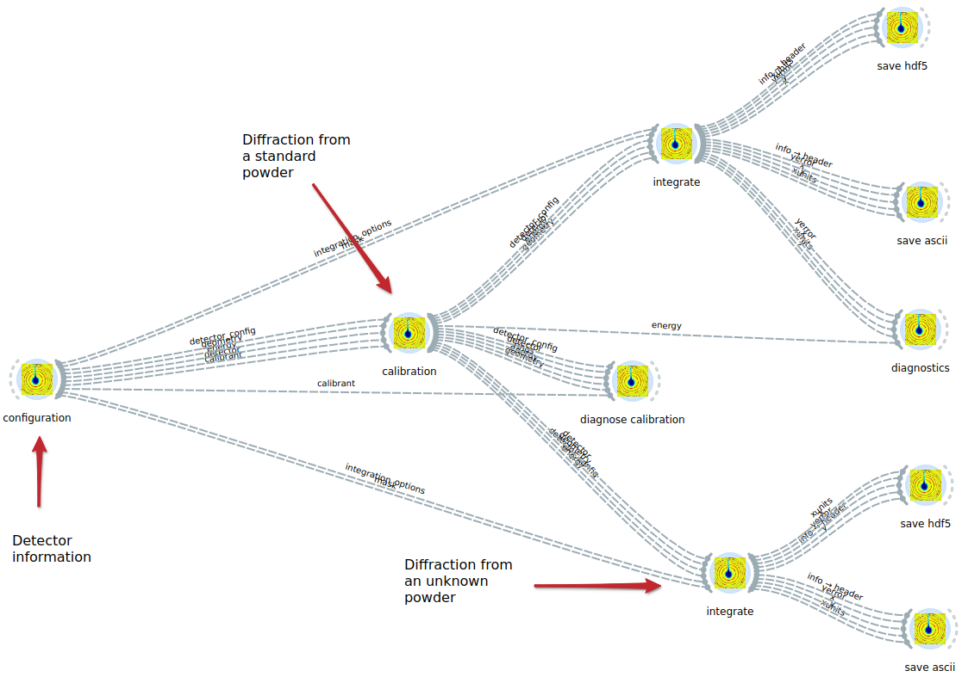
Composability in reality
Composability in reality means making things easier to use, deploy, mix + match
Workflows
Software packaging
Data accessibility
Multi-platform support e.g. notebooks, workflows, VMs, clusters, laptops, etc.

Slide 10
Which services with composability potential?
→ Virtual Research Environment - VISA Service + DOI resolved EOSC Data transfer service (CERN FTS) composability; work started in EOSC Future and can be consolidated in OSCARS.
→ Data transfer – PaN community uses mostly Globus, this can be a composable service
→ Workflows – many workflow systems can be used to orchestrate multiple software / data transfer e.g. Galaxy / EWOKS. Extend to include dependencies to be installed.
→ Software – packaging and installation of software could be ‘composable’ e.g. CVMFS → Data formats – required for FAIR for running software and long term access e.g. HDF5
Possible demonstrator of a PaN Data Lake using EOSC Data transfer service.

Slide 11
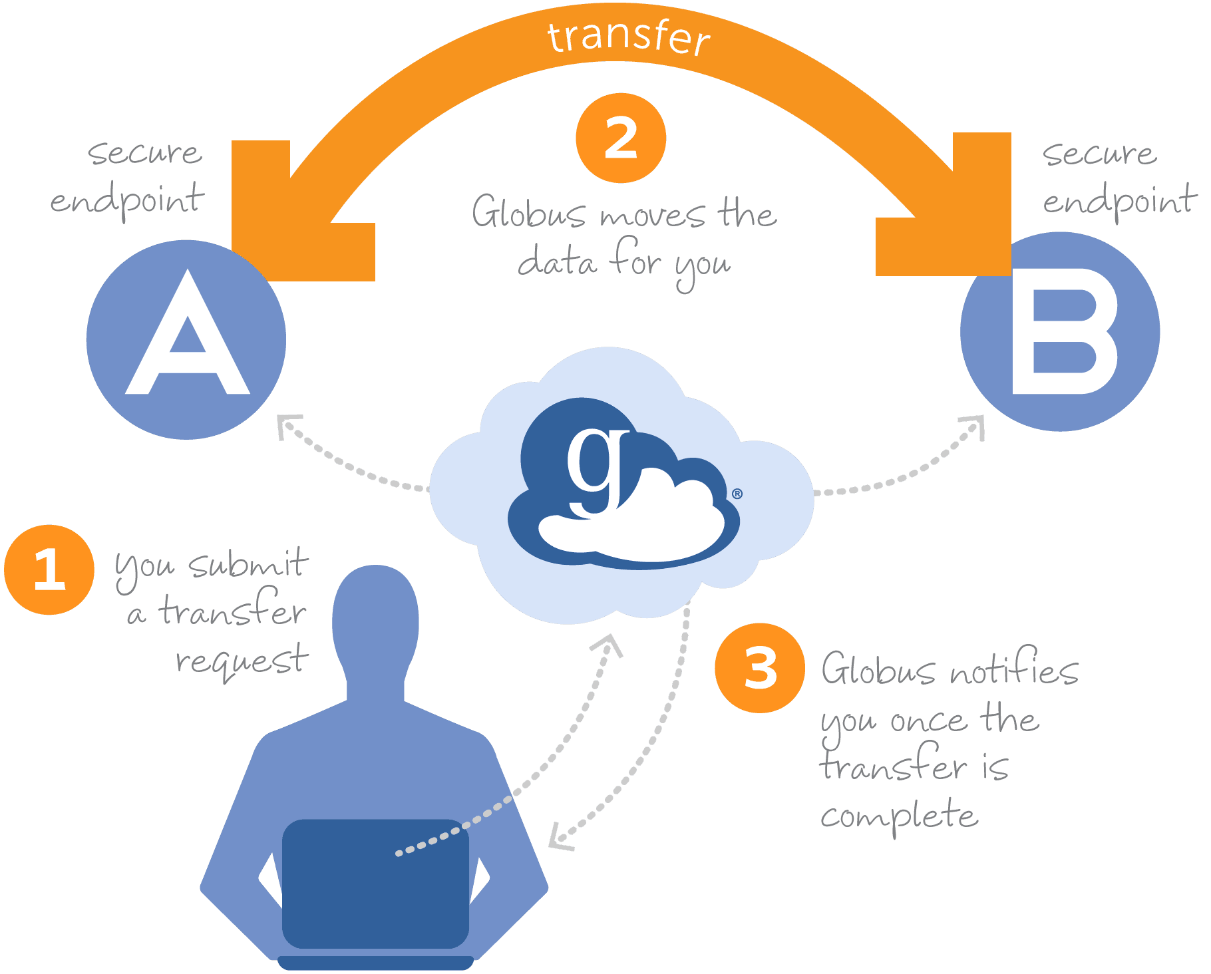
Composable data transfer with Globus
Use Globus APIs to make a composable service to move data from data repository to users laptop and/or workflows
Will make users lives easier

Slide 12
Which challenges or obstacles do you foresee?
AGREEING ON common solutions with other clusters for:
Software catalogue – can we share catalogues?
Software – code camps and RSE best practices
Ontologies – what can we learn from other clusters
Workflows – sharing via WorkflowHub
Data Formats – sharing tools for common formats
Training – common training platforms to share training material
Composability becomes too ABSTRACT and does not help scientists

Slide 14
What is a service?
As per ITIL framework, a service is defined as a means of delivering value to customers by facilitating outcomes they want to achieve, without the customer having to manage specific costs and risks. Essentially, a service helps customers reach desired results while minimizing the burden of handling the underlying processes or resources.
To consider Software as a Service (SaaS) there are certain conditions to be met ex. Hosted in cloud or USED through web browser than being installed on the local machine of the end user
To consider Data as a Service (DaaS) there are certain conditions to be met ex. Centralised storage, on demand access etc.

