Slide 1
Deciphering the dynamics of the Milky Way bar and spiral arms with Gaia
News from the dark, OM vs. DM, Marseille, france - 15/11/2024
PhD candidate:
Supervisor:
Yassin Rany Khalil Benoit Famaey
(Unistra, ObAS)
(CNRS, ObAS)

Slide 2
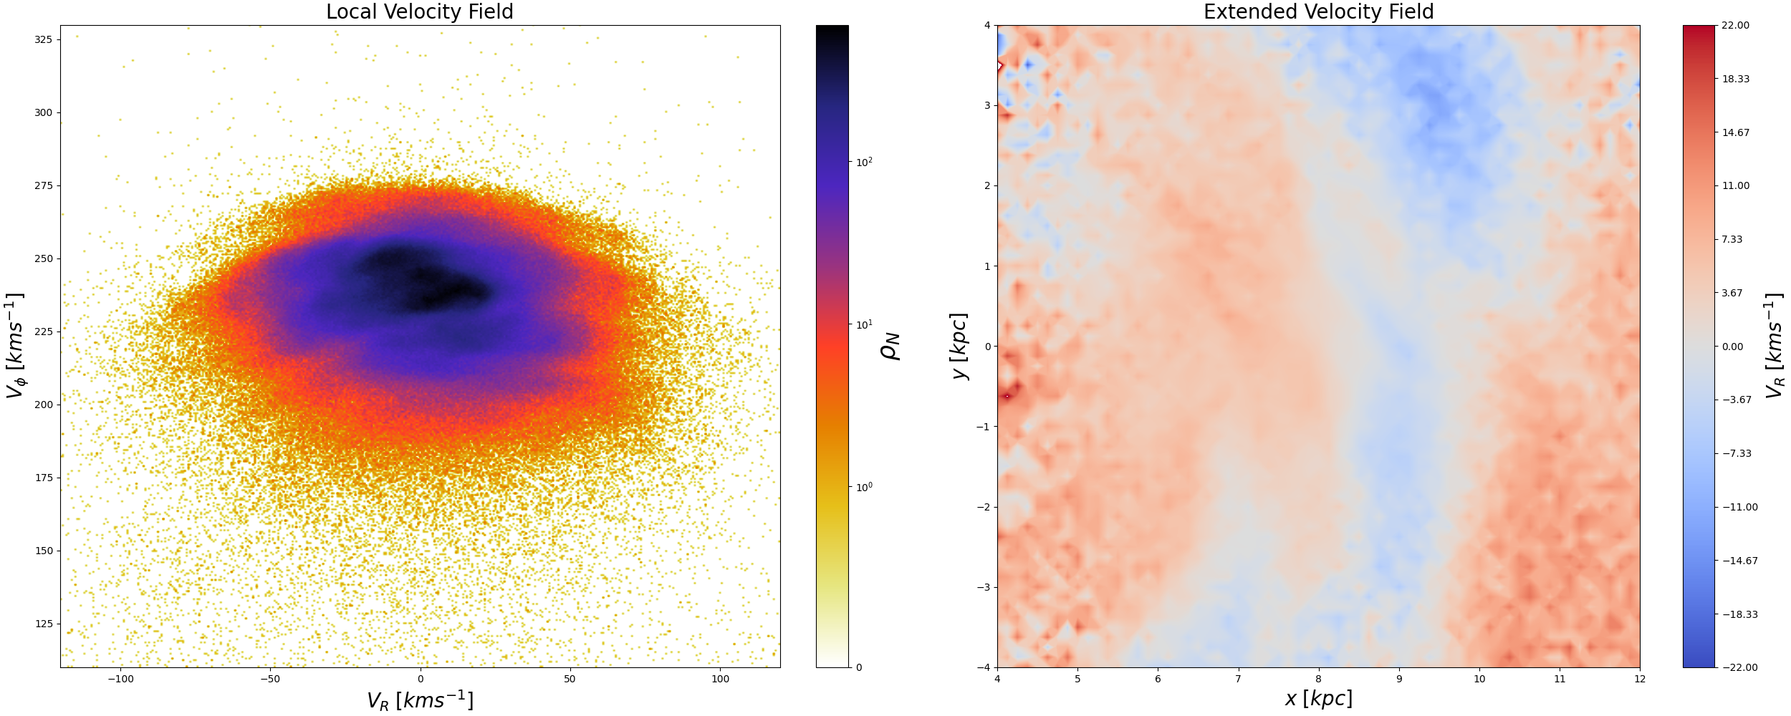
Gaia mission sample: Velocity fields
Yassin Rany Khalil, Observatory of Strasbourg, yassin.khalil@unistra.fr

Slide 3
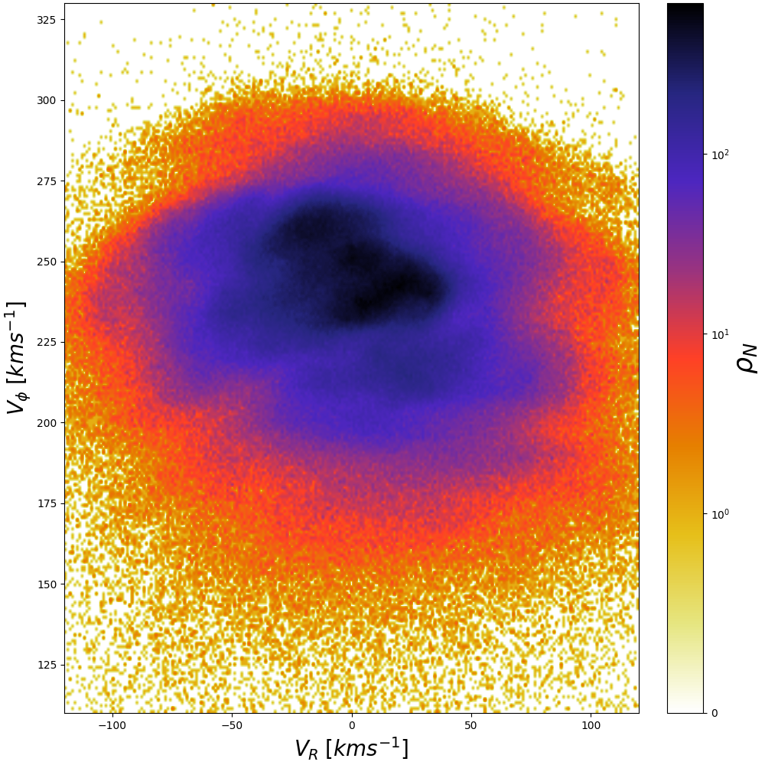
Local velocity field: Gaia DR3
Hat
Sirius
Hyades
Hercules
Coma
Bobylev
Horn
Yassin Rany Khalil, Observatory of Strasbourg, yassin.khalil@unistra.fr

Slide 4
Axisymmetric model
Thin disk
Thick disk
Dark Matter
Bulge
$$f=η\frac{Ω}{2^{\frac{5}{2}}π^{\frac{3}{2}}κ{\overset{˜}{σ}}_{R}^{2}}exp\left(-\frac{R_{g}}{h}\right)exp\left(-\frac{J_{r}κ}{{\overset{˜}{σ}}_{R}^{2}}\right)$$
Properties
DM halo mass: $3.1×{10}^{11}M_{⊙}$
Baryonic mass: $6×{10}^{10}M_{⊙}$
Mass inside $20kpc$: $2.2×{10}^{11}M_{⊙}$
$$Σ_{DM,⊙}=1.3×{10}^{-2}M_{⊙}pc^{-3}$$
$s(0)=0$; $s(1)=-0.6$, $s(3)=-1$
Yassin Rany Khalil, Observatory of Strasbourg, yassin.khalil@unistra.fr

Slide 5
Bar model
Model from Thomas et al., 2023
3 superposed modes $m=2,4,6$
Angle: ${28}^{∘}$
Length $≈5kpc$
Visible perturbations and resonances
$$lκ+m(Ω_{bar}-Ω)=0$$
Co-rotation and Hat are very constraining

Slide 6
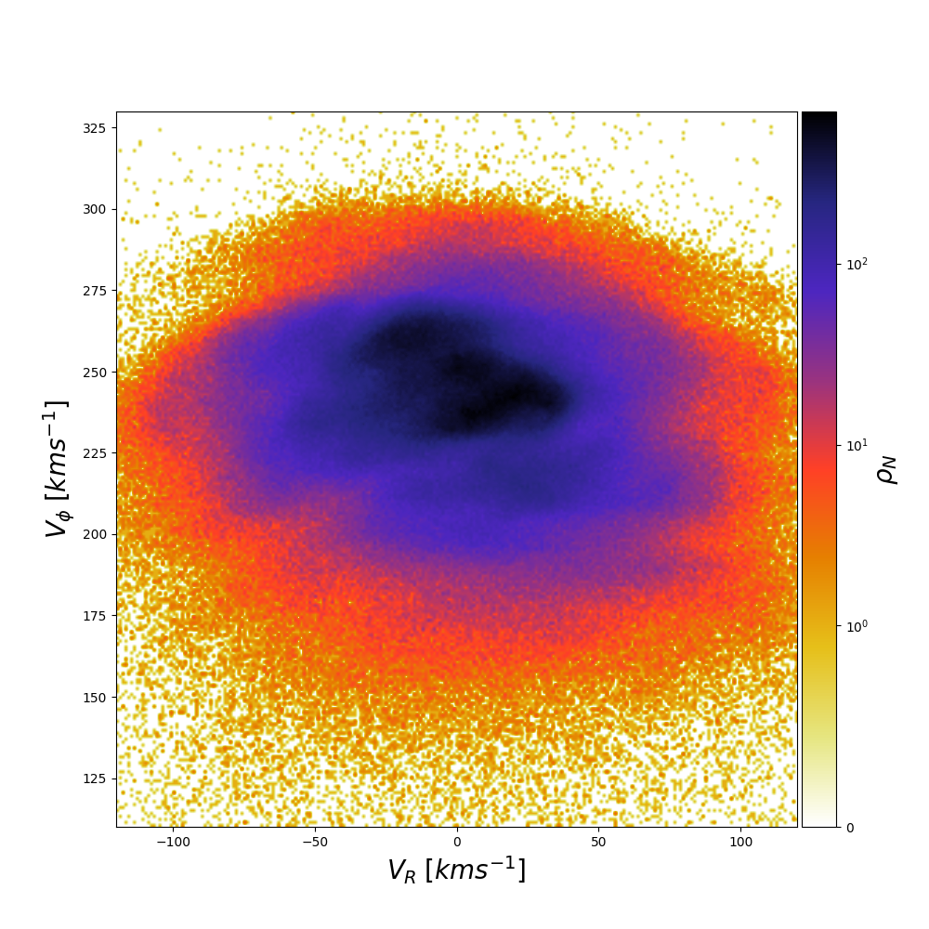

Slide 7
Bar model
Don’t reproduce data fully
Good at inner regions when $40≳Ω≳35$
Too strong features at $Ω>40$
Can be fixed when exploring the spiral arms (as it affect mostly the inner parts)

Slide 8
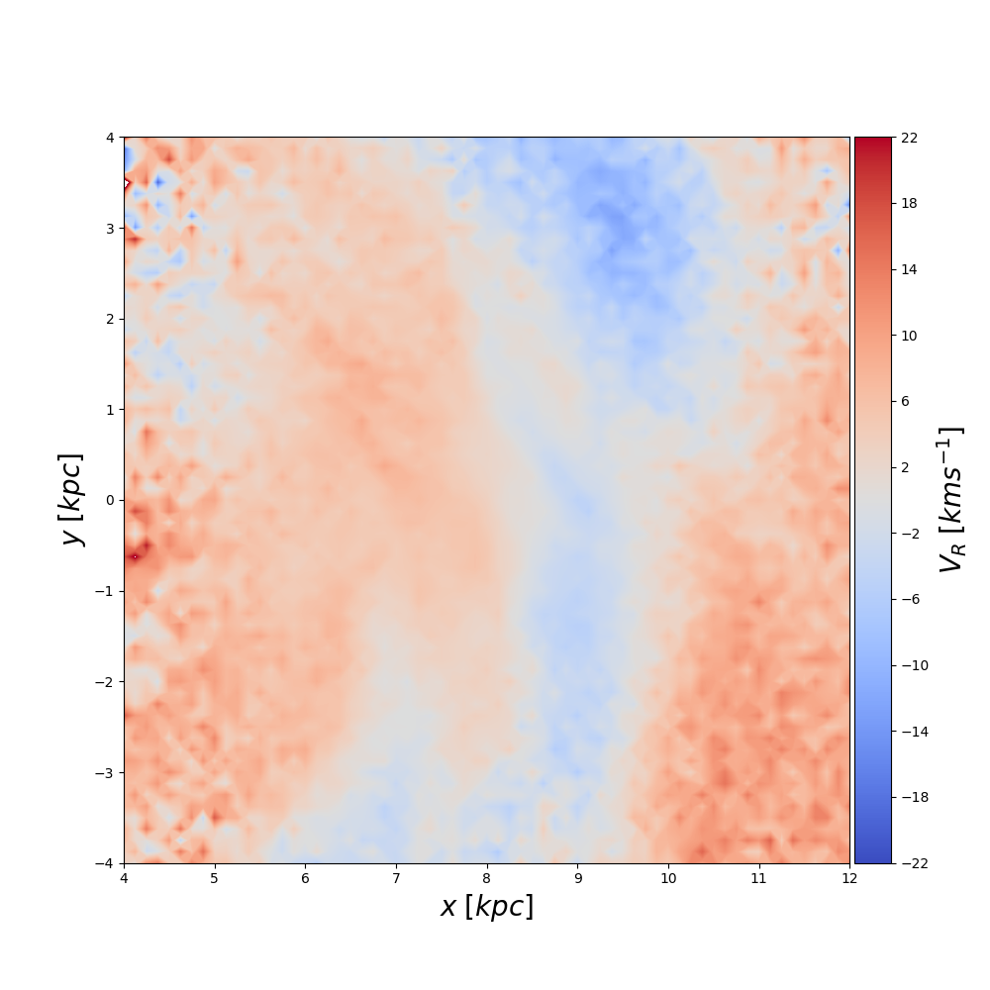

Slide 9
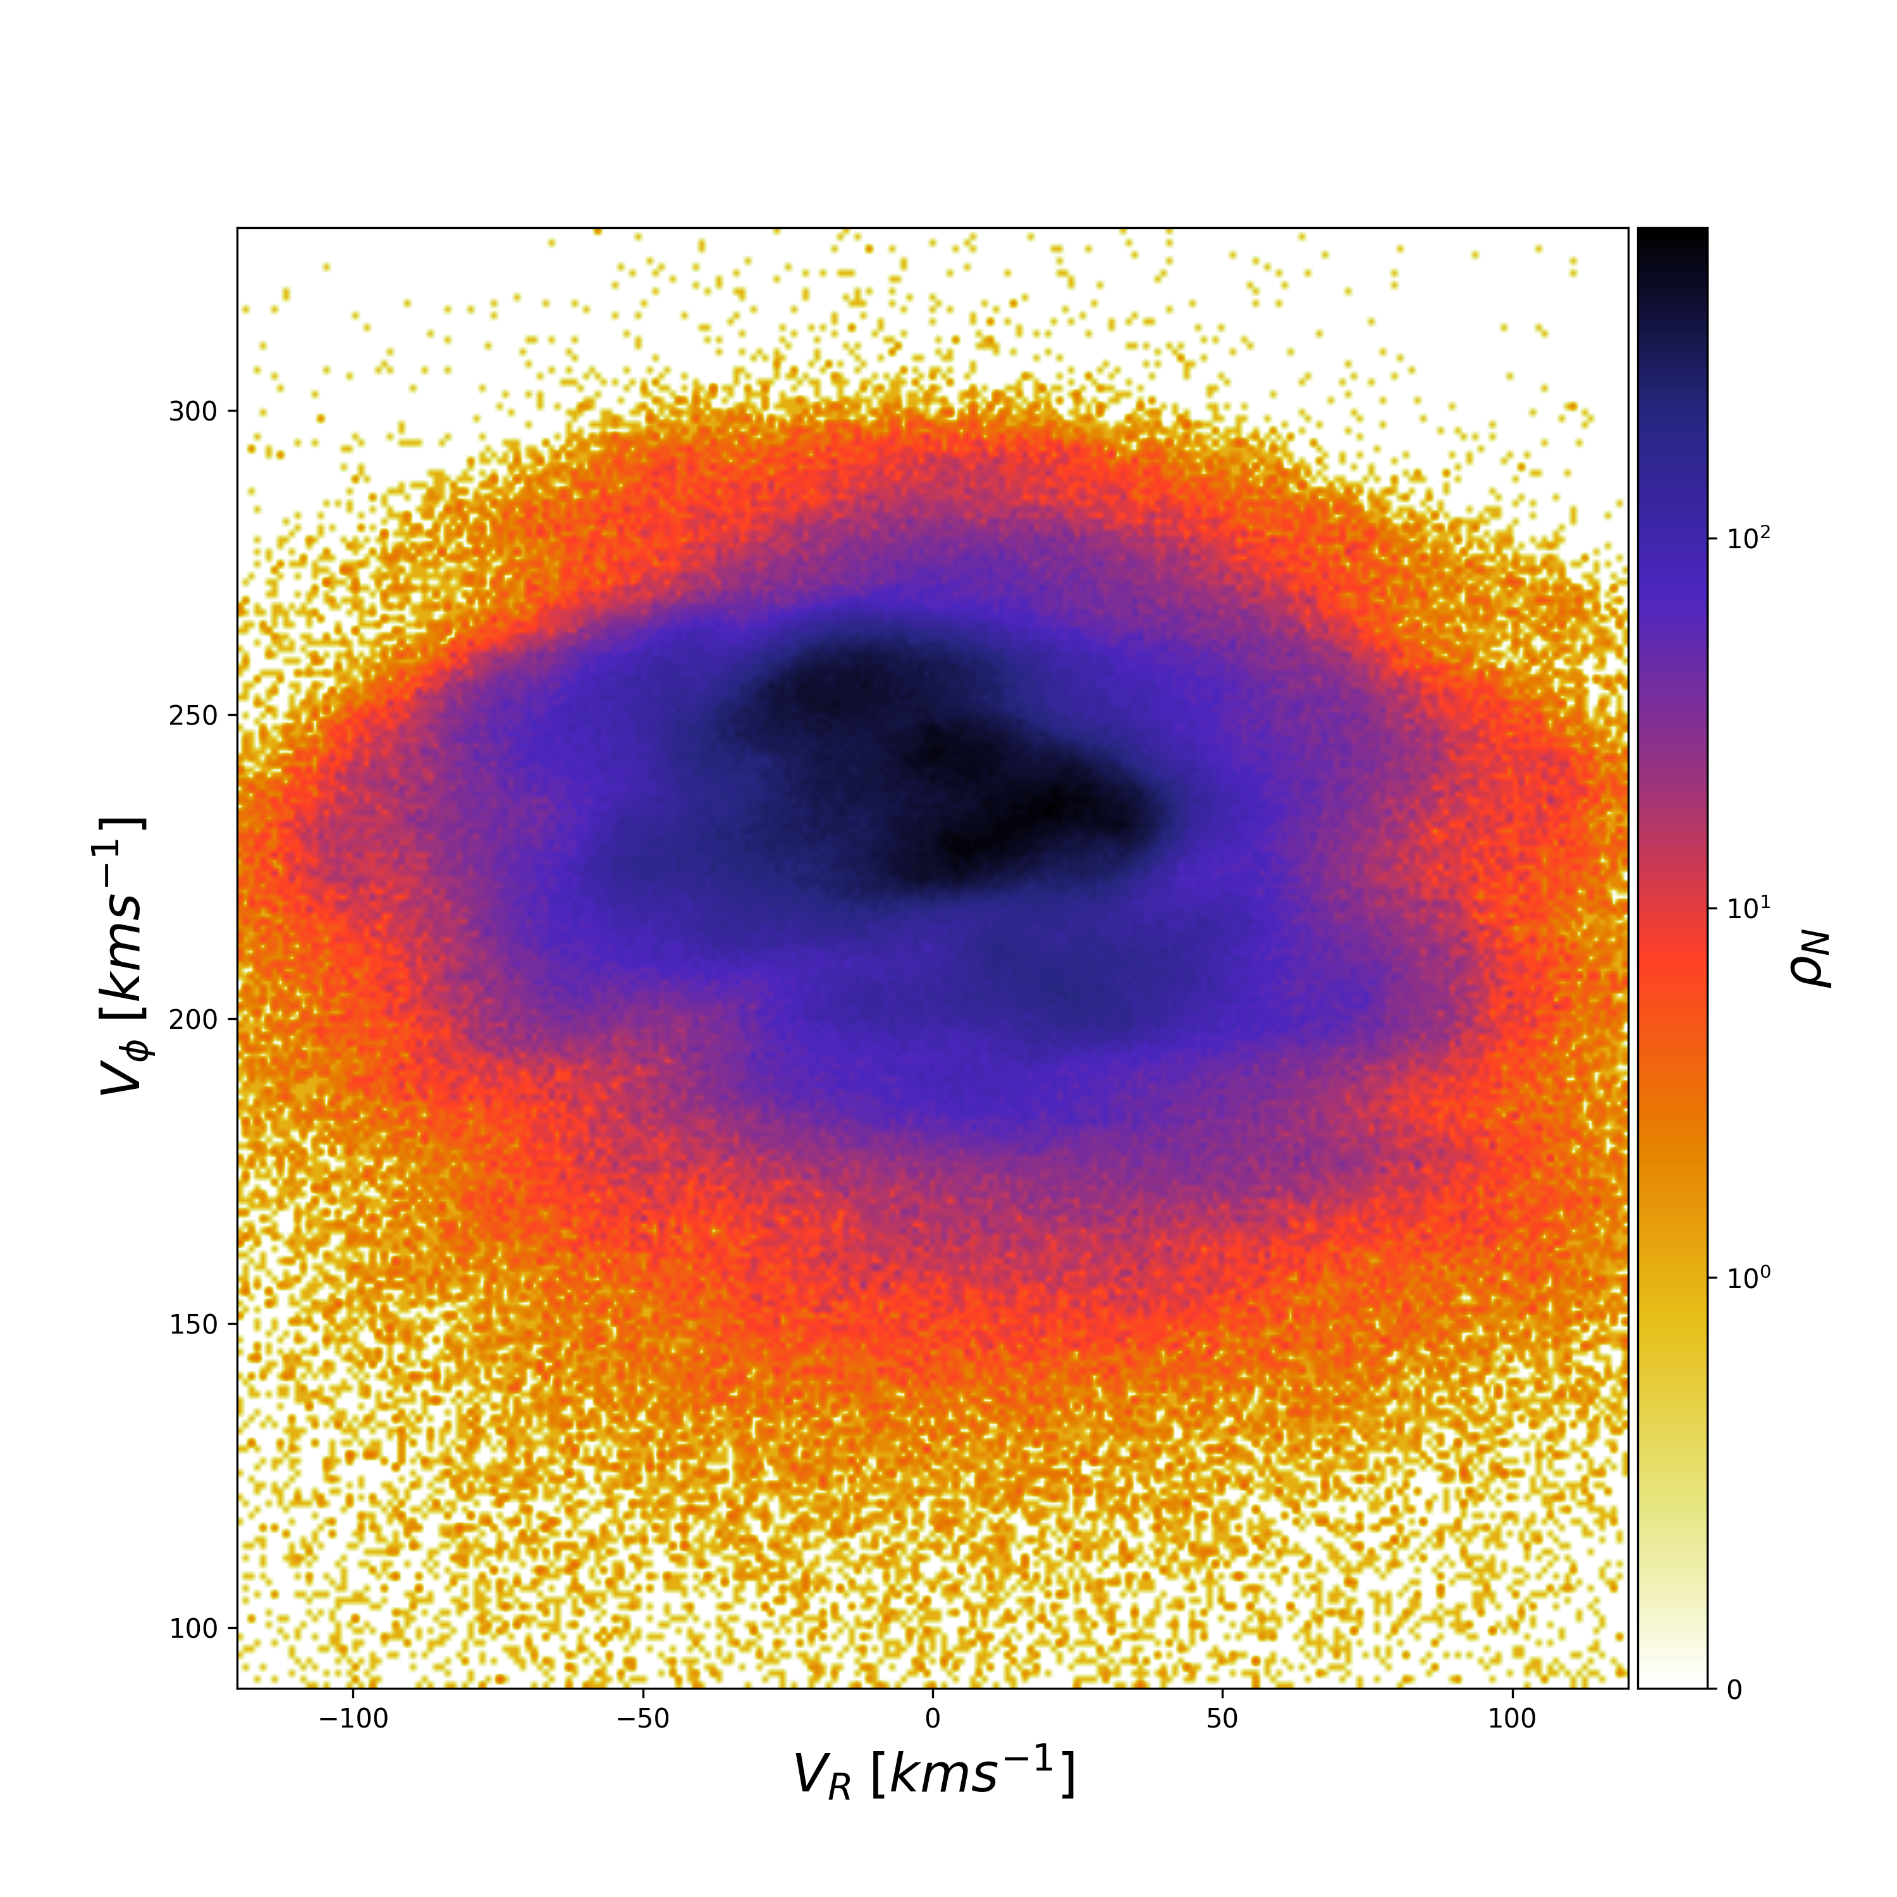
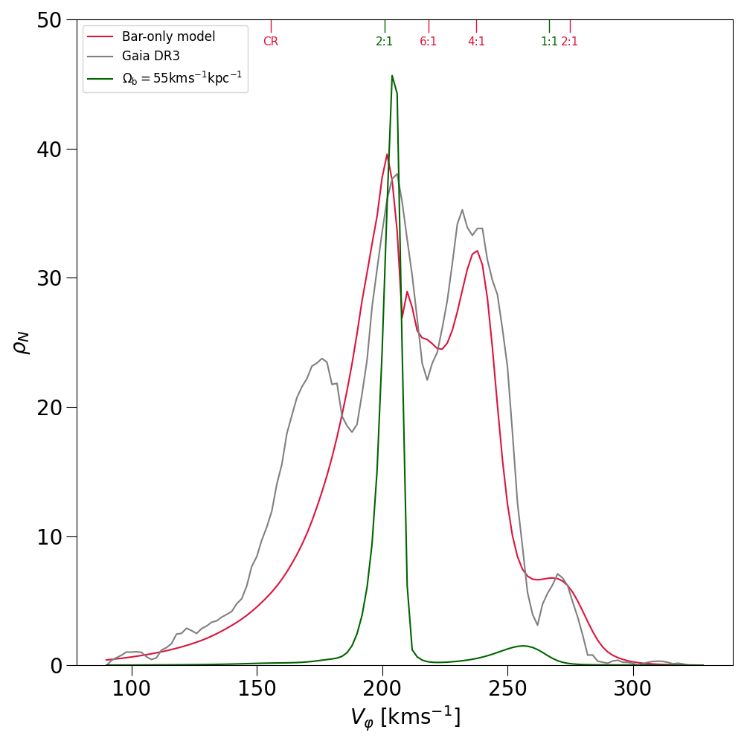
Bar model
$$Ω=37kms^{-1}kpc^{-1}$$
Yassin Rany Khalil, Observatory of Strasbourg, yassin.khalil@unistra.fr

Slide 10
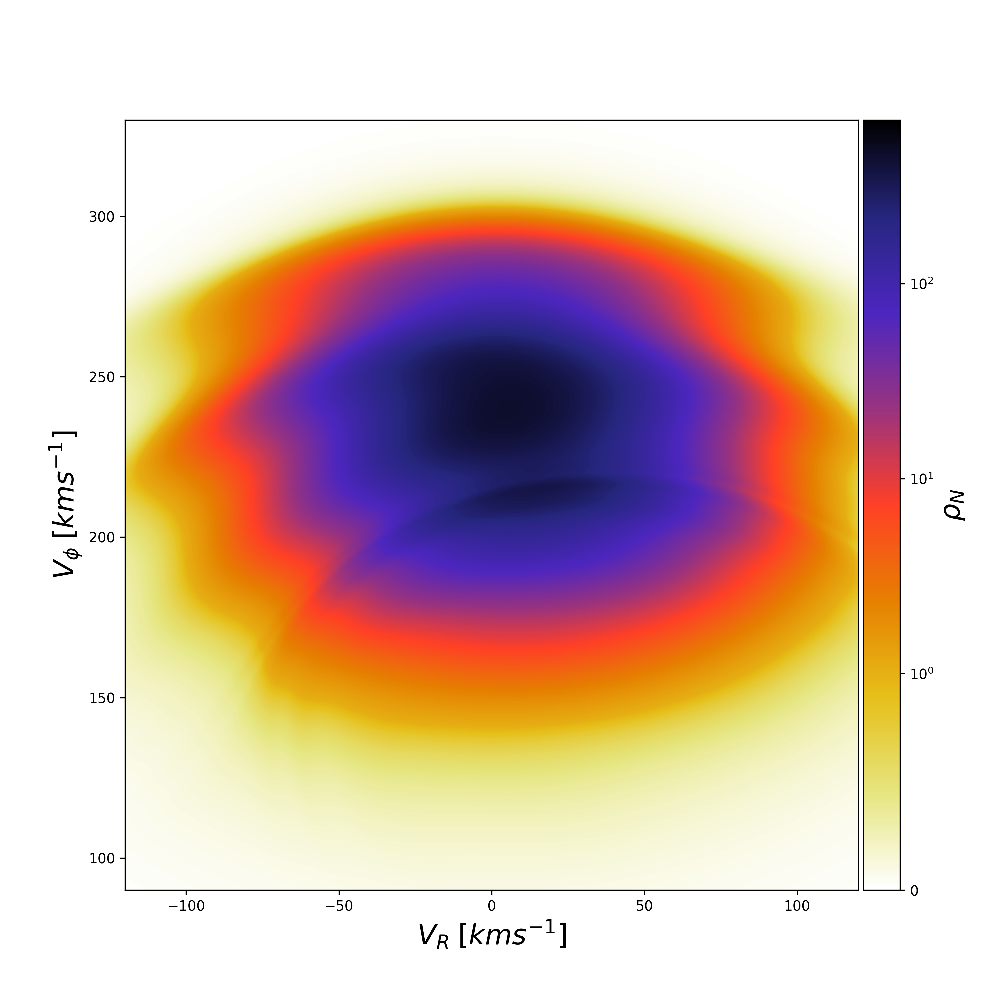
Bar model
Yassin Rany Khalil, Observatory of Strasbourg, yassin.khalil@unistra.fr

Slide 11
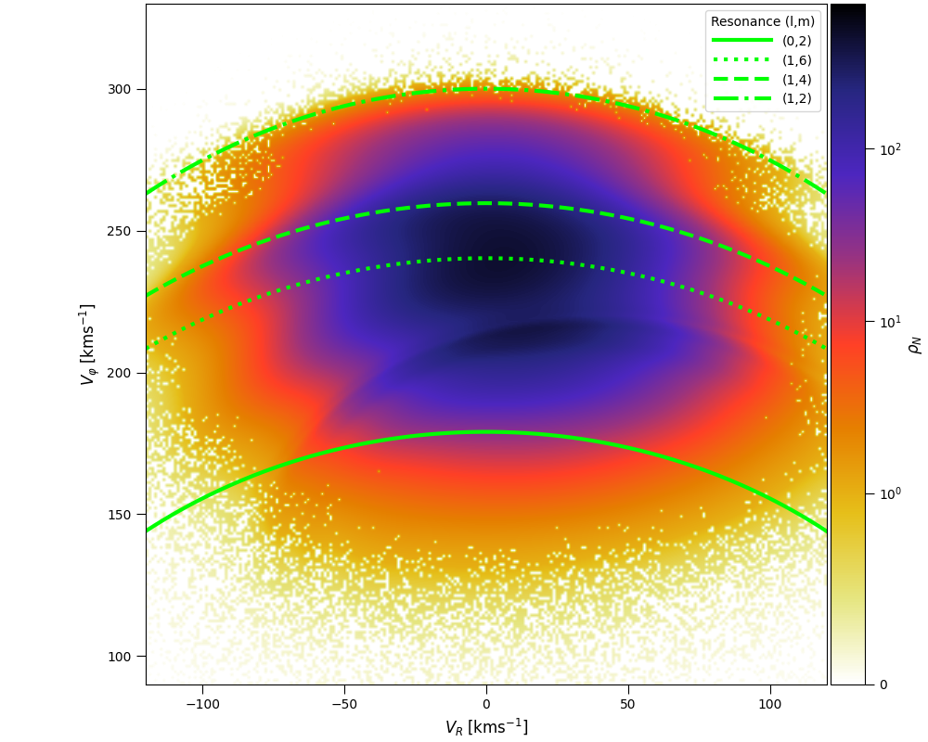
Bar model
$$lκ+m(Ω_{bar}-Ω)=0$$
Using Pau Ramos approximation.
Yassin Rany Khalil, Observatory of Strasbourg, yassin.khalil@unistra.fr

Slide 12
Bar model

Slide 13
Probing the parameter space
Differential evolution (DE) to search parameters candidates for axisymmetric+bar+spiral arms models
Constraints on velocity sign for some points
Constrained DE (J. Lampinen 2002 in Scipy)
Constraints on Sirius at Solar Neighbourhood
Constraints on $V_{R}$ for 16 points on the disk
Constraint on DF possible
Pitch angle: $6^{∘}<i<{30}^{∘}$
Phase: $0^{∘}<ϕ_{0}<{360}^{∘}$
Density contrast: $0\%<δ<35\%$
Pattern speed $10<Ω<37(kms^{-1}kpc^{-1})$
Best candidate
Mode m=2
Start growing 60 Myr after the Bar
Contrast of density of about 25%
Mode m=3
Start growing 160 Myr after the Bar
Contrast of density of about 10%
Yassin Rany Khalil, Observatory of Strasbourg, yassin.khalil@unistra.fr

Slide 14
Extended velocity field
Bar only model
Gaia DR3
Bar + 2 spiral arms modes
Yassin Rany Khalil, Observatory of Strasbourg, yassin.khalil@unistra.fr

Slide 15
Local velocity field
Bar only model
Gaia DR3
Bar + 2 spiral arms modes
Yassin Rany Khalil, Observatory of Strasbourg, yassin.khalil@unistra.fr

Slide 16
Local velocity field
Bar only model
Gaia DR3
Bar + 2 spiral arms modes
Hercules
Hercules
Hercules
Yassin Rany Khalil, Observatory of Strasbourg, yassin.khalil@unistra.fr

Slide 17
Local velocity field
Hyades
Hyades
Hyades
Bar only model
Gaia DR3
Bar + 2 spiral arms modes
Yassin Rany Khalil, Observatory of Strasbourg, yassin.khalil@unistra.fr

Slide 18
Local velocity field
Sirius
Sirius
Sirius
Bar only model
Gaia DR3
Bar + 2 spiral arms modes
Yassin Rany Khalil, Observatory of Strasbourg, yassin.khalil@unistra.fr

Slide 19
Local velocity field
Bar only model
Gaia DR3
Bar + 2 spiral arms modes
Yassin Rany Khalil, Observatory of Strasbourg, yassin.khalil@unistra.fr

Slide 20
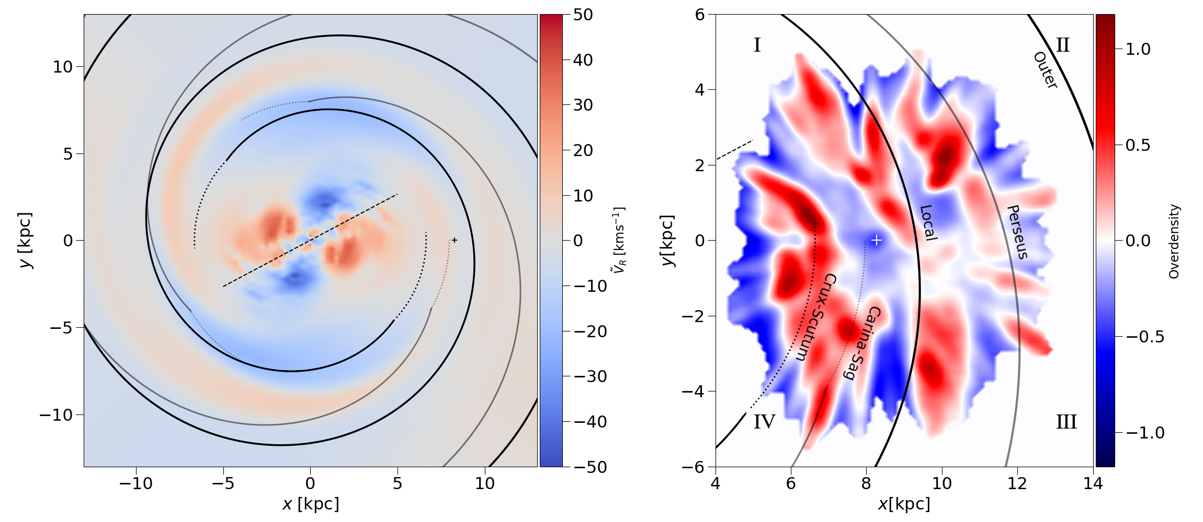
Milky Way disk: Median radial velocity
Yassin Rany Khalil, Observatory of Strasbourg, yassin.khalil@unistra.fr

Slide 21
Position of the spiral arms
Yassin Rany Khalil, Observatory of Strasbourg, yassin.khalil@unistra.fr

Slide 22
Implications on the Solar orbit
Yassin Rany Khalil, Observatory of Strasbourg, yassin.khalil@unistra.fr

Slide 23
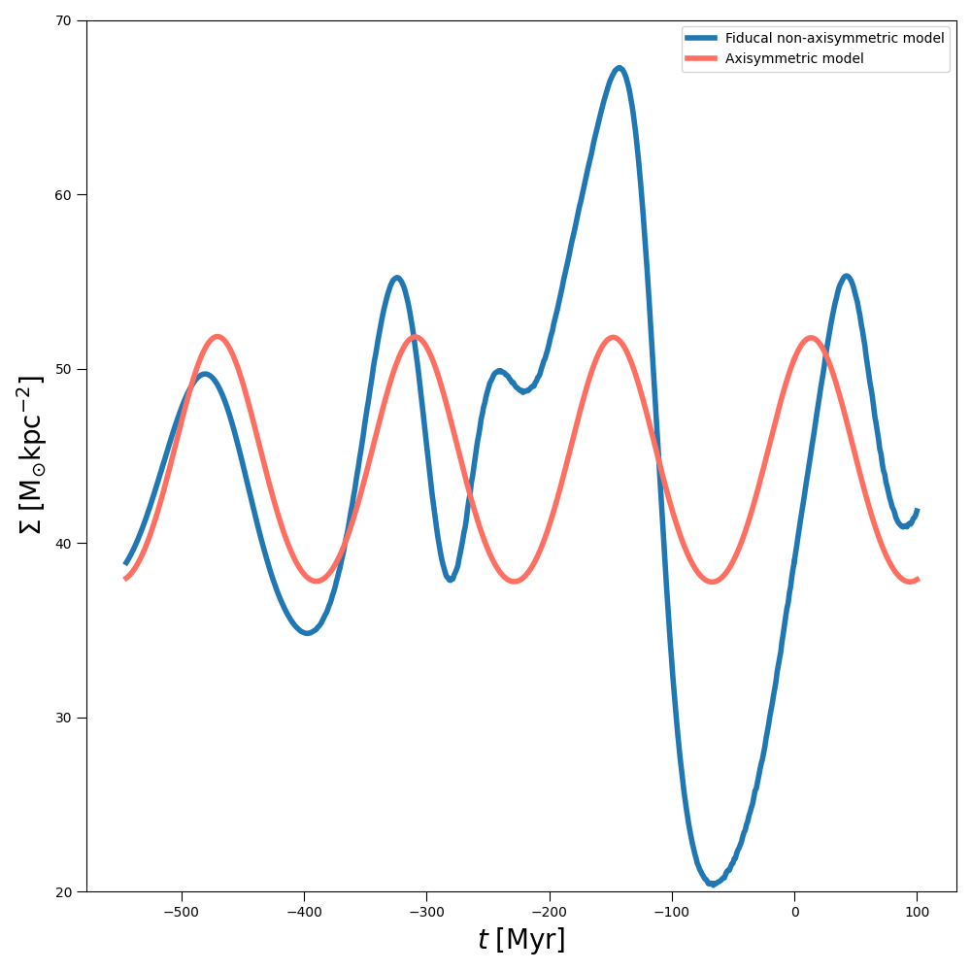
Implications on the Solar orbit
Yassin Rany Khalil, Observatory of Strasbourg, yassin.khalil@unistra.fr

Slide 24
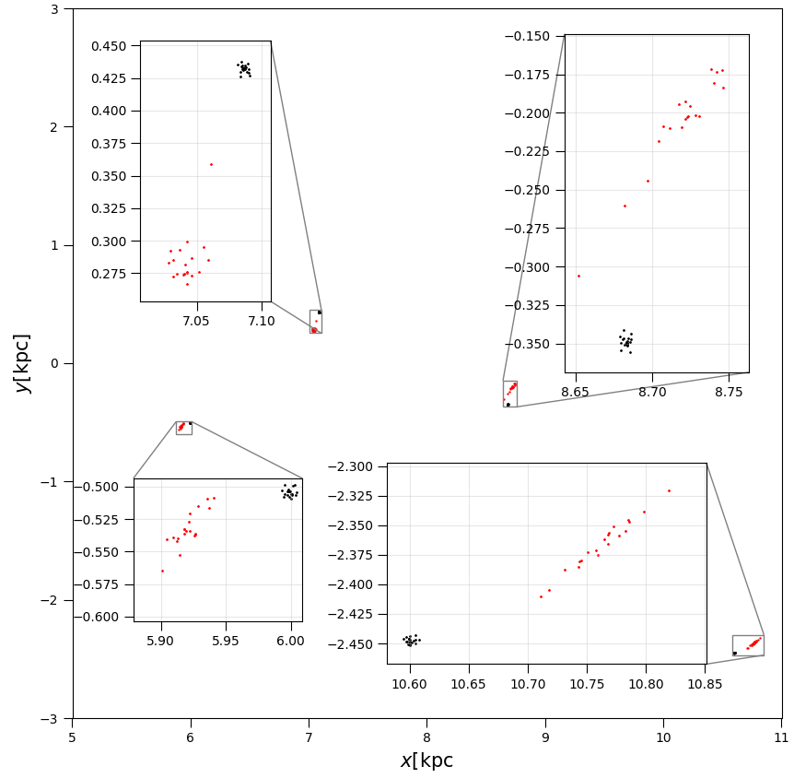
Implications on Young Associations
Yassin Rany Khalil, Observatory of Strasbourg, yassin.khalil@unistra.fr

Slide 25
Conclusion & Perspectives
Possibly the most realistic non-axisymmetric dynamical model for the Milky Way disk
It can be extended to 3 dimensions
It is possible to improve the approach to constrain at once the non-axisymmetric and axisymmetric structures
Other configurations can be explored as evolving pattern speed for the bar and/or for the spiral arms
The established model can be used to improve direct measurements of spiral arms pattern speed with young associations
Yassin Rany Khalil, Observatory of Strasbourg, yassin.khalil@unistra.fr

Slide 26
Thank you !
Yassin Rany Khalil, Observatory of Strasbourg
yassin.khalil@unistra.fr

Slide 27
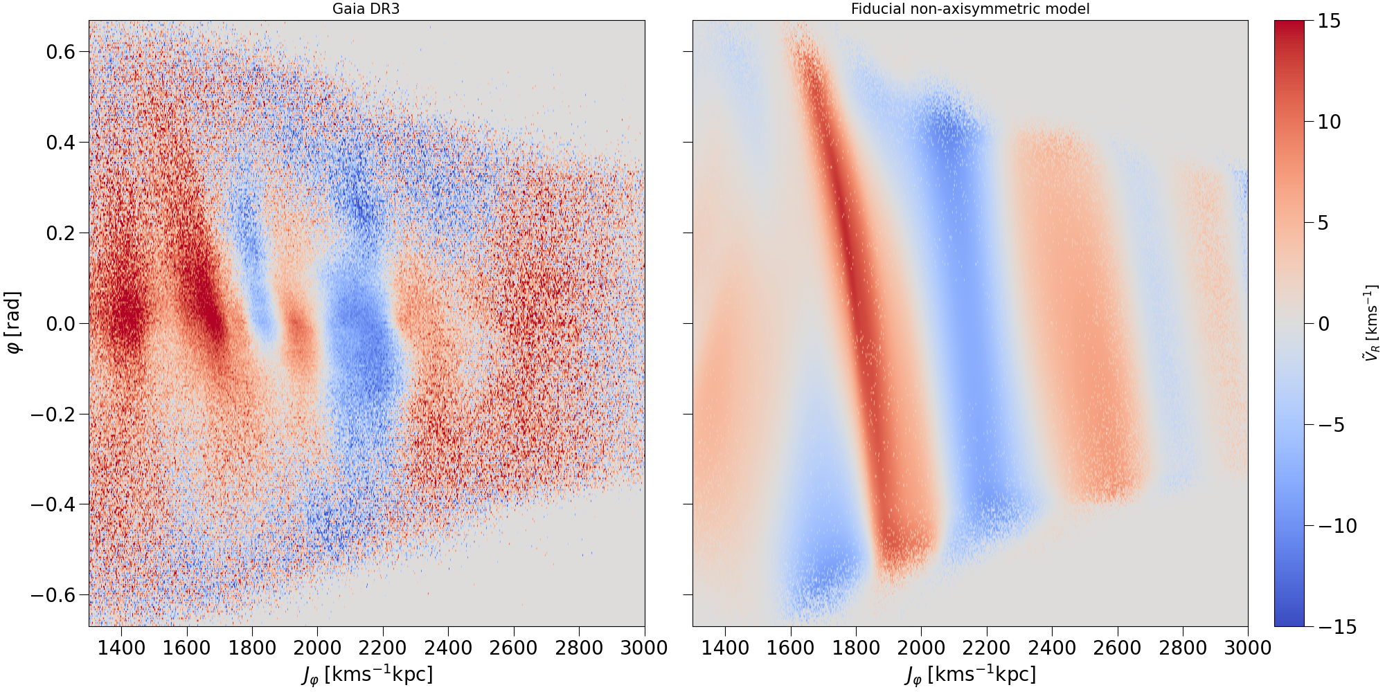

Slide 28
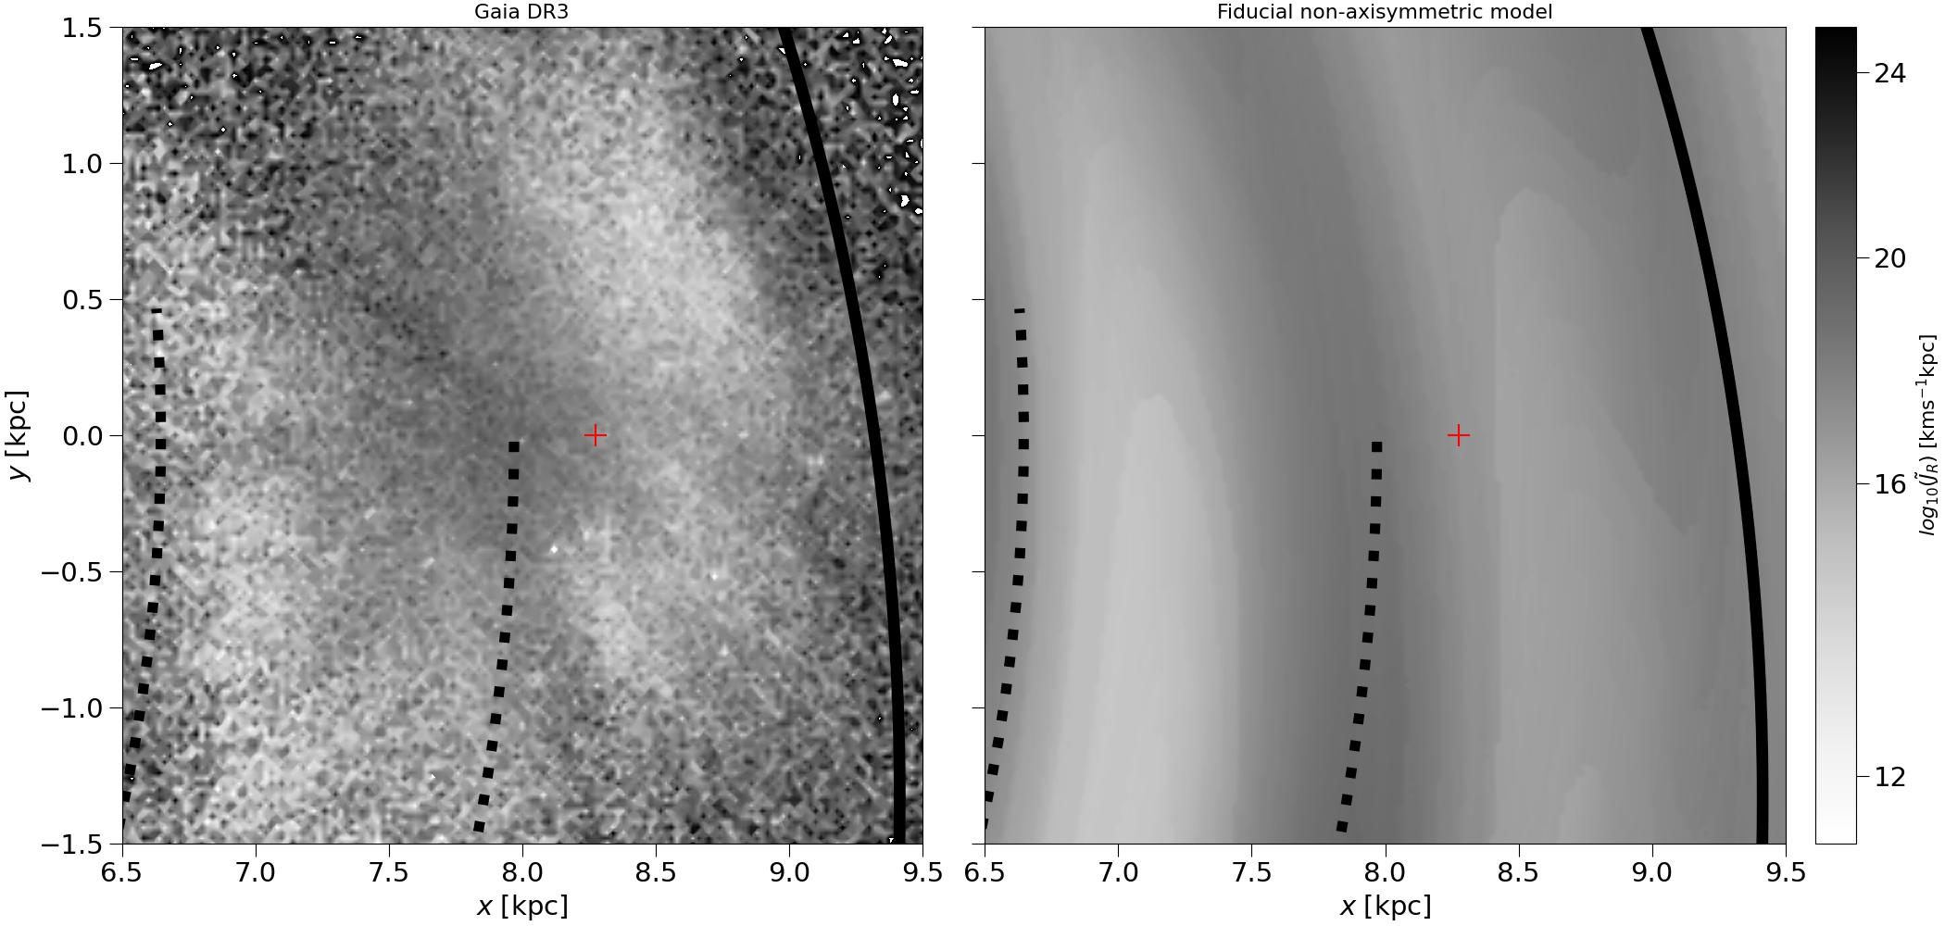

Slide 29
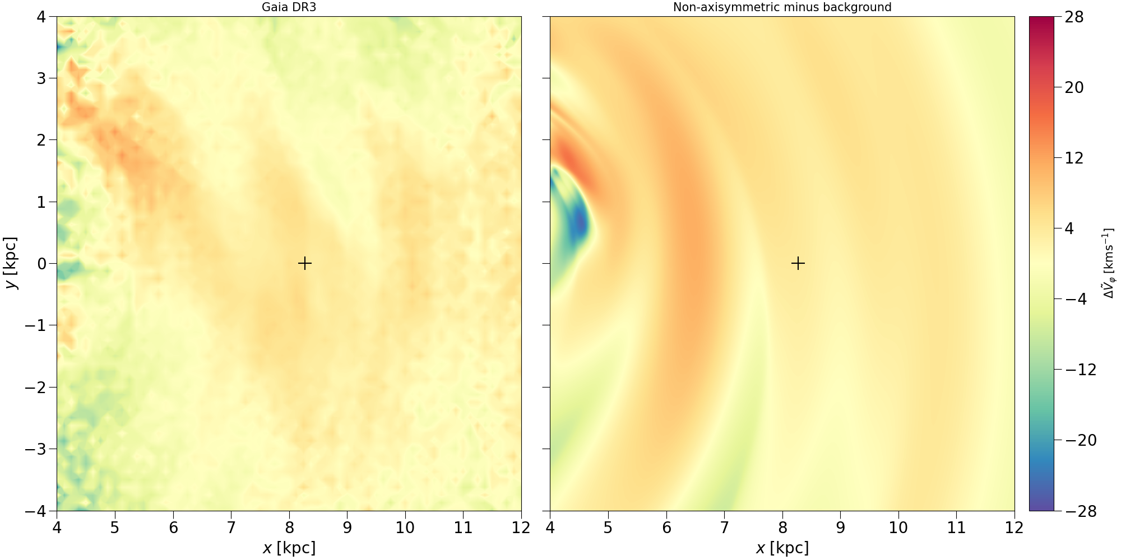

Slide 30
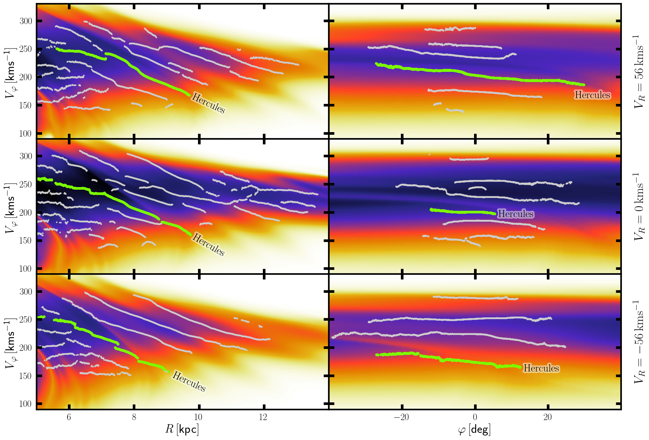

Slide 31
Distribution functions
Stellar systems: systems of stars bounded by gravitational long-range force.
We assume a system of $N$ stars of same mass $m$.
Each star has a position $x=(x,y,z)$ and velocity $v=(v_{x},v_{y},v_{z})$
Distribution function
Gives the probability $f(x,v,t)d^{3}xd^{3}v$ to find a star in the volume $d^{3}xd^{3}v$ centred on $(x,v)$ at time $t$
Density at position $x$: $ρ(x,t)=∫f(x,v,t)d^{3}v$
Number density at $x$: $Nρ(x,t)$, with $N$ the number of stars
Average velocity at position $x$: $\overline{v}=ρ^{-1}(x,t)∫vf(x,v,t)d^{3}v$

Slide 32
Vlasov-Poisson Equation
Vlasov-Poisson Equation
$\frac{∂f}{∂t}+v⋅\frac{∂f}{∂x}-∇Φ⋅\frac{∂f}{∂v}=0$
$$∇^{2}Φ=4πG∫d^{3}vf$$
Asymptotic limit of an infinite particle stellar system for the first equation (with negligible interaction term) of BBGKY hierarchy formulation of the Liouville equation
Collision-less dynamics
Relaxation time $τ_{relax}$: time to a star’s velocity change by its order thorough stellar encounters
Typically $τ_{relax}>τ_{Hubble}$. Increases with number of stars and crossing time $\left(\frac{R}{v}\right)$.

Slide 33
Vlasov-Poisson Equation
Key results encoded in the Vlasov equation:
The distribution function in an infinitesimal Lagrangian volume is conserved. $\frac{df}{dt}=0$
The distribution function is conserved along the orbits
Open the possibility to the backwards integration method (Vauterin & Dejonghe 1997; Dehnen 1999)
Why this is important ?
It is very hard to compute distribution functions for the galaxy with both the bar and spiral arms
Multiple pattern speed are concerned
Resonant effects and overlap of resonances can be very hard to characterise
Usually made with perturbation theory for one structure alone

Slide 34
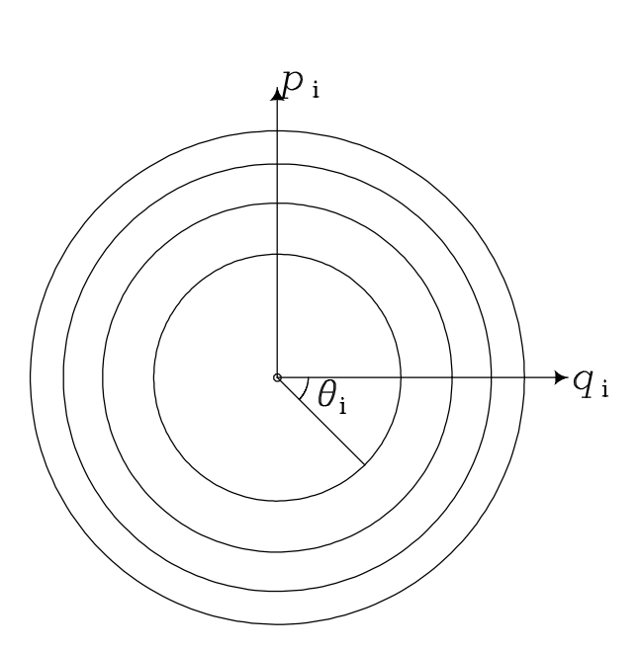
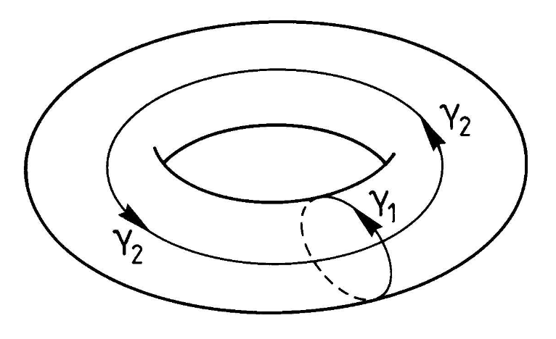
Actions-Angles variables
Jeans theorems help us solve for the Vlasov equation for equilibrium:
If integrable system: $f=f(I_{1},I_{2},I_{3})$ and if in axisymmetry and equilibrium: $f=f(E,L_{z},I_{3})$.
But, how to choose the integrals $I$? Actions $J$ and Angles $θ$
Canonical variables: $H=H(J)$ and $J=const$ as well as $\overset{·}{θ}=const$
Natural phase-space coordinates for regular orbits in (quasi)-integrable systems.
Transforming $(x,v)$ to $(J,θ)$ is volume-conserving (appropriate for DFs).
Angle-Action variables as polar coordinates. Binney & Tremaine 2008.

Slide 35
Actions-Angles variables
How we compute it ?
Transformations of $(x,v)$ to $(J,θ)$ is exactly know for some separable potentials like the Stäckel potential
In the Stäckel Fudge we use the real potential locally as if it were a Stäckel potential: $Δ_{2}=z^{2}-R^{2}+3\left[3z\frac{∂Φ}{∂R}-3R\frac{∂Φ}{∂z}+Rz\left(\frac{∂^{2}Φ}{∂R^{2}}-\frac{∂^{2}Φ}{∂z^{2}}\right)\right]{\left(\frac{∂^{2}Φ}{∂R∂z}\right)}^{-1}$(Sanders 2012)
In practice, accurate and efficient computations it with AGAMA (Vasiliev 2019) library

Slide 36
Axisymmetric model
Thin disk
Thick disk
Dark Matter
Bulge
$$f=η\frac{Ω}{2^{\frac{5}{2}}π^{\frac{3}{2}}κ{\overset{˜}{σ}}_{R}^{2}}exp\left(-\frac{R_{g}}{h_{R}}\right)exp\left(-\frac{J_{r}κ}{{\overset{˜}{σ}}_{R}^{2}}\right)$$
$${\overset{˜}{σ}}_{R}(R_{g})={\overset{˜}{σ}}_{R}(R_{0})exp\left(-\frac{R_{g}-R_{0}}{h_{σ,R}}\right)$$
$f(J)=f_{thin}(J)+βf_{thick}(J)$
Khalil et al., in preparation.
Yassin Rany Khalil, Observatory of Strasbourg, yassin.khalil@unistra.fr

Slide 37
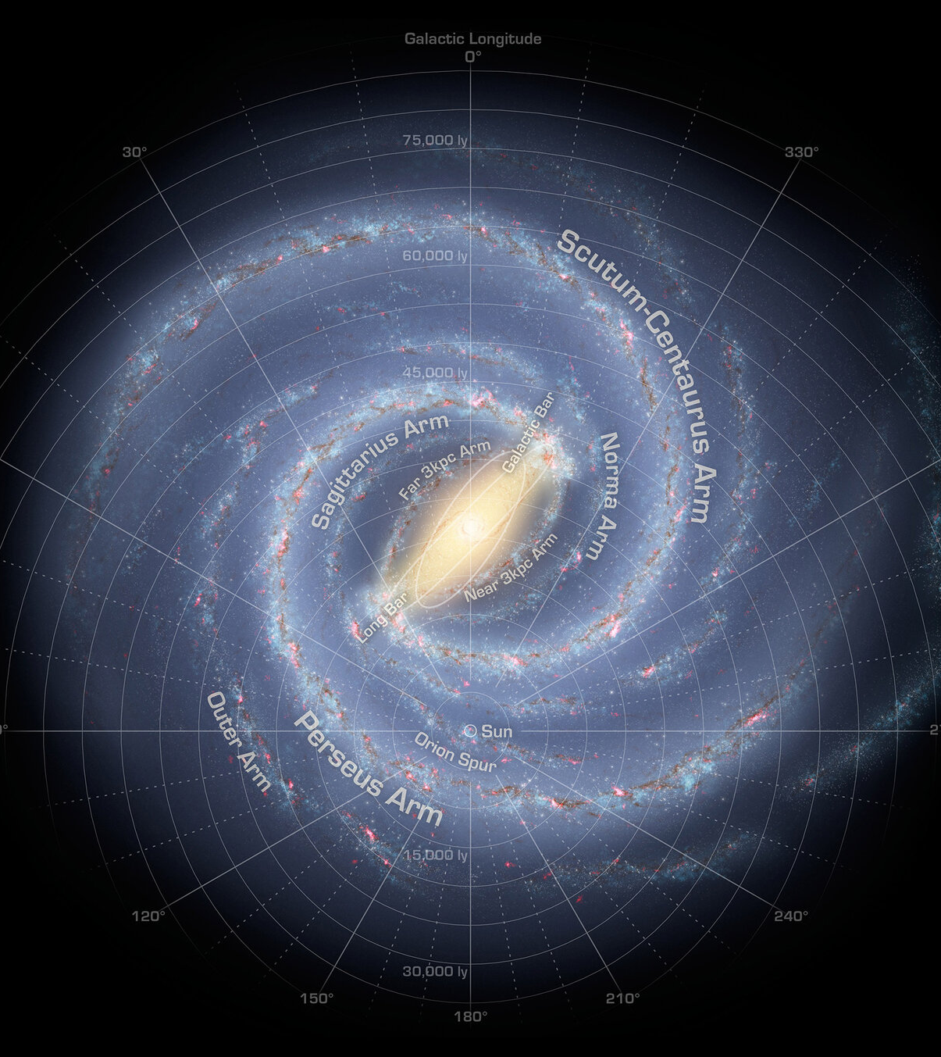
Backwards Integrations (Vauterin & Dejonghe 1997; Dehnen 1999)
Integrate orbits starting from different « local » positions in the configuration space
Integrate back in time to a time where bar and spiral arms were not present.
Compute the orbits actions at this time.
Compute the axisymmetric DF at this original time :
By conservation we have the DF at $t=now$ for joint bar and spiral arms
$$V_{ϕ}$$
$$V_{R}$$
$$(R,ϕ)$$
$$(V_{R},V_{ϕ})$$
Credits: NASA/JPL-Caltech/R. Hurt (SSC/Caltech) + Adaptions (Yassin Rany Khalil)

Slide 38
Liouville equation
Idealised stellar system of $N$ identical stars of mass $μ$.
Position $x=(x_{0},...,x_{N})$ and velocities $v=(v_{0},...,v_{N})$.
Phase-space probability distribution function $P_{N}(x,v)$.
Temporal evolution of $P_{N}(x,v)$
Liouville equation : $\frac{∂P_{N}}{∂t}+\overset{N}{\underset{i=1}{∑}}\left[v_{i}⋅\frac{∂P_{N}}{∂x_{i}}+μF_{i}^{tot}⋅\frac{∂P_{N}}{∂v_{i}}\right]=0$.

Slide 39
BBGKY Hierarchy
The reduced distribution functions are defined as*: $f_{n}(Γ_{1},...,Γ_{n},t)≡μ^{n}\frac{N!}{(N-n)!}P_{n}(Γ_{1},...,Γ_{n},t)$
So that the BBGKY hierarchy is given by:
$\frac{∂f_{n}}{∂t}+\overset{n}{\underset{i=1}{∑}}v_{i}⋅\frac{∂f_{n}}{∂x_{i}}+\overset{n}{\underset{i=1}{∑}}\overset{n}{\underset{k=1,k≠i}{∑}}μF_{ik}⋅\frac{∂f_{n}}{∂v_{i}}+\overset{n}{\underset{i=1}{∑}}∫dΓ_{n+1}F_{i,n+1}⋅\frac{∂f_{n+1}}{∂v_{i}}=0$. *With $P_{n}(Γ_{1},...,Γ_{n},t)≡∫dΓ_{n+1}...dΓ_{N}P_{N}(Γ_{1},...,Γ_{N},t)$ with $Γ_{m}=(x_{m},v_{m})$.

Slide 40
BBGKY Hierarchy for $n=1$
$f_{1}(Γ_{1},t)$ is the one-particle phase-space density in terms of mass.
For the two-particle reduced distribution function, let’s define $g_{2}(Γ_{1},Γ_{2})$ such that:
$f_{2}(Γ_{1},Γ_{2},t)=f_{1}(Γ_{1},t)f_{1}(Γ_{2},t)+g_{2}(Γ_{1},Γ_{2})$.
The BBGKY hierarchy for $n=1$:
$\frac{∂f_{1}}{∂t}+v_{1}⋅\frac{∂f_{1}}{∂x_{1}}+\left[∫dΓ_{2}f_{1}(Γ_{2},t)F_{12}\right]⋅\frac{∂f_{1}}{∂v_{1}}+∫dΓ_{2}F_{12}⋅\frac{∂g_{2}(Γ_{1},Γ_{2})}{∂v_{1}}=0$
In the limit $n→N$, $∫dΓ_{2}F_{12}⋅\frac{∂g_{2}(Γ_{1},Γ_{2})}{∂v_{1}}→0$

Slide 41
Collionsless Boltzmann Equation
(= Vlasov Equation)
BBGKY hierarchy for $n=1$ in the limit $n→N$: $\frac{∂f_{1}}{∂t}+v_{1}⋅\frac{∂f_{1}}{∂x_{1}}+\left[∫dΓ_{2}f_{1}(Γ_{2},t)F_{12}\right]⋅\frac{∂f_{1}}{∂v_{1}}=0$ .
Notice that:$-∇Φ=∫dΓ_{2}f_{1}(Γ_{2},t)F_{12}$.
The phase-space density of stars in an infinitesimal Lagrangian volume is conserved.
$\frac{∂f_{1}}{∂t}+v_{1}⋅\frac{∂f_{1}}{∂x_{1}}-∇Φ⋅\frac{∂f_{1}}{∂v_{1}}=0$ $⟺$ $\frac{df_{1}}{dt}=0$.

Slide 42
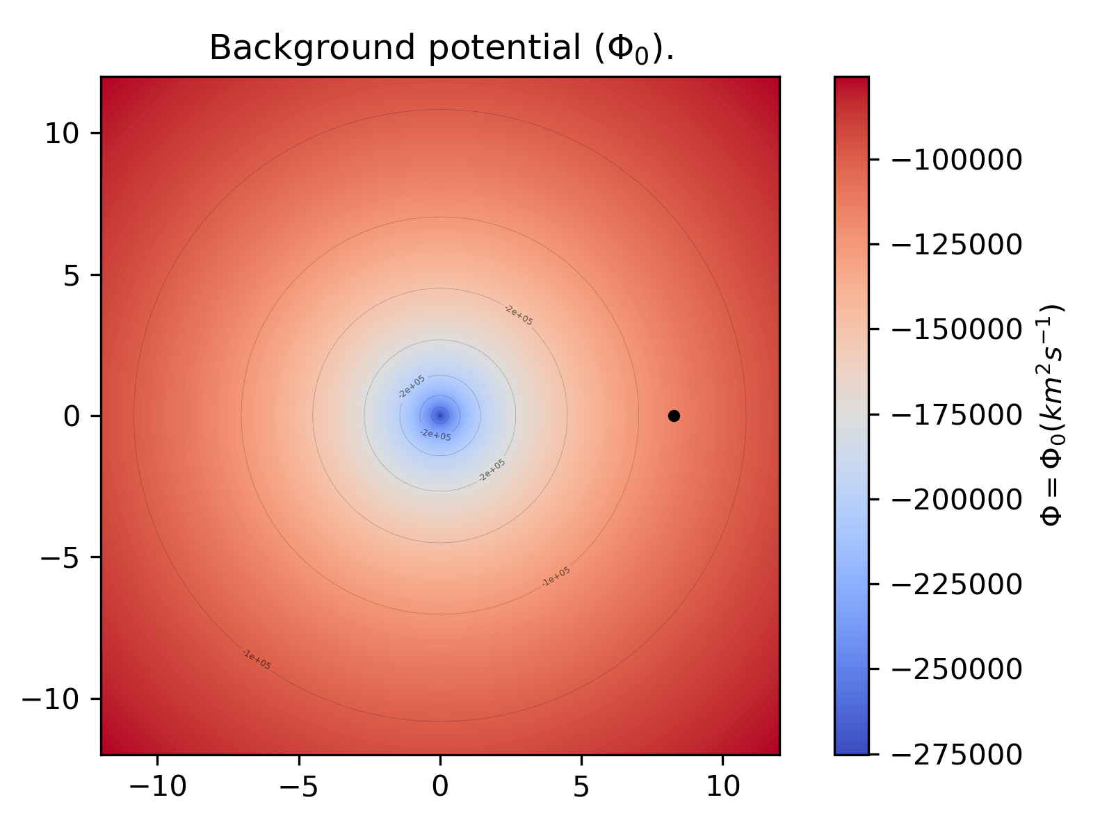
Background potential
2 disk density profiles: Stellar thin disk and Interstellar medium thick disk
$$ρ=Σ_{0}exp[-(R/R_{d})^{1/n}-R_{0}/R+ϵcos(R/R_{d})]$$
3 parameters each
2 spheroidal density profiles: Dark Matter and Bulge.
$$ρ=ρ_{0}(r/r_{0})^{-γ}(1+(r/r_{0})^{α})^{(γ-β)/α}exp[-(r/r_{cut})^{ξ}]$$
5 parameters each
So the background model has $2⋅(3+5)=16$ parameters
Sun's velocity and position counts for more $6$ parameters

Slide 43
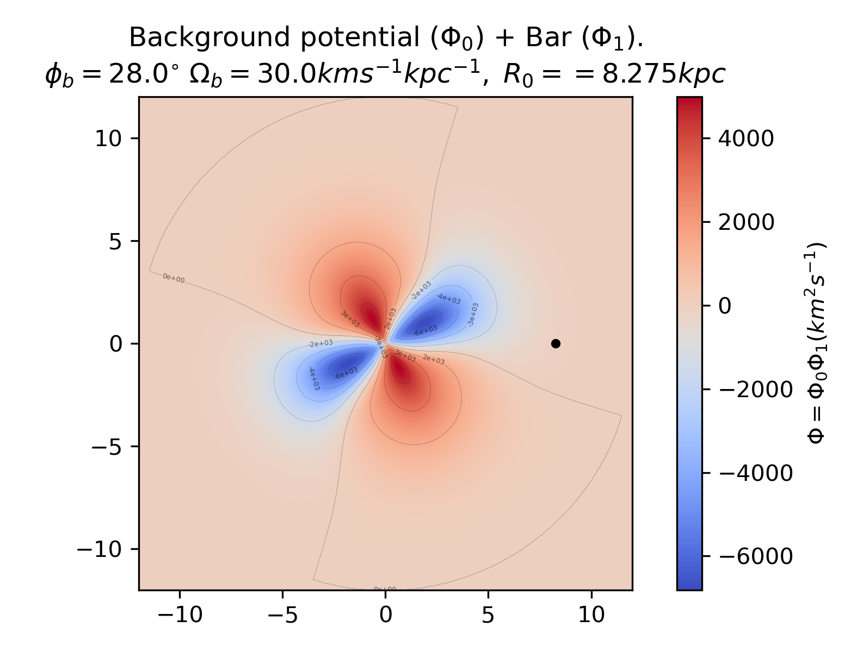
Bar potential
Bar potential:
$Φ_{1}(r,ϕ,z,m,R_{max},A,a,b,ϕ_{b},Ω_{bar},t)=A{\overline{r}}^{a-1}(1-\overline{r})^{b-1}cos(m(ϕ-ϕ_{b}-Ω_{bar}t))$
$\overline{r}=\frac{r}{R_{max}}$. Cutoff at $R_{max}=12kpc$.
Bar angle $ϕ_{b}$
Bar pattern speed $Ω_{bar}$
Amplitude $A$
Radial profile parameters $a,b$
3 superposed modes $m=2,4,6$
Each mode has 3 free parameters: $A,a,b$
So the Bar model has $2+3⋅2=11$ parameters

Slide 44
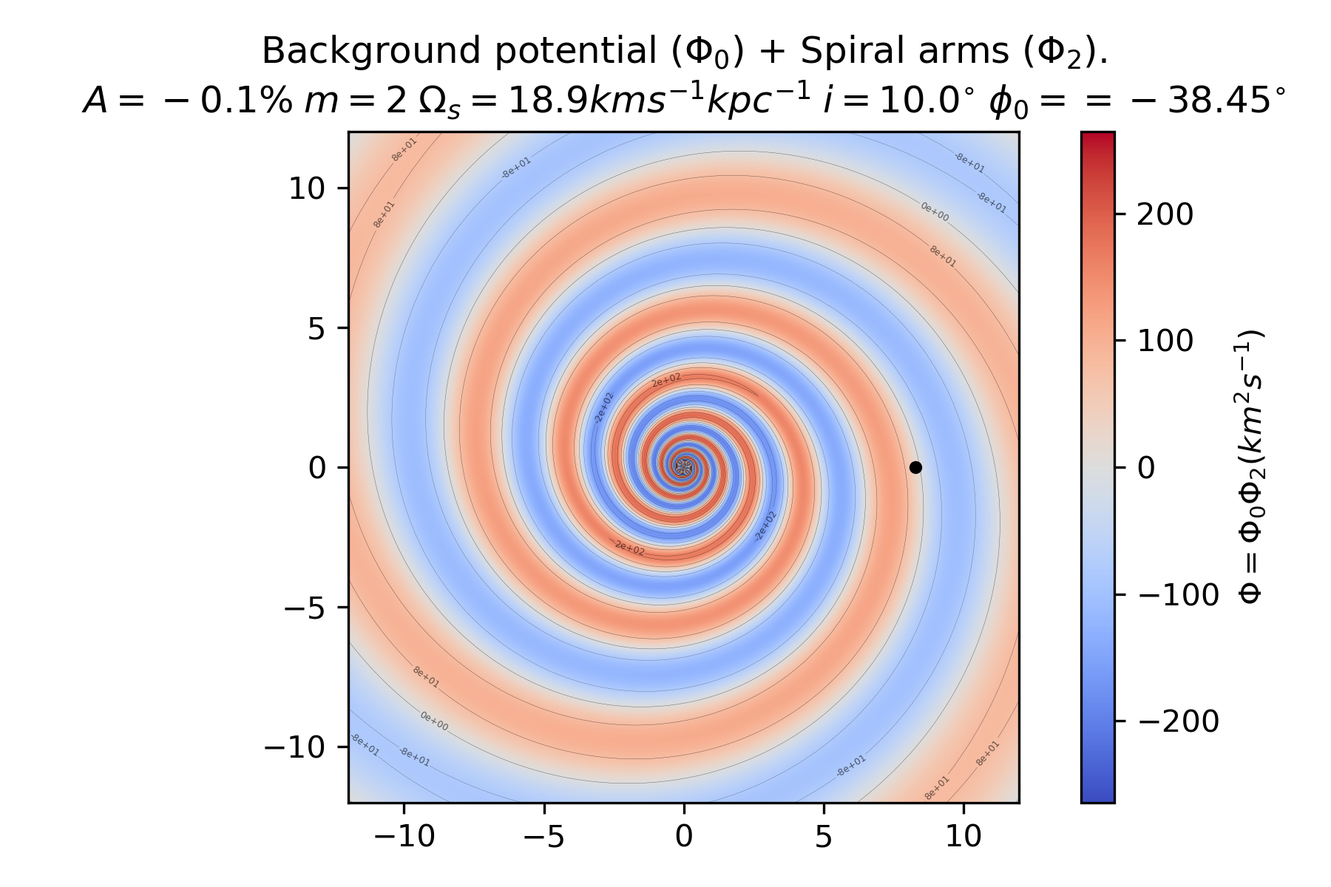
Spiral arms potential
Spiral Arms potential:
$$Φ_{2}=Acos\left(m\left((ϕ-ϕ_{0})-Ω_{s}t+ln\left(\frac{R}{R_{0}}\right)tan(i)^{-1}\right)\right)$$
Amplitude $A$
Pit angle $i$
Spiral arms pattern speed $Ω_{s}$
Phase $ϕ_{0}$
Arms number $m$
So the Spiral Arms model has $5$ parameters

