Slide 1
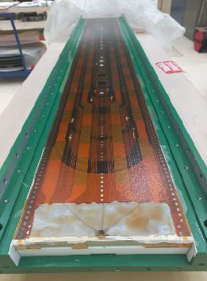
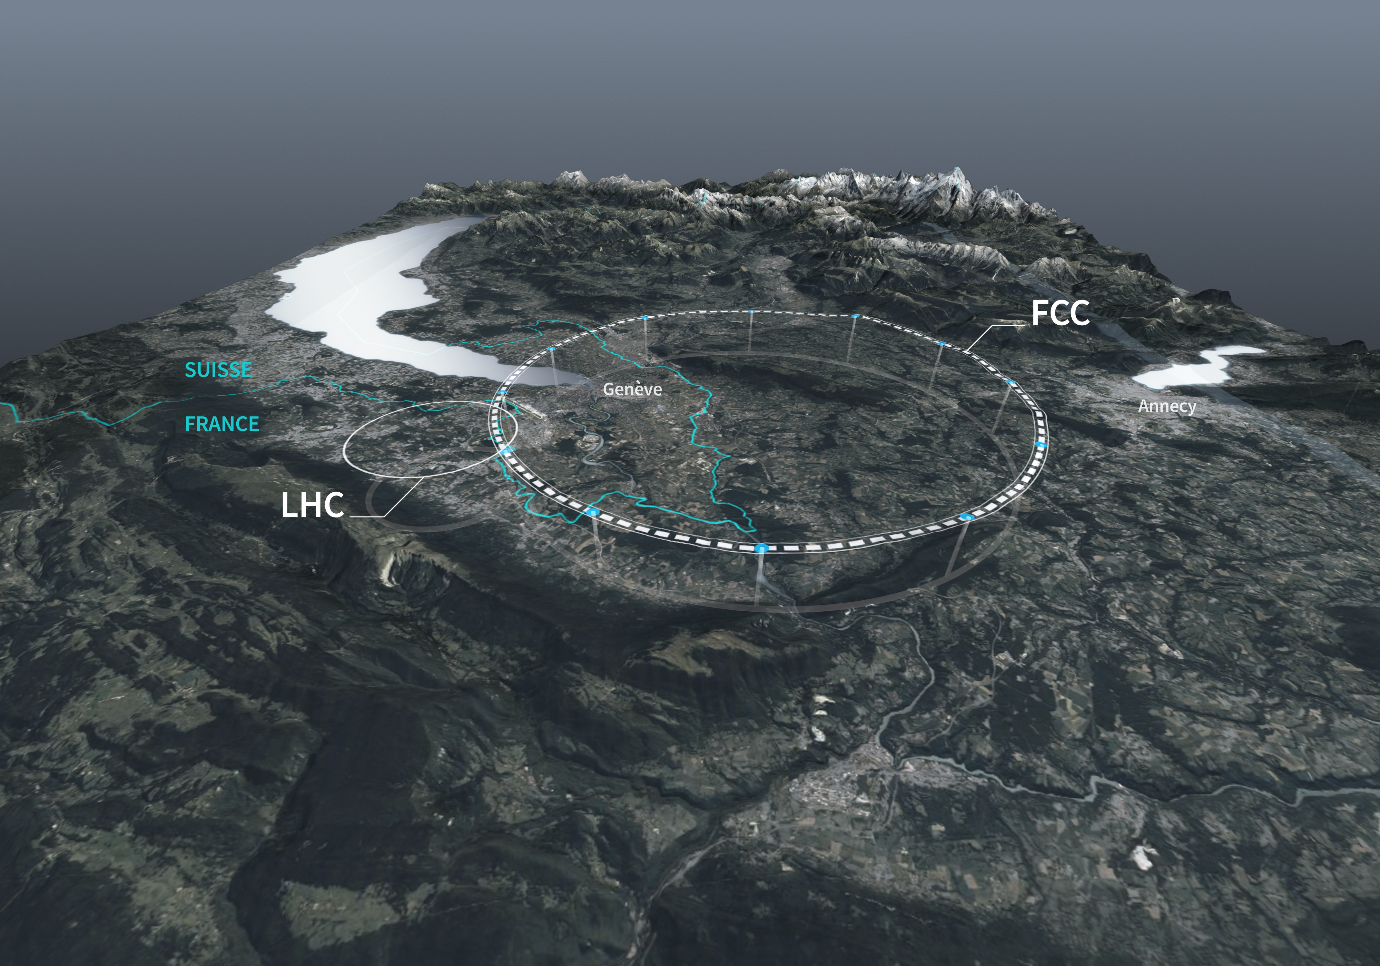
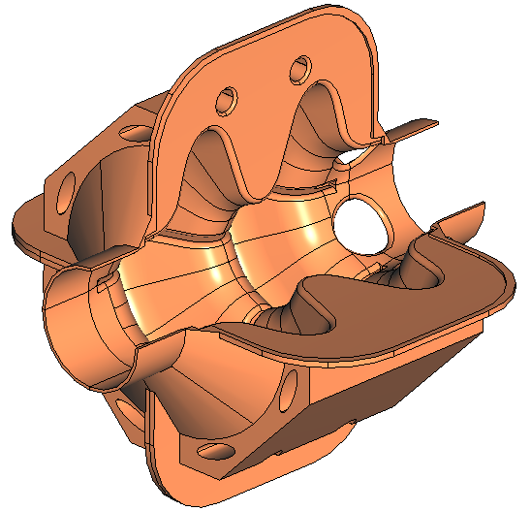
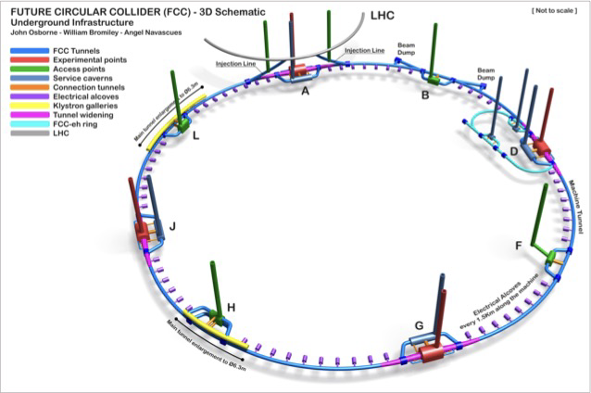
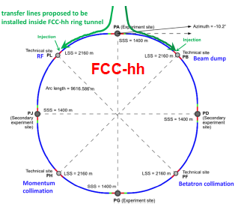
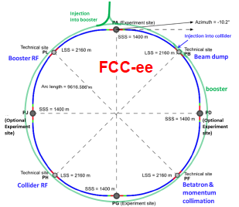
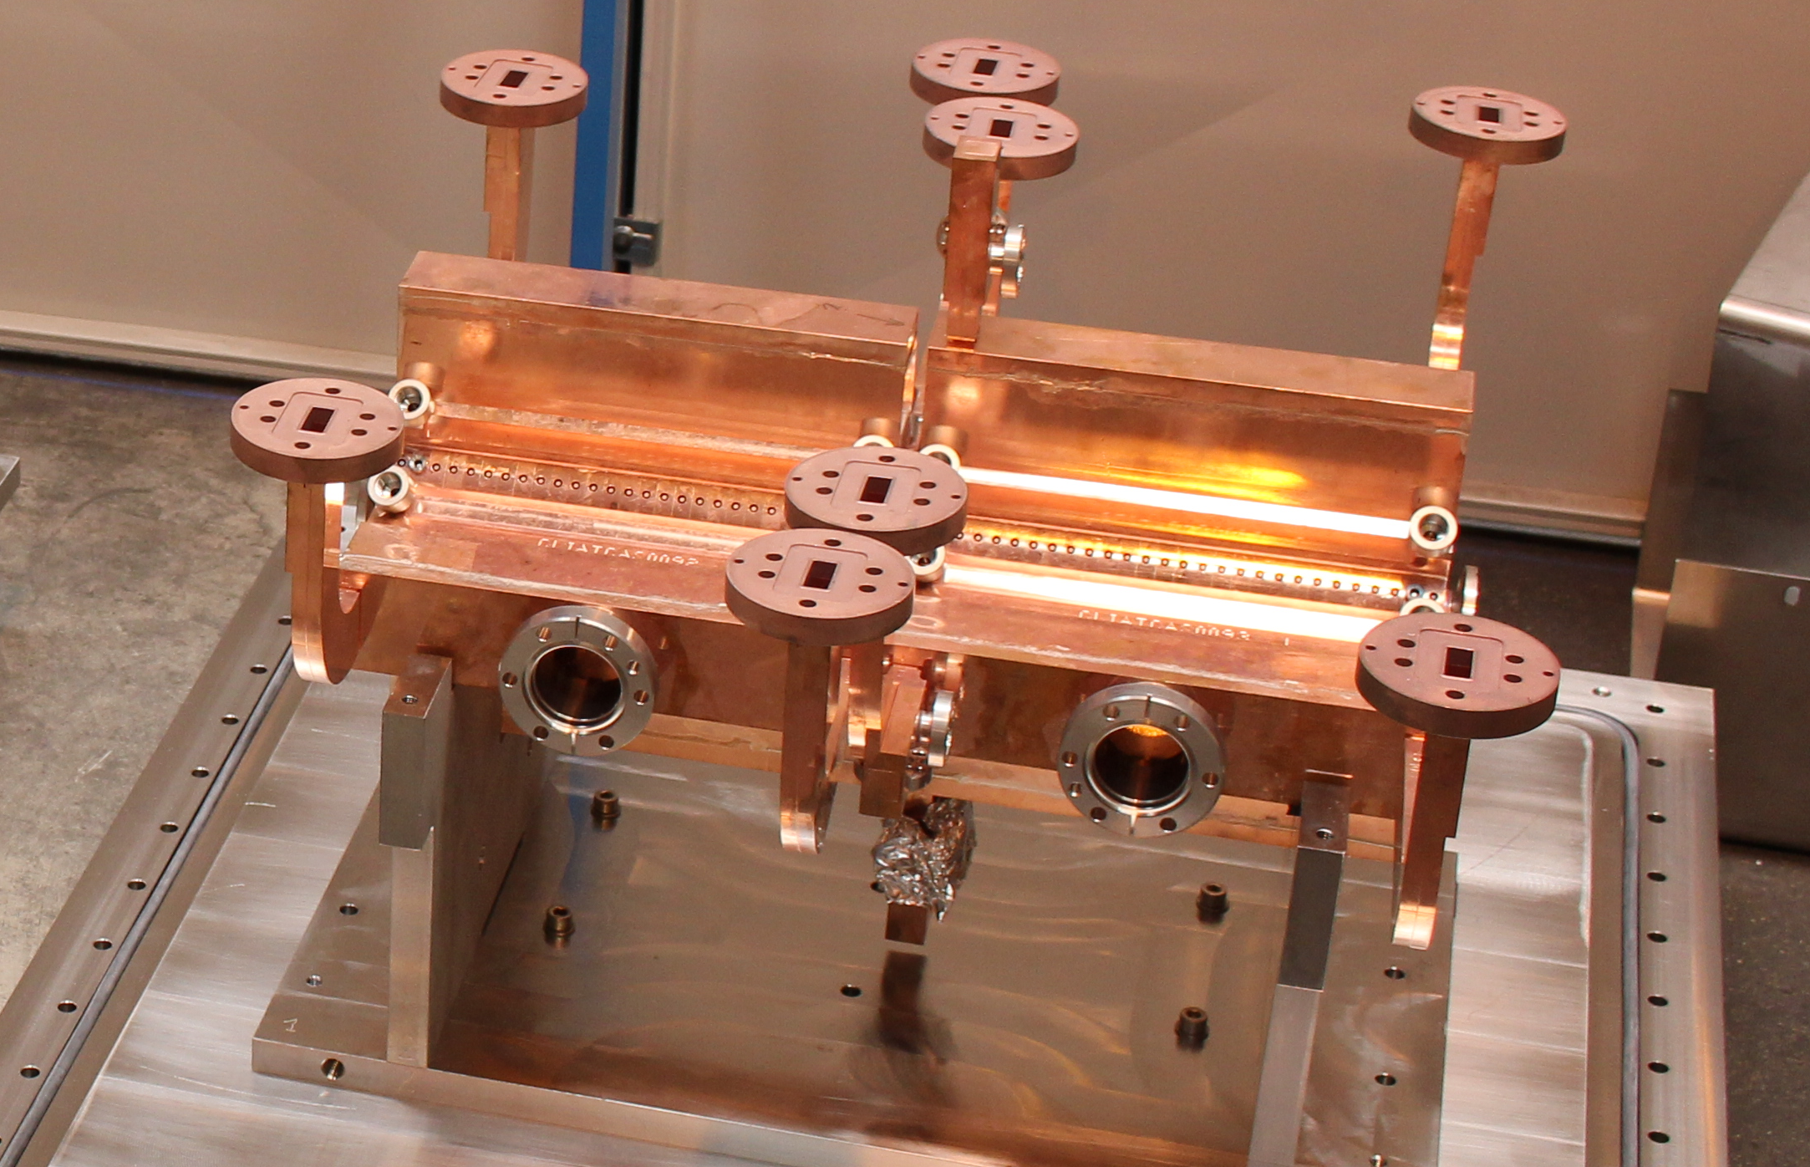
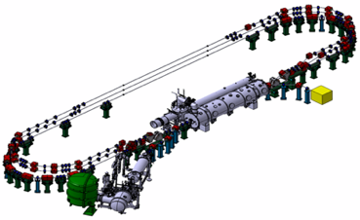
Accelerator technologies with potential for QCD beyond the LHC
A. Faus-Golfe
Notes:
Thanks for the invitation and the useful discussions with Carlos, Cirille, Michael, Gines and Alberto, that help me to prepare this talk where
I will try to summarize the “state of the art” of some of the technologies with potential beyond the LHC.

Slide 2
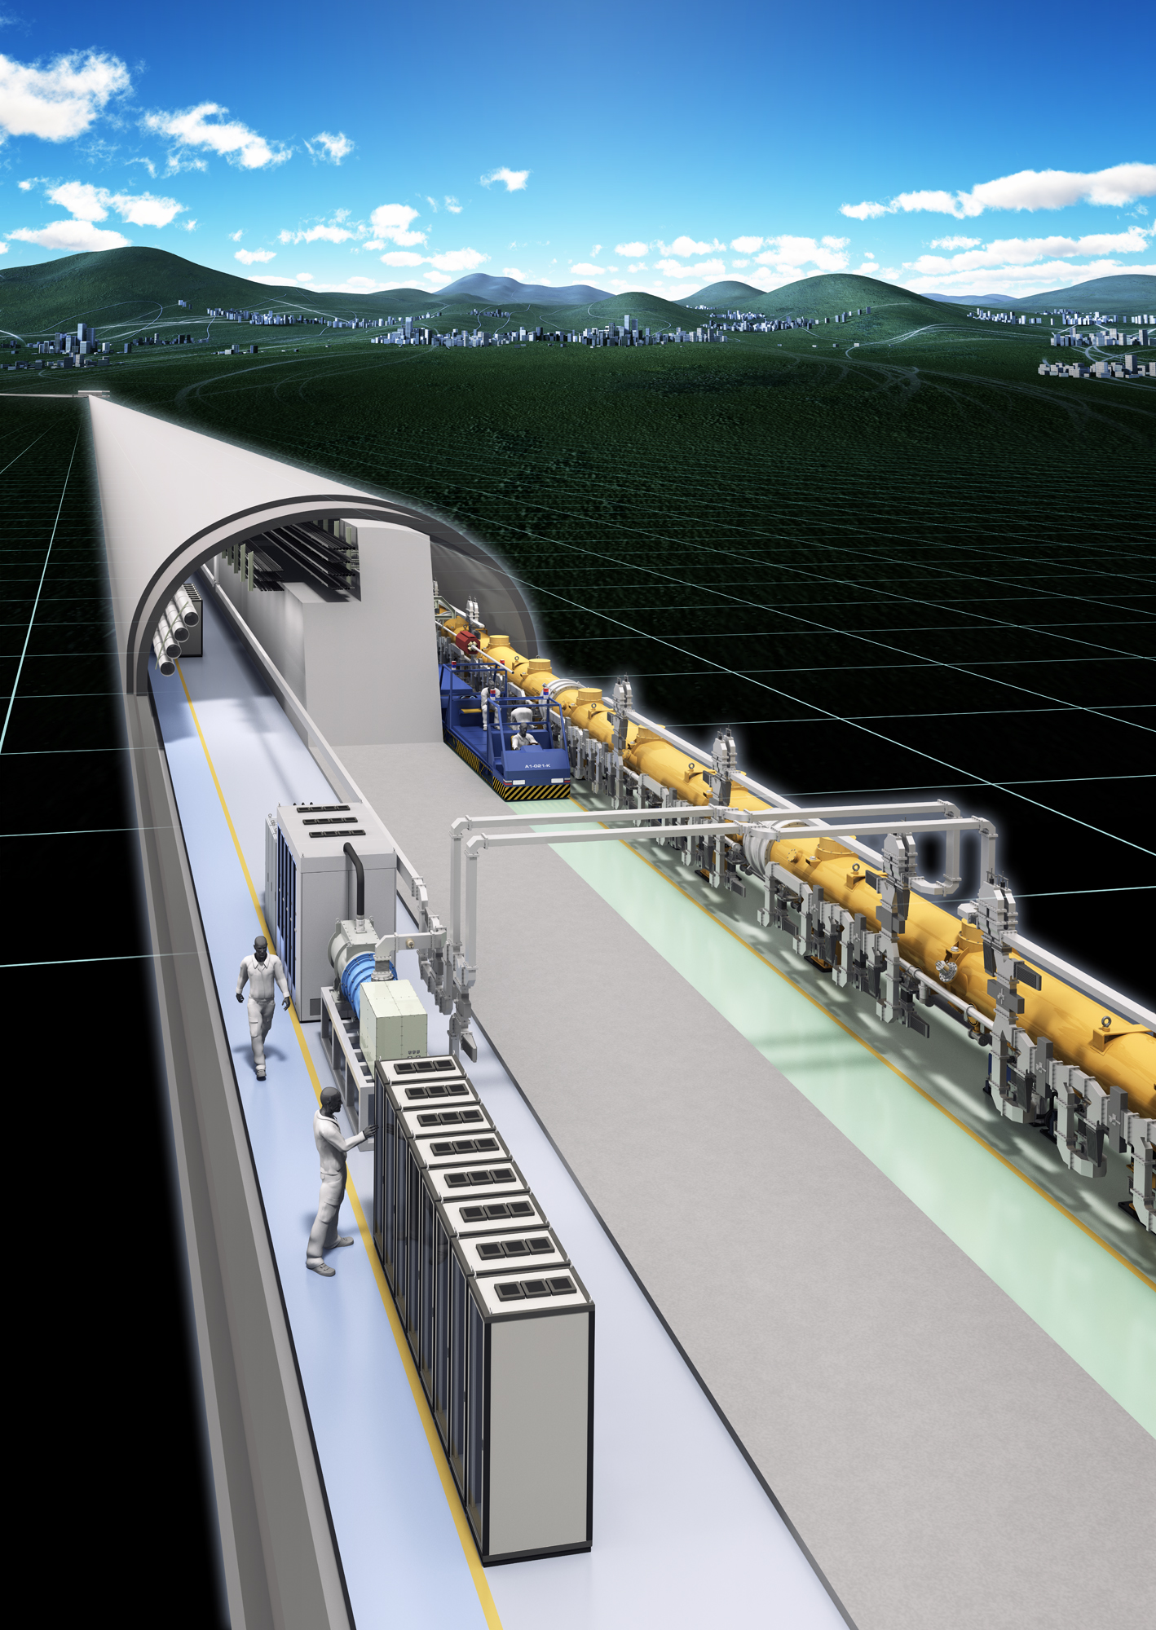
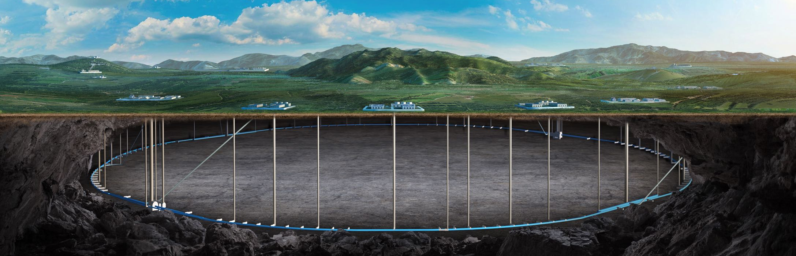
Outline
Medium Term Plan
EPPSU
EPPSU
Long Term Plan
2020 | 2021 | 2022 | 2023 | 2024 | 2025 | 2026 | 2027 | 2028 | 2029 | 2030 | 2031 | 2032 | 2033 | 2034 | 2035 | 2036 | 2037
Snowmass
Higgs Factories e+e-
Linear: ILC/CLIC/C³/HALHF
Circular: FCC-ee, CEPC
Future Collider Projects
ESSP & Snowmass context
State of the Art and Scientific Issues
FCC-hh
Scenarios for FCC-hh
High Field Magnet program
FCC-eh
ERL technologies
Hadron Circular Colliders
hh: FCC-hh, SPPC
ep: FCC-eh
Notes:
I will first introduce the context of the HEP future colliders accelerator projects in the EPPSU2020 and the Snowmass’21.
After discussion with some of the organizers we agree the I will mainly centred my talk in hadron collider projects: he FCC-hh and FCC-eh.

Slide 3
Outline
Medium Term Plan
EPPSU
EPPSU
Long Term Plan
2020 | 2021 | 2022 | 2023 | 2024 | 2025 | 2026 | 2027 | 2028 | 2029 | 2030 | 2031 | 2032 | 2033 | 2034 | 2035 | 2036 | 2037
Snowmass
Higgs Factories e+e-
Linear: ILC/CLIC/C³/HALHF
Circular: FCC-ee, CEPC
Future Collider Projects
ESSP & Snowmass context
State of the Art and Scientific Issues
FCC-hh
Scenarios for FCC-hh
High Field Magnet program
FCC-eh
ERL technologies
Hadron Circular Colliders
hh: FCC-hh, SPPC
ep: FCC-eh
Notes:
I will first introduce the context of the HEP colliders projects, EPPSU2020 and the Snowmass’21.
After discussion with some of the organizers we agree the I will mainly centred my talk in hadron collider projects: he FCC-hh and FCC-eh.

Slide 4
Context: EPPSU 2020 process update
20 strategy statements have been unanimously adopted by the European Strategy Group (ESG) in January 2020:
High-priority future initiative:
Prepare a Higgs factory, followed by a future hadron collider with sensitivity to energy scales an order of magnitude higher than those of the LHC, while addressing the associated environmental and technical challenges
Note: H. Abramowizc ESG January 2020.
Notes:
In the EPPSU 2020 one of the high-priority future initiative is the preparation of a Higgs factory, followed by a future hadron collider, while addressing the associated environmental and technical challenges

Slide 5
HEP Future Collider Key Technologies
Notes:
Summarizing which are the landscape of the accelerator and the necessary technology to be successful

Slide 6
Context: The LDG process
LDG Report
Notes:
As an outcome of the European Strategy for Particle Physics 2020, CERN Council has mandated the Laboratory Directors Group (LDG) to define and maintain a prioritised accelerator R&D roadmap towards future large-scale facilities for particle physics.
The five key areas where progress in R&D is needed:
• High-field magnets, including use of high-temperature superconductors
• Plasma wakefield acceleration and other high-gradient accelerating structures
• Bright muon beams
• Energy recovery linacs
In addition, it is proposed to launch an activity on the education and training needs of accelerator physicists.
The EPs (Expert Pannel) are charged with defining the roadmap in their respective areas.

Slide 7
Context: Snowmass’21 process
Angeles Faus-Golfe
IJClab
Notes:
Similarly, in 2021 The Snowmass process has started in USA culminating in the summer 2022 in a community meeting in Seattle.
As a result of this discussion we have for instance in the Energy and Accelerator Frontier a re-schedule of the HEP colliders and new colliders project s appeared with high-momentum in USA.

Slide 8
Context: HEP Future Collider Timelines
Notes:
Re-scaling of some projects, noticed the CERN alignment and others appearing in USA labs like C3 and Muon collider.

Slide 9
Context: Snowmass’21 process
In the area of colliders, the panel endorses an off-shore Higgs factory, located
in either Europe or Japan, to advance studies of the Higgs boson following the HL-LHC
while maintaining a healthy on-shore particle physics program. The US should actively
engage in design studies to establish the technical feasibility and cost envelope of Higgs
factory designs. We recommend that a targeted collider panel review the options after
feasibility studies converge. At that point, it is recommended that the US commit funds
commensurate with its involvement in the LHC and HL-LHC.
2023 P5 Report
Angeles Faus-Golfe
IJClab
Notes:
The P5 report was published in March 2023 and in the collider area, the panel endorse and off -shore e+e- facility in Europe or Japan as well as the contribution to the R&D in some targeted collider topics

Slide 10
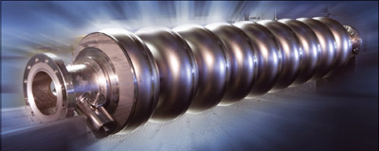
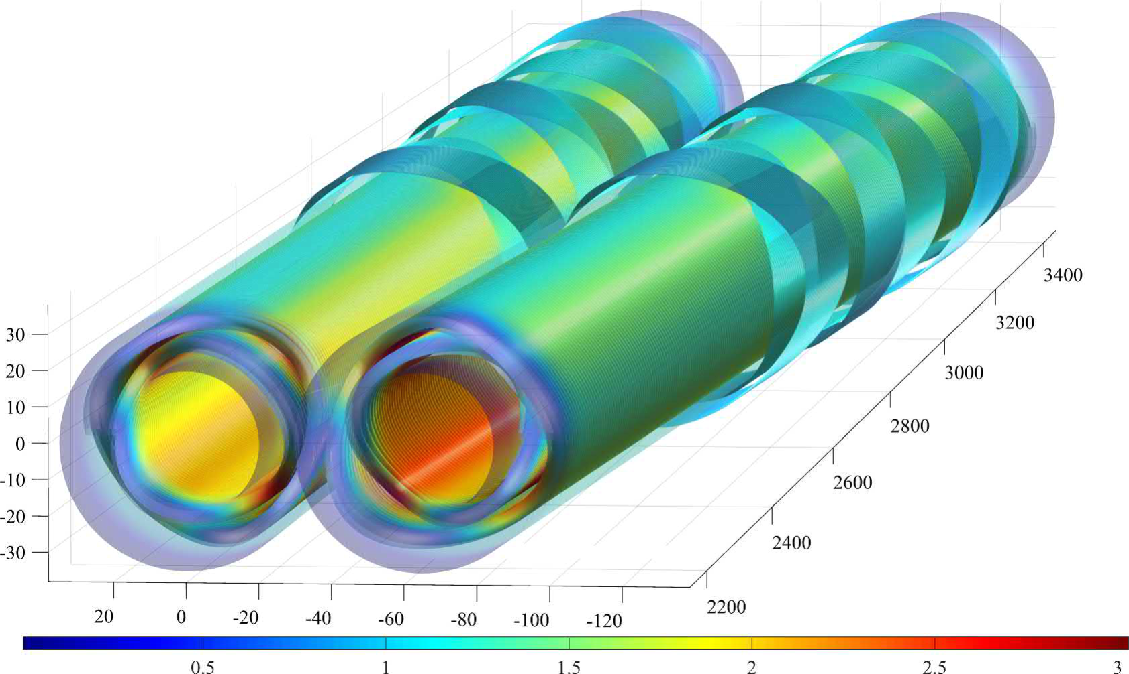
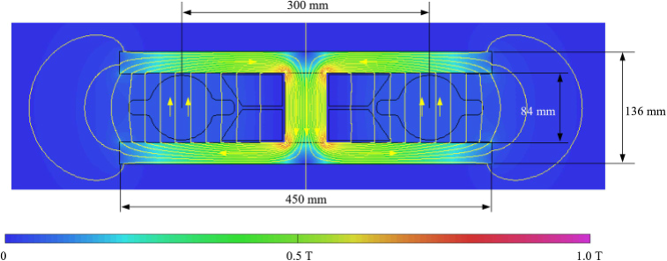
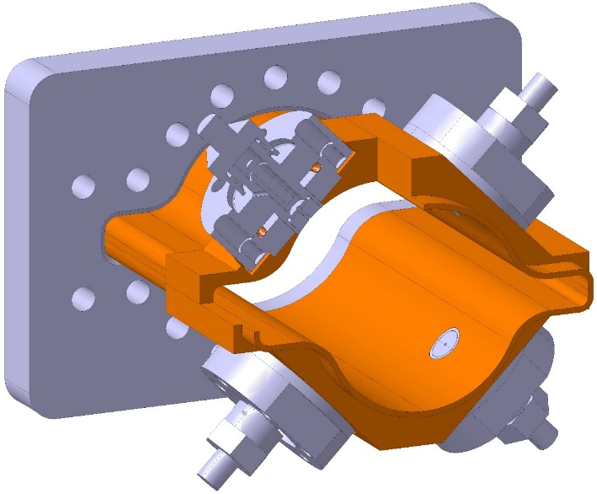
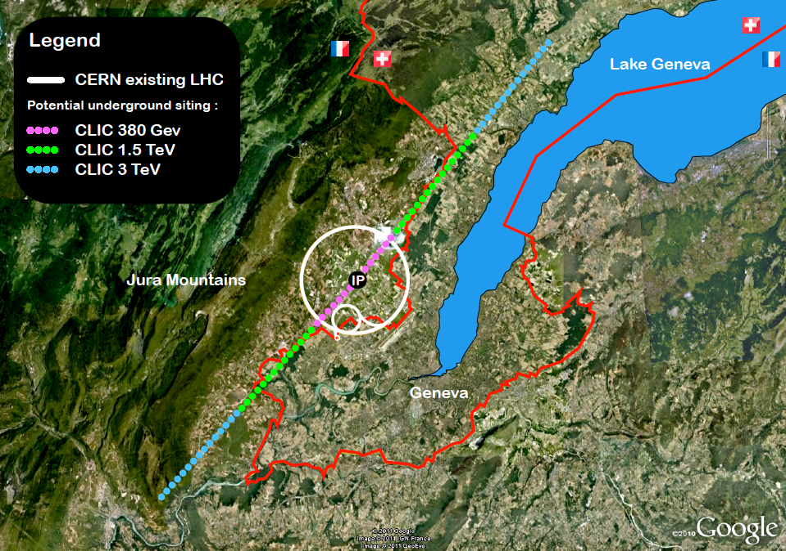
HEP Main Future Collider Key Technologies
 |  |  | RF cavities |  |  |  |  |  | Magnets
Components |  |  | SCRF |  |  |  | NCRF | HLRF | SC Mag. |  | NC Mag. | Vac | IRs | Injec-e+ | Sust – C footprint | Others
Techniques |  |  | Design | HG/HQ | CRYO | CRAB |  | HE-Klys | Nb₃Tn | CRYO
PROJECTS | FCC | FCC-hh |  |  |  | X |  |  | X | X |  | X |  |  | X | Integr.
 |  | FCC-ee | X | X | X | X |  | X |  |  | X | X | X | X | X | Integr.
 | LC | ILC |  | X | X | X |  | X |  |  |  |  | X | X | X
 |  | CLIC |  |  |  | X | X | X |  |  | X |  | X |  | X
HFM R&D in good track
e⁺e⁻ Higgs factory technology is ready
Notes:
After this context we could pass to the technology aspects.
From the point of view of the technologies I summarized here the Key technologies in the main HEP FC projects, special remark for the sustainability and Carbon footprint aspects that has now to be integrated in all the accelerator designs.
Since 2020 there has been an enormous effort in the EW and Higgs as a result we could say the e+e- technology is mature, other technologies for FCC-hh as the High Field Magnets are on going and in good track.
In the following I will described shortly le FCC-ee and I will be centered mainly in the description of the FCC-hh and finally I will briefly described the FCC-eh option

Slide 11
FCC project
Notes:
The FCC has an integrated program with stage 1 : FCC-ee
stage 2 : FCC-hh (similar to LHC from LEP)

Slide 12
FCC Timeline
FS Mid-Term Review passed!
Notes:
The timeline for this integrated program is described in the top with a more detailed for FCC-ee accelerator in the bottom.
Notice the MT review passed

Slide 13
FCC-ee
Notes:
The FCC-ee parameters, 4 modes of operation.
Luminosity is limited by 50 MW SR power per beam, with 4 IPs

Slide 14
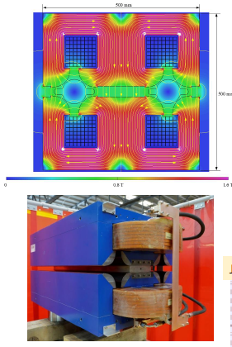
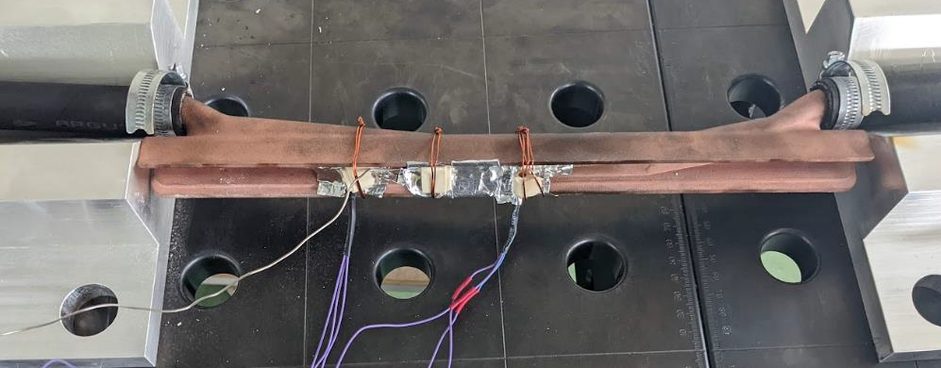
FCC-ee key technologies
Impressive R&D and prototyping effort since 2020
Twin quadrupoles
Polarimeters
SR absorbers 3D printed
Notes:
A lot of R&D: beam dynamics. and prototyping since 2020 and more will come

Slide 15
FCC-hh
Notes:
Similar for th FCC-hh, energy range between 80-120 TeV depending on the magnet technology.

Slide 16
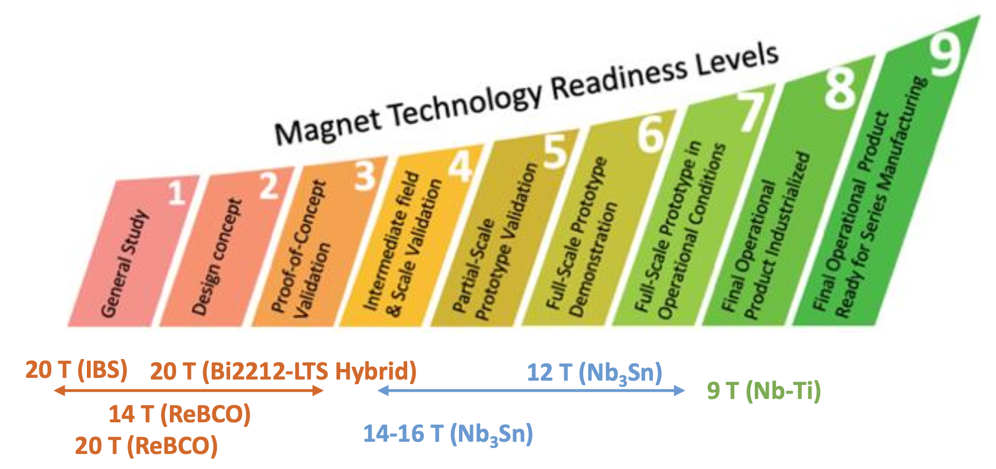
FCC-hh key technologies
Notes:
Since 2020 there has been a more reduced effort on the optics design the main effort has been the HFM

Slide 17
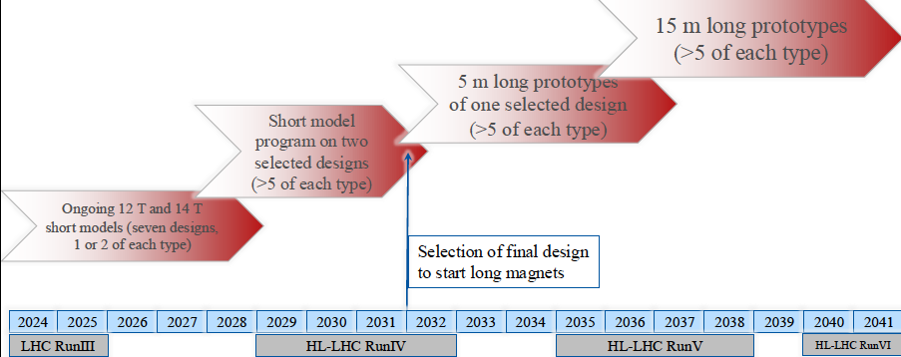
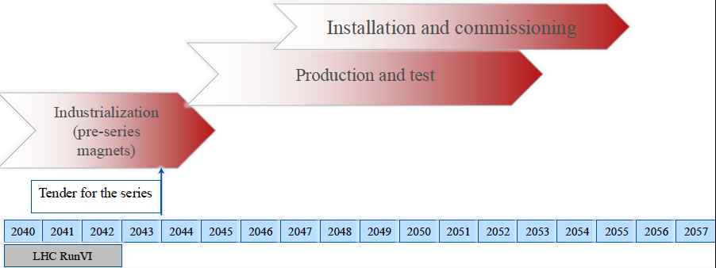
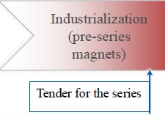
Notes:
The HFM program has been revised in June 2024 with a new target of 14 TeVs based on Nb3Tn. Starting with a short model 1.9K and extendable to 4,2 K. For scaling after at 15m.
HTS with a target of 15-20 Tesla range will be use in simple and short magnets as the correctors. Concerning the energy reach with 14 Tesla the target is now 85 TeV.

Slide 18
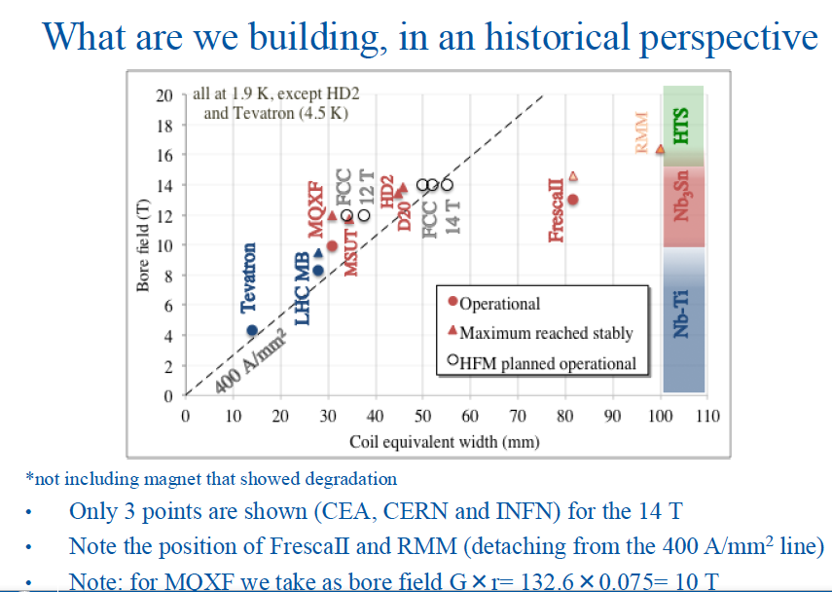
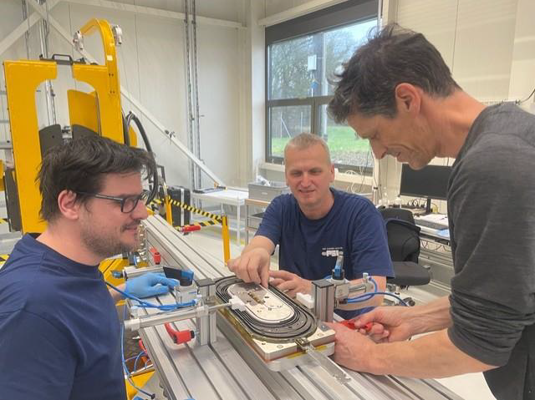
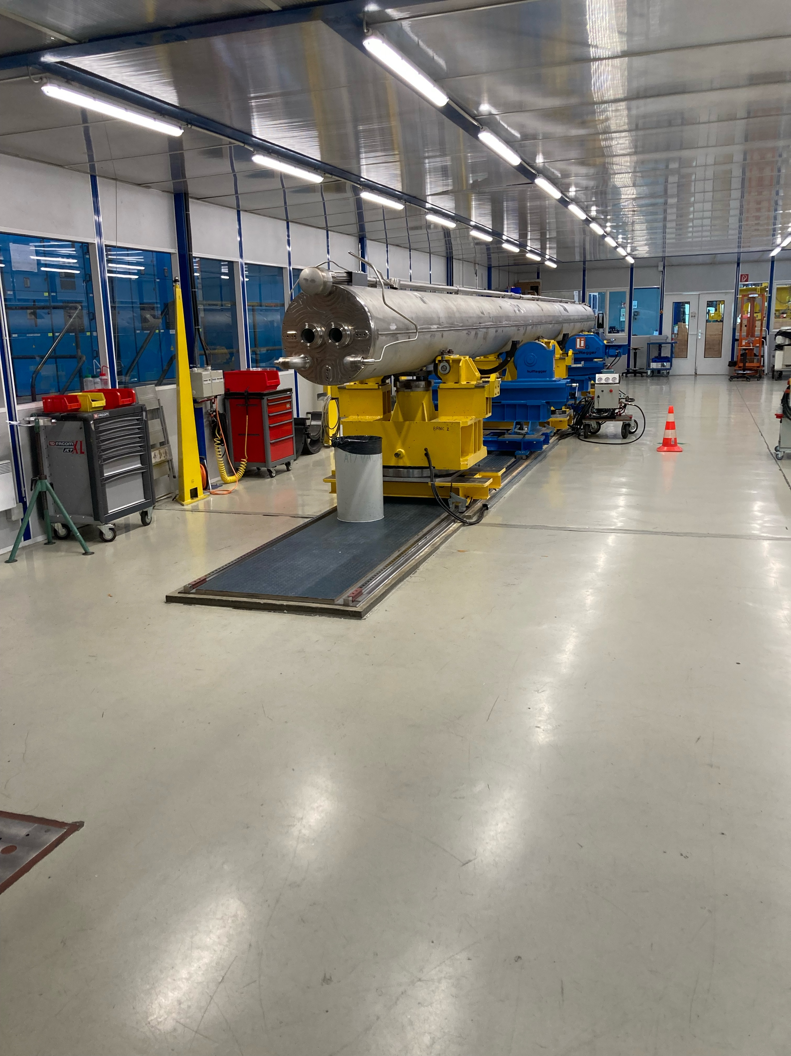
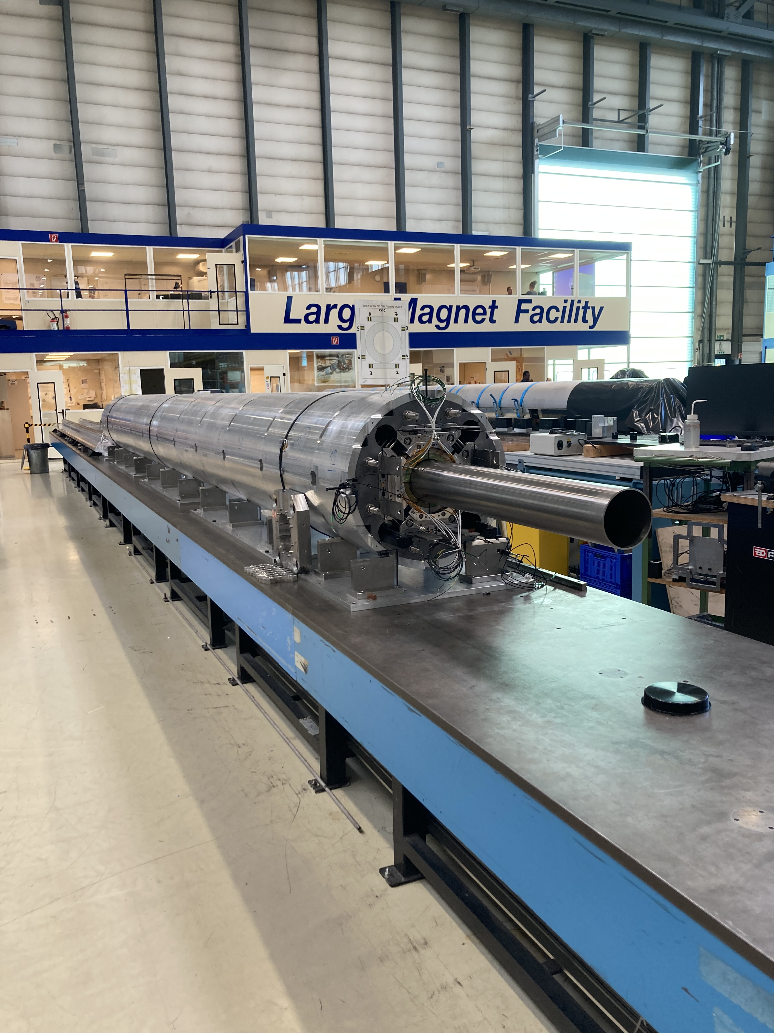
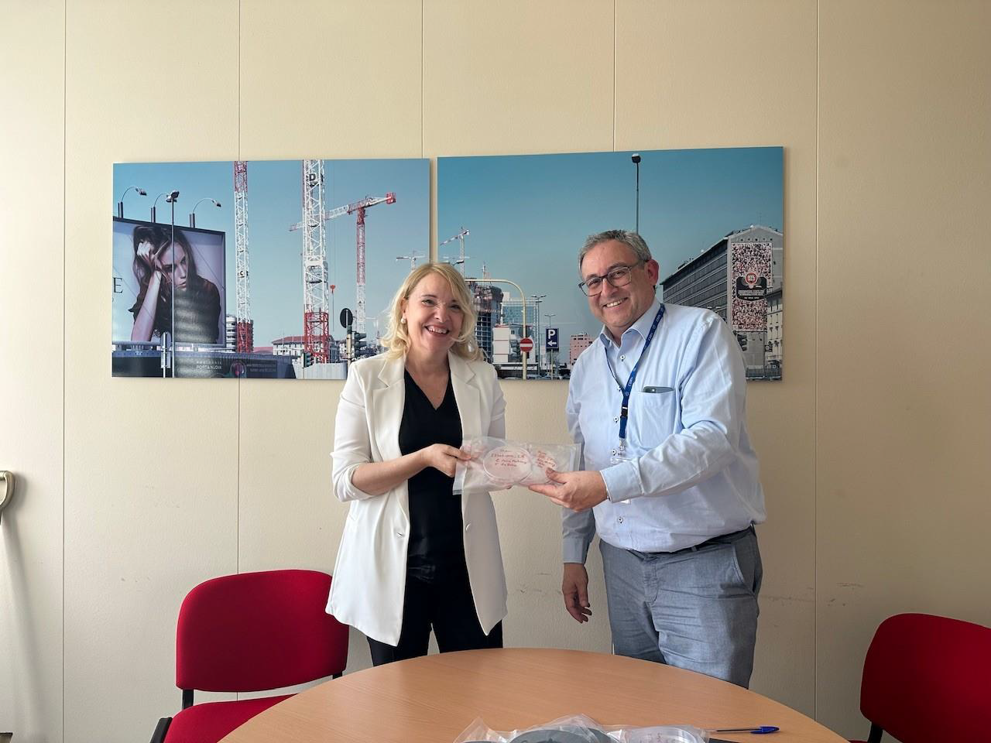
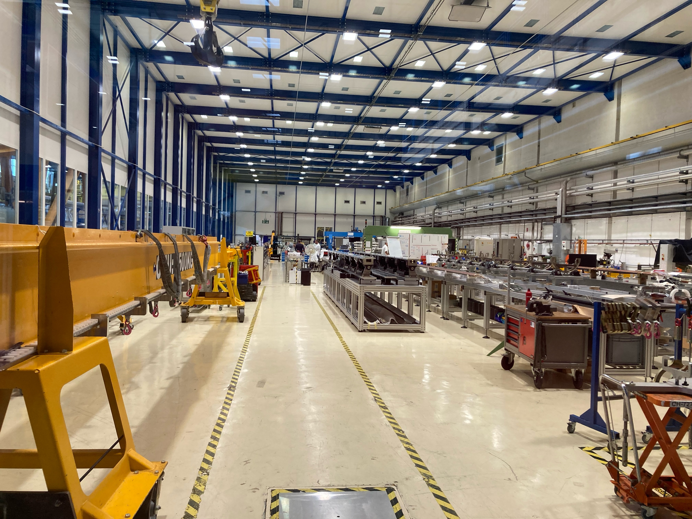
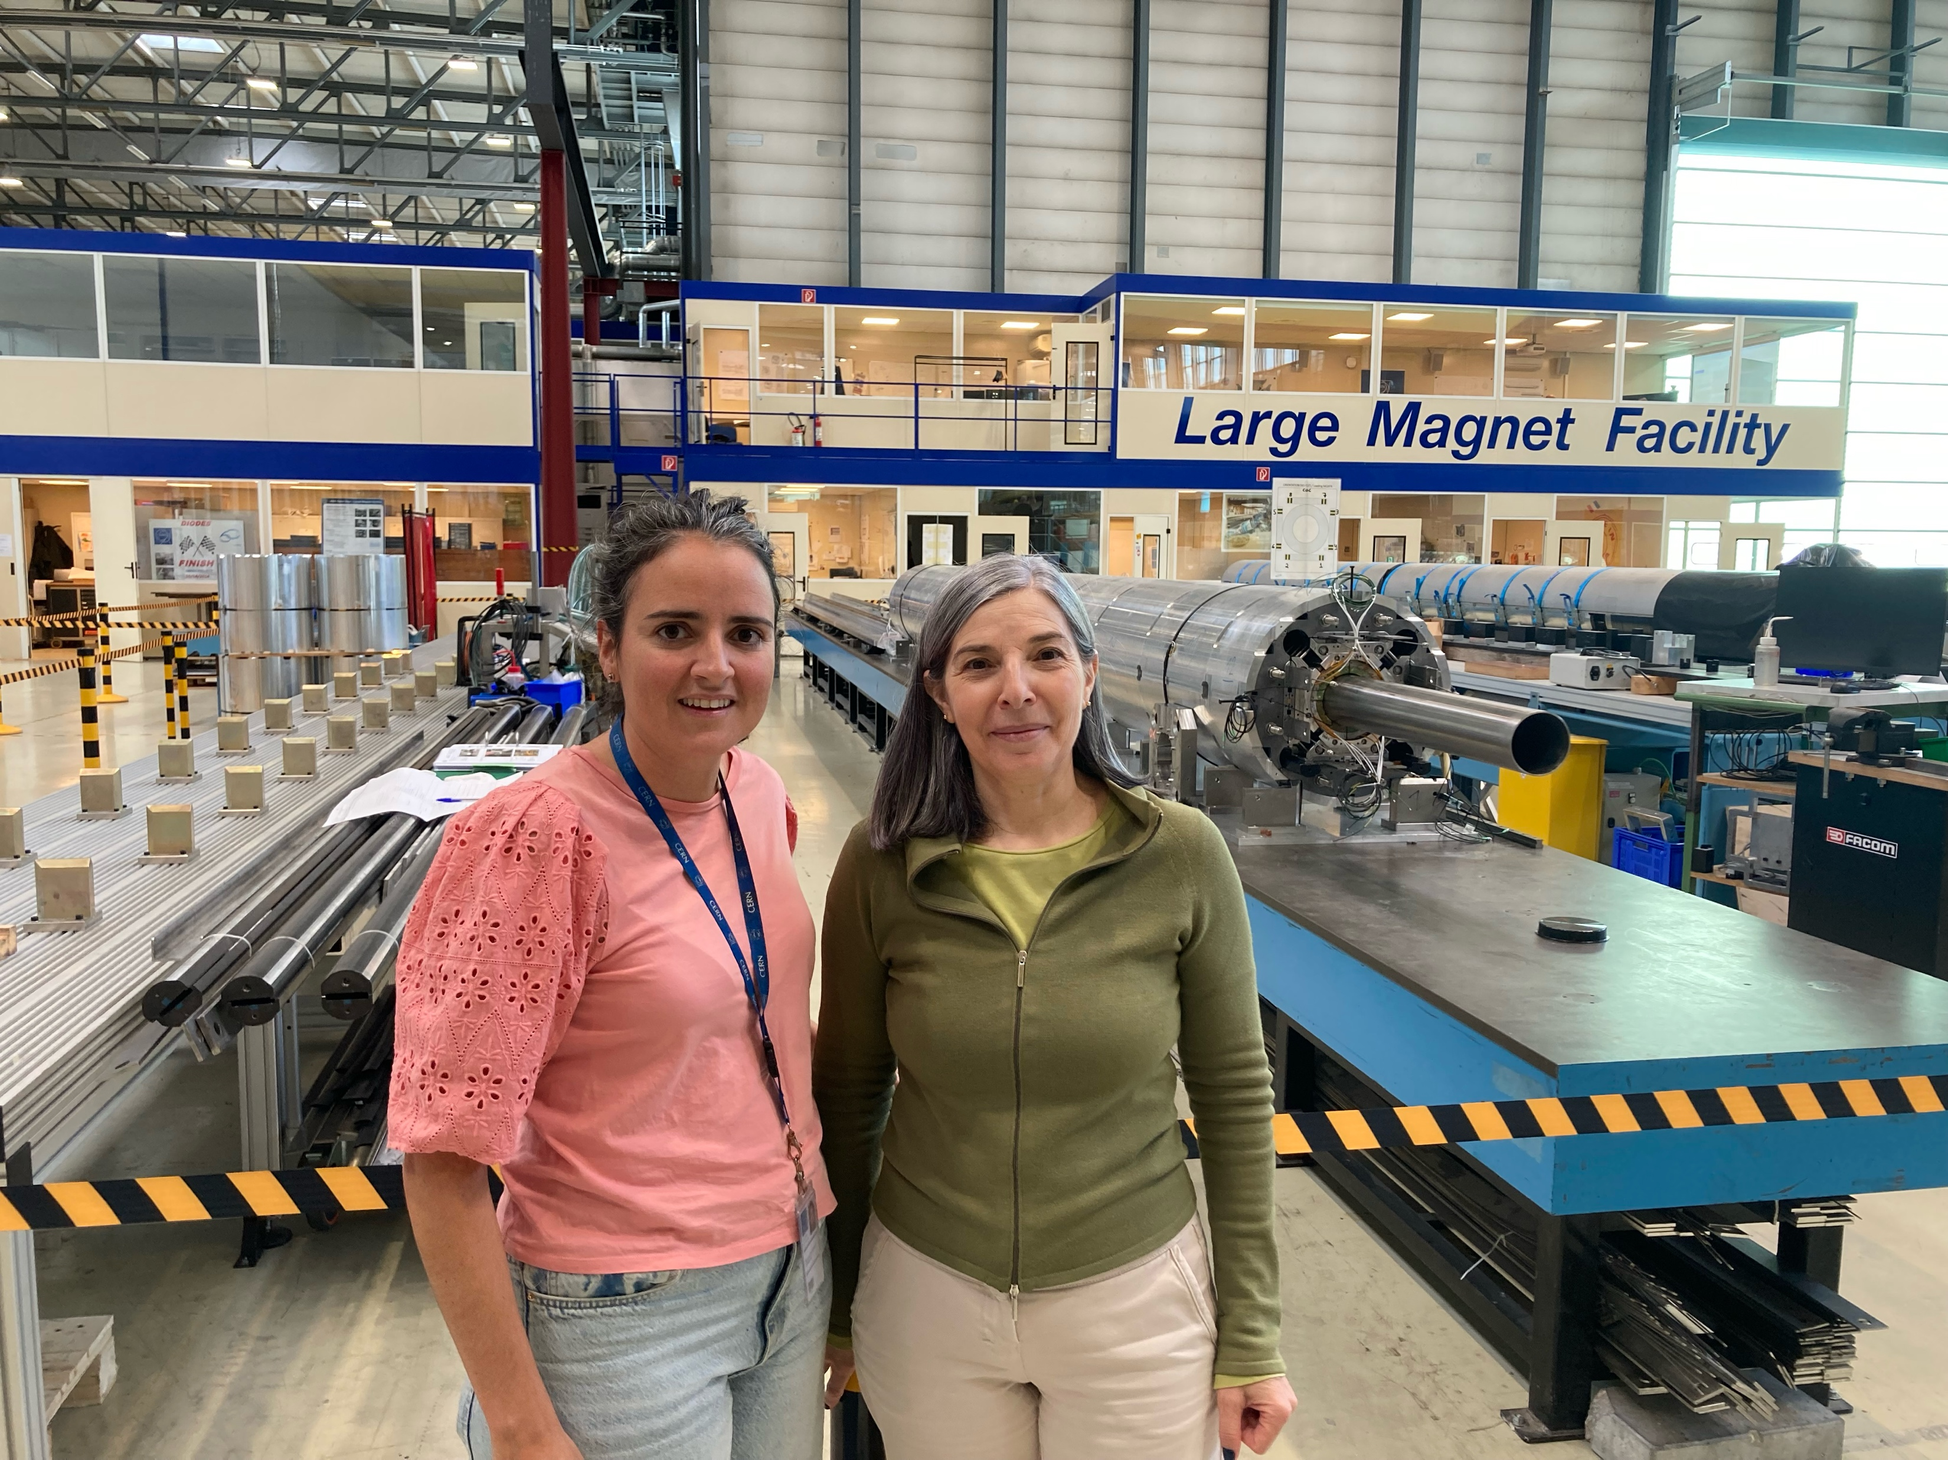
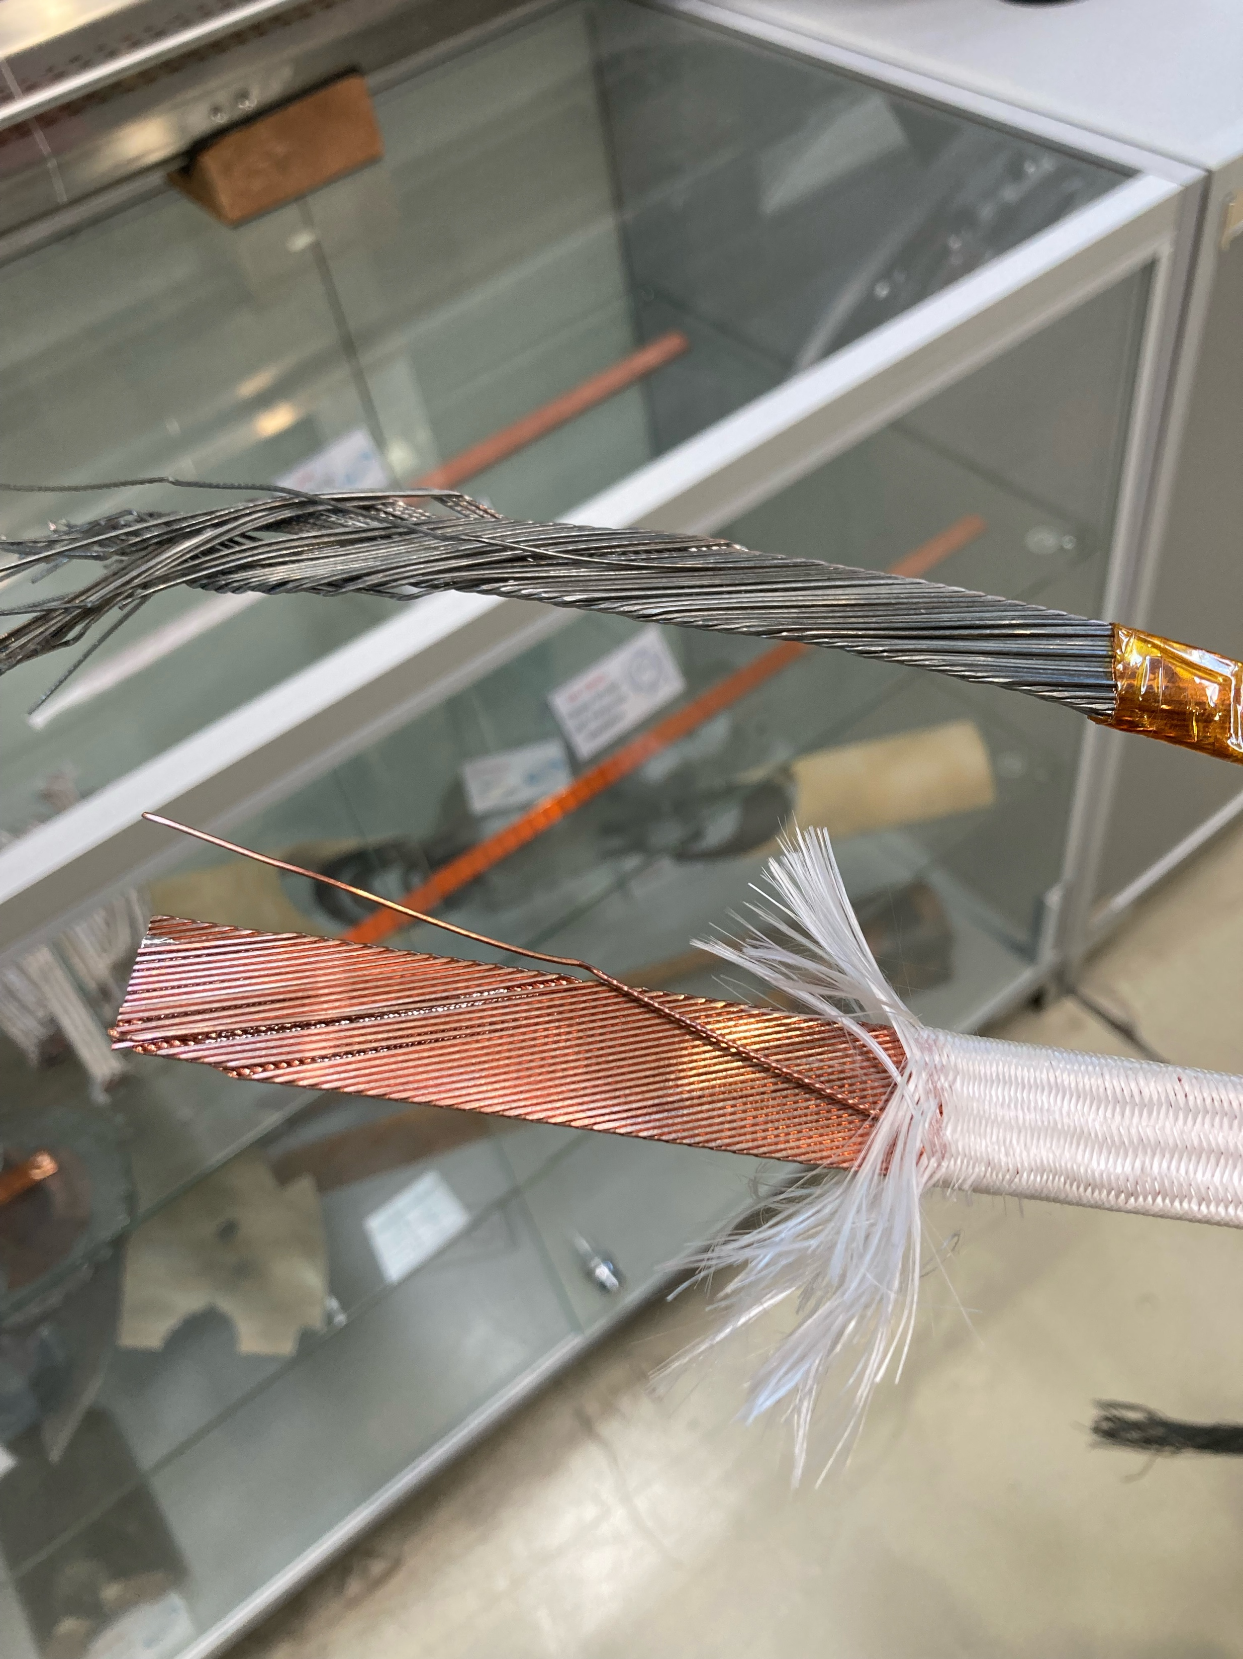
Some HFM updated news
Nb3Sn magnets
First R2D2 coil in CEA (E. Rochepault, et al.)
Manufacturing of SSSMCC in PSI (D. Araujo, B Auchmann, et al.)
Large Magnet facility at CERN (S. Izquierdo , et al)
Delivery of first REBCO tape made in KIT to CERN
HTS magnets
Notes:
If we put the magnets in a historical perspective, for accelerators we have to follow the line of 400 A/mm² (compact and high-current)
Some news in the prototypes side:
For the Nb3Sn: R2D2 at CEA or the SSSMC in PSI and others prototypes at the Large Magnet Facility at CERN
For the HTS; the REBCO cable for KIT arrived at CERN

Slide 19
FCC-hh new scenarios
Notes:
All of this motivates that FCC-hh new scenarios have been started to be studied. A working group has been settled, first meeting 3 September. The idea in principle, is not to have an alternative plan A but a plan B. But the risk is high in this sense.
Based in the new target of the HFM program, 6 scenarios have been proposed and a working group has been created to discuss the possible Physics cases.
Luminosity is limited by the maximum power to be removed from the cold magnets.

Slide 20
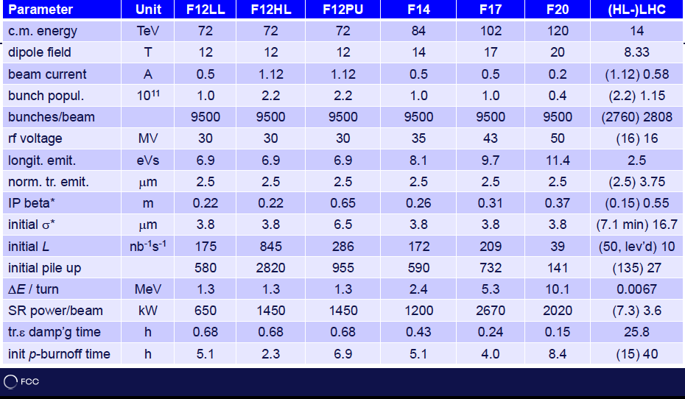
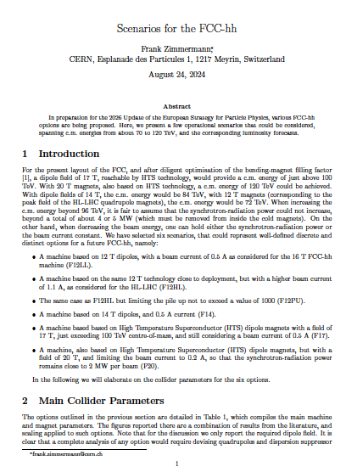
FCC-hh new scenarios
Notes:
All details are summarized in a document.

Slide 21
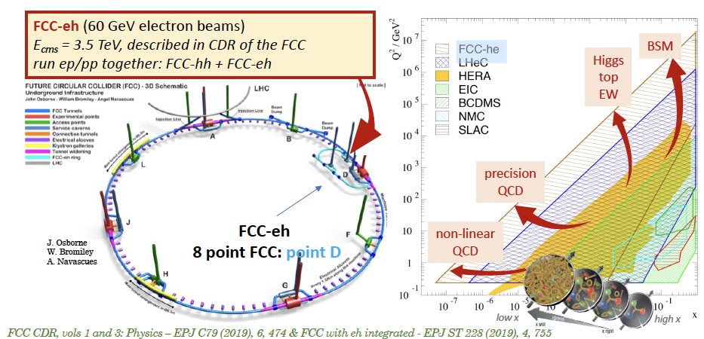
FCC-eh
Notes:
Changing of collider option the other candidate for the QCD studies is the FCC-eh where the protons are collideing with a 60 GeV electron beam provided by an ERL

Slide 22
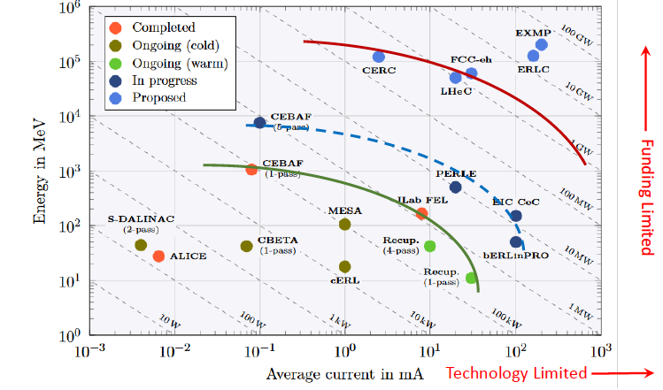
FCC-eh & ERL technologies
ERLs landscape
Notes:
The demonstration of the high-power, multiturn ERL technology will be crucial. A possible path trough the FCC-eh is showed in the slide including LHeC option.

Slide 23
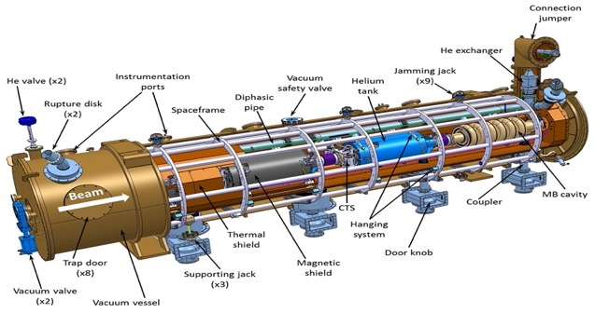
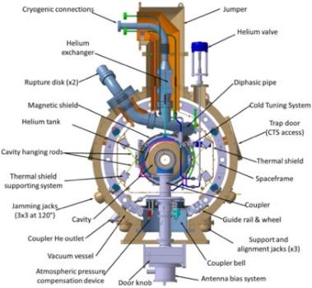
ERLs R&D facilities
iSAS - Innovate for Sustainable Accelerating Systems
QCD & heavy ion EPPSU 2025
Notes:
R&D is being pursued in two facilities: PERLE at Orsay and BerlinPro complemented with the cryogenic development in the ISAS EU project.

Slide 24
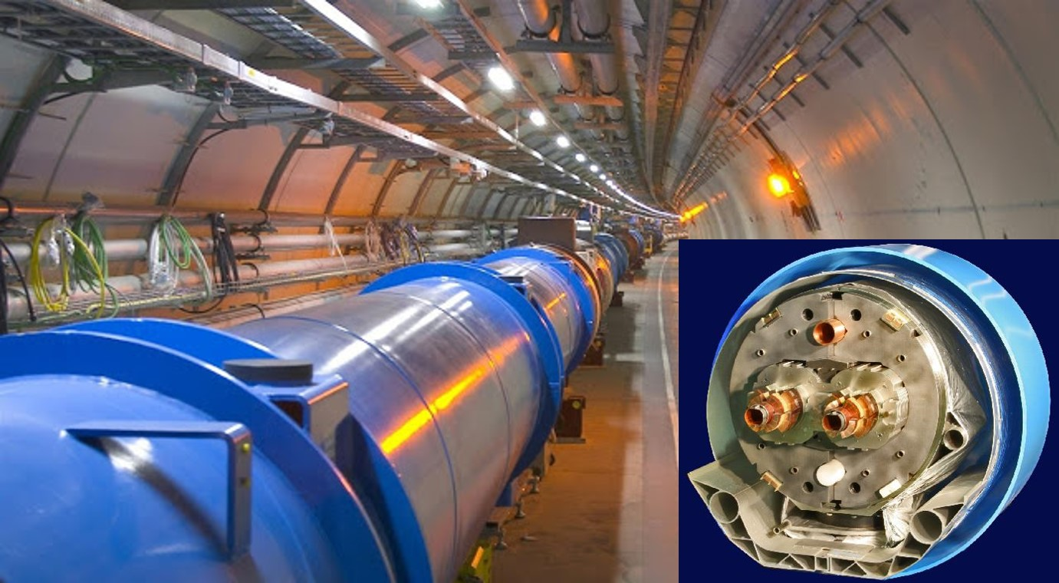
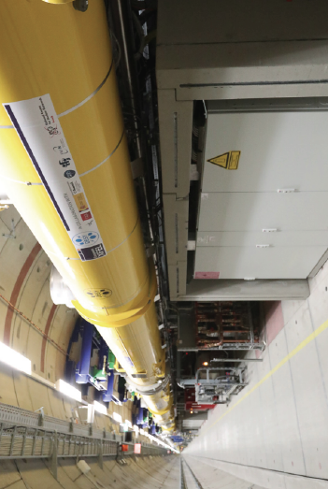
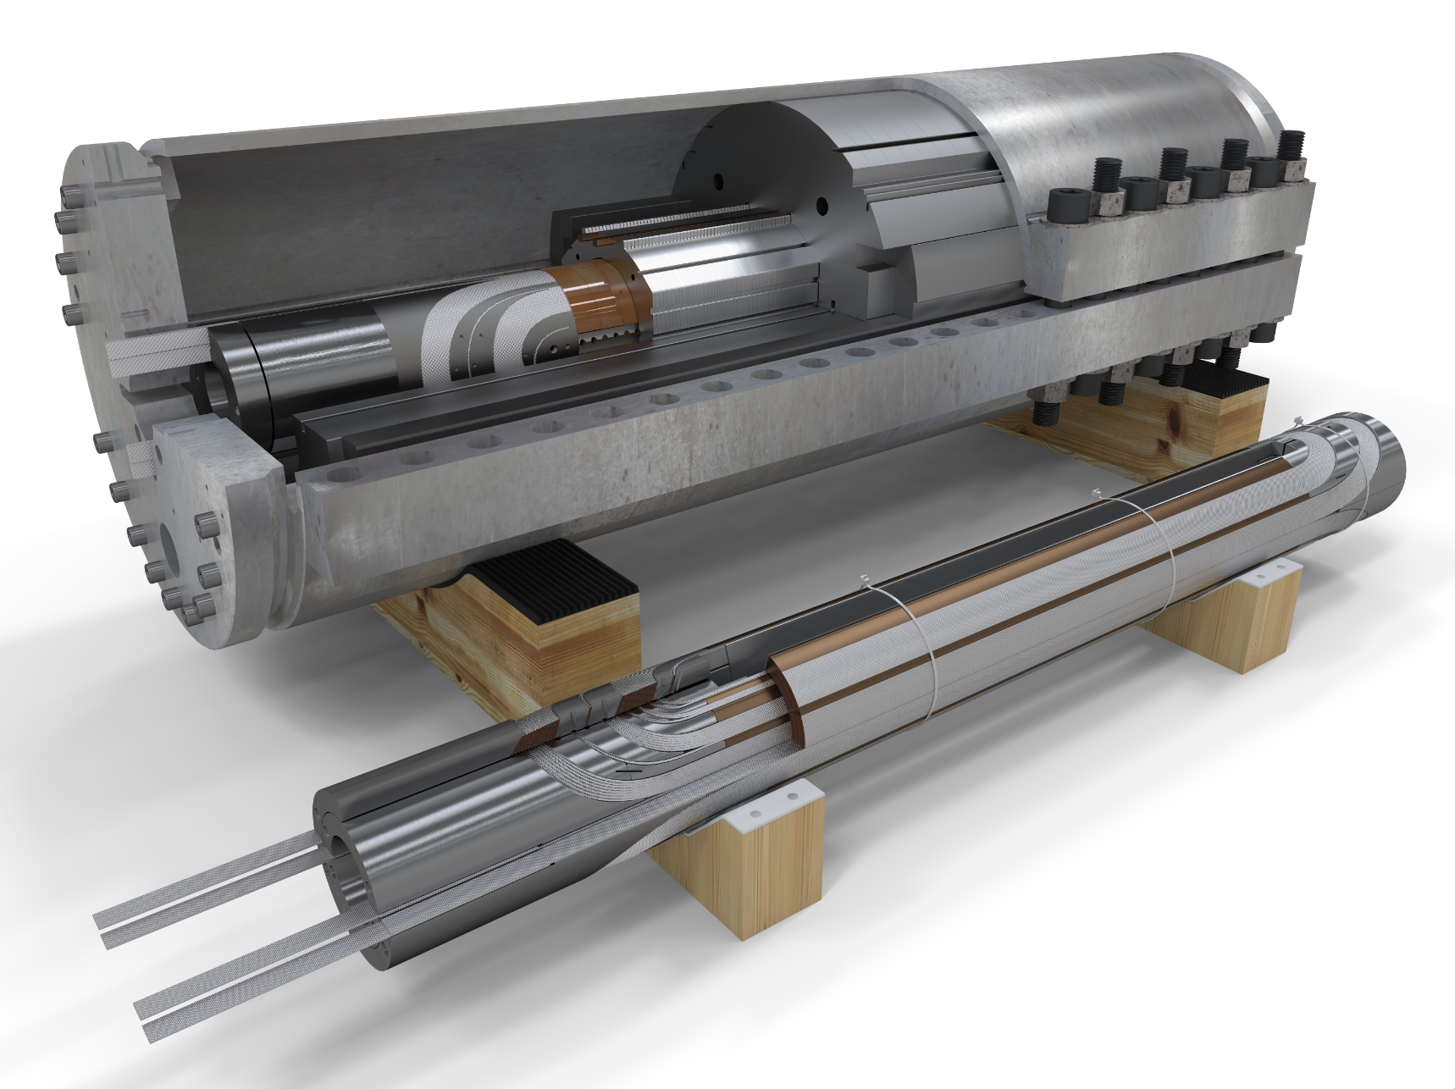
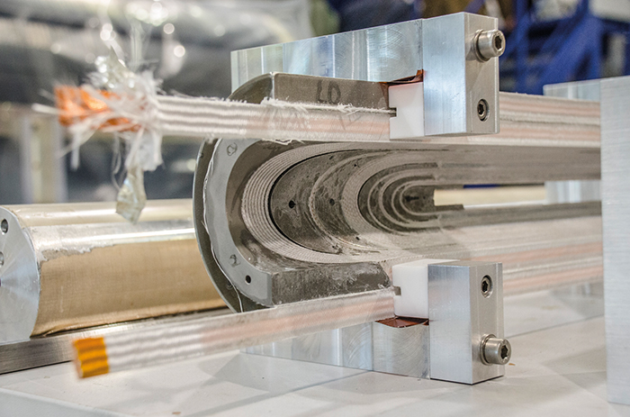
Present and Future Large Accelerator projects
An uncompleted view ...
International Large Scale Projects
EPPSU
EPPSU
2020 | 2025 | 2030 | 2035 | 2040 | 2045 | 2050 | 2055 | 2060 | 2065 | 2070 | 2075
ESS
EIC
CepC
ILC
1.3GHz SC
SppC
FCChh
14T Nb₃Tn
FAIR
FCCee
LBNF
HL-LHC
12T Nb₃Tn
CLIC
12 GHz NCRF
HL-LHC
12T Nb₃Tn
EIC
FCCeh
ERL
C3
Cool Copper
μ⁺μ⁻
In operation
Start operation
In construction
Under study (start operation)
(technology ready)
LHC
ATF2
Super KEKB
RHIC (2025)
Notes:
Currently there is a certain number of large accelerators in operation, in construction and under study for HEP or other Physic domains.

Slide 25
Present and Future Large Accelerator projects
An uncompleted view ...
A complex choice
International Large Scale Projects
EPPSU
EPPSU
2020 | 2025 | 2030 | 2035 | 2040 | 2045 | 2050 | 2055 | 2060 | 2065 | 2070 | 2075
“Tell us what you want, and we will build it”
But tell us NOW. It will take time.
Quads for LHC upgrade took 2 – 3 decades.
Accelerator Frontiers Snowmass’21
Notes:
Currently there is a certain number of large accelerators in operation, in construction and under study for HEP or other Physic domains. The choice for a FC is rather complex, and not only drove by Physics...

Slide 26
Thanks for your attention
Special thanks to
FranK Zimmermann, Susana Izquierdo-Bermudez, Walid Kaabi, Shin Michuzono, Steinar Stapnes, Benno List, Tatsuya Nakada, Akira Yamamoto

Slide 27
EPPSU 2025

Slide 28
Some collider costs.....
ILC 250 ~ 5 BILCU in 2012 (escalation is around 30 %, SRF and CFS to be about 2/3 of the total cost, updated cost, reviewed by an external committee, will be available beginning of the next year.

