Slide 1

The MARCO Magnet
Valerio Calvelli
On Behalf of EIC Detector Magnet team
EIC France 2024
IJC Lab Orsay, Oct 9-11, 2024

Slide 2
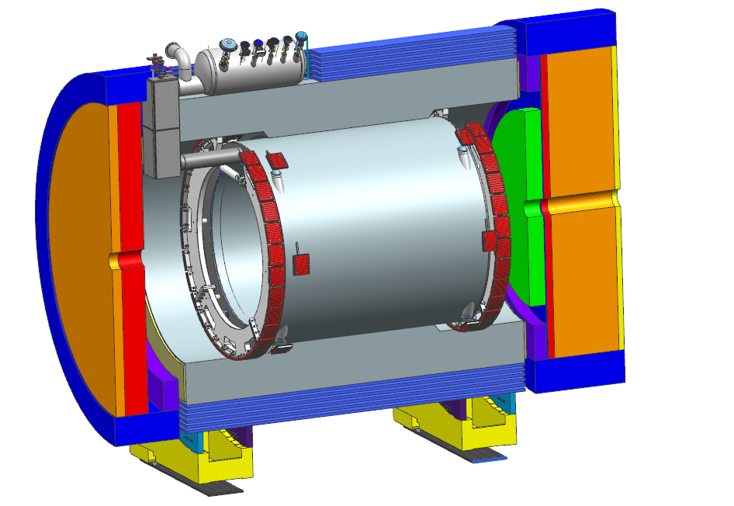
The MARCO Magnet
Parameter | Value
Coil length | 3.51 m
Warm bore diameter | 2.84 m
Cryostat length | 3.84 m
Cryostat outer diameter | 3.54 m
Current | 3924 A
Central Field B₀ | 2.0 T
Energy | 45.7 MJ
Field Uniformity | 12.5 % ± 100 cm around center 80 cm radius
Projectivity in RICH Area | < 0.1 (mrad@30GeV/c) < 10 T/A/mm² From Z = 180 cm to 280 cm
Thickness/Nuclear interaction length | 0.468
Detailed Design Phase Concluded
Final TDR Review in Oct 5/6, 2023 :
No remarks on the technical design.
DOE Review Nov 17, 2023 (CD3A) :
Project approved

Slide 3
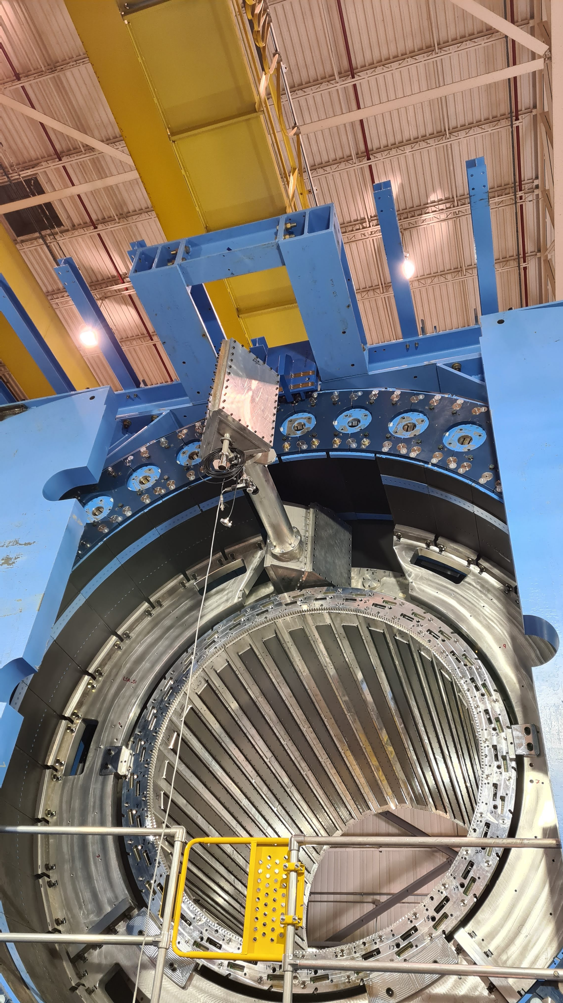

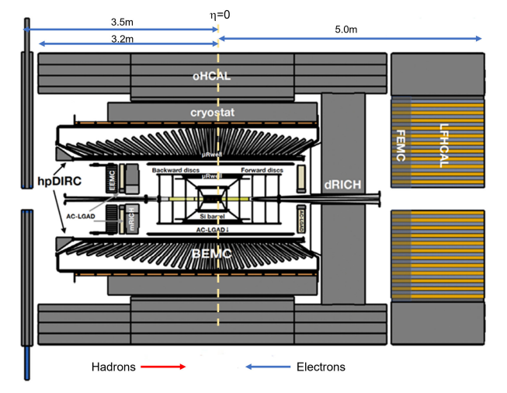
Why MARCO?
ECCE
Reuse of BaBar @ 1.5 T in the ECCE yoke
25y operative life + 30y of operation forecast
Sensors problems
New solenoidal magnet @ 1.5 T for replacement as contingency plan – DOE Request
ePIC
MAgnet with Renewed COils
ePIC → Same Barrel Calorimeter structure as sPHENIX
New solenoidal magnet @ 1.5 T (minimum), possibly 2.0 T
Same dimensions as BaBar
August 2022, from 1.5 T to 2.0 T

Slide 4
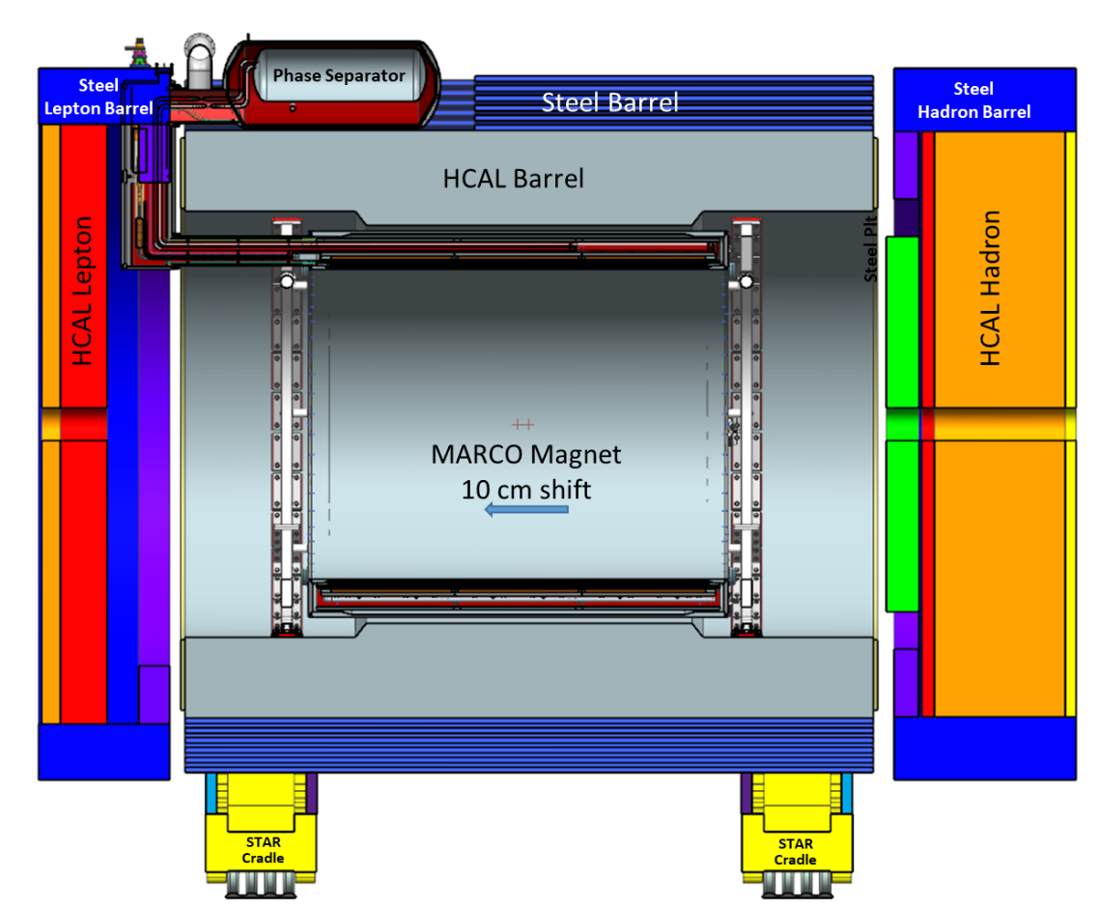
What is different?
ePIC
Ferromagnetic Yoke in ePIC is different respect to ECCE
Magnet is shifted of 10 cm respect to the IP
BaBar in ePIC with
I = 5 kA (existing lines)
T_{margin} = 2.7 K (@4.5K)
provides only 1.15 T at IP
Goal is 2 T, possibly using existing lines and with
T_{margin} = 2.5 K (@Tmax in the coil)

Slide 5
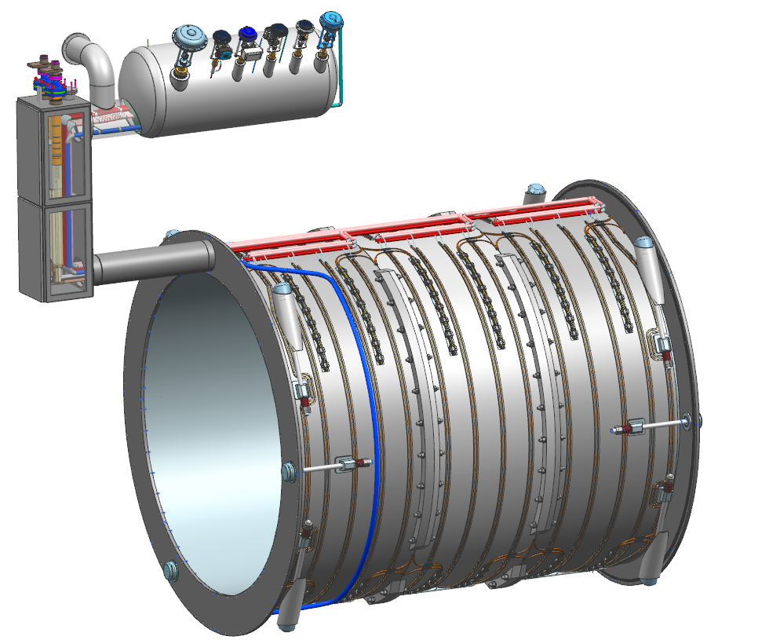
MARCO at a glance
Phase Separator
Mandrel
(3 Modules)
Vapor Cooled Lead
Primary/Spare Thermosiphon
Conductor Splices
Chimney
Radial Tie-Rods
(4 each end)
Outer Vacuum Vessel / Thermal Shield removed for clarity
Axial Tie-Rods
(3 each end)

Slide 6
MARCO: a technological revolution
Detector magnets → Aluminum stabilizer conductors because Aluminum is 3x more transparent to the passage of particles
No existing extrusion line in the world
2022: this technology is not available anymore
2024: CERN and ENEA work together to rediscover this technology again → no industrial partner
CHINA works on it too
Conclusions from Workshop on Superconducting Detector Magnets @ CERN, 12/14 Sept 2022

Slide 7
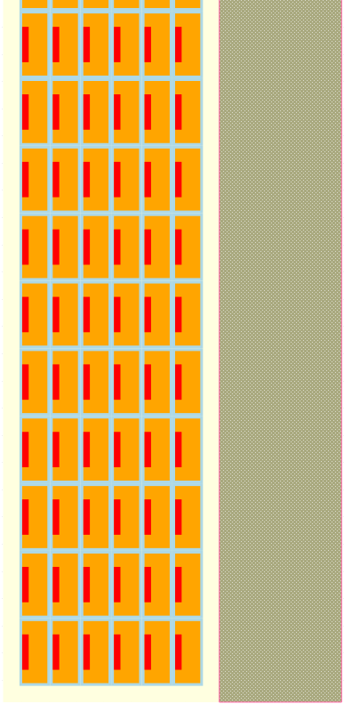
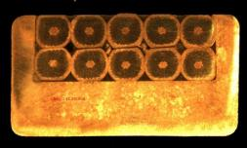
MARCO: a technological revolution
33.6 mm
30 mm
Material | Transparency
 | BaBAR 1.15 T* (Al conductor) | Marco 2T (Cu conductor)
Al | 0.382 | 0.113
Cu | 0.011 | 0.166
SS/Brass | 0.000 | 0.181
NbTi | 0.007 | 0.008
G10 | NA | 0.028
Total | 0.400 | 0.468
 | Copper
 | NbTi/Cu
 | Brass
 | G10
 | Fiber-glass
It is possible to use copper stabilizer conductors for detectors magnets
3492 mm
6 layers
1668 turns
External mandrel
*in ePIC yoke. In sPHENIX, B = 1.4 T
RIC: Rutherford cable In Copper Channel
1506.5 mm
RIC conductor for the Iseult 11.7T MRI
  Design developed by CEA/Alstom
  Cable production by Luvata
  The insertion line still exists!
Internal winding method
On-going contract with Luvata

Slide 8
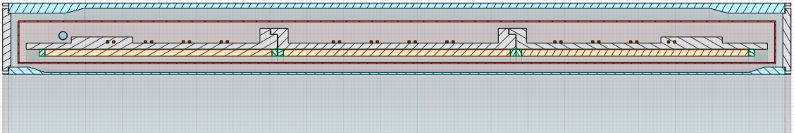
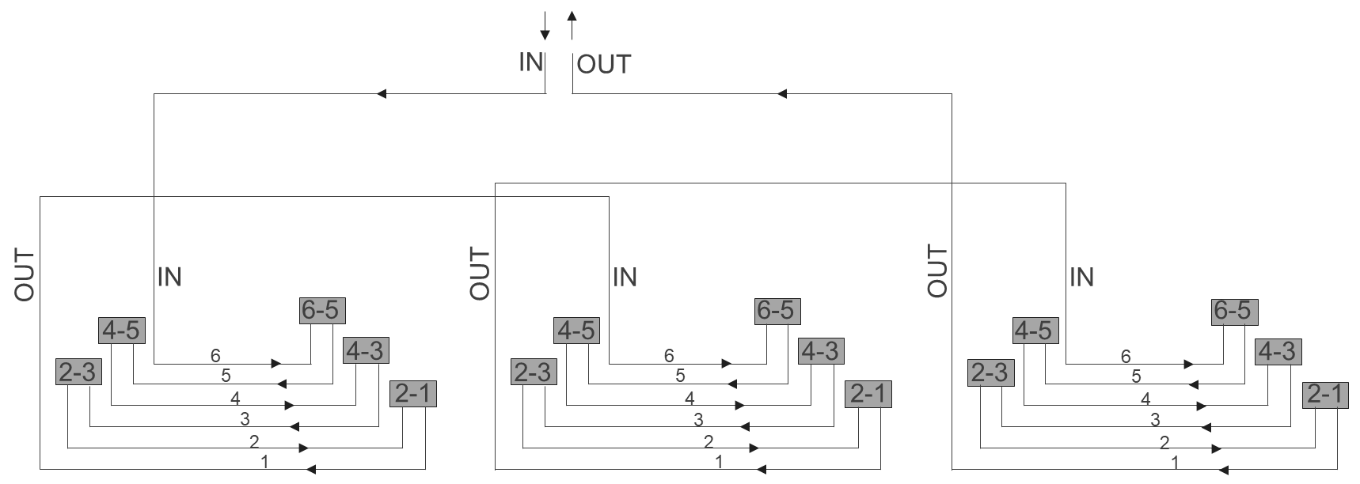
MARCO: Cold Mass Design
cryostat
3850
1668 turns
93 turns per layer
6 layers
3 modules
350
Lepton
Hadron
MOD 3
MOD 2
MOD 1
z
IP
100
offset

Slide 9
MARCO: Conductor Design
 | Parameters | Values | Units
Strand | Strand diameter | 0.7 | mm
 | Cu/NbTi | 1.3
 | Ic @ 2.7T & 4.7K | > 680 | A
 | Filament diameter | < 30 | µm
 | RRR Cu | > 80
Cable | NbTi strands | 20
 | Transposition pitch | 50 | mm
Channel | RRR Cu | > 100
 | Copper section (Final) | 43.7 | mm²
Conductor | Nominal current | 3924 | A
 | RRR conductor | > 100
 | Temp. margin @ 2.6T & 4.7K | 2.5 | K
 | LL Margin @ 2.6T & 4.7K | 46.8 | %
 | σ_{0.2%} @ 293K | > 165 | MPa
 | Unit length | 1.05 | km
 | Total length | 18.9 | km
Rutherford cable:
20×Ø=0.7 Nb-Ti strands
Fiber Glass Insulation
Solder
R~0.3
1.26
(2.31)
4.6
6.78
I_{c} degradation: 15%
Copper
11.4
0.26
Dimensions are in mm
Iseult RICC conductor | I_{c} degradation
Cabling process | <5%
Soldering process | <5%
4.9 mm
9.2 mm
Qualification tests on samples are ongoing at Twente University

Slide 10
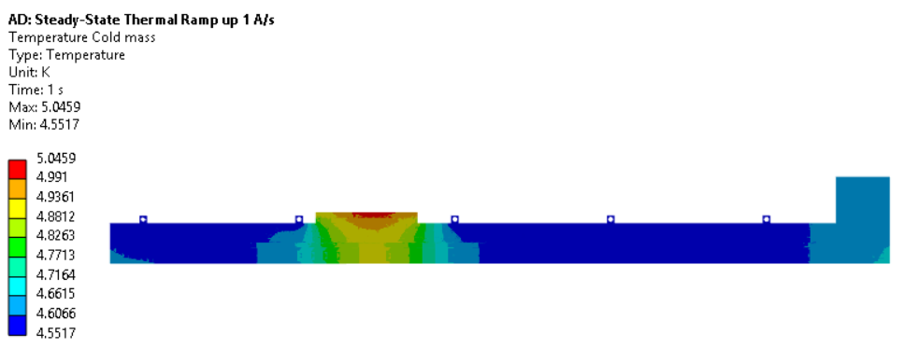
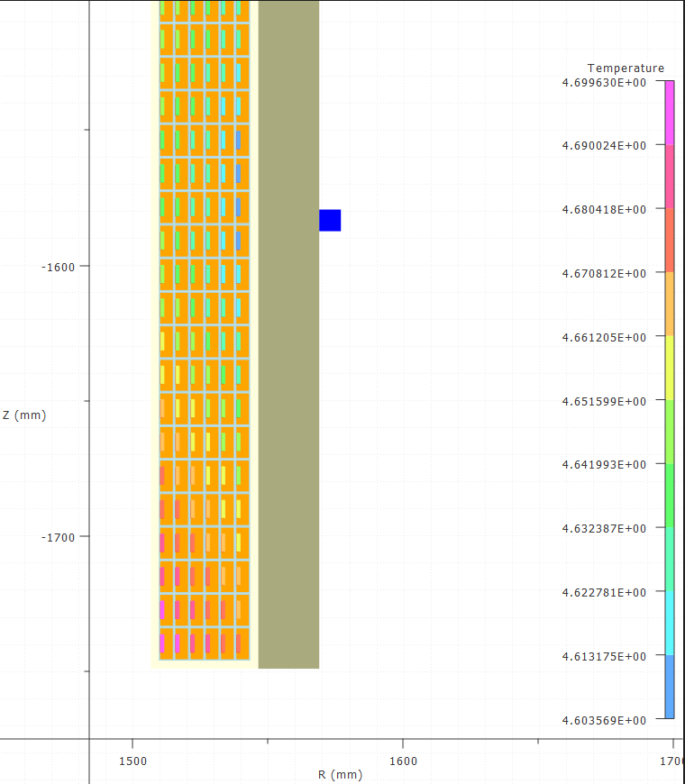
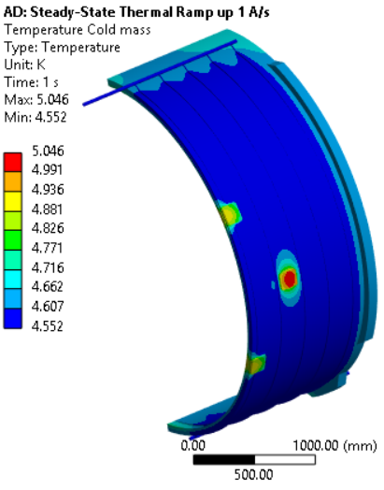
MARCO: Conductor Margins
B₀ | 1.5 T | 1.7 T | 2.0 T | Units
Current | 2900 | 3296 | 3924 | A
B_{peak} | 2.00 | 2.27 | 2.67 | T
Temp. margin | 3.1 | 2.9 | 2.5 | K
Enthalpy margin |  |  | 7.4 | kJ/m³
Load line margin | 60.6 | 55.3 | 46.8 | %
I / Ic(T_{m},B_{peak}) | 17.3 | 21.3 | 28.8 | %
T helium = 4.55 K
T cable @ Bpeak ≤ 4.7 K
ΔT = 0.15 K
B_{peak}

Slide 11
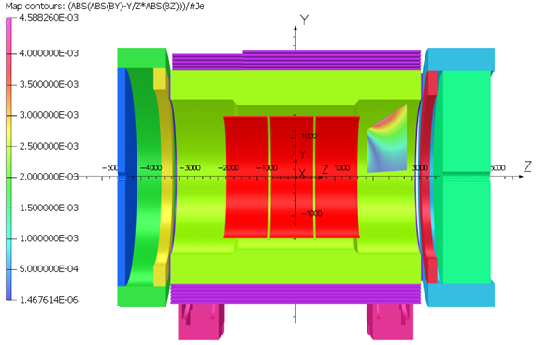
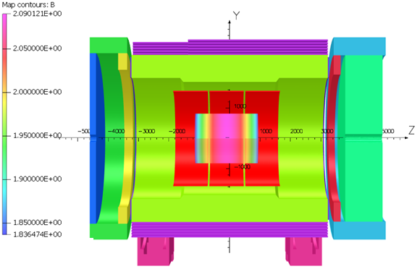
MARCO: Magnetic Performances
Projectivity region
Parameter | 1.5 T | 1.7 T | 2.0 T | Units
Current | 2942 | 3335 | 3924 | A
# turns | 1668
B₀ | 1.505 | 1.706 | 2.000 | T
Bpeak | 2.003 | 2.271 | 2.672 | T
Energy | 25.440 | 32.689 | 45.008 | MJ
Inductance | 5.847 | 5.847 | 5.846 | H
Fz tot | -23.8 | -29.2 | -32.2 | kN
Parameter | 2.0 T | Requirement | Units | Validation
B₀ | 2.000 | 2.0 | T | OK
Field uniformity | 12.5 | 12.5 | % | OK
Projectivity | 3.28 | < 10 | T/A/mm² | OK
Transparency | 0.468 | <0.5 |  | OK
B5300 | 15.4 | <10 | G | Local solution to be studied
B7200 | 10.9 | <10 | G
B3400 | 2.4 | <10 | 2.4 | OK
Uniformity region

Slide 12
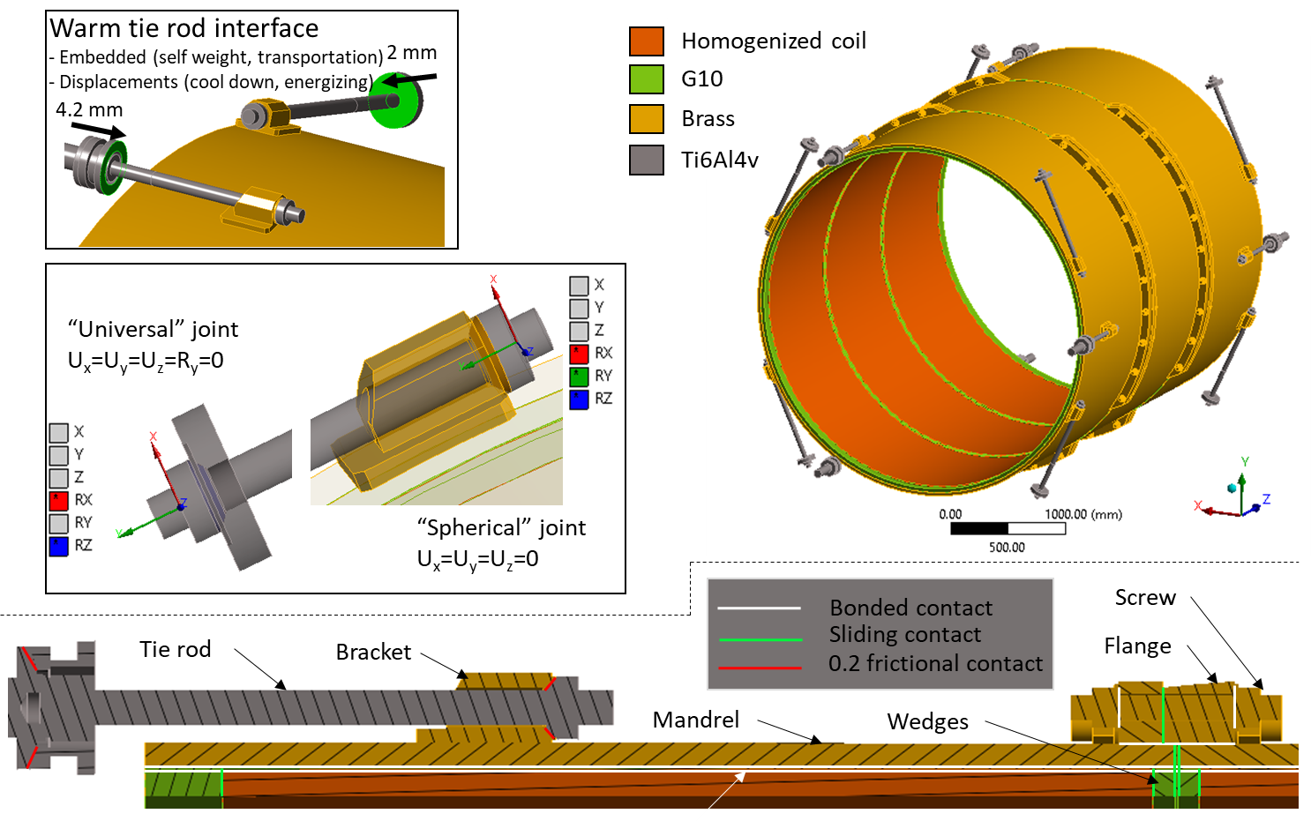
MARCO: Mechanical Design

Slide 13
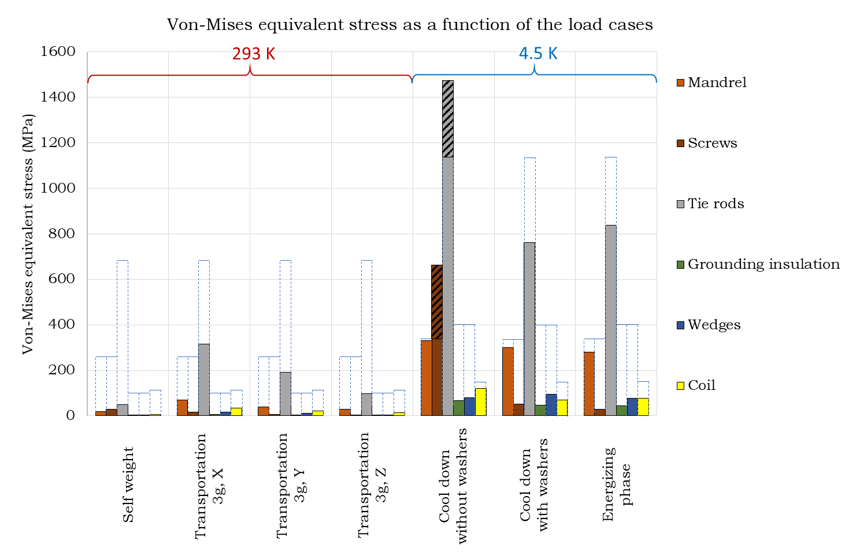
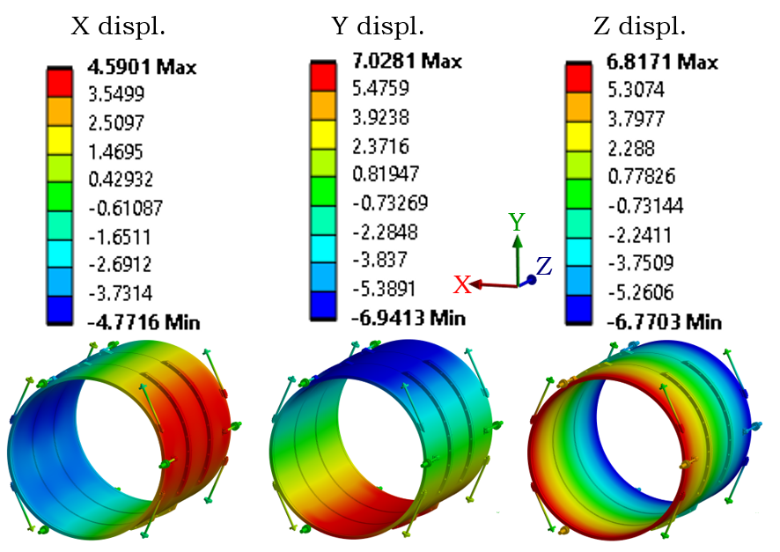
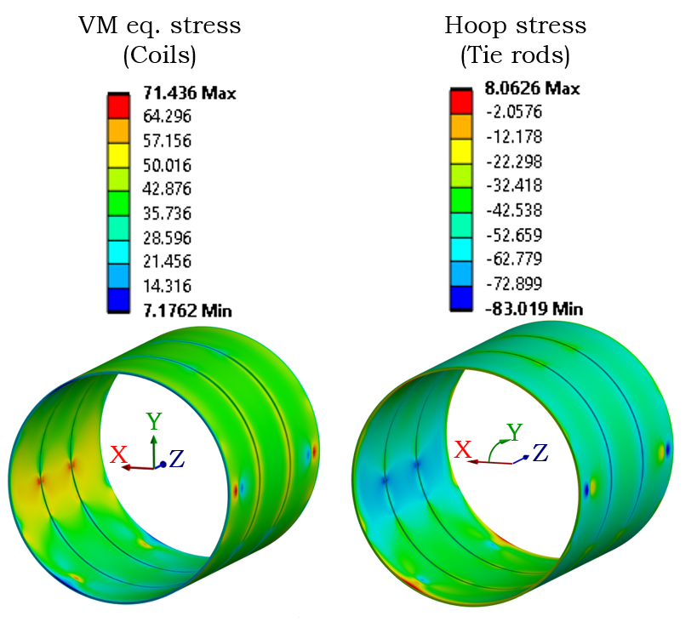
MARCO: Mechanical Performances #1

Slide 14
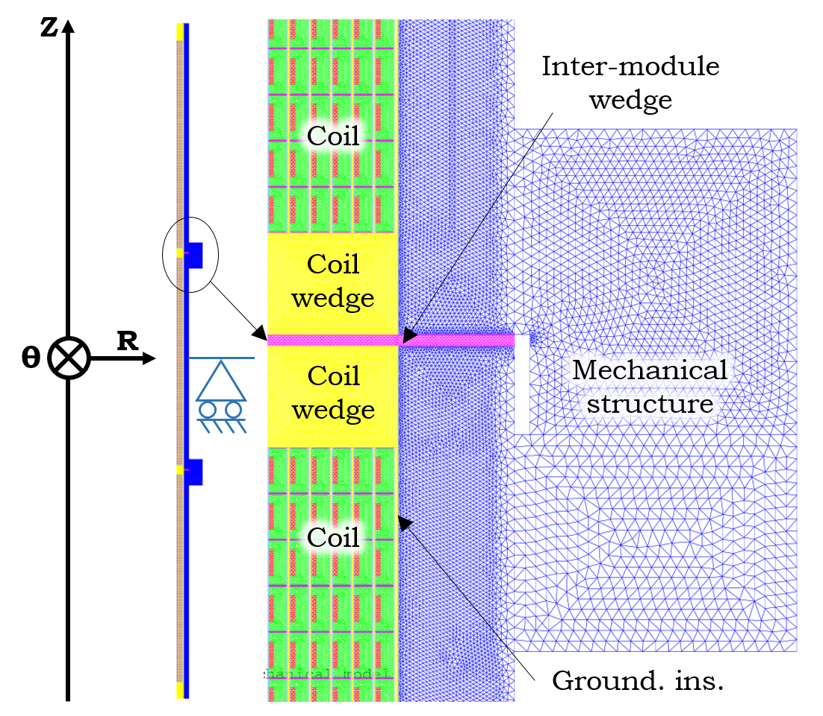
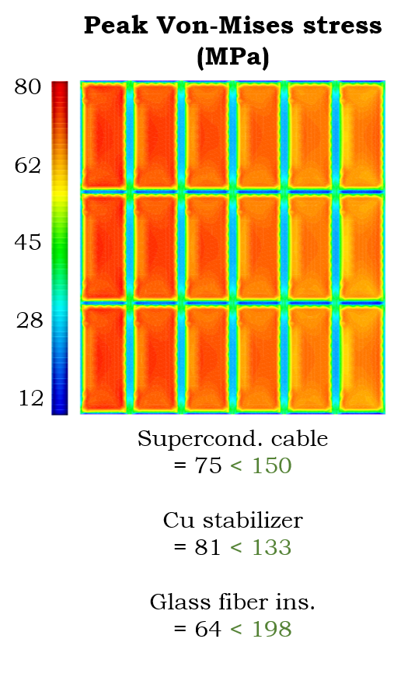
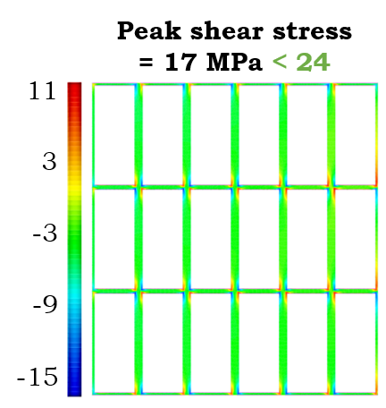
MARCO: Mechanical Performances #2

Slide 15
MARCO: Cryogenics Design
Phase separator
13 W
Cool-down the magnet should take around 10 days
Current leads
12 W – 0.65 g/s
Joints
0.3 W
Tie-rods
4 W
Heat loads:
Thermal shield (45K – 65K) = 600 W
Cold mass = 31.3 W
Safety devices dimensioned according to
NORM EN21013-3 (stricter than ASME BPVC VIII Div.1)
Thermal radiation
21 W
Cable hysteresis
2.8 W@ 1A/s
Mandrel eddy currents
3.2 W@ 1A/s

Slide 16
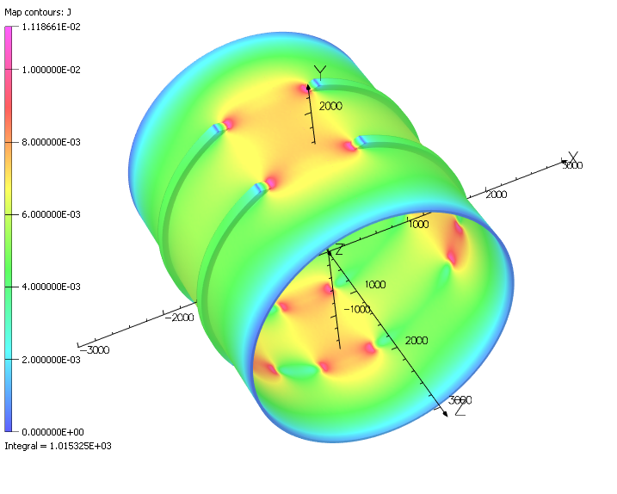
MARCO: The role of the mandrel for safety
Parameter | Value | Units
Current | 3924 | A
B₀ | 2.000 | T
Inductance | 5.846 | H
Ramp | 1 | A/s
Power | 3.642 | W
Eddy current | -1015.32 | A
R mandrel (P/I²) | 3.516 | μΩ
M mandrel | 3.570 | mH
L mandrel | 2.346 | μH
k | 0.964
The strong electromagnetic coupling between the mandrel and the coils will induce a quench-back

Slide 17
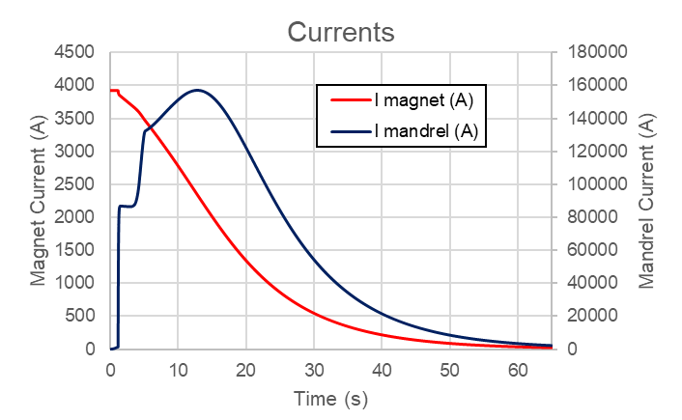



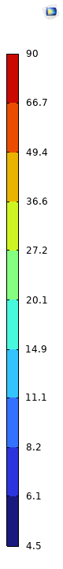
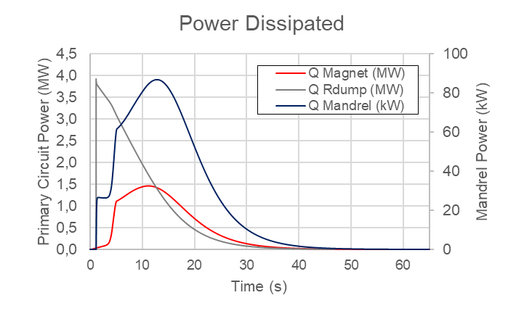
MARCO: Quench
T (K)
MOD1
MOD2
MOD3

Slide 18
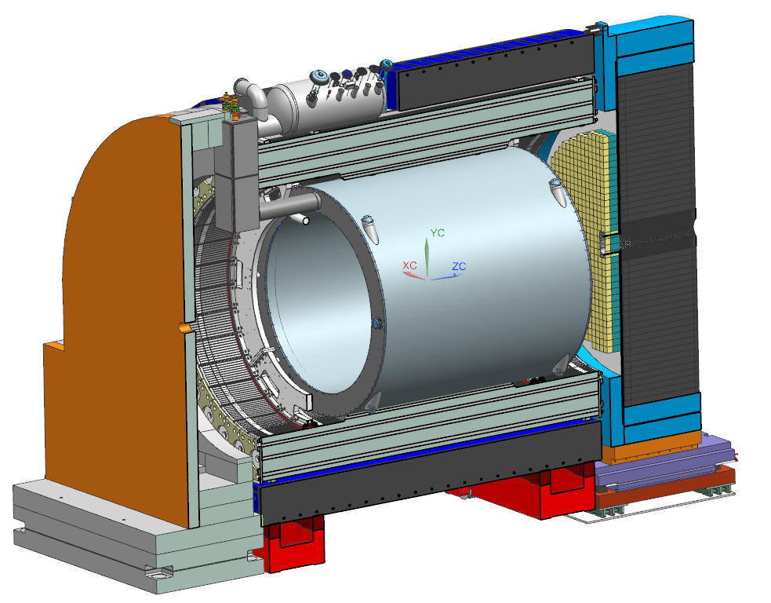
Conclusions
MARCO Detailed Design is achieved:
One in a kind magnet
RIC conductor in copper jacket based on Iseult design
Confortable margins at nominal case
Robust mechanical design
No issue on transparency (even with copper)
Magnet design is full of redundancies to make it work for more than 30 years
MARCO passed the CD3a and it is ready for the procurement phase
Conductor sample in production and test
Technical design report available in the next weeks
(there you will find the instrumentation, fault scenarios, drawings etc etc etc…)

