Slide 1

CNRS/IN2P3/IJCLAB in-kind contribution to EIC accelerator
Supply of the cryomodules for the Rapid Cycling Synchrotron (RCS).
Guillaume OLRY
Acknowledgments to Denis Reynet, Gilles Olivier, Nicolas Gandolfo et Patxi Duthil

Slide 2
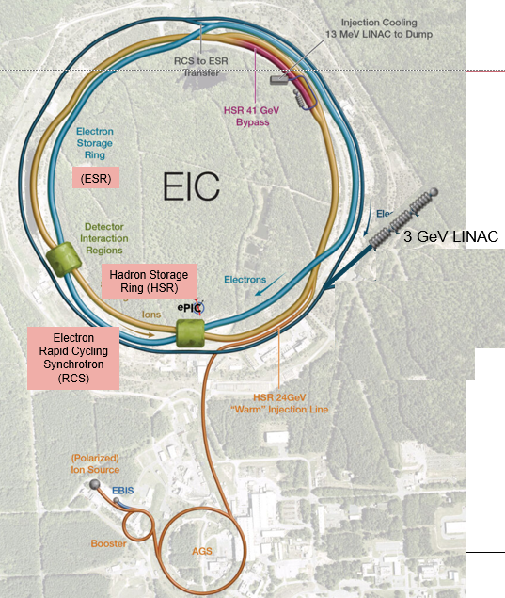


EIC accelerator complex
Slide from S. Nagaitsev – EIC Advisory Board (08/2024)
Accelerator Status in a glance:
Polarized ion/proton source
Ion injection and initial acceleration systems – Linac (200 MeV), Booster (1.5 GeV), AGS (25 GeV)
Hadron Storage Ring (40-275 GeV) – HSR
Electron Pre-Injector (3 GeV) – EPI
Electron Rapid Cycling Synchrotron (3 GeV – top energy) – RCS
Electron Storage Ring (5 GeV – 18 GeV) – ESR
High Luminosity Interaction Region(s) – IR
Strong Hadron Cooler System – SHC
e- pre-injector

Slide 3
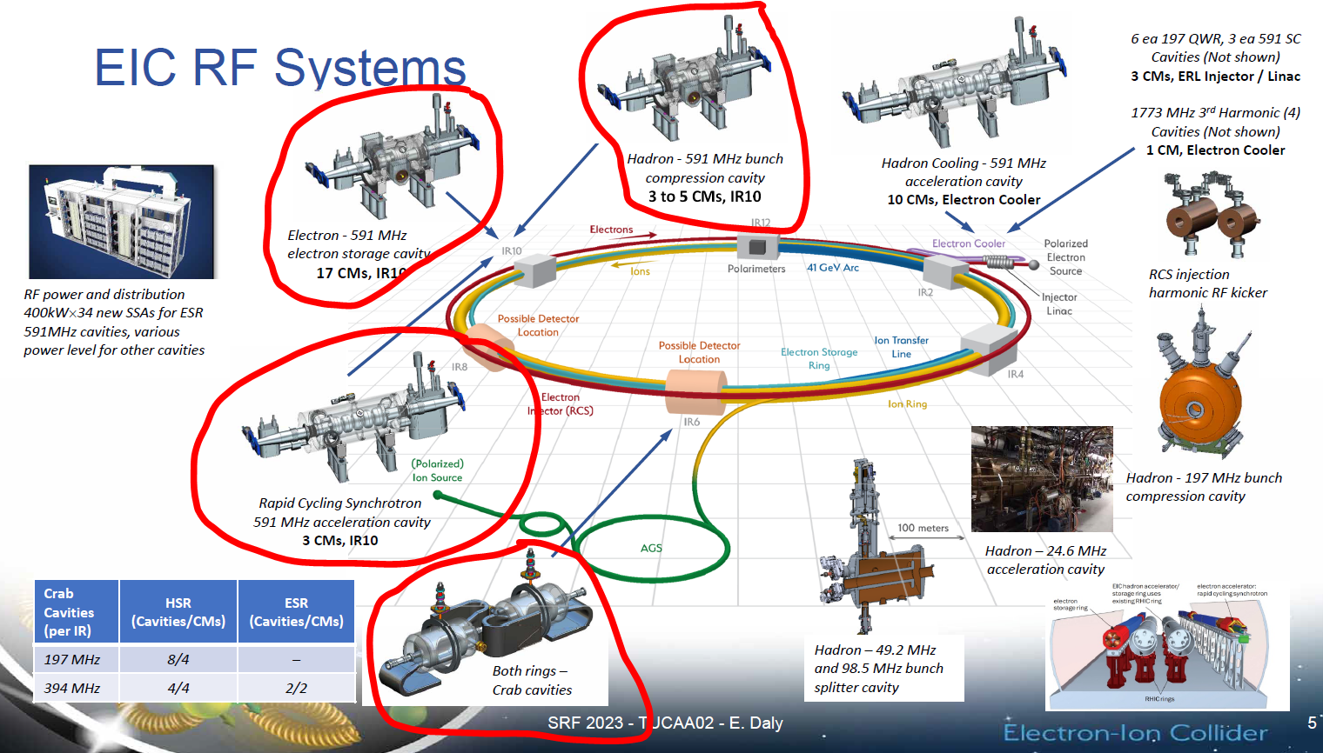
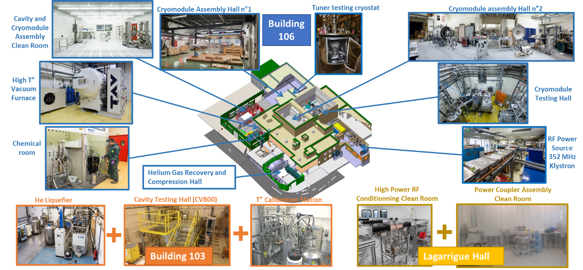
SRF cryomodules for the EIC accelerators
out of date
EIC accelerators : based on SRF cryomodules for the e- pre-injector, RCS, ESR, HSR, Crabbing, (Cooler?)
IJCLAB is a well-known actor in accelerator community and had major contributions to the construction of accelerators such as LHC, XFEL, SPIRAL2, MYRRHA, ESS or PIP2.
> 100 people spread across the Supratech platform, the Engineering division and the Accelerators division of the laboratory have built up expertise in, for example:
  beam dynamics,
  ultra-high vacuum techniques,
  cryogenics,
  mechanical design of cryostat,
  Superconducting RF cavities,
  RF conditioning of fundamental power couplers,
  Low Level RF systems,
  preparation of cavities,
  cavity string assembly in ISO 4 clean,
  qualification test in vertical cryostat
Slide from E.Daly – SRF conference 2023
Supratech platform

Slide 4
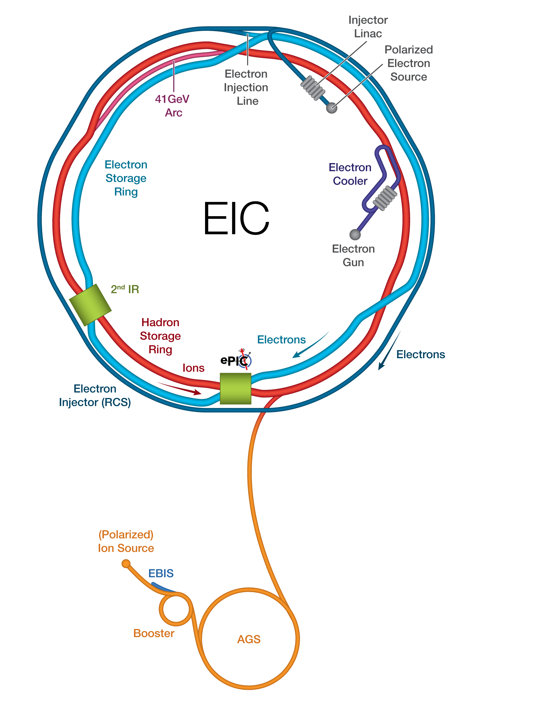
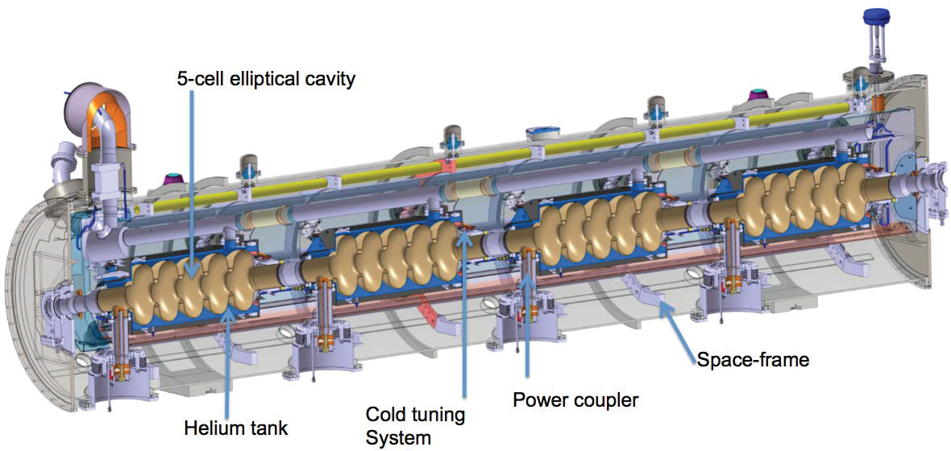
Background and first proposal
Starting point...March 2023: discussions begin internally between IN2P3 & IJCLAB on the possibility of an in-kind for the EIC accelerators...but what proposal?
In the context of PERLE (=new Energy Recovery Linac being built at IJCLAB), the on-going collaboration between IJCLAB & JLAB on RF systems, the funding of the first PERLE SRF Cryomodule through the EU iSAS project...the idea of proposing two SRF Cryomodules “à la PERLE” for the ERL e- Cooler is put forward.
x2
vs.
x8
PERLE SRF cryomodule
ERL cooler cryomodule
May 2023 to December 2023: (A lot of) exchanges with our EIC colleagues (BNL + JLAB) to understand the needs for the ERL Cooler and discuss about the IN2P3/IJCLAB to produce, assemble, test and deliver these 2 CMs to BNL.
→... 1st feedback from EIC on our proposal...position unclear. “yes but no”... “no but maybe”.
J. Yeck – RRB meeting (dec 2023)

Slide 5
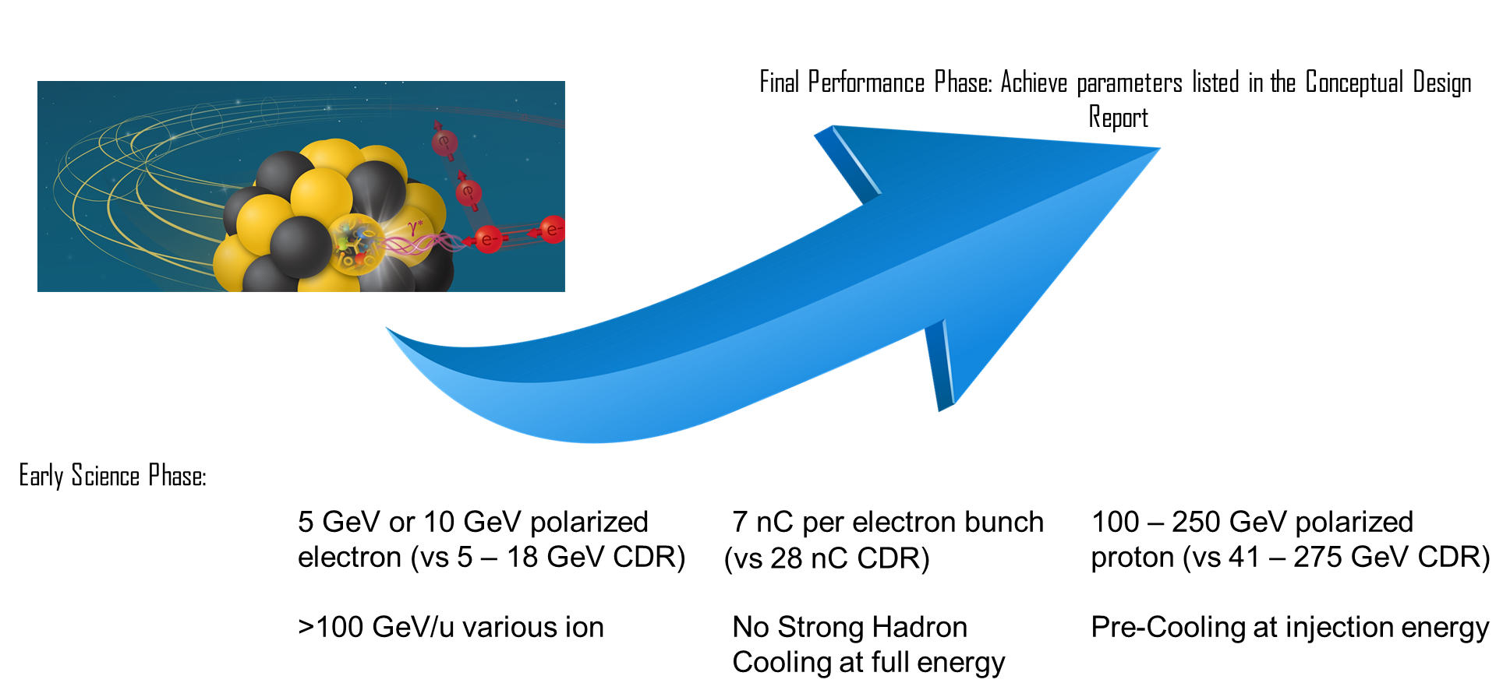
From the ERL cooler to the RCS...
February 29, 2024: S. Nagaitsev delivered a clear message: « the ERL Cooler is off the agenda now... But there is a need for other accelerators, including the RCS »
IJCLAB/IN2P3 started from scratch to redefine an “interesting” proposal.
Mars/Avril 2024: EIC-DOE / IJCLAB-IN2P3 agreement on a new proposal to supply of the 3 (+1) cryomodules for the Rapid Cycling Synchrotron (RCS) .
Slide from S. Nagaitsev – EIC Advisory Board (08/2024)

Slide 6
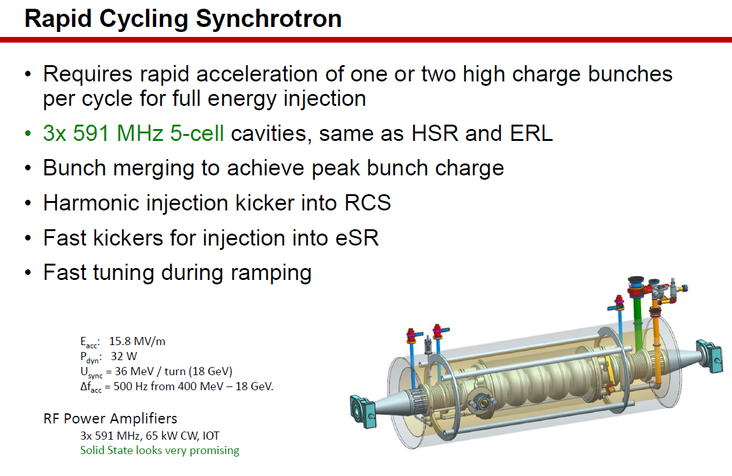
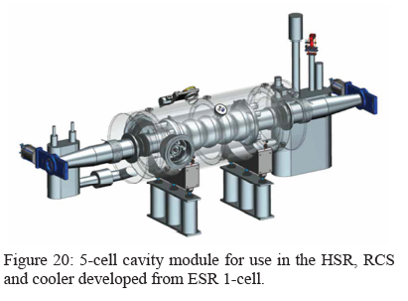
Proposal outline
Assumptions
The overall design baseline is the EIC CDR cryomodule.
The designs of the cavities, power couplers, HOMs, frequency tuning systems and beam absorbers (=critical components) are on duty by EIC/JLAB (but IJCLAB will participate).
The RF source(s) used for power coupler conditioning and final cryomodule testing are supplied by EIC.
Costs are estimated on the basis of the 2015 costs of the Spoke and Elliptique ESS prototypes, with a factor of x1.5 (excluding cavity costs, which have a factor of x2).
RH CNRS: need of non permanent staff ~40%
R.Rimmer FCC week 2020
IN2P3/IJCLAB commitments
Participation to the CM design. Design of all tooling required for the preparation, assembly and testing of the components.
Purchase of all components and their follow-up. Implementation and monitoring of quality assurance.
Qualification of the critical components (cavities, couplers, tuning systems).
Assembly of the cryomodules (clean room + cryostating).
Final test of the cryomodules.
Delivery to BNL
R.Rimmer 65th ICFA Adv. Beam Dyn. Workshop High Luminosity Circular e⁺ e⁻ Colliders

Slide 7
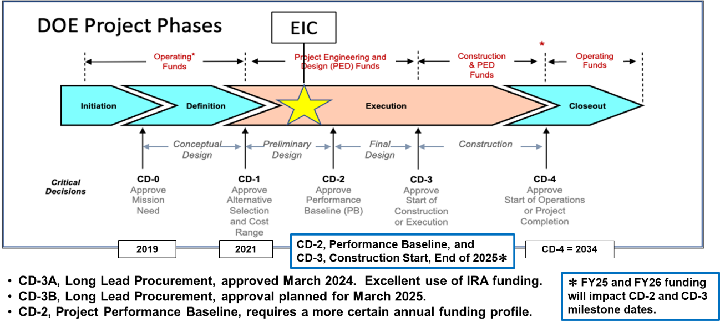
Planning
The duration of the in-kind contribution has been estimated at 5,5 years, i.e. 66 months (from January 2026 to mid-2031) assuming the start of the contribution on 1 January 2026 after the CD-3 decision scheduled end of 2025.
(J.Yeck, EIC Advisory Board Meeting, August 2024)

Slide 8
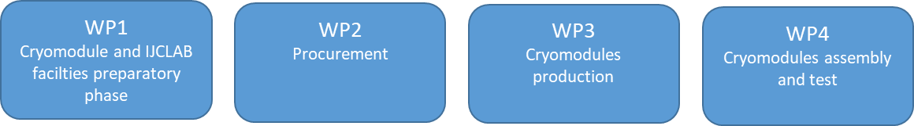
Organisation and Timeline
The project has been divided in 4 main Work Packages.
The present planning has been established without taking into account any constraints from EIC and does not include contingencies.
No risk analysis has been conducted so far but 2 risks have been identified since the beginning: the time and human resources required for the procurement phase and possible difficulties in recruiting non-permanent staff.
It reflects the present IN2P3/IJCLAB capabilities to fulfil the contribution.
The balance between permanent/non-permanent staff is estimated 60%/40%. Permanent staff is not yet allocated to the project.

Slide 9
Supratech platform upgrades
  → The Supratech platform is a great asset for this in-kind contribution but needs to be improved
2 important phases:
WP1. 1-year (2 FTEs) studies to adapt/upgrade some of the Supratech equipment needed for the preparation of the critical components and their test:
  finalize the installation and commissioning of the new vertical cryostat,
  new cryo-distribution line for the cryomodule test
  new cryostat for tuning systems.
  new RF coupler conditioning test bench
WP3. 1-year (3 FTEs) to modify/upgrade the Supratech equipment and prepare the sites for assembly and testing (incl. C&C/instrumentation, cryogenics and RF equipment

Slide 10
About €...
Cost estimate ~ 17.825 M€
Remarks:
1/ Purchase volume is about 10.65 M€ with circa 10 call for tenders (>143k€) and more than 100 orders in 15 to 24 months...this is a challenge and an identified risk of delay.
Need to anticipate as much as possible some critical call for tenders and orders even before the end of the cryomodule design (e.g. Niobium material, cavities, couplers, instrumentation, etc., some equipment to finalize the new vertical cryostat, etc)
2/ EIC contribution represents 45.6 FTE including 18.3 FTE on non-permanent staff.
Comparison with ESS over 10 years (for preparation and assembly of 14 CMs (excluding tests) and purchase and installation of 13 valve boxes): ~100 FTE including ~46 FTE on non permanent staff.
→ ESS manpower budget was x2 the one planned for the EIC contribution. Same permanent/non-permanent staff ratio (~40%)

Slide 11
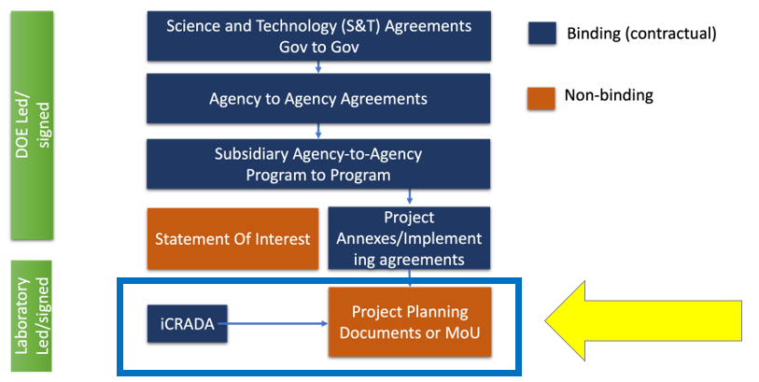
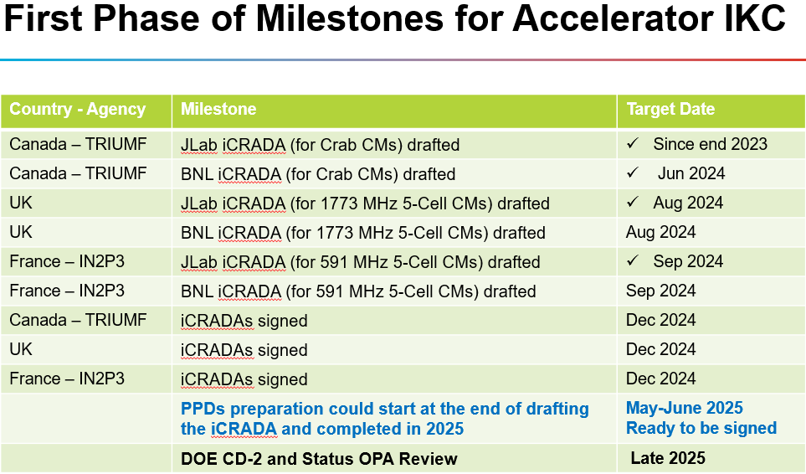
Status of today
As a common effort to the EIC accelerator and ePIC detector construction, IN2P3 and CEA are currently preparing a request for funding to the French ministry.
In parallel, iCRADA preparation between DOE and IN2P3 are on-going
  Draft V1 of the DOE/IN2P3 iCRADA for the cryomodules production with Jlab ahs been received → currently being proofread
  We wait for the draft of the second iCRADA (with BNL) for cryomodules shipping.
Luisella Lari, EIC Advisory Board, 2 August 2024
The year 2025 should be dedicated to the finalisation of the iCRADAs agreements, the drafting of the Project Planning Documents and the start of the first technical exchanges.
EIC France - 11/10/2024

Slide 12

Merci pour votre attention

