Slide 1
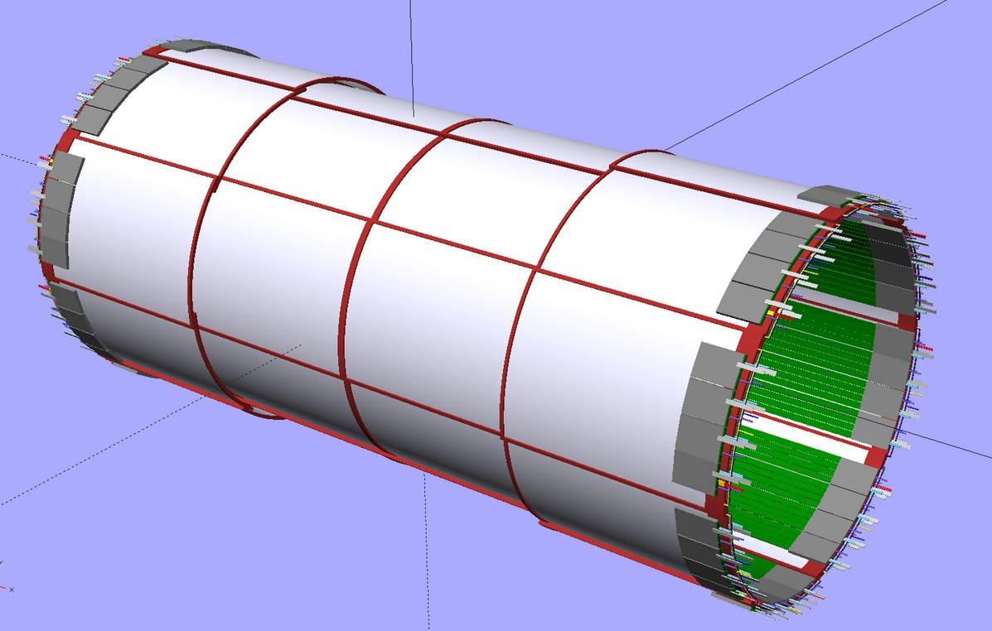
CyMBaL
Micromegas for EIC
Dylan Neff
CEA Saclay
F. Bossù, A. Bonenfant, A. Francisco, C. Goblin, F. Jeanneau, C. Libourel, V. Maâch, I. Mandjavidze, D. Neyret, S. Polcher Rafael, M. Vandenbroucke
10/10/2024
EIC France 2024

Slide 2
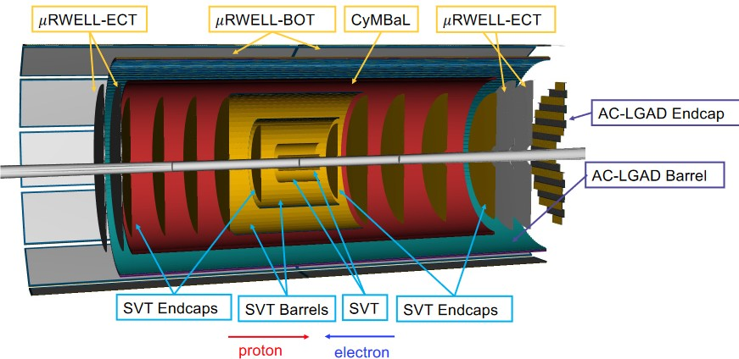
Cylindrical Micromegas Barrel Layer (CyMBaL)
Tracking System (Barrel)
Silicon Vertex Trackers (SVT)
CyMBaL
Barrel Time of Flight (BTOF)
μRWELL-BOT
What will CyMBaL do?
Fast tracklets for track seeding
Full hermetic coverage
Reliable redundancy
CyMBaL Requirements
Spatial Resolution: ~150μm
Timing Resolution: ~10ns
Low Material Budget: ~0.5%X0

Slide 3
CyMBaL: Fast Tracklets
BTOF
μRWELL-BOT
CyMBaL
Reconstruct tracklets with fast outer tracking detectors
CyMBal
BTOF
μRWELL-BOT
Use these tracklets to seed tracks for the slower Silicon Vertex Tracker (SVT)
SVT integration time of 2-5μs
Events every ~2μs, expect some pile-up
Fast tracklets matched to SVT tracks give precise time information
Micromegas lower in noise than silicon, provide reliable hits for track reconstruction
Silicon Vertex Tracker

Slide 4
CyMBaL: Fast Tracklets
BTOF
μRWELL-BOT
CyMBaL
Reconstruct tracklets with fast outer tracking detectors
CyMBal
BTOF
μRWELL-BOT
Use these tracklets to seed tracks for the slower Silicon Vertex Tracker (SVT)
SVT integration time of 2-5μs
Events every ~2μs, expect some pile-up
Fast tracklets matched to SVT tracks give precise time information
Micromegas lower in noise than silicon, provide reliable hits for track reconstruction
Silicon Vertex Tracker

Slide 5
CyMBaL: Fast Tracklets
BTOF
μRWELL-BOT
CyMBaL
Reconstruct tracklets with fast outer tracking detectors
CyMBal
BTOF
μRWELL-BOT
Use these tracklets to seed tracks for the slower Silicon Vertex Tracker (SVT)
SVT integration time of 2-5μs
Events every ~2μs, expect some pile-up
Fast tracklets matched to SVT tracks give precise time information
Micromegas lower in noise than silicon, provide reliable hits for track reconstruction
Silicon Vertex Tracker

Slide 6
CyMBaL: Fast Tracklets
BTOF
μRWELL-BOT
CyMBaL
Reconstruct tracklets with fast outer tracking detectors
CyMBal
BTOF
μRWELL-BOT
Use these tracklets to seed tracks for the slower Silicon Vertex Tracker (SVT)
SVT integration time of 2-5μs
Events every ~2μs, expect some pile-up
Fast tracklets matched to SVT tracks give precise time information
Micromegas lower in noise than silicon, provide reliable hits for track reconstruction
Silicon Vertex Tracker

Slide 7
CyMBaL: Fast Tracklets
BTOF
μRWELL-BOT
CyMBaL
Reconstruct tracklets with fast outer tracking detectors
CyMBal
BTOF
μRWELL-BOT
Use these tracklets to seed tracks for the slower Silicon Vertex Tracker (SVT)
SVT integration time of 2-5μs
Events every ~2μs, expect some pile-up
Fast tracklets matched to SVT tracks give precise time information
Micromegas lower in noise than silicon, provide reliable hits for track reconstruction
Silicon Vertex Tracker

Slide 8
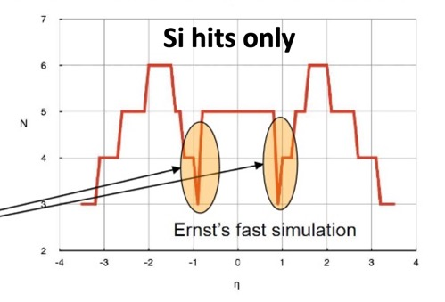
CyMBaL: Gap Coverage
Silicon Vertex Tracker has a gap in rapidity between barrel and forward disks, as low as 3 hits max at η=1
CyMBaL and BTOF cover this gap, bringing tracking back to 5 hits

Slide 9
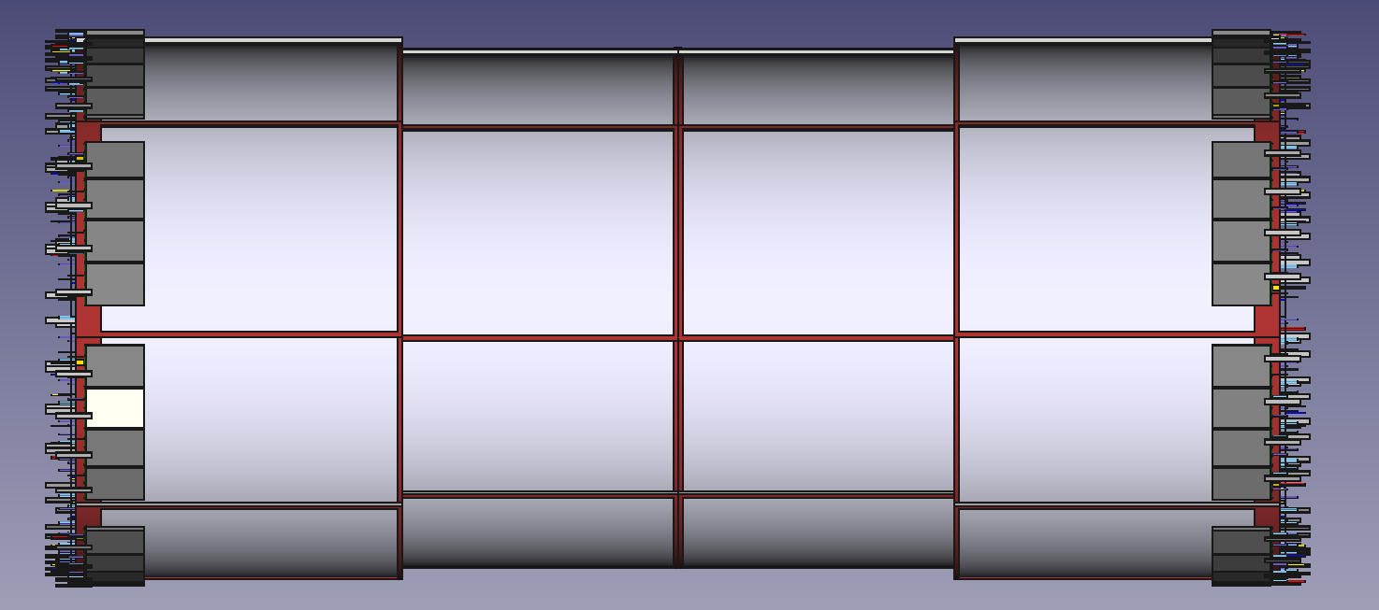
CyMBaL: Layout
Fully hermetic: Overlap in phi and z
Two curvature radii
Central cylinders: 50 cm
Forward cylinders: 55 cm
32 modules
4 along z, 8 around azimuth
1024 readout channels/module → 32k total
Keeping zones:
Z = [-105, 143] cm
R = [55, 60] cm

Slide 10
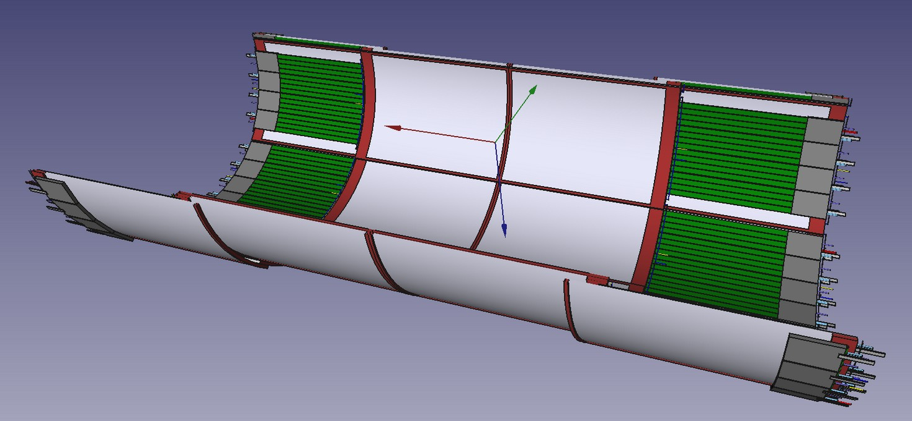
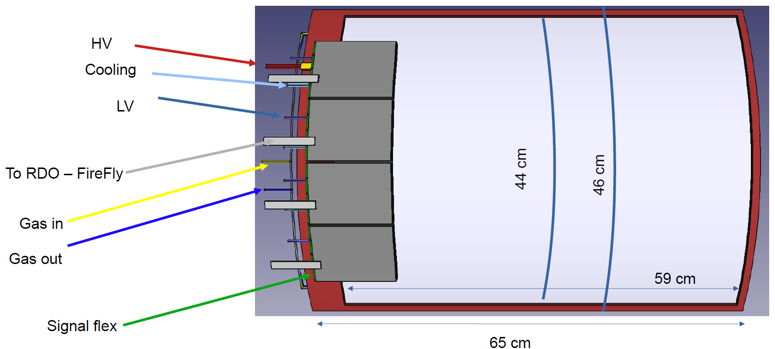
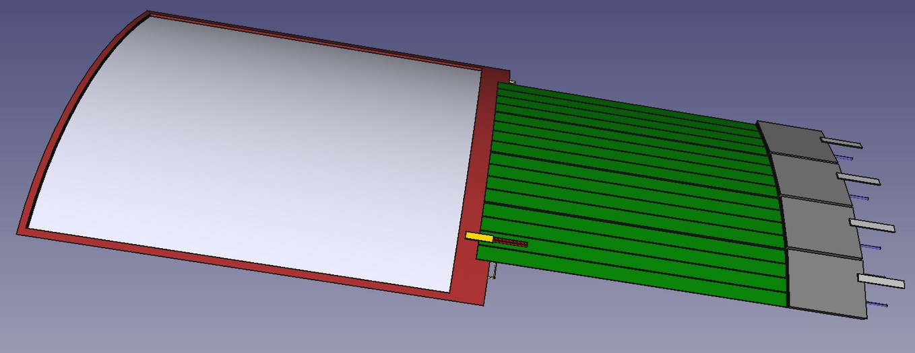
CyMBaL: Module
Single module design with two curvature radii simplifies production and reduces cost
Front end boards based on SALSA ASIC at edges of detector to reduce material budget
50cm micro-coaxial cables connecting central modules
2D readout strips with pitch ~1 mm

Slide 11
CyMBaL: Micromegas Design
CyMBaL Requirements
Cylindrical shape
~2T magnetic field
5cm radial keeping zone → tight space!
Low material budget
CyMBaL Design

Slide 12
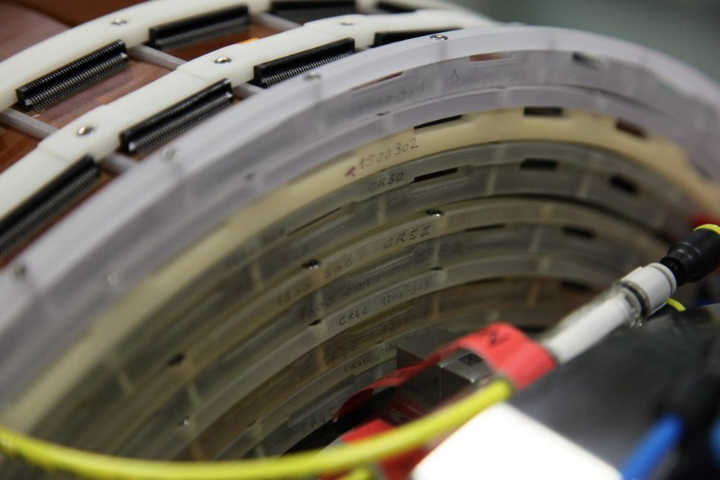
CyMBaL: Micromegas Design
Saclay has experience building a detector that meets these requirements
CyMBaL Requirements
Cylindrical shape
~2T magnetic field
5cm radial keeping zone → tight space!
Low material budget
Cylindrical Micromegas built for the CLAS12 experiment at Jefferson National Lab
Operates in 5T magnetic field
Cylindrical shape
Compact and light
CyMBaL Design
CLAS12 Cylindrical Micromegas

Slide 13
CyMBaL: Micromegas Design
Saclay has experience building a detector that meets these requirements
CyMBaL Requirements
Cylindrical shape
~2T magnetic field
5cm radial keeping zone → tight space!
Low material budget
Cylindrical Micromegas built for the CLAS12 experiment at Jefferson National Lab
Operates in 5T magnetic field
Cylindrical shape
Compact and light
CyMBaL Design
CLAS12 Cylindrical Micromegas
Key Difference:
Upgrade necessary for readout 1D CLAS12 → 2D CyMBaL

Slide 14
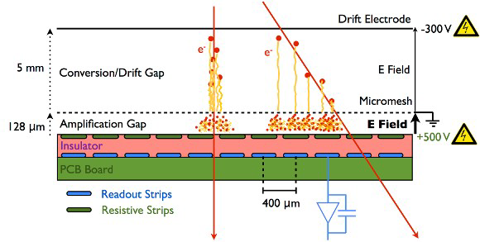
Micromegas Detectors
Gas ionized by incident particle

Slide 15
Micromegas Detectors
Gas ionized by incident particle
Electrons drift to mesh

Slide 16
Micromegas Detectors
Gas ionized by incident particle
Electrons drift to mesh
Avalanche in amplification gap

Slide 17
Micromegas Detectors
Gas ionized by incident particle
Electrons drift to mesh
Avalanche in amplification gap
Charge spreads on resistive layer

Slide 18
Micromegas Detectors
Gas ionized by incident particle
Electrons drift to mesh
Avalanche in amplification gap
Charge spreads on resistive layer
Signal is induced on readout strips

Slide 19
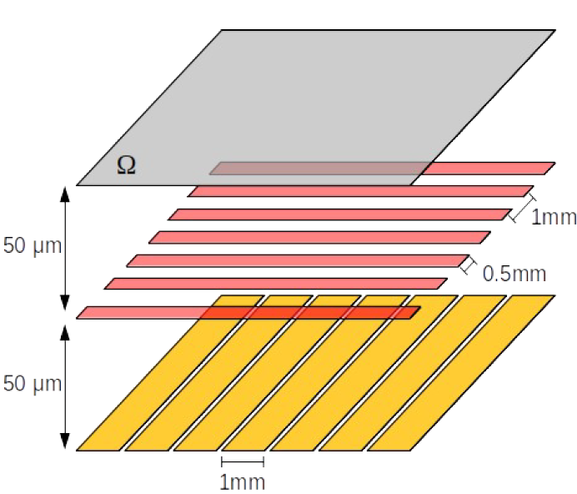
Micromegas Detectors
Gas ionized by incident particle
Electrons drift to mesh
Avalanche in amplification gap
Charge spreads on resistive layer
Signal is induced on readout strips
Resistive Layer
Thin top strips
Design Goals
Spread charge over multiple strips to improve spatial resolution by a weighted average
Share charge equally between top and bottom strips
Wide bottom strips
Samy Polcher Rafael

Slide 20
Developing and Optimizing 2D Detector Design
Resistive Layer
Wide bottom strips
Thin top strips

Slide 21
Developing and Optimizing 2D Detector Design
Resistive Layer
Wide bottom strips
Strip Readout
Strip design
Diamonds
Strips
Strip width
Strip pitch
Thin top strips
Diamonds
Strips

Slide 22
Developing and Optimizing 2D Detector Design
Resistive Layer
Wide bottom strips
Strip Readout
Strip design
Diamonds
Strips
Strip width
Strip pitch
Thin top strips
Resistive Layer
Resistivity
Pattern
Full
Strip
Grid
Diamonds
Strips
Full
Strip
Grid

Slide 23
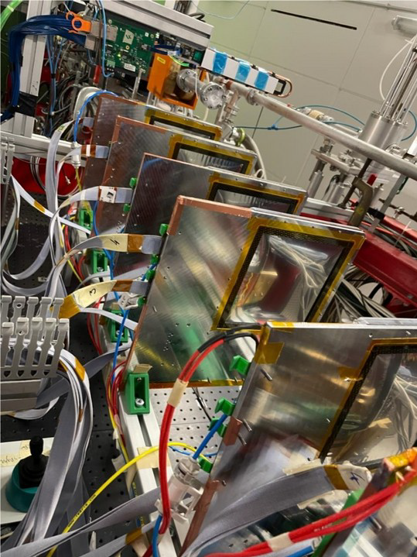
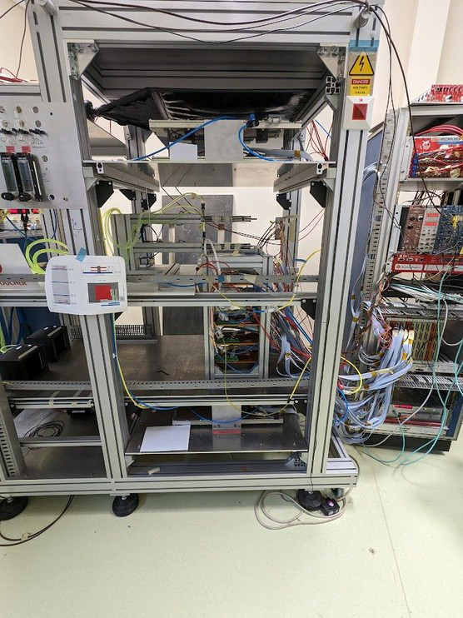
Developing and Characterizing Prototypes
Two Options for Testing Prototypes
Beam Test
Cosmics
Key Measurements
Time resolution
Spatial Resolution
Efficiency
Charge sharing
Cluster Size
Gain Curves
Mainz test in July 2023
Limited results due to multiple scattering
Possible future test at CERN
Test bench set up at CEA-Saclay
Can quickly test new detectors
Limited statistics for precise measurements
Pro
Con

Slide 24
Results from the Mainz Beam Test
Measurements from beam test data
Charge Sharing
Cluster Size
Spatial Resolution
Extrapolation from reference detector
True track
Analysis on most detectors was limited due to influence from multiple scattering

Slide 25
Results from the Mainz Beam Test
Measurements from beam test data
Charge Sharing
Cluster Size
Spatial Resolution
Caveat: D1, D2 μRWell, not micromegas
Extrapolation from reference detector
True track
Analysis on most detectors was limited due to influence from multiple scattering

Slide 26
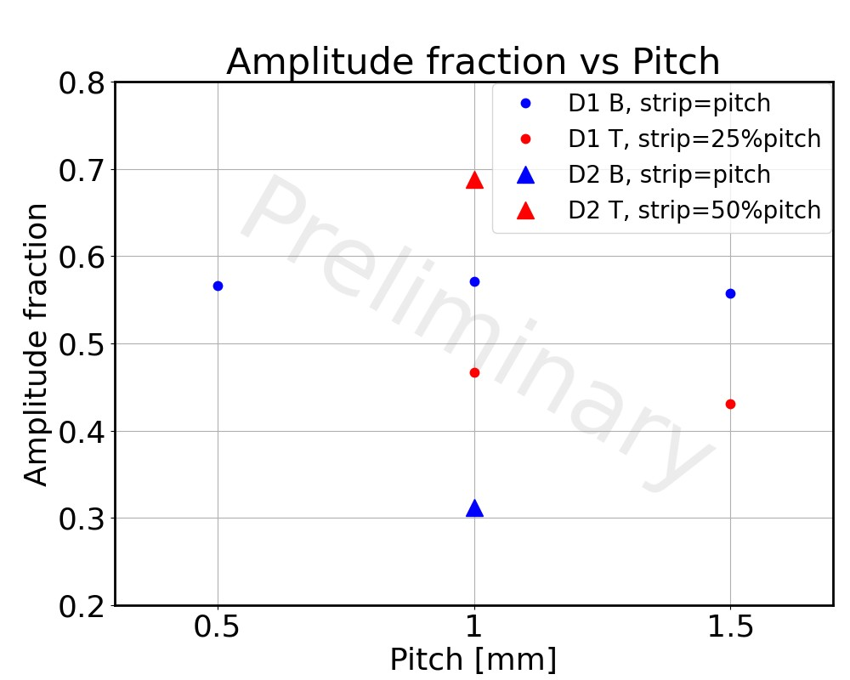
Charge Sharing
D2
Width
Pitch
width
width
What fraction of the charge is collected on the Top vs Bottom strips?
Most of charge collected on Top strips for D2
Samy Polcher Rafael

Slide 27
Charge Sharing
D2
D1
Width
Pitch
width
width
width
width
What fraction of the charge is collected on the Top vs Bottom strips?
Most of charge collected on Top strips for D2
More equal sharing in D1 where Top strip width reduced
Can tune Top strip width to optimize charge sharing
Samy Polcher Rafael

Slide 28
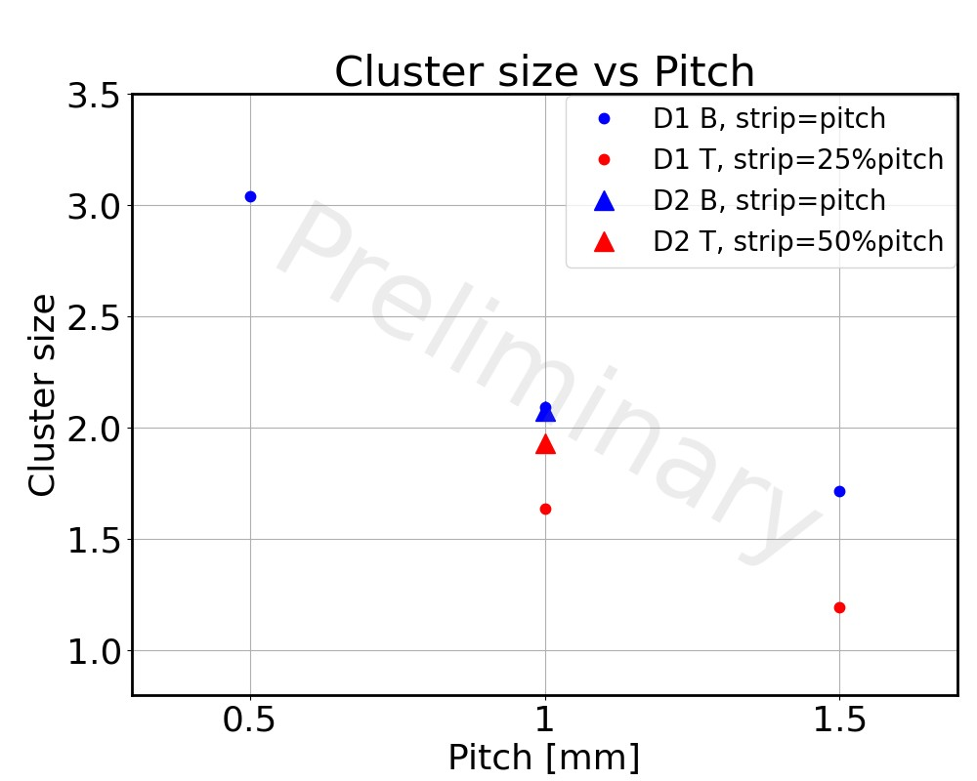
Cluster Size
D2
D1
Size 3
Width
Pitch
Size 3
width
width
width
width
Cluster Size: Number of adjacent strips above threshold
For cluster size > 2, a weighted average can improve spatial resolution. Larger cluster size desirable
Smaller pitch increases cluster size
Wider Top strips (D2) increase cluster sizes
Samy Polcher Rafael

Slide 29
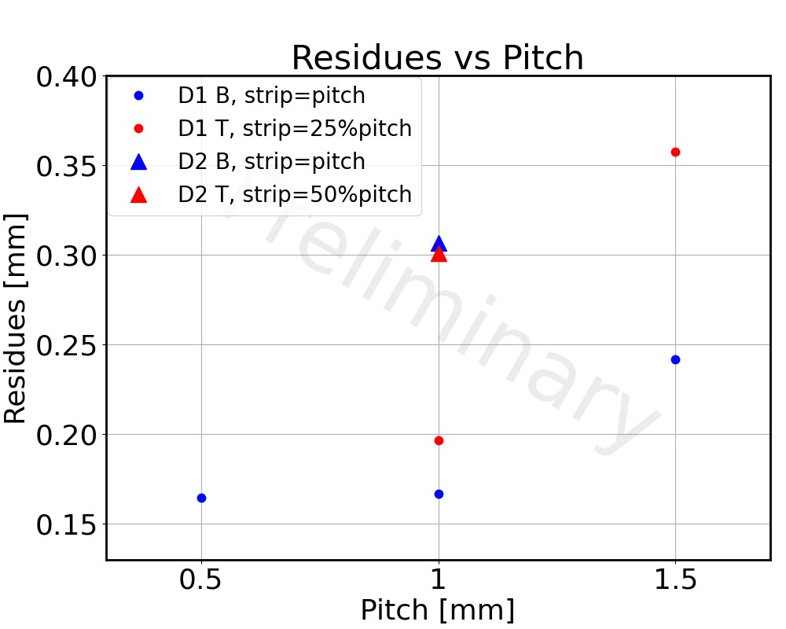
Spatial Resolution
D1
Width
Y Position
Pitch
X Position
Residuals vs Pitch
width
width
Residuals [mm]
Residuals: Difference between a track’s true position and measured position
Finer pitch gives better (smaller) residuals at the expense of more readout channels
Residuals under 200μm for 0.5 and 1.0 mm pitch
Samy Polcher Rafael

Slide 30
Summary
CyMBaL will provide a reliable and fast tracking point between the Silicon Vertex Tracker (SVT) and the Barrel Time Of Flight (BTOF)
Will also help cover rapidity gap in the SVT
Mainz beam test showed that 200μm spatial resolution possible with 1mm 2D strip readout
Work ongoing to characterize other prototype detectors and determine optimal 2D readout for CyMBaL

Slide 31
Summary
CyMBaL will provide a reliable and fast tracking point between the Silicon Vertex Tracker (SVT) and the Barrel Time Of Flight (BTOF)
Will also help cover rapidity gap in the SVT
Mainz beam test showed that 200μm spatial resolution possible with 1mm 2D strip readout
Work ongoing to characterize other prototype detectors and determine optimal 2D readout for CyMBaL
Thanks for your attention!

Slide 32
Backup

Slide 33
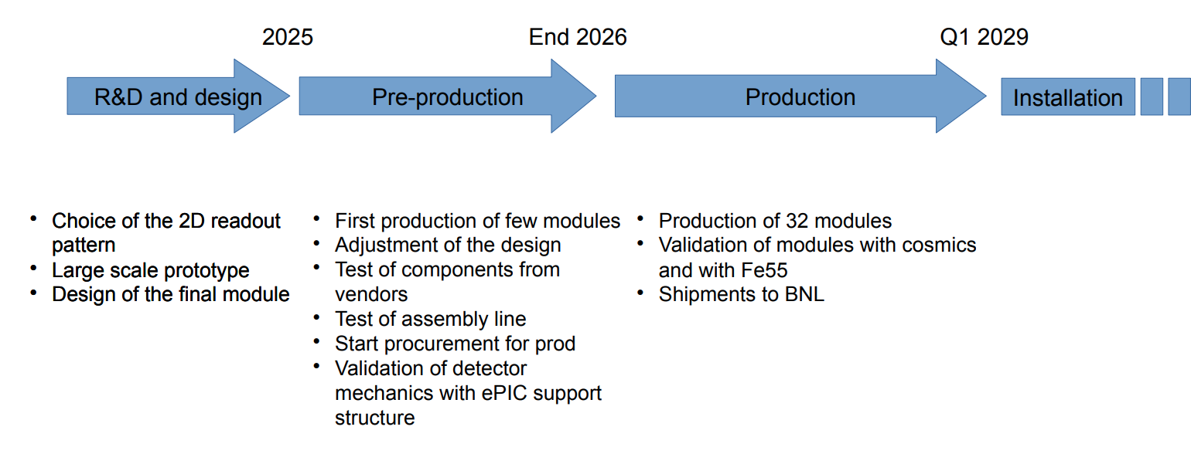
CyMBaL Timeline

Slide 34
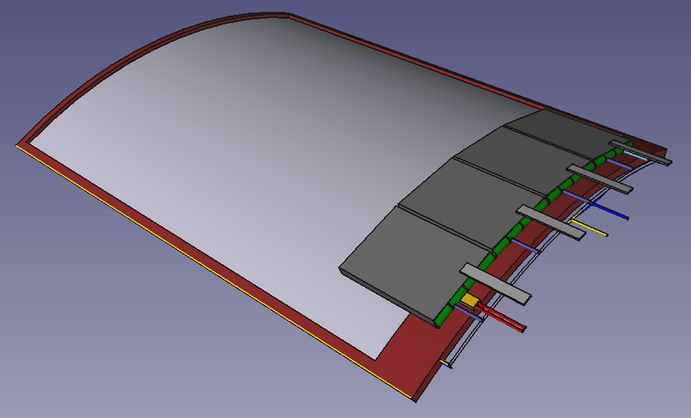

Slide 36
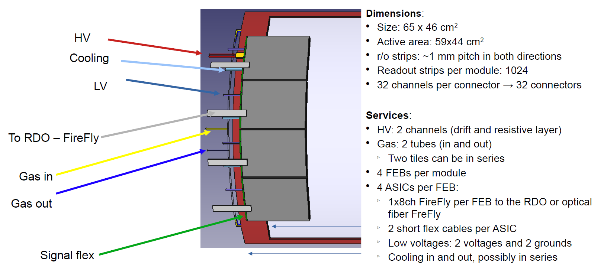

Slide 37
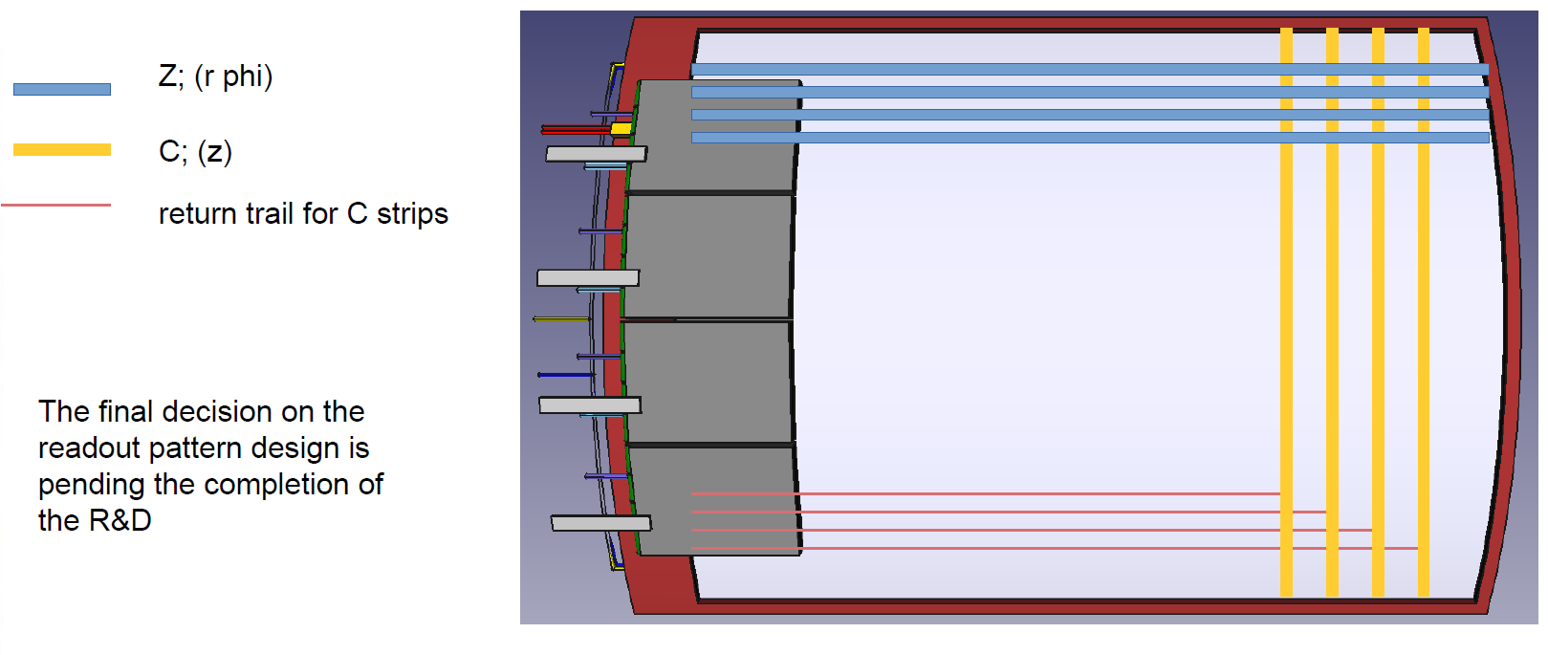

Slide 38
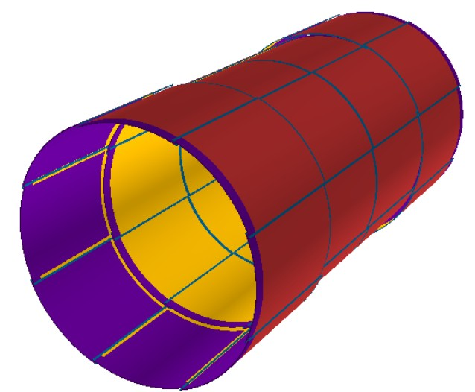

Slide 39
Measuring Tracking Resolution
Detector
Track
True Hit
A track passes through (hits) a detector

Slide 40
Measuring Tracking Resolution
Detector
Track
True Hit
Measured Hit
A track passes through (hits) a detector
The detector measures position of hit
Not necessarily in the true hit position

Slide 41
Measuring Tracking Resolution
Detector
Track
(x_{T}, y_{T})
True Hit
Measured Hit
dy
dx
(x_{M}, y_{M})
A track passes through (hits) a detector
Residual: Difference between true and measured hit position
The detector measures position of hit
Not necessarily in the true hit position

Slide 42
Measuring Tracking Resolution
Detector
Track
(x_{T}, y_{T})
True Hit
Measured Hit
Residual distribution can tell us resolution of detector: ↪ precision of tracking
dy
dx
(x_{M}, y_{M})
A track passes through (hits) a detector
Residual: Difference between true and measured hit position
The detector measures position of hit
Not necessarily in the true hit position

Slide 43
Spatial Resolution
D2
D1
Width
Pitch
Residuals vs Pitch
width
width
width
width
Residuals [mm]
Samy Polcher Rafael

