Slide 1
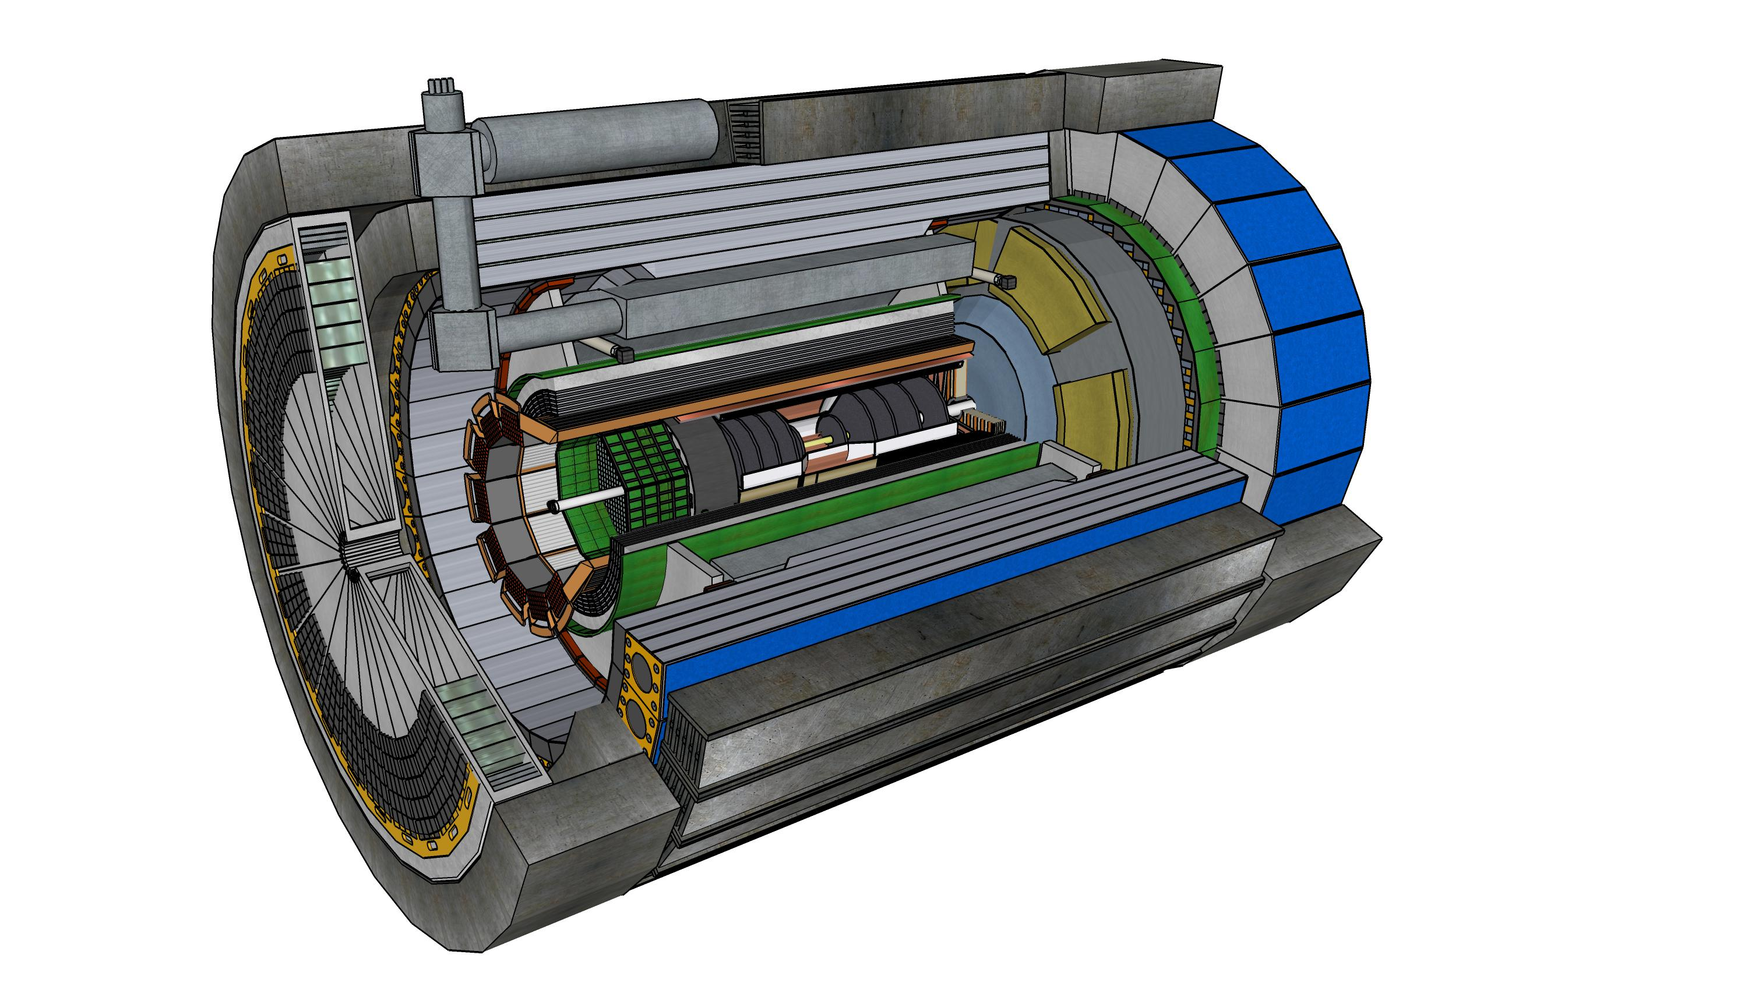



EIC Science, the ePIC Detector and Collaboration
John Lajoie
Oak Ridge National Laboratory

Slide 2
EIC Science

Slide 3
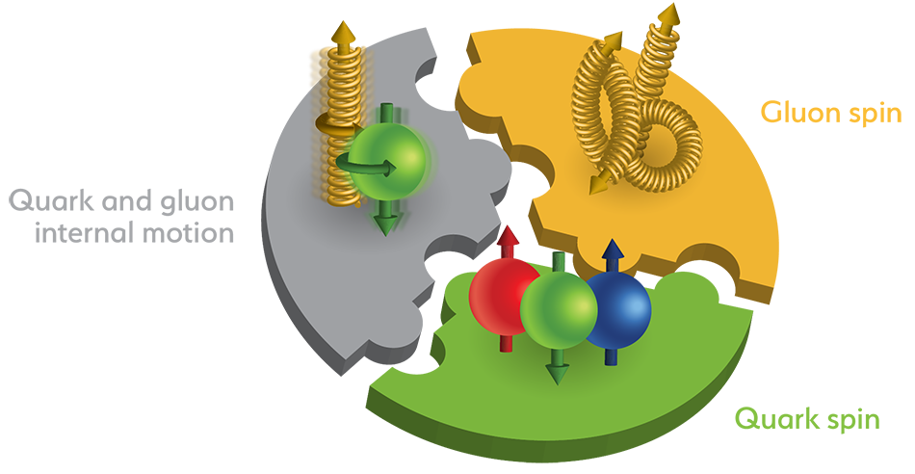
The Structure of the Proton
3 Valence Quarks
Sea Quarks and Gluons
Only 20-30% of the proton spin comes from the valence quarks!
Increase Energy
Mass is driven by a complicated sum of various QCD interactions!

Slide 4
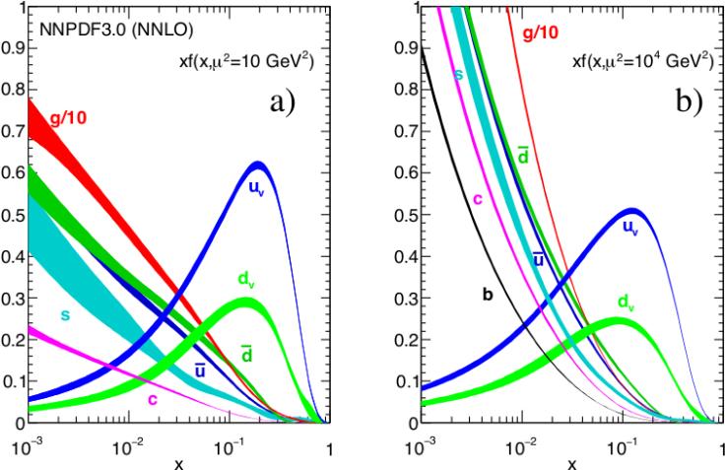
Longitudinal Momentum Structure
What do these distributions look like for protons in a nucleus?
Where does this saturate?
Parton Number Density
x
x
Fraction of Proton Momentum Carried by Parton

Slide 5
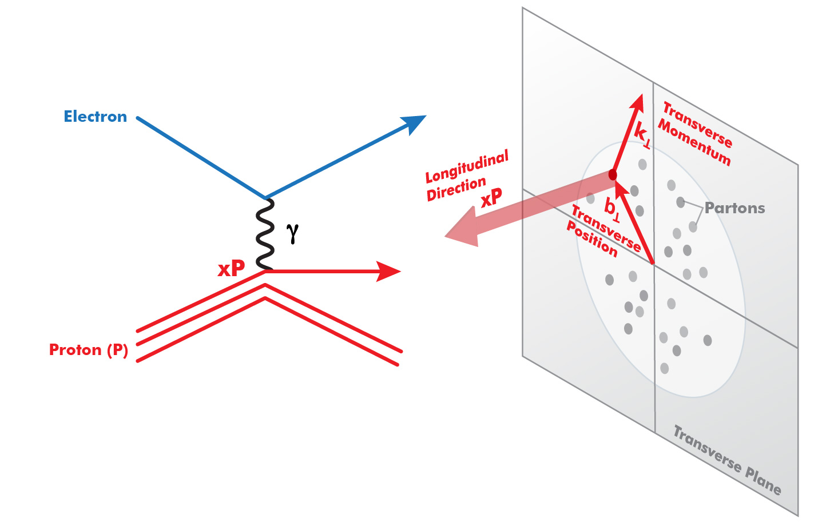
3D Imaging in Space and Momentum
The EIC will have both polarized electrons and hadrons.
Transversely polarized nucleon
Unpolarized nucleon
3D imaging in space and momentum
longitudinal structure (PDF)
+ transverse position information (GPDs)
+ transverse momentum information (TMDs)

Slide 6
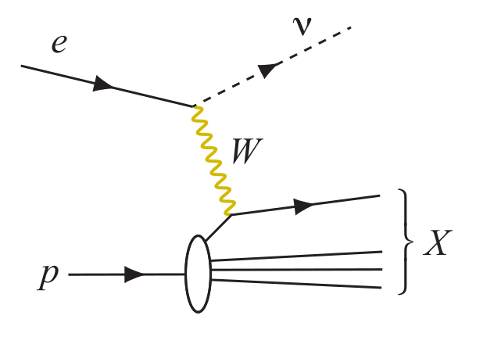
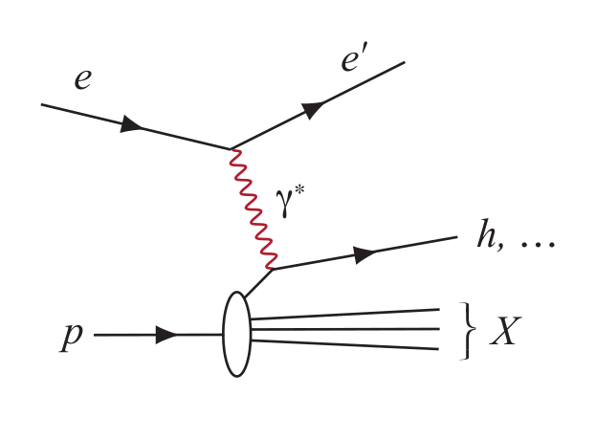
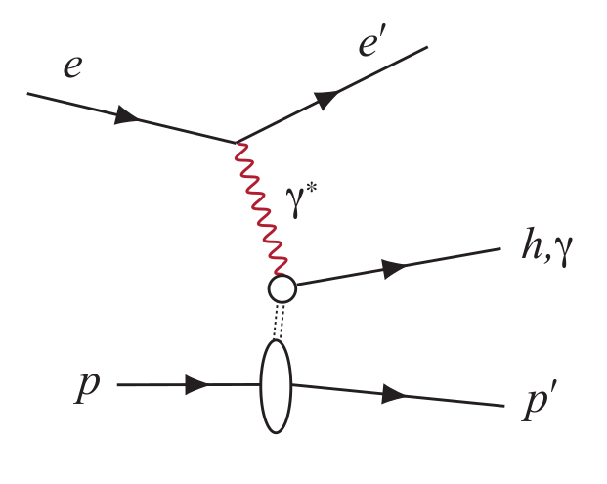
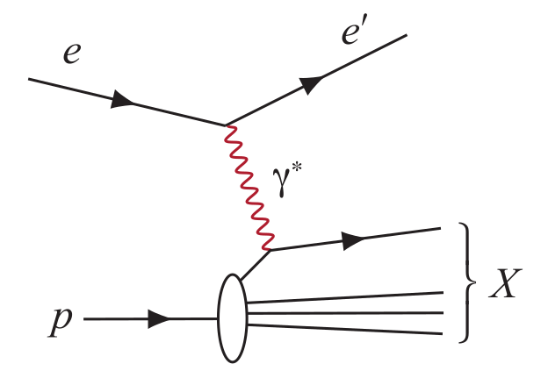
Experimental Processes to Access EIC Physics
DIS event kinematics - scattered electron or final state particles (CC DIS, low y)
Neutral Current DIS
Detection of scattered electron with high precision - event kinematics
Charged Current DIS
Event kinematics from the final state particles (Jacquet-Blondel method)
Semi-Inclusive DIS
Precise detection of scattered electron in coincidence with at least 1 hadron
Deep Exclusive Processes
Detection of all particles in event
Parton Distributions in nucleons and nuclei
Spin and
Flavor structure of nucleons and nuclei
Tomography Transverse Momentum Dist.
QCD at Extreme Parton Densities - Saturation
Tomography
Spatial Imaging

Slide 7
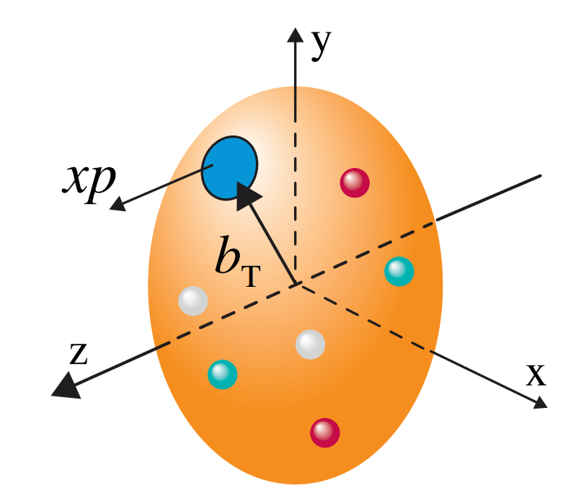
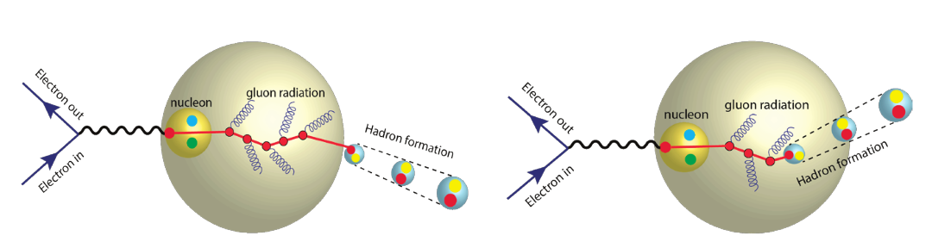
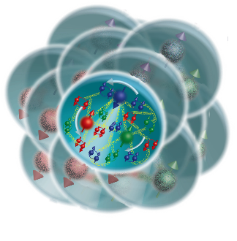
The Collaboration Pursues the Science
How do the nucleon properties like mass and spin emerge from quarks and their interactions?
How are the sea quarks and gluons distributed in space and momentum inside the nucleon? How is spin dynamically generated?
What is the mechanism through which quark-gluon interactions give rise to nuclear binding?
Is there a saturation point for the density of gluons in nuclei at high energies, and does this lead to the formation of gluonic matter with universal properties across all nuclei, including the proton?
In what manner do color-charged quarks and gluons, along with colorless jets, interact with the nuclear medium? And how do the confined hadronic states emerge from these quarks and gluons?
What impact does a high-density nuclear environment have on the interactions, correlations, and behaviors of quarks and gluons?
7
Notes:
Important to note that the French theory community played a crucial role in building the physics case for the EIC and is continuing to make significant contributions.

Slide 8
The ePIC Detector

Slide 9
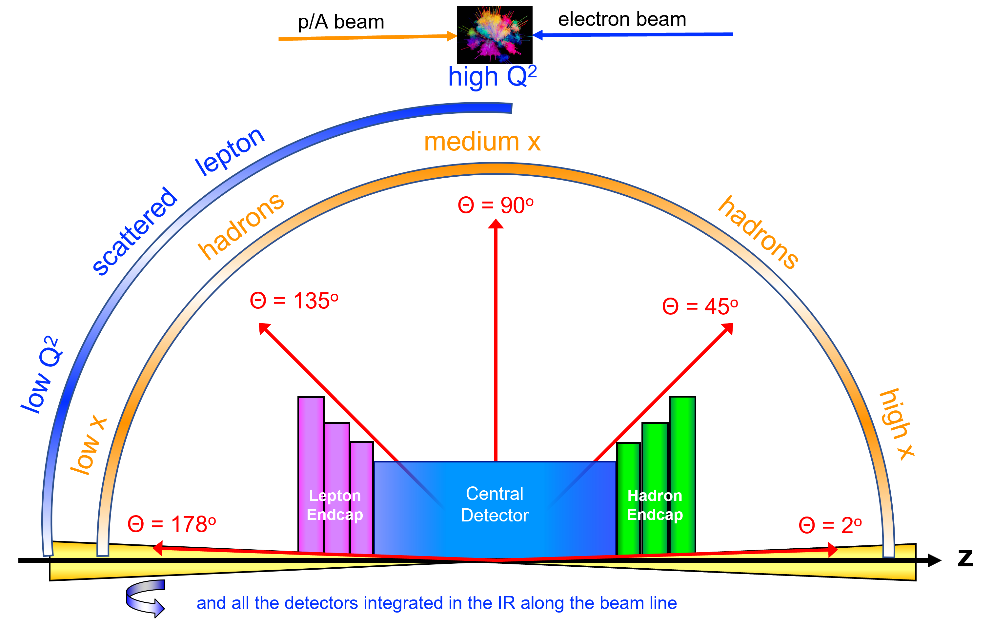
Requirements for an a EIC Detector
Vertex detector → Identify primary and secondary vertices,
  Low material budget: 0.05% X/X₀ per layer;
  High spatial resolution: 10 mm pitch CMOS Monolithic Active Pixel Sensor
Central tracker → Measure charged track momenta
  MAPS – tracking layers in combination with micro pattern gas detectors
  MPGD: μRWell or MicroMegas
electron and hadron endcap tracker → Measure charged track momenta
  MAPS – disks in combination with micro pattern gas detectors
Particle Identification → pion, kaon, proton separation on track level
  RICH detectors (modular and dual radiator RICH, DIRC) & Time-of-Flight
  high resolution timing detectors (LAPPDs, LGAD) 10 – 30 ps
  novel photon sensors: MCP-PMT / LAPPD
Electromagnetic calorimeter → Measure photons (E, angle), identify electrons
  PbWO₄ Crystals (backward), W/SciFi Spacal (forward)
  Barrel: Pb/SciFi+imaging part or new Scintillating glass
Hadron calorimeter → Measure charged hadrons, neutrons and K_{L}⁰
  challenge achieve ~50%/√E + 10% for low E hadrons (<E> ~ 20 GeV)
  Fe/Sc sandwich with longitudinal segmentation
DAQ & Readout Electronics: trigger-less / streaming DAQ
  Integrate AI into DAQ → cognizant Detector
Very forward and backward detectors → scattered particles under very small angles
  Silicon tracking layers in lepton and hadron beam vacuum
  Zero – degree high resolution electromagnetic and hadronic calorimeter
Radius/Distance from IP

Slide 10
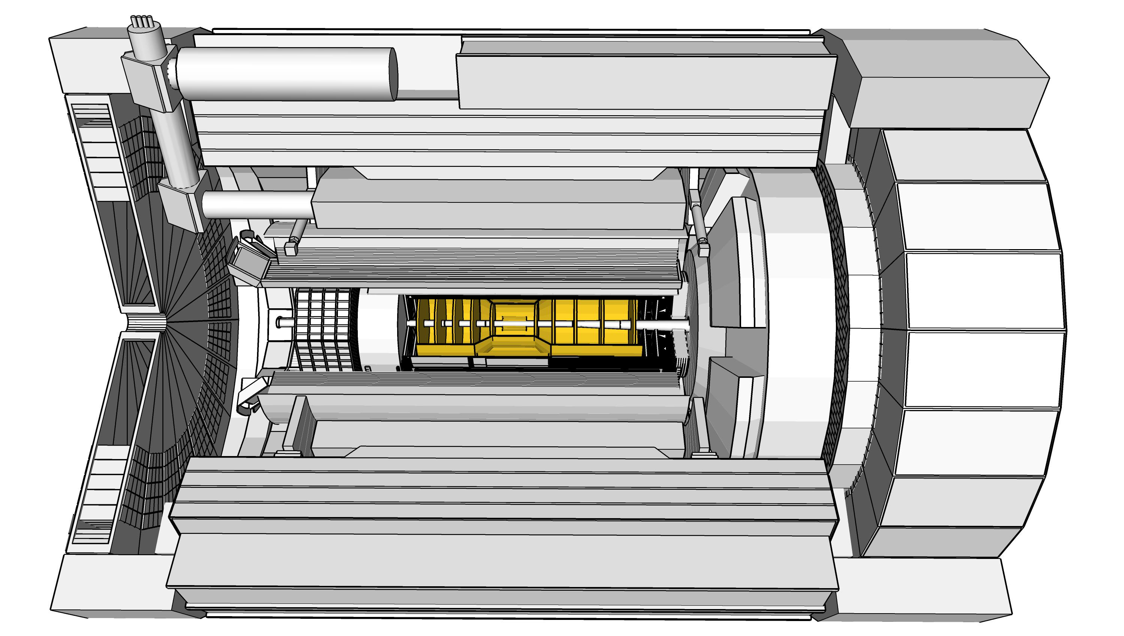
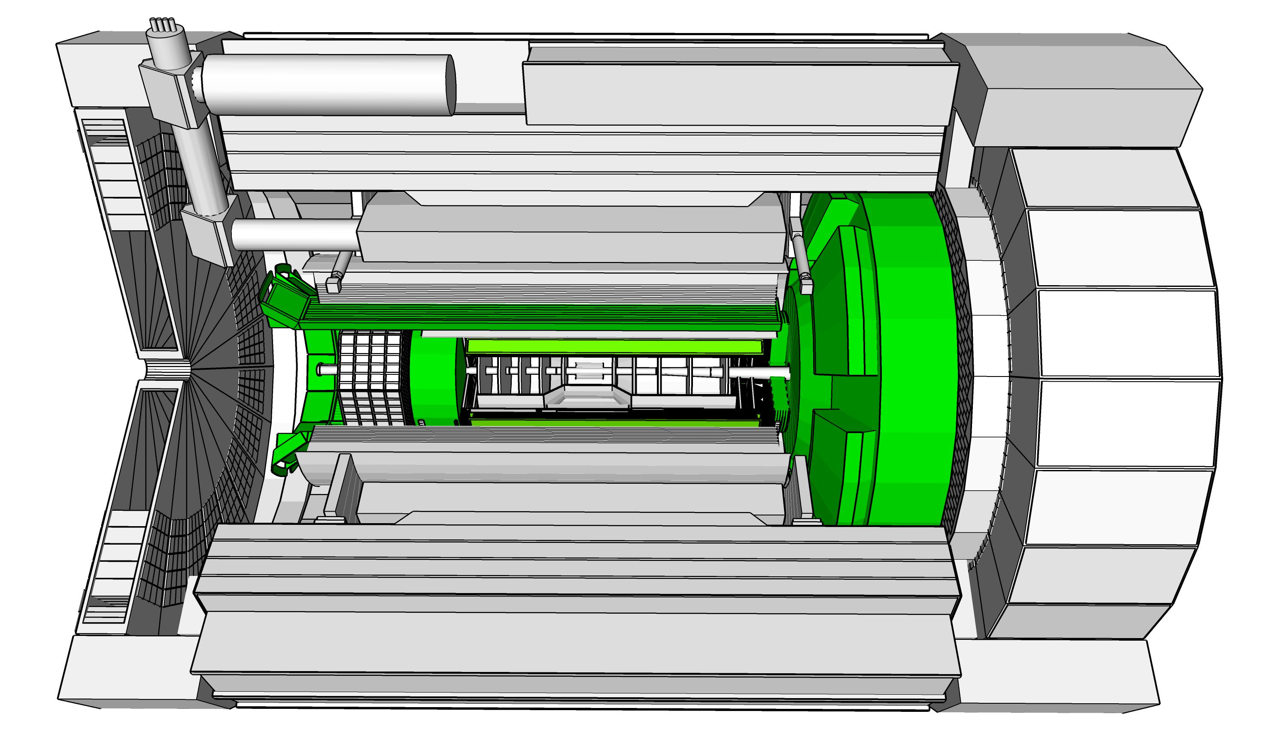
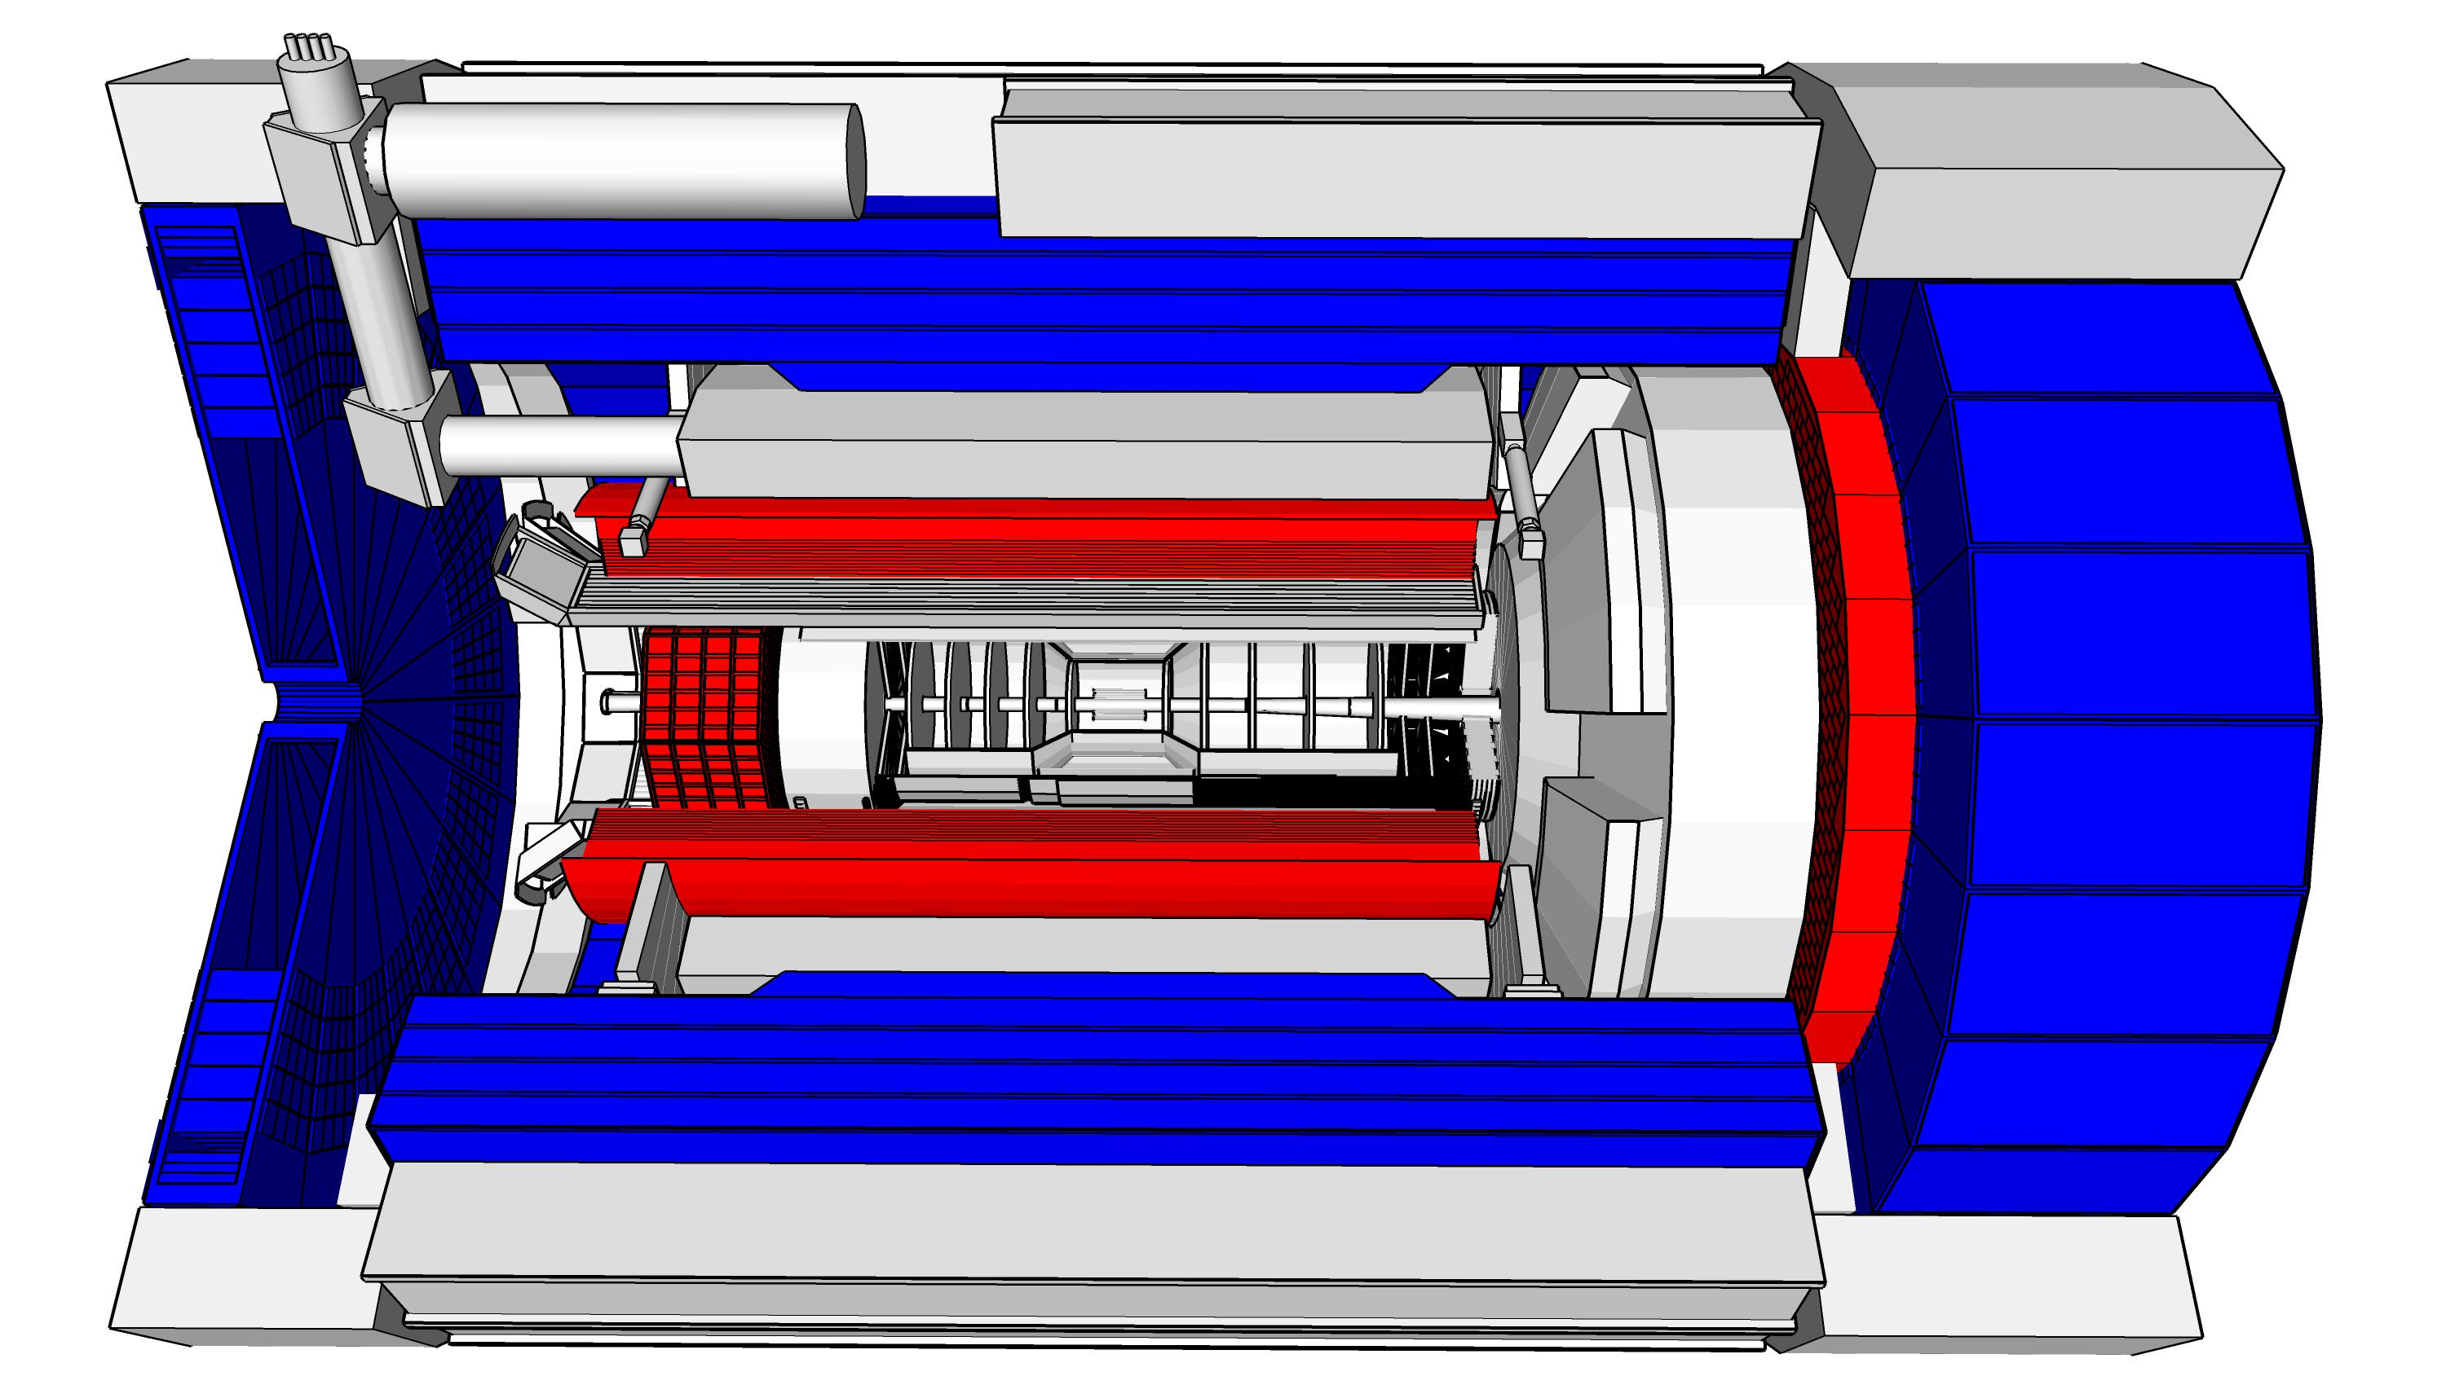
ePIC Detector Design
4.5m
η=0
5.0m
“Backward”
“Forward”
Tracking:
  New 1.7T (2.0T) solenoid
  Si MAPS Tracker
  MPGDs (μRWELL/μMegas)
PID:
  high-performance DIRC
  proximity-focused RICH
  dual-radiator RICH
  AC-LGAD (~30ps TOF)
Calorimetry:
  Imaging Barrel EMCal
  PbWO4 EMCal (backwards)
  Finely segmented EMCal +HCal
  in forward direction
  Outer HCal (sPHENIX re-use)
  Backwards HCal (tail-catcher)
6.52m
hadrons
electrons

Slide 11
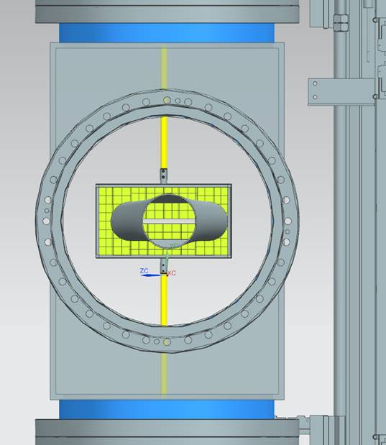
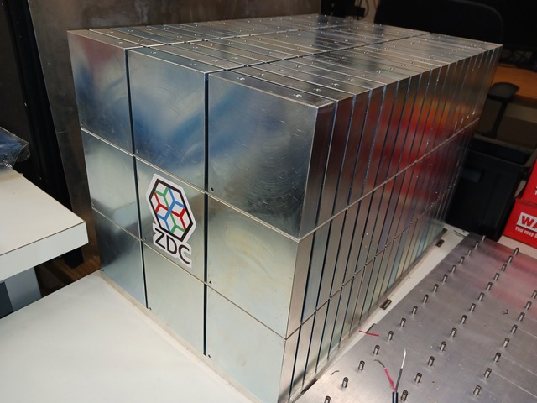

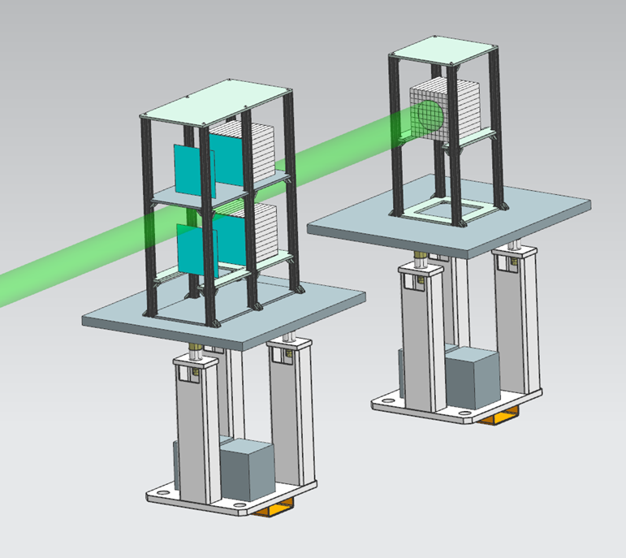
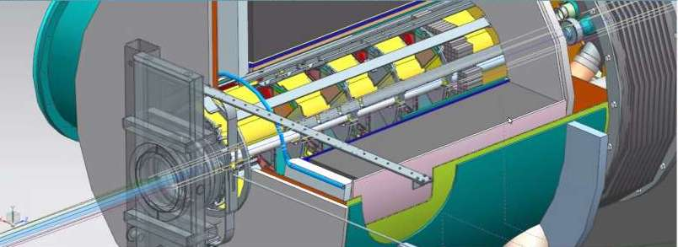
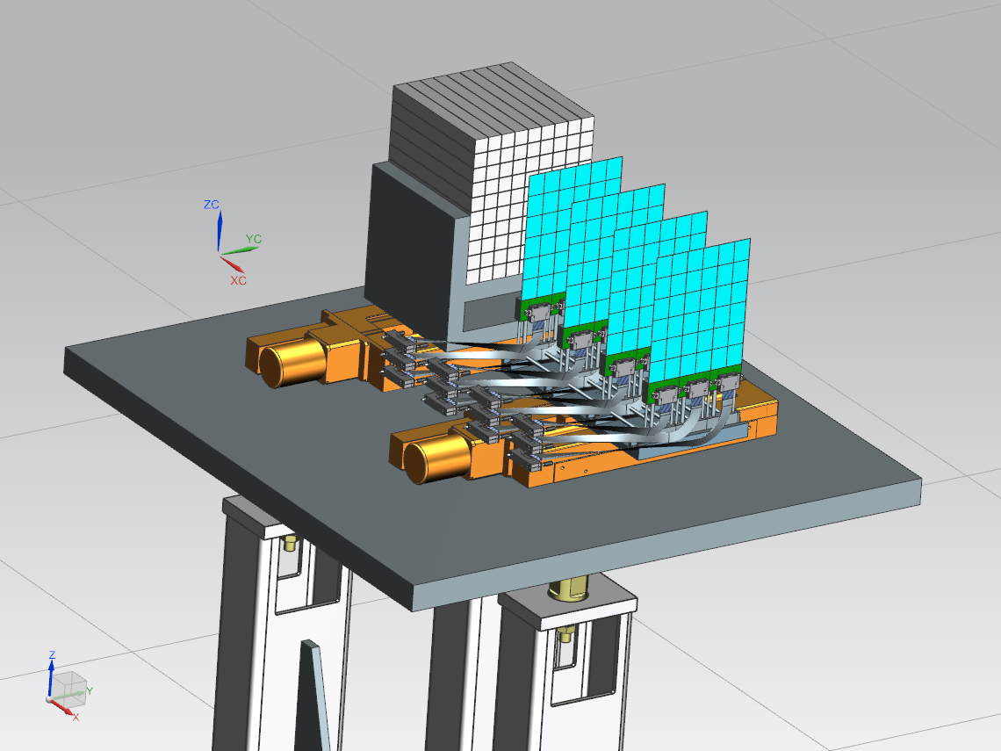
ePIC Far-Forward/Far-Backward Detectors
Main Function:
detection of forward scattered neutrons and γ
Technology:
EMCAL: 2x2x20 cm³ PbWO₄ calorimeter
Synergy with backward ECal
HCAL: Steel-SiPM-on-Tile
Synergy with forward HCal
Zero Degree Calorimeter
e beam
Main Function:
measure bunch-by-bunch luminosity through Bethe-Heitler process
Technology:
Pair-spectrometer: each with
2 tracking layers of AC-LGAD / FCFD
Synergy with Barrel-ToF
Calorimeter: Tungsten-powder + SciFi SPACAL
Synergy with forward ECal
Roman Pots and
Off-Momentum Detectors
Main Function:
detection of forward scattered protons and nuclei
Technology:
2 stations with 2 tracking layers each
AC-LGAD / EICROC ( 500x500 μm² pixel)
Synergy with forward ToF
B0 Magnet Sectrometer
p/A beam
Main Function:
detection of forward scattered protons and γ
Technology:
4 tracking layers each
AC-LGAD / EICROC ( 500x500 μm² pixel)
Synergy with forward ToF
EMCAL: 2x2x20 cm³ PbWO₄ calorimeter
Synergy with backward ECal
Luminosity System
Low-Q2 Taggers
Main Function:
detection of scattered electrons
Technology:
2 stations with 4 tracking layers each (16x18cm²)
Si / Timepix4
Calorimeter: Tungsten-powder + SciFi SPACAL
Synergy with forward ECal

Slide 12
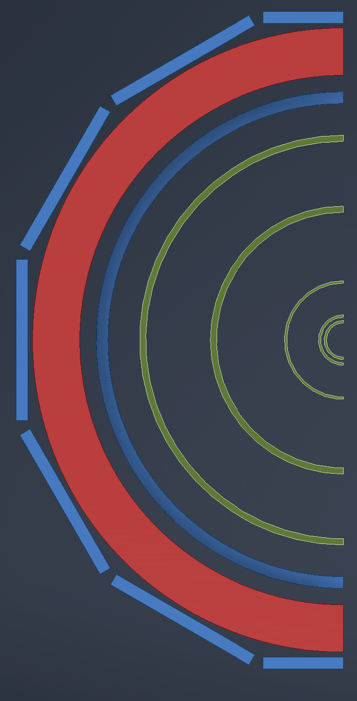

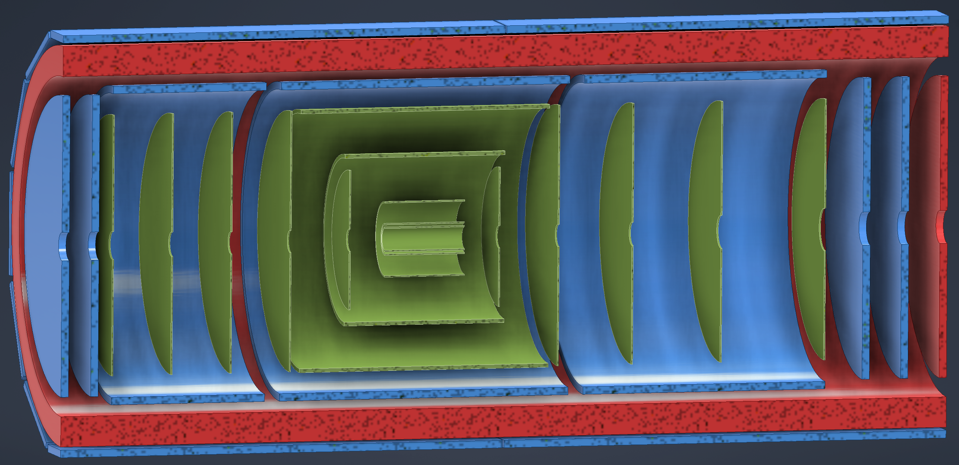
ePIC Tracking Detectors
MAPS Tracker:
  Small pixels (20 μm), low power consumption (<20 mW/cm²) and material budget (0.05% to 0.55% X/X₀) per layer
  Based on ALICE ITS3 development
  Vertex layers optimized for beam pipe bakeout and ITS-3 sensor size
  Barrel layers based on EIC LAS development
  Forward and backwards disks
MPGD Layers:
  Provide timing and pattern recognition redundancy
  Cylindrical μMEGAs
  Planar μRWell’s before hpDIRC
    Impact point and direction for ring seeding
AC-LGAD TOF and AstroPix (BECAL)
  Additional space point for pattern recognition / redundancy
world’s first
at
world’s first
at
MAPS Barrel + Disks
MPGD Barrels + Disks
AC-LGAD based ToF

Slide 13
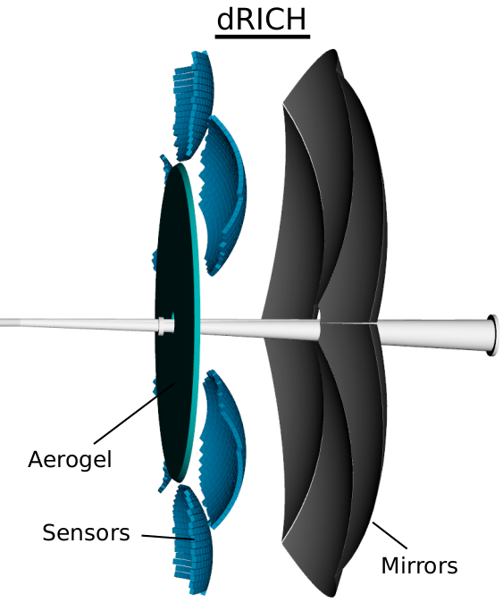
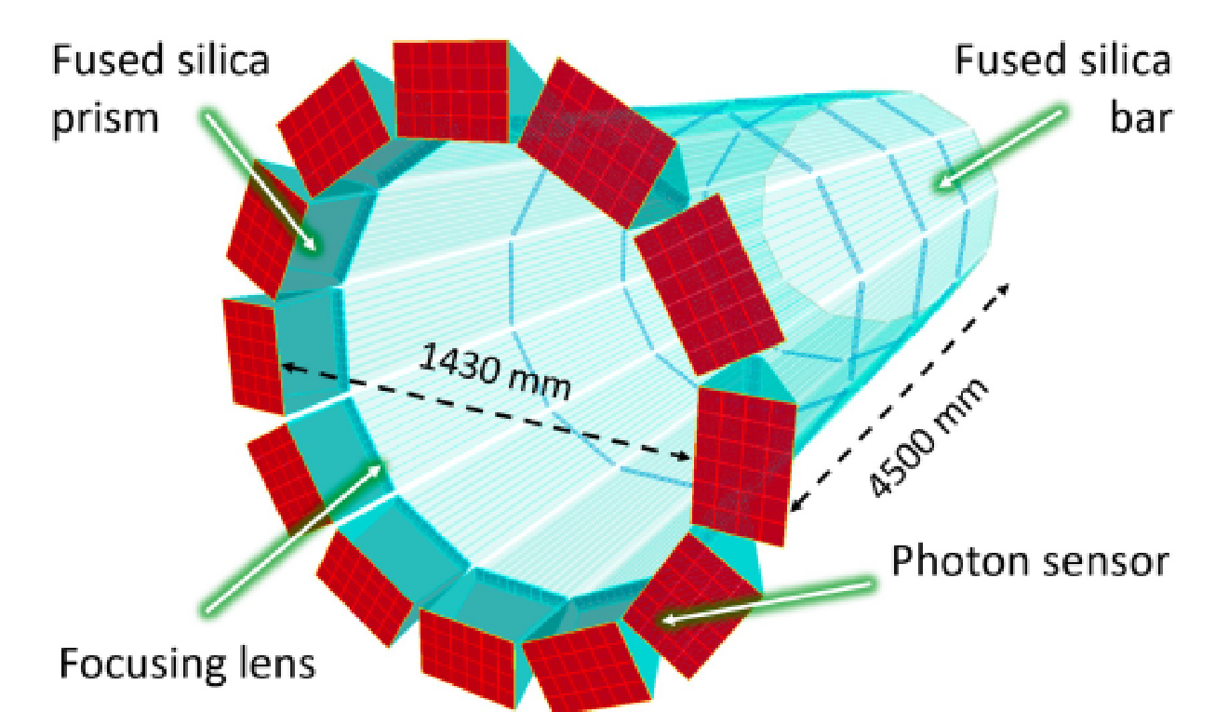
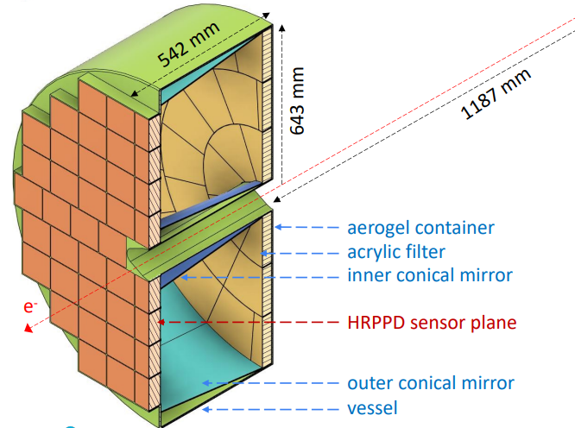
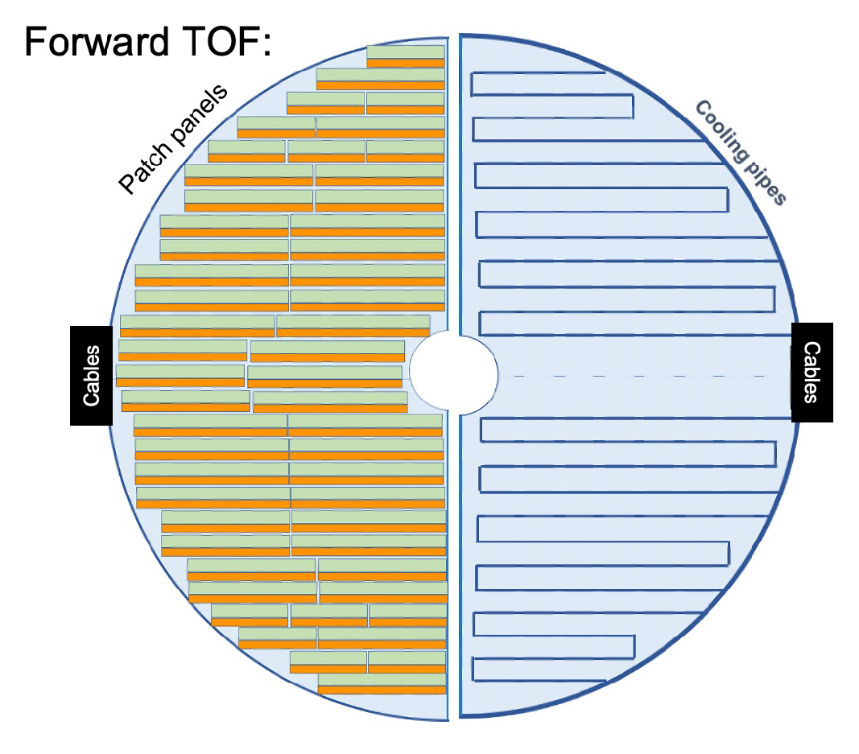
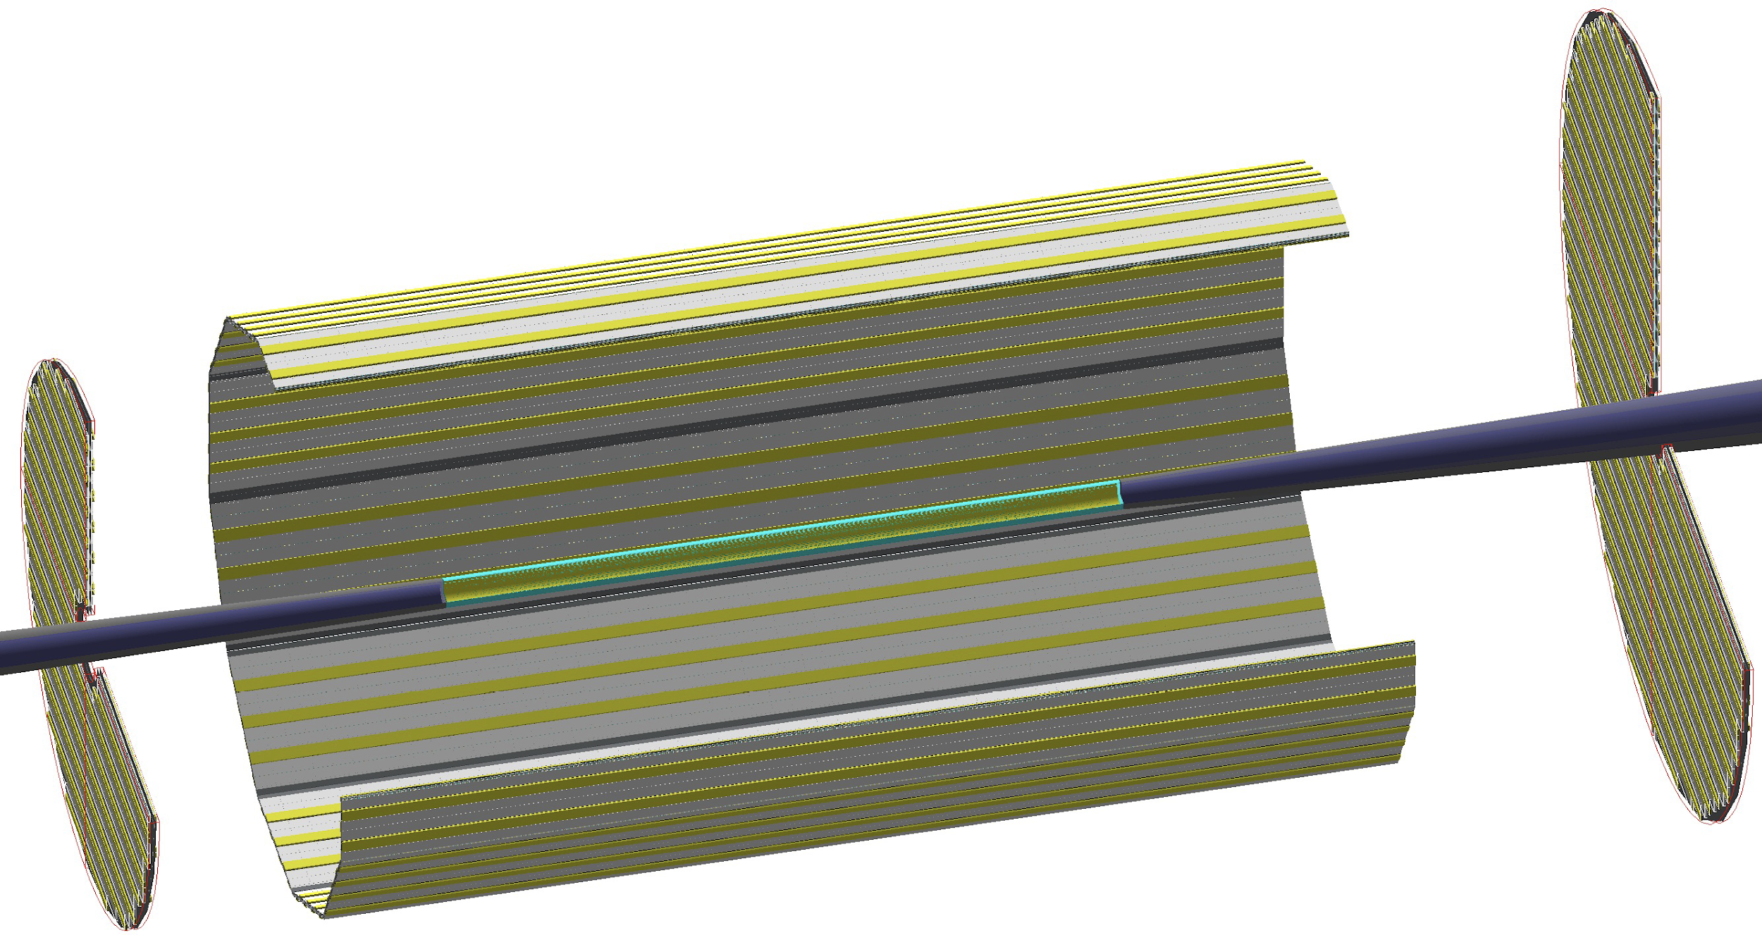
Particle ID
Dual-Radiator RICH(dRICH)
High-Performance DIRC
Quartz bar radiator (BaBAR bars)
light detection with MCP-PMTs
Fully focused
π/K 3σ separation at 6 GeV/c
Proximity Focused (pfRICH)
Long proximity gap (~40 cm)
Sensor: HRPPDs
up to 9 GeV/c 3σ π/K sep.
world’s first
at
C₂F₆ Gas Volume and Aerogel
Sensors tiled on spheres (SiPMs)
π/K 3σ sep. at 50 GeV/c
AC-LGAD
TOF (~30ps)
world’s first
at
world’s first
at
hadrons
electrons
Accurate space point for tracking
forward disk and central barrel

Slide 14
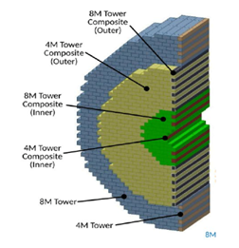
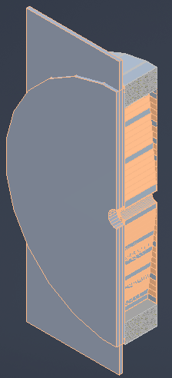
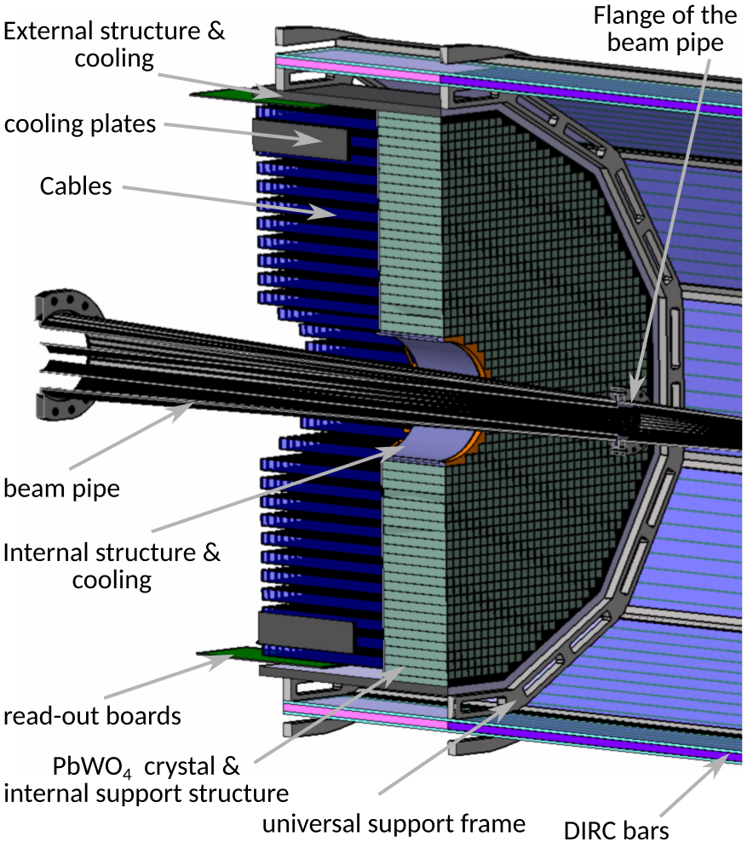
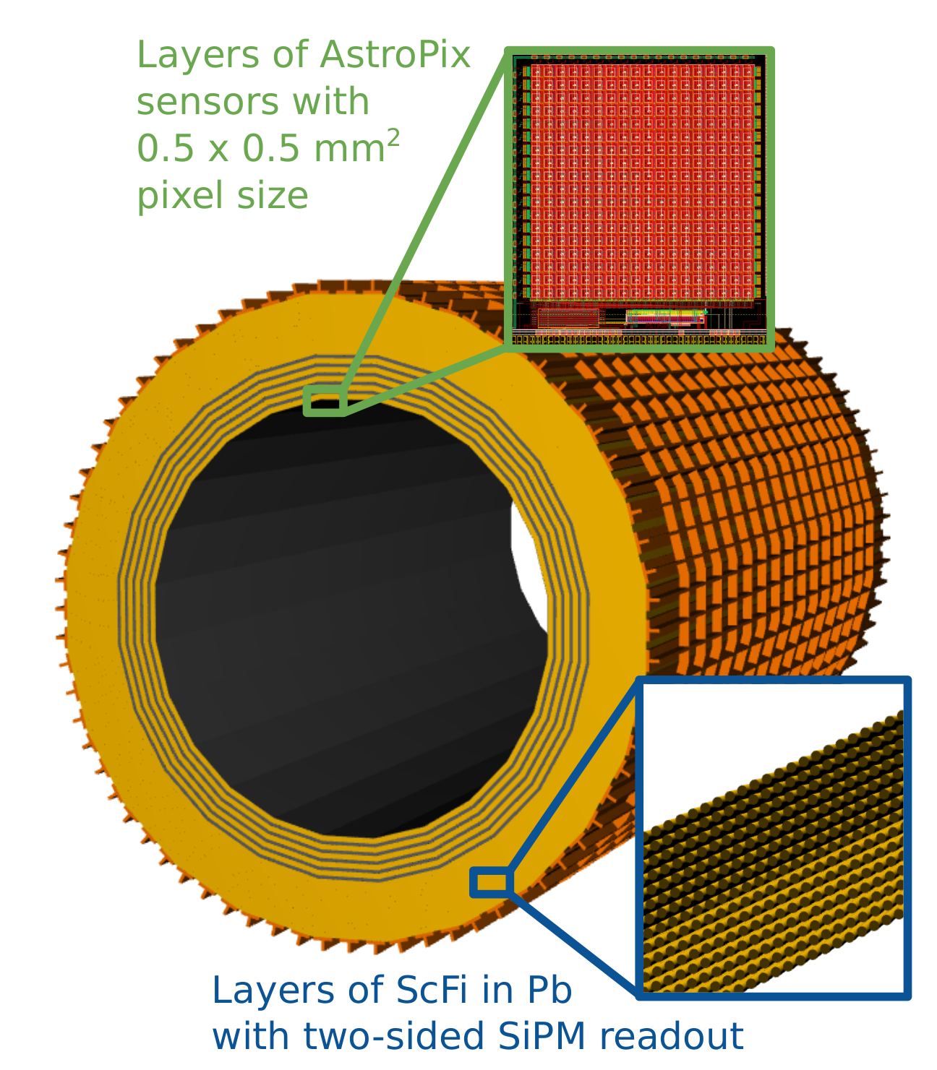
Calorimetry
hadrons
electrons
Backwards HCal
Steel/Sc Sandwich
tail catcher
world’s first
at
High granularity
W/SciFi EMCal
Longitudinally separated HCAL with high-η insert
world’s first
at
Backwards EMCal
PbW04 crystals, SiPM photosensor
Barrel HCAL
(sPHENIX re-use)
world’s first
at

Slide 15













ePIC Central Detector International Participation
In-kind contribution goals are 30% of the Detector and 5% of the Accelerator
Superconducting
Solenoid (MARCO)
Dual-radiator
RICH
Forward Electromagnetic
Calorimeter
Barrel
Electromagnetic
Calorimeter
Tracking
Detectors
EIC-France is making vital contributions to the ePIC detector and the realization of the EIC science program.
Backward
Electromagnetic
Calorimeter
Time-of-Flight
Backward Hadronic
Calorimeter
Data-Acquisition
Electronics
HGCROC/CALOROC, EICROC, SALSA

Slide 16



Far-Forward/Far-Backward Detectors International Participation
B0 Magnet Spectrometer
Zero Degree Calorimeter
e beam
Roman Pots and
Off-Momentum Detectors
p/A beam
Luminosity System
Low-Q2 Taggers
IR vacuum – crucial interface for detectors

Slide 17
The ePIC Collaboration

Slide 18
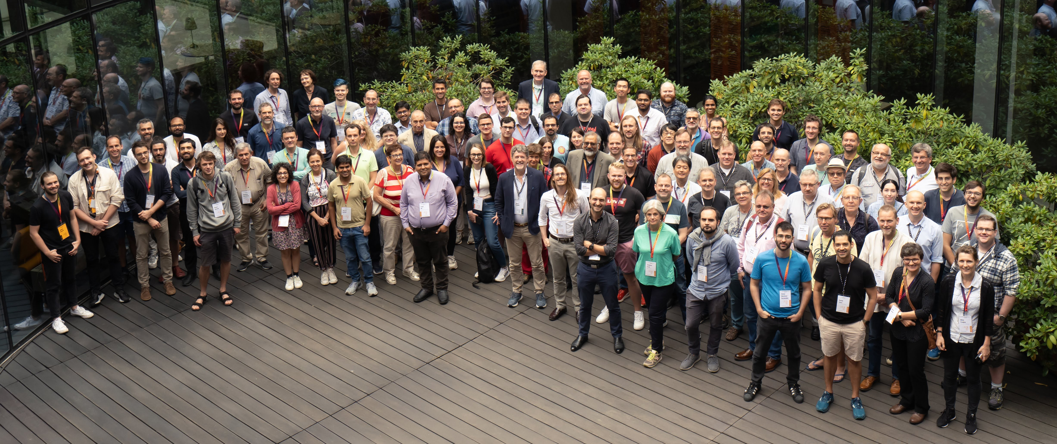
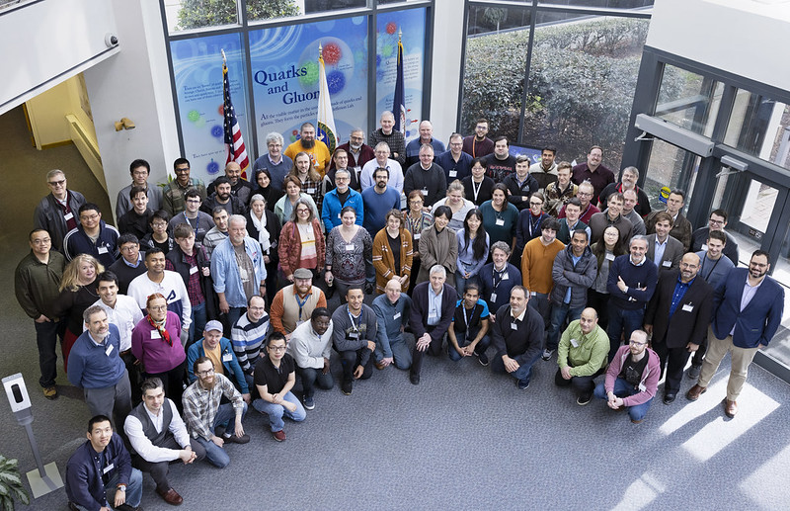
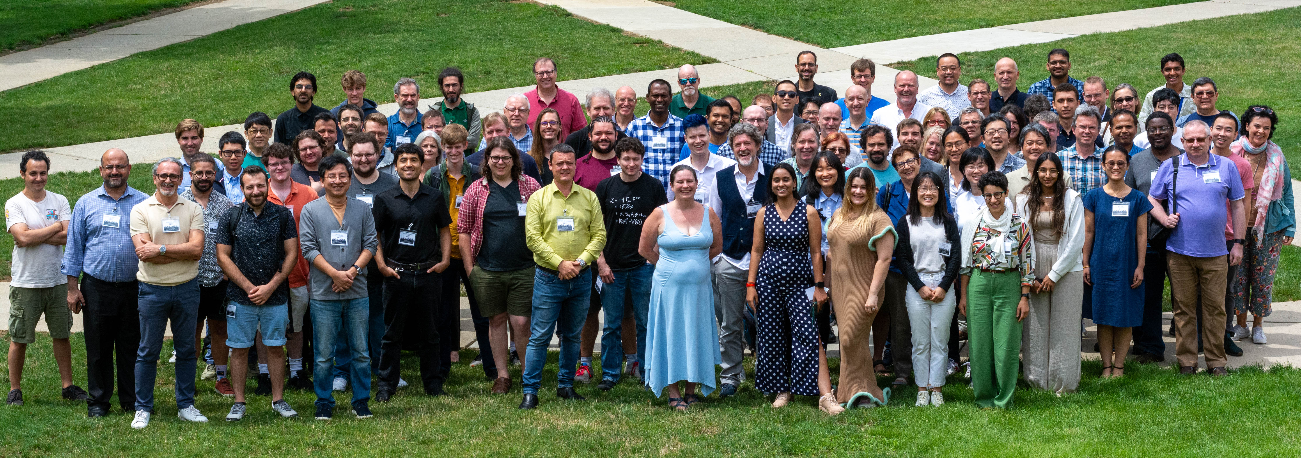
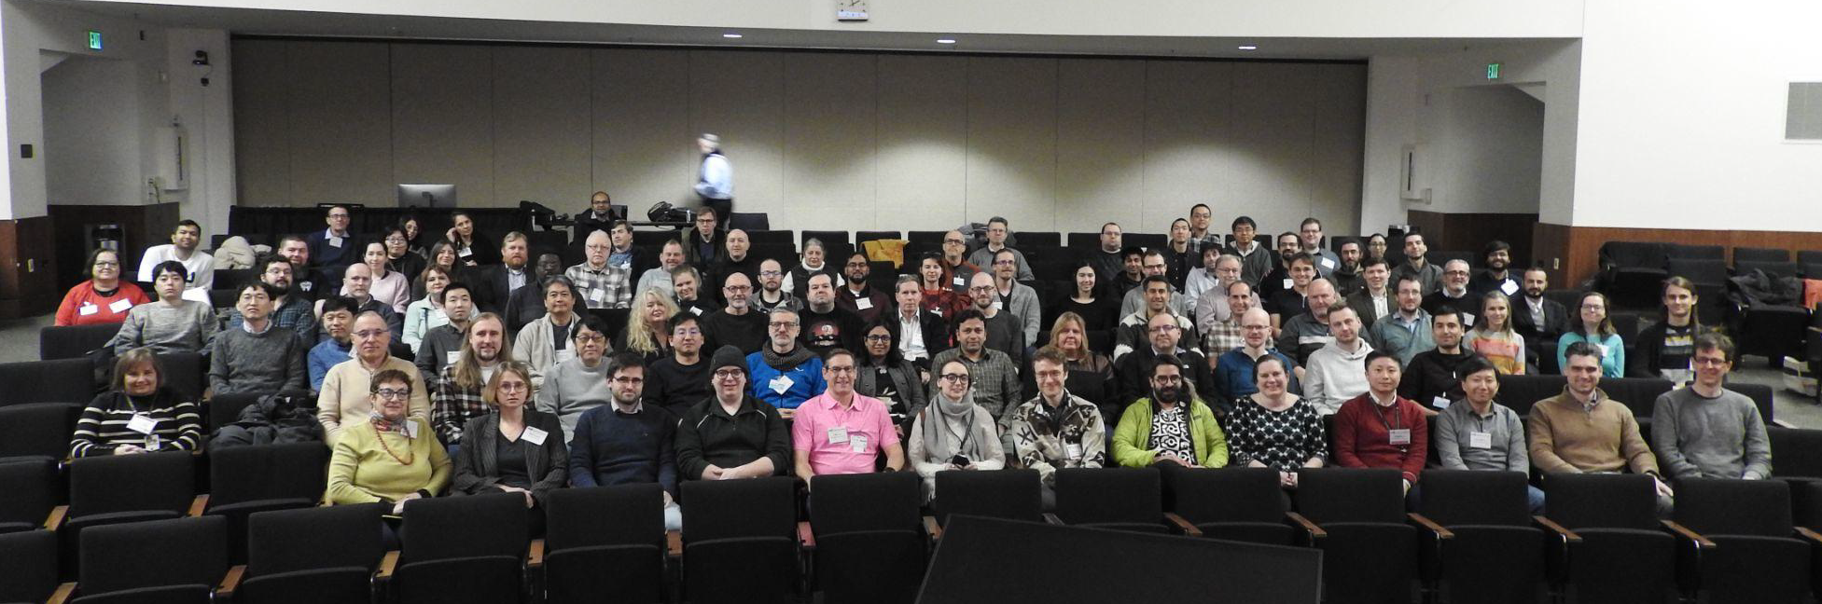
The Collaboration
Warsaw, July 2023
JLab, Jan. 2023
ANL,
Jan 2024
ePIC is a community of scientists dedicated to realizing the EIC science mission.
The ePIC Collaboration is as unique as the ePIC detector.
EICUG/ePIC Meeting – Lehigh, July 2024

Slide 19
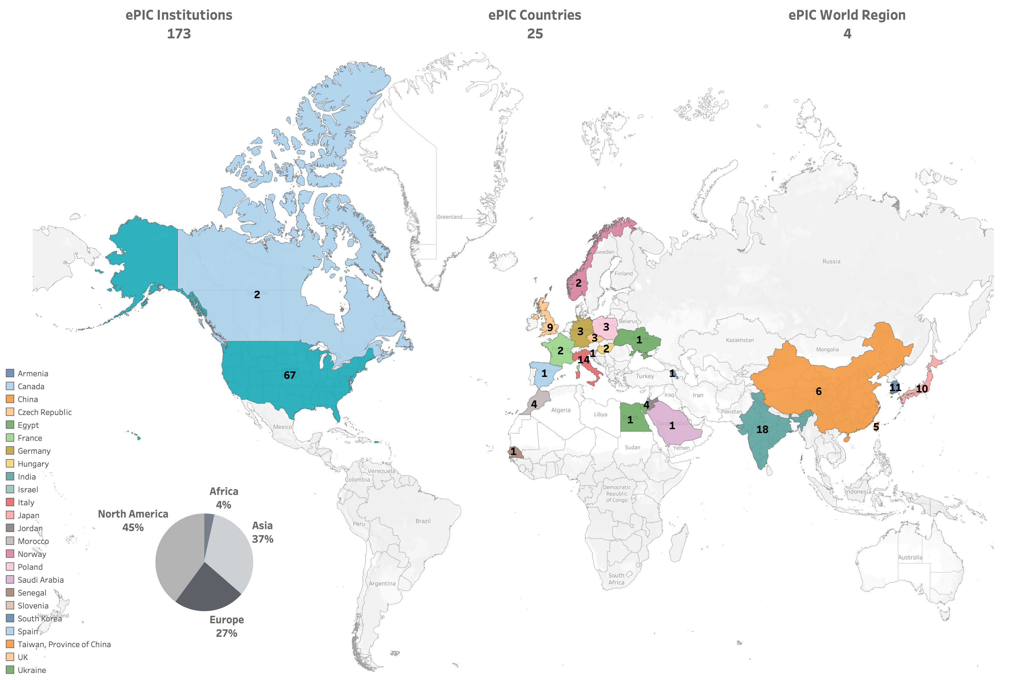










International
New Institutions Joining ePIC in 2024:
Univ. of Texas at Austin
Univ. Mohammed V in Rabat
Univ. Ibn Tofail in Kénitra
Univ. Mohammed
Premier in Oujda
Univ. Mohammed VI
in Bengurir
Kent State Univ.
Laboratoire
Leprince-Ringuet (LLR)
American University
in Cairo
Central University
of Haryana
Indian Institute of
Technology Mandi
ePIC Initiated in
July 2022
Currently:
>850 collaborators (from 2024 Institutional Survey)

Slide 20
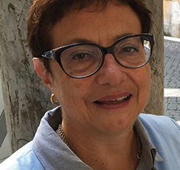

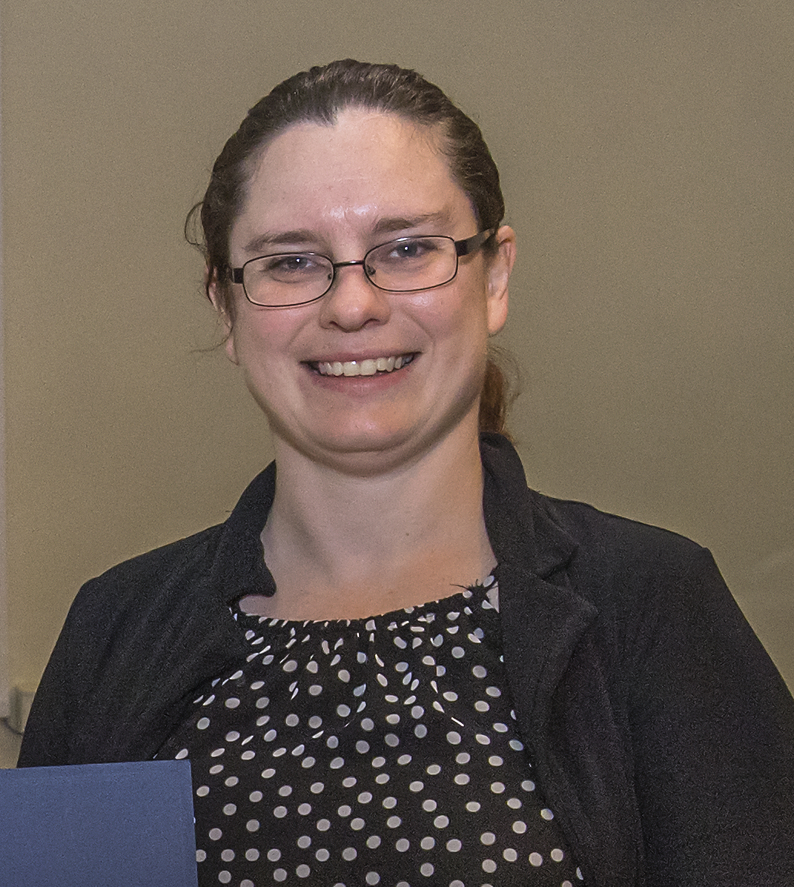
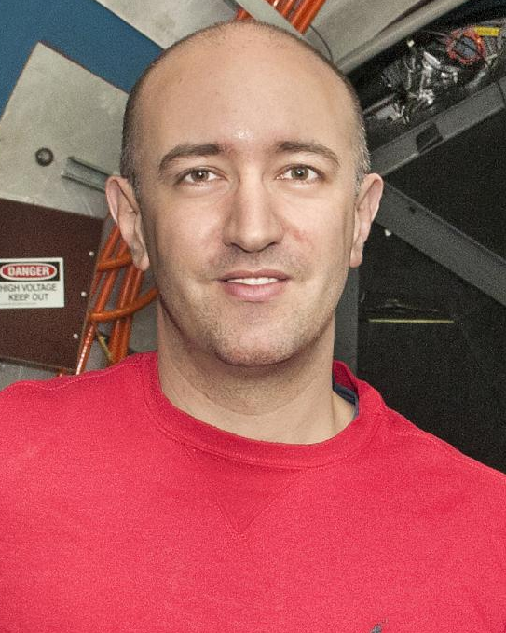
ePIC Collaboration Structure
Collaboration Council
Institutional Representatives
Spokesperson’s Office
Spokesperson (SP)
Deputies
EIC Project
Executive Board
Standing Committees
DE&I
Conferences and Talks
Membership
Elections
Publications
Ad-Hoc Committees
Technical Coordinator (TC)
Software and Computing Coordinator (SCC)
Analysis Coordinator
(AC)
Technical Coordinator (Acting)
• Silvia Dalla Torre (INFN)
Deputy TC’s:
Prakhar Garg (Yale)
Oskar Hartbrich (ORNL)
Matt Posik (Temple)
SCC Coordinator
• Markus Diefenthaler (JLab)
Dmitry Kalinkin
(Kentucky, Deputy SCC for Development)
Torre Wenaus
(BNL, Deputy SCC for Infrastructure)
Wouter Deconinck
(U. Manitoba, Deputy SCC for Operations)
Analysis Co-Coordinators
• Rosi Reed (Lehigh Univ.)
• Salvatore Fazio (Univ. Calabria)

Slide 21
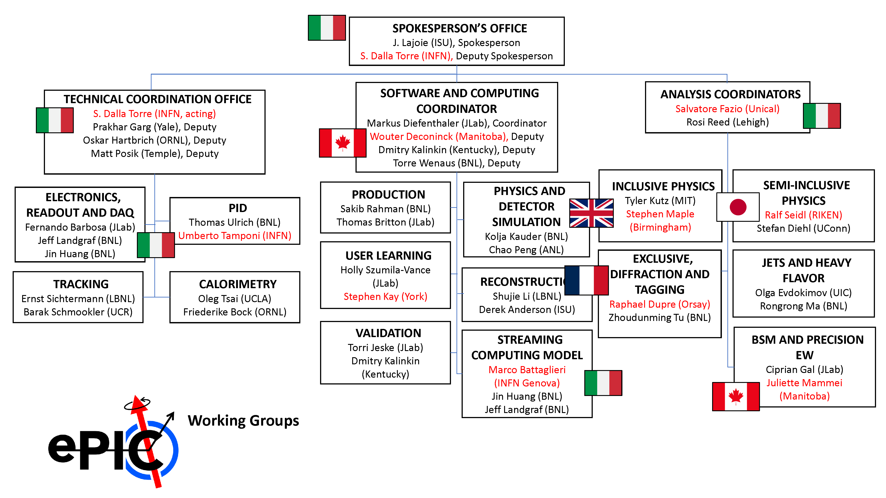
ePIC Working Group Structure

Slide 22
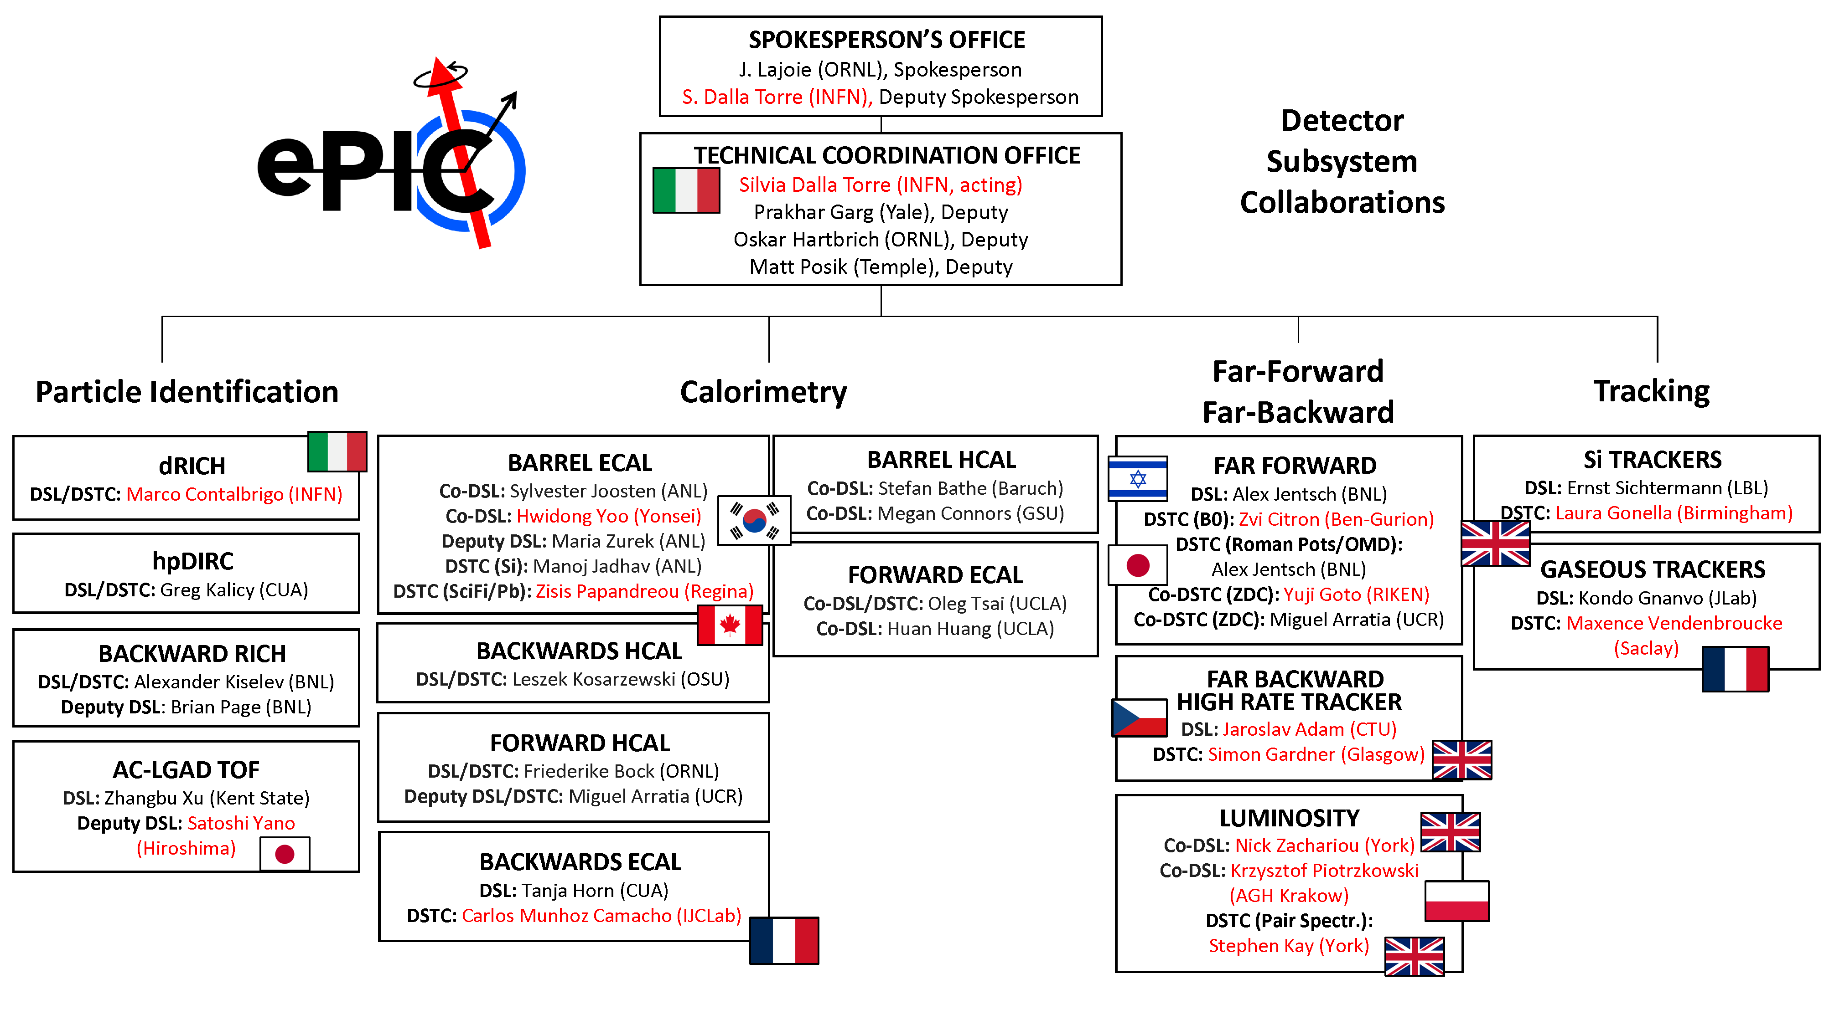
ePIC DSC Structure

Slide 23
TDR Strategy and Publications
In 2024 the ePIC collaboration will produce:
  A draft of the ePIC contributions to the EIC TDR
    The EIC TDR is the top priority
      Chapters on Physics Goals and Requirements and Experimental Systems
      Not just the document, but the simulations and detector R&D that form the basis
      Requires close cooperation between the collaboration and the project!
In 2025 the collaboration will produce:
  An ePIC Detector Design paper:
      Derived and expanded from the Experimental Systems TDR chapter
  An ePIC Physics Performance paper:
      Derived and expanded from the Physics Goals and Requirements TDR chapter
  An ePIC Streaming Computing Model paper
Version 0.1 In Review
Version 1.0 for CD-3B review (Dec 1st)
process design phase
structuring the
effort
draft ePIC pre-TDR
ePIC pre-TDR (CD-2)
writing
(TDR/notes)
Preparing papers for
publication
Mid Jan.24
Mid Mar.24
End Oct. 24
Late 2024
Early 2025

Slide 24
Summary
The EIC Science program will offer fundamental, new insights into QCD and the dynamical generation of hadron structure
The ePIC detector technical design is progressing to address the full range of EIC science:
  Detector R&D efforts transitioning to PED and integration
  EIC-France is making vital contributions
The ePIC Collaboration is strong, active and growing!
  New member institutions bring new strengths
  International participation is key to the success of ePIC!
    International collaborators play key roles in collaboration leadership

Slide 25


Slide 26
ePIC Resources
Public Website - https://www.bnl.gov/eic/epic.php
Mailing Lists – https://lists.bnl.gov/mailman/listinfo
Indico Agenda - https://indico.bnl.gov/category/402/
  ePIC Software and Computing: https://indico.bnl.gov/category/435/
Wiki - https://wiki.bnl.gov/EPIC
ePIC Software Training:
  Landing Page: https://eic.github.io/documentation/landingpage.html
  Tutorials: https://eic.github.io/documentation/tutorials.html
Mattermost: https://chat.epic-eic.org
ePIC Zenodo Community: https://zenodo.org/communities/epic

Slide 27
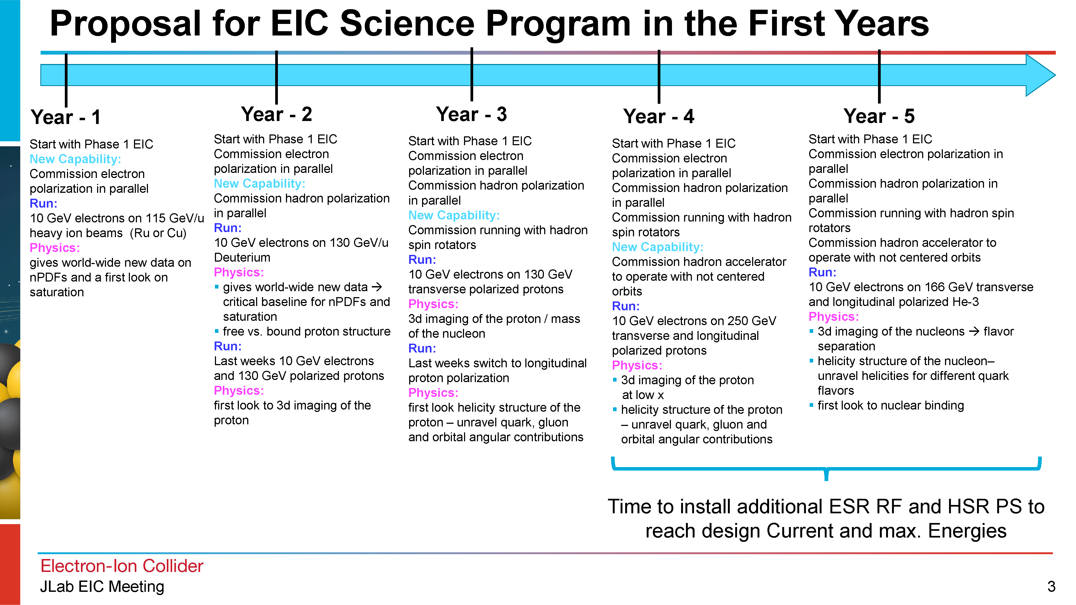
Early Science with ePIC
From Elke’s talk @ Jlab EIC Meeting 10/4
At the recent EICUG/ePIC meeting, the discussion of what the staging the EIC might mean to an early science program was initiated.
This starting point has generated a growing discussion within the collaboration - the collaboration is motivated to define a meaningful and impactful early science program within the EIC.
ePIC Early Science Workshop

Slide 28
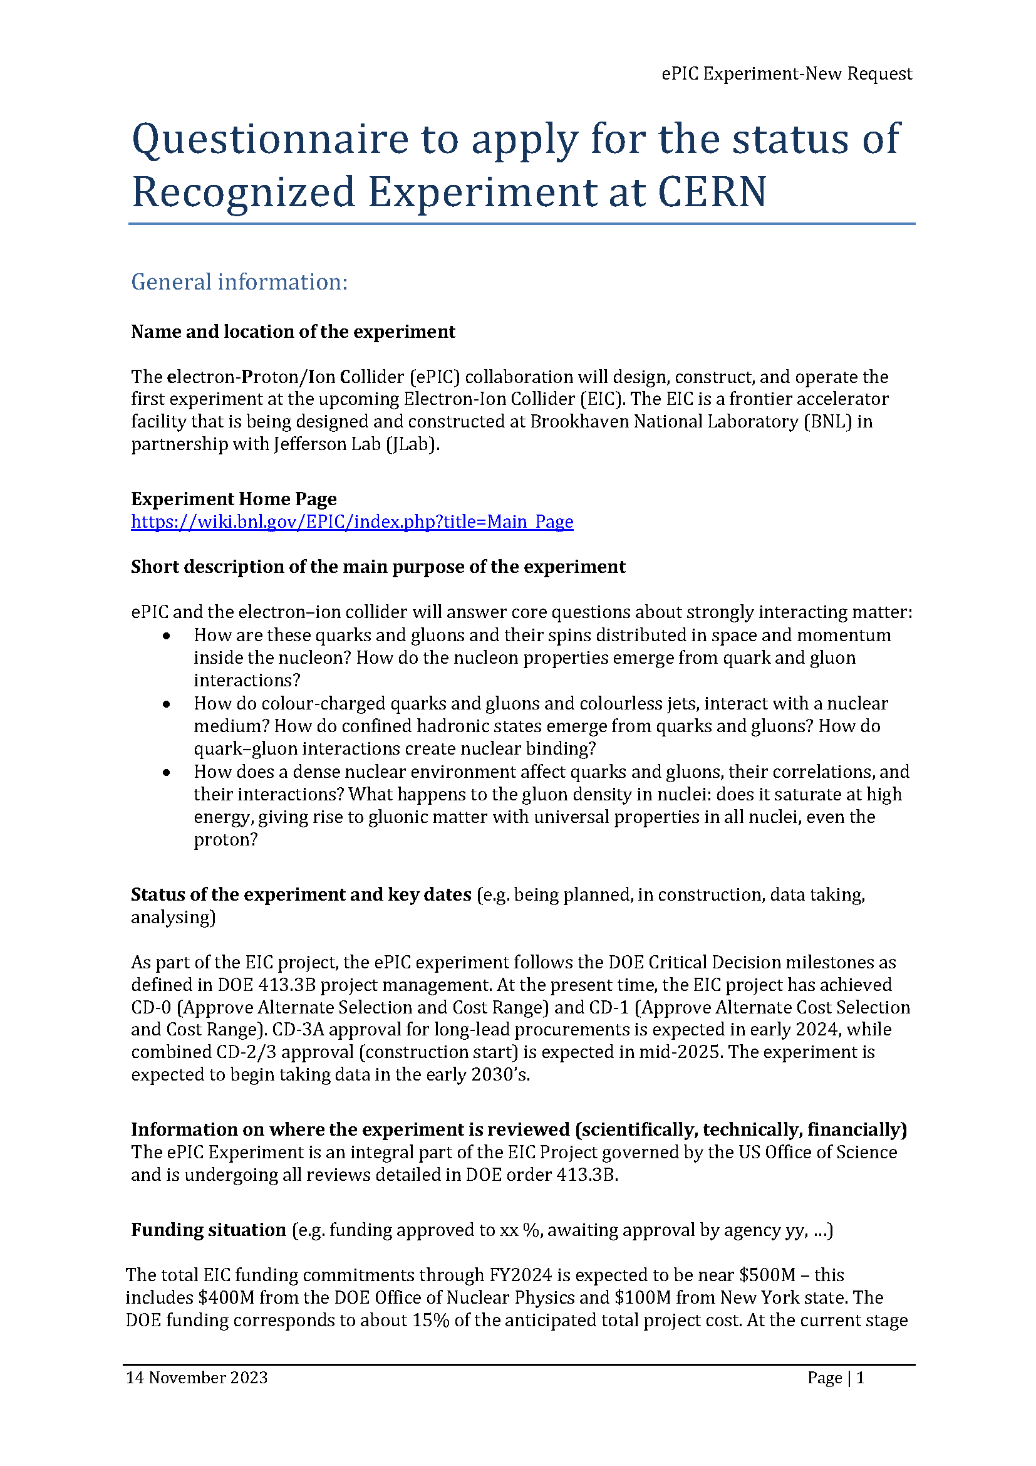
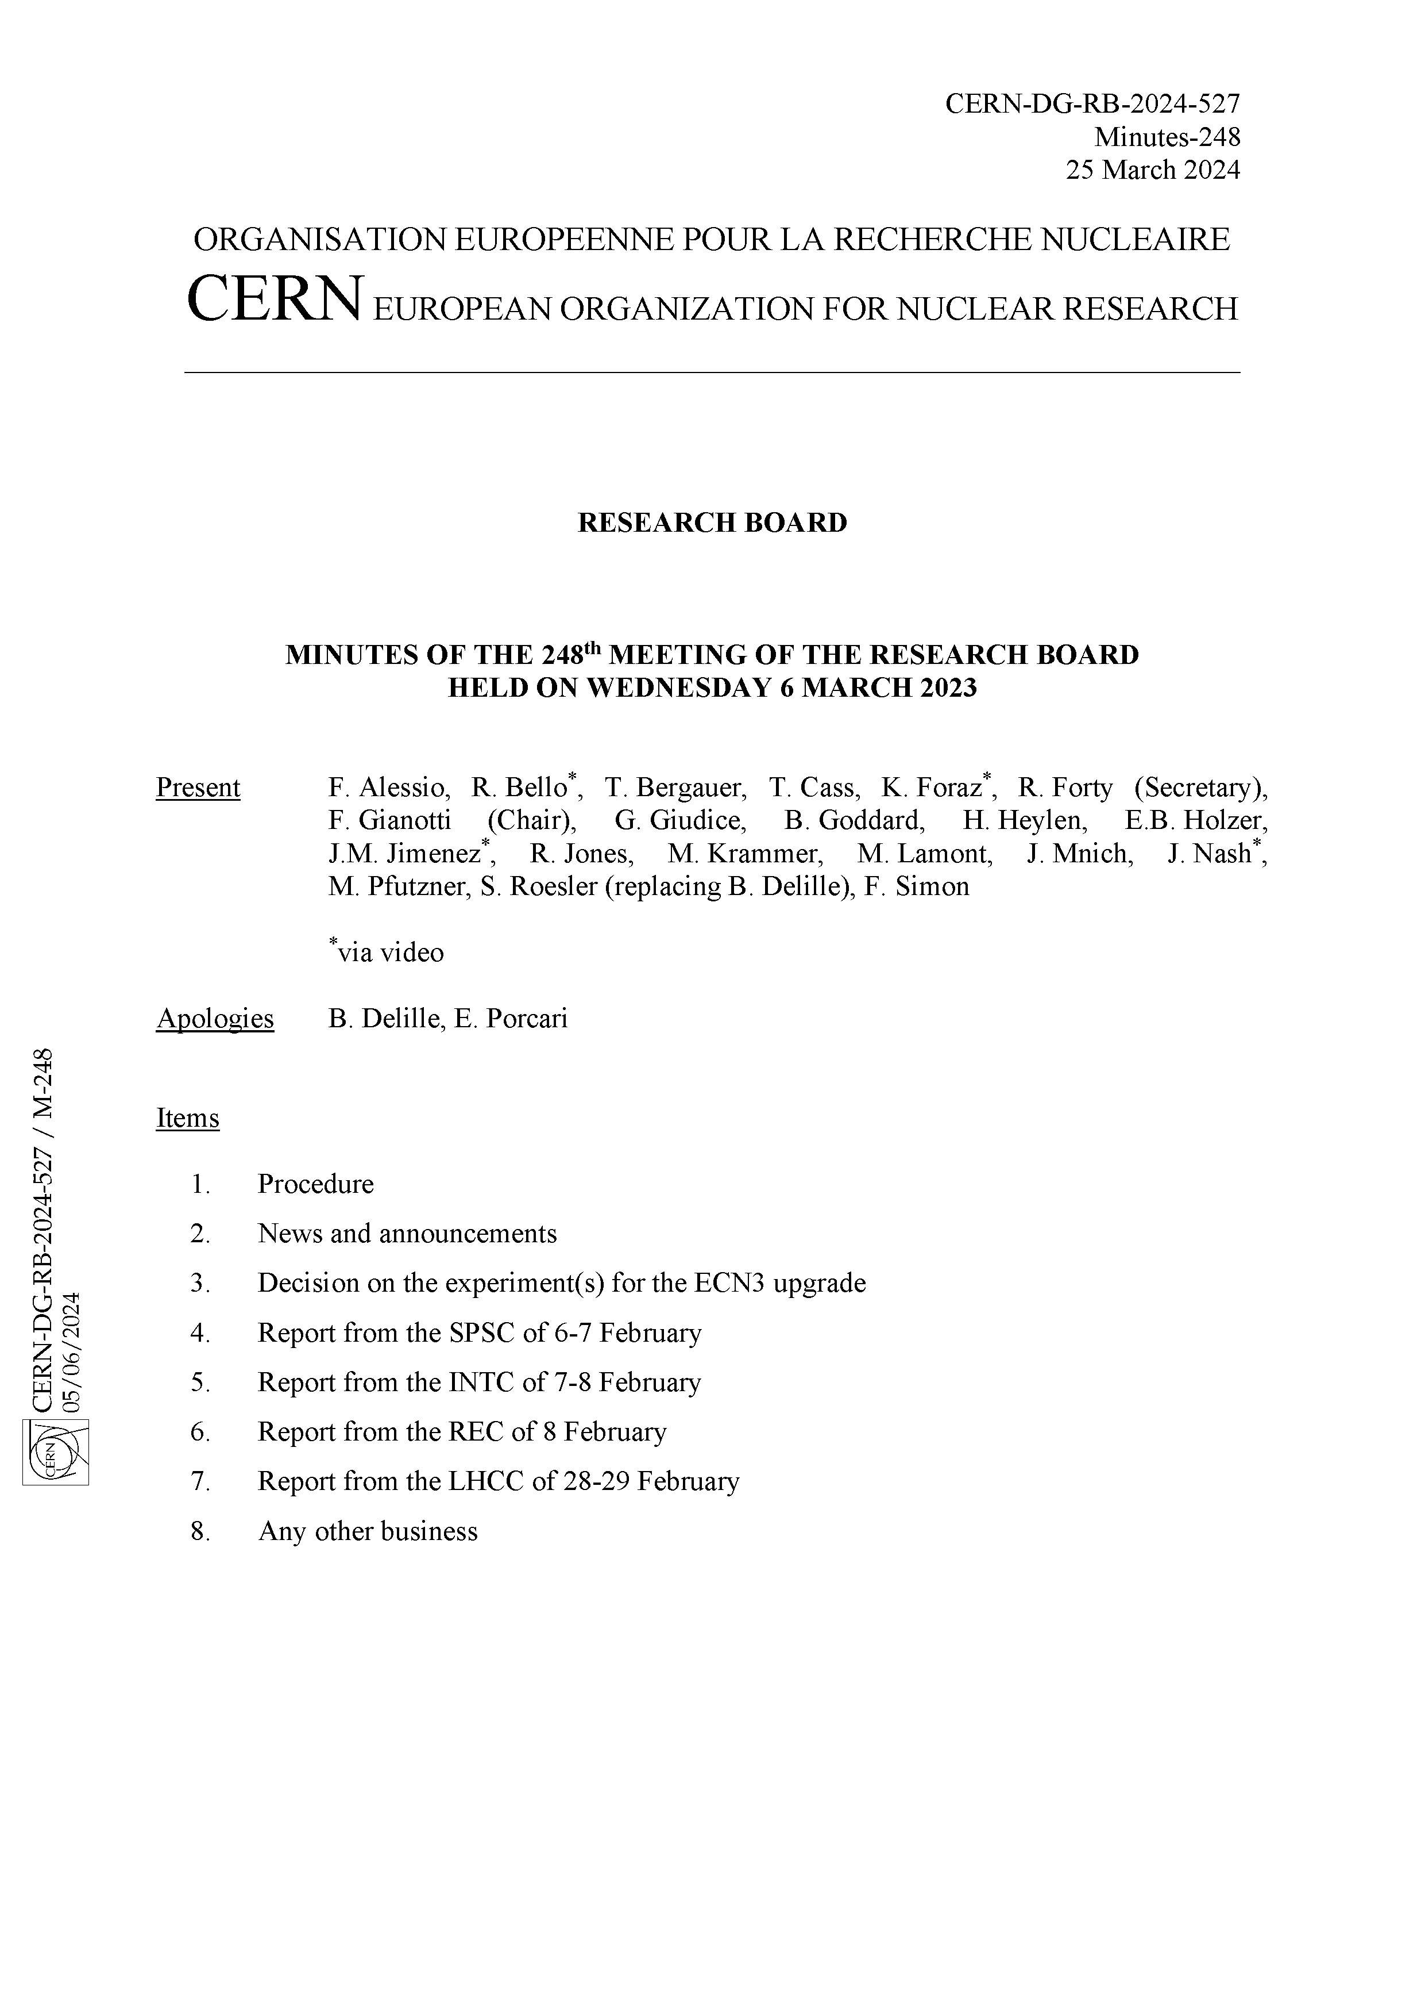
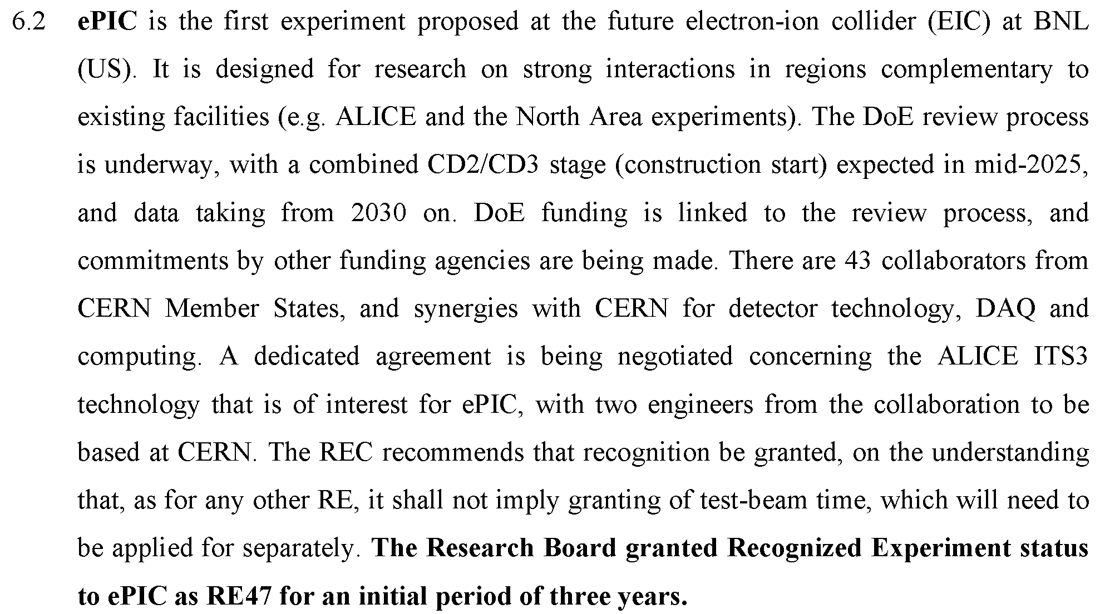
CERN Recognized Experiment
Progress on Recognized Experiment status:
  8/23 email from Helge Meinhard:
Draft MOU under discussion, expect to have this completed by end of 2024
“I'm pleased to report that the administrative hurdles are out of the way,
I'll reach out to all experiments REC considered earlier this year.”

Slide 29





ePIC Committees
DE&I Committee:
Chair: Megan Connors (GSU)
Vice-Chair: Christine Nattrass (UTK)
Francesco Bossù (CEA-Saclay), Wouter Deconinck (University of Manitoba), Narbe Kalantarians (Virginia Union University) , Iris Ponce Pinto (Yale University) , Maya Shimomura (Nara Women’s University) , Allison Zec (University of New Hampshire)
Collaboration Council
Institutional Representatives
Conferences and Talks:
Chair: Maria Zurek (ANL)
Vice-Chair: Brian Page (BNL)
Barbara Jacak (Berkeley), Daniel Brandenburg (OSU), Dmitry Kalinkin (Kentucky), Nick Zachariou (York), Xuan Li (LANL), Nicola Rubini (Bologna), Wouter Deconinck (Manitoba)
Standing Committees
DE&I
Conferences and Talks
Membership
Elections
Publications
Ad-Hoc Committees
Membership Committee:
Chair: Peter Steinberg (BNL)
Vice-Chair: Pietro Anontioli (INFN-Bologna)
Friederike Bock (ORNL), Helen Caines (Yale), Doug Higinbotham (JLab), Bedhangas Moharty (NISER), Silvia Niccolai (IJCLAB), Marzia Rosati (ISU)
Elections Committee:
Chair: Helen Caines (Yale)
Vice-Chair: Ken Barish (UCR)
Past-Chair: John Arrington (LBNL)
Maria Stefaniak (OSU), Domenico Elia (INFN)
Publications Committee:
Chair: Rene Bellwied (U. Houston)
Vice –Chair: Annalisa Mastroserio (INFN Bari)
Lokesh Kumar (Panjab U.), Michela Chiosso (Torino), Prithwish Tribedy (BNL), Markus Diefenthaler (JLab), Sevil Salur (Rutgers),
ex-officio w. Conferences and Talks Committee:
Daniel Brandenburg (OSU)
All ePIC Standing Committees now formed and at work.

