Slide 1
EIC France 2024
IJCLab Orsay, October 9-11, 2024
Marcella Grasso
Scientific Director for Nuclear Physics
CNRS – Nucléaire et Particules
IN2P3
https://www.bnl.gov/eic/

Slide 2

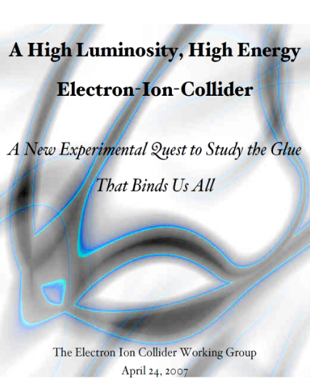


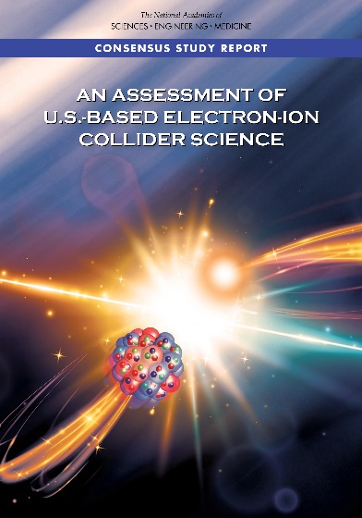
The Scientific Foundation for an EIC was Built Over Two Decades
2002
Electron-Ion Collider..central to the nuclear science program of the next decade.
“a high-energy high-luminosity polarized EIC [is] the highest priority for new facility construction following the completion of FRIB.”
2007
The science questions that an EIC will answer are central to completing an understanding of atoms as well as being integral to the agenda of nuclear physics today.”
2009
2010
Gluons and the Quark Sea at High Energies
2012
2013
2015
Major Nuclear Physics Facilities for the Next Decade
2018
NSAC
2021
“…essential accelerator and detector R&D [for EIC] should be given very high priority
in the short term.”
“We recommend the allocation of resources …to lay the foundation for a polarized Electron-Ion Collider…”
March 14, 2013
“..a new dedicated facility will be essential for answering some of the most central questions.”
“The quantitative study of matter in this new regime [where abundant gluons dominate] requires a new experimental facility: an Electron Ion Collider..”

Slide 3



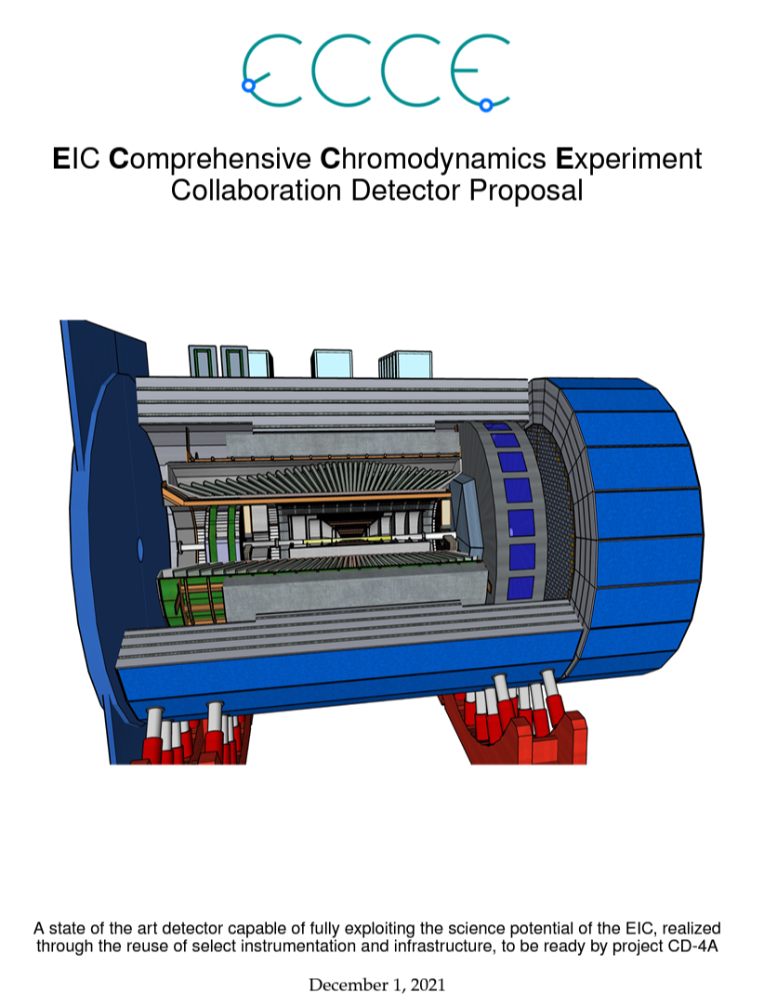
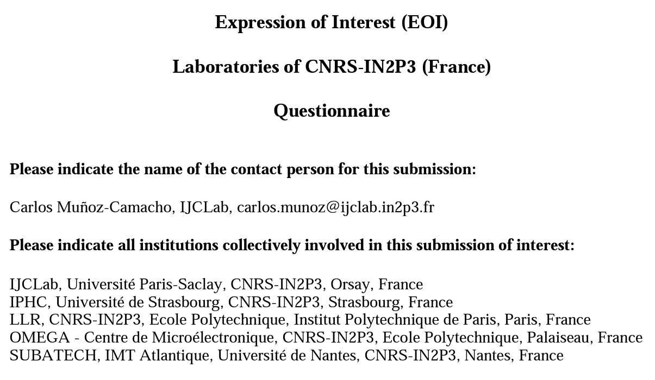
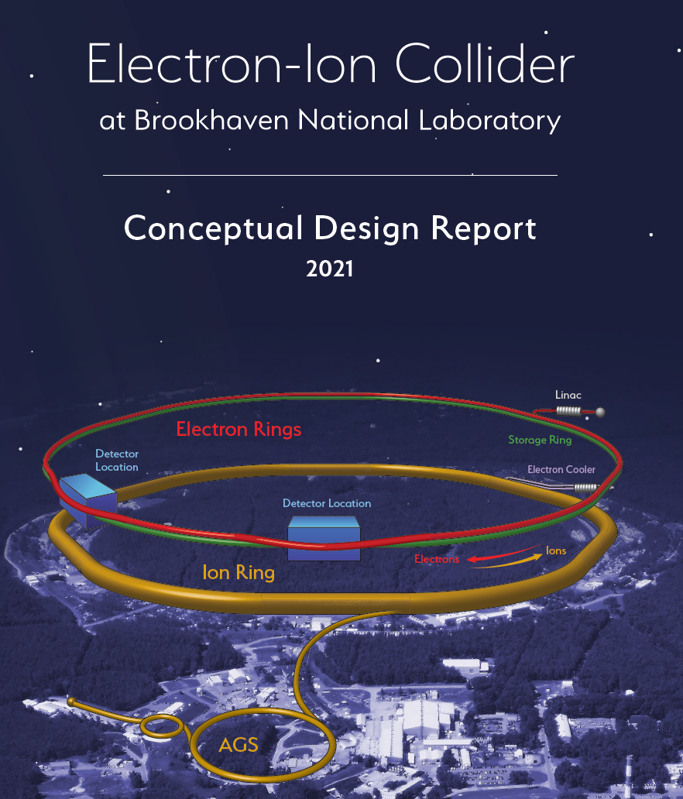
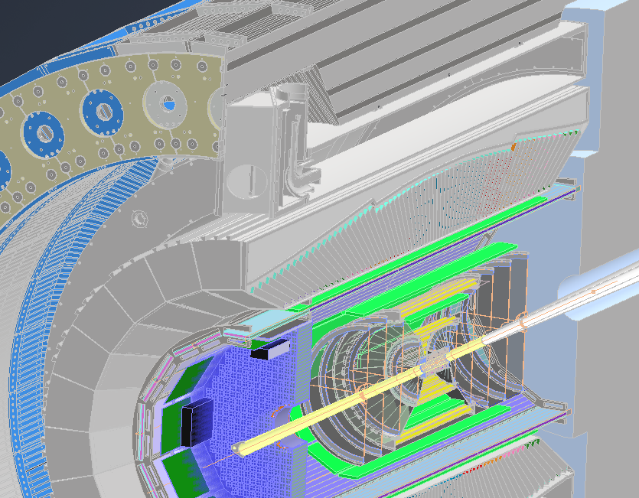
CNRS/IN2P3 involvement in EIC
2014: Participation to the EIC White Paper
2020: Co-conveners and leadership roles in Yellow Report
IN2P3 physicists are experts in nucleon 3D imaging, central to the EIC science, with a fruitful experimental program being carried out at Jefferson Lab
2019: EICUG Meeting in Paris
2020: Physics co-convener in the ECCE detector proposal
2020: Expressions of Interest
ePIC Collaboration:
- Calorimetry co-convener
- Exclusive processes WG co-convener
- Backward ECAL Technical Coordinator
Also, IN2P3 members have served in several EICUG committees and serve in the new EIC-related generic detector R&D advisory panel
2021: Contribution to the EIC CDR

Slide 4




Scientists, interested in the detector and in the physics that will be done there:
presently, Jefferson Lab physicists at IJCLab and CMS at LLR
Several theorists are interested also in other laboratories
Support from engineers and technicians in the two laboratories
Participation of Omega
Engineers and technicians interested in the accelerator project
Joint IN2P3 - Ecole Polytechnique microelectronics design center: designing ASICs for nuclear physics, particle physics and astrophysics detectors

Slide 5
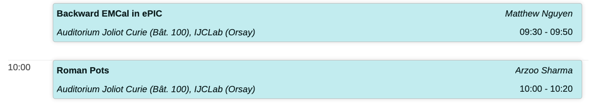
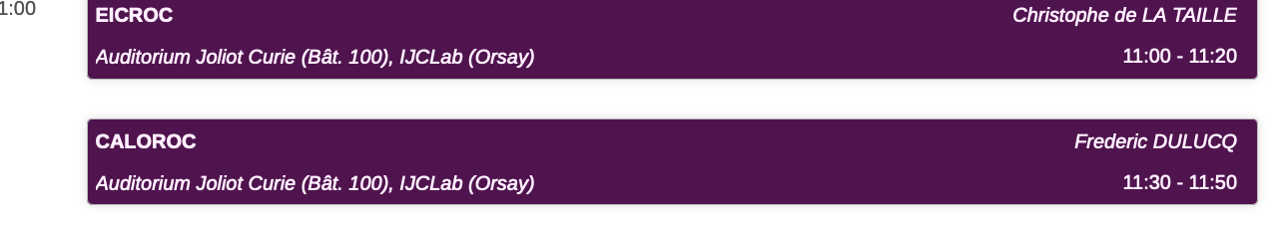
In particular, some talks:
Detector section 10/10
ASICs section 10/10
Accelerator section 11/10

Slide 6
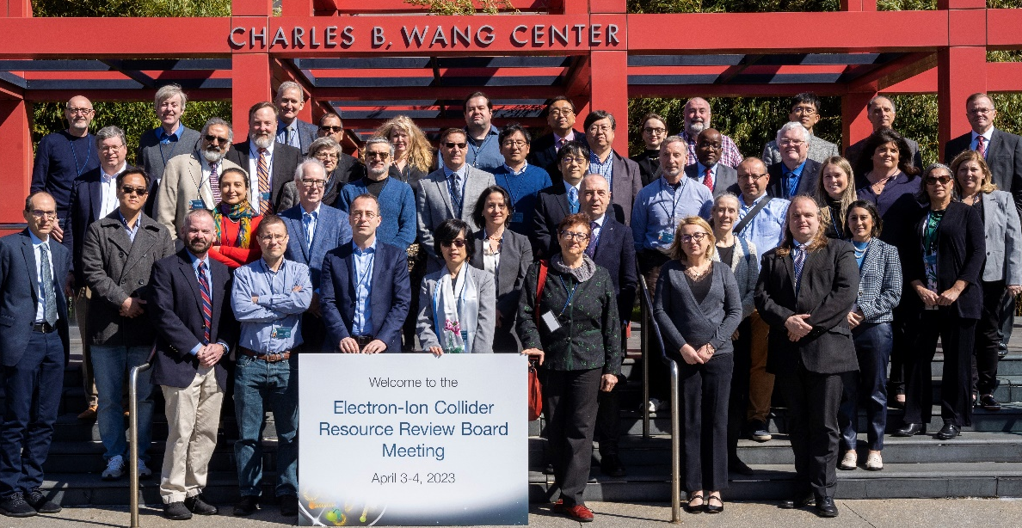
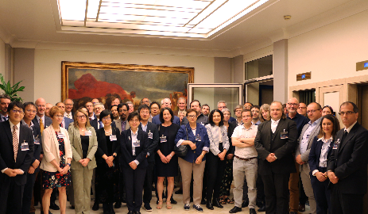
The Electron-Ion-Collider project at IN2P3
IN2P3 in the EIC Advisory Board and in the EIC RRB
RRB, New York 2023
RRB, Rome 2024

Slide 7
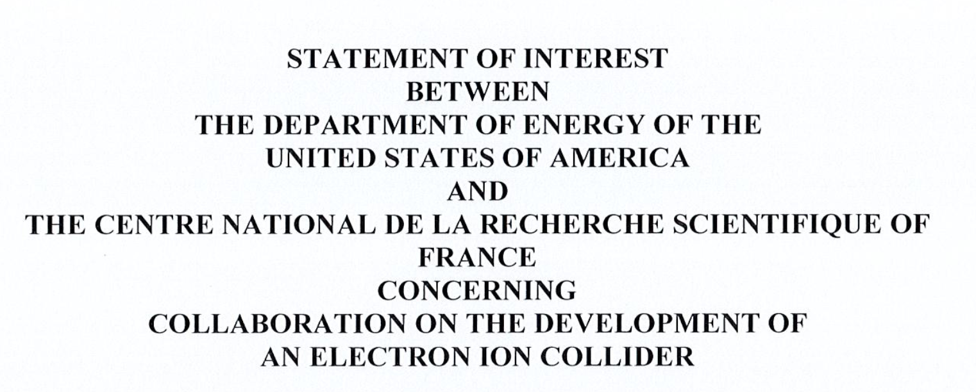
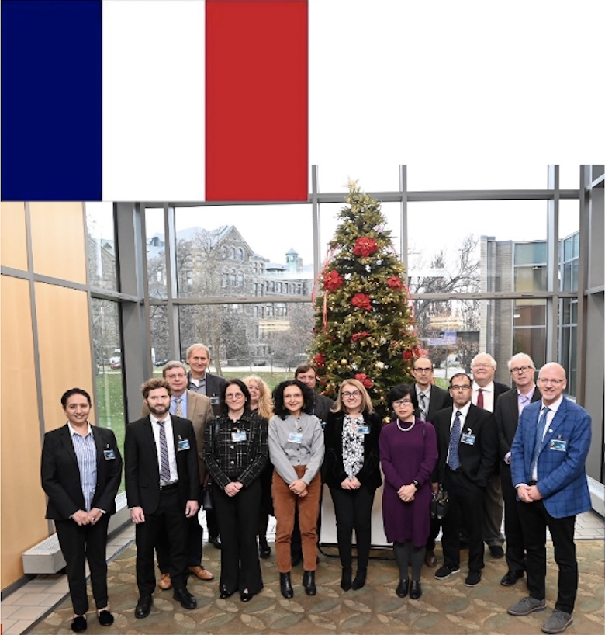
Signature of a DOE-CNRS Statement of Interest on the EIC project, January 2024 (CEA signed a few months before)
New agreement recognizes existing international cooperation and planned future efforts toward building an Electron-Ion Collider (EIC) and carrying out its scientific program

Slide 8
European Strategy for Particle Physics update 2025
Ongoing process
Hadronic physics is also discussed

Slide 9

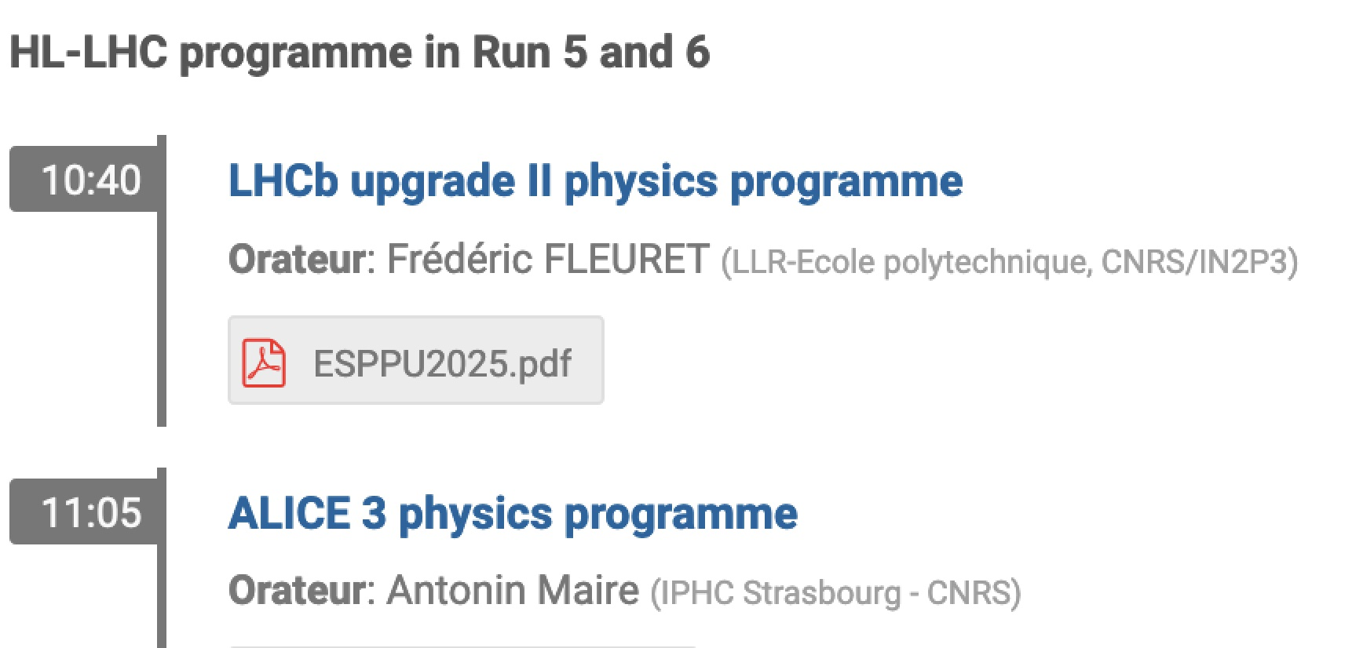
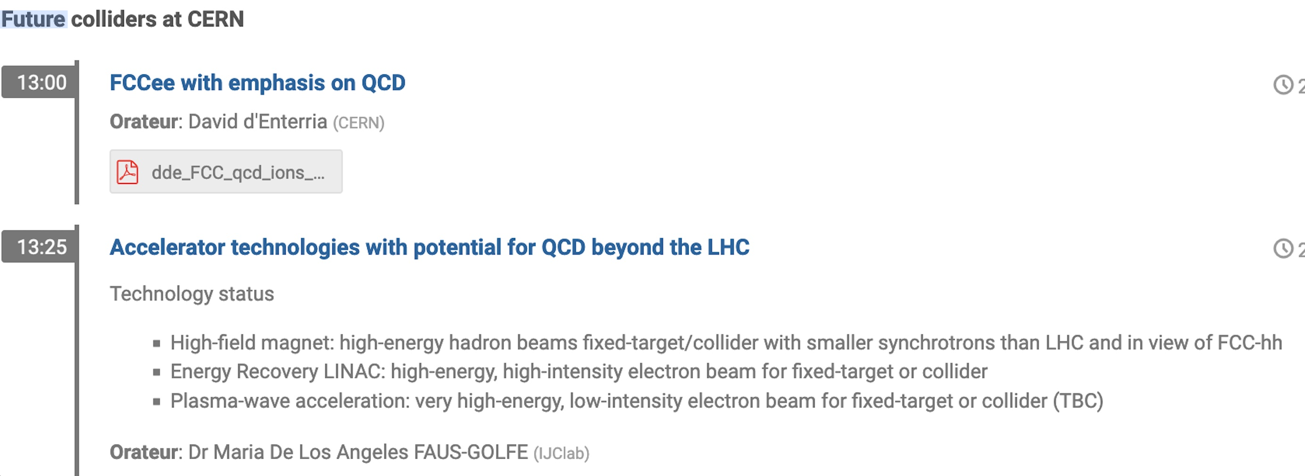
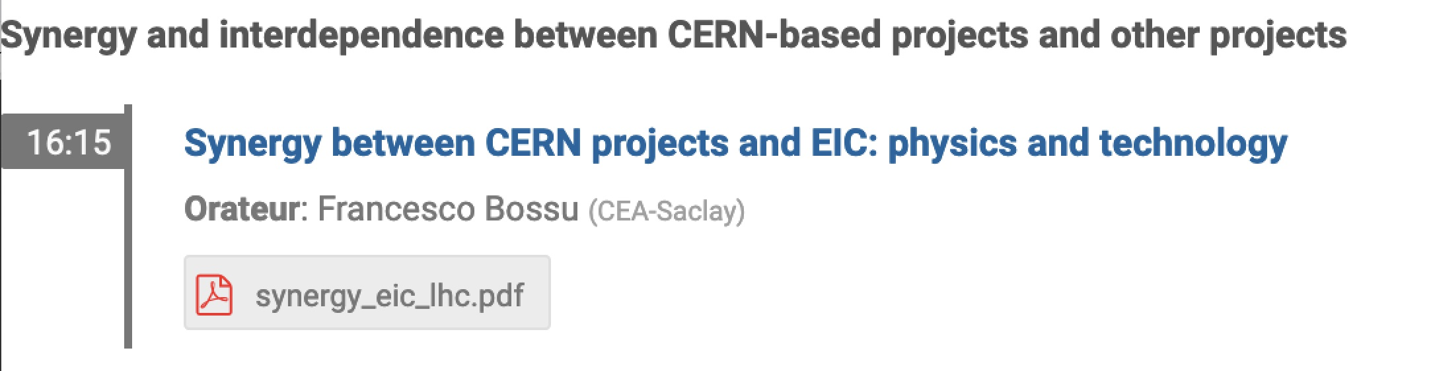
1-day discussion with several talks (about 45 participants from CNRS and CEA)
Objective : preparing a French bottom-up contribution

Slide 10
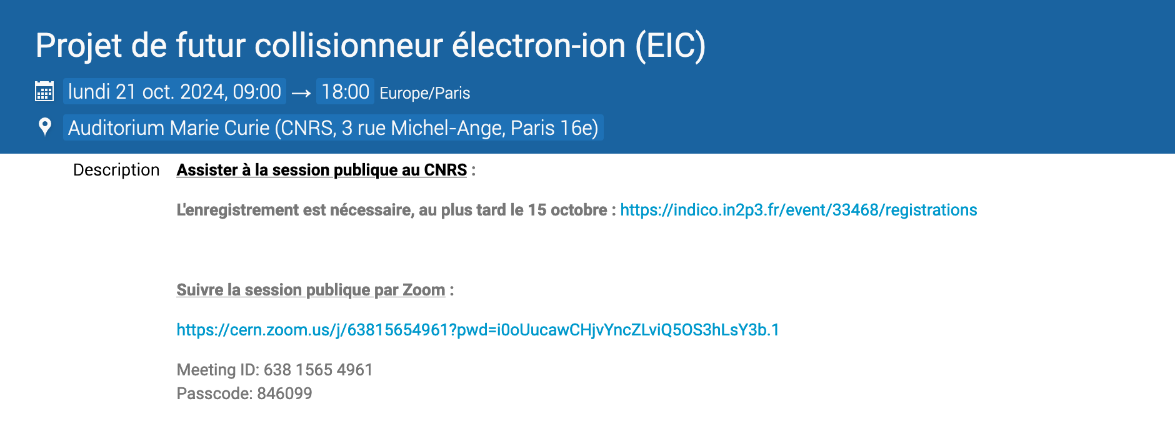
IN2P3 Scientific Council dedicated to EIC

Slide 11
Thank you for your attention
https://www.bnl.gov/eic/

