Slide 1
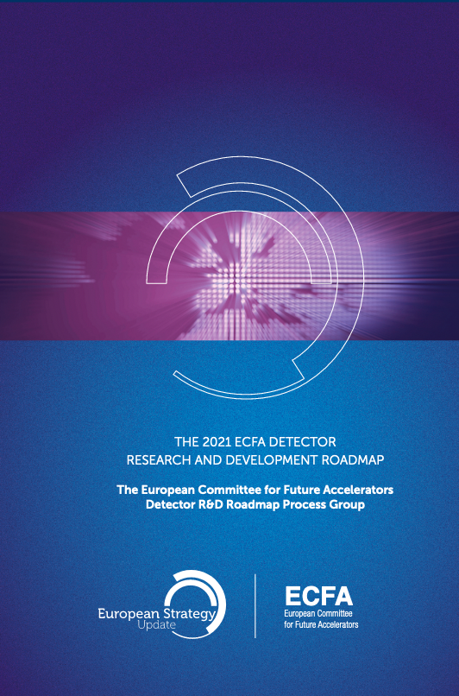
reference document
https://cds.cern.ch/record/2784893
Overview of detector R&D
future programs context
new techniques & detector concepts
R&D framework
Early Career Researcher’s Workshop | France
8 Oct. 2024, APC Paris
D. Contardo IP2I CNRS/IN2P3

Slide 2
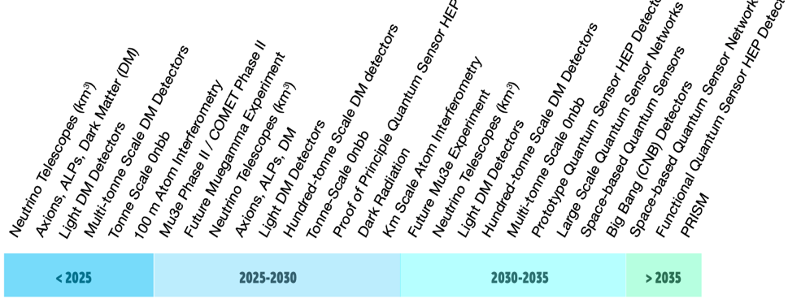
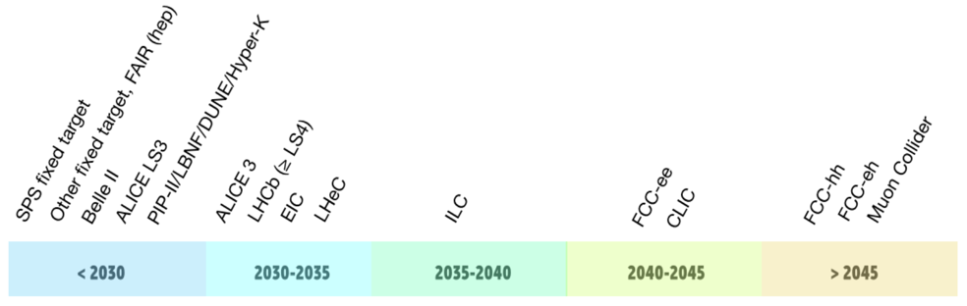
Future HEP programs identified in the ECFA detector R&D roadmap
    Future experiments
    at large accelerator facilities at small accelerators, nuclear reactors, cosmic rays
future collider focus in this presentation
highlights in back-up
    R&D areas
gaseous - solid state - photon and PID - calorimeter
liquid - quantum and emerging technologies
electronics and on-detector processing - integration - training and career
range of dates of the programs are as understood at the time of the roadmap preparation in 2021

Slide 3
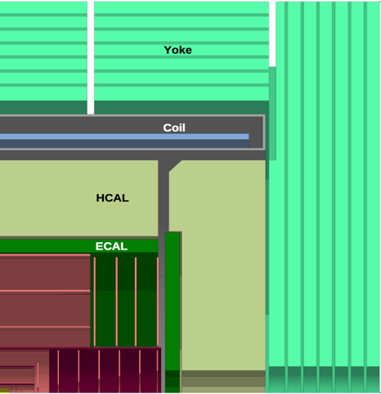
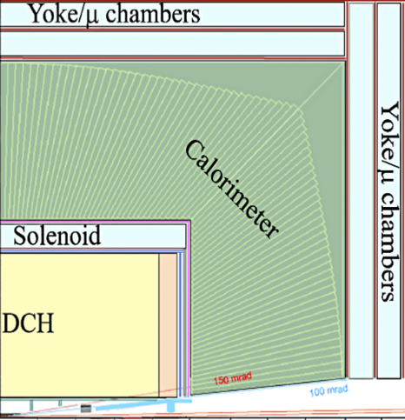
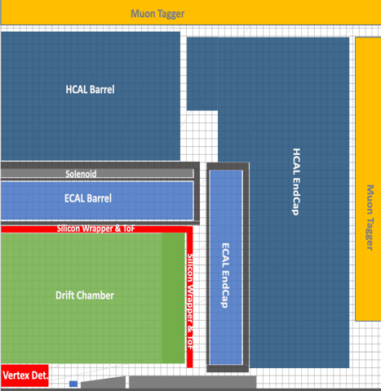
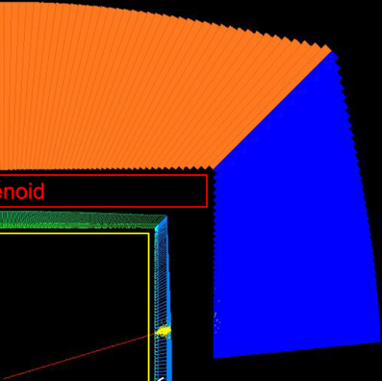

3rd ECFA workshop on e+e- Higgs, Top & ElectroWeak Factories (this week)
possible detector concepts at FCC-ee and their system technologies
CLD/ILD’
IDEA’
ALLEGRO
Muons MPGD, MWPC, RPC
ECAL High Granularity Si/W. Crystal Liquified Noble Gaz
HCAL Scint./MPGD/RPC Dual Readout Scint. Tile
Tracking full-Si Si-VD + TPC + Si-layer Si-VD + DCH + Si-layer
PID RICH in front of ECAL TPC+ ToF layer DCH + ToF
TPC
3

Slide 4
Solid State Detectors for tracking and Time of Flight Particle ID

Slide 5
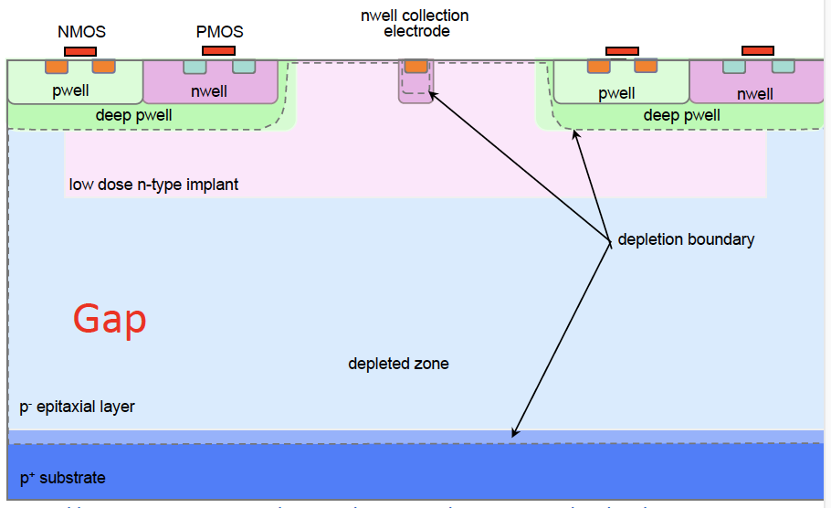
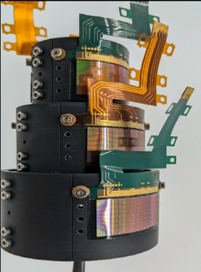
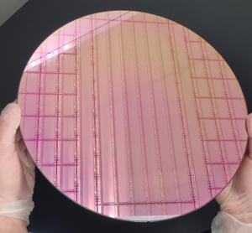
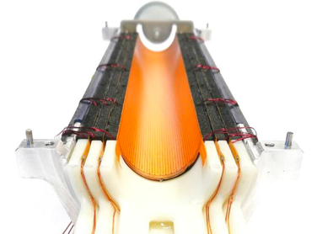
Vertex Detector (track origin precision)
most precise (highest channel density) and transparent (lowest X/X₀)
Monolithic CMOS sensors
CMOS Imaging Sensor
commercial process*
State of the Art 1st implementation
ALICE-LHC ITS3 planned for LS3 (2026-2028)*
σ_{hit} ≃ 5 μm, X/X₀ ≃ 0.1% /layer
New foundry process in 65 nm node with stitching technique
≃ 20 μm pitch, ≃ 10 x 28 cm area, ≲ 50 μm thickness → bending), ≲ 40 mW /cm² power → gas flow cooling
* current timeline for detector installation in experiment

Slide 6
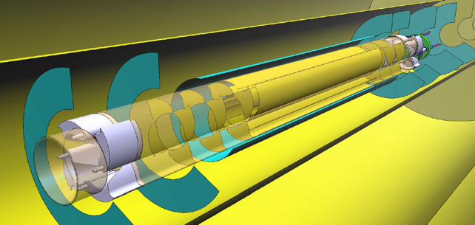
Vertex Detector next generations
further improve resolution and X/X₀, hit rate and radiation tolerance; implement 5D features
challenge to implement readout features for high channel densities at low power consumption
Next generation
ALICE-3 planned for LS4 (2033-2034)*
σ_{hit} ≃ 2.5 μm, ≲ 0.1% X/X₀ /layer
niel 10¹⁶ neq/cm², tid 300 MRad**
hit rate 100 MHz/cm²
iris design for insertion of VD in Beam Pipe
Next to next generation planned for FCC-ee (2041-2044)*
main performance constraints similar to ALICE-3
but different Machine Detector Interface and beam backgrounds
efficiency, hermeticity and knowledge of acceptance crucial for systematic errors
opportunity for one leap in technologies with finer foundry nodes and 3D integration techniques
* current timeline for detector installation in experiment

Slide 7
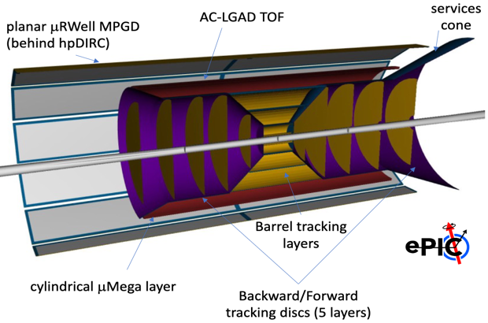
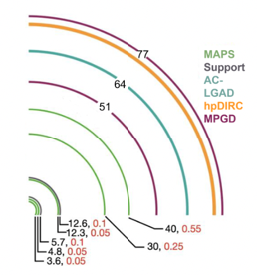
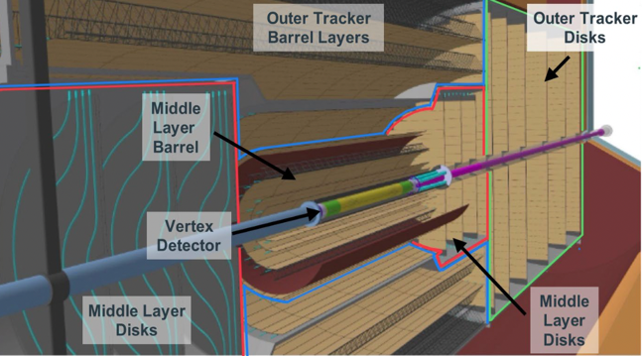
MCMOS application in Central Tracking (track momentum precision)
combine position resolution and low X/X₀ in large area layers
pixel granularity is not needed in longitudinal direction design must be adapted compared to VD
1st implementation and next applications
ePIC (EIC) 3035* - O(10) m²
ITS3 technology
ALICE-3/LHCb – LS4 2033-2034* O(60/10) m²
Next to Next application planned for FCC-ee (2041-2044)*
≃ 5 to 7 μm resolution (depending on radius) with much reduced X/X₀ compared to SoA
* current timeline for detector installation in experiment

Slide 8
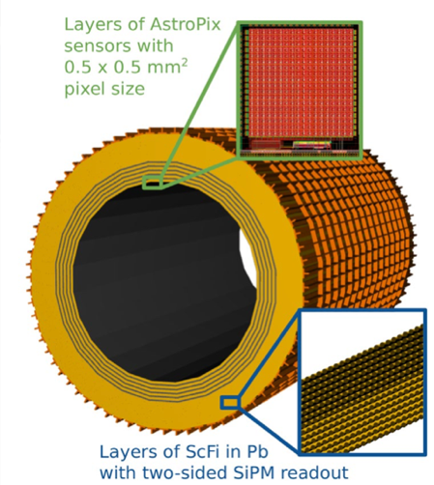
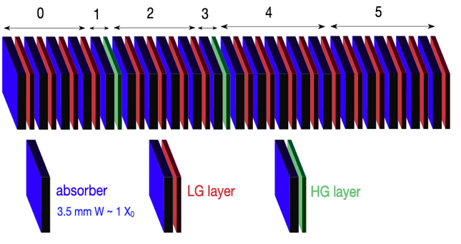
MCMOS application in Si/W EM Calorimetry
improve compactness (sampling fraction) and/or imaging capability
state of the art (1st implementation in experiment)
ALICE-3 - LS3 2026-2029* FOrwardCALorimeter
20 layers with 2 MCMOS layers of pixels 30x30 μm²
ePIC (EIC) 3033*
AMS 180 nm process
MCMOS design for a calorimeter can be with pads and analog readout
“Blue Sky” with pixels enabling 5D imaging with particle counting in showers
(with similar challenges as for VDs)
* current timeline for detector installation in experiment

Slide 9
Towards 5D* tracking with Solid Sate Devices
State of the Art timing precision ≃ 20 ps, but not achieved at high channel densities
(present detector concepts all consider specific ToF layers for PID)
several designs and foundry process under study are illustrated below
“Blue Sky” goal to collapse best individual properties in a single sensor
at FCC-hh similar channel densities will be needed to fight collision pile-up in a full 5D tracking
with timing precision < 10 ps, data flows & radiation levels 2 orders of magnitude higher than achieved today
this will require a leap in technologies (with new materials, finer nodes, 3D electronics integration…)
*precision timing requires time walk correction ie measure of the signal amplitude usually perfomed with a Time over Threshold mesurement

Slide 10
Gas detectors for Tracking and PID
a challenge in some cases is to perform with eco-friendly gas mixtures

Slide 11
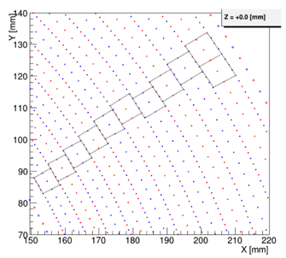
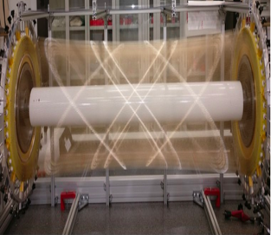
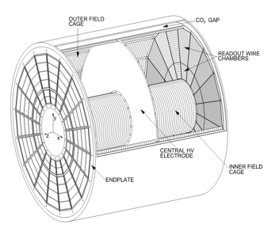
Large Volume Gaseous Detectors
most transparent for momentum resolution, number of hits for far vertices and PID up to ≃ 50 GeV
O(100) points with O(100) μm precision, O(1/5) % X/X₀ (barrel/endcap), energy loss precision ≲ 3%
Drift Chamber
ex MEG-II
State of the art
Time Projection Chamber
ALICE and CALICE ILD/ILC prototypes
4-5 m (L) x 4 m (D), 340000 wires
light/thin wires new materials
dN/dx ionization cluster counting
with O(1) GHz waveform sampling
Next generations
at e-e colliders
enable use at FCC with
reduced ion backflow
dN/dx ionization cluster
counting with high granularity MPGD
ex. CMOS monolithic μMegas readout
InGrid

Slide 12
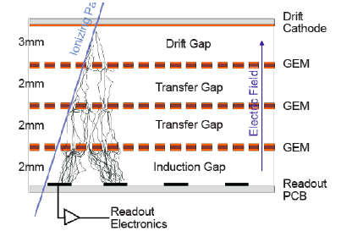
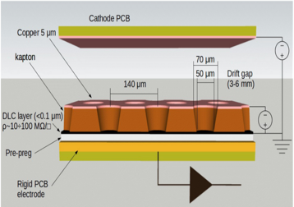
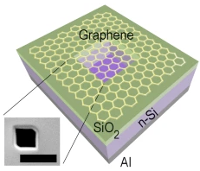
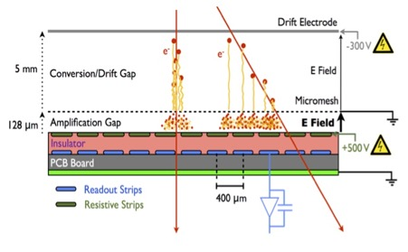

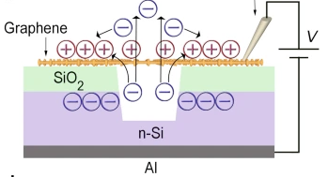
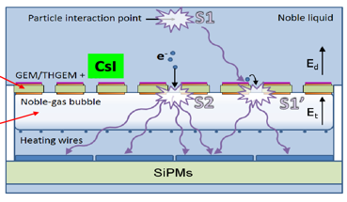
Micro-Pattern Gaseous Detectors for tracking
muon detection – sampling calorimetry – readout in RICH and NGL TPCs – ToF PID
SoA GEM CMS-LS2
new generation μRWell
“Blue Sky” concept
Graphen material grid
single amplification
Diamond-Like Coating
AC coupling readout
(thin - easy assembly)
μMegas ATLAS-LS2
Dual Phase Noble Gas Liquid TPC
ToF with Cerenkov radiator
and photocathod
cylindrical design
ex. Picosec μMegas
O(25) ps
RO of scint. and ioni. GEM + photocathode + SiPM

Slide 13
PID with light devices

Slide 14
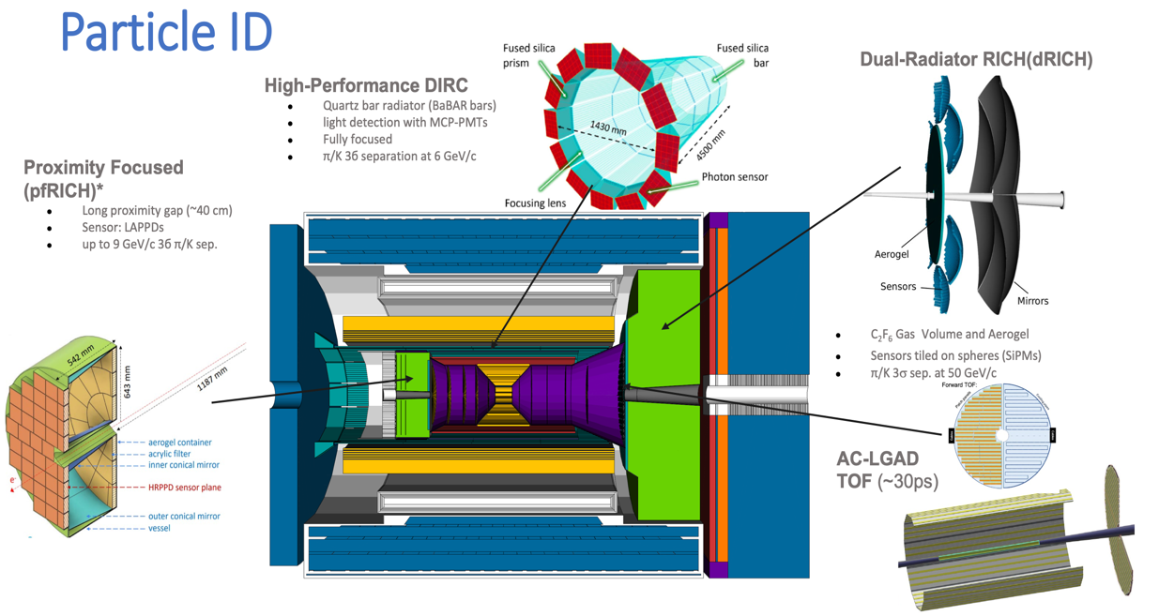
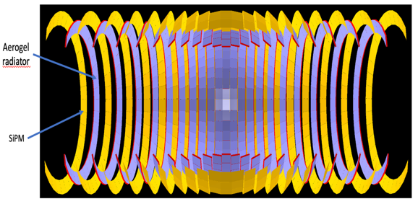
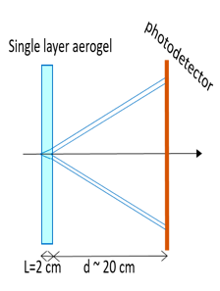
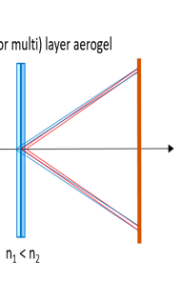
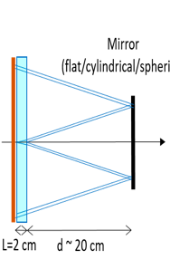
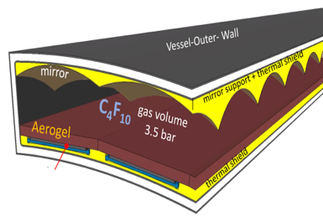
Ring Imaging Cherenkov detectors
ALICE-3 - LS4 2033-2034*
Aerogel RICH + SiPM 34 m²
projective geometry
ePIC (EIC) – 2033* and LHCb-II LS4 2033-2034 DIRC concept focusing lens / expansion design
MCP-PMT readout (slide 16)
ePIC (EIC) 3035
LAPPD readout
LAPPD readout
dual radiator RICH
aerogel + gas
readout w/ SiPMs
(also FCC-ee concept)
Next generation for FCC-ee mometum up to 50 GeV
dual radiator design with SiPM
And also readout of gas RICH with new generation of MPGDs
equipped with photocathodes for photon conversion (slide 12)
* current timeline for detector installation in experiment

Slide 15
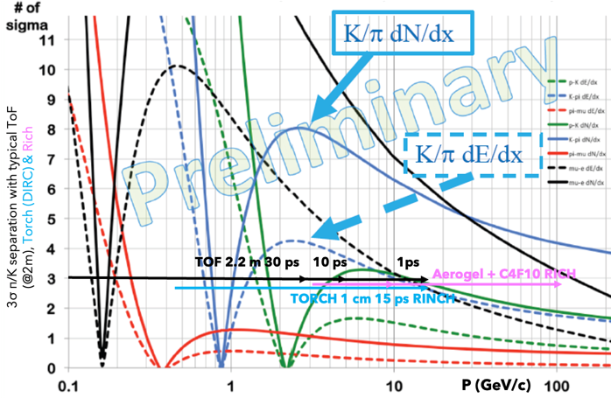
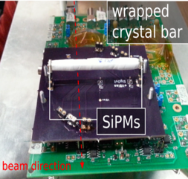
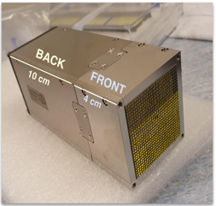
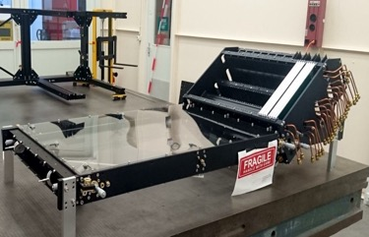
Light devices for ToF PID
stand alone (momentum range fixed by precision)
cover dE/dx crossing in gas detectors, complete RICH coverage at low momentum
State of the Art CMS and next applications in LHCb-II
CMS ≃ 25 ps
LYSO crystal + 2 SiPM
ToA and ToA
LHCb ≃ 15 ps
Spaghetti Calo.
Crystal + MCP PMT
waveform sampling
LHCb ≃ 15 ps
TORCH RICH
Cerenkov radiator
+ MCP-PMT
Next generation at FCC-ee (2043-2044)*
ToF PID integrated in electomagnetic homogenous and DUAL Readout Calorimetry (slide 19)
* current timeline for detector installation in experiment

Slide 16
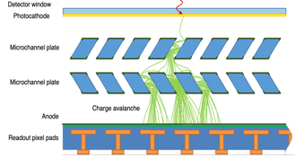
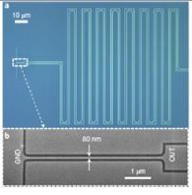
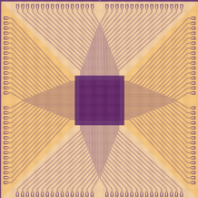
Photo-Detectors are crucial to all light devices
RICH and ToF detectors, Calorimeters, Liquified Noble Gas TPCs
in a nutshell challenge to improve single photon sensitivity over large WL range (scint. & Cerenkov)
also need to improve the radiation tolerance
State of the Art and next generation of applications
next to next generation
MCP-PMT
ePIC then LHCb-II RICH & Calo
SiPM
CMS ToF & HGCal then ALICE-3 RICH
MCP-PMT with nano-pores
SPAD digital monolithic SIPM
“Blue Sky” quantum devices
ex. Superconducting Nanowire Single Photon Detectors
high QE from 10 nm to 10 µm WL, DCR < 10⁻⁵ cps, Timing ≃ 3 ps, rate O(1) GHz/mm²
Micro-lens SPAD
32 x 32 array
NIST - JPL

Slide 17
Calorimetry systems

Slide 18
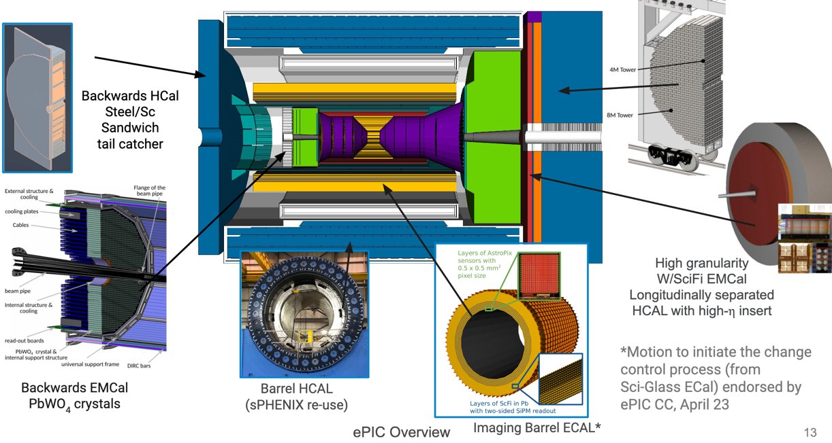
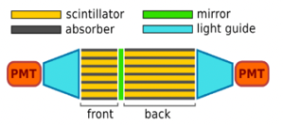
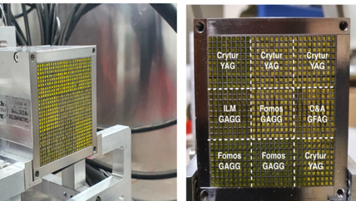
Calorimeter systems
Improve energy resolution with PFlow technique, Em/Had energy compensation, precision timing
State of the Art 1st implementations and next application in LHCb-II
ePIC calorimetry features several SoA concepts
CALICE/CMS-like had. Scint. tiles HGCAL
LHCb-II
Spaghetti Calorimeter
CMS like
PbWO4 crystals
& Scint. Glass R&D
waveform digtizing, ≃ 15 ps precision
3D printing: absorber & possibly square fibers

Slide 19
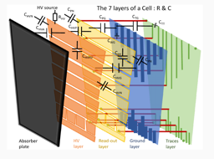
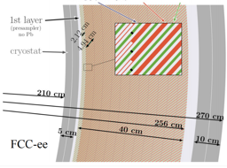
Calorimeter systems
Improve energy resolution with PFlow technique, Em/Had energy compensation, precision timing
next generation planned for FCC-ee (2043-2044)*
Sampling w/ embedded electronics (HGCal)
  ECal 40 layers Si/W (slide 8)
  HCal 44 layers in Steel: Scint., RPCs – multigap semi-digital w/ ≃ 100 ps - MPGDs
Dual Readout (DRCal)
  ToF layer
  Homogenous Crystal ECal with Dual Readout
  Dual readout HCal spagetthi design (outside solenoid)
Liquified Noble Gas ECal (NLGCal)
  new accordion design,12 depth segmentation
  with large multi-layers PCB
Common system aspects
  low power electronics
  uniformity, hermetivcity, stability monitoring and calibration
Ballpark expected performance of different designs
HGCal σEM(Had)/E ≃ 16(44)%/√E ⊕ 1(2)% (beam test)
DRCal σEM(Had)/E ≃ 13(31)%/√E ⊕ 0.2(0.4)% (simulation)
LNGCal σEM(Had)/E ≃ 8(37)%/√E ⊕ 0.7(1)% (simulation)
HGCal σE(Jet)/E ≃ 3.5 % (50 GeV) w/ PFlow
* current timeline for detector installation in experiment

Slide 20
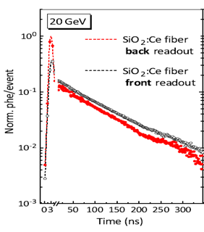
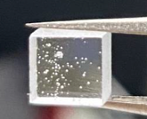
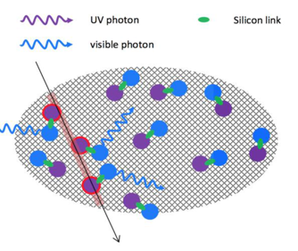
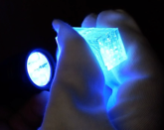
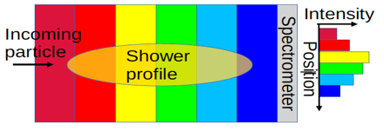


R&D for light devices in calorimeters (and other sytems)
new materials
nano/quantum materials
Fibers providing both Cherenkov and scint.
Glass scintillators for homogenous designs
Luminophore
Wave Length Shifting
Quantum Dot ex. perovskite
embedded in polymer
Sapphire:Ti
Cerenkov
Scintillation
BaSiO₂
SiO₂:Ce₃ fibers
new concepts
“Blue Sky” concepts
Homo. DR ECAL
with fine ⊥ granul.
Homo.had. With
⊥ & // granularity
Opaque scintillator crystal grains
Chromatic calorimetry and tracking
InGaAs photodiode
InAs QD layers in GaAs

Slide 21
Electronics
enable 5D devices at high channel density under extreme rates and radiation levels
ASIC with ultralow power - new architecture, new technology nodes, new materials
Photonics / wireless data transmission
Intelligence on-detector
Implementation of previous features in 3D stacking of technology layers
Provide access to technologies, methodologies and characterization tools
Mechanics & integration
light and compact systems with high mechanical precision, uniformity, hermeticity, stability…
Global/System design and integration (structures, services, environment, sclability, robotics
Low mass mechanics and thermal management (materials, manufacturing, embedded cooling
Detector cooling (evaporative and liquid, gas, connexions and instrumentation
Design and characterization tools

Slide 22
Outlook

Slide 23
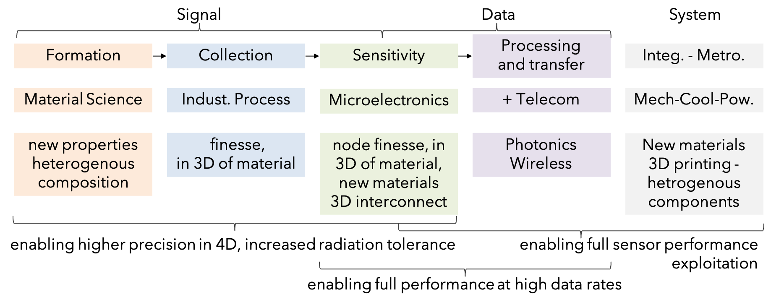
Generic problematic and trends in R&D
enabling higher precision in 5D, increased radiation tolerance
14

Slide 24

Detector Concepts optimization
must anticipate the experiment from end to end in simulation
providing feedback to detector R&D and on performance of possible configuration of systems
13

Slide 25

Worldwide organization of the work
New DRD collaborations formed at CERN to fulfill Detector R&D roadmap goals*
initial program developed in proposals approved by the DRDC - covering a 1st phase of 3-4 years
EDP web page
contact point for the community
EDP/DRD
Managers Forum
common issues
DRD1
Gaseous Detector
M. Titov
E. Oliveri
DRD2
Liquid Detector
R. Guenette
J. Monroe
DRD3
Solid State Detector
G. Kramberger
G. Pellegrini
DRD4
Photon det.
and PID
M.Fiorini
G. Wilkinson
DRD5
Quantum,
emerging
techno.
M. Demarteau
M. Doser
DRD6
Calorimetry
R. Poeschl
R. Ferrari
DRD7
Electronics
on-detector
processing
F. Simon
F. Vasey
DRD8
Mechanics and
Integration
B. Schmidt
A. Mussgiller
DRDC wep page and presentations of DRDs at open sessions
* all strategic programs in slide 2

Slide 26
reference document
https://cds.cern.ch/record/2784893
Conclusion
R&D is a continuous process
  it needs early and long term planning to matched project’s timelines
It is an area with relatively fast turn-around to make a difference with new ideas at different stages of ECRs
It needs practice training beyond academic path
  the ECFA training panel is working on this (schools…)
  the DRDs offer an opportunity for real practice
    and also acknowledgement of work (also rewarded in collaborations and more widely through instrumentation prizes)
HEP R&Ds have several potential societal benefits (not addressed here)
  training in instrumentation in HEP framework can have interest at commercial companies
As in any other areas, the contribution of ECRs to instrumentation is absolutely crucial
  EDP will prepare an input to the ESPP process and would like to collect ECR views

Slide 27
Highlights on Neutrino, Dark Matter, 0𝜈ββ decay programs and detectors

Slide 28

Neutrino, Dark Matter, 0𝜈ββ decay detectors
measure low energy deposits with multi-purpose detectors of increasing volumes
Bolometers
Quantum Sensors
Neutrino
0𝜈ββ
Dark Matter
Liquid Detrectors
Water Cherenkov
O(10²) 𝛾/MeV
visible range
Liquid Scintillators
O(10⁴) 𝛾/MeV
visible range
Noble Liquid TPC
Ionization and O(4x10⁴) 𝛾/MeV VUV 128(178) nm for LAr(Xe)

Slide 29





State of the Art Liquid Detector examples
Neutrino
DUNE (2026-2028)
LAr 17kt TPC
Dark Matter
Darkside (2025)
20t Double Phase Xe TPC
JUNO Neutrino (2023)
20 kt of liquid scintillator
40 000 PMTs Φ = 50 cm
horizontal drift
Hyper-Kamiokande (2027)
0𝜈ββ nEXO 5t Xe TPC
260 ktons ultra pure water Cherenkov, readout 40 000 PMT Φ = 50 cm
Vertical drift drift

Slide 30




Liquid Detectors R&D and new concepts
Dual Phase TPC
New concepts
Xe doping in LAr
to increase electro-luminescence
DUNE Phase2 new concept Theia
25kt Water Based Liquid Scintillator
both Cerenkov and scintillation
luminophore/quantum dots
dychroic filters of WL / waveform sampling
LiquidO
opaque scintillator two contain signal in close fibers collection z-coordinate through both end time measurement
Several common system aspects to scale detectors by O(10)
  improve purity of liquid by O(10) to reduce signal absorption
  improve radiopurity by O(10-1000) - all materials
Several synergies with collider R&D
  light devices materials, readout (MPGDs, photo-detectors…)
  cold electronics
DUNE phase-2 FD3 - FD4
Single readout of scintillation and ionization signals
GEMs + photocathodes + SiPM

Slide 31









Phonon detection
Transition Edge Sensors loss of superconductivity
Kinetic Inductance Detector transmission in a LC resonator
  Quantum Capacitance Detector shift of resonator frequency with change of capacity in a tunnel junction
CaWO₄
or Al₂O₃
or Ge
or Si…
Squid
multiplexed readout
Single KID 2 cm CRESST 1-10gr
Quantum Capacitance Detector
TES
W thin film
T_{C} 20 mk
Super CDMS DMS 1.39(0.61) kg kgr
R&D to reach sub-ev sensitivity, in extended scale systems
  superconducting film material (Al, W, TiNx, Nb)
  configuration of signal measurement structures
  production process and readout
10 cm
3.3 cm

