Slide 1
Absolute radii measurements with muonic atoms: A heavyweight solution to a small problem
Michael Heines
Supervisor: Thomas Cocolios
On behalf of the muX and quartet collaborations

Slide 2
Contents
Why do we need absolute charge radii?
Measuring charge radii with muons
Microgram targets
Experiments at PSI
Summary and outlook

Slide 3
Contents
Why do we need absolute charge radii?
Measuring charge radii with muons
Microgram targets
Experiments at PSI
Summary and outlook

Slide 4
Measurements of $δ<r^{2}>$
[1] Koszorús, Á., et al. "Charge radii of exotic potassium isotopes challenge nuclear theory and the magic character of N= 32." Nature Physics 17.4 (2021): 439-443.
[2] Garcia Ruiz, R. , et al. "Unexpectedly large charge radii of neutron-rich calcium isotopes." Nature Physics 12.6 (2016): 594-598.
Notes:
Koszorús, Á., et al. "Charge radii of exotic potassium isotopes challenge nuclear theory and the magic character of N= 32." Nature Physics 17.4 (2021): 439-443.
Garcia Ruiz, Ronald Fernando, et al. "Unexpectedly large charge radii of neutron-rich calcium isotopes." Nature Physics 12.6 (2016): 594-598.

Slide 5
Benefit of absolute radii
[1]
Visualizing global trends
Isotone shifts
Mirror nuclei
Input for other studies
[1] Angeli, István, and Krassimira Petrova Marinova. "Table of experimental nuclear ground state charge radii: An update." Atomic Data and Nuclear Data Tables 99.1 (2013): 69-95.

Slide 6
Mirror radii
32(Si, Ar)
18(O, Ne)
19(F, Ne)
22(Ne, Mg)
36(S, Ca)
7(Li, Be)
34(S, Ar)
35(Cl, Ar)
54(Fe, Ni)
39(K, Ca)
23(Na, Mg)
38(Ar, Ca)
37(Cl, Ca)
37(Ar, K)

Slide 7
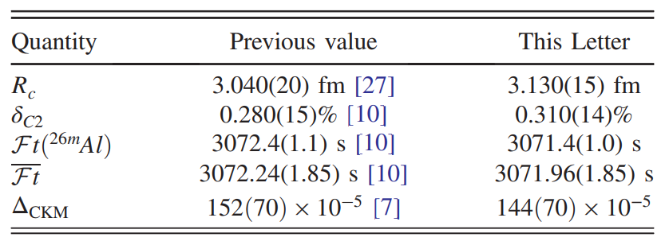
Radii for V_{ud}
[1]
[1]
Many of the radii are deemed unreliable, how much could V_{ud} shift?
[1] Plattner, P., et al. "Nuclear Charge Radius of Al 26 m and Its Implication for V ud in the Quark Mixing Matrix." Physical Review Letters 131.22 (2023): 222502.

Slide 8
The lack of new absolute radii
[1]
Both methods faded out in the early ’90s
Data not available
Not all stables done
Reliable treatment of errors?
[1] Angeli, I. "Table of nuclear root mean square charge radii." (1999).

Slide 9
The lack of new absolute radii
[1]
Both methods faded out in the early ’90s
Data not available
Not all stables done
Reliable treatment of errors???
Many absolute radii should have > 2x uncertainty
[1] Ohayon, Ben. "Radii of Mirror Nuclei and Isobaric Triplets." arXiv preprint arXiv:2409.08193 (2024).

Slide 10
Contents
Why do we need absolute charge radii?
Measuring charge radii with muons
Microgram targets
Experiments at PSI
Summary and outlook

Slide 11
Muonic atoms
Bohr model
$E_{n}∝\frac{mZ^{2}}{n^{2}}$
$r_{n}∝\frac{n^{2}}{mZ}$
Muons:
$m_{µ}≈207 m_{e}$
$τ_{μ}≈2.2 µs$
Effect:
Enhanced binding energy
Closer to the nucleus → More sensitive to nuclear effects
K
$$e$$
$$μ$$

Slide 12
Muonic atoms
Bohr model
$E_{n}∝\frac{mZ^{2}}{n^{2}}$
$r_{n}∝\frac{n^{2}}{mZ}$
Muons:
$m_{µ}≈207 m_{e}$
$τ_{μ}≈2.2 µs$
Effect:
Enhanced binding energy
Closer to the nucleus → More sensitive to nuclear effects
K
$$e$$
$$μ$$

Slide 13
Muonic atoms
Bohr model
$E_{n}∝\frac{mZ^{2}}{n^{2}}$
$r_{n}∝\frac{n^{2}}{mZ}$
Muons:
$m_{µ}≈207 m_{e}$
$τ_{μ}≈2.2 µs$
Effect:
Enhanced binding energy
Closer to the nucleus → More sensitive to nuclear effects
µK
µ⁻
$$e$$
$$μ$$

Slide 14
Muonic atoms
Bohr model
$E_{n}∝\frac{mZ^{2}}{n^{2}}$
$r_{n}∝\frac{n^{2}}{mZ}$
Muons:
$m_{µ}≈207 m_{e}$
$τ_{μ}≈2.2 µs$
Effect:
Enhanced binding energy
Closer to the nucleus → More sensitive to nuclear effects
µK
µ⁻
$$e$$
$$μ$$
Muon n = 14 orbital is inside electron n = 1 orbital → electron correlation is negligible

Slide 15
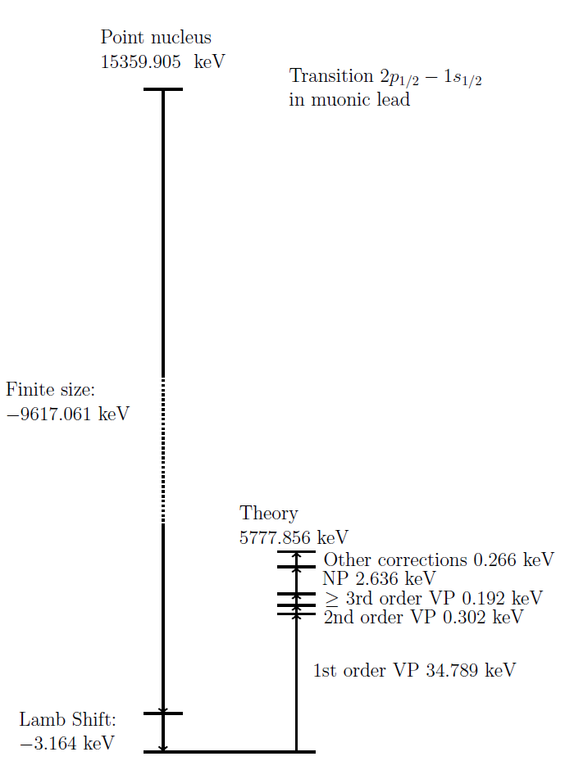
How sensitive are we?
[1]
Groundstate wavefunction has sizeable overlap with the nucleus
Sensitivity increase:
Nuclear size: ${\left(\frac{m_{μ}}{m_{e}}\right)}^{3}≈{10}^{7}$
Quadrupole: ${\left(\frac{m_{μ}}{m_{e}}\right)}^{2}≈5×{10}^{4}$
Octupole: ${\left(\frac{m_{µ}}{m_{e}}\right)}^{3}≈{10}^{7}$
[1] Skawran, Alexander. Development of a new method to perform muonic atom spectroscopy with microgram targets. Diss. ETH Zurich, 2021.

Slide 16
Extracting radii
Finite size correction scales with $\frac{1}{r^{3}}≈{10}^{7}$
Calculate transition energy for many radii → Compare with experiment
Typical limitations:
Nuclear polarization (theory)
Nuclear shape (electron scattering)
Energy calibration
Simple calculations with mudirac code [1]
[1] Sturniolo, Simone, and Adrian Hillier. "Mudirac: A Dirac equation solver for elemental analysis with muonic X‐rays." X‐Ray Spectrometry 50.3 (2021): 180-196.

Slide 17
King plot
$$δ{\left\langle r^{2}\right\rangle }^{A,A′}=\frac{1}{F_{i}}\left(δν_{i}^{A, A^{′}}−\frac{A −A^{′}}{A A^{′}}M_{i}\right)$$
$M_{i}$ : Mass shift factor
$F_{i}$ : Field shift factor
$$\frac{A A′}{A −A′} δν_{i}^{A, A′}=M_{i}+F_{i} \frac{A A′}{A −A′}δ{\left\langle r^{2}\right\rangle }^{A,A′}$$

Slide 18
King plot
$$δ{\left\langle r^{2}\right\rangle }^{A,A′}=\frac{1}{F_{i}}\left(δν_{i}^{A, A^{′}}−\frac{A −A^{′}}{A A^{′}}M_{i}\right)$$
$M_{i}$ : Mass shift factor
$F_{i}$ : Field shift factor
$$\frac{A A′}{A −A′} δν_{i}^{A, A′}=M_{i}+F_{i} \frac{A A′}{A −A′}δ{\left\langle r^{2}\right\rangle }^{A,A′}$$

Slide 19
King plot
No odd-Z element with 3 stable isotopes!
$$δ{\left\langle r^{2}\right\rangle }^{A,A′}=\frac{1}{F_{i}}\left(δν_{i}^{A, A^{′}}−\frac{A −A^{′}}{A A^{′}}M_{i}\right)$$
$M_{i}$ : Mass shift factor
$F_{i}$ : Field shift factor
$$\frac{A A′}{A −A′} δν_{i}^{A, A′}=M_{i}+F_{i} \frac{A A′}{A −A′}δ{\left\langle r^{2}\right\rangle }^{A,A′}$$

Slide 20
King plot
$$δ{\left\langle r^{2}\right\rangle }^{A,A′}=\frac{1}{F_{i}}\left(δν_{i}^{A, A^{′}}−\frac{A −A^{′}}{A A^{′}}M_{i}\right)$$
$M_{i}$ : Mass shift factor
$F_{i}$ : Field shift factor
$$\frac{A A′}{A −A′} δν_{i}^{A, A′}=M_{i}+F_{i} \frac{A A′}{A −A′}δ{\left\langle r^{2}\right\rangle }^{A,A′}$$
[1] Koszorús, Á., et al. "Charge radii of exotic potassium isotopes challenge nuclear theory and the magic character of N= 32." Nature Physics 17.4 (2021): 439-443.
[2] Garcia Ruiz, R. , et al. "Unexpectedly large charge radii of neutron-rich calcium isotopes." Nature Physics 12.6 (2016): 594-598.

Slide 21
Contents
Why do we need absolute charge radii?
Measuring charge radii with muons
Microgram targets
Experiments at PSI
Summary and outlook

Slide 22
Measuring microgram materials
Traditionally: Limited to target mass O(10-100 mg)
Hydrogen gas cell (100 bars; 0.25% deuterium)
Limited to O(5 µg)
Down to 20 year half-life (radioprotection)
Muon veto
Muon entrance
Target
H₂
H₂
D₂
D₂
H₂
H₂
H₂
H₂
H₂
H₂
H₂
H₂
H₂
D₂
H₂
D₂
H₂
[1] Bubak, M., & Fajman, M. P. (1987). Cross sections for hydrogen muonic atomic processes in two-level approximation of the adiabatic framework (No. JINR-E--4-87-464). Joint Inst. for Nuclear Research.
[2] Adamczak, Andrzej, et al. "Muonic atom spectroscopy with microgram target material." The European Physical Journal A 59.2 (2023): 15.

Slide 23
Measuring microgram materials
Traditionally: Limited to target mass O(10-100 mg)
Hydrogen gas cell (100 bars; 0.25% deuterium)
Limited to O(5 µg)
Down to 20 year half-life (radioprotection)
H₂
H₂
D₂
D₂
µ⁻
H₂
H₂
H₂
H₂
H₂
H₂
H₂
H₂
H₂
D₂
H₂
D₂
H₂
[1] Bubak, M., & Fajman, M. P. (1987). Cross sections for hydrogen muonic atomic processes in two-level approximation of the adiabatic framework (No. JINR-E--4-87-464). Joint Inst. for Nuclear Research.
[2] Adamczak, Andrzej, et al. "Muonic atom spectroscopy with microgram target material." The European Physical Journal A 59.2 (2023): 15.

Slide 24
Measuring microgram materials
Traditionally: Limited to target mass O(10-100 mg)
Hydrogen gas cell (100 bars; 0.25% deuterium)
Limited to O(5 µg)
Down to 20 year half-life (radioprotection)
H₂
H₂
D₂
D₂
H₂
H₂
H₂
µH
H₂
H₂
H₂
H₂
H₂
D₂
H₂
D₂
H₂
[1] Bubak, M., & Fajman, M. P. (1987). Cross sections for hydrogen muonic atomic processes in two-level approximation of the adiabatic framework (No. JINR-E--4-87-464). Joint Inst. for Nuclear Research.
[2] Adamczak, Andrzej, et al. "Muonic atom spectroscopy with microgram target material." The European Physical Journal A 59.2 (2023): 15.

Slide 25
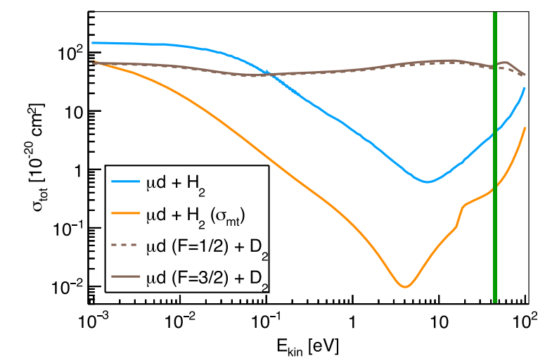
Measuring microgram materials
Traditionally: Limited to target mass O(10-100 mg)
Hydrogen gas cell (100 bars; 0.25% deuterium)
Limited to O(5 µg)
Down to 20 year half-life (radioprotection)
MFP_{µD} >> MFP_{µH}
H₂
H₂
D₂
D₂
H₂
H₂
H₂
H₂
H₂
H₂
H₂
H₂
H₂
D₂
H₂
µD
H₂
[1] Bubak, M., & Fajman, M. P. (1987). Cross sections for hydrogen muonic atomic processes in two-level approximation of the adiabatic framework (No. JINR-E--4-87-464). Joint Inst. for Nuclear Research.
[2] Adamczak, Andrzej, et al. "Muonic atom spectroscopy with microgram target material." The European Physical Journal A 59.2 (2023): 15.

Slide 26
Measuring microgram materials
Traditionally: Limited to target mass O(10-100 mg)
Hydrogen gas cell (100 bars; 0.25% deuterium)
Limited to O(5 µg)
Down to 20 year half-life (radioprotection)
H₂
H₂
D₂
D₂
H₂
H₂
H₂
H₂
H₂
µZ
H₂
H₂
H₂
H₂
D₂
H₂
D₂
H₂
[1] Bubak, M., & Fajman, M. P. (1987). Cross sections for hydrogen muonic atomic processes in two-level approximation of the adiabatic framework (No. JINR-E--4-87-464). Joint Inst. for Nuclear Research.
[2] Adamczak, Andrzej, et al. "Muonic atom spectroscopy with microgram target material." The European Physical Journal A 59.2 (2023): 15.

Slide 27
Measuring microgram materials
Traditionally: Limited to target mass O(10-100 mg)
Hydrogen gas cell (100 bars; 0.25% deuterium)
Limited to O(5 µg)
Down to 20 year half-life (radioprotection)
H₂
H₂
D₂
D₂
H₂
H₂
H₂
H₂
H₂
µZ
H₂
H₂
H₂
H₂
D₂
H₂
D₂
H₂
[1] Bubak, M., & Fajman, M. P. (1987). Cross sections for hydrogen muonic atomic processes in two-level approximation of the adiabatic framework (No. JINR-E--4-87-464). Joint Inst. for Nuclear Research.
[2] Adamczak, Andrzej, et al. "Muonic atom spectroscopy with microgram target material." The European Physical Journal A 59.2 (2023): 15.

Slide 28
Contents
Why do we need absolute charge radii?
Measuring charge radii with muons
Microgram targets
Experiments at PSI
Summary and outlook

Slide 29
PSI – High intensity proton accelerator facility (HIPA)

Slide 30
Using germanium detectors

Slide 31
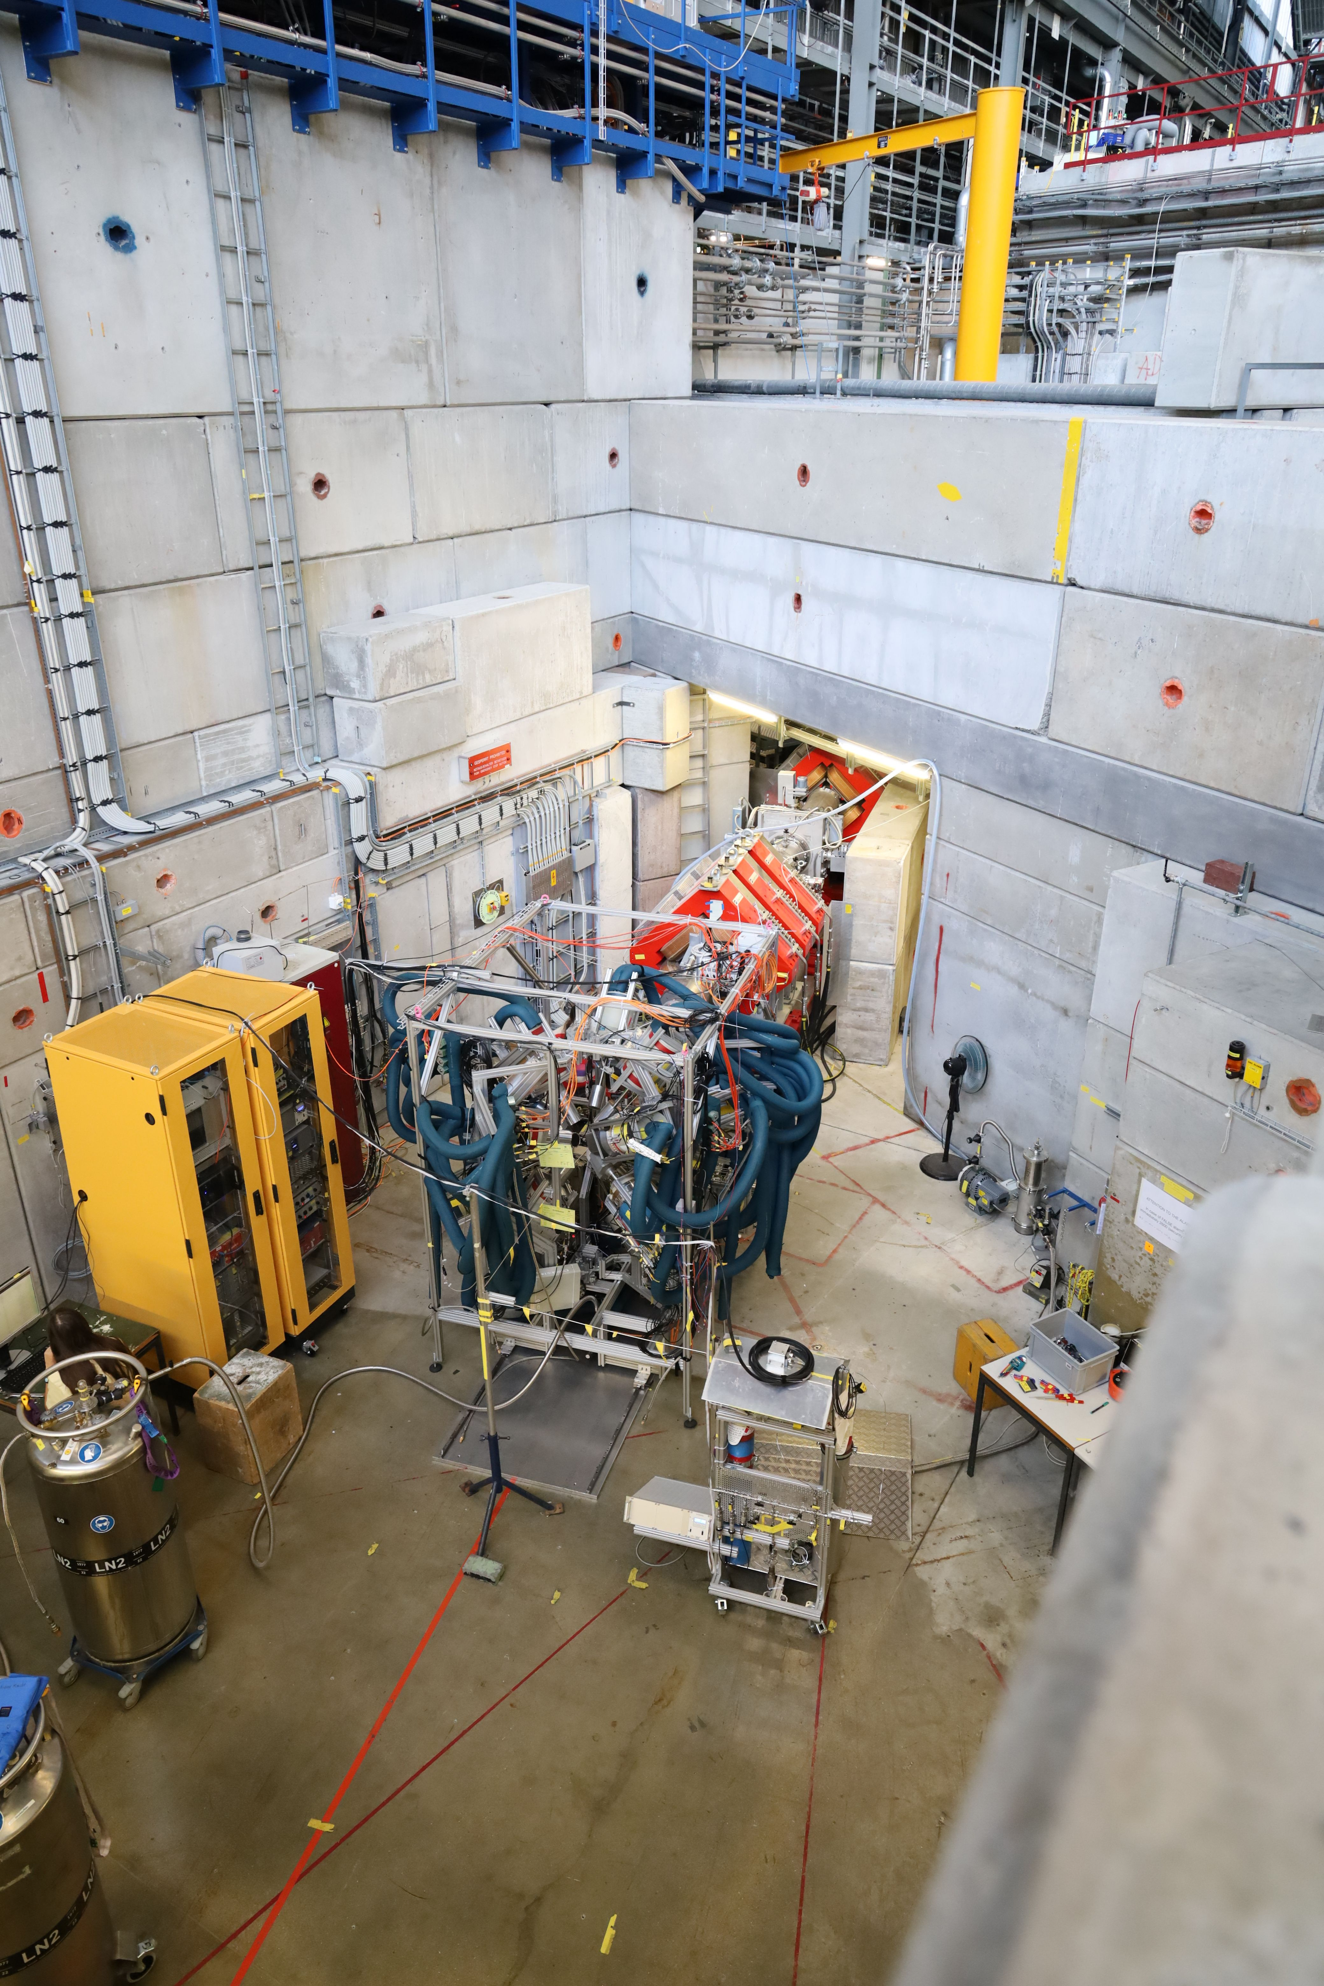
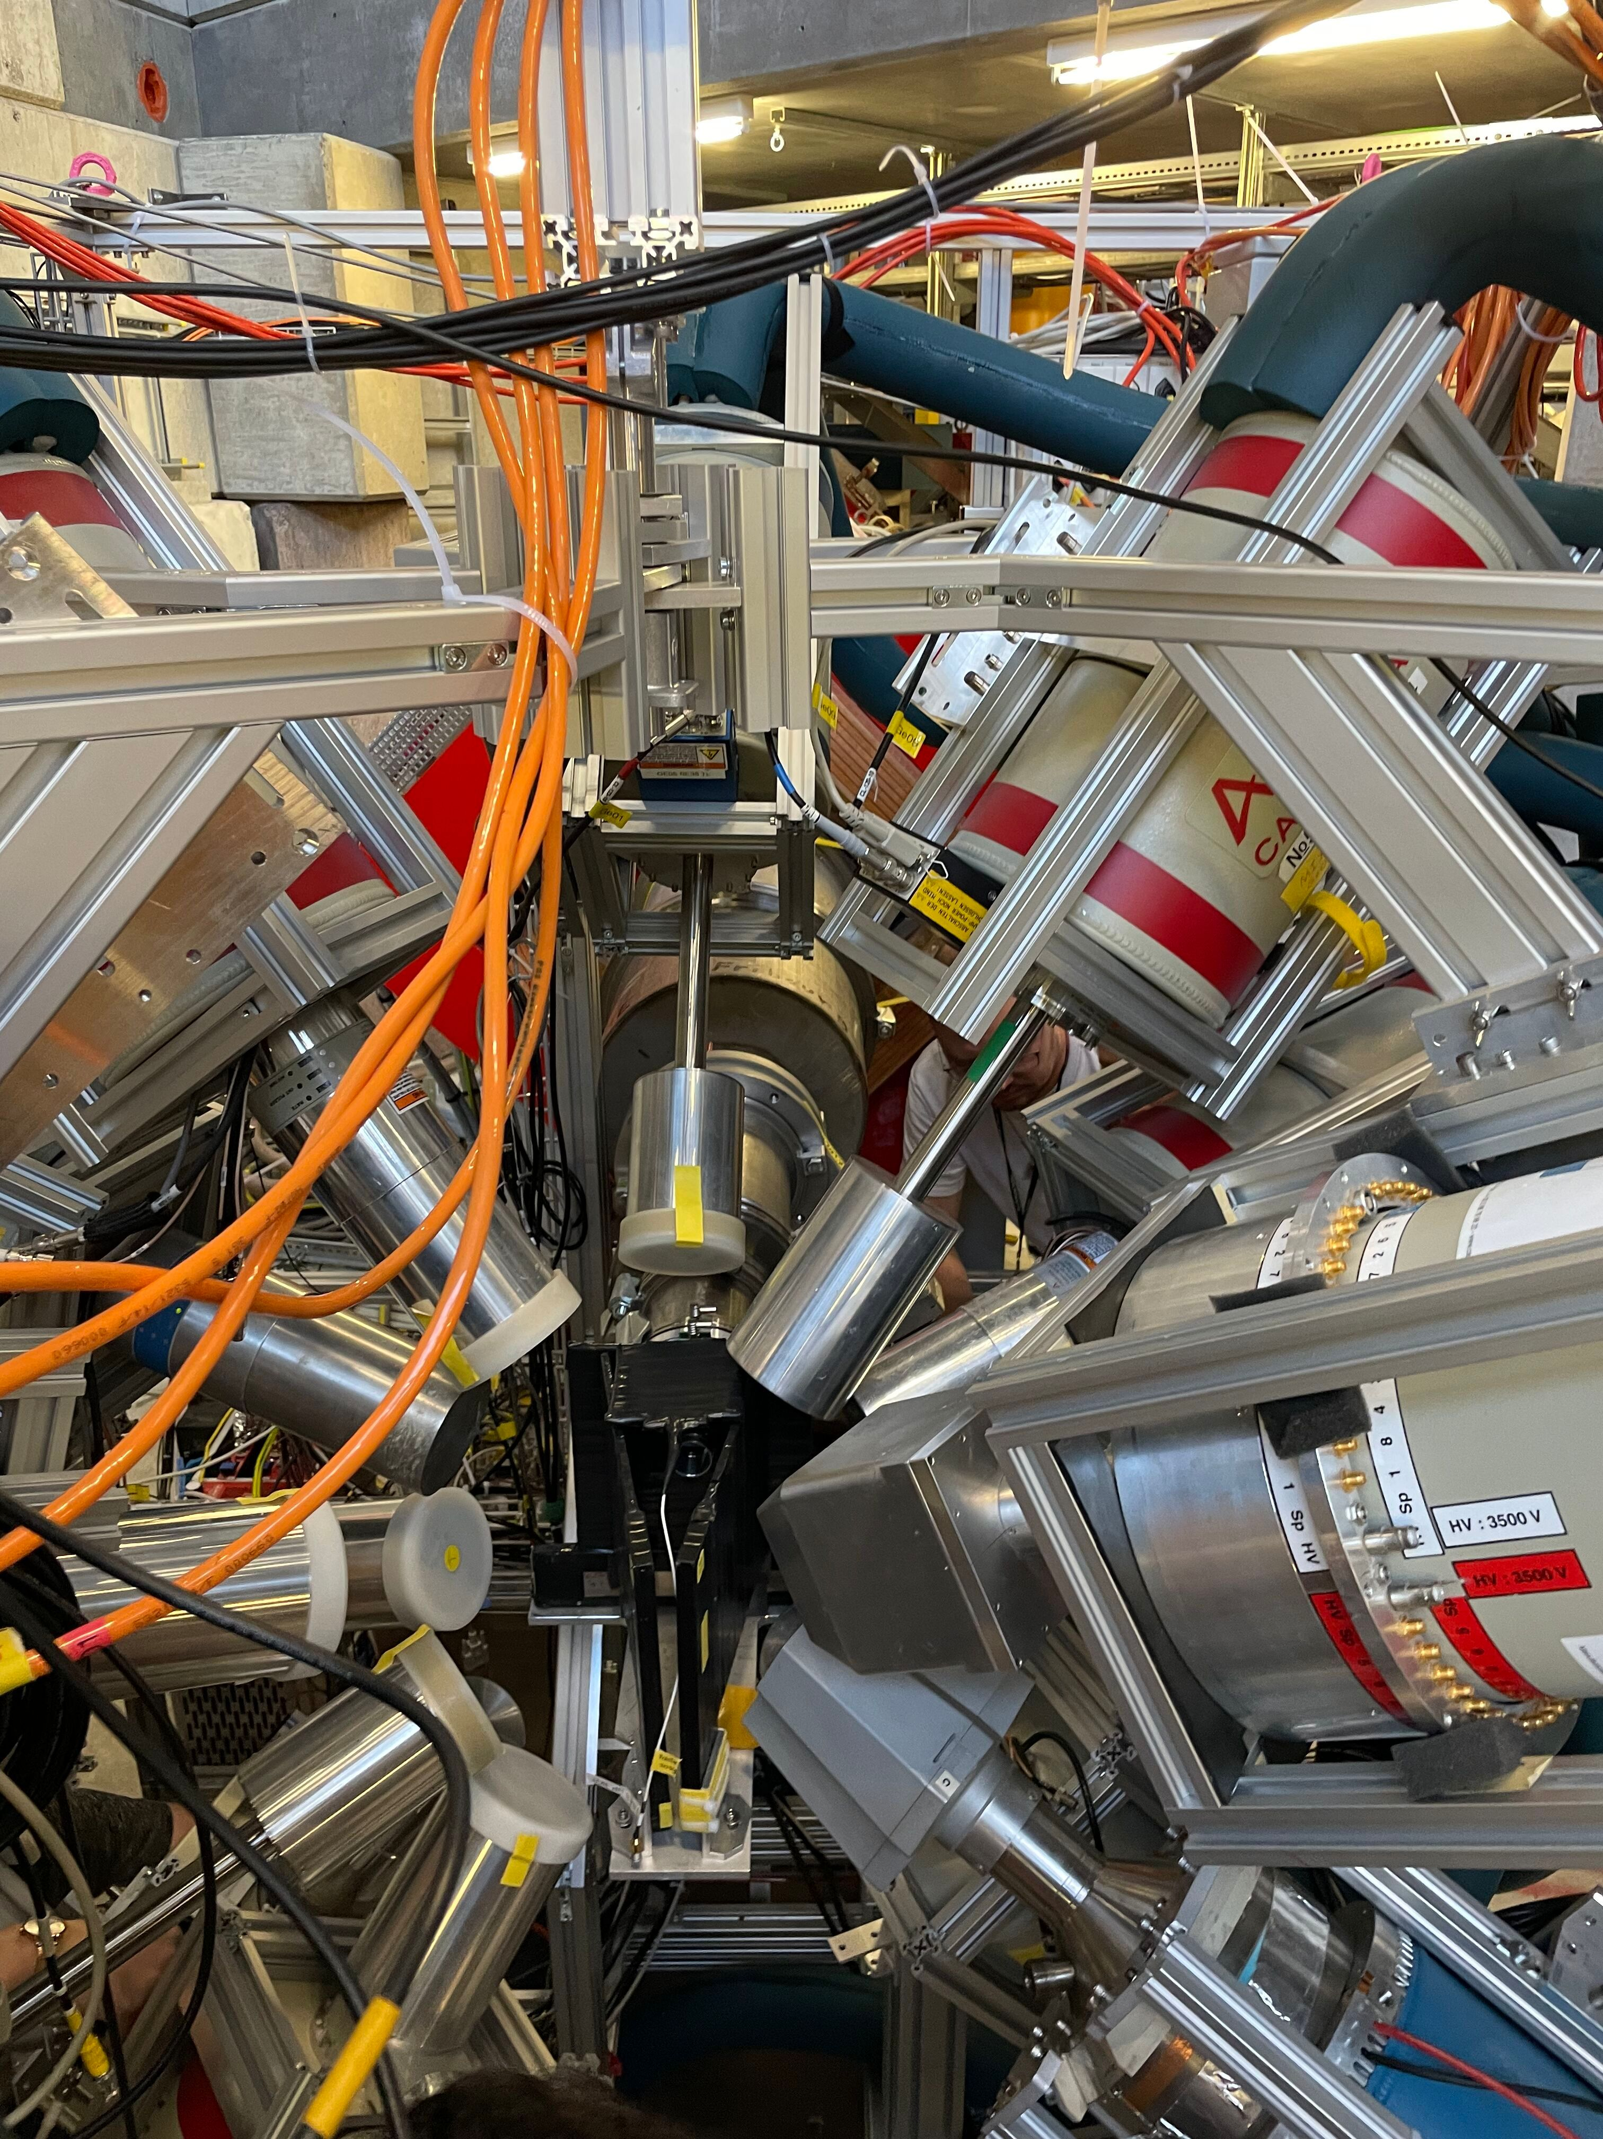
Setup

Slide 32
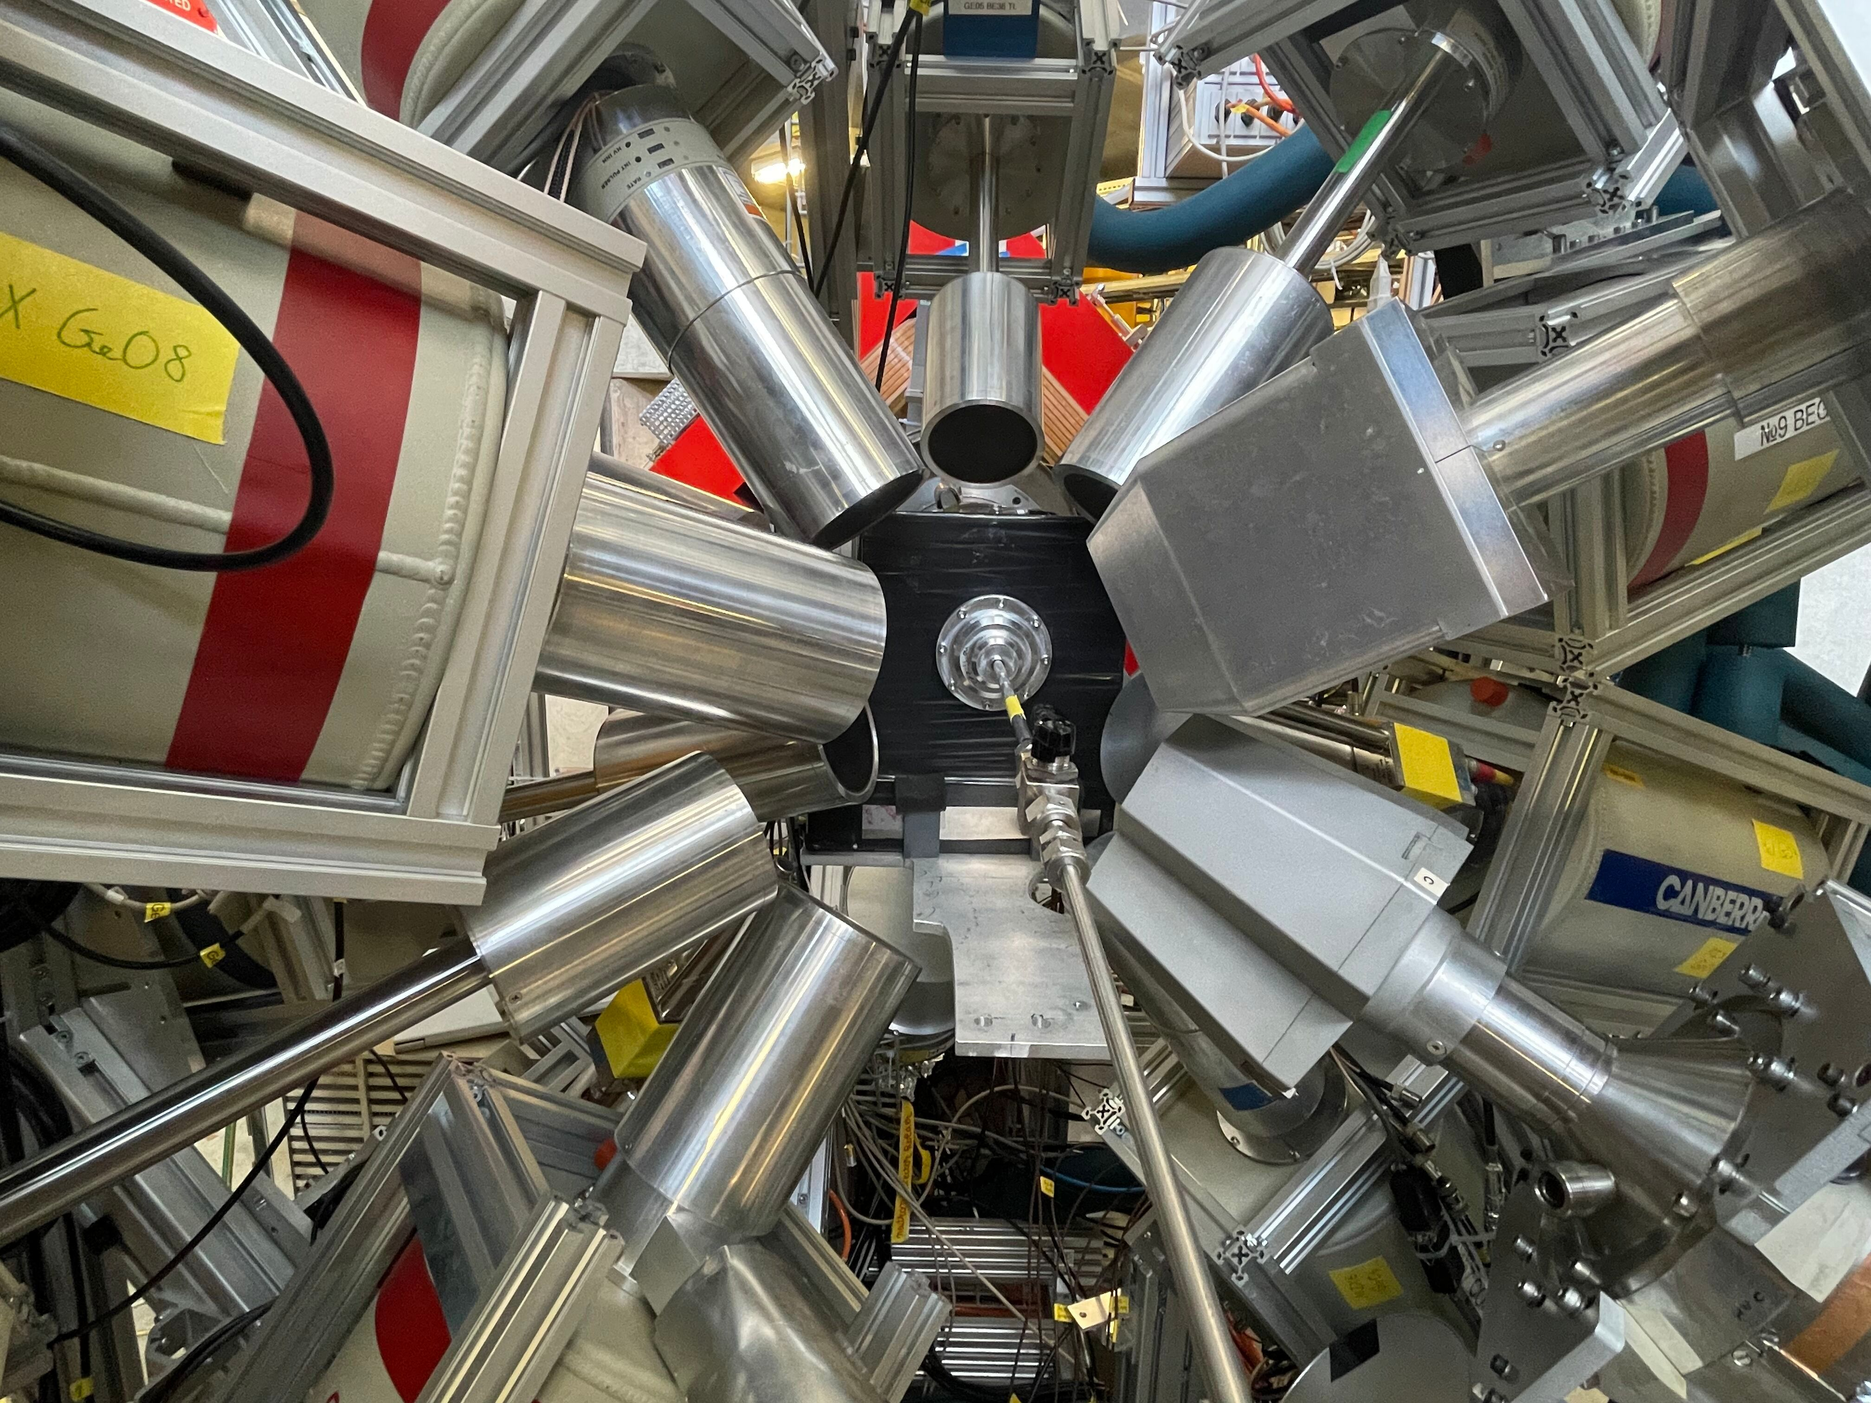
Setup
µ beam
Gas inlet

Slide 33
Interpreting energy Vs time plots
^{110m}Ag

Slide 34
Interpreting energy Vs time plots
^{110m}Ag

Slide 35
Interpreting energy Vs time plots
³⁹K np-1s

Slide 36
Interpreting energy Vs time plots
Muon capture
^{110m}Ag

Slide 37
Vud relevant cases
^{35, 37}Cl:
³⁵Cl: Mirror nuclei of ³⁵Ar (well-known)
³⁷Cl: Mirror nuclei of ³⁷Ca(well-known)
³⁴Cl: 0+ → 0+ → After laser spectroscopy
^{39, 40, 41}K:
^{38m}K: 0+ → 0+
³⁷K: Mirror nuclei of ³⁷Ar(well-known)
³⁹K: Mirror nuclei of ³⁹Ca(well-known) → Will not improve much
^{28, 29, 30}Si:
²⁶Si: 0+ → 0+
³²Si: Mirror nucleus of ³²Ar (high isospin asymmetry)

Slide 38
Mirror radii
32(Si, Ar)
18(O, Ne)
19(F, Ne)
22(Ne, Mg)
36(S, Ca)
7(Li, Be)
34(S, Ar)
35(Cl, Ar)
54(Fe, Ni)
39(K, Ca)
23(Na, Mg)
38(Ar, Ca)
37(Cl, Ca)
37(Ar, K)

Slide 39
Chlorine measurement (preliminary)
Muonic 2p-1s energy:
^{nat}Cl: 578.56(30) keV
Expected improvement on 2p-1s transition energy:
300 eV → < 30 eV
Expected improvement on radii:
0.45% → ~0.10-0.15 % (including systematics)
Literature $δ<r^{2}>^{35, 37}=0.03(16)$
Currently worst radius in the region by more than a factor 3

Slide 40
Chlorine measurement (preliminary)
Muonic 2p-1s energy:
^{nat}Cl: 578.56(30) keV
Expected improvement on 2p-1s transition energy:
300 eV → Most likely < 30 eV
Expected improvement on radii:
0.45% → ~0.10-0.15 % (including systematics)
Literature $δ<r^{2}>^{35, 37}=0.03(16)$

Slide 41
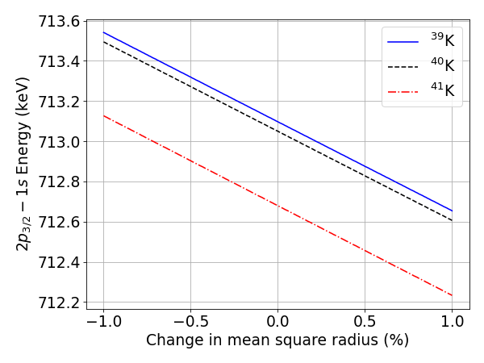
Potassium muonic isotope shift (preliminary)
10 hours
Ag-110m
5 days
10 hours
$$Ti\left(μ, νn\right)Sc$$

Slide 42
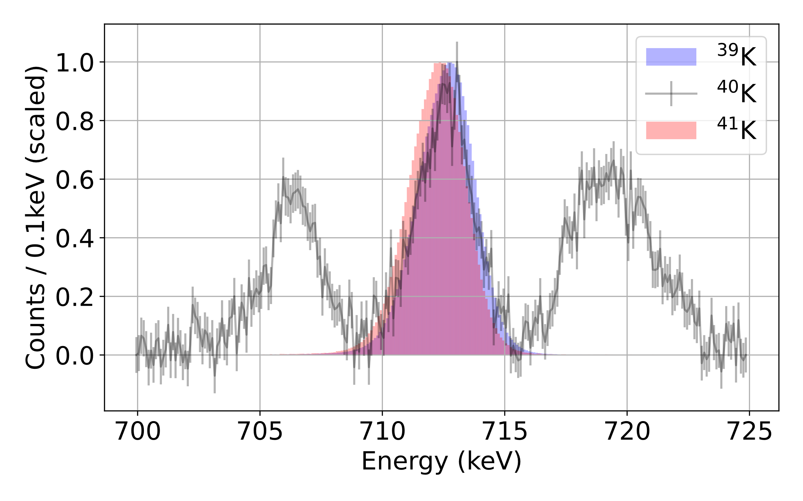
Potassium muonic isotope shift (preliminary)

Slide 43
Fitted spectrum ³⁹K 2p1s

Slide 44
Fitted spectrum ³⁵Cl 2p1s

Slide 45
Using metallic magnetic calorimeters (MMC)

Slide 46
MMC setup at PSI
Slide courtesy : Daniel Unger

Slide 47
MMC setup at PSI
Slide courtesy : Daniel Unger
$μ^{−}$ beam
dilution refrigerator
solid-state detectors

Slide 48
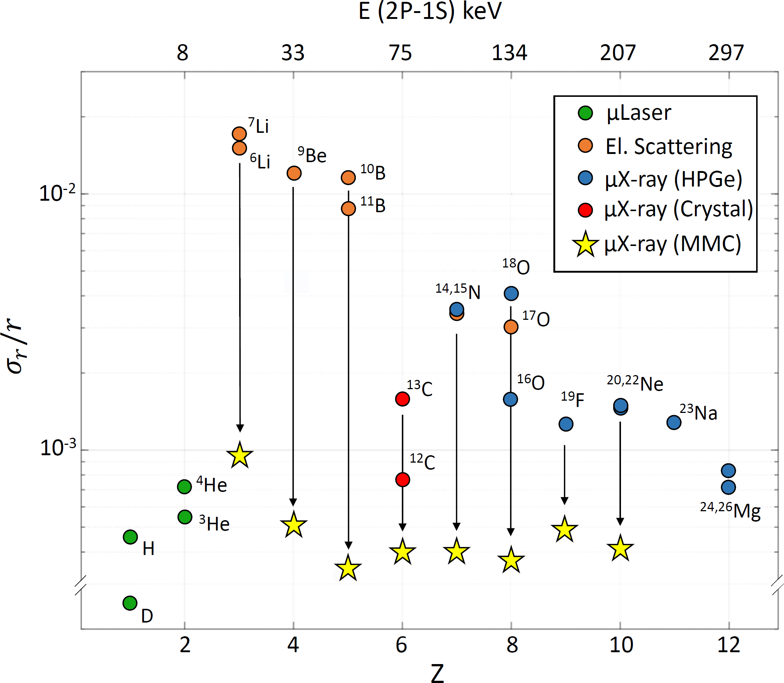
Quartet collaboration
Charge radius for Z= 3-10
Slide courtesy : Daniel Unger

Slide 49
Vud relevant cases
Mirror pairs:
Some that are currently not used due to large uncertainty
⁷Li - ⁷Be mirror pair: Very large isospin asymmetry!
¹⁰C, ¹⁴O: 0+ → 0+
²⁰Ne: Daughter of ²⁰F → Talk Prof. Oscar Naviliat-Cuncic

Slide 50
Mirror radii
32(Si, Ar)
18(O, Ne)
19(F, Ne)
22(Ne, Mg)
36(S, Ca)
7(Li, Be)
34(S, Ar)
35(Cl, Ar)
54(Fe, Ni)
39(K, Ca)
23(Na, Mg)
38(Ar, Ca)
37(Cl, Ca)
37(Ar, K)

Slide 51
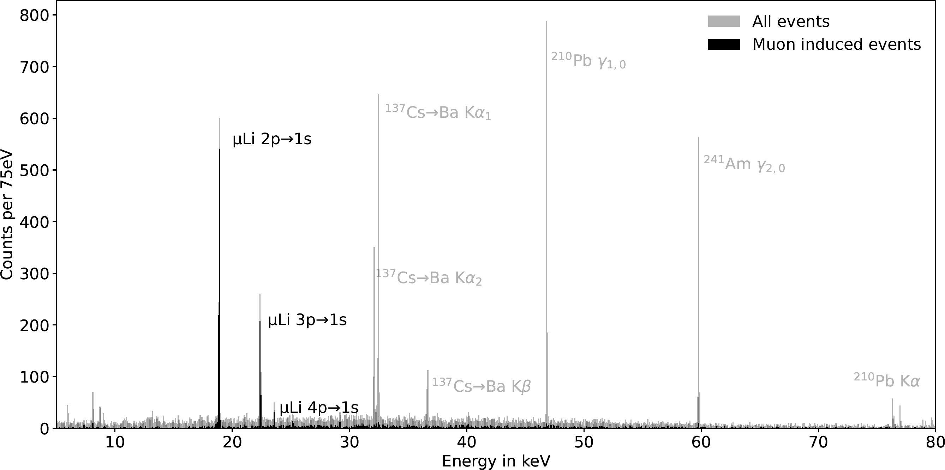
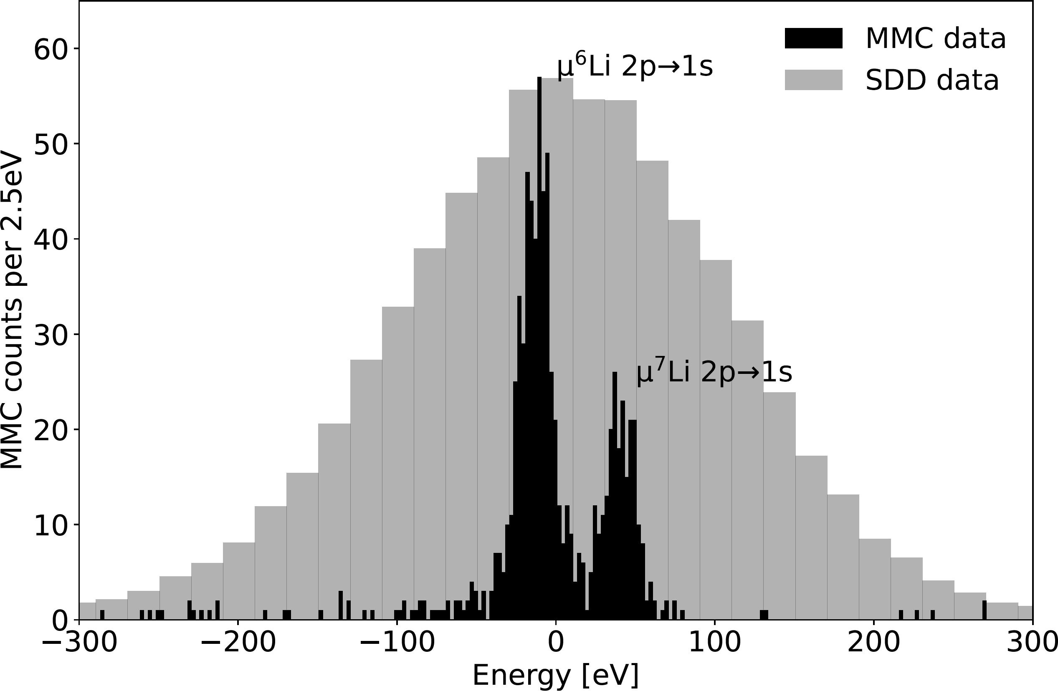
High resolution detectors
Slide courtesy: Daniel Unger
preliminary
preliminary
QUARTET Research Proposal
Isotope shift of muonic ⁶Li and ⁷Li resolved !

Slide 52
Summary and outlook
Absolute nuclear charge radii are needed for V_{ud}
Underestimated uncertainties
No new measurements since ’90s
Our work:
Try to relaunch the field
Accurately estimate uncertainties
Hopefully extract first new radii very soon

Slide 53
Backup slides

Slide 54
Primary goals
Remeasurement of ^{39, 41}K (macroscopic target)
First measurement of ⁴⁰K (microscopic implanted target)
a
First measurement of isotopically pure ^{35, 37}Cl (macroscopic target)
q

Slide 55
The spectra
Data for highest resolution detector!
³⁹K
³⁵Cl

Slide 56
Extracting Barrett radii
$$ρ\left(r\right)=\frac{1}{1+exp\left(4\ln\left(3\right) \frac{r−R_{0}}{t}\right)}$$
Barret moment:
$$<r^{k}e^{−αr}> =\int_{0}^{∞}{r^{k+2}e^{−αr} ρ\left(r\right) dr }$$
Barret radius:
$3 {\left[R_{kα}\right]}^{−3}\int_{0}^{R_{kα}}{r^{k+2}e^{−αr}} dr= <r^{k}e^{−αr}$>
No nuclear shape sensitivity while keeping nuclear size sensitivity
From theory input calculate transition energy as function of Barrett radius
[1] Fricke, G., et al. "Nuclear ground state charge radii from electromagnetic interactions." Atomic Data and Nuclear Data Tables 60.2 (1995): 177-285.

Slide 57
The sensitivity to the nuclear shape

Slide 58
The sensitivity to the nuclear shape

Slide 59
Converting Barrett radii to rms radii
Electron scattering / Nuclear theory → $ρ\left(r\right)$
$$V_{n}^{e}=\frac{R_{kα}^{e}}{<r^{2}>_{e}^{1/2}}$$
Apply to extracted Barret radii
$$<r^{2}>^{1/2} =\frac{R_{kα}^{μ}}{V_{2}^{e}}$$
$$R_{kα}$$ | $$R_{RMS}$$ | $$V_{2}^{e}$$
4.382 | 3.414 | 1.2836
4.397 | 3.427 | 1.2830

