Slide 1
General presentation

Slide 2


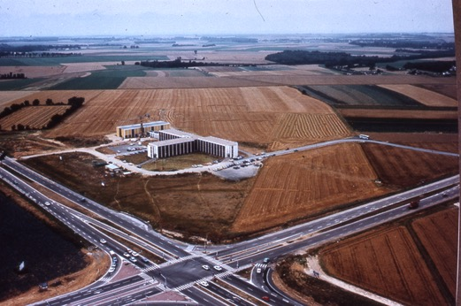

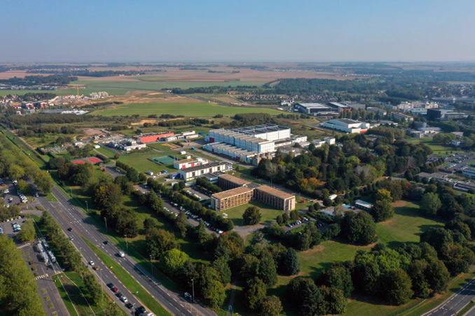
A brief history of GANIL
1976 Creation of GANIL GIE
(Grand Accélérateur National d’Ions lourds)
1983 First experiment
2001 SPIRAL1 exotic beams
2006 SPIRAL2 Project signature of convention for construction Inclusion on European Strategy Forum for
Research Infrastructures (ESFRI) roadmap
2011 Start of SPIRAL2 Construction
  2019 Start of the SPIRAL2 commissioning
  2020 First neutron beams at SPIRAL2
  2022 First heavy ion beams at SPIRAL2
GANIL late 70s
GANIL 2023

Slide 3
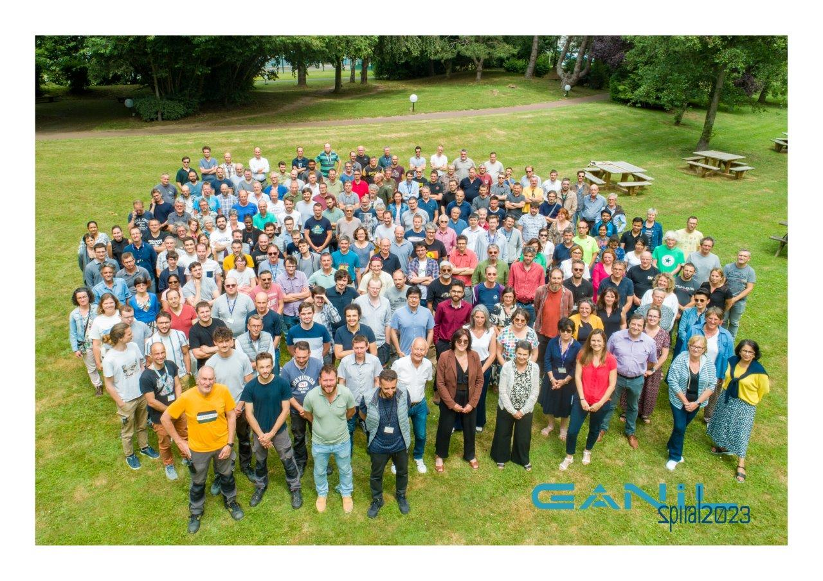
Some numbers
• 239 permanent staff CNRS and CEA
(engineers, technicians, 28 researchers). 1 from Caen University
75 temporary staff
28 CDD engineers, technicians,
21 PhD
13 post-docs
13 apprenticies
CIMAP = 24 permanent staff
+ 15 PhD + 8 postdocs
More than 300 scientists yearly to perform experiments

Slide 4
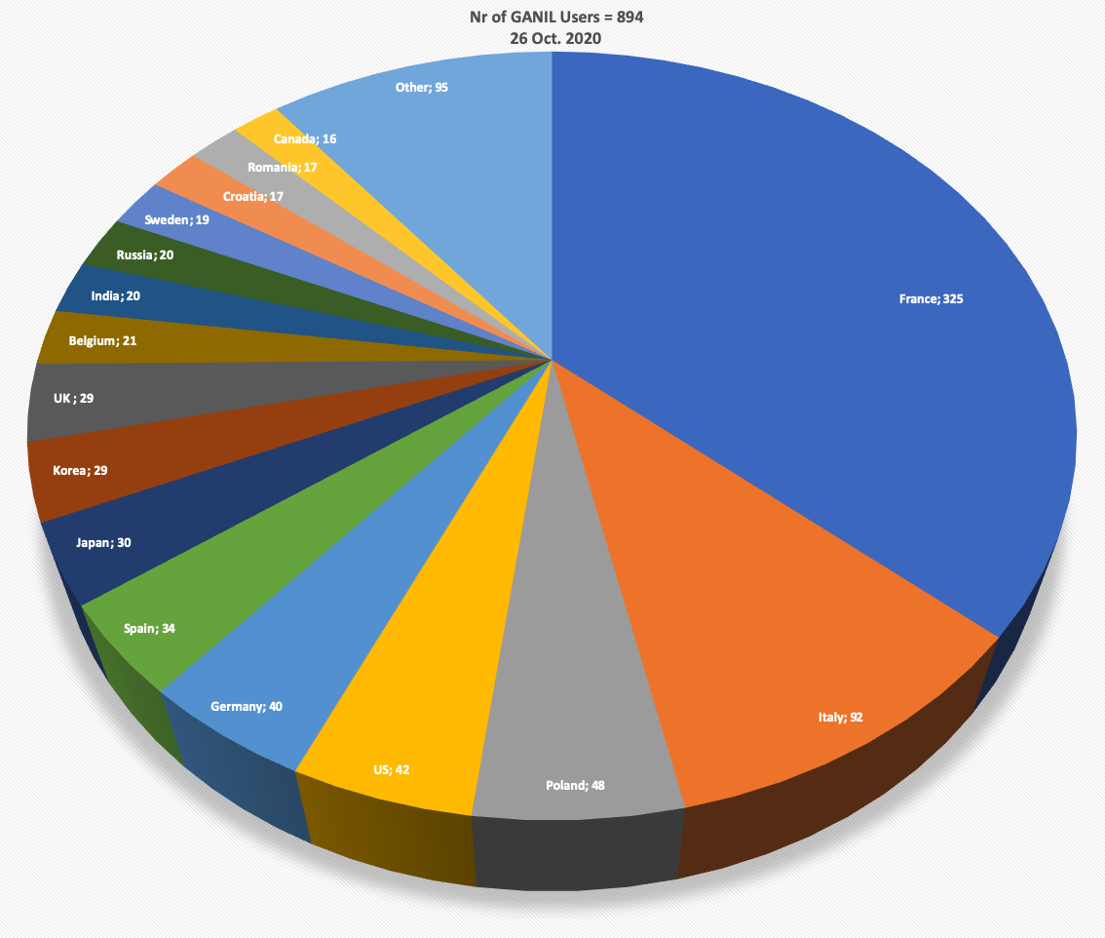
Some numbers
• An international scientific community of ≈ 1000 members
France
Italie
Pologne
USA
Allemagne
Espagne
Japon
Corée
Royaume Uni
Belgique
Inde
Russie
Suède
Roumanie
Canada
95 PhD students working on GANIL data
A major facility for heavy ions in the world
with GSI/FAIR (Germany), RIBF/RIKEN (Japan), FRIB/MSU (USA), ISOLDE (CERN)…

Slide 5
Scientific programs at GANIL

Slide 6


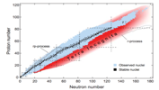
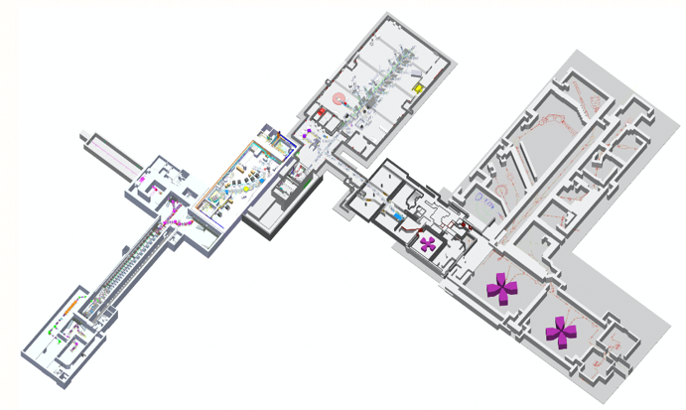
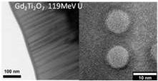
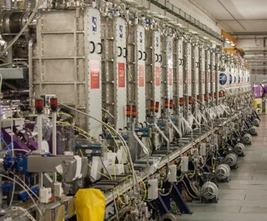

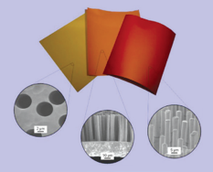
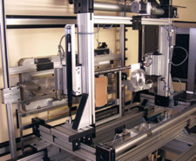

A multi-user pluridisciplinary laboratory
Nuclear Astrophysics
Astrochemistry
Nuclear Physics
Materials under irradiation
R&D on accelerators and detectors
Nanostructuration
Radiobiology, new therapies
Industrial applications: microporous membranes, tests of electronic components

Slide 7

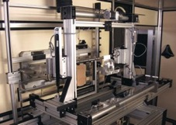
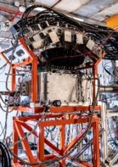
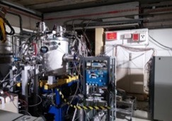
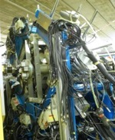
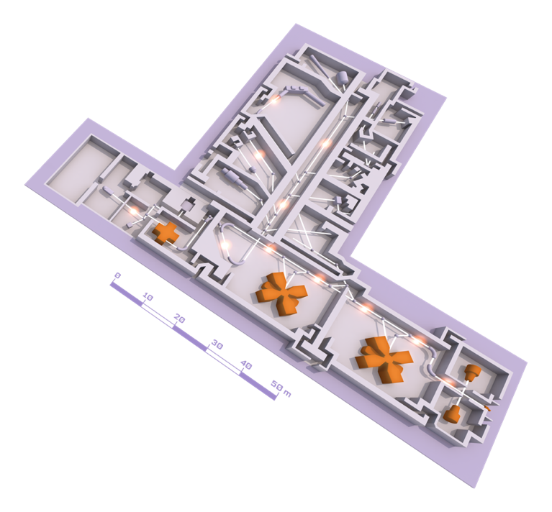
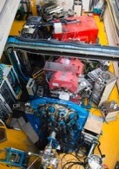
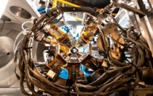
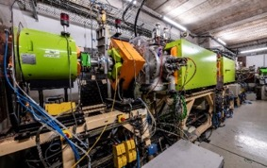
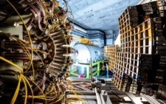
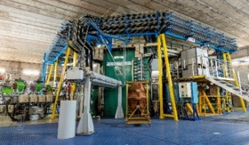
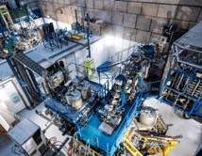
A multi-user pluridisciplinary laboratory
EXOGAM
ACTAR TPC
Porte échantillon pour irradiation
MUGAST
Experimental rooms
AGATA
LISE SPECTROMETER
VAMOS
5 cyclotrons
Stable beams: ¹²C à U
Energy : from <1 MeV up to 95MeV/u
SPIRAL1 radioactive beams
Up to 4 experiments in parallel
GANIL CYCLOTRONS
INDRA + FAZIA
CYCLOTRON
SOURCES

Slide 8
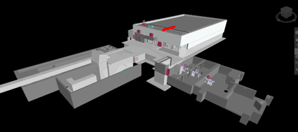
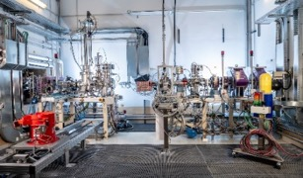
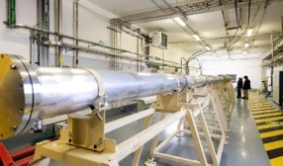
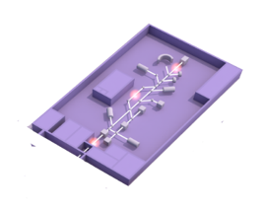


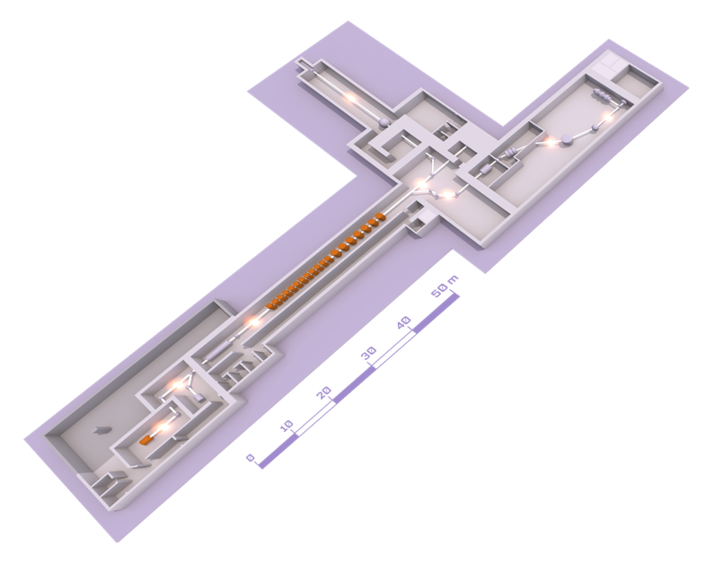
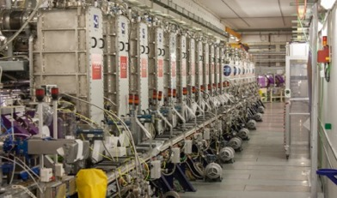
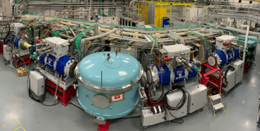
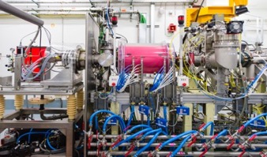
SPIRAL2 LINAC and the new experimental rooms
EXPERIMENTAL ROOM DESIR
(Decay, Excitation and Storage of Radioactive Ions)
EXPERIMENTAL ROOM NFS (NEUTRONS FOR SCIENCE)
Convertor room
Time of Flight room
EXPERIMENTAL ROOM S3 (SUPER SEPARATOR SPECTROMETER)
LINEAR accelerator (LINAC)
High intensity beams :
5 mA, 33 MeV protons
5 mA, 40 MeV deutons
1 mA, <14,5 MeV/A heavy ions
ION SOURCE

Slide 9


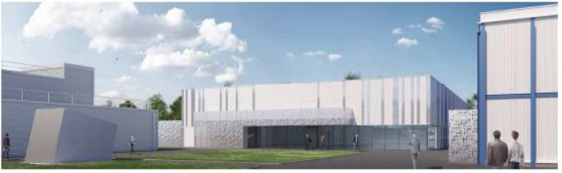
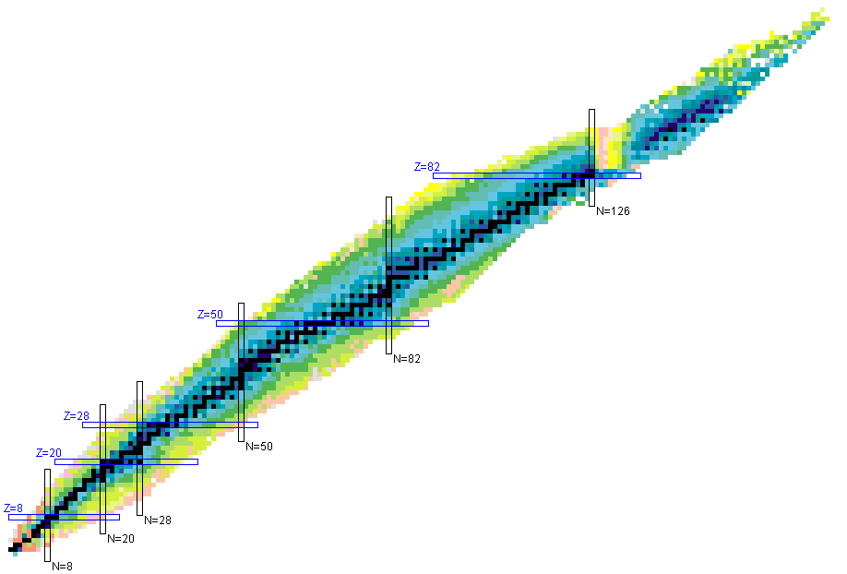
DESIR:
Decay, Excitation and Storage of Radioactive Ions
Site inauguration novembre 2023
First stable beams 2026
First experiments 2027
S³-LEB
  Fusion-evaporation
  (Multi-)nucleon Transfer
Beams from SPIRAL1 and S3
Important beam preparation and purification capabilities
High resolution and high precision experiments
Studies of fundamental properties of nuclei:
masses, lifetimes, decay modes, spin, quadrupolar moments…
Nucleosynthesis
Fundamental interactions, study of weak interaction
S³-LEB
SPIRAL 1 Upgrade
  Beam & target fragmentation

Slide 10
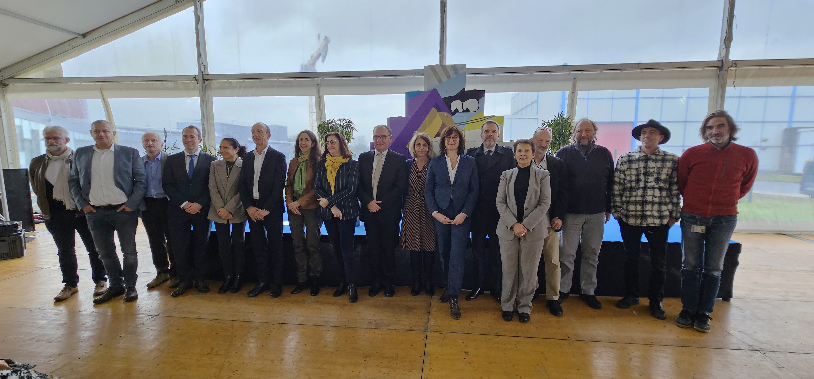
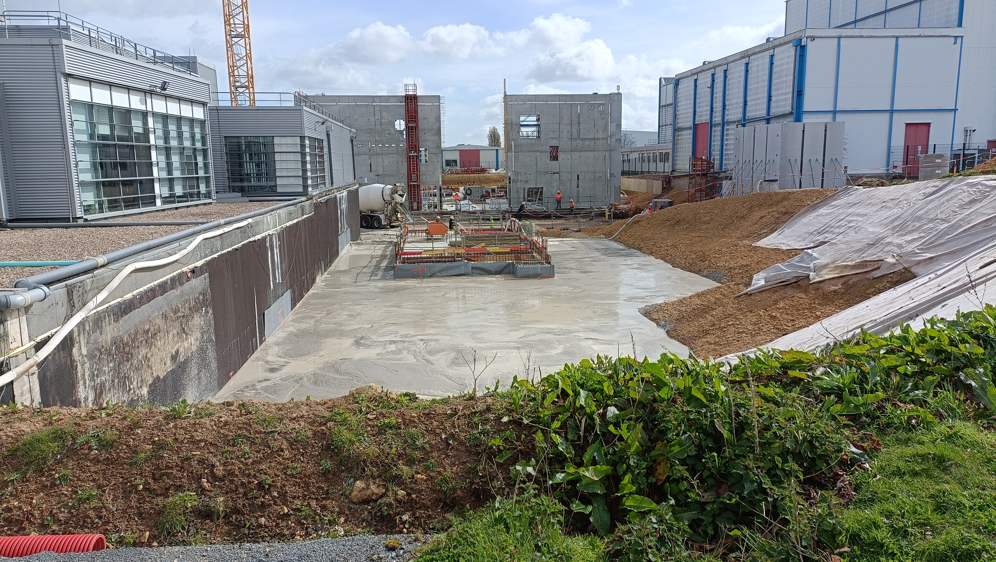
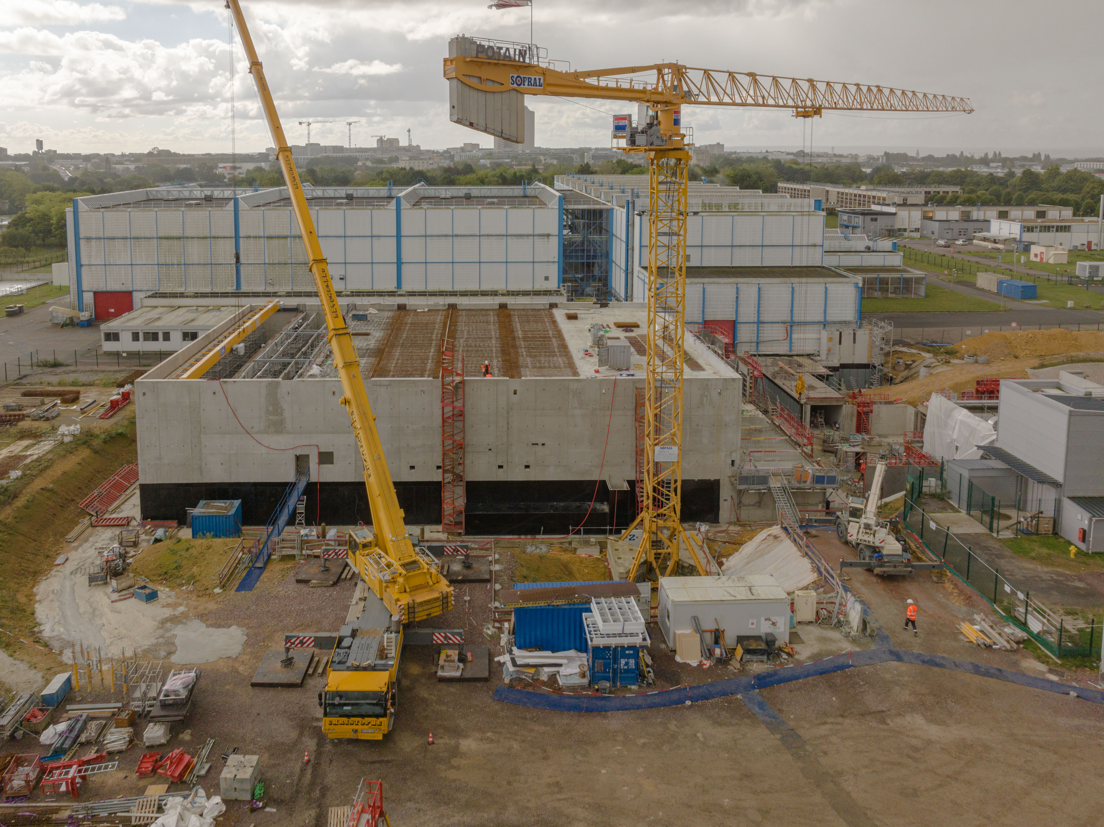
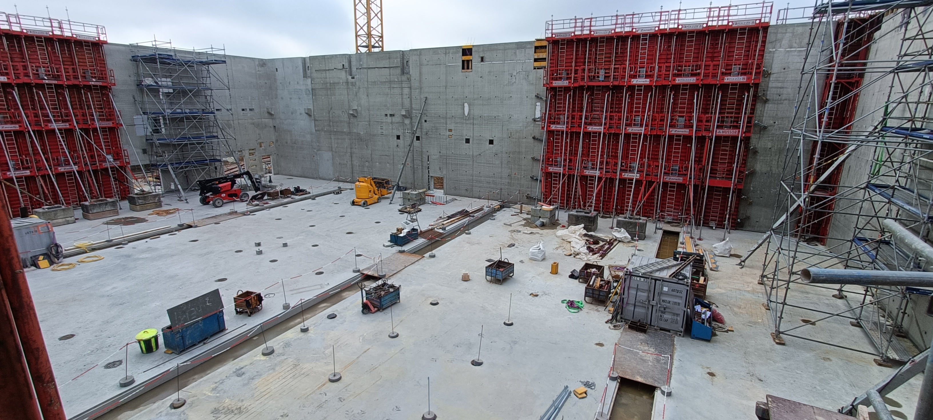
Some pictures of DESIR
Nov. 2023 site inauguration
Four walls in May 2024
Mid september 2024

Slide 11
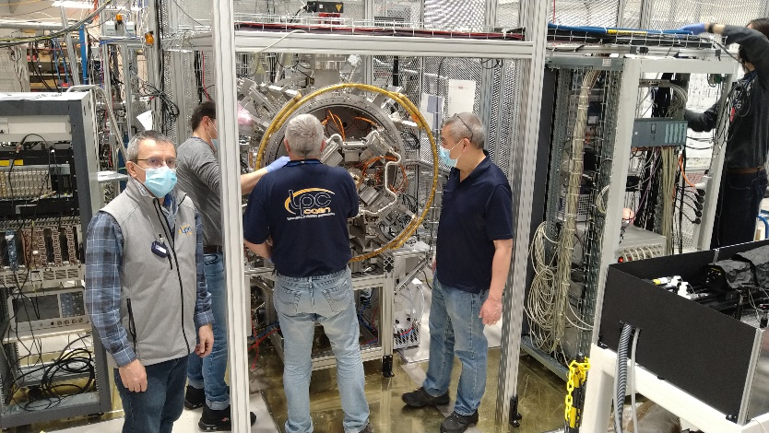
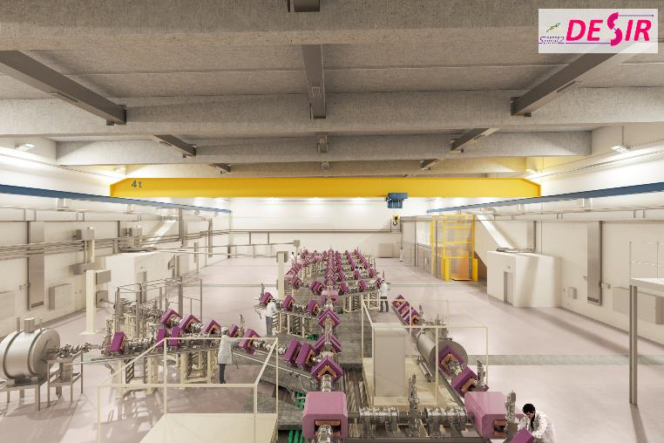

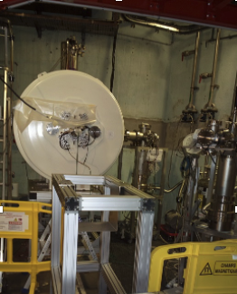
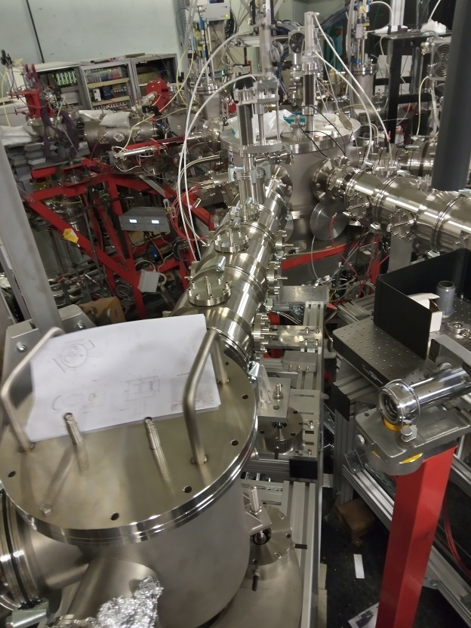
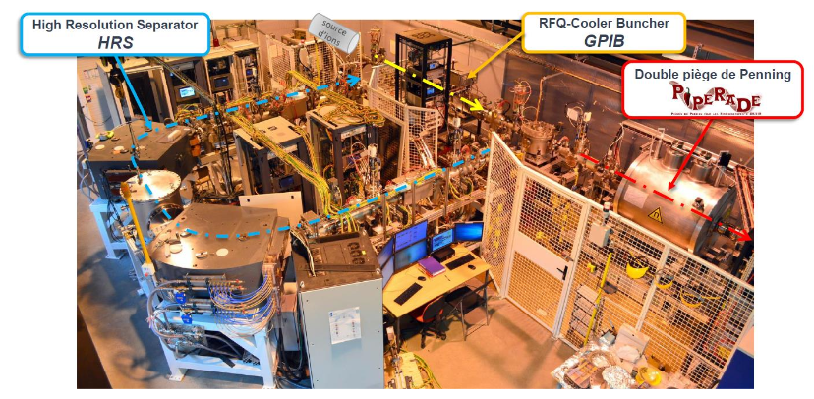


Some pictures of DESIR
S³-LEB beam
SPIRAL1 beam

Slide 12
Welcome at GANIL!

