Slide 1
The application of modular neural networks in map reconstruction
Journées de Rencontre Jeunes Chercheur, Saint-Jacut-de-la-Mer 2024
Leonora Kardum

Slide 2
Light introduction to CMB

Slide 3
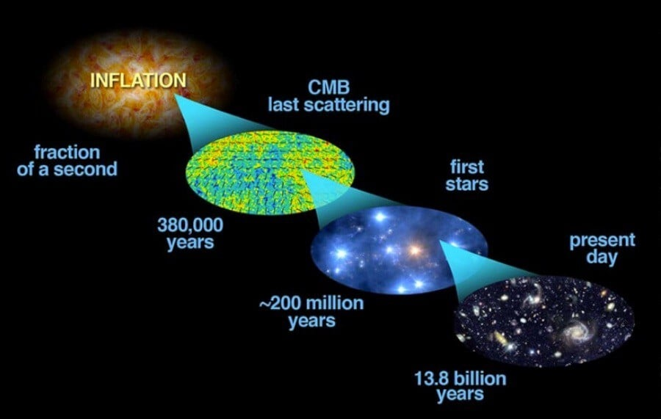
Light introduction to CMB
partially polarized photon field released 380,000 years after the Big Bang when neutral hydrogen was formed
thermal distribution of 2.7K

Slide 4
Light introduction to CMB
small Universe with hot opaque plasma
particles in thermal equilibrium
With the addition of expanding Universe:
Recombination
Leads to decrease of free electron density
Photon decoupling

Slide 5
Light introduction to CMB
partially polarized photon field released 380,000 years after the Big Bang when neutral hydrogen was formed
thermal distribution of 2.7K

Slide 6
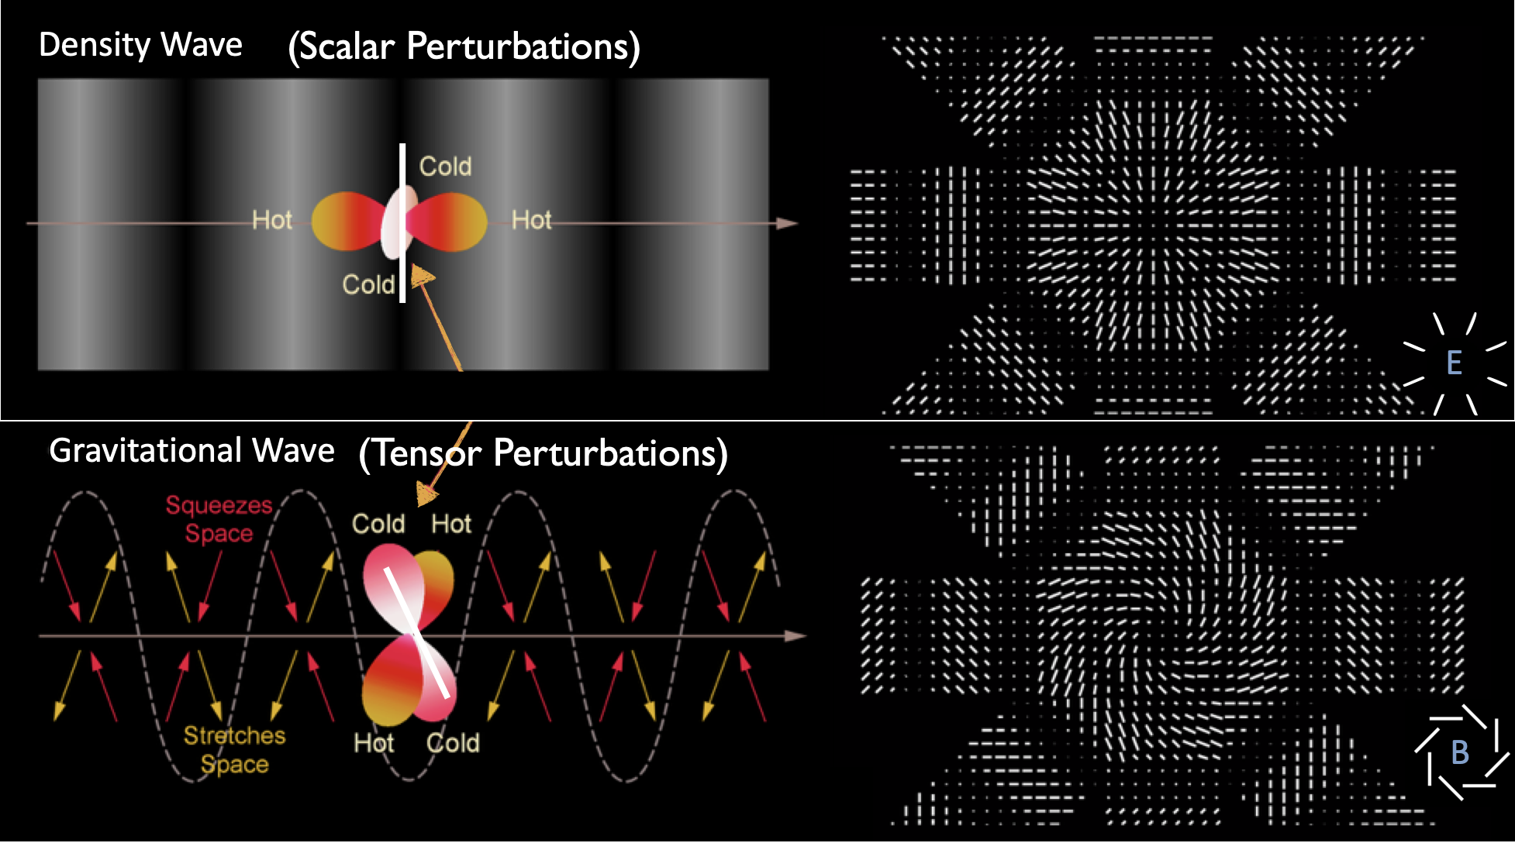
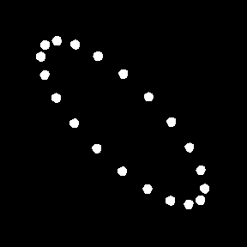

Slide 7
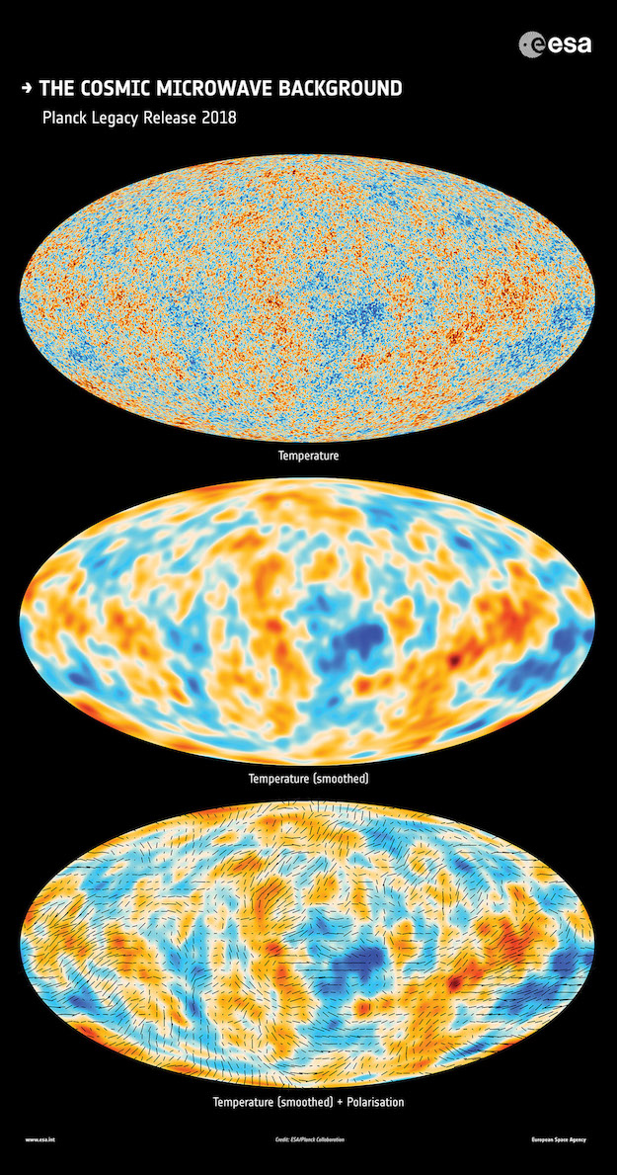
Light introduction to CMB
1 in 10000
partially polarized photon field released 380,000 years after the Big Bang when neutral hydrogen was formed
thermal distribution of 2.7K
variations in the CMB are extremely small

Slide 8
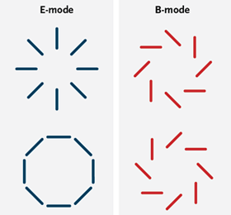
Light introduction to CMB
1 in 10000
partially polarized photon field released 380,000 years after the Big Bang when neutral hydrogen was formed
thermal distribution of 2.7K
variations in the CMB are extremely small
Polarization fully described by scalar and pseudo-scalar fields: E and B-modes

Slide 9
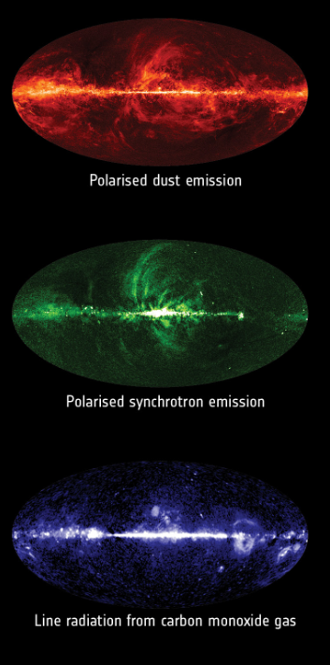
Light introduction to CMB
Image credit: ESA and the Planck Collaboration
partially polarized photon field released 380,000 years after the Big Bang when neutral hydrogen was formed
thermal distribution of 2.7K
variations in the CMB are extremely small
Polarization fully described by scalar and pseudo-scalar fields: E and B-modes
Several foreground contaminants, significance depends on frequency

Slide 10
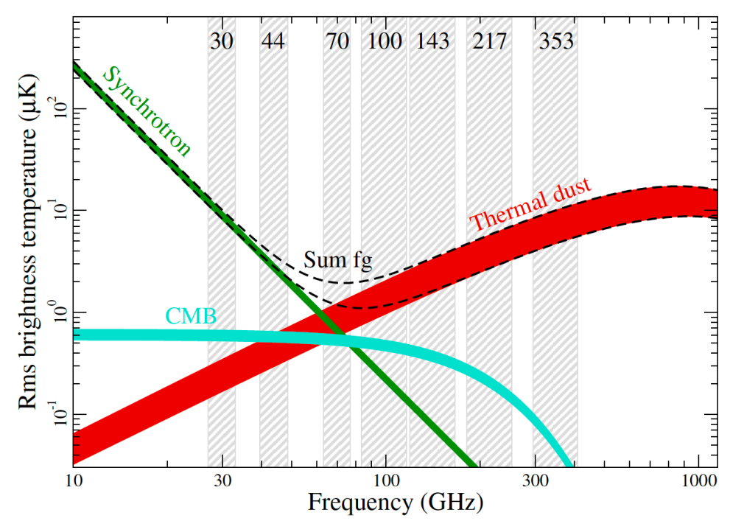
Light introduction to CMB
Image credit: ESA and the Planck Collaboration
partially polarized photon field released 380,000 years after the Big Bang when neutral hydrogen was formed
thermal distribution of 2.7K
variations in the CMB are extremely small
Polarization fully described by scalar and pseudo-scalar fields: E and B-modes
Several foreground contaminants, significance depends on frequency

Slide 11
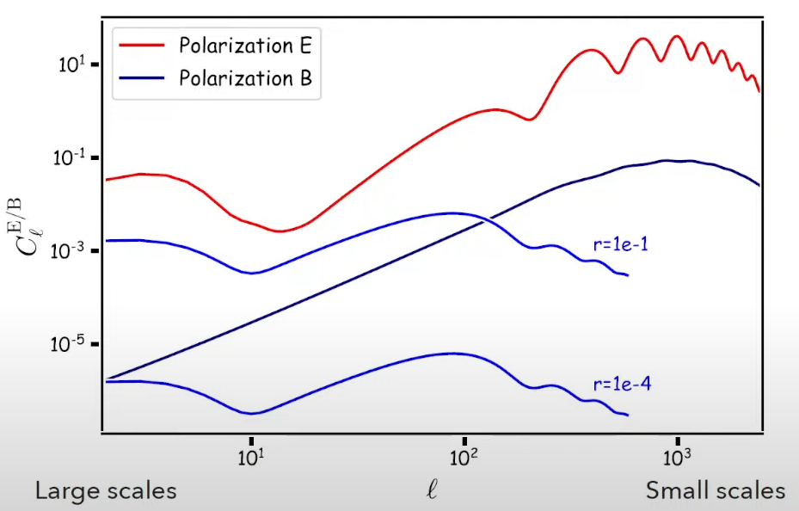
Challenges
Cosmology with gravitational lensing of the Cosmic Microwave Background, Louis Legrand, ICTP/SAIFR - IFT/Unesp
Galactic Foregrounds:
Synchrotron Radiation
Thermal Dust Emission
Free-Free Emission
Instrumental Noise and Systematics:
Photon Noise
Detector Noise
Atmosphere
*Foreground components vary with frequency, necessitating observations at multiple frequencies
Tensor to scalar ratio r: Represents the relative strength of primordial gravitational waves (tensor perturbations) to density fluctuations (scalar perturbations)
Extremely weak signal

Slide 12
Challenges
Cosmology with gravitational lensing of the Cosmic Microwave Background, Louis Legrand, ICTP/SAIFR - IFT/Unesp
Tensor to scalar ratio r: Represents the relative strength of primordial gravitational waves (tensor perturbations) to density fluctuations (scalar perturbations)
Extremely weak signal

Slide 13
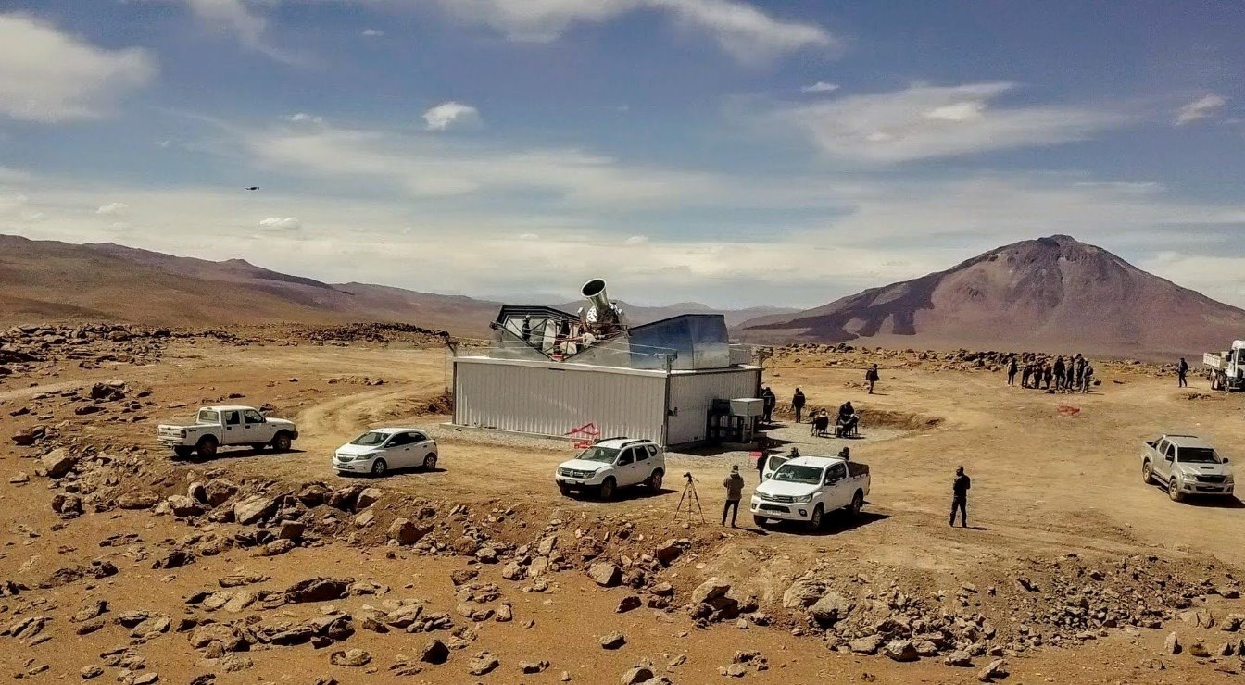
QUBIC
The Q & U Bolometric Interferometer for Cosmology

Slide 14
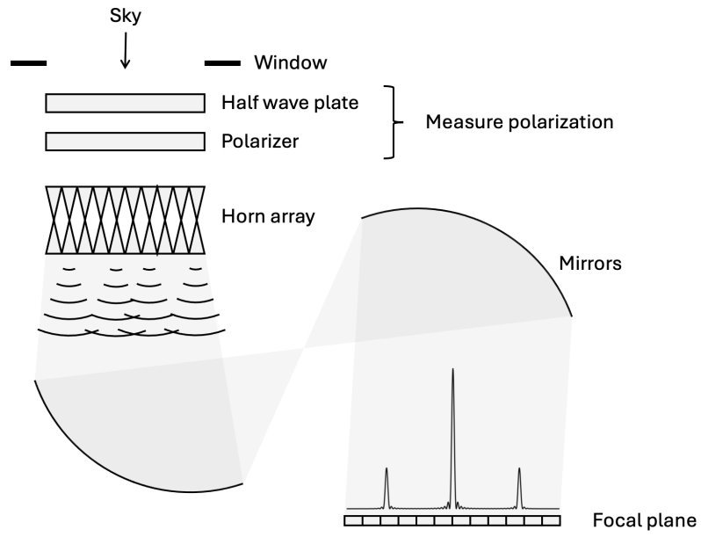
QUBIC
unique instrument combining interferometry and bolometry to observe the CMB, using an array of bolometers to measure temperature and polarization fluctuations
Battistelli, E.S., Ade, P., Alberro, J.G. et al. QUBIC: The Q & U Bolometric Interferometer for Cosmology. J Low Temp Phys 199, 482–490 (2020). https://doi.org/10.1007/s10909-020-02370-0

Slide 15
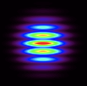
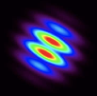
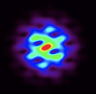
QUBIC
unique instrument combining interferometry and bolometry to observe the CMB, using an array of bolometers to measure temperature and polarization fluctuations
Battistelli, E.S., Ade, P., Alberro, J.G. et al. QUBIC: The Q & U Bolometric Interferometer for Cosmology. J Low Temp Phys 199, 482–490 (2020). https://doi.org/10.1007/s10909-020-02370-0

Slide 16
QUBIC
unique instrument combining interferometry and bolometry to observe the CMB, using an array of bolometers to measure temperature and polarization fluctuations
Battistelli, E.S., Ade, P., Alberro, J.G. et al. QUBIC: The Q & U Bolometric Interferometer for Cosmology. J Low Temp Phys 199, 482–490 (2020). https://doi.org/10.1007/s10909-020-02370-0

Slide 17
QUBIC
unique instrument combining interferometry and bolometry to observe the CMB, using an array of bolometers to measure temperature and polarization fluctuations
Battistelli, E.S., Ade, P., Alberro, J.G. et al. QUBIC: The Q & U Bolometric Interferometer for Cosmology. J Low Temp Phys 199, 482–490 (2020). https://doi.org/10.1007/s10909-020-02370-0

Slide 18
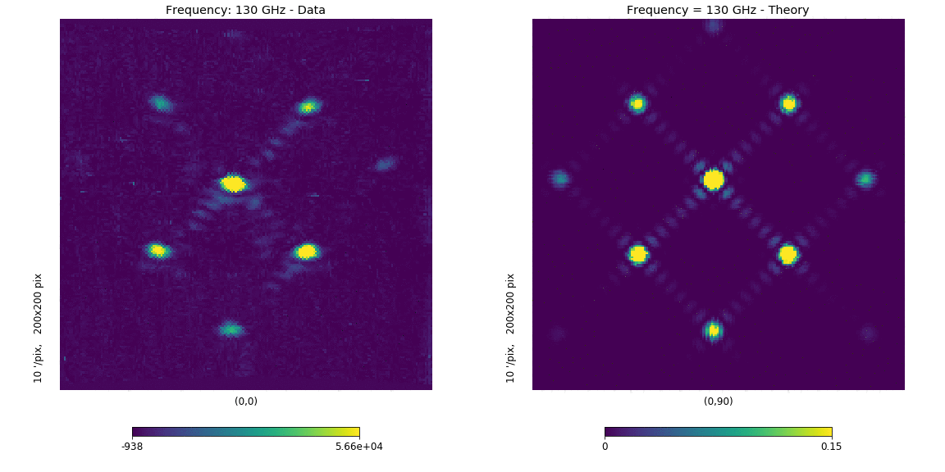
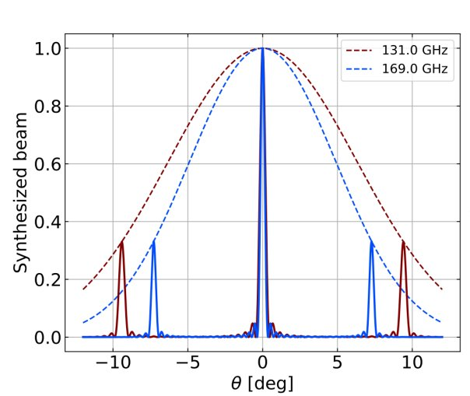
QUBIC
unique instrument combining interferometry and bolometry to observe the CMB, using an array of bolometers to measure temperature and polarization fluctuations
QUBIC produces multiple peaks due to its interferometric setup: Spectral splitting of light enables the separation of different frequency components, aiding in component separation

Slide 19
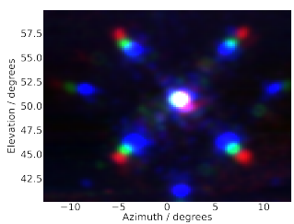
QUBIC
unique instrument combining interferometry and bolometry to observe the CMB, using an array of bolometers to measure temperature and polarization fluctuations
QUBIC produces multiple peaks due to its interferometric setup: Spectral splitting of light enables the separation of different frequency components, aiding in component separation

Slide 20
Physics guided Machine Learning

Slide 21
Physics guided Machine Learning
Choosing appropriate layers (e.g., convolutional, recurrent, graph-based) depending on the data structure
Using layers that incorporate physical knowledge (e.g., known operators)
Operators like rotation, scaling, and convolution should be well-understood and correctly implemented based on problem specifics and used structures
Proper architecture design ensures that the network can learn complex relationships without overfitting (due to unneccesary complexity) or underfitting (due to improper introduction of known operators)

Slide 22
Physics guided Machine Learning
Case-specific issues:
Rotational Invariance: CMB data is inherently spherical, so the analysis must be invariant to rotations on the sphere
Handling Sparsity: Both the data and applied operators can be sparse! CMB observations often cover only parts of the sky, while operators are represented with sparse matrices (e.g. detector beam)
Particularities of the detector: Different instrument process data in different manners. The network has to represent the complex process inside QUBIC.

Slide 23
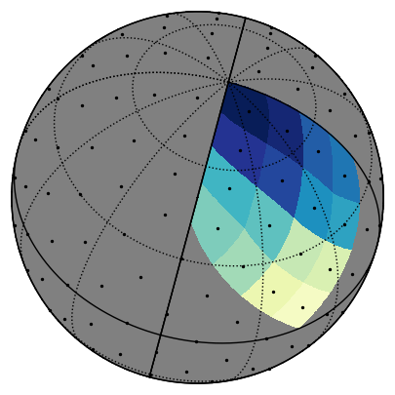
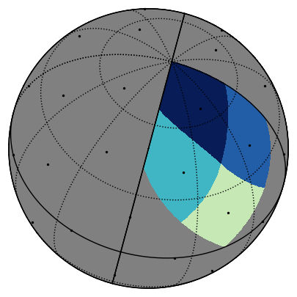
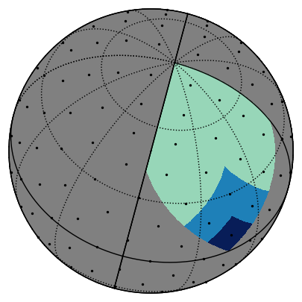
Physics guided Machine Learning
Conventional layers need to be adapted for to the complexity of the data to maintain accuracy.
Layers should respect the Healpix geometry!
The heart of any layer is the aggregation function: fundamental concept in neural networks, particularly in GNNs, where it involves combining information from neighboring nodes to form richer representations.
Calls for proper integration of neighbourhood. – How can we know what is proper?
The analysts choose this based on the specifics of the attempted solution!
The aggregation function determines the operation, but will treat patches as Euclidian in default!!

Slide 24
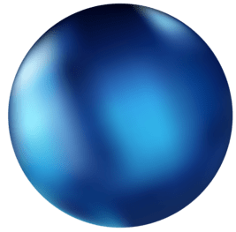
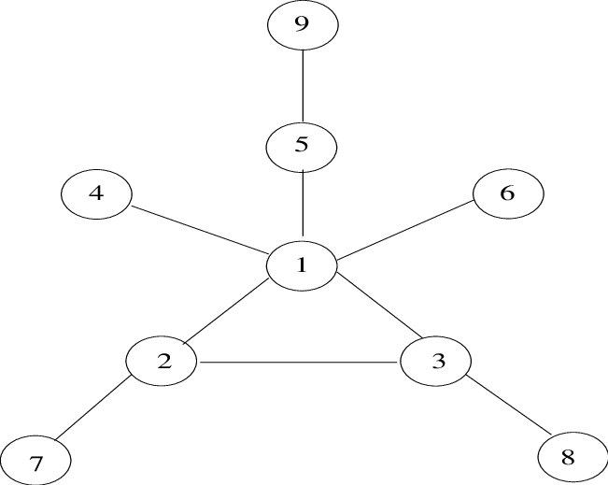
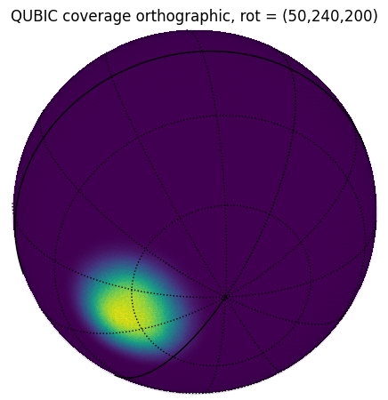
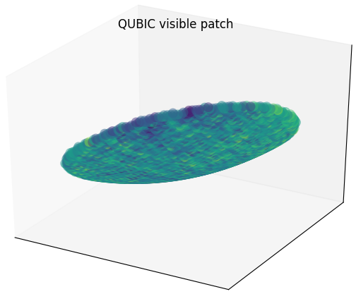
Physics guided Machine Learning
Data from different sources and types can be represented in a unified structure; naive handling of multifeature data can easily lead to discrepancies!
3
3

Slide 25
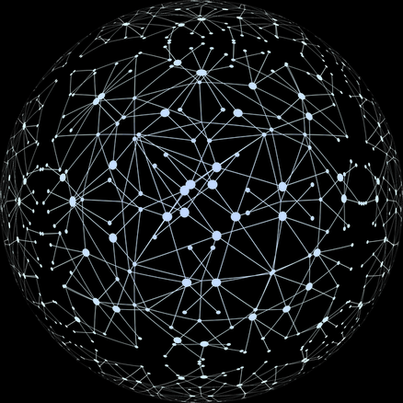
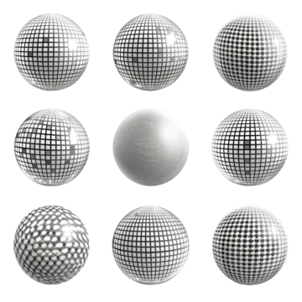
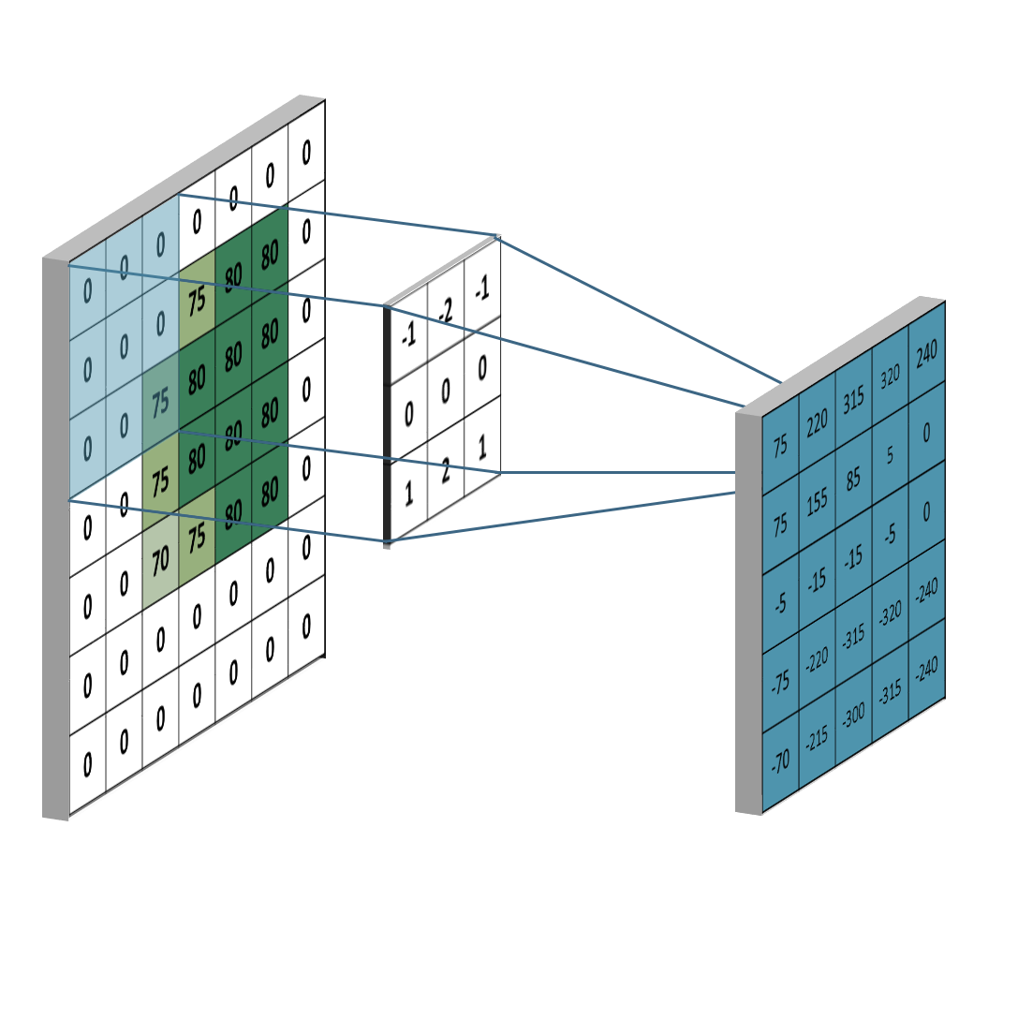
Physics guided Machine Learning
Data from different sources and types can be represented in a unified structure; naive handling of multifeature data can easily lead to discrepancies!
LSTM
Dana type: temporal, sequential
Used for: processing of TOD, frequency dependance
Convolution NN
Dana type: 2D projections of maps
Used for: finding structure in small areas, local feature extraction
Graph CN
Dana type: spherical maps with additional features and relationships
Used for: complex and complete studies of maps
Spherical NN
Dana type: spherical maps
Used for: processing intensity maps

Slide 26
Physics guided Machine Learning
Data from different sources and types can be represented in a unified structure; naive handling of multifeature data can easily lead to discrepancies!
Adjusted!
LSTM
Dana type: temporal, sequential
Used for: processing of TOD, frequency dependance
Convolution NN
Dana type: 2D projections of maps
Used for: finding structure in small areas, local feature extraction
Graph CN
Dana type: spherical maps with additional features and relationships
Used for: complex and complete studies of maps
Spherical NN
Dana type: spherical maps
Used for: processing intensity maps

Slide 27
Physics guided Machine Learning
Modulating and informing

Slide 28
Physics guiding
Physics guided Machine Learning
incorporate knowledge of physical processes directly into the architecture
blend the INTERPRETABILITY of physics with the power of neural networks

Slide 29
Physics guiding
Physics guided Machine Learning
In contrast to generic neural networks, which often rely on convolution and dense layers to learn transformations, physics-guided layers explicitly encode known relationships
incorporate knowledge of physical processes directly into the architecture
blend the INTERPRETABILITY of physics with the power of neural networks
Example: simple exponential function y = e^{βx}
Dont
Do

Slide 30
Physics guiding
Physics guided Machine Learning
In contrast to generic neural networks, which often rely on convolution and dense layers to learn transformations, physics-guided layers explicitly encode known relationships
incorporate knowledge of physical processes directly into the architecture
blend the INTERPRETABILITY of physics with the power of neural networks
Example: simple exponential function y = e^{βx}
Dont
Do
*Enhances interpretability, requires fewer training, and allows fitting!!!

Slide 31
Physics guiding
Physics guided Machine Learning
In contrast to generic neural networks, which often rely on convolution and dense layers to learn transformations, physics-guided layers explicitly encode known relationships
incorporate knowledge of physical processes directly into the architecture
blend the INTERPRETABILITY of physics with the power of neural networks
Interpretability: Each layer has a clear physical meaning, enabling the analysis of the network
Data Efficiency: Requires less data to train
Stability: Constrained by physics, the network avoids overfitting and learns realistic behavior
Parameter Estimation: Learnable parameters in layers correspond to real-world quantities, such as decay constants or optical efficiencies, and are extractable after training

Slide 32
Modular NNs
Physics guided Machine Learning
composed of distinct components or layers, each designed to perform a specific operation
Each module operates INDEPENDENTLY

Slide 33
Modular NNs
Physics guided Machine Learning
composed of distinct components or layers, each designed to perform a specific operation
Each module operates INDEPENDENTLY
s
nn.Module
Inv(L)
nn.Module
Inv(U)
d = B I D L (HW P) F A T U s
nn.Module
Inv(D)
nn.Module
Inv(HW)
nn.Module
Inv(T)
nn.Module
Inv(I)
nn.Module
Inv(P)
nn.Module
Inv(A)
nn.Module
Inv(B)
nn.Module
Inv(F)
d

Slide 34
Modular NNs
Physics guided Machine Learning
composed of distinct components or layers, each designed to perform a specific operation
Each module operates INDEPENDENTLY
Independent Design: Each operator is implemented as a separate module, allowing focused and efficient development
Improved Debugging: Simplifies troubleshooting by usolating errors or inaccuracies to specific modules
Easy Retraining: Only the module affected by changes needs to be retrained, saving computational resources
Flexibility: If a single operator needs to be updated due to changes in experimental design or new insights, it can be replaced or retrained without impacting the rest of the network​

Slide 35
Modular NNs
Physics guided Machine Learning
Flexibility: If a single operator needs to be updated due to changes in experimental design or new insights, it can be replaced or retrained without impacting the rest of the network​
nn.Module
Inv(L)
nn.Module
Inv(U)
nn.Module
Inv(D)
nn.Module
Inv(HW)
nn.Module
Inv(T)
nn.Module
Inv(I)
nn.Module
Inv(P)
nn.Module
Inv(A)
nn.Module
Inv(B)
nn.Module
Inv(F)
NN seq

Slide 36
Modular NNs
Physics guided Machine Learning
nn.Module
Inv(F)
Flexibility: If a single operator needs to be updated due to changes in experimental design or new insights, it can be replaced or retrained without impacting the rest of the network​
nn.Module
Inv(L)
nn.Module
Inv(U)
nn.Module
Inv(D)
nn.Module
Inv(HW)
nn.Module
Inv(T)
nn.Module
Inv(I)
nn.Module
Inv(P)
nn.Module
Inv(A)
nn.Module
Inv(B)
NN seq

Slide 37
Modular NNs
Physics guided Machine Learning
nn.Module
mod - Inv(F)*
Flexibility: If a single operator needs to be updated due to changes in experimental design or new insights, it can be replaced or retrained without impacting the rest of the network​
nn.Module
Inv(L)
nn.Module
Inv(U)
nn.Module
Inv(D)
nn.Module
Inv(HW)
nn.Module
Inv(T)
nn.Module
Inv(I)
nn.Module
Inv(P)
nn.Module
Inv(A)
nn.Module
Inv(B)
NN seq

Slide 38
Modular NNs
Physics guided Machine Learning
Flexibility: If a single operator needs to be updated due to changes in experimental design or new insights, it can be replaced or retrained without impacting the rest of the network​
nn.Module
Inv(L)
nn.Module
Inv(U)
nn.Module
Inv(D)
nn.Module
Inv(HW)
nn.Module
Inv(T)
nn.Module
Inv(I)
nn.Module
Inv(P)
nn.Module
Inv(A)
nn.Module
Inv(B)
nn.Module
mod - Inv(F)*
NN seq

Slide 39
Operator NNs
Physics guided Machine Learning
neural network architecture designed to model, learn, or invert mathematical operators
Visualization, studying operator properties, reusing the operator or learned parameters
Combination of physics guidance and modularity inevitably ends as an Operator Network :)
d = B I D L (HW P) F A T U s
s = U⁻¹ T⁻¹ A⁻¹ F⁻¹ P⁻¹ HW⁻¹ L⁻¹ D⁻¹ I⁻¹ B⁻¹ d

Slide 40
Operator NNs
Physics guided Machine Learning
neural network architecture designed to model, learn, or invert mathematical operators
Visualization, studying operator properties, reusing the operator or learned parameters
Combination of physics guidance and modularity inevitably ends as an Operator Network :)
d = B I D L (HW P) F A T U s
s = U⁻¹ T⁻¹ A⁻¹ F⁻¹ P⁻¹ HW⁻¹ L⁻¹ D⁻¹ I⁻¹ B⁻¹ d
extract

Slide 41
Classic
Accurate
Deep learning
Computationally efficient
PG + M NN
Interpretable
Established
Interpretable
Adaptable
SIMPLE
Accurate
Computationally efficient
Adaptable
Scalable
Generalization
Retrainable (pu)
Accurate
GPU acceleration, parallelized computations, optimized matrix operations, batch processing

Slide 42
Classic
Accurate
Deep learning
Computationally efficient
PG + M NN
Interpretable
Established
Interpretable
Adaptable
SIMPLE
Accurate
Computationally efficient
Adaptable
Scalable
Generalization
Retrainable (pu)
Accurate
Exchanging a part | Resimulate, regenerate | Resimulate, retrain all | Update 1 module
Fitting | MC studies over a range | - | Straightforward
Extension | Extend, resimulate, fit | Extend, retrain all | Extend 1 module
Performance interpretability | Complex but possible | - | Straightforward
Operator studies | Resimulate w / w/o, study | - | Extract (straightforward), study

Slide 43
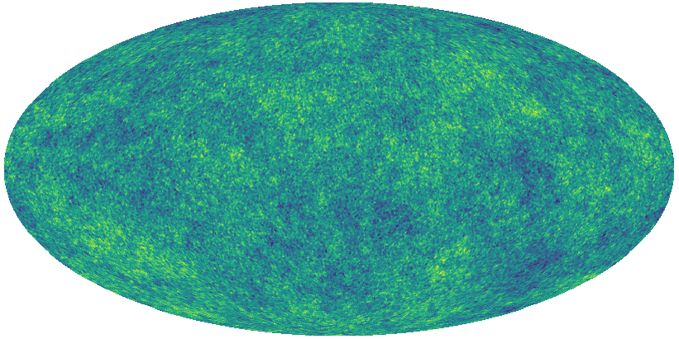
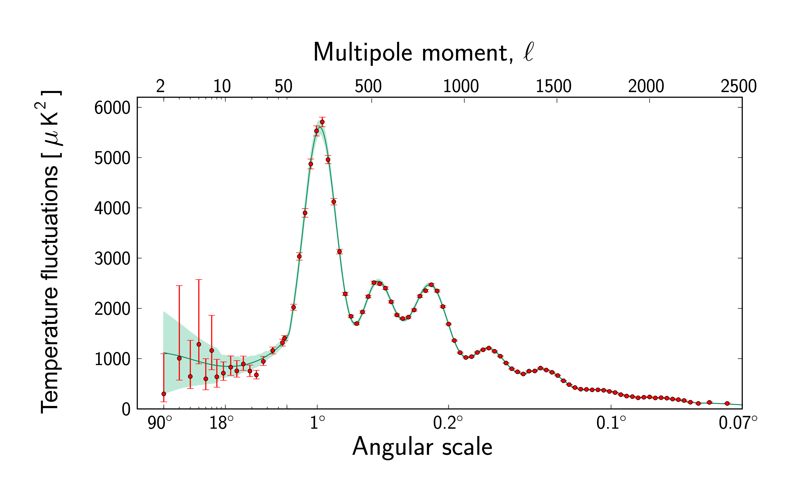
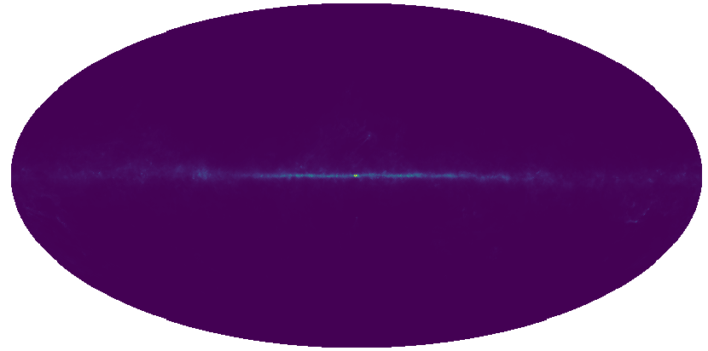
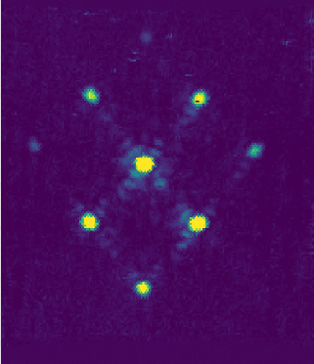
The framework
T
O
D
hp
r
CAMB
H
pysm

Slide 44
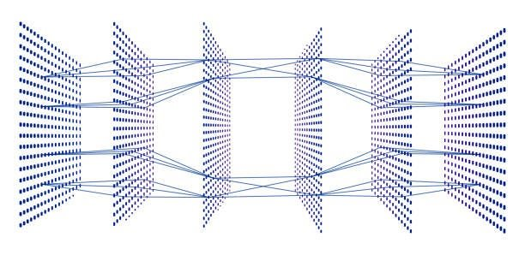
The framework
I
. . .
. . .
r
CAMB
H⁻¹
Q
Physics guided modular NN
. . .
U
T
O
D
T
O
D
T
O
D
. . .

Slide 45
The framework
I
Q
Namaster
U

Slide 46
In conclusion...

Slide 47
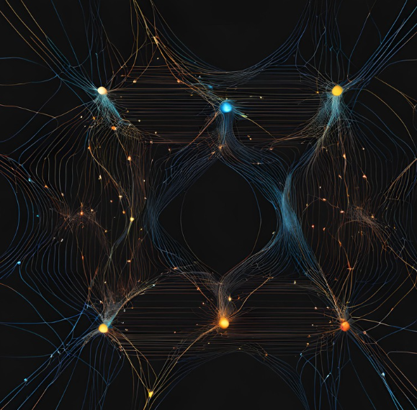
Leonora Kardum
LABORATOIRE ASTROPARTICULE & COSMOLOGIE
for Journées de Rencontre Jeunes Chercheur, at Saint-Jacut-de-la-Mer 2024
Thank you for your attention!

