Slide 1
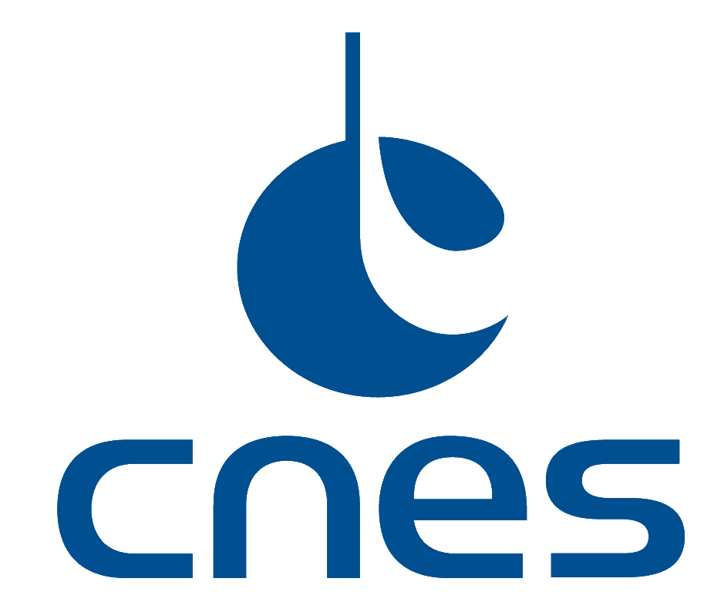
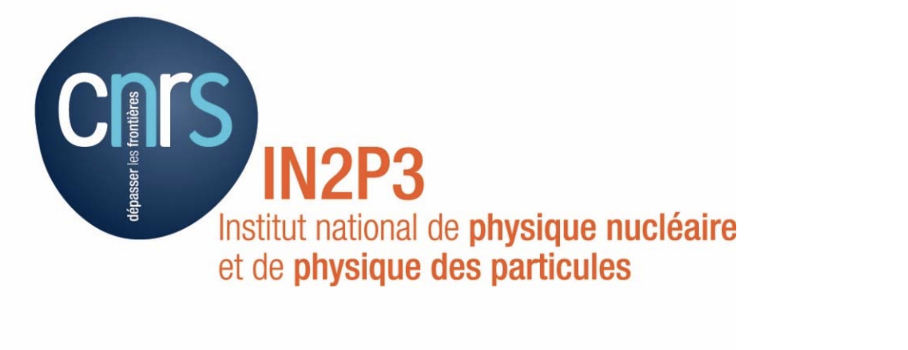
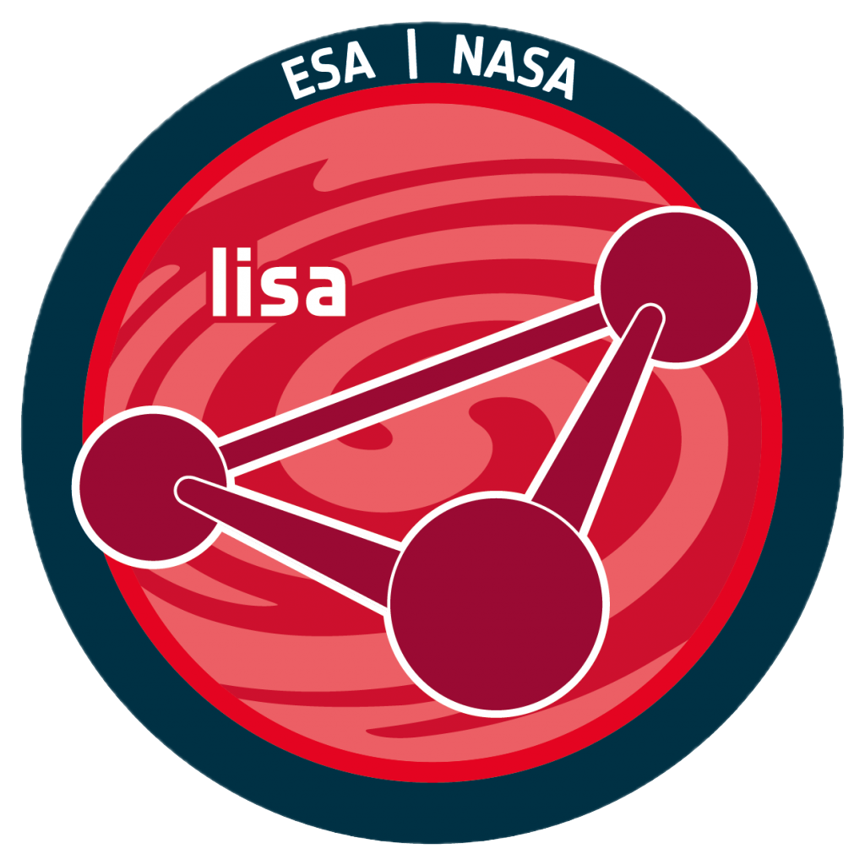


Testing and validating the performance of LISA on ground
Beams Simulator and IDS Test Set Up
Journées Rencontre Jeune Chercheurs
Laboratoire AstroParticule et Cosmologie - Maxime Vincent

Slide 2
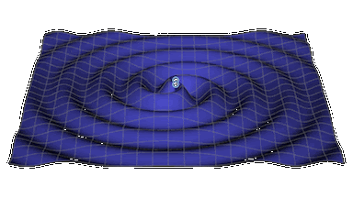
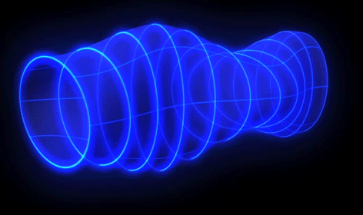
Gravitational waves
What are gravitational waves?
  ripples in the fabric of spacetime, predicted by Einstein’s general theory of relativity
  transverse, quadrupolar waves
  Localy distort spacetime by alternately contracting and expanding distances in all directions
  Travel at the speed of light, unaffected by matter, making them ideal probes of distant cosmic events
What causes gravitational waves?
  Generated by the acceleration of massive objects in spacetime
  Commonly produced by:
    Orbiting compact binaries: e.g., neutron star pairs or black hole mergers.
    Non-spherical supernovae explosions.
    Cosmic strings or early universe phenomena (inflation).
  Require extreme gravitational fields for detectable amplitudes.

Slide 3
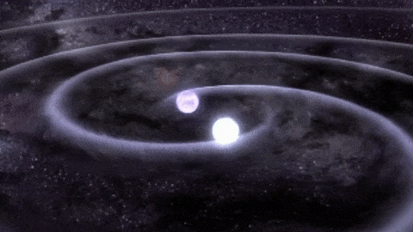
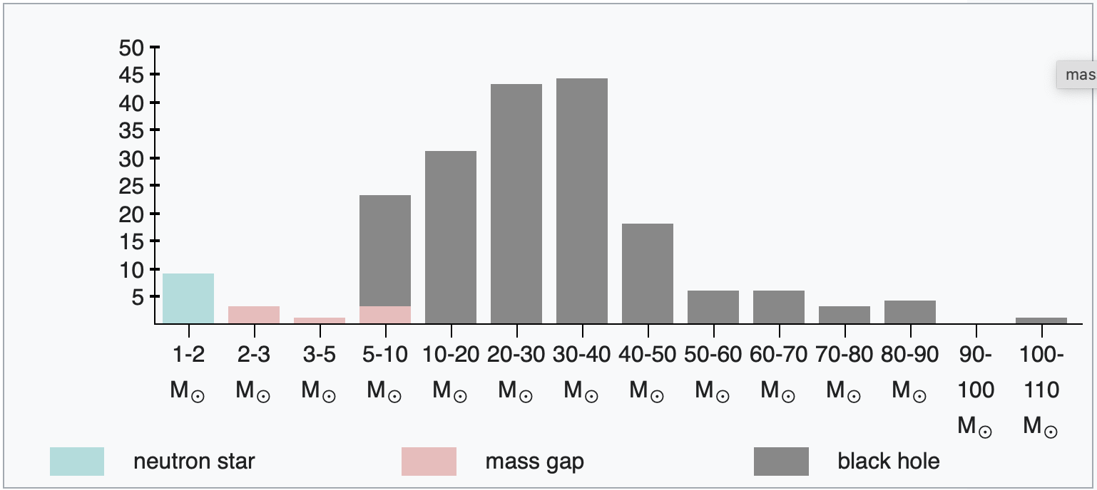
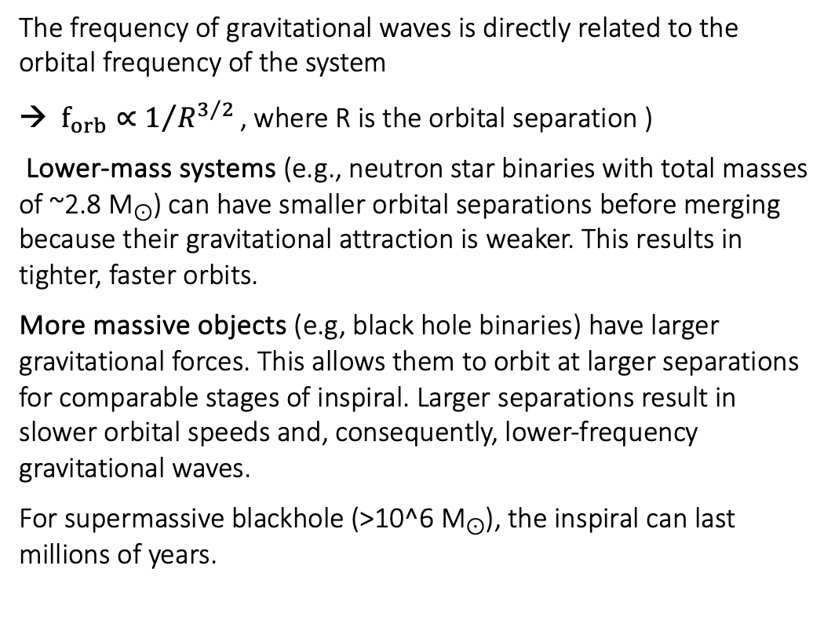
Gravitational waves
The frequency of gravitational waves is directly related to the orbital frequency of the system
→ $f_{orb}∝1/{R^{3/2}}\text{​}$, where R is the orbital separation )
Lower-mass systems (e.g., neutron star binaries with total masses of ~2.8 M⊙​) can have smaller orbital separations before merging because their gravitational attraction is weaker. This results in tighter, faster orbits.
More massive objects (e.g, black hole binaries) have larger gravitational forces. This allows them to orbit at larger separations for comparable stages of inspiral. Larger separations result in slower orbital speeds and, consequently, lower-frequency gravitational waves.
For supermassive blackhole (>10^6 M⊙), the inspiral can last millions of years.
Notes:
. For two orbiting objects, the orbital frequency increases as the objects spiral closer due to energy loss via gravitational wave emission.

Slide 4
Detection of gravitational waves
The only way to detect GW is to use the tricks of nature
  Gravitational waves distort spacetime, stretching and squeezing distances between objects.
  The speed of light remains invariant in all reference frames (key to detection).
  As spacetime deforms, the path length of light traveling between two objects changes.
  A measurement of the travel time of light would allow to detect these waves
Gravitational waves cause fractional changes in distance, denoted by the strain h=∆L/L, typically on the order of h∼10⁻²¹ for detectable events.
A 4 km detector, light would take 23.3 µs to travel the 4000m and the strain on that detector would stretch it by 4×10⁻¹⁸ m.
Time delay due to changed path length ∆t= 1.33×10⁻²⁶ s but the fastest clock allows measurements up to only 10⁻¹⁸ s

Slide 5
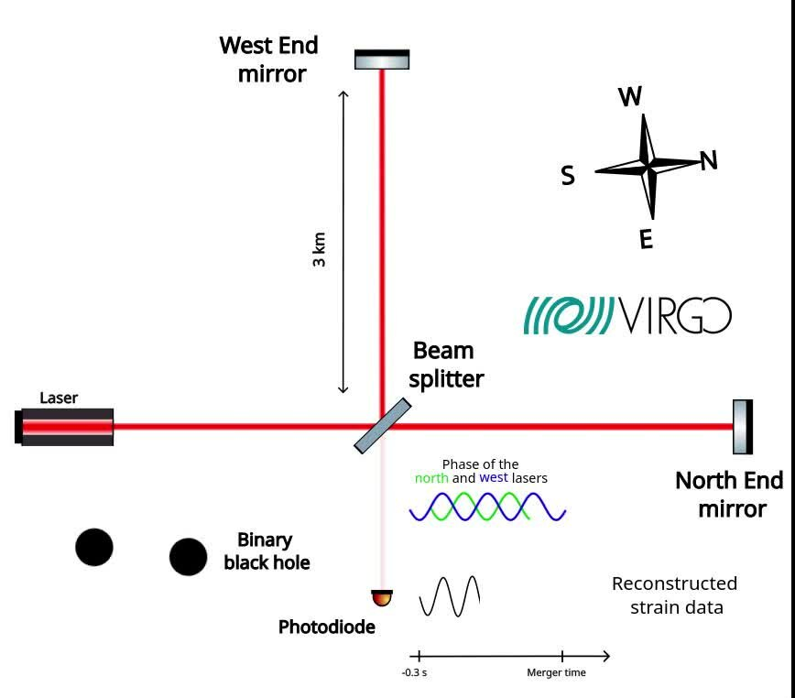
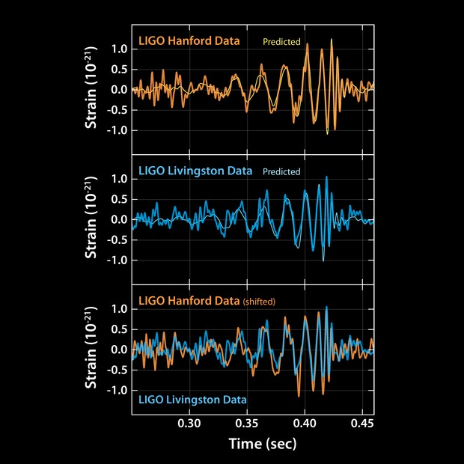
Detection of gravitational waves
We use laser interferometry to measure relative changes in distance caused by gravitational waves
Michelson interferometer are used on earth based detectors
The laser beam travels in the arms of the interferometer and are by design in phase opposition so the detector sees nothing due to destructive interferences
When a gravitational wave hits the detectors, one arm of the interferometer will periodically shorten and lengthen : light will travel more or less distance
The phase of the laser beam will be affected by this change in distance, the interference will then periodically become more or less destructive and result in the detection of light

Slide 6
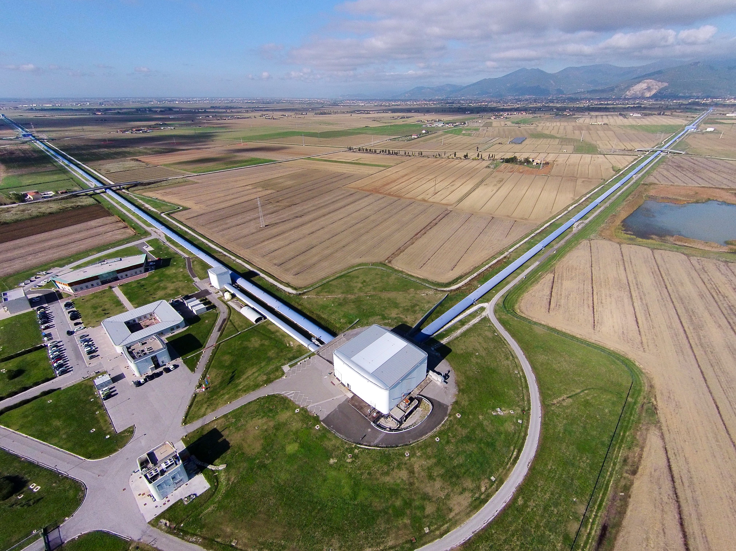
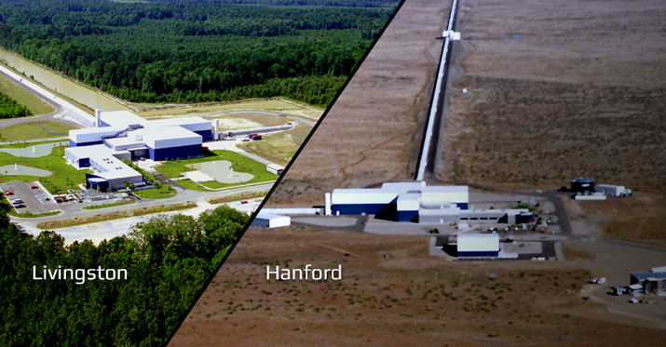
Detection of gravitational waves
Italian / French detector VIRGO in Italia
3 km long, sensitive to the 10 Hz to 10 000 Hz frequency band
Can detect binary neutron stars mergers up to 80 Mpc
LIGO detectors in the United States
4 km long, sensitive to the 10 Hz to 10 000 Hz frequency band
Can detect binary neutron stars mergers up to 200 Mpc

Slide 7
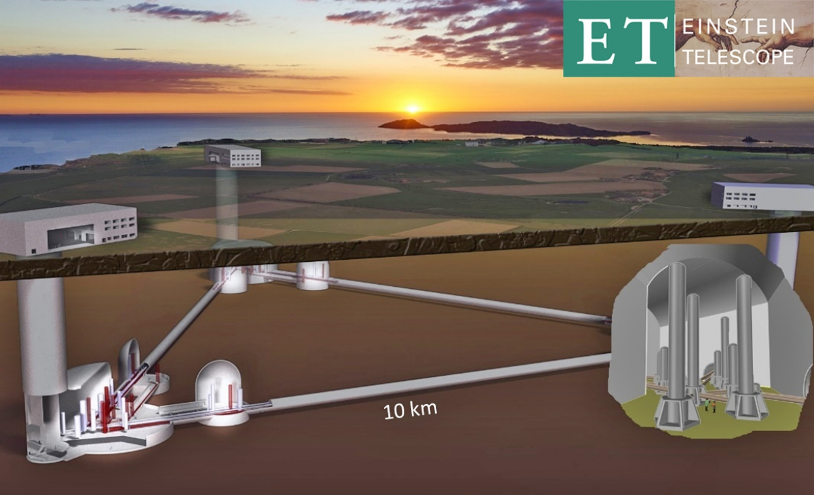
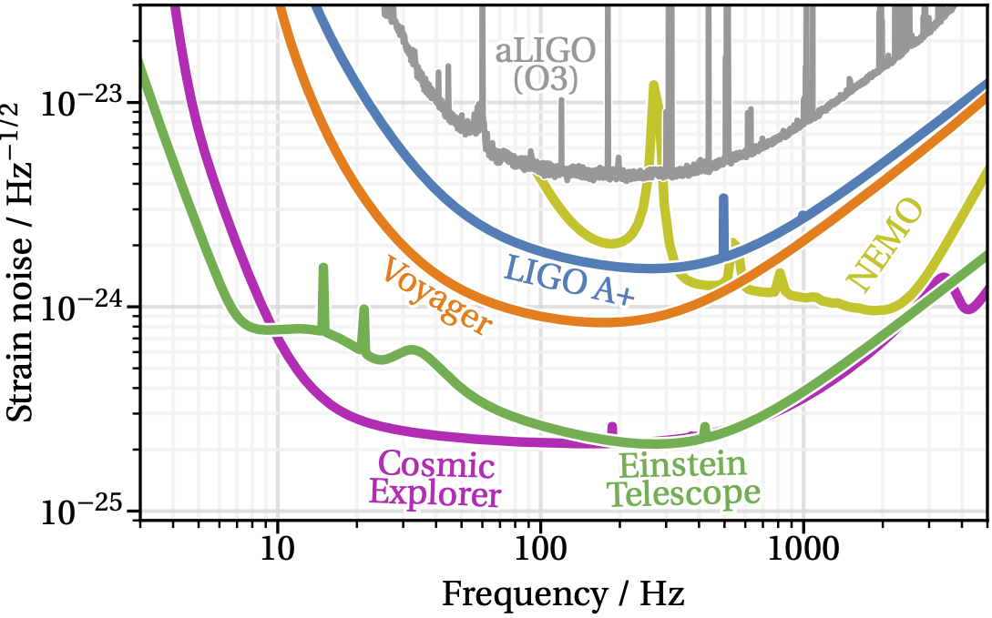
What about the lower frequency band ?
Ground-based detectors like LIGO and Virgo are limited to high-frequency events (10 Hz to a few kHz).
Low-frequency gravitational waves (from supermassive black hole binaries or early universe signals) are drowned out by seismic noise and other environmental disturbances below ~10 Hz.
The sensitivity of interferometers depends on the length of their arms. Larger arms amplify the tiny distortions caused by gravitational waves, improving detection.
Current detectors (4 km arms) can measure strains as small as h∼10⁻²³. However, extending the arm length reduces noise and increases sensitivity at both lower and higher frequencies. Future projects like the Einstein Telescope (10 km arms) and Cosmic Explorer (40 km arms) aim to greatly expand detection capabilities.

Slide 8
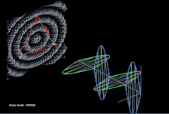
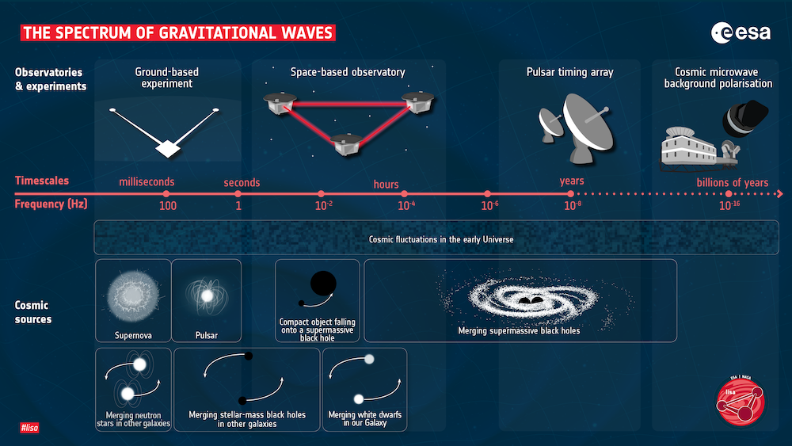
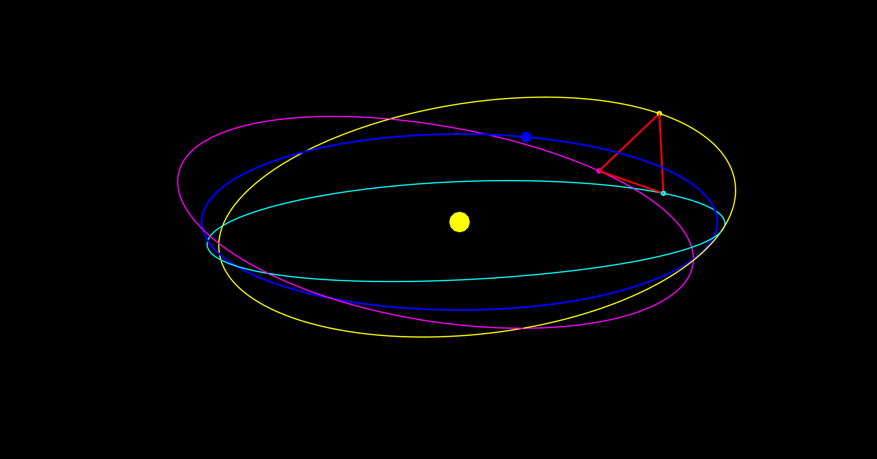
Detection of gravitational wave from space
To overcome seismic noise and further increase arm length, space-based detectors like LISA are being developed
The Laser Interferometer Space Antenna (LISA) will be the first space-based gravitational wave detector. (Led by ESA, to be launched in 2035)
LISA will target low-frequency waves (0.1 mHz–1 Hz) that ground-based detectors cannot access.
LISA consists of three spacecraft forming a triangle, separated by 2.5 million kilometers.
Scientific Goals:
  Detecting supermassive black hole mergers across the universe.
  Observing extreme mass ratio inspirals
  Searching for primordial gravitational waves from the early universe.

Slide 9
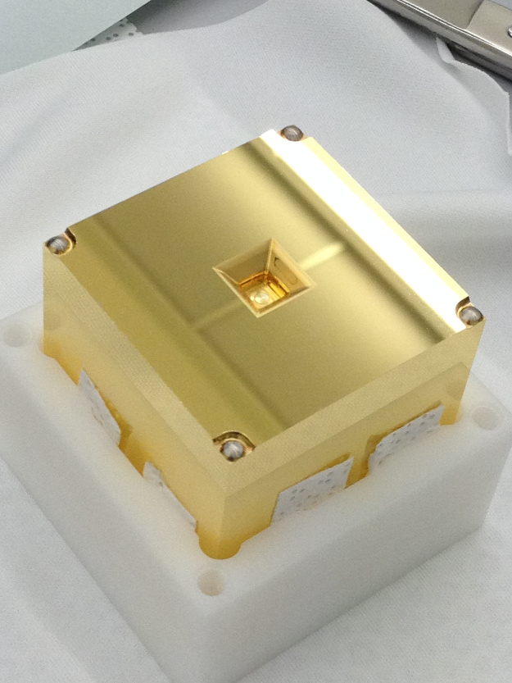
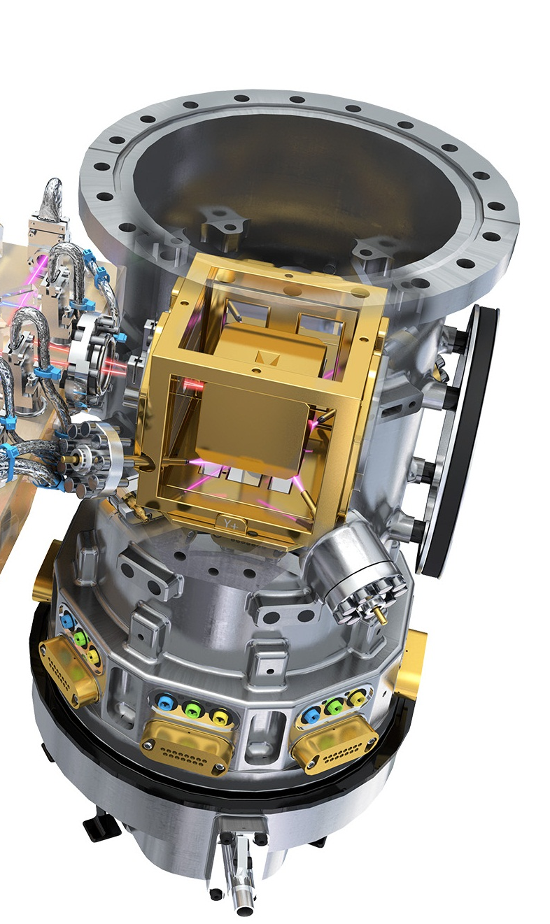
Laser Interferometer Space Antenna
LISA will be able to measure distances variations between two spacecraft (separated by 2.5 MKm) up to a precision of 10 pm in the 0.1 mHz to 1 Hz frequency band, yielding a strain sensitivity of 10⁻²¹ (2 500 000 ± 0.00000000000001 km )
Each spacecraft hosts two test masses that are in an isolated vaccum chamber at the center of mass of the spacecraft so that they are isolated from any disturbing forces (except gravity), they act as the gravitational reference.
46 mm cube of roughly 2 kg of Gold-Platinum
The test masses are free floating in these chambers and Micro-Newton thrusters maintain the spacecraft’s position relative to the test masses, minimizing noise from external forces like solar radiation pressure or interplanetary medium effects.

Slide 10
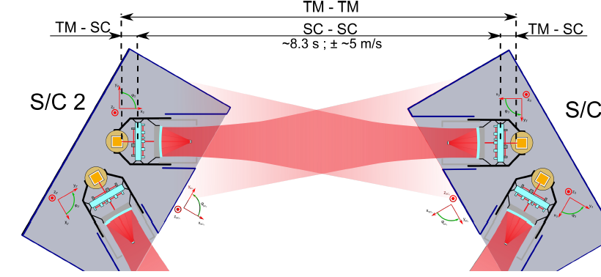
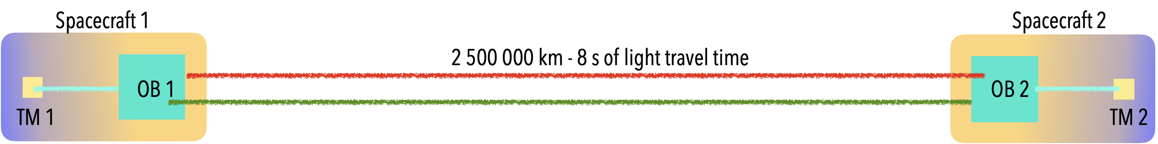
Laser Interferometer Space Antenna
The measurement is a split interferometric measurement : :
By combining the above measurements, the relative motion of the spacecraft is removed, isolating the true test mass-to-test mass distance that will be the distance affected by gravitational waves.
Unlike Earth based detector that use homodyne interferometry (one laser beam split in two : constructive or destructive interefrences, dark or bright fringes) LISA will use heterodyne interferometry : the two laser beams interfering have a small frequency offset (few MHz).
The laser beam coming from the distant spacecraft is interfered with a local reference laser beam that doesnt see signal.
TM - SC
SC - SC
SC - TM

Slide 11
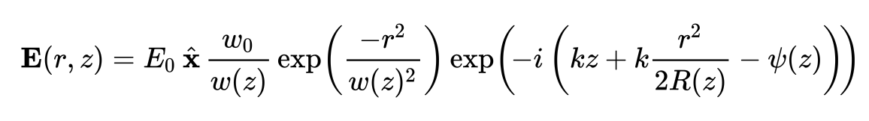
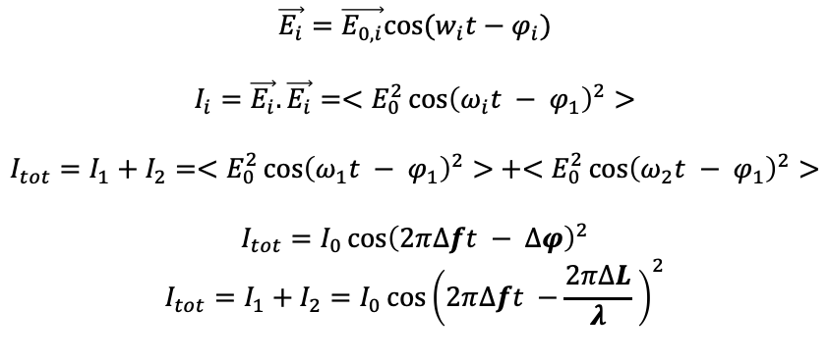
Laser Interferometer Space Antenna
Heterodyne interferometry results in a sine optical wave (beatnote) that oscillate at a frequency equal to the difference in frequency between the two laser beams. (~ 5 to 25 MHz in LISA)
Any variation of the optical pathlenght (OPL, distance that the laser beam travels) will induce a variation in the phase of the beatnote signal.
That allows tracking of the changes in OPL along with it’s direction.
$$\vec{E_{i}}=\vec{E_{0,i}}cos⁡(w_{i}t−φ_{i})$$
$$I_{i}=\vec{E_{i}}.\vec{E_{i}}=<E_{0}^{2}\cos{{\left(ω_{i}t − φ_{1}\right)}^{2}>}$$
$$I_{tot}=I_{1}+I_{2}=<E_{0}^{2}\cos{{\left(ω_{1}t − φ_{1}\right)}^{2}>}+<E_{0}^{2}\cos{{\left(ω_{2}t − φ_{1}\right)}^{2}>}$$
$$I_{tot}=I_{0}\cos{{\left(2π∆ft − ∆φ\right)}^{2}}$$
$$I_{tot}=I_{1}+I_{2}=I_{0}\cos{{\left(2π∆ft −\frac{2π∆L}{λ} \right)}^{2}}$$

Slide 12
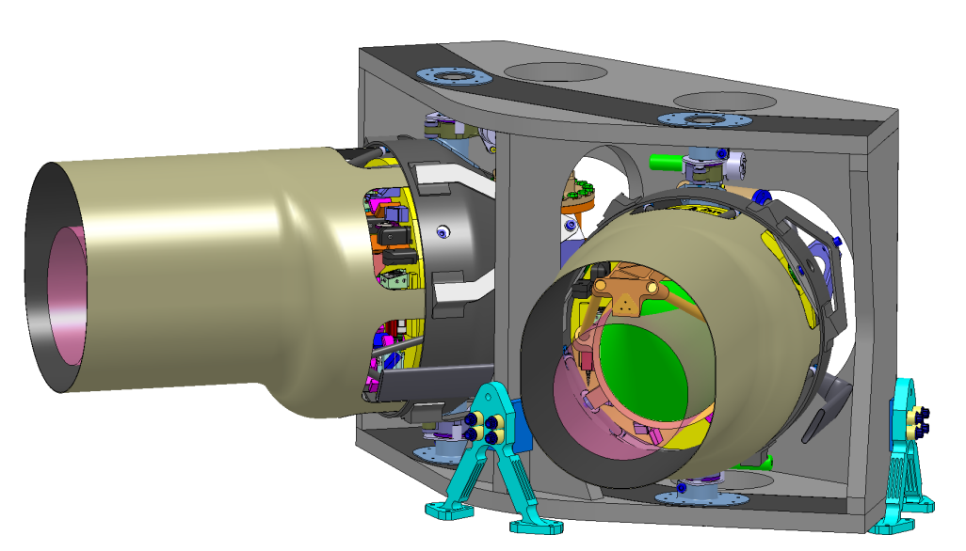
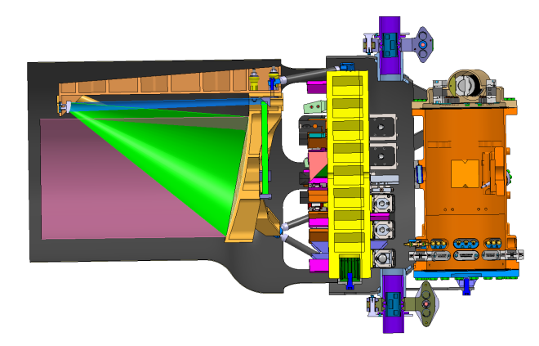
Laser Interferometer Space Antenna
LISA Core assembly
Movable Optical Sub Assemble (MOSA)
There is a total of 6 units of the instrument, one is:
  One 30 cm telescope
  One optical bench
  One laser source
  One phase measurement system
  One gravitational reference system

Slide 13
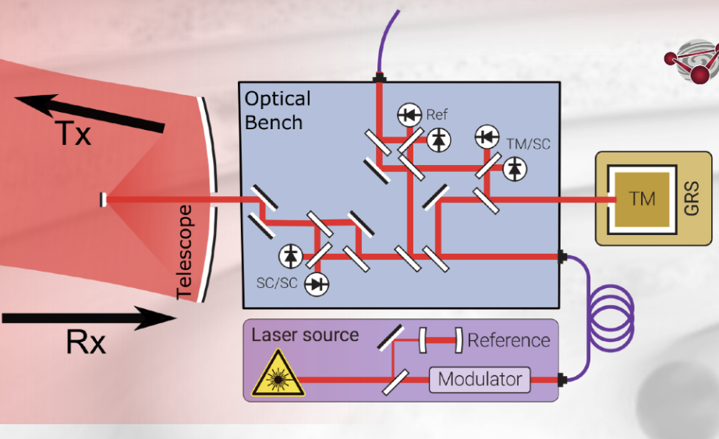
LISA Core Assembly (2 MOSA)
Movable Optical Sub Assemble (MOSA)
  Main payload elements (per link)
    Telescope (TEL)
    Optical Bench (OB)
    Test Mass (TM)
    Phasemeter (PMS)
    Laser (Tx Laser)
  The IDS (Interferometric Detection System) is a subset of the payload elements: OB and PMS (& OBMCU)
Interferometric Detection System
IDS +

Slide 14
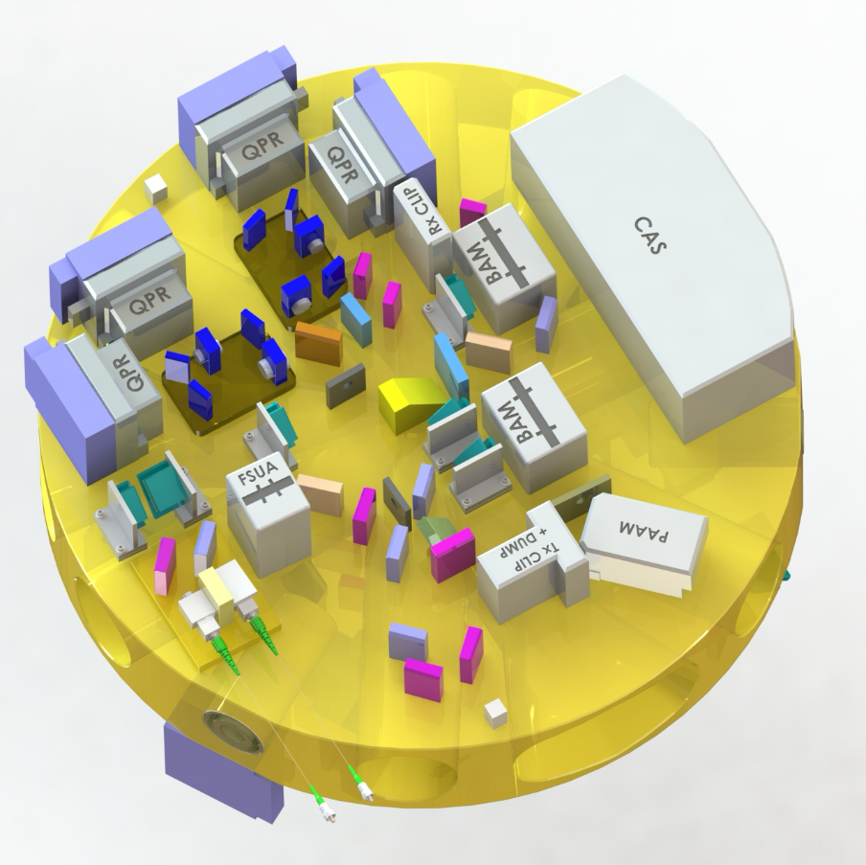
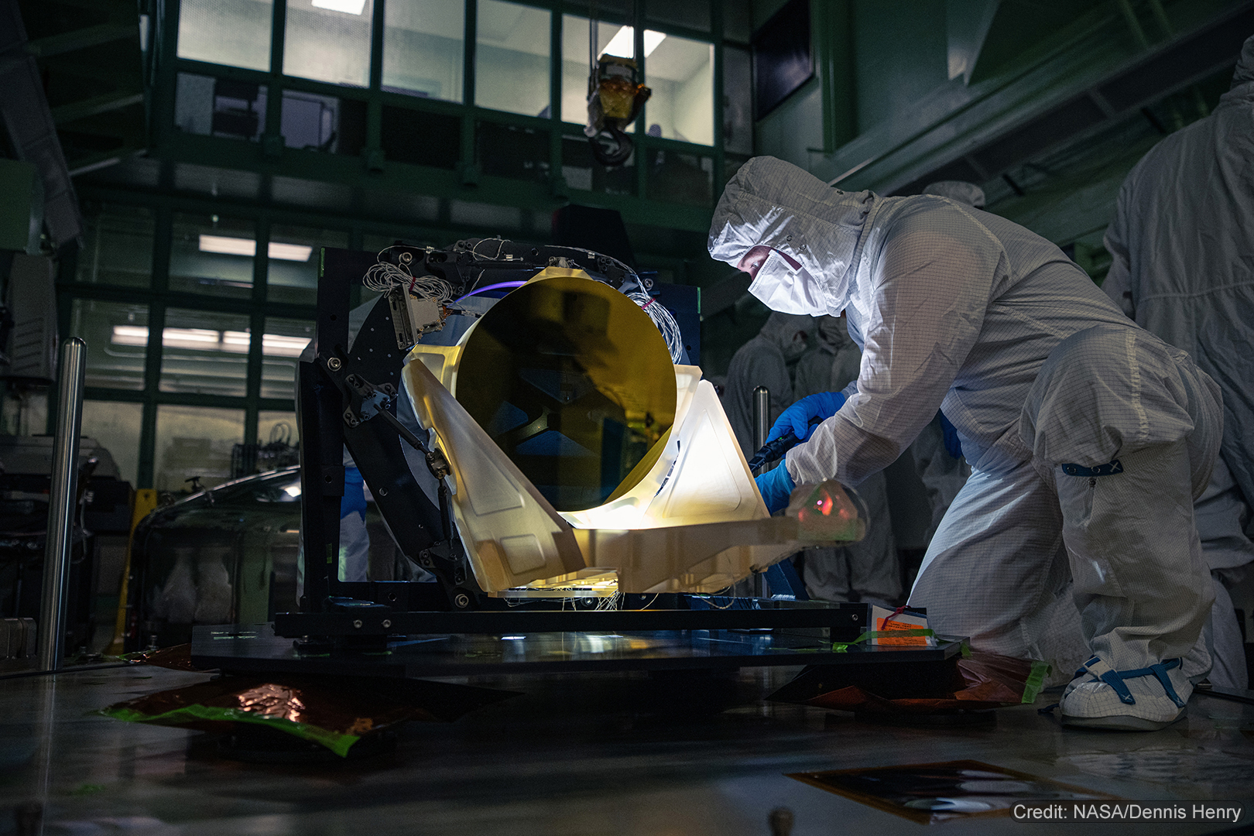
Laser Interferometer Space Antenna
Two sided zerodur optical bench
Telescope engineering unit

Slide 15
What does France do for LISA ?
France is tasked with the full functionnal and performance testing of the interferometric detection system at the heart of the measurement
  insure that picometer stability is reached on the interferometers of the LISA optical bench
  characterize the tilt-to-length coupling coefficients between misalignements of the interfering beams and the optical pathlenght measurement [ dOPL/dθ ]
Test campaign planned for 2026-2030 to be performed on the engineering and qualification model of the IDS, only moment where the performance of the mission will be validated
2022-2023 : demonstrator campain to perform a first heterodyne interferometric measurement and reach pm level

Slide 16
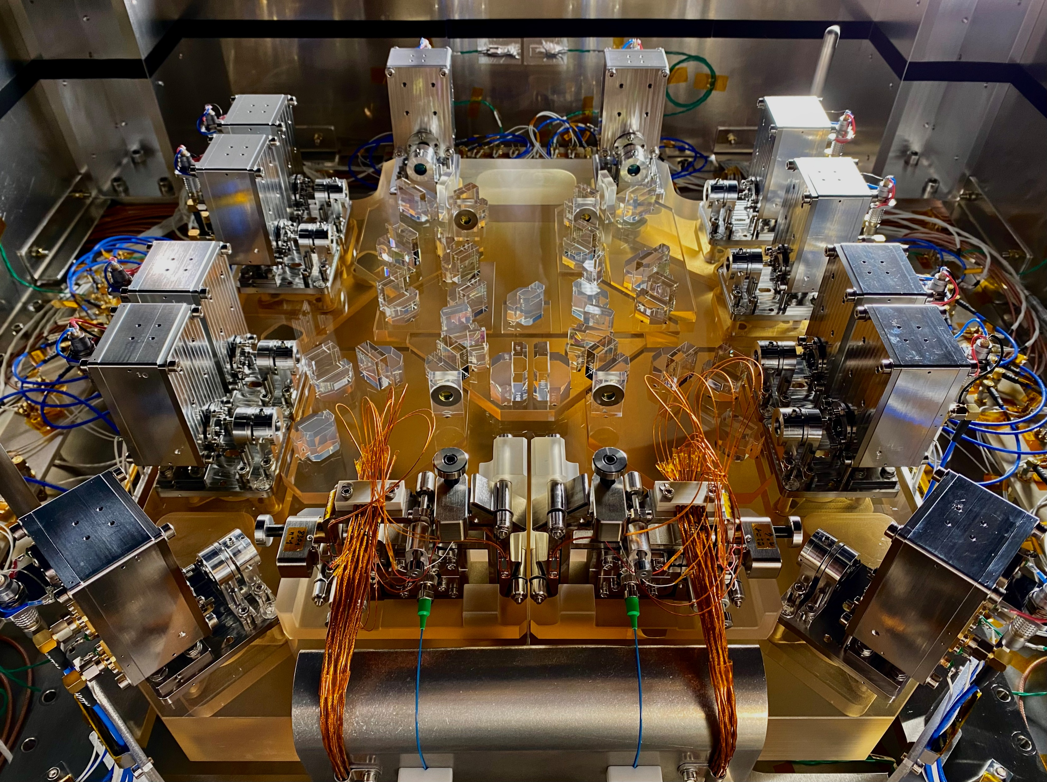

Slide 17
IFO 2
UNEQ
IFO 3
UNEQ
Power
Monitoring
Power
Monitoring
IFO 1
REF
17

Slide 18
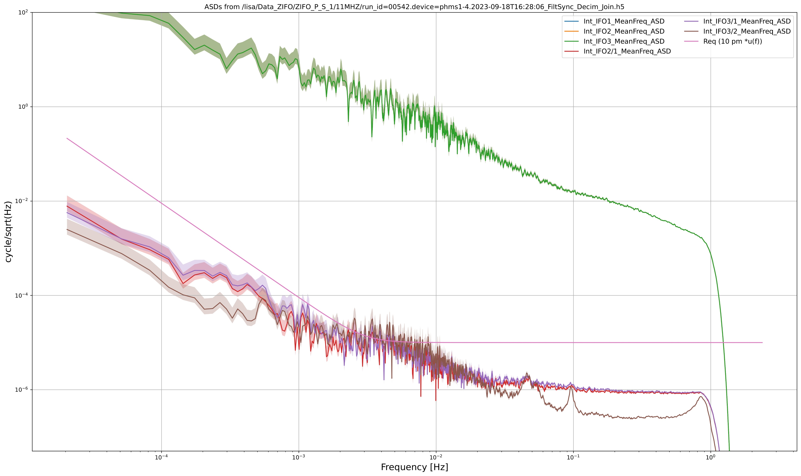
Individual interferometers
Combined interferometers
10 pm/√Hz
Amplitude spectral density of the optical pathlength stability measurement
1 pm/√Hz

Slide 19
Testing the instruments performance
To test an instrument, we usually just perform measurements once the instrument is built (or on testing models).
For LISA it is not possible :
- we don’t have a 2 500 000 km clean room on Earth
- seismic noise prevents reaching the same performance
- there are too many units of the instrument to test

Slide 20
Testing the instruments performance
To test an instrument, we usually just perform measurements once the instrument is built (or on testing models).
For LISA it is not possible :
- we don’t have a 2 500 000 km clean room on Earth
- seismic noise prevents reaching the same performance
- there are too many units of the instrument to test
We have to simulate the other parts of the instrument that interfaces with the IDS under test :
- distant spacecraft optical bench (spacecraft – spacecraft)
- gravitational reference system (test mass – spacecraft)
- local adjacent optical bench (clock and phase transfer)

Slide 21
Testing the instruments performance
To test an instrument, we usually just perform measurements once the instrument is built (or on testing models).
For LISA it is not possible :
- we don’t have a 2 500 000 km clean room on Earth
- seismic noise prevents reaching the same performance
- there are too many units of the instrument to test
We have to simulate the other parts of the instrument that interfaces with the IDS under test :
- distant spacecraft optical bench (spacecraft – spacecraft)
- gravitational reference system (test mass – spacecraft)
- local adjacent optical bench (clock and phase transfer)

Slide 22
Testing the instruments performance
To test an instrument, we usually just perform measurements once the instrument is built (or on testing models).
For LISA it is not possible :
- we don’t have a 2 500 000 km clean room on Earth
- seismic noise prevents reaching the same performance
- there are too many units of the instrument to test
We have to simulate the other parts of the instrument that interfaces with the IDS under test :
- distant spacecraft optical bench (spacecraft – spacecraft)
- gravitational reference system (test mass – spacecraft)
- local adjacent optical bench (clock and phase transfer)

Slide 23
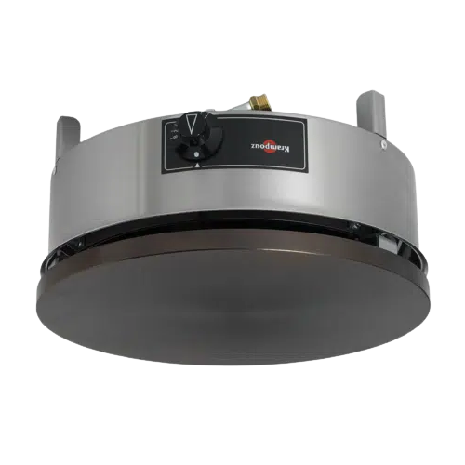
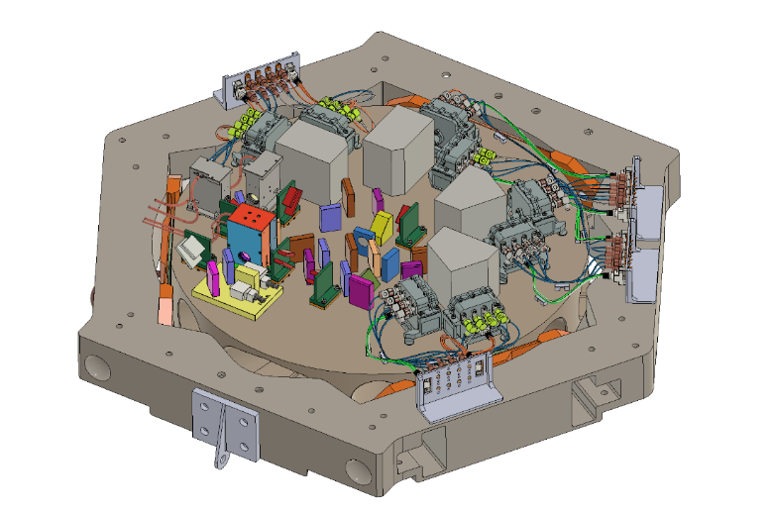
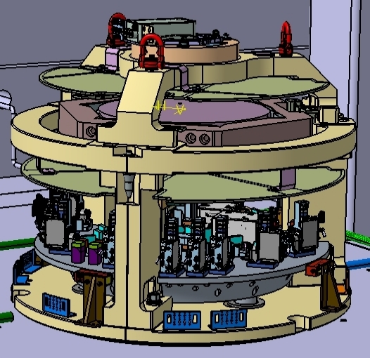
Beams Simulator
TMSIM
To do so, we are developing a complex optical bench to simulate the interface with the IDS adjacent to the IDS under test and the one with the IDS on the distant spacecraft.
We must simulate a 2W beam coming from 2 million kilometers that will be ~100 pW at arrival, and design the experiment to reach a stability specified for space.
The stability and performance of this test equipment must be at least as good as the one under test to verify its performance : 10 pm/√Hz
OB
STS
BSIM

Slide 24
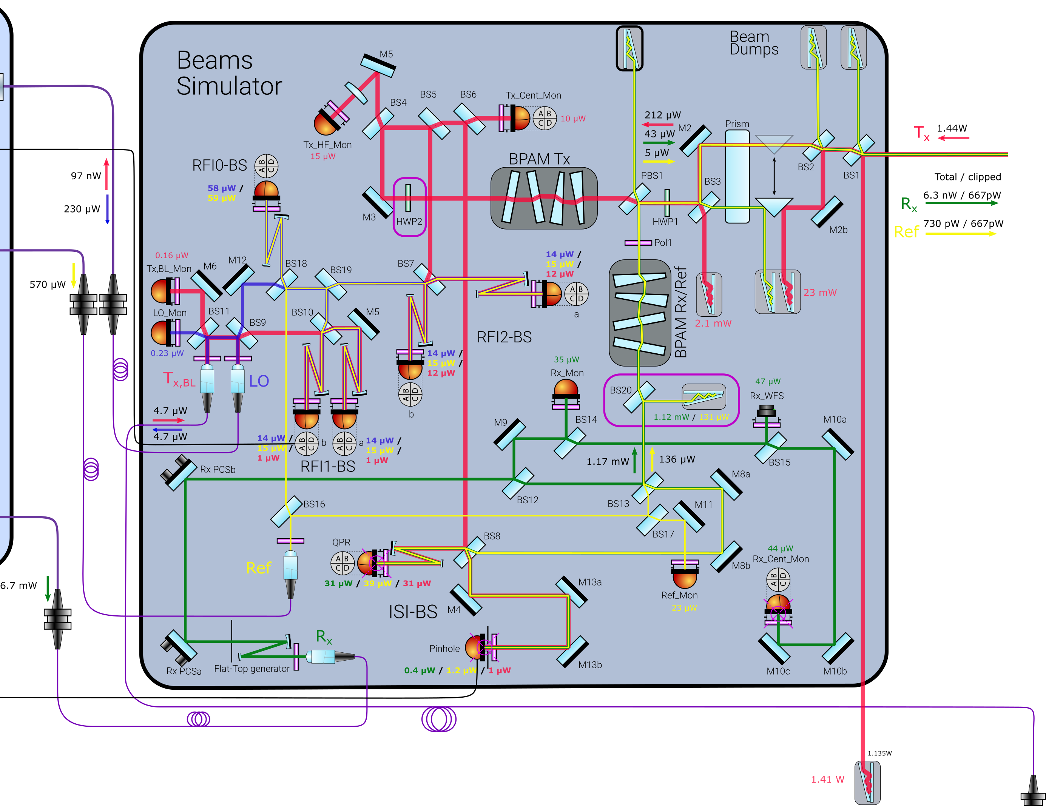
Beams Simulator
5 different beams interfering :
  Rx flat top beam: simulate the beam coming from distant spacecraft, clipped by the telescope (~600 µW)
  Tx gaussian beam : simulate the beam outgoing from the local spacecraft (~1.4 W)
  Tx Back Link: simulate the beam sent to the adjacent IDS
  REF : reference beam serving as proxy for alignement
  LO : local oscillator provided to the OB (ie. Beam coming from adjacent IDS)
4 interferometers :
  ISI BS: main IFO, simulates the Science IFO on the distant spacecraft, ie. one half of the interspacecraft interferometer.
  RF0, RF1, RF2 : monitoring of phase stability between Tx and Tx_BL, estimation of various phase stabilities.

Slide 25
Beams Simulator
5 different beams interfering :
  Rx flat top beam: simulate the beam coming from distant spacecraft, clipped by the telescope (~600 µW)
  Tx gaussian beam : simulate the beam outgoing from the local spacecraft (~1.4 W)
  Tx Back Link: simulate the beam sent to the adjacent IDS
  REF : reference beam serving as proxy for alignement
  LO : local oscillator provided to the OB (ie. Beam coming from adjacent IDS)
4 interferometers :
  ISI BS: main IFO, simulates the Science IFO on the distant spacecraft, ie. one half of the interspacecraft interferometer.
  RF0, RF1, RF2 : monitoring of phase stability between Tx and Tx_BL, estimation of various phase stabilities.

Slide 26
Beams Simulator
5 different beams interfering :
  Rx flat top beam: simulate the beam coming from distant spacecraft, clipped by the telescope (~600 µW)
  Tx gaussian beam : simulate the beam outgoing from the local spacecraft (~1.4 W)
  Tx Back Link: simulate the beam sent to the adjacent IDS
  REF : reference beam serving as proxy for alignement
  LO : local oscillator provided to the OB (ie. Beam coming from adjacent IDS)
4 interferometers :
  ISI BS: main IFO, simulates the Science IFO on the distant spacecraft, ie. one half of the interspacecraft interferometer.
  RF0, RF1, RF2 : monitoring of phase stability between Tx and Tx_BL, estimation of various phase stabilities.

Slide 27
Beams Simulator
5 different beams interfering :
  Rx flat top beam: simulate the beam coming from distant spacecraft, clipped by the telescope (~600 µW)
  Tx gaussian beam : simulate the beam outgoing from the local spacecraft (~1.4 W)
  Tx Back Link: simulate the beam sent to the adjacent IDS
  REF : reference beam serving as proxy for alignement
  LO : local oscillator provided to the OB (ie. Beam coming from adjacent IDS)
4 interferometers :
  ISI BS: main IFO, simulates the Science IFO on the distant spacecraft, ie. one half of the interspacecraft interferometer.
  RF0, RF1, RF2 : monitoring of phase stability between Tx and Tx_BL, estimation of various phase stabilities.

Slide 28
Beams Simulator
5 different beams interfering :
  Rx flat top beam: simulate the beam coming from distant spacecraft, clipped by the telescope (~600 µW)
  Tx gaussian beam : simulate the beam outgoing from the local spacecraft (~1.4 W)
  Tx Back Link: simulate the beam sent to the adjacent IDS
  REF : reference beam serving as proxy for alignement
  LO : local oscillator provided to the OB (ie. Beam coming from adjacent IDS)
4 interferometers :
  ISI BS: main IFO, simulates the Science IFO on the distant spacecraft, ie. one half of the interspacecraft interferometer.
  RF0, RF1, RF2 : monitoring of phase stability between Tx and Tx_BL, estimation of various phase stabilities.

Slide 29
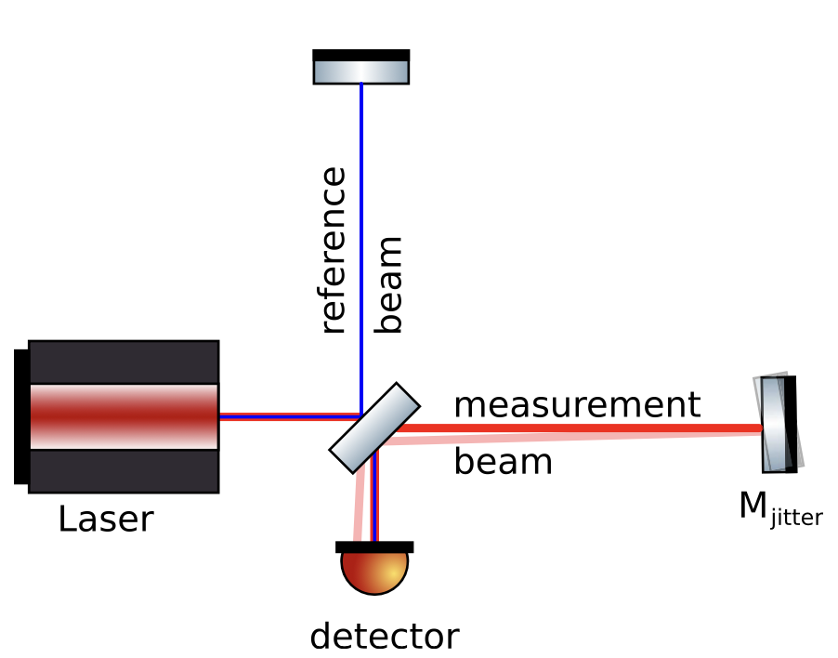
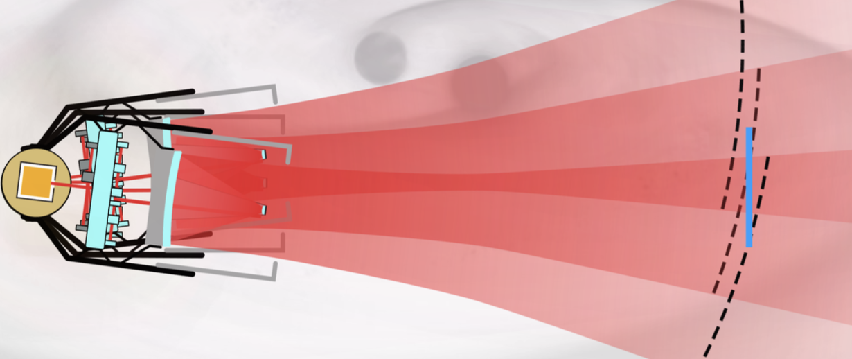
Tilt to Lenght coupling characterisation
The LISA spacecrafts will have some residual angular and lateral jitter
There is a coupling between this residual jitter and the phase read out of the interferometer which gives us the optical path length difference of the arms
The response of the interferometer will be different as a function of the angle between beams, the alignment of the beams or the beam properties
Two types of coupling : geometric and non geometric
Notes:
the IDS must be capable to perform acquisition for up to 2µrad off-pointing of the spacecraft (which corresponds to 268µrad on OB space)

Slide 30
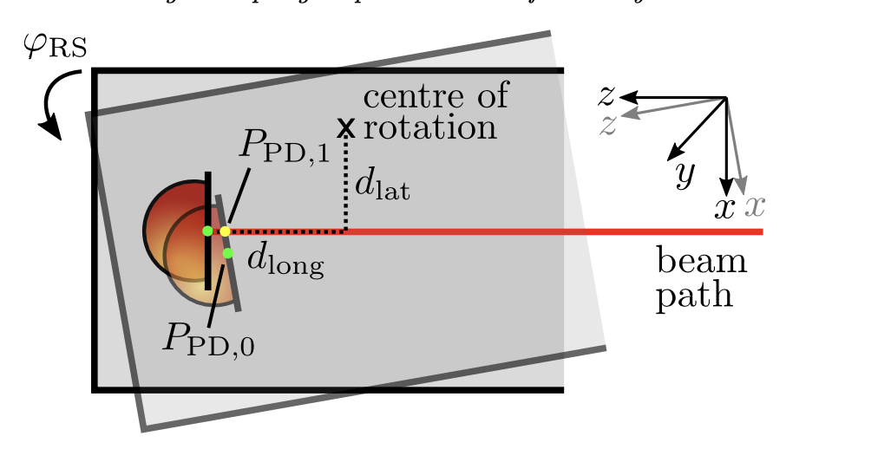
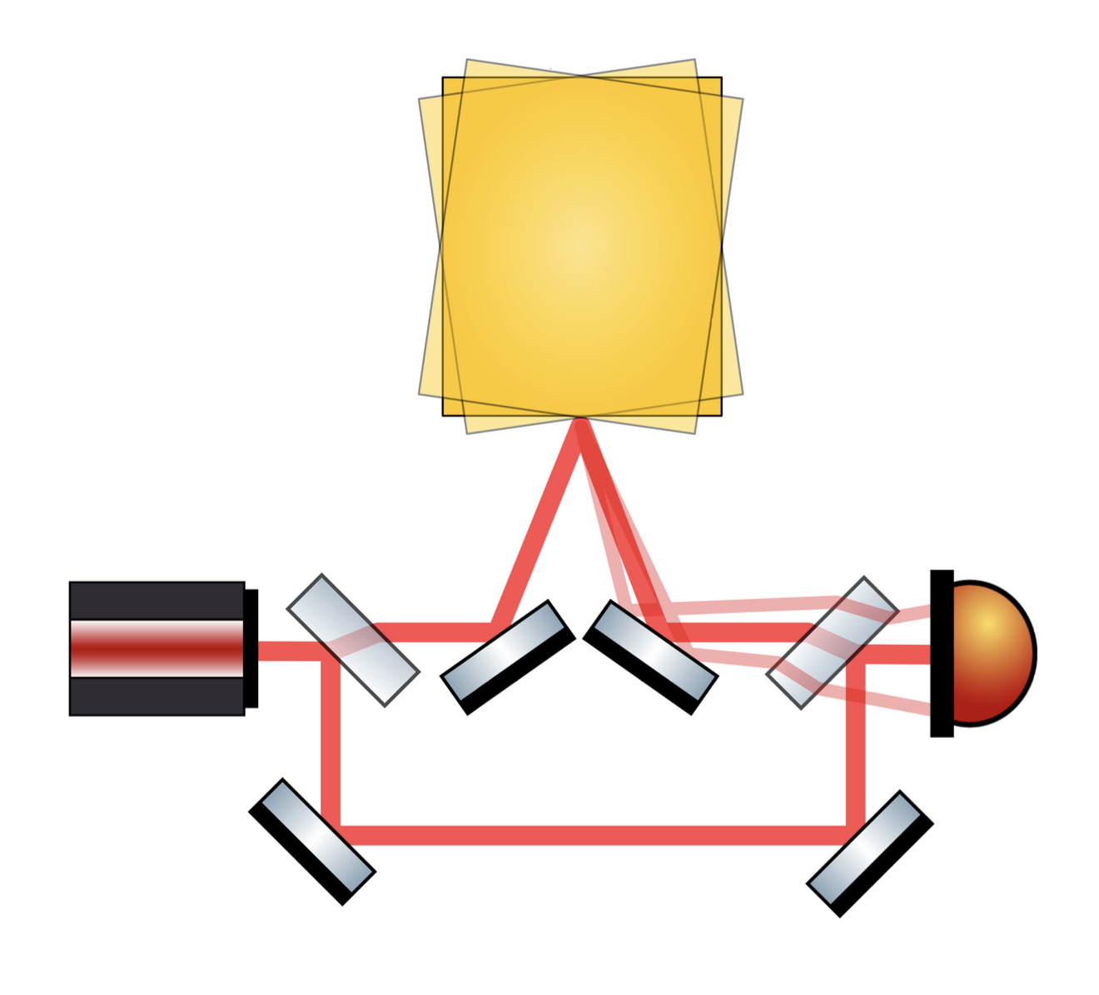
Tilt to Lenght coupling
Geometric tilt to lenght coupling : direct alteration of the optical path lenght of the laser beam
Fully dependant on design and independant of beam type
Angular jitter of the interferometric beam affects it’s geometric path thus adding an unwanted aditionnal OPL component
This coupling can be minized by having dedicated imaging systems and adequat design of the interferometer
Marie-Sophie Hartig et al 2022 J. Opt. 24 065601

Slide 31
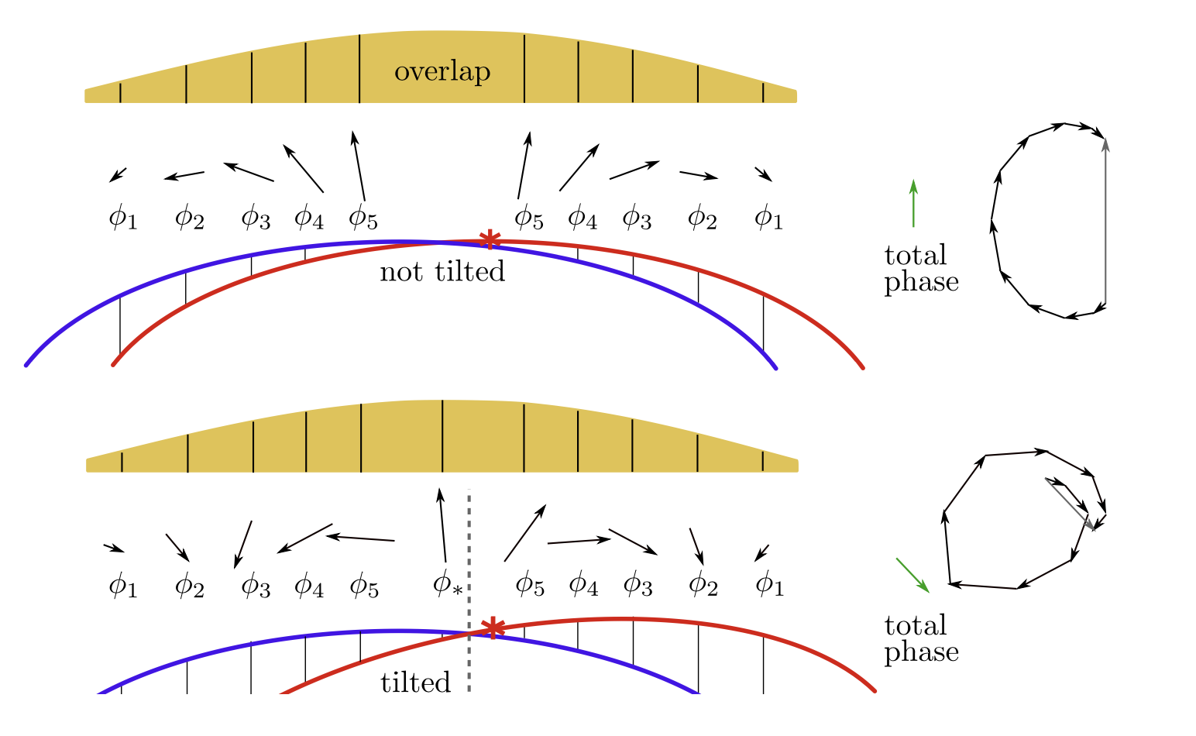
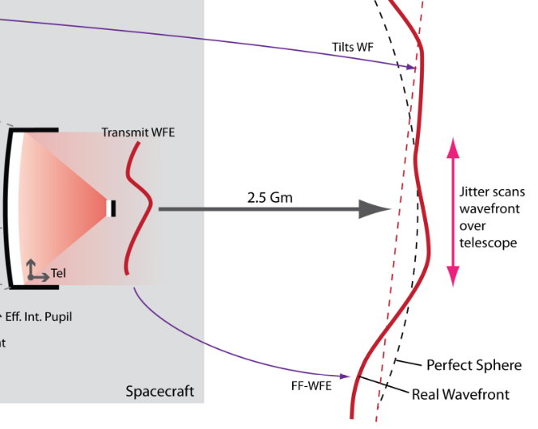
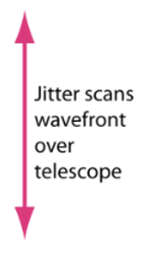
Tilt to Lenght coupling
Non geometric TTL is every contributor to the coupling that does not originate from direct spatial OPD changes
The jitter of one of the beams will induce changes in the interference pattern
The phase integrated over the quadrant of the photoreceptor might be different inducing a variation in the read out of the interferometer
Some sources of N-G TTL : wavefront curvature differences, intensity distribution, waist position wrt to QPD, WFE, beam overlap, QPD geometry (Single element or quadrant photoreceiver)
arXiv:2207.06278v3
Different local wavefront curvature
due to wavefront error and spacecraft jitter

Slide 32
Tilt to Lenght coupling
Non geometric TTL is every contributor to the coupling that does not originate from direct spatial OPD changes
The jitter of one of the beams will induce changes in the interference pattern
The phase integrated over the quadrant of the photoreceptor might be different inducing a variation in the read out of the interferometer
Some sources of N-G TTL : wavefront curvature differences, intensity distribution, waist position wrt to QPD, WFE, beam overlap, QPD geometry (Single element or quadrant photoreceiver)
arXiv:2207.06278v3
Different local wavefront curvature
due to wavefront error and spacecraft jitter

Slide 33
Tilt to Lenght coupling
Non geometric TTL is every contributor to the coupling that does not originate from direct spatial OPD changes
The jitter of one of the beams will induce changes in the interference pattern
The phase integrated over the quadrant of the photoreceptor might be different inducing a variation in the read out of the interferometer
Some sources of N-G TTL : wavefront curvature differences, intensity distribution, waist position wrt to QPD, WFE, beam overlap, QPD geometry (Single element or quadrant photoreceiver)
arXiv:2207.06278v3
Different local wavefront curvature
due to wavefront error and spacecraft jitter

Slide 34
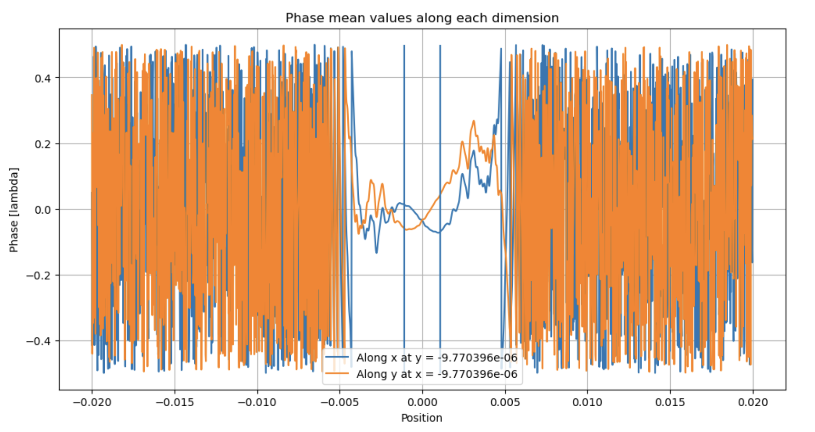
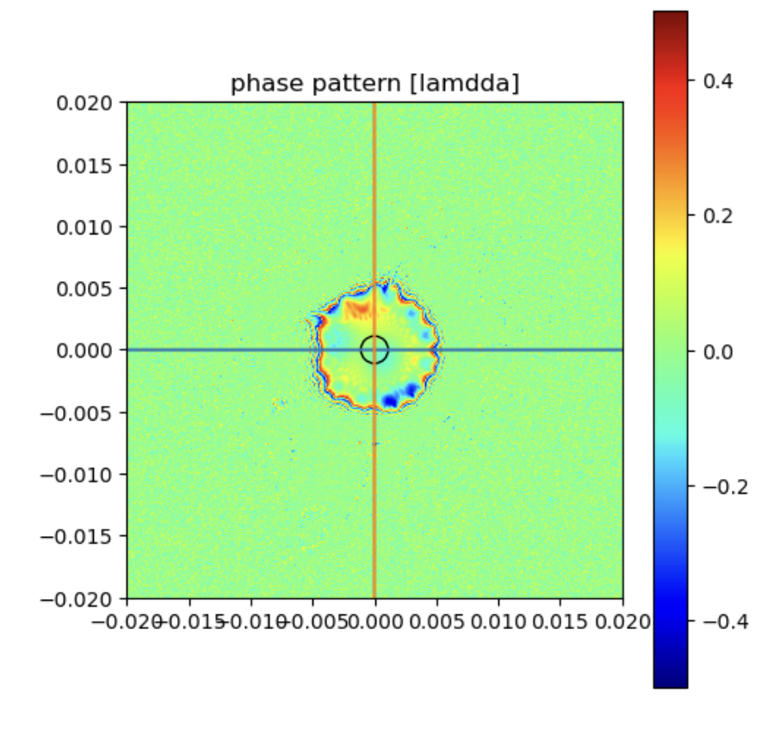
Non correctable TTL
Some of the non-geometric sources of TTL are not correctable
Wavefront Error : deviation between the ideal and actual wavefront, caused by the injection system and the optics that are traversed, will cause TTL when integrated on QPR surface
Need to be carefully understood and quantified to specify the BSIM bench correctly and reach the required performance
Currently performing optical simulation of various wavefront errors levels (λ/30 nm, λ/20 nm, λ/10 nm) and the TTL contribution induced

Slide 35

Explication du code : application à l’étude WFE
Flat top creation
( 1 flat top)
Creation of the TTL actuation
( N flat top, 1 par angle d’act.)
Shift of the flat top
(N flat top)
Random generation of Zernikle distribution
and
Looping on that part to get stats
WFE error creation
(Zernike 1 à 36)
Interference between flattops and gaussian beams
Calculation of phase differences
Gaussian beam creation
Shift of the beam
QPD mask creation
$$TTL\left(θ\right)=\frac{dφ}{dθ}∗\frac{λ}{2π}$$
TTL (0, ±100, ±250 , ±400 µrad)
saved in .csv
3rd degre polynomial fit

Slide 36
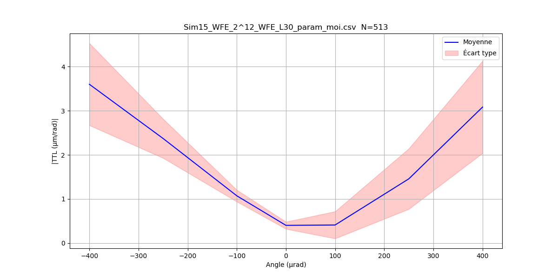
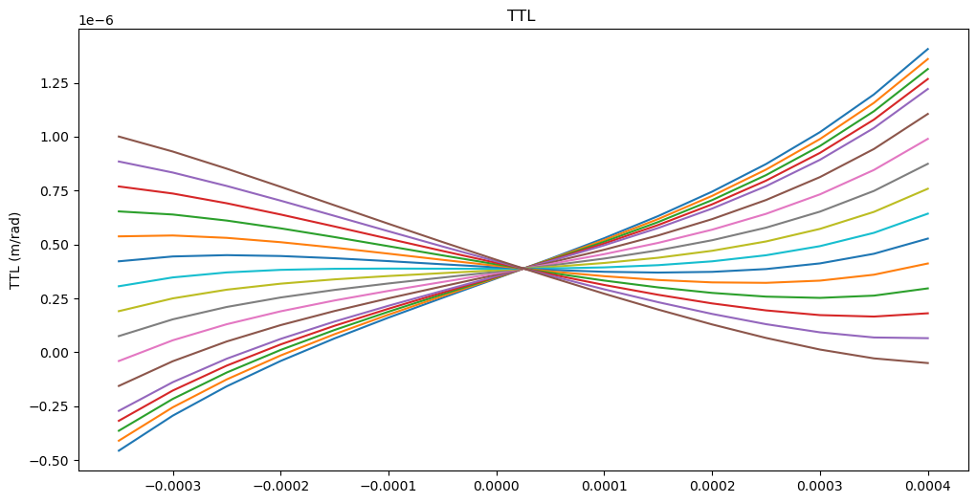
TTL coupling induced by a wavefront error of λ/30 RMS (35nm) with a 10 mm large flat top beam interfering with a 2 mm large gaussian beam on a 2.24 mm detector.
Results are to be considered with a x2.5 factor due to imaging systems, yielding a ~9µm/rad contrib.
TTL coupling induced by a wavefront error of λ/30
totally allocated to Zernike coefficient Z40.
Results are to be considered with a x2.5 factor due to imaging systems, yielding a 2.5µm/rad coef.

Slide 37
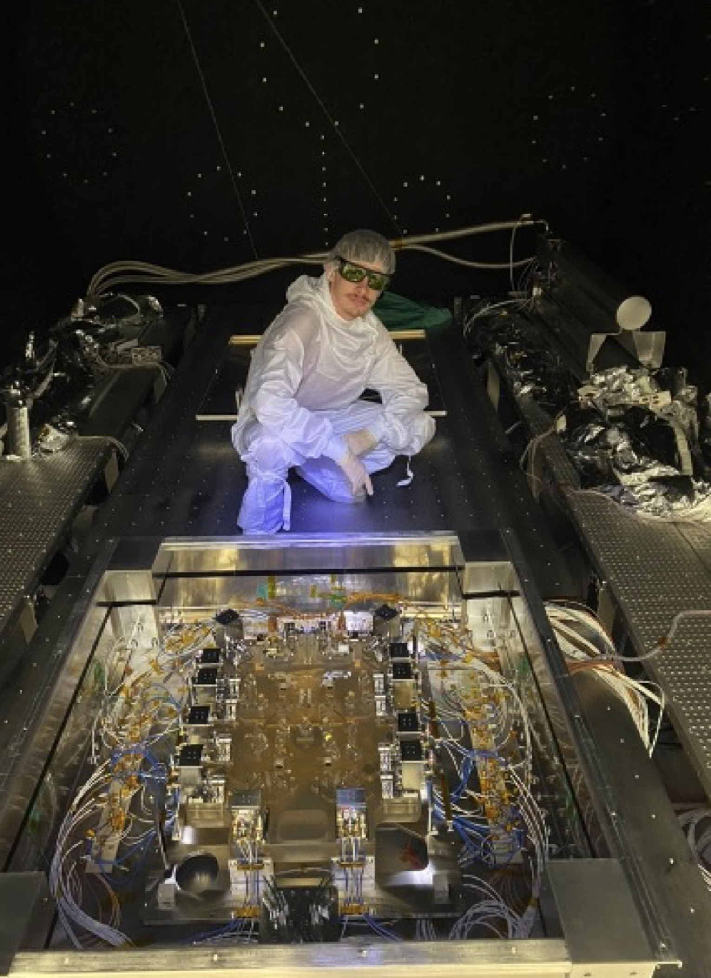
Thank you for your attention !

