Slide 1

The “green” use of fluorocarbons in Cherenkov detectors
and silicon tracker cooling systems: challenges and opportunities
https://link.springer.com/article/10.1140/epjp/s13360-023-04703-w
See also: https://indico.cern.ch/event/1263731/contributions/5398511/attachments/2648319/4584649/G_Hallewell_DRD4%20Rad%20Gas%20GWP%20with%20annexes%20May%2016%202023.pdf
https://indico.cern.ch/event/1371158/contributions/5773321/attachments/2788215/4861759/G_Hallewell_ATLAS_sustainability_forum_Jan_26_2024_v2.pptx
ICHEP2024 (July 2024): https://indico.cern.ch/event/1291157/contributions/5900402/
“From the Speed of Sound to the Speed of Light: and beyond!”
G. D. Hallewell
Aix Marseille Université, CNRS/IN2P3, CPPM, Marseille, France
With thanks to many people for information, as detailed on a later slide.
.
G. Hallewell: Seminaire CPPM: 16 sep 2024
1
Notes:
1

Slide 2
Abstract (see https://indico.in2p3.fr/event/33405)
Saturated fluorocarbons (SFCs: of chemical form C_{n}F_{(2n+2)}) are chosen for their optical properties (refractive index and UV transparency) for use as Cherenkov radiators, with C₄F₁₀ and CF₄ used in the COMPASS and LHCb RICH1&2 ring imaging Cherenkov detectors to provide μ±/π±/K±/p± particle identification over a wide momentum range. Non-conductivity, non-flammability and radiation resistance also make SFCs ideal coolants, with C₆F₁₄ liquid used in all LHC experiments, while C₃F₈ evaporatively cools the ATLAS silicon tracker.
These fluids however have high GWPs (>5000*CO₂), and represented around 36%of CERN’s CO₂-equivalent emissions in 2018. There is thus an impetus to reduce their use, losses in purification and wastage through leaks, via improved monitoring and closed circulation system design.
While not yet industrialised over the full C_{n}F_{2n}O range, spur-oxygenated fluoro-ketones can offer similar performance at very low, or zero GWP. The radiation tolerance and thermal performance of 3M 'NOVEC 649' (C₆F₁₂O) was sufficiently promising for it to be chosen by CERN to replace C₆F₁₄. Subject to optical testing, 3M 'NOVEC 5110' (C₅F₁₀O) - blended with nitrogen and monitored in real time by sound velocity gas analysis - might replace C₄F₁₀ and CF₄ in RICH detectors.
Ultrasonic gas mixture analysis is very sensitive to concentration changes of a heavy vapour in a light carrier, and is used for real-time monitoring of C₃F₈ coolant leaks from the ATLAS pixel and SCT silicon trackers into their nitrogen-flushed environmental volumes, where typical C₃F₈ sensitivity of better than 10⁻⁵ is achieved. Advanced new ultrasonic algorithms allow measurement of the concentrations of a pair of gases of particular interest on top of a varying known baseline of other gases. The technique could be used to blend fluoro-ketones with nitrogen or argon to reduce the GWP “load” of large volume Cherenkov radiators. The technique is also of interest in xenon-based anaesthesia, which has a similar problematic.
Light fluoro-ketone molecules (e.g. C₂F₄O, with similar thermodynamics to C₂F₆) – might allow lower temperature, 0GWP operation than evaporative CO₂ in Si trackers operated at high luminosity.
This seminar outlines an approach to GWP reduction with fluoro-ketone fluids and the blending of heritage SFCs or fluoro-ketones with lighter gases using ultrasonic monitoring and control. Possible avenues for the use of fluoro-ketones in liquid phase and evaporative cooling of silicon trackers are discussed.
G. Hallewell: Seminaire CPPM: 16 sep 2024

Slide 3
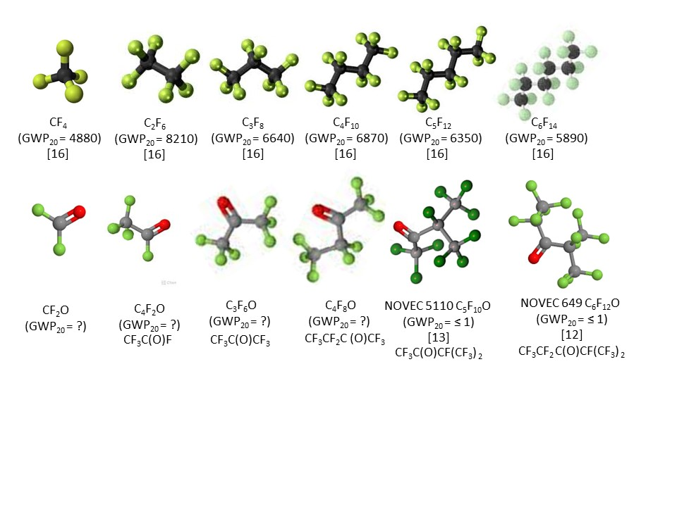
“Green” fluorocarbons for Cherenkov detectors & silicon tracker cooling systems: challenges and opportunities
Saturated fluorocarbons (PFCs, SFCs: C_{n}F_{(2n+2)}) chosen for optical properties as Cherenkov radiators: C₄F₁₀ & CF₄ in COMPASS & LHCb RICH1&2.
Non-conductivity, non-flammability, non-toxicity & radiation resistance
➔ ideal coolants
- C₆F₁₄ used in all LHC experiments,
- C₃F₈ evaporatively cools ATLAS silicon tracker, TOTEM;
These fluids however have high GWPs (GWP₂₀ > 5000*CO₂);
Fluoro-ketones (C_{n}F_{2n}O), while not industrialised over a wide C_{n}F_{2n}O range,
can offer similar performance at very low, or 0 GWP however F-gas restrictions;
Gas blending using ultrasonic monitoring will be needed: promising advances
Radiation tolerance & thermal performance of linear-C₆F₁₂O (3M NOVEC 649 ®) sufficiently promising to be considered by CERN to replace C₆F₁₄ for
cooling, but acid production & materials compatibility to resolve;
We will see that fluoro-ketone molecular shape and O atom placement
affects GWP, chemi-activity, toxicity, and might limit future options
GEOMETRY IS EVERYTHING!!!!
G. Hallewell: Seminaire CPPM: 16 sep 2024

Slide 4

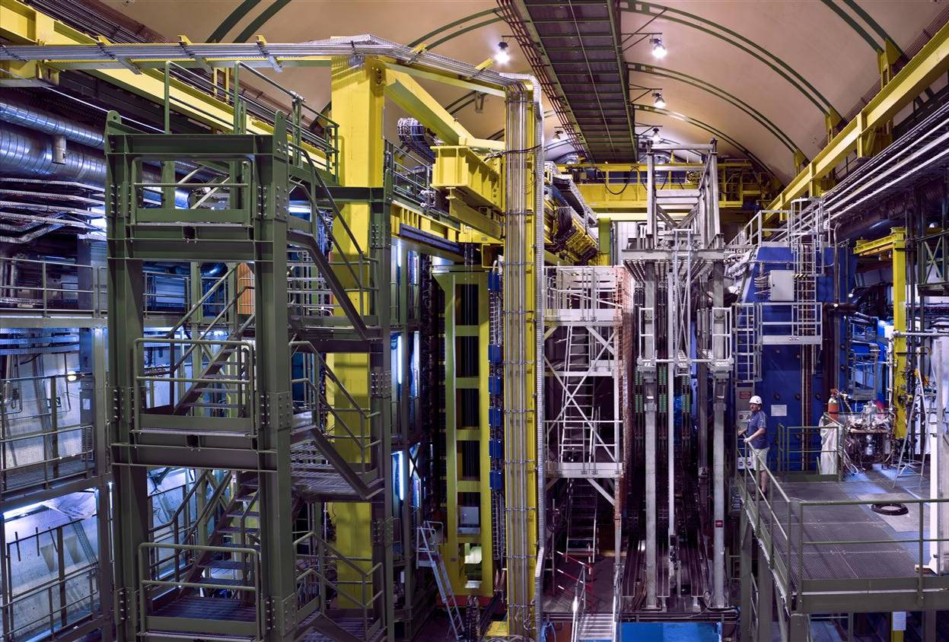
LHCb Detector (CERN-LHC)
RICH2
RICH1
Two RICH detectors identify μ±/π±/K±/p±: momentum 1 - 100 GeV/c
RICH1: C₄F₁₀ (4 m³ gas at 1 bar) + aerogel: RICH2: CF₄ (100 m³ gas at 1 bar)
G. Hallewell: Seminaire CPPM: 16 sep 2024

Slide 5
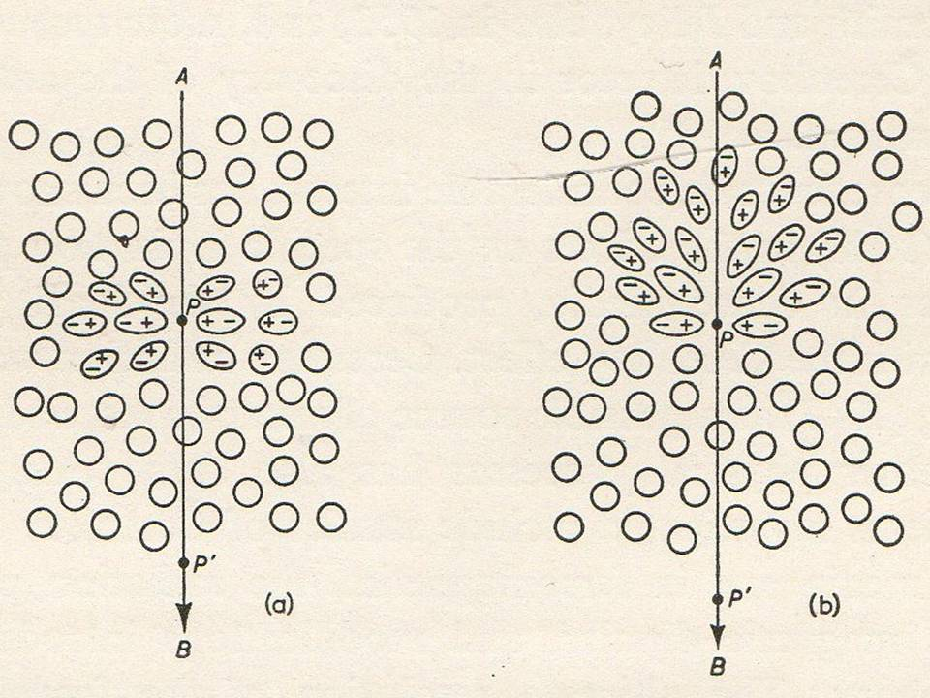
L’effet Tcherenkov: mécanisme
Quand une particule chargée passe dans un milieu
diélectrique les molécules polaires sont déplacées
par son passage: pôles – (+) attirées par une
particule chargée + (-).
Chaque molécule absorbe une très faible quantité
d’énergie en faisant une rotation
Après le passage de la particule, cette énergie est
émise par les molécules ➔ « de-excitation »
comme une onde électromagnétique (E-M)
Si la vitesse de la particule est inférieure à celle
de la lumière dans le milieu, la « de-excitation »
collective donne une émission E-M de forme isotrope
Hallewell/ Conférence Université de temps libre, La Ciotat 02.04.2017

Slide 6
L’effet Tcherenkov: mécanisme
Quand une particule chargée passe dans un milieu
diélectrique, les molécules polaires sont déplacées
par son passage: pôles – (+) attirées par une
particule chargée + (-).
Chaque molécule absorbe une très faible quantité
d’énergie en faisant une rotation
Après le passage de la particule, cette énergie est émise
par les molécules ➔ « de-excitation »
comme une onde électromagnétique
Si la vitesse, v, de la particule dépasse celle de la
lumière dans le milieu, la « de-excitation » collective
donne une émission cohérente de forme conique
Hallewell/ Conférence Université de temps libre, La Ciotat 02.04.2017

Slide 7
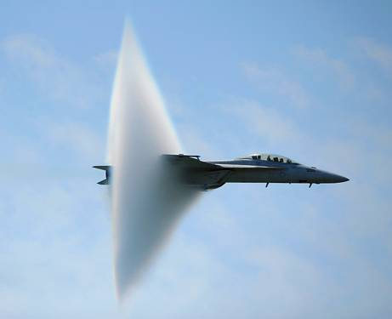
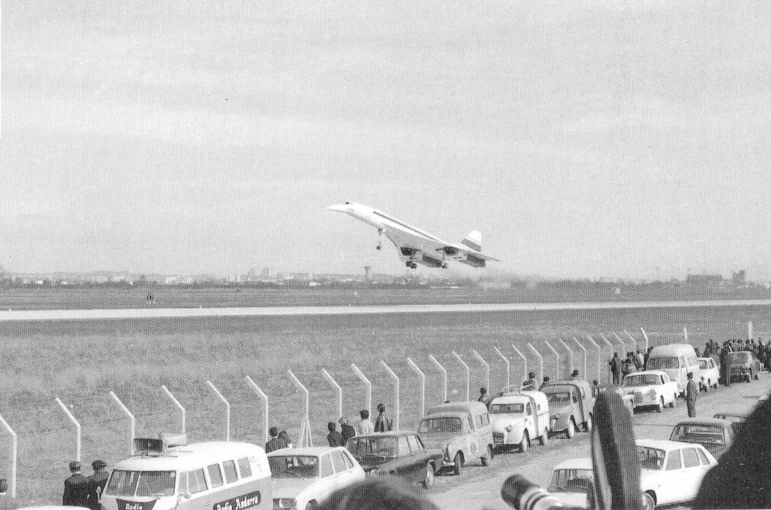
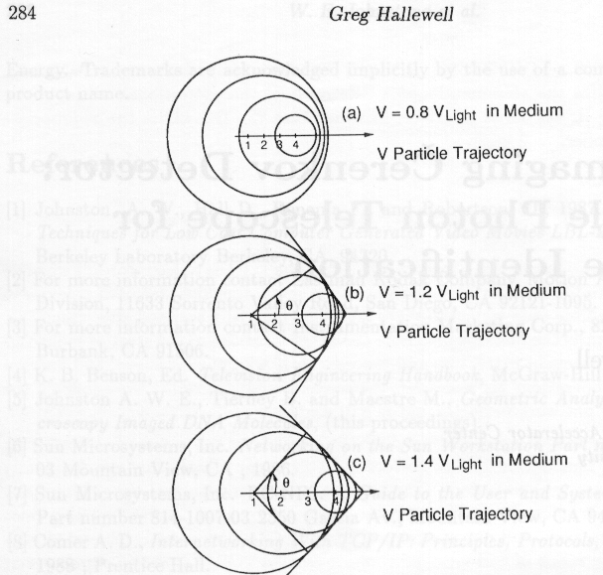
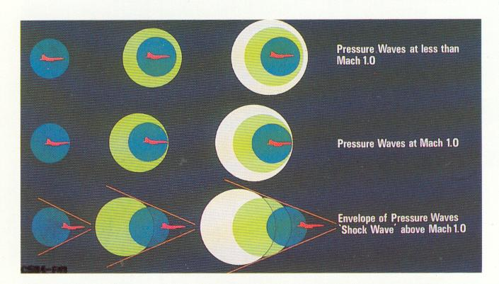
Emission du Rayonnement Tcherenkov
Ondes de Choc
v < Mach 1.0
Ondes
v < Mach 1.0
V_{part} = 0.8 * V_{lum} _{(milieu)}
Trajectoire particule
Seuil pour l’émission d’une
onde de choc cohérente:
β = v_{part} > v_{lum(milieu)}
Ondes de Choc
v = Mach 1.0
Ondes de Choc
v = Mach 1.0
Enveloppe des Ondes de Choc
v > Mach 1.0
V_{part} = 1.2 * V_{lum (milieu)}
Enveloppe des Ondes de Choc
v > Mach 1.0
Trajectoire particule
Angle d’émission, θ, de
l’onde de choc cohérente p.r. à la trajectoire de la particule:
θ = cos⁻¹ (v_{lum(milieu)} /v_{part})
V_{part} = 1.4 * V_{lum (milieu)}
Trajectoire particule
Similarité entre l’onde de choc sonique du Concorde, F18… et l’onde lumineuse Tcherenkov
Hallewell/ Conférence Université de temps libre, La Ciotat 02.04.2017

Slide 8
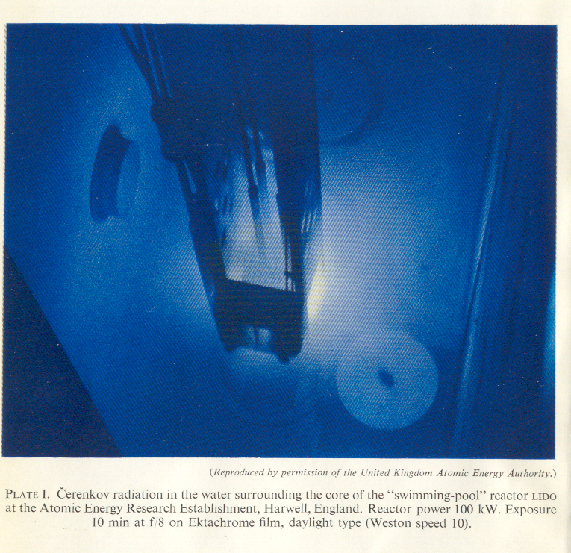
Même si le rendement en photons est très faible, avec des millions de particules chargées baladant simultanément on voit un effet impressionnant…
Lumière Tcherenkov produite par des électrons rapides en modérateur D₂O;
réacteur nucléaire “LIDO” de type ‘piscine’: Harwell, GB (1950’s)
Source: electrons sortant des désintégrations de noyeaux uranium
Hallewell/ Conférence Université de temps libre, La Ciotat 02.04.2017

Slide 9
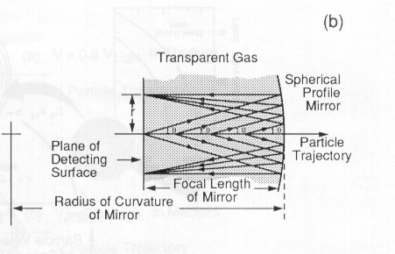
Capteurs de radiation Tcherenkov:
Mode: mesure de la masse et l’énergie de la particule par le rayon d’anneau de lumière
“RICH detectors” = Ring Imaging Cherenkov
Θ_{c} = cos⁻¹ (1/βn)
Dans un gaz:
r = f tanθ_{c}
of Refractive index n
Multi
Capteur de lumière
resolution ~mm² et de surface ~m²
f
r
Hallewell/ Conférence Université de temps libre, La Ciotat 02.04.2017

Slide 10
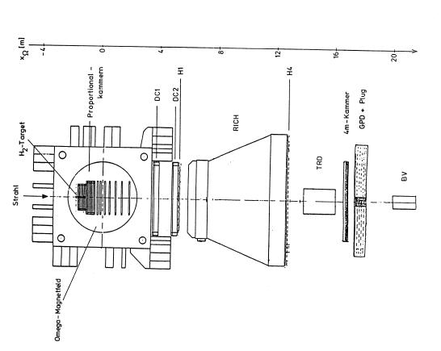
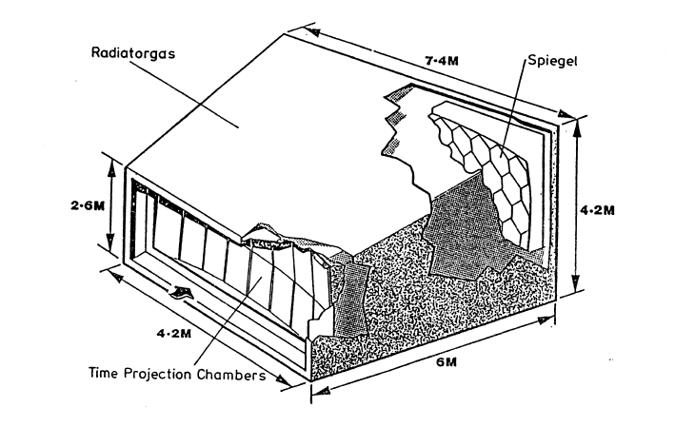
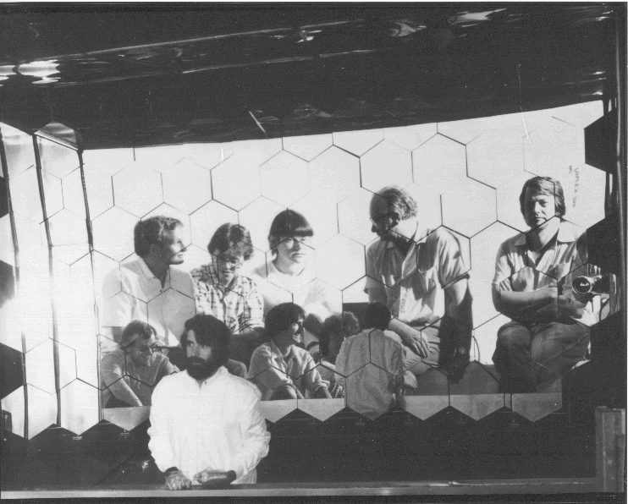
Premier grand détecteur RICH: au spectromètre
“OMEGA” supraconducteur, CERN, 1982-88
Collaboration WA69: Bonn, Lancaster, Manchester, Rutherford & Sheffield
Paschal Coyle missed
out on this photo
Faisceau
Particule secondaire à identifier
OMEGA RICHdetektor
Hallewell/ Conférence Université de temps libre, La Ciotat 02.04.2017

Slide 11
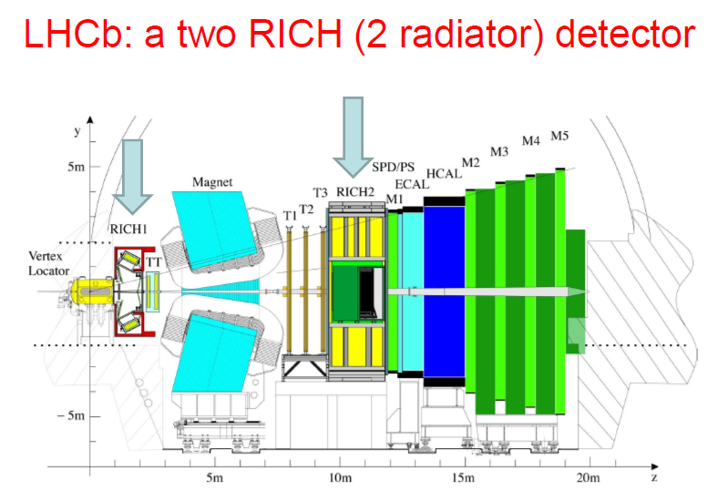
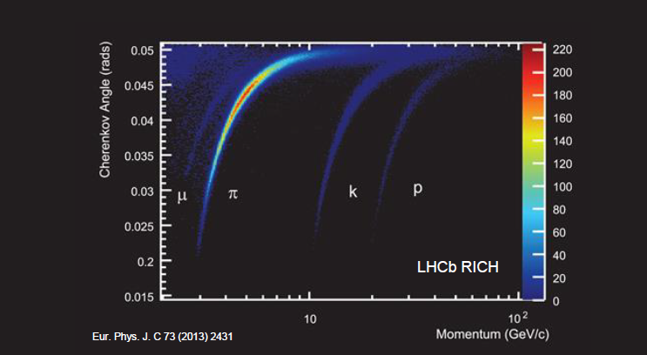
RICH 1: C₄F₁₀ radiator:
lower momentum PID
RICH 2: CF₄ (+CO₂) radiator:
higher momentum PID
COMBINED RICH PEFORMANCE & PARTICLE SPECIES IDENTIFCATION RANGE
Saturation angle (β ⎝ ⎝c)
Θ_{c} = cos⁻¹ (1/n)
Θ_{c} = cos⁻¹ (1/βn)
G. Hallewell: Seminaire CPPM: 16 sep 2024

Slide 12
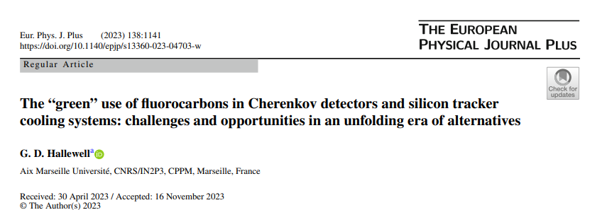
https://link.springer.com/article/10.1140/epjp/s13360-023-04703-w
OK, back to the farm….
G. Hallewell: Seminaire CPPM: 16 sep 2024

Slide 13
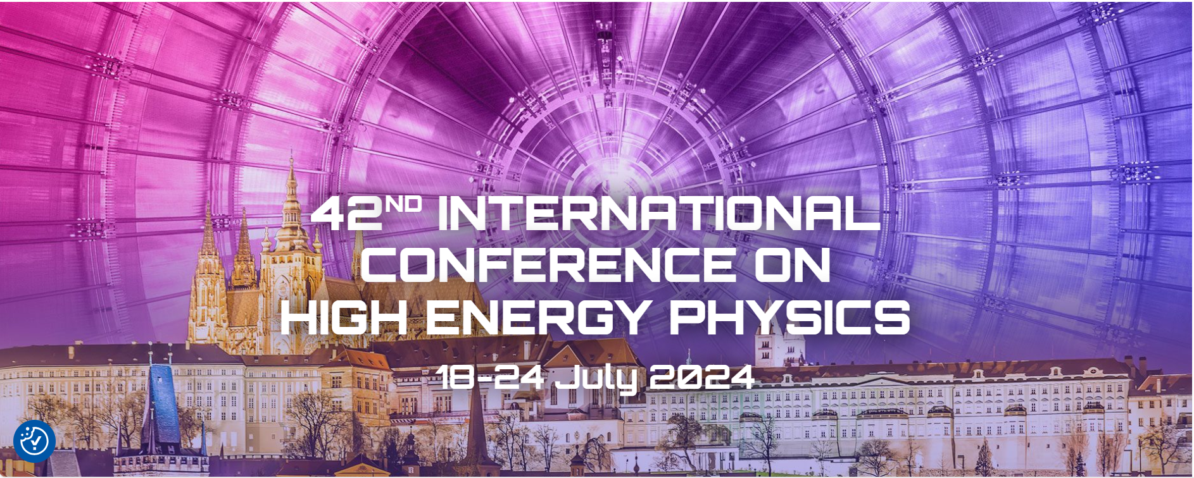
Green use of fluorocarbons in Cherenkov detectors and silicon tracker cooling systems: challenges & opportunities. https://indico.cern.ch/event/1291157/contributions/5900402/
G. D. Hallewell
Aix Marseille Université, CNRS/IN2P3, CPPM, Marseille, France
G. Hallewell: Green FCs for Cherenkov detectors and Si tracker cooling: Sustainability session ICHEP2024 Praque 18-24 July 2024
.
13
Notes:
13

Slide 14
Molecular shapes and GWP (1)
SATURATED FLUOROCARBONS (C_{n}F_{(2n+2)}) with current uses at CERN
RICH (Gas)
Si COOLING (Evap.)
RICH (Gas)
COOLING (Liq.)
Current
uses
at CERN
Ex-DELPHI
RICH (Gas)
FLUOROKETONES (C_{n}F_{2n}O)
Inh. Toxicity H330,
Reactive
InH. Toxicity
H331,
reactive
Inh. Toxicity
H331,
reactive
RICH
(Gas?)
RICH
(Gas (blend))
COOLING (Liq.)
Probable
Uses
(if/when
available)
C₂F₄O
Upper: molecular shapes of SFCs, including common gaseous Cherenkov radiators
Lower: shapes of some non-cyclic C_{n}F_{2n}O analogues
(20-year GWPs noted where known – refs: https://link.springer.com/article/10.1140/epjp/s13360-023-04703-w)
G. Hallewell: Seminaire CPPM: 16 sep 2024

Slide 15
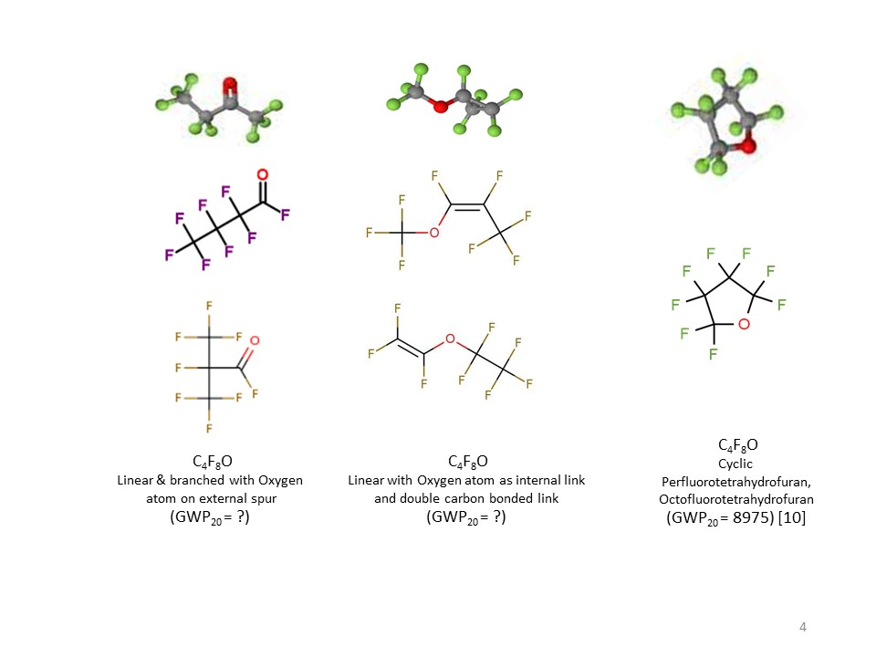
Molecular shapes and GWP (2)
☺
CAS: 67641-44-5
H332, H335, H336
ALICE VHMPID,
BTeV studies:
Refractive index,
UV transparancy OK
(similar to C₄F₁₀), but…
CAS: 337-20-2
H335
?
?
CAS 335-42-2
H331, H335
CAS 773-14-8
Unlisted
?
CAS:10493-43-3
H332, H335, H336
High GWP!!
CAS: 677-84-9
H335
Cyclic, non-cyclic & non-cyclic double carbon-bonded C₄F₈O isomers: refs at end.
Placement of oxygen atom can also determine chemi-potential, flammability & toxicity­
G. Hallewell: Seminaire CPPM: 16 sep 2024

Slide 16
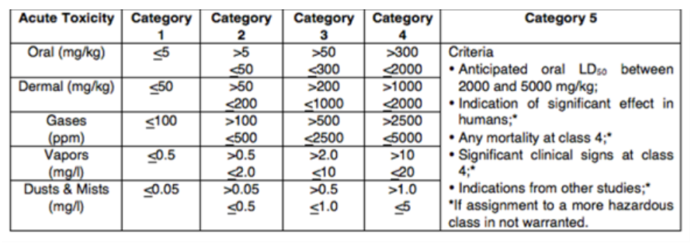
Classification Criteria for Inhalation Toxicity
H330 | Fatal if inhaled
H331 | Toxic if inhaled
H332 | Harmful if inhaled
H333 | May be harmful if inhaled
H334 | May cause allergy or asthma symptoms or breathing difficulties if inhaled
H335 | May cause respiratory irritation
H336 | May cause drowsiness or dizziness
H310 | Fatal in contact with skin
H311 | Toxic in contact with skin
H312 | Harmful in contact with skin
H313 | May be harmful in contact with skin
H314 | Causes severe skin burns and eye damage
H315 | Causes skin irritation
G. Hallewell: Seminaire CPPM: 16 sep 2024

Slide 17
So why are some of these spurred fluoro-ketones
C_{n}F_{2n}O potential low GWP substitutes for saturated fluorocarbons?
C_{n}F_{(2n+2)}
G. Hallewell: Seminaire CPPM: 16 sep 2024

Slide 18
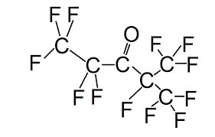
Q: What gives a spurred-Oxygen fluoro-ketone molecule (like 3M NOVEC 649/1230®) its low GWP?
A: Structure!: a double-bonded oxygen atom on a peripheral spur of the molecule
This fluoro-ketone configuration is:
CF₃CF₂C(O)CF(CF₃)₂
G. Hallewell: Seminaire CPPM: 16 sep 2024
18

Slide 19
Q: What gives NOVEC 649/1230 its low GWP?
https://www.nist.gov/system/files/documents/el/fire_research/R0301570.pdf
[15]
Scission by UV photons of λ around 300 nm
In the atmosphere (low pressure, high UV): the fragments do not reassociate* into saturated fluorocarbons of the type C_{n}F_{(2n+2)} (which would have high GWP)
*The Environmental Impact of CFC Replacements HFCs and HCFCs
T. WALLINGTON et al Environ.Sci.Technol.1994(28)7 320A https://doi.org/10.1021/es00056a714
G. Hallewell: Seminaire CPPM: 16 sep 2024
19

Slide 20

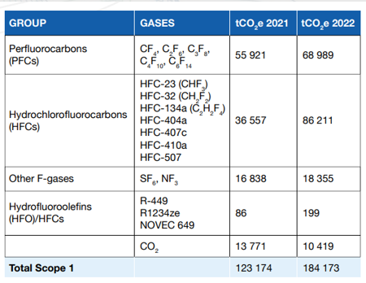
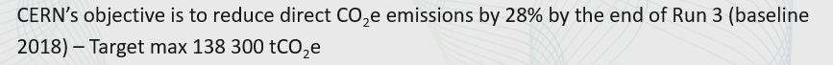
This latest CERN environmental report https://doi.org/10.25325/CERN-Environment-2023-003
CF₄ LHCb RICH2: GWP₂₀ = ¬ 4880_{_CO2}* [16]
C₂F₆ ATLAS evap cooling (potential use): GWP₂₀ = ¬ 8210_{_CO2}* [16]
C₃F₈ F2 Chemicals , Astor, ATLAS evap cooling: GWP₂₀ = ¬ 6640_{_CO2}*[16]
C₄F₁₀ LHCb RICH1, COMPASS RICH: GWP₂₀ = ¬ 6870_{_CO2}* [16]
C₅F₁₂ PP50: GWP₂₀ = ¬ 6350_{_CO2}* [16] (ex-DELPHI, no longer used at CERN)
C₆F₁₄ PP1, F2 Chemicals: Liquid cooling, many expts:
GWP₂₀ = ¬ 5890_{_CO2}*[16]
For some perspective: SF₆ GWP ~ 23000 * CO₂
See also:
https://www.ghgprotocol.org/sites/default/files/ghgp/Global-Warming-Potential-Values%20%28Feb%2016%202016%29_1.pdf
For 100 yr (average of 2nd, 4th & 5th assessment reports; AR2,4,5)
Collective loss of SFCs only around 10 tonnes (whole of LHC + expts)
(compare that to mass-loss at a ‘grande surface’ supermarket!)
R449: (CFH blend) GWP=1397
R1234 (HFO): GWP = 7
NOVEC 649 (C₆F₁₂O): GWP=0
G. Hallewell: Seminaire CPPM: 16 sep 2024

Slide 21
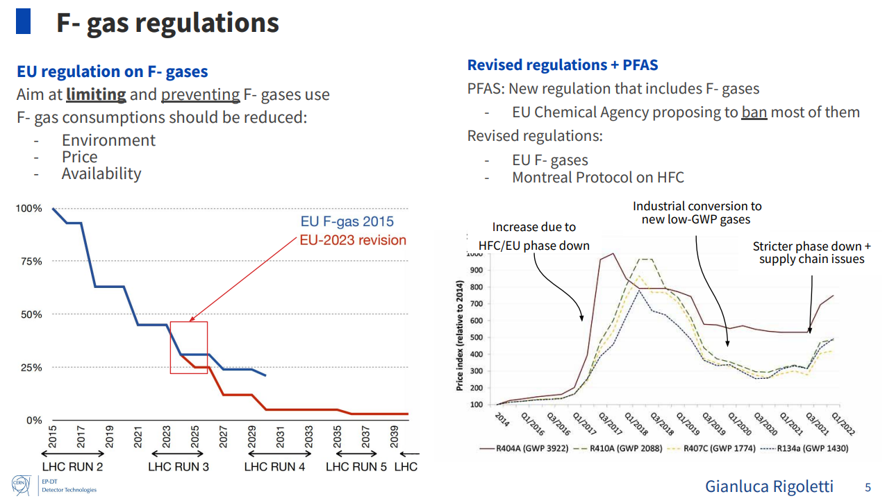
EU strategy to reduce Fluronated (PFAS) compound production and use
(includes also fluorinated plastics not shown here: see back-up material)
Dynamic price hiking :
like imposing demand-dependent customs duty…?
Projected Usage
ICHEP2024
G. Hallewell: Seminaire CPPM: 16 sep 2024

Slide 22
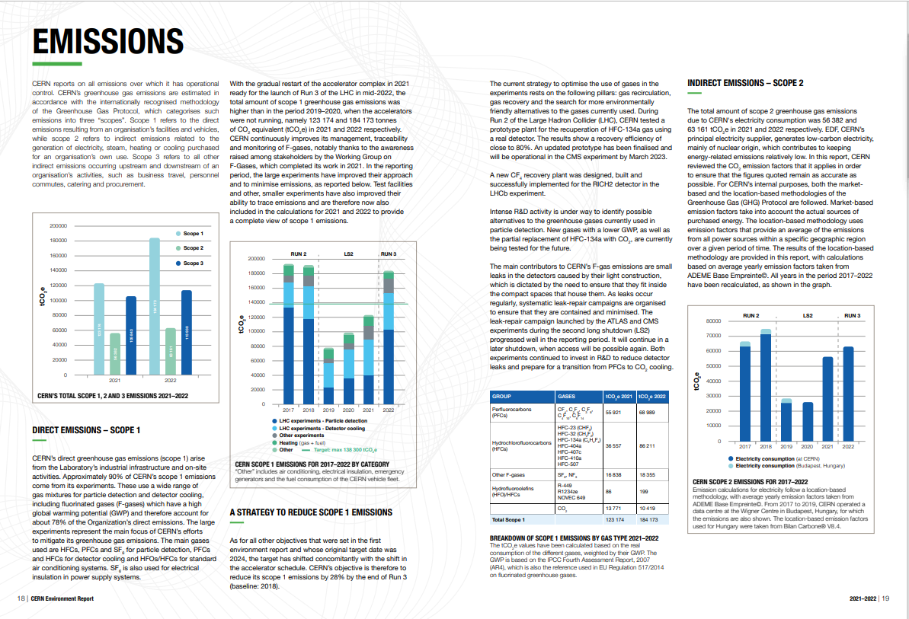
https://doi.org/10.25325/CERN-Environment-2023-003
But no mention at all of the ATLAS ultrasonic fluorocarbon leak monitor system !
G. Hallewell: Seminaire CPPM: 16 sep 2024

Slide 23
Ultrasonic gas analysis in ATLAS: the only fluorocarbon leak detection of its type at CERN.
G. Hallewell: Seminaire CPPM: 16 sep 2024

Slide 24
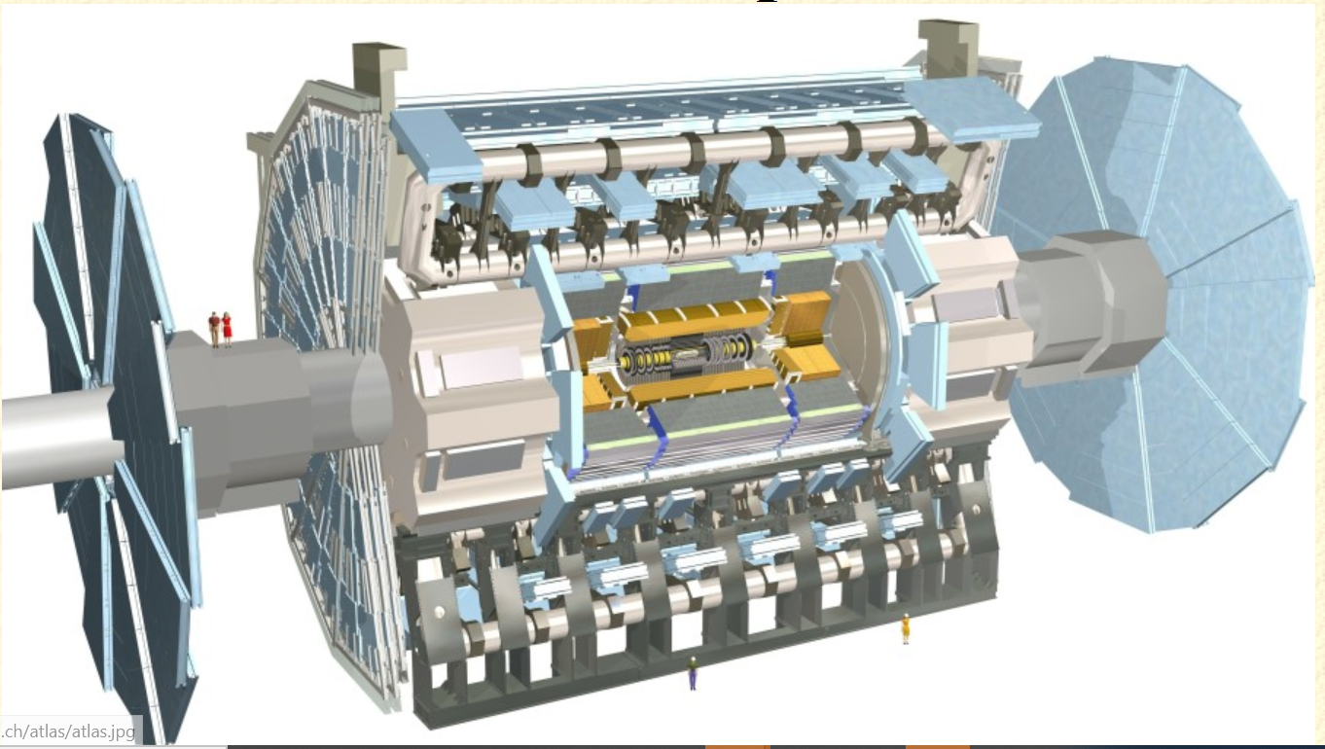
Unpeeling the ATLAS Onion
ATLAS Inner detector:
Includes silicon microstrips
(‘SCT’ tracker) & pixel detectors
G. Hallewell: Seminaire CPPM: 16 sep 2024

Slide 25
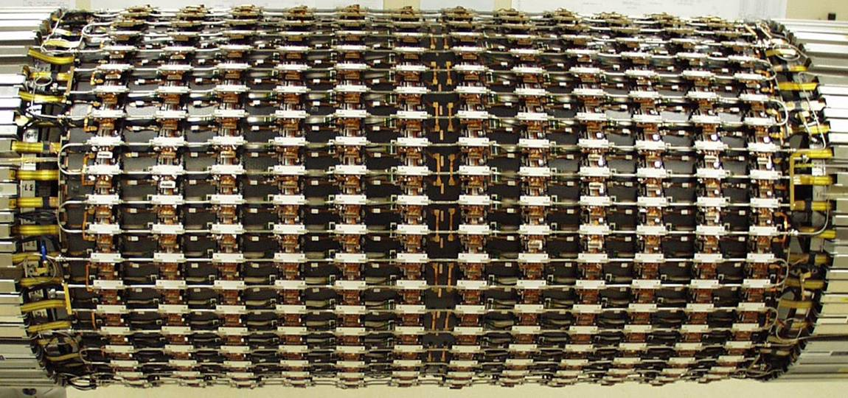
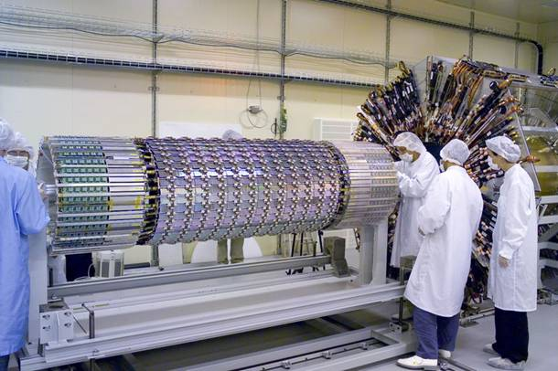
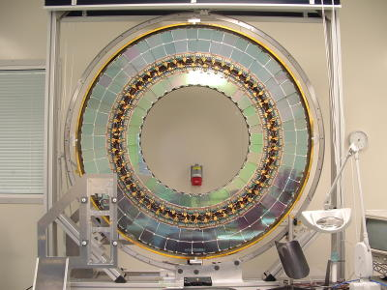
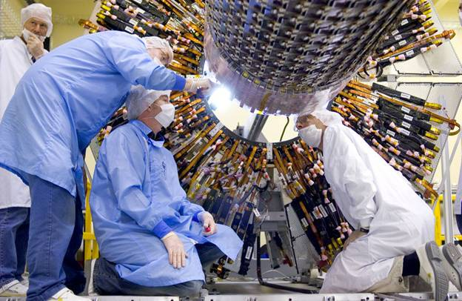
Unpeeling the ATLAS Onion: the evaporators
‘Semi-Conductor Tracker’ (SCT) silicon microstrip tracker surrounding pixel detector
SCT + pixels: 204 C₃F₈ evaporative cooling circuits
60kW total power to evacuate (1.2 kgs⁻¹ C₃F₈)
G. Hallewell: Seminaire CPPM: 16 sep 2024

Slide 26
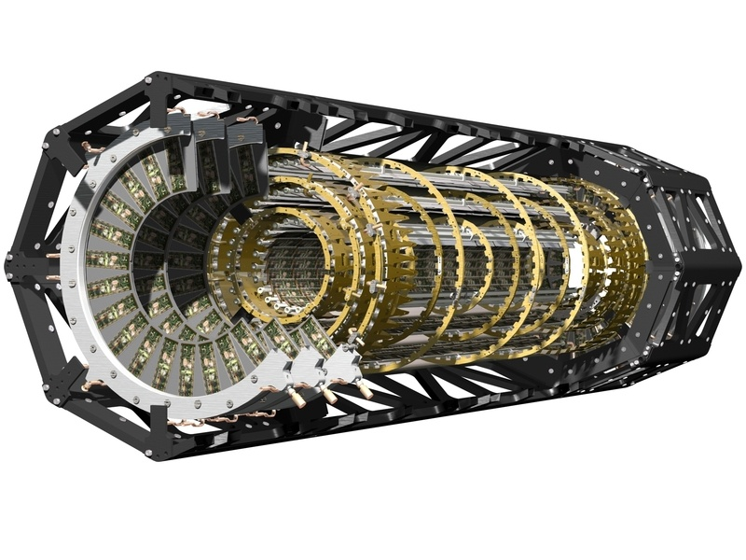
Unpeeling the ATLAS Onion:
Outer Silicon Pixel Detector Structure
~50 Horizontal evaporative C₃F₈ cooling channels (l ~ 1,60m)
18 “radial” channels: disk sectors
(Another (innermost layer) is cooled by evaporating CO₂)
G. Hallewell: Seminaire CPPM: 16 sep 2024

Slide 27
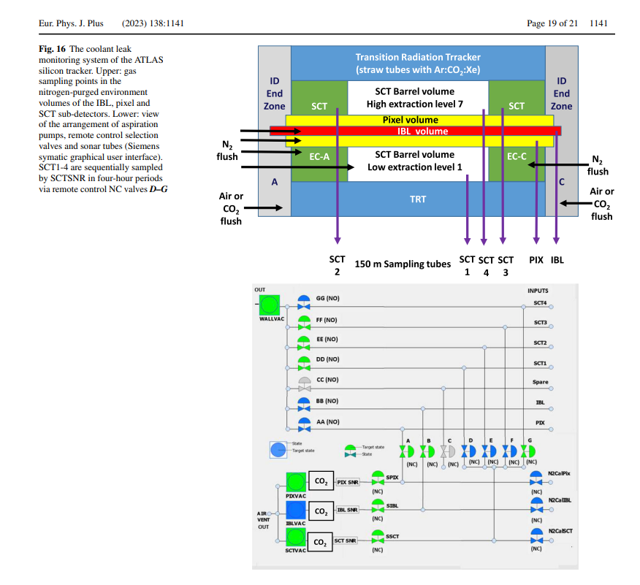
G. Hallewell: Seminaire CPPM: 16 sep 2024

Slide 28
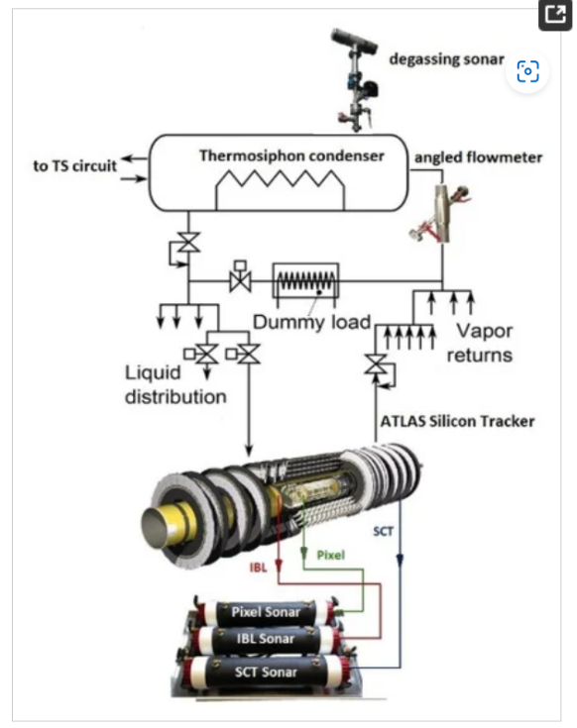
Ultrasonic gas analysis in a process environment with multiple background gases
https://www.mdpi.com/2410-390X/5/1/6
Gas aspirated through
150m tubes from
silicon tracker
N₂ environmental
volumes to
‘sonar’ devices
to look for C₃F₈
leak rates
(C₃F₈ in N₂ )
G. Hallewell: Seminaire CPPM: 16 sep 2024

Slide 29
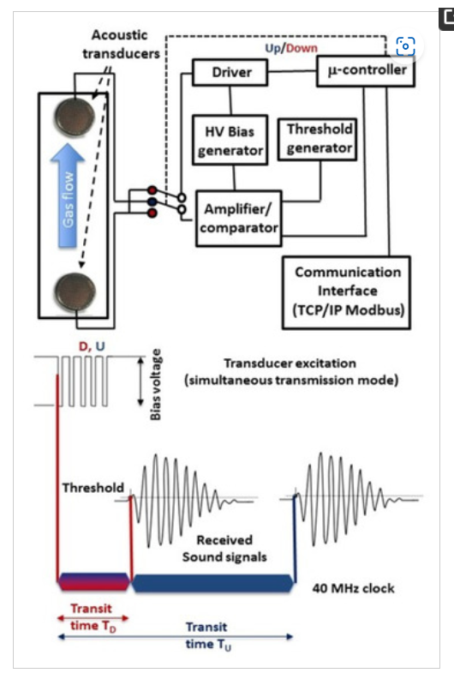
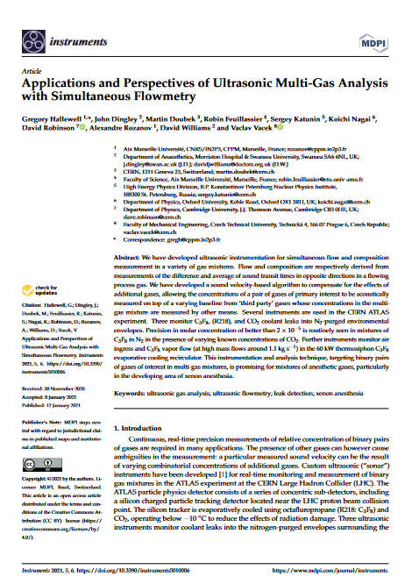
Ultrasonic gas analysis in a process environment with multiple background gases
https://www.mdpi.com/2410-390X/5/1/6
Precision: 10⁻⁵ C₃F₈ into N₂ at 1 bar
G. Hallewell: Seminaire CPPM: 16 sep 2024
29

Slide 30
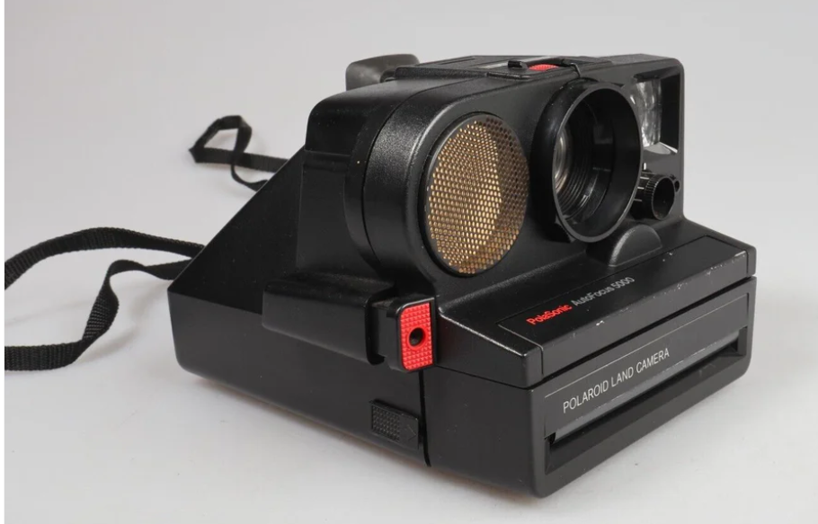
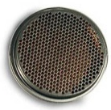
Polaroid Capacitative transducer components
Capacitative 350V activation/ bias ➔ rapid response
37mm diameter determines 50 kHz dominant frequency: can operate over wide pressure range (50mbar ➔>35 bar…)
G. Hallewell: Seminaire CPPM: 16 sep 2024
30

Slide 31
Ultrasonic algorithm to find component molar concentrations
ω_{i=1,2…}
of a pair of gases of primary interest in multi-gas blends
G. Hallewell: Seminaire CPPM: 16 sep 2024
31

Slide 32
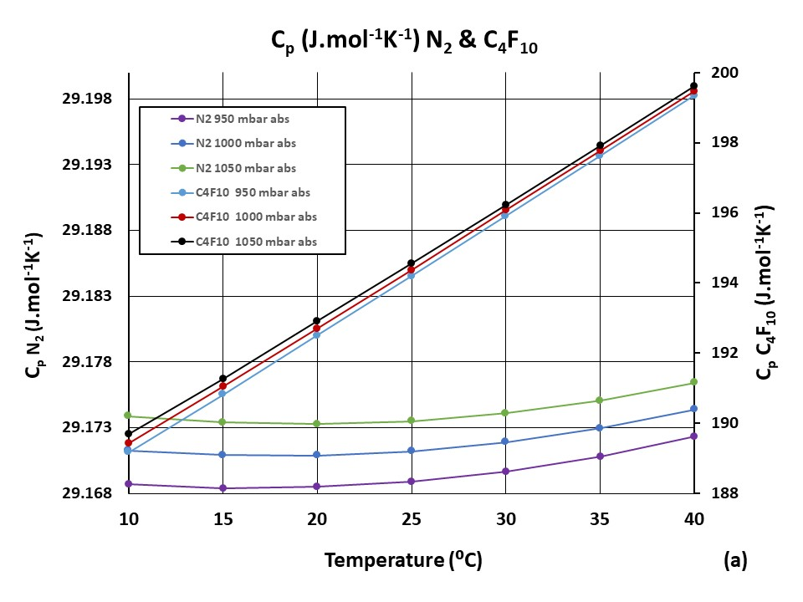
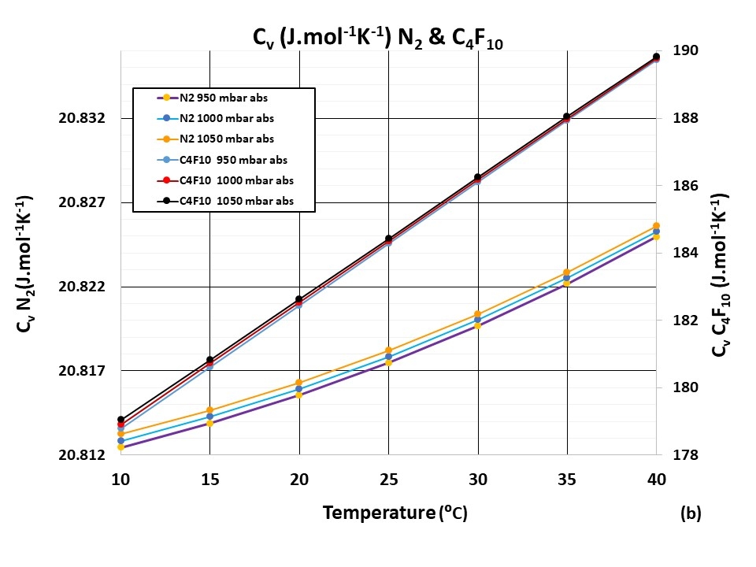
(1) Calculate data base of individual C_{Vi..n} C_{Pi..n}
over expected T, P. range:
Example here: C₄F₁₀: (mol. wt.) = 238 in N₂ (mol. wt. = 28)
G. Hallewell: Seminaire CPPM: 16 sep 2024
32

Slide 33
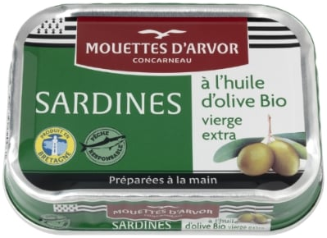
(2) Calculate c_{‘theo’} as a function of concentration from component
Cp, Cv’s over the expected sonar temperature, pressure range to
make database of c_{‘theo’} vs. conc. fit equations to store in ‘cans’
Example here 0- 1% C₃F₈ (m.w.= 188) in N₂ (m.w.= 28): only one pressure shown here for clarity)
Polynomial
Fit
Parameters
G. Hallewell: Seminaire CPPM: 16 sep 2024
33

Slide 34

(3) CAN UTILITY: Store these c_{‘theo’} vs. molar conc. polyfit coeffs covering expected temperature & pressure range in “cans” at P,T grid intersections
(4) Calculate component concentrations ω_{i} from measured sound velocity c_{meas} & stored fit coeffs. interpolated to correspond to the measured T, P
T_{min}
T ➔
T_{max}
P_{max}
P ➔
P_{meas}
P_{step}
P_{min}
T_{step}
T_{meas}
!! This grid can become 3-D or higher-D with known contaminant gas(es) ➔
34
G. Hallewell: Seminaire CPPM: 16 sep 2024

Slide 35
Aah…what if 3 gases are present?
Acoustic Ambiguity ?
2 combinations of 3 gases ➔ same c… so must find ω₃ from a different
(non-acoustic) technology source…
Examples inc. clinical…):
CO₂ from ND infra-red,
H₂O from hygrometry,
O₂ from EC cell… etc.
G. Hallewell: Seminaire CPPM: 16 sep 2024
35

Slide 36
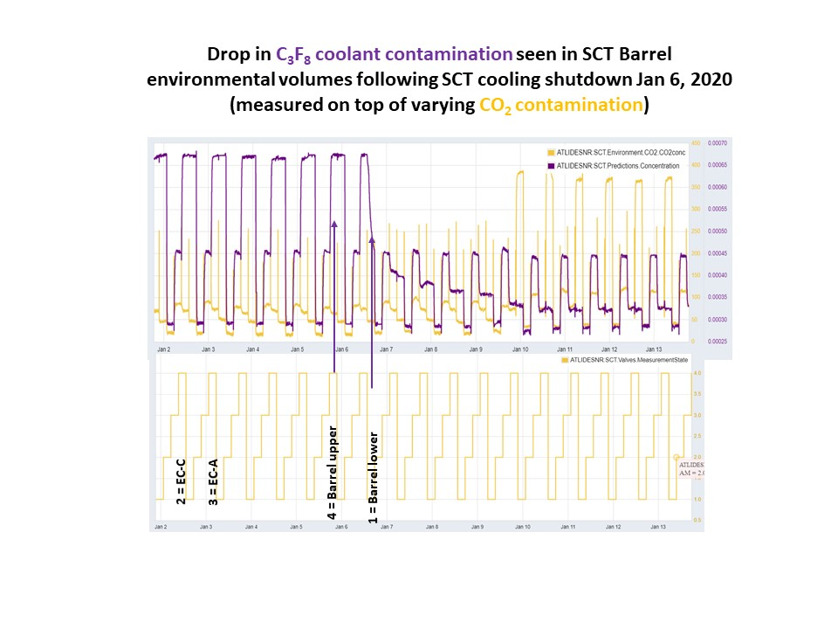
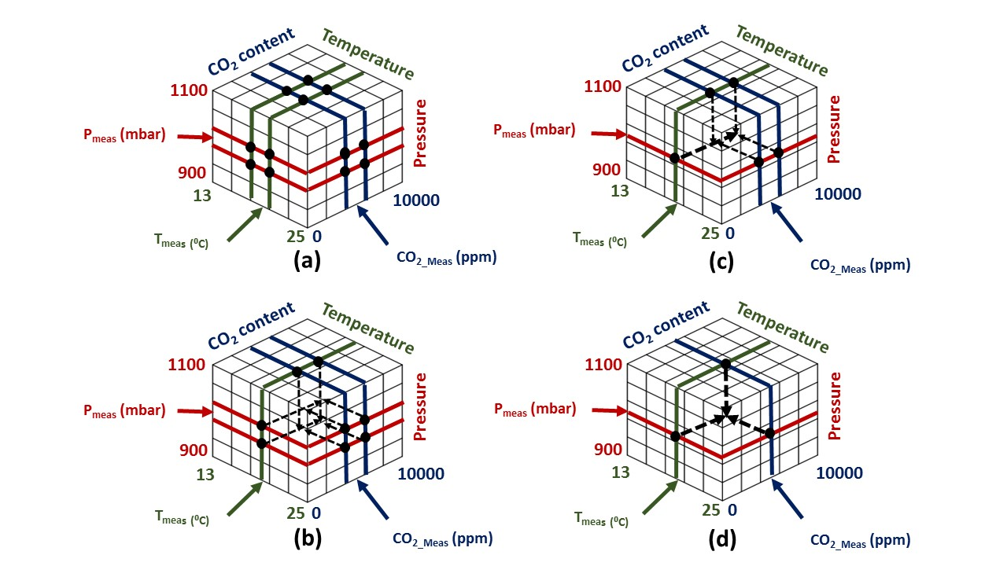


Example: Look-up tables of SoS. vs. composition for C₃F₈/N₂ (+ CO₂) (ATLAS silicon tracker cooling leak analysis)
https://www.mdpi.com/2410-390X/5/1/6
CAN UTILITY DB expanded
from 2-D to 3-D:
C₃F₈/N₂ fit coeffs
stored @{T, P, CO₂} grid
Extra interpolation step,
starting from grid cub(oid) of uncertainty
to T_{meas}, P_{meas},CO_{2 meas}
Calculate sound vel vs. conc. eqns from
C₃F₈ & N₂ AND KNOWN CONTAMINANT GAS
Cp & Cv over expected T,P, %CO₂ range.
Demonstration:
1st acoustic measurement of concentrations of binary gas pair
of interest (C₃F₈/N₂)
in known varying conc. of 3rd gas (CO₂) :
(4 envelopes cycling every 4 hours)
Algorithm: industrial & anaesthesia applications
G. Hallewell: Seminaire CPPM: 16 sep 2024
36

Slide 37
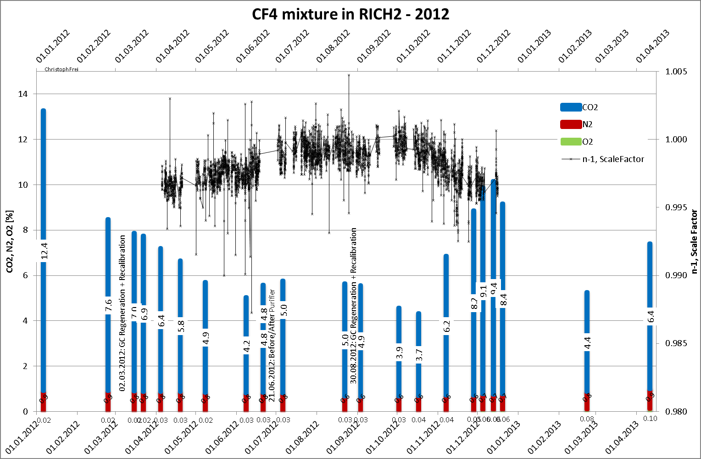
LHCb RICH 2 change in refractivity with varying CO₂ radiator addition
Acoustic ‘pair’ would be CF₄ & N₂ : O₂ by e-chemical cell, CO₂ from NDIR)
G. Hallewell: GasRad GWP: ECFA TF-4 Meeting May16-17th 2023
G. Hallewell: Seminaire CPPM: 16 sep 2024
37

Slide 38
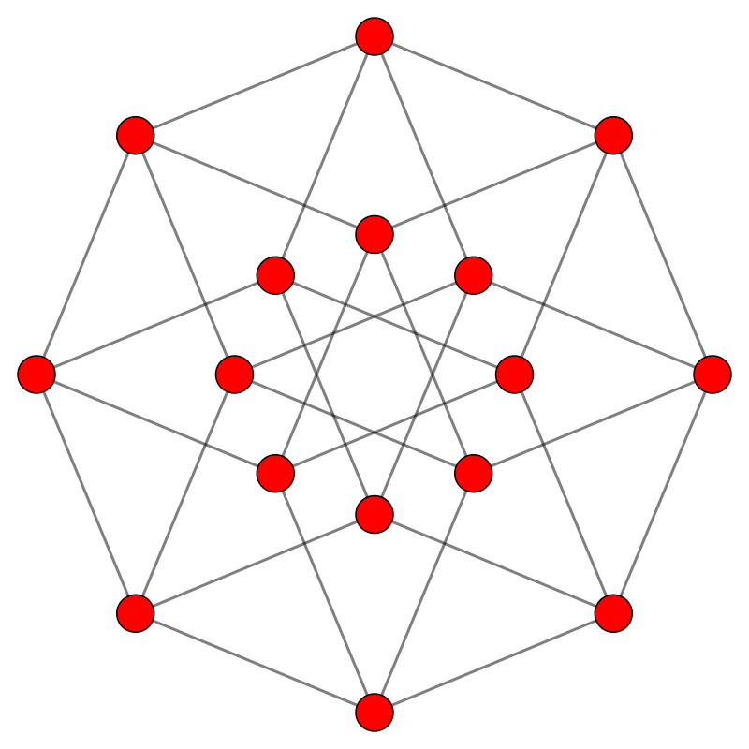

Example with a second known contaminant gas: here H₂O but could be another measurable gas like O₂ : 4-D {T,P, CO₂, H₂O} Process dataspace example ‘Cans’ of c vs. conc_{1,2} fit coefficients now at corners of tesseract. (Here in Coxeter B4 projection)
8 cube faces:
2 x {T,P,CO₂} exc. H₂O
2 x {T,P, H₂O} exc. CO₂
2 x {T, CO₂, H₂O} exc. P
2 x {P, CO₂, H₂O} exc. T
T
CO2
H2O
P
CO2
T
P
H2O
P
H2O
H2O
P
CO2
T
T
P
H2O
CO2
CO2
T
T
P
P
H2O
H2O
T
CO2
P
H2O
CO2
T
Opposite cubic faces explored in the following slides
38
G. Hallewell: Seminaire CPPM: 16 sep 2024

Slide 39
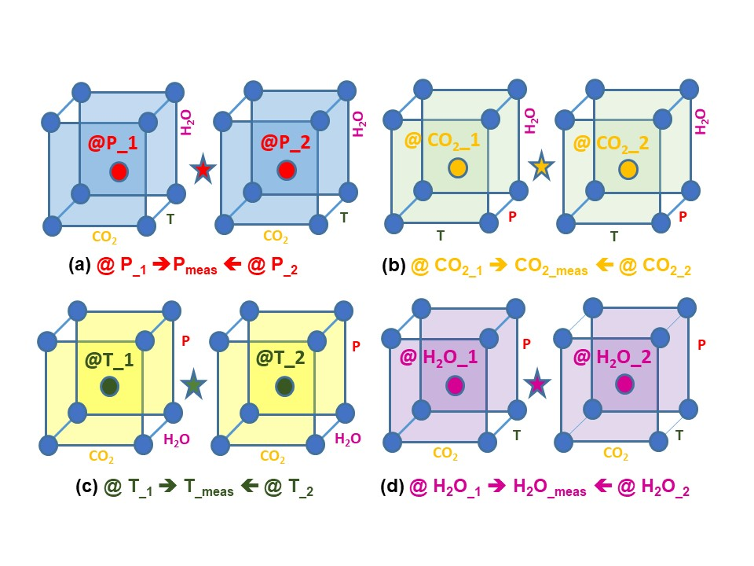
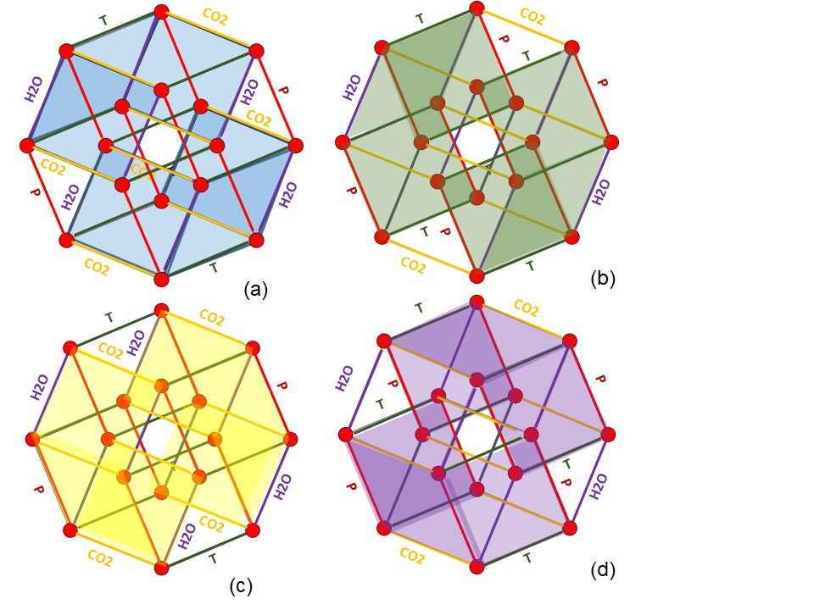
Canterpolation (Extractio-reduction)
Tessar-Can-Action
https://www.mdpi.com/2410-390X/5/1/6
G. Hallewell: Seminaire CPPM: 16 sep 2024
39

Slide 40
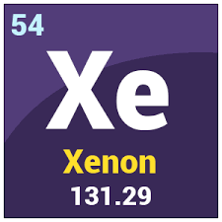
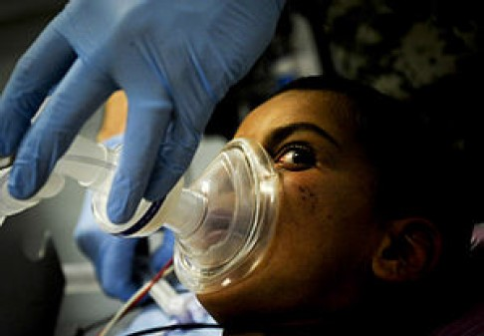

Short digression:
Anesthésie et Ventilation: oxygène avec xénon
Présente dans l’air (8.7.10⁻⁸)
Masse moléculaire: 131
Séparation en séquence de liquéfaction/ distillation progressive
d’air pour LN₂, LO₂, Ar etc…
Potentiel comme gaz anesthésique connu depuis les 1950’s
Le seul gaz noble anesthésique @ la pression normale
Anesthétique idéale : rapide, effets indésirables minimaux
Anesthésie
Très cher: (Xe médical @ € 30/n.t.p. litre) ➔ peu utilise
Systèmes de circulation fermée nécessaires:
Consommation Xe ciblée < 16 litres/anesthésie typique de 4h
Récupération de Xe Post-opératoire:
(système + dégazage partiel de patient)
Ventilation:
Neuro-protecteur contre blessures hypoxique/
Ischémique du cerveau
suite aux manques d’oxygène
G. Hallewell: Seminaire CPPM: 16 sep 2024
40

Slide 41
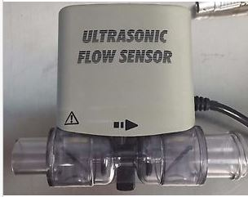
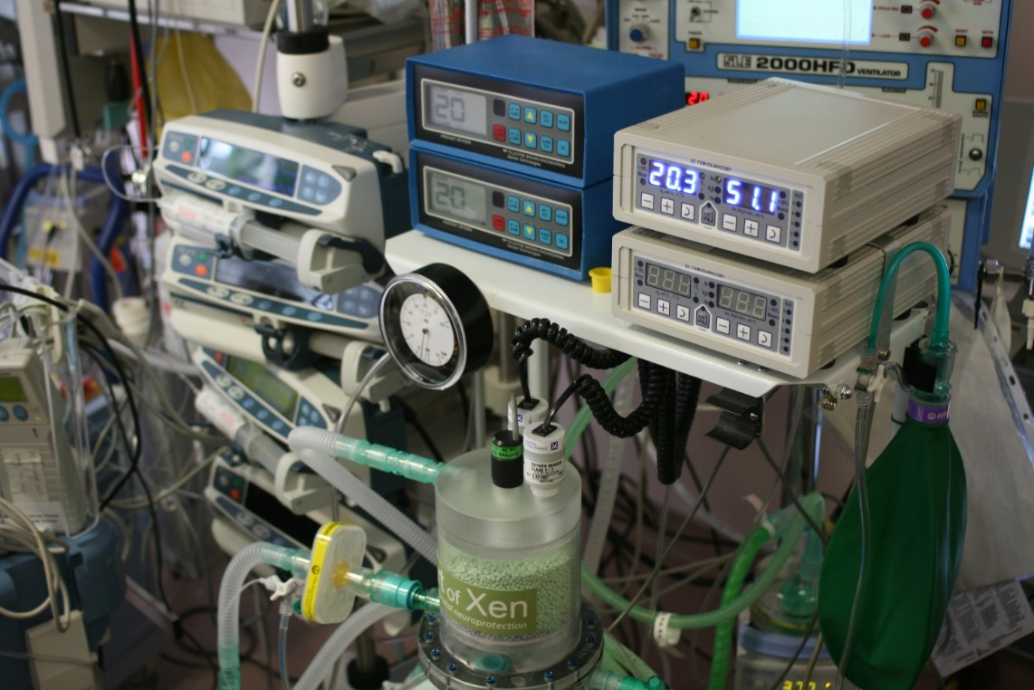
Contrôle de mélanges Xénon – Oxygène (aujourd’hui)
Soda-lime
CO₂ adsorber
Technologie actuel “split”: (Instrum. Russe)
Sonde électrochimique pour O₂,
Sonde conductibilité thermique pour Xe: (analyseur INSOVT GKM-03):
Retro-adaptation de débitmètre ultrasonique (« FDA-approved »: Drager Spirocell) ajout de logiciel pour l’analyse simultanée des mélanges Xe-O₂ : preuve de principe
Inc. GH (CPPM), J. Dingley & D. Williams: Dept. Anaesthetics, Swansea Uni., GB
G. Hallewell: Seminaire CPPM: 16 sep 2024
41

Slide 42
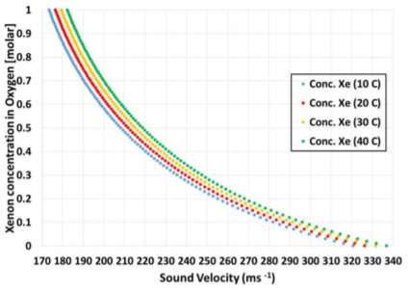
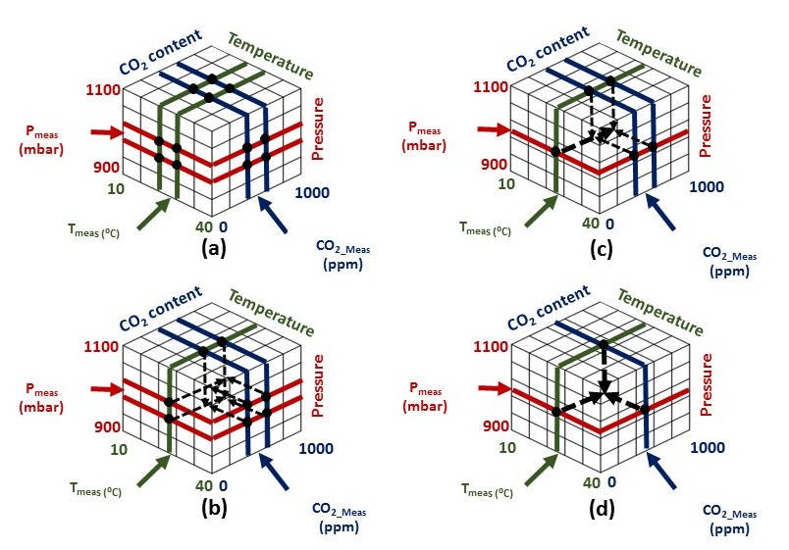
Analyseur a ultrasons de mélanges de gaz Xe-O₂
In practice, work in the 100%RH regime:
➔ H₂O molar concentration given by svp:
Xe/O₂ anesthetic gas mixture can contain CO₂ if soda-lime absorber cannister ineffective.
implement Xe/O₂ gas concentration measurement algorithm in T, P, CO₂ space
Pour mesurer la concentration de Xe avec une
précision de 0.1% il faut mesurer la vitesse de son
avec une précision de 0.2 m/s
(instrument @ CERN: typ. 0.05 m/s)
Masse moléculaire Xe: 131
Masse moléculaire di-oxygène: 32
Polyfit parms
in « cans »
Maybe go to 4D (tessaract) if need to monitor on top of varying H₂O conc..
G. Hallewell: Seminaire CPPM: 16 sep 2024

Slide 43

Database growth control
(important in instruments using embedded μ-controllers)
SoS CALC: Of course, C_{P} & C_{V} for all gases (primary & background)
must be calculated for all T, P points on the n-D grid;
CAN FILLING: Calculate & fit c in gas pair of primary interest from C_{P} & C_{V} over their conc. range AND @T, P, known background gas conc. Grid points.
Database size (3-D example)
DB size = No. primary fit coeffs * $\frac{RoI_T}{d_T}$*$\frac{RoI_P}{d_P}$*$\frac{RoI_Conc. bkd gas 1}{d_Conc. bkd gas 1}$…
RoI_n = range of interest_n: d_n = stepsize_n ➔ Database explosion ?!?
Increasing stepsize (➔ longer interpolation distance) can reduce No. of cans (“cubes” become “cuboids”)…
Some dimensions can be suppressed altogether using physical law (rather than empirical changes):
example for temperature dimension: $c_{t_{abs1}}=c_{t_{abs0}}\sqrt{\frac{t_{abs1}}{t_{abs0}}}$
G. Hallewell: Seminaire CPPM: 16 sep 2024
43

Slide 44
Cherenkovicity…
G. Hallewell: Seminaire CPPM: 16 sep 2024

Slide 45
RICH 1: C₄F₁₀ radiator:
lower momentum PID
RICH 2: CF₄ (+CO₂) radiator:
higher momentum PID
COMBINED RICH PEFORMANCE & PARTICLE SPECIES IDENTIFCATION RANGE
G. Hallewell: Seminaire CPPM: 16 sep 2024

Slide 46




Refractive index & GWP ’load’ in a Cherenkov Gas Radiator
3 large RICH detectors currently in operation at CERN:
using saturated fluorocarbon gas volumes:
C₄F₁₀ (COMPASS: 100m³, LHCb RICH 1: 4m³): GWP₂₀ = 4880,
CF₄ (LHCb RICH 2: 100m³): GWP₂₀ = 6870
V,ρ
A Cherenkov radiator vessel of volume V(m³) filled with
a blend of gases of densities ρ_{i} (kgm⁻³),
fractional concentrations w_{i} and individual GWP_{i} (tonnes CO₂ eq.)
has a GWP environmental “load” (& release potential) L given by:
$L=\frac{V}{1000}\sum_{i}{{(wi.\text{r}i .GWPi}^{}}$) (tonnes CO₂ eq.) [Eq. (1)]
With j contaminant gases of known molar concentrations w_{j} present we can still
add a small concentration ω_{x} of (heavier) SFC or Lin-FK vapour of high refractivity
(n-1)_{x} with ω_{y} of light transparent gas to substitute the refractivity (n-1)_{z(target)}
of a lighter SFC at high concentration – to achieve a lower overall GWP load.
${{(n−1)}_{z(target)}=w_{x}[\left(n−1\right)}_{x}$ ${−(n−1)}_{y}]+$ ${(n−1)}_{y}$ + $\sum_{j=1}^{jmax}{w_{j}[{{(n−1)}_{j}−(n−1)}_{y}]}$
[Eq. (2) ➔Eq. (2b)]
ω_{x} = $\frac{{{(n−1)}_{z}− (n−1)}_{y}+\sum_{j=1}^{jmax}{w_{j}[{{(n−1)}_{y} − (n−1)}_{j}]}}{{ {\left(n−1\right)}_{x} − (n−1)}_{y}}$ [Eq. (3) ➔ Eq. (3b)]
The corresponding radiator gas mixture refractivity is given by :
$\text{(}\text{n}\text{−1)}rad =\sum_{i}{{(wi.\text{(}\text{n}\text{−1)}i}^{}}$) [Eq. (2)]
For just two gases we can blend small conc. ω_{x} of (heavier) SFC or Fluoro-Ketone
vapour of high refractivity (n-1)_{x} with ω_{y} of light transparent gas, refractivity (n-1)_{y}
to replicate refractivity (n-1)_{z} of a lighter SFC at high conc. – for a lower GWP load.
ω_{x} = $\frac{{{(n−1)}_{z(target)}−\left(n−1\right)}_{y}}{{ {\left(n−1\right)}_{x}−(n−1)}_{ y}}$ [Eq. (3)]
G. Hallewell: Seminaire CPPM: 16 sep 2024

Slide 47


An interesting fluoroketone: C₅F₁₀O
MW = 266: GWP <1 (e.g. 3M Novec 5110®)
Blend with N₂ to match C₄F₁₀ or CF₄ - refractivity?
G. Hallewell: Seminaire CPPM: 16 sep 2024
47

Slide 48


Use real-time speed of sound to get component molar concentrations,ω_{i}
(SoS traditionally also called “c” by acousticians to confuse things)
$\text{(}\text{n}\text{−1)}rad =\sum_{i}{{(wi.\text{(}\text{n}\text{−1)}i}^{}}$)
Then use standard refractivity formula to get from calculated ω_{1,2}
to refractive index of the radiator gas in real-time, along with standard relativistic expressions to get from n to Cherenkov γ thresholds for different particle species and β = 1 angle
Real-time measurement of speed of sound c takes us via the relative concentrations of the components to the speed of light β and beyond!! in the radiator gas
Eyes on the prize…(focus here on LHCb RICH2 (n-1)…)
(488.10⁻⁶)_{CF4} = (~1750.10⁻⁶)_{C5F10O}*0.12+(300.10⁻⁶)_{N2}*0.88
G. Hallewell: Seminaire CPPM: 16 sep 2024
48

Slide 49




Historical: The SLD barrel CRID gas radiators (SLAC: 1990s)
87% C₅F₁₂/13%N₂
gas radiator
Sonar transducer
6 transducer pairs
@ 3 different heights
(hydrostatics)
G. Hallewell: Seminaire CPPM: 16 sep 2024
49

Slide 50

Maintaining C₅F₁₂/N₂ refractive index
through sonar-based active mixture control
(In this paper submitted to IEEE TNS)
Spokesperson:
KM3NeT
Flowmeter
analyzer in supply line
to tune the blend by
hardwired 4-20mA
links to mass flow controllers
Undergrads: Queen Elizabeth College
+ Notting Hill
Spokesperson:
DUNE
G. Hallewell: Seminaire CPPM: 16 sep 2024
50

Slide 51
SLD-CRID: Cherenkov threshold in C₅F₁₂/N₂ mixtures
vs. measured speed of sound in radiator gas mixture (1)
Typical mix 87%C₅F₁₂,13%N₂
C₅F₁₂ concentration (%)
G. Hallewell: Seminaire CPPM: 16 sep 2024
51

Slide 52

SLD-CRID: Cherenkov threshold in C₅F₁₂/N₂ mixtures
vs. measured speed of sound in radiator gas mixture (2)
So.. from (“acoustic”) c to β…
Cherenkov Threshold (GeV/c)
β = 1/n
Measured Sound Velocity (m/s)
52
G. Hallewell: DRD4 WG 2 Low GWP FC radiator gases: June 19 2024

Slide 53
Cherenkov threshold: C₅F₁₀O/N₂ & (heritage) C₅F₁₂/N₂ blend
and GWP load comparison for LHCb RICH2 (100m³ CF₄)
C₅F₁₂ SFC/N₂ and NOVEC5110 (C₅F₁₀O) /N₂ will be very similar (MW 266 vs. 288)
LHCb RICH 2: CF₄ thresholds
GWP load = (0.95 molar*4880*V.ρ)
~ 14% molar C₅F₁₀O
gives a GWP load reduction of 1737 tonnes:
Even substituting CF₄ with ~ 13% molar heritage stock C₅F₁₂ reduces GWP load by ~800 tonnes
C₅F₁₂ or C₅F₁₀O concentration (%)
LHCb RICH 2 with C₅F₁₀O/N₂
GWP load = (0.13 molar*1*V.ρ)
G. Hallewell: Seminaire CPPM: 16 sep 2024
53

Slide 54
GWP load reduction through CF₄ index matching (LHCb RICH2)
Table 1: GWP loads of various SFCs and NOVEC 5110 blended with N₂ ((n-1) = 310.10⁻⁶) to match refractivity of CF₄ and C₄F₁₀
assumed radiator volume: 100 m³
Base fluid | Base fluid density (1bar,25˚C) kgm⁻³ | Base fluid GWP (20-yr) | Component (n-1) (*10⁶) (@ nm) | % Blend with N₂ to match (n-1) CF₄ | GWP load (t.CO₂) | % Blend with N₂ to match (n-1) C₄F₁₀ | GWP load (t.CO₂)
CF₄ LHCb RICH2 (100m³) | 3.56 [18] | 4880 [16] | 488 (180-310 nm) [19] | 100 | 1737 | not applicable | n/a
CF₂O | - |  |  | ~100 | 1 | n/a | n/a
C₂F₆ | 5.63 [18] | 8210 [16] | 793 (180-310 nm) [19] | 38.1 | 1762 | not applicable | n/a
Lin-C₂F₄O | - |  |  | - |  | n/a | n/a
C₃F₈ | 7.75 [18] | 6640 [16] | 1180 (250 nm) [16] | 21.4 | 1099 | not applicable | n/a
Lin-C₃F₆O | - |  |  | - |  | n/a | n/a
C₄F₁₀ LHCb RICH1 (4m³): COMPASS (100m³) | 9.97 [18] | 6870 [16] | 1450 (250 nm) [16] | 16.3 | 1119 | 100 | 6849
Lin-C₄F₈O (Non-cyclic C₄F₈O)* | 9.5 (est.) | Probably < 1 (NOVEC 5110 Analogy) | 1380 @ 400nm (based on 3M PFG-3480 c-C₄F₈O [7]: linear C₄F₈O not yet measured but assumed similar) | 18.4 | 0.18 | 112.7* (>100% would imply necessity of operating C₄F₈O at slight overpressure) | 1.07
C₅F₁₂ | 11.63 [18] (BP 30 ˚C at 1 bar) | 6350 [16] | 1750 (180-310nm)[19] (40 ˚C, undiluted) | 13.0 | 957 | 79.3 | 5857
NOVEC 5110 C₅F₁₀O | 10.7 [13] (BP 27 ˚C at 1 bar) | <1 [13] | Not yet measured: probably around 1650 by analogy with C₄F₁₀ and C₄F₈O ratio | 13.9 | 0.149 | 85.2 | 0.91
Hypothetical (not industralised)
Note: Xe ((n-1) around 750.10⁻⁶), GWP=0, another possibility for CF₄ substitution:
Higher concentration (more m³) of a very expensive gas however
Positions of presently unavailable-in-bulk C_{n}F_{2n}O fluids are shown in italics. Refractivities to match (CF₄ and C₄F₁₀) shown in bold.
GWP loads and refractivities calculated using eqs. (1)-(3): assumed radiator volume: 100 m³
*Made in research quantities by Synquest Inc. as isomers Heptafluorobutyryl fluoride PN: 2116-2-07 CAS: 335-42-2
Octafluoro-2-butanone PN: 2117-2-10 CAS: 337-20-2 & Heptafluoroisobutyryl fluoride PN: 2116-2-0A CAS: 677-84-9
https://link.springer.com/article/10.1140/epjp/s13360-023-04703-w
G. Hallewell: Seminaire CPPM: 16 sep 2024

Slide 55
Radiator volume GWP load: 100 m³ gas radiator with different mw gases blended with nitrogen to replace CF₄
(note: blends with Ar very similar: need refractivity data for linear fluoro-ketones, probably similar to SFCs) blends with CO₂ not consdered: high CO₂ triple point temp (-56 C) ➔ thermodynamic recirculation difficulty)
CF₄ (pure) 1737 tonnes
CF₄
C₂F₆
Krypton: (>100% indicates need
for slight pressuisation)
C₄F₁₀
C₃F₈
C₅F₁₂
Xe
G. Hallewell: Seminaire CPPM: 16 sep 2024

Slide 56

C₄F₁₀ radiator (COMPASS): volume 100m^{3,} 1 bar
G. Hallewell: Seminaire CPPM: 16 sep 2024

Slide 57
Situation for RICH radiators using C₄F₁₀ with N₂ passivant
Can make the same C₅F₁₀O comparison
as previously done for a CF₄ radiator (see preceeding table)
Of course… low GWP non-cyclic C₄F₈O
would be easier to circulate, if available.
Cherenkov Threshold (GeV/c)
C₄F₁₀ concentration in radiator gas (%)
Measured Sound Velocity (m/s)
57
G. Hallewell: DRD4 WG 2 Low GWP FC radiator gases: June 19 2024

Slide 58
Cherenkov threshold in C₅F₁₀O/N₂ mixtures
and GWP load comparison with COMPASS RICH (100m³)
COMPASS (& LHCb RICH 1): C₄F₁₀ thresholds
COMPASS RICH GWP load = (6849 tonnes)
N₂-NOVEC5110 (C₅F₁₀O) very similar to C₅F₁₂ (MW 266 vs. 288)
85% Novec 5110 gives a huge GWP load reduction of 6849 tonnes
C₅F₁₀O concentration (%)
58
G. Hallewell: DRD4 WG 2 Low GWP FC radiator gases: June 19 2024

Slide 59
Even bigger GWP load reduction through C₄F₁₀ index matching
(eg here: COMPASS RICH)
Table 1: GWP loads of various SFCs and NOVEC 5110 blended with N₂ ((n-1) = 310.10⁻⁶) to match refractivity of CF₄ and C₄F₁₀
assumed radiator volume: 100 m³
Base fluid | Base fluid density (1bar,25˚C) kgm⁻³ | Base fluid GWP (20-yr) | Component (n-1) (*10⁶) (@ nm) | % Blend with N₂ to match (n-1) CF₄ | GWP load (t.CO₂) | % Blend with N₂ to match (n-1) C₄F₁₀ | GWP load (t.CO₂)
CF₄ LHCb RICH2 (100m³) | 3.56 [18] | 4880 [16] | 488 (180-310 nm) [19] | 100 | 1737 | not applicable | n/a
CF₂O | - |  |  | ~100 | 0 | n/a | n/a
C₂F₆ | 5.63 [18] | 8210 [16] | 793 (180-310 nm) [19] | 38.1 | 1762 | not applicable | n/a
Lin-C₂F₄O | - |  |  | - |  | n/a | n/a
C₃F₈ | 7.75 [18] | 6640 [16] | 1180 (250 nm) [16] | 21.4 | 1099 | not applicable | n/a
Lin-C₃F₆O | - |  |  | - |  | n/a | n/a
C₄F₁₀ LHCb RICH1 (4m³): COMPASS (100m³) | 9.97 [18] | 6870 [16] | 1450 (250 nm) [16] | 16.3 | 1119 | 100 | 6849
Lin-C₄F₈O (Non-cyclic C₄F₈O)* | 9.5 (est.) | Probably < 1 (NOVEC 5110 Analogy) | 1380 @ 400nm (based on 3M PFG-3480 c-C₄F₈O [7]: linear C₄F₈O not yet measured but assumed similar) | 18.4 | 0.18 | 112.7* (>100% would imply necessity of operating C₄F₈O at slight overpressure) | 1.07
C₅F₁₂ | 11.63 [18] (BP 30 ˚C at 1 bar) | 6350 [16] | 1750 (180-310nm)[19] (40 ˚C, undiluted) | 13.0 | 957 | 79.3 | 5857
NOVEC 5110 C₅F₁₀O | 10.7 [13] (BP 27 ˚C at 1 bar) | <1 [13] | Not yet measured: probably around 1650 by analogy with C₄F₁₀ and C₄F₈O ratio | 13.9 | 0.149 | 85.2 | 0.91
Lin-C₄F₁₀O: Almost Nirvana if industrialised,
Might need slight over-pressure
or slightly-modified Cherenkov thresholds
G. Hallewell: Seminaire CPPM: 16 sep 2024

Slide 60
C_{n}F_{2n}O fluid selection search criteria
Bibliographic
Materials tests
Optotests
Start(ed)
Next C_{n}F_{2n}O fluid
(order & isomer)
to evaluate
Y
Non-
Flammable
(MSDS)
?
Y
Non-
Oxone-
depleting
?
Y
Non-toxic
(MSDS)
?
N
N
N
N
Low GWP!
?
Y
N
N
N
Acid
formation
with H₂O
?
Y
Y
Rad.
Tolerant
(more for
cooling)
?
Y
N
Y
Materials/
purifier
Compatible
?
Dielectric
?
Y
N
Recirc.
Thermo-
dynamics
OK
?
Y
UV-Vis
transparency
OK
?
Y
(n-1) &
Chrom. Disp.
OK
?
Y
Accept
fluid
N
N
N
G. Hallewell: Seminaire CPPM: 16 sep 2024

Slide 61






Some molecular shapes to study (or eliminate) for UVT, GWP, radiation stability & materials compatibility: example: C₄F₈O isomers,
Pentafluoroethyl trifluorovinyl ether CAS: 10493-43-3
Flammable,
H332, 335, 336
Inhalation toxicity Cat 4
Octafluoro-3-methoxyprop-1-ene
CAS: 67641-44-5
H332, 335, 336
Inhalation toxicity Cat. 4
Octafluorotetrahydrofuran
CAS: 773-14-8
Shape is everything:
The more shielded the O atom,
the less toxicity, more chemical stability
and probably bigger GWP:
Need expert Chemist input
BTeV, ALICE VHMPID evaluated; good properties but high GWP
Source: https://www.synquestlabs.com
Octafluoro-2-butanone
CAS: 337-20-2
Inhalation toxicity H335:
may cause resp. irritation
2,2,3,3,4,4,4-Heptafluorobutanoyl
Fluoride CAS: 335-42-2
H331, 335 Inhalation toxicity Cat. 3
Heptafluoroisobutyryl
Fluoride CAS: 677-84-9
H335 Inhalation toxicity Cat. 3
Most promising candidate?
analogy with NOVEC 5110,
649 structures…
G. Hallewell: Seminaire CPPM: 16 sep 2024

Slide 62
Classification Criteria for Inhalation Toxicity
H330 | Fatal if inhaled
H331 | Toxic if inhaled
H332 | Harmful if inhaled
H333 | May be harmful if inhaled
H334 | May cause allergy or asthma symptoms or breathing difficulties if inhaled
H335 | May cause respiratory irritation
H336 | May cause drowsiness or dizziness
H310 | Fatal in contact with skin
H311 | Toxic in contact with skin
H312 | Harmful in contact with skin
H313 | May be harmful in contact with skin
H314 | Causes severe skin burns and eye damage
H315 | Causes skin irritation
G. Hallewell: Seminaire CPPM: 16 sep 2024

Slide 63
Detector cooling (liquid)
G. Hallewell: Seminaire CPPM: 16 sep 2024

Slide 64


NOVEC 7110
C₄F₉OCH₃
(GWP₂₀=249)
CERN has tested
3M NOVEC 649 C₆F₁₂O, (GWP = 0) &
NOVEC 7110 C₄F₉OCH₃ (GWP=249)
Equivalent radiation stability
to C₆F₁₄ used as a liquid coolant
in all LHC experiments;
(C₆F₁₂O) needs dessicants to prevent acid formation, but standard molecular sieves, activated-C OK: chosen MAPMT coolant; LHCb RICH detector (T ~15°C)
G. Hallewell: Seminaire CPPM: 16 sep 2024
64

Slide 65

G. Hallewell: Seminaire CPPM: 16 sep 2024

Slide 66

Low temp. (-40°C) cooling operation more of a problem
with NOVEC 649:
Undissolved residual water can cause acid formation;
Unresolved issue
G. Hallewell: Seminaire CPPM: 16 sep 2024

Slide 67

G. Hallewell: Seminaire CPPM: 16 sep 2024

Slide 68
The Silicon tracker cooling aspect
See also https://link.springer.com/article/10.1140/epjp/s13360-023-04703-w
G. Hallewell: Seminaire CPPM: 16 sep 2024

Slide 69




Examples from cooling particle physics Si trackers (ATLAS, CMS, LHCb)
Two distinct types of detector cooling geometry at HL-LHC:
Tube and block ‘DNA’
ATLAS barrel SCT (present) ATLAS ITK Barrel longerons and Si module
block attachment (future HL-LHC)
Disadvantages: long(er) heat conduction path (more interfaces) Si➔ cold(er) coolant: lower Thermal figures of merit
(2) Micro-channel cooling
LHCb VELO upgrade
Advantages: shortest heat conduction path to coolant: coolant can be warmer:
Disadvantages: fraglity issues: channels etched in silicon and cover plate attached
G. Hallewell: Seminaire CPPM: 16 sep 2024

Slide 70



Micro-channel cooling: the LHCb VELO upgrade
G. Hallewell: Seminaire CPPM: 16 sep 2024

Slide 71


Micro-channel cooling: more on the LHCb VELO upgrade
Recent mastery of evaporative CO₂ cooling in microchannels
G. Hallewell: Seminaire CPPM: 16 sep 2024

Slide 72


CO₂ problems:
High evaporation pressure at room temperature (60-70 bar):
(test pressure 150 bar)
the detector has to ‘surf ‘ down the saturated liquid line to the operating evaporation temperature of -30 ➔ -40 °C (pressure around 12 - 18 bars):
fatigue cycling an issue in
microchannels..?
(2) High triple point temperature of -56 °C
limits the lowest temperature attainable in the tubes of a tube & block cooling system: may not be cold enough for operation of Si detectors after years of irradiation in the LHC High Luminosity program (2029-41)
ATLAS plans to change its inner pixel detector half way through…
A very complicated alternative trans-critical krypton evaporative cycle has been proposed …
G. Hallewell: Seminaire CPPM: 16 sep 2024

Slide 73

The Silicon Tracker
Perspective in the HL-LHC era
https://lhc-commissioning.web.cern.ch/schedule/LHC-long-term.htm
G. Hallewell: Seminaire CPPM: 16 sep 2024

Slide 74


People are clearly worried about poor performance of CO₂ particularly for ‘tube & block’ tracker cooling geometries
Cold Krypton system for the Phase III Upgrade of the LHC
[46] L. Contiero et al; Cold Krypton system for the Phase III Upgrade of the LHC,
Forum on Tracking Detector Mechanics 2023, Tuebingen Germany May 31-June 2 2023
Luca Contiero, Krzysztof Banasiak (NTNU), Armin Hafner (NTNU), Bart Verlaat (CERN), Paolo Petagna (CERN)
G. Hallewell: Seminaire CPPM: 16 sep 2024

Slide 75

G. Hallewell: Seminaire CPPM: 16 sep 2024

Slide 76
Presentation outlines
Necessity to go colder with the future upgrade of the LHC (HL-LHC plan)
Issues: temperatures unattainable by current CO₂ cooling technology
Definition of a new cooling cycle using Krypton
Definition of the different transient modes encountered during gradual cooldown
Design principles to base future design
Dynamic modelling and control logic
Prototype to test cooling concept
HL-LHC operation
2029-2041 (at least)
!!!!
[46] L. Contiero et al; Cold Krypton system for the Phase III Upgrade of the LHC,
Forum on Tracking Detector Mechanics 2023, Tuebingen Germany May 31-June 2 2023
G. Hallewell: Seminaire CPPM: 16 sep 2024

Slide 77


Xenon demonstrator for the Krypton cycle
Use of Krypton problematic due to very cold temperatures (T_{crit} ≈ -64°C)
Xenon proposed thanks to its warmer critical temperature (≈ 17degC)
Required to precondition the unit to start in supercritical phase
Krypton
Xenon
Gymnastodynamics
[46] L. Contiero et al; Cold Krypton system for the Phase III Upgrade of the LHC,
Forum on Tracking Detector Mechanics 2023, Tuebingen Germany May 31-June 2 2023
G. Hallewell: Seminaire CPPM: 16 sep 2024

Slide 78
Low GWP Alternatives to CO₂:
Noble gases like Xenon and Krypton
Both very expensive and in very short supply, particularly since the war in Ukraine.
Complex transcritical circulation for Krypton (outside the scope of this unit);
Xenon probably just squeaks in (~50 bar @ 15 C) but still has relatively high pressure evaporation at room temp, but no triple point problem (-112 ˚C)
(2) Fluoroketone (C_{n}F_{2n}O) replacements for SFCs
G. Hallewell: Seminaire CPPM: 16 sep 2024

Slide 79


Analogy: a Fluoroketone (C_{n}F_{2n}O) replacement
for a saturated fluorocarbon (C_{n}F_{(2n+2)})
Thermophysical Properties of NOVEC 649 (C₆F₁₂O) & C₆F₁₄
(at 25°C except where noted)
Fluid thermophysical property | NOVEC 649: C₂F₅C(O)CF(CF₃)₂ Perfluoro-2-methyl-3-pentanone (C₆F₁₂O fluoro-ketone) | C₆F₁₄ (Perfluorohexane, Saturated fluorocarbon)
Boiling temp @ 1 atm (˚C) | 49 | 56
Critical Temp (˚C) | 169 | 178
Critical Pressure (MPa) | 1.87 | 1.89
Freezing temperatre (˚C) | < -100 | < -100
Specific heat (J.kg⁻¹K⁻¹) | 1103 | 1050
Density (kg.m⁻³) | 1610 | 1680
Kinematic viscosity (cSt) | 0.42 | 0.4
Latent Heat (J.kg⁻¹) | 88 | 88
Vapour Pressure @ 25 ˚C (kPa) | 40.4 | 30.9
Vapour Pressure @ 100 ˚C (kPa) | 441 | 350
Water solubility (ppm_{w}) | 21 | 10
No reason why thermo parameters
of other SFCs and same
order FK analogs shouldn’t be
similarly similar
(though placement of the O atom affects chemi-activity and toxicity, not just GWP…)
G. Hallewell: Seminaire CPPM: 16 sep 2024

Slide 80
Some Thermodynamic comparisons two convenient SFCs, CO₂, Xe
(F-K thermodynamics should be similar to same carbon order SFCs)
C₃F₈ probably
won’t go cold
enough for
HL-LHC operation, particularly in tube & block trackers
https://link.springer.com/article/10.1140/epjp/s13360-023-04703-w
A C₂F₄O isomer would be the ideal fluid: much cheaper than Xe (depends on toxicity considerations & studies)
G. Hallewell: Seminaire CPPM: 16 sep 2024

Slide 81


SWOT analysis of cooling fluids HL-LHC
Strengths CO₂ Non-flammable, non-toxic, electrical insulator, non-ozone-depleting, radiation resistant, GWP=1 | Weaknesses CO₂ High pressure circulation (60 bar) at ambient temp before cooldown to operating temp High triple point ( -56°C)
Threats CO₂ High triple point may make Si tracker operation problematic: less thermal ‘headroom’ after heavy irradiaton (‘thermal runaway’ phenomenon) | Opportunities CO₂ Extensive R&D program at CERN Evaporative coolant of choice for ATLAS, CMS for start of HL-LHC program
Strengths C₂F₆ Non-flammable, non-toxic, electrical insulator, non-ozone-depleting, radiation resistant | Weaknesses C₂F₆ Very high GWP (around 6000 x CO₂)
Threats C₂F₆ Production will be phased out unless a strong motivation from semiconductor manufacture industry | Opportunities C₂F₆ Proved to decrease the operating temp of an ATLAS SCT thermal model in blend with 75% C₃F₈
Strengths C_{n}F_{2n}O Non-flammable, electrical insulator, non-ozone-depleting, radiation resistant, GWP=0 | Weaknesses C_{n}F_{2n}O
Threats C_{n}F_{2n}O (CAS 354-34-7) Large scale industrial production may depend on the phasing-out of SFCs, needs of semiconductor manufacture industry: Material compatibility needs further study. Toxicity studies needed | Opportunities C_{n}F_{2n}O Expertise in particle physics community for 3M NOVEC 649 (C₆F₁₂O)
Strengths xenon Non-flammable, non-toxic, electrical insulator, non-ozone-depleting, radiation resistant, GWP=0 | Weaknesses xenon High pressure circulation (50 bar) at ambient temp before cooldown to operating temp (amost transcritical) Extremely expensive
Threats xenon Very difficult future procurement (war in Ukraine) (10⁻⁸ atmospheric content.) | Opportunities xenon Could find expertise In particle physics community for fabrication of circulators: already used in dark matter experiments
Tetrafluorooxirane
Trifluoroacetyl fluoride
CAS-354-34-7
H311, H331
CAS: 694-17-7
Unlisted
G. Hallewell: Seminaire CPPM: 16 sep 2024

Slide 82
On the turning away…
The uncertain ECHA (European Chemicals Agency) route to fluorocarbon (PFC, PFAS…) prohibition
(A path paved with impracticalities..?)
Au revoir 3M… need to clarify manufacturers’ attitudes (Dehon Co. (Fr), Synquest (USA), F2 (UK), various companies in China)…
on future lin-fluoroketone (C_{n}F_{2n}O) production
Electronics industry is the driver: we just ride the coat-tails!
[51] ECHA/NR/23/04;
https://echa.europa.eu/-/echa-publishes-pfas-restriction-proposal]
[52] ECHA Candidate List of substances of very high concern for Authorisation;
https://echa.europa.eu/candidate-list-table
[53] Annex to the Annex XV restriction report proposal for restriction: Per- & polyfluoroalkyl substances (PFASs); ECHA; 22/03/2023
https://echa.europa.eu/documents/10162/d2f7fce1-b089-c4fd-1101-2601f53a07d1
[54] Per- and polyfluoroalkyl substances (PFAS); ECHA
https://echa.europa.eu/hot-topics/perfluoroalkyl-chemicals-pfas
[references from https://link.springer.com/article/10.1140/epjp/s13360-023-04703-w
: see back –up material
G. Hallewell: Seminaire CPPM: 16 sep 2024

Slide 83


Massive use of fluorocarbons in electronics industry for semiconductor manufacture and soldering complex computer mother boards with SMD components
Vapour phase (non-contact) soldering of components on PCBs
(particularly surface mount) in high T fluorocarbon atmosphere !!!
The demand for vapour phase soldering is hardly going to “evaporate”.
New, lower GWP, transfer vapours will be needed (e.g. NOVEC)
83
G. Hallewell: Seminaire CPPM: 16 sep 2024

Slide 84
Conclusion
High GWP Saturated fluorocarbons (SFCs: C_{n}F_{(2n+2)}) have ideal optical properties as Cherenkov radiators: C₄F₁₀ and CF₄ used in COMPASS & LHCb RICH1&2;
Non-conductivity, non-flammability & radiation resistance ➔ ideal coolants: C₆F₁₄ used in all LHC experiments; C₃F₈ evaporatively cools ATLAS silicon tracker;
While not industrialised over a wide C_{n}F_{2n}O range fluoro-ketones could offer similar performance at very low, or 0 GWP;
Radiation tolerance & thermal performance of 3M NOVEC 649 (lin-C₆F₁₂O) & NOVEC 7110 (C₄F₉OCH₃) sufficiently promising for consideration to replace C₆F₁₄ @ CERN or cooling; issues with lin-C₆F₁₂O with acid formation via residual water to be resolved
Cherenkov detectors: subject to optical testing, lin-C₄F₈O could replace C₄F₁₀ while lin-C₄F₈O or lin-C₅F₁₀O (or even heritage C₅F₁₂) blended with N₂ and monitored in real time by sound velocity gas analysis - could replace CF₄ in RICH radiators;
SI tracker COOLING: Lighter molecules (e.g. C₂F₄O, with similar thermodynamics to C₂F₆) - would allow lower temperature, 0GWP operation than evaporative CO₂ in Si trackers operated at high luminosity: low order C_{n}F_{2n}O toxicity vs molecular shape needs study
Future PFAS Availability issues to understand, but total PFAS bans unrealistic due to demands of the electronics industry which we can profit from.
G. Hallewell: Seminaire CPPM: 16 sep 2024

Slide 85
https://link.springer.com/article/10.1140/epjp/s13360-023-04703-w
Thanks to…
Helen McNamee and Andy Penman (F2 Chemicals, Preston, UK);
Cristophe Frei and Antonello di Mauro (CERN) for discussions on the current availability of fluorocarbons for use as Cherenkov gas radiators;
Jaroslav Vavra (SLAC) for recollections of the SLD CRID commissioning;
Paola Tropea and Erik Butz (CERN) and Nick Lumb (CPPM) for thermal operation details of the CMS silicon tracker;
Martin Doubek (CERN), Koichi Nagai (Oxford University) and Alexandre Rozanov (CPPM) for similar data on the TOTEM and the ATLAS IBL, SCT and pixel detectors
Eric Vigeolas (CPPM) and Joleen Pater (Manchester University) for information on the expected thermal performance of elements of the upgraded ATLAS ITk silicon tracker under HL-LHC conditions.
Paula Collins and Wiktor Byczynski (CERN) for extensive information on the LHCb VELO;
Mathieu Perrin-Terrin (CPPM) for information on the NA62 Gigatracker;
Sune Jacobsen (CERN) for information concerning the cooling of the LHCb Scintillating fibre tracker.
G. Hallewell: Seminaire CPPM: 16 sep 2024

Slide 86
References and back-up material
G. Hallewell: Seminaire CPPM: 16 sep 2024

Slide 87
References (1 of 3) https://link.springer.com/article/10.1140/epjp/s13360-023-04703-w
[1] CERN Environment Report 2017–2018 https://doi.org/10.25325/CERN-Environment-2020-001
[2] B. Mandelli; Eco-gas mixtures and mitigation procedures for Green-house Gases (GHGs);
ECFA Detector R&D Road-map Symposium: T.F. 1 Gaseous Detectors, 29/4/2021
https://indico.cern.ch/event/999799/contributions/4204191/attachments/2236047/3789965/BMandelli_ECFA.pdf,
[3] B. Mandelli; R&D for the optimization of the use of greenhouse gases in particle detector systems;
Mini workshop on gas transport parameters for present and future generation of experiments: CERN April 22, 2021
https://indico.cern.ch/event/1022051/contributions/4325947/
[4] G. Rigoletti; Studies to reduce greenhouse gas emissions from detectors at the LHC; EP-DT Seminar May 4, 2022.pdf (cern.ch)
[5] S. Dalla Torre et al; Long term experience with C₄F₁₀ in COMPASS RICH-1; Presentation 11th Intl. Workshop on Ring Imaging Cherenkov detectors, Edinburgh, Scotland, Sept 12-16 2022. https://indico.cern.ch/event/1094055/contributions/4932286/attachments/2508724/4311387/RICH2022_C4F10_dallatorre.pdf
[6] 3M PFG-3480: c-octofluorotetrahydrofuran (C₄F₈O). Note: fluid out of production : product reference now used for a non-fluidic product. For historic product data sheet mentioning its high GWP see (for example): http://static6.arrow.com/aropdfconversion/a7116f41dfdd5b79d2eb7b40afd687f8af23d8ef/mediawebserver(563).pdf
[7] M. Artuso et al; Nucl. Instr & Meth. A Volume 558, (2006), 373-387
[8] Product #2H07-2-08 Synonyms: 2,2,3,3,4,4,5,5-octafluorotetrahydrofuran, Perfluorotetrahydrofuran; CAS No: 773-14-8, MDL No. MFCD00465561: SynQuest Labs Inc., 13201 Rachael Boulevard, Alachua, FL 32615, USA https://www.synquestlabs.com/Home/ProductDetail?SearchText=Octafluorotetrahydrofuran
[9] T. Acconcia et al ; Nucl. Instr & Meth A 767 (2014) 50–60
[10] M. Vollmer et al; Abundances, emissions, and loss processes of the long-lived and potent greenhouse gas octafluorooxolane (octafluorotetrahydrofuran, c-C4F8O) in the atmosphere; Atmos. Chem. Phys., 19, 3481–3492, 2019
[11] 3M Novec® range of fluorinated fluids; https://www.3m.com/3M/en_US/p/c/b/novec/?Ntt=novec
[12] 3M Novec 649/1230 fluid (C₆F₁₂O); https://multimedia.3m.com/mws/media/569865O/3m-novec-engineered-fluid-649.pdf,
https://multimedia.3m.com/mws/media/124688O/3m-novec-1230-fire-protection-fluid.pdf]
[13] 3M Novec 5110 fluid (C₅F₁₀O); https://multimedia.3m.com/mws/media/1132123O/3m-novec-5110-insulating-gas.pdf
[14] CERN report EN-CV 22/12/2017, EDMS 1751219 2017-334 rev 1.0: Technical Note NOVEC Fluids Qualification Report: Report on the study executed for the qualification of the NOVEC Fluid for Detector Cooling applications.
[15] J. Owens, Understanding the stability and environmental characteristics of a sustainable Halon alternative.
3M Performance Materials 3M Center, St. Paul, MN 55144
[16] CERN Mini-workshop on gas transport parameters for present and future generation of experiments 20/04/2021;
S. Easo; LHCb-RICH detectors and their gas radiators
https://indico.cern.ch/event/1022051/contributions/4333562/attachments/2231064/3780374/LHCb-RICH-Current-GasRadiators-April-2021.pdf,
Options for alternate radiators in LHCb-RICH system (including calculations by O. Ullaland); S. Easo,
https://indico.cern.ch/event/1022051/contributions/4319538/attachments/2231436/3781060/LHCb-RICH-Future-Radiators.pdf
G. Hallewell: Seminaire CPPM: 16 sep 2024

Slide 88
References (2 of 3) https://link.springer.com/article/10.1140/epjp/s13360-023-04703-w
[17] S.Easo; Nucl.Inst.& Meth. A 876 (2017) 168-173
[18] E. Lemmon, M. Huber, & M. McLinden; REFPROP Standard reference database 23, version 9.0 (2010)
U.S. National Institute of Standards & Technology.
[19] E. Nappi and J. Seguinot Rivista del Nuovo Cimento Vol. 28, N. 8-9 2005 DOI 10.1393/ncr/i2006-10004-6
[20] K. Abe et al. ; IEEE Trans. Nucl. Sci. 45 (1998) 648 SLAC-PUB-7705 DOI: 10.1109/23.6826
[21] G. Hallewell et al; Nucl. Instr. & Meth A264 (1988) 219-234
[22] G. Hallewell; Nucl. Instr & Meth A 876, (2017) 50-53
[23] G. Hallewell et al; MDPI Instruments (2021) 5(1), 6;
[24] P. Stassi et al; Ultrasonic Gas mixture analysis system in the Forward RICH of DELPHI,
DELPHI Internal Note 95-124 RICH73, 25 July 1995
[25] M.Sannino; Nucl. Instr. and Methods in Physics Research A 595 (2008) 208–211
[26] C. D'Ambrosio et al; Monitoring, Alignment and Control of the RICH Detectors;
LHCb-Memo-2000-80 RICH 6 September 2000.
[27] P. Fauland, PhD thesis; (COMPASS experiment) University of Bielefeld March 2004.
[28] Now marketed as SensComp model 600 transducer, http://www.senscomp.com/ultrasonic-sensors/
[29] T. Blake et al; Nucl. Instr. Meth A791 (2015) 27-31
[30] A. Papanestis; Nucl. Instr. Meth. A766 (2014) 14–18
[31] R. Calabrese et al; 2022 JINST 17 P07013
[32] J. Vavra (SLAC National Laboratory); private communication.
[33] P. Tropea; The CMS tracker fluorocarbon cooling system,
Engineering Forum: experiences from cooling systems for LHC detectors Oct 30 2008
P. Tropea, E. Butz (CERN); private communications.
[34] G. Aglieri Rinella et al, 2019 JINST 14 P07010
M. Perrin-Terrin (CPPM); private communication.
[35] G. Anelli et al ; 2008 JINST 3 S08007
M. Doubek (CERN); private communication.
[36] D. Attree et al, 2008 JINST 3 P07003
K. Nagai (Oxford), A. Rozanov (CPPM); private communications.
[37] W. Adam et al ; 2021JINST16P02027
CMS Technical Design Report for the Pixel Detector Upgrade CMS-TDR-011, CERN-LHCC-2012-016 07/09/2012
[38] ATLAS Insertable B-Layer Technical Design Report; CERN-LHCC-2010-013 ATLAS TDR 19 15/09/2010
A. Rozanov (CPPM); private communication.
G. Hallewell: Seminaire CPPM: 16 sep 2024

Slide 89
References (3 of 3) https://link.springer.com/article/10.1140/epjp/s13360-023-04703-w
[39] O. de Aguiar Francisco et al; Nucl. Instr. Meth A. 1039 (2022) 166874
https://www.sciencedirect.com/science/article/pii/S0168900222003394
P. Collins & W. Byczynski (CERN); private communications.
[40] Fluoroketone C₂F₅C(O)CF(CF₃)₂ as a Heat Transfer Fluid for Passive and Pumped 2-Phase Applications;
P. Tuma, 3M Co., 3M Center, 236-2B-01St. Paul, MN 55144, USA, Proc. 2008 IEEE 24th IEEE Semiconductor Thermal
Measurement and Management Symposium, San Jose CA, March 16-20 DOI: 10.1109/STHERM.2008.4509386
also accessible via: https://twiki.cern.ch/twiki/pub/LHCb/SciFiDemoCooling/F.Tuma_c6K_as.....pdf
[41] L. Gruber et al; Nucl. Instr. & Meth. 958 (2020) 162025 https://www.sciencedirect.com/science/article/abs/pii/S016890021930422X?via%3Dihub
[42] ”Building the future of LHCb”; C. Frei, S. Gambetta, B. Leverington; CERN Courier, September 2021 (2 September 2021)
https://cerncourier.com/a/building-the-future-of-lhcb
[43] M. Battistin et al; Int. J. Chemical Reactor Engineering 2015; 13(4): 511–521
[44] R. Bates et al; 2015 JINST 10 P03027
[45] https://lhc-commissioning.web.cern.ch/schedule/LHC-long-term.htm
[46] L. Contiero et al; Cold Krypton system for the Phase III Upgrade of the LHC,
Forum on Tracking Detector Mechanics 2023, Tuebingen Germany May 31-June 2 2023
[47] L. Contiero et al; Krypton, applied as refrigerant for cooling of silicon detector trackers;
GL 2022: 15th IIR-Gustav Lorentzen Conference on Natural Refrigerants, Trondheim, Norway, June 13-15 2023
[48] D. Alvarez et al: Thermo-Mechanical Performance of the Local Supports for the ATLAS ITk Pixel Outer Barrel:
Experimental and FEA Studies; Forum on Tracking Detector Mechanics 2023, Tuebingen Germany May 31-June 2 2023
E. Vigeolas (CPPM), J. Pater (Manchester University); private communications
[49] B. Verlaat; CO₂ cooling experiences in the LHCb Velo Thermal Control System
Engineering Forum: experiences from cooling systems for LHC detectors Oct 30 2008
[50] R. Bates et al; 2013 JINST 8 P02006
[51] ECHA/NR/23/04; https://echa.europa.eu/-/echa-publishes-pfas-restriction-proposal]
[52] ECHA Candidate List of substances of very high concern for Authorisation;
https://echa.europa.eu/candidate-list-table
[53] Annex to the Annex XV restriction report proposal for restriction: Per- & polyfluoroalkyl substances (PFASs);
ECHA; 22/03/2023 https://echa.europa.eu/documents/10162/d2f7fce1-b089-c4fd-1101-2601f53a07d1
[54] Per- and polyfluoroalkyl substances (PFAS); ECHA
https://echa.europa.eu/hot-topics/perfluoroalkyl-chemicals-pfas
G. Hallewell: Seminaire CPPM: 16 sep 2024

Slide 90


NOVEC 649: C₆F₁₂O: GWP <1
NOVEC 7100: C₅F₉H₃O: GWP = 297
NOVEC 649 cools MAPMTs in LHCb!
90
G. Hallewell: Seminaire CPPM: 16 sep 2024

Slide 91

G. Hallewell: Seminaire CPPM: 16 sep 2024

Slide 92
The uncertain ECHA path to prohibition
(a path paved with impracticalities?)
G. Hallewell: Seminaire CPPM: 16 sep 2024

Slide 93

G. Hallewell: Seminaire CPPM: 16 sep 2024

Slide 94

G. Hallewell: Seminaire CPPM: 16 sep 2024

Slide 95

G. Hallewell: Seminaire CPPM: 16 sep 2024

Slide 96

G. Hallewell: Seminaire CPPM: 16 sep 2024

Slide 97
Some Conclusions at this stage : drawing on https://link.springer.com/article/10.1140/epjp/s13360-023-04703-w
Is the banning of fluorocarbons…a realistic aim? … probably not…
Attractive alternatives to saturated fluorocarbons (C_{n}F_{(2n+2)}) currently exist (!!):
Fluoro-ketone (C_{n}F_{(2n)}O): & NOVEC® molecules with side-spurred O atoms;
3M seem to have lost enthusiasm to produce fluorinated fluids after 2025, but companies like F2 Chemicals (Preston, UK), Astor (Ru), Synquest (FL), Techspray (GA) continue (probably many others: e.g.China): groups at CERN looking into alternative suppliers (stated Jan 26 2024)
We are a small-scale users who will always ride on the back of the semiconductor industry.
We should nonetheless enter discussions with other manufacturers! CERN is already doing this!
But discussion should concentrate on C_{n}F_{2n}O molecules over the full carbon spectrum with GWP = 0.
Points relevant to ATLAS cooling: “Although these fluids do not yet exist in large quantities over the full C_{n}F_{2n} “matrix” the radiation tolerance and thermal performance of NOVEC 649 (C₆F₁₂O) is sufficiently promising for it be chosen by LHCb as a C₆F₁₄ replacement for the cooling silicon photomultipliers of the new scintillating fibre tracker. Since the NA62 Gigatracker [34] successfully used C₆F₁₄ liquid cooling, NOVEC649 may also turn out to be a good substitute for the liquid cooling of future silicon microchannel vertex detectors built in technologies (and/or with inter-module connectivity) unable to resist the high maximum test pressures (160 bars) typical of CO₂ evaporative cooling systems. Such vertex detector cooling systems would contain a relatively small volume of liquid coolant.
A new C₂F₄O – structured evaporative coolant could be a thermodynamic substitute for C₂F₆ or xenon to achieve silicon temperatures of -40 ˚C or lower in “block and tube” tracker configurations operated at high luminosity below the practical temperature limit for CO₂ evaporative cooling systems.”
G. Hallewell: Seminaire CPPM: 16 sep 2024

Slide 98

https://indico.cern.ch/event/1155238/attachments/2436920/4173752/EP-DT%20Seminar%20May%202022.pdf
https://indico.cern.ch/event/1155238/attachments/2436920/4173752/EP-DT%20Seminar%20May%202022.pdf
98
CPPM ATLAS physics meeting Feb 23 2024

Slide 99
Approaches to low-GWP fluorocarbon RICH radiator gases
.
See also:
https://link.springer.com/article/10.1140/epjp/s13360-023-04703-w (paper: EuroPhysics J. Plus, Dec 2023)
https://indico.cern.ch/event/1263731/contributions/5398511/attachments/2648319/4584649
/G_Hallewell_DRD4%20Rad%20Gas%20GWP%20with%20annexes%20May%2016%202023.pdf
https://indico.cern.ch/event/1410802/ (DRD4 WG2 meeting 17 May 2024)
https://indico.cern.ch/event/1420840/ (DRD4 WP_3.1 meeting 28 May 2024)
“From the Speed of Sound to the Speed of Light: and beyond!”
99
Notes:
99

Slide 100
G. Hallewell: Seminaire CPPM: 16 sep 2024

Slide 101








UV transparency, refractivity, cmhemical stability & compatibility studies needed
for different C_{n}F_{2n}O molecular shapes.
RICH detector community very competent & equipped for detailed UVT & (n-1)
- much ex-DELPHI RICH diagnostic equipment at CERN for example
A
Minuteman Model 302 VM.
ALICE VHMPID: transparancy
measurements in c-C₄F₈O
Octafluorotetrahydrofuran
CAS: 773-14-8
Synquest Inc. FL, USA
Most probable PC spectral range
in new build gas RICH detectors
G. Hallewell: Seminaire CPPM: 16 sep 2024

Slide 102

Q: What gives NOVEC 649/1230 its low GWP?
https://www.nist.gov/system/files/documents/el/fire_research/R0301570.pdf
[15]
Scission by UV photons of λ around 300 nm
In the atmosphere (low pressure, high UV): the fragments do not reassociate* into saturated fluorocarbons of the type C_{n}F_{(2n+2)} (which would have high GWP)
*The Environmental Impact of CFC Replacements HFCs and HCFCs
T. WALLINGTON et al Environ.Sci.Technol.1994(28)7 320A https://doi.org/10.1021/es00056a714
G. Hallewell: Seminaire CPPM: 16 sep 2024
102

