Slide 1
Listen at Vivaldi with Virgo light
D. Verkindt, Animascience, 4th july 2024

Slide 2
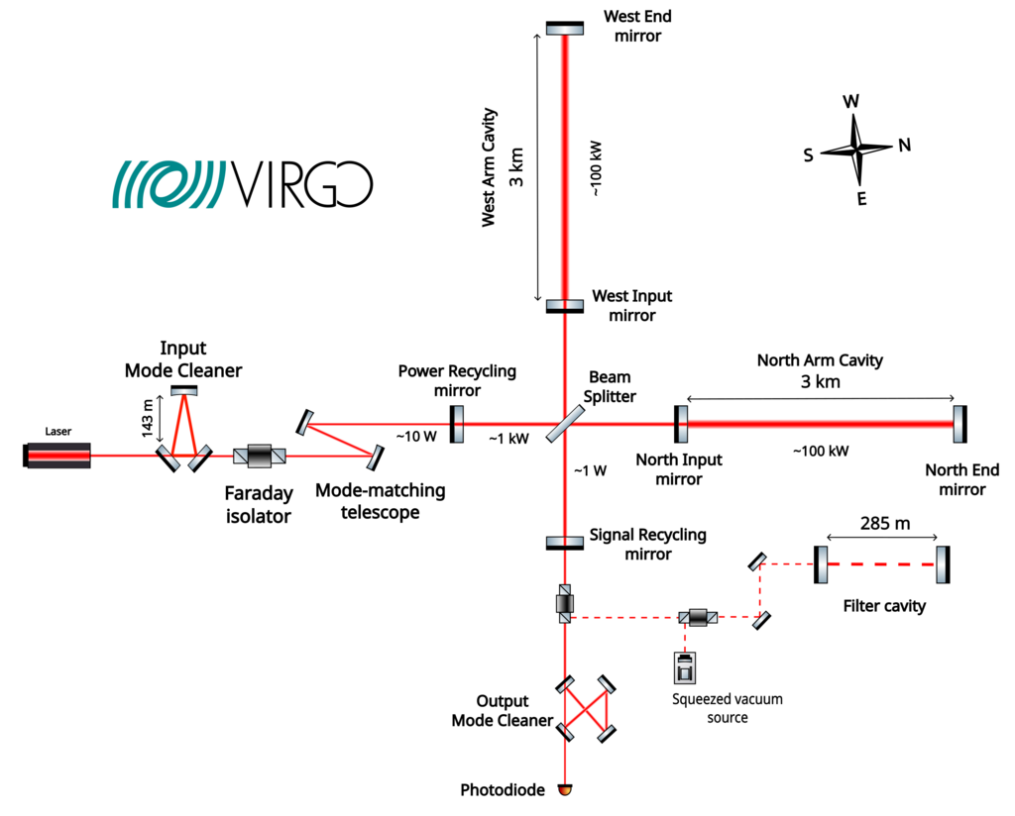
The big instrument to listen music…

Slide 3
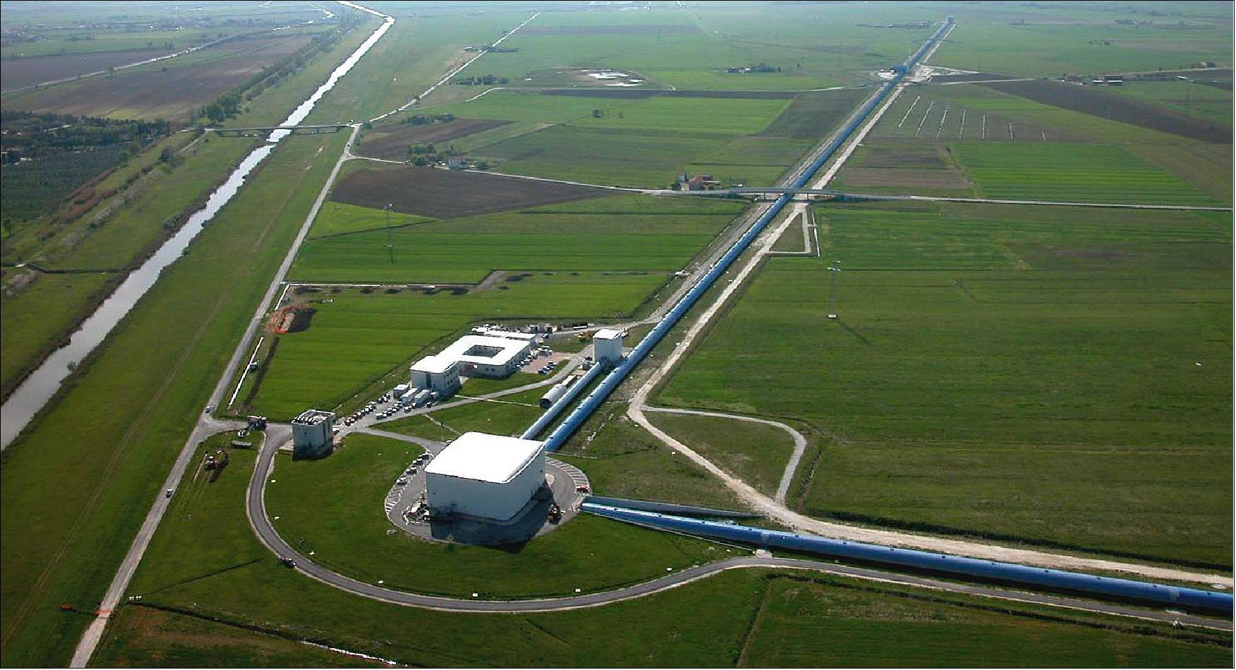
The big instrument to listen music…

Slide 4
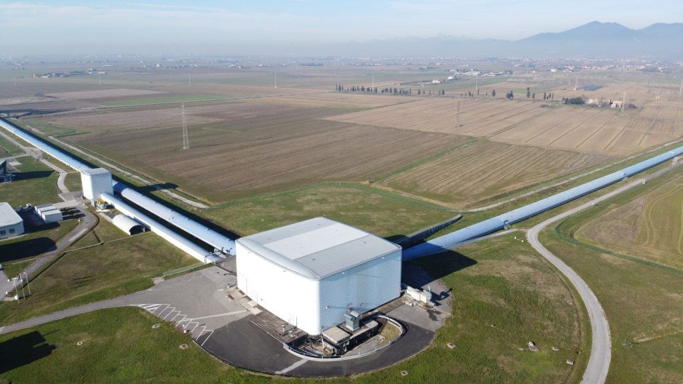
The main buiding…

Slide 5
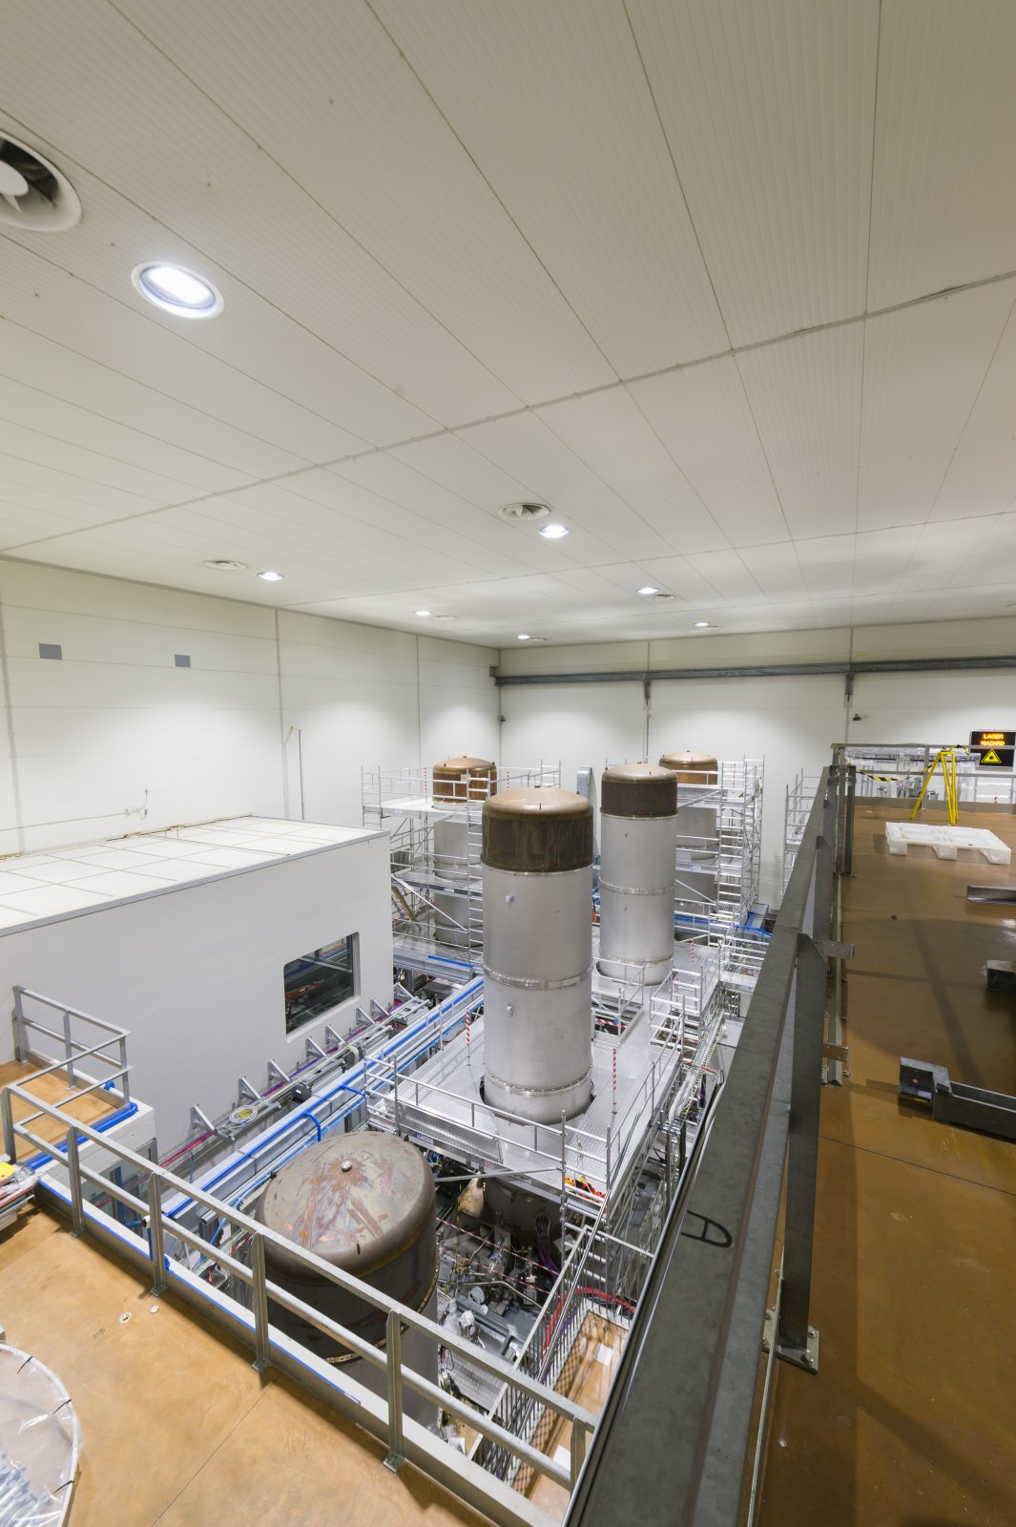
Inside the main buiding…

Slide 6
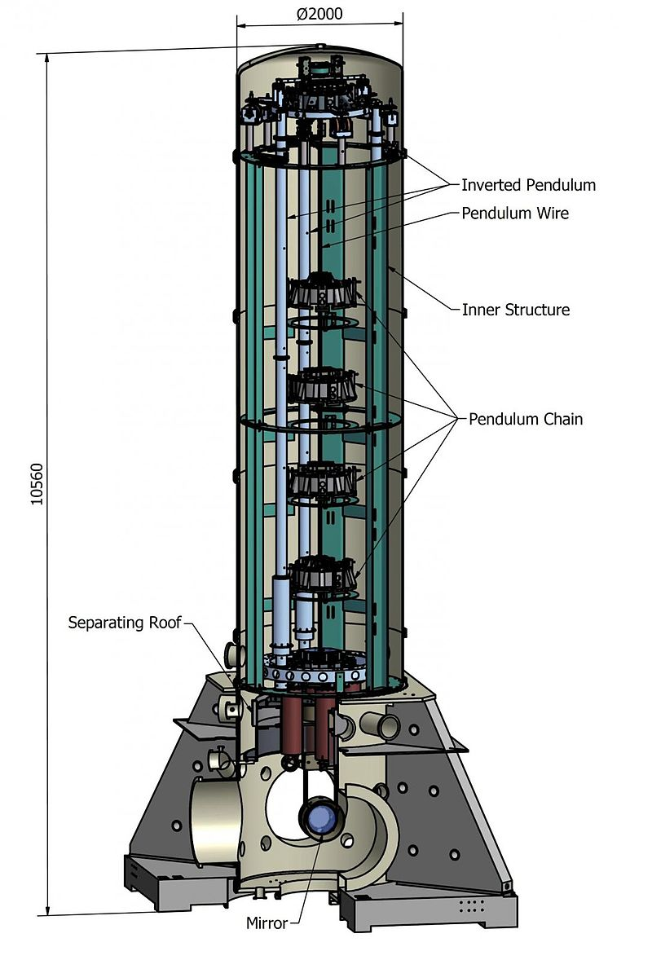
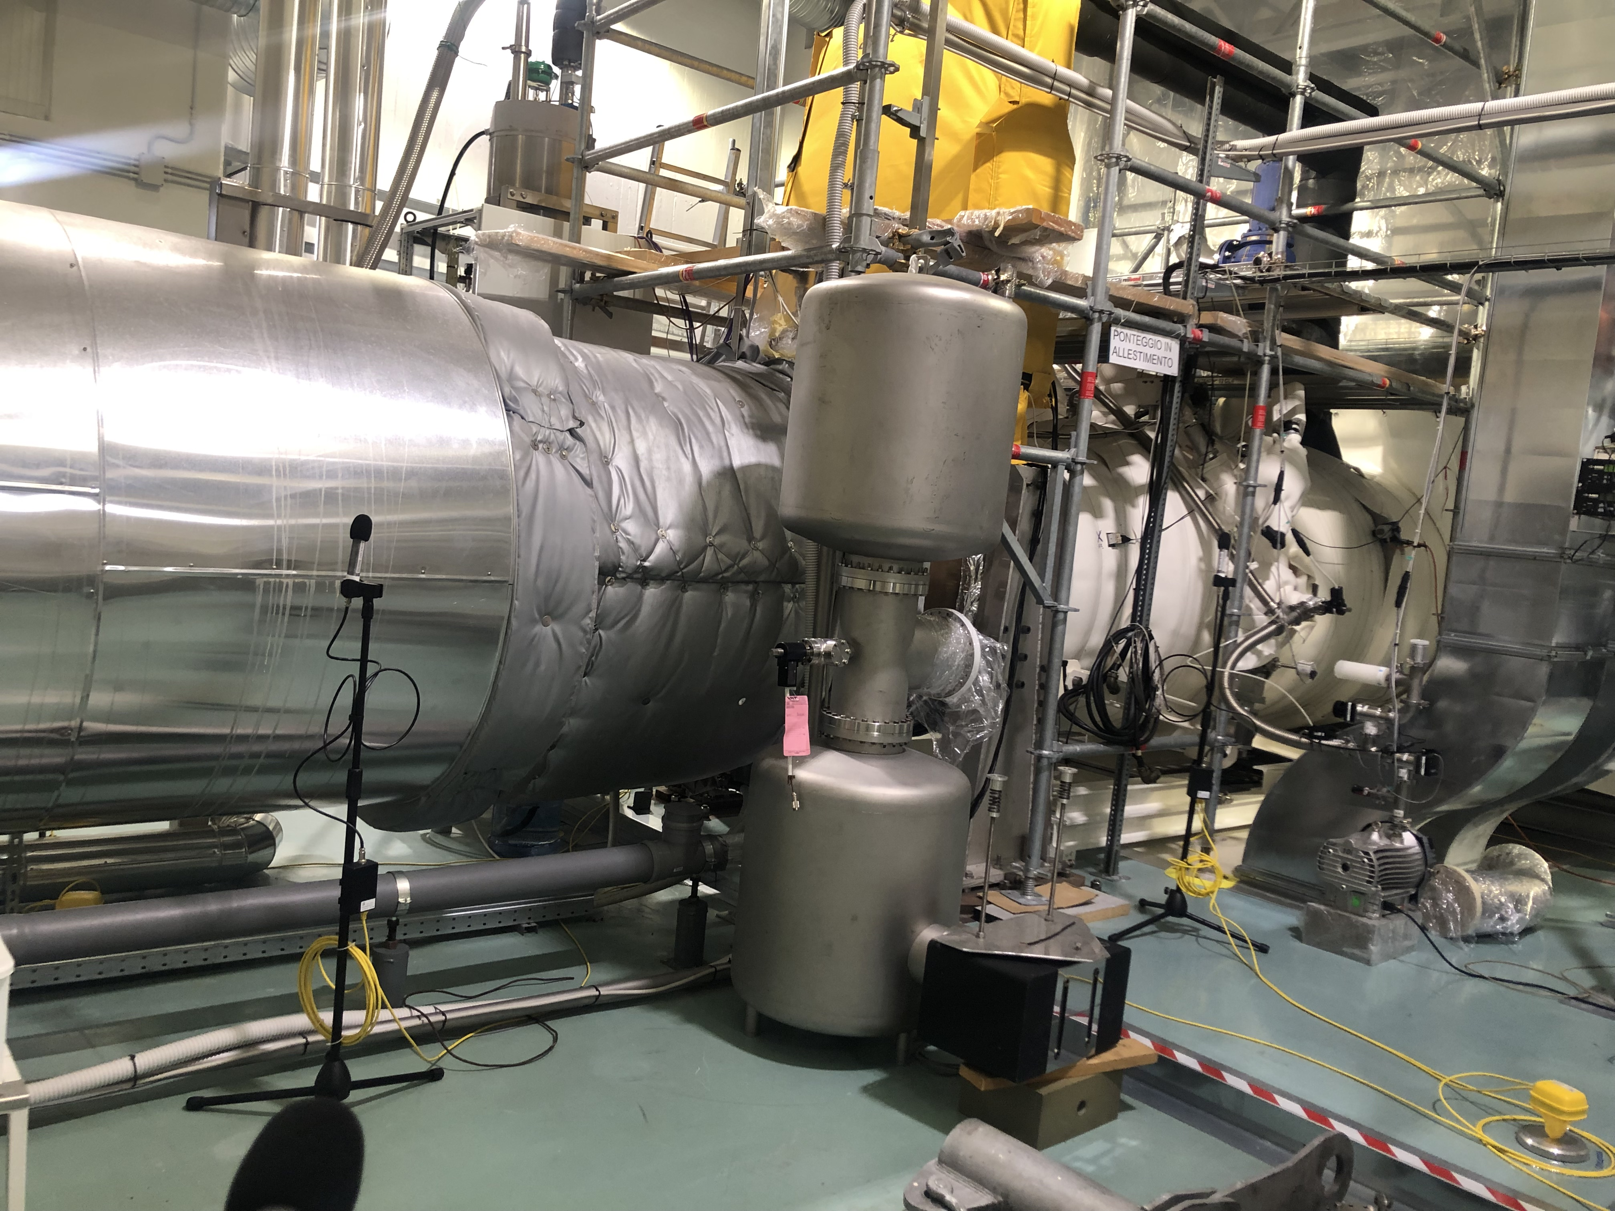
Seismic and acoustic isolation

Slide 7
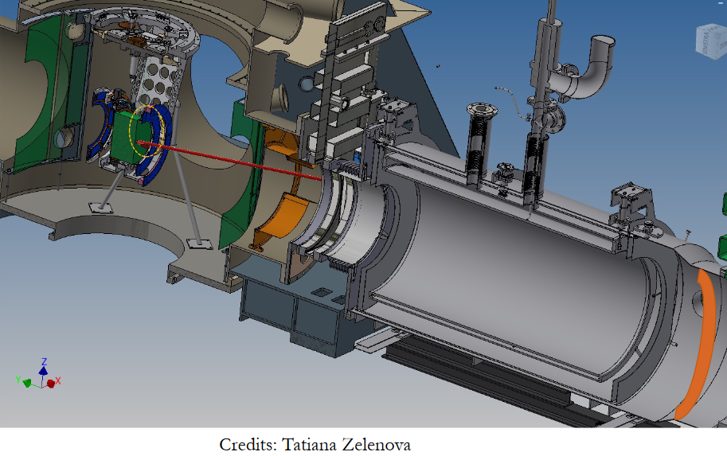
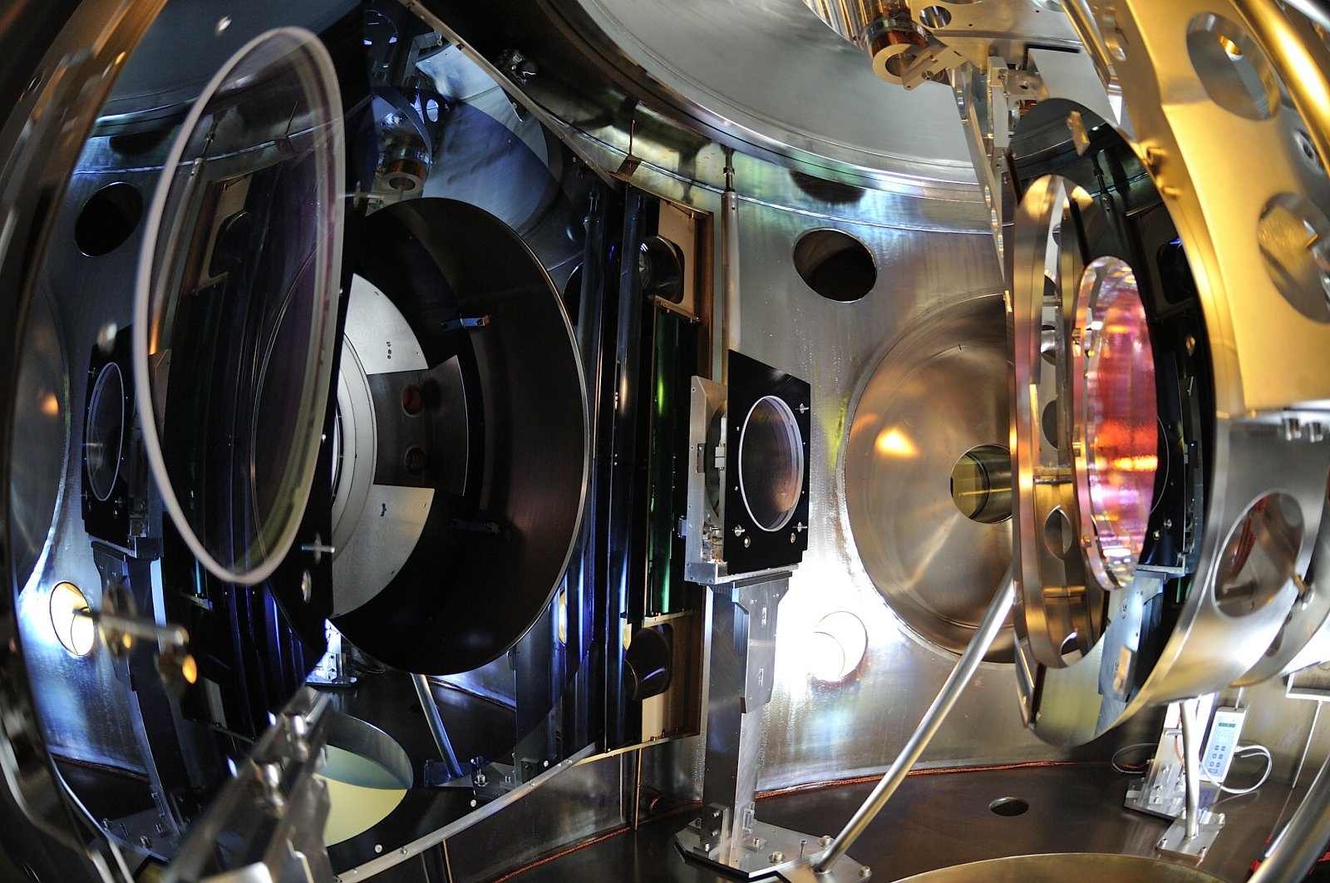
Various components may scatter the laser light in Virgo

Slide 8
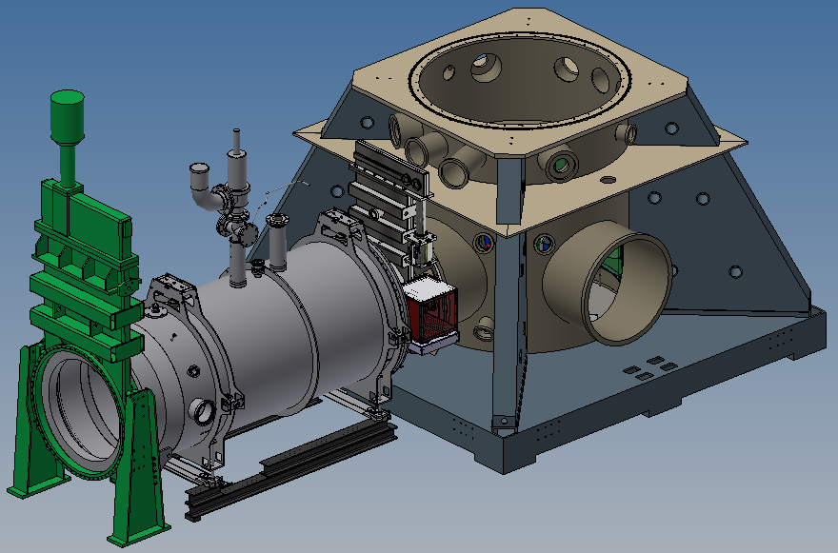
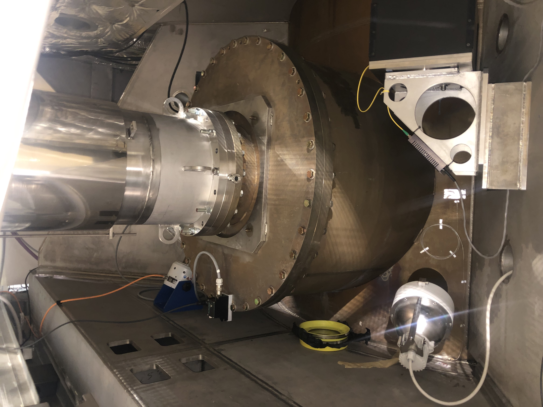
Tapping tests
Clamped small shaker
PC bench
Near cryo-baffle
metallic support of photon calibrator bench
Cryotrap holding points and metallic structure
CT accelerometer near Cryo-baffle

Slide 9
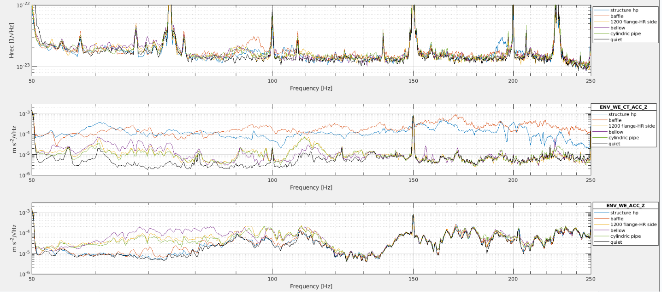
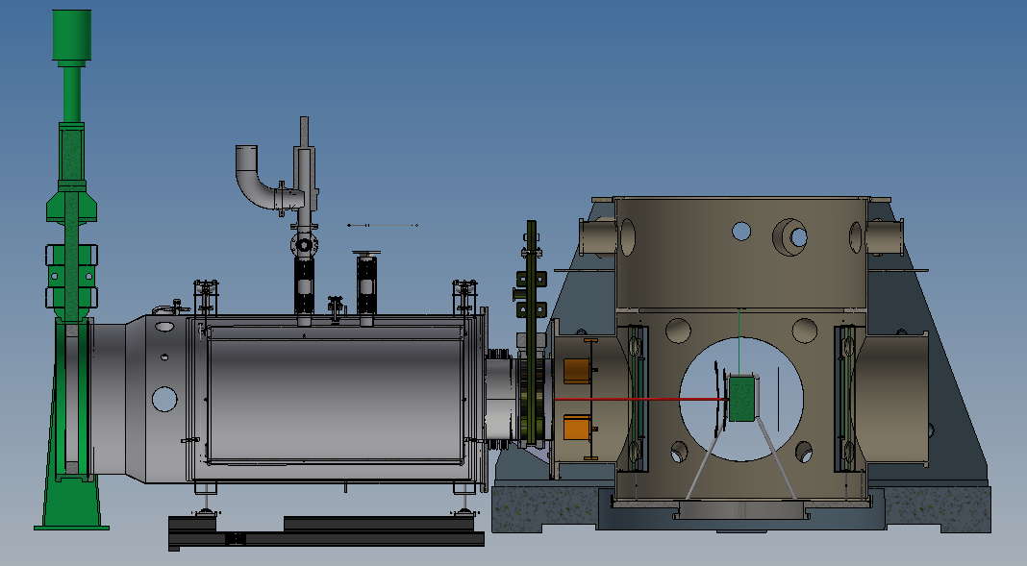
Tapping tests
Hrec
CT accelerometer
1200 flange AR side accelerometer
Cylindric vacuum pipe
1200 flange
1200 flange
Near bellow

Slide 10
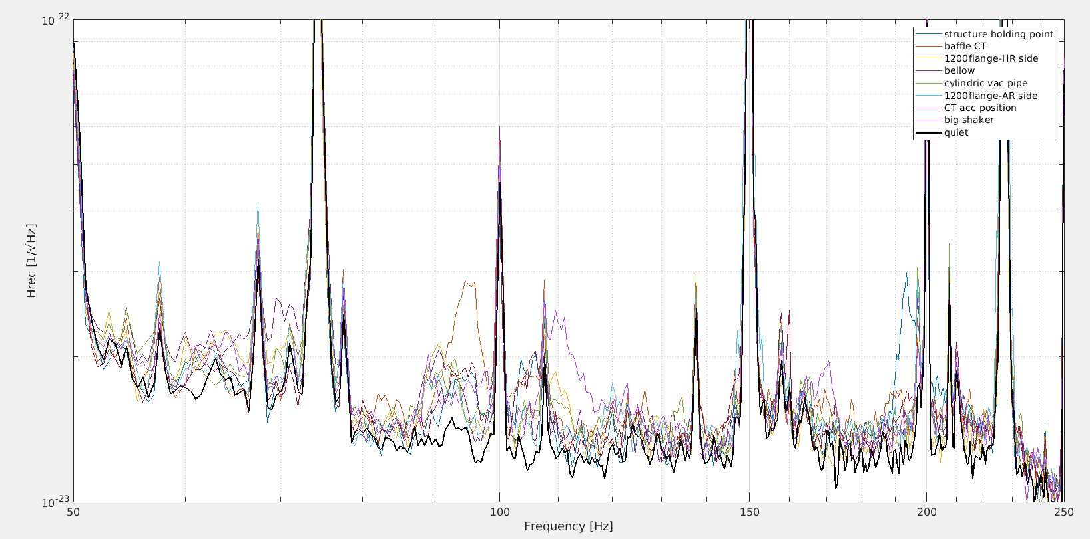
Tapping tests
Hrec spectrum
ENV_WE_CT_ACC_Z
ENV_WEB_MIC
Hrec

Slide 11
The big instrument to listen music
In 2003, we listened Vivaldi in the output light of Virgo…

