Slide 1
SPARC/FIFO status
2024-06-10
Ch. Flouzat
Notes:
1

Slide 2
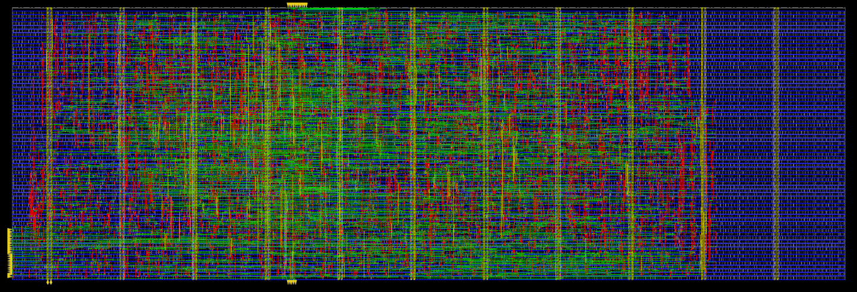
New version of the FIFO/Serializer
https://cernbox.cern.ch/files/spaces/eos/user/c/cflouzat/SPARC
size WxL=550x180
-------------------------------------------------------------------------------------------------------------------------------------------------------------------------------
| Snapshot | WNS (ns) | TNS (ns) | FEPS | WNS_R2R (ns) | TNS_R2R (ns) | FEPS_R2R | DRV(T) | DRV(C) | POWER(L) | UTIL | INSTS | AREA (um^2) | DRC | WALL (s) |
| | | | | | | | Tran (ns) | Load (pF) | Leakage (mW) | Density (%) | | | | |
|-------------+----------+----------+------+--------------+--------------+----------+-----------+-----------+--------------+-------------+-------+-------------+-----+----------|
| syn_generic | 0.890 | 0 | 0 | 0.890 | 0 | 0 | 0 | 0 | 0.02 | 0.00 | 10116 | 117241 | | 0:01:39 |
| syn_map | 0.025 | 0 | 0 | 0.025 | 0 | 0 | 0 | 0 | 0.01 | 0.00 | 2951 | 46312 | | 0:01:50 |
| syn_opt | 0.025 | 0 | 0 | 0.025 | 0 | 0 | 0 | 0 | 0.01 | 0.00 | 2944 | 46294 | | 0:01:38 |
| floorplan | | | | | | | | | | 47.50 | 2944 | 46294 | | 0:01:44 |
| prects | 0.212 | 0 | 0 | 0.212 | 0 | 0 | 0 | 0 | 0.01 | 47.69 | 3015 | 46477 | | 0:02:38 |
| cts | 0.263 | 0 | 0 | 0.263 | 0 | 0 | 0 | 0 | 0.01 | 50.29 | 4605 | 49020 | 0 | 0:04:00 |
| postcts | 0.262 | 0 | 0 | 0.262 | 0 | 0 | 0 | 0 | 0.01 | 50.65 | 4657 | 49368 | | 0:03:23 |
| route | 0.151 | 0 | 0 | 0.151 | 0 | 0 | 0 | 0 | 0.01 | 50.65 | 4654 | 49364 | 1 | 0:04:31 |
| postroute | 0.205 | 0 | 0 | 0.205 | 0 | 0 | 0 | 0 | 0.01 | 50.66 | 4657 | 49374 | 0 | 0:05:18 |
| signoff | -0.549 | -187 | 534 | 0.456 | 0 | 0 | | | | | | | | 0:04:34 |
| opt_signoff | 0.205 | 0 | 0 | 0.205 | 0 | 0 | 0 | 0 | 0.01 | 50.66 | 4657 | 49374 | 0 | 0:10:48 |
-------------------------------------------------------------------------------------------------------------------------------------------------------------------------------
2
Notes:
2

Slide 3
Management of the Reset of the FIFO
Problem:
1/ when in reset, the FIFO needs clock pulses on bot POP and PUSH access. Unfortunately, there is no push pulses (from pixel matrix) while in reset.
2/ Need several clock cycles to reset the FIFO
Proposal:
A finite state machine was designed to ensure 4 clock pulses when RN falls down.
RN
clk_pop
lclk_sel
lfifo_rst_no
lpush_en_no
GCLK_CELLs
clk_push
OR
NORMAL
WAIT
NORMAL
RESET_3
RESET_5
RESET_2
RESET_4
RESET_1
RESET_0
RN
clk_pop
lclk_sel
3
Notes:
3

