Slide 1
Status of the SPARC design
Jean SOUDIER
Designers: Jean Soudier, Christophe Flouzat
Reviewers: Frédéric Morel

Slide 2
Functional layout
Asynchronous
PADs (Data, Control, Bias, Power)
Design by IRFU
25µm
Biasing
Provided by CERN
Front-end
1
Front-end
3
Fixed priority arbiter
2
Front-end
4
Pixel
Fixed priority arbiter
1
Front-end
2
Front-end
31
Fixed priority arbiter
16
Front-end
32
16µm
…
32 pixels
1,5mm
Fixed priority arbiter (line)
32 pixels
TDC / counter
FIFO
SERIALIZER
SlowControl
100 Mbit/s
1,5mm

Slide 3
PADs count
Name | Type | Count (24) | Speed
FIFO_Data | Digital Output | 3 | 125MHz
FIFO_Clk | Digital Input | 1 | 125MHz
FIFO_Full | Digital Output | 1 | -
SC_Clk | Digital Input | 1 | 40MHz
SC_SCK | Digital Input | 1 | 4MHz
SC_MISO | Digital Output | 1 | 4MHz
SC_MOSI | Digital Input | 1 | 4MHz
SC_CSEL | Digital Input | 1 | -
TDC_Clk | Digital Input | 1 | 250MHz
TDC_out | Digital Output | 1 | 250MHz/32MHz
RN | Digital Input | 1 | -
MAT_RN | Digital Input | 1 | -
AB_Clk | Digital Output | 1 | 500MHz (won’t work)
PULSE_CMD | Digital Output | 1 | 100MHz
PIX_BIAS | Analog Input | 8 | -
Name | Type | Count (27) | Function
PWELL | Well | 1
DVDD | Power | 2 | Digital power
DVSS | Ground | 2 | Digital ground
AVDD | Power | 2 | Analog power
AVSS | Ground | 2 | Analog ground
SUB | Substrat | 1 | Substrat

Slide 4
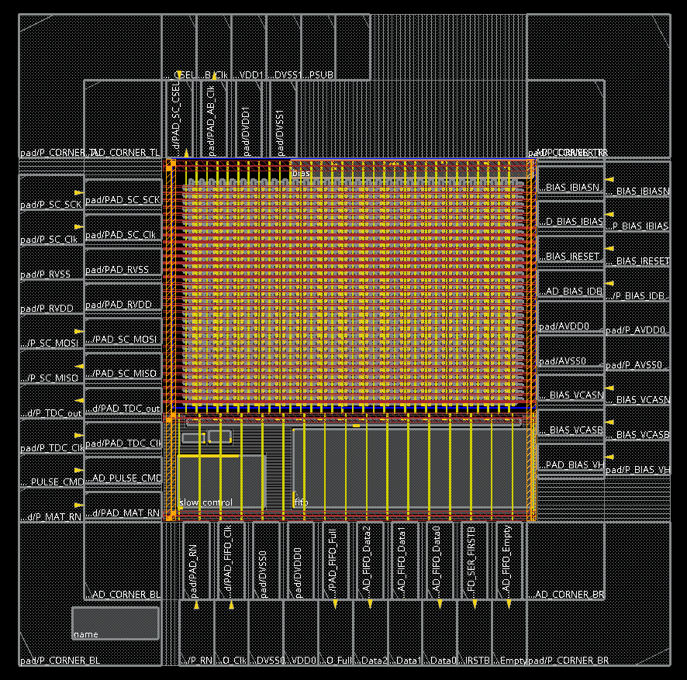
Integration
[M1 to M4] : FIFO, Slow control, Column, Pixel
[M1 to M3] : Digital In Pixel, Line, VCO, TDC
[M1 to M2] : Biasing
[ZA] : Name

Slide 5
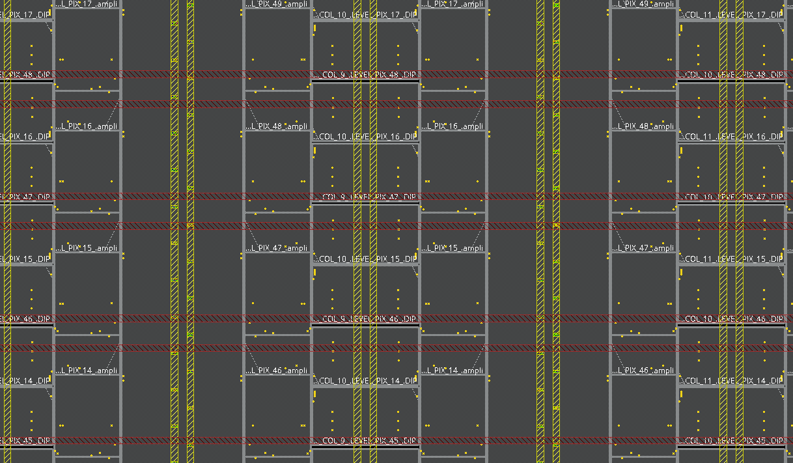
Integration
Row selection [M7]
RN, Col, Modes [M4]
Req, Ack [M1|3]

Slide 6
Circuit Communications
Slow Control over SPI (16bits => 4b CONTROL, 4b SELECTION, 8b DATA)
FIFO double entry asynchronous (24b x 64w)
3 Serializer of 8bits (24b/3)
TDC counter 13bits for timestamping

Slide 7
Slow control registers (SPI)
Address | Usage | Direction
0 - 7 | Column mask selection | W
8-9 | Row selection | W
10 | TDC, Digital pixel and FIFO tuning | W
11 | Matrix and VCO tuning | W
12 | Fifo information pop | R
13 | Fifo information push | R
14 | Test reg 0XF1 | R
15 | Test reg 0xE2 | R
Control (4b) | Address (4b) | Value (8b)
Control | Usage
2 | Set register
3 | Get register
4 | Reset
5 | Get SPI data
6 | Get ID 0xABCD

Slide 8
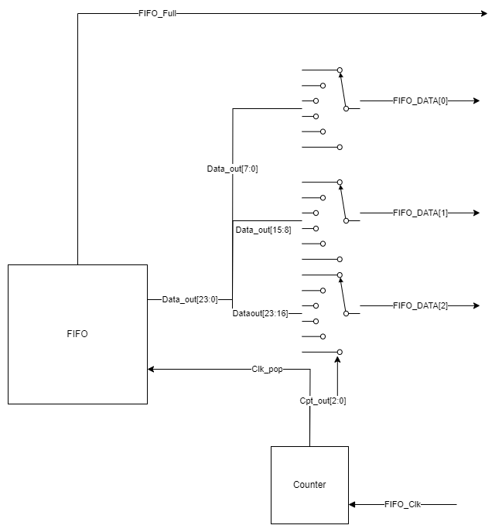
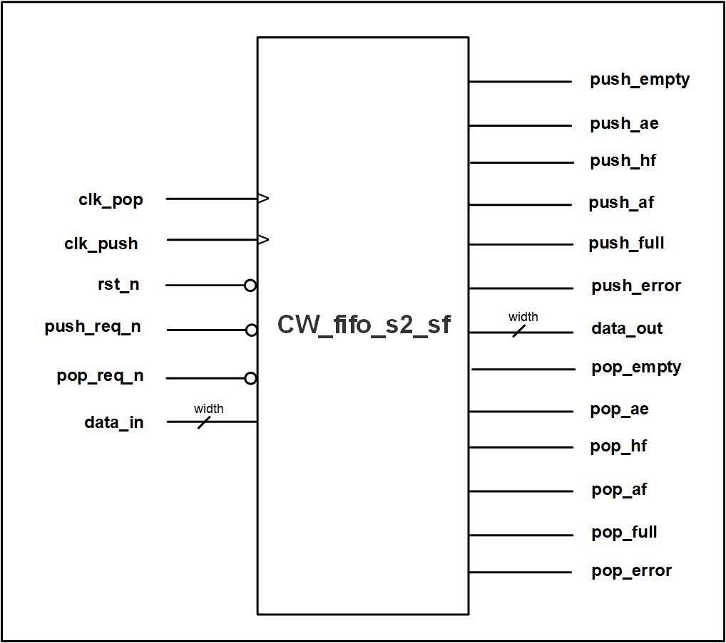
Schematic FIFO 24b x 128w
Fast OR | Pixels (1b) | Timestamp (Gray 13b) | Address (10b)
FIFO reset is at least 3 clock cycle with RN down

Slide 9
Status
Design | RTL/Schematic | Simulation | Layout | Post-Simulation | Designer
VCO | OK | OK | OK | To do (Isabelle) | Jean
Biasing | OK | - | In progress | To do (Isabelle) | Jean
Digital pixel | OK | OK | OK | OK | Jean
Analog Pixel (integration) | - | - | OK | To do (Andreï) | Jean
Columns | OK | OK | OK | OK | Jean
Line | OK | OK | OK | OK | Jean
FIFO & Serializer | OK | OK | OK | Hold + RN SM | Christophe
Slow Control | OK | OK | OK | OK | Jean
TDC | OK | OK | OK | OK | Jean
PAD | OK | OK | OK | OK | Jean
SPARC (Top) | OK | OK | Integration | LVS, DRC, IR_DROP, STA | Jean

Slide 10
Status
Design | RTL/Schematic
VCO | Post-simulation multi-corner, jitter
Biasing | Routing, Post-simulation
Digital pixel | OK
Analog Pixel (integration) | M7 via access, Post-simulation
Columns | Replace pins
Line | OK
FIFO & Serializer | Hold checks, RN SM, pin, stripes, shape
Slow Control | OK
TDC | OK
PAD | Separator, Replace
SPARC (Top) | Annoter RTL, floorplan, power routing, pre-routing, DRV, STA(glitch), LVS, DRC, IR Drop, Functionnal verifications, perfomances

Slide 11
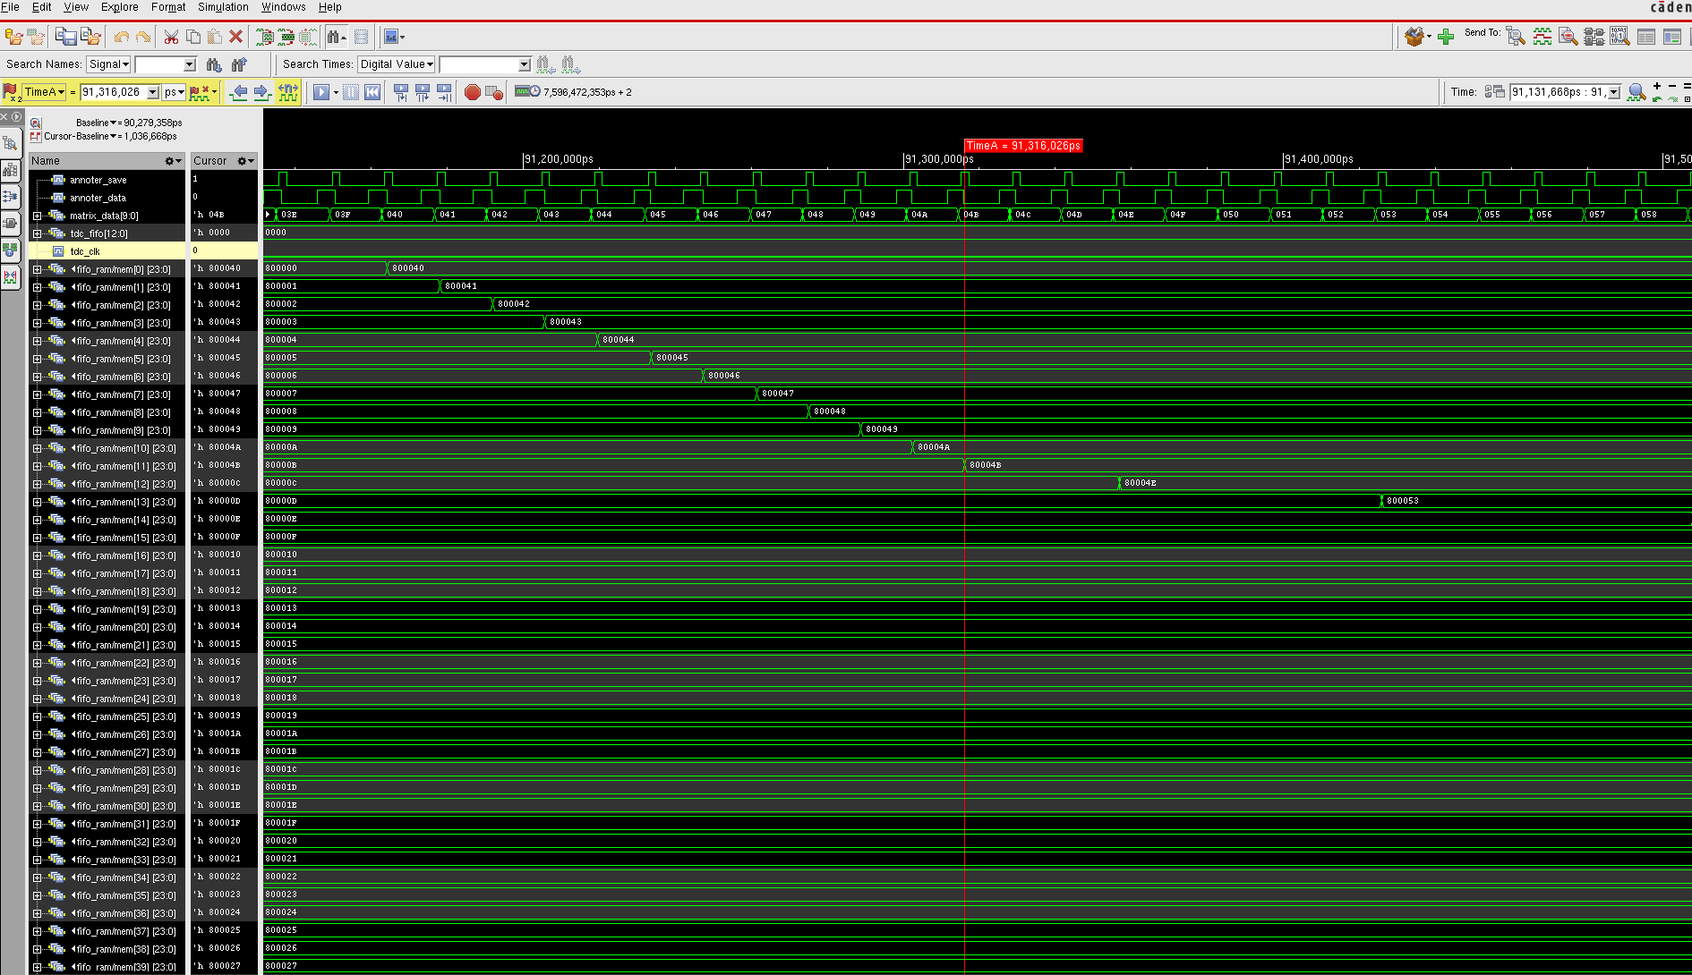
STA
Setup violations on TDC->FIFO & Sel_Reg
Setup violations on MAT->FIFO, Hold TDC

Slide 12
Calendar
S24: Finish FIFO + Biasing
S25-27: Holidays (mail)
S28: Finish integration
S29: STA/IR Drop
S30: LVS/DRC
S31: Functionnal

Slide 13
Tanks you for your attention

Slide 14
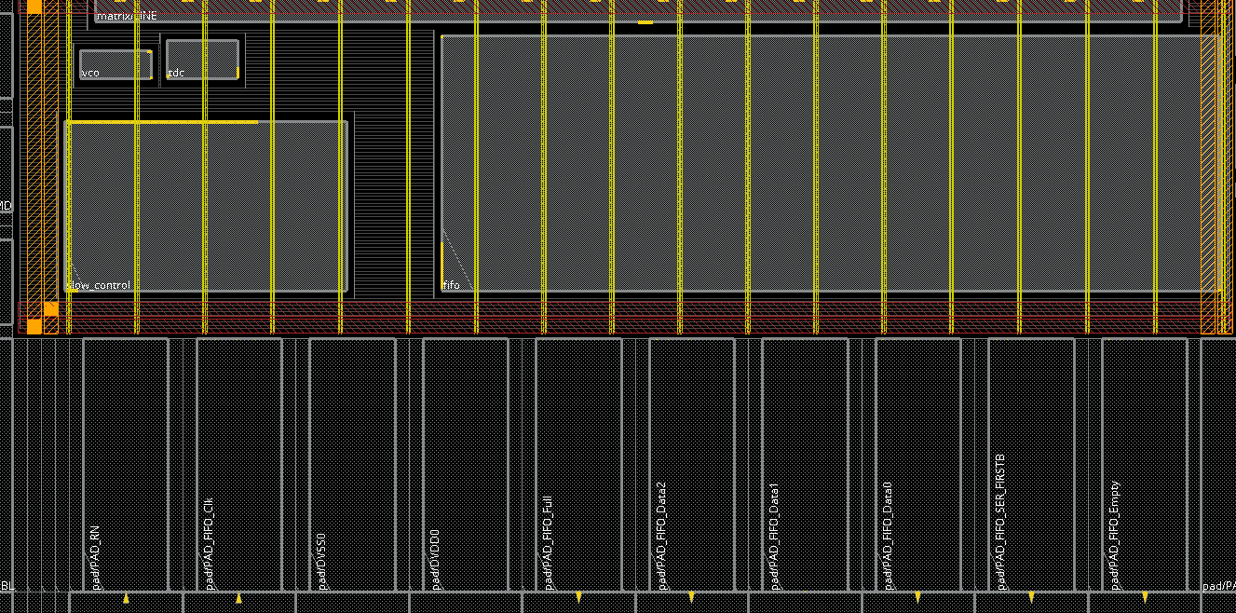
FIFO floorplan
Clk_push, DataIn [0:9]
Pop_*, push_*
DataIn [23:10]
PAD (RN, CLK_POP, push_full, DataOut[2:0], Fifo_clk_pop, push_empty)

