Slide 1
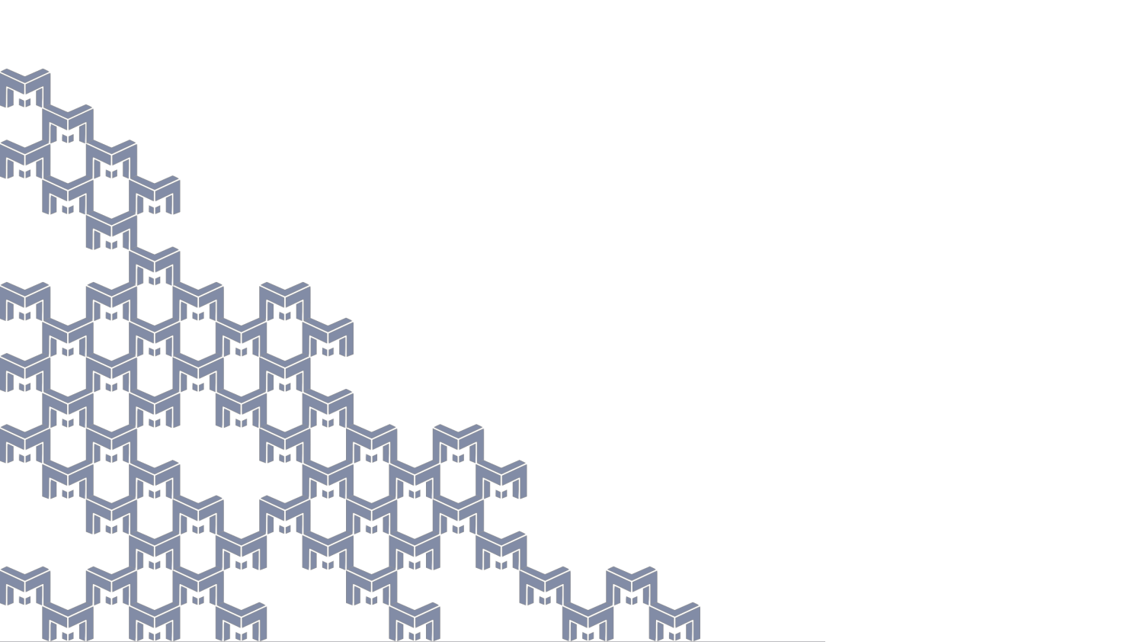



MUSES – an overview
The nuclear phase diagram puzzle
from neutron stars to heavy-ion collisions
IRL-NPA FRIB
November 1st, 2024
Dr. Johannes Jahan
University of Houston
Notes:
Hello everyone, I am […], working at […] as […], and it is a pleasure to give this talk today about the status of the MUSES project, on behalf of the MUSES collaboration.

Slide 2
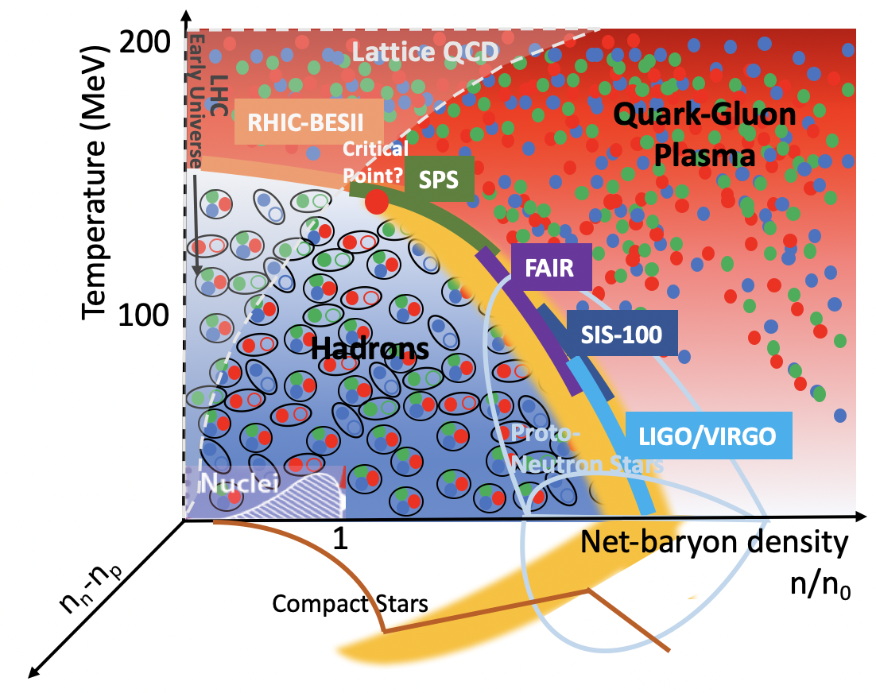
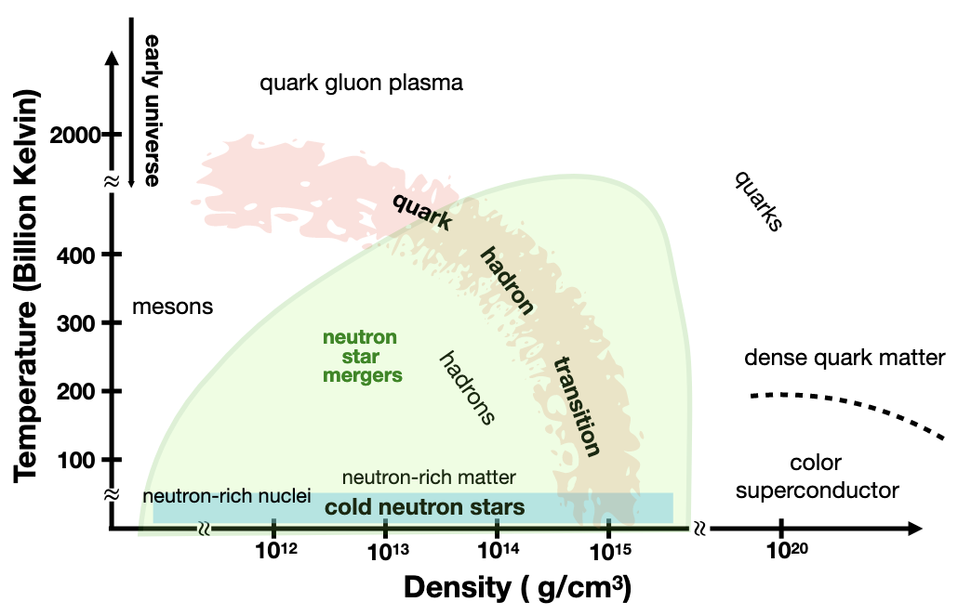
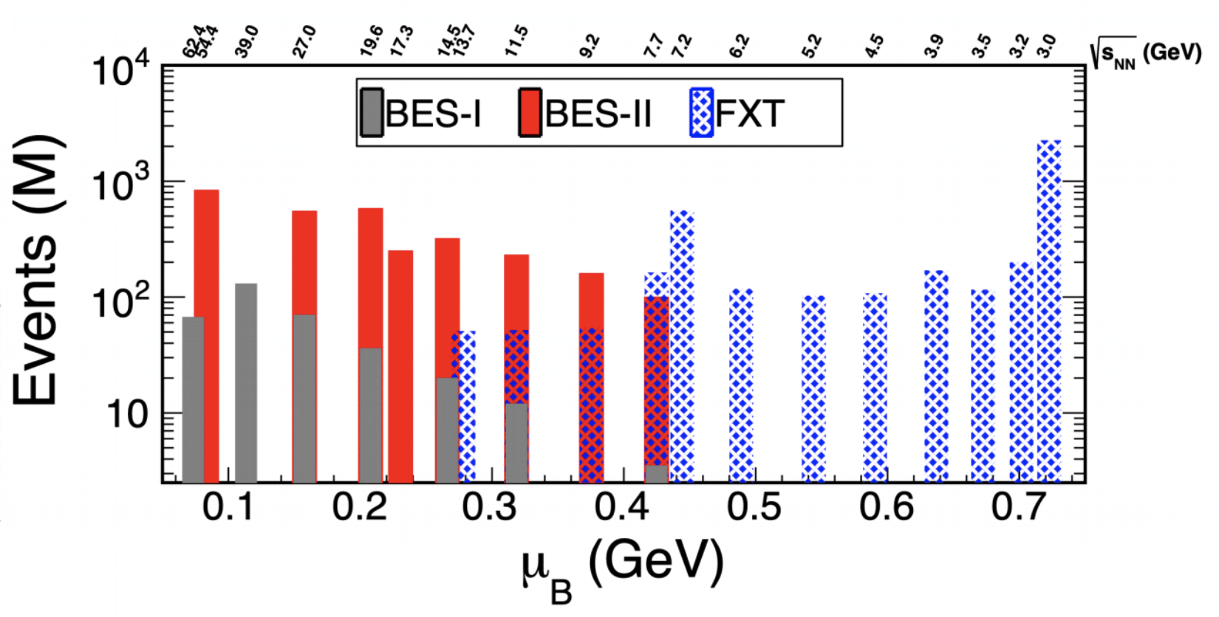

Motivating science goals
Run 2019:
  Collider: √s_{NN}=14.6, 19.6, 200 GeV
  Fixed target: √s_{NN}=3.2 GeV
Run 2020:
  Collider: √s_{NN}=9.2, 11.5 GeV
  Fixed target: √s_{NN}=3.5, 3.9, 4.5, 5.2, 6.2, 7.2, 7.7 GeV
Run 2021:
  Collider: √s_{NN}=7.7, 17.3 GeV
  Fixed target: √s_{NN}=3.0, 9.2, 11.5, 13.7 GeV
Where is the transition line at high density?
Is there a critical point in the QCD phase diagram?
What are the degrees of freedom in the vicinity of the phase transition?
"Normal" matter
What are the phases of QCD at high density?
How are heavy nuclei created and what is the site of the
r-process?
2
Notes:
Let's start with reminding some of the questions we are trying to answer when studying strongly interacting matter under extreme conditions [LIST QUESTIONS 1-3].
On the cartoon of the QCD phase diagram: compilation of experimental facilities and the regions of the phase diagram that they are supposed to explore.
Most imminent results from the RHIC BES-II (just finished its runs in 2021) ; soon, results covering these collision energies and chemical potentials will be published.
Exciting thing about this plot: there is also a corner (high density + low temperatures) where information from NS and mergers can help us to map out the phase diagram, and help us answering the following questions: [LIST QUESTIONS 4-5].

Slide 3
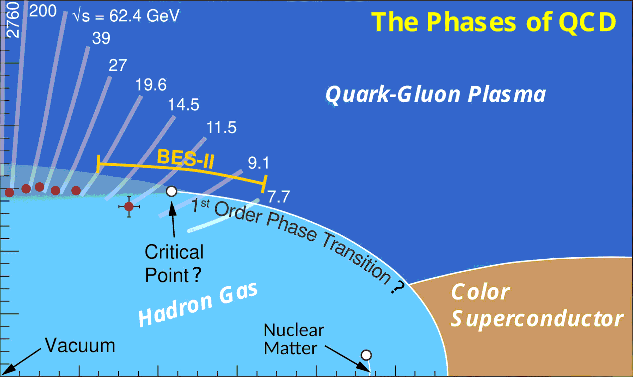
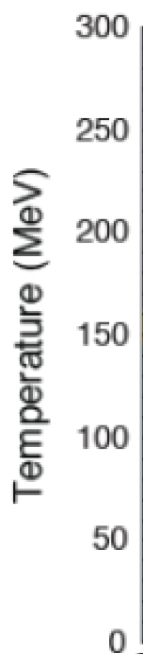


What happens at Finite densities?
Perturbative QCD
Lattice QCD
Holography
From 1st principles calculation, lattice QCD
only allows to compute thermodynamics at μ_{B} = 0 (matter/antimatter=1).
Deconfined quarks
Expansion methods can be used, but still restricted to low density regions
We need to merge the lattice QCD EoS with other effective theories
Careful study of their respective range of validity
Quarkyonic
Matter?
Chiral EFT
Color
Superconductor?
Liquid-Gas, Nuclei
Could we try to merge them
together to ensure full coverage
of the phase diagram ?
Lattice QCD: S. Borsanyi, C. R. et al, PRL (2021)
pQCD: Andersen et al., PRD (2002); Annala et al., Nat. Ph. (2020)
Interacting HRG: V. Vovchenko et al., PRL (2017)
Quarks: Ratti et al., PRD (2006), Dexheimer et al., PRC (2009);
Baym et al., Astr. J. (2019)
Liquid-gas, Nuclei: see e.g. Du et al. PRC (2019)
Chiral EFT: see e.g. Holt, Kaiser, PRD (2017)
Quarkyonic: McLerran et al. (2007), Vovchenko et al. (2023)
Holography: R. Critelli, C. R. et al., PRD (2017)
CSC: Alford et al., PLB (1998); Rapp et al., PRL (1998);
S. Rossner, C. R. et al, PRD (2007).
7
Notes:
Let's go back on the phase diagram, and discuss how it can be described theoretically. We know that lattice QCD simulations, based on 1st principles QCD calculations, can only be achieved at 0 chemical potentials and then be extrapolated to cover the low-density region of the phase diagram. But what do we do about the rest..? -> We need to resort to effective theories or models.
At low T / intermediate densities:
- DOFs should be interacting hadrons
- we know there is a liquid-gas phase transition
- chiral effective field theory is the low-energy theory of QCD
In the deconfined phase at intermediate T / finite density:
- holographic approaches describe the strongly coupled QGP
At very large T and mu_B:
- we recover pQCD
In the very dense and hot area:
- models with deconfined quarks + more exotic phases such as quarkyonic matter / color superconductivity.
There is hence a lot of knowledge that goes into all the different phases of matter on this phase diagram, and one can think of putting them all together to achieve full coverage of the phase diagram.

Slide 4
MUSES – Modular Unified solver of the Equation of state
“An open-source cyberinfrastructure fostering a community-driven ecosystem that provides key computational tools to promote, transform and support groundbreaking research in nuclear physics and astrophysics, computational relativistic fluid dynamics, gravitational-wave and computational astrophysics.”
Modular: while at low densities the equation of state is known from 1st principles, at high μ_{B} we will implement different models (“modules”) that the user will be able to pick
Unified: the different modules will be smoothly merged together to ensure maximal coverage of the phase diagram, while respecting established limiting cases (lattice, perturbative QCD, Chiral EFT…)
4
Notes:
This is how MUSES was envisioned.
MUSES stands for Modular Unified Solver of the Equation of State and it will deliver an open-source cyberinfrastructure [...].
Modular means that, especially at large chemical potentials, we will implement different choices for the equation of state, or modules, that the user will be able to choose.
Unified means that the different modules will be provided with tools to smoothly merge together different EoS to ensure maximal coverage of the phase diagram.

Slide 5
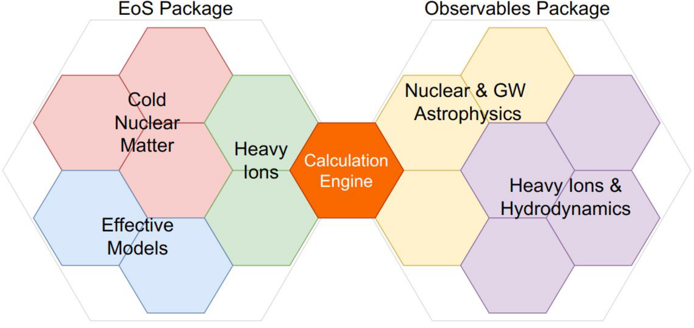
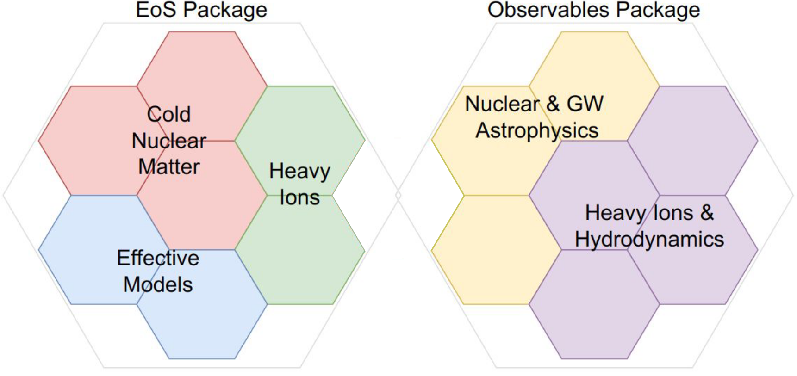
MUSES goals and milestones
CyberInfrastructure of interoperating tools and services within a replicable and flexible deployment system
  Upgrade of existing calculation tools to modern programming languages
  Equation of State (EoS) package that combines all the EoS modules using smooth transition functions
  Observables & toolkit package to compute observables and provide tools to facilitate comparison with experiments
  Web-based tools and services that provide interactive interfaces to the calculation engine
  Job management system and a deployment system that can be reproduced in other computing environments
Equations of state
Observables & Toolkit
5
Notes:
The goals and milestones of MUSES are to develop a cyberinfrastructure of interoperating tools and services with a replicable and flexible deployment system.
We will:
- upgrade existing calculation tools to modern programming languages
- develop the EoS package that can combine different EoS modules that you can see here (as well as using smooth transition functions between them to maximize the coverage oh the phase diagram)
- develop an observable & tools package, that will provide some tools (interpolation, EoS inversion) and ways to compute useful observables for the users from heavy-ion and astrophysics communities
- develop web-based tools and services for the users, that provide interactive interfaces to the calculation engine
- introduce a job management system that executes the calculations requested by the users, using the best available processing system, and a deployment system that can be downloaded and run locally (Docker)

Slide 6

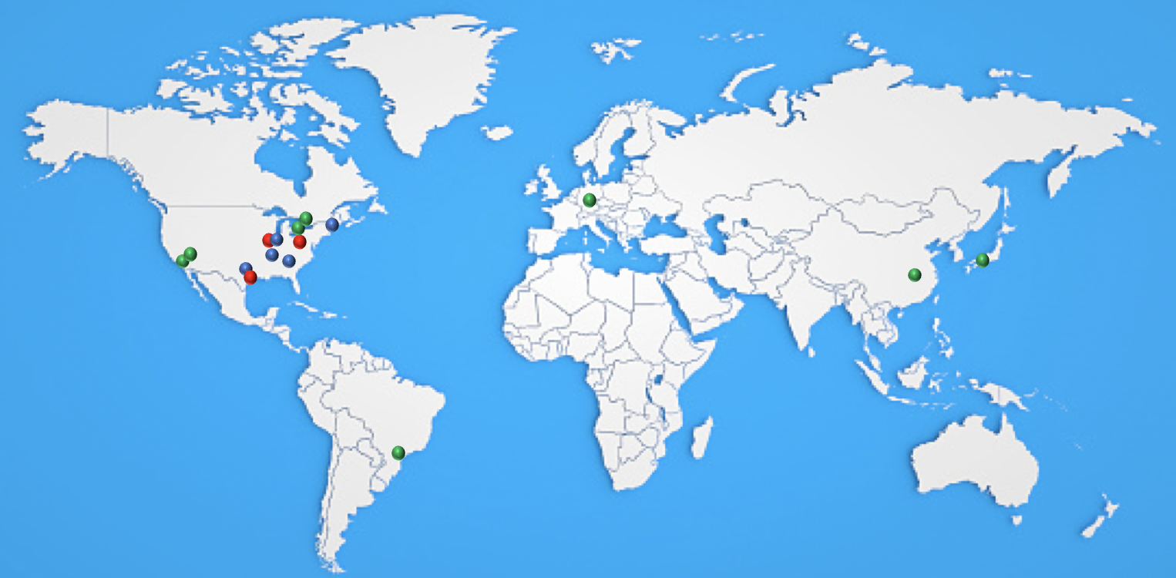
This is the list that appeared in the proposal, BUT:
1st MUSES collaboration paper was signed by 58 authors
→ We are growing!
participants
PI and co-PIs
Nicolas Yunes; University of Illinois at Urbana-Champaign; PI
Jacquelyn Noronha-Hostler; University of Illinois at Urbana-Champaign; co-PI
Jorge Noronha; University of Illinois at Urbana-Champaign; co-PI
Claudia Ratti; University of Houston; co-PI and spokesperson
Veronica Dexheimer; Kent State University; co-PI
Senior investigators
Roland Haas; National Center for Supercomputing Applications
Timothy Andrew Manning; National Center for Supercomputing Applications
Andrew Steiner; University of Tennessee, Knoxville
Jeremy Holt; Texas A&M University
Gordon Baym; University of Illinois at Urbana-Champaign
Mark Alford; Washington University in Saint Louis
Elias Most; Princeton University
External collaborators
Helvi Witek; University of Illinois at Urbana-Champaign
Stuart Shapiro; University of Illinois at Urbana-Champaign
Katerina Chatziioannou; California Institute of Technology
Phillip Landry; California State University Fullerton
Reed Essick; Perimeter Institute
Rene Bellwied; University of Houston
David Curtin; University of Toronto
Michael Strickland; Kent State University
Matthew Luzum; University of Sao Paulo
Hajime Togashi; Kyushu University
Toru Kojo; Central China Normal University
Hannah Elfner; GSI/Goethe University Frankfurt
6

Slide 7
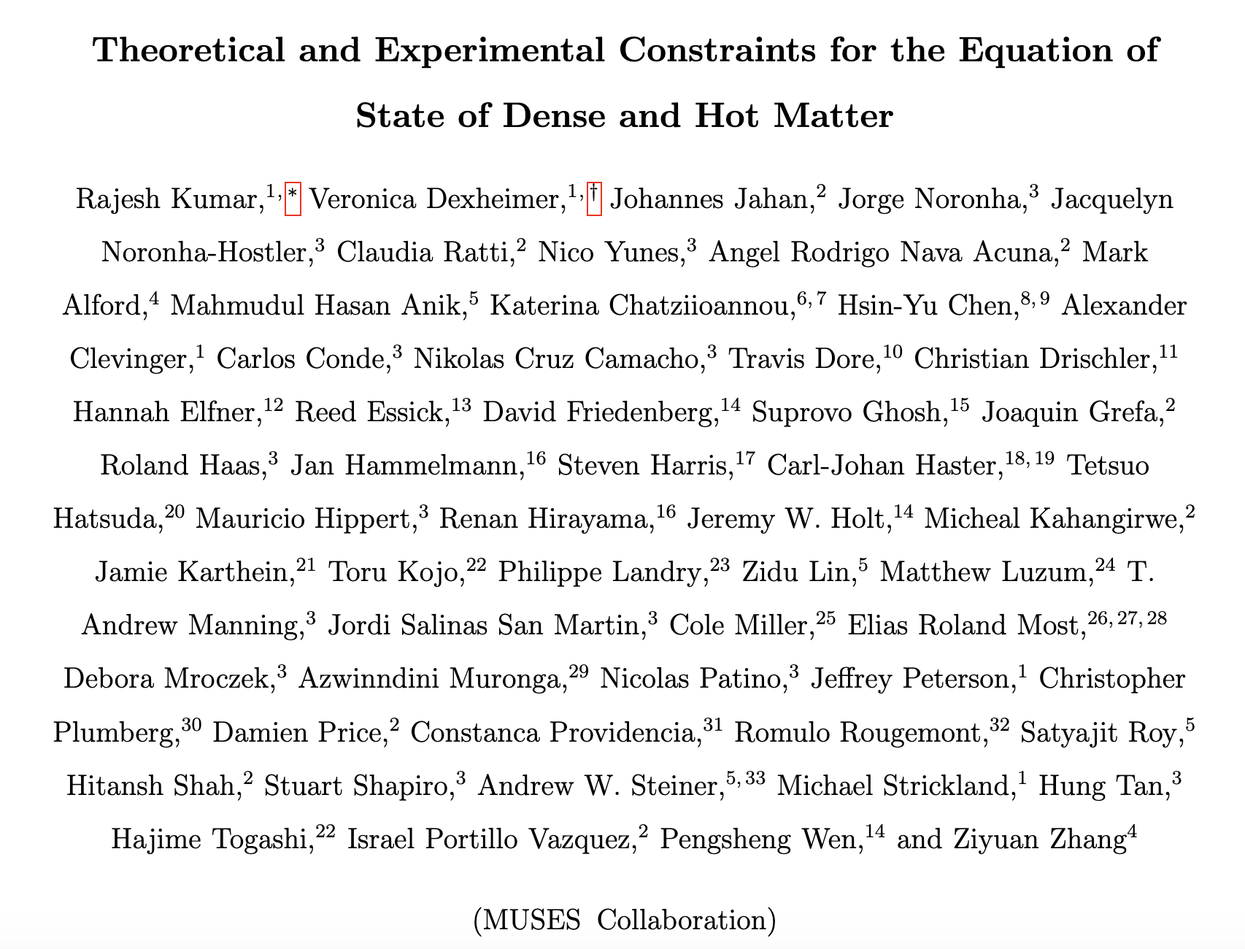
First muses-wide publication
Published in
Living Reviews in Relativity
Living Rev.Rel. 27 (2024)
(arXiv:2303.17021)
7
Notes:
Our first collaboration-wide publication, released in March 2023, was an attempt to review all theoretical and experimental constraints for the nuclear EoS at finite T and mus.

Slide 8
Public release: Nov. 2024
DETAILS
1st set of modules will be released very soon (just a few more weeks to wait...)
They will be publicly available & open-source
We invite people to test these modules and give us feedback!
The modules to be released will be marked by during this talk
RELEASE
8
Notes:
In the case of Neutron Stars and their mergers, studying such systems usually requires to consider... [DETAILS].
Hence, we need in that case to provide to the community... [NEEDS].

Slide 9
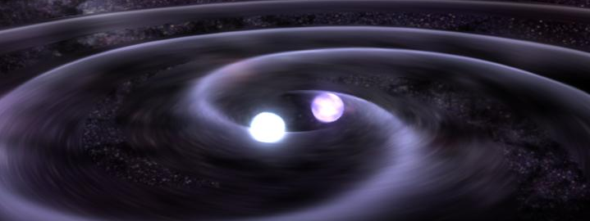
Eos for Neutron stars
Insert : https://www.google.com/search?sxsrf=APwXEddfRz9MFIWVWU43LOd-2tDCpNGJ3Q:1687448488980&q=neutron+star+binary+merger&tbm=isch&sa=X&ved=2ahUKEwjcmYy-m9f_AhUGKewKHXl_BZQQ0pQJegQIDRAB&biw=1396&bih=656&dpr=1.38#imgrc=IoFiVyC5VPI1nM
NASA Scientific Visualization Studio
9
Notes:
Going to higher densities, the neutron star Equation of State working group will include several models for the high-density, low-temperature region of the phase diagram.

Slide 10
Neutron stars & mergers: details
and needs
DETAILS
Long lifetime
Weak interaction must be considered
Flavor is driven out of equilibrium temporarily (mergers)
Electrically neutral for stability
<ρ_{Q}>=0
NEEDS
Standard EoS: (p, s, ε, ρ_{B}, c_{s}², μ_{i}, Y_{i})
T=0 EoS for mergers and neutron stars
Finite-T EoS for mergers
Lepton EoS
Flavor equilibration tied to microscopic EOS models
10
Notes:
In the case of Neutron Stars and their mergers, studying such systems usually requires to consider... [DETAILS].
Hence, we need in that case to provide to the community... [NEEDS].

Slide 11
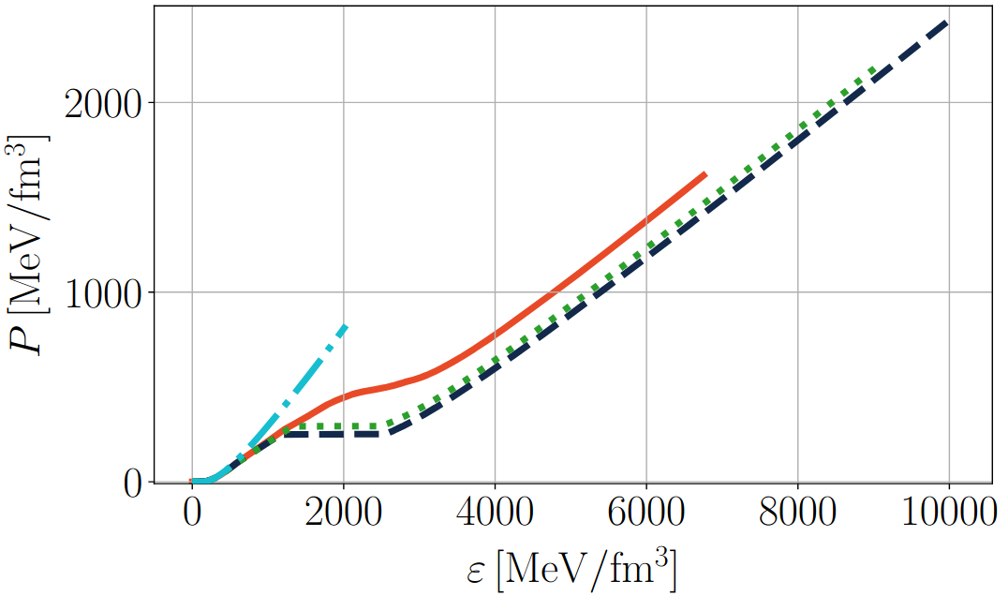
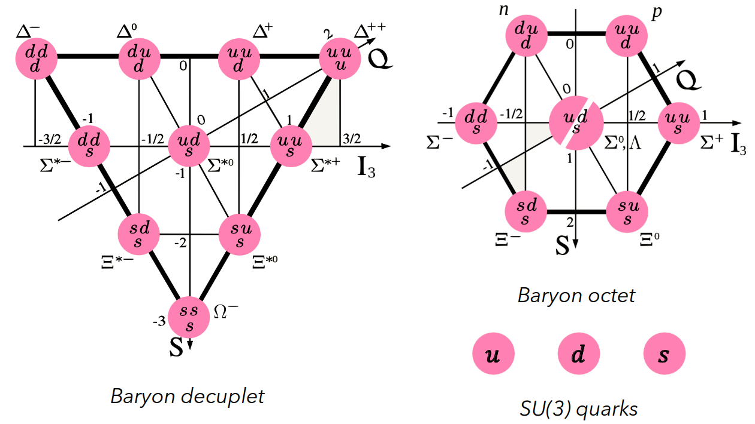
Multi-phase Equation of state for neutron stars
Dexheimer's group
Range: T ~ 0 MeV ; μ_{B} < 1600 MeV / n_{B} < ~10n_{s}
Chiral Mean Field (CMF) model
  Crossover at low density and first-order phase transition at high density
  Based on non-linear sigma model with the addition of deconfined quarks
  and different parametrizations of vector meson self-interaction term
  Reproduces nuclear & astrophysics constraints, and matches pQCD in relevant regimes
V. Dexheimer, S. Schramm, PRC 81 (2009)
N. Cruz-Camacho, V. Dexheimer et al., arXiv:2409.06837
RELEASE
Outlooks:
Add finite-T extension (T < 160 MeV)
Add magnetic field
Thermal meson interactions
Study sensitivity of parameters
11
Notes:
Here are summarised all the different EoS that will be included to describe the region of the phase diagram relevant for NS and mergers study:
- Chiral Mean Field (CMF) model, which features a crossover at low density and a first-order phase transition at high density
Based on the non-linear sigma model with addition of deconfined quarks, it reproduces several astrophysical constraints it matches pQCD in relevant regime
- Another model including both hadronic and quark DOFs is the so-called QHC19 model (G. Baym et al.)
It includes a hadronic phase which describes non-uniform and uniform matter + beta-equilibrium, and a quark matter phase based on NJL model with vector interaction
-> Will be integrated after optimisation too, but only for the NJL part (deconfined quarks) at first

Slide 12
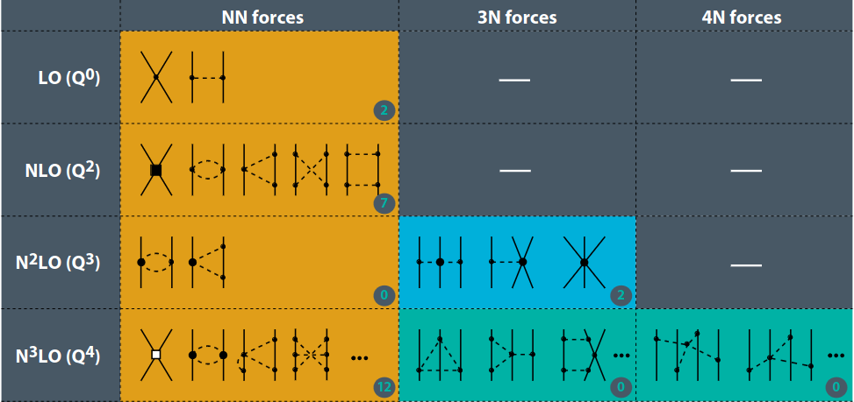
Hadronic Equations of state for neutron stars
Holt's group
Range: T ~ 0 MeV ; n_{B} < ~2n_{s}
Chiral effective field theory (ChiEFT)
  Interacting nucleons and pions within chiral effective field theory
  Fitted to nucleon scattering data and boundstate potentials
  Can compute both symmetric and asymmetric EoS: 0 < Y_{p} < 0.5
J. Holt & N. Kaiser, PRC (2017)
RELEASE
Outlooks:
Add extension at finite-T (up to 30 MeV)
Include a wider variety of
ChiEFT potentials
Provide uncertainty quantification
12
Notes:
We also have 2 purely hadronic models:
- UTK, developed by Andrew Steiner et al., contains nucleonic degrees of freedom.
- ChiEFT, developed by Jeremy Holt et al., contains interacting nucleons and pions within chiral EFT.
So, the users will be able to choose which equation of state to implement, in which range of T and mu and our calculational engine will spit it out.

Slide 13
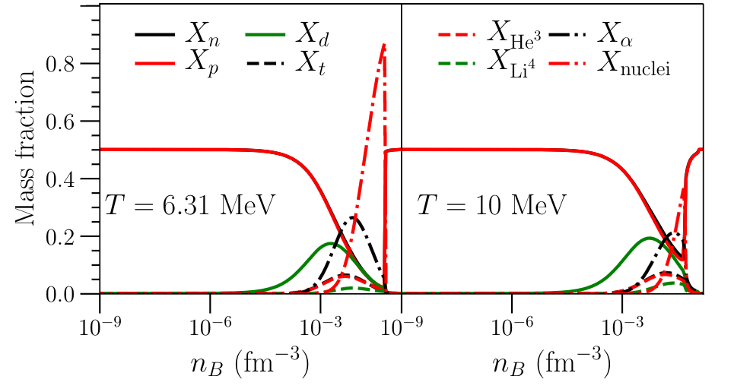
Hadronic Equations of state for neutron stars
Steiner's group
Range: T ~ 0 MeV ; 10⁻¹² < n_{B} < 2 fm³
University of Tennessee in Knoxville (UTK) EoS
  Includes nucleonic degrees of freedom based on a phenomenological fit of free energy density to
    nuclear experiments
    astronomical observations
    + guided by many-body theory calculations
  Defined for both symmetric and asymmetric matter
  for 0.01 < Y_{p} < 0.5
RELEASE
Y_{e} = 0.5
X. Du, A. Steiner, J. Holt, PRC (2019)
X. Du, A. Steiner, J Holt, PRC 110 (2022)
Outlooks:
Addition of finite T equations of state
Extension to strangeness degrees of freedom
Machine learned emulator
13
Notes:
We also have 2 purely hadronic models:
- UTK, developed by Andrew Steiner et al., contains nucleonic degrees of freedom.
- ChiEFT, developed by Jeremy Holt et al., contains interacting nucleons and pions within chiral EFT.
So, the users will be able to choose which equation of state to implement, in which range of T and mu and our calculational engine will spit it out.

Slide 14
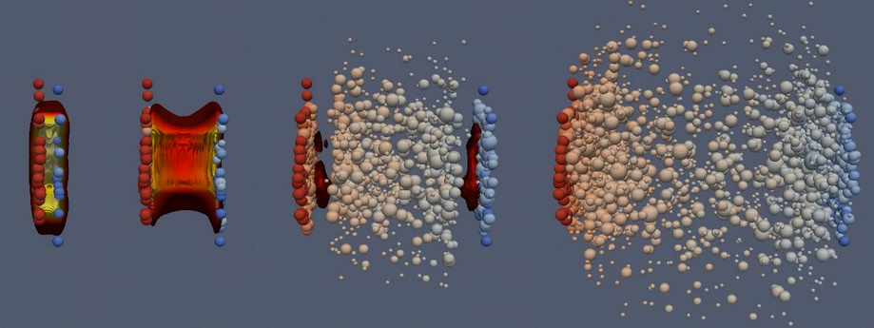
MADAI collaboration
Eos for Heavy ions
14
Notes:
Given this premise, let me now introduce the working groups and tell you what each one of them will be producing.
We start from the heavy-ion working group, which covers the small-to-intermediate region of the phase diagram.

Slide 15
Heavy ion collisions: details
and needs
DETAILS
System is described in terms of hydrodynamic simulations
and/or microscopic transport
System is not in finite-sized, short lifetime
Strangeness neutrality <n_{S}>=0
+ locally conserved
Charge: p vs. n in ions <n_{Q}>=0.4<n_{B}>
NEEDS
To take into account local fluctuations,
4D Equations of State are needed
Free parameters: T, μ_{B}, μ_{S}, μ_{Q}
Thermodynamic variables (p, s, ε, n_{B}, c_{s}²)
1st and 2nd order derivatives of pressure with respect to chemical potentials
Inclusion of critical point
Transport coefficients
Notes:
From the experiments, we know that we have the following constraints... [DETAILS].
Hence, we need to provide to the community... [NEEDS].

Slide 16
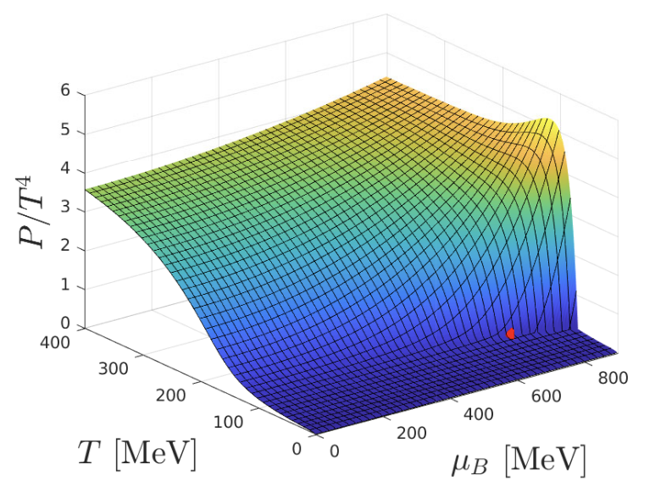
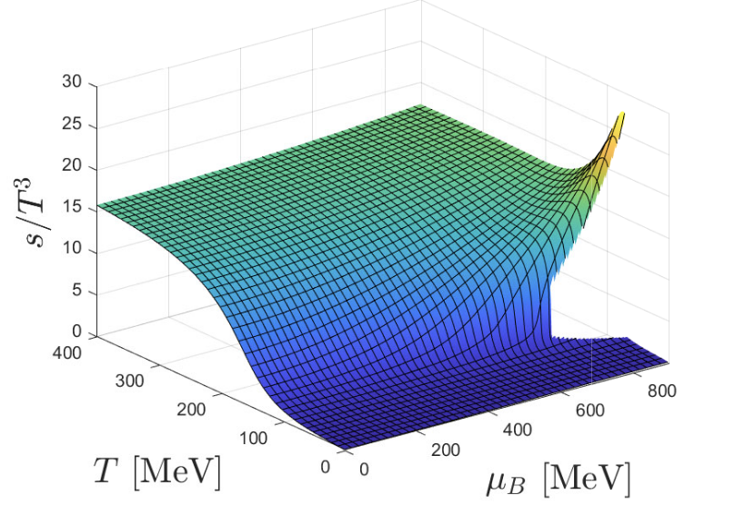
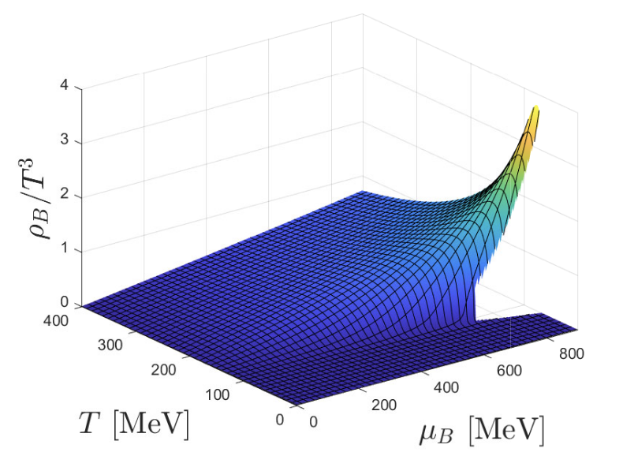
Equation of state from holography
Noronha/Ratti’s groups
Range: 30 MeV < T < 400 MeV ; μ_{B} < 1100 MeV
RELEASE
Use gauge/gravity correspondence to obtain QCD thermodynamics from an Einstein-Maxell-Dilaton Holographic model
Fix the parameters to reproduce everything we know from the lattice
Calculate equation of state at finite density, but only for finite μ_{B}
Currently includes a critical point (T^{CEP} = ~100 MeV ; μ_{B}^{CEP} = ~600 MeV)
Outlooks:
Extension to multiple conserved charges
J. Grefa, C. Ratti et al., PRD (2021)
J. Grefa, C. Ratti et al. subm. To PRD (2023)
16
Notes:
Finally, another module which bridges the gap between HI and merger regimes is the EoS obtained from holography.
This is based on an Einstein-Maxwell Dilaton Holographic model that reproduces lattice QCD results and transport properties of the QGP. Currently, the model only has 1 conserved charge (B), and predicts a CP at T=89 MeV / muB=723 MeV
The next goal is to include > 1 conserved charge in this model.

Slide 17
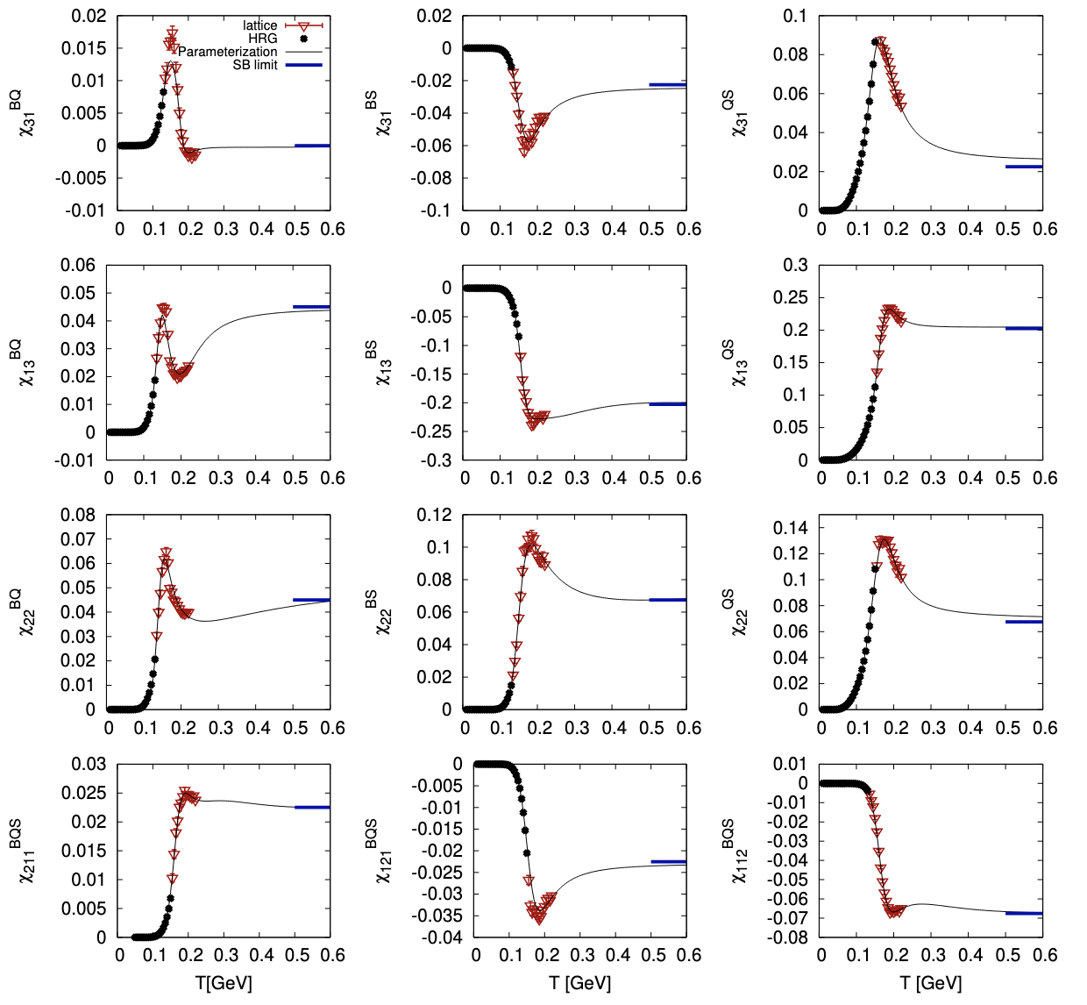
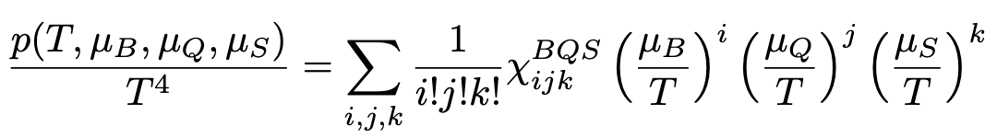
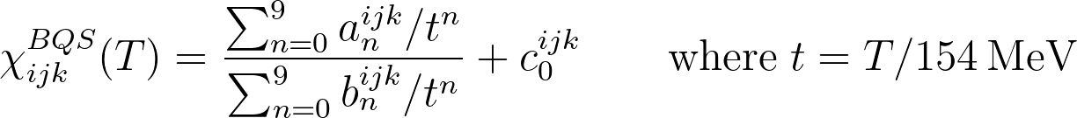
Ratti’s group
4D Equation of state from l-QCD (BQS-EoS)
RELEASE
Range: 30 MeV < T < 600 MeV ; μ_{B/Q/S} < 450 MeV
Full Taylor expansion needed to study different μ_{B/Q/S} scenarios
Parametrized susceptibilities fitted on lattice QCD + HRG
Coefficients are available from lattice-QCD up to
global order 4 (μ/T < 2.5)
S. Borsanyi, C. Ratti et al., JHEP (2018)
J. Noronha-Hostler, C. Ratti et al., PRC (2019)
A. Monnai et al., PRC (2019)
17
Notes:
This first module is designed to obtain an EoS from lattice QCD at finite T and mu_B, which can contain S and Q fractions that can be chosen by the user.
We build a Taylor expansion of the pressure in powers of all three chemical potentials, which allow us to have a full 4-Dimensional EoS that can be trusted up to mu_{B,Q,S}/T ~ 2.5
To build this Taylor expansion, we need diagonal + off-diagonal coefficients, which are available from lattice QCD simulations up to global order 4 in the derivatives, and that are parametrized in this code to enable fast computing.

Slide 18
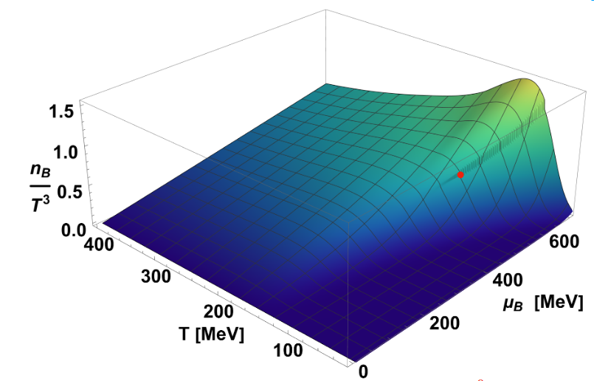
Ratti’s group
2D Ising-T.Ex.S Equation of state from l-QCD
RELEASE
Range: 30 MeV < T < 800 MeV ; μ_{B} < 700 MeV
Novel T'-Expansion Scheme (TExS) allows to extend lattice-based EoS up to μ_{B}/T~3.5
(EoS available at μ_{S}=μ_{Q}=0)
Includes a parametrized critical point from
3D-Ising universality class, with free location along a transition line parametrized according to physical constraints
S. Borsanyi, C. Ratti et al., PRL (2021)
S. Borsanyi, C. Ratti et al., PRD (2022)
M. Kahangirwe, J.J., C. Ratti et al., PRD (2024)
Outlooks:
Extend it to the case <n_{S}>=0 & <n_{Q}>=0.4<n_{B}>, relevant for HICs
Provide adaptive grid to better resolve CP
Notes:
We also have a 2D EoS with an extended coverage in mu_B, based on a new Alternative T-Expansion Scheme (AlTExS) developed recently.
This expansion scheme, which is different from Taylor, allows us to push our coverage up to muB/T ~ 3.5.
We have then been able to include a critical point from the 3D-Ising universality class into this EoS (only for muS=muQ=0 so far), by ensuring the conservation of the correct critical exponents.
We leave to the user the freedom to choose the location of the CP along a 1st order transition line fixed by our mapping, and to parametrize the shape of the critical region.

Slide 19
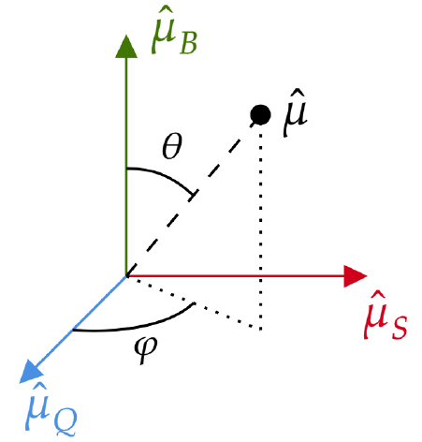
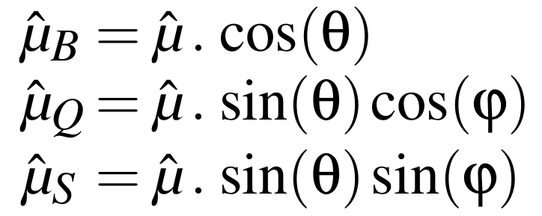
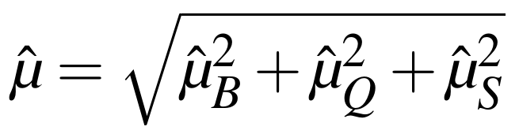
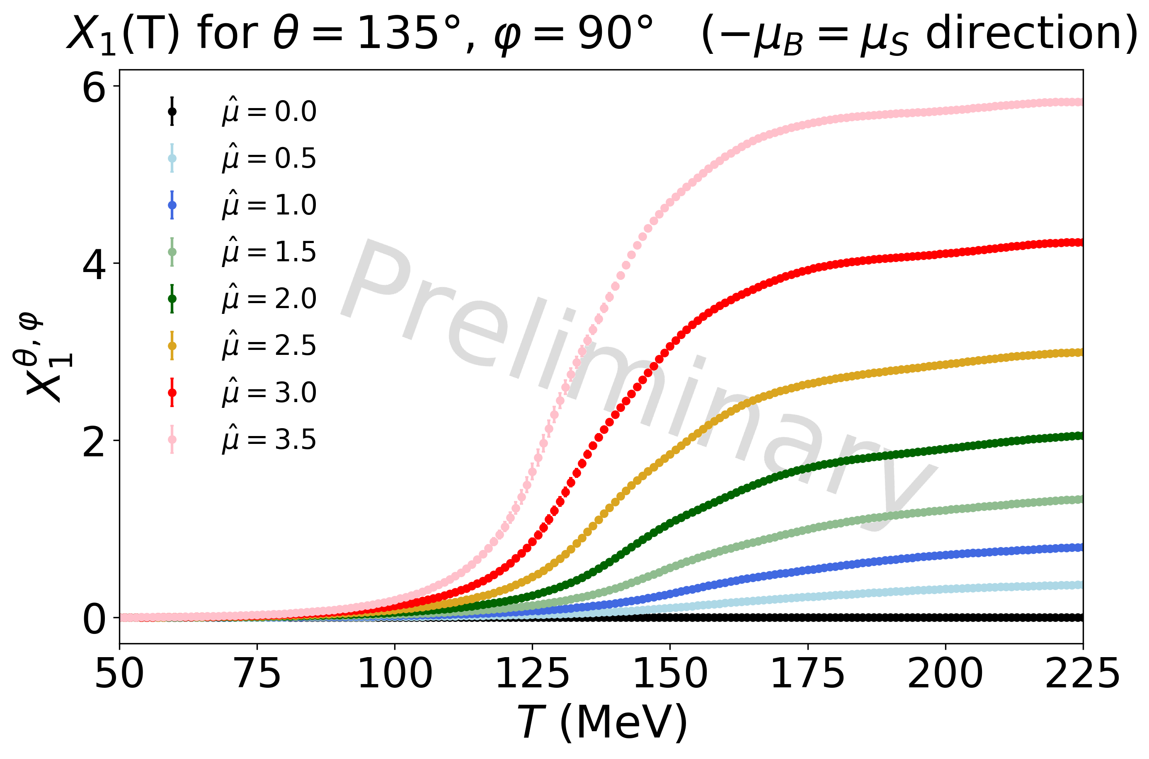
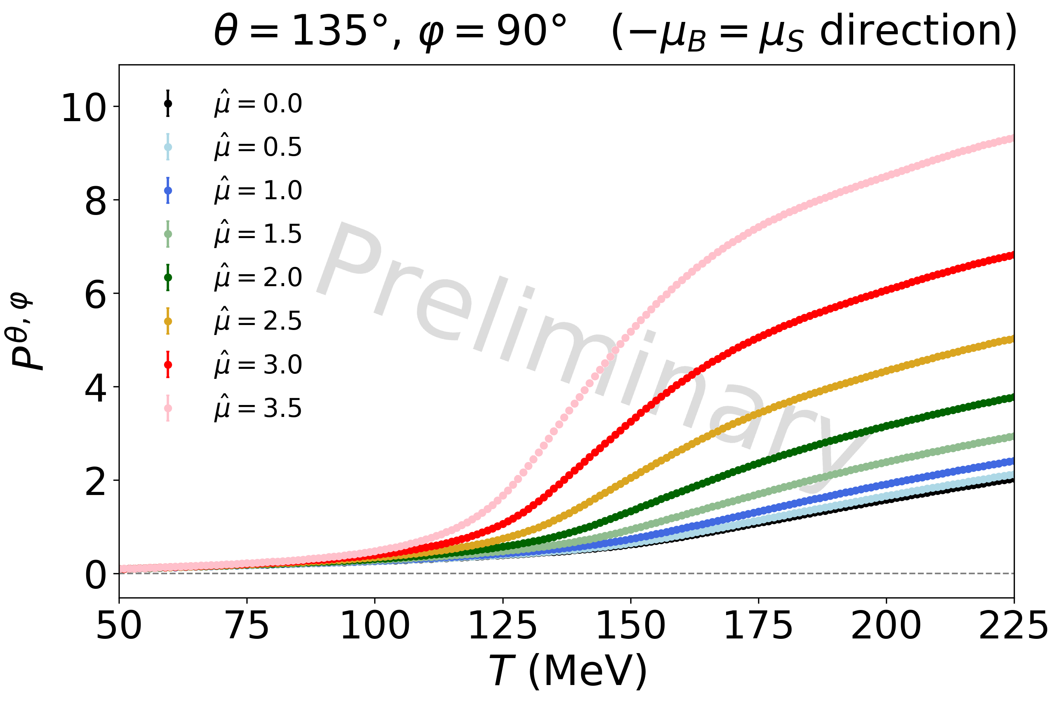
Ratti’s group
4D-T.EX.s Equation of state from l-QCD
In development
Range: T < 800 MeV ; μ_{B/Q/S} <? 700 MeV
Generalization of the previous 2D T'-Expansion Scheme to 3 conserved charges
by projecting the "cartesian" (μ_{B}, μ_{Q}, μ_{S}) coordinates to spherical ones
still a 2D-TExS expansion, along a constant μ/T line
J.J., P. Parotto, C. Ratti et al., (in preparation)
19

Slide 20
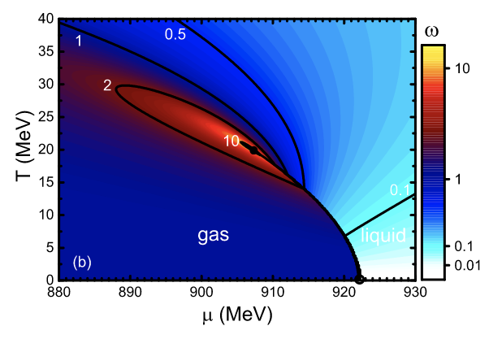
Hadron resonance gas (HRG) model
Vovchenko/Noronha-Hostler/Ratti’s groups
Range: 0 < T < 160 MeV ; μ_{B} < 930 MeV
In development
HRG model provides a well-established and realistic EoS at low temperatures
Ideal version is based on the assumption that an interacting gas of hadrons in the ground state can be well-approximated by an ideal gas of resonances
At large density, we need to incorporate additional interactions (van Der Waals)
Describes the liquid-gas phase transition
Goals:
Implementing FIST into module for thermodynamics results
Give flexibiliy on the particle list as input
Extend hadronic spectrum to the most updated PDG list
V. Vovchenko, H. Stoecker & M. Gorenstein., PRL (2017)
V. Vovchenko, H. Stoecker, Comput. Phys. Com. (2019)
Notes:
At low temperatures, where lattice QCD simulations are difficult, the HRG provides a good description of the thermodynamics of nuclear matter.
Its ideal version is based on the assumption that an interacting gas of hadrons in the ground-state can be well approximated by an ideal gas of hadrons and resonances.
However, this description needs to be modified at large density to include additional interactions such as van der Waals, which are able to describe the liquid-gas phase transition.
Goal: include the van der Waals HRG code from FIST into MUSES and fix the parameters to describe the liquid-gas critical point in a multi-component scenario (update using PDG2021+ list).

Slide 21
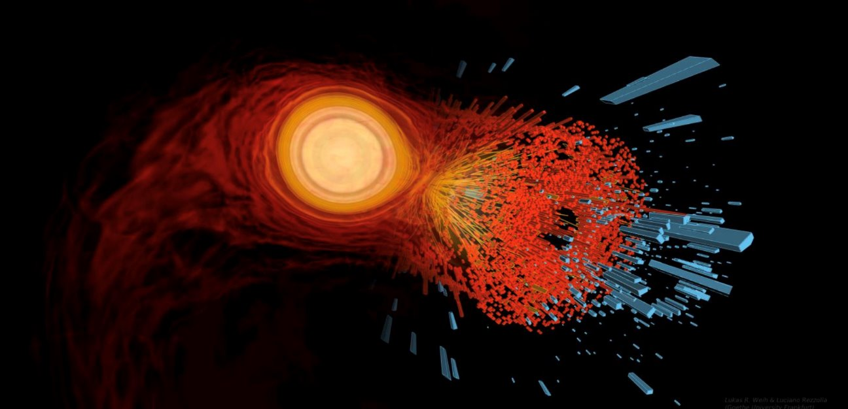
Observables & tools
21
Notes:
Finally, let me talk about the users working group.

Slide 22
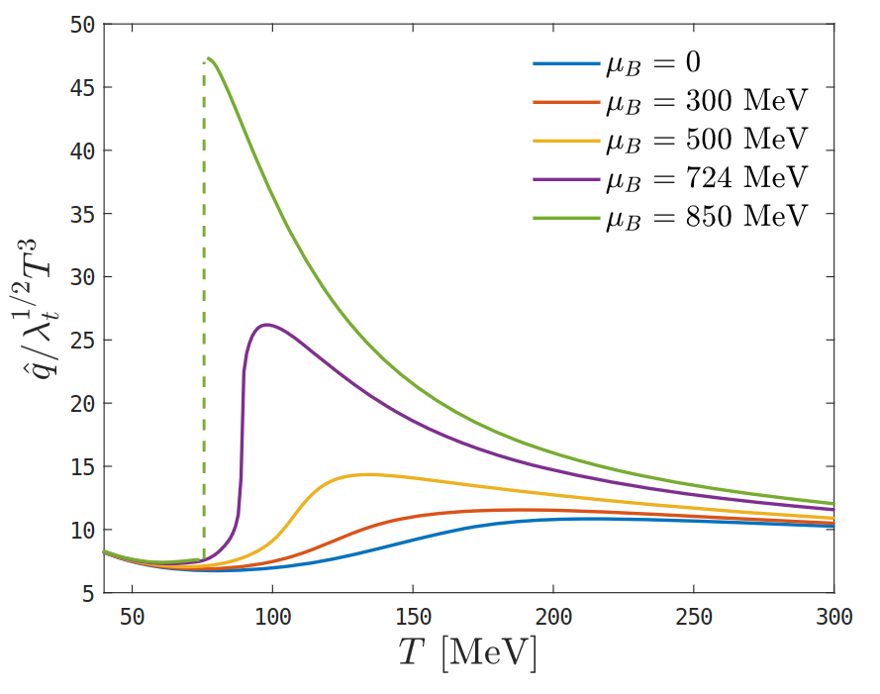
Noronha/Ratti/Vovchenko’s groups
Observables for heavy-ions
Transport coefficients from Holographic module
  Thermal conductivity
  Baryon conductivity & diffusion
  Shear & bulk viscosities
  HQ drag force & Langevin diffusion coefficients
  Jet quenching parameter
J. Grefa, C. Ratti et al., PRD (2022)
Freeze-out physics
  T and μ_{B} at chemical freeze-out can be fitted from experimental data with HRG
  will be incorporated from Thermal-FIST
V. Vovchenko et al., PRC (2016)
22
Notes:
In order to provide tools that are complementary to EoS calculations to the users, we will also deliver a set of packages to compute observables of interest for the HI community.
- we plan to provide a package which will provide combination of contributions from different hadron family to the total pressure, from which equivalent combination for susceptibilities can be derived.
Based on HRG + lQCD study, this can be used to study different contribution to criticality for instance, and to improve the quality of the proxies used in the experiment
- from the Holographic module, one can get many different transport coefficients on top of the regular thermodynamics variables (list […])
- finally, using the Thermal-FIRST package, it's possible to achieve fits to extract (chemical) freeze-out properties with HRG

Slide 23
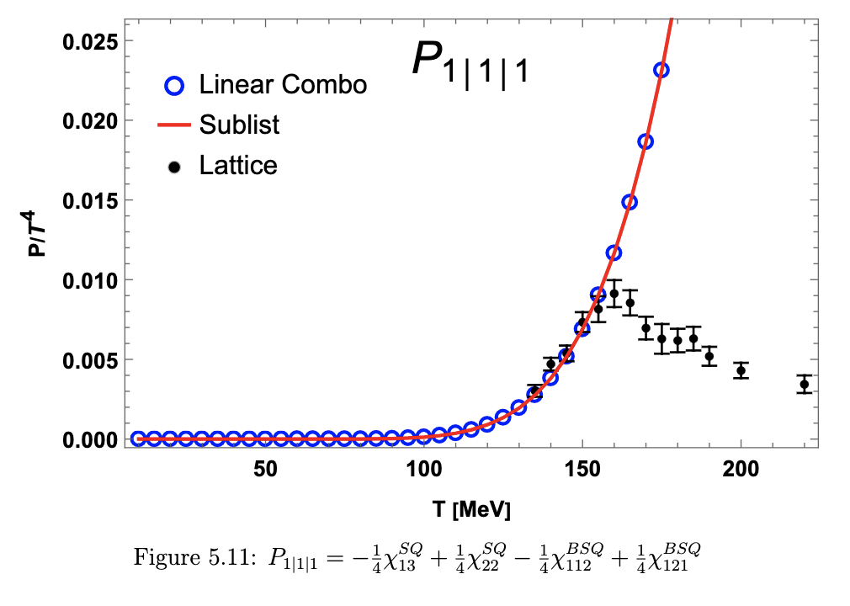
Noronha-Hostler/Ratti's groups
Additional toolkit for heavy-ions
Susceptibilities & hadronic species contributions
  Susceptibilities from lattice QCD will be computable
  using HRG, one can study the breakdown of different hadron families:
    we will provide combinations for hadronic contributions to total pressure
    we will provide analogous relations for susceptibilities
A. Nava, J.J., C. Ratti et al. (in preparation)
PDG21+ list
  Add up all resonances from PDG
  (from * to *****)
  Create decay channels through radiation for unknown higher energy baryons
J. Salinas San Martin, R. Hirayama, et al. (2016)
23
Notes:
In order to provide tools that are complementary to EoS calculations to the users, we will also deliver a set of packages to compute observables of interest for the HI community.
- we plan to provide a package which will provide combination of contributions from different hadron family to the total pressure, from which equivalent combination for susceptibilities can be derived.
Based on HRG + lQCD study, this can be used to study different contribution to criticality for instance, and to improve the quality of the proxies used in the experiment
- from the Holographic module, one can get many different transport coefficients on top of the regular thermodynamics variables (list […])
- finally, using the Thermal-FIRST package, it's possible to achieve fits to extract (chemical) freeze-out properties with HRG

Slide 24
Alford/Dexheimer/Most/Yunes’s groups
Toolkit for Neutron STARS
Lepton module
  Takes in nuclear EoS
  Compute the charged lepton densities necessary to ensure having charge neutrality
Flavour equilibration
  β-equilibrium (by balancing rates)
  Given an EoS, computes:
    Urca rates
    ( n p + e + ν_{e} / p + e n + ν_{e})
    Equilibrium charge fractions
    Relaxation rates
    Damping time
    Susceptibilities
    Bulk viscosity
RELEASE
Outlooks:
include neutrinos
include photons
RELEASE
M. Alford, A. Haber et al., Universe (2021)
M. Alford, A. Haber et al., PRC (2024)
Adapter modules for NS & mergers simulation tools
  Ensuring compatibility with CompStar Online Supernovae Equations of State (CompOSE),
  a standard format, with the aim to provide thousands of 1D/2D/3D EoS tables for NS
  Ensuring compatibility with merger simulations
RELEASE
24
Notes:
The first observable module for NS is the QLIMR module, which enable to calculate, from a given EoS, all the following « macroscopic » observables: […].
Then, we have a flavor equilibration module that can help to compute information regarding the composition of NS and equilibration processes: […].
We will also ensure compatibility with the CompOSE format to make sure that our EoS can be employed through the standards of the astrophysical community for NS and mergers simulations.

Slide 25
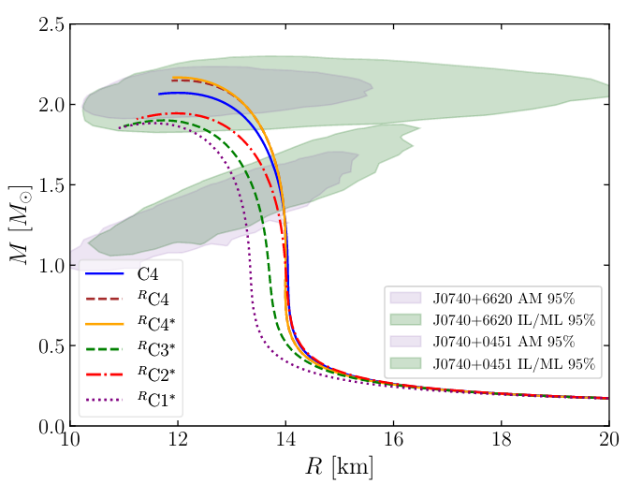
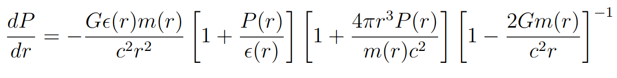
Yunes’s group
Observables for Neutron stars
QLIMR module
  Given an EoS, solves the Tolmann-Oppenheimer-Volkoff (TOV) equations
  and computes:
    Q: quadrupole moment Q of NS
    L: tidal Love number (tidal force deformability)
    I: moment of inertia
    M: mass of NS (+Δm to correct for rotation)
    R: radius of NS (+ΔR to correct for HRG too)
    Local function p(R), m(R)...
RELEASE
R. Kumar, V. Dexheimer et al., PRD 109 (2024)
25
Notes:
The first observable module for NS is the QLIMR module, which enable to calculate, from a given EoS, all the following « macroscopic » observables: […].
Then, we have a flavor equilibration module that can help to compute information regarding the composition of NS and equilibration processes: […].
We will also ensure compatibility with the CompOSE format to make sure that our EoS can be employed through the standards of the astrophysical community for NS and mergers simulations.

Slide 26
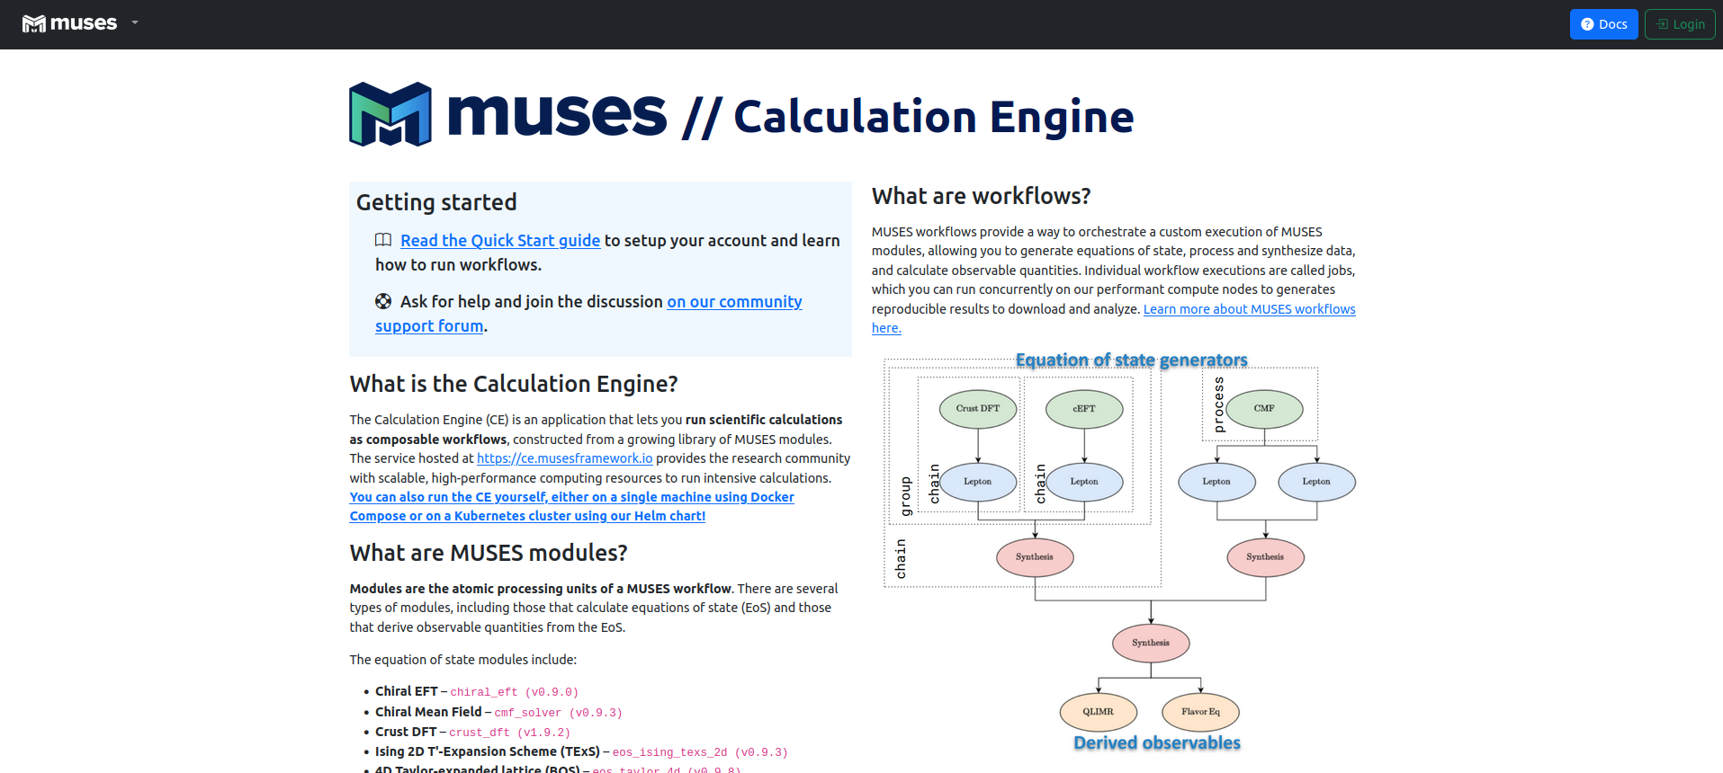
Public release
26
Notes:
Finally, let me talk about the users working group.

Slide 27



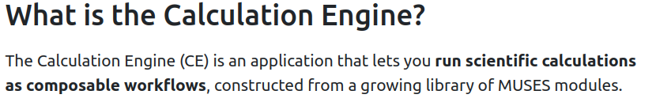
using the MUSES calculation engine
Modules can be run on a dedicated cluster
(access given via login)
Online documentation on the use of the CE, the different modules, etc.
Forum as a platform for users-developers exchanges about support, feedback...
27

Slide 28
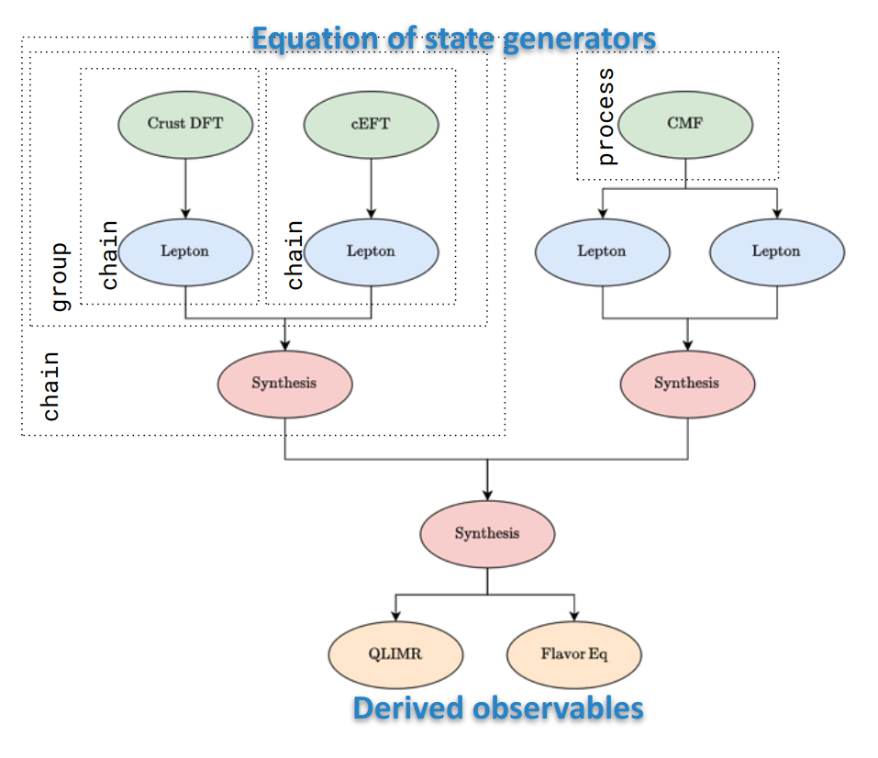
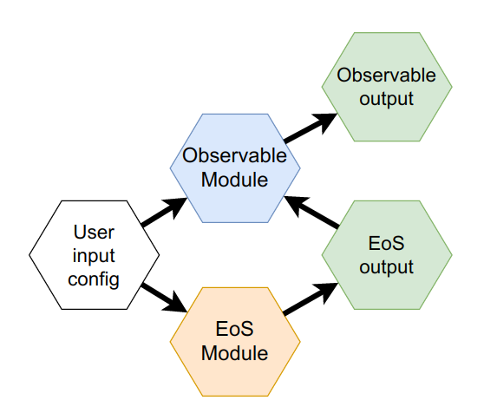
Workflows in MUSES
Example of a typical workflow within MUSES,
implying EoS generation + observable calculation
More complex workflows can also be defined
28

Slide 29
Conclusions
MUSES will provide a public-accessible framework with a single friendly-user interface, to compute EoSs and related observables from different approaches
Public release planned for Nov. 2024: open access soon!
  3 modules for NS EoS
  3 modules for HI EoS
  2 toolkit modules / 1 observable modules
Most modules have plans for improvement ( 1.1.0)
Suggestions, feedback and new collaborators
are welcome!
29
Notes:
So to conclude, we are very excited to start working on the MUSES project.
MUSES will provide a cyberinfrastructure delivering EoS tables and related observables which are of need for HIC modeling and NS & mergers simulations, with new tools to help merging consistently different types of EoS, and ensure a maximal coverage of the phase diagram.

Slide 30
Backup slides

Slide 31

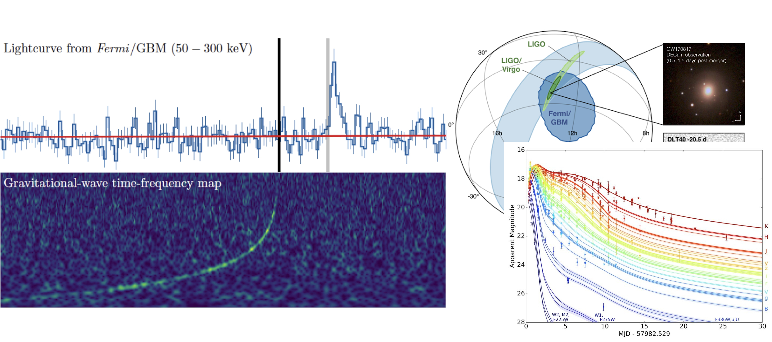
LIGO/Virgo PRL (2017)
P.S. Cowperthwaite et al., Astrophys. J. Lett. (2017)
31

Slide 32
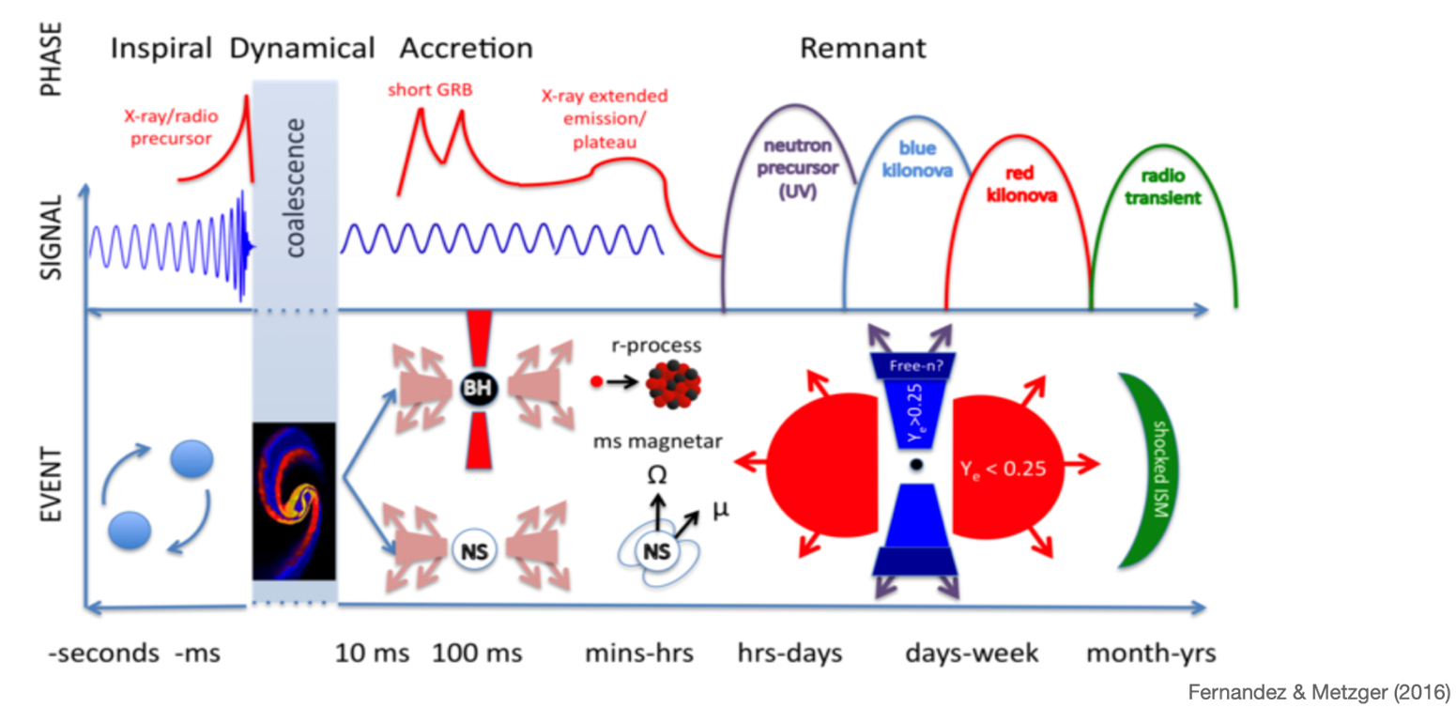
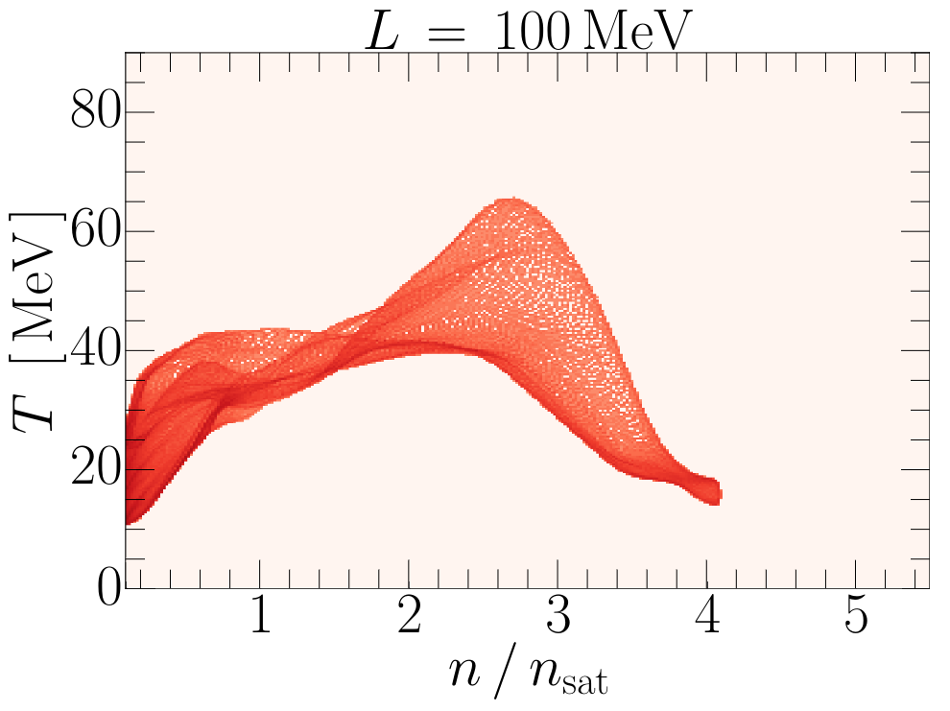
Anatomy of a Neutron star MERGER
E.R. Most, C.A. Raithel, PRD 104 (2021)
32
Notes:
This cartoon shows phases of a NS merger as a function of time, showing the associated observational signatures and underlying physical phenomena.
Nuclear physics, with possible answers to the open questions listed at the beginning, is encoded in all phases.

Slide 33
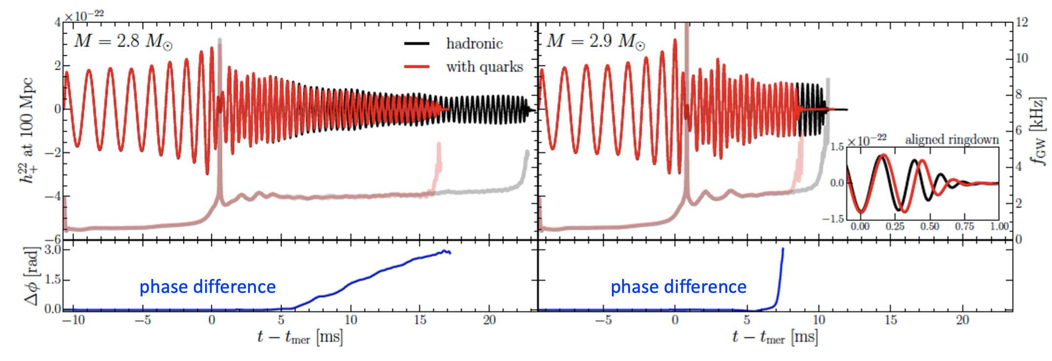
Neutron star merger and the EOS
Einstein telescope
Cosmic explorer
Einstein
Telescope
/VIRGO
Post-merger signal sensitive to order of the phase transition
Next generation observatories will be able to detect it!
Need to combine the nuclear physics input and simulations
E.R. Most, V. Dexheimer et al., PRL (2019)
33

Slide 34
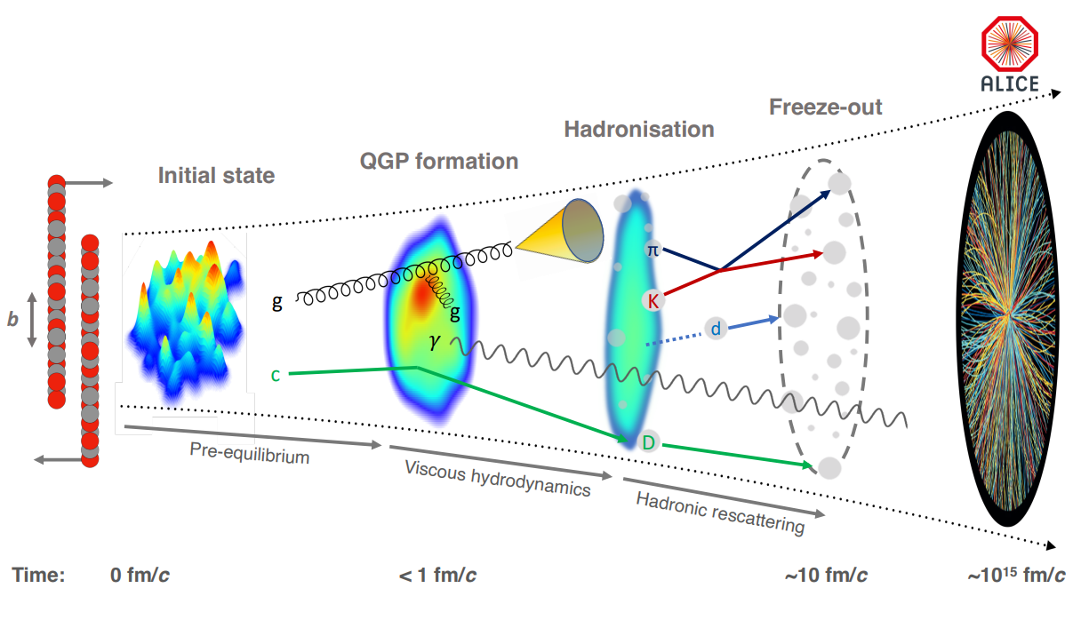
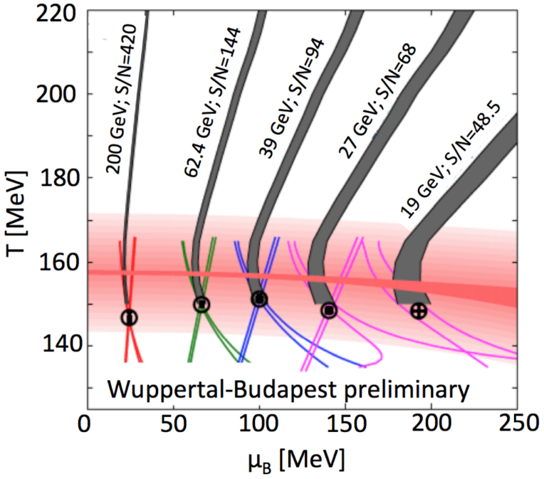
Anatomy of a heavy-ion collision
The ALICE experiment: A journey through QCD, CERN-EP-2022-227 (2022)
34
Notes:
Coming back to Earth now, let's discuss how we probe the phase diagram of nuclear matter at very small scales.
This cartoon represents the scenario of a HIC, and the different phases through which the system will evolve.
One can see that such experiments allow to probe dynamically different phases of the phase diagram, and in particular phase transitions, in its different regions depending on the center-of-mass energy of the collision.

Slide 35
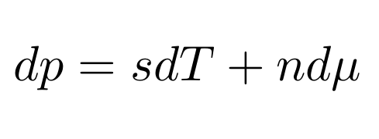
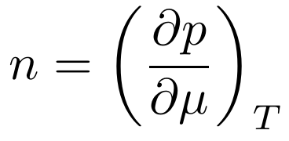
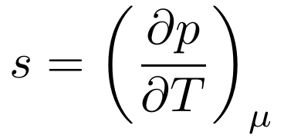
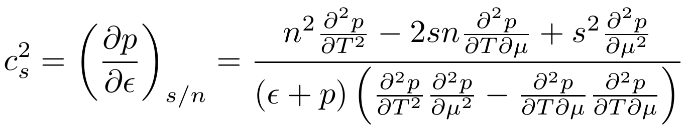
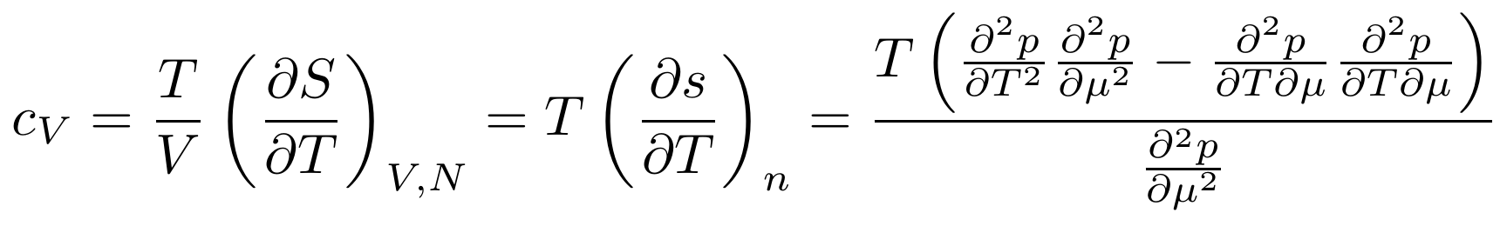
Thermodynamics relations
Notes:
Let me go a bit more into the physics details. If we were able to solve QCD at high density, none of this would be necessary. QCD can only be solved numerically through lattice simulations in the range of temperature and density relevant to both heavy-ion and neutron star communities. However, this numerical technique is based on Monte Carlo importance sampling, which cannot be applied at finite density because the quantity used to sample the configurations becomes complex and cannot be used as a weight anymore. This is the reason why we don’t know the equation of state and phase diagram of strongly interacting matter at all temperatures and densities from first principles. We need to rely on models to explore the regions which lattice QCD cannot reach yet.

Slide 36

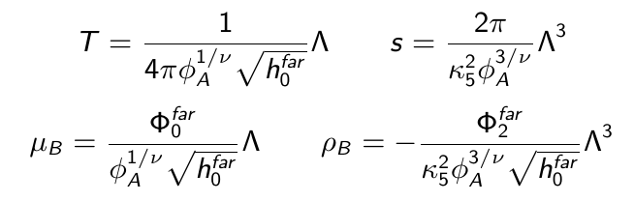
Equation of state from holography
Noronha/Ratti’s groups
Range: 30 MeV < T < 400 MeV ; μ_{B} < 1100 MeV
RELEASE
String theory/Classical gravity in 5D
Quantum Field Theory
in 4D
By solving the equations of motion (EoM) for
a 5D Einstein-Maxwell-Dilaton (EMD) model
defined by the following action:
(simplest action reproducing a realistic 4D QCD EFT)
...one can obtain the following thermodynamic quantities by
using the UV behavior of the EMD fields
fixing free parameters Λ, κ₅ and the functional form of V(ϕ) and f(ϕ) by matching with lQCD results at µ_{B} = 0
36
Notes:
In order to get thermodynamics for QCD from Holography, one can use gauge/gravity correspondence from a 5D EMD model with the action shown here.

Slide 37





Ratti’s group
2D Ising-T.Ex.S Equation of state from l-QCD
RELEASE
Range: 30 MeV < T < 800 MeV ; μ_{B/Q/S} < 700 MeV
Empirical observation:
all 1st order susceptibilities scale when defining a µ_{B}-dependent temperature T'(T, µ_{B})
scales like:
Main identity
one can thus redefine temperature and use an alternative expansion scheme:
with alternative expansion coefficients κ, related to susceptibilities:
M. Kahangirwe, J.J., C. Ratti et al., PRD (2024); arXiv:2402.08636

Slide 38



Ratti’s group
2D Ising-T.Ex.S Equation of state from l-QCD
α-RELEASE
Range: 30 MeV < T < 800 MeV ; μ_{B/Q/S} < 700 MeV
Implement scaling behavior of 3D-Ising model EoS:
Define map from 3D-Ising model to QCD
Estimate contribution to Taylor coefficients from 3D-Ising model critical point​
​​
Reconstruct full baryon density​
​
with​
M. Kahangirwe, J.J., C. Ratti et al., PRD (2024); arXiv:2402.08636

Slide 39

Ratti’s group
4D-T.EX.s Equation of state from l-QCD
Range: T < 800 MeV ; μ_{B/Q/S} <? 700 MeV
Generalization of the previous 2D T'-Expansion Scheme to 3 conserved charges
by projecting the "cartesian" (μ_{B}, μ_{Q}, μ_{S}) coordinates to spherical ones
still a 2D-TExS expansion, along a constant μ/T line
Calculate expansion coefficient λ₂ based on so-called "generalized susceptibilities" X_{2/4}
(linear combinations of lattice QCD susceptibilities) + their Stefan-Boltzmann limits
39

Slide 40





4D-T.EX.s Equation of state from l-QCD
Ratti’s group
Range: T < 800 MeV ; μ_{B/Q/S} <? 700 MeV
Compute the "generalized charge density" X₁ along the projected line
using the expanded temperature T' and the T.Ex.S main identity
(modified to match with Stefan-Boltzmann limit at T ∞)
with
Obtain pressure by integrating X₁, allowing then to compute all thermodynamics
40
Notes:
We even now have found a way to extend the Alternative T-Expansion Scheme to all 3 conserved charge chemical potentials, by redefining the coordinates from (T, μB, μQ, μS) to (T, μ, α, β) in order to obtain an expansion along a single μ line as in the 2D AlTExS described previously.
The construction of the EoS remains then the same, except for the T' expansion coefficients κ, now defined as λ because computed differently.
Although the formula to define λ is identical to the one defining κ coefficients, it does not employ lattice χ directly anymore, but X coefficients that are linear combinations of χ based on the angles coming from the previous change of coordinates.

Slide 41

Cyberinfrastructure
41
Notes:
Finally, let me talk about the users working group.

Slide 42

Low-level services
The client-facing API will handle communication with client applications through a webpage
Direct communication with the Batch and Provenance for storage
Provenance will record all useful information:
user activity, workflows executed, models evaluated, inputs/outputs, details of computational jobs
(all only accessible internally)
Storage will consist of a collection
of services that store and serve data
42

Slide 43

Typical MODULE Design
43

