Slide 1
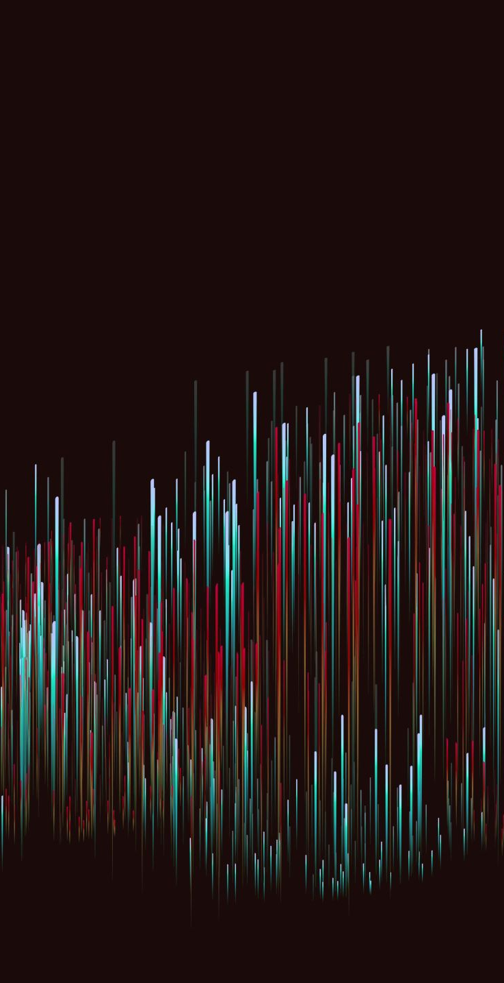




Hyperonic phase transitions in dense matter
Based on the preprint https://arxiv.org/abs/2409.06837
NikolAs Cruz Camacho, Jacquelyn Noronha-Hostler, Andrew T. Manning, Roland Haas, Rajesh Kumar, Mateus Pelicer, Jeff Peterson, Veronica Dexheimer
Dense Nuclear Matter Equation of State from Theory and Experiments (IRL-NPA FRIB)
East Lansing, MI, 11/01/2024

Slide 2
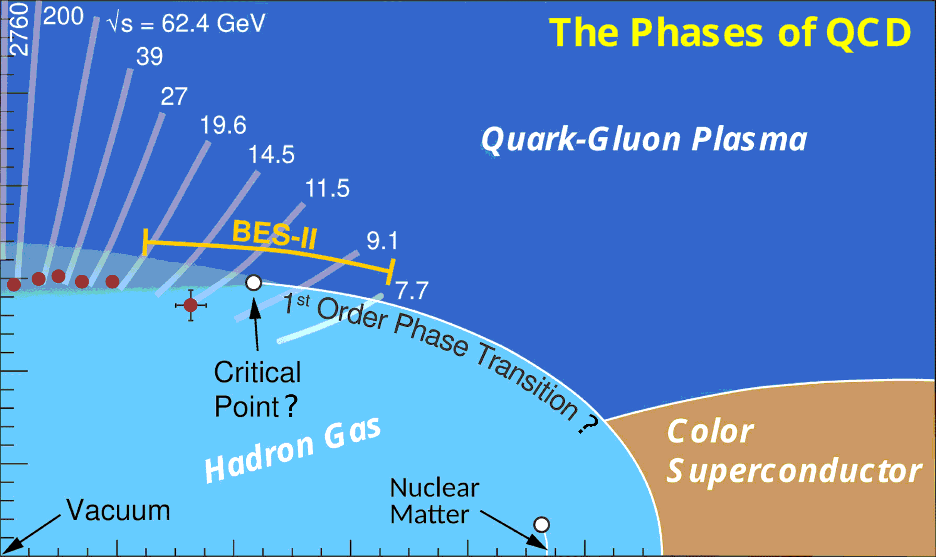
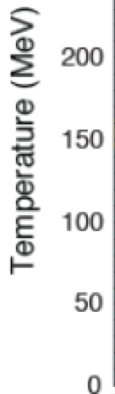

motivation
Perturbative QCD
Is there a critical point in the QCD phase diagram?
Where is the transition line at high density?
What are the phases of QCD at high density?
Lattice QCD
CMF
????
How to ensure full coverage
of the QCD phase diagram ?
Liquid-Gas, Nuclei
Chiral EFT
Modified from Johannes Jahan’s talk at MUSES collaboration meeting 2024
https://events.musesframework.io/event/3/

Slide 3
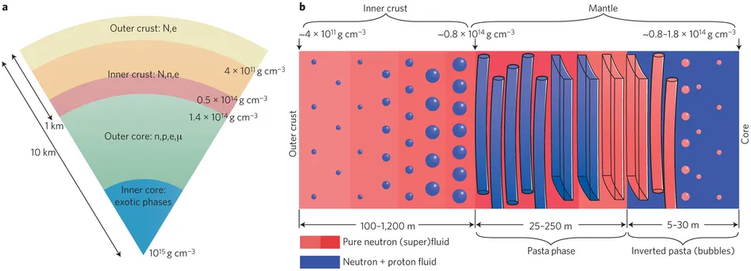



NS structure
CMF
$$(T, \underline{μ_{B},μ_{S},μ_{Q}})$$
constrained
Taken from https://astrobites.org/2017/10/05/nuclear-pasta-in-neutron-stars/
$$(\underline{T=0},μ_{B},μ_{S},μ_{Q})$$
What is the content of the exotic phases? What are the phase transition orders?
Model: CMF++ (CMF at zero temperature in C++)

Slide 4
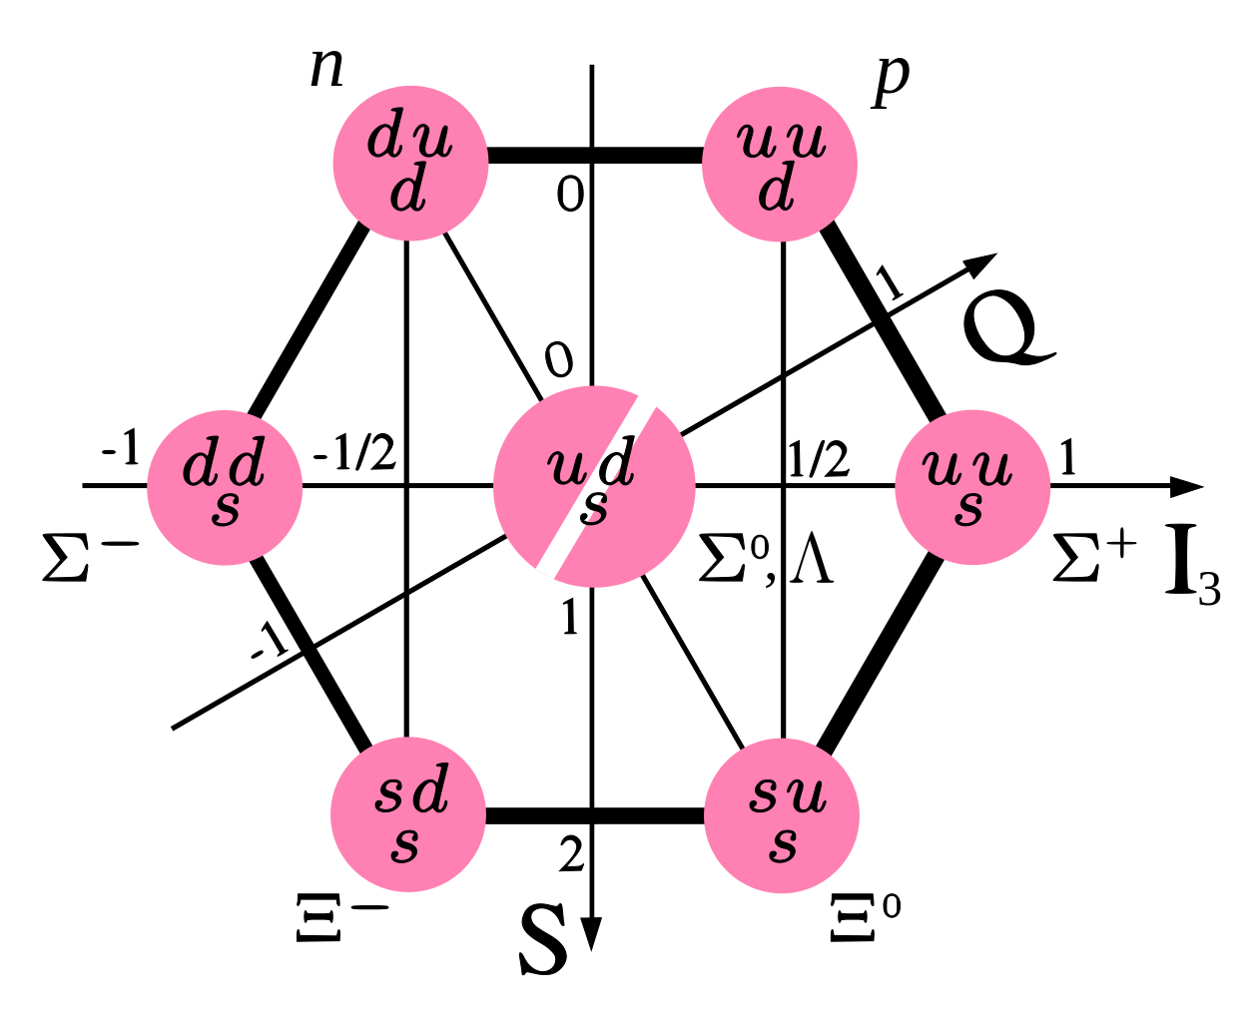
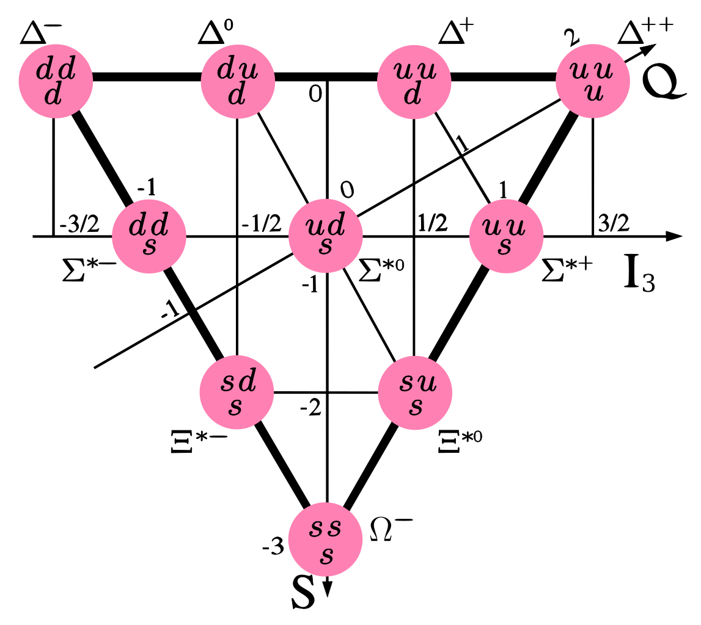





CMF++ Particles considered
SU(3) quarks
Hyperons (particles with strangeness) can be systematically turned on/off in CMF++
Baryon octet
Baryon decuplet

Slide 5
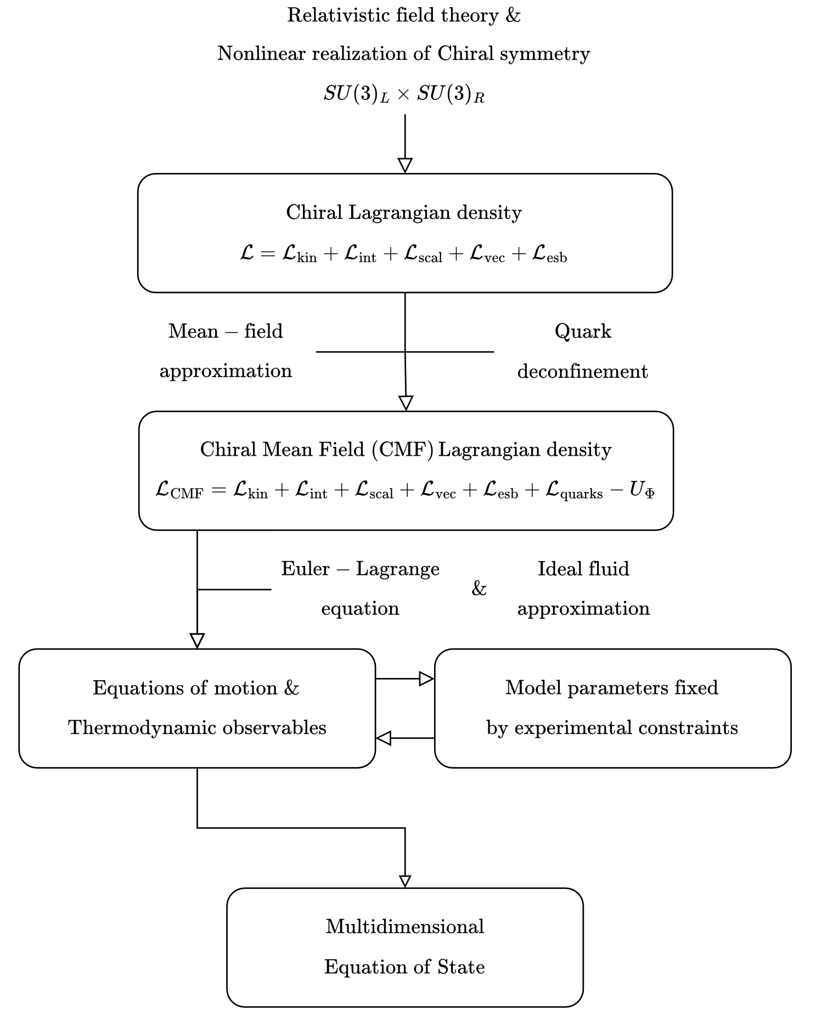
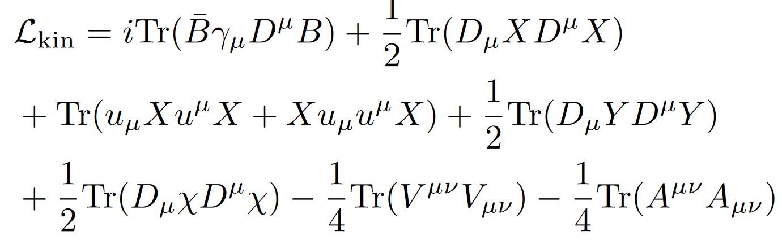
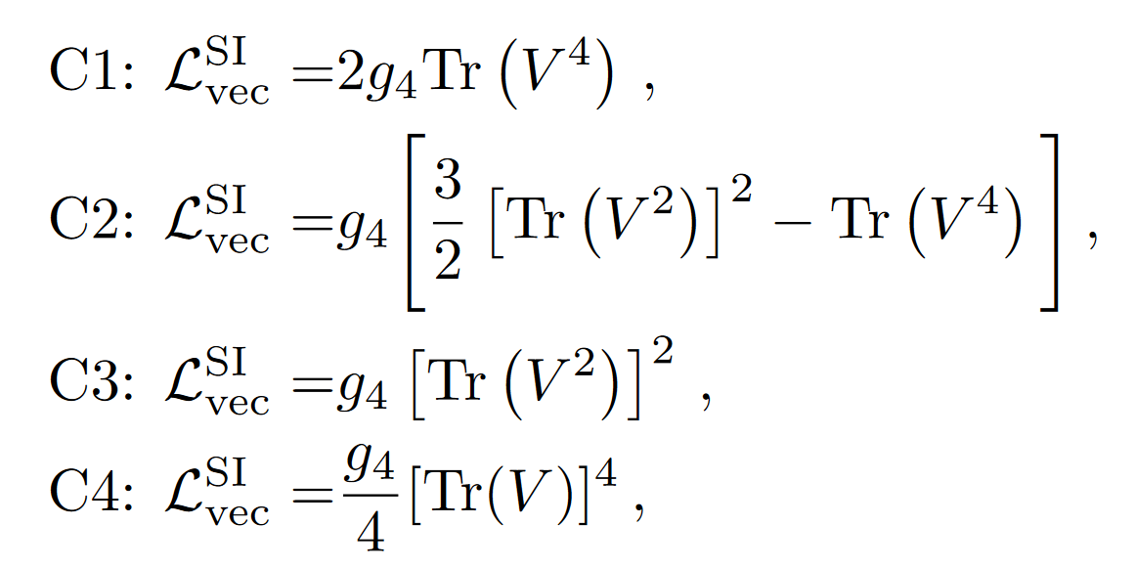
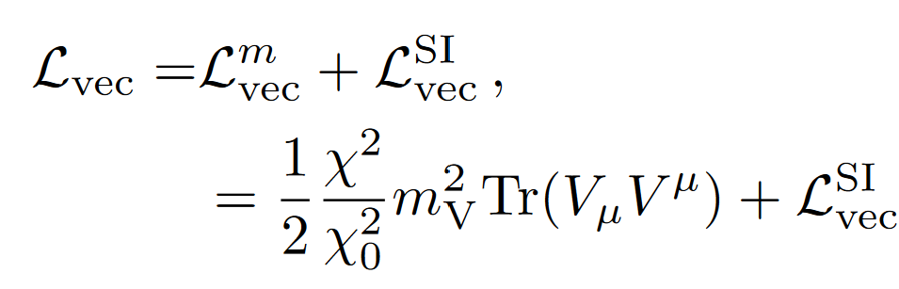
Chiral Lagrangian
Before mean field approximation:
CMF is a non-linear extension of the linear sigma model with quarks
Taken from https://arxiv.org/abs/2409.06837

Slide 6
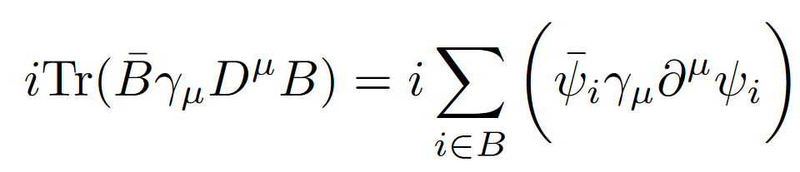
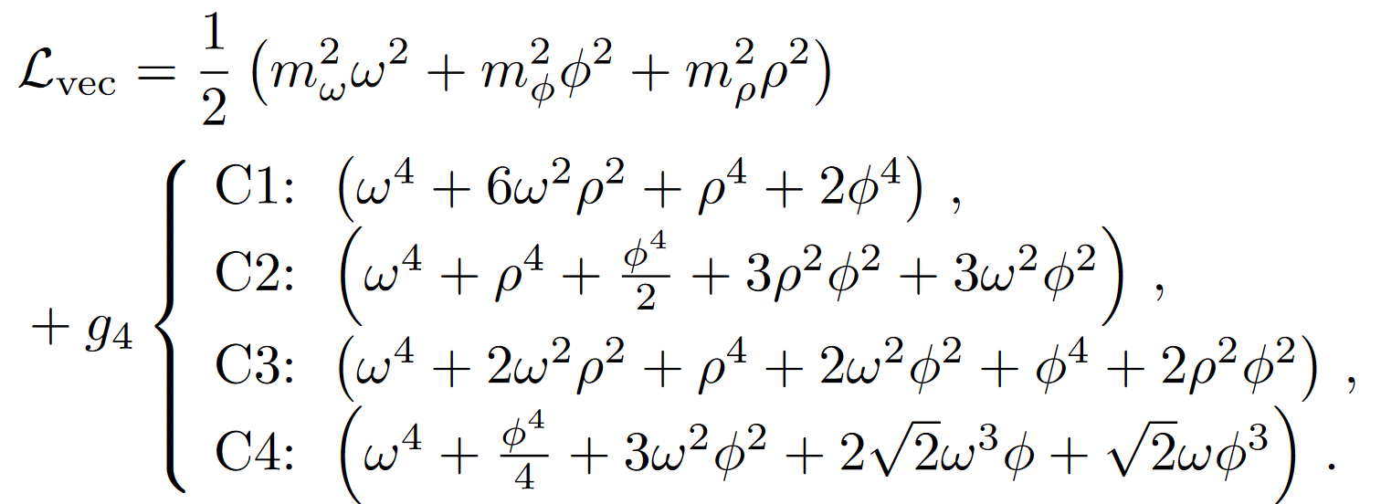
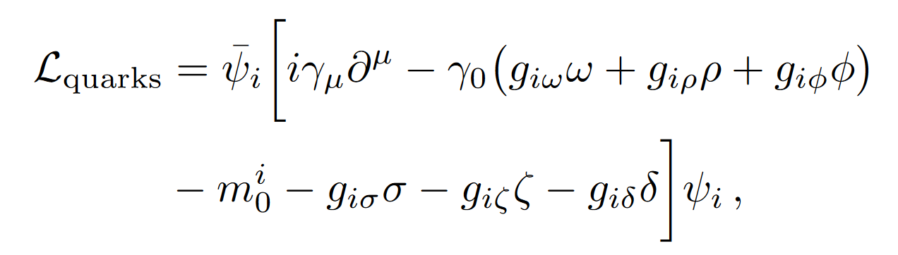
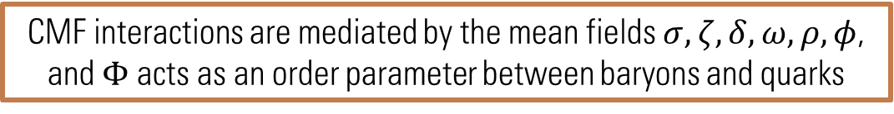
CMF++ Lagrangian
After mean field approximation:
CMF interactions are mediated by the mean fields $σ, ζ, δ, ω, ρ, φ$, and $Φ$ acts as an order parameter between baryons and quarks
Taken from https://arxiv.org/abs/2409.06837

Slide 7

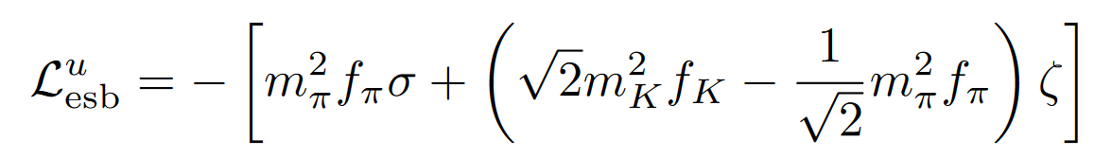
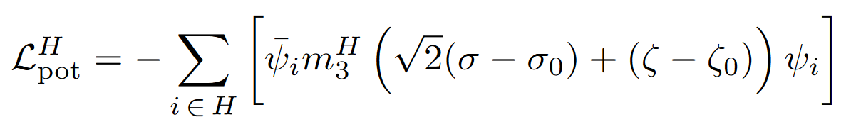
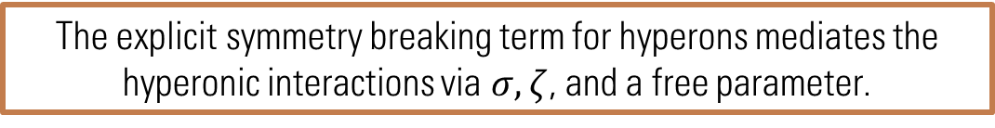
CMF++ Lagrangian
Hyperonic details in the explicit symmetry breaking sector:
The explicit symmetry breaking term for hyperons mediates the hyperonic interactions via $σ, ζ$, and a free parameter.
Taken from https://arxiv.org/abs/2409.06837

Slide 8
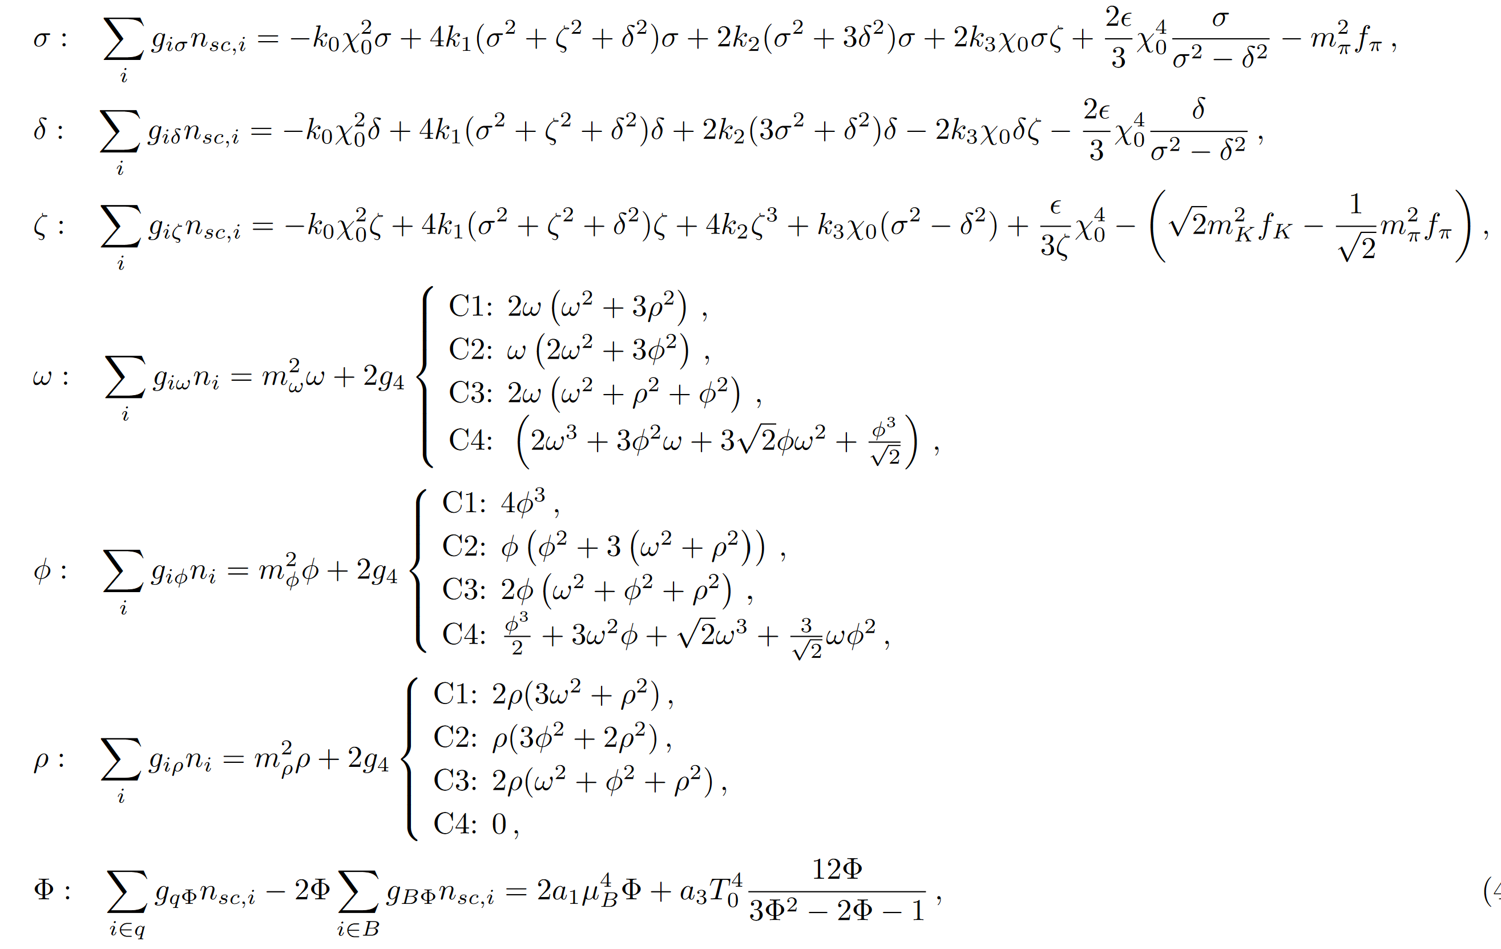
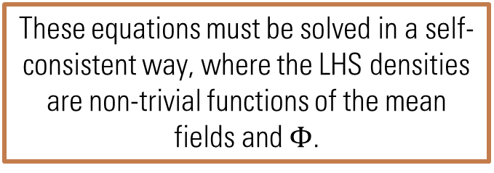
Equations of motion
After
Euler-
Lagrange
equation:
These equations must be solved in a self-consistent way, where the LHS densities are non-trivial functions of the mean fields and $Φ$.
In our approach we used fsolve, which is based on MINPACK.

Slide 9
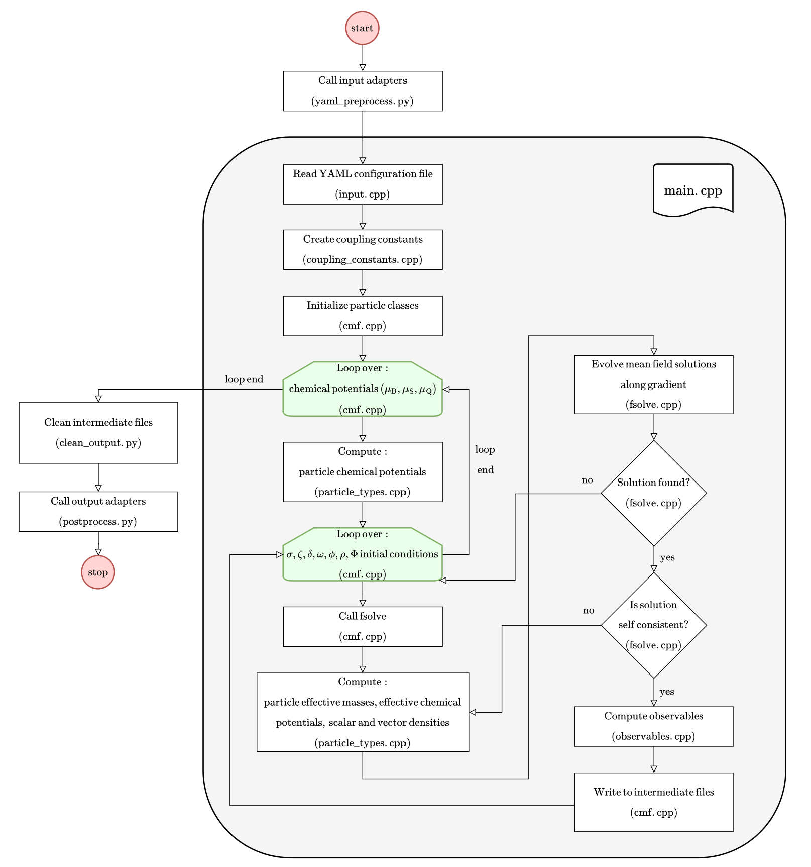
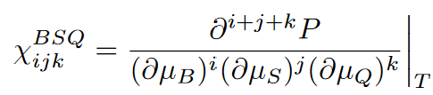
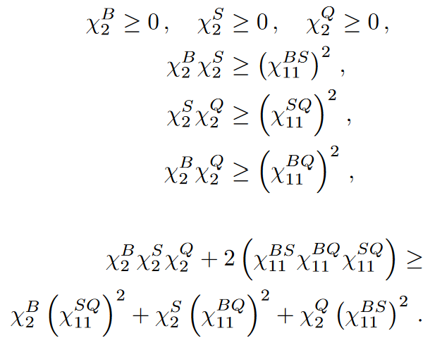

Algorithm flowchart
Taken from
https://arxiv.org/abs/2409.06837
Stability conditions for $T=0$
1D
2D
3D

Slide 10
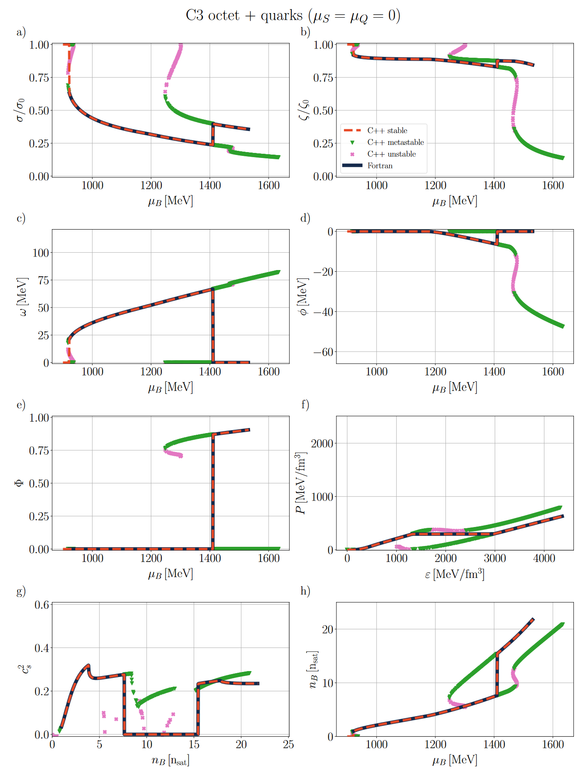
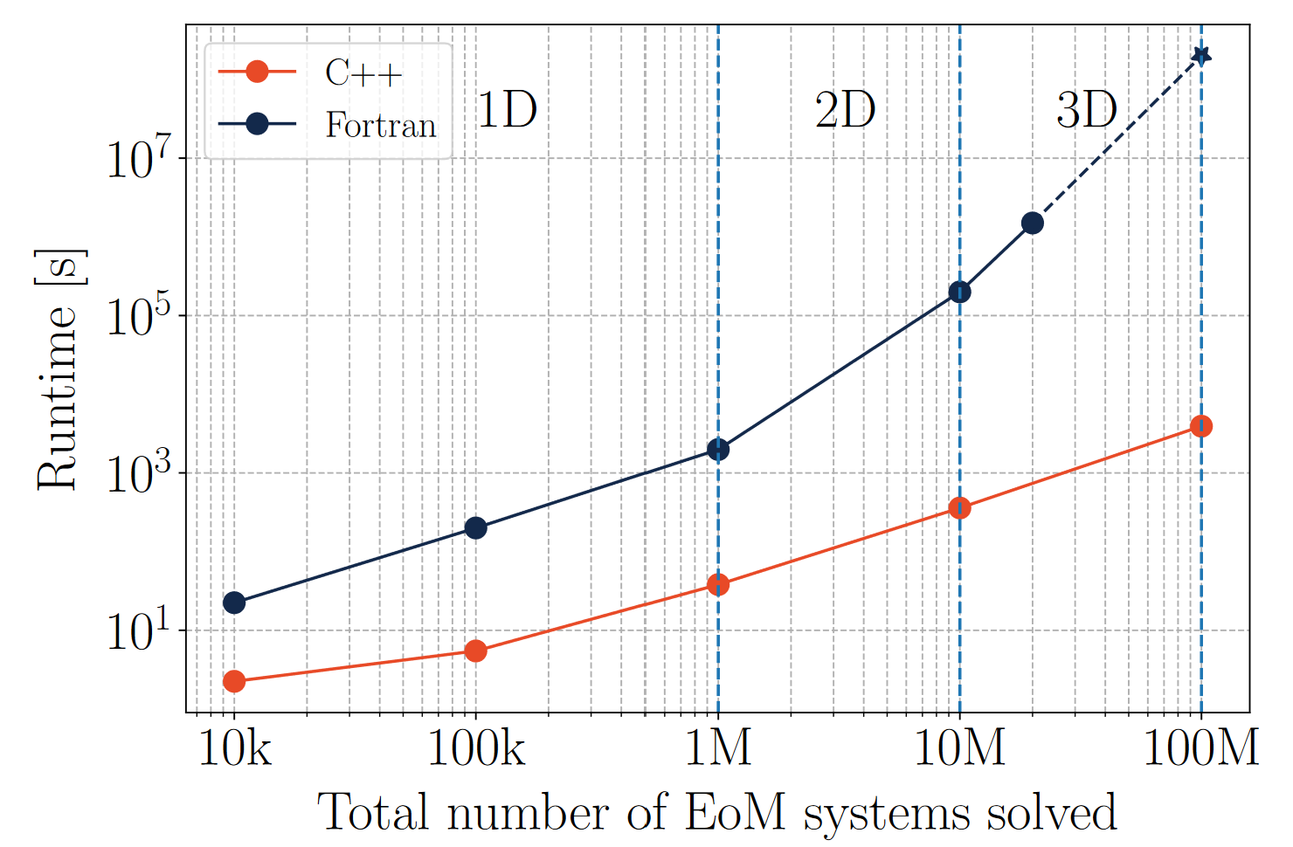
Fortran vs C++
Runtime has been improved more than 4 orders of magnitude for 3D EoSs, from 6.4 years to 64 minutes.
Taken from https://arxiv.org/abs/2409.06837

Slide 11
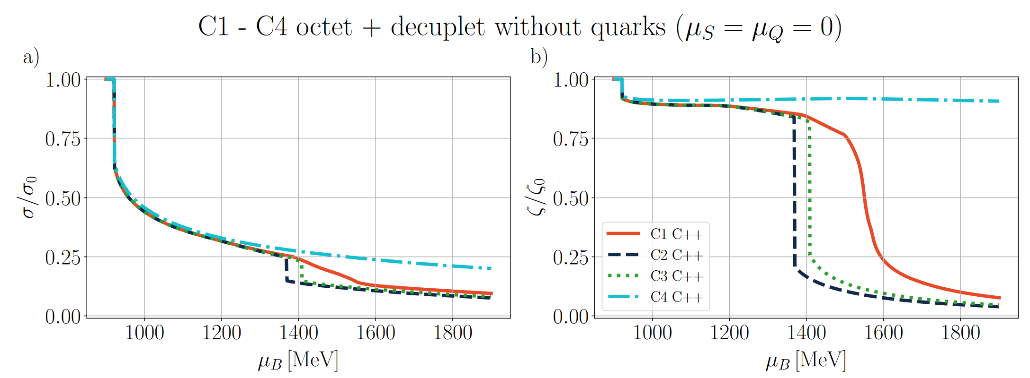
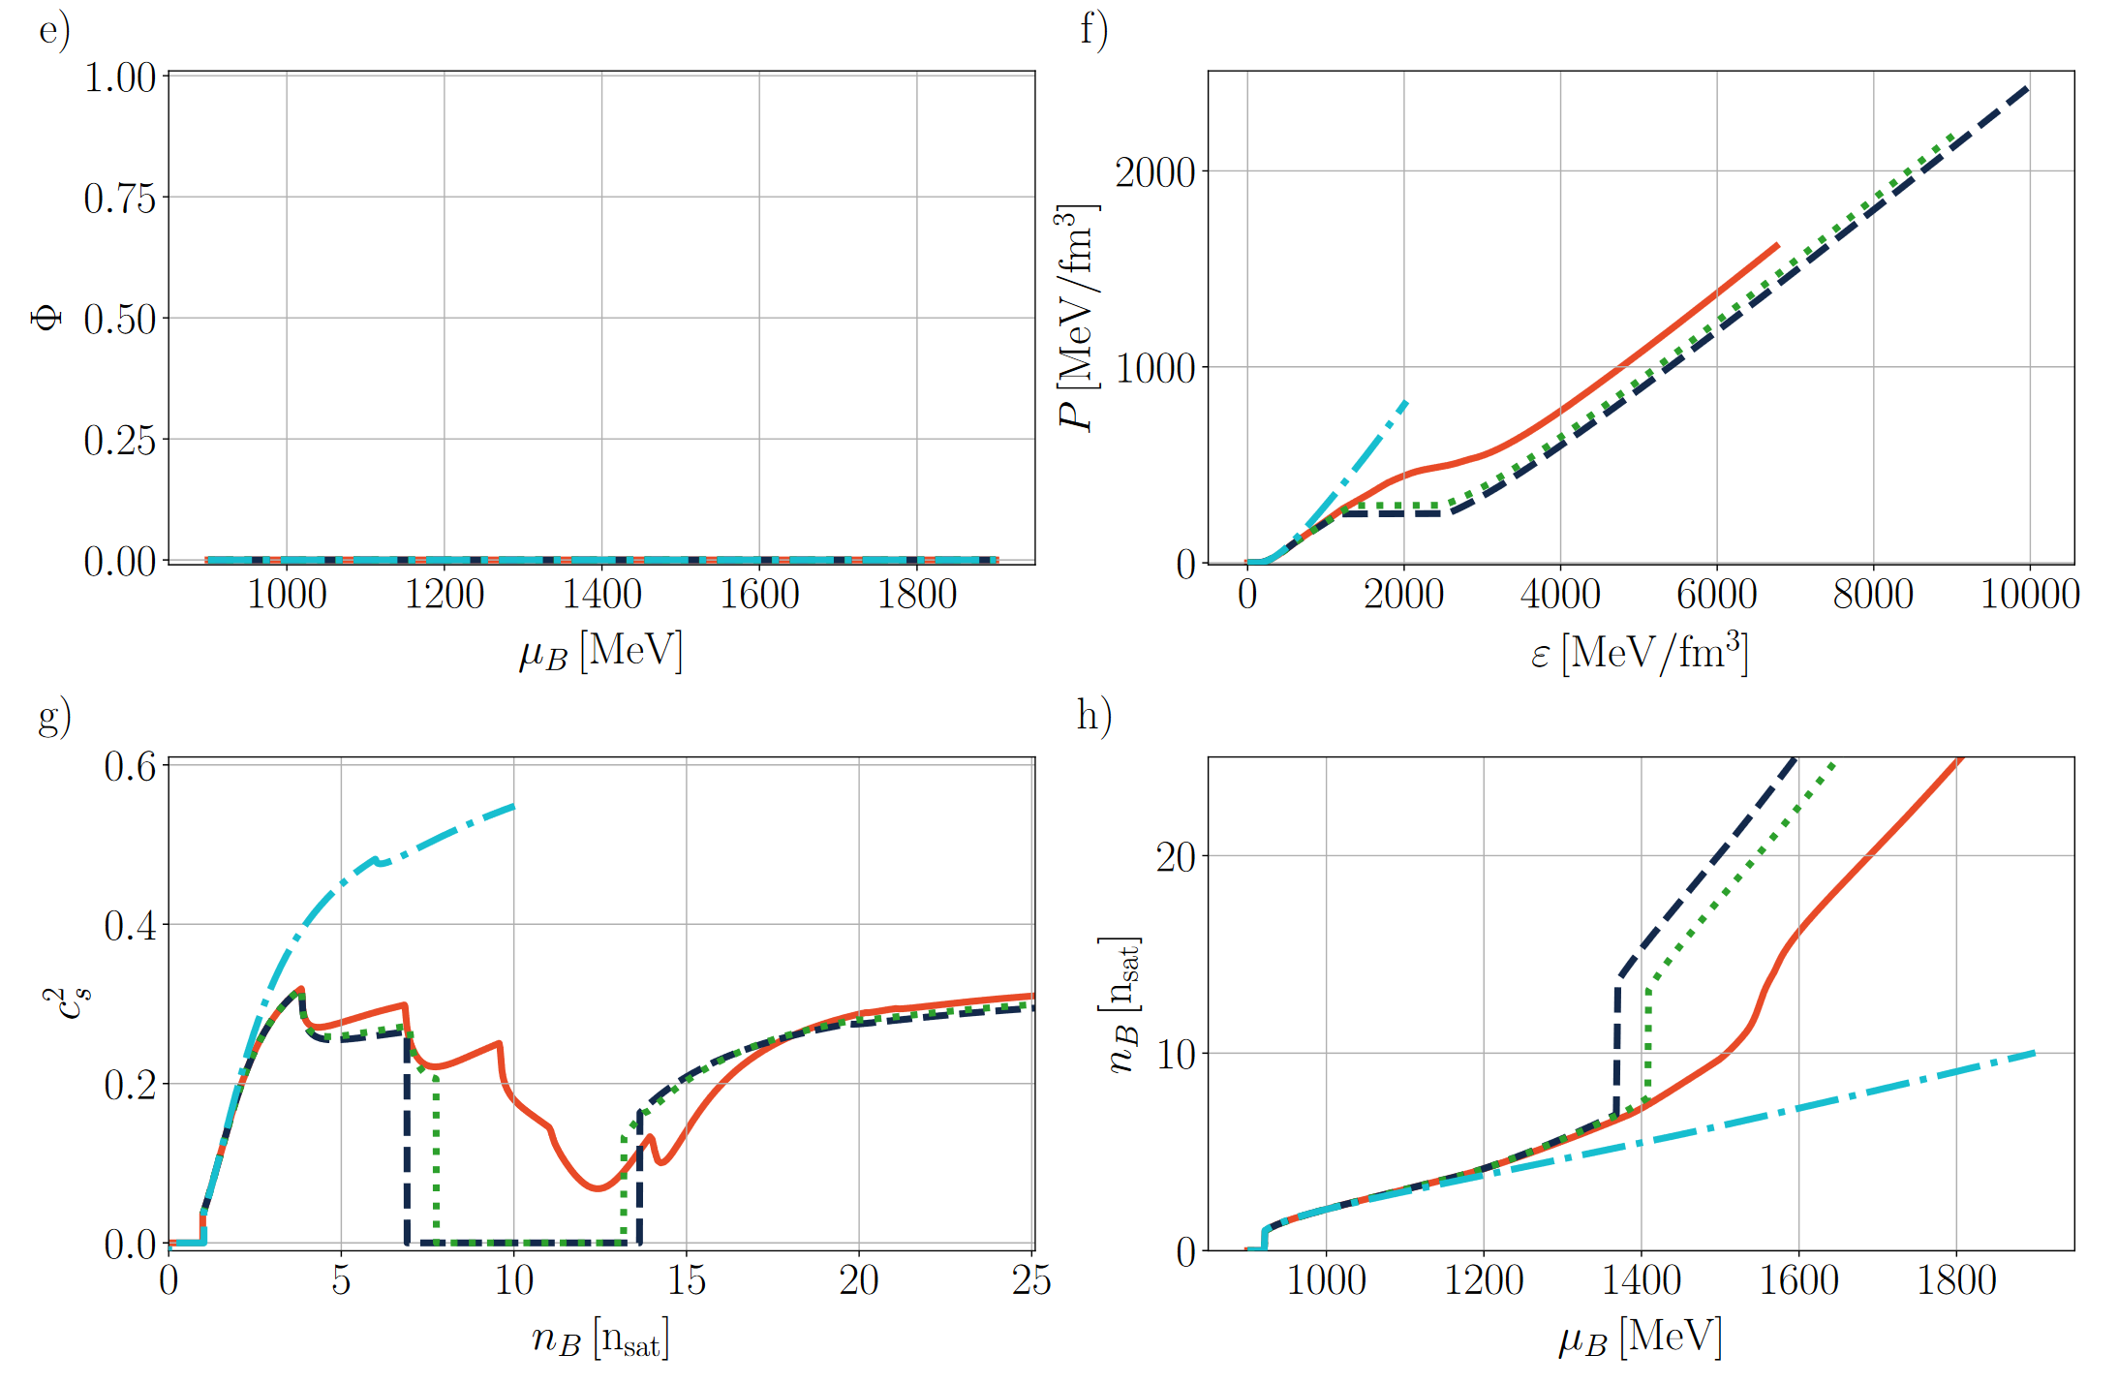
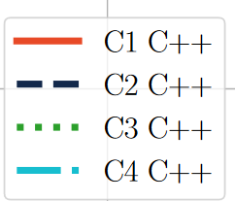
1D EoS and Speed of sound
Details are hard to see in the EoS
First-order phase transitions
Higher-order phase transitions
Taken from https://arxiv.org/abs/2409.06837

Slide 12
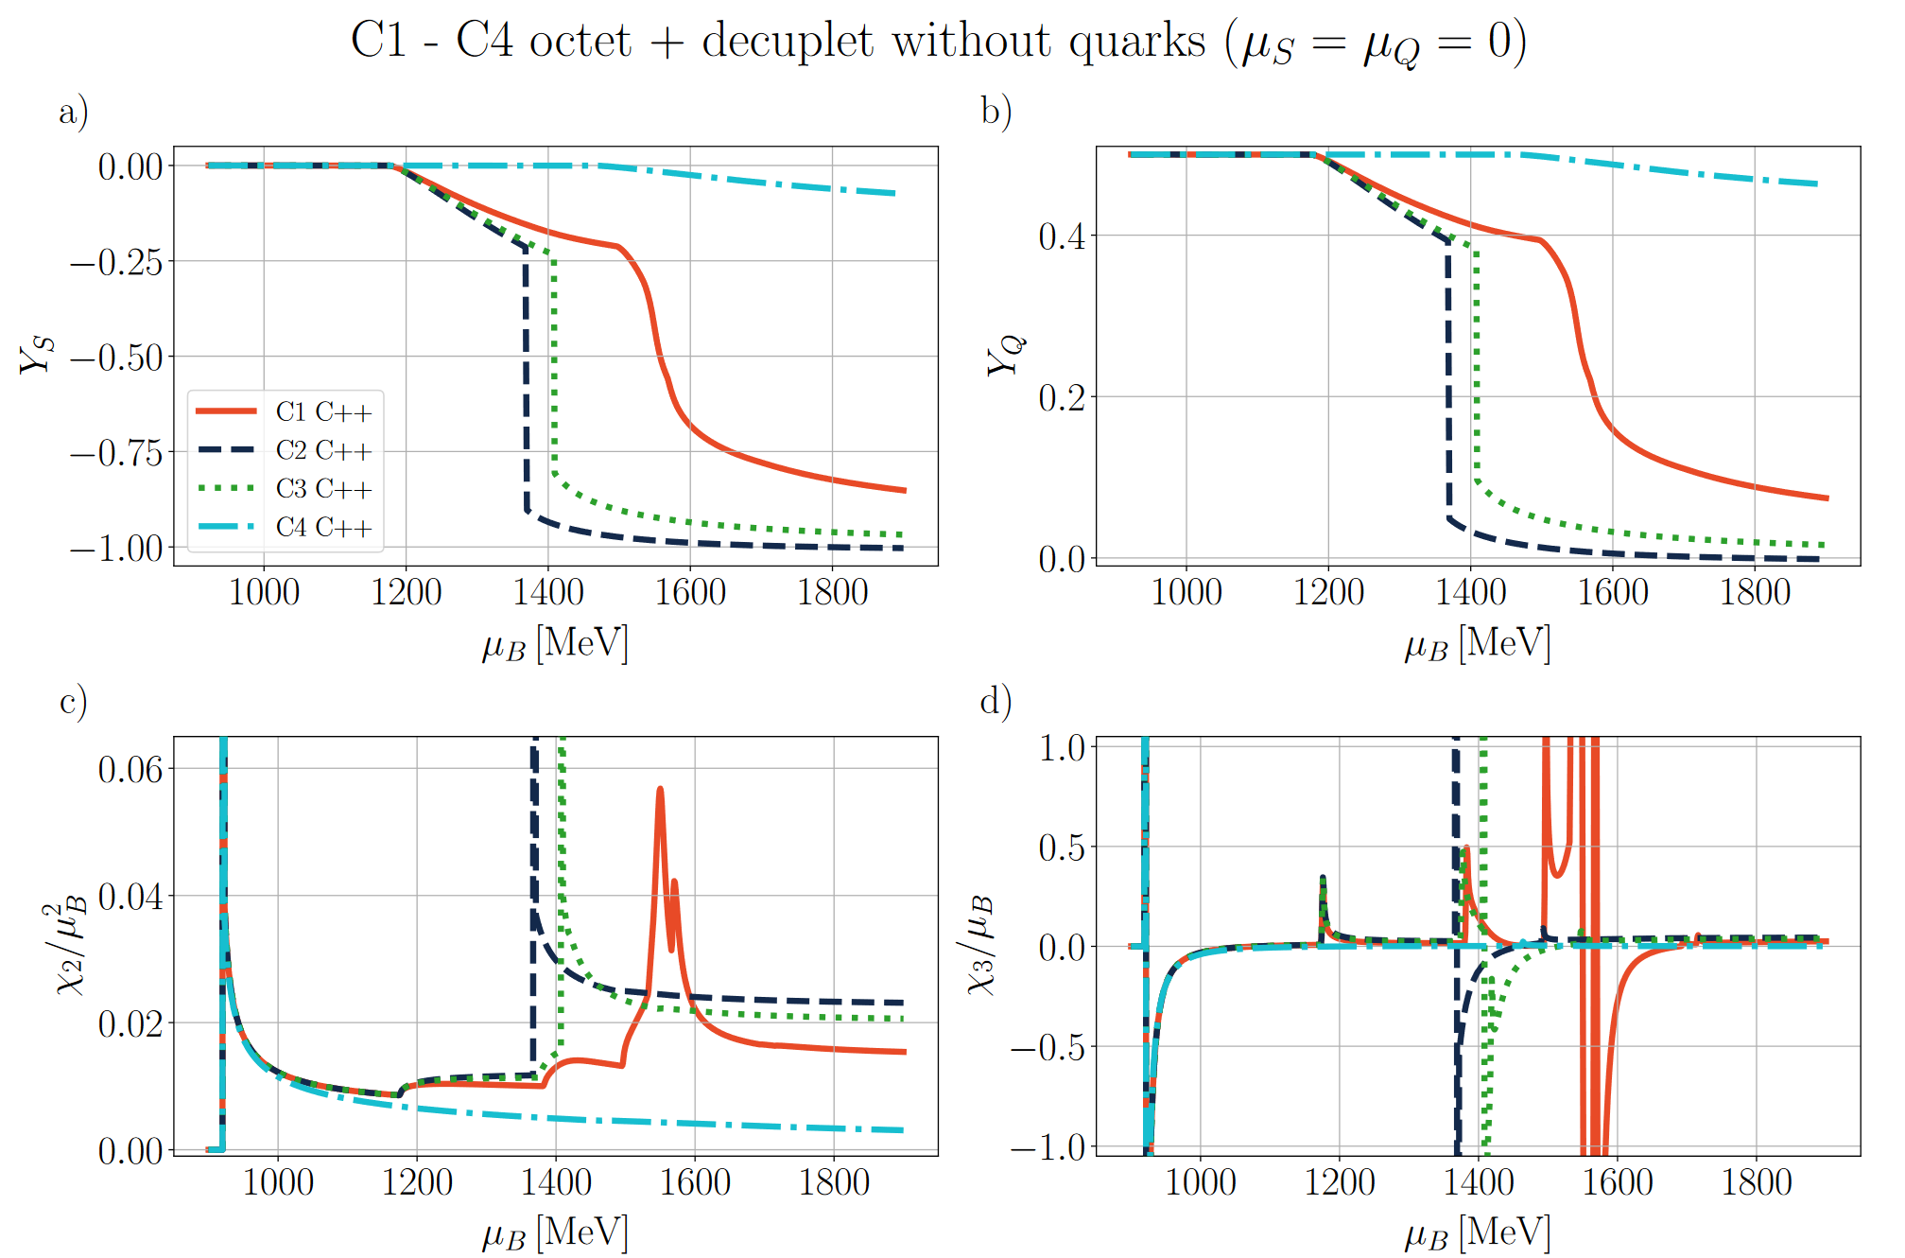
Diverse phase transitions
LG phase transitions
First-order phase transitions
Second-order phase transitions
Third-order phase transitions
Taken from https://arxiv.org/abs/2409.06837

Slide 13
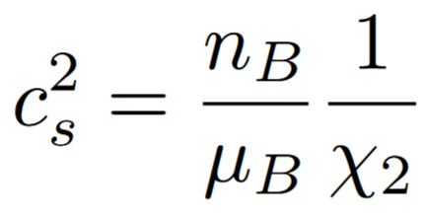
Speed of sound and susceptibilities
LG phase transitions
First-order phase transitions
Second-order phase transitions
Third-order phase transitions
Taken from https://arxiv.org/abs/2409.06837

Slide 14
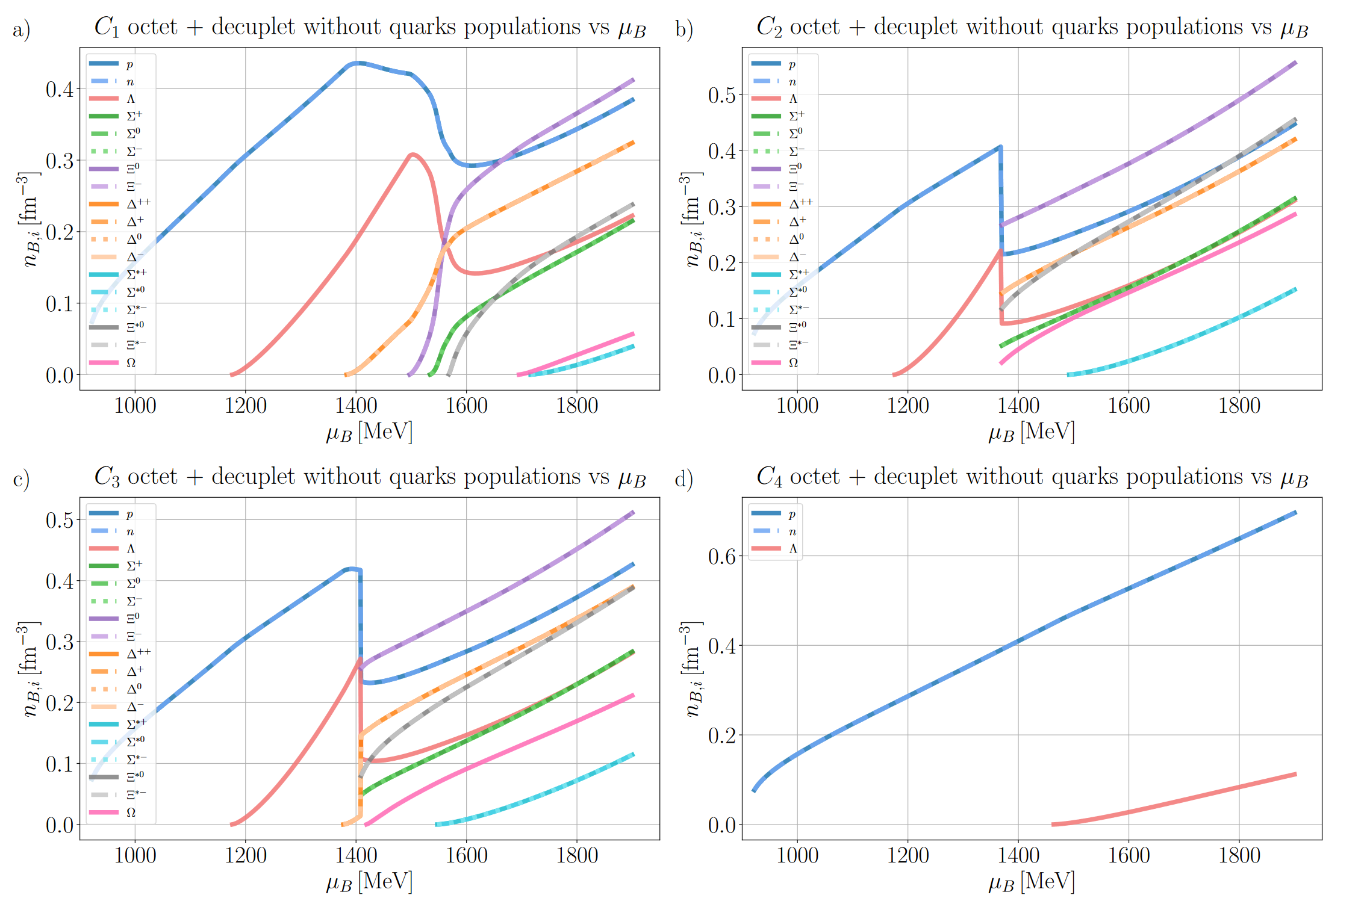
1D EoS Populations
Octet hyperons
Decuplet
Decuplet hyperons
Taken from https://arxiv.org/abs/2409.06837

Slide 15

















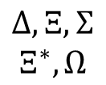


1D EoS Populations
C1
C2
$$n,p$$
$$n,p$$
$$Λ$$
$$Λ$$
$$Δ$$
$$Ξ$$
$$Δ,Ξ,Σ$$
$$Ξ^{∗},Ω$$
$$Σ$$
$$Ξ^{∗}$$
$$Ω$$
$$Σ^{∗}$$
$$Σ^{∗}$$
C3
C4
$$n,p$$
$$Λ$$
$$n,p$$
$$Δ$$
$$Ξ,Σ,Ξ^{∗}$$
$$Ω$$
$$Λ$$
$$Σ^{∗}$$
Taken from https://arxiv.org/abs/2409.06837

Slide 16
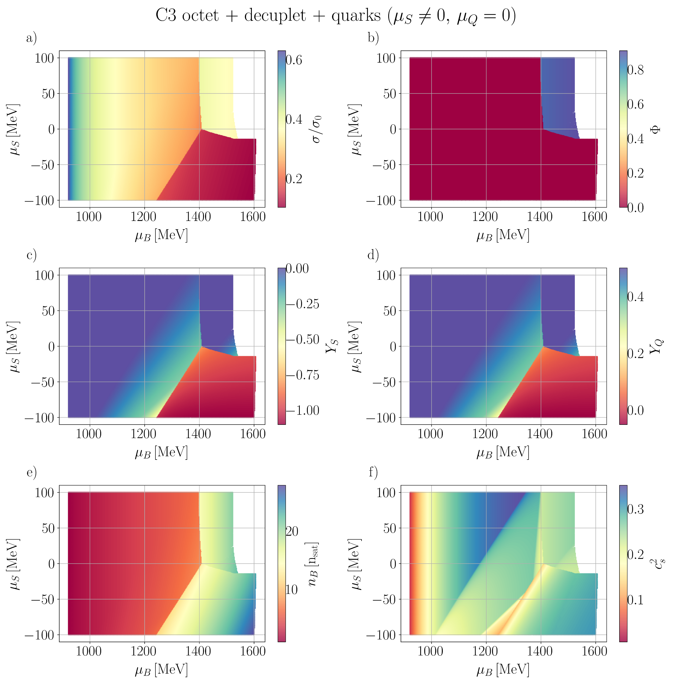

2D EoS - Constant $μ_{Q}$
Light hadron phase
Strangeness dominated phase
Quarks
Tri-critical point found: coexistence of quarks, octet and decuplet baryons
Taken from https://arxiv.org/abs/2409.06837

Slide 17
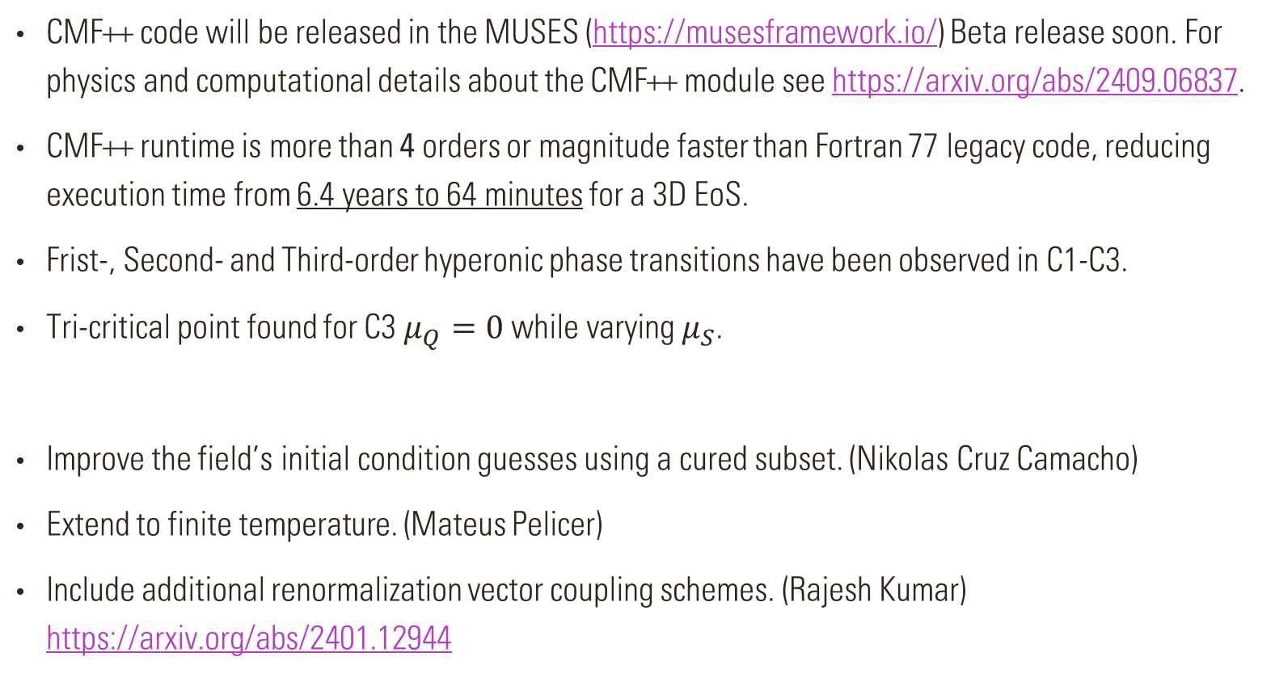
Conclusions and outlook
CMF++ code will be released in the MUSES (https://musesframework.io/) Beta release soon. For physics and computational details about the CMF++ module see https://arxiv.org/abs/2409.06837.
CMF++ runtime is more than 4 orders or magnitude faster than Fortran 77 legacy code, reducing execution time from 6.4 years to 64 minutes for a 3D EoS.
Frist-, Second- and Third-order hyperonic phase transitions have been observed in C1-C3.
Tri-critical point found for C3 $μ_{Q}=0$ while varying $μ_{S}$.
Improve the field’s initial condition guesses using a cured subset. (Nikolas Cruz Camacho)
Extend to finite temperature. (Mateus Pelicer)
Include additional renormalization vector coupling schemes. (Rajesh Kumar) https://arxiv.org/abs/2401.12944

Slide 18

Thank you for your time and attention

