Slide 1
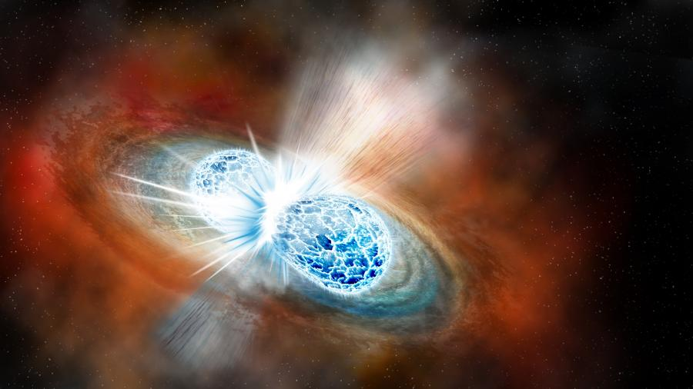




Heavy-ion collision measurements at early FRIB and a look towards FRIB400
Kyle W. Brown
(brownk@frib.msu.edu)
IRL-NPA FRIB Workshop
Oct 28th, 2024
Picture Credit: Robin Dienel

Slide 2
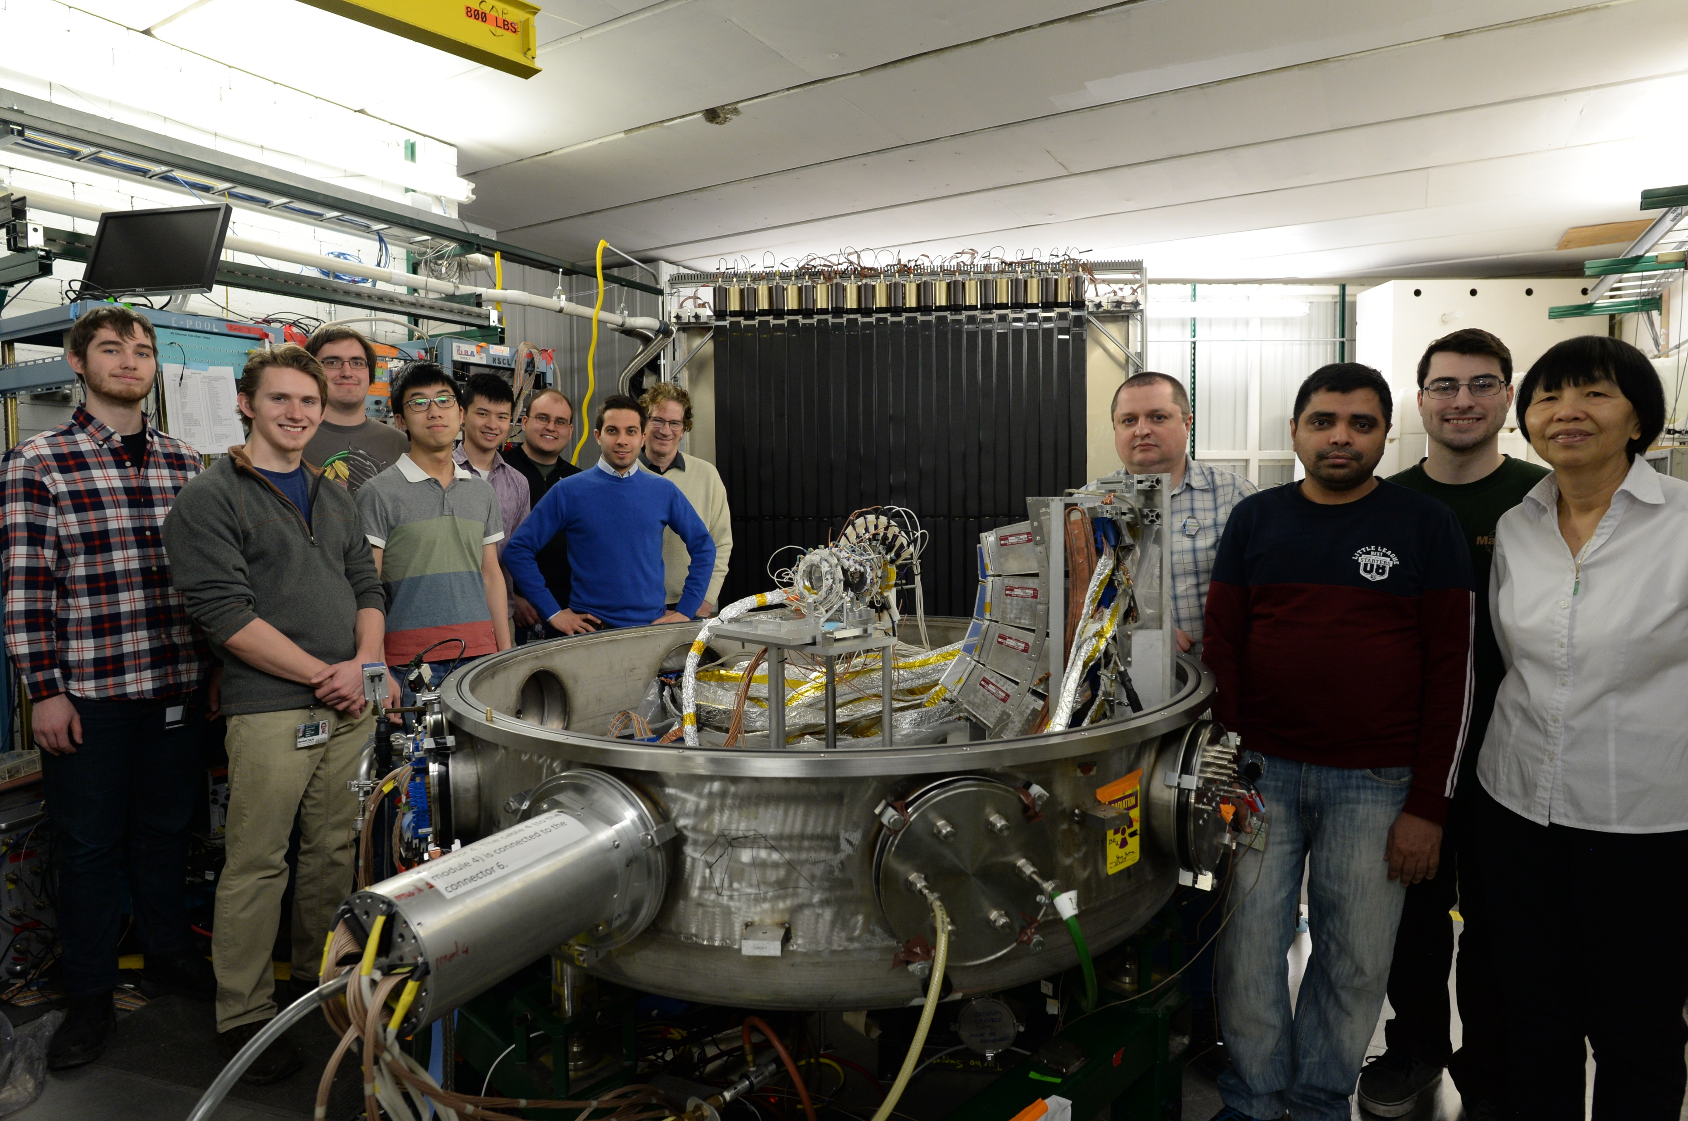
HiRA Collaboration
The work presented today is a combination of hard work by many talented students and postdocs
Special thanks to:
  Students: Zhu Kuan (PhD 2020), Sean Sweany (PhD 2020), Om Bhadra Khanal (PhD 2022), Chi En Teh (PhD 2023), Jeonghyeok Park
  Postdocs: Pierre Morfouace, Danelle Dell’Aquila, Chenyang Niu, Renshang Wang, Som Paneru
Collaborators: GANIL, Kyoto University, RIKEN, Korea University, Institute for Basic Science, INFN, ORNL, UNAM

Slide 3
Outline
Current state of experiment nuclear science constraints on the Symmetry Energy
Results from Ca+Ni experiment at NSCL
Experimental program for extracting Symmetry energy at FRIB, FRIB400, and HRS

Slide 4
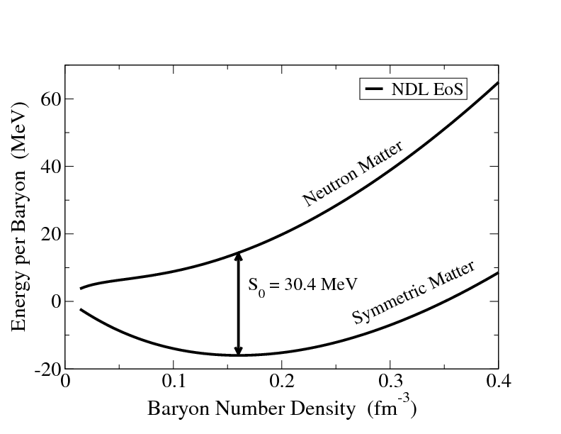
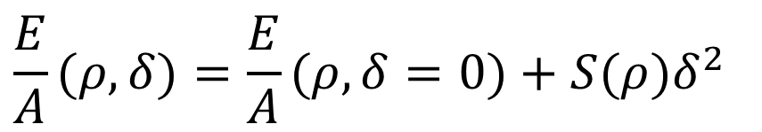
Density dependence of the Symmetry Energy
For symmetric matter, binding only depends on density. Minimum is determined by GMR
Adding in the asymmetry
adds a new term we call the Symmetry Energy
Symmetry Energy is the difference in binding between pure neutron matter and symmetric nuclear matter
HIC experiments are only terrestrial probe for EoS away from Sat Density
$$\frac{E}{A}(ρ,δ)=\frac{E}{A}(ρ,δ=0)+S(ρ)δ^{2}$$
Symmetry Energy: cost for N≠Z
(largest EoS uncertainty)
M. Meixner arXiv:1303.0064 [astro-ph.HE]
Notes:
Add NS, this is like DFT, assuming you can get the energy from the density.
NDL EoS – Norte Dame Livermore

Slide 5
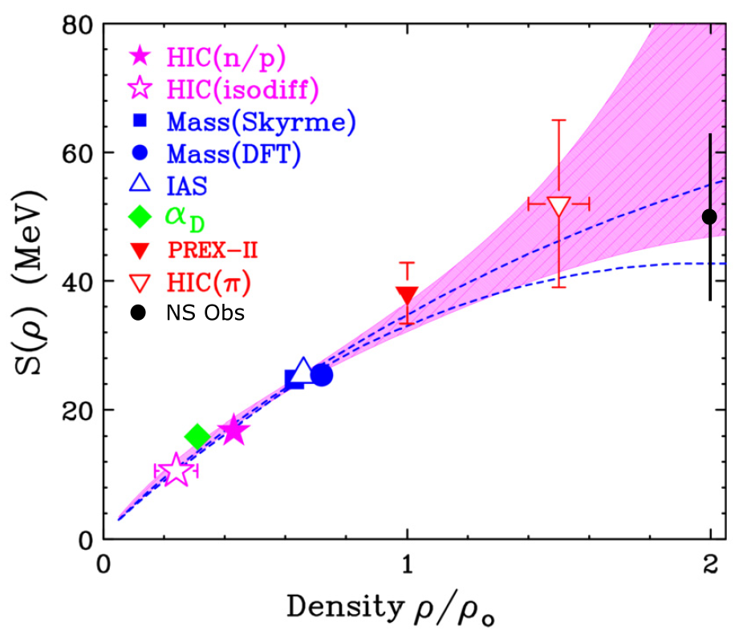
Experimental Constraints

Slide 6
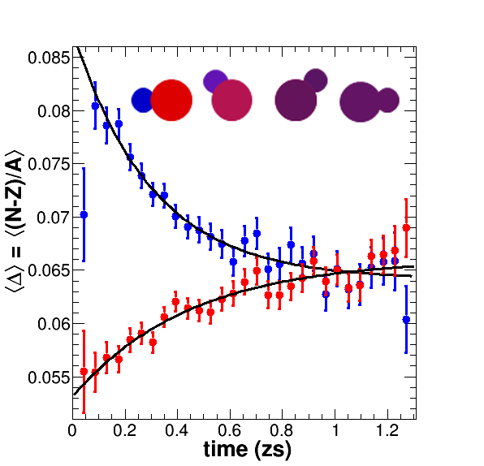
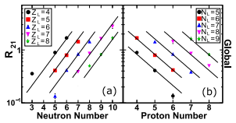
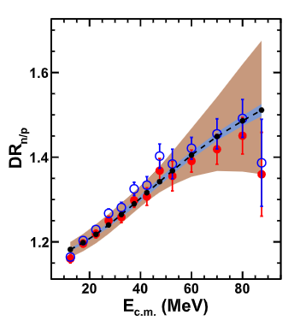
Symmetry Energy @ ρ < ρ₀
PRC 101 (2020) 034605
PLB 799 (2019) 135045
PRL 118 (2017) 062501
PRC 95 (2017) 044604
PRC 101 (2020) 034605

Slide 7
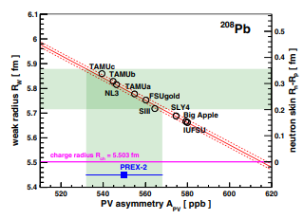
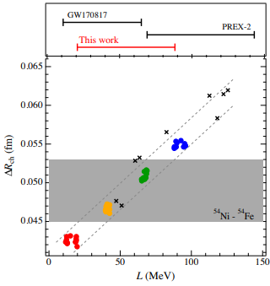
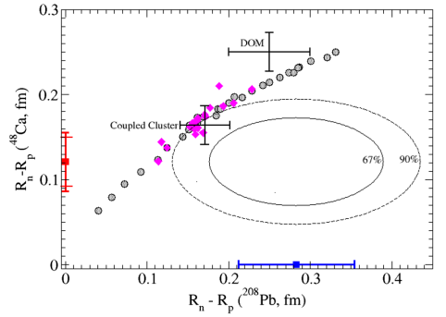
Symmetry Energy @ ρ ≈ ρ₀
PRL 126 (2021) 172502
PRL 129 (2022) 042501
PRL 127 (2021) 182503

Slide 8
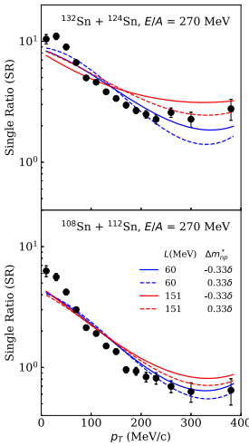
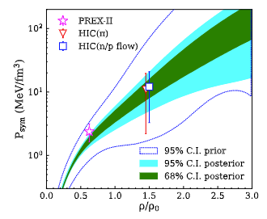
Symmetry Energy @ ρ > ρ₀
PRL 126 (2021) 162701
C. Y. Tsang arXiv:2310.11588

Slide 9
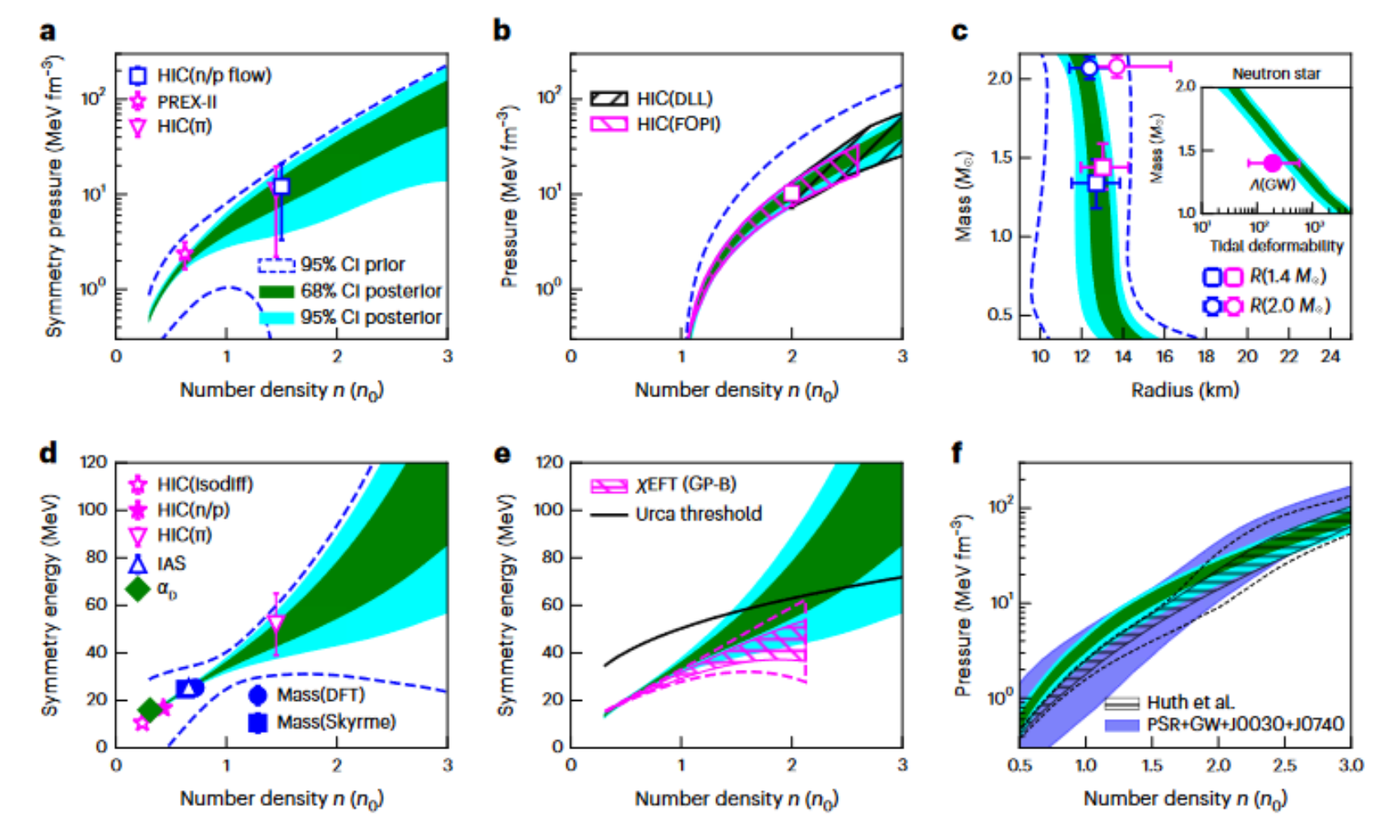
Nuclear + Astro
C. Y. Tsang Nature Astronomy 8, 328 (2024)

Slide 10
Symmetry Energy @ ρ > ρ₀
PRL 126 (2021) 162701
C. Y. Tsang arXiv:2310.11588

Slide 11
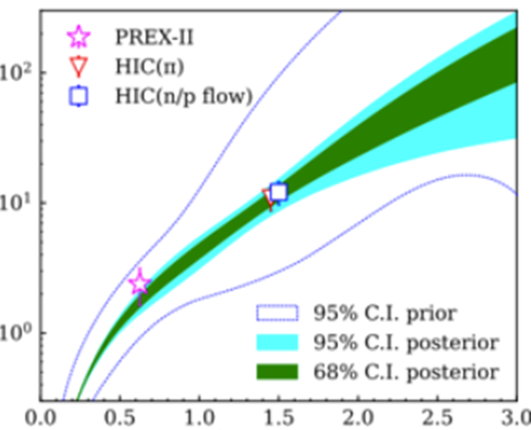
Symmetry Energy @ ρ > ρ₀
PRL 126 (2021) 162701
Effect of reducing the error bars to 20%
C. Y. Tsang arXiv:2310.11588

Slide 12
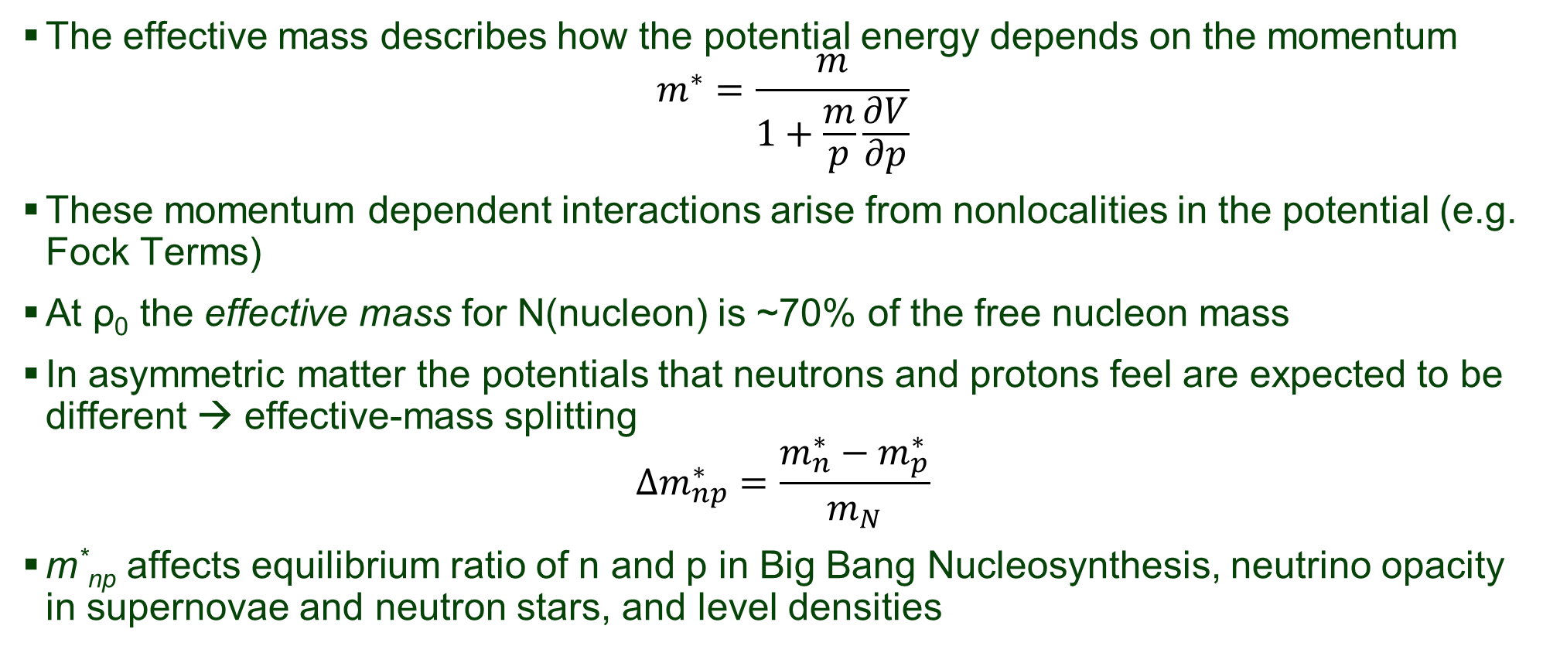
Momentum Dependence
The effective mass describes how the potential energy depends on the momentum
$$m^{∗}=\frac{m}{1+\frac{m}{p}\frac{∂V}{∂p}}$$
These momentum dependent interactions arise from nonlocalities in the potential (e.g. Fock Terms)
At ρ₀ the effective mass for N(nucleon) is ~70% of the free nucleon mass
In asymmetric matter the potentials that neutrons and protons feel are expected to be different → effective-mass splitting
$${Δm}_{np}^{∗}=\frac{m_{n}^{∗}−m_{p}^{∗}}{m_{N}}$$
m*_{np} affects equilibrium ratio of n and p in Big Bang Nucleosynthesis, neutrino opacity in supernovae and neutron stars, and level densities

Slide 13
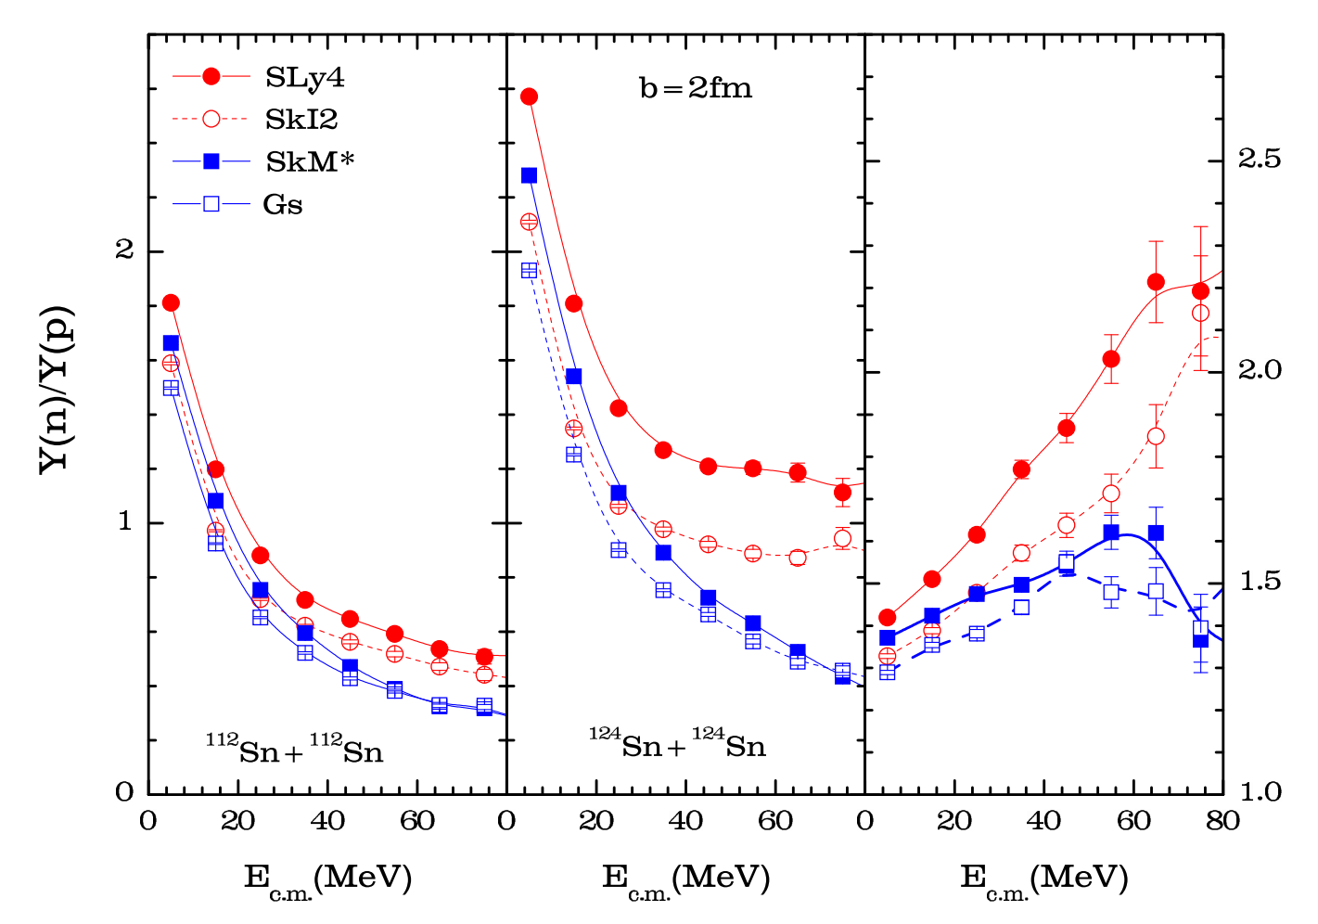
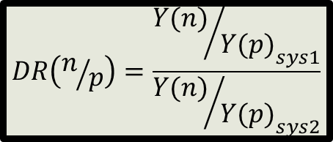
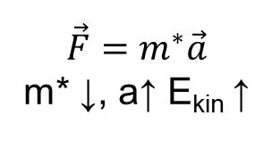
Observable for Δm*_{np}
Density Dep.
= Large L
= Small L
$$DR\left(n/p\right)=\frac{{{Y(n)}/{Y(p)}}_{sys1}}{{{Y(n)}/{Y(p)}}_{sys2}}$$
Momentum Dep.
m*_{p}>m*_{n}
m*_{n}>m*_{p}
$$\vec{F}=m^{∗}\vec{a}$$
m* ↓, a↑ E_{kin} ↑
Zhang et al. PLB 732, 186 (2014)

Slide 14
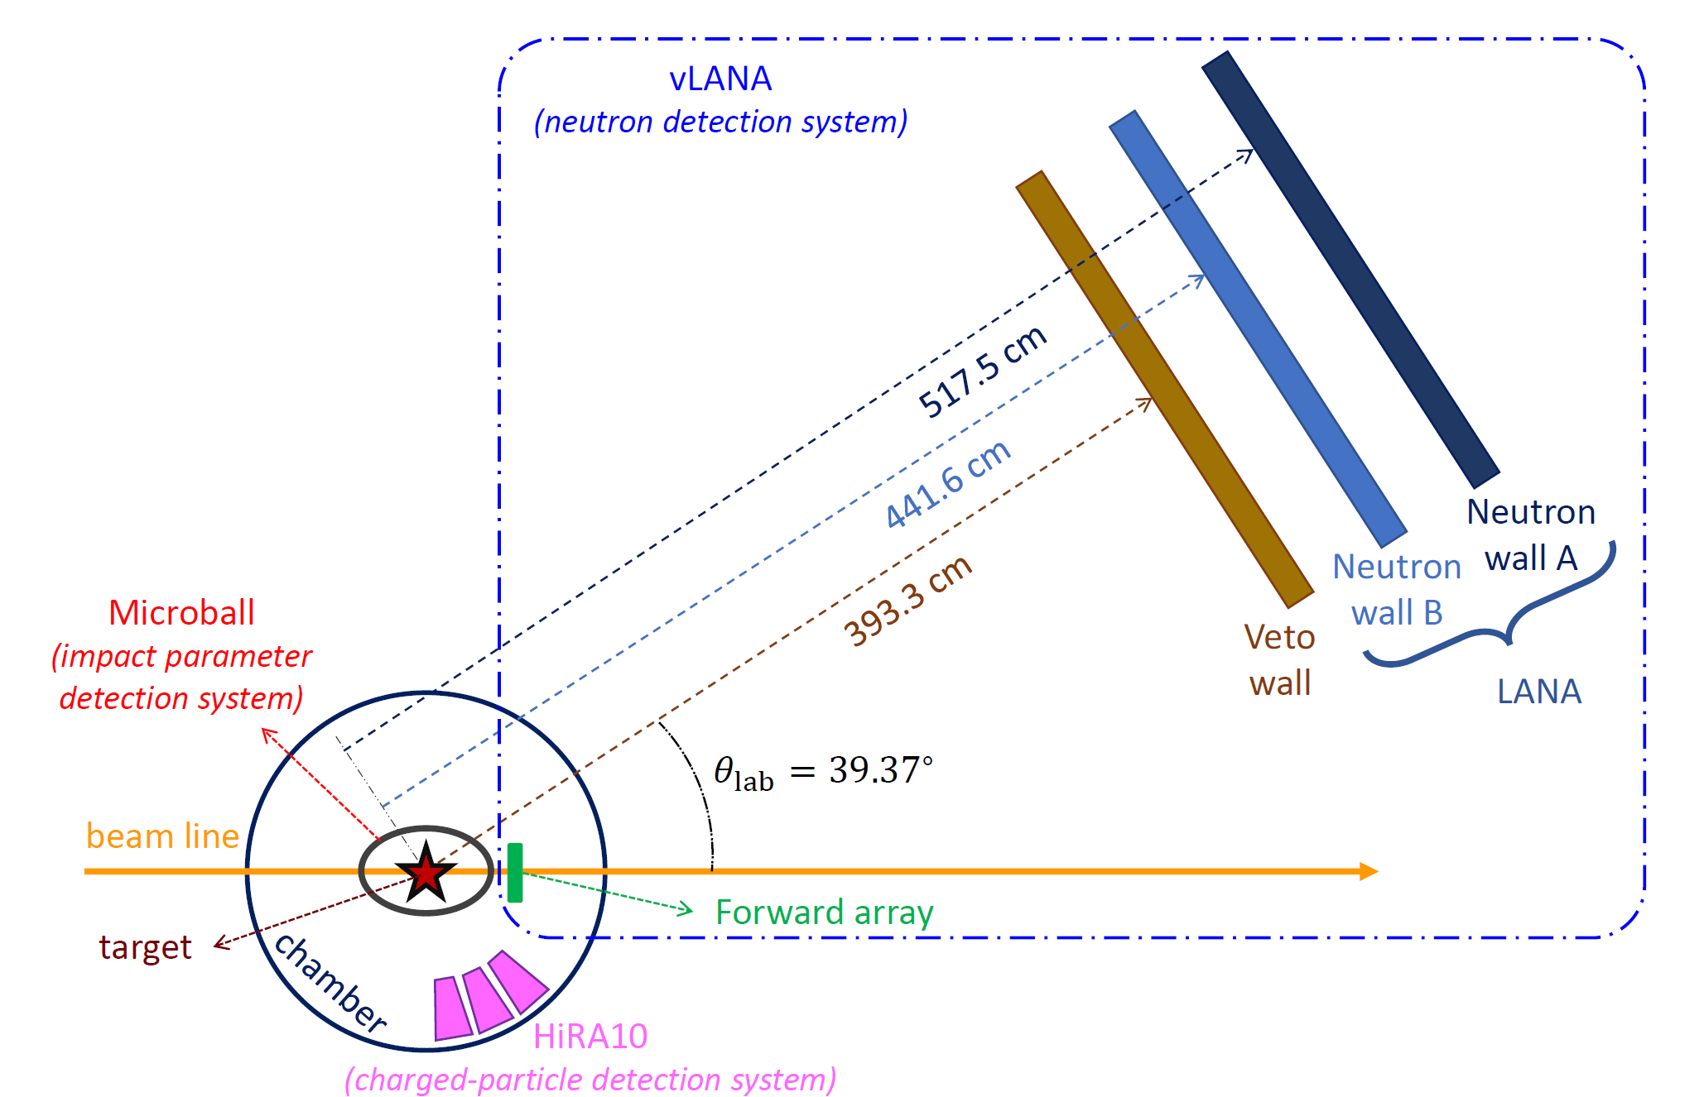
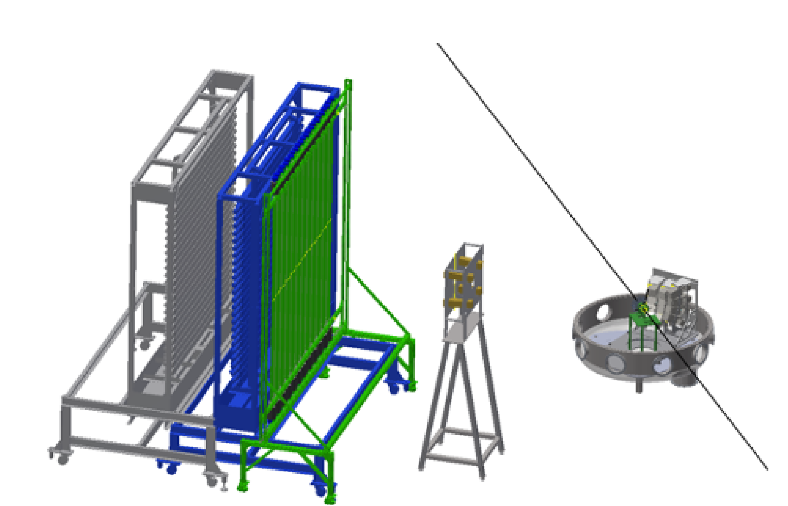
Experimental Setup

Slide 15
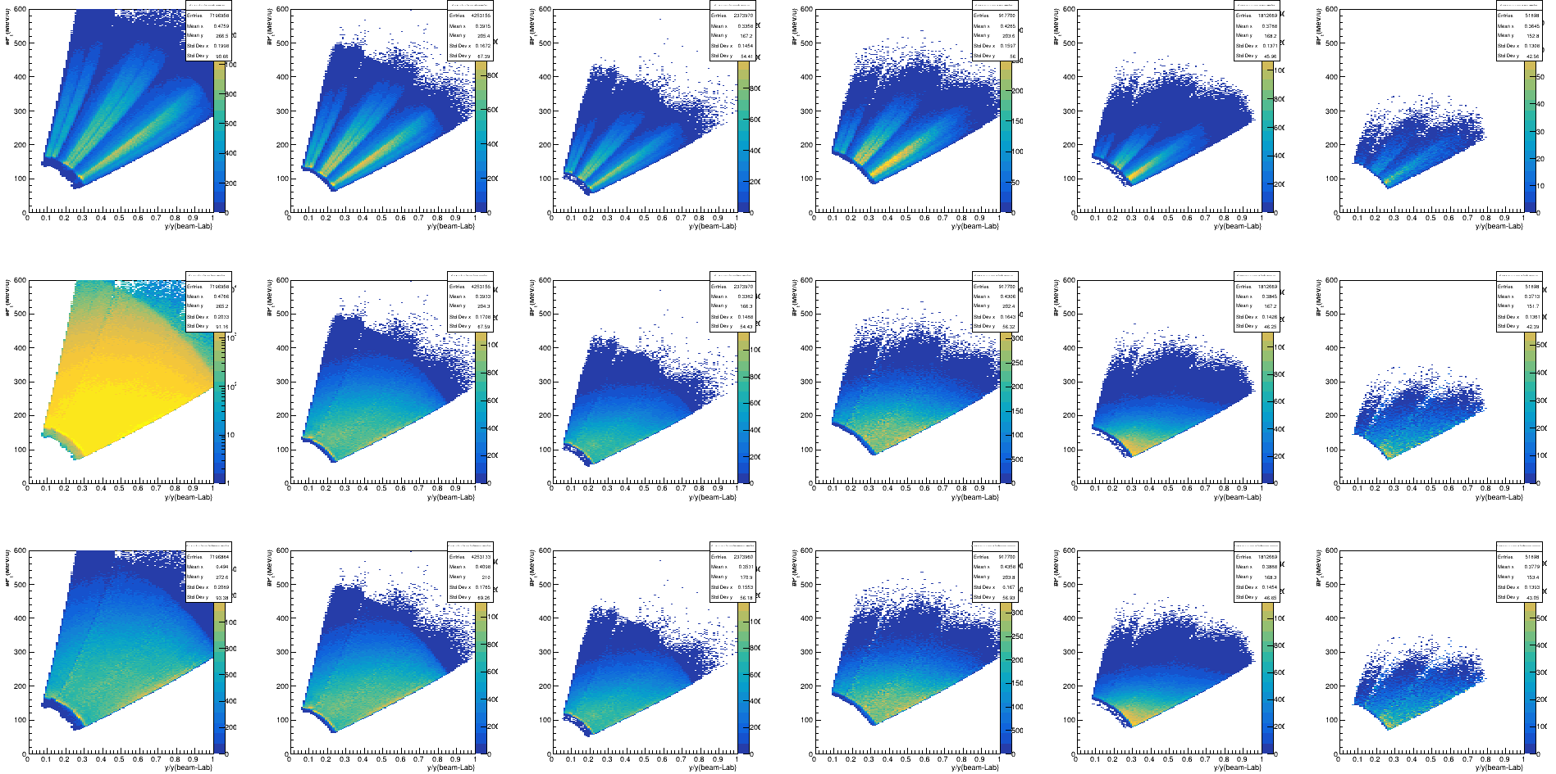
HiRA Data - P_{t}/A vs Rapidity
P
D
T
³He
⁴He
⁶He
P_{t}/A
y/y_{beam}
Top: Raw Data
Bottom: Efficiency and Reaction Loss Corrected
S. Sweany (Thesis 2020),R. Wang, KWB, D. Dell’Aquila

Slide 16

Charged Particle Spectra
deuterons
S. Sweany (Thesis 2020),R. Wang, KWB, D. Dell’Aquila

Slide 17
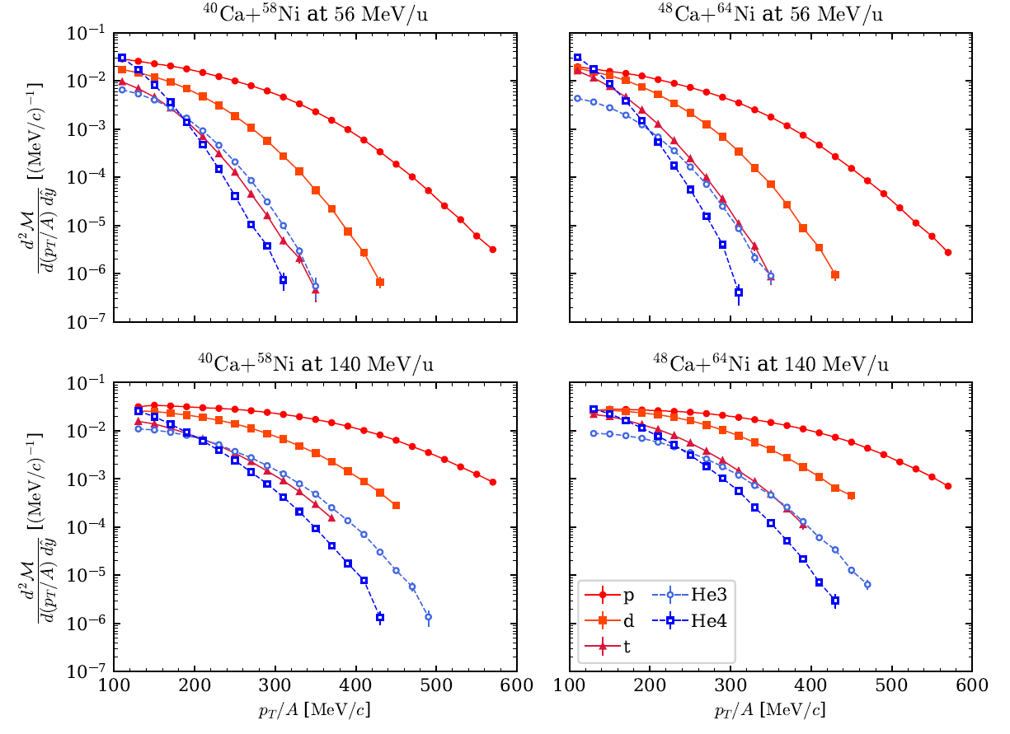
Charged Particle Spectra
S. Sweany (Thesis 2020),R. Wang, KWB, D. Dell’Aquila

Slide 18
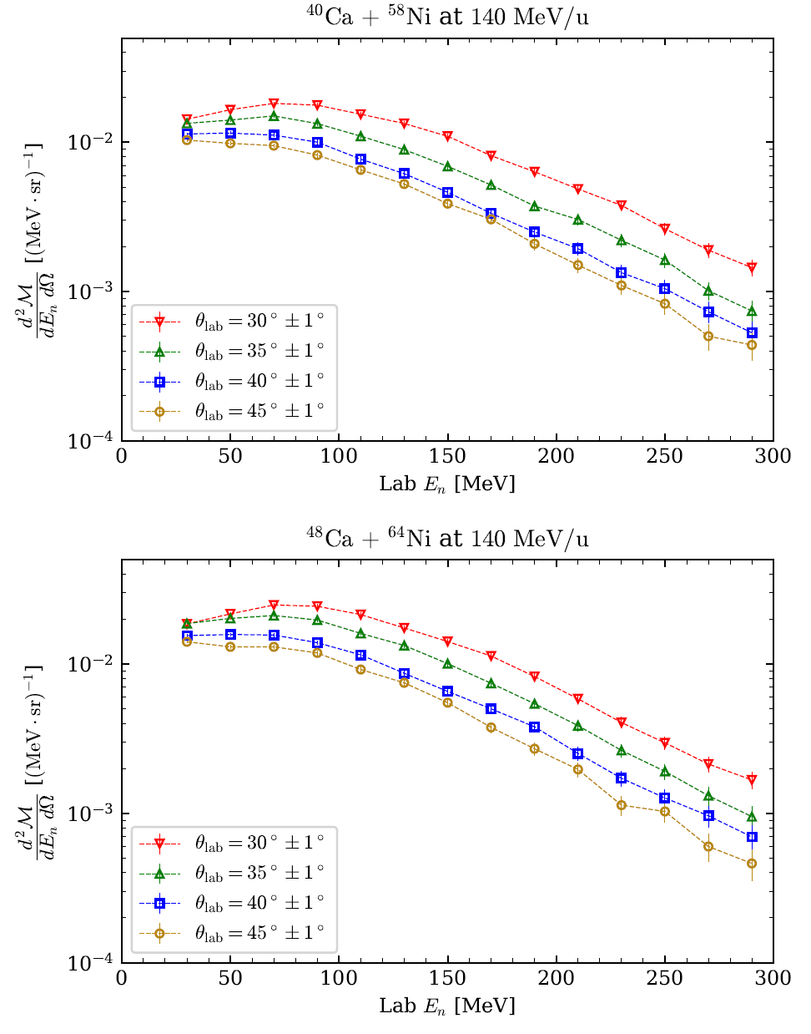
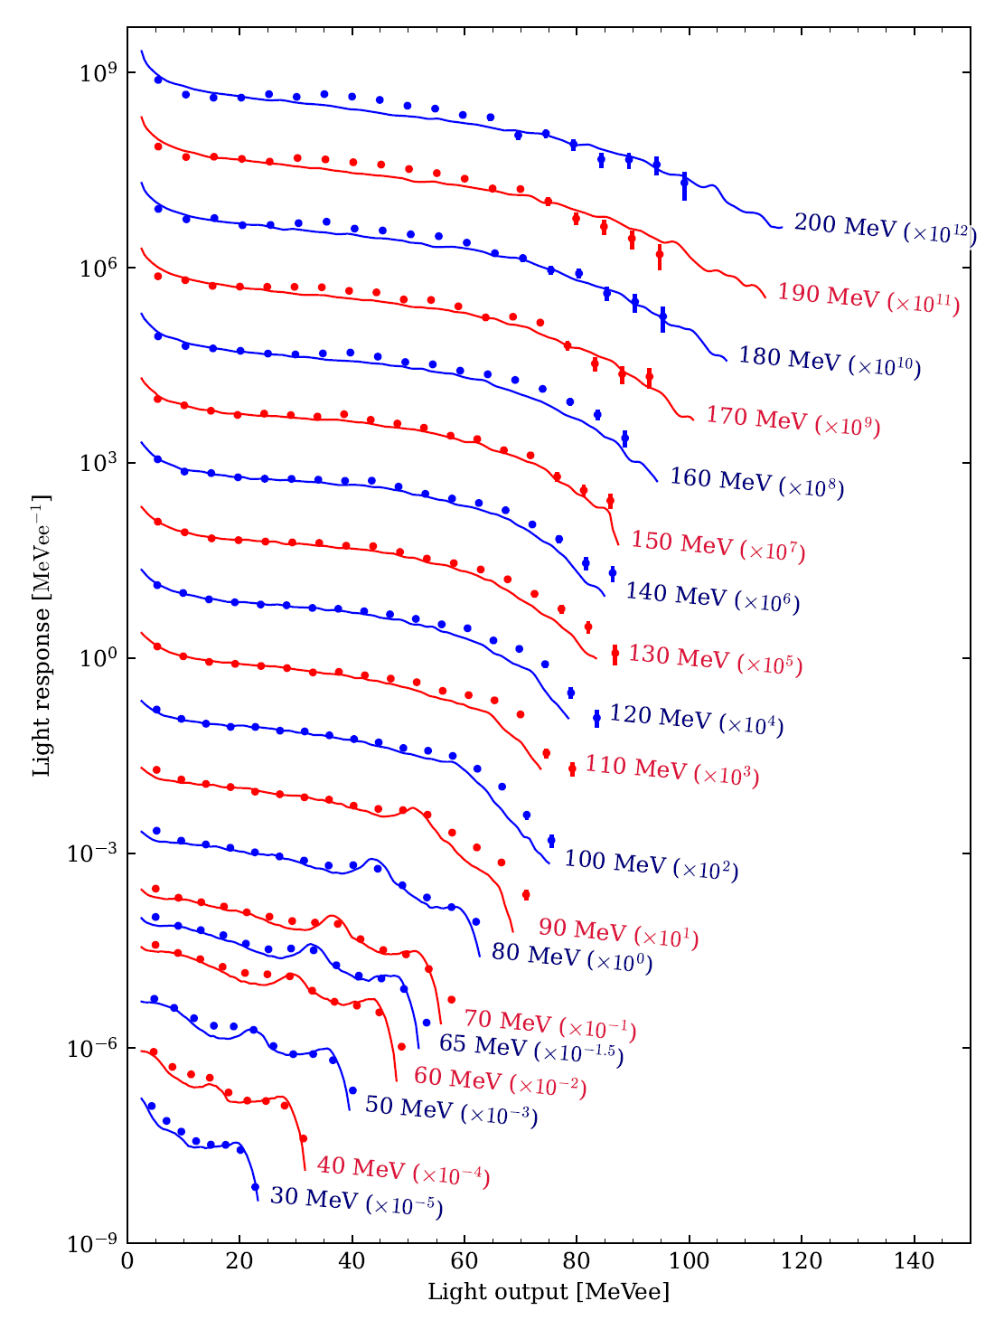
Neutrons
J. Park et al. NIM A 1065, 169475 (2024)
K. Zhu (Thesis 2020), C. Teh (Thesis 2023), S. Paneru, J. Park

Slide 19
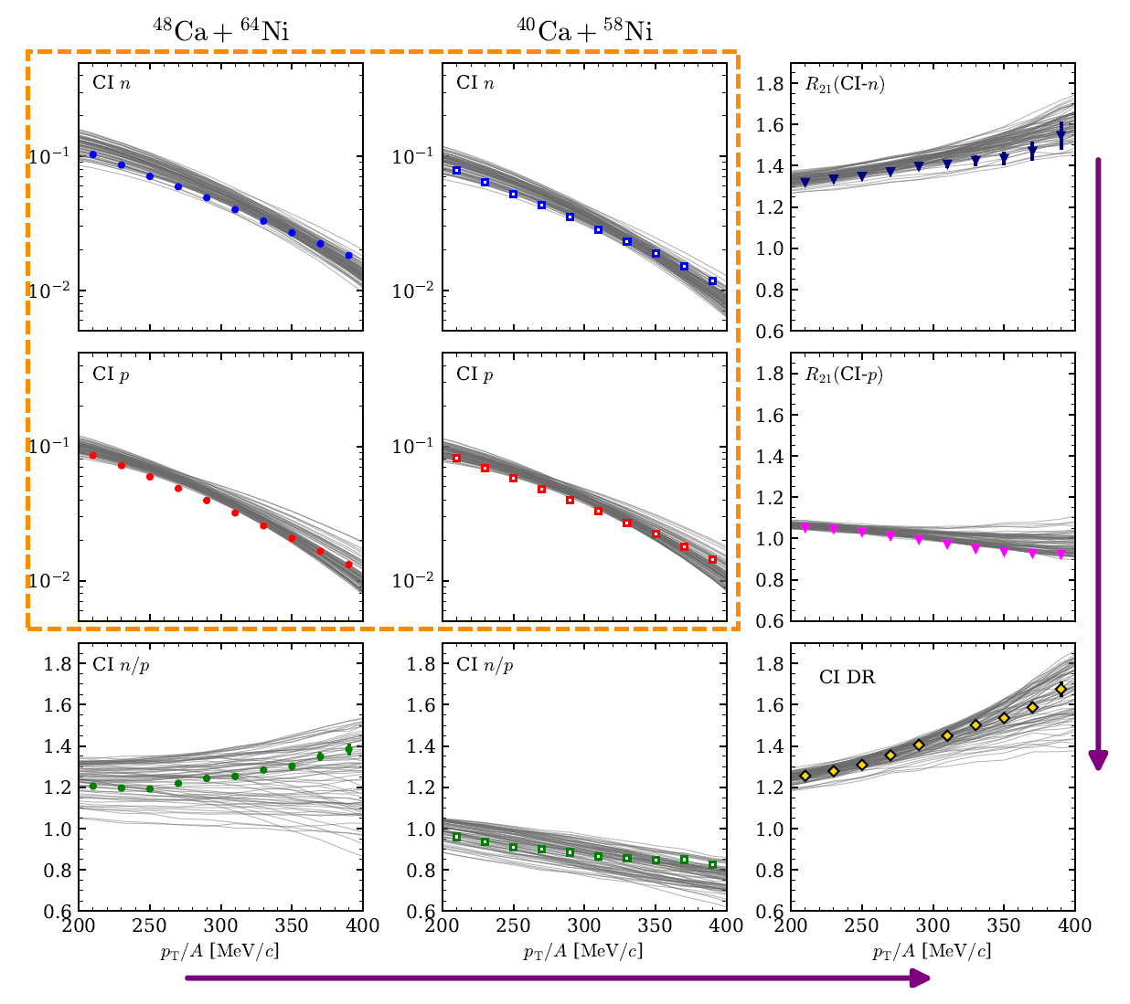
Single and Double Ratios
Coalescence invariant n and p spectra (light clusters broken into free n and p), and their ratios
Grey lines are 75 Latin Hypercube Sampling of (S₀, L, m*_{s}, m*_{v}) used to train gaussian emulator
Chi-En (Fanurs) Teh (Thesis 2023)

Slide 20
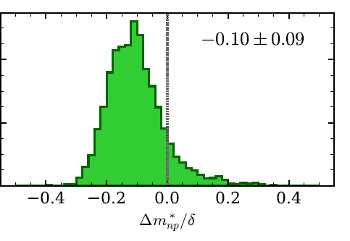
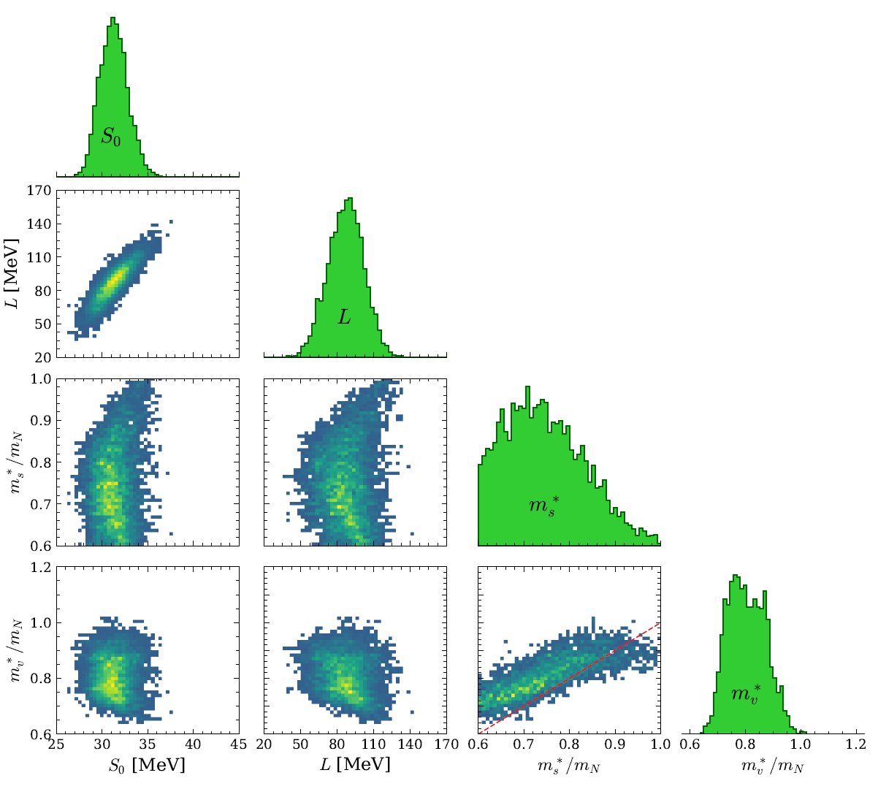
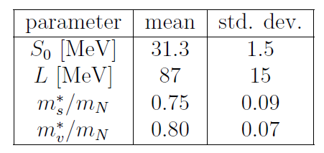
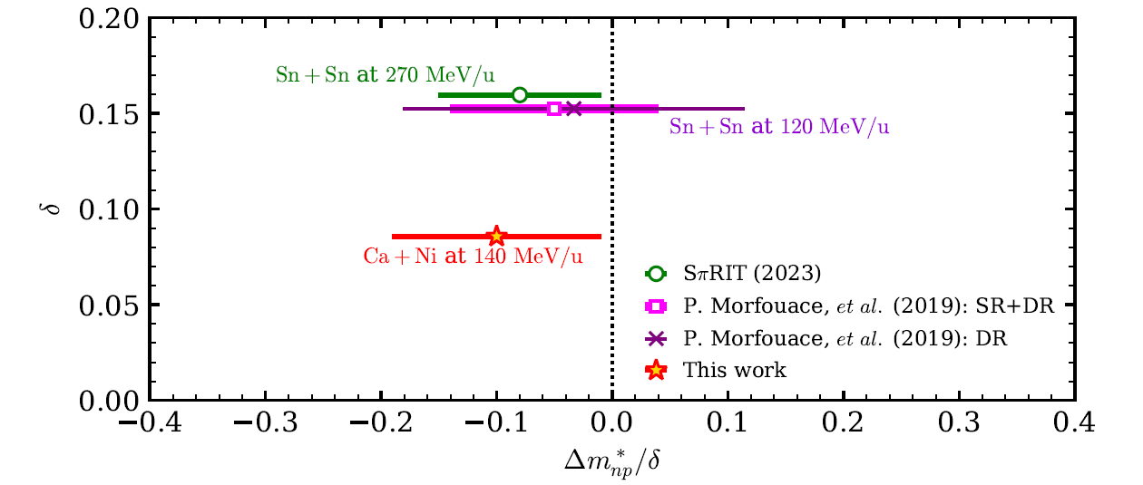
Extracting Constraints
Chi-En (Fanurs) Teh (Thesis 2023)

Slide 21
What can be done with FRIB and FRIB400?

Slide 22
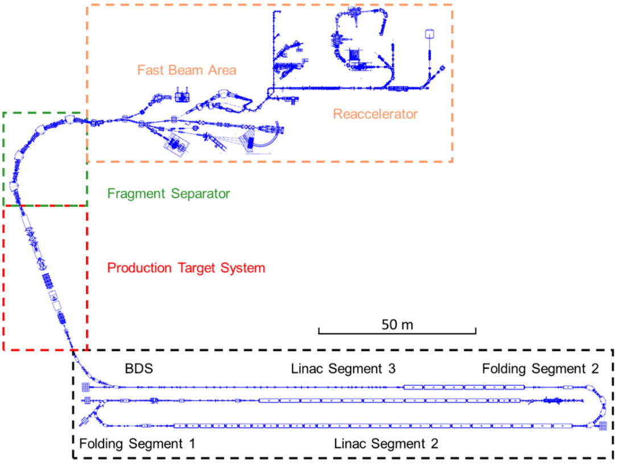
Schematic Overview of the FRIB Facility
Stopped Beam Area
High power heavy ion accelerator (200 MeV/u, 400 kW for all beams Oxygen to Uranium)
Superconducting linear accelerator with 3 segments – 46 total cryomodules
Three-stage fragment separator
Fast, Stopped and Reaccelerated beams available
ReA3,6 (up to 10 MeV/u re-accelerator); can operate in stand-alone mode
Pre-separator

Slide 23
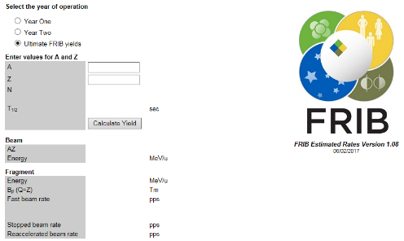
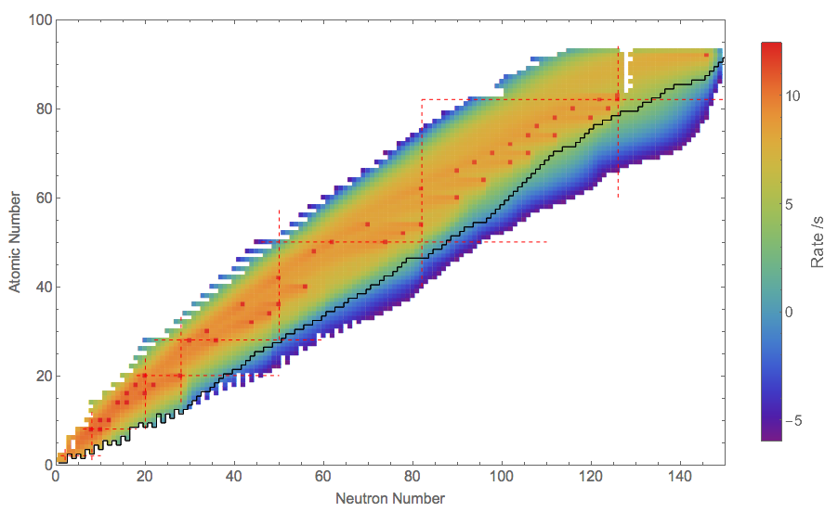
FRIB Estimated Beam Rates
https://groups.nscl.msu.edu/frib/rates/fribrates.html
Beams:
Fast
Stopped
Reaccelerated
Log
O. Tarasov, et al. EPAX 2.15

Slide 24
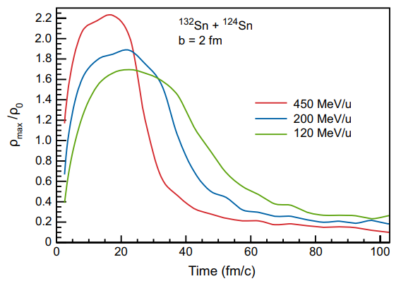
EoS Studies at FRIB
FRIB Upgrade Whitepaper

Slide 25
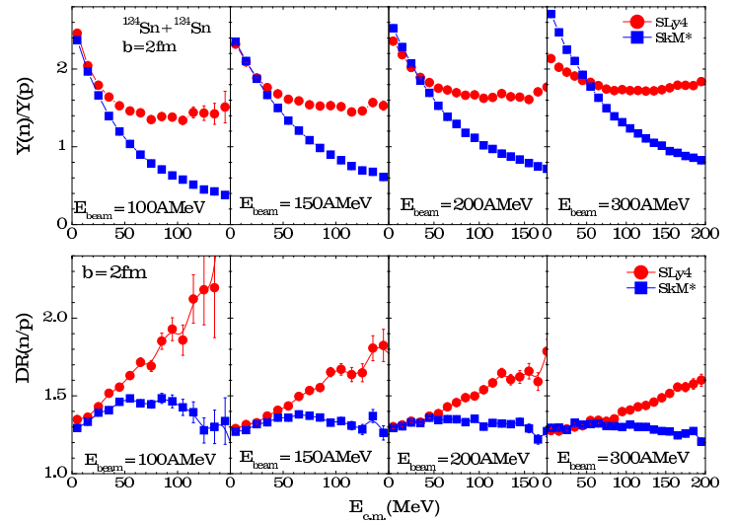
Momentum dependence (effective masses)
The sensitivity of the n/p ratio on the effective mass (momentum dependence) drops off with beam energy
If we want to measure this for higher density, we need another observable
m*_{p}>m*_{n}
m*_{n}>m*_{p}
F = m*a
If m* ↓, then a↑ E_{kin} ↑
Zhang et al. PLB 2014

Slide 26
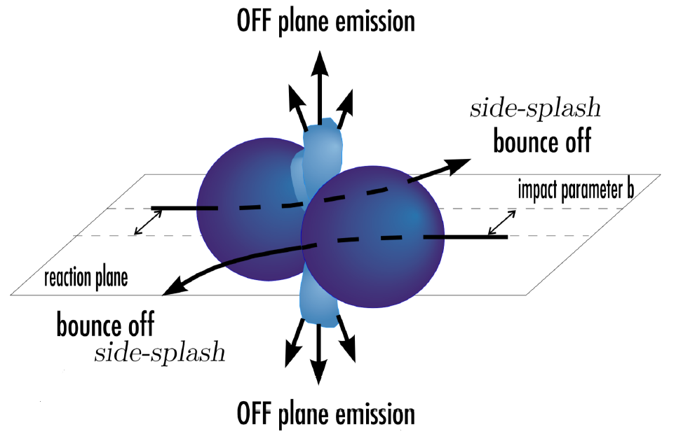
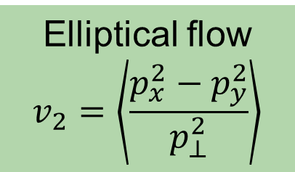
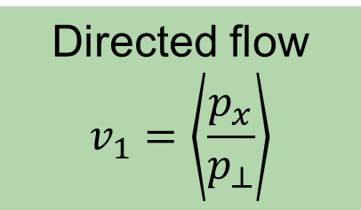
Directed and Elliptical Flow
Directed flow
$$v_{1}=\left\langle \frac{p_{x}}{p_{⊥}}\right\rangle$$
Elliptical flow
$$v_{2}=\left\langle \frac{p_{x}^{2}−p_{y}^{2}}{p_{⊥}^{2}}\right\rangle$$
Neutron
Proton
Projectile and target “spectators” block the escape of matter rom the high P region and force it out of plane.
Magnitude of this enhancement reflects the pressure in the central region
v₂ more selective probe than n/p spectral ratio of the symmetry with smaller systematic errors

Slide 27
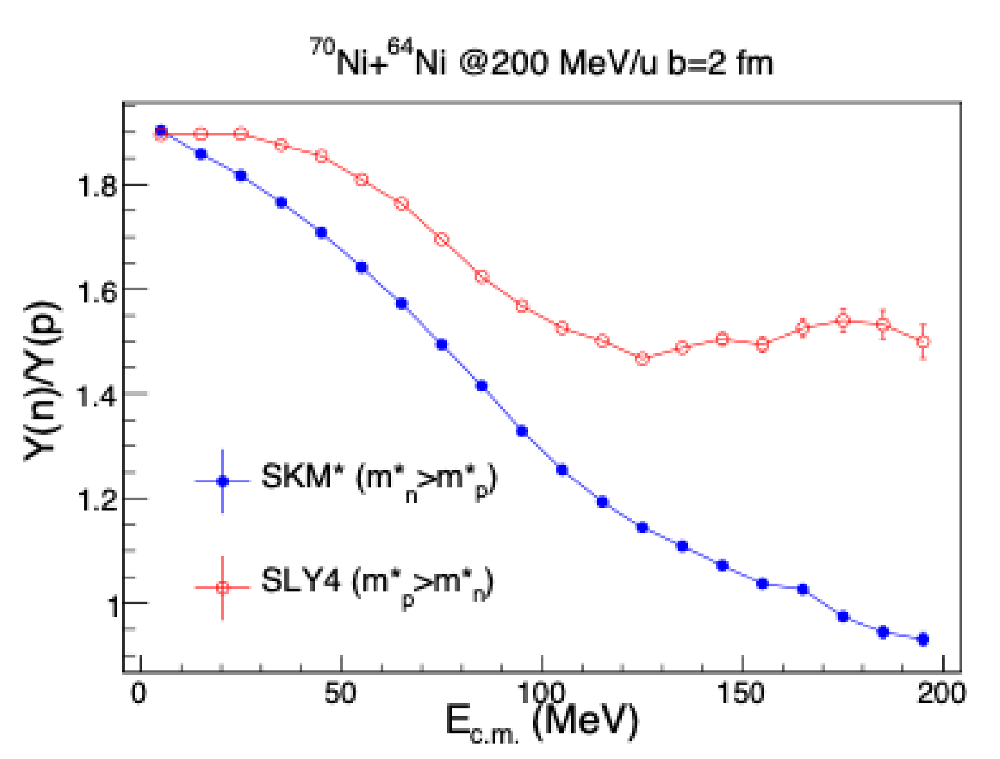
FRIB PAC2
First experiments at FRIB will focus on the momentum dependence with two observables
  n/p spectral ratio
  Directed and elliptical flow
⁷⁰Ni+⁶⁴Ni and ⁵⁶Ni+⁵⁸Ni at 200 MeV/u
ImQMD calculations show n/p ratio still sensitive to effective mass difference

Slide 28
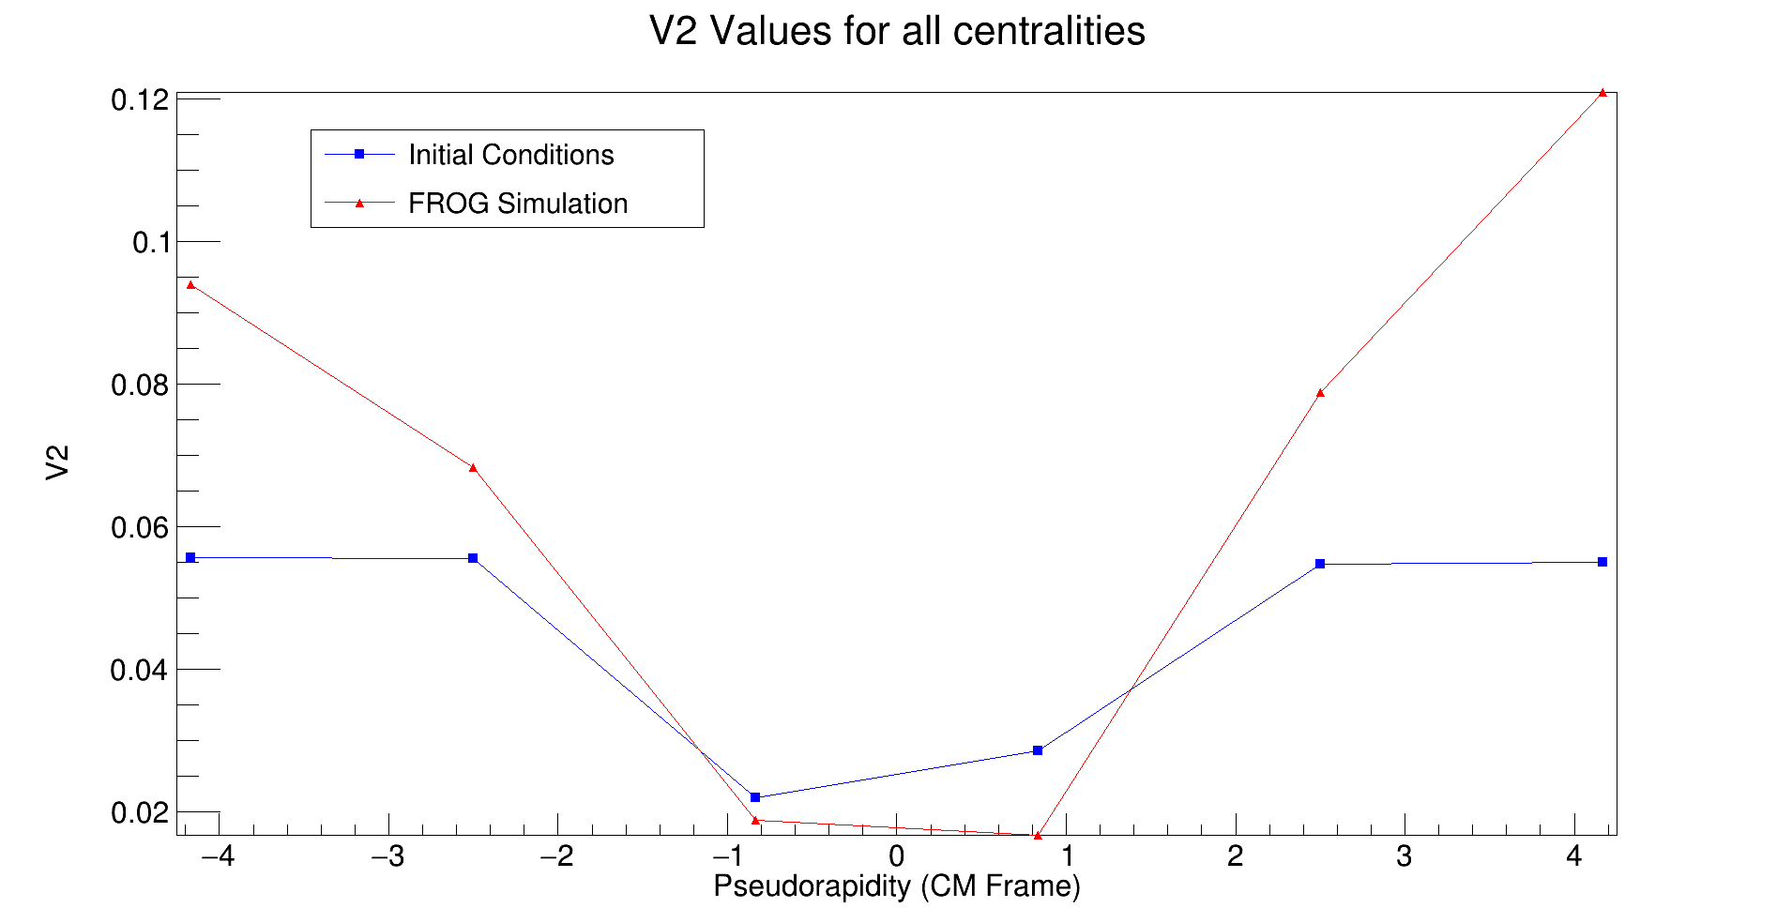
FRIB PAC2
First experiments at FRIB will focus on the momentum dependence with two observables
  n/p spectral ratio
  Directed and elliptical flow
⁷⁰Ni+⁶⁴Ni and ⁵⁶Ni+⁵⁸Ni at 200 MeV/u
ImQMD calculations show n/p ratio still sensitive to effective mass difference
System also has large enough flow signal to be measured, used to “benchmark” the two observables against one another

Slide 29
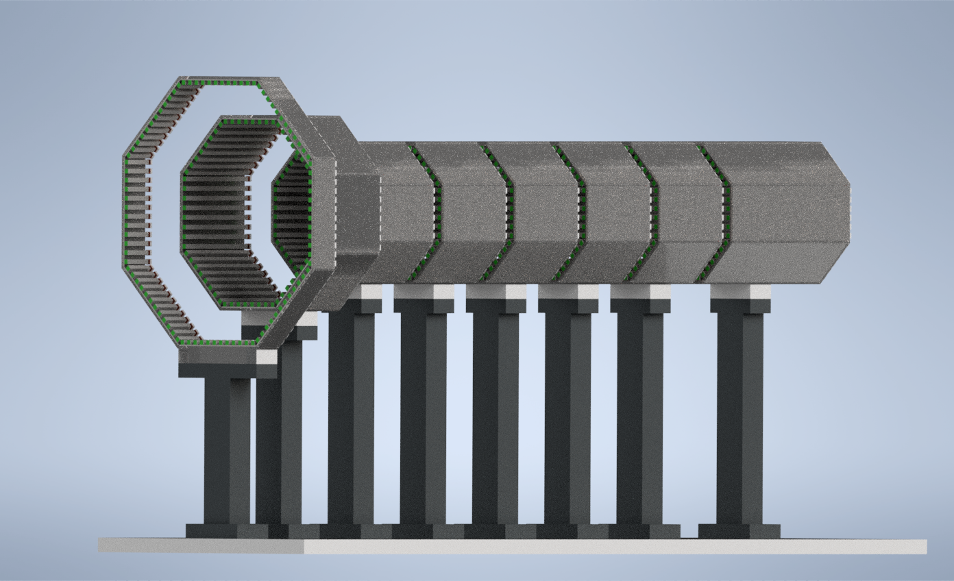
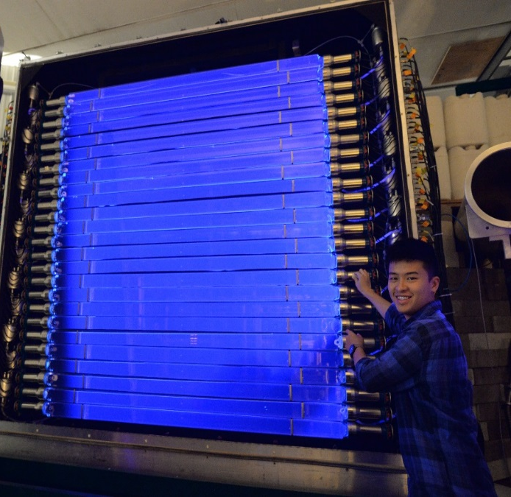
Reaction Planes with new Fiber Array
NSF funded (PHY-2309923) project to study direct and elliptical flow
Creation of a new fiber array for reaction plane and multiplicity determination
Refurbishment of the LANA neutron walls

Slide 30
FRIB PAC2
Neutrons
Protons, light clusters
Reaction Plane
Multiplicity

Slide 31
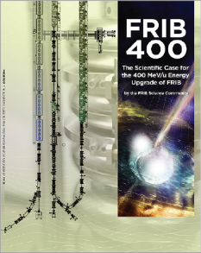
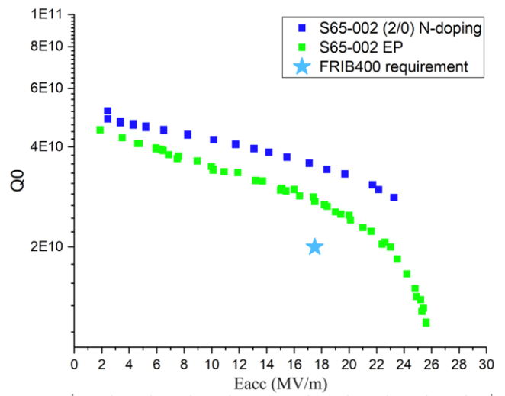
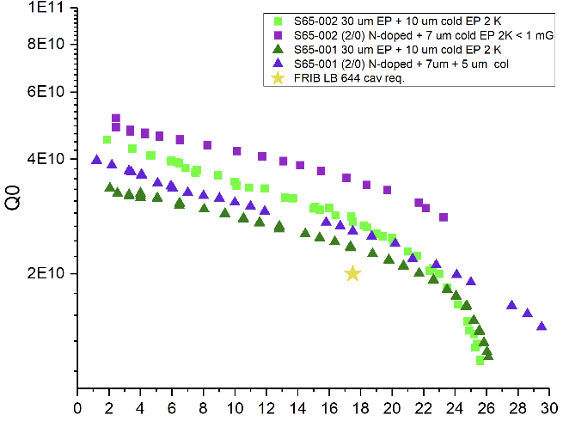
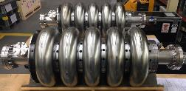
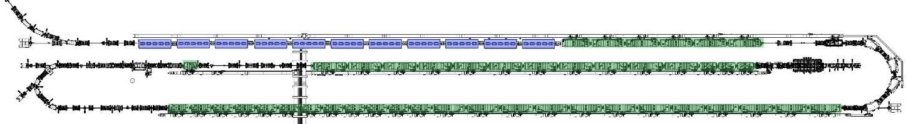
FRIB Energy Upgrade to 400 MeV/nucleon
Science Case Made, Technology Being Demonstrated
Community made science case
  Access to key regions needed to model nucleosynthesis in neutron-star mergers
  Luminosity gain over 50 for rarest isotopes
  Energy better matched to exploring nuclear equation of state for neutron-star merger
  Energy better matched for knockout and charge-exchange reactions
FRIB400 SRF Cavity R&D Progress
FRIB400 Design goal
FRIB400 White Paper
LINAC Upgrade
  Add 11 cryomodules, each with five β=0.65 elliptical cavities operating at 644 MHz
Demonstrated that the design goal can be met with standard ILC EP. Pursuing R&D on advanced surface treatment such as nitrogen doping (see right)
P Ostromouv et al.
FRIB Linac Layout with Upgrade Cryomodules

Slide 32
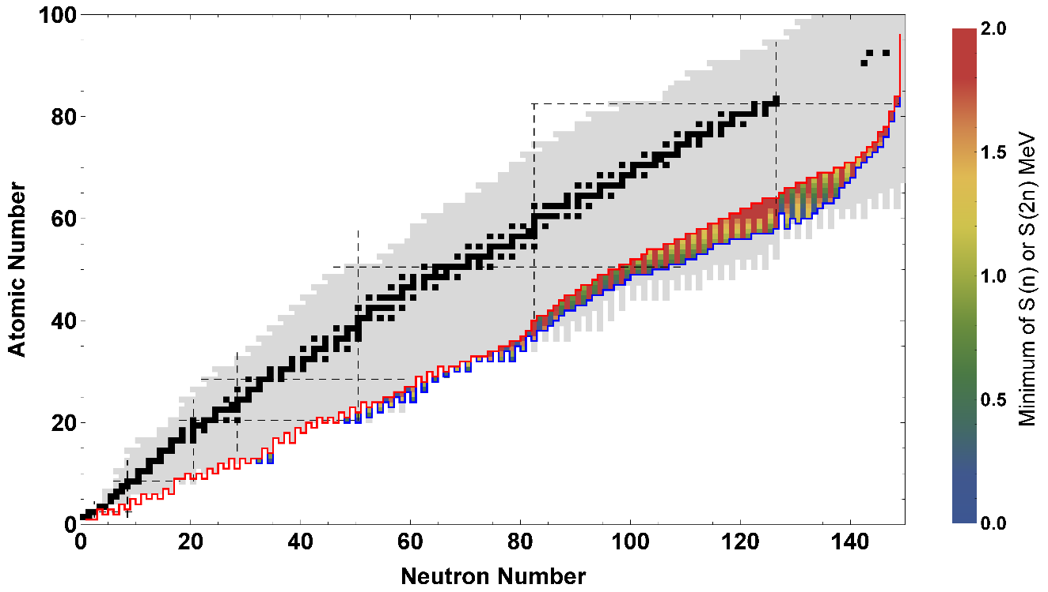
FRIB400 Scientific Reach Extended
Drip line extended to Z ≈ 60
Blue – FRIB400 reach
Red – FRIB200 reach

Slide 33
Future Sym En experiments with FRIB & FRIB/HRS
Looking towards FRIB full power and FRIB 400 → Need observables more sensitive to the high densities
  Pions
  Flow
Experiments with previous experiment systems can continue for flow, but pions require a new device →TPCs (2 possibilities)
Collecting science input and technical constraints now from community on TPC for FRIB → Contact S. Hudan (hudan@iu.edu) or KWB (brownk@frib.msu.edu).
More discussion of future plans in the working groups

Slide 34
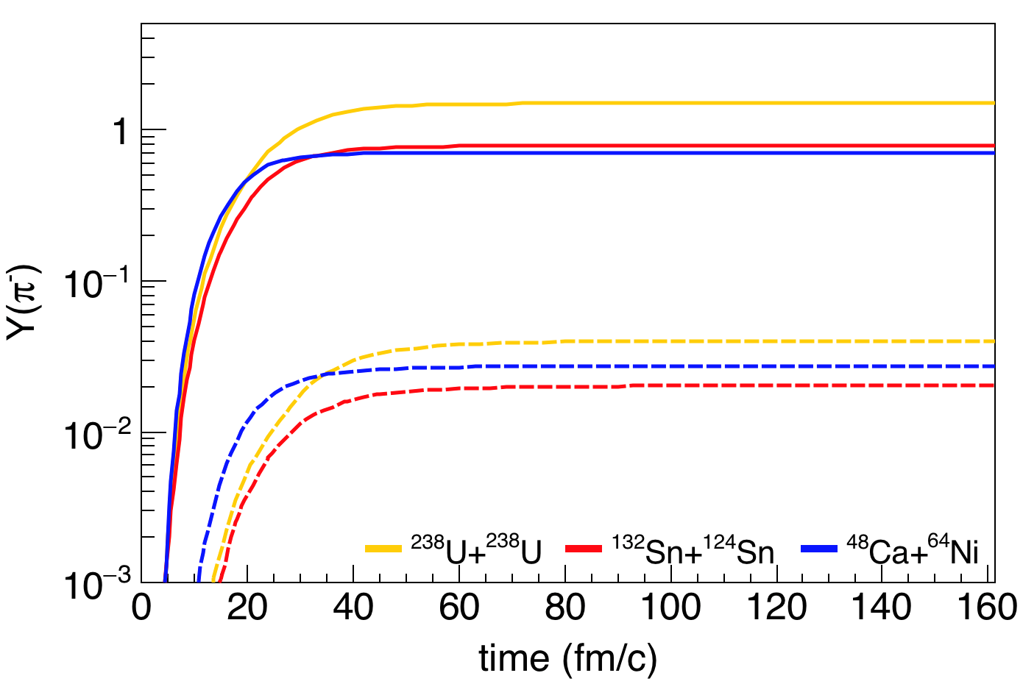
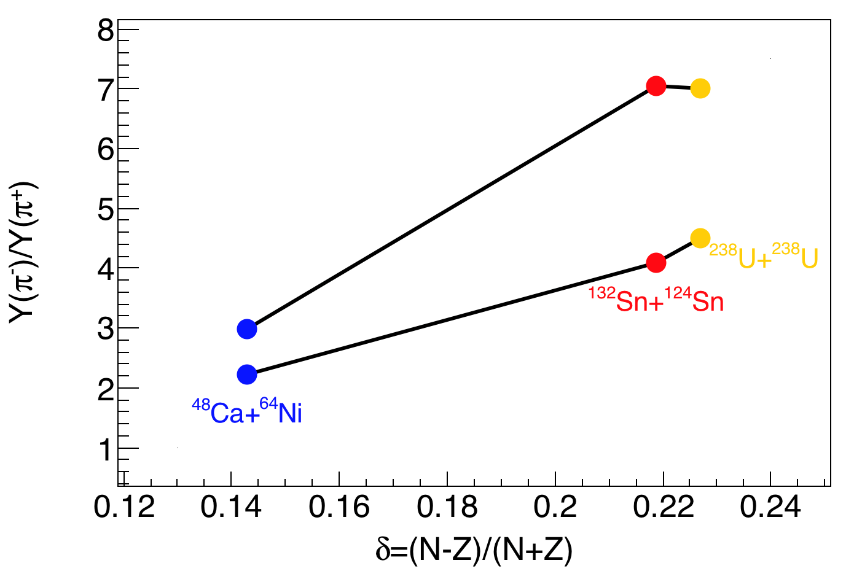
Pions @ FRIB400
FRIB-400
FRIB
FRIBU boost intensities, asymmetry and pion cross-sections
Intensity increase: Allow explorations of more asymmetric systems.
Energy increase: yields increase exponentially above pion thresholds
Regions at ρ>1.8ρ₀ become more extensive

Slide 35
Take away
We are taking a staged approach to the experimental efforts on the high-density EoS at FRIB
  Short term: discrete arrays of detectors for detecting n and LCPs to study particle ratios and flow
  Mid Term: “AT-TPC”-like device to study sub-threshold pion production near 200 MeV/u
  Long Term: Either “AT-TPC”-like or “SπRIT”-like TPC with the HRS and HRS/FRIB400
We need further input from transport theory to guide the most efficient use of beam time. Are there other observables we should rather be focused on?

Slide 36
backup

Slide 37

SOLARIS/AT-TPC in Fast Beam Area
4 T solenoidal spectrometer fitted with the Active Target Time Projection Chamber
Could be moved to the fast beam area for measuring Pion production from HIC
Requires the fabrication of a new readout pad plane with a higher density of pads in the central region.
Need to have inner field cage for high ionization in beam region
SOLARIS Whitepaper

Slide 38

Future with HRS
The SπRIT TPC could be modified to fit into the High Rigidity Spectrometer or a similar detector could be built with modern improvements
Needs to fit in 60 cm gap of D1
This will enable measurements of pion production and elliptical flow
Can be coupled with LANA or upgraded neutron walls

Slide 39

Current Height Budget & Easy Changes
Readout electronics (168.5 mm)
Current TPC is 50.5 x 86.4 x 134.4 cm³ in size and has ~12k anode pads
Designed for use in the SAMURAI magnet
Total height of current TPC – 75 cm – Too large for D1 gap
Fitting the TPC in at HRS:
  Moving GET electronics off of the top and reducing support structure (replace GET with something else)
    Requires R&D for preamps
    Reduction of a bit more than 10 cm
  Small reduction of the drift cage
Structure (19.05 mm)
Wire /pad planes (14 mm)
Field cage drift (503 mm)
Cathode(10.54 mm)
Voltage step down (17.7 mm)
Structure (12.7 mm)

Slide 40


Fitting the TPC into the DS1 gap
Main Constraints to fit TPC:
DS1 vertical gap of 60 cm
DS1 horizontal gap of 212.7 cm
Figure from J. Barney
Notes:
Vertical gap is a balance between

Slide 41

Neutron measurements
Figure from S. Noji
Notes:
Vertical gap is a balance between

