Slide 1
Radio detection of high velocity clouds in nearby galaxies
ILANCE internship
Gabriel LARUELLE

Slide 2
Plan
What is a molecular cloud?
Why are we interested in high velocity Molecular clouds?
PHANGS ALMA
High velocity giant molecular clouds in nearby galaxies
Conclusion
Notes:
Each part is 2 min except 6 min for my work and 1 min for conclusion

Slide 3
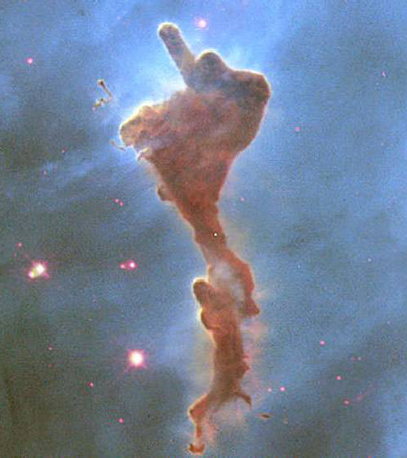
Giant Molecular Clouds (GMCs)
Part of the interstellar medium (ISM)
Dense and cold
H₂ (mostly), H₂O, CO, NH₃
<1% of volume in the Milky Way but 50% mass of gas
Giant if M > 10⁴ M_{sun}
5-200pc in diameter
Notes:
First discovered in 1951 by Ewen and Purcell, (21cm line of hydrogen)
Can also find methanol, ethanol, benzene and polycyclic aromatic hydrocarbons
Less than one percent but the densest part of it -> place were stars form

Slide 4
High Velocity GMCs
Velocity relative to host galaxy > 50km/s
Maintains star formation rate
Origin : unknown (nearby galaxies, supernovae,…)
Notes:
First detected in 1963 by H2 line but supposed in 1956 by Jan Oort (netherlands Leiden University)

Slide 5
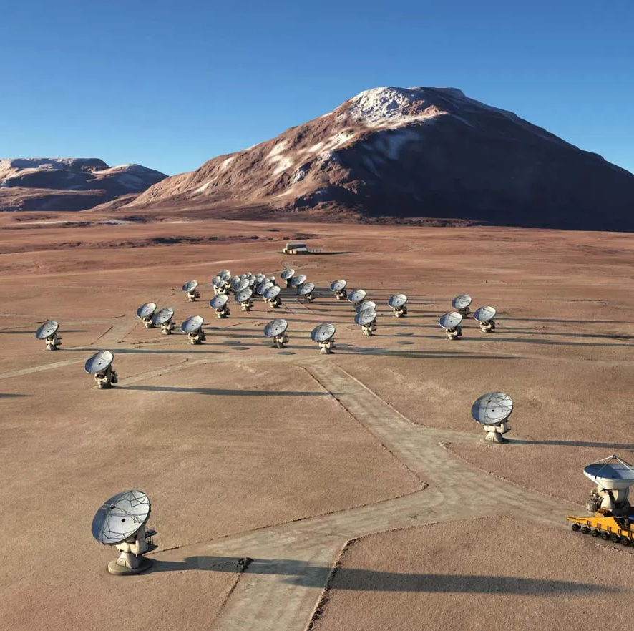
PHANGS-ALMA data
Physics at High Angular resolution in Nearby Galaxies
Atacama Large Millimeter Array
Radio interferometer
CO (1-0) transition data
Cube data
Object | Beam size (°) | Pixel size (°)
M74 | 3,1.10⁻⁴ | 5,6.10⁻⁵
M64 | 4,0.10⁻⁴ | 8,3.10⁻⁵
NGC 2903 | 3,5.10⁻⁴ | 8,3.10⁻⁵
Encyclopedia Britannica - Artist's rendering of the Atacama Large Millimeter Array (ALMA) in an extended configuration.

Slide 6
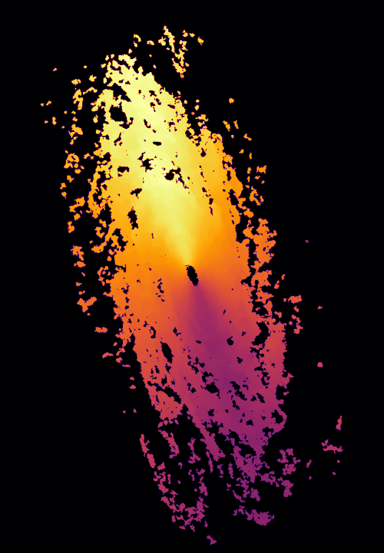
Objects of study
Velocity (km/s)
NGC 3521

Slide 7
Detecting High Velocity clouds in the cube
Subtract noise and apply mask
Detect maximums of emission
Associate emission pixels (watershed algorithm)
Compute properties (mass, velocity dispersion, …)

Slide 8
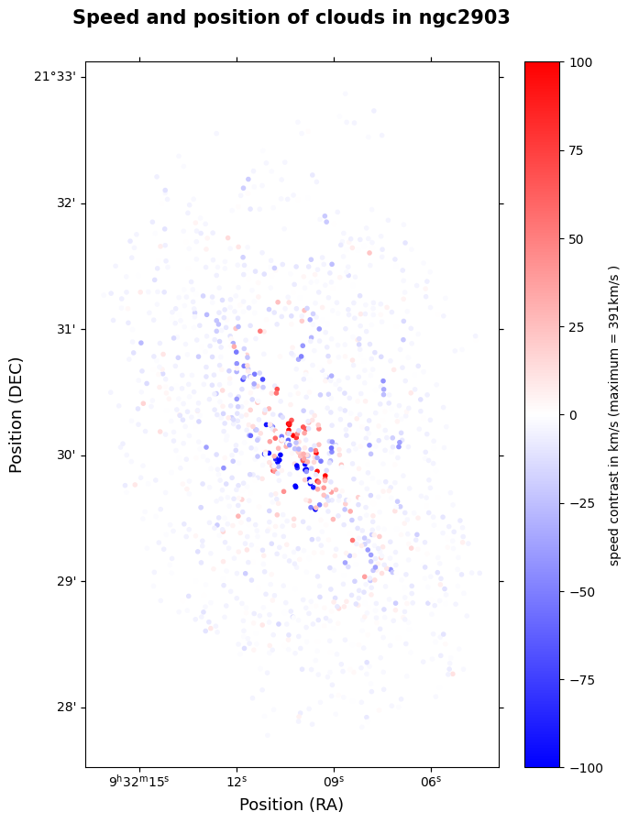
One Example : NGC 2903

Slide 9
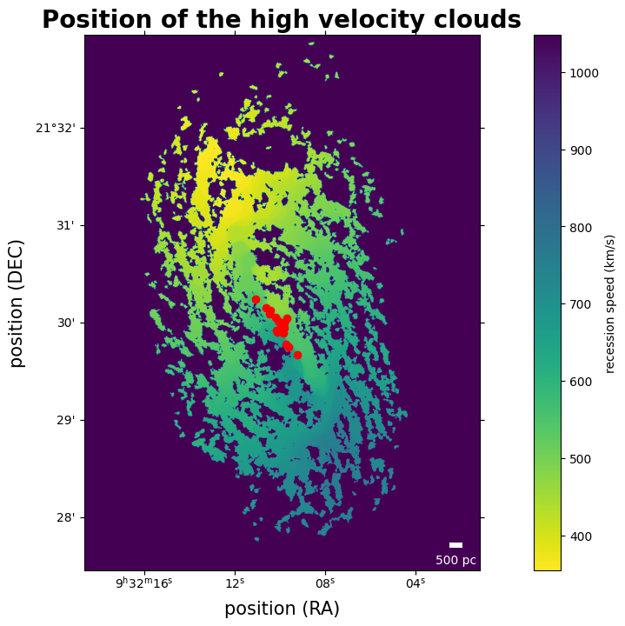
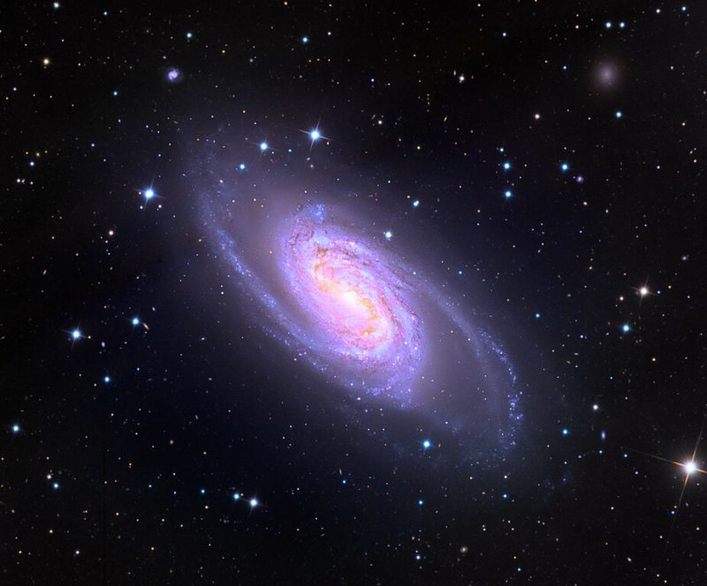
Progress and results
NGC 2903 Adam Block Arizona University Mount Lemon Sky Center
Notes:
Slide with all four galaxies and the found clouds :
Some galaxies seem to have no clouds
Bars potential seems to induce high width clouds wich can be mistaken fot high velocity GMCs
Noise quickly starts being an issue

Slide 10
Notes:
Zoom in on one galaxy + the speed channels of one cloud

Slide 11
Notes:
Zoom in on one galaxy + the speed channels of one cloud
Add visual label

Slide 12
Notes:
Zoom in on one galaxy + the speed channels of one cloud
Add visual label

Slide 13
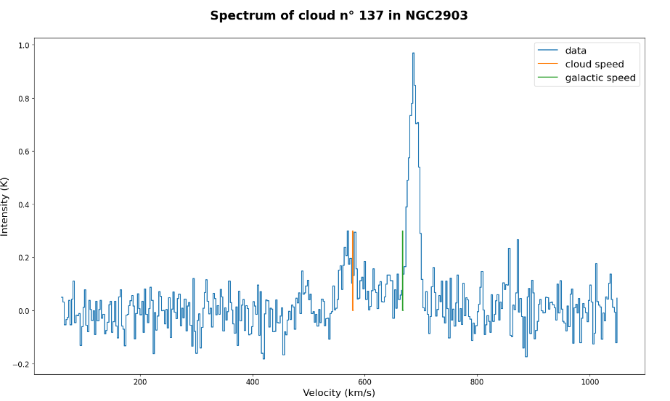
Spectra of a single cloud
Notes:
Show the clouds spectra

Slide 14
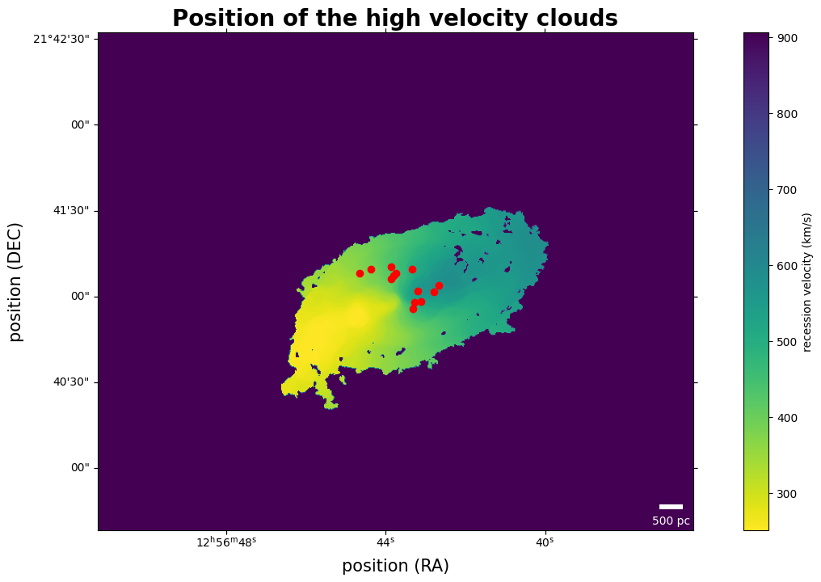
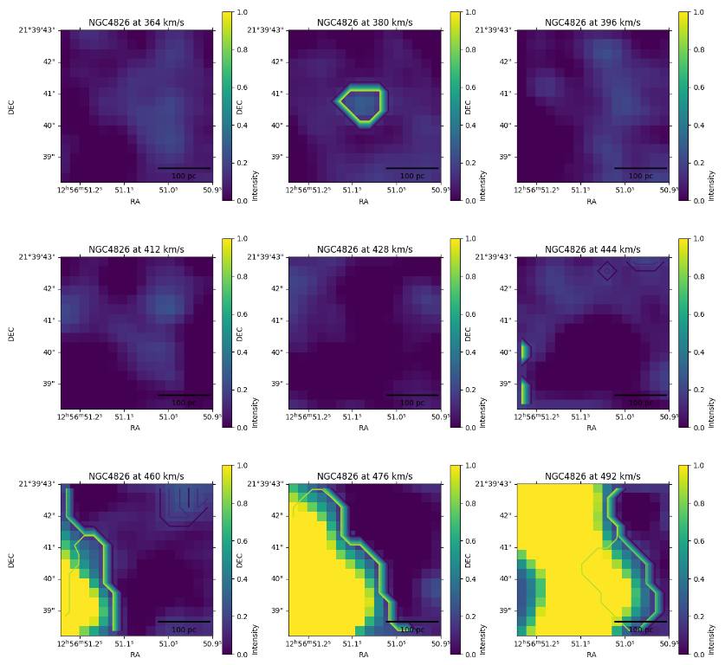
An example: NGC 4826

Slide 15
A single spectrum

Slide 16
Other parameters
Object | Resolution | Gas mass Sensitivity | Neighbors | Inclination
M74 | 53 pc | 63.10⁴ M_{sun} | >5 | 6°
NGC 1637 | 130 pc | 154.10⁴ M_{sun} | - | 31°
NGC 2903 | 99 pc | 117.10⁴ M_{sun} | - | 60°
NGC 3521 | 73 pc | 108.10⁴ M_{sun} | - | 73°
NGC 4826 | 28 pc | 33.10⁴ M_{sun} | CVI group | 60°
Bar potential
Inclination influence on detection
Notes:
Slide with the noise estimate of each galaxy+add the neighbourg correlation
Link with the history of the galaxy (previous collisions etc)

Slide 17
Conclusion
Extracting clouds
Calculate characteristics
Filter to obtain HVC
Bias proofing results
Correlate with presence of neighboring galaxies / other sources

Slide 18
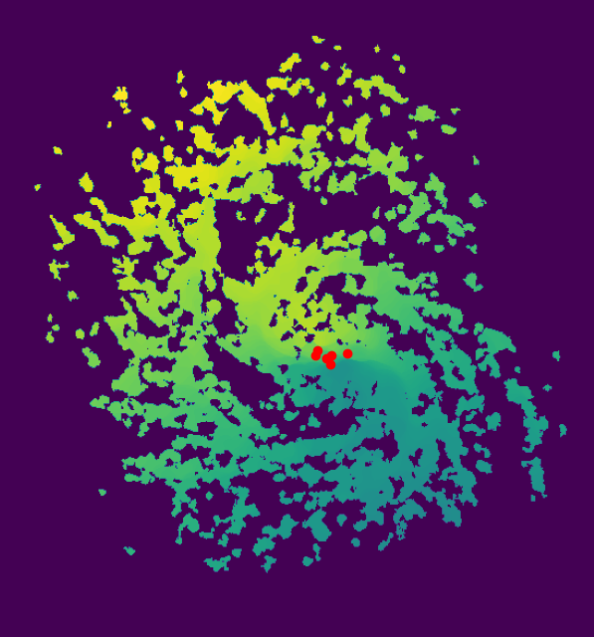
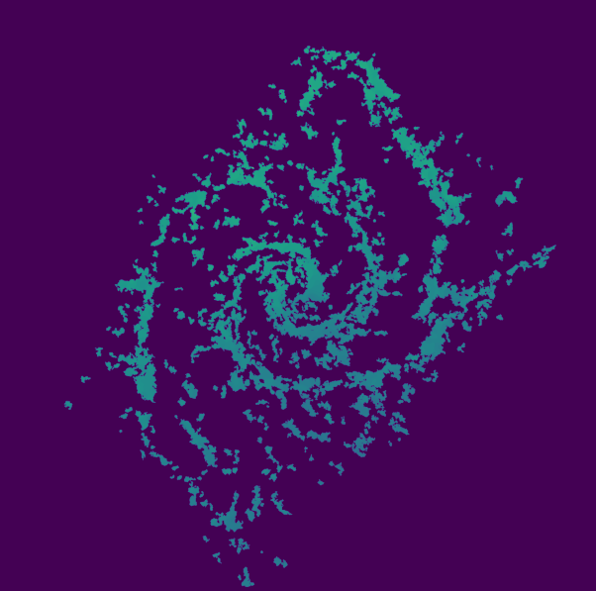
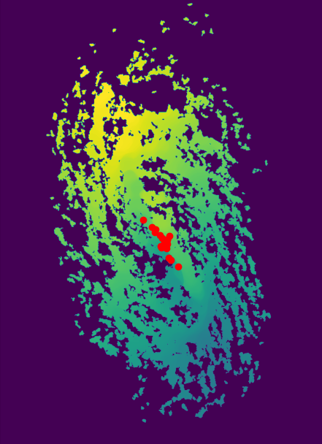
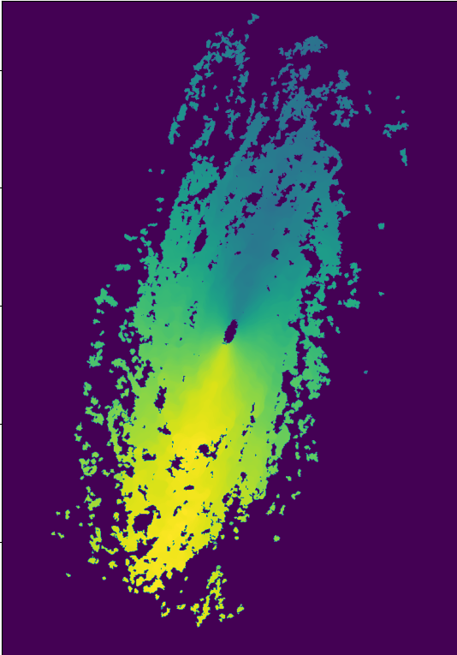
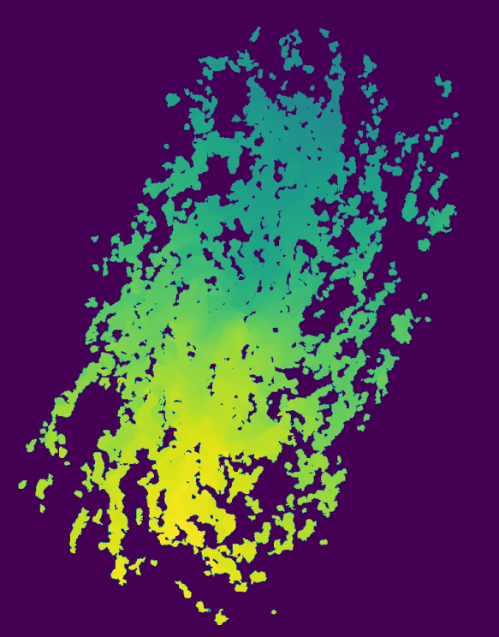
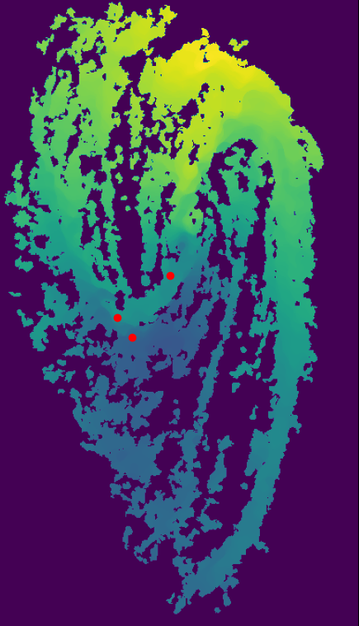
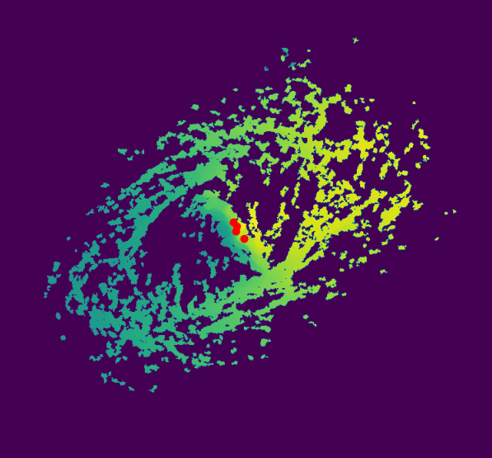
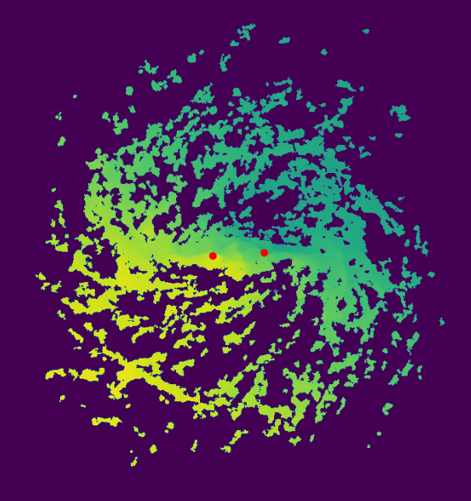

Slide 19
Interferometry

