Slide 1
Identifying new high redshift radio galaxies
Kadri Victor
June 6th ILANCE meeting

Slide 2
Radio galaxies
Among the most luminous objects in radio wavelengths
This emission results from the presence of an accreting (super-) massive black hole at their centre
The black hole activity is believed to regulate star formation
Only a limited number of radio galaxies are known at redshift $z ≳4$

Slide 3
How to detect high redshift sources : the Lyman break
Lyman ($α$) break : energy required for the electron of an hydrogen atom to go from $n=1$to $n=2→$ wavelength : 121.6 nm
Light emitted by galaxies at wavelengths lower than 121.6 nm is absorbed => “dropout” or “break”
In the observed spectra of galaxies, the Lyman break is redshifted at a wavelength $λ_{break}=\left(1+z\right)×121.6$ nm

Slide 4
The example of a Lyman dropout
Faint in g-band, detected in r and i band
Lyman dropout with $z \sim 4$

Slide 5
Selecting high redshift radio galaxy candidates
Powerful radio sources : detected at 1.4 GHz (VLA FIRST survey)
If the source has a high redshift, then the Lyman break is redshifted in optical wavelengths (Subaru HSC survey)
Cross-matching the two surveys to select Lyman dropouts

Slide 6
Spectral flux density
For photons in a frequency band $\left[ν, ν+dν\right]$coming from a solid angle $dΩ$ and crossing a surface $dA$ during a time interval $[t, t+dt]$, the specific intensity $I_{ν}$ is defined as :
$$dE_{ν}= I_{ν}\cos{θ}dt dA dΩ dν$$
The spectral flux density is then defined as :
$F_{ν}=\int{I_{ν}\cos{θ}}$ $dΩ$
It is usually expressed in Jansky (symbol Jy), with $1$ Jy $={10}^{−26} Wm^{−2}{Hz}^{−1}$.

Slide 7
AB magnitude
The AB magnitude corresponding to a spectral flux density $F_{ν}$ is defined as:
$$m=−2.5\log{\frac{F_{ν}}{F_{0}}}$$
with $F_{0}=3631 Jy$.
Subaru HSC provides the spectral flux densities and AB magnitudes for :
g-band : 473 nm (magnitude $m$ denoted $g$)
r-band : 623 nm ($m→r$)
i-band : 777 nm ($m→i$)
z-band : 892 nm ($m→z$)
y-band : $1005$ nm ($m→y$)

Slide 8
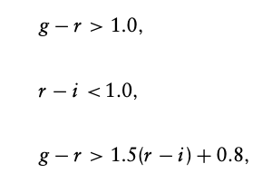
A quantitative criterion to select g-dropouts
Ono et. al. 2018. Great Optically Luminous Dropout Research Using Subaru HSC (GOLDRUSH). I. UV luminosity functions at z ∼ 4–7 derived with the half-million dropouts on the 100 deg2 sky. Publications of the Astronomical Society of Japan, Volume 70, S10.

Slide 9
The example of a g-dropout
Faint in g-band, detected in r and i band
g-dropout
Redshift $z \sim 4$

Slide 10
Spectral Energy Distribution (SED) modelling of the g-dropout
The redshift obtained from SED modelling is $z=3.7±0.4$

Slide 11
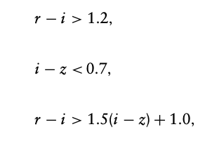
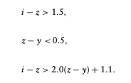
Quantitative criteria to select g, r and i-dropouts
Ono et. al. 2018. Great Optically Luminous Dropout Research Using Subaru HSC (GOLDRUSH). I. UV luminosity functions at z ∼ 4–7 derived with the half-million dropouts on the 100 deg2 sky.
Publications of the Astronomical Society of Japan, Volume 70, S10.

Slide 12
Expected redshifts for g, r and i-dropouts
$$z_{expected} \sim 4$$
$$z_{expected} \sim 5$$
$$z_{expected} \sim 6$$

Slide 13
The Lyman “i-dropout”

Slide 14
The Lyman “i-dropout” is actually a low redshift source
The redshift obtained from SED modelling is $z=1.92±0.07$ !
Dusty galaxy => mistaken for a high redshift source

Slide 15
SED properties of g and r-dropouts : redshift
g-dropouts
r-dropouts

Slide 16
SED properties of g and r-dropouts : redshift error
g-dropouts
r-dropouts

Slide 17
SED properties of g and r-dropouts : stellar mass
g-dropouts
r-dropouts

Slide 18
SED properties of g and r-dropouts : stellar mass error
g-dropouts
r-dropouts

Slide 19
Future work
Add infrared data to better constrain the stellar mass and other physical properties derived from SED modelling
Include radio data as well (requires to use additional SED modules)

Slide 20
Appendix: expected redshifts for g, r and i-dropouts
Ono et. al. 2018. Great Optically Luminous Dropout Research Using Subaru HSC (GOLDRUSH). I. UV luminosity functions at z ∼ 4–7 derived with the half-million dropouts on the 100 deg2 sky. Publications of the Astronomical Society of Japan, Volume 70, S10.

