Slide 1
Colimated Beam Projector
in2p3 focal plane meeting 30/05/24
Nathan Amouroux

Slide 2
Batoid : CBP photons in ComCam
CBP
M2
ComCam
M1/M3

Slide 3
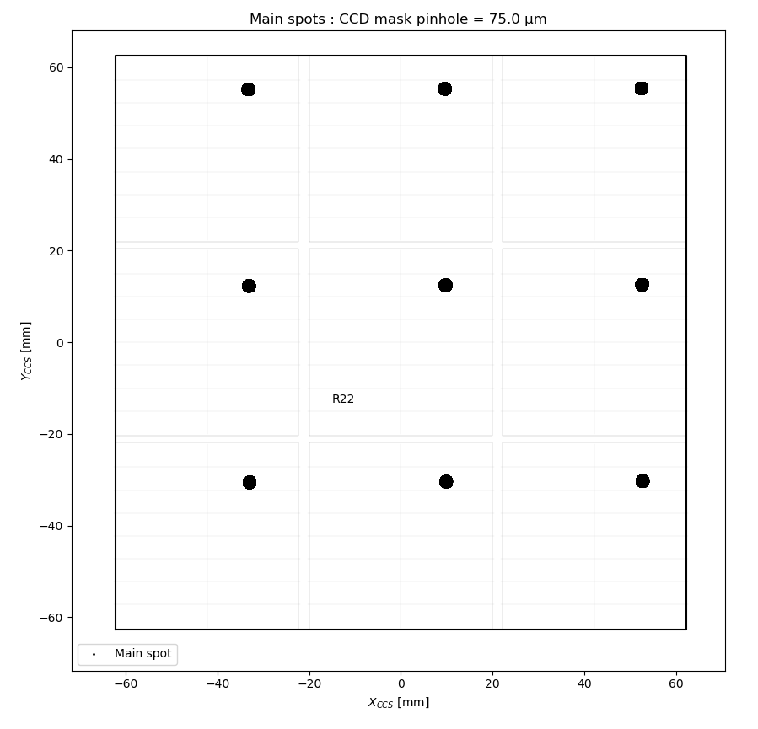
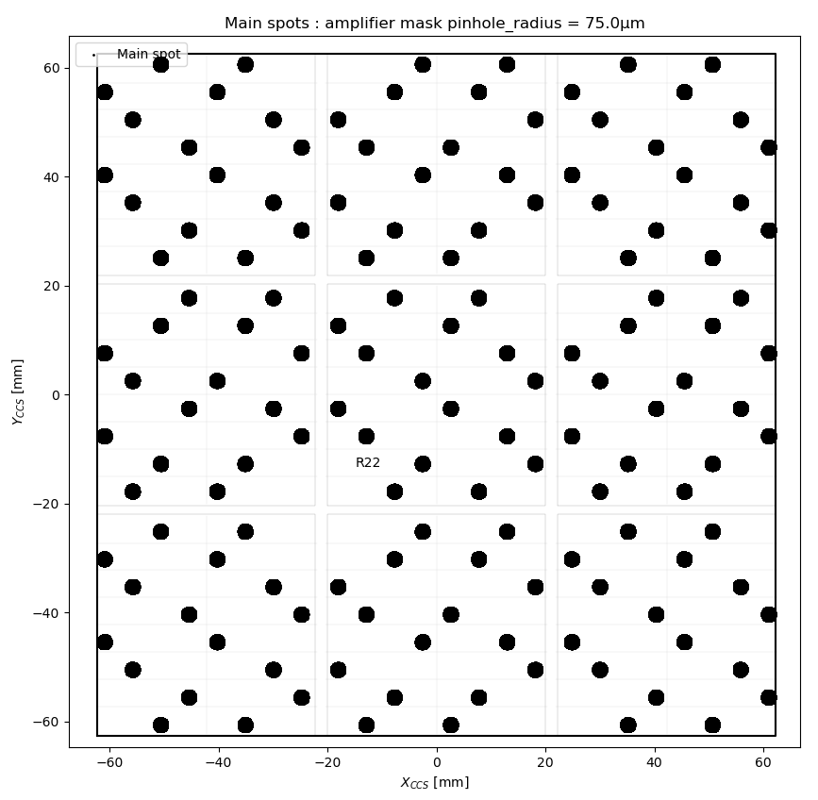
Propagating CBP spots
Masks
1 star per CCD
1 star per amp

Slide 4
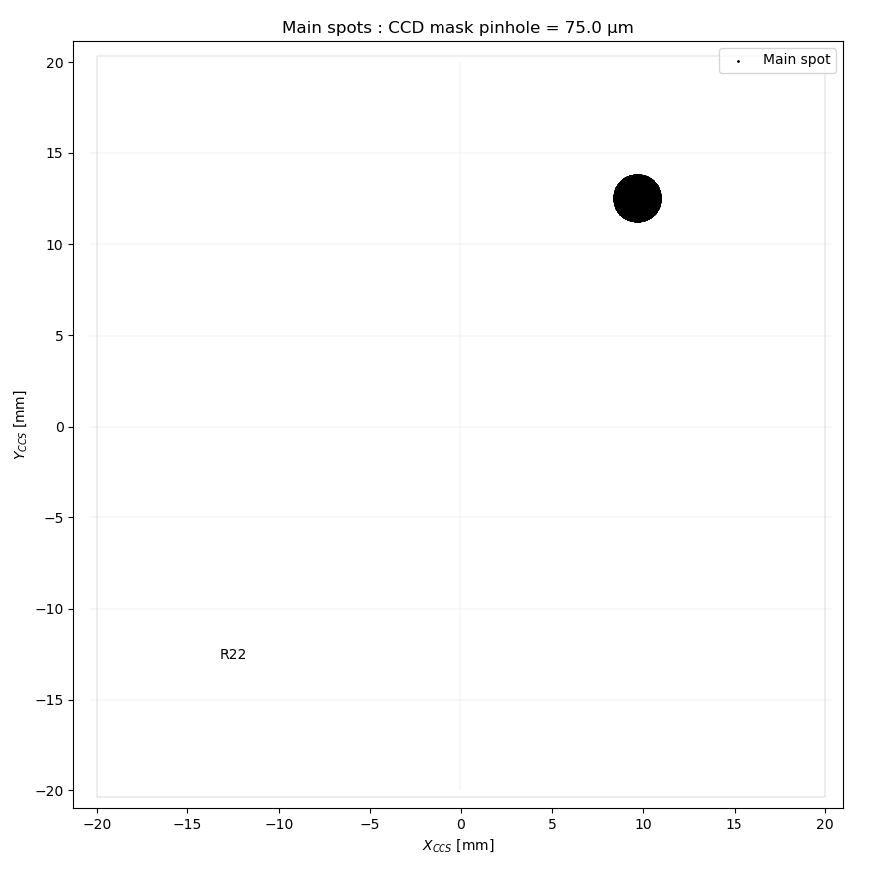
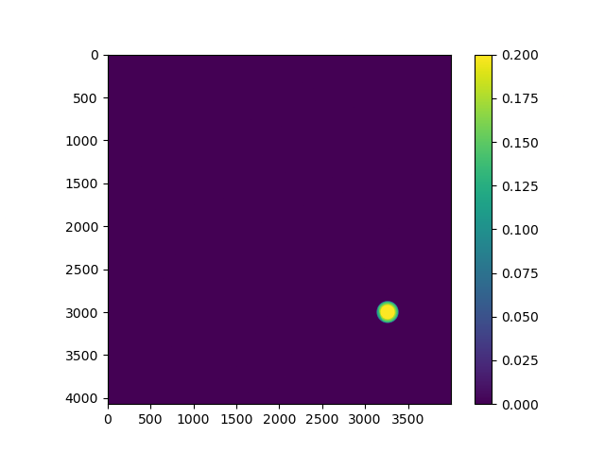
ComCamSim image simulation
One CBP spot
Focal plane positions (x,y) → px position

Slide 5
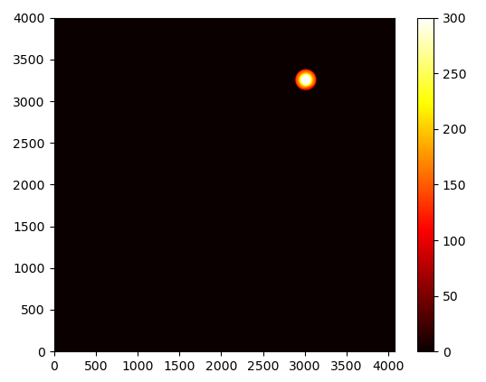
ComCamSim image simulation
One CBP spot
Photon array → sensor accumulation → Galsim image
Photon array
Galsim Image

Slide 6
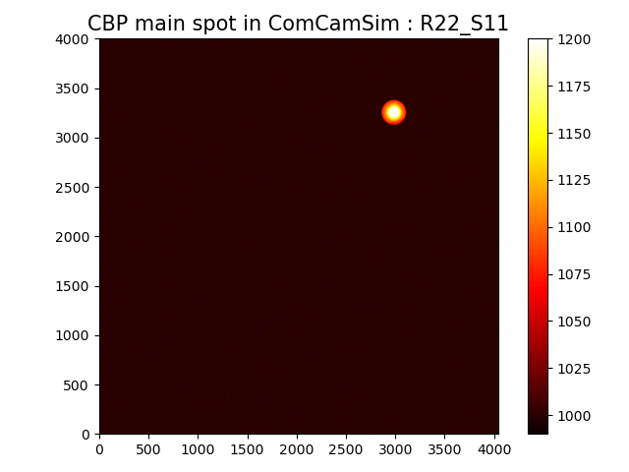
ComCamSim image simulation
One CBP spot
GalSim image → ImSim image
Config file + headers
Galsim Image
ImSim Image

Slide 7
ComCamSim image simulation
One CBP spot
Arbitrary flux : need to take exptime into account
Some configuration arguments not well controlled/understood
→ In discussion with Josh
Realistic calibration quantities values?
Selected sensor not an LSST one e.g basic sensor.
Next step : photometry with this spot

Slide 8
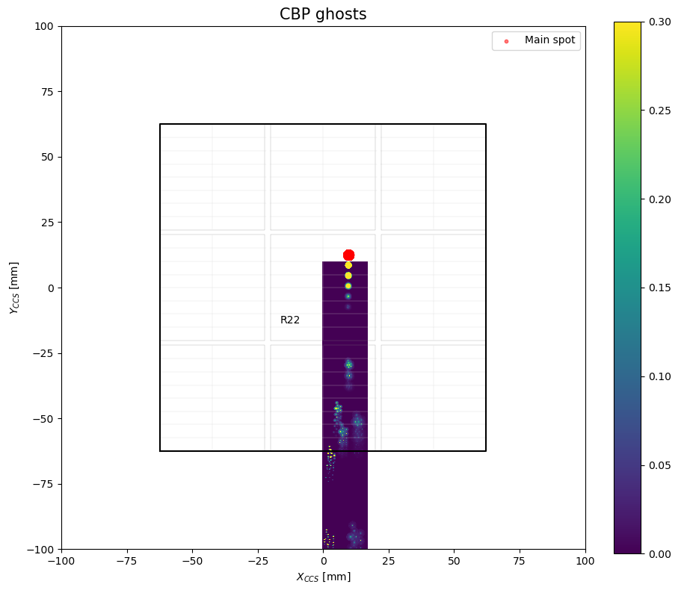
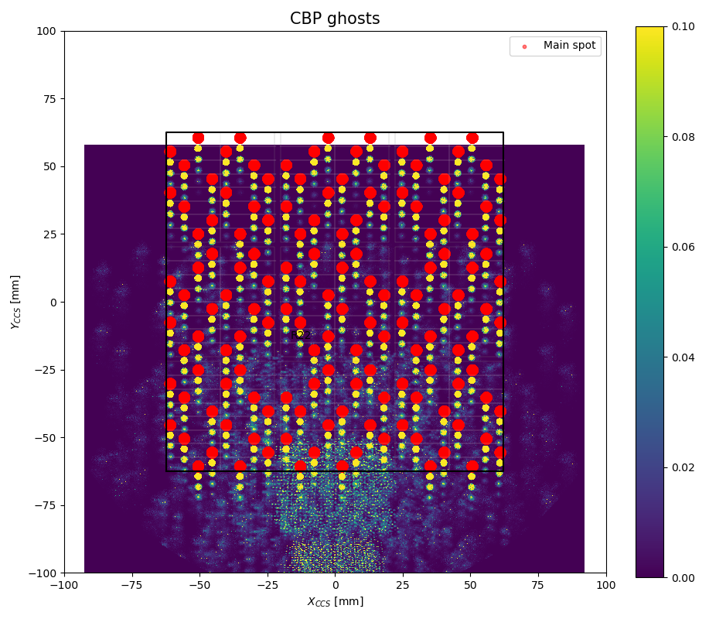
ComCam’s ghosts
One spot & one spot per amp
Pixels 10 000x too wide → Wrong scale

Slide 9
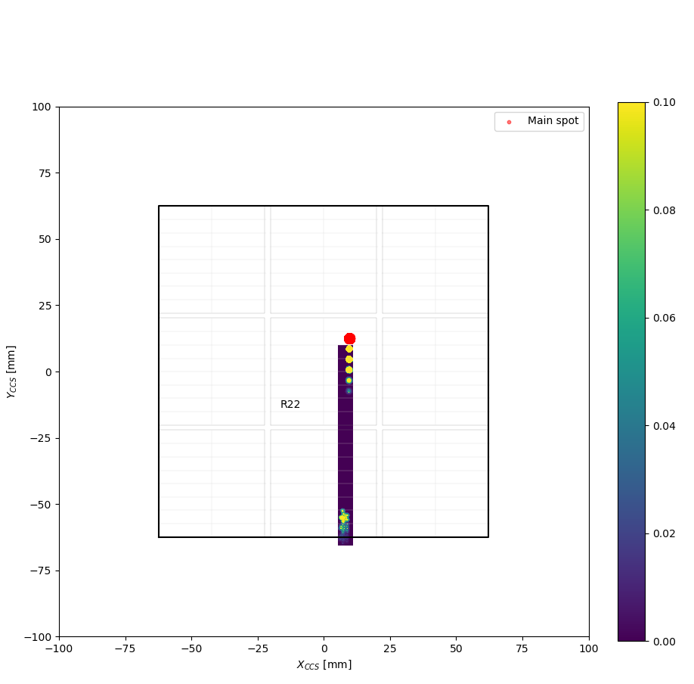
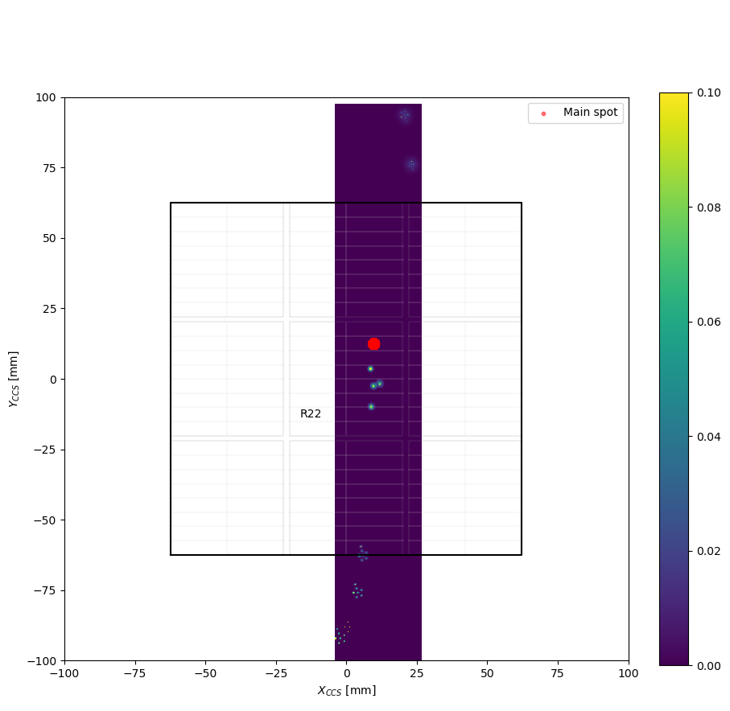
ComCam’s ghosts
One spot
Reflectiveness on filters only
Reflectiveness on optics only

Slide 10
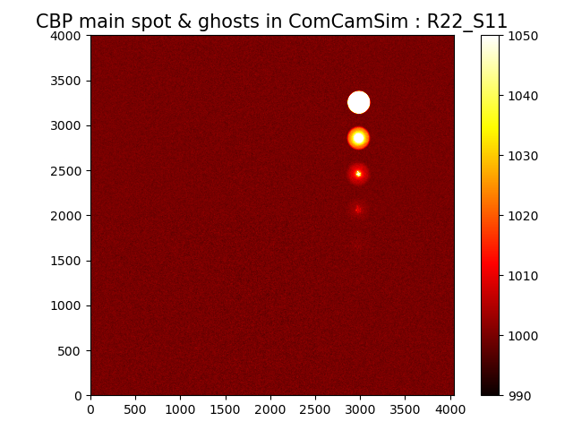
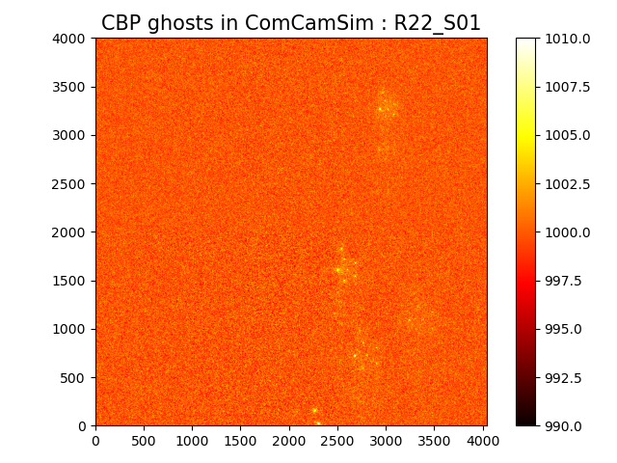
ComCam’s ghosts Image
One spot
Main spot CCD
Lower CCD
Very bright ghosts

Slide 11
Thanks for your attention !

