Slide 1

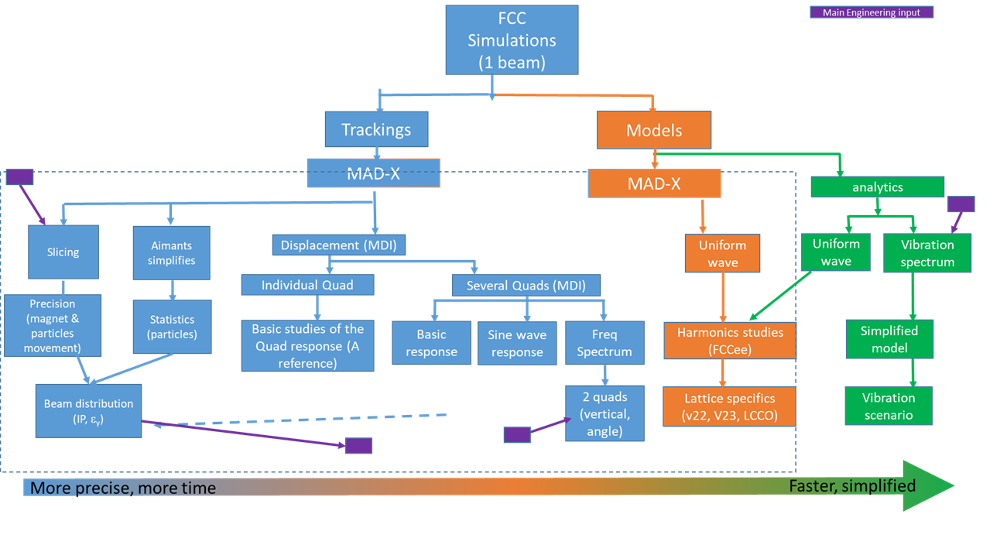
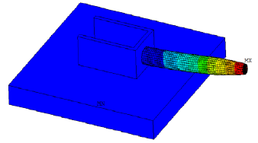
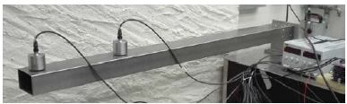
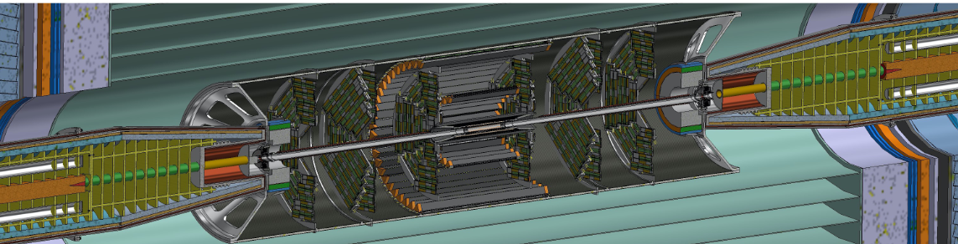
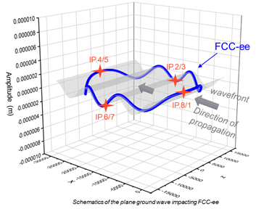
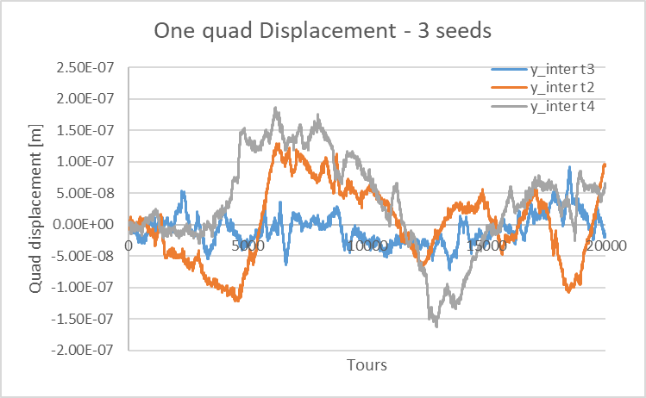
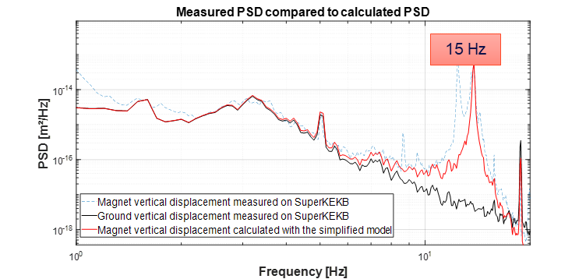
FCC LAPP simulation: Kind of global view of the present work
Note: similar scheme for Engineering at LAPP
Note: a parallel work is being done with SAD on superKeKB. 2 beams
Presented at FCC tuning meeting (May 2024)

Slide 2
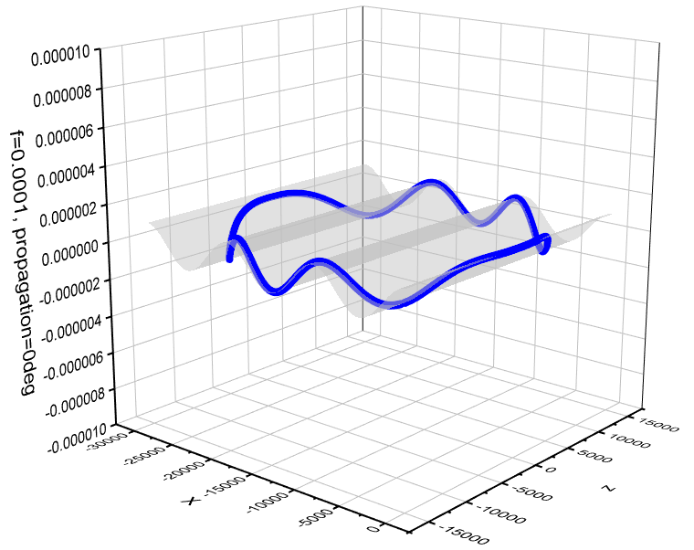
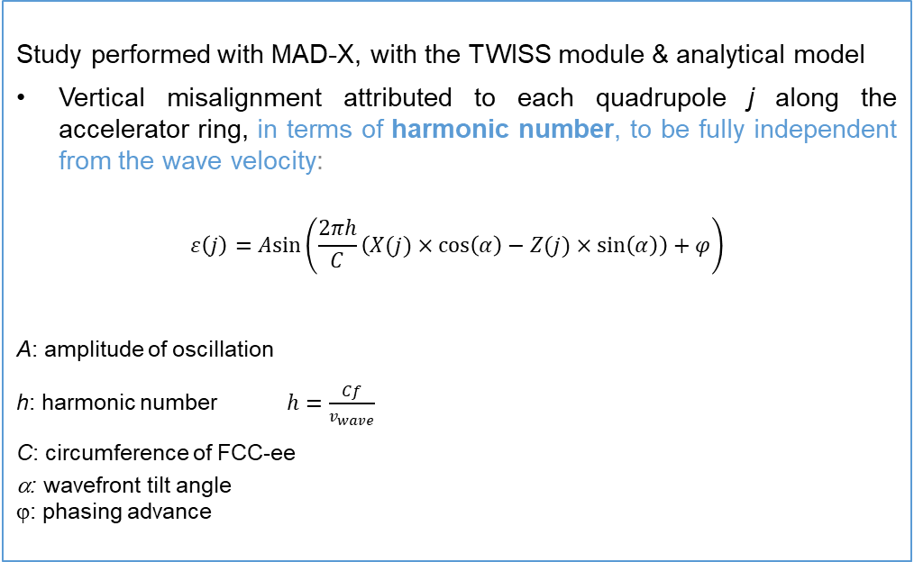
Plane Ground wave Studies: a corrugated model (E.Montbarbon et al)
Presented at FCC tuning meeting (May 2024)
Aims of the study:
  Compute the response of a potential spatial coherence on the performances of FCC-ee
  Compare simulation results obtained to the ones of other machines (e.g. LEP, LHC)
Definition:
  The coherence length is the maximum distance of two points oscillating on a same ground wave.
In our study:
  Vertical misalignement of beam elements according a plane sinusoidal wave
  Photography of the wave impact on the accelerator
Computer tools:
Optics simulations carried out with MAD-X (5.09.00)
Post-treatment held with Python, thanks to cpymad module (3.6.9)
Optics-related matters:
Z lattice (V22), with 4 IPs
Start of the sequence at IP.1
Lattice V22, IP naming here
Study performed with MAD-X, with the TWISS module & analytical model
Vertical misalignment attributed to each quadrupole j along the accelerator ring, in terms of harmonic number, to be fully independent from the wave velocity:
$$ε\left(j\right)=Asin⁡\left(\frac{2πh}{C}\left(X(j)×\cos\left(α\right)−Z(j)×\sin\left(α\right)\right)+φ\right)$$
A: amplitude of oscillation
h: harmonic number $h=\frac{Cf}{v_{wave}}$
C: circumference of FCC-ee
α: wavefront tilt angle
ϕ: phasing advance
FCC-ee
IP.4/5
IP.2/3
Amplitude (m)
wavefront
IP.8/1
IP.6/7
Direction of
propagation
Schematics of the plane ground wave impacting FCC-ee

Slide 3
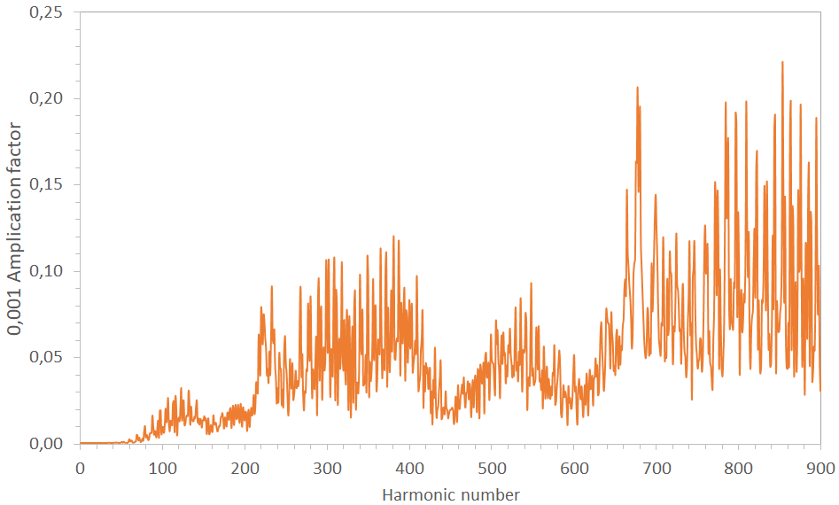
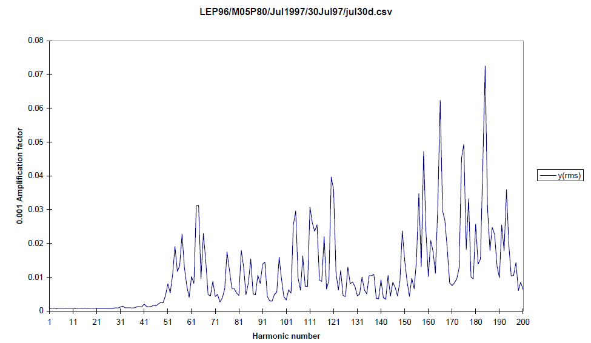
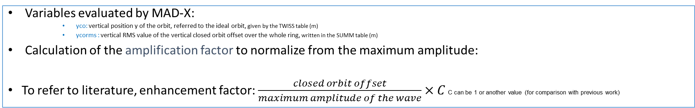
FCC-ee ycorms results: comparison with LEP
Presented at FCC tuning meeting (May 2024)
Variables evaluated by MAD-X:
    yco: vertical position y of the orbit, referred to the ideal orbit, given by the TWISS table (m)
    ycorms : vertical RMS value of the vertical closed orbit offset over the whole ring, written in the SUMM table (m)
Calculation of the amplification factor to normalize from the maximum amplitude:
To refer to literature, enhancement factor: $\frac{closed orbit offset}{maximum amplitude of the wave}×C$ C can be 1 or another value (for comparison with previous work)
FCC-ee
LEP
Q_{y} = 214
Q_{y} = 76
Similar shape of ycorms spectra for FCC-ee and LEP
However, more sensitivity in the case of FCC-ee: at h = Q_{y}: 4 times bigger amplitude for FCC-ee
Now it has to be investigated the induced effects on the machine with further analysis.
E. Keil, Effect of Plane Ground Waves on the Closed Orbit in Circular Colliders, CERN SL/97-61 (AP), 1997
R. J. Steinhagen, "LHC Beam Stability and Feedback Control", 2007
M. Schaumann, "The effect of ground motion on the LHC and HL-LHC beam orbit", 2023

Slide 4
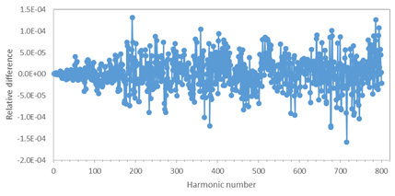

More exhaustive studies (would need much more slides!)
E.Montbarbon + I.Debonis + F.Poirier + MSc Student et al
Presented at FCC tuning meeting (May 2024)
With MAD-X
1: Misalignment of all beam elements or only quadrupoles relative to the wave:
  Maximum relative difference: 0.016%
  The impact on the closed orbit is dominated by quadrupoles misalignments: no peculiar characteristic added by other beam elements
  Consistent with results obtained for the comparison between the analytical model and MAD-X simulations
2: Misalignment of only quadrupoles when sextupoles are on/off
  Maximum relative difference: 0,3%
  Peak at h = 677 observed
  No considerable impact on yco given by the sextupoles
3: Misalignment of both quadrupoles and sextupoles
  Maximum relative difference: 0,015%
4: Only dipoles affected by the plane wave:
  Maximum yco = 3 nm
  No relevant impact on dipoles misalignment because of the plane ground wave
5: Only IR quadrupoles affected by the plane ground wave:
  Periodic structure of yco at IP.8 relative to h
1: All beam elements or only quadrupoles
2: Only quadrupoles when sextupoles are on or off
3: Both quadrupoles and sextupoles or quadrupoles only
4: Only dipoles
5: Only IR quadrupoles
6: All quadrupoles except IR quadrupoles
1: Misalignment of all beam elements or only quadrupoles relative to the wave:
Relative difference @ IP.8 = $\frac{{yco}_{Q}−{yco}_{SQ}}{{yco}_{Q}}$
More ongoing: scan of plane wave parameters

Slide 5
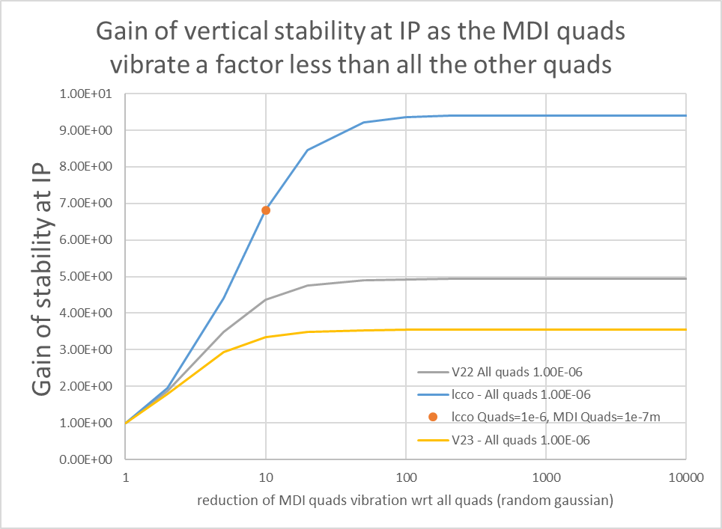
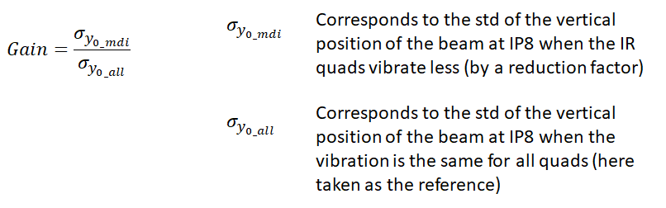
To go beyond the Plane Ground Wave model: random vibration
Presented at FCC tuning meeting (May 2024)
No plane wave in this case!
Analytical method:
“Vibrations” model:
  Random vertical displacements of the quadrupoles, following a gaussian distribution
  1000 seeds
Focus on the MDI region:
  5 quadrupoles for V22/V23
  4 quadrupoles for lcco
If the “vibrations” in the IR region are reduced by a factor 10 compared to the rest of FCC-ee, the vertical closed orbit is ≈ 5 times less mouving (& closer to the nominal orbit).
In the case of QC1 vibrations (3 quadrupoles), the maximum gain is equal to 2.
lattice | Gain if factor=10
V22 | 4.37
V23 | 3.35
lcco | 6.81
Points at an effort of lowering vibration closest to IP = gain
Study could be extended further away from IP

Slide 6
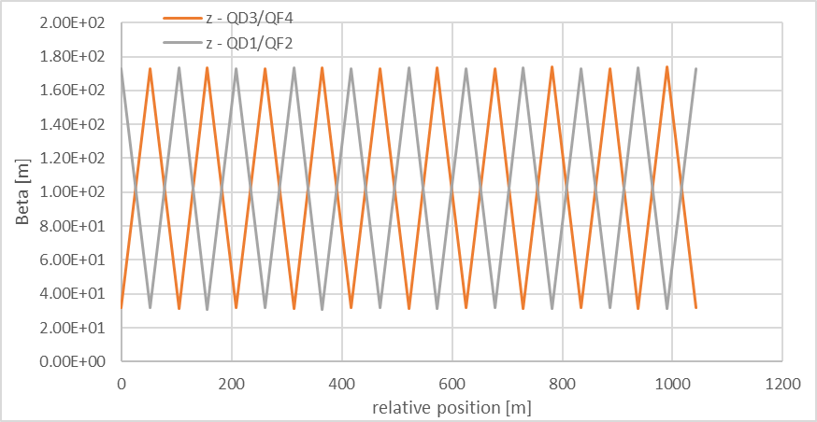
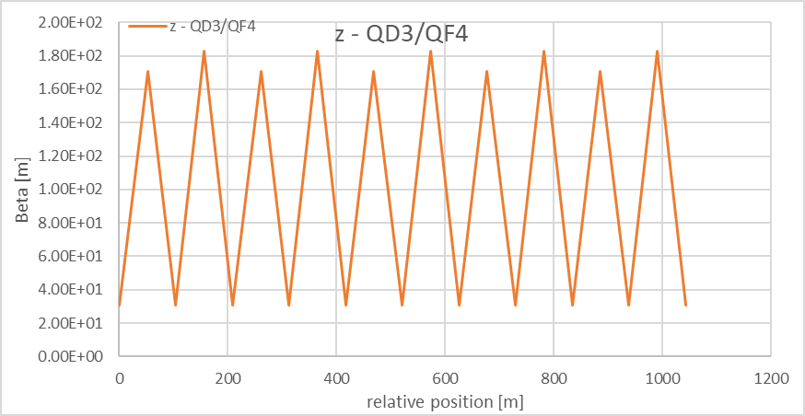
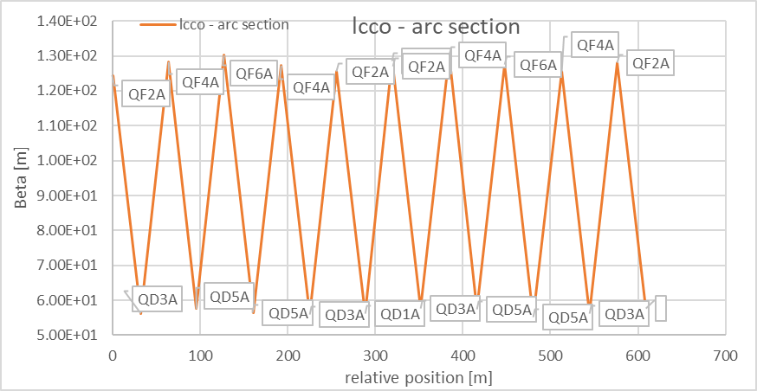
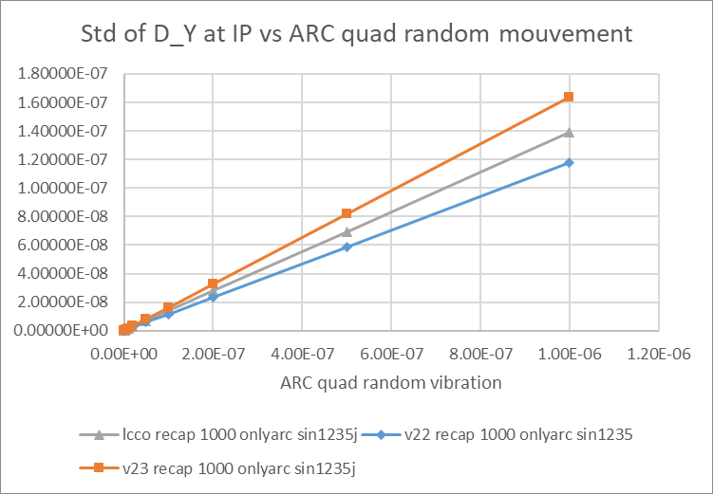
Arc-cell (AC) Quadrupoles random distribution impact at IP
Beta function in the arcs as seen by the analytical code for each lattice:
Presented at FCC tuning meeting (May 2024)
V22
V23
lcco
Response at IP to random gaussian (RG) displacement of quads in arcs
1000 seeds/point
Same seeds for each lattice runs → ok for comparison (but no systematics)
i.e. if the arc quads only are moved by a RG of 200nm, the sigma of the centroid is:
Some relevant characteristics
- Least sensitive → V22
- Sensitivity is global

Slide 7
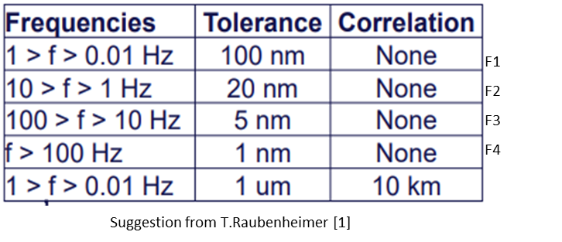
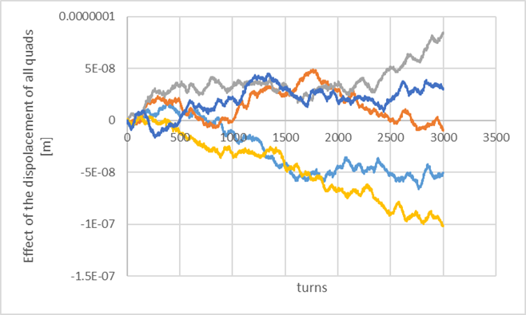
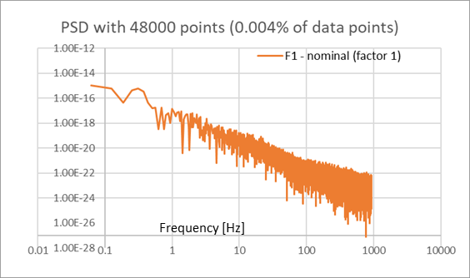
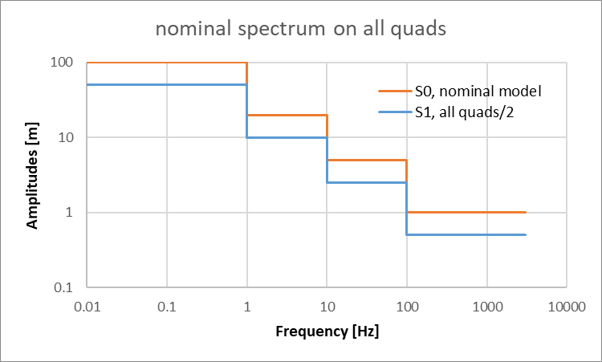
More complexe studied scenario
Presented at FCC tuning meeting (May 2024)
Vibration models have been built and used with the analytic model based on suggestion from T.Raubenheimer:
  The model is easily adaptable to various scenarios studies
At IP, what is the beam displacement (at the 3000th turn)?
Study with the modification of amplitudes within the model:
  Scenarii not necessarily wise (i.e. testing the outcome)
Scenario name | Type | Std (centroid) [m] | Gain wrt S0
S0 | Nominal | 7.3399 10-8
S1 | All quads move by a factor 2 less | 3.6700 10-8 | 50%
S2 | All quads move by a factor 2 less in the range 1Hz to 3000Hz | 7.0404 10-8 | 4%
S3 | MDI quads move by a factor 2 less in the range 100 Hz to 3000Hz | 7.3354 10-8 | 0.06%
Not realistic scenario but we could easily think of other scenario:
i.e. mitigating the vibration within a range (with a perfect feedback?)
S3, MDI, gain of 0.06%
S2, gain of 4%
S1, gain of 50%

Slide 8
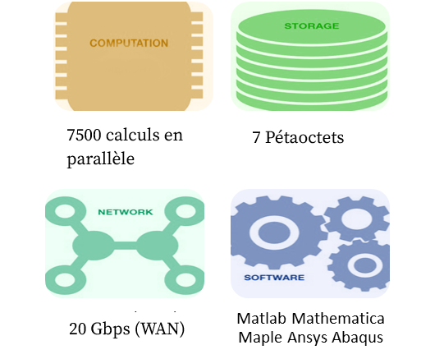
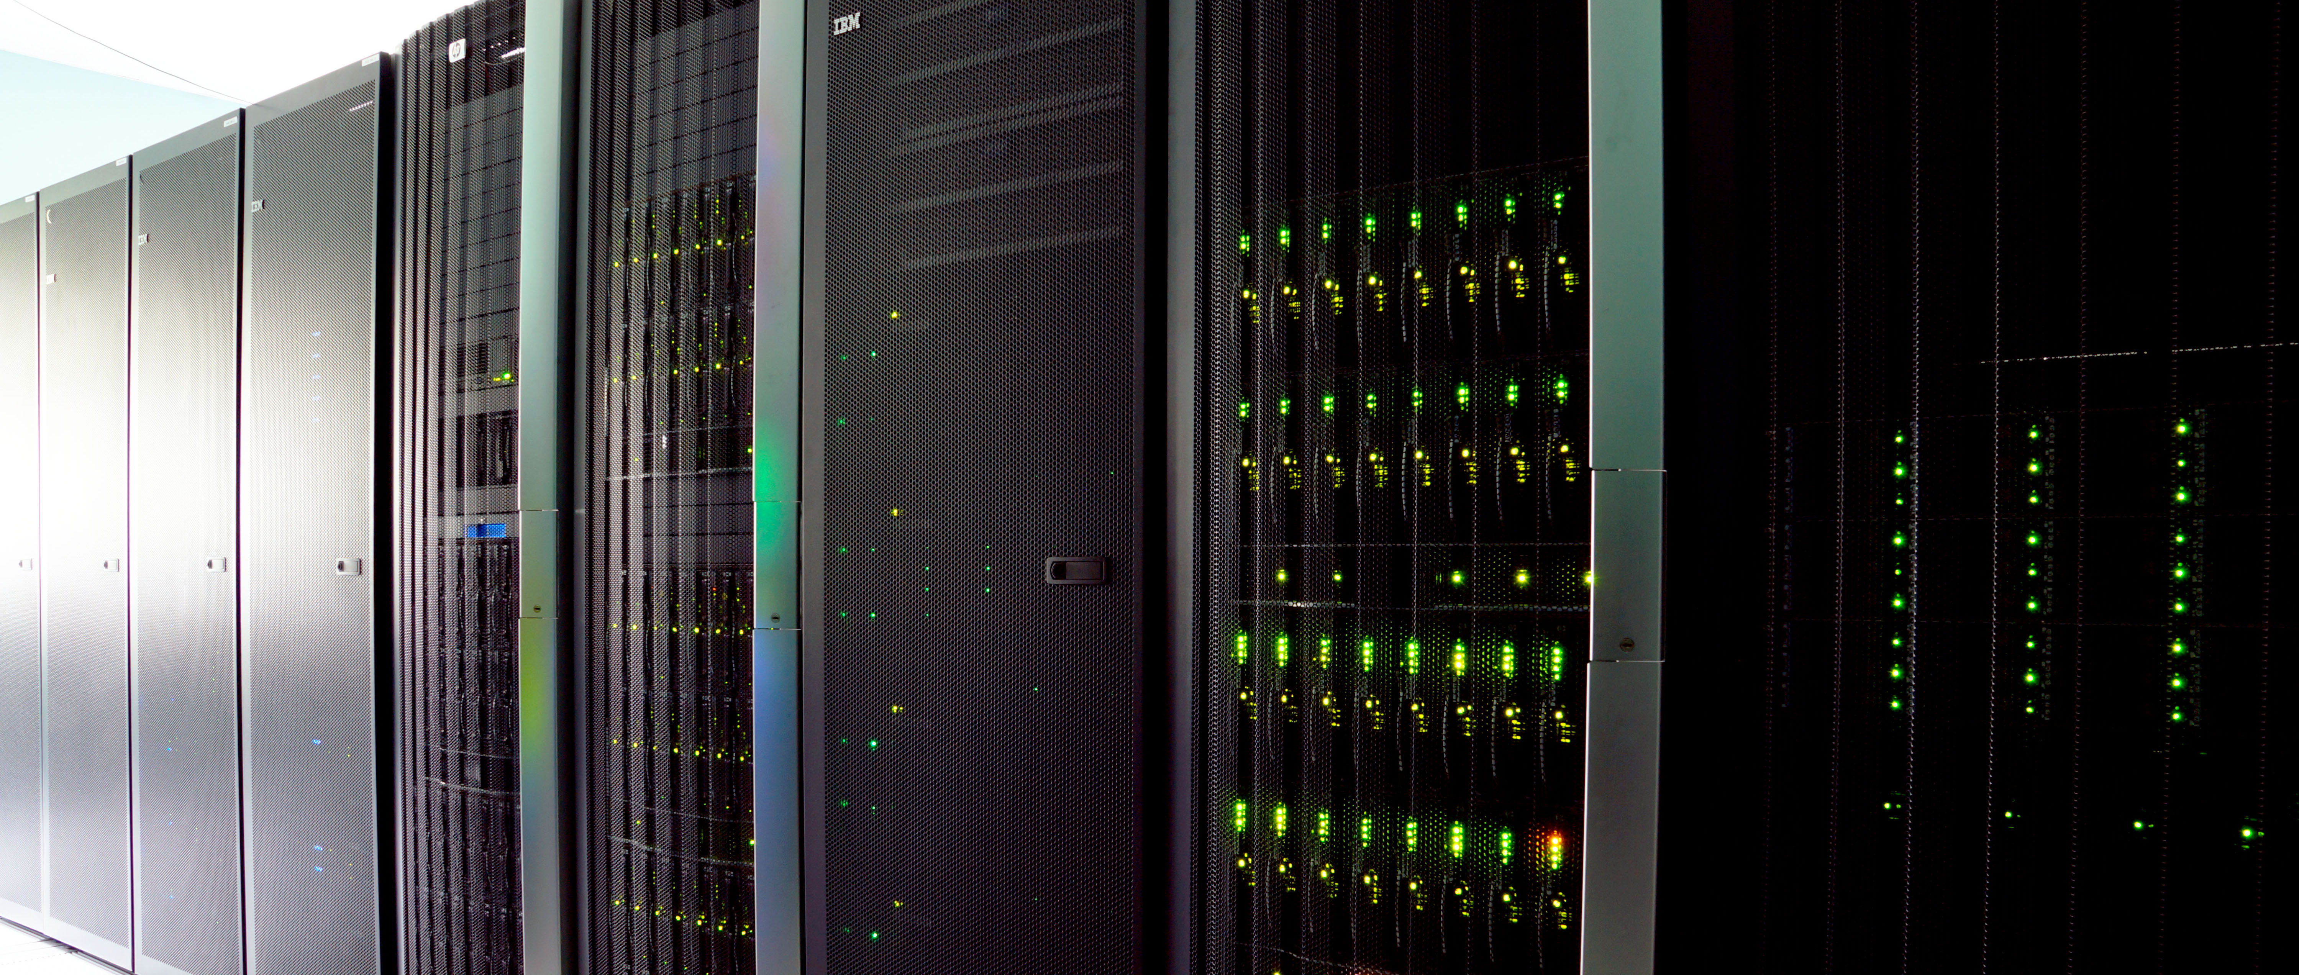
A few words to finish on present vibrations studies
A naïve approach for the simulation of the vibration:
  Analytical accelerator model:
    Fast (1.18 billions data for the spectrum: runs for 4h)
    Ok for first scenario studies and some comparison studies
    The model has its limit and limited parameters check (Here centroid, can be extended though)
  A first vibration model spectrum that needs to be “played with” to check various vibration scenario (spectrum and amplitude)
  It is versatile and can relatively quickly produce some results
    point out to the needs and what to do (in terms of simulation)
    But very naïve approach here (better approach would start-up from a modeled/real PSD and translate that in a temporal displacement)
  Focus on
    MDI: tightening there will help to be less sensitive to vibration
    ARCs: some differences between the lattices → Much more detailed work required*. (work with F.Carra group)
Though this will need:
  A more refined/thorough and in-depth scrutiny for the accelerator and vibration model:
    MAD-X (and other codes. We might explore Xsuite if adapted?)
      Tracking (not yet)? Quadrupole Slicing (not yet) useful when mechanics come into play?
    Modeled and more real spectrum will be included
      A suggestion with the ARC-Cell group is to take in PSD for LHC (low and high amplitude model)
      Use of more real model and/or measurements
        LAPP is discussing with experts from local branch of earth science Institute
        Discussed also with the SLAC/Lucretia team on their Algorithm (G.White thanks to T.Raubenheimer)
      Integration of the spectrum in a MAD-X study?
  Simulation with MAD-X does take a lot of time so we need to point to what could be done (here is the need for the analytics)
  The use of a data center: MUST**, at University of Haute Savoie, is being assessed for MAD-X simulation.
*Will the amplitude & dispersion of an uncorrelated High Freq over large amount of quadripoles plays a substantial role at IP: to be checked in simulation!
**MUST: Mésocentre de calcul et de stockage de l'Université Savoie Mont Blanc

Slide 9
Developpement en simulation FCC
Recapitulation: Les simulations en vue de la prise en compte des mouvements du sol s’etablissent et se développent autour:
  De travaux sur un modélisation analytique: Celle-ci a depuis le début 2023 permis de mettre en place des grandes lignes et tester des scenarios (onde plane et vibrations) pour le FCC → il semble permettre de:
    définir une méthodologie et des grandes lignes d’études
    répondre rapidement a quelques questions de la communauté physique accélérateur
  De travaux sur une modélisation dans MAD-X: plus complexe et prenant plus d’effets et est plus précis. Il permet de répondre plus spécifiquement aux questions posées
    Stage Master M2 en cours sur MAD-X (comparaison pour les lattices et études paramétriques en développement)
  Ces deux modélisations vont pour l’instant main dans la main grâce a un benchmark fait en 2023 et ne répondent pas au même problématique.
Les simulations permettent d’intégrer les travaux en ingénierie mécanique. Même plus: les modélisations ont besoin des travaux en mécanique et peuvent orienter des demandes envers la mécanique:
  Que se soit sur SuperKeKB avec les mesures in-situ
  les travaux internes (modèles de vibration, psd, et support pour “girder” simplifié)
Besoins actuels:
  Disposer de premiers modèles de vibrations temporelles (mécanique) pour les intégrer dans les modélisations accélérateurs (analytique et MAD-X). Ces modèles permettront d’affiner les méthodologies et axes prioritaires.
  Préparer les intégrations pour les modèles plus élaborés (provenant d’ISTERRE)
Futur Modélisation:
  Continuer les études avec les
    Modèles analytiques sur la vibration
    MAD-X sur les ondes planes
  Inclusion des études de vibrations dans MAD-X (reprise des Travaux pre-2023)
  Integration des travaux sur les modeles de vibrations (collaboration ISTERRE et autres)
    Apprentissage de generation de donnees modelisees de vibrations
Délivrables:
  A prévoir papier sur Vibrations et papier sur ondes planes
  Communication a venir: FCC week, juin 2024 sur les vibrations (SuperKeKB, FCC)
Ressources humaines:
  Travaux avec MUST (F.Chollet)
  Sujet de thèse doctorat proposé: « Impact of Vibrations on the Performance of Electron Positron Circular Colliders”
    Essentiel afin de dynamiser les travaux sur les modeles MAD-X
    Etudiant M2 du LAPP = meilleur candidat
  Integration du Post-Doc

