Slide 1
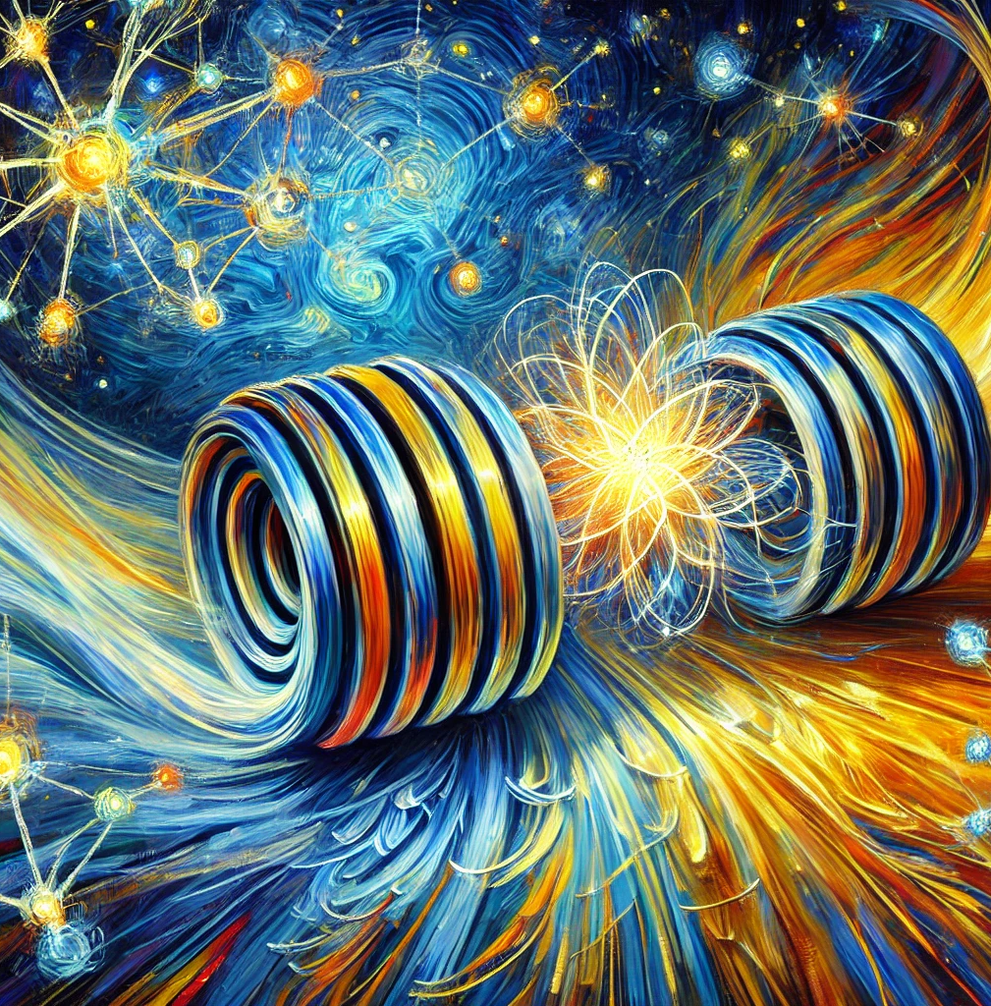
Superconducting magnet design through multi-physics optimisation
Damien Minenna — Robin Penavaire — Valerio Calvelli — Simon Bagnis — Guillaume Dilasser — Thibaut Lemercier — Gilles Lenoir — Jean-Pierre Lottin — Michel Segreti — Damien Simon — Francesco Stacchi — Hajar Zgour

Slide 2
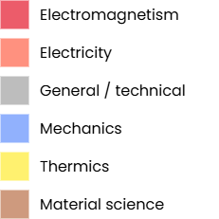
Design of a superconducting magnet
  Challenging and long process
  Superconducting magnet = integrated system
    Conductor(s), winding geometry, frame, cooling, power supply …
  Cross-disciplinary studies
    Magnetism, materials, mechanics, cryostats, quench, LTS, HTS, electricity, …
  Diversity of software
    Simulation costs (time & licences)
  Project
    Targets (sometimes unclear): desired magnetic properties
    Constraints: dimensions, fringe field, material properties, mechanical strength, quench protection, …
      Price
    Several phases from conceptual and technical design to construction and operation
  Huge number of parameters
  All must be processed together
  Objectives
  Speed up drastically design phases
  Help analyse data through the various phases
OPERA | RAT | ROXIE | FEMM | ANSYS | Cast3M | THEA
COMSOL | Hepak | Cryocomp | SolidWorks | NX | In-house codes

Slide 3
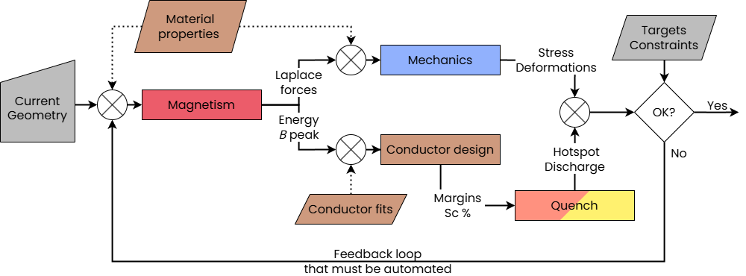
Pre-design
  Magnetism, conductor, mechanics, quench
  A hundred inputs (genes)
    Dimensions, materials (Young modulus, hysteresis, etc)
    Engineering current density, …
    Assumptions on homogenised winding properties
    Within project requirements and physics constraints
  A hundred outputs (phenotype)
    B field, Forces, Von Mises, margins, hotspot, …
  Challenges
  Communication between different physics
  Share data
  Include everything together
    Everything is connected
  Understand the design
  Find solutions

Slide 4
ALESIA
A toolbox for superconducting magnets
Project Manager
Gestion of large amonts of data and scripts
Multi-parametric optimiser
To optimize designs
Supervised LEarning
To emulate designs
Interface with physics softwares
With FE codes (Opera, Cast3m, …)
Material Data Manager
Uniformised database
Data Analyser
Post processing
Physics studies
Conductor, quench, analytic models, …

Slide 5
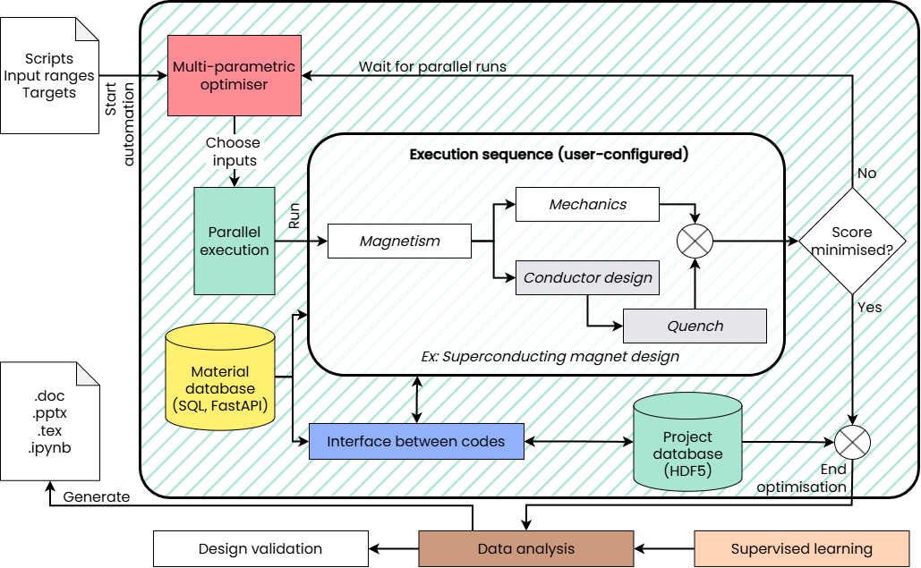
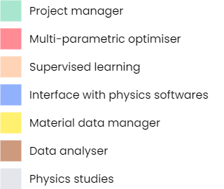
Principle

Slide 6
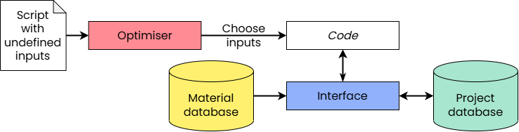
Manager
Project manager
  Multi-OS (Windows, Linux, Mac, HPC)
  Automated optimisation
    Create inputs
      According to interdependencies
    Launch scripts
    Save all data (HDF5 format)
    Parallelised runs
  Can take into account any scientific codes
    Not limited to superconducting magnets
  Material database
  BH curves, Young's modulus, shear modulus, Poisson’s ratio, thermal expansion, heat capacity, conductivity, resistivity, density, …
  Interface with physics software
  Input data from ALESIA to code
  Output data from code to ALESIA
  Functions to ease scripts
    Ex: Create objects and automatically add material properties
  Implemented
    Opera 2D & Opera 3D, Cast3M, Python
  Ongoing
    ANSYS, COMSOL, RAT

Slide 7
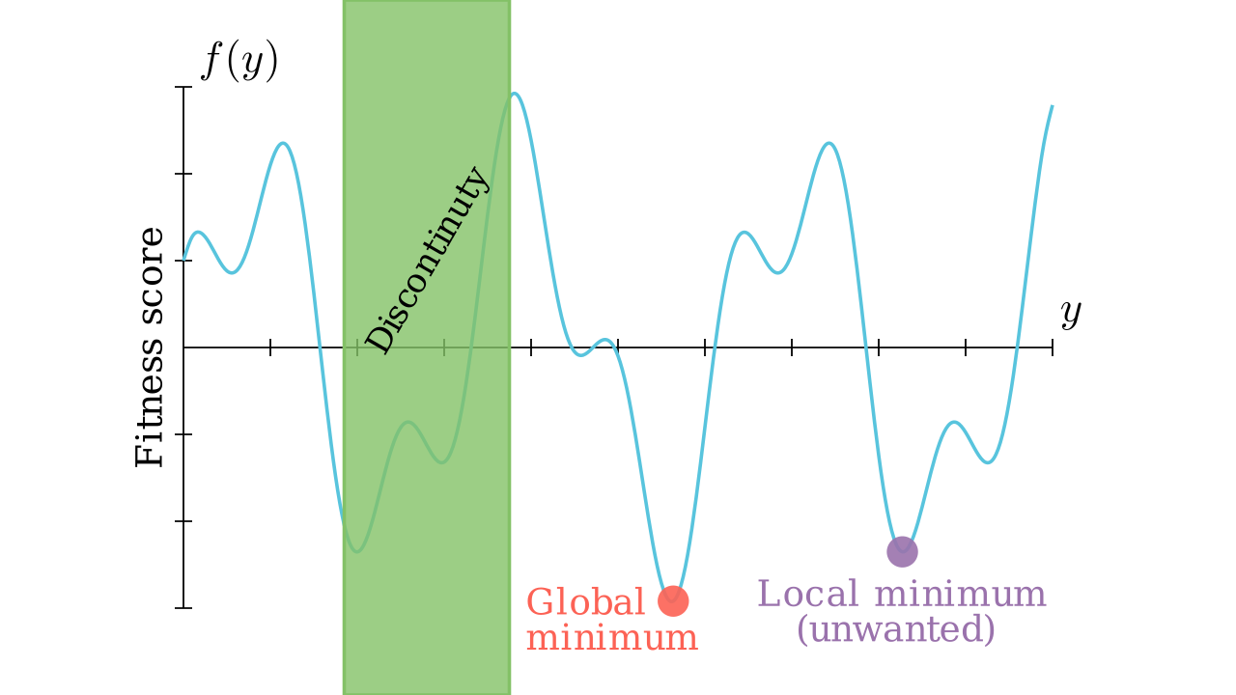
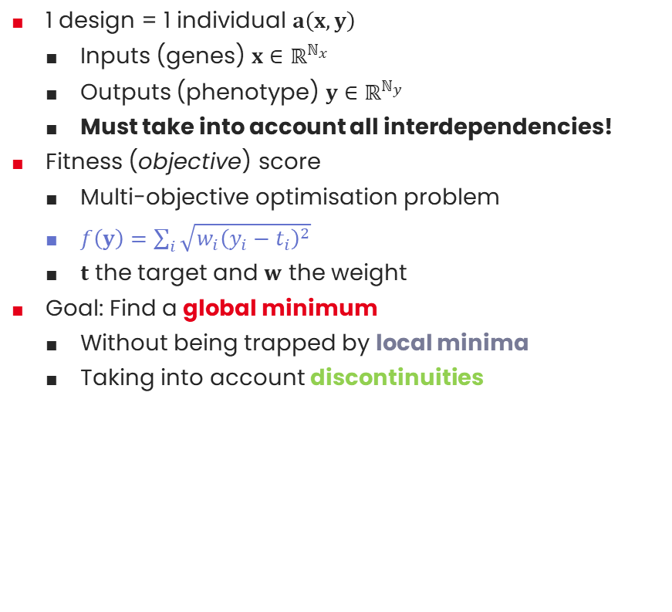
Multi-parametric optimisers
  1 design = 1 individual $a\left(x,y\right)$
    Inputs (genes) $x∈ℝ^{ℕ_{x}}$
    Outputs (phenotype) $y∈ℝ^{ℕ_{y}}$
    Must take into account all interdependencies!
  Fitness (objective) score
    Multi-objective optimisation problem
    $f\left(y\right)=\sum_{i}^{​}{\sqrt{w_{i}{\left(y_{i}−t_{i}\right)}^{2}}}$
    $t$ the target and $w$ the weight
  Goal: Find a global minimum
    Without being trapped by local minima
    Taking into account discontinuities
  Optimisers implemented
  Nonlinear programming
    Pattern search
    Gradient descent
  Non-guided iterative analysis
    Randomised algorithm | random scan
    Grid Search (1D scan)
  Naturally inspired | Evolutionary algorithm
    Genetic Algorithm
    Particle Swarm Optimiser
    Differential Evolution
    Covariance Matrix Adaptation Evolution Strategy (CMA-ES)
  Active learning
    Bayesian Optimiser
  Parallelised optimisers

Slide 8


Slide 9
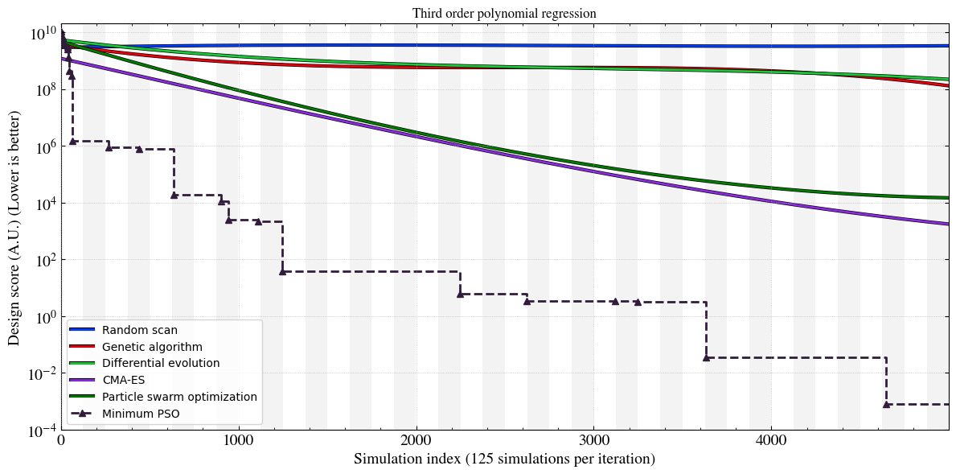
Optimisers for magnet design
  Score (T⁸ m² MPa² K²)
  Goal: less than 10

Slide 10
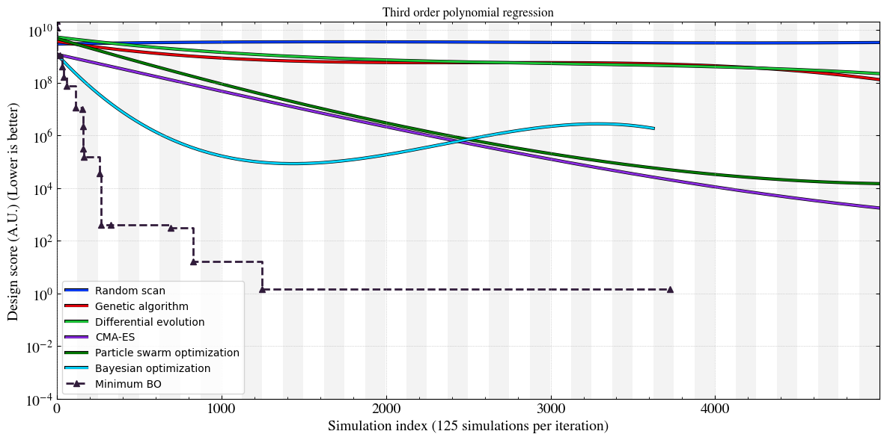
Optimisers for magnet design
  Score (T⁸ m² MPa² K²)
  Goal: less than 10

Slide 11
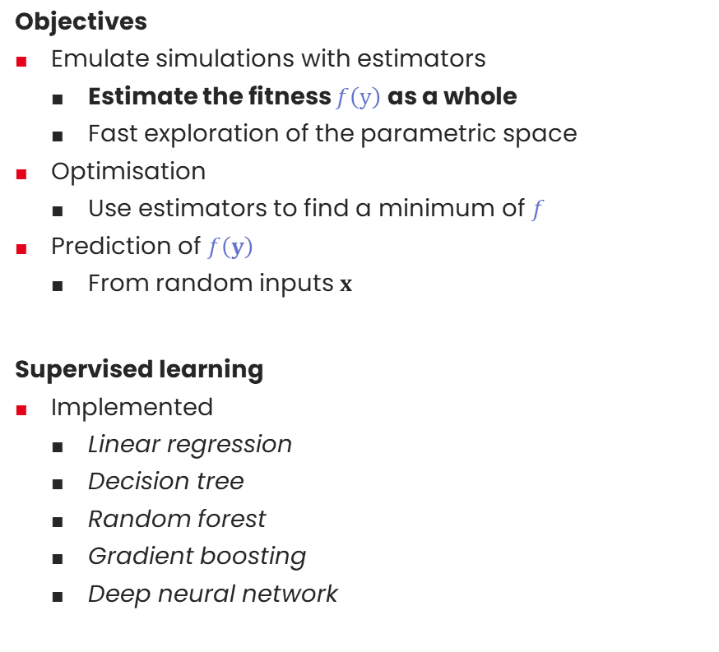
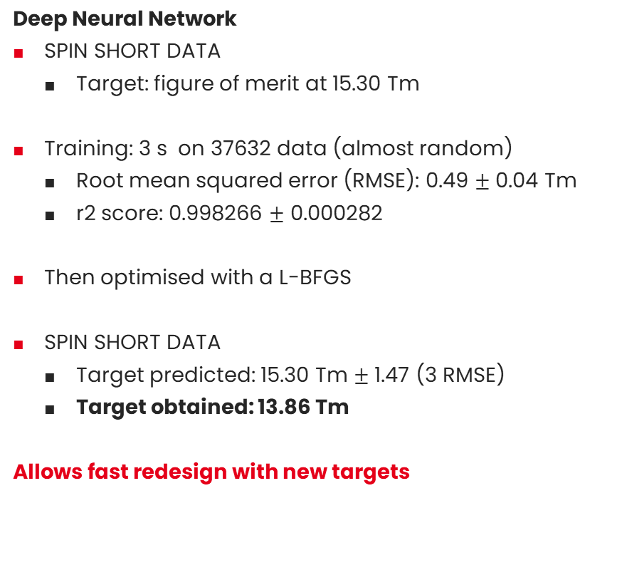
Supervised learning
Deep Neural Network
  SPIN SHORT DATA
    Target: figure of merit at 15.30 Tm
  Training: 3 s on 37632 data (almost random)
    Root mean squared error (RMSE): 0.49 $±$ 0.04 Tm
    r2 score: 0.998266 $±$ 0.000282
  Then optimised with a L-BFGS
  SPIN SHORT DATA
    Target predicted: 15.30 Tm $±$ 1.47 (3 RMSE)
    Target obtained: 13.86 Tm
  Allows fast redesign with new targets
Objectives
  Emulate simulations with estimators
    Estimate the fitness $f\left(y\right)$ as a whole
    Fast exploration of the parametric space
  Optimisation
    Use estimators to find a minimum of $f$
  Prediction of $f\left(y\right)$
    From random inputs $x$
Supervised learning
  Implemented
    Linear regression
    Decision tree
    Random forest
    Gradient boosting
    Deep neural network

Slide 12
Conclusions
  ALESIA a new toolbox at CEA/IRFU
  To drastically speed up design phases
  Full and automated process
  Holistic understanding of the design
    For cross-disciplinary teams
  Manage large amounts of data
  Can be used on any magnet project
  Can handle any software (Opera, Cast3m, …)
  Cross-platform and documented
  Not limited to magnets
  Highlights
  Several solutions for the SPIN ROTATORS project obtained
  Arguably, the first superconducting magnet fully predicted by a deep neural network

Slide 13
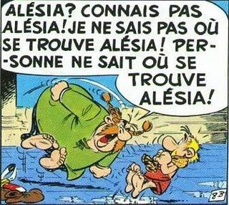
Thank you!

Slide 14
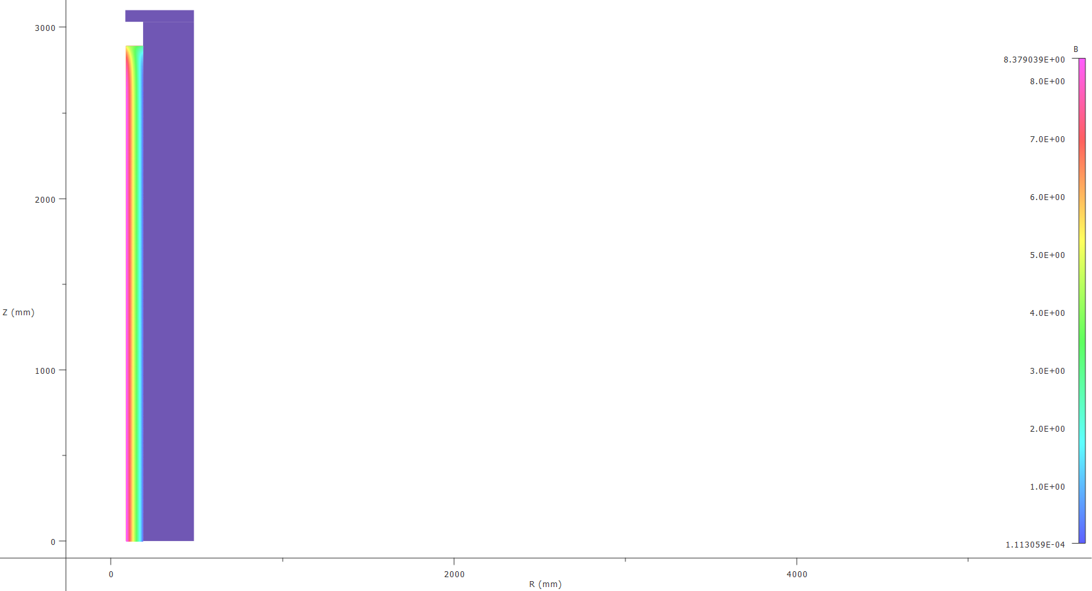

Magnetism
  Inputs
  Coil dimension
  Yoke dimension
  Engineering current density
  Outputs
  Magnetic field
    Peak
    Stray field
  Magnetic energy
  Figure of merit
  Laplace forces
Ongoing
  3D simulations

Slide 15
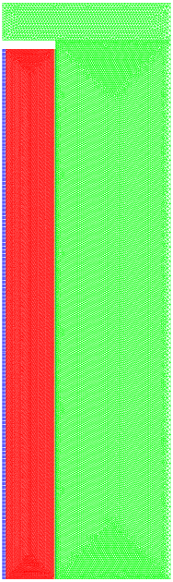
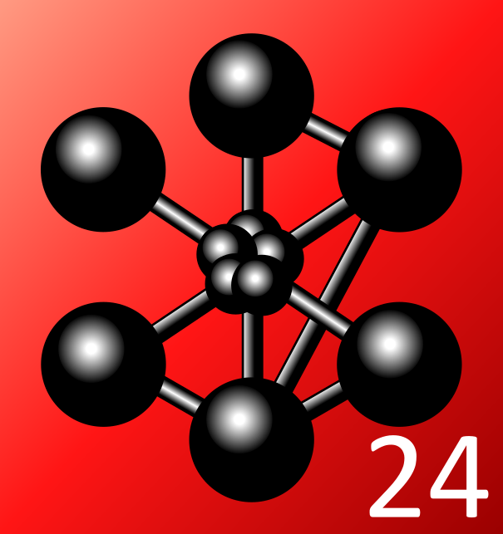

Mechanics
Z
  Rule of mixtures
  Averaging mechanical properties
    According to proportions
    Conductor as one composite
  Allows fast simulations
  Inputs
  Coil, mandrel and yoke dimensions
  Material properties
  Magnetic map
  Outputs
  Von Mises stress
  Displacements
Ongoing
  3D conductor model
θ
R

Slide 16
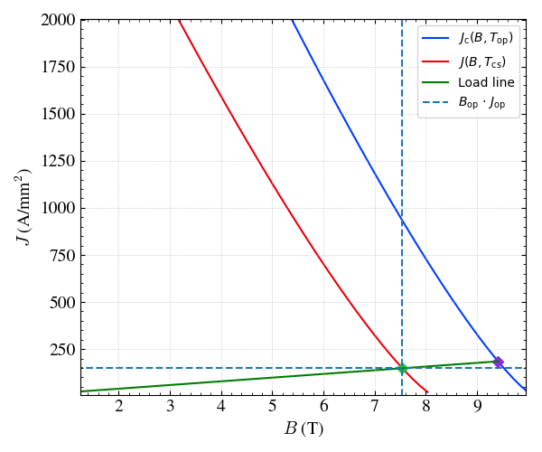
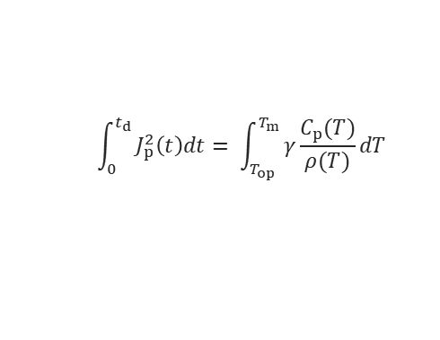
Conductor & Quench
  Fits implemented
  NbTi
    Bottura, IEEE TAS (2000)
  Nb3Sn, from Stacchi (private communication)
    ITER IT
    ITER DTT
    MQXF
  HTS
    Fujikura, from Fleiter & Ballarino, Internal note (2014)
  Conductors
  Margins
    Load line
    Temperature
    Current density
    Sc area
  Quench
  From Wilson, Superconducting Magnets (2002)
    Adiabatic propagation velocity
    Minimum Propagating Zone (MPZ)
    Minimum Quench Energy (MQE)
    Hotspot temperature
      From heat balance equation
  Ongoing:
    THEA model
    Qtransit
$$\int_{0}^{t_{d}}{J_{p}^{2}\left(t\right)dt= \int_{T_{op}}^{T_{m}}{γ\frac{C_{p}(T)}{ρ(T)}dT}}$$

Slide 17
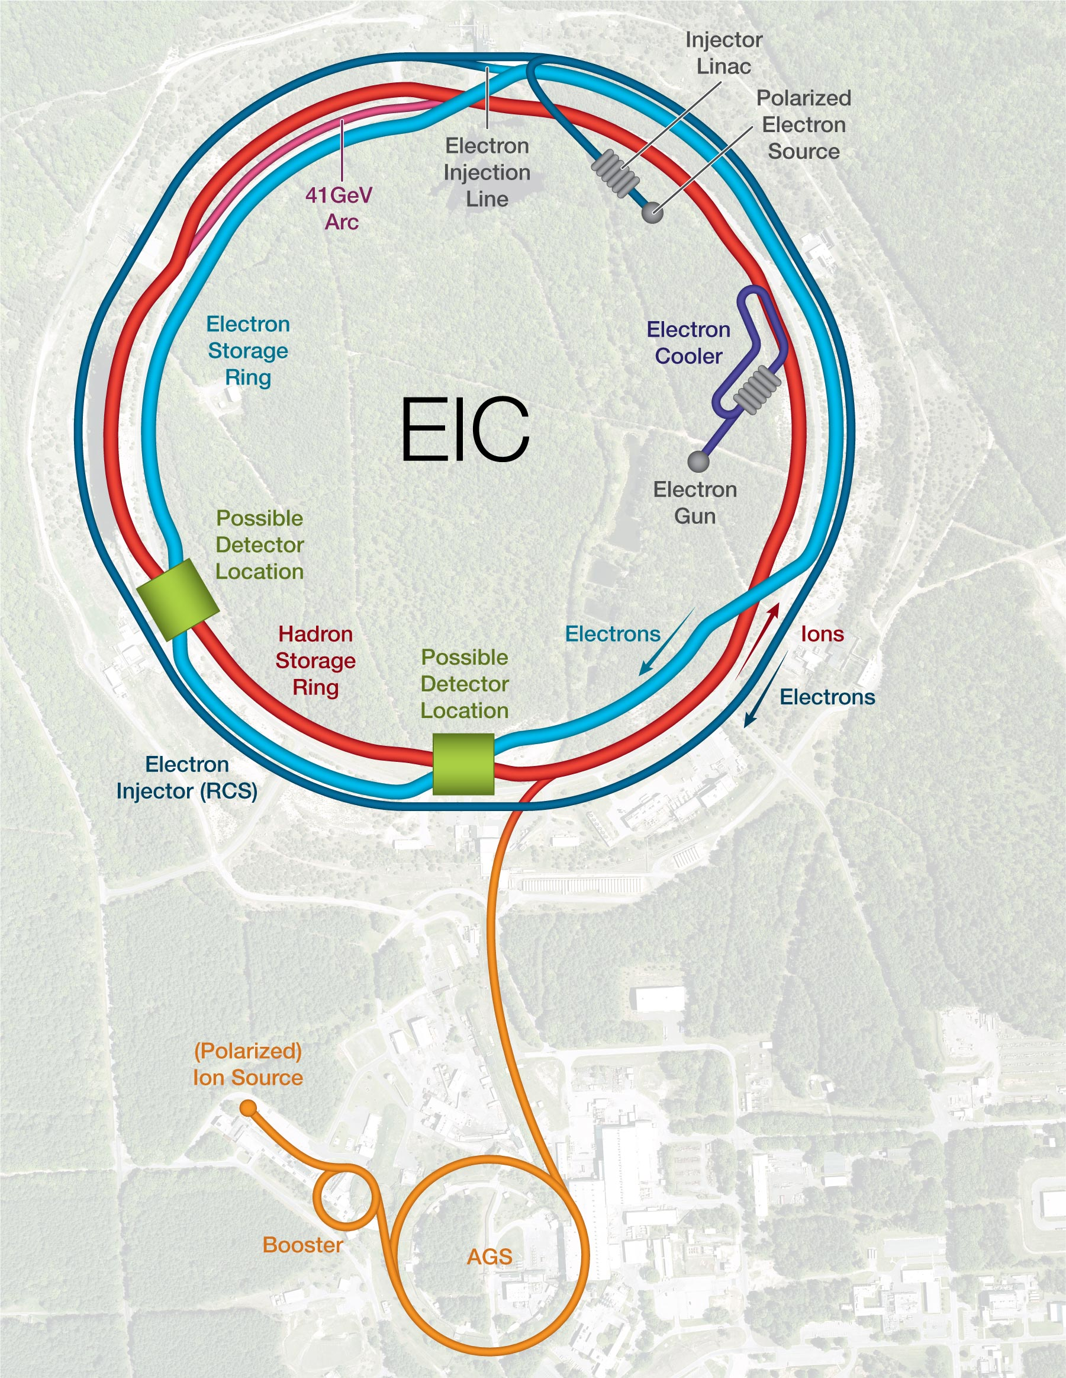
The Electron–Ion Collider / CEA contributions
Understand how the strong interaction creates 99% of the visible mass of the universe
Goals
  3D imaging of protons and atomic nucleus
  Studying quarks and gluons dynamics in nucleons
  Understanding the proton spin
    Need to control the spin of electrons
  Machine
  Upgrade of the Relativistic Heavy Ion Collider
    Circumference: 4 Km
  High luminosity
  Highly spin-polarized beams
  Large centre of mass energy range (29 – 140 GeV)
  Large ion species range (proton to uranium)
Detector magnet
  Marco
    1 solenoid
      2 T, 2.84 m bore diameter, 3.84 m long
Accelerator magnets
  SPIN ROTATORS
    4 SHORT solenoids
      8.5 T, 84 mm bore diameter, 2.5 m long
    4 LONG solenoids
      8.5 T, 84 mm bore diameter, 6.6 m long
Marco
SPIN ROTATORS

Slide 18
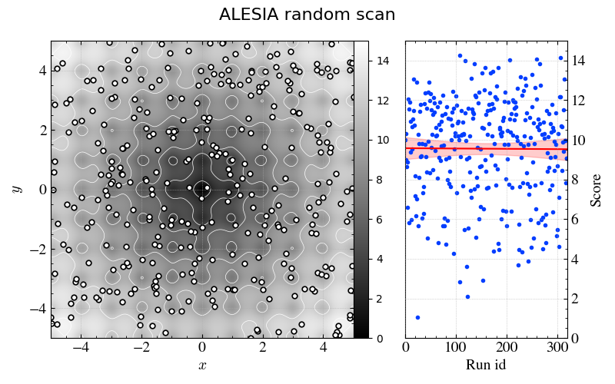
Example
2D Ackley function
  Goal:
    Find the global minimum
    Quicky
  Here:
    320 points
    16 iterations of 20 individuals

Slide 19
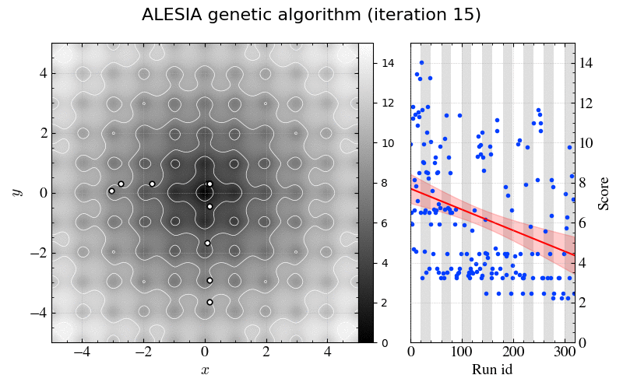
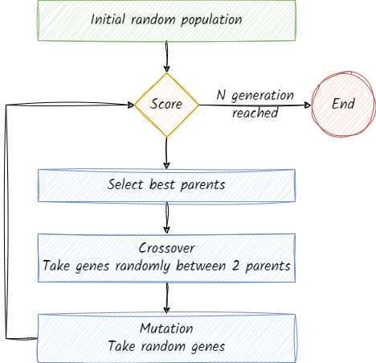
Genetic algorithm

Slide 20
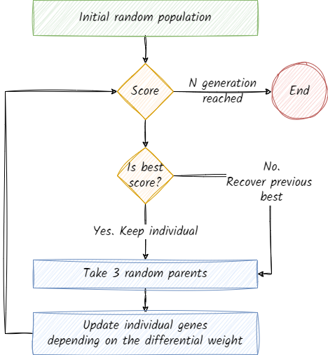
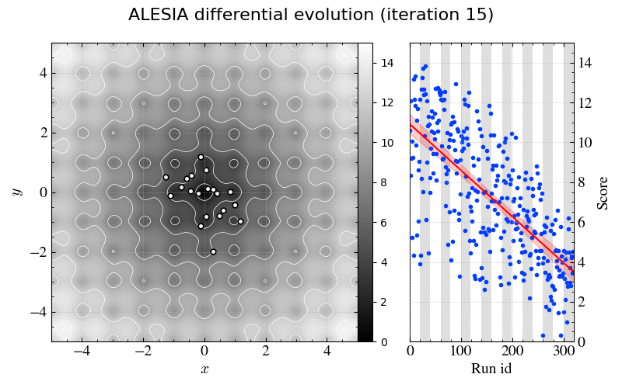
Differential evolution

Slide 21
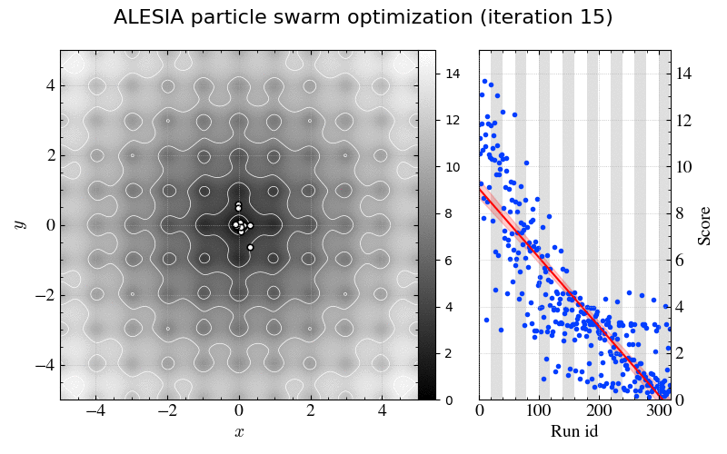
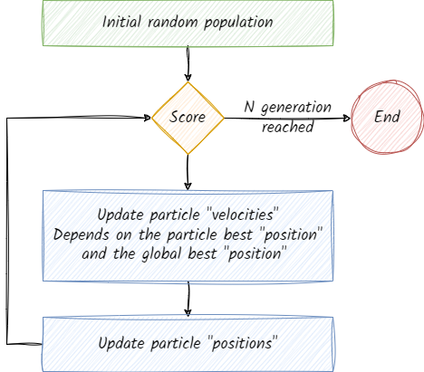
Particle swarm optimization

Slide 22
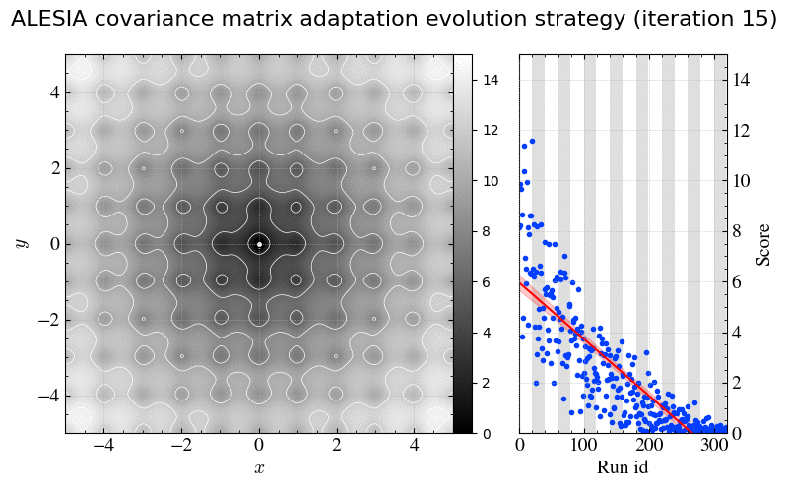
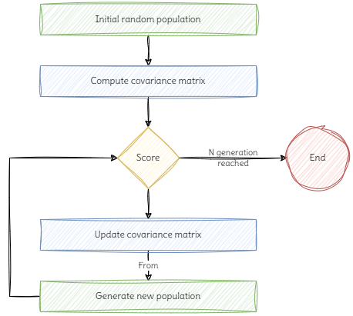
Covariance matrix adaptation evolution strategy (CMA-ES)

Slide 23
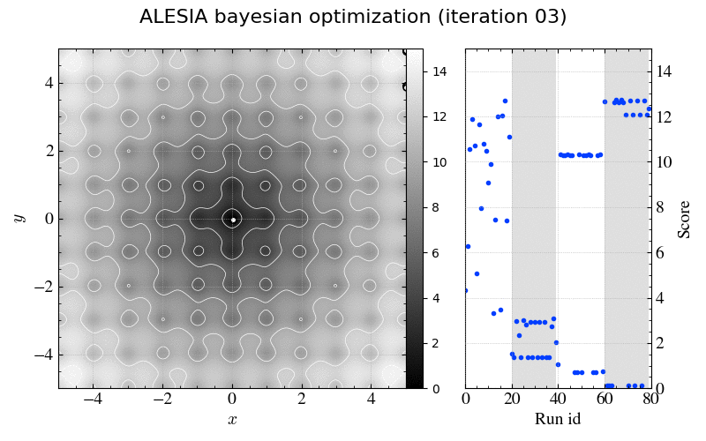
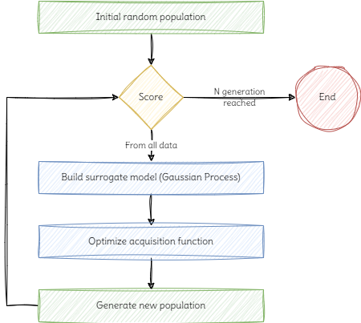
Bayesian optimisation

Slide 24
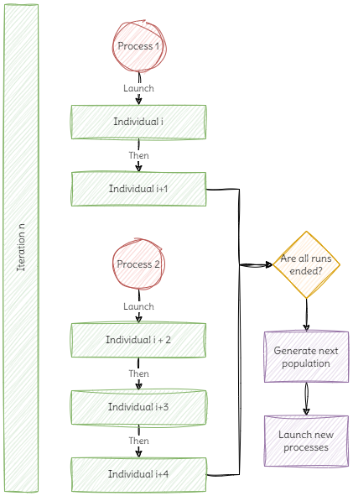
Optimiser parallelisation
  CPU parallel computing
    Implemented for each optimisers
  Ex: Spin Rotators
    Simulation time (2D) ~ 5 min
    Time / proc ~ 10 s
  Toward 3D simulations
  Toward job queue
    HPC clusters

Slide 25
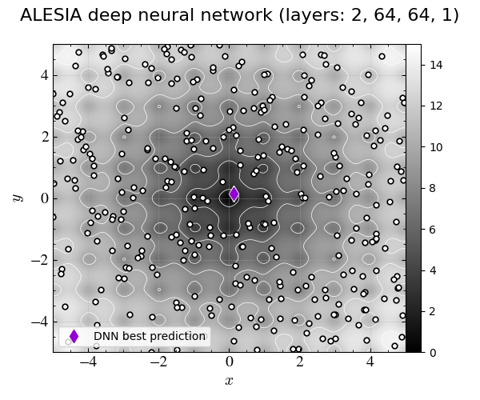
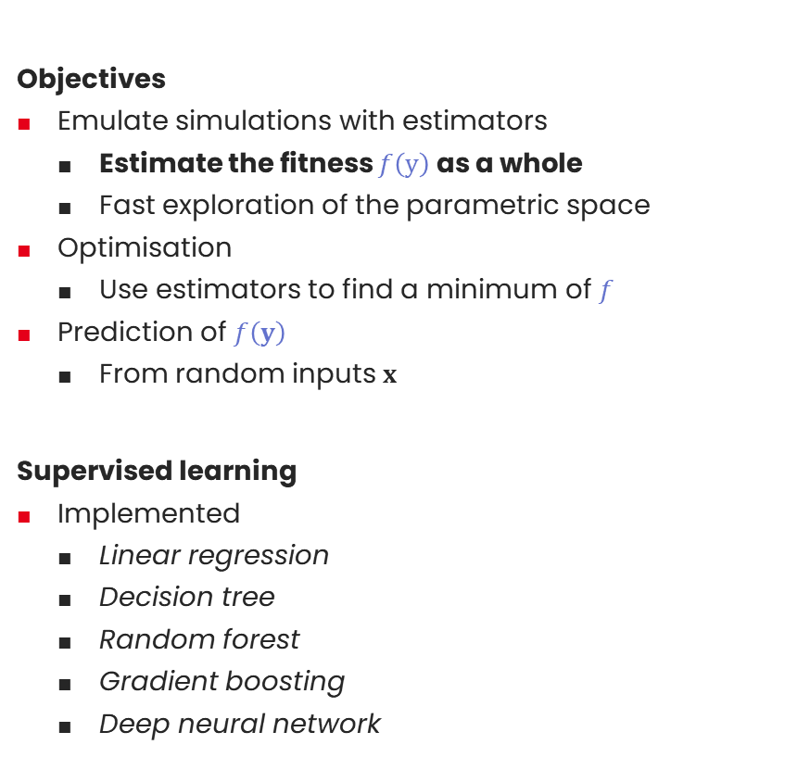
Supervised learning
  The data generated in different projects can be used for regression analysis
Objectives
  Emulate simulations with estimators
    Estimate the fitness $f\left(y\right)$ as a whole
    Fast exploration of the parametric space
  Optimisation
    Use estimators to find a minimum of $f$
  Prediction of $f\left(y\right)$
    From random inputs $x$
Supervised learning
  Implemented
    Linear regression
    Decision tree
    Random forest
    Gradient boosting
    Deep neural network

Slide 26
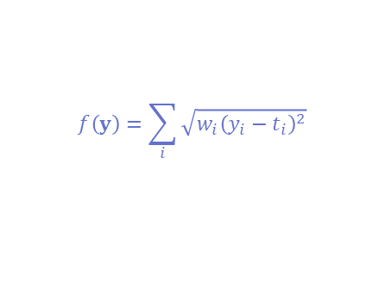
Goals
z
Optimisation
  87 genes
    With 10 ranged parameters
      Ex: Current density: 20 – 100 A/mm²
  110 outputs
Simulation
  Magnetism, Mechanics, Conductor, Quench
    Simulation time: 5 min
Outputs (Targets)
  Figure of merit
    SHORT: 15.3 Tm | LONG: 46.75 Tm
  Stray fields at 2 positions
  von Mises stress: 130 MPa
  Hotspot: 130 K
Goals
  Do everything together
  Find acceptable solutions
IRON
FOM
COIL
$$f\left(y\right)=\sum_{i}^{​}{\sqrt{w_{i}{\left(y_{i}−t_{i}\right)}^{2}}}$$
BORE OVERTURE + CRYOSTAT
MANDREL
INSULATION
SS SHEET
r

Slide 27
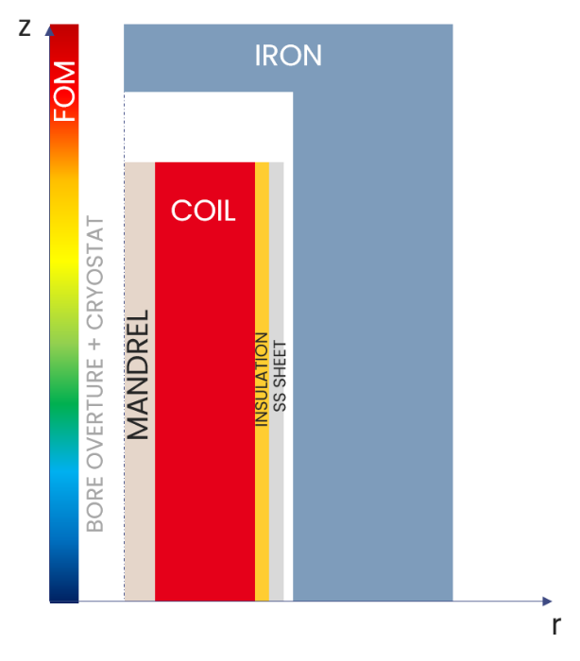
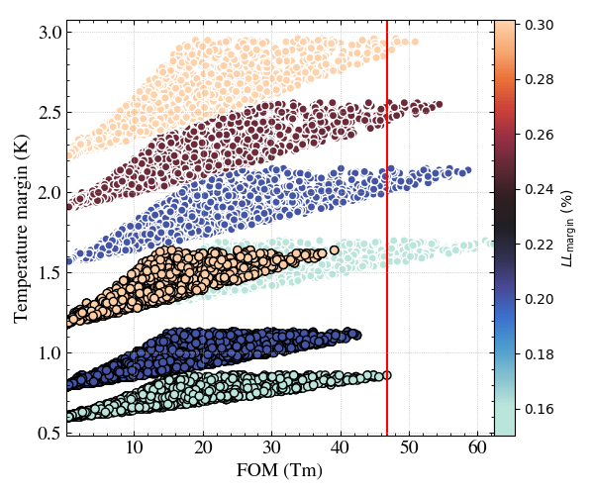
LONG Solenoid – NbTi Results
Optimisation of the figure of merit (FOM)
  38903 successful runs
    Using the genetic algorithm
  Data are multi-parametric
White circles: 2 K
  Solution exists with comfortable margins
Black circles: 4.55 K
  Goal is here but margins are limited
Goal = 46.75 Tm

Slide 28
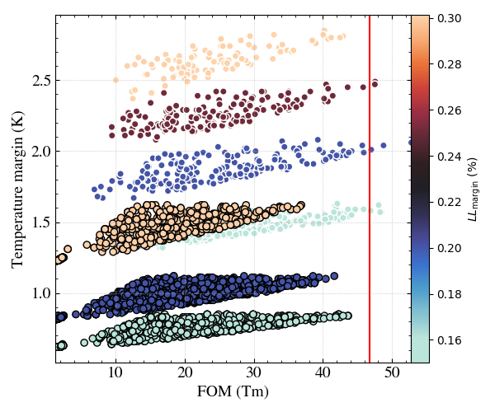
LONG Solenoid – NbTi Results Physical Limits
Criteria applied:
Stray field B_{rcs} < 3 G
von Mises < 150 MPa
T_{hotspot} < 150 K
Goal = 46.75 Tm
Increased sensitivity to requirements
Hotspot is not a problem (well below < 150 K) thanks to the dump resistance
von Mises stress increases with the FOM
B_{rcs} increases with the FOM (Limits are around 50 Tm)
White circle:
2.00 K :
Solutions exist with comfortable margins
No solution was found with 30% LL margin
No solution found above 50 Tm
Margins in temperature are still comfortable
(CMS = 2 K)
Black circle:
4.55 K :
No solution was found close to the goal
43.7 Tm is the best solution (15% LL margin)

Slide 29
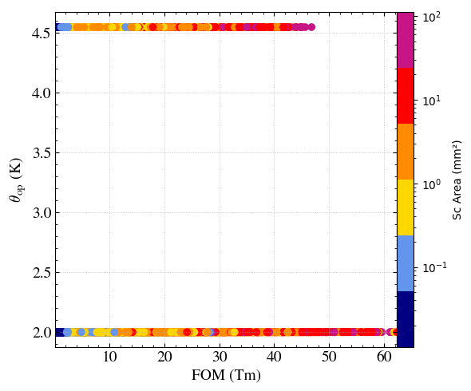
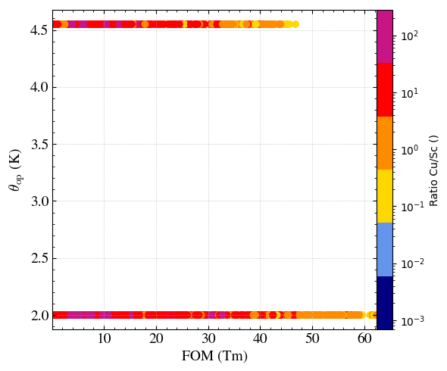
LONG Solenoid – NbTi Results Feasibility Limits
46.75 Tm
46.75 Tm
Pure Cu
« Pure » NbTi !
Not feasible
RIC/WIC
Rutherford/Monolith
Not feasible
« Pure » NbTi !
Not feasible
CTE NbTi (300K – 4K) = -1.5 ∙ 10⁻³
CTE G10 (300K – 4K) = -2.5 ∙ 10⁻³
CTE Cu (300K – 4K) = -3.2 ∙ 10⁻³
CTE SS (300K – 4K)= -2.8 ∙ 10⁻³
The conductor needs copper to have a similar thermal contraction respect to the mandrel
Rutherford cables will be riskier for the mechanics

Slide 30
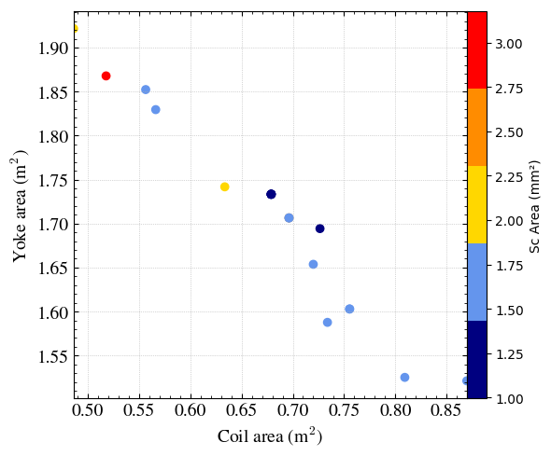
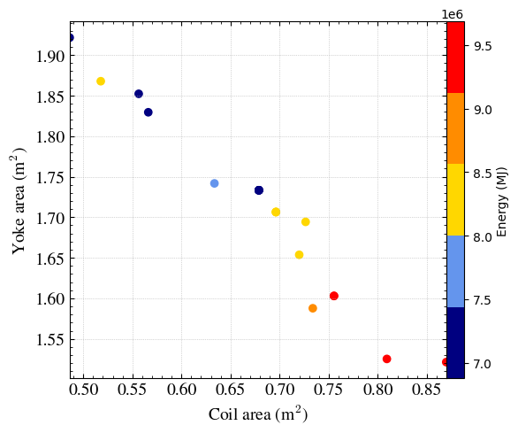


LONG Solenoid – NbTi Conductors @2 K
 | Coil area
 | Yoke area
Solutions between $FOM= {46.75}_{−2.5}^{+5} Tm$
$→FOM≥46.75 Tm$
Cond.2
Cond.2
Energy (J)
Cond.1
Cond.1
Cond.1 : minimum of SC area (~1 mm²)
FoM: 47 Tm
Von Mises: 94 MPa
T_{Hot spot}: 65 K
J_{eng} = 51.5 A/mm²
SC area: 1 mm²
Bare conductor area: 10.9 mm²
Cond.2 : minimum of Energy (~7 MJ)
FoM: 48.5 Tm
Von Mises: 113 MPa
T_{Hot spot}: 55 K
J_{eng} = 70 A/mm²
SC area: 1.46 mm²
Bare conductor area: 15.3 mm²
This can be a WIC !
This can be a RIC !

